Slide 1
Class 14 Last Day
Keith A. Pray
SocialImps.com

Slide 2
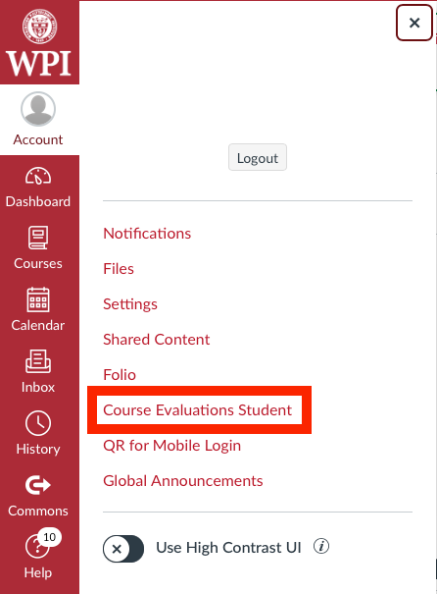
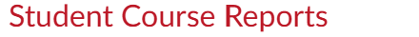
Overview
Class 12:
Students Present
Students’ Choice
Class 13:
Assistant Evaluation
Course Evaluation
Group Presentations
Class 14:
Group Presentations
Team_Evaluation_v2.0.docx
Points to date
Notes:
Remind groups to turn in slides on Canvas.
Note that we took a first pass at web site grading so please let us know if you make substantiative changes

Slide 3
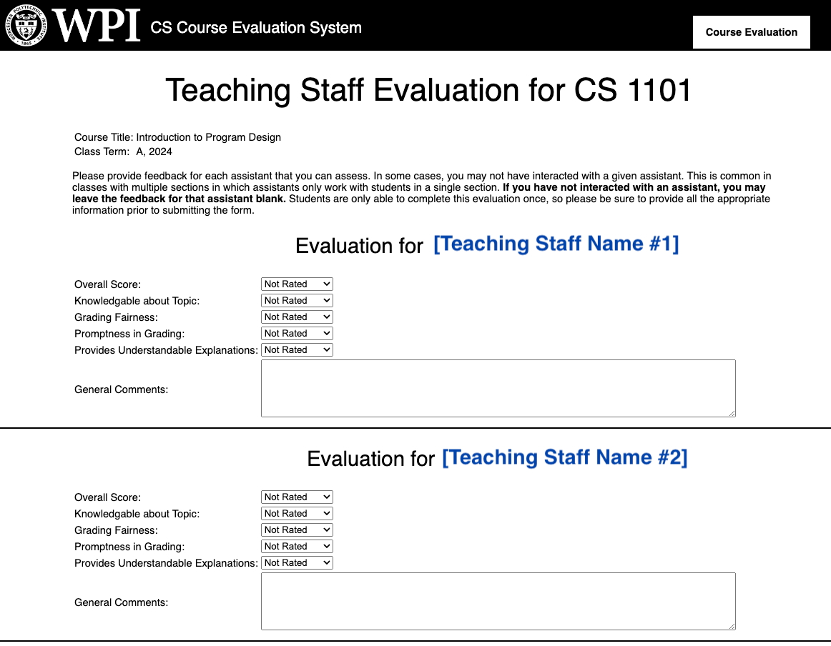
Example Student Assistant Evaluation
From: CS Course Evaluations <no-reply-csgcs@cs.wpi.edu> Subject: CS 1101 Student Staff (TA/GLA/SA) Evaluation Date: February 26, 2024 at 10:30:15 AM EDT To: <cshue@wpi.edu> Greetings, Our records show that you are enrolled in CS 1101 and the department has assigned course assistants to support this class. To help us ensure the highest teaching quality possible, the department would like to solicit your feedback on this course assistance. If you are currently registered for multiple CS classes, you will receive an email for each class with a class-specific evaluation link. To provide your feedback, please access the following link: https://grads.cs.wpi.edu/evals/?page=review&token=[15_character_key] To ensure honest feedback to improve our courses, the system will not associate your response with your identity. You may contact your course instructor to provide additional feedback, if desired. Thank you for your assistance, Prof. Matthew Ahrens, Computer Science TA/SA Coordinator Prof. Craig Shue, Computer Science Department Head

Slide 4
Papers
Nice improvement!
Supporting data still the main challenge
Notes:
Save for next time:
More Clear Conclusions
Significant Counter Points
Clearly state conclusion
First statement preferred
Absolute statements are difficult to prove
Avoid: all, always, any, every, everyone, never, none… unless you can show it
Be sure to put quotes around entire quote
Hyperbole is the best thing ever!
but not in these papers
Print 2 sided and save a tree
Use template, saves time (and -1 point)
Include Counter Point and Response
Include Author, Title, Publish Date, Publisher for references
Read paper aloud to proof

Slide 5
Grades To Date
High: 60
68 Max Possible
- Discussion 1-13 - Papers 1-4 - Individual Presentation
Does not include points:
- 1 Discussion - 35 Group Project - Extra Credit

Slide 6
6
Notes:
Automation Paper results. This term’s additions in RED

Slide 7
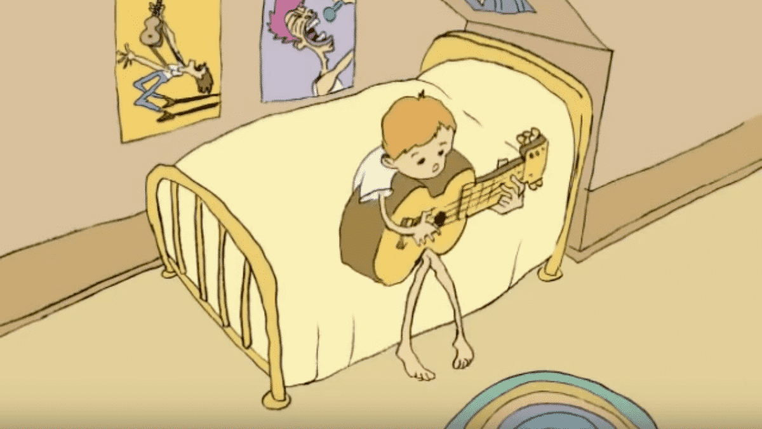

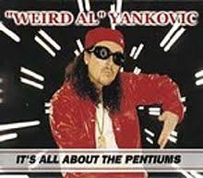
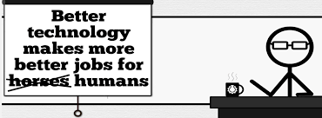


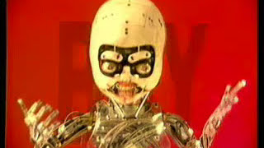
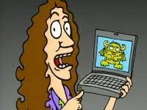
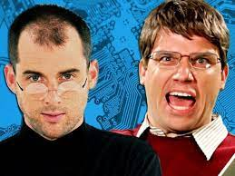

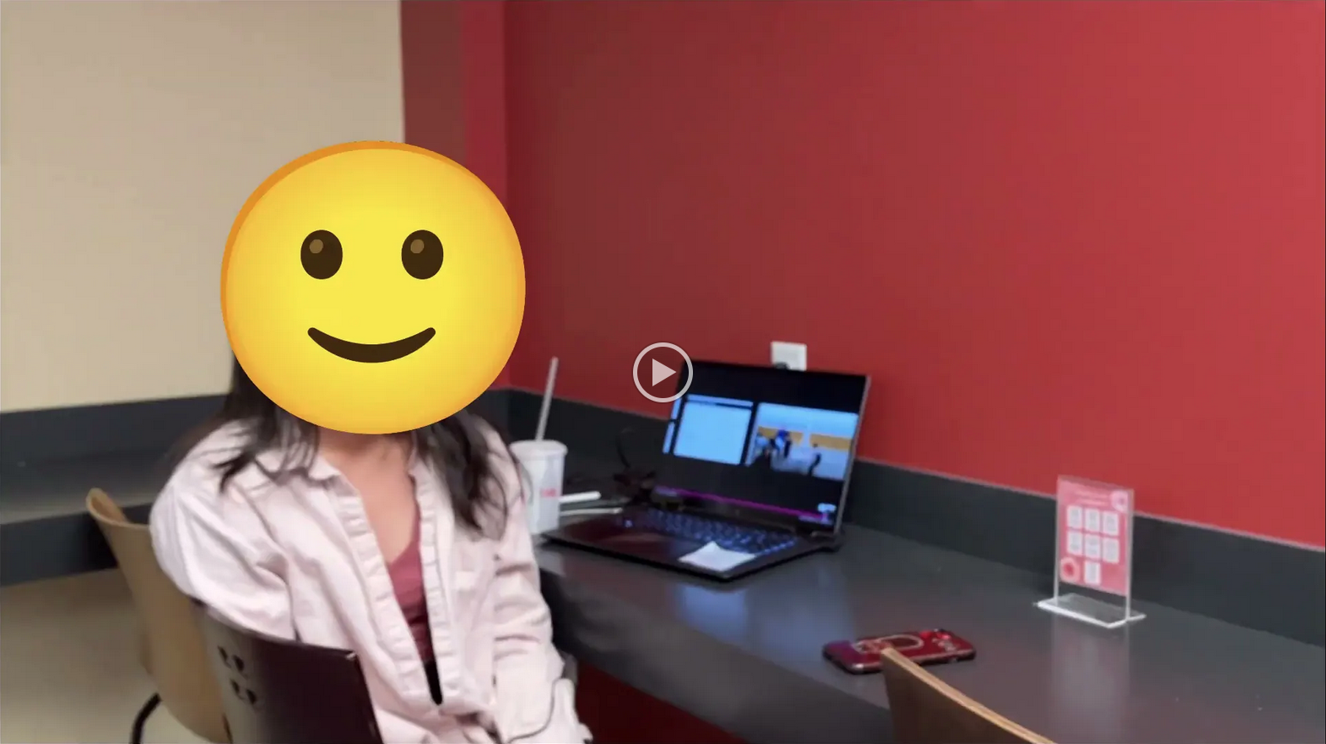
Student Choice – Interesting Videos (1/2)
X
Don’t Download This Song (2006)
- Weird Al (3:53)
It’s All About The Pentiums (1999)
- Weird Al (3:34)
White and Nerdy (2006)
- Weird Al (2:50)
Virus Alert (2006)
- Weird Al (3:43)
Word Crimes (2014)
- Weird Al (3:45)
Copyright: Forever Less One Day (2011)
- CGP Grey (6:27)
Humans Need Not Apply (2014)
- CGP Grey (15:00)
This Video Will Make You Angry (2015)
- CGP Grey (7:25)
Technologic (2005). ← Which topic?
- Daft Punk (2:55)
Epic Rap Battles of History: Steve Jobs vs. Bill Gates (2013) (2:47)
Passwords (2024) ← Compare
- Elizabeth Levin, Silas Joy (WPI CS3043) (5:37)
© 2023 Keith A. Pray
Notes:
Technologic: Critical Thinking, Ethics, Networked Communications, Information Privacy, Reliability, Professional Ethics?
David Autor Will automation take away all our jobs? (18:27) (2016) https://www.ted.com/talks/david_autor_will_automation_take_away_all_our_jobs/transcript?language=en TEDxXambridge, 2016-12-19
All Last Accessed 2018-10-04
CGP Grey – behind paywall now
Copyright: Forever Less One Day (6:27)
https://www.youtube.com/watch?v=tk862BbjWx4
CGP Grey
Humans Need Not Apply (15:00) – 2014-08-13
http://www.youtube.com/watch?v=7Pq-S557XQU
Last access 2016-04-22
CPG Grey This Video Will Make You Angry [Thought Germs] (7:25) – 2015-03-10
https://www.youtube.com/watch?v=rE3j_RHkqJc
Weird Al – It’s All About The Pentiums (3:34)
https://www.youtube.com/watch?v=qpMvS1Q1sos
TODO: Tie into Ray Kurzweil Singularity
Epic Rap Battles of History: Steve Jobs vs. Bill Gates (If class ok with obscene lyrics) (2:47)
https://www.youtube.com/watch?v=njos57IJf-0
Also Work links on web site http://socialimps.keithpray.net/documents/
-----
Passphrases (2:08 need to give context for video)
https://firstlook.org/theintercept/2015/03/26/passphrases-can-memorize-attackers-cant-guess/
If not shown during first class
What "Orwellian" really means - Noah Tavlin (5:31)
http://ed.ted.com/lessons/what-orwellian-really-means-noah-tavlin
Weird Al – White and Nerdy (2:50) and look at lyrics
https://www.youtube.com/watch?v=N9qYF9DZPdw
Weird Al Yankovic “Don’t Download This Song” (3:53) 2006-08-21 released exclusively as digital download
https://www.youtube.com/watch?v=zGM8PT1eAvY
Styx - Mr. Roboto (1983) (5:34) https://www.youtube.com/watch?v=uc6f_2nPSX8
Epic Rap Battles of History: Steve Jobs vs. Bill Gates (If class ok with crude lyrics) (2:47)
https://www.youtube.com/watch?v=njos57IJf-0
Daft Punk - Technologic (2005) (2:55)
https://www.youtube.com/watch?v=D8K90hX4PrE

Slide 8
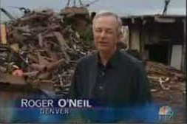

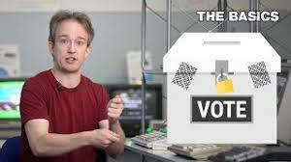
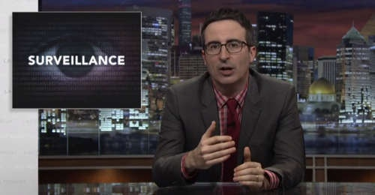


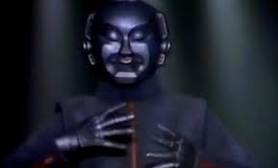

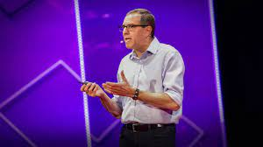


Student Choice – Interesting Videos (2/2)
MSNBC on Denver's Automated Baggage System (2010) (2:27)
Last Week tonight with John Oliver (2015) - Snowden (33:14)
3D Printed Homes (2018)
- News Story (1:28)
The Game Of Trust (2017) - Nicky Case
Adobe Firefly (2023) - Adobe (1:16)
What "Orwellian" really means (2015) - Noah Tavlin (5:31)
Why Electronic Voting is Still a Bad Idea (2019) - Tom Scott (12:00)
Welcome To Life (2012) - Tom Scott (2:44)
Mr. Roboto (1983)
- Styx (5:34)
Will automation take away all our jobs? (2016) – David Autor (18:27)
What is your password? (2015)
- Jimmy Kimmel Live (2:49)
© 2023 Keith A. Pray
Notes:
All Last Accessed 2018-10-04 unless publish date later
Last Week tonight with John Oliver – Patriot Act, Edward Snowden (33:14)
http://www.upworthy.com/john-oliver-flew-10-hours-to-russia-to-interview-edward-snowden-and-get-him-on-record?c=ufb1
TODO: Tie into Ray Kurzweil Singularity
Epic Rap Battles of History: Steve Jobs vs. Bill Gates (If class ok with obscene lyrics) (2:47)
https://www.youtube.com/watch?v=njos57IJf-0
Also Work links on web site http://socialimps.keithpray.net/documents/
-----
Passphrases (2:08 need to give context for video)
https://firstlook.org/theintercept/2015/03/26/passphrases-can-memorize-attackers-cant-guess/
If not shown during first class
What "Orwellian" really means - Noah Tavlin (5:31)
http://ed.ted.com/lessons/what-orwellian-really-means-noah-tavlin
MSNBC on Denver's Automated Baggage System 2010-08-23 (2:27)
https://www.youtube.com/watch?v=xx8f4x6C_KY
Accessed 2019-04-09
These 3D printed homes can be constructed for $4,000 (3:00 – 2018-04-02)
http://www.businessinsider.com/3d-printed-homes-constructed-icon-new-story-tech-charity-4000-dollars-2018-3
https://www.youtube.com/watch?v=SvM7jFZGAec (1:28)
Last access 2018-04-22
Why Electronic Voting is a BAD Idea – Computerphile (Tom Scott) (8:20)
https://www.youtube.com/watch?v=w3_0x6oaDmI
Tom Scott
http://tomscott.com
Welcome To Life (2:44)
https://www.youtube.com/watch?v=IFe9wiDfb0E&feature=youtu.be
Jimmy Kimmel Live – What is your password? (2:49)
https://www.youtube.com/watch?v=opRMrEfAIiI

Slide 9

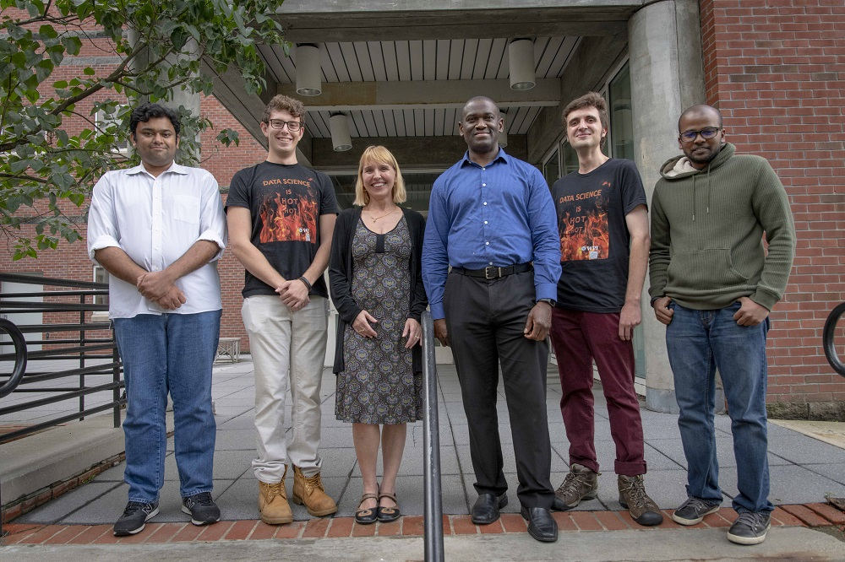

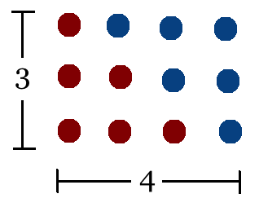
Student Choice – Interesting Articles 1/2
Communications of The ACM – Latest edition (through library)
Facebook security breach: Up to 50m accounts attacked - Dave Lee, North America technology reporter, 2018-09-29
WPI Secures $2.8 Million to Develop a Smartphone App to Help Assess the Health of Soldiers, 2018-09-24
Quantified Toilets, 2014, Quantified Toilets LLC (empty) What a Toilet Hoax Can Tell Us About the Future of Surveillance – Jennifer Golbeck, The Atlantic, 2014-04-29
What Did Ada Lovelace's Program Actually Do? - Sinclair Target, 2018-08-18 (First Programming Bug 1843?)
Notes:
All Last Accessed 2021-04-03

Slide 10
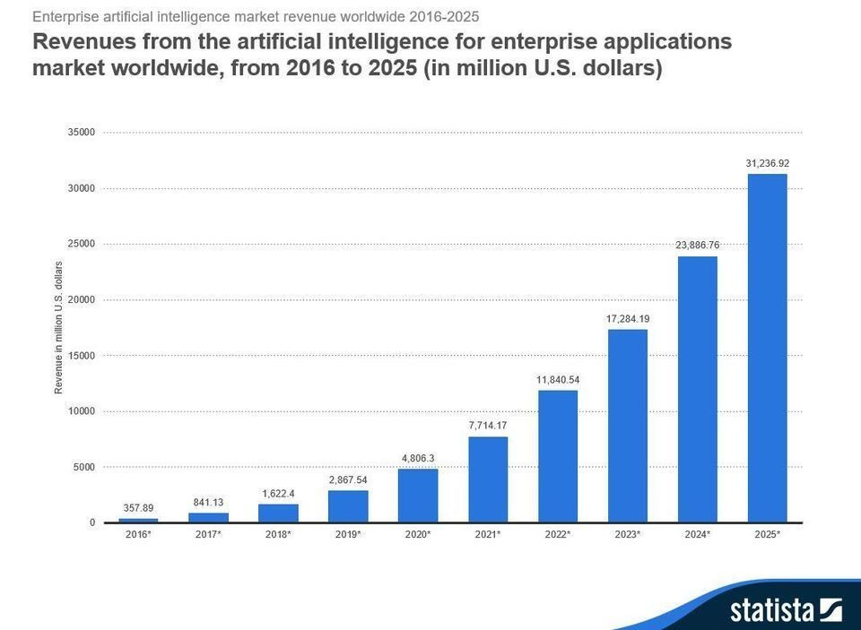
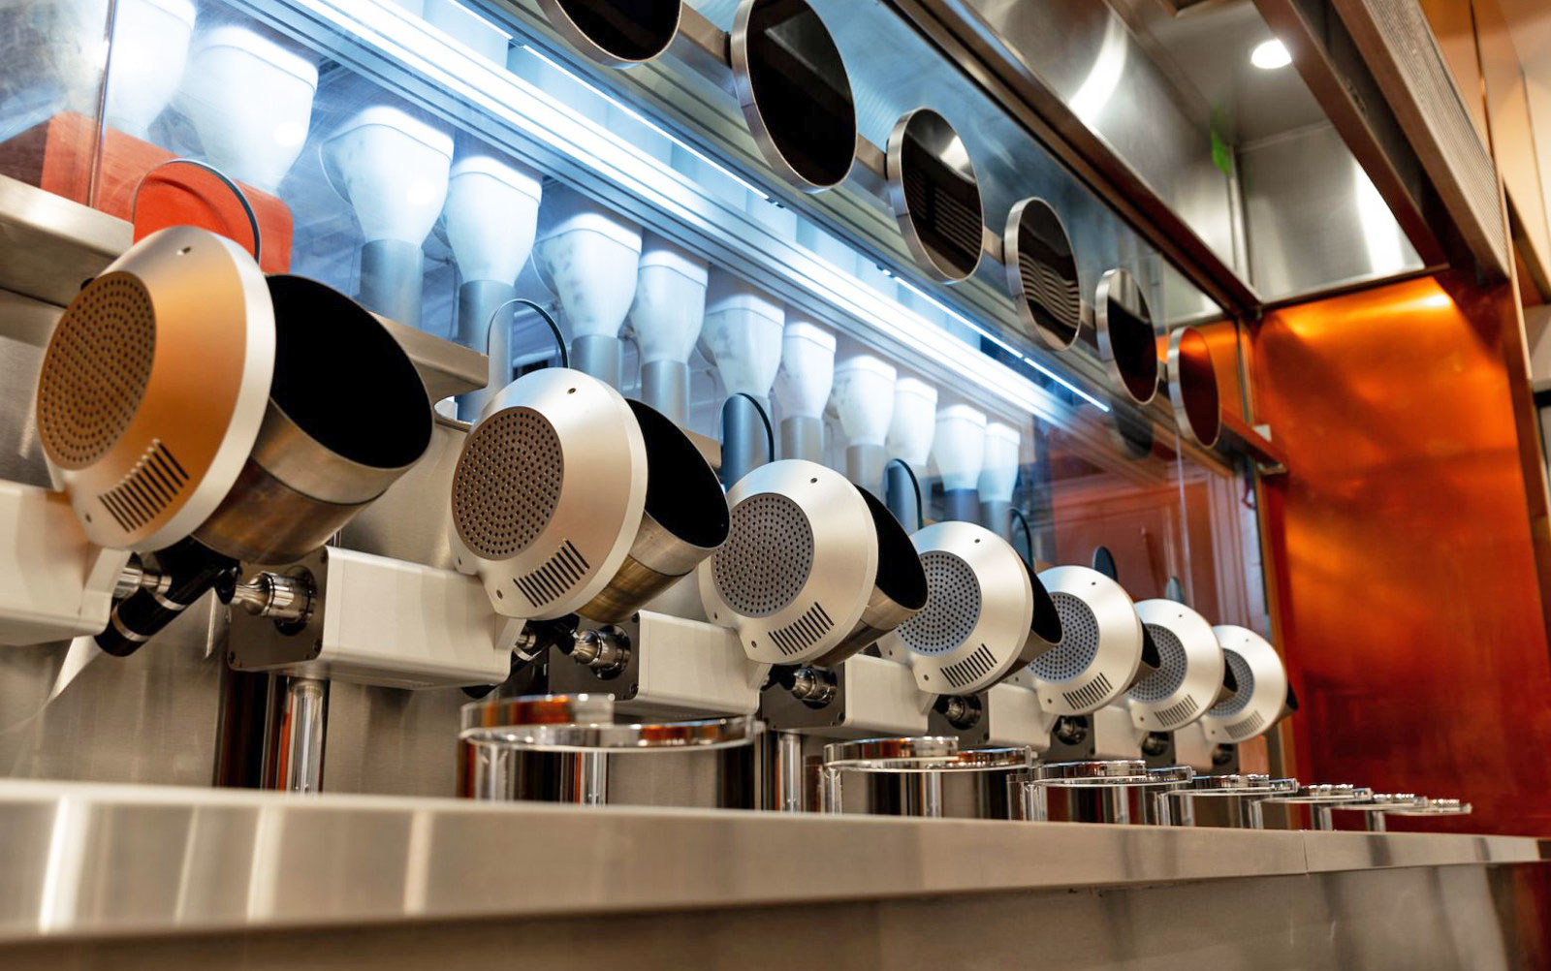
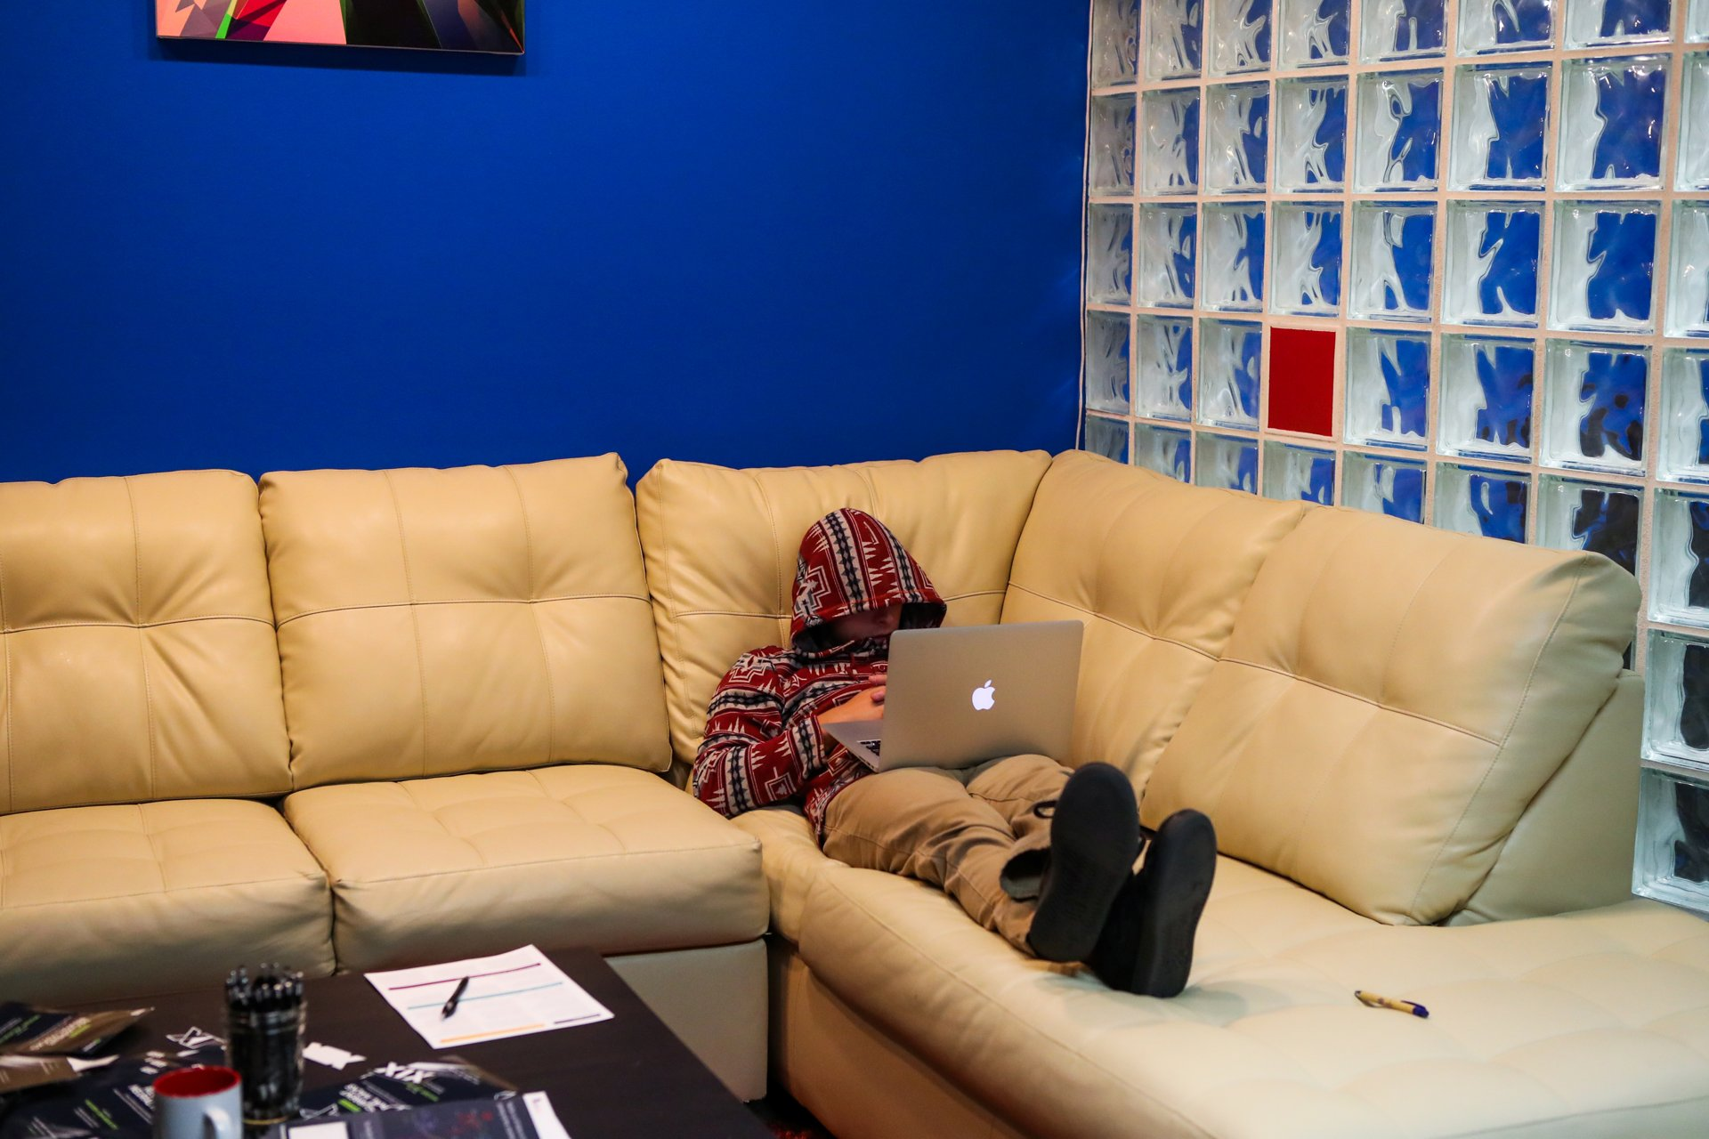
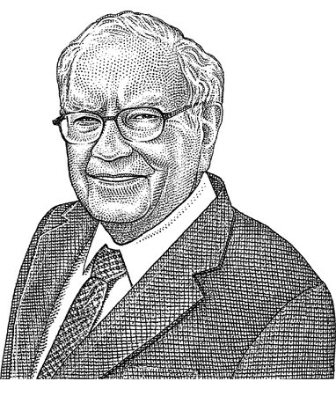
Student Choice – Interesting Articles 2/2
We know ethics should inform AI. But which ethics? - Mauro Guillen, World Economic Forum, 2018-07-26
MIT-born Spyce raises $21M to open new robotic restaurants - Lucia Maffei, BostInno, 2018-09-07
The Coders Programming Themselves Out of a Job - Brian Merchant, The Atlantic, 2018-10-02
Berkshire Hathaway’s Stock Price Is Too Much for Computers - Alexander Osipovich, The Wall Street Journal, 2021-05-05 (approaching $429,496.7295 32 bit limit) (access limited)
Notes:
All Last Accessed 2021-04-03
Spyce image: https://www.engadget.com/2018/05/04/boston-robotic-kitchen-spyce/ , 2018-05-04
Coders Programming Themselves Out of a Job image: Gabrielle Lurie, Reuters (date unknown)

Slide 11
Class 14 The End
Keith A. Pray
SocialImps.com

