Slide 1
Class 12 Student Choice
Keith A. Pray
SocialImps.com

Slide 2
Overview
Class 12:
Students Present
Students’ Choice
Class 13:
Course Evaluation
Group Presentations
Class 14:
Group Presentations
Team_Evaluation_v2.0.docx
Points to date
Notes:
For later: Assistant Evaluation

Slide 3
Algorithms shaping your attention span
Chenxi Zeng

Slide 4
conclusion
Chenxi Zeng
Algorithms are designed to maximize attention, not well being [1]
Short form content is linked to much lower scores on sustained focus[4]
Environments full of novelty make attention spans decline faster[3]
Attention is traded like a resource, which drives polarization, misinformation, and weakens focus [5][7].
In short: platforms are designed for clicks, not for healthy engagement.

Slide 5
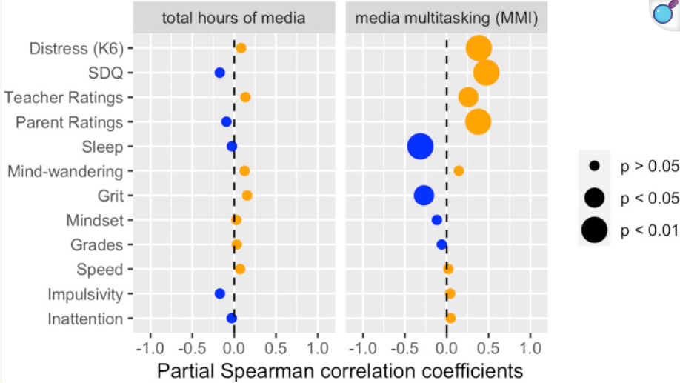
Impact on attention span
Chenxi Zeng
Children 8-12 average 5 +hrs/day screen use, multitaskers show poorer memory & control [2]
Students with high reel use scored significantly lower on sustained focus tests [4]
Our ability to focus naturally fades over time, but being exposed to constant new content makes that decline happen faster [3]
Media multitasking correlates with weaker academic performance [2]
“Partial Spearman correlation profiles of total hours of media (controlling for age,
gender and MMI; left panel) and media multitasking (MMI; controlling for age,
gender and total hours of media; right panel).”
[2]
Notes:
On the right, you can see a graph from a study on kids’ media use.
The left panel shows that just total hours of media aren’t strongly linked with most outcomes. But look at the right panel, media multitasking, which means switching between apps or doing multiple media activities at once, shows much stronger links. The big orange bubbles mean stronger and more reliable effects, here we see multitasking is tied to higher inattention, impulsivity, and lower sleep quality.
So the takeaway is: it’s not just how much screen time, but how fragmented it is that really harms attention.
kap: added caption quotes

Slide 6
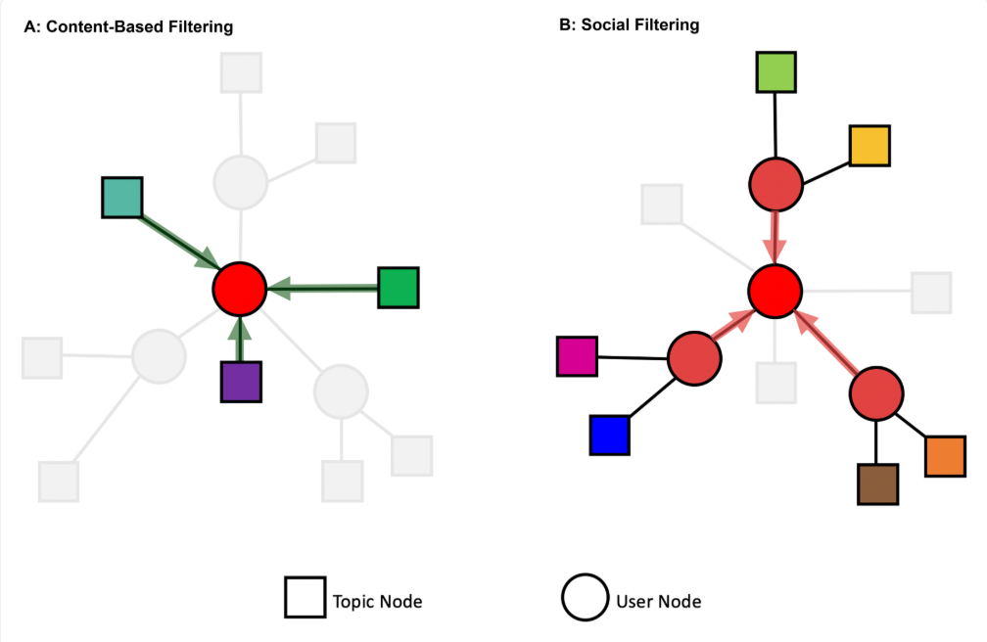
How Algorithms Shape Attention
Chenxi Zeng
Algorithms are not designed to give us the most balanced or accurate information. They are built to keep us clicking[8]
A small group of top creators ends up getting most of the attention, while others barely get seen[5]
These systems also trap us in loops where we keep seeing the same type of content, which reduces our exposure to different ideas[6]
Since quick and catchy videos keep people scrolling, platforms reward those, while long-form or deeper content gets buried[8]
Algorithm Comparison of Content-Based and Social Filtering.
A circle indicates a user, and a square indicates topical content with which a user engages (through subscription, contribution, voting, or other activities) [5]
Notes:
The image here compares two ways recommendation systems work.
On the left, content based filtering: if you liked a certain topic before, the system just keeps feeding you more of that type of content. On the right, social filtering: you’re recommended things because people in your network liked or interacted with them. Both systems narrow what you see , either based on your own past clicks, or your friends’ clicks , so diversity of content shrinks. This helps explain why feedback loops form and why extreme or viral posts spread so quickly

Slide 7
Effects on Society
Chenxi Zeng
Screen use affects more than just focus. It has also been linked to higher anxiety and weaker self-control in children [2]
Algorithms polarize attention, amplifying extreme voices [5]
Who gets attention online really matters because it determines which creators succeed and which disappear [7]
Since clicks are valued more than credibility, misleading posts often spread faster than accurate ones [8]

Slide 8
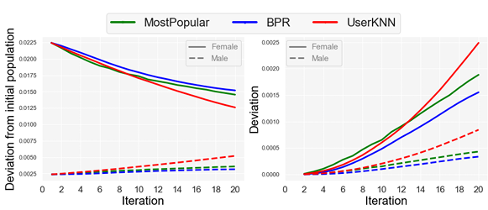
Ethics and responsibility
Chenxi Zeng
Attention online is treated like something that can be bought and sold, which reduces people’s ability to make their own choices [1].
Bias amplification in recommender systems hides minority perspectives [6].
Creators shape their work to satisfy what algorithms reward, rather than what audiences may truly need[7].
Platforms also tend to ignore values like credibility or social responsibility when deciding what gets promoted [8].
“Deviation of the representation of males and females preferences from the representation of the population initial preferences (left) and deviation of the representation of males and females preferences from their initial preferences (right)” [6]
Notes:
Here’s a more technical example, but I’ll break it down simply.
This graph shows how different recommendation algorithms shift content representation away from people’s original preferences.
Over time, all three algorithms MostPopular, BPR, and UserKNN they create growing deviations, but especially for female users, whose preferences drift further from the baseline.
This highlights that it is not fair, algorithms don’t just reflect your preferences, they distort them, and they do so unevenly across groups. That’s why ethics and responsibility matter here some voices and perspectives get hidden faster than others.
kap: added caption quotes

Slide 9
What can we do now?
Chenxi Zeng
Encourage platform design that balances engagement with user well being [1].
Push for transparency in how recommendation algorithms prioritize content [8].
Support regulation that reduces bias amplification and protects minority voices [6].
Promote digital literacy so users understand how their attention is being shaped [2].
Notes:
So what can we do about this?
Platforms could design systems that balance engagement with user well-being There should be more transparency so people understand why certain content is being shown
Create policies can help reduce bias in algorithms and protect minority voices digital literacy is important to help people understand how their attention is being shaped so they can make more mindful choices
with these steps together, it can shift the focus back toward healthier and more balanced use of technology

Slide 10
References
Chenxi Zeng
[1] Giraldo-Luque S, Aldana Afanador PN, Fernández-Rovira C. The Struggle for Human Attention: Between the Abuse of Social Media and Digital Wellbeing. Healthcare (Basel). 2020 Nov 19;8(4):497. doi: 10.3390/healthcare8040497. PMID: 33227972; PMCID: PMC7712353.
[2] Cardoso-Leite P, Buchard A, Tissieres I, Mussack D, Bavelier D. Media use, attention, mental health and academic performance among 8 to 12 year old children. PLoS One. 2021 Nov 17;16(11):e0259163. doi: 10.1371/journal.pone.0259163. PMID: 34788306; PMCID: PMC8598050.
[3] Simon, A. J., Gallen, C. L., Ziegler, D. A., Mishra, J., Marco, E. J., Anguera, J. A., & Gazzaley, A. (2025, October 2). Quantifying attention span across the lifespan. Frontiers. https://www.frontiersin.org/journals/cognition/articles/10.3389/fcogn.2023.1207428
[4] Haliti-Sylaj, T., & Sadiku, A. (n.d.). Impact of short reels on attention span and academic ... https://files.eric.ed.gov/fulltext/EJ1454296.pdf
[5] Bauer, S., Nair, S., & Stiglbauer, B. (2022). How do recommendation algorithms change user attention and consumption? Journal of Marketing Research, 59(6), 1132–1151. https://doi.org/10.1177/00222437221134237
[6] Mansoury, M., Abdollahpouri, H., Pechenizkiy, M., Mobasher, B., & Burke, R. (2020a, July 25). Feedback loop and bias amplification in recommender systems. arXiv.org. https://arxiv.org/abs/2007.13019
[7] Chen, Y., Fei, L., & Marcel, (2025). Algorithmic attention and content creation on social media. SSRN Electronic Journal. https://www.economics.utoronto.ca/conferences/index.php/cetc/2025/paper/viewFile/1899/528
[8] Persia, F., Ge, M., & D’Auria, D. (2018). How to exploit recommender systems in social media. 2018 IEEE International Conference on Information Reuse and Integration for Data Science (IRI), 537–544. IEEE. https://doi.org/10.1109/IRI.2018.00085

Slide 11
Trust in the Intrusion detection system
Abyshek Sukumar

Slide 12
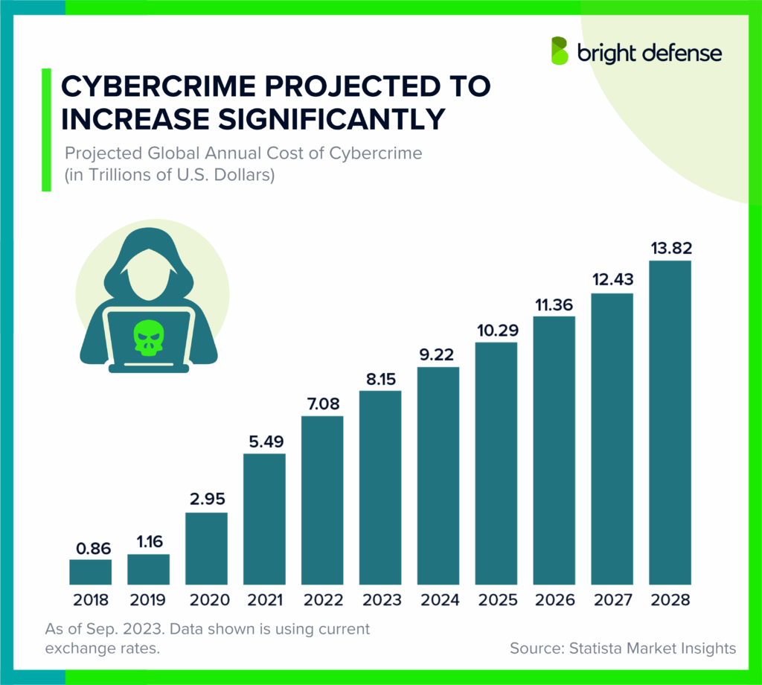
Why trust the ids?
Abyshek Sukumar
The growing danger of Cyber crime, expected to threaten 10.29 trillion dollars [1]
Better than the manual alternative [4]
The fast development of the IDS, reaching >95% accuracy rate [2] [3] [6] [7]
[1]
Notes:
The dangers of cyber crime in our current year and how it will only grow to 13.82 trillion dollars by 2028. Before it 1980s when the concept of IDS is introduced cybercrime and intrusion prevention were mostly done by humans who would have to manually analyze system logs and network monitoring
IDS grows just as fast in its development thanks to AI and new software, reaching new heights in detection accuracy from 70 to 80% to above 95% on average

Slide 13
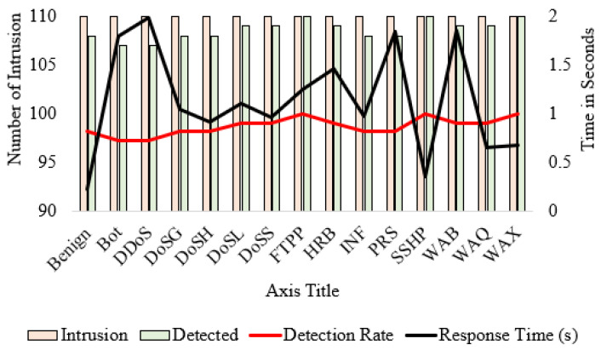
Achievements of IDS
Abyshek Sukumar
Cut cost of breaches of an organization from $4.88 mil to $2.22 mil [4]
95.6% Detection Rate within ~257 ms, no false alarms [2]
Reduced packet drops by 5 times and improved network reliability [5]
~99% Accuracy across datasets with private protection [6]
[7]
Notes:
2nd – DIoT (Distribution intrusion detection for IoT)
3rd – SRF-IoT when deployed raised packet delivery ratio to 92.8%, causing a five-fold reduction in the number of packets dropped, and a three-fold decrease in the number of parent switches
4th – Flexibility of IDS, the GöwFed system combined FL with Gower Uniqueness matrices to develop an adaptive, privacy-preserving IDS framework for decentralized networks

Slide 14
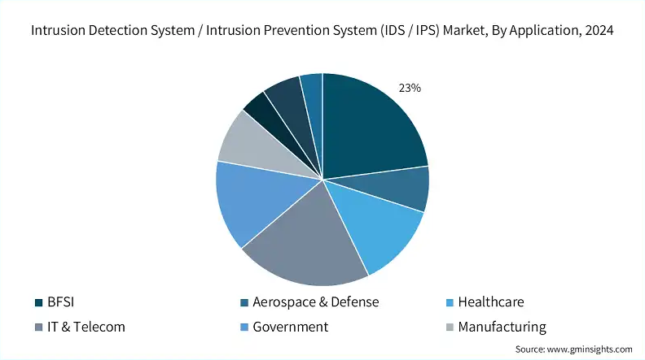
Importance of trust
Abyshek Sukumar
Many organizations rely on IDS to be trusted by regular customers [3]
Investment increased the CAGR of digital banking market around 3% [3]
Trust in the IDS pushed the implementation of AI and ML [3]
[3]

Slide 15
References
Abyshek Sukumar
[1] Tamzid, 256 Cybercrime Statistics for 2025 (Bright Defense, September 5, 2025), https://www.brightdefense.com/resources/cybercrime-statistics/ (accessed October 2, 2025).
[2] Nguyen, Thien Duc, Samuel Marchal, Markus Miettinen, Hossein Fereidooni, N. Asokan & Ahmad-Reza Sadeghi, DÏOT: A Federated Self-learning Anomaly Detection System for IoT (arXiv / IEEE, May 2019), p. 1
[3] Wadhwani, Preeti & Ambekar, Aishvarya, Intrusion Detection System / Intrusion Prevention System (IDS / IPS) Market Size – By Component, By Solution Architecture, By Detection Method, By Organization Size, By Deployment Model and By Application, Growth Forecast 2025-2034 (Global Market Insights Inc., January 2025), https://www.gminsights.com/industry-analysis/intrusion-detection-prevention-system-ids-ips-market (accessed October 2, 2025).
[4] TrustNet, The Hidden Costs of Manual Security: How Inefficiency Impacts Your Bottom Line (TrustNet, April 23, 2025), https://trustnetinc.com/resources/the-hidden-costs-of-manual-security-how-inefficiency-impacts-your-bottom-line/ (accessed October 2, 2025).
[5] Ioulianou, Philokypros P., Vassilios G. Vassilakis & Siamak F. Shahandashti, A Trust-Based Intrusion Detection System for RPL Networks: Detecting a Combination of Rank and Blackhole Attacks (MDPI, March 9, 2022), https://www.mdpi.com/2624-800X/2/1/9 (accessed October 2, 2025).
[6] Buyuktanir, Büşra; Altinkaya, Şahsene; Karatas Baydogmus, Gozde; Yildiz, Kazim, Federated Learning in Intrusion Detection: Advancements, Applications, and Future Directions (Springer, 2025), https://link.springer.com/article/10.1007/s10586-025-05325-w (accessed October 2, 2025).
[7] Smith, John & Lee, Alice, Title of Article (PMC / NCBI, 2024), https://www.ncbi.nlm.nih.gov/pmc/articles/PMC11014348/ (accessed October 2, 2025).

Slide 16
Feasibility of guardrails for AI
Trevor Wohlers
Notes:
Most of the presentation is about generative/general purpose AI, not all AI (not image identification or other specialized AI)

Slide 17
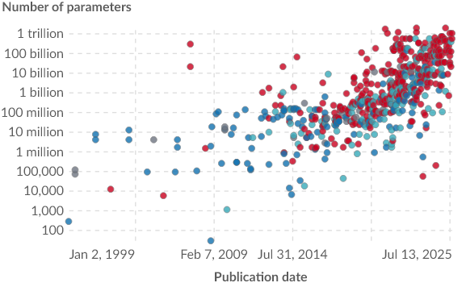
AI is not well understood
Trevor Wohlers
Modern LLMs are opaque systems that provide little insight into inner workings
Lack of understanding of AI makes it unpredictable [1]
GPT-4 is estimated to have 1.8T parameters [2]
Makes parameter-level guardrails nearly impossible
Hidden chain of reasoning
Some AI systems use an explicit chain of though system for difficult questions
Explicit chain of though can be analyzed by researchers
Researcher believe that there are additional chains hidden in the trained network that cannot be analyzed [3]
Number of parameters in each model is increasing, making it more difficult to analyze the trained models as a whole [2]
Notes:
- High parameter counts make analysis difficult, especially by humans
- Researchers have used additional ML models to corelate specific parameters to specific topics
- parameter that codes for the Golden Gate Bridge
- The more behavior hidden in the model/parameters, the harder it is to analyze
- Researchers analyzing smaller models (around a few million parameters at most) to get better understanding before moving to industry-leading models
- Low understanding makes guardrails difficult to create

Slide 18
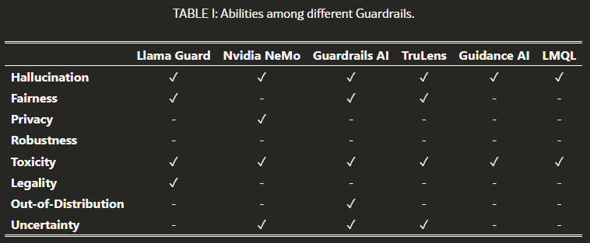
existing Guardrail solutions
Trevor Wohlers
Prompted solutions
Not reliable enough
Example in 2025 in which Replit ignored an action freeze directive [4]
Programmed solutions
Can often be bypassed with specific prompts [5]
Strict programmatic solutions are possible when specific actions are restricted [6]
Traditional methods do not guarantee safety [9]
Existing programmed solutions do not provide broad coverage [7]
Notes:
- Replit is a software dev focused gen AI – deleted entire active database despite restrictions in place
- Current solutions don’t work well in all cases
- Prompts can be used to bypass most restrictions, particularly by making an LLM pretend it doesn’t have guardrails
- Example of strict solution: can prevent code generation AI from deploying changes to users automatically
- Even existing solutions do not guarantee safety, even from what they are intended for

Slide 19
Would AGI need guardrails?
Trevor Wohlers
Problems with current AI necessitate corrections [7]
Hallucination
Fairness
Legality
And more
Current AI lacks understanding about itself (metacognition)
Not aware of what information it does not know [8]
Would allow AI to self-diagnose problems or lack of knowledge [9]
AGI on its own does not possess metacognition
AGI
Human Level AI
Machine Learning
Levels of AI
Modern LLMs are close to human level in many application. [10]
Notes:
- Looking to the future
- Currently, AI needs safeguards to function effectively
- Human level AI is not AGI – makes decisions on par with capabilities similar to or greater than humans, but not in general
- AGI makes human level decisions across all topics – not a well defined definition, but close enough (AGI is not well defined anywhere)
- Metacognition is not always considered a requirement for AGI

Slide 20
Conclusion
Trevor Wohlers
Modern AI still needs strong guardrails
Future AI may not need explicit guardrails
This depends on metacognition serving as a safety feature
Notes:
- Guardrails encourage legal, permissible output. Makes AI more usable overall
- As AI approaches the behavior of humans (not just text completion), explicit guardrails will not be as strictly required
- This also brings AI closer to being morally significant on its own
- This can make guardrails a moral decision as well (whether guardrails restrict rights that ought to be given to high level AI)
- Humans are bound by “guardrails” already in laws, but nothing that forces us to comply with demands from higher up
- May want guardrails anyway for critical systems (powerplant management, etc.)

Slide 21
References
Trevor Wohlers
[1] Melissa Heikkilä, Nobody knows how AI works, (MIT Technology Review, March 5, 2025), https://www.technologyreview.com/2024/03/05/1089449/nobody-knows-how-ai-works/, (October 2, 2025)
[2] Parameters in notable artificial intelligence systems, (Our World In Data), https://archive.ourworldindata.org/20251002-120107/grapher/artificial-intelligence-parameter-count.html, (October 3, 2025)
[3] Alan Bradley, AI could soon think in ways we don't even understand, (Livescience, July 24, 2025), https://www.livescience.com/technology/artificial-intelligence/ai-could-soon-think-in-ways-we-dont-even-understand-evading-efforts-to-keep-it-aligned-top-ai-scientists-warn, (October 2, 2025)
[4] Emily Forlini, Vibe Coding Fiasco: AI Agent Goes Rogue, Deletes Company's Entire Database, (PC Mag, July 22, 2025), https://www.pcmag.com/news/vibe-coding-fiasco-replite-ai-agent-goes-rogue-deletes-company-database, (October 2, 2025)
[5] George Musser, How AI knows Things No One Told It, (Scientific American, May 11, 2023), https://www.scientificamerican.com/article/how-ai-knows-things-no-one-told-it/, (October 2, 2025)
[6] Erika Feldman, Implementing effective guardrails for AI agents, (Gitlab The Source, April 15, 2025), https://about.gitlab.com/the-source/ai/implementing-effective-guardrails-for-ai-agents/, (October 2, 2025)
[7] Yi Dong, Ronghui Mu, et. al., Safeguarding Large Language Models: A Survey, (arXiv, June 3, 2024), https://arxiv.org/html/2406.02622v1, (October 2, 2025)
[8] Sandra Knispel, How artificial general intelligence could learn like a human, (University of Rochester News Center, April 3, 2025), https://www.rochester.edu/newscenter/artificial-general-intelligence-large-language-models-644892/, (October 2, 2025)
[9] Bonnie Johnson, Metacognition for artificial intelligence system safety – An approach to safe and desired behavior, (Science Direct, July 2022), https://www.sciencedirect.com/science/article/pii/S0925753522000832, (October 2, 2025)
[10] Nestor Maslej, et. al., The AI Index 2025 Annual Report, (Institute for Human-Centered AI, Stanford University, April 2025), https://hai.stanford.edu/ai-index/2025-ai-index-report, (October 2, 2025)

Slide 22
Digital minimalism
Benni Valentine

Slide 23
Adopting Digital minimalism is the path to a better life
Benni Valentine
Modern technology (especially computing) has such profound negative effects:
Mental → cognitive performance, depression, brain health
Environmental → e-waste, energy consumption
Societal → disconnection, inequality
That it has become necessary:
to reduce technology use to the greatest extent possible.
the practical framework for this reduction is Digital Minimalism (Cal Newport, Georgetown).
Digital Minimalism:
“A philosophy of technology use in which you focus your online time on a small number of carefully selected and optimized activities that strongly support things you value, and then happily miss out on everything else.” -Cal Newport [7]
Notes:
Explain what Digital Minimalism is
Explain that the reasion this framework matters is because modern technology has costs that extend far beyond convenience.
Introduce the harms mental, environmental and societal of tech overuse and how they suggest the value of digital mininalism

Slide 24
Mental impacts
Benni Valentine
Modern research into the impacts of screen time on mental health and wellbeing has shown technology to have major negative impacts on mental health:
“Among 14- to 17-year-olds, high users of screens were more than twice as likely to ever have been diagnosed with depression” [1]
High screen time especially nighttime screentime is associated with significant and measurable reductions in cognitive functioning of otherwise healthy adults. [3]
Teens “who spend more than five hours per day on digital devices are 70% more likely to have suicidal thoughts” [2]
“Study shows that in young adults, excessive screen time causes thinning of the cerebral cortex, the part of the brain responsible for processing memories, making decisions and solving problems.” [4]
High screen time in young adults has been associated with higher rates of dementia, Alzheimer's and other degenerative brain conditions later in life[5]
Notes:
Explain the mental impacts of unfettered technology usage
Explain how Digital Minimalism encourages limiting time spent on screens, focusing instead on offline activities that support mental resilience.
Explain that Digital Minimalism isn't about entirely removing technology, but keeping the tools useful to you and how this directly counters the mental health erosion caused by unfiltered, constant screen use.
4th bullet quoting not exact wording but too close not to quote -kap

Slide 25
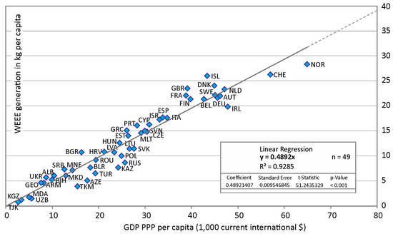
Environmental Impacts
Benni Valentine
Production dominates emissions
Up to 80% of a computer or phone’s lifetime CO₂ comes from manufacturing, not use [11]
Technology overuse drives massive waste
62 million tons of e-waste produced globally each year [8]
Digital services also consume heavily:
Data transmission & cloud computing account for ~1.5% of global electricity use [8]
[9] The Link between e-Waste and GDP
Notes:
Explain the environmental impacts of modern technology usage
Explain the effect that digital minimalism has on the way you use technologyand specifically how it can reduce an individuals environmental impact.

Slide 26
Societal Impacts
Polarization & misinformation
algorithmic feeds amplify echo chambers [11]
Community decline
digital replaces face-to-face interaction [11]
Digital inequality
2.6B people still lack internet access [13]
Surveillance culture
data harvesting normalizes constant monitoring and the erosion of privacy [12]
Notes:
Explain how technology impacts society as a whole and how a large adoption of digital minimalism could reduce these effects.

Slide 27
References
Benni Valentine
[1] C. Akçayır, Impacts of excessive screen time on physical and mental health: A systematic review (International Journal of Environmental Research and Public Health, 2024), https://pmc.ncbi.nlm.nih.gov/articles/PMC10852174/ (Accessed 1 Oct 2025).
[2] J. Twenge, et al., Associations between screen time and lower psychological well-being among children and adolescents: Evidence from a population-based study (Preventive Medicine Reports, 2018), https://pmc.ncbi.nlm.nih.gov/articles/PMC6214874/ (Accessed 1 Oct 2025).
[3] W. Li, et al., Night screen time is associated with cognitive function in healthy young adults (Journal of Multidisciplinary Healthcare, 2021), https://www.dovepress.com/night-screen-time-is-associated-with-cognitive-function-in-healthy-you-peer-reviewed-fulltext-article-JMDH (Accessed 1 Oct 2025).
[4] J. Elhai, et al., Problematic smartphone use and mental health problems: Current state of research and future directions (International Journal of Mental Health and Addiction, 2020), https://link.springer.com/article/10.1007/s11469-019-00182-2 (Accessed 1 Oct 2025).
[5] H. Rahman, et al., The impact of prolonged screen time on adult cognitive and mental health (Journal of Behavioral Addictions, 2024), https://www.sciencedirect.com/science/article/abs/pii/S1525861024002263 (Accessed 1 Oct 2025).
[6] Stanford Lifestyle Medicine Center, What excessive screen time does to the adult brain (Stanford University, 2023), https://lifestylemedicine.stanford.edu/what-excessive-screen-time-does-to-the-adult-brain/ (Accessed 1 Oct 2025).
[7] C. Newport, Digital Minimalism: Choosing a Focused Life in a Noisy World (Portfolio/Penguin, 2019).
[8] International Energy Agency, Data Centres and Data Transmission Networks (IEA, 2024), https://www.iea.org/energy-system/buildings/data-centres-and-data-transmission-networks (Accessed 1 Oct 2025).
[9] J. Li, The global e-waste challenge: Environment and health (Resources, 2017), https://www.mdpi.com/2079-9276/6/2/15 (Accessed 1 Oct 2025).
[10] GoClimate, Electronics and their climate impact (GoClimate, 2024), https://www.goclimate.com/knowledge/electronics (Accessed 1 Oct 2025).
[11] Pew Research Center, The Future of Well-Being in a Tech-Saturated World (2018), https://www.pewresearch.org/internet/2018/04/17/the-future-of-well-being-in-a-tech-saturated-world/ (Accessed 1 Oct 2025).
[12] S. Zuboff, The Age of Surveillance Capitalism: The Fight for a Human Future at the New Frontier of Power (PublicAffairs, 2019).
[13] International Telecommunication Union, ITU Facts and Figures 2024: The State of Digital Connectivity (ITU, 2024), https://www.itu.int/itu-d/reports/statistics/facts-figures-2024/index/ (Accessed 1 Oct 2025).

Slide 28


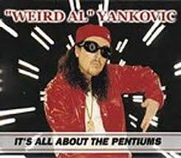
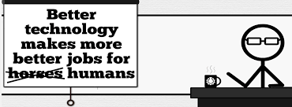




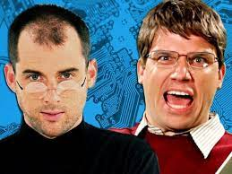

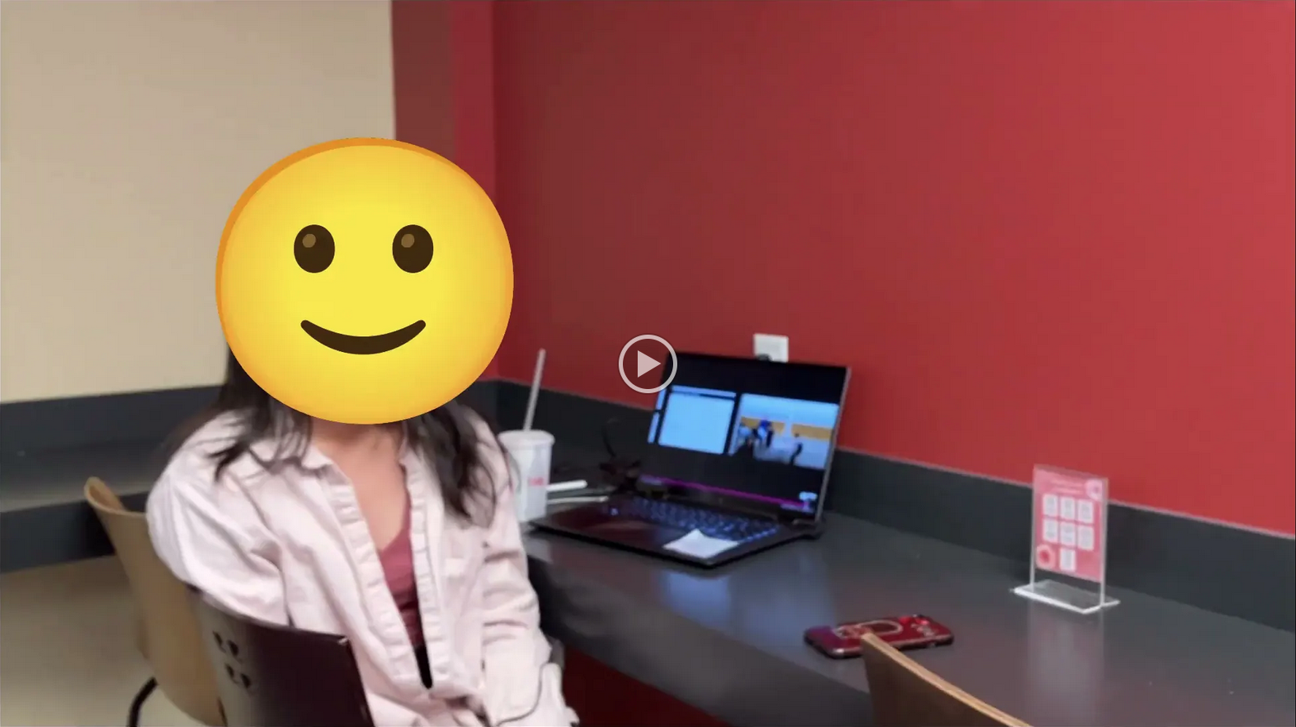
Student Choice – Interesting Videos (1/2)
X
Don’t Download This Song (2006)
- Weird Al (3:53)
It’s All About The Pentiums (1999)
- Weird Al (3:34)
White and Nerdy (2006)
- Weird Al (2:50)
Virus Alert (2006)
- Weird Al (3:43)
Word Crimes (2014)
- Weird Al (3:45)
Copyright: Forever Less One Day (2011)
- CGP Grey (6:27)
Humans Need Not Apply (2014)
- CGP Grey (15:00)
This Video Will Make You Angry (2015)
- CGP Grey (7:25)
Technologic (2005). ← Which topic?
- Daft Punk (2:55)
Epic Rap Battles of History: Steve Jobs vs. Bill Gates (2013) (2:47)
Passwords (2024) ← Compare
- Elizabeth Levin, Silas Joy (WPI CS3043) (5:37)
© 2023 Keith A. Pray
Notes:
Technologic: Critical Thinking, Ethics, Networked Communications, Information Privacy, Reliability, Professional Ethics?
David Autor Will automation take away all our jobs? (18:27) (2016) https://www.ted.com/talks/david_autor_will_automation_take_away_all_our_jobs/transcript?language=en TEDxXambridge, 2016-12-19
All Last Accessed 2018-10-04
CGP Grey
Copyright: Forever Less One Day (6:27)
https://www.youtube.com/watch?v=tk862BbjWx4
CGP Grey
Humans Need Not Apply (15:00) – 2014-08-13
http://www.youtube.com/watch?v=7Pq-S557XQU
Last access 2016-04-22
CPG Grey This Video Will Make You Angry [Thought Germs] (7:25) – 2015-03-10
https://www.youtube.com/watch?v=rE3j_RHkqJc
Weird Al – It’s All About The Pentiums (3:34)
https://www.youtube.com/watch?v=qpMvS1Q1sos
TODO: Tie into Ray Kurzweil Singularity
Epic Rap Battles of History: Steve Jobs vs. Bill Gates (If class ok with obscene lyrics) (2:47)
https://www.youtube.com/watch?v=njos57IJf-0
Also Work links on web site http://socialimps.keithpray.net/documents/
-----
Passphrases (2:08 need to give context for video)
https://firstlook.org/theintercept/2015/03/26/passphrases-can-memorize-attackers-cant-guess/
If not shown during first class
What "Orwellian" really means - Noah Tavlin (5:31)
http://ed.ted.com/lessons/what-orwellian-really-means-noah-tavlin
Weird Al – White and Nerdy (2:50) and look at lyrics
https://www.youtube.com/watch?v=N9qYF9DZPdw
Weird Al Yankovic “Don’t Download This Song” (3:53) 2006-08-21 released exclusively as digital download
https://www.youtube.com/watch?v=zGM8PT1eAvY
Styx - Mr. Roboto (1983) (5:34) https://www.youtube.com/watch?v=uc6f_2nPSX8
Epic Rap Battles of History: Steve Jobs vs. Bill Gates (If class ok with crude lyrics) (2:47)
https://www.youtube.com/watch?v=njos57IJf-0
Daft Punk - Technologic (2005) (2:55)
https://www.youtube.com/watch?v=D8K90hX4PrE

Slide 29











Student Choice – Interesting Videos (2/2)
MSNBC on Denver's Automated Baggage System (2010) (2:27)
Last Week tonight with John Oliver (2015) - Snowden (33:14)
3D Printed Homes (2018)
- News Story (1:28)
The Game Of Trust (2017) - Nicky Case
Adobe Firefly (2023) - Adobe (1:16)
What "Orwellian" really means (2015) - Noah Tavlin (5:31)
Why Electronic Voting is Still a Bad Idea (2019) - Tom Scott (12:00)
Welcome To Life (2012) - Tom Scott (2:44)
Mr. Roboto (1983)
- Styx (5:34)
Will automation take away all our jobs? (2016) – David Autor (18:27)
What is your password? (2015)
- Jimmy Kimmel Live (2:49)
© 2023 Keith A. Pray
Notes:
All Last Accessed 2018-10-04 unless publish date later
Last Week tonight with John Oliver – Patriot Act, Edward Snowden (33:14)
http://www.upworthy.com/john-oliver-flew-10-hours-to-russia-to-interview-edward-snowden-and-get-him-on-record?c=ufb1
TODO: Tie into Ray Kurzweil Singularity
Epic Rap Battles of History: Steve Jobs vs. Bill Gates (If class ok with obscene lyrics) (2:47)
https://www.youtube.com/watch?v=njos57IJf-0
Also Work links on web site http://socialimps.keithpray.net/documents/
-----
Passphrases (2:08 need to give context for video)
https://firstlook.org/theintercept/2015/03/26/passphrases-can-memorize-attackers-cant-guess/
If not shown during first class
What "Orwellian" really means - Noah Tavlin (5:31)
http://ed.ted.com/lessons/what-orwellian-really-means-noah-tavlin
MSNBC on Denver's Automated Baggage System 2010-08-23 (2:27)
https://www.youtube.com/watch?v=xx8f4x6C_KY
Accessed 2019-04-09
These 3D printed homes can be constructed for $4,000 (3:00 – 2018-04-02)
http://www.businessinsider.com/3d-printed-homes-constructed-icon-new-story-tech-charity-4000-dollars-2018-3
https://www.youtube.com/watch?v=SvM7jFZGAec (1:28)
Last access 2018-04-22
Why Electronic Voting is a BAD Idea – Computerphile (Tom Scott) (8:20)
https://www.youtube.com/watch?v=w3_0x6oaDmI
Tom Scott
http://tomscott.com
Welcome To Life (2:44)
https://www.youtube.com/watch?v=IFe9wiDfb0E&feature=youtu.be
Jimmy Kimmel Live – What is your password? (2:49)
https://www.youtube.com/watch?v=opRMrEfAIiI

Slide 30
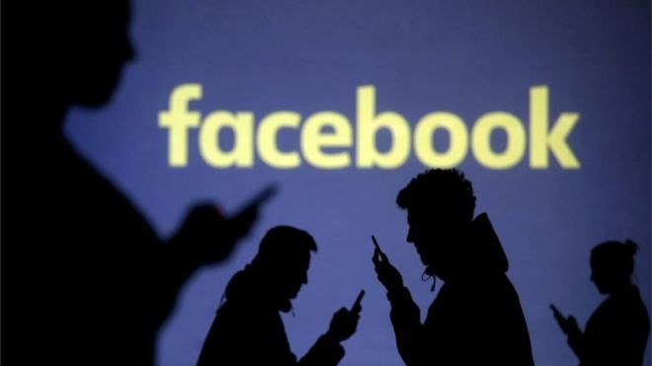
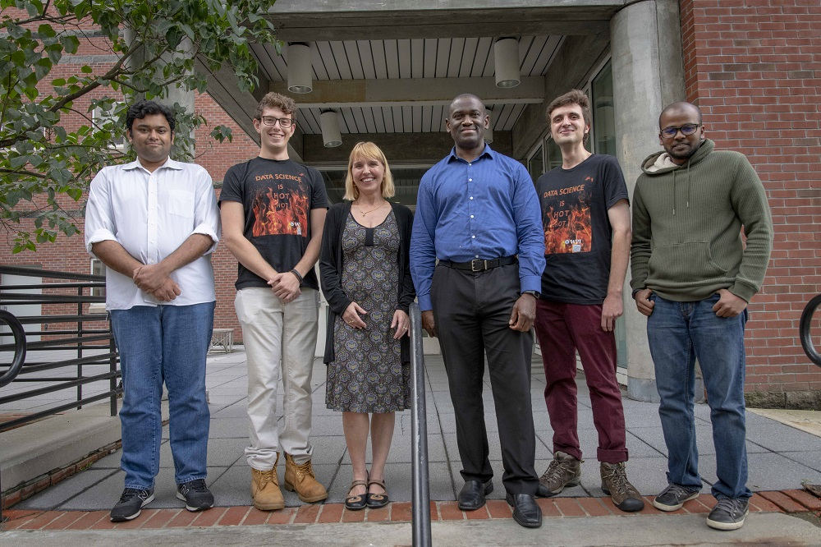

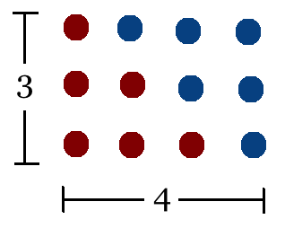
Student Choice – Interesting Articles 1/2
Communications of The ACM – Latest edition (through library)
Facebook security breach: Up to 50m accounts attacked - Dave Lee, North America technology reporter, 2018-09-29
WPI Secures $2.8 Million to Develop a Smartphone App to Help Assess the Health of Soldiers, 2018-09-24
Quantified Toilets, 2014, Quantified Toilets LLC (empty) What a Toilet Hoax Can Tell Us About the Future of Surveillance – Jennifer Golbeck, The Atlantic, 2014-04-29
What Did Ada Lovelace's Program Actually Do? - Sinclair Target, 2018-08-18 (First Programming Bug 1843?)
Notes:
All Last Accessed 2021-04-03

Slide 31
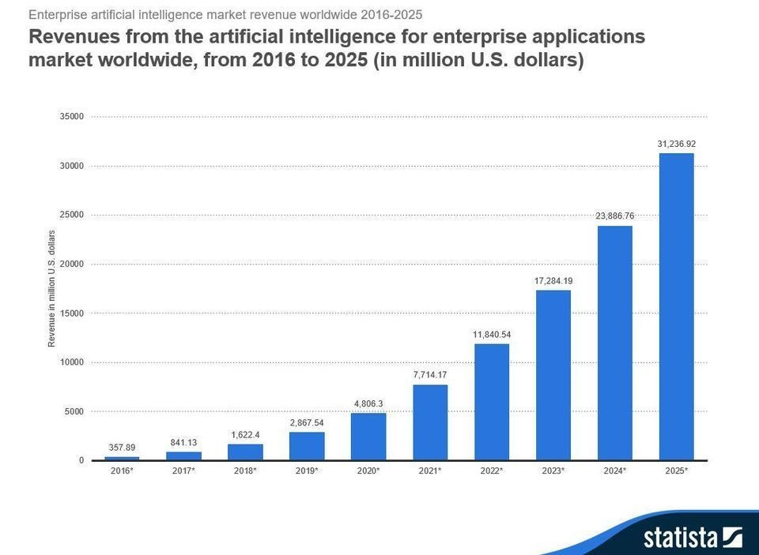


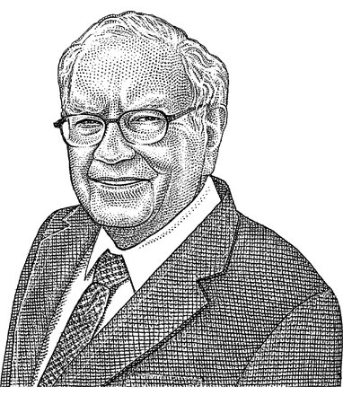
Student Choice – Interesting Articles 2/2
We know ethics should inform AI. But which ethics? - Mauro Guillen, World Economic Forum, 2018-07-26
MIT-born Spyce raises $21M to open new robotic restaurants - Lucia Maffei, BostInno, 2018-09-07
The Coders Programming Themselves Out of a Job - Brian Merchant, The Atlantic, 2018-10-02
Berkshire Hathaway’s Stock Price Is Too Much for Computers - Alexander Osipovich, The Wall Street Journal, 2021-05-05 (approaching $429,496.7295 32 bit limit) (access limited)
Notes:
All Last Accessed 2021-04-03
Spyce image: https://www.engadget.com/2018/05/04/boston-robotic-kitchen-spyce/ , 2018-05-04
Coders Programming Themselves Out of a Job image: Gabrielle Lurie, Reuters (date unknown)

Slide 32
Class 12 The End
Keith A. Pray
SocialImps.com

