Slide 1

Class 11
Livelihood
Keith A. Pray
SocialImps.com
Notes:
Styx - Mr. Roboto (1983) (5:34)
https://www.youtube.com/watch?v=uc6f_2nPSX8
Accessed 2025-04-28
Ask about Automation paper:
What did people choose to automate
Share 1 main reason

Slide 2
Papers
Support claims with data
Define test strategy clearly
Min 5 high quality sources
https://socialimps.com/assignments/paper-guidelines/
Notes:
Save for next time:
https://socialimps.com/assignments/references/
Excellent improvement!
Better quantification, some improvement left to be had
Use high quality sources
Clearly state conclusion
First statement preferred
Absolute statements are difficult to prove
Avoid: all, always, any, every, everyone, never, none… unless you can show it
Be sure to put quotes around entire quote
Hyperbole is the best thing ever!
but not in these papers
Use template, saves time (and -1 point)
Include Counter Point and Response
Include Author, Title, Publish Date, Publisher for references
Read paper aloud to proof
Changing a couple words does not constitute paraphrasing.
Include tests/results in Appendix
Ask for help if you have trouble with backing data
Define test strategy clearly

Slide 3
Grades
To Date
44 Max Possible
- Discussion 1-10
- Papers 1-3

Slide 4
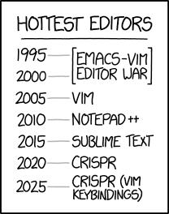
Overview
Review
Assignment
Students Present
https://www.xkcd.com/1823/
Notes:
Used to be full circle. Might have to retire this if no one know what emacs and vi are.
CRISPR: Clustered Regularly Interspaced Short Palindromic Repeats
Allows permanent modification of genes within organisms.
Published 2017-04-12 according to https://www.explainxkcd.com/wiki/index.php/List_of_all_comics_(1501-2000)
Kickstarter Charter
https://www.kickstarter.com/charter?ref=about_subnav

Slide 5
Overview
Review
Assignment
Students Present
C lustered
R egularly
I nterspaced
S hort
P alindromic
R epeats
Permanent gene modification
https://www.xkcd.com/1823/
Notes:
Full circle (not quite since the Emacs/VIM comic no longer used… may have to retire this as students seem to not be aware of different text editors).
CRISPR: Clustered Regularly Interspaced Short Palindromic Repeats
Allows permanent modification of genes within organisms.
Published 2017-04-12 according to https://www.explainxkcd.com/wiki/index.php/List_of_all_comics_(1501-2000)
Kickstarter Charter
https://www.kickstarter.com/charter?ref=about_subnav

Slide 6
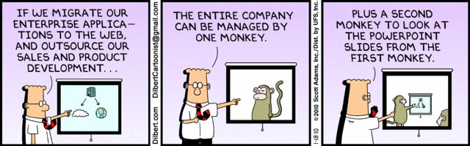
Let’s Look At One way to handle a Decrease In Jobs
Notes:
Poll class:
Expected salary range upon graduation? Min, Max? Put in spreadsheet.
Assume 40 hour work week.
How many people would work:
32 hours for 0.8 * Max?
24 hours for 0.6 * Max?
…continue until Min is reached.

Slide 7
My Reading Notes
p. 457 “Mr.” → “Ms.”
p. 458 Asimov “Three Laws of Robotics” not guarantee as his stories show… absolutes “never” difficult to prove.
p. 459 Tesla and other newer car manufacturers similar to 15 person hours per car? 2003, 2008 sources update?
p. 460 “all time… work time” 1998 source, newer corroborate?
p. 461 securities industry employment rise source 2005.
p. 462 “Working less, making more” 2001 source, now? “stone-age” source 1991, now?
p. 463 Cost of AC, screens, etc. much lower. 2022 home size source 2001? Cancelled vacation not computing, sounds likely, just in computing fields? Kantian, Stuart treated himself as a means to an end, see Virtue p. 464
p. 465 Multiple citing Wikipedia ☹
p. 468 ChatGPT Plus (et al) → more Digital Divide?
p. 473 Hawking, appeal to authority fallacy? AI needs us like we need plants, we’ve done great keeping plants safe…
p. 475 Generative AI transparency difficult with text. Brake efficiently, rear end collision most common accident p. 379, 2017, diff. now?
p. 476 Trolly, most, many, quantify.
p. 479 Amazon, Slack, source title Intel.
p. 481 Uber/Lyft lawsuit sources 2015, outcome? Monitoring data needs update, 2008 newest. Security and IP seem more likely primary purpose, 2002 source. Many people only regular Internet access was at work. More schools using cameras source 2003, need newer for claim.
p. 482 Multinational Team Patents need sources. India salary info from 2003. Jobs moving out of US 2008 source.
p. 483 3. Arg statement, 1999, still holding?
p. 484 WTO seems implementation complaint, not globalization. Corn, wheat example from 2012. Are the subsidies more the problem than globalization?
p. 485 Gates quote, what about new grads without experience?
p. 486 90% computers made in China 2014 source. 2015 example of Chinese university accomplishment.
p. 489 No other reasons for North Korea? No newspaper, radio, TV claim from 2001. Secondary school 2003. DVD player may be more relevant example than VCR.
p. 491 Online courses synchronous or asynchronous?
p. 492 DSL still relevant?
p. 493 More Wikipedia citing ☹
p. 494 2022 CEO salary source 2003? Still true more people know Windows than Mac? Is US still dominant economic power?
p. Rec Center gives students advantage, but who really pays?
p. 496 Blue laws limiting store hours computing?
p. 498 “bus” → “bust”
p. 501 21. I think Blaise doesn’t watch movies.
p. 502 29. Ignores cost of living differences.
Questions I liked: 15, 16, 17, 22, 23, 24, 25, 26, 27, 32, 33

Slide 8
Group Quiz
List 2 ways IT can lead to organizational change.
List 4 ways a Video Game Producer may protect its IP and what specific IP each protects.
List a computing technology that can be used to protect an individual’s privacy.
List a computing technology that can be used to intrude upon an individual’s privacy.
Notes:
Could split into groups for this.
Fill time with Work Discussion on Course Web Site

Slide 9
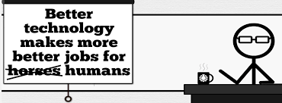


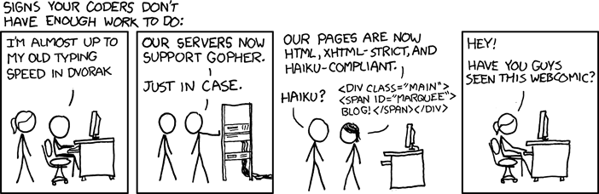
Overview
Review
Assignment
Students Present
http://xkcd.com/554/
Notes:
CGP Grey
Humans Need Not Apply (15:00) – 2014-08-13
http://www.youtube.com/watch?v=7Pq-S557XQU
Last access 2016-04-22
These 3D printed homes can be constructed for $4,000 (3:00 – 2018-04-02)
http://www.businessinsider.com/3d-printed-homes-constructed-icon-new-story-tech-charity-4000-dollars-2018-3
https://www.youtube.com/watch?v=SvM7jFZGAec (1:28)
Last access 2018-04-22
David Autor
Will automation take away all our jobs? (18:27) (2016)
https://www.ted.com/talks/david_autor_will_automation_take_away_all_our_jobs/transcript?language=en
TEDxXambridge, 2016-12-19
Review Group Assignment Details.
Or first watch video: depends on student presentations, no thunder stealing.
Look at:
BBC Intelligent Machines
http://www.bbc.com/news/technology-33978561
BBC Likelihood of robot taking your job
http://www.bbc.com/news/technology-34066941
Gopher protocol for sharing library data, ftp search, precursor to web/http

Slide 10
Assignment Reminders
Finish all reading
Finish Automation Paper
Optional Game Paper due last day of class
Group Web Sites and Presentations
If your group is not presenting prepare 3 questions for each group that is presenting by visiting their web sites.
  See Group Project Details

Slide 11
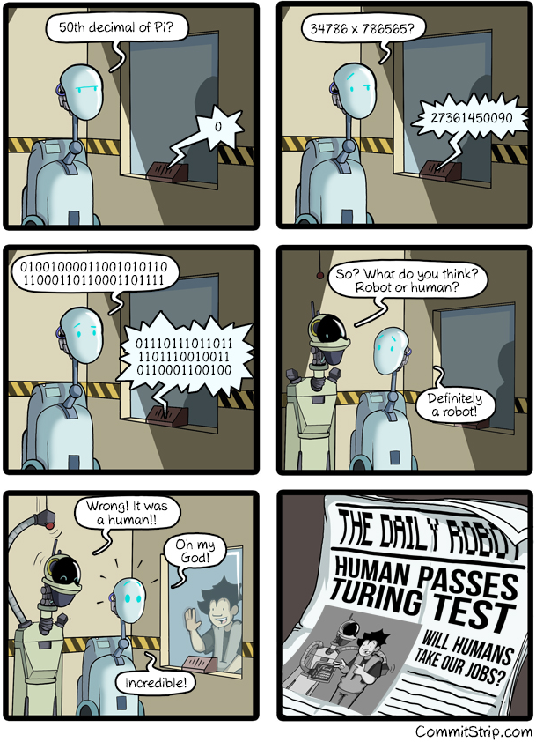
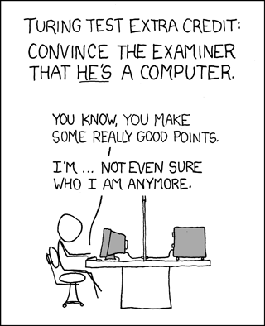
Overview
Review
Assignment
Students Present
https://xkcd.com/329/
Notes:
http://www.commitstrip.com/en/2016/04/14/meanwhile-in-a-parallel-universe-3/ (2016-04-14)
01001000011001010110
11000110110001101111
Hello
01110111011011
1101110010011
0110001100100
World
https://xkcd.com/329/ (2007-10-15)

Slide 12
High Frequency Trading
Brian Wang
Notes:
Hello everyone! My name is ________, and I’m excited to discuss the social implications of high frequency trading with all of you today.

Slide 13
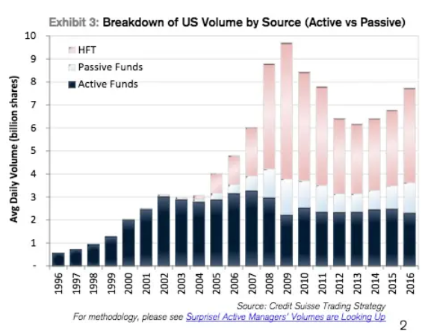
What is HFT?
Brian Wang
Uses algorithms to automate the buying and selling of financial assets
Transactions occur in fractions of a second
Has become a significant source of trading volume in modern markets [1].
Growth of HFT to around 50% of average daily volume (3-4 billion shares a day) [1]
Notes:
So, what is high frequency trading?
High frequency trading, abbreviated as HFT, is the use of algorithms to automate financial asset transactions (like buying and selling stocks), with these transactions occurring in fractions of a second. If we look at this figure, which displays the growth of US trading volume (the quantity of financial assets bought and sold each day), we see that HFT has driven a shift in modern markets, where HFT accounts for around 50% of daily volume, between 3-4 billion shares a day.

Slide 14
Liquidity
Brian Wang
How easily it is to buy and sell something
HFT is claimed to provide economic benefits through liquidity [12].
Statistically significant relationship between liquidity and macroeconomic variables [2].
Macroeconomic Variable | R^2 value with Liquidity
Real GDP | 0.60
Real Consumption | 0.55
Real Investment | 0.51
R^2 values between liquidity and macroeconomic variables are all above 0.5 [2]
Notes:
Liquidity, in the context of HFT, can be defined as how easily it is to buy or sell something. There is a seller for a buyer and a buyer for a seller.
Based on the previous graph, we saw that HFT does contribute to daily market volume, facilitating financial transactions. It is because of this that HFT is claimed to provide economic benefits through liquidity.
And we know that liquidity is important. Beyond allowing for an efficient market where the gaps between supply and demand are minimized, research shows a statistically significant relationship between liquidity and macroeconomic variables. Here I have a summary table I created from a research study on large European stock markets and the r^2 values with the macroeconomic variables of real GDP (essentially how much a country produces), real consumption (how much people are spending), and real investment (how much people are investing in things that can generate value). These r^2 values are all above 0.5, indicating that more than 50% of behavior in these macroeconomic variables can be attributed to the behavior of liquidity, indicating a relationship between liquidity and economic growth.

Slide 15
Conclusion
Brian Wang
High Frequency Trading fails to provide genuine economic benefits;
  It creates an illusion of liquidity
  It undermines market fairness and public trust.
  It privatizes benefits with socialized costs.
Notes:
When we analyze high frequency trading in depth, especially regarding its provision of liquidity, we actually find that high frequency trading fails to provide genuine economic benefits. In fact, it creates an illusion of liquidity, undermines market fairness and public trust, and privatizes benefits with socialized costs.

Slide 16
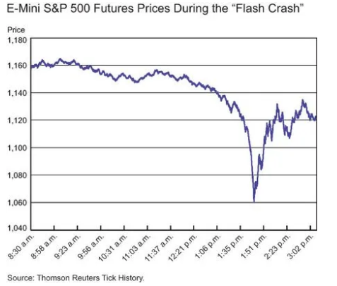
Analysis of HFT Liquidity
Brian Wang
HFT adds liquidity in single stock extreme price movements (EPMs) [3]
HFT pulls back when liquidity is needed during coEPMs [3]
Contributes to market instability, while undermining public trust.
2010 Flash Crash: Significant drop in minutes in stock index due to algorithmic selling [4]
Notes:
Let’s first analyze liquidity provided by HFT firms.
Research into HFT liquidity found that during extreme price movements of single stocks (EPMs), HFT firms do provide liquidity. However, when multiple stocks experience an EPM at once, called a coEPM, HFT firms actually pull back, demanding liquidity.
A historical example of this is the 2010 flash crash, where a very large sell order was placed that put significant downward pressure on the market. Instead of providing liquidity by buying, HFT firms reacted by selling very quickly, unloading their assets to cover their losses, driving the prices of major indices down in a matter of minutes.
This reveals the way HFT contributes to rather than alleviates market instability given that HFT firms demand liquidity when liquidity is low
This also demonstrates how HFT undermines public trust, where HFT only provides liquidity when it is safe and profitable, withdrawing it when it is most needed, indicating that HFT drives privatized benefits with socialized costs.

Slide 17
Ghost Liquidity
Brian Wang
10% of reported liquidity can be attributed to HFT ghost liquidity [5].
Cancellation of orders on other venues of more than 60% of trade size [6].
Systematically exposes slower reacting traders to higher execution costs.
Contributes to market unfairness with privatized benefits and socialized costs, while undermining public trust.
Notes:
If we look further into HFT behaviors surrounding liquidity, we can also note a phenomenon known as ghost liquidity, which is essentially when observed or reported liquidity differs from actual liquidity. This occurs when a firm places orders at multiple trading venues to get the best price. As soon as an order is filled, orders at the other venues are canceled before they are executed.
Research into ghost liquidity found that 10% of reported liquidity can be attributed to HFT ghost liquidity. What this statistic means is that for every 100 shares of total buy/sell orders placed during the day, 10 shares of these orders are ultimately canceled by HFT firms conducting this practice.
Research also shows that the size of these cancellations can be more than 60% of the initial trade size. So, for example, an HFT firm places a 1 million share order of NVIDIA across multiple venues. At one venue, 100,000 shares are executed. At the other venues, this HFT firm is expected to cancel at least 60,000 shares of its order.
This further contributes to market unfairness as general investors who may place orders at venues with seemingly high liquidity are faced with an illusion of liquidity. They are unable to access that liquidity when the orders are canceled and are subject to higher execution costs. (reasoning for higher execution costs is simply supply and demand; if the supply is not there, buyers will have to buy at higher costs and sellers will have to sell at lower prices. This is known as a wider spread.)
In other words, HFT makes slower reacting traders who are unable to react quickly to the illusory liquidity are systematically exposed to higher execution costs, contributing to market unfairness and undermining the public trust in the idea that HFT firms benefit society through their provision of liquidity.
This also further emphasizes the idea that HFT drives privatized benefits with socialized costs.

Slide 18
First-Hand Testimony
Brian Wang
“I thought I was happy. While the economy was falling apart, I was getting rich and so was everyone around me… After two years in high-frequency trading, I could see how little value it actually created. And I saw first-hand it was nowhere near enough to offset the damage it wrought - where computers create whipsaw volatility and fortunes are made and lost in milliseconds. I knew in my heart that I was nothing more than a leech, regardless of how impressive my trading algorithms were. The brain drain that sucked so many smart and talented people away from noble pursuits and into financial services to earn their fortunes made me question the very foundation of my economic assumptions.
- Dave Lauer, 2012 [7]
Notes:
Here I have this first-hand testimony from a former high frequency trader. I’m not going to read the entire quote but I do want to emphasize some important points. Here, Lauer highlights how he and everyone around him was getting rich while the economy fell apart, connecting to the contribution of HFT to privatized benefits and socialized costs.
He also notes how their algorithms actually created volatility, manipulating the behavior of prices to profit, further emphasizing market unfairness and the systematic disadvantage it puts on general investors.
He notes the idea of brain drain as well, a common criticism that the profitability of HFT has artificially attracted talented people away from more ”noble” pursuits such as medicine.

Slide 19
Brain Drain
Brian Wang
Bank deregulation in US was found to decrease value added per employee by a statistically significant 2.8 – 4.3% [8].
Approximately 8,000 people employed in HFT in 2024 [9].
Highlights idea of privatized benefits and socialized costs.
Notes:
The point on brain drain further highlights HFT creating privatized benefits and socialized costs.
While there are no direct studies quantifying brain drain in HFT, a study on US bank deregulation in the US found that expansion of talent into finance led to a 2.8-4.3% decline in value added per employee at R&D-intensive manufacturing firms.
By analogy, the ~8,000 people employed in HFT in 2024 likely represent highly skilled STEM workers who could have otherwise contributed to sectors with broader economic and social benefits.

Slide 20
References
Brian Wang
[1] Frank Chaparro, Credit Suisse: Here’s how high-frequency trading has changed the stock market (Business Insider, March 20, 2017), https://www.businessinsider.com/how-high-frequency-trading-has-changed-the-stock-market-2017-3 (Accessed September 28, 2025).
[2] Nicholas Apergis, Panagiotis G. Artikis, and Dimitrios Kyriazis, Does stock market liquidity explain real economic activity? New evidence from two large European stock markets (Journal of International Financial Markets, Institutions and Money, September 2015), https://www.sciencedirect.com/science/article/pii/S1042443115000554 (Accessed September 28, 2025).
[3] J Jonathan Brogaard, Allen Carrion, Thibaut Moyaert, Ryan Riordan, Andriy Shkilko, and Konstantin Sokolov, High frequency trading and extreme price movements (Journal of Financial Economics, May 2018), https://www.sciencedirect.com/science/article/pii/S0304405X18300278#bib0027 (Accessed September 28, 2025).
[4] Adam Biesenbach and Maco Cipriani, The Flash Crash, Two Years On (Liberty Street Economics, May 7, 2012), https://libertystreeteconomics.newyorkfed.org/2012/05/the-flash-crash-two-years-on/ (Accessed September 28, 2025).
[5] Hans D Degryse, Rudy de Winne , Carole Gresse, and Richard Payne, High frequency trading and ghost liquidity (35th Annual Conference of the French Finance Association (AFFI), May 2018), https://hal.science/hal-01894838/, (Accessed September 28, 2025).
[6] Vincent van Kervel, Competition for Order Flow with Fast and Slow Traders (The Review of Financial Studies, March 15, 2012), https://papers.ssrn.com/sol3/papers.cfm?abstract_id=2021988 (Accessed September 28, 2025).
[7] Laure Madonna, The Ethics of High Frequency Trading (Seven Pillar Institute, Winter/Spring 2013), https://sevenpillarsinstitute.org/wp-content/uploads/2017/11/Laure-Madonna-High-Frequency-Trading.pdf (Accessed September 28, 2025).
[8] Christiane Kneer, The Absorption of Talent into Finance: Evidence from U.S. Banking Deregulation (De Nederlandsche Bank, September 2013), https://www.dnb.nl/media/bjrdi1qh/working-paper-391.pdf (Accessed September 29, 2025)
[9] IBIS World, High Frequency Trading in the US - Employment (2004–2030) (IBIS World, November 2024), https://www.ibisworld.com/united-states/employment/high-frequency-trading/4740/ (Accessed September 29, 2025).
Notes:
Thank you for listening to my presentation on high frequency trading. Here are my sources. I’m happy to take any questions.

Slide 21
How Does AI affect C.S. Careers?
Ahmed Hamiroune
Notes:
Intro:
My presentation is about how AI affects Computer Science (C.S.) careers

Slide 22
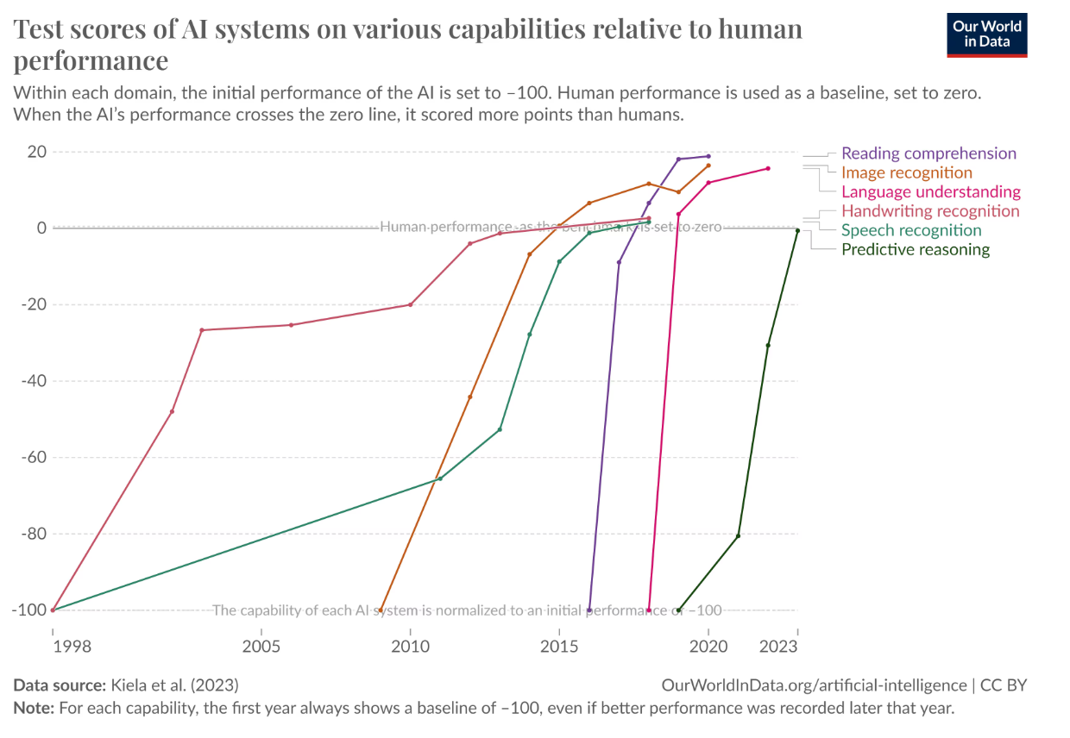
Automation from AI is different from previous technologies
  Ahmed Hamiroune
AI different from previously seen [1]
  The Industrial Revolution: Automated physical tasks
  The Information Technology Revolution: Automated computational tasks
  AI goes beyond: Automates tasks that are learned dynamically; can learn and evolve
Other differences [2]:
  Exponential growth: despite being in it’s infancy [10]
  Recently surpassed human performance in language understanding, img recognition, etc [10]
Despite general concerns, expert predictions positive… [4]
[10]
Notes:
First, I want to talk about concerns regarding AI in the C.S. field that I’ve come across in my research.
The main concern that I came across was the concern that AI will come to replace jobs in programming and CS.
The primary reason for this concern was first how AI differs from previous disruptive technological advancements like the Industrial Revolution and the Information Technology revolution.
The difference being that AI automates tasks that require more thought, like image recognition or code creation.
Some other differences include a very fast exponential growth despite being in relative infancy, and like it shows in the graphic here,
that it as surpassed human capability in a variety of areas like reading comprehension and language understanding, so there are some concerns regarding AI replacing jobs in C.S and
related fields.
However, despite these concerns, expert predictions are positive for such fields.

Slide 23
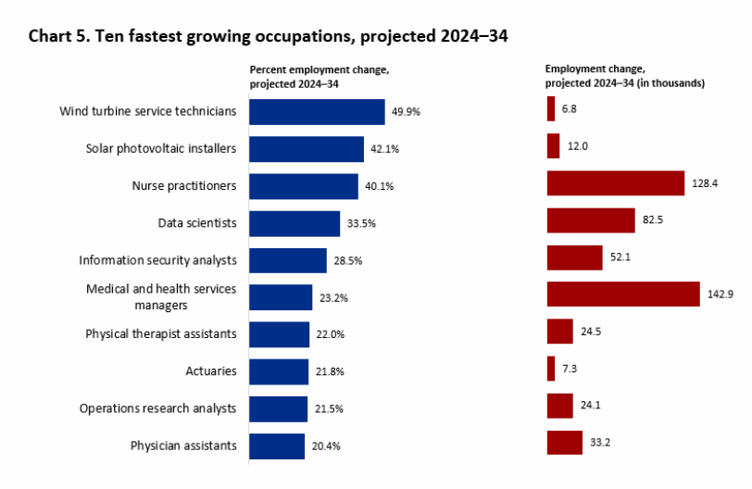
Experts Predict High Growth for C.s. Jobs
  Ahmed Hamiroune
Overall employment predictions [4]
  Computer and Math projected increase by ~10% between 2024 & 2034
  Data science and info security projected growth of 33.5% and 28.5%
Impact on entry level jobs [3]
  Entry-level jobs decreased by 6% between 2022-2025
  Vs 6-9% increase for older workers
Growth varies across occupations [9]
  Replaces basic & repetitive C.S. roles
  Growth in AI related areas
[4]
Notes:
The Bureau of Labor Statistics has overall positive projections from 2024-2034 for C.S, with employment in Math/C.S. field projected to increase by roughly 10% in that time, and as this graphic is showing as shown in the graphic, data science and information security fields are in the top 4 fastest growing occupations according to the projections.
These projections are not solely influenced by AI. They are also projections, not confirmed numbers.
Also, not all roles will be affected equally.
Lower-level jobs more negatively affected by AI while higher level jobs will likely be more positively affected. Specifically, employment for entry level positions
has decreased by about 6% between 2022-2024, while employment for older/more experienced workers increased between 6 to 9%.
Functions replaced:
Highly repetitive data processing
Basic quality assurance testing
Routine code generation for well-defined problems
Certain technical support functions

Slide 24
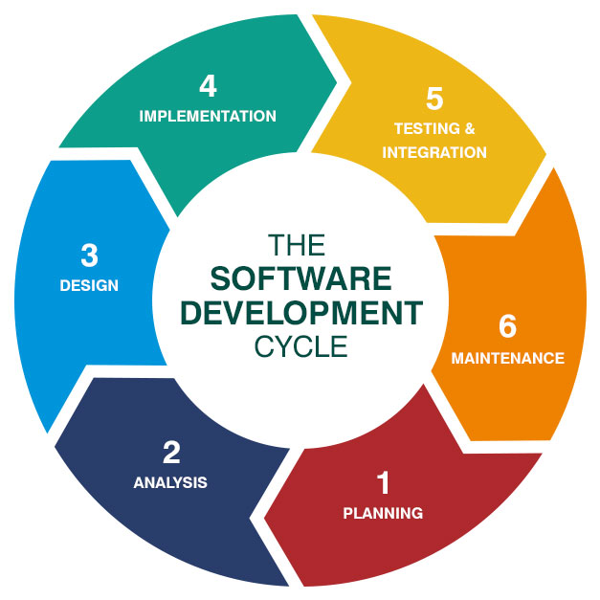
AI will change, not Eliminate, C.S.
Jobs
  Ahmed Hamiroune
Improves productivity [5]
  Assists developer in several stages of software development lifecycle:
  Can take care of simpler parts of implementation,
  Can aid testing and maintenance
Frees up time for more complex tasks [5]
  architectural planning
  system integration
Creates new opportunities in non-technical sectors [11]
  Ex: Healthcare, Finance, etc
<Graphic as big as will fit>
[7]
Notes:
From my research, I do not think AI will fully replace human workers. I believe, if used correctly, it will be able to address a lot of the more simple and tedious tasks, assisting in all stages of the software development process and allowing the worker to focus on tasks that require human insight and focus, complex design, cybersecurity, and ethics.
AI could help with each part of the software development cycle.
It can help with planning and design, take care of simpler or more tedious parts of implementation, and aid with testing and maintenance.
Examples of roles AI will take over:
design/implementation: can help with finding built-in functions to use
testing/maintenance: can create tests to maintain the code and make sure it works
Allows worker to spend more time on planning/analysis

Slide 25
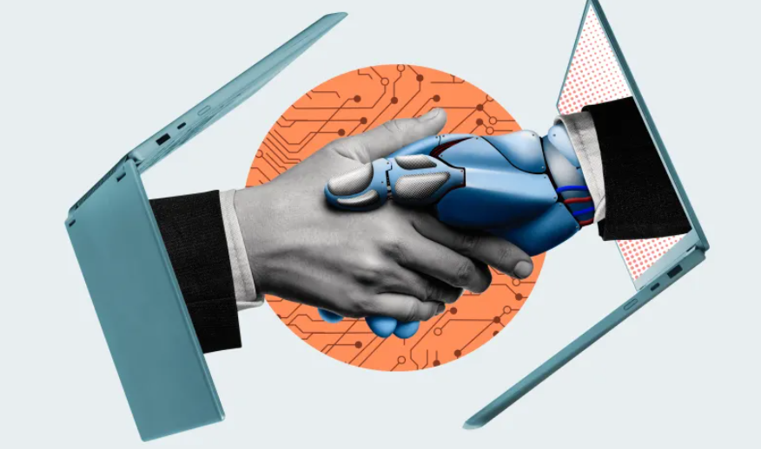
opportunities for growth with AI
  Ahmed Hamiroune
Prepare [8]
  Master core skills to perform more complex tasks
  Skills like problem-solving, critical thinking, communication
Up-skill [8]
  Adopt AI tools for tasks in current roles
  Use AI to augment what is there, not replace
Retrain
  Remain adaptive to future advancements
  Transition towards other C.S. tasks with higher growth
[8]
Notes:
You may be asking yourself “If AI eliminates the need for entry-level jobs, how do I stay ahead of it?”
The first thing to do is prepare. Practice core skills that AI has a harder time doing, like problem-solving, critical thinking, and communication.
The second thing is to gain experience in using AI responsibly for your tasks. Use it to augment the skills you have, but don’t let it replace them.
The third thing is to remain adaptive. With how much AI has advanced in the past few years, it is possible that it advances in some other way in the
future that automates an even larger range of tasks, so being able to adapt to such changes may be beneficial.
This is not an extensive list. There are likely other strategies that may work better, these are just the best practices that I came across.

Slide 26
References
  Ahmed Hamiroune
  All Sources Accessed 30 Sep. 2025:
[1] Soroushian, John. “What Past Waves of Automation Can Teach Us About AI.” Bipartisan Policy Center, 9 Jul. 2024, https://bipartisanpolicy.org/blog/what-past-waves-of-automation-can-teach-us-about-ai/#:~:text=Fortunately%2C%20new%20jobs%20were%20created%20in%20the,banks%20decreased%2C%20leading%20to%20more%20employment%20opportunities
[2] Will AI Replace Software Engineers? Exploring the Future of Software Development. 22 Nov. 2023, https://onlinecs.baylor.edu/news/will-ai-replace-SWEs#:~:text=What%20are%20the%20Potential%20Concerns,%2C%20tools%2C%20and%20workforce%20training
[3] Canaries in the Coal Mine? Six Facts about the Recent Employment Effects of Artificial Intelligence. Erik Brynjolfsson, Bharat Chandar, Ruyu Chen, 26 Aug. 2025, https://digitaleconomy.stanford.edu/wp-content/uploads/2025/08/Canaries_BrynjolfssonChandarChen.pdf
[4] Employment Projections — 2024−2034. 28 Aug. 2025, https://www.bls.gov/news.release/pdf/ecopro.pdf
[5] AI in Software Development | IBM. Matthew Finio, Amanda Downie, 7 Oct. 2024, https://www.ibm.com/think/topics/ai-in-software-development
[6] “How AI Affects Careers in Computing.” Michigan Technological University, https://www.mtu.edu/computing/ai/career-affects/
[7] Understanding the Software Development Life Cycle | Datarob. 6 Aug. 2019, https://datarob.com/essentials-software-development-life-cycle/
[8] Will Computer Science Be Replaced by AI? 29 Apr. 2025, https://www.herzing.edu/blog/will-computer-science-be-replaced-ai
[9] “How AI Affects Careers in Computing.” Michigan Technological University, https://www.mtu.edu/computing/ai/career-affects/
[10] Elliot, David. “A Short History of AI in 10 Landmark Moments.” World Economic Forum, 3 Oct. 2024, https://www.weforum.org/stories/2024/10/history-of-ai-artificial-intelligence/
[11] “Advancements in AI and Machine Learning.” Johns Hopkins Engineering Online, 8 May 2025, https://ep.jhu.edu/news/advancements-in-ai-and-machine-learning/
Notes:
And here are my sources
Thanks

Slide 27
Regulating the Robot Revolution
Sean Mullaney

Slide 28
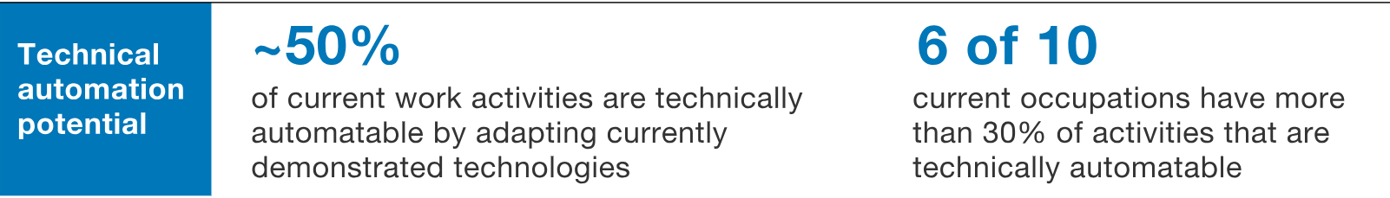
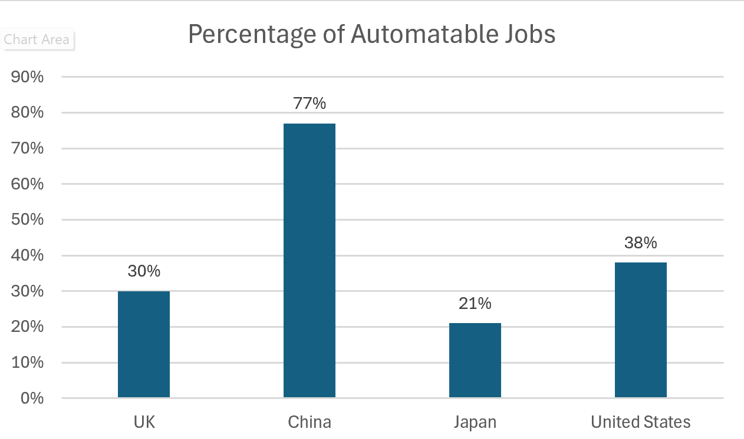
Robots Are Stealing Jobs
Sean Mullaney
[1]
By 2030, an estimate of 400-800 million jobs will be replaced or displaced by robots. [1]
About 50% of work activities are currently automatable. [1]
  Insurance assessment
  Accounting
  Cashier
  Manufacturing
[2]
[2]
Notes:
By 2030 an estimate of 400-800 million jobs will be replaced or displaced by robots.
50% of work activities are currently automatable.
Essentially only jobs requiring human touches like nurses, artists, and social workers are safe.

Slide 29
Robots Are stealing jobs
Sean Mullaney
60,000
workers replaced by robots at Apple and Samsung supplier Foxconn in 2016 [4]
2.25
million robots have entered the workforce in the past 20 years [3]
1.7
million jobs have been lost to automation since 2000. [3]
Notes:
These are some present statistics of robots stealing jobs….
A single company Foxconn the global leader in electronic manufacturing replaced 60,000 workers by robots.
2.25 million robots have entered the workforce in the past 20 years

Slide 30
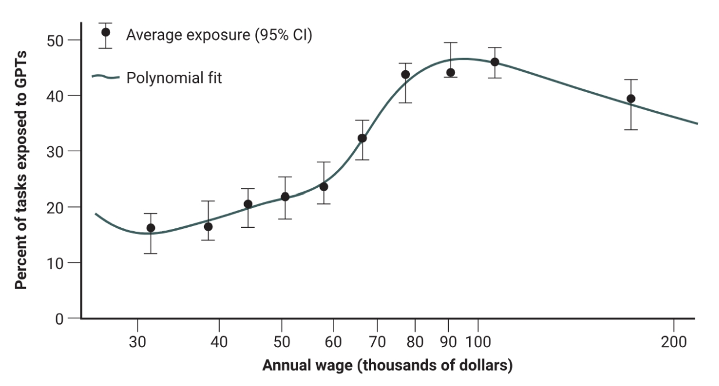
Wealth and intelligence Gap
Sean Mullaney
Increase in higher skill jobs create a societal division in competencies and income [5]
Jobs with an annual wage between $45,000 to $90,000 most exposed to GPTs [6]
Rich get Richer
  One robot replaces six workers. [5]
  One robot per 1000 workers is 0.25% to 0.50% cheaper. [5]
[6]
Notes:
Generative Pre-trained Transformers – medium class higher percentage of tasks exposed
The elimination of repetitive jobs and increase in higher skills jobs will create a societal division in competencies and income.
Those who can afford to go to school or training, will be among the higher class with greater education and wealth.
Those who can’t afford or choose not to, will most likely be among the lower class, uneducated about the robotic revolution.

Slide 31
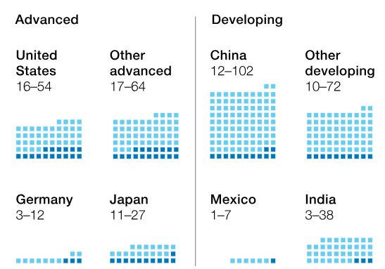
Robots Stunt Country Development
Sean Mullaney
Developing countries relying on cheap labor restricted from growing. [2]
An estimation of 40% more workers in developing countries are in need to find new jobs. [1]
Automation decreases the need for companies to outsource production to other countries
[1]
Notes:
Number on the right is million of workers needing to switch occupations (light blue boxes)
Developing countries like China and India rely heavily on cheap labor and production to employ its people and uphold an economy. Developing countries have 40% more workers in need of finding new jobs compared to advanced countries due to automation.

Slide 32
Creation of New jobs
Sean Mullaney
Automation will create new jobs that require higher education and skills [2]
  Programming
  IT Services and Data Integration
  Human-Machine Interaction
  Research and Development Roles
14% of workers will need to switch occupational categories by 2030 [1]
[2]
Notes:
There are estimations everywhere of automation creating hundreds of thousands to millions of new jobs in existing and new fields. Studies say that 65% of children now will be hired in jobs that don’t yet exist.
Fields in programming, IT services and Data Integration, Human-Machine Interaction, and Research and Development will most likely see an increase in job opportunities.

Slide 33
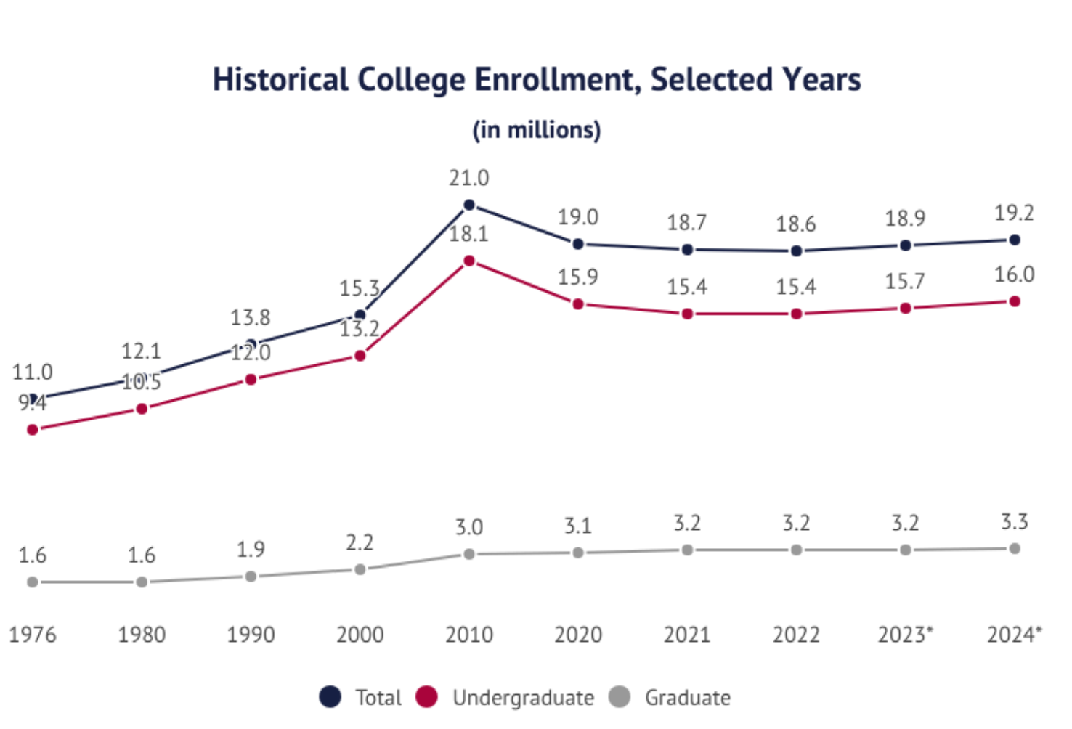
Need for Higher education
Sean Mullaney
Increase in higher skill jobs, requires a higher level of education for employees.
  7 out of 10 of the skills in highest demand need education and/or training. [2]
As technology advances, enrollment increases
  15.3 million to 21 million from 2000 to 2010 [7]
  Introduced the mobile internet and social media
[2]
[7]
Notes:
An increase in higher level skills and jobs require a higher level of education for employees. Currently 7 out of 10 of the skills in the highest demand need education or training.
We have had similar instances in the past, for example in the graph we can see that from 2000 to 2010 college enrollment jumped from 15.3 million to 21 million considering new technology like the mobile internet and social media

Slide 34
Conclusion
Sean Mullaney
Robots and Automation needs to be regulated
  They are replacing and displacing jobs across the world
  Creating a wealth and intelligence gap
  Stunting growth of developing countries
While automation can create an abundance of jobs, they will require higher education further supporting the wealth and intelligence gap
Notes:
Robots and Automation needs to be regulated or hundred of millions of workers will be replaced or displaced, causing a wealth and intelligence gap, and slower development for countries.
While automation can create and abundance of jobs, they will require higher education. Higher education is expensive, not everyone can afford to attend universities, causing a gap in society.

Slide 35
References
Sean Mullaney
[1] Manyika, J. Jobs lost, jobs gained: What the future of work will mean for jobs, skills, and wages. (McKinsey & Company) https://www.mckinsey.com/featured-insights/future-of-work/jobs-lost-jobs-gained-what-the-future-of-work-will-mean-for-jobs-skills-and-wages (Accessed 9-28-2025).
[2] Weiyu Wang and Keng Siau, Artificial Intelligence, Machine Learning, Automation, Robotics, Future of Work and Future of Humanity: A Review and Research Agenda. Journal of Database Management vol. 30, no. 1 (2019) https://go.gale.com/ps/i.do?p=AONE&u=mlin_c_worpoly&id=GALE%7CA759221696&v=2.1&it=r&password= (Accessed 9-28-2025).
[3] Darina L. Rise of Robots – Jobs Lost to Automation Statistics in 2023 (Lefttronic, 2023) https://leftronic.com/blog/jobs-lost-to-automation-statistics (Accessed 9-28-2025).
[4] Foxconn robots replace 60,000 workers at chinese apple supplier (ICT Monitor Worldwide, May 27, 2016) http://ezproxy.wpi.edu/login?url=https://www.proquest.com/wire-feeds/foxconn-robots-replace-60-000-workers-at-chinese/docview/1791957115/se-2 (Accessed 9-28-2025).
[5] Salento, Angelo. Digitalization and the regulation of work: theoreticall issues and normative challenges (Springer-Verlag London, 2017). https://link.springer.com/article/10.1007/s00146-017-0738-z (Accessed 9-29-2025).
[6] Manning, Sam. AI’s impact on income inequality in the US. Brookings. (Brookings, July 3, 2024) https://www.brookings.edu/articles/ais-impact-on-income-inequality-in-the-us/ (Accessed 9-29-2025).
[7] Hanson, M. College Enrollment & Student Demographic Statistics. Education Data Initiative. https://educationdata.org/college-enrollment-statistics

Slide 36
Class 11
The End
Keith A. Pray
SocialImps.com
Notes:
If there’s time and we didn’t get to it:
Kickstarter Charter
https://www.kickstarter.com/charter?ref=about_subnav
CGP Grey
Humans Need Not Apply (15:00) – 2014-08-13
http://www.youtube.com/watch?v=7Pq-S557XQU
Last access 2016-04-22
These 3D printed homes can be constructed for $4,000 (3:00 – 2018-04-02)
http://www.businessinsider.com/3d-printed-homes-constructed-icon-new-story-tech-charity-4000-dollars-2018-3
https://www.youtube.com/watch?v=SvM7jFZGAec (1:28)
Last access 2018-04-22
Look at:
BBC Intelligent Machines
http://www.bbc.com/news/technology-33978561
BBC Likelihood of robot taking your job
http://www.bbc.com/news/technology-34066941

Slide 37
Remote With Zoom
Turn your camera on
Sign in with First and Last Name
Stay muted unless you are going to speak
Use the raise your hand feature to ensure a turn
Wait until the end of student presentations to ask questions
  Write them down so you don’t forget

