Slide 1
Class 10
Professional Ethics
Keith A. Pray
SocialImps.com

Slide 2
Overview
Review
Debate
Assignment
Students Present
Notes:
ADD QUIZ AS BACKUP IF CLASS DISCUSSION NOT LONG ENOUGH

Slide 3
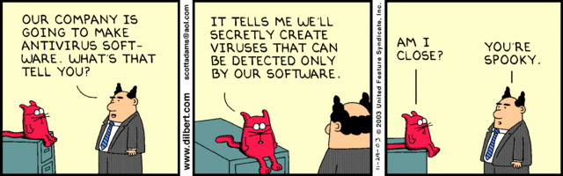
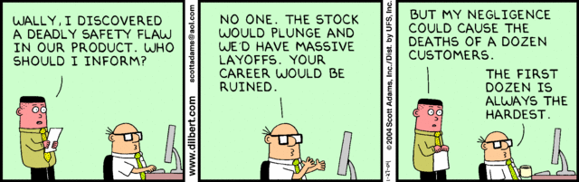
Notes:
Ask how many people in ACM or IEEE

Slide 4
My Reading Notes
p. 413 Forgery proof IDs possible? ”Papers.” common dystopian theme.
p. 418 ACM Code of Ethics and Professional Conduct published 2018 vs 1997
pp. 422-423 3.09 = 5.05
p. 454 “3. Would decision hold up to public scrutiny?”– social contract, not virtue ethics?
p. 430 Are not web logs usually public?
p. 431 “…Chuck had these files…” implies guilt. → “…files on Chuck’s computer…” seems better. Antiworm scenario very similar to p. 76. Check if [5] 2003 source about Blaster worm.
p. 432 Consent of telecommunications companies… or their clients?
p. 433 will != consequences
p. 434 Saving public taxes $15K not considered
p. 435 DEI claims source [7] 2001, need newer
p. 436 Source [11] 2018, computing demographics now?
p. 437 Org pressure, macho culture, harassment source [1]8 2008, newer source needed.
p. 438 Additional advice: Ask for help, share context and possible biases. How to ensure everyone’s voice is heard in class?
p. 440 $3 million over how many employees?
p. 441 Many whistle blower definitions do not require internal reporting attempts.
p. 445 Org failure what I generally see.
p. 446 “return to using principle-based…” source from 2003, needs update. This happened a while ago, perhaps not everywhere.
p. 447 pension quote source from 1983, tough to get a pension now, consider finding newer
No mention of Snowden but for Question 24.
p. 451 # 21 not really computing
Questions I liked: 23, 25, 29, 30
Notes:
An error of commission is one where the person responds where they should not. This is compared to an error of omission, where the person fails to respond when they should.

Slide 5
Debate Ground Rules
Develop FPS Based on Current War?
Before Debate
  10 minutes to converse with your team
  Share argument points, counter points, and responses
  Share experiences, especially in different countries, cultures, situations
  Decide who will:
    Go first
    Respond to which points from opposing side
During Debate
  1 turn per person until everyone on your team has spoken
  Try to keep remarks to 30 seconds
Notes:
Release Game or Not Debate
Chapter 9 In-class Exercises # 24.
Should we (the company) produce the game?
Use the SWE Code Of Ethics as the basis for your argument.
If Remote:
Add “(YES)” or “(NO)” to the end of your name in Zoom to show your side

Slide 6
Assignment
1 Page Paper
  What should computerized automation be applied to next?
Finish all reading
Group Project
  Add analysis to website addressing remaining topics
  Group Presentation Draft
    Submit as Power Point on Canvas
    Post Power Point file (.pptx) on group website for download
      Do not make viewer export it from another tool
Notes:
1 Page Paper Ideas:
For Good - How will you use your computing related education to do good in the world?
Dark Net - Is the Dark Net good or bad?
Does computerized automation help the economy or society?
What should computerized automated be applied to next?
If productivity has increased so much, why are we working so hard? Should we?
What job skills will survive computerized automation?

Slide 7
Overview
Review
Debate
Assignment
Students Present
Notes:
Show WPI and/or corporate code of ethics.

Slide 8
E-Waste & you
Michael Creighton
Michael Creighton
Notes:
So far, we have talked a lot about computing, but we have only talked briefly about the consequences of computing.

Slide 9
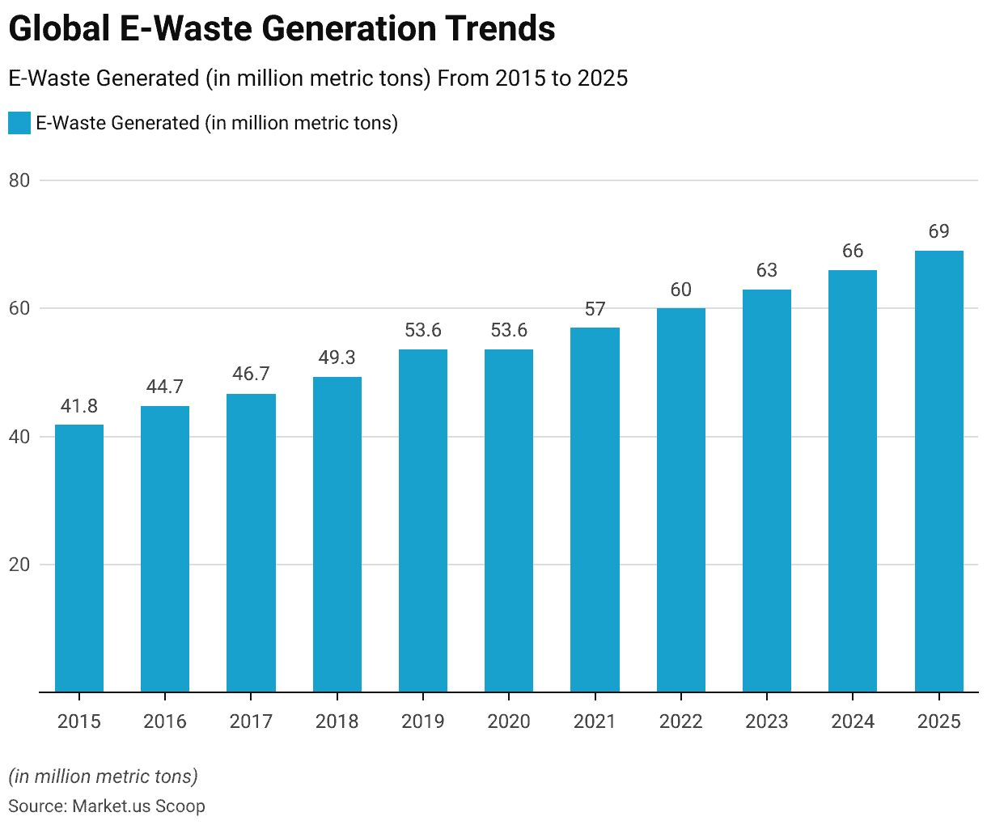
E-waste – a global issue
Michael Creighton
In 2022, there was a record of ~62 million tons of e-waste produced [1]
  Up 82% from 2010
  Projected to rise another 32% in 2030 to 82 million tons
Introducing the issue, only 22.3% of all e-waste was properly collected and recycled in 2022 [1]
  This left $62 billion worth of recoverable natural resources unaccounted for
  Also increases health risks globally
<Graphic as big as will fit>
Steady increase in E-Waste 2015->2025 [2]
Notes:
Read first bullet; This graph shows how e-waste generation has changed over the past 10 years, with more than 27 million tons of waste generated since 2015. Read second bullet

Slide 10
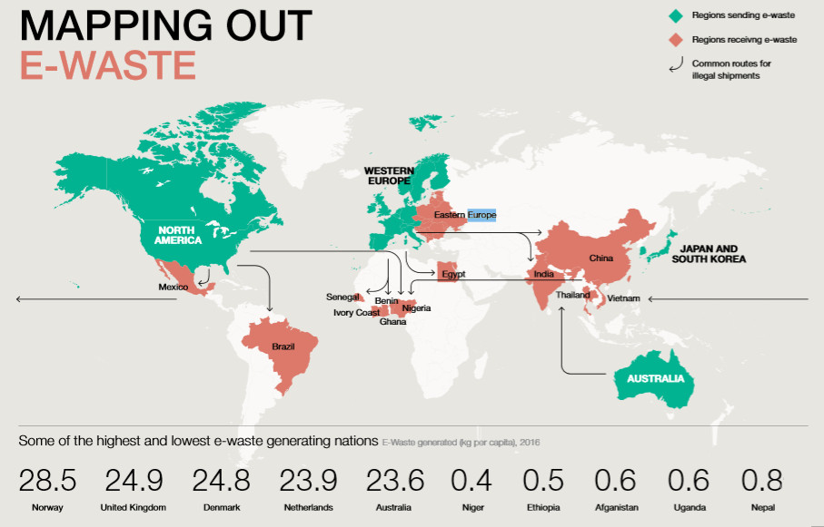
Health Implications
Michael Creighton
E-Waste contains numerous hazardous chemicals [3]
  Mercury
  Lead
  Nickel
  Cadmium
  Other organic compounds
Exposure to e-waste during infancy or childhood can lead to obesity, asthma, or neurodevelopmental disorders [3]
  This has been proven from over 23 different studies from 1965 to 2012 [3]
[10] Nations in green are the top producers of e-waste, and nations in red receive the most e-waste
Notes:
So as you can see, the problem has been laid out in front of us, but there are alternative e-waste pollutants that have been introduced to the world recently.
According to the Geneva Environment Network, health effects also include the risk of cancers, miscarriages, and diminished IQs. The regions most affected by these, as you can see by the map in red, are China, India, Brazil, Mexico, Nigeria, Eastern European nations, and other African nations.

Slide 11
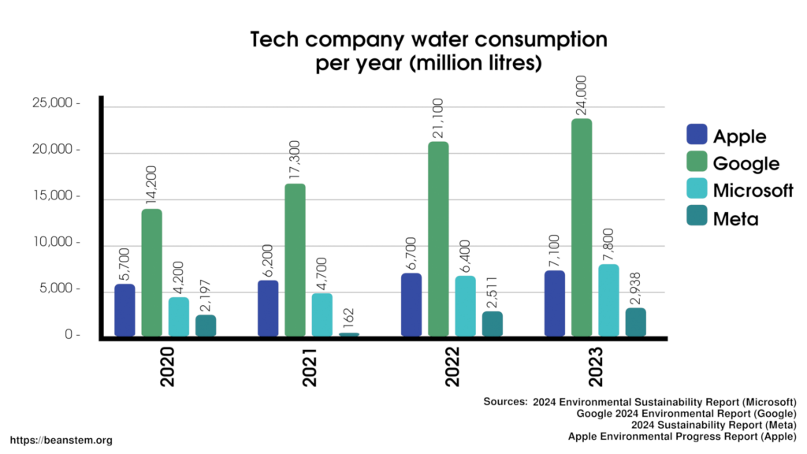
Use of AI
Michael Creighton
AI usage could account for up to 5 million metric tons of e-waste by 2030 [4]
  AI hardware has a lifespan of ~2 years [4]
AI’s water usage is projected to hit 6.6 billion m^3 by 2027 [5]
Comparison of major US Companies’ water consumption [6]
Notes:
First bullet point; AI companies generate so much waste due to the increasing demand for the newest hardware technologies, such as processors, graphics cards, memory modules, and storage devices. All of these pieces of technology contain the same valuable metals that general e-waste also discards. Second bullet; Water is already our most precious and essential natural resource, while we choose to use it on AI, which is already controversial to begin with.
Looking at this graph; it is not directly correlated with AI, but AI does have a part to play in the jump of consumption for Google and Meta in 2022.

Slide 12
What can we do?
Michael Creighton
Most substantial changes are to be done at the government level [7]
  However, we can limit the use of AI, promote companies that are taking the initiative to reduce e-waste
Through Earth 911, there are lists of how to recycle your electronics and where to do it [9]
  Massachusetts-specific sources can be found with Mass Save [8]
Notes:
In 2010, the Obama administration established an Interagency Task Force on Electronics Stewardship, which laid out a plan for e-waste that had four main steps: 1. incentivizing greener designs of electronics 2. leading by example 3. increasing domestic recycling, and 4. reducing harmful exports of e-waste and building capacity in developing countries. This list is relatively short, but the problem was only just being addressed, and many other efforts are being done by larger organizations that you can go to to contribute.
Sub bullet point: For us individually, some things that we can do are limit our use of AI, as AI is not a necessity for everything, so limiting our usage of AI will help with that issue at the very minimum. We should also not be throwing out our electronics in the trash. There is a website called Earth 911, where you can enter information such as your location and the items you are disposing of, and it will show you where to recycle your electronics. There is also a Massachusetts-specific website called Mass Save, but Earth 911 is one of their sources of information.

Slide 13
References
Michael Creighton
[1] UNITAR, The Global E-Waste Monitor 2024, https://ewastemonitor.info/the-global-e-waste-monitor-2024/
[2] Market.us, E-Waste Statistics 2025 By Easy Recycling, Waste, Methods, January 13, 2025 https://scoop.market.us/e-waste-statistics/
[3] NIH, Health consequences of exposure to e-waste: an updated systematic review, December 8, 2021, https://pmc.ncbi.nlm.nih.gov/articles/PMC8674120/
[4] MIT Technology Review, AI will add to the e-waste problem. Here’s what we can do about it., October 28, 2024 https://www.technologyreview.com/2024/10/28/1106316/ai-e-waste/
[5] Forbes, AI Is Accelerating the Loss of Our Scarcest Natural Resource: Water, February 25, 2024, https://www.forbes.com/sites/cindygordon/2024/02/25/ai-is-accelerating-the-loss-of-our-scarcest-natural-resource-water/
[6] BeanStem, Short: AI water consumption, January 23, 2025, https://beanstem.org/short-ai-water-consumption/
[7] US Environmental Protection Agency, Cleaning Up Electronic Waste (E-Waste), May 16, 2025, https://www.epa.gov/international-cooperation/cleaning-electronic-waste-e-waste
[8] Mass Save, Electronics Recycling, https://www.masssave.com/residential/shop-products/recycling/electronics
[9] Earth 911, Electronic Recycling, https://search.earth911.com/
[10] The Growing Environmental Risks of E-Waste, Geneva Environment Network, https://www.genevaenvironmentnetwork.org/resources/updates/the-growing-environmental-risks-of-e-waste/

Slide 14
Hidden bias in AI
Naushin Uddin

Slide 15
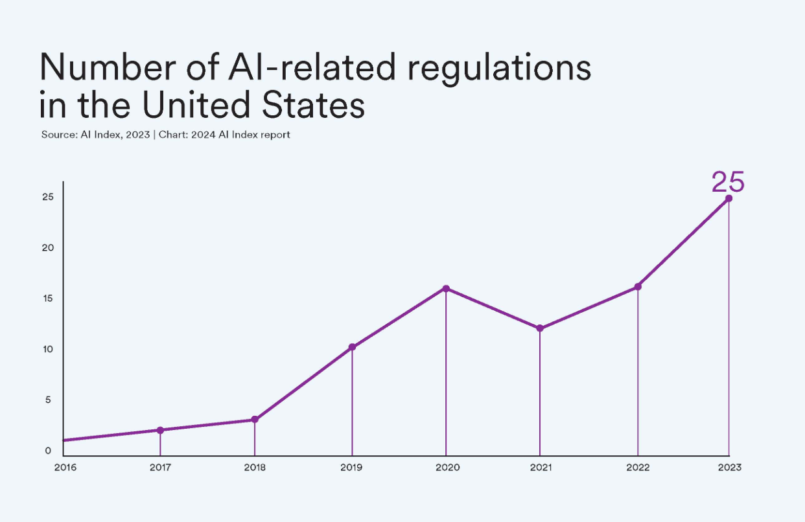
Bias in AI is Dangerous but Preventable
Naushin Uddin
AI systems can reproduce and scale human discrimination [1][8]
Harms become amplified when deployed in healthcare, hiring, and policing [8]
With oversight and design, AI can be fairer and safer
[5]
Notes:
-What starts as human prejudice gets multiplied by technology.
-This is especially serious in areas like healthcare, hiring, and policing.
-A biased algorithm here doesn’t just make mistakes, it reinforces discrimination where fairness really matters.
- If we carefully design these systems, use diverse data, and keep humans involved in oversight, AI can be developed in ways that are fairer and safer.
this chart shows the number of AI-related regulations passed in the U.S. between 2016 and 2023.
You can see it starts really low, and has been going up, a lot fo states have taken it upon themselves to crete state level laws like the Colorado AI Act and cali ai act

Slide 16
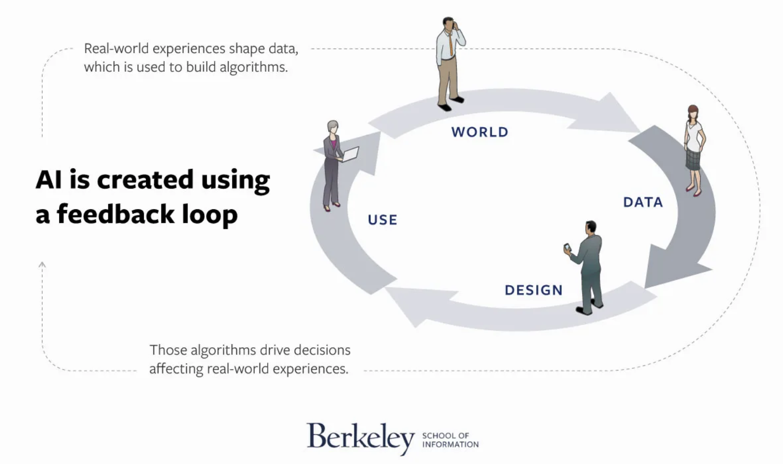
Biased data produces biased outcomes
Naushin Uddin
AI models recognize patterns, not meaning or truth [2]
Training data reflects human choices and systemic biases [1][7][8]
“Garbage in → Garbage out” [7][8]
  biased data produces biased predictions
Underrepresented groups often misclassified or excluded [1][8]
Bias compounds at scale, reinforcing existing inequalities in society [8]
[8]
Notes:
I wanted to start off by talking about how AI becomes biased in the first place.
AI models don’t actually “understand” anything, they just pick up on patterns present in the data used to train it.
So if the data itself has bias, which comes from human choices or bigger systemic issues, the AI will copy that.
-Idk if yall have heard the phrase of “Garbage in, garbage out” comes in. If the data is biased going in, the predictions coming out are gonna be biased too [7][8].
-Groups that are underrepresented in the data usually get misclassified or left out entirely [1][8]. (ex: a dataset with 90% men 10% women)
-And once these systems are rolled out at a big scale, the bias gets multiplied and ends up reinforcing inequalities that already exist [8].
it starts with the world, real-world experiences and inequalities shape the data we collect, that data is then used in the design stage to train and build algorithms, Once those algorithms are created, they’re put to use in real-world applications, the decisions those algorithms make go back into the world and influence future data, So if bias is present at any stage — world, data, design, or use — it doesn’t just stay there. It gets repeated and reinforced every time the loop continues.

Slide 17
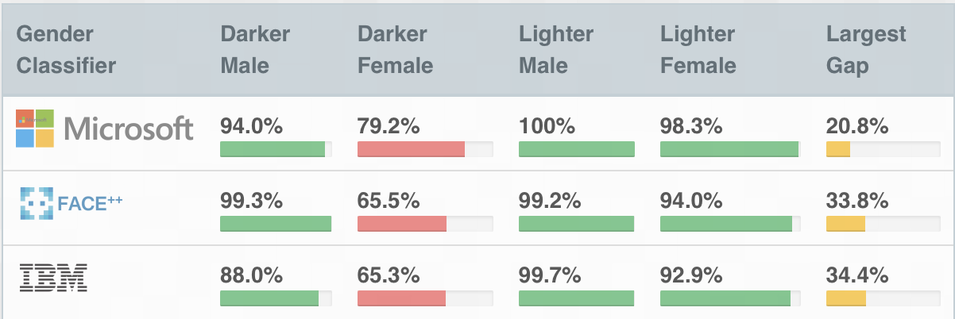
Bias in Facial recognition
Naushin Uddin
“The Gender Shades Project” [4]
  1270 images
Performs better on lighter skin tones [4]
93.6% of faces misgendered by Microsoft were those of darker subjects [4]
[4]
Notes:
-One big example of this is bias in facial recognition,
There was a study called The Gender Shades Project that tested about 1,270 images,
- the split between men and women as well as darken and ligher skin was around 50-50 (not perfectly but), and used 3 major platforms Microsoft, face++, and IBM
-The results showed that facial recognition systems performed much better on lighter skin tones
- For Microsoft specifically, 93.6% of the faces that were misgendered were darker-skinned subjects
results of the study
- When we analyze the results by intersectional subgroups - darker males, darker females, lighter males, lighter females - we see that all companies perform worst on darker females.

Slide 18
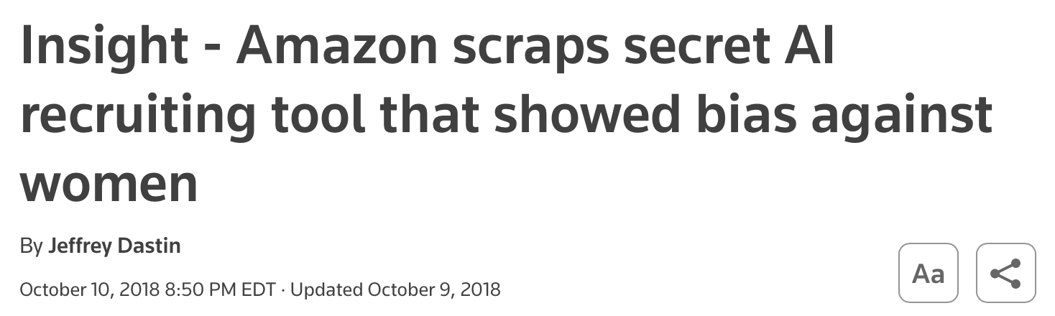
Bias in hiring ai
Naushin Uddin
Amazon’s AI penalized resumes containing the word “women’s” [6]
System trained on patterns from submitted resumes from the past 10 years, which was male dominated [6]
Shows limitations in machine learning
Scrapped in 2017 [6]
[6]
Notes:
Another example of AI bias happened with Amazon’s hiring system.
The AI penalized resumes that included the word ‘women’s,’ like ‘women’s soccer team’ or ‘women’s chess club’ [6].
This was because model was trained on 10 years of past resumes — and most of those came from men [6].
So the system basically learned that male candidates were better, which shows the limits of relying only on machine learning especially when the data isn’t representative of the population.
Because of this, Amazon scrapped the tool in 2017 [6].
(Point to the screenshot) → “Here’s the Reuters article headline reporting when Amazon officially shut it down.”

Slide 19
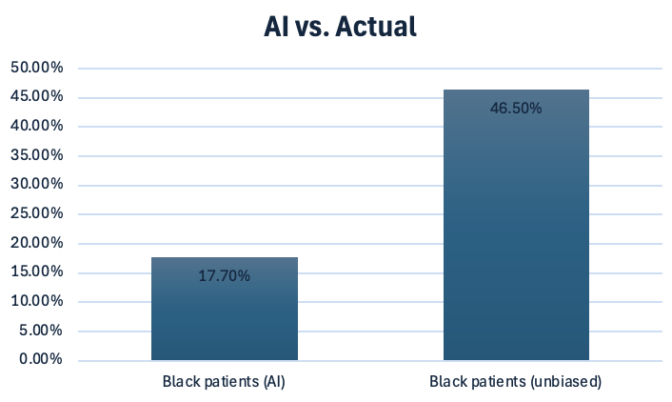
Bias in healthcare ai
Naushin Uddin
Widely used hospital algorithm referred fewer Black patients for extra care [9]
Based risk scores on health costs, not actual illness [9]
Equally sick Black patients had lower scores due to systemic healthcare access gaps [9]
Information for bar graph was taken from citation [9]
Notes:
where an algorithm was being used in hospitals across the U.S.
the system was supposed to flag which patients needed extra care programs [9].
But instead of measuring actual illness, it used past healthcare costs as the main factor [9].
Because Black patients historically had less access to care, their costs were lower, even when they were just as sick.
it reffered fewer black patients
Only 17.7% of “high-risk” patients flagged were Black, if the algorithm had been corrected, the proportion of Black patients flagged for extra care would nearly triple, 46.5%.

Slide 20
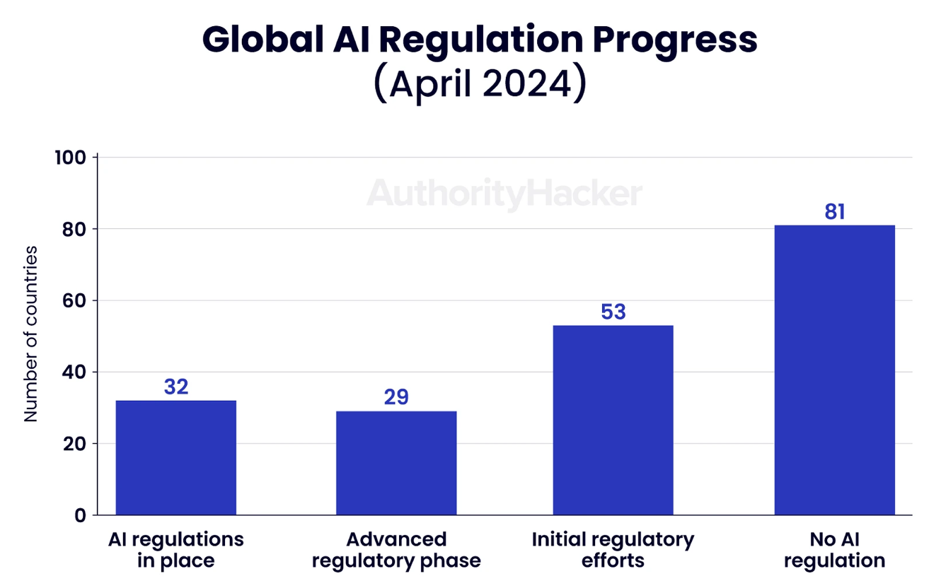
Conclusion: Oversight and policy reduce AI bias
Naushin Uddin
Human choices in data, labeling, and testing directly shape fairness in AI
Growing global push for regulation: 59 new U.S. AI regulations in 2024 [5]
EU AI Act sets strict standards for “high-risk” AI in healthcare, policing, and beyond [3]
Global progress is uneven, many countries remain without AI regulations [3]
Takeaway: Effective oversight and policy are essential to reducing bias and ensuring responsible AI
[4]
Notes:
Human choices in data, labeling, and testing embed or reduce bias
Diverse, representative datasets reduce discriminatory outcomes
Responsible design decisions can prevent harm before deployment
“So to wrap everything up, I want to highlight why oversight and policy matter so much when it comes to AI bias.”
Human choices — like how we collect data, how we label it, and how we test — all directly shape whether AI is fair or biased.
In the U.S. alone, there were 59 new AI regulations introduced in 2024 [5]. That shows there’s already a strong push for oversight.
In Europe, the EU AI Act is setting strict standards for ‘high-risk’ systems like healthcare and policing [3].
But progress isn’t even worldwide — as the chart shows, 81 countries still don’t have AI regulations at all [4].
The big takeaway: effective oversight and strong policy are key if we want AI to reduce bias instead of making it worse.

Slide 21
References
Naushin Uddin
[1] Chapman University, Bias in AI: Understanding Risks and Building Trust, (2023), https://www.chapman.edu/ai/bias-in-ai.aspx (Accessed Sept. 20, 2025).
[2] Hopsworks, AI Pipelines Explained, (2024), https://www.hopsworks.ai/dictionary/ai-pipelines (Accessed Sept. 20, 2025).
[3] Stanford Institute for Human-Centered Artificial Intelligence, AI Index 2025, (2025), https://hai.stanford.edu/ai-index (Accessed Sept. 21, 2025).
[4] Buolamwini, J. & Gebru, T., Gender Shades: Intersectional Accuracy Disparities in Commercial Gender Classification, (2018), http://gendershades.org/overview.html (Accessed Sept. 21, 2025).
[5] Stanford HAI, AI Index: State of AI in 13 Charts, (2024), https://hai.stanford.edu/news/ai-index-state-ai-13-charts (Accessed Sept. 23, 2025).
[6] Dastin, J., Amazon scraps secret AI recruiting tool that showed bias against women, Reuters (2018), https://www.reuters.com/article/world/insight-amazon-scraps-secret-ai-recruiting-tool-that-showed-bias-against-women-idUSKCN1MK0AG (Accessed Sept. 23, 2025).
[7] XenonStack, Machine Learning Pipeline: Architecture and Applications, (2023), https://www.xenonstack.com/blog/machine-learning-pipeline (Accessed Sept. 24, 2025).
[8] UC Berkeley School of Information, Artificial Intelligence Bias: Causes, Effects, and Solutions, (2022), https://ischoolonline.berkeley.edu/blog/artificial-intelligence-bias/ (Accessed Sept. 25, 2025).
[9] Ledford, H., Millions of Black people affected by racial bias in health-care algorithms, Nature News (2019), https://www.nature.com/articles/d41586-019-03228-6 (Accessed Sept. 25, 2025).

Slide 22
AI user
Accountability
Zach Cote

Slide 23
Conclusion
Zach Cote
AI is not the main source of blame
The blame rests with the user or the company [6]
In future AI could evolve and take over the blame [3]
Companies can also instate protections and claims to protect themselves from the possible failures[7]
Notes:
More laws need to be set up to help outline how cases involving AI error or being "responsible" so that there is a more concrete line of who should carry the responsibility
It also should vary depending on how the creator allows the use of the AI and if the user is following the usage terms.
Ultimately the user will always hold a small portion of the blame because they are choosing to utilize this technology.
Overall, AI shouldn’t be the main thing to blame as of right now however
depending on the situation the user or the creator of the AI should be held
responsible
As time goes on and the AIs evolve there is a chance that they can become
possibly the sole person responsible but until that point the responsibility still rests with humans as a whole
Creating a fund for insurances
Creating set rules for liability when using the ai

Slide 24
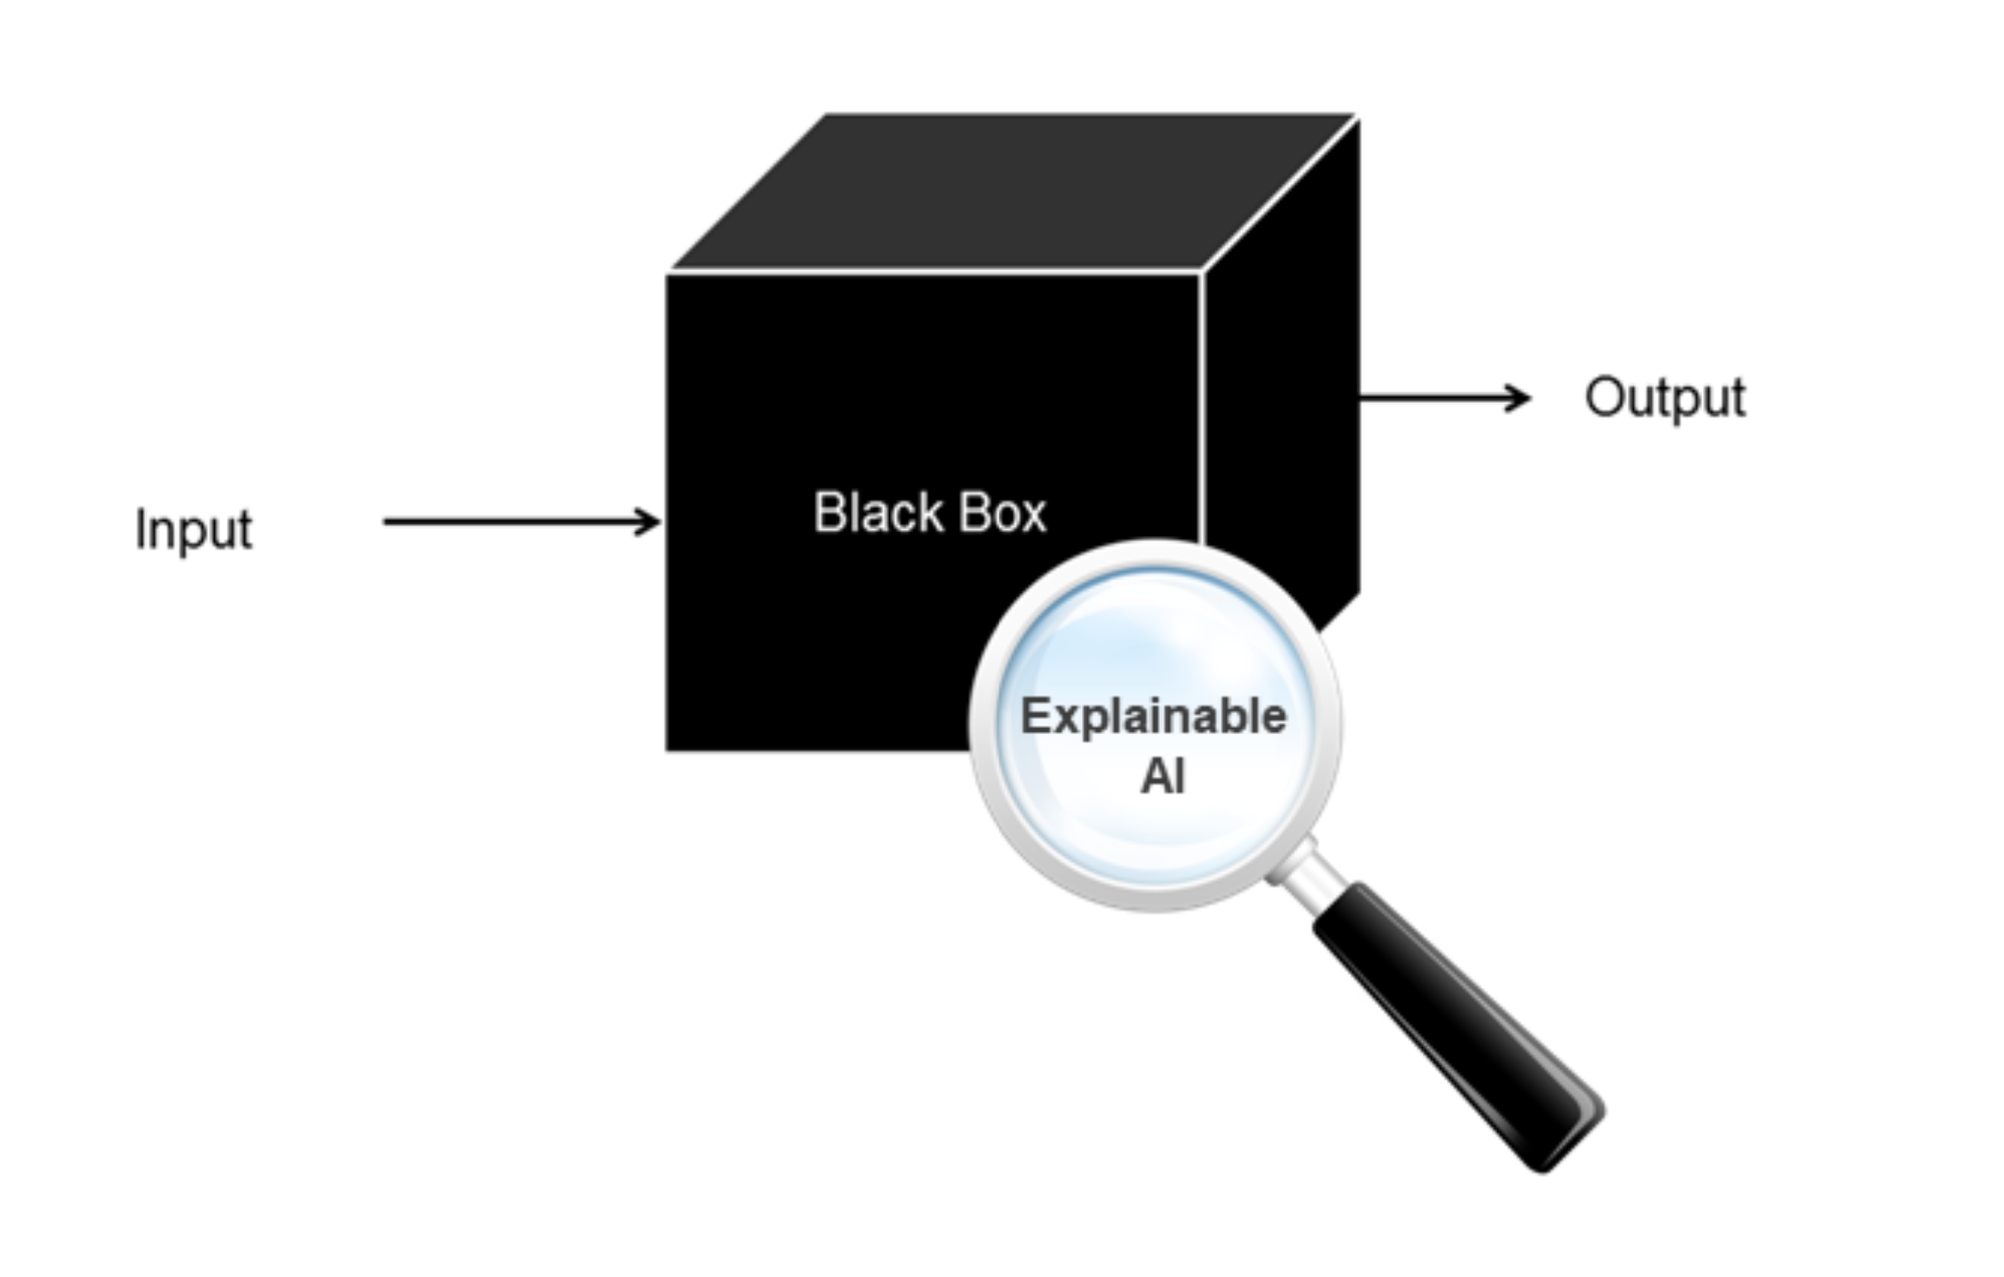
Who's to Blame
Zach Cote
When things go wrong, we naturally
try to push the blame onto someone else and we can push that onto an AI that we use.
However, AI is a tool that is meant to take in information and produce an output [4] which means that we as the user need to in some of the blame
[5]
Notes:
AIs work by being trained initially by humans and learning from what they are tasked with
When we use AIs we are giving them a prompt and the AI thinks through the prompt and releases an output based off the parameters it is trained on or has learned
Most AIs are black boxes which makes it hard for majority of people to even predetermine an AIs response to a specific prompt
Another issue that is encountered when it comes to a mistake made because there is multiple people involved in process( User, Creator, Trainer)
Also some companies might push error onto AIs in order to avoid lawsuits but as the AI evolves it might become possible to actually hold an AI accountable

Slide 25
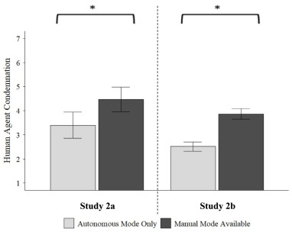
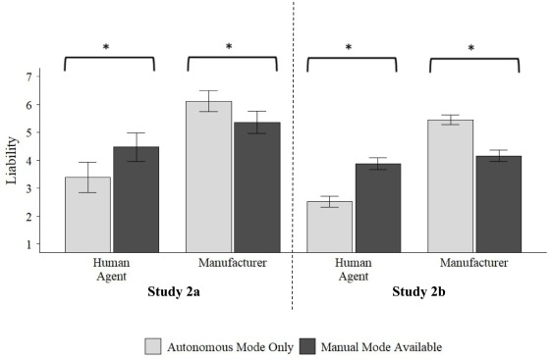
creator or User
Zach Cote
Test 1 Test 2
Compares how liable people are when they are using an autonomous vehicle.
[1]
Similar test but added if the creator is responsible
Notes:
A study was conducted to see who the general population believed was responsible when it came to accidents involving an autonomous car.
Split into two groups, One that was told that the car was also manual while the other was just autonomous
Test was repeated with a focus on creator vs User
The gray demonstrates the amount people felt the human was liable for the vehicle crash when fully autonomous and the darker gray is for if manual mode was available
In the second study they added if the creator of the vehicle was responsible with the same stats but included the liability of the creator for the accident.
Overall when manual mode was available the creator was held less liable and closer to the liability rating of the human in manual mode being available.
The study also shows that the human is deemed as less liable when using the autonomous mode

Slide 26
Reasons for whose Responsibility
Zach Cote
The way the AI is used
How the AI is intended to work
Testing/ Training
How much control does the user have?
ETC...
Notes:
-If the user is using the AI incorrectly and that is why the AI is creating an error then the responsibility falls on the User
-if the AI is loaded with biases or improperly trained then it would fall on the person in charge of training the AI.
If the user does not have control over how the AI is operating like a autonomous car
It also can change as the AI evolves itself which can lead for the decision to go to the court system where people will decide based off information provided

Slide 27
Past Outcomes
Zach Cote
Depending on the use of the AI and the reasons that someone has for filing against the AI they can sue the creator of the AI.
Some of the outcomes favor the user while others favor the creator of the AI
[2]
Notes:
Examples
Anthropic paid a 1.5 m settlement fee for using copyrighted work to train its AI on Aug 26
A mother sued Character.AI for its involvement in her sons death
Other AIs have managed to get away with using online material without any permission by stating that they were not trained with copyrighted work and accessed it legally

Slide 28
References
Zach Cote
[1] Arnestad, Mads N, and Samuel Myers. The Existence of Manual Mode Increases Human Blame for AI Mistakes, 28 Aug. 2024, www.sciencedirect.com/science/article/pii/S0010027724002178?via%3Dihub.
[2] Panettieri, Joe. “Generative AI Lawsuits Timeline: Legal Cases vs. OpenAI, Microsoft, Anthropic, Google, Nvidia, Perplexity, Intel and More.” Sustainable Tech Partner for IT Service Providers, 21 Sept. 2025, sustainabletechpartner.com/topics/ai/generative-ai-lawsuit-timeline/.
[3]“Can Artificial Intelligence Be Sued? Who Is Responsible When AI Makes the Decisions?” University of Helsinki, 5 Mar. 2019, www.helsinki.fi/en/news/economics/can-artificial-intelligence-be-sued-who-responsible-when-ai-makes-decisions.
[4] “Who’s Really to Blame When AI Fails?” Killed by Robots, 20 Apr. 2025, killedbyrobots.com/whos-really-to-blame-when-ai-fails/.
[5] Kosinski, Matthew. “What Is Black Box AI and How Does It Work?” IBM, 2 June 2025, www.ibm.com/think/topics/black-box-ai.
[6] Tiwari, Ankita. “Who Is Responsible When AI Makes a Mistake?” RISKINFO, RISKINFO, 11 July 2025, www.riskinfo.ai/post/who-is-responsible-when-ai-makes-a-mistake.
[7] Qin, Lily. “Who’s to Blame When Ai Fails? The Struggle for Legal Accountability.” Carnegie Mellon Policy and Law Review, 22 Sept. 2025, cmuplr.org/2025/09/04/whos-to-blame-when-ai-fails-the-struggle-for-legal-accountability/.
All resources accessed on 9/24 unless stated otherwise

Slide 29
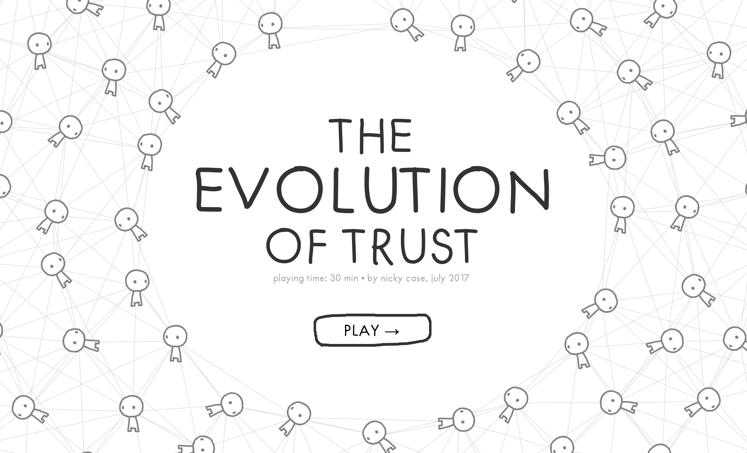
Class 10
The End
Keith A. Pray
SocialImps.com
Notes:
TODO: Add Snowden interview video link and thumbnail
The Game Of Trust - NICKY CASE
https://ncase.me/trust/
This is the end. Any slides beyond this point are for answering questions that may arise but not needed in the main talk. Some slides may also be unfinished and are not needed but kept just in case.

Slide 30
Remote With Zoom
Sign in with First and Last Name
Stay muted unless you are going to speak
To speak use the raise your hand feature
To answer yes/no questions use the “yes” ”no” buttons
Turn your camera on
Wait until the end of student presentations to ask questions
  Write them down so you don’t forget

