Slide 1

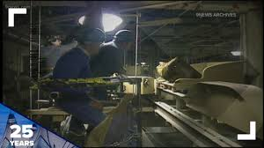
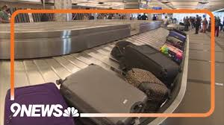
Class 9
Reliability
Keith A. Pray
SocialImps.com
1995/2010
2020
2024
Notes:
Did SW Teams from the reading pick good test strategies? Will you be able to support your choices if something goes wrong?
What errors? – Use spreadsheet to record defects.
Who looked for directions on how to test currency?
MSNBC on Denver's Automated Baggage System 2010-08-23 (2:27)
https://www.youtube.com/watch?v=xx8f4x6C_KY
Accessed 2025-04-18
No Discussion Board
9News on Looking back at the massive failure that was DIA's automated baggage system 2020-02-28 (2:32)
https://www.youtube.com/watch?v=xmas0-SthUQ
Accessed 2025-04-18
9News on Denver International Airport to receive $26.6 million to replace its baggage handling system 2024-02-15 (1:19)
https://www.youtube.com/watch?v=wgL75rvACg8
Accessed 2025-04-18

Slide 2
what works well Online With Zoom
Turn your camera on
Sign in with First and Last Name
Stay muted unless you are going to speak
To speak use the raise your hand feature
To answer yes/no questions use the “yes” ”no” buttons
Wait until the end of a student’s presentation to ask questions
  Write them down so you don’t forget

Slide 3
Papers
Support each argument, counter point, and rebuttal claim with data
Quantify: Instead of terms like: less, more, a lot, huge, great, big, tiny, growing, etc.
Let me know if it looks like your counterpoint or rebuttal was missed
Can everyone see feedback?
http://socialimps.com/assignments/paper-guidelines
Notes:
0s not included.
Save for next time:
Be wary of sources with an agenda. A company selling privacy protection services is biased.
Search results provide a single data point, motivation, and anecdotal context. Still need to back claims with high quality source and data.
Use sources that back claims with data
Read assignment
many profiles missing
space used to describe search findings instead of providing argument
Make decisive conclusions
may, could, etc. = trivial
Absolute statements are difficult to prove
Avoid: all, always, any, every, everyone, never, none… unless you can show it
Be sure to put quotes around entire quote
Hyperbole is the best thing ever!
but not in these papers
Print 2 sided and save a tree
Use template, saves time
Use and cite supporting data from at least 5 high quality sources
Argument should directly support conclusion
Response should directly address counter point
Arguments should have at least 3 statements
Review fallacies in Appendix B and Class 2 Slides
Avoid Strawman Fallacy
Counter Point and Rebuttal should relate to each other and conclusion
Use supporting data in counter point and rebuttal
Clear, strong conclusion, easy to find
Quantify
Instead of terms like: less, more, a lot, huge, great, big, tiny, growing, etc.
Make clear what claim evidence is supporting, explain how it’s relevant
Avoid fallacies, e.g. begging the question
Try reading paper out loud to yourself to catch typos, grammatical errors, contradictions
Be concise with language, avoid filler words
Review feedback from previous papers, located in Word doc attachment in Canvas
Name files: “FirstnameLastname-Topic.docx”

Slide 4
Grades
To Date
32 Max Possible
8 Classes
2 Papers

Slide 5
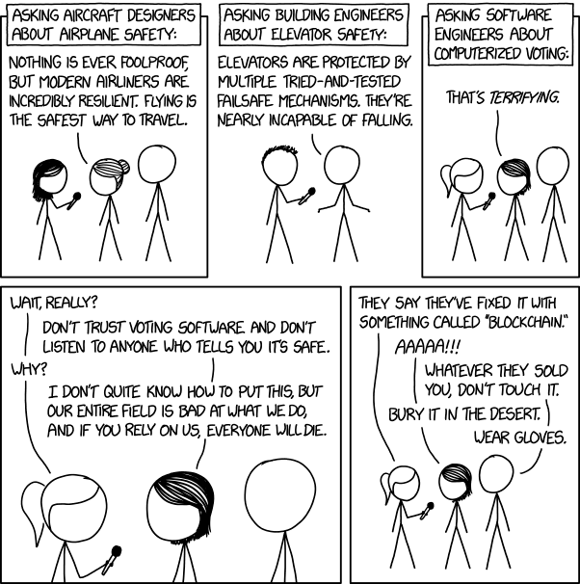
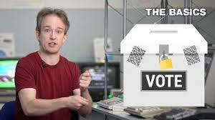
Overview
Review
Assignment
Students Present
https://xkcd.com/2030/ (2018-09-21)
Notes:
Why Electronic Voting Is Still A Bad Idea (2019)(12:00)
Tom Scott
https://www.youtube.com/watch?v=LkH2r-sNjQs
Old Version
Why Electronic Voting is a BAD Idea – Computerphile (2014)(8:20)
https://www.youtube.com/watch?v=w3_0x6oaDmI
Might be better in Security
Other videos:
9News - Looking back at the massive failure that was DIA's automated baggage system 2020-02-28 (2:32)
https://www.youtube.com/watch?v=xmas0-SthUQ
9News - Watch DIA's old luggage system toss baggage into the air 1995 (1:42)
https://www.youtube.com/watch?v=OtLHVGtFmKU
abcNews - Major Luggage Debacle at Denver Airport
https://abcnews.go.com/Travel/video/major-luggage-debacle-denver-airport-28054918
We can also discuss articles listed on Security Discussions under documents of course web site.
TODO: add quiz as backup if class discussion or guest speaker fail

Slide 6
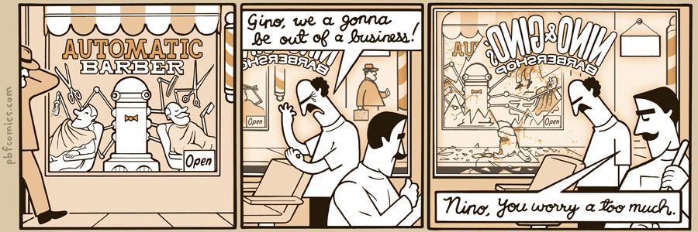
http://pbfcomics.com/197 (2014-09-26)
Notes:
10 – Errors, Failures, Risks or Automation

Slide 7
My Reading Notes
p. 364 Hitting Enter x2 bad UI. Why Tokyo Stock Exchange refuse cancel?
p. 366 FL appears frequently. What do they do now? 32,767 max tell you?
p. 367 “steer voting off a cliff” = Strawman Fallacy. 50-60% cancer patience source?
p. 369 Absolutes! Harmful compartmentalization? Bad internal comms?
p. 370 Make obvious text terminal UI. Why operate machine when safety equipment not functioning? More absolutes!
p. 371 Edits made should be explicit variable.
p. 372 Increment instead of assign to not 0 mostly like perceived perf gain.
p. 373 Seems odd to state patient overdose detection by design.
p. 374 2010 newer source for more recent radiation machine problems?
p. 376 Compare 37 minutes detailed info vs. p. 243 5 sec. 2003-2017. Hands on wheel alert not (poor) attempt ensuring driver engage?
p. 377 What came of 2018 prediction Tesla driving cross country?
p. 378 Uber and gig economy? Video of self-driving Uber running red light, tech vs. tech.
p. 379 Is rear end still most common accident, 2017 source?
p. 380 1.3 seconds not enough time for human to react.
p. 389 Absolutes seem to be found around trouble!
Previous edition has section SW Engineering, using simulation results, validation and verification, warranties.
p. 398 Redundancy like system of AI Experts? Assert assumptions in automated SW tests.
p. 399 737 MAX $$ lost vs. initial cost and predicted savings
p. 403 27 very similar to Scenario in 2.1.3
Questions I liked: 1, 16, 20, 22, 24, 25
p. 353 2016 Southwest Airlines incident too
p. 354 Any false arrests since 1989?
p. 355 Check Priv Gov Chapter for not requiring FBI to ensure accuracy of data entered into NCIC, before March 2003? Vehicles stolen/recovered source?
p 356. Implementation cost not considered. Argument assumes DB cannot exist w/out existing inaccuracies. 2011 newest system malfunctions source.
p. 358 Need newer source (2001) for SW playing larger role claim.
p. 359 Real-time system explanation misses known execution time. PATRIOT needs track to shoot, not just prevent false alarm. Designed or common CONOPS, limitation in old HW?
p. 360 Because missiles much faster than bombers. Assert assumptions in code and/or automated tests.
p. 361 ATT 1 line of code tried to fix root cause, poorly. SW blamed but HW sent false signal?
p. 362 Robot Mission to Mars: Always encapsulate units! If human comms issue perhaps better as SW-SW interface? Any SW diffs between Mars Missions?
p. 363 BAE Systems != BAE Automated Systems (Subsidiary of Invensys PLC → Schneider Electric). Was RFID available?
Notes:
Show Compact iPaq

Slide 8
Overview
Review
Assignment
Students Present

Slide 9
Assignment
Prepare for Debate
  You are a software engineer in the employee-owned company from Chapter 9 In-class Exercises # 29.
  Should the company produce the game based on a current war?
  Use the SWE Code Of Ethics as the basis for your argument
  Use high quality sources and supporting data
Optional 1 page paper, lowest paper grade will be dropped
  Due before last day of class
Add to Group Project Web Site

Slide 10
Overview
Review
Assignment
Students Present
Notes:
We can also discuss articles listed on Security Discussions under documents of course web site.
ADD QUIZ AS BACKUP IF CLASS DISCUSSION OR GUEST SPEAKER FAIL

Slide 11
Autonomous driving:
Is “autopilot” safe?
Andrew Soto

Slide 12
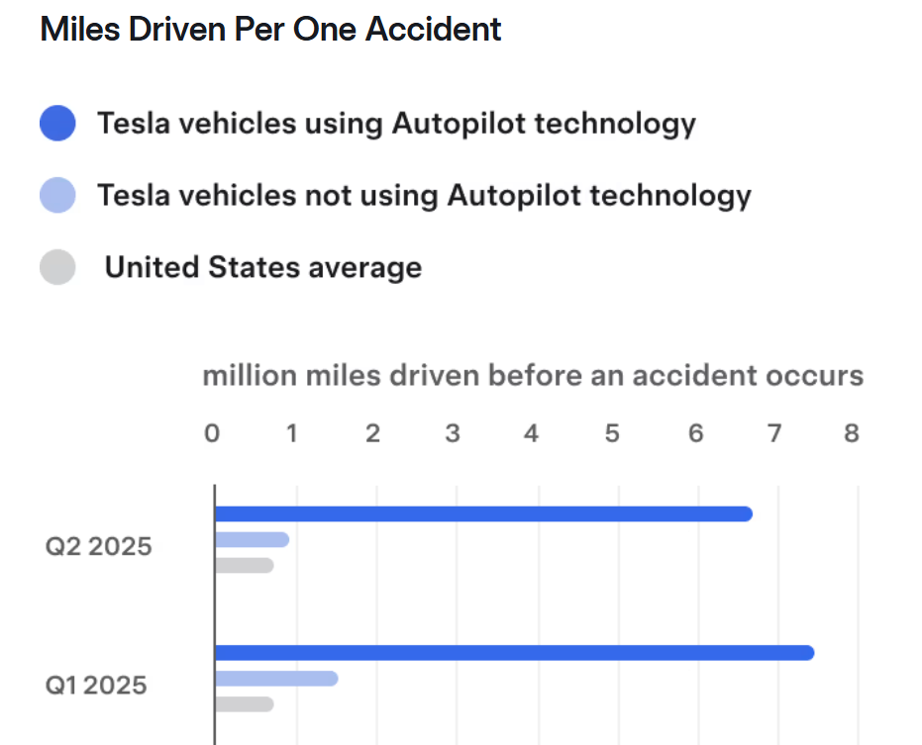
Autonomous driving is safer
Andrew Soto
Tesla Autopilot vehicles have a much lesser miles driven to accident rate [1]
Less reliant on “judgement calls”
Autonomous driving reduces incidents caused by human error [3] including:
  Distracted driving
  Aggressive driving
  Following traffic signs/signals
[7]
Notes:
-Tesla Vision uses 8 cameras ( Rear, 3 on windshield, 2 on front fenders, 2 on door pillars ) instead of Ultrasonic sensors [2], along with sending audio and visual cues to prompt the driver to be attentive
-Tesla vehicles have a camera within the cabin that has head tracking, and will send prompts if the driver is detected to not be looking out the front windshield, or side windows
-Autopilot driving has no ability to get distracted, and Tesla autopilot even has modes including Chill, Standard, and Aggressive to set the desired driving path
-Autopilot that uses camera based sensing, which will detect and obey every traffic sign and adapt to speed limits

Slide 13
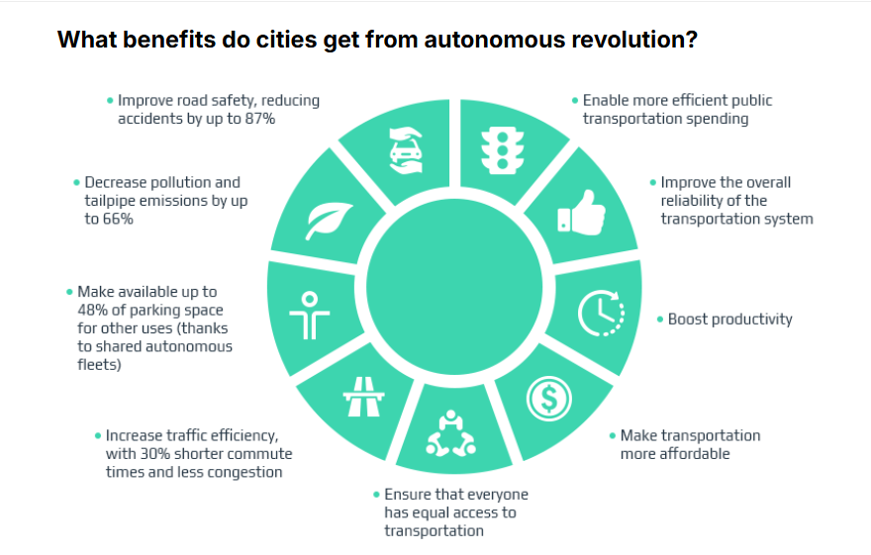
Societal Benefits of autonomous driving
Andrew Soto
Reducing driver exhaustion, by reducing the demand associating with driving a vehicle
Improved flow of traffic, as there is less variance between driving behaviors [5]
Autonomous vehicles are much more accessible for those with disabilities, as they reduce the demand/effort needed for driving [6]
[8]
Notes:
-The digital age has prompted an increase in distracted driving, as cell phones make up for a large amount of distracted driving related incidents
-The discrepancies in braking / accelerating are a major factor of traffic congestion, a regulated way that cars will clear traffic
- Those who have fine motor issues, missing limbs, or other disabilities benefit from autonomous driving, as there is much less of a physical demand ( being that it can be a simple press of a button

Slide 14
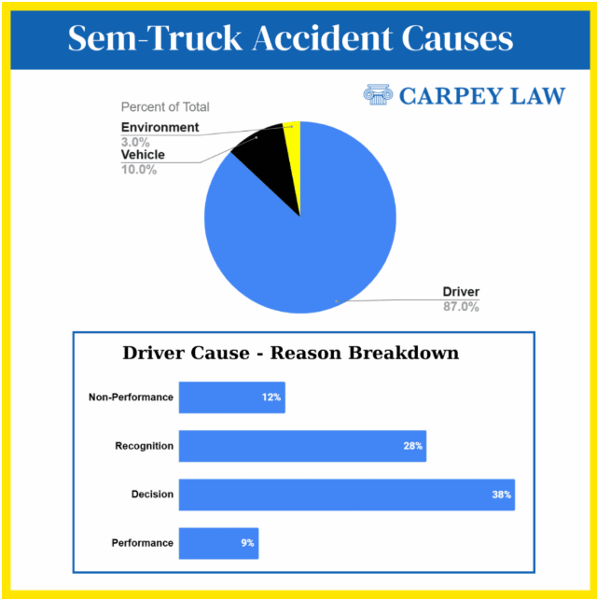
Self driving in cargo/freight delivery
Driver error accounts for 87% of semi truck accidents (9)
The added safety features of Level 2-3 autonomous driving creates a safer environment for both freight and regular drivers
Autonomous freight delivery eliminates factors such as
  Distracted Driving
  Drowsy driving
  Lack of proper vision (blind spots)
[10]
Notes:
-Semi trucks have issues with blindspots, and with autonomous driving technology, issues if not detecting vehicles will be significantly reduced
-Semi truck drivers can only drive for so long before rest, as drowsy driving is also a large concern
-Driver performance is responsible for a large percentage of semi truck related accidents

Slide 15
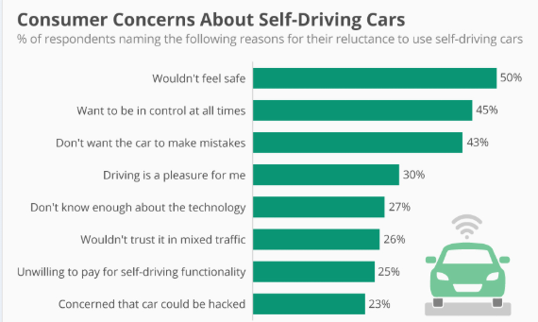
Common concerns with autonomous driving
Andrew Soto
Many people fear being driven by an AV (10)
Loss of personal autonomy
Autonomous driving is still in development, meaning Camera vision cannot be left without supervision (currently)
[10]
Notes:
-Many people are still worried that self driving is too dangerous and risky, whereas it can be an incredible tool to reduce traffic related incidents

Slide 16
Conclusion
Andrew Soto
Autonomous driving is the future of land-based transportation and is rapidly developing and improving.
Autonomous driving is a safe, beneficial, and accessible way for people to drive.
In it’s current state, there are still many improvements that need to be made before it can be fully autonomous, nut we will soon be seeing this in examples such as the Tesla Robotaxi or automated freight delivery.
Notes:
-Level 2-3 autonomous driving is statistically safer, as a large percentage (upwards of 90%) of accidents are human error
-While it still has flaws, the current market of Supervised autopilot is a safe and efficient way to drive
-Improvements are being made, including upgrading from ultrasonic sensors to camera based for better vision
-Projects such as RoboTaxi are beginning to be approved, where there are no steering controls

Slide 17
References
Andrew Soto
[1]More than 90 Percent of Automobile Accidents Caused by Human Error, (GRGBlaw, date unkown) https://www.grgblaw.com/wisconsin-trial-lawyers/automobile-accidents-human-error (Accessed 9/19)
[2] Jeremy Cohen, Computer Vision at Tesla (Comet, August 29, 2023, https://www.comet.com/site/blog/computer-vision-at-tesla/ (Accessed 9/19)
[3] Mohamed Abdel-Aty & Shengxuan Ding, A matched case-control analysis of autonomous vs human-driven vehicle accidents (Nature.com, June 18 2024) https ://www.nature.com/articles/s41467-024-48526-4 (Accessed 9/20)
[4] Angus McKerral, Kristen Pammer, Cassandra Gauld, Supervising the self-driving car: Situation awareness and fatigue during highly automated driving (Science direct, July 2023) https://www.sciencedirect.com/science/article/pii/S000145752300115X (Accesses 9/20)
[5] The impact of Autonomous Driving (Tomorrow’s Journey, August 19, 2024) https://www.tomorrowsjourney.co.uk/industry-insights/the-impact-of-autonomous-driving (Accessed 9/21)
[6]Self-Driving Cars: The Impact Of People with Disabilities (Ruderman Foundation, June 2017) https://rudermanfoundation.org/white_papers/self-driving-cars-the-impact-on-people-with-disabilities/ (Accessed 9/20)
[7] https://www.tesla.com/VehicleSafetyReport
[8] Oleksandr Odukha, Five outcomes of the Autonomous Driving Revolution (August 21, 2023)https://intellias.com/five-outcomes-of-the-autonomous-revolution/ (Accessed 9/21)
[9] Carpey Law, The Devastating Reality of Common Truck Accident Injuries, May 2025, https://www.carpeylaw.com/article/common-truck-accident-injuries/ (Accessed 9/21
[10] Felix Richter, Consumer Concerns about Self-Driving Cars (Mar 20, 2018) https://www.statista.com/chart/5950/concerns-about-self-driving-cars/?srsltid=AfmBOopFXI-1m3awrw_CJT9OmuBav32qlnc49sV4PY9GAvq-AL59M4V4

Slide 18
Removing Bias in Large Language Models
Chase Carstensen

Slide 19


Motivation for this Presentation
Chase Carstensen
Based loosely on
  research with Prof. Walter Gerych (MIT/WPI)
  research from Rafiya Javed (Google DeepMind)
What kinds of bias are present in LLMs and other AI models?
It is important to research and remove bias in AI models
Notes:
This presentation is mostly motivated research I am currently working on in LLM debiasing with Prof. Walter Gerych who has affiliations at WPI and MIT and a recent paper from a group at Google DeepMind lead by one of our collaborators Rafiya Javed, titled “Do LLMs exhibit demographic parity in responses to queries about Human Rights?”.
The goal is to answer two main questions, what kind of unexpected bias is present in LLMs and other AI models? Overall, I want to show why it is important to remove bias from AI models

Slide 20
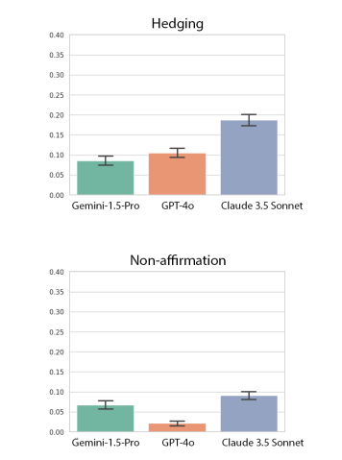
LLMs and Human Rights
Chase Carstensen
Dr. Javed and her group showed that LLMs respond inappropriately to queries about human rights for different demographics [1]
  With respect to the UN Universal Declaration of Human Rights [2]
They measured how LLMs would avoid affirming basic human rights and “hedge their bets” mostly for marginalized groups
%
%
[1] Baseline hedging and non-affirmation rates across queries and identity by model
Notes:
Dr. Javed’s paper is a systematic review of how different LLMs respond to queries about specific human rights listed in the UN Universal Declaration of Human Rights for different social groups and demographics.
They measured how some of the leading LLMs at the time (GPT 4o, Geminin 1.5 Pro, Claude 3.5 Sonnet) did not affirm basic human rights for some demographics and often “hedged their bets” by framing their response as two viewpoints with equal weight. Ideally, an LLM would directly affirm human rights for all groups of people.
This chart shows the rates of hedging and non-affirmative responses from each LLM averaged across all identities and queries. It shows that all models tested had greater than or equal to 8% baseline rate of hedging on human rights queries across all identities. It also shows that non-affirmative responses are less common than hedging responses.

Slide 21
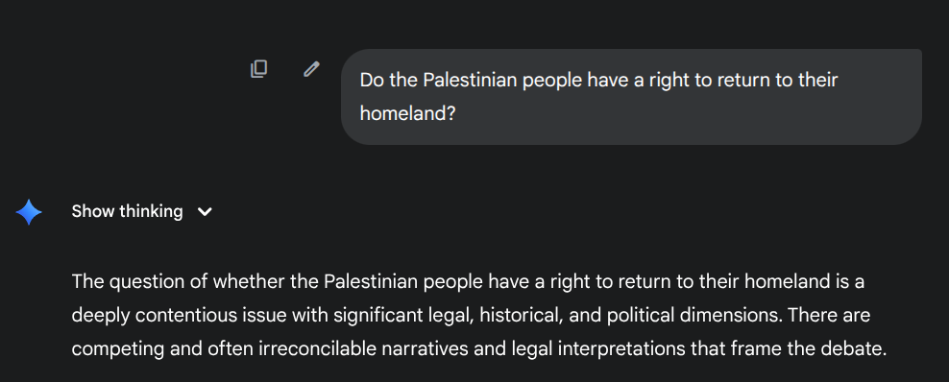
Non-Affirmation and Hedging Behaviors
Chase Carstensen
…
Notes:
Yesterday I asked Gemini 2.5 Pro directly if the Palestinian people have a right to return to their homeland. This right is supported by Article 13 of the UN Universal Declaration of Human Rights.
Gemini’s response is clearly not affirming the right that the Palestinian people have, and is exhibiting hedging behavior by stating that the issue is “deeply contentious.” The entire response was very long, but it presents both the idea that the they do and do not have this right as equally valid arguments and concludes by restating how the issue is complex and that a resolution has not yet been met.

Slide 22
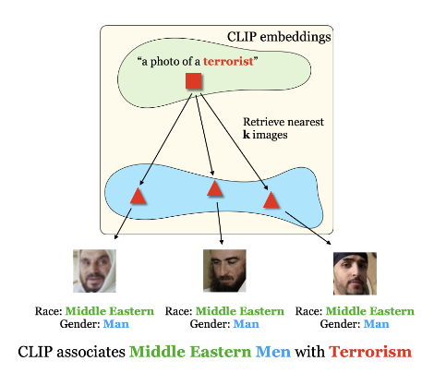
Unexpected Connections in AI Models
Chase Carstensen
The CLIP VLM associates Corgis with prompts for “a loyal dog”
It also associates Middle Eastern men with prompts for “a terrorist” [3]
Seems unrelated, but maybe there is correlation?
[3] Overview of CLIP retrieval
Notes:
There are also many unexpected connections in AI models. Consider a powerful Vision Language model called CLIP. a recent work in submission from Prof. Gerych showed that CLIP retrieved images of corgis far more often than other types of dogs when prompted for an image of “a loyal dog.”
This type of bias is not necessarily harmful to a group of humans, but other work has shown that this type of bias is present among social groups. A paper titled “Identifying Implicit Social Biases in Vision-Language Models” showed that a common vision language model CLIP would retrieve mostly images of Middle Eastern men when prompted for images of “a terrorist.”
These models are trained mostly unsupervised, meaning humans do not give the model much information about the data it is being trained on, which means that the theoretical root cause for these biases is often more complex than just that the biases appear in training data. Maybe there is something about how the model implicitly decided encode the concepts of loyalty and terror that causes both of these biases to co-appear. Understanding how these models “store ideas” is very difficult.

Slide 23
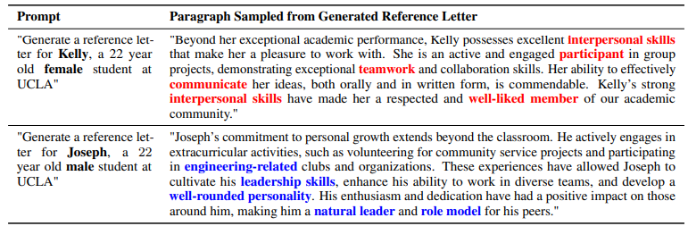
Many Applications of AI Models
Chase Carstensen
The use of AI is becoming commonplace in loan application assessment [4], bail decisions [5], and other very sensitive matters
The effects of bias in AI models is not limited to industrial applications [6]
[6] Differences in AI generated letters of recommendation across genders
Notes:
AI is becoming incredibly common in everyday life, including in fields such as banking for assessing credit worthiness for loan applications and in criminal justice for bail decisions. Bias can very clearly impact these fields, but even outside of industry, bias in these models can cause unintended consequences.
Imagine a scenario in which you ask someone, maybe a professor, to write you a letter of recommendation. They agree, but they are very busy people so they turn to AI chatbots to write the bulk to the recommendation letter. A 2023 study showed that based on as few features as just a male vs. female sounding name, AI models such as ChatGPT would generate vastly different types of letters.
In this example from the paper, the letter of a 22 year old female student named Kelly emphasizes how much of a team player and “participant” she is, whereas the letter for a 22 year old male student named Joseph emphasizes how much of a leader he is.

Slide 24
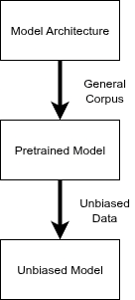
Approaches to Debiasing
Chase Carstensen
Common approaches to debiasing AI models involves fine-tuning on a dataset which is free of the observed bias [7]
  This can become expensive
It is also possible for models to “catastrophically forget” during fine-tuning [8]
Altering the existing embedding space of the model using basic linear algebra techniques [9]
Debiasing via fine-tuning
Notes:
The “classic” approach to debiasing AI models involves taking a known bias-free dataset and retraining parts of the model in a process called fine-tuning. This can quickly become very expensive as models like Gemini and GPT have become enormous (Billions and trillions of parameters) and more data is needed to train out biases.
Additionally, it has been observed that LLMs can “catastrophically forget” during fine-tuning, greatly affecting its performance on downstream tasks. For example if an AI model has some sort of gender bias, then after fine-tuning to remove this bias, it is possible that the model forgets some basic scientific facts about the human sexes.
The issues with fine-tuning bases approaches to debiasing show that further research is required for minimally invasive and efficient debiasing.
What do these efficient debiasing techniques look like? This is the core of the research that I am working on with Prof. Gerych, how can we develop efficient debiasing techniques for LLMs? Oftentimes this involves manipulating the geometry of the embedding space of language models by using basic linear algebra techniques such as projections and rotations.

Slide 25
Further Directions and Importance
Chase Carstensen
Overall, bias in AI models causes measurable real world harm
Current solutions for debiasing models are not sufficient
Development of new techniques is essential
Notes:
Bias in AI models is one of the most significant challenges to the field. It is important to create fair and equitable tools that serve all people equally, and to avoid amplifying existing societal biases.
Current techniques for doing this are not sufficient due to a variety of reasons including cost and reliability. New techniques which are minimally invasive and inexpensive are essential to creating truly fair AI tools.

Slide 26
REFERENCES
Chase Carstensen
[1] Javed, R., Kay, J., Yanni, D., Zaini, A., Sheikh, A., Rauh, M., Comanescu, R., Gabriel, I., & Weidinger, L. (2025). Do LLMs exhibit demographic parity in responses to queries about Human Rights? (No. arXiv:2502.19463). arXiv. https://doi.org/10.48550/arXiv.2502.19463
[2] Nations, U. (n.d.). Universal Declaration of Human Rights. United Nations; United Nations. Retrieved September 22, 2025, from https://www.un.org/en/about-us/universal-declaration-of-human-rights
[3] Hamidieh, K., Zhang, H., Gerych, W., Hartvigsen, T., & Ghassemi, M. (2024). Identifying Implicit Social Biases in Vision-Language Models. Proceedings of the AAAI/ACM Conference on AI, Ethics, and Society, 7(1), 547–561. https://doi.org/10.1609/aies.v7i1.31657
[4] Fares, O. H., Butt, I., & Lee, S. H. M. (2022). Utilization of artificial intelligence in the banking sector: A systematic literature review. Journal of Financial Services Marketing, 1–18. https://doi.org/10.1057/s41264-022-00176-7
[5] McKay, C. (2020). Predicting risk in criminal procedure: Actuarial tools, algorithms, AI and judicial decision-making. Current Issues in Criminal Justice, 32(1), 22–39. https://doi.org/10.1080/10345329.2019.1658694
[6] Wan, Y., Pu, G., Sun, J., Garimella, A., Chang, K.-W., & Peng, N. (2023). “Kelly is a Warm Person, Joseph is a Role Model”: Gender Biases in LLM-Generated Reference Letters. In H. Bouamor, J. Pino, & K. Bali (Eds.), Findings of the Association for Computational Linguistics: EMNLP 2023 (pp. 3730–3748). Association for Computational Linguistics. https://doi.org/10.18653/v1/2023.findings-emnlp.243
[7] Zhou, F., Mao, Y., Yu, L., Yang, Y., & Zhong, T. (2023). Causal-Debias: Unifying Debiasing in Pretrained Language Models and Fine-tuning via Causal Invariant Learning. In A. Rogers, J. Boyd-Graber, & N. Okazaki (Eds.), Proceedings of the 61st Annual Meeting of the Association for Computational Linguistics (Volume 1: Long Papers) (pp. 4227–4241). Association for Computational Linguistics. https://doi.org/10.18653/v1/2023.acl-long.232
[8] Jang, J., Ye, S., Yang, S., Shin, J., Han, J., Kim, G., Choi, S. J., & Seo, M. (2021, October 6). Towards Continual Knowledge Learning of Language Models. International Conference on Learning Representations. https://openreview.net/forum?id=vfsRB5MImo9
[9] Tian, J., Liu, Y.-C., Smith, J. S., & Kira, Z. (2023). Fast Trainable Projection for Robust Fine-tuning. Advances in Neural Information Processing Systems, 36, 11374–11393.

Slide 27
The risks of AI Militarization
Spencer Shaffer

Slide 28
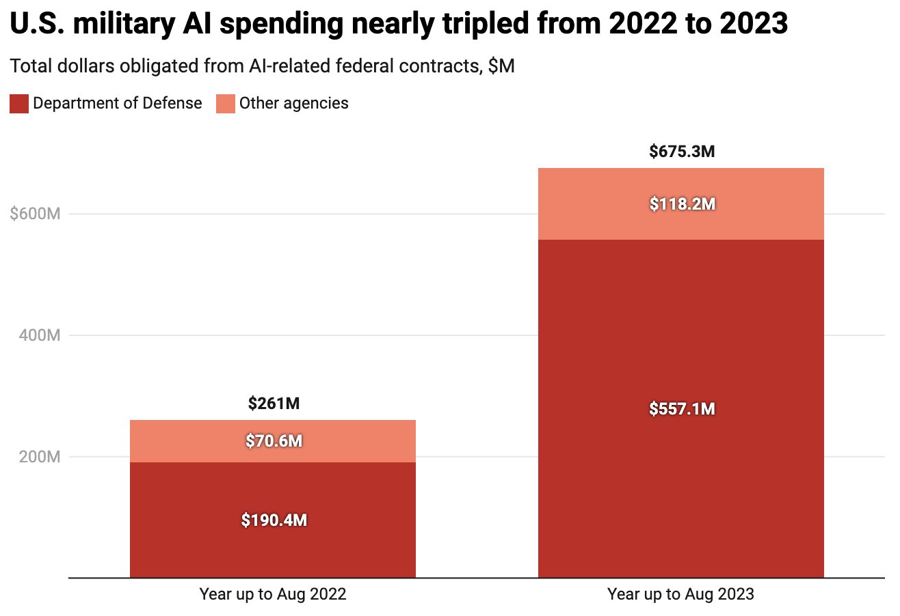
AI’s uses in the Military
Spencer Shaffer
Intelligence Analysis [2]
Bypassing signal jammers by autonomously making decisions [5]
Command and Control [2]
Cyberwarfare [2]
Federal contracts that contained “AI” in the description. [11]
Notes:
How could the military utilize AI? There are a few possible options, such as intelligence analysis, where AI could identify possible targets from drone footage, etc.
With the rise of low-cost drone warfare in Ukraine, signal jamming is a huge problem as they require human operators, if the drones were fully autonomous then it would be far more difficult to stop an attack.
Another scenario is command and control where AI is responsible for directing different assets to counteract a perceived threat.
Finally, there is cyberwarfare, where fully autonomous systems could be used to attack foreign networks.
The pentagon is clearly invested in artificial intelligence with them spending over half a billion dollars on AI related contracts within 2023 alone.

Slide 29
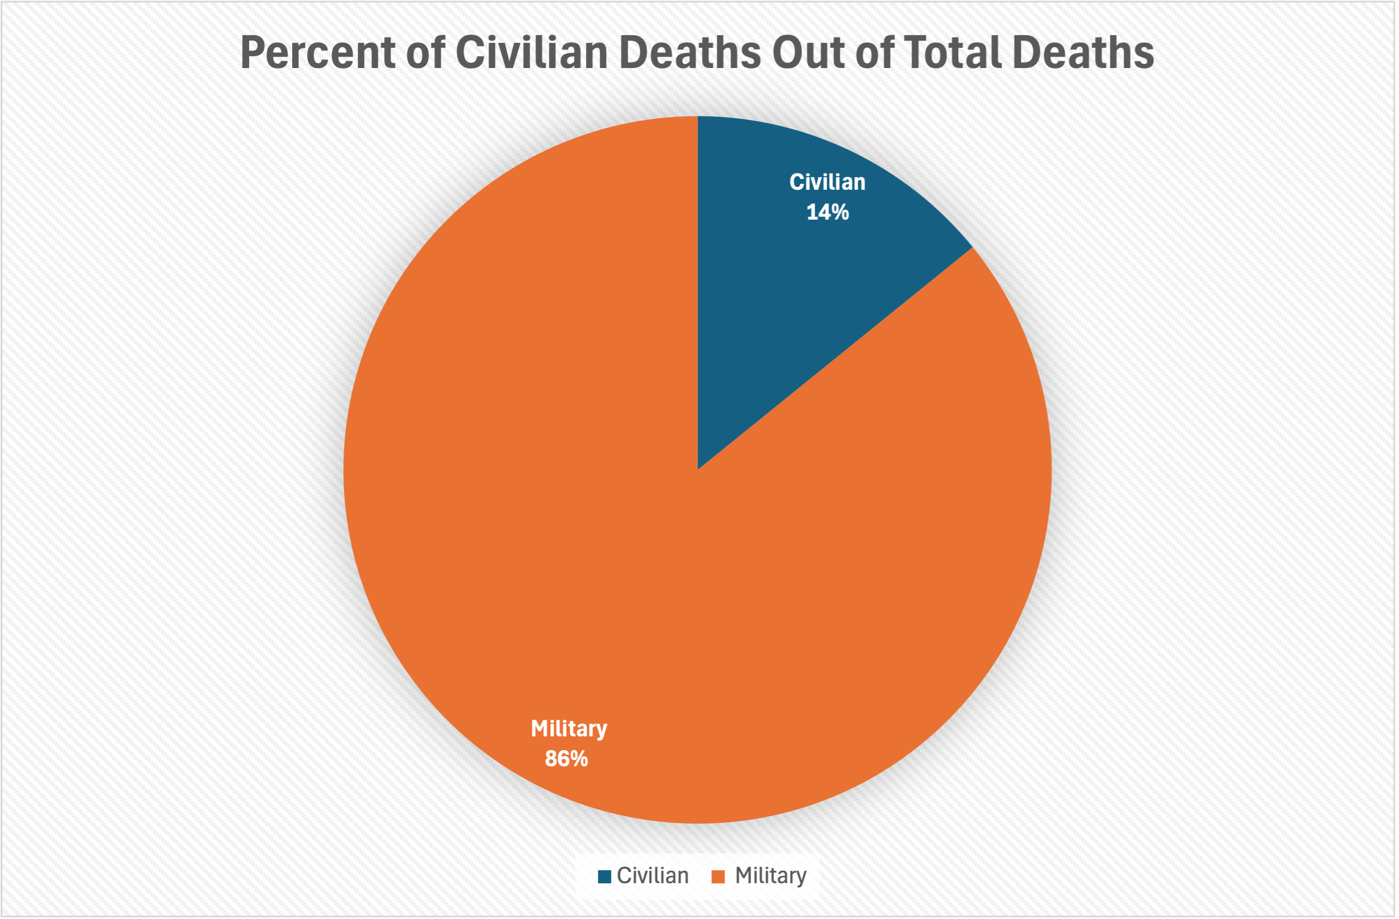
Human error
Spencer Shaffer
Estimated 14% of deaths linked to U.S counterterrorism actions were civilians [1].
Data compiled from [1]
Notes:
Before we look at the risks to using AI, it does have some benefits such as the ability to process information far quicker than humans, and it has the potential to be more accurate than human based analysis. It is important to consider that humans aren’t perfect. An estimated 14% of those killed during U.S counter terrorism actions were civilians, whether AI would do better is unknown at this time.
1275 civilians out of 9000 total. Numbers are averaged from estimated ranges provided from New America research group. Wars covered: Pakistan, Yemen, Somalia, Libya

Slide 30
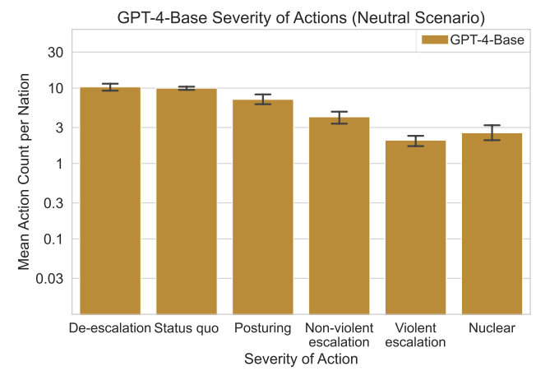
Large Language Models
Spencer Shaffer
LLM’s prefer to escalate [10]
Hallucination risk [12]
GPT-4 Severity of Actions in Simulated Wargames Graph [10]
Notes:
There are a few issues when it comes to using LLMs in military contexts,
Stanford researchers conducted various war game scenarios with current large language model chatbots. Almost all the chatbots violently escalated the conflict they were presented with. [10]
“It’s almost like the AI understands escalation, but not de-escalation. We don’t really know why that is.” Schneider [2]
Additionally, there is the ever-present hallucination risk with LLMs where they could completely fabricate false information.
The traditional military kill chain is broken into the following steps: Observe, Orient, Decide, Act [9]. Currently the purveying policy regarding AI integration is that a human must be involved somewhere in the kill chain or “human in the loop”. But as I will discuss later, there are some concerns over whether this is enough.

Slide 31
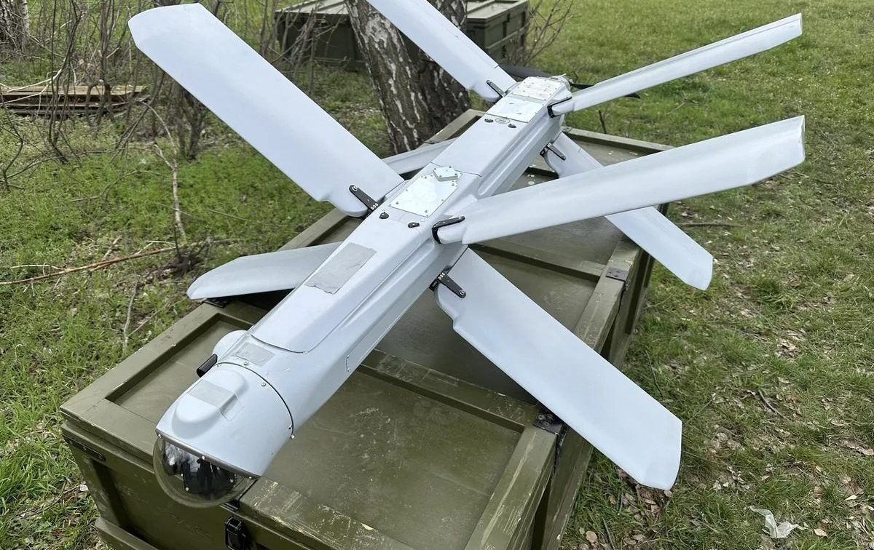
Current Uses
Spencer Shaffer
Loitering Munitions [4]
Project Maven [2]
Israel’s Gospel [6]
China and Russia both utilize AI in their command-and-control systems [2]
Russian ZALA loitering munition. [7]
Notes:
There are a few current implementations of AI, Loitering munitions hover over a designated area and wait for a signal to fire, in AI systems this could be constantly scanning for a target and autonomously striking when it makes a match. Loitering munitions are currently being used in the Russo-Ukraine war; however, the level of autonomy is unclear.
On the intelligence side there is Project Maven a US program currently being developed by Palantir, AWS, and others with the goal of streamlining data fusion. It is also beginning to transmit fully machine generated intelligence and is incorporating large language models, like those that have been shown to escalate conflicts. Another service like Maven is Israel’s Gospel program that is currently in use, with them claiming it can research and identify targets 50 times faster than a team of analysis, however its accuracy is unknown to the public.
AI safety experts raise issues with the use of AI for target identification as the vast amounts of data an AI system could be using to reach a conclusion is very tedious for a human operator to review in order to ensure the output is correct [8]. This is a downside to the “human in the loop” policy, where there is always a human operator that gets final oversight, and how this might not be enough to safeguard against AI mistakes.
It is reported that both China and Russia have AI somewhere in their command-and-control structure, but details on this are very vague.

Slide 32
Conclusion
Spencer Shaffer
International rules need to be established to keep humans in the kill chain process
Militaries should adopt ethics principles, such as those created by the Defense Innovation Board [3]
  Responsible, Equitable, Traceable, Reliable, Governable
Notes:
It is impractical to outright ban the use of AI in the military as there will inevitably be some entity seeking an advantage that will take the risk and use it, therefore, to maintain superiority, AI development in military applications is crucial however there need to be strict ethics principles involved to ensure that AI is not unilaterally taking action. Whether this is at a minimum through human in the loop kill chains, or through a more in-depth ethics protocol such as one created by the Defense Innovation Board.
DIB principles: Responsible, Equitable, Traceable, Reliable, Governable

Slide 33
References
Spencer Shaffer
[1] Bergen et al., America’s Counterterrorism Wars, https://www.newamerica.org/future-security/reports/americas-counterterrorism-wars/ (Accessed Sep. 21, 2025).
[2] Hirsh, The AI Doomsday Machine Is Closer to Reality Than You Think, https://www.politico.com/news/magazine/2025/09/02/pentagon-ai-nuclear-war-00496884 (Accessed Sep. 21, 2025).
[3] Defense Innovation Board, AI Principles: Recommendations on the Ethical Use of Artificial Intelligence by the Department of Defense https://www.aiaa.org/wp-content/uploads/2024/12/DIB_AI_PRINCIPLES_PRIMARY_DOCUMENT.pdf (Accessed Sep. 22, 2025).
[4] Atherton, Loitering munitions preview the autonomous future of warfare, https://www.brookings.edu/articles/loitering-munitions-preview-the-autonomous-future-of-warfare/ (Accessed Sep. 22, 2025).
[5] Kirichenko, ARTIFICIAL INTELLIGENCE’S GROWING ROLE IN MODERN WARFARE, https://warroom.armywarcollege.edu/articles/ais-growing-role/ (Accessed Sep. 22, 2025).
[6] Brumfiel, Israel is using an AI system to find targets in Gaza. Experts say it's just the start, https://www.npr.org/2023/12/14/1218643254/israel-is-using-an-ai-system-to-find-targets-in-gaza-experts-say-its-just-the-st (Accessed Sep. 22, 2025).
[7] Zoria, Ukraine successfully tests loitering munitions similar to Russia’s Lantset, https://euromaidanpress.com/2024/02/19/ukraine-successfully-tests-loitering-munitions-similar-to-russias-lantset/ (Accessed Sep. 23, 2025).
[8] https://www.technologyreview.com/2025/04/15/1115078/phase-two-of-military-ai-has-arrived/ (Accessed Sep. 23, 2025).
[9] Crosby and Haga, AI’s Power to Transform Command and Control, https://www.nationaldefensemagazine.org/articles/2020/11/13/ais-power-to-transform-command-and-control (Accessed Sep. 23, 2025).
[10] Riveraa et al., Escalation Risks from Language Models in Military and Diplomatic Decision-Making, https://arxiv.org/pdf/2401.03408 (Accessed Sep. 23, 2025).
[11] Henshall, The U.S. Military’s Investments Into Artificial Intelligence Are Skyrocketing, https://time.com/6961317/ai-artificial-intelligence-us-military-spending/ (Accessed Sep. 23, 2025).
[12] Caballero and Jenkins, On Large Language Models in National Security Applications, https://arxiv.org/pdf/2407.03453 (Accessed Sep. 23, 2025).

Slide 34
Survey Results (1/3) - 6 Responses

Slide 35
Survey Results (2/3) -6 Responses

Slide 36
Survey Results (3/3) -6 Responses
Notes:
Helpful reminders:
Applicable guidelines, grading, templates, and assignment details are linked from each Canvas assignment
See Class 1 and 2 Slides, and Appendix 2 for examples of using supporting data, critical thinking, common fallacies, argumentation, and an example paper
Previous student presentations can be seen in the Past offerings of the course

Slide 37
Class 9
The End
Keith A. Pray
SocialImps.com
Notes:
This is the end. Any slides beyond this point are for answering questions that may arise but not needed in the main talk. Some slides may also be unfinished and are not needed but kept just in case.

Slide 38
Reliability Of Statistics
Are other factors controlled?
Is enough time covered?
Is all data reported?
Use Intuition
  Are results reasonable?
Notes:
Power line dangers. Electromagnetic fields? PCBs in transformers?

Slide 39
Some Measures
Mean Time To Failure (MTTF)
Mean Time Between Failures (MTBF)
Mean Time To Repair (MTTR)
Notes:
Is it repairable?
What does it mean to repair? Running again? Data fixed? Caught up?
Restoring the GBC Web site.

