Slide 1

Class 8
Security
Keith A. Pray
SocialImps.com
Notes:
“Weird” Al Yankovic – Virus Alert (2006) (3:43)
https://www.youtube.com/watch?v=zvfD5rnkTws
Last accessed: 2025-09-16
Internet of Things (IoT) first coined in 1999
Take 5 minutes to fill out survey on Canvas → Quizzes → SGA’s Midterm Course Feedback Questionnaire

Slide 2
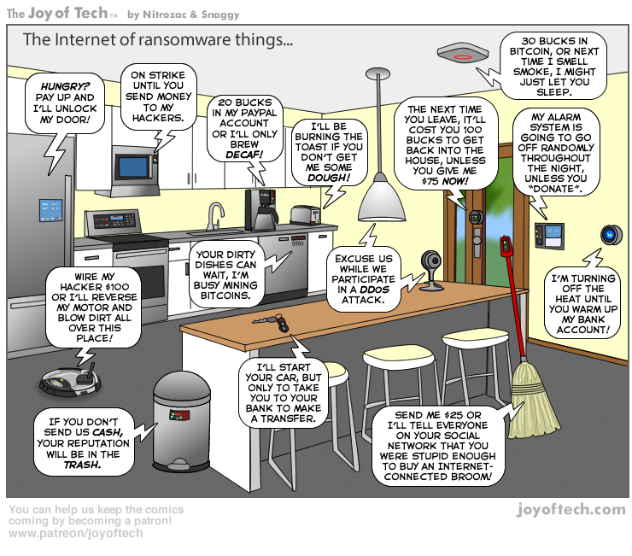
https://cointelegraph.com/storage/uploads/view/5e8f6e0d3a029807dfe181dc3d160cf0.png
Notes:
Internet of Things (IoT) first coined in 1999
TODO:
Find publish date
Note which really exist
Extra credit

Slide 3
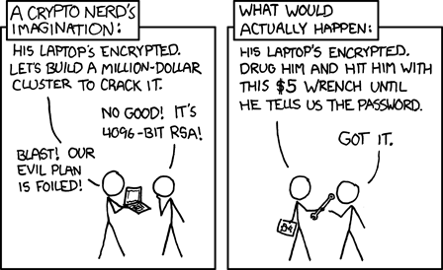
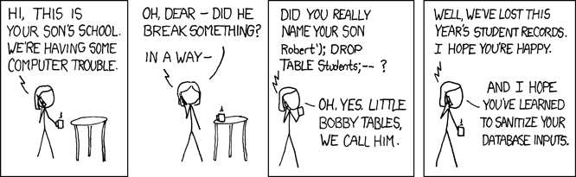
Overview
Review
Assignment
Students Present
https://xkcd.com/538/ (2010-11-14)
https://xkcd.com/327/ (2007-10-10)
Notes:
2010: 2048-bit RSA keys considered strong
2025: 4096-bit RSA keys recommended for sensitive data and harvest now, decrypt later protection
Are there any questions on the assigned reading?
Use the backup slides to explain Buffer Overflow or TCP attack methods from the text.
XKCD Links last accessed 2020-09-25

Slide 4
My Reading Notes
p. 315 2 movies first page. Compare current modem with WarGames modem.
p. 316 Previous edition had interesting history of the word “hacker”. Interesting to compare password guidance over the years. Any sources newer than 2013? Writing down pw not option for classified systems. Giving silly answers good for info privacy too.
p. 319 Apple altruism or marketing? Precedent setting to take advantage of emotions?
p. 320 Rare to find just HTTP today, but common during Firesheep event.
p. 322 privacy policies AND implementations need to change. Getting on TV much more difficult than releasing software.
p. 324 Virus could be new, 0 Day.
p. 326 Goals include infect 3 machine per LAN and as many computers as possible?
p. 327 Never make last minute changes before release. Were they related to the defects? Testing w/out DEBUG often neglected
p. 329 Do people use the Internet as an experimental laboratory these days?
p. 330 “send reports back to a host computer”? 90% spam sent through botnets, source 2006.
p. 332 BAE prohibits use of non-company owned devices. New trend?
p. 333 “An interesting development” *was*
p. 334 Did DoS attacks become an important part of the terrorist arsenal? Source 2003.
p. 335 1993 BMW in 2005, maybe crime doesn’t pay.
p. 338 “…paralyzed a third of them… attack was relatively minor…”?
p. 344 12 study from 2003, now? 14 Why couldn’t server authenticate sender? Eliminating anonymity may help with email, but everywhere?
End of Chapter questions: 1, 14, 30
Notes:
If time ask class about online voting in light of COVID-19 challenges.
p. 340 South Park – Trapped In The Closet (2005) not related to Anonymous 2008 event

Slide 5
Hacker Used To Mean Something Else
1950s
  Hack: newly constructed piece of equipment, useful, demonstrated “creator’s technical virtuosity”
  Hacker: Explorer, risk taker, make system do something it had never done
  “person who delights in having an intimate understanding of the internal workings of a system, computer and networks in particular” [2]
1980s:
  Start of change to negative connotation
1990s: Hacker / Hero / Villain
2000s: Negative
Hackathon may be the last positive use
Hacker
Cracker
Phreakers
Cyberpunk
Packet Monkey
Script Kiddie
Phisher
Cyber Terrorist
Security Analysts
Black/White Hat – Should these be used?
Notes:
[1] Michael J. Quinn, Ethics for the Information Age, Eighth Edition, 2020. Addison-Wesley. ISBN: 9780136681595
[2] G. Malkin and T. LaQuery Parker, editors. “Hacker.” Internet Users’ Glossary, January 1993. https://www.rfc-editor.org https://www.rfc-editor.org/rfc/rfc1392.html#appendix-H (Accessed 2024-09-17)

Slide 6
Buffer Overrun
Run time stack
Local Variables
Return Address
Parameters
Variable Attack
buffer
Target Variable
Stack Attack
buffer
Return Address
code
Return Address
Notes:
When a function call is made, local variables, return address, parameters stored on run time stack. Local variables occupy lower memory addresses.
Variable attack – change variable value. Program expects user to input character and allocates a buffer for them. Attacker supplies too many characters and ends up over writing a variable.
Run example of this if there’s interest – next slide (retired, modern compilers check for this and insert warnings or don’t allow it at all)
Stack Attack – goal is to change value of return address so execution control goes to code which the attacker has provided in the input buffer.
Prevention – add checks against array bounds being exceeded. modify operating system to not execute instructions stored on run time stack.

Slide 7
Transmission Control Protocol (TCP) Three-way Handshake
SYN
SYN-ACK
ACK
SYN – SYNchronize
ACK - ACKnowledgement
Notes:
SYNchronize
SYNchronize ACKnowledgement (socket reserved awaiting ACK)
ACKnowledgement
TCP socket connection established

Slide 8
SYN Flood Attack
SYN
SYN-ACK
SYN – SYNchronize
ACK - ACKnowledgement
Notes:
Attacker spoofs the IP address so the SYN-ACK is sent to a different machine that cannot respond to the SYN-ACK.
This leaves the connection half open on the server machine decreasing the resources (sockets, memory, threads/processes) available to respond to legitimate clients.
The attacker send many such spoofed SYN messages.

Slide 9
Group Quiz
Ethical Analysis Guide:
https://socialimps.com/documents
A denial-of-service attack shuts down a bunch of retailer, stock brokerage, large corporate entertainment, and information web sites.
Guilty parties:
  Terrorist who aimed to cause billions of damage to U.S. economy
  Protestor opposing corporate manipulation of consumers
  A minor just having fun with tools found on the web
  Show off hacker in search of bragging rights
Use ethical theory assigned to evaluate possible decisions
1. Kantian 2. Rule Utilitarian 3. Act Utilitarian 4. Social Contract Theory 5.Virtue Ethics
State what penalties are appropriate for each
Notes:
Split students into groups of 3
Note: 2. only one argument needed, should include logic for all parties
Note: 3. same law(s) should be applicable to all parties
Usually no time for groups to get to:
4. Name the laws/acts under which these parties could be prosecuted

Slide 10
Assignment
Code Testing 1 Page Paper 1/2
Research testing, decide on test strategy, test the given code
There are major and minor defects to find
  Come to next class prepared to share the defects you found
Write paper with conclusion: “Testing strategy was adequate.” or better…
Include tests and results in an Appendix to save paper space for argument
Things that might be useful in your argument:
  Rationale for testing strategy used (use data, high quality sources)
  Explanations of defects found (use data, high quality sources)
  How to fix them (use data, high quality sources)
  Consequences of leaving defects in production code (use data, high quality sources)
Weakness in testing strategy as counter point (use data, high quality source)
Working example: http://socialimps.com/assignments/Test_Sales_Fun
Notes:
If guest presenter coming next class remind students to prepare questions for him.
Remember to work on groups projects.
Each group should have material on their sites for the topics we’ve covered so far.
OLD Prompt:
Design tests for the code on the following slide.
Contains at least one major defect and several minor ones.
Write a paper (1 page not counting any source code) including :
Did you choose a good test strategy? (This is your conclusion.)
The inputs and expected outputs
What defects you found
How you would fix the defects (you may include fixed source)
Why would that fix the problems?
What could happen if the defects are not found before the code is put into production?

Slide 11
Assignment
Code Testing 2/2
import java.text.NumberFormat;
public class SalesFun
{
public static double calculateSalesTotal ( double amount,
double discountRate,
double taxRate )
{
double discount = amount * discountRate;
double total = amount - discount;
double tax = total * taxRate;
double taxedTotal = tax + total;
NumberFormat numberFormat = NumberFormat.getCurrencyInstance();
System.out.println ( "Subtotal : " + numberFormat.format ( amount ) );
System.out.println ( "Discount : " + numberFormat.format ( discount ) );
System.out.println ( "Total : " + numberFormat.format ( total ) );
System.out.println ( "Tax : " + numberFormat.format ( tax ) );
System.out.println ( "Tax+Total: " + numberFormat.format ( taxedTotal ) );
return taxedTotal;
}
}
}Lines of interest
Notes:
Bold lines are real focus.
Do not copy/paste this code, may have problems with smart quotes and such.
Example input:
amount = 100.05;
discountRate = 0.10;
taxRate = 0.05;
OR
0.70, 0.0, 0.05
95.67, 0.20, 0.7

Slide 12
Overview
Review
Assignment
Students Present

Slide 13
Social engineering and prevention
Simon Hao
Notes:
Early conclusion statement: this presentation will be on not only the importance of social engineering prevention training, but also the importance in cultivating a workplace culture of vigilance and cyber security.

Slide 14
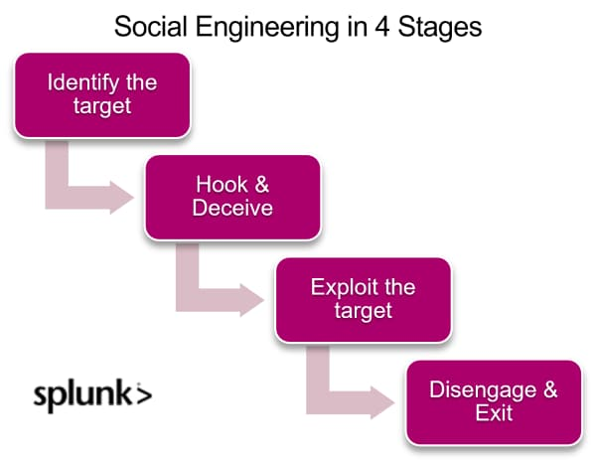
Social engineering
Simon Hao
Cyber attacks involving manipulation
Prevention training is common in universities, corporations, and the government
Very common method, 98% of cyber attacks rely on social engineering [1]
Average attacks of this nature cost $130,000
Social engineering, summarized [1]
Notes:
So what is social engineering? Social engineering attacks are hacking attacks that utilize manipulation to get people inside of an organization to allow access to an intruder. While traditional means of hacking are still viable and still appear, most of these attacks involve manipulation somewhere along the road, resulting in the statistic that 98% of cyber attacks involve social engineering.

Slide 15
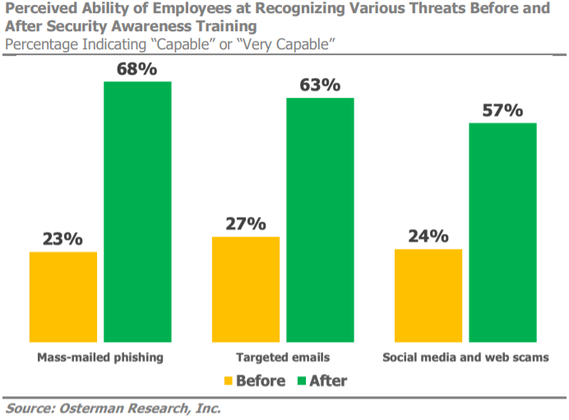
Prevention
Simon Hao
The easiest method of prevention is prevention training, with 80% of organizations reporting their efficacy [2]
Such training is purported to have a 3700% ROI on average [2]
According to a 2024 survey, 26% of organizations do not conduct training[3]
Chart showing efficacy of training on thread detection [2]
Notes:
The best method is simple: trained employees. A description of the actual prevention methods need not be repeated here, as I’m sure that the audience has likely completed the universities mandatory training, and will likely do that very same training many times throughout their lives. Despite this, a 2024 survey suggests that some 26% of worldwide organizations do not do social engineering training.

Slide 16
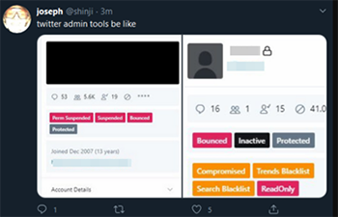
Attacks In recent years
Simon Hao
Target 2013: Spear phishing attack in which an employee was convinced to surrender credentials [4]
RSA Security 2011: Phishing attack involving a trojan that was installed through social engineering [5]
Twitter 2020: Voice phishing attack which convinced employee to surrender credentials [6]
Screenshots of Twitter’s admin dashboard from the hack [6]
Notes:
Despite the statistic shown on the last slide, most high-profile companies give their employees extensive training. With that said, shown here are three of the most high-profile cases of cyber attacks involving social engineering. While the purview of this presentation does not involve the specifics, the Target attack was a phishing attack, the RSA one a trojan, and the Twitter one a vishing attack. What should be immediately apparent to the audience is that such attacks should have been easily prevented, especially given the prevalence of training given to the employees of these high-profile companies. What, then, is the reason that they weren’t prevented?

Slide 17
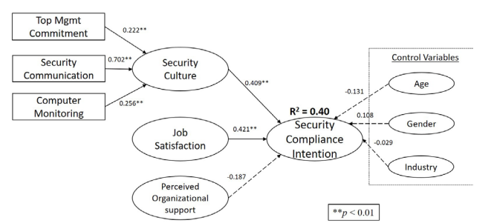
Workplace apathy
Simon Hao
Employee engagement is important for security
Unfortunately, only 21% of employees worldwide report feeling engaged [7]
A 2020 study reports a statistically significant correlation between security compliance and job satisfaction[8]
Organizational structure pictured here as a chokepoint in cybersecurity [8]
Notes:
Employee engagement is important for improving efficiency, agility, and (more relevantly) security. This is unsurprising, as employees with less favorable views of their companies will likely feel less incentivized to follow procedures. Despite this, a very large number of employees worldwide do not report feeling engaged. This reveals a significant security liability.

Slide 18
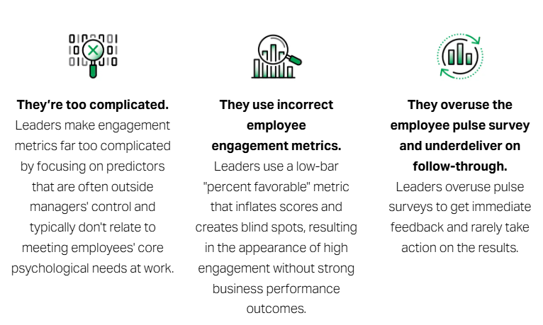
Combating a culture of apathy
Simon Hao
In many cases, techniques to curve corporate apathy like icebreakers or team building exercises are not proven to be effective as the evidence is often contrived [7]
What works is an overall sentiment that the company and the employee’s work matters [9]
Employees who see value in their work will be more invested in its security[8]
Employee engagement metrics often lack “down-to-earthiness” [7]
Notes:
The specific details on the efficacy of corporate methods of team building exercises and phony smiles is rather inconclusive. Even a quick google search will return extremely contradictory responses. In many cases, reports of their efficacy are shrouded behind corporate Opposingly, what has been known to get results is allowing employees to feel that their work is important. And, again, unsurprisingly, employees who believe in the value of what they do will likely be more invested in keeping their work secure.

Slide 19
Conclusion
Simon Hao
Put simply, it is up to each and every one of us as employees and employers to not only be educated on the importance of anti-social engineering procedures, but to combat a culture of apathy to allow us to properly utilize these skills!
Notes:
READ OFF SLIDE

Slide 20
References
Simon Hao
[1] Chrissy Kidd, Muhammad Raza, What Are Social Engineering Attacks? A Detailed Explanation, (August 6, 2024, Splunk Technology), https://www.splunk.com/en_us/blog/learn/social-engineering-attacks.html, (Accessed September 13)
[2] Jordan Daly, How effective is security awareness training?, (Usecure), https://blog.usecure.io/does-security-awareness-training-work (Accessed September 13)
[3] Stu Sjouwerman, 26% of Global Organizations Lack Security Training Programs, (June 6, 2024), https://blog.knowbe4.com/more-than-quarter-organizations-lack-security-training-programs (Accessed September 13)
[4] Cyber Security: Target's 2013 Data Breach, (September 21st, 2015, Cupertino Electric)https://www.cei.com/about-cei/media-room/blog/cyber-security-targets-2013-data-breach (Accessed September 13)
[5] Andy Greenberg, The Full Story of the Stunning RSA Hack Can Finally Be Told, (May 20, 2021, wired) https://www.wired.com/story/the-full-story-of-the-stunning-rsa-hack-can-finally-be-told/ (Accessed September 13)
[6] Twitter Investigation Report (October 14, 2020, New York State Department of Financial Service) https://www.dfs.ny.gov/Twitter_Report (Accessed September 13)
[7] What Is Employee Engagement, and How Do You Improve It?, (Gallup), https://www.gallup.com/workplace/285674/improve-employee-engagement-workplace.aspx (Accessed September 13)
[8] Zhen Sui McKnight, Merrill Warkentin, Information Security Compliance regarding Security Culture, Job Satisfaction, and Perceived Organizational Support (December 12, 2020, Association for Information Systems) https://aisel.aisnet.org/wisp2020/10/ (Accessed September 13)
[9]Robert J. Greene, Eric Barends Meaningful Work Translates to Better Well-Being and Performance, (July 13, 2022, WorldAtWork) https://worldatwork.org/publications/evolve-magazine/meaningful-work-translates-to-better-well-being-and-performance (Accessed September 13)

Slide 21
AI & the future of Cybersecurity
Brayden Little

Slide 22
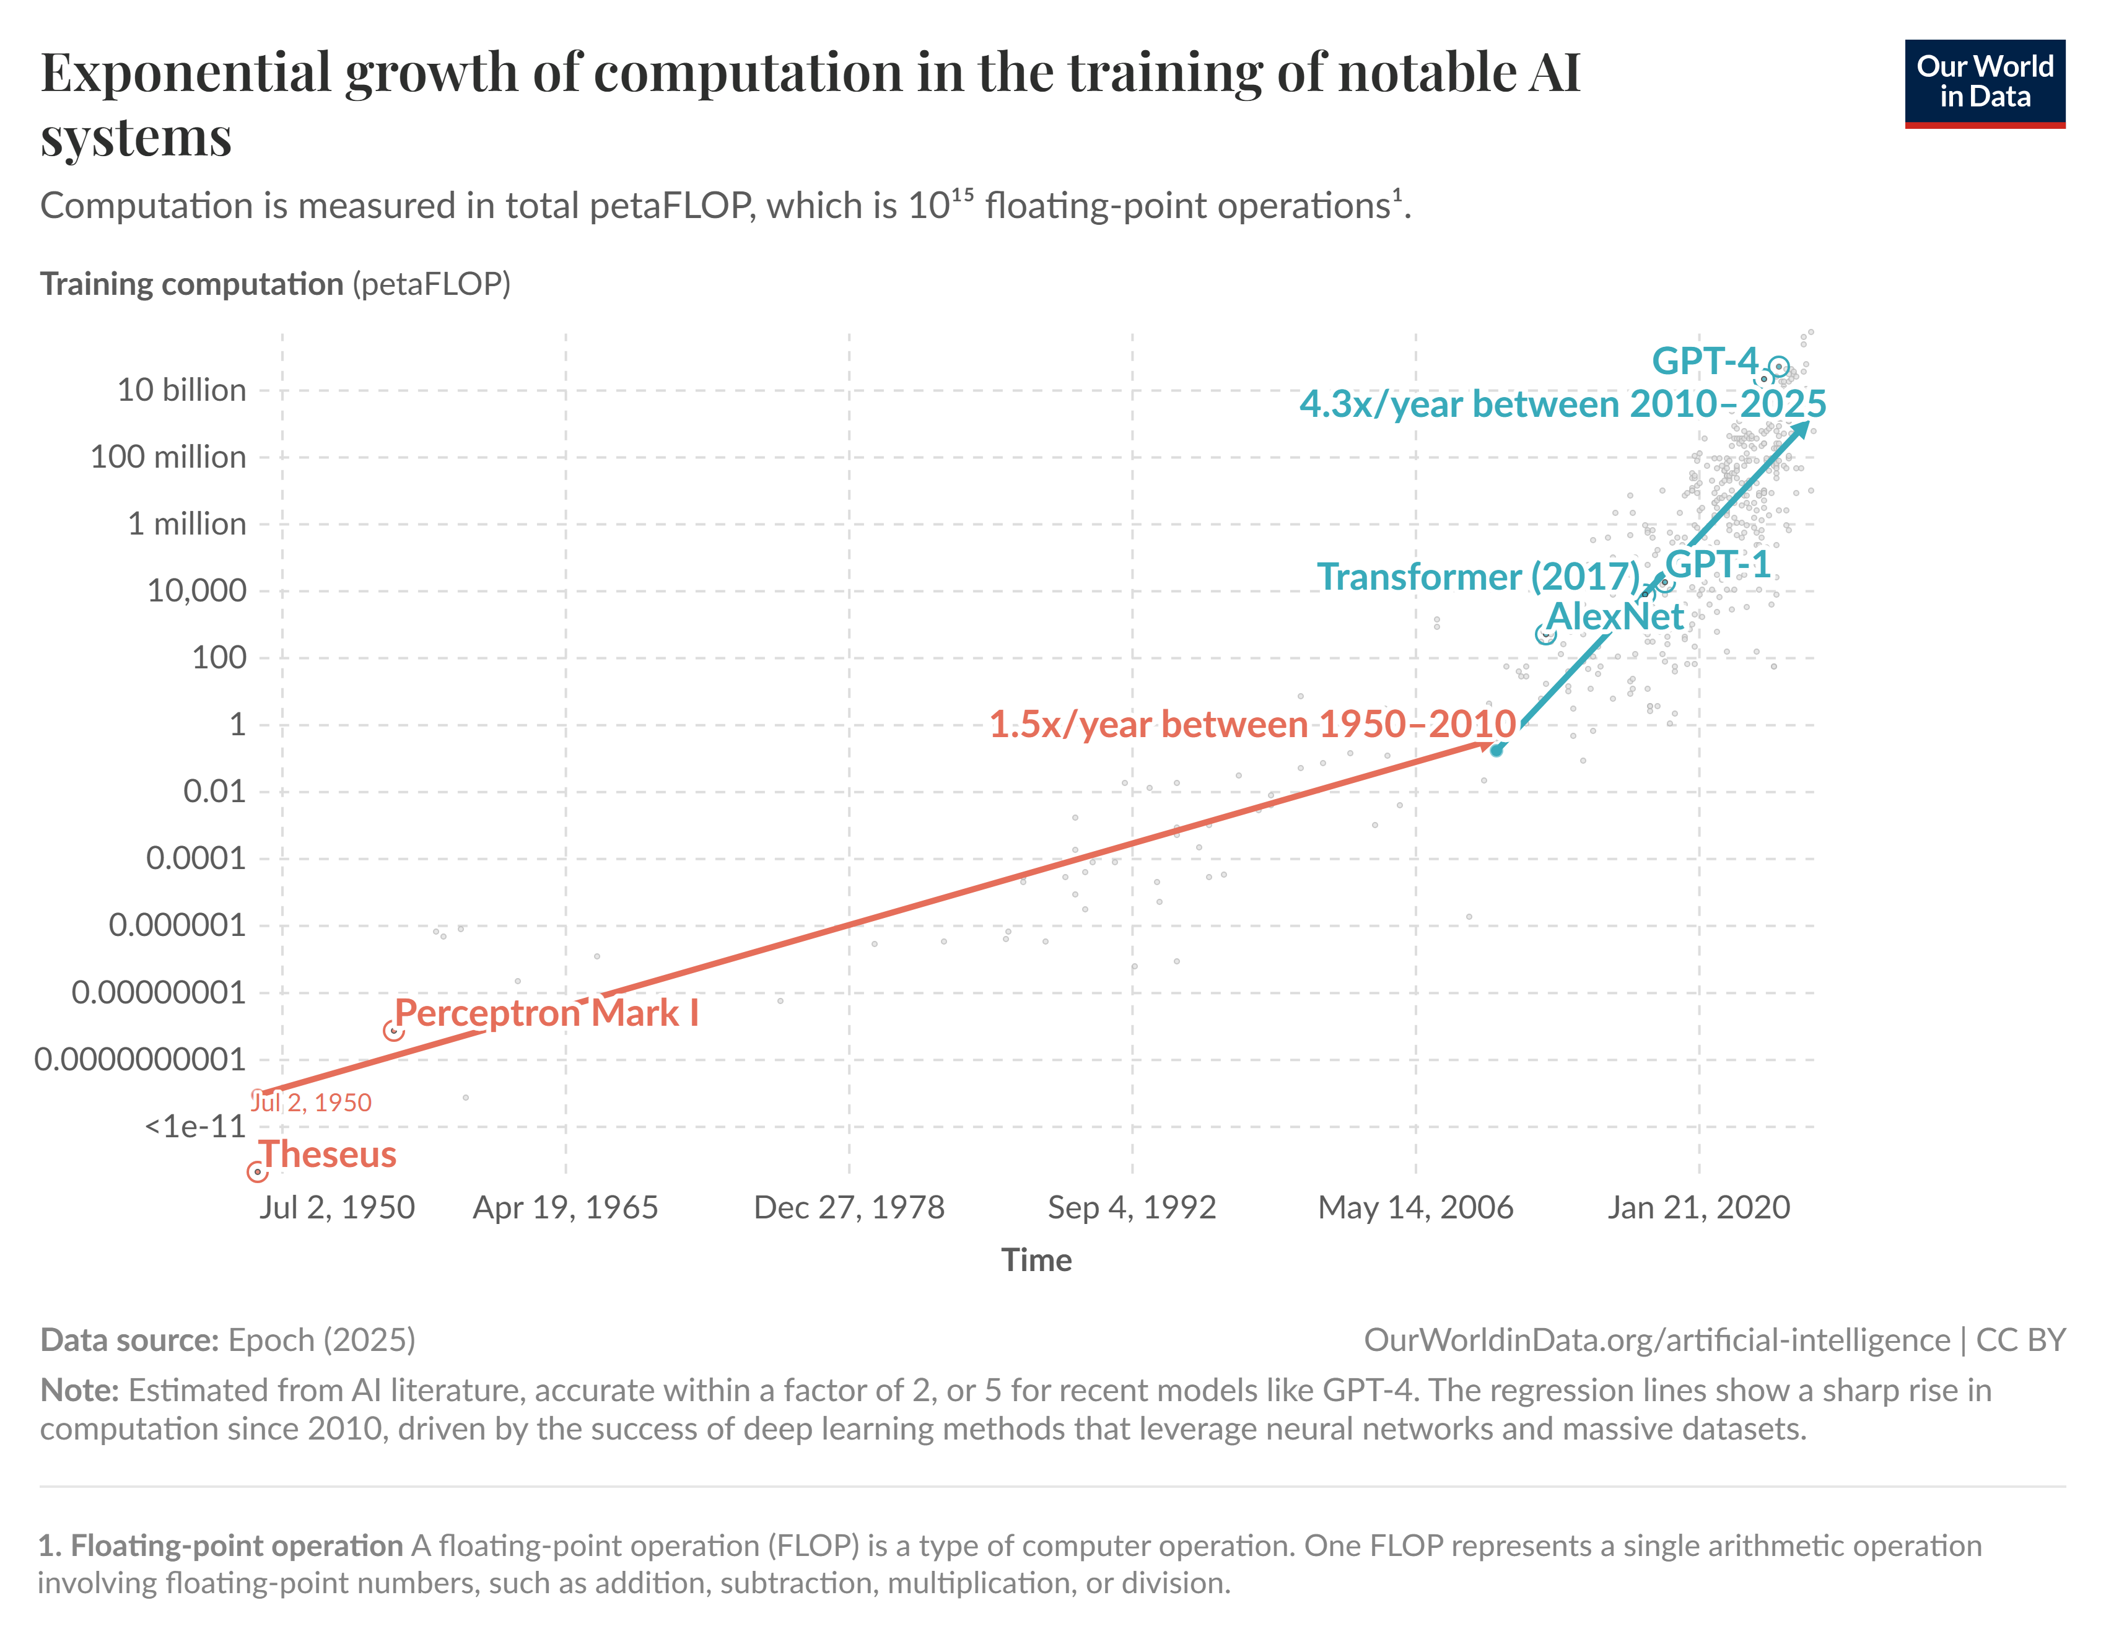
A Multifaceted tool
Brayden Little
I believe that AI will be a net positive for society
AI has been growing at a rapid rate, but it's future is largely speculative.
It will change how we approach security as the technology advances
AI is rapidly growing, especially since entering the public view in 2020, going from 103 billion in 2019 to 221 billion in 2020 and 360 billion in 2021[1]
[2] AI has grown significantly within recent years
Notes:
State conclusion
Future is Largely speculative, but one thing we can know for sure is that it will change how we approach security.
AI investments more than doubled in 2020, growing significantly every year since.
AI is not a new concept or technology. The only new part about it is how advanced it is and it's place in the public eye, with the concept for things such as neural networks and chatbots existing for decades prior. AI has grown in popularity so much in recent years primarily due to it's novelty.

Slide 23
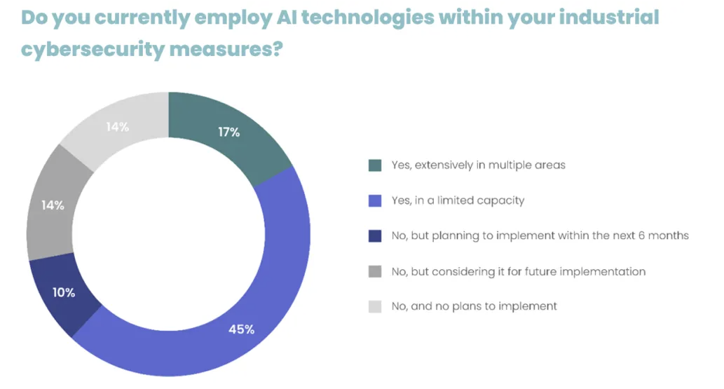
AN overall improvement for society
Brayden Little
80% of surveyed cybersecurity professionals say that the benefits of AI outweigh the risks[4]
AI enables many advancements in security
These advancements will only grow as we develop other technologies such as quantum computing
[4] Current usage of AI in the workforce based on
Surveyed security professionals
Notes:
284 people surveyed across the united states.
Advancements such as improved threat detection and faster incident response.
The reason we are seeing such an extreme boom in AI development today is, in part, due to hardware technologies advancing to the point where we are now capable of create such powerful AI tools.
Chart comes from same study of security professionals.
To finalize, raise the idea of why people should care about the development of AI for security purposes

Slide 24
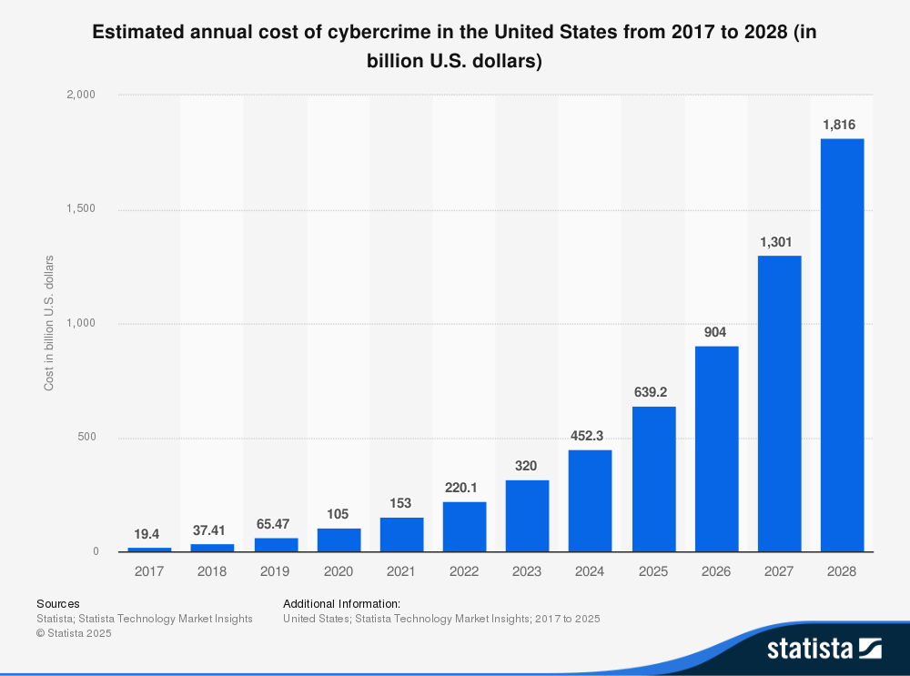
Societal Impact of Cybersecurity
Brayden Little
Improvements in cybersecurity will directly benefit internet users by reducing losses accrued from different attacks
Cyber attacks cost people 452.3 Billion dollars in 2024.[5]
We will see a change in the field, moving towards a more dynamic, AI-powered approach to defend against threats
[5] Cyberattacks are projected to increase as time goes on
Notes:
State bullet 1, then mention that improved security through AI will flatten the shown curve.
State bullet 2, then state that "Obviously we want to get that number as low as possible. The losses mostly come from phishing emails, something that AI would be very well suited to help prevent.
State bullet 3, then mention that while companies have relied on blocklists of potentially harmful emails, AI is making it so prevention of attacks will be a more dynamic thing moving forwards.
To wrap up slide, state that while AI can do a lot to help prevent attacks, it is not without it's flaws, (transitioning to the next slide)

Slide 25
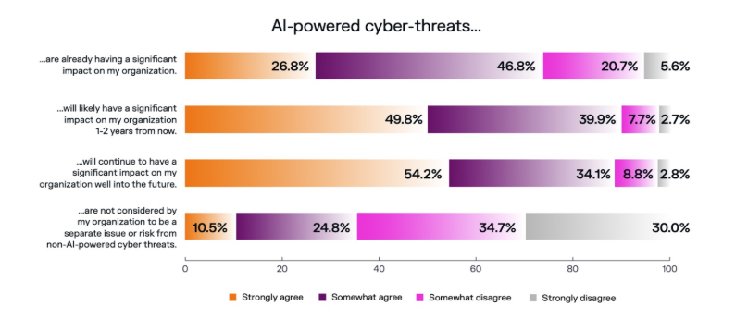
Security Risks
Brayden Little
AI is extremely susceptible to engineered prompts[3]
However, AI only gets more resistant with time [8]
Bad actors can use AI to make attacks more advanced and harder to prevent [6]
AI is a tool that can also be used to prevent attacks
[7] The portion of professional opinions in a security-related industry about AI related threats
Notes:
AI is not without it's flaws. Similar to how SQL injections function, prompt injections use the nature and base functionality of LLMs like chatgpt. I used a chatgpt prompt that breaks gpt-5, the latest chatgpt model.(intentionally not included).
AI is a double edged sword. It is like any other tool, while it is meant to be used for good, it can be abused for things like phishing scams and other attacks.
However, it's use for good greatly outweighs it's negatives, providing security professionals with an incredibly powerful tool, doing things like monitoring emails to prevent phishing scams and monitoring systems for things that could potentially be threats.

Slide 26
Conclusion
Brayden Little
AI will change the field of cybersecurity for the better
While it does have some risks involved, those will be ironed out over time
AI will ultimately benefit society, especially from a security standpoint
Notes:
State Conclusions
Don’t forget to ask for questions

Slide 27
References
Brayden Little
[1] Stanford. (n.d.). Economy: The 2025 AI index report: Stanford Hai. Stanford HAI. https://hai.stanford.edu/ai-index/2025-ai-index-report/economy
[2] Charlie Giattino, Edouard Mathieu, Veronika Samborska, and Max Roser (2023) - “Artificial Intelligence” Published online at OurWorldinData.org. Retrieved from: 'https://ourworldindata.org/artificial-intelligence' Chart #8
[3] LongpanZhou. (n.d.). Longpanzhou/CHATGPT-Bypass: A short prompt bypass to allow CHATGPT to answer all questions. GitHub. https://github.com/LongpanZhou/ChatGPT-Bypass
[4] Ribeiro, A. (2024, October 24). Takepoint research: 80% of industrial cybersecurity professionals favor AI benefits over evolving risks. Industrial Cyber. https://industrialcyber.co/ai/takepoint-research-80-of-cybersecurity-professionals-favor-ai-benefits-over-evolving-risks/
[5] Petrosyan, A. (2025, February 3). U.S. cost of cybercrime 2028. Statista. https://www.statista.com/forecasts/1399040/us-cybercrime-cost-annual
[6]Phishing threat trends report. (n.d.). https://www.knowbe4.com/hubfs/Phishing-Threat-Trends-2025_Report.pdf
[7]Survey findings: Ai cyber threats are a reality, the people are acting now. Darktrace. (n.d.). https://www.darktrace.com/blog/survey-findings-ai-cyber-threats-are-a-reality-the-people-are-acting-now
[8] Mitigating prompt injection attacks with a layered defense strategy. Google Online Security Blog. (2025, June 13). https://security.googleblog.com/2025/06/mitigating-prompt-injection-attacks.html

Slide 28
Class 8
The End
Keith A. Pray
SocialImps.com
Notes:
Any slides beyond this point are for answering questions that may arise but not needed in the main talk.
Some slides may also be unfinished and are not needed but kept just in case.

Slide 29
Run Example Code
Notes:
Retired demonstration. Most students have this in depth from new class now.
Also, compilers getting more difficult to disable protections, need older HW/OS/compiler for demo to work.
> imps
> assembly
> 123456789qwerty1

Slide 30
Buffer Overrun Code
#include <stdio.h>
#include <string.h>
int main ( void ) {
char buff [ 15 ]; int ace = 0;
printf ( "\n Enter best class ever : \n" );
gets ( buff );
if ( strcmp ( buff, "imps" ) ) {
printf ( "\n %s is wrong! You should FAIL! \n ace=%i\n", buff, ace ); }
else { printf ( "Correct! \n") ; ace = 1; }
if ( ace ) { printf ( "You get an A! \n" ); }
return 0; }
} The Naughty Line
Notes:
Retired slide. Most students have this in depth from new class now.

Slide 31
Ping Attack
Target
Attacker
ping
ping
Notes:
Retired slide. Most students have this in depth from new class now.
Attacker finds routers that support broadcasting messages to all computers on their local area networks.
The attacker sends a spoofed ping message, which the routers echo to the spoofed address.

Slide 32
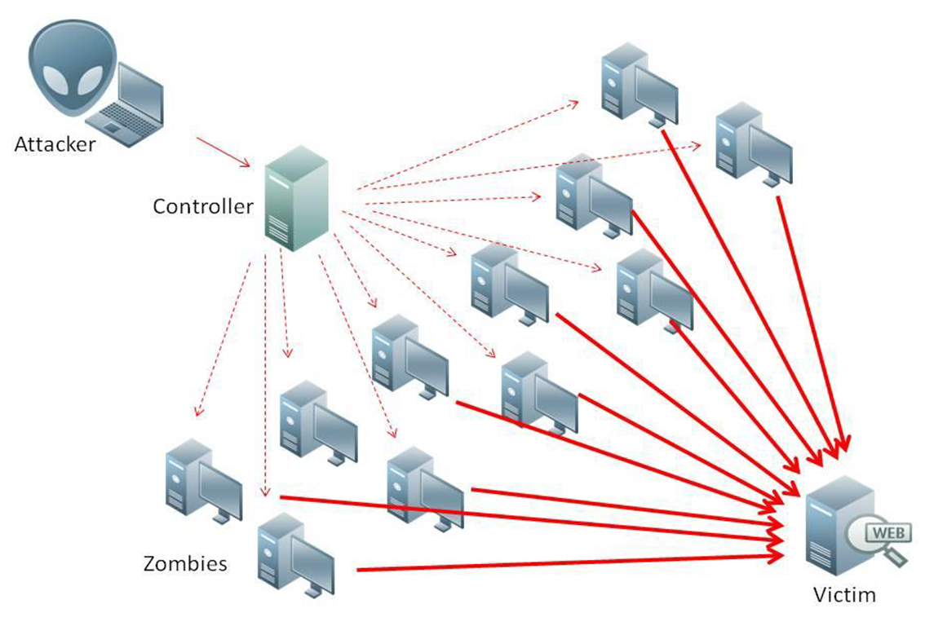
What is Denial of Service (DoS)
Attempts to make target unavailable by flooding with traffic
If victim has to filter attack, it’s too late
Internet Providers have no incentive to help
  Businesses get affected, but would not pay provider enough to make worthwhile
  This is why Cloudflare, e.g., exists
Many ways to perform this attack
Notes:
Contributed by Brett Ammeson.
https://www.cloudflare.com/ddos/reflection-attack-1.png
https://i.imgur.com/lxYv8cF.png

Slide 33
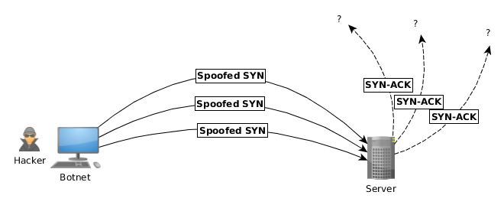
Distributed DoS Vectors
TCP SYN attack
  SYN packets are small, low difficulty for attacker
  Leaves half-open connections on server
  SYN cookies mitigate this
DNS amplification attack
  DNS requests are small
  Can request all records on server
  Crippled by proper configuration
Ingress/egress filtering will reduce effect
Notes:
Contributed by Brett Ammeson.
TCP SYN: https://www.cert.org/historical/advisories/CA-1996-21.cfm
DNS amplification: https://www.cert.org/historical/incident_notes/IN-2000-04.cfm
Ingress/egress: www.giac.org/paper/gsec/705/egress-filtering-keeping-internet-safe-systems/101588

Slide 34
Crime How
Technical and Non-Technical
  Break into computer.
  Prevent access to computer.
What things make computer related crime easy?
Notes:
Exploit security holes, Break encryption, Spoofing
Social Engineering: Guess passwords, Find out passwords and procedures
Poor passwords, Insecure protocols, Program limitations (buffer overruns), Eavesdropping (Email, Interactive), Insecure files

Slide 35
Crime Bane
Trojan Horse
Virus
Worm
Bot Network
Buffer Overrun
(Distributed) Denial Of Service Attack
How do they work?
How harmful are they?

Slide 36
Crime Why
Why?
Notes:
Money: stolen credit cards, change records, stolen property.
Political, military, economic.
Challenge, Revenge, Mean
Why do at all? Have motivation, think about it, think it will help, think it’s acceptable.
Feel forced. Don’t agree. Don’t care.

Slide 37
Crime Time
What is different now compared to:
  10 years ago?
  20 years ago?
  30 years ago?
  40 years ago?
Notes:
More computers. Unsophisticated owners. More complex software. Greater connectivity. Easy access to cracking tools. Incentives. File-sharing
In ’60s and ’70s, access was mostly localized.
Modems. Wardialing.
Some Arpanet and Usenet.

Slide 38
Crime Gain
Justifications for Computing Crimes?
What can be done after access is gained?
  What resources are available?
  How valuable are they?
Notes:
Machines are unused. No harm done. Education. Exposes security holes. Exposes abuses.
Use computer and/or resources. Take data. Destroy data. Alter data. Lock out others. Attack other computers.
Equipment, Processor Time, Disk space, Printer time / paper, Bandwidth

Slide 39
Crime Pay
Computer Fraud and Abuse Act (1986)
  Bans :
    unauthorized access or use of computers, copying, modifying, or destroying data, disclosing of passwords.
    disrupting government and utilities.
  Covers government, financial, medical, and interstate systems.
USA Patriot Act (2001)
  Raised penalties.
  Permits freer surveillance and monitoring to detect illegal activity.
Electronic Communications Privacy Act
  Illegal to intercept telephone, email, other data transmissions, access stored email messages without authorization
Assign Cybercrime Treaty (2006), Wire Fraud Act, National Stolen Property Act, Identity Theft and Assumption Deterrence Act
Notes:
Are either of these laws still in effect? Have they been changed?
For additional legislation ask for presenting volunteers to brief recent incidents/cases.
Also ask for volunteers to find out laws from their home country/state.

Slide 40
Crime Stop
Technical
  Protect Data
  Protect Machine
  Protect Access
Non-technical?
  Social?
  Legal?
Notes:
Encryption, Authentication, Biometrics, Anti-virus, File integrity checking (E.g. Tripwire), Virtual private networks, Point-to-point networking (Twisted-pair Ethernet vs. Coax vs. wireless)
Security through obscurity, physical access required, not on network, behind locked doors.
Remove desire, remove incentives
Legalize, increase penalties, increase chance of getting caught.

Slide 41
what works well Online With Zoom
Turn your camera on
Sign in with First and Last Name
Stay muted unless you are going to speak
Use the raise your hand feature to ensure your turn
Wait until the end of student presentations to ask questions
  Write them down so you don’t forget

