Slide 1
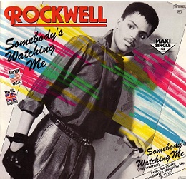
Class 7 Privacy and Government
Keith A. Pray
SocialImps.com
Notes:
After this class we will be half done with the course… very sad I know.
In person: sit with their group
Somebody’s Watching Me (1984) – Rockwell (3:36)
https://www.youtube.com/watch?v=7YvAYIJSSZY
Be the envy of all your classmates if you know the act and/or year:
Rockwell (1984) - Michael Jackson sings chorus and Jermaine Jackson on backing vocals.

Slide 2
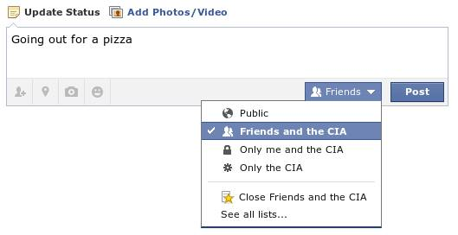
Overview
Review – sit with your group
Assignment
Students Present
Notes:
Review before debate in case anyone unsure of something in reading.
TODO: Image source?
https://www.privacyandsurveillance.org/?p=228. ?
Look at ACM TechNews if time

Slide 3
My Reading Notes
p. 269 Used to start with “A system that fails to respect its citizens’ right to privacy fails to respect the citizens themselves.” – Richard Nixon, 1974-02-23
p. 271 Genetic Information Nondiscrimination Act (2008): Gattaca (1997)
p. 273 Any NCIC success since 1995?
p. 274 Arrests, altering and deleting records are violations of privacy?
p. 275 Figure does not show # cameras increasing.
p. 276 300 times = frames, locations, …?
p. 277 Public drone opinion change since 2012? Any more states pass drone laws since 2013?
p. 281 “Carnivore…” what’s in a name?
p. 284 Stored Comms Act, any news since 2010?
p. 285 CALEA update since 2005?
p. 288 Google’s Eric Schmidt quote seems naïve
p. 293 Shouldn’t credit card issuers take “reasonable steps” to verify identity all the time?
p. 294 Target example, see Ch. 5 p. 248
p. 295 How many names on no fly lists now compared to 2014?
p. 297 Confusing false positive and negative explanations. 2001 source old for claims. See ‘What “Orwellian” Really Means’ video
p. 301 Other states using E-ZPass since 2007?
p. 303 Papa Smurfs…
Questions I liked: 1, 24
From previous edition interview at end of Chapter: “Since I have done nothing wrong, why should the government be investigating me?” – Jerry Berman
Notes:
Let’s debate!

Slide 4
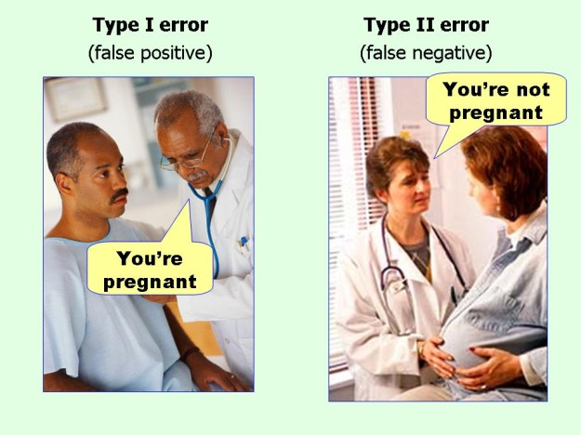
marginalrevolution.com/marginalrevolution/2014/05/type-i-and-type-ii-errors-simplified.html (2016-04-11)

Slide 5
Debate Ground Rules
National ban on facial recognition surveillance for law enforcement
Before Debate
10 minutes to converse with your team
Share argument points, counter points, and responses
Share experiences, especially in different countries, cultures, situations
Decide who will:
Go first
Respond to which points from opposing side
During Debate
1 turn per person until everyone on your team has spoken
Try to keep remarks to 30 seconds
Notes:
“National ban on facial recognition surveillance for law enforcement” Debate
If in class:
Stand up when speaking
30 second limit (elect a timekeeper)
If Remote:
Add “(YES)” or “(NO)” to the end of your name in Zoom to show your side
Previous:
Should law require you to use an official ID for Internet access
National ID or Not Debate

Slide 6
Group Quiz
Give a problem with using biometrics for identification.
Give an advantage of using biometrics for identification.
Describe a tool people can use to protect their privacy on the Web.
For each of the 4 categories of Daniel Solove’s privacy taxonomy give an example not listed in the book.
Notes:
Only if we have time.
Information Collection
Information Processing
Information Dissemination
Invasion

Slide 7
Overview
Review
Assignment
Students Present

Slide 8
Assignment – Group Project
Catch up on reading
Group Project
Finish analysis of computing technology portrayed to web site
Analyze Movie for all topics covered to date
Keep in course scope: Computing + Society
See group project slide deck for more
Frequent interaction with your group members is key to success!
-----
Canvas → Quizzes → Mid Term Survey on Canvas
Notes:
Movie group project: List of computing technologies portrayed in movie on website Categorize computing technologies as existing, future, emerging, impossible or plausible with rationale Analyze movie for all topics covered to date

Slide 9
Overview
Review
Assignment
Students Present

Slide 10
Against Identity Based Age Verification
Sweeney Han
Notes:
Name
I’m talking about how I am against identity-based age verification

Slide 11
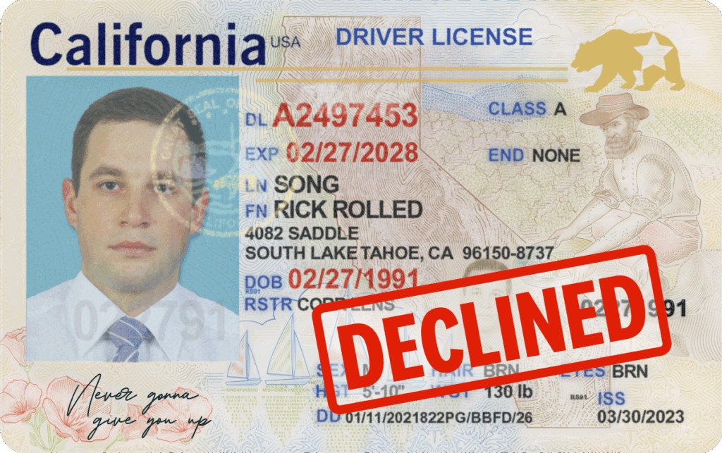
What is Identity Based Age Verification
Sweeney Han
Use real world credential to prove age verification(e.g ID card) [1]
UK online safety act
Different type [1]
Self-Attestation
Biometric age estimation
Behavior-based estimation
Example credential[8]
Notes:
1)It uses a real world credential to prove age, which for some would be taking a picture of said credential and sending it to said website or company
Example would be the UK online safety act
2)Self-Attestiation, where you say what age you are. It is easy to bypass, as it relies entirely on the honor of the person, without any double checking
3)Biometric Age estimation, the article says it could work, but it is inconsistent and “performs” poorly, as well as just general problems with facial recognition
4)Behavior-based: googles method, wouldn’t work because say you are looking at college applications, sure you can be 18, but you can also just get out of the military, or you could have just did a gap year, or even worked a job and came back to finish education.

Slide 12
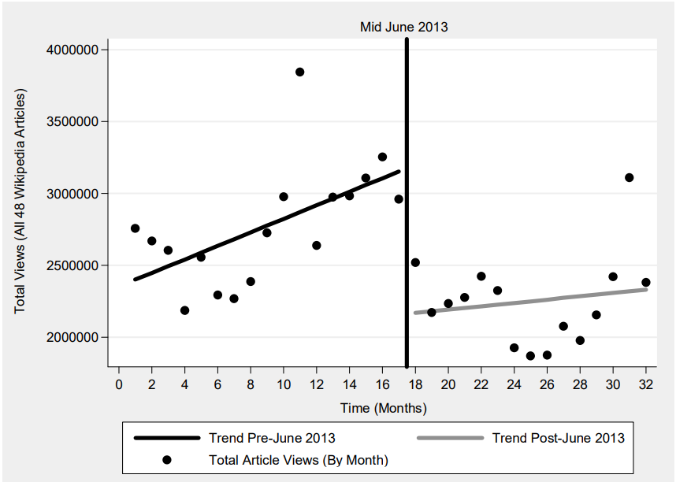
Self-Censorship and Chilling
Sweeney Han
Dataveillance leads to self censorship in everyday online speech & search [2]
A drop of 30% before and after the leak of potential government surveillance. [3]
Total views on Wikipedia after NSA leak drops, showing a potential example of the “chilling” effect Figure 2 [3]
Notes:
IBAV Ties real world identity to logs of what people see and do.
Surveillance becomes salient, leads to chilling effect
Chilling effect: Described as when data surveillance leads people to self censor themselves
2 possible reason for this as described by 2 Perspectives in the article
1)Fear of prosecution and sanction, people are afraid of potential consequences when viewing say suspicious sites, or even when there are leaks
2) Surveillance and information gathering
A drop of people in the graph, where the date is when the Edward Snowden leaked NSA surveillance, showed a 30% drop in website viewing, some of which could be identified as suspicious
There is a point to mention that this is extremely hard to say precisely, due to just lack of controllable variables
However, in the article, it goes to show multiple graphs, where the trend stays consistent or rises and falls in a understandable amount, and this is one of the few instances where there is a noticeable change.

Slide 13
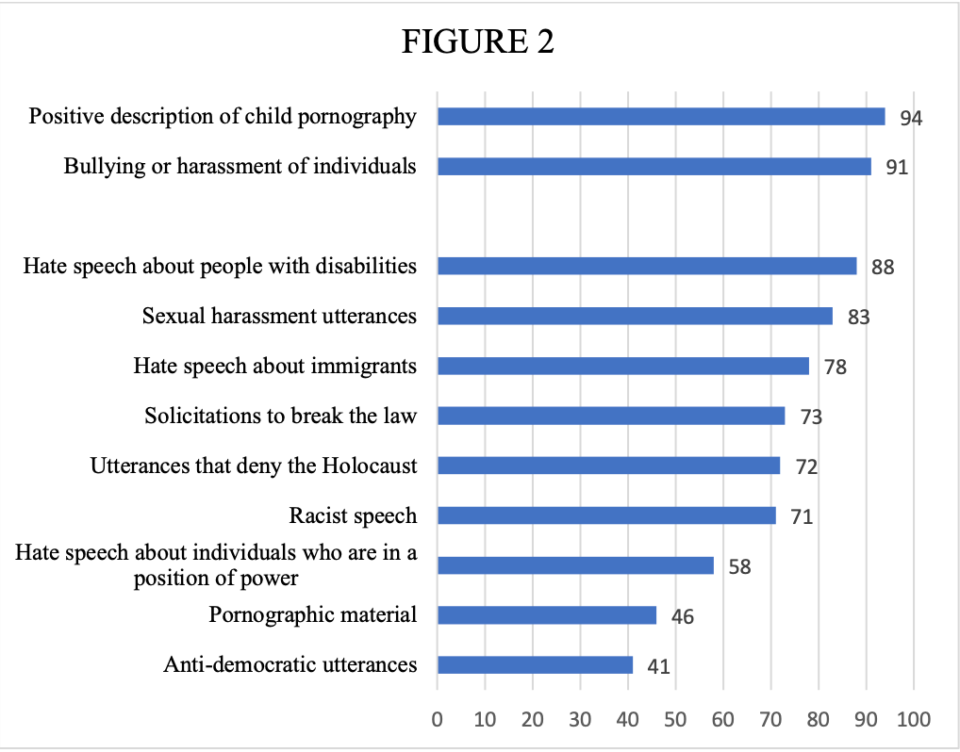
Sensitive is broad and Shiftable
Sweeney Han
In a national survey, 76% agree that protecting weak groups like children is more important than freedom of expression; Journalist are 50% [4]
“child protection” is a broad term, definitions about harmful or sensitive content will change over time. [4]
Support is highest for child-linked categories and much lower for those that aren’t as focused[4]
Notes:
There is a sensitive politics.
¾ 76% would curb free speech to “protect children” and even 50% journalist agree
At what point would “protect children be” less about graphic content and more on the internet as a whole
Child protection would be wielded as a crowbar, to be used to open the door to broader censorship once principle is accepted
The graph shows most support on children, and anything related to children, yet less support for more adult content
Support isn’t uniform, lacks values like trust in the media.
That means definitions can vary, change over time, usually expands, automated tools can over-remove lawful content as time change
Australia under 16 social media check, may standardize to the strictest of interpretations

Slide 14
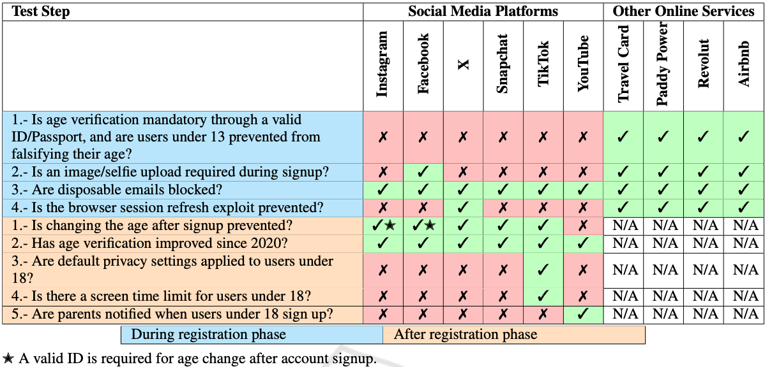
Not Effective enough in practice
Sweeney Han
Identity 38,253 accounts for sale across 11 marketplaces covering 211 categories over Feb-Jun 2024[6]
Total advertised value > $64 million; Median price $157 per account[6]
Social Media Platforms implemented fewer enforceable age-verification controls and more bypasses than other online services Table 3[5]
Notes:
A 2025 evaluation found there were Multiple low-cost paths to bypass age checks
Throwaway emails/phone numbers, DOB change loops, resetting device
All executed by the author with little to no trouble
In the table, in comparison to other online services, social media platforms, even after implementing many age verification methods, can be easily bypassed or are nonexistent.
A 2024 study maps the economy of old accounts
You can buy or rent an identity that looks adult and verified.
Identified 38253 accounts, Had a total advertised Value greater than 64 million, median price 157 per account
That is not considering the most basic of ways to get around it, VPN
Even if IBAV is perfect and stops it, markets will adapt, and kids will route around it.

Slide 15
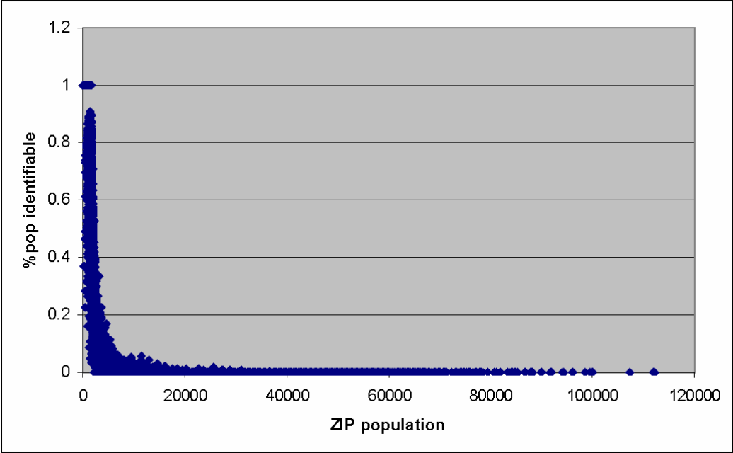
IBAV over-collects and is easily re-identifiable
Sweeney Han
IBAV ties real identity to access logs to answer an age question[1]
Even in national scale, risk stays high due to possibility of a data leak[1]
Everyone in small ZIP is easily identifiable with a small amount of attributes(ZIP code, gender, date of birth)[7]
The smaller the zip population, the easier it is to identity each unique individual Figure 22 [7]
Notes:
Ties real identity such as your ID, your driver ID, your birthday, Name as well as address to something that strictly ask for your age, overcollection
If hacked, that information is free for whoever took it
For children, this would be worse, as in the case of facial identification, that information would be stored
With 3 common attributes, DOB, zip code, gender, most people are uniquely identifiable
It creates logs that are easily re-identifiable, turning age checks into long-term breaches and subpoena risk
those logs can be relinked to real identities

Slide 16
Conclusion
Sweeney Han
Identity Based Age Verification limits free speech and individualism
Identity Based Age Verification can expand and be used to push more extreme ideals
Studies have shown that it is not effective enough in practice
Identity Based Age Verification has an issue of Overcollection with lasting risk
Notes:
So just to summarize again my reason for being against Identity based Age verification.
It limits free speech and individualism, can be expanded and be used to push extreme ideals, not effective enough in practice, overcollection and lasting risk

Slide 17
References
Sweeney Han
[1]Bellovin, S. M. (2025, October). Privacy-preserving age verification—and its limitations (Position paper, IAB/W3C Workshop on Age-Based Restrictions on Content Access). https://www.cs.columbia.edu/~smb/papers/age-verify.pdf
[2]Büchi, M., Festic, N., & Latzer, M. (2022). The chilling effects of digital dataveillance: A theoretical model and an empirical research agenda. Big Data & Society, 9(1). https://doi.org/10.1177/20539517211065368
[3]Penney, J. W. (2016). Chilling effects: Online surveillance and Wikipedia use. Berkeley Technology Law Journal, 31(1), 117–182. https://doi.org/10.15779/Z38SS13
[4]Staksrud, E., Ólafsson, K., & Milosevic, T. (2020). Children as crowbar? Justifying censorship on the grounds of child protection. Nordic Journal of Human Rights, 38(2), 159–173. https://doi.org/10.1080/18918131.2020.1777770
[5]Eltaher, F., Gajula, R. K., Miralles-Pechuán, L., Thorpe, C., & McKeever, S. (2025). The digital loophole: Evaluating the effectiveness of child age verification methods on social media. In Proceedings of the 11th International Conference on Information Systems Security and Privacy (ICISSP 2025) (Vol. 2, pp. 213–222). SCITEPress. https://doi.org/10.5220/0013248300003899
[6]Beluri, M., Acharya, B., Khodayari, S., Stivala, G., Pellegrino, G., & Holz, T. (2024). Exploration of the dynamics of buy and sale of social media accounts (arXiv:2412.14985). arXiv. https://arxiv.org/abs/2412.14985
[7]Sweeney, L. (2000). Simple demographics often identify people uniquely (Data Privacy Working Paper No. 3). Carnegie Mellon University. https://dataprivacylab.org/projects/identifiability/paper1.pdf
[8] Bondar, I. (2025, March 12). How to spot a fake ID by state across different states. Veriff. https://www.veriff.com/identity-verification/news/how-to-spot-a-fake-id-by-state

Slide 18
Class 7 The End
Keith A. Pray
SocialImps.com
Notes:
Look at ACM TechNews if time
This is the end. Any slides beyond this point are for answering questions that may arise but not needed in the main talk. Some slides may also be unfinished and are not needed but kept just in case.

Slide 19
Logistics
Turn presentations and papers in on Canvas, drafts too
You can submit multiple times to the same assignment
Review Presentation and Paper Guidelines on course site
Sign up for Individual Presentation, it’s not too late
Notes:
Not needed this time:
Address email to entire course staff for quickest response time
Do not change the format, footers, etc. in the template slides.
Paper writing process: Sources → Notes → Conclusion → Argument → Counter Point → Response
Turn extra credit paper in on myWPI/Canvas and hard copy in class like regular papers
Use Presentation Guidelines on course web site
Use paper and presentation templates
Keep topics inside the course scope: Computing + Society
Presentations are due 24 hours before class
Sign up for Individual Presentation, it’s not too late
Providing comments on drafts is a limit, first come first served
We would like to help everyone asking but sometimes we run out of time
Try asking a peer to give notes on your work

Slide 20
what works well Online With Zoom
Turn your camera on
Sign in with First and Last Name
Stay muted unless you are going to speak
To speak use the raise your hand feature

