Slide 1
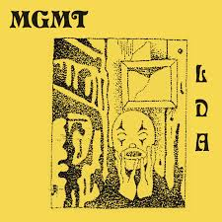
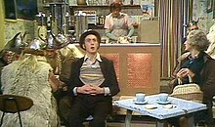
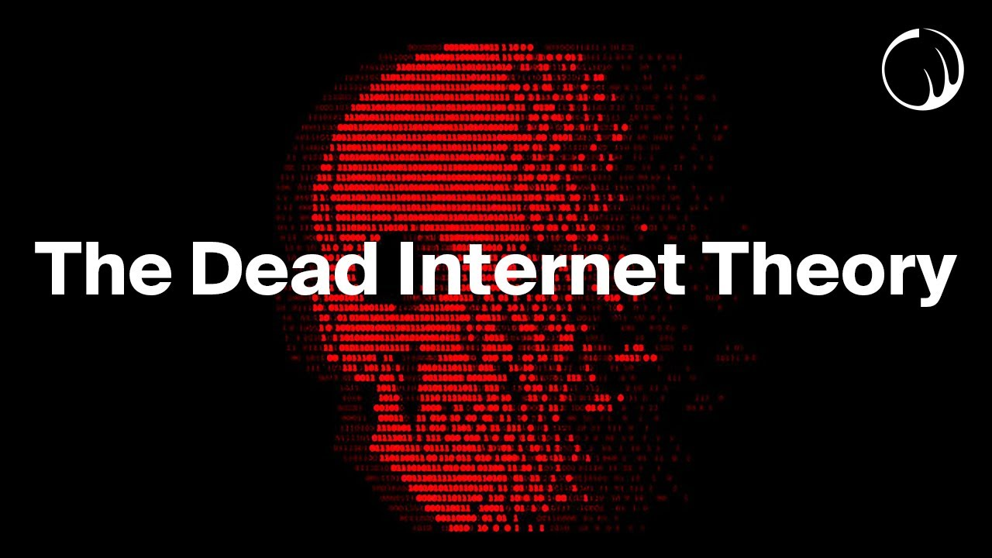
Class 4 Communication
Keith A. Pray
SocialImps.com
Notes:
Monty Python – Spam (3:19) (1970)
https://www.youtube.com/watch?v=anwy2MPT5RE
Pursuit of Wonder - The Internet Will End Soon… (17:53)(2024)
https://www.youtube.com/watch?v=y0N9fD3rFaw
TSLAMP – MGMT (4:30) (2018)
https://www.youtube.com/watch?v=T8EL51jlrJA
TODO: get lyrics: https://genius.com/Mgmt-tslamp-lyrics
Above last access 2025-03-28
If forgot to show the ethical analysis guide, do so now.
Possible song:
TODO: Find clean version to use
Welcome to the Internet - Bo Burnham (from "Inside" -- ALBUM OUT NOW) (4:40)
Very Explicit Lyrics
https://www.youtube.com/watch?v=k1BneeJTDcU

Slide 2
Overview
Review
Assignment
Students Present
Notes:
Show syllabus updates if any

Slide 3
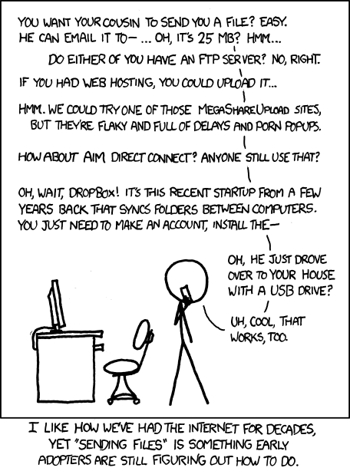
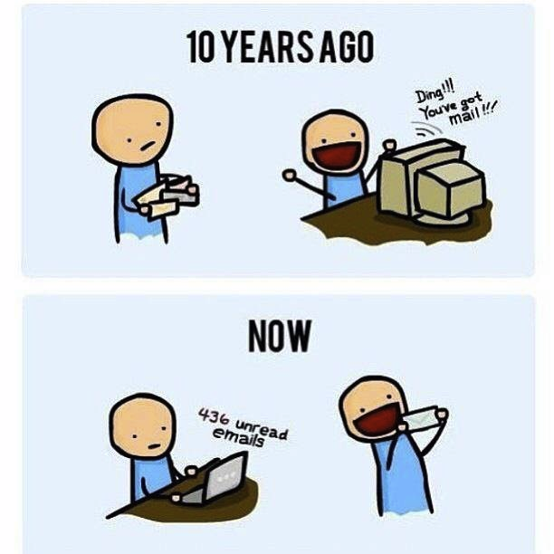
http://poofytoo.com/
30
http://xkcd.com/949/
Notes:
What is more exciting now for you, email or snail mail?
http://xkcd.com/949/
2011

Slide 4
My Reading Notes
p. 124 Search engines link deeper than home page
p. 125 Any US agencies employing this many people?
p. 128 Adult bookstores lowering property values source?
p. 132 “texted… images”
p. 133 Stating people searching did not consent to material being blocked makes more sense.
p. 134 Example with decision could be more helpful. Sexting examples all from 2009?
p. 136 “Identify fraud”. College students still as likely, 2013 source?
p. 137 Do mobile plans still charge extra for text messages? “Kit Messenger” → “Kik Messenger”
p. 139 punished vs. stopped?
p. 141 Cyberbullying since 2009?
p. 143 Hunter Moore convictions seem unrelated to “Anyone Up?” site.
p. 144 Have South Korean gaming related deaths declined since 2011?
p. 150 Q 30 See: https://en.wikipedia.org/wiki/Wikipedia:Citing_Wikipedia
p. 152 Q 49 How likely is a business to not set up a web site? Q 51 “attachments” → plugins?
Questions I liked: 17, 18, 24, 26, 30, 34, 36, 44, 51, 53
p. 105 Example cell phone use nice addition
p. 106 First e-games 1972 at Stanford [1]. How does 5 mil. Viewers compare to traditional sport viewer counts?
p. 108 Spam downward trend still? 2012 source. ½ 350 billion (p. 25)? 2011-2023 80% → 45% [2] so perhaps.
p. 109 Are rules against email personal use most common now? Anh did not force people to complain.
p. 112 15% # transactions or $$?
p. 113 Wikipedia critics source from 2005, is quality still in question?
p. 114 IoT interaction security nightmare?
p. 116 ”…no way Bitcoin will ever replace credit cards for everyday transactions.” absolutes difficult to prove.
p. 117 M-PESA redundant with p. 105 Are scratch codes for meds still used, 2012 source? Twitter → X
p. 118 Twitter only marketing tool source 2009, still?
p. 121 “may have” = weak conclusion. Who funded studies?
p. 122 Easier consolidation of newspapers. Advertisers switching away from newspaper source from 2014.
Notes:
[1] Owen Good (19 October 2012). "Today is the 40th Anniversary of the World's First Known Video Gaming Tournament". Kotaku. Retrieved 1 August 2013
[2] Ani Petrosyan (Sep 17, 2024). “Spam share of global email traffic 2011-2023”. https://www.statista.com/statistics/420400/spam-email-traffic-share-annual/ Retrieved 2024-09-28

Slide 5
Group Quiz
Name methods some governments use to control access to information. There are at least 5.
A large company has a policy prohibiting employees from blogging about company products.
Does it violate the First Amendment? Why?
Name two possible reasons for the policy.
Is it reasonable? Why?
What does “URL” stand for and what is it?
Notes:
Censorship (religious, governmental, private). Adult authentication. Firewalls. Government owned media outlets (TV and radio stations, newspapers), private photocopier ownership illegal
First Amendment prohibits Congress from making laws limiting free speech, not private companies.
Uniform Resource Locator

Slide 6
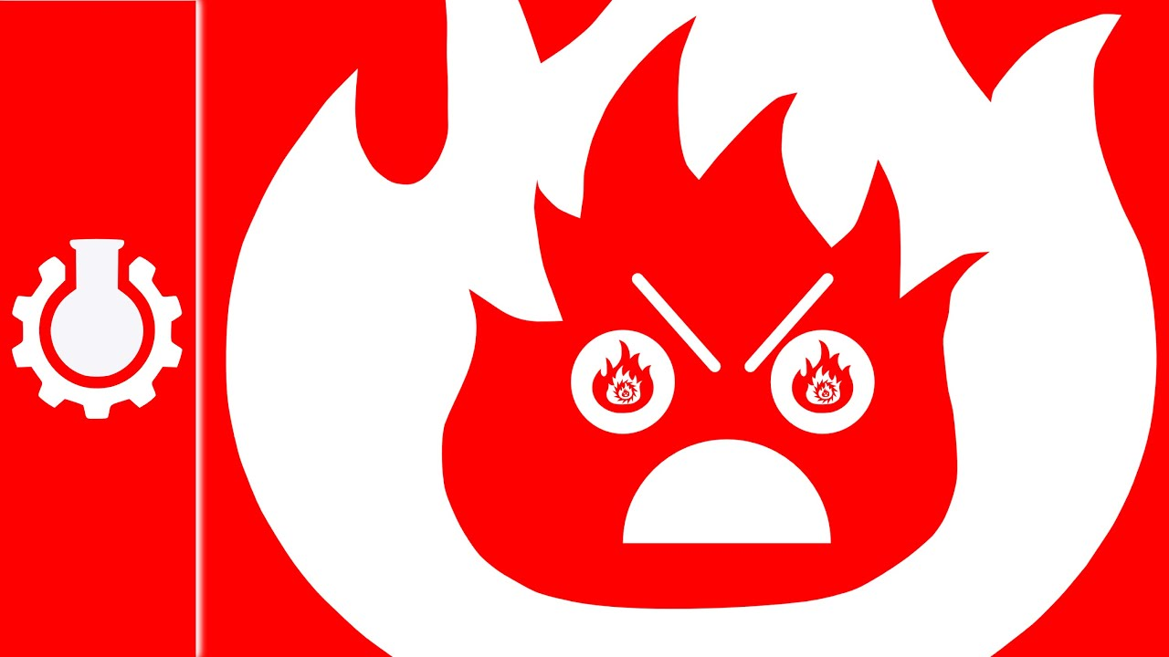
Overview
Review
Assignment
Students Present
Notes:
But before that:
CPG Grey - This Video Will Make You Angry [Thought Germs] (7:25) – 2015-03-10
https://www.youtube.com/watch?v=rE3j_RHkqJc
Last access: 2025-03-28

Slide 7
Assignment
Reading
Individual Presentations
Extra Credit – One page paper
Is WPI’s IT Acceptable Use Policy morally acceptable?
Work on your group project
1.3 Average Individual Happiness!
1-3 scale with 1 = everyone getting their first pick
See full group project description on course website
Send Web Site URL – We start looking at them next class
Notes:
- Or review group project and individual presentation guidelines right now.
Possible One page paper:
Global intellectual property laws, friends or foes?

Slide 8
Overview
Review
Assignment
Students Present
Notes:
Aim to start by 5:20

Slide 9
Banning social media for minors
Hunter Jack

Slide 10
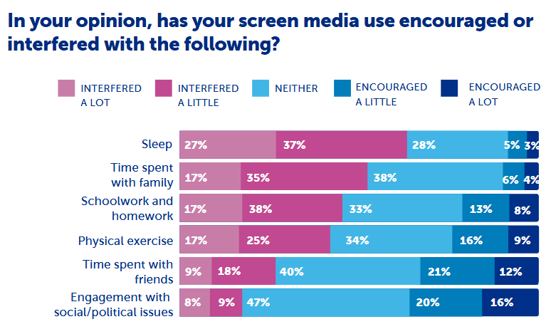
Social media is addictive
Hunter Jack
Addictive
Adolescents use social media for an average of 3.5 hours per day (5)
Social media addiction causes changes in brain structure comparable to gambling or drug addiction (7)
53% feel at least somewhat addicted (6)
Causes sleep deprivation
60% said it interfered with sleep (6)
A third of teens use screens until midnight or later (5)
A majority of teens surveyed said that social media interfered with sleep and family (6)
Notes:
About 95% of kids aged 13-17 use social media. About 40% of kids aged 8-12 use social media (3).
A 2021 survey on 8th and 10th graders found that adolescents use social media for an average of 3.5 hours per day (5).
Moreover, the same survey found that a fourth of teens use it for 5+ hours per day, and a seventh use if for 7+ hours per day (5).
A 2017 study found social media addiction causes changes in brain structure comparable to gambling or drug addiction (7).
A 2022 survey on adolescents aged 13-17 found that 53% of people said they felt at least somewhat addicted to social media, with 29% saying they felt slightly addicted.
In that same survey, 60% said it interfered with sleep, 52% said it interfered with family, and 45% said it interfered with school
A third of teens use screens until midnight or later (5).

Slide 11
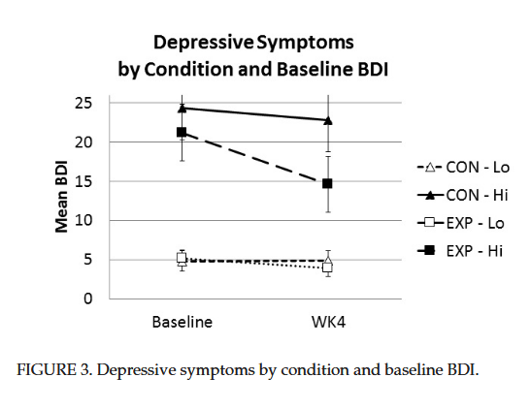
Social media increases risk of mental health problems
Hunter Jack
Anxiety and Depression
Teens who spend more than 3 hours a day on social media have twice the risk of developing depression or anxiety (3)
Reducing social media usage leads to significant improvements (5)
Cyberbullying
Anonymity makes cyberbullying easier than ever (2)
A review of 36 studies found that cyberbullying is linked to depression (5)
College students with high baseline depression benefit heavily from reducing social media use (12)
Notes:
Study on 143 college students showed that limiting social media usage to 30 minutes a day for 3 weeks led to significant improvements in self reported anxiety and depression (12)
Effects on reducing social media usage are especially strong for those with higher baseline depression (12)
Some may argue that anxiety and depression cause higher social media usage rather than the other way around, but this study shows that if someone reduces their social media usage, their mental health improves, which implies that social media usage causes anxiety and depression.
Social media also empowers cyberbullying, and a review of 36 studies found that experiencing cyberbullying was linked to depression (5)

Slide 12
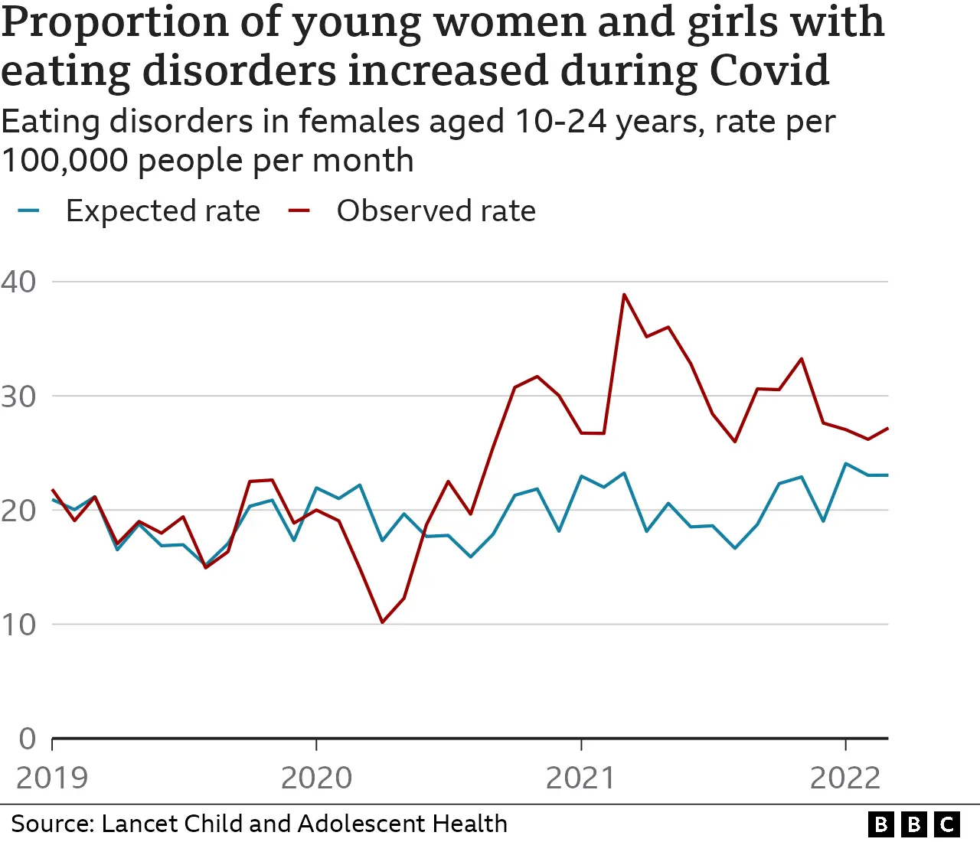
Social media INCREASES RISK OF EATING DISORDERS
Hunter Jack
Body image and eating disorders
46% of teens reported feeling worse about their bodies due to social media (5)
A synthesis of 20 studies found social media usage was linked to eating disorders (5)
Eating disorders rose during the pandemic (11)
Notes:
A 2022 survey of adolescents aged 13-17 found that 46% said social media made them feel worse about their bodies (5). 40% said it made no difference, and only 14% said it made them feel better.
A synthesis of 20 studies linked social media usage to eating disorders (5).
Eating disorders rose during the pandemic, a time when people were stuck at home and using social media more (11).

Slide 13
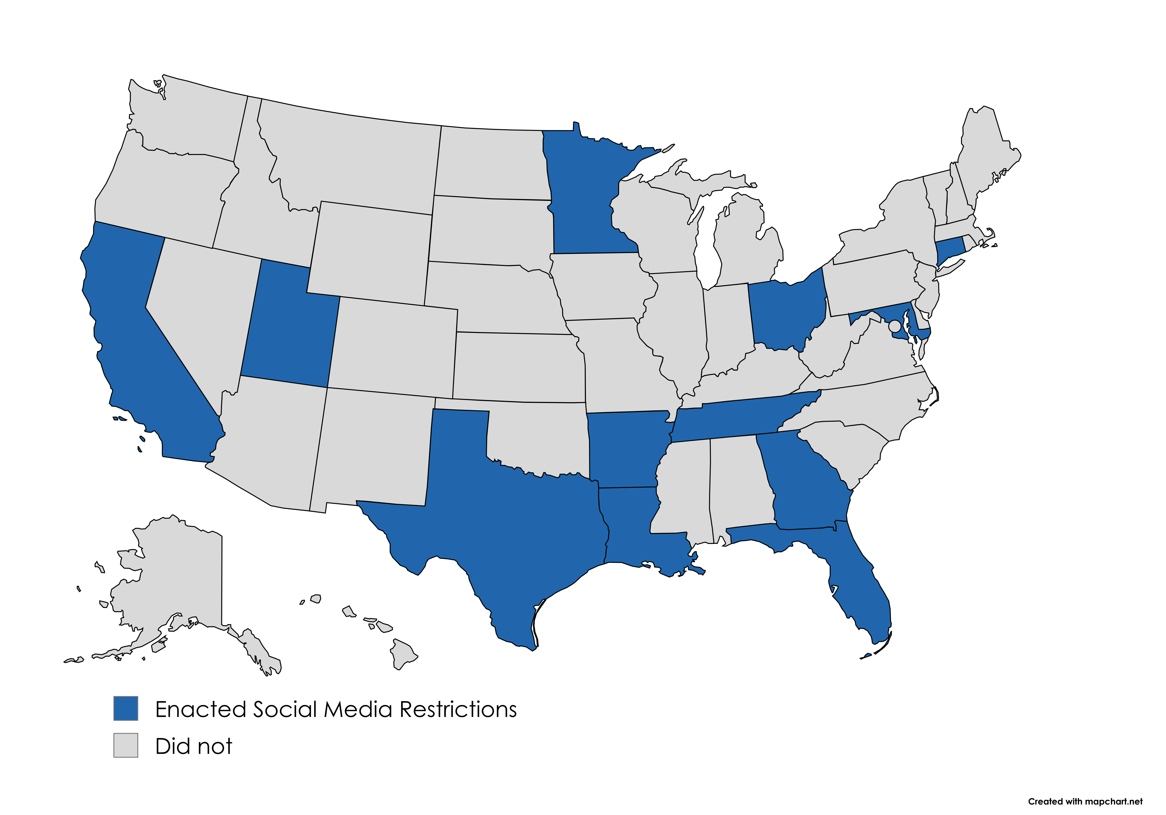
GOVERNMENTS have experimented with bans
Hunter Jack
In 2024, Australia banned kids under 16 from having accounts (8)
Some websites are exempt
Kids Off Social Media Act introduced in US congress (4)
Prohibits kids under 13 from having accounts
Bans algorithmic recommendations for kids under 17
Some states have implemented restrictions (1)
Many restrictions have faced legal challenges
12 states have implemented social media restrictions for minors as of April 2025 (9, author generated image)
Notes:
The Australia law applies to websites like YouTube, FaceBook, SnapChat, Instagram, and Twitter (8).
Websites may be exempt depending on their primary purpose. For instance, websites with the primary purpose of messaging, video calls, online gaming, and education are exempt (8).
Many bans implemented so far do not require ID verification and instead allow websites to use other means to verify age (8).
KOSMA prohibits kids under 13 from having accounts and bans algorithmic recommendations for kids under 17, meaning they would have to actively search for the content they want to see (4)
Many state bans have faced legal challenges, partially due to potential first amendment violations (1)
12 states have implemented restrictions so far (though some have been blocked) (9)
27 states have at least advanced bills with restrictions (1)

Slide 14
SOME HAVE RAISED VALID CONCERNS ABOUT bans
Hunter Jack
ID Verification
Australian law and proposed US law do not require it (4, 8)
Requiring ID verification is a privacy concern
Without ID verification, it would be easier to find workarounds
Free Speech Concerns
Positive Effects
Most adolescents report social media helps them stay connected to their friends (5)
Notes:
In order to restrict social media usage for minors, age verification is required. The Australian law and KOSMA do not require ID verification, creating potential for workarounds (4, 8)
The Australian Law says companies are required to take reasonable steps to prevent workarounds to social media restrictions (8)
If companies don’t use ID verification, they may estimate age based on activity (similar to YouTube) which would likely be controversial
VPNs may be used as a workaround, but websites are able to block VPN traffic

Slide 15
OVERALL, SOCIAL MEDIA RESTRICTIONS ARE JUSTIFIED
Hunter Jack
There may be some positive effects, but social media usage clearly does more harm than good
Concerns surrounding age verification and potential workarounds are valid, but companies can fight against workarounds
As some governments enact laws restricting social media and others do not, eventually it will be possible to compare the outcomes to see if restrictions are successful

Slide 16
References
Hunter Jack
[1] Edelman, Adam, “Texas moves forward with expansive social media ban for minors”, (NBC, May 24, 2025), https://www.nbcnews.com/politics/politics-news/texas-moves-forward-expansive-social-media-ban-minors-rcna208238 (Accessed August 31, 2025)
[2] Ehmke, Rachel, “How using social media effects teenagers”, (Child Mind Institute, June 20, 2025), https://childmind.org/article/how-using-social-media-affects-teenagers/ (Accessed August 31, 2025)
[3] “How social media can negatively affect your child”, (Cleveland Clinic, January 15, 2024), https://health.clevelandclinic.org/dangers-of-social-media-for-youth (Accessed August 31, 2025)
[4] “Kids Off Social Media Act”, (Brian Schatz), https://www.schatz.senate.gov/kosma (Accessed August 31, 2025)
[5] “Social Media and Youth Mental Health”, (Department of Health and Human Services), https://www.hhs.gov/sites/default/files/sg-youth-mental-health-social-media-advisory.pdf (Accessed August 31, 2025)
[6] Bickham, David, “Adolescent Media Use: Attitudes, Effects, and Online Experiences” (Digital Wellness Lab, August 2022), https://digitalwellnesslab.org/wp-content/uploads/Pulse-Survey_Adolescent-Attitudes-Effects-and-Experiences.pdf (Accessed August 31, 2025)
[7] He, Qinghua, “Brain anatomy alterations associated with Social Networking Site Addiction” (Pub Med, March 23, 2017), https://pubmed.ncbi.nlm.nih.gov/28332625/ (Accessed August 31, 2025)
[8] Taylor, Josh, “How will Australia’s under-16s social media ban be enforced, and which platforms will be exempt?” (The Guardian, July 31, 2025), https://www.theguardian.com/technology/2025/aug/01/how-australia-under-16s-social-media-ban-enforced-tiktok-instagram-facebook-exempt-platforms (Accessed August 31, 2025)
[9] Gratton, Peter, “12 States with Teens’ Social Media Regulation—Is Yours One of Them?” (Investopedia, April 25, 2025), https://www.investopedia.com/states-with-social-media-regulation-for-teens-8757983 (Accessed August 31, 2025)
[10] Armstrong, Martin, “Mental Health: The Impact of Social Media on Young People” (Statista, September 6, 2019), https://www.statista.com/chart/19262/impact-of-social-media-on-mental-health/ (Accessed August 31, 2025)
[11] Roxby, Philippa, “Sharp rise in teenage girls with eating disorders during Covid” (BBC, June 20, 2023), https://www.bbc.com/news/health-65954131 (Accessed August 31, 2025)
[12] Hunt, Melissa, “No More FOMO: Limiting Social Media Decreases Loneliness and Depression” (ResearchGate, November 2018), https://www.researchgate.net/publication/328838624_No_More_FOMO_Limiting_Social_Media_Decreases_Loneliness_and_Depression (September 1, 2025)
Notes:
3 -> 1
7 -> 2
9 -> 3
11 -> 4
13 -> 5
14 -> 6
15 -> 7
16 -> 8
40 -> 9
41 -> 10
42 -> 11

Slide 17
Social Media and Your Mental Health
David Restrepo

Slide 18
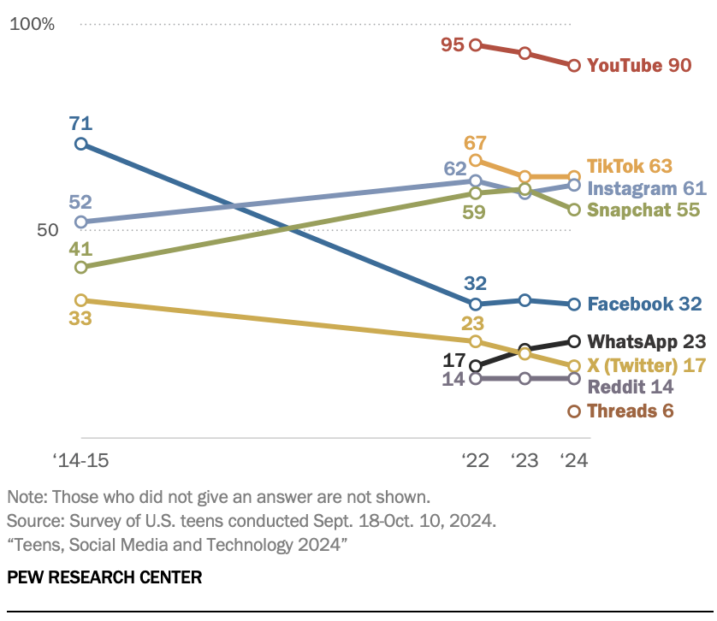
Social Media Is Central to modern life But Detrimental
David Restrepo
Nearly half of teens report being online "almost constantly," a rise from 24% in 2014-2015 [1]
Average daily use: 3+ hours [6]
High usage of platforms like Instagram, Snapchat, creating a digital-first lifestyle
First thing many people check in the morning
[1]
Notes:
95% of U.S. teens use social media (Pew)
Nearly half online "almost constantly"
Average use = 3+ hours daily
Sets the stage -> too big to ignore impact

Slide 19
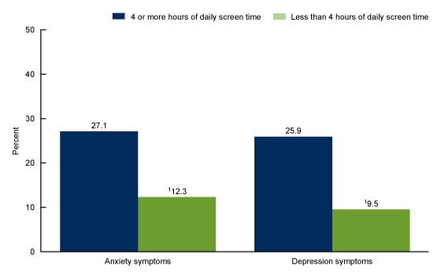
The effect of heavily using social media
David Restrepo
Problematic or excessive social media use correlates with sleep issues, depression, anxiety, and feelings of exclusion
Teens report both benefits and harms; increased unrealistic body comparison and FOMO (fear of missing out) [3]
[10]
Notes:
APA: links to anxiety, depression, and poor sleep
Body image -> worsens through comparison
FOMO = constant stress, pressure to keep up
More time online = higher risk

Slide 20
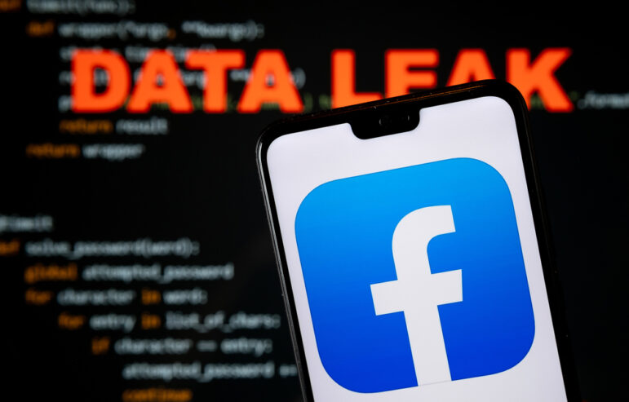
Effects on your Body Image
David Restrepo
Meta's internal research (2021) revealed problems [5]
1 in 3 teen girls reported worsened body image
Leak triggered global debate on platform safety
[5]
Notes:
Meta's leaked 2021 research
1 in 3 teen girls -> body image worsens
Internal data - > company knew about harms
Sparked global concern -> lawmakers, parents, media
Shows harm is systemic, not accidental

Slide 21
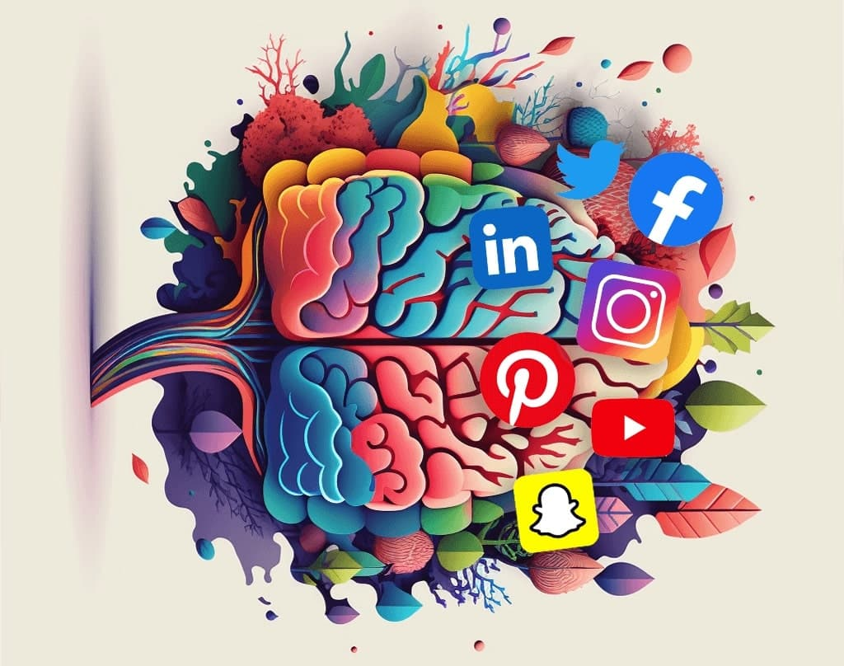
Healthy use reduces harm
David Restrepo
Limiting daily social media use significantly enhances mental health among young adults [7]
Reducing social media near bedtime can improve sleep, emotional health, and reduce risk behaviors [8]
[11]
Notes:
Limiting screen time -> improves sleep, mood
Positive online communities can help
Curate feeds -> follow supportive/realistic content
Users can take small actions -> lessen risks

Slide 22
References
David Restrepo
[1] Emily A. Vogels et al., Teens, Social Media and Technology 2022, (Pew Research Center, 2022) https://www.pewresearch.org/internet/2022/08/10/teens-social-media-and-technology-2022/ (9/2/2025)
[2] Michelle Faverio and Olivia Sidoti, Teens, Social Media and Technology 2024, (Pew Research Center, 2024) https://www.pewresearch.org/internet/2024/12/12/teens-social-media-and-technology-2024/ (9/2/2025)
[3] Briana Mendez-Padilla, Teens more acutely aware of social media’s impact on mental health, (k-12 Dive, 2025)
https://www.k12dive.com/news/teen-recognition-social-media-mental-health-impacts-growing/749074/ (9/2/2025)
[5] Federica Pedalino and Anne-Linda Camerini, Instagram Use and Body Dissatisfaction: The Mediating Role of Upward Social Comparison with Peers and Influencers among Young Females, (PubMed Central, 2022)
https://pmc.ncbi.nlm.nih.gov/articles/PMC8834897/(9/2/2025)
[6] Benjamin Zablotsky et al., Daily Screen Time Among Teenagers: United States, July 2021–December 2023
, (National Center for Health Statistics, 2024) https://www.cdc.gov/nchs/products/databriefs/db513.htm(9/2/2025)
[7] Chris Palmer, In brief: Limiting social media boosts mental health, the negatives of body positivity, and more research , (American Psychological Association, 2023) https://www.apa.org/monitor/2023/11/benefits-limiting-social-media(9/2/2025)
[8] Kathy Katella, How Social Media Affects Your Teen’s Mental Health: A Parent’s Guide, (Yale Medicine, 2024) https://www.yalemedicine.org/news/social-media-teen-mental-health-a-parents-guide(9/2/2025)
[9] Unknown, Social Media and Youth Mental Health( The U.S. Surgeon Generals Advisory, 2023) https://www.hhs.gov/sites/default/files/sg-youth-mental-health-social-media-advisory.pdf(9/2/2025)
[11] Mitch Prinstein et al., Social Media and Mental Health: Safety in the Digital Age?, (DividedWeFall, 2023)
Social Media and Mental Health: Safety in the Digital Age? — Divided We Fall(9/2/2025)

Slide 23
Class 4 The End
Keith A. Pray
SocialImps.com
Notes:
Use remaining time for group project questions and/or review group assignment slides.
This is the end. Any slides beyond this point are for answering questions that may arise but not needed in the main talk. Some slides may also be unfinished and are not needed but kept just in case.

Slide 24
what works well REmotely With Zoom
Turn your camera on
Sign in with First and Last Name
Stay muted unless you are going to speak
To speak use the raise your hand feature
Wait until the end of student presentations to ask questions
Write them down so you don’t forget

