Slide 1
Internet of Nano Things
Matthew Micciolo
James C. Piatt
Kevin A. Valente-Comas
Ziyao Xu
http://ziyaojoexu.com/cs3043/

Slide 2
Introduction
Kevin Valente
While none of the research / development being done now is negative, there is a high probability for this technolgy to be used in negative ways once and if commercialized
Notes:
None of the research / development being done right now is being done for harm or malicious intent.
However, the use of today’s technology has proven that the technology could be used for harm.
For now there are no signs this technology is being used in negative ways.

Slide 3
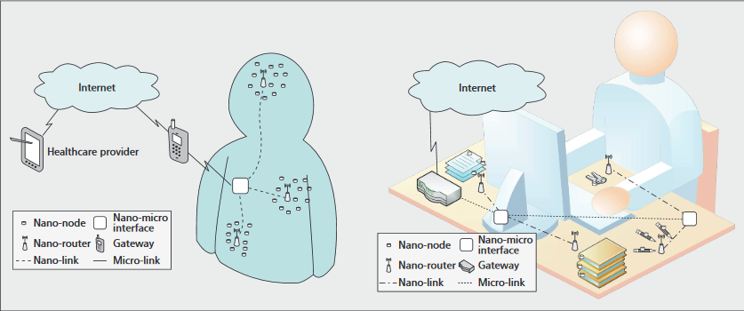
What is the Internet of Nano Things?
Matthew Micciolo
Large collection of nano devices connected to the internet
Examples:
  Nanobots
  Nanosensors
New solutions in different fields
  Medical
  Military
  Agricultural
All devices could be connected together allowing for communication between them
Diagram of Internet of Nano Things
[10], [13]
Notes:
Similar to the internet of things that most people are familiar with right now
Different due to the fact that all the devices are nano devices. For example, in the photo there is a nano-micro-interface that goes to different nano-routers and then to different nano-nodes themselves.
Large number of devices connected to the internet with the exception that these are nano things (very small or microscopic)
Examples:
Nanobots
Nanosensors
Could provide new solutions to many fields
All devices connected together allowing for communication

Slide 4
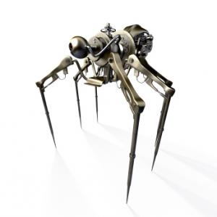
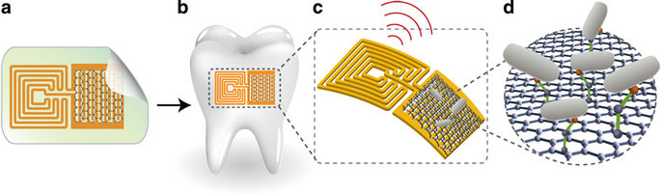
Nanosensors and Nanorobots
Matthew Micciolo
Nanosensors
Sensor that can operate on the nanoscale
Ex. Measure temperature in a living cell
Nanorobots
Extremely small robot that operates on the microscopic scale
Size range: 0.01 to 0.1 micrometers
Enable gathering of more information
Faster processing
Less energy use
Less material use
Grain of sand = 1mm
[14], [15], [16], [17], [22]
Notes:
Nanosensors
Detect airborne particles, bacteria + viruses. Measuring temperature, displacement, flow, acceleration
Nanorobots
Very small robot
0.01 - 0.1 micrometer (1 ten thou to 1 thou of a mm)
Made from carbon nanotube
Enable the gathering of more information due to them being so small.This means you can fit more of them in the same space as a regular sensor.
Faster processing due to the parts being smaller and closer together
Less energy due to how small they are
Less material use due to how small they are
First diagram is a special enamel sensor that is placed on the side of the booth. This can then be RFID scanned to see if there is any bad cavity causing bacteria on the tooth or not
Second diagram is a rendering of what a nanobot would look like

Slide 5
Ethical Issues
Matthew Micciolo
Could be used in a positive or negative way
Possible erroneous uses of The Internet of Nano Things
  Hacking / Manipulation of information
    Nano devices hacked and then used maliciously (RFID)
  Weaponization
    Military use (WMD)
  Chemical / Biological
    Agricultural (Poisoning)
  Tracking / Privacy
    Listening in on conversations
[17]
Notes:
Nanotechnology could be used both non-malicious or malicious ways
Some possible ways it can be used maliciously include:
Hacking / Manipulation of information
Someone could hack nanorobots inside of some that may be used for a medical reason or store personal information
Weaponization
Deploying nanorobots as a weapon of mass destruction. Possible some sort of disease spreading bot or one that can get in the body and do damage. Plague?
Chemical / Biological
Man made crop eating insects for the purpose of destroying crops and poisoning them. Could cause famine.
Tracking / Privacy
Since the bots are so small they could potentially cling to you or your stuff and track where you go and listen in on your conversations

Slide 6
Issues with Privacy and Hacking
Matthew Micciolo
Already issues today with The Internet of Things
Possible concerns if commercialized (based off The Internet of Things)
  Car hacking (Chevrolet and Chrysler)
  Critical medical devices(University of Alabama)
  Other wifi connected devices (Hello Barbie, Samsung fridge)
What would stop the same from happening with The Internet of Nano Things?
[18]
Notes:
The closest thing to The Internet of Nano Things would be just The Internet of Nano Things which is currently being developed right now.
Based off of recent events with the regular Internet of Things it's possible the same could happen to The Internet of Nano Things such as
Hacking - One example would be issues with Chevrolet and Chrysler cars being hacked remotely and taken over
Critical medical devices could become compromised. At the University of Alabama, hacking and taking over of drug infusion pumps and pace makers
Other internet of things item that got hacked
Hello Barbie (intercept audio between doll and phone and change it)
Samsung smart fridge (Designed to sync over wifi, issues with SSL certificates leaving credentials open to theft)

Slide 7
Issues with Weaponization
Kevin Valente
Biological effects
  Body incapable of proper disposal
  Oxidative stress
Deposit of poison/disease
Molecular deconstruction
[7,8,9]
Notes:
Nanobots can be made out of any type of nanoparticles including those that the body can’t process/ dissolve.
Oxidative stress is caused by highly reactive oxidants, which causes a large chain of free radical reaction.
Nanobots can deposit a poison or a disease within the body and dissolve.
Nanobots could be used to deconstruct structures or biological organisms.

Slide 8
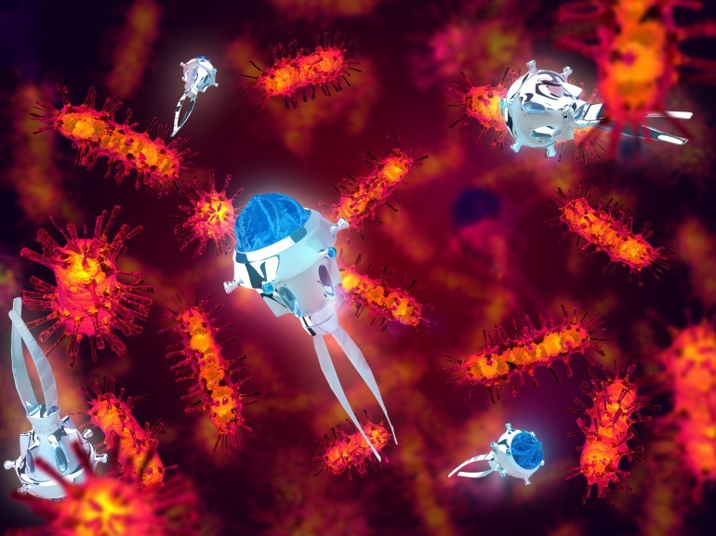
Medical Nanotech
Kevin Valente
Nanomedicine: application of nanotech to healthcare
  Work at the molecular level
Medicine delivery, nanites go to a place in the body then dissolve, releasing the drug
Done on mice
No side effects
One of nanomedicine’s main uses
Image from [1]
[1,2,3,4,5,6,19,20]
Notes:
Also referred as Nanomedicine. The use of nanotechnology for medical applications for the preservation and improvement of human health.
An experiment done in the University of California, San Diego was successful in administering medication through the use of nanobots in a live subject (rat). The subject suffered no side-effect.
Currently they use chemical and acoustic to communicate with each other. For future applications, researchers are trying to switch to RF signals for easier communication.
Future use of nanomedicine include faster diagnosis, monitoring and controlling (blood pressure, diabetes) and the treatment of various diseases (include cancer and arteriosclerosis).

Slide 9
Ethics of Nanomedicine
James
Fine line between medical and non-medical nanotech
Enhancement
Hard to analyze ethically, very broad field. Constantly changing
Data collected inside your body, then transmitted.
Privacy
Infrastructure to handle constant data
[11]
Notes:
Implants in soldiers, new steroids for athletes, etc. Don’t even want to get into Transhumanism. Every time ethicists puzzle out the ramifications of some new technique, two more will come. Long-term follow-up data doesn’t exist.
There’s also huge amounts of data to be generated. How do you guard it? Imagine if a medical lab started running a hundred times more tests than usual.

Slide 10

Food Industry
Joe
IoNT Dairy Farm
precision agriculture
Grass monitoring
Animal health and feed management
Monitoring field conditions
Nano Food Packaging
Nanosensor log all atmospheric impacts on the product
Data store and transfer through RFID
Enhance food safety and extend product life
[12]
Notes:
So far a lot of stuff we covered are still in its very early stage and it’s not closely related to our daily life.
But there are some applications with IoNT that will affect our life in the near future.
And they are mostly related to the food industry.
This brings another big issues, which is the safety.
The first example is the application on food packaging.
Scientist was successfully assemble nanosensor and RFID into the food container. The nano sensor is able to monitor the atmospheric impact from the factory to customers, as well as the freshness of the food
These data then store into the RFID tag. The salesperson can scan the tag and be able to tell the freshness of the food
The purpose of this application is to enhance food safety and extend product life
However
There’s potential of nano-poisoning
The nana-sensor might attached on the food
Very hard tell if there's nanostuff in food
Long term, harmful for human body
Data Secruity issue
Heavily rely on the data to making decisions
Food gone bad might not be thrown away
http://hrcak.srce.hr/file/113159
http://www.foodmicrosystems.eu/wp-content/uploads/FoodMicroSystems-D3.3.pdf

Slide 11
Food Industry
Joe
However…
  Nano-poisoning
  Data Security

Slide 12
In Popular Media
James
Doctor Who: the Doctor Dances, series 1 ep 10
  Episode is about a batch of medical nanites that get misprogrammed and start killing people.
  The Doctor Explains: https://www.youtube.com/watch?v=g71422yI7EY
Gamer (2009)
  Movie is about death row inmates who get nanites in their brains that let them be remote controlled. The villain’s plan is to release a batch of similar nanites that can be inhaled so that he can mind control anyone anytime he wants.
  https://www.youtube.com/watch?v=QnaTtsClgc4
Notes:
In media, nanobots are usually depicted as being able to cause ‘magic’ large-scale changes to the body. They are often treated as a disease or compared to a virus. If someone has nanobots, don’t touch their skin, and don’t let them breathe on you.

Slide 13
Current Legal Status
Joe
As of now there are no laws or regulations limiting the use of nanotechnology. However, some are aware and are actively constructing a Code of Ethics for Nanotechnology.
Notes:
No laws or regulations limiting nanotechnology. Some are aware and are constructing a Code of Ethics for Nanotechnology.

Slide 14
The Future
Matthew Micciolo
1 Year
- More experiments on rodents for nanomedicine
5 Years
- Experiments on apes or other mammals
10 Years
- Attempt to start trails on humans
25 Years
-Available to market
[1], [4]

Slide 15
References
[1] Sebastian Pop, Nanites Deliver Medicine in Living Creatures for the First Time Ever, http://news.softpedia.com/news/Nanites-Deliver-Medicine-in-Living-Creatures-For-the-First-Time-Ever-470757.shtml (October 2, 2016)
[2]Margarete Rouse, Nanomedicine, http://whatis.techtarget.com/definition/nanomedicine (October 2, 2016)
[3]Robert A. Freitas, What is nanomedicine? (Elsevier, March 2005), 2-9, http://www.sciencedirect.com/science/article/pii/S1549963404000048
[4]UK Essays, Analysing Potential Uses Of Nanorobotics Biology Essay, https://www.ukessays.com/essays/biology/analysing-potential-uses-of-nanorobotics-biology-essay.php (October 2,2016)
[5]Sanjeeb K. Sahoo, Vinod Labhasetwar, Nanotech approaches to drug delivery and imaging (Elsevier, December 2003) 1112-1120, http://www.sciencedirect.com/science/article/pii/S1359644603029039
[6]Harry F. Tibbals, Medical Nanotechnology and Nanomedicine (Taylor & Francis Group, 2011), https://books.google.com/books?id=VT8jgh81zycC&pg=PA340&lpg=PA340&dq=nanomedicine+pacemakers&source=bl&ots=fVHw1adZrL&sig=5Zb0lhXKDJgSRJZpE0CmqTrpRtg&hl=en&sa=X&ved=0ahUKEwjn_bzywq_PAhXTZj4KHRh6BdAQ6AEIJTAB#v=onepage&q=nanomedicine%20pacemakers&f=false

Slide 16
Reference Cont.
[7]Lucas Drayton Bradley, REGULATING WEAPONIZED NANOTECHNOLOGY: HOW THE INTERNATIONAL CRIMINAL COURT OFFERS A WAY FORWARD, http://digitalcommons.law.uga.edu/cgi/viewcontent.cgi?article=1053&context=gjicl (October 2, 2016)
[8]Dr Ananya Mandal, What is Oxidative Stress?, http://www.news-medical.net/health/What-is-Oxidative-Stress.aspx (October 2, 2016)
[9] Andrew Chen, The Ethics of Nanotechnology, https://www.scu.edu/ethics/focus-areas/more/technology-ethics/technology-ethics-resources/the-ethics-of-nanotechnology/ (October 3, 2016)
[10] Ian F. Akyildiz and Josep Miquel Jornet, The Internet of Nano-Things (September 28, 2016) http://bwn.ece.gatech.edu/surveys/nanothings.pdf
[11] Michael Berger, Ethical aspects of nanotechnology in medicine.’ http://www.nanowerk.com/spotlight/spotid=3938.php
[12] Ileš, Davor, Goran Martinović, and Dražan Kozak. "Review of potential use, benefits and risks of nanosensors and nanotechnologies in food." Strojarstvo: časopis za teoriju i praksu u strojarstvu 53.2 (2011): 127-136.
[13] What is Nanotechnology? (September 28, 2016) http://www.nano.gov/nanotech-101/what/definition
[14] What are Nanobots? (September 15, 2016) http://www.innovateus.net/science/what-are-nanorobots
[15] Manu S. Mannoor, Graphene-based wireless bacteria detection on tooth enamel (September 28, 2016) http://www.nature.com/articles/ncomms1767

Slide 17
References Cont.
[16] Nanosensors, A Definition, Applications and How Nanosensors Work AZoNano (September 28 ,2016) http://www.azonano.com/article.aspx?ArticleID=1840
[17] What are Nanobots? (September 28, 2016) http://www.tech-faq.com/nanorobots.html
[18] How the Internet of Things got Hacked (October 3, 2016) https://www.wired.com/2015/12/2015-the-year-the-internet-of-things-got-hacked/
[19] Jamil El-Ali, Peter K. Sorger and Klavs F. Jensen ‘Cells on chips.’ Nature 442, 403-411 (27 July 2006)
[20] British Society for Nanomedicine, http://www.britishsocietynanomedicine.org/what-is-nanomedicine.html
[21] Neil Jacobstein, Foresight Guidelines for Responsible Nanotechnology Development,
http://www.foresight.org/guidelines/current.html (October 3, 2016)
[22] Benefits and Applications, http://www.nano.gov/you/nanotechnology-benefits (October 4, 2016)

