Slide 1
Cell and Gene Manipulation
Annie Hernandez, Alora Hillman, Rene Jacques, Aditya Nivarthi

Slide 2
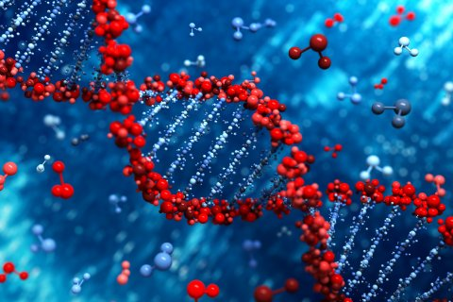
What is gene/cell manipulation?
Modifying genetic or tissue material of an organism
Uses biotechnology to modify DNA, RNA or cells
Notes:
ANNIE
Gene and cell manipulation is used to make low level changes in organisms (humans) to change the body behavior or characteristics
It has been used for trying to cure illnesses that are passed genetically down generations, remove characteristics of a human that may be unwanted, or add characteristics that may be wanted, and to understand how genes and cells affect the human body and are affected by changes
We are focusing on genetic engineering in humans

Slide 3
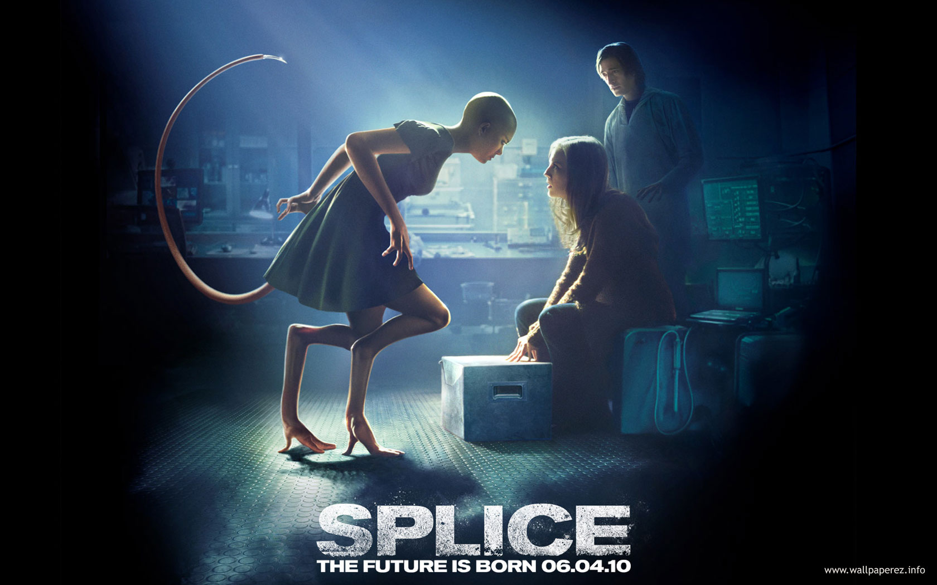
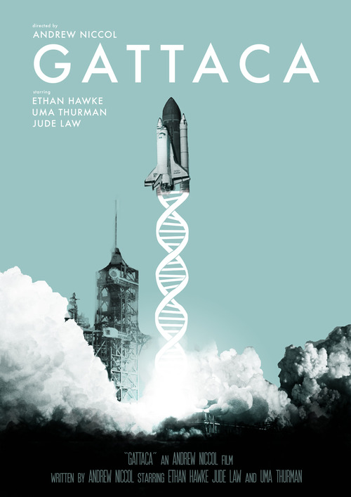

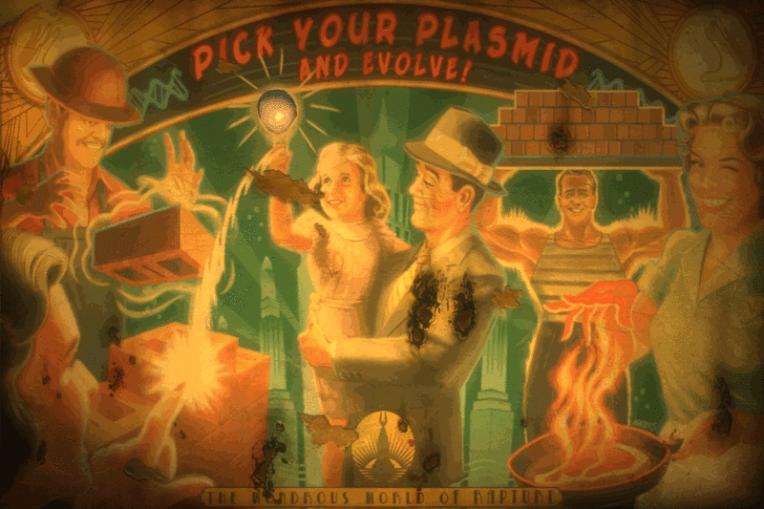
Depiction In Media
Gattaca
Jurassic Park
BioShock
Splice
Notes:
ANNIE
What is actually realistic about each movie/game?
Gattaca
Gene manipulation mostly used to dissuade disease and correct genetic disorders (at birth). Main character is one of few “natural” babies
Societal changes - discrimination based on genetic makeup (main character analyzed to find future capabilities and a 99% chance of death by 30 due to a heart disorder)
Jurassic Park
Scientists bring dinosaurs back to life by using preserved DNA along with artificially created DNA
This makes them transgenic animals (or “spliced” animals)
Bioshock
Main character and many enemies use sea slug stem cells to gain new abilities or improve on pre-existing ones
Overuse causes physical and mental damage, due to cell instability
Splice
Mostly meant as a cautionary tale. Scientists splice together genes of various animals to find medical benefits, eventually start splicing with humans too
Side effects of gene modification that were unforeseen occur, such as regeneration, sex changes, and spontaneous wing growth,

Slide 4
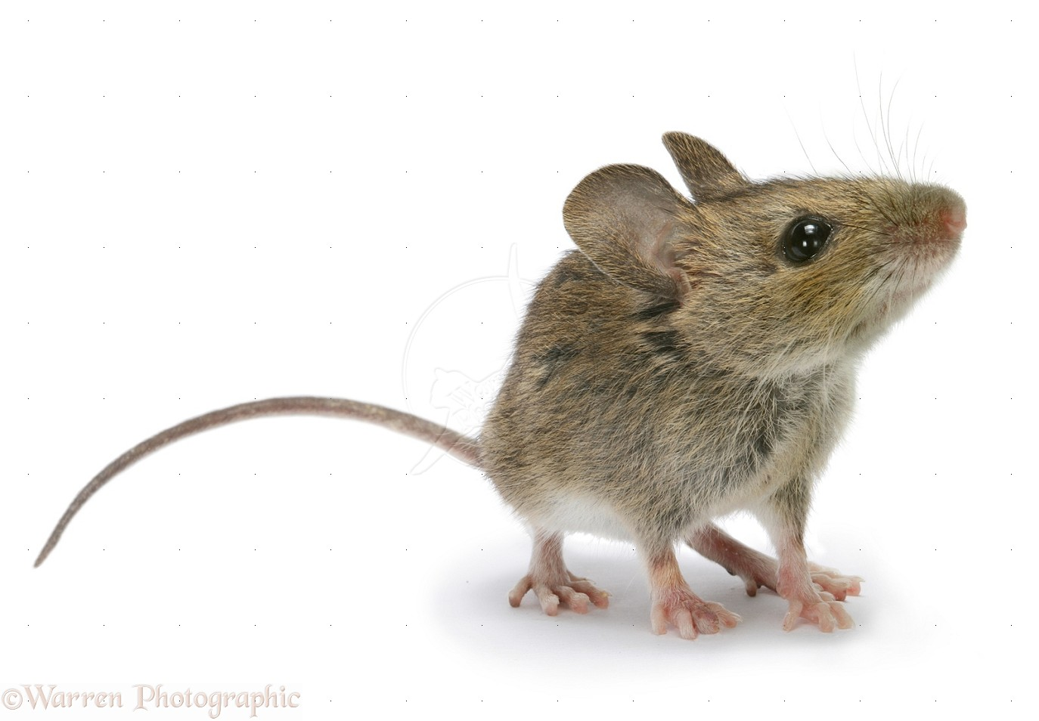
History
1972 - Paul Berg created the first recombinant DNA molecules
1973 - Herbert Boyer and Stanley Cohen directly transfer DNA between organisms
1973 - Rudolf Jaenisch creates the first genetically modified animal (a mouse)
Notes:
ADITYA NIVARTHI
Recombinant DNA
Berg was able to bring together DNA molecules from multiple sources and bind them together to make DNA not found in organisms
This was possible with the discovery that DNA from all organisms share a similar structure (except nucleotide sequence)
Mouse
Successfully added foreign DNA into a mouse embryo
They injected DNA sequences for leukemia and showed that the same sequences had integrated within the mouse’s and its offspring's’ genomes
These breakthroughs eventually lead to genetic modification becoming a commercialized field (next slide)

Slide 5
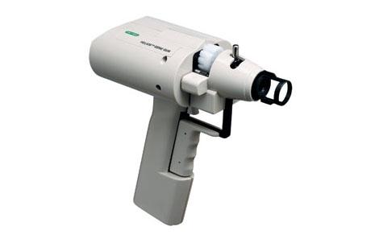
History
1978 - Insulin created through genetically modified bacteria
1983 - First genetically engineered plant created
1985 - First transgenic livestock produced
1987 - Invention of the gene gun
Notes:
ADITYA NIVARTHI
Genetic modified insulin
Scientists created synthetic genes with genetic code for human insulin
The injection passed the synthetic genes, which eventually merged with the protein chains
This process could be used to help diabetics receive sufficient amounts of insulin quickly, as previous methods were far too costly and time consuming (taken from pancreas of animals)
Commercialization
DNA discovered in 1869 (107 years)
Genentech created engineered insulin (humulin) for treating diseases through bacteria
Gene gun
The gun was made in order to prove genetic transformation was possible
Tested on onions since they have larger cells
Used high propulsion of particles covered in DNA to send synthetic genes to be merged.
They were able to prove it worked when the onion tissue exposed the genes that they had inserted

Slide 6
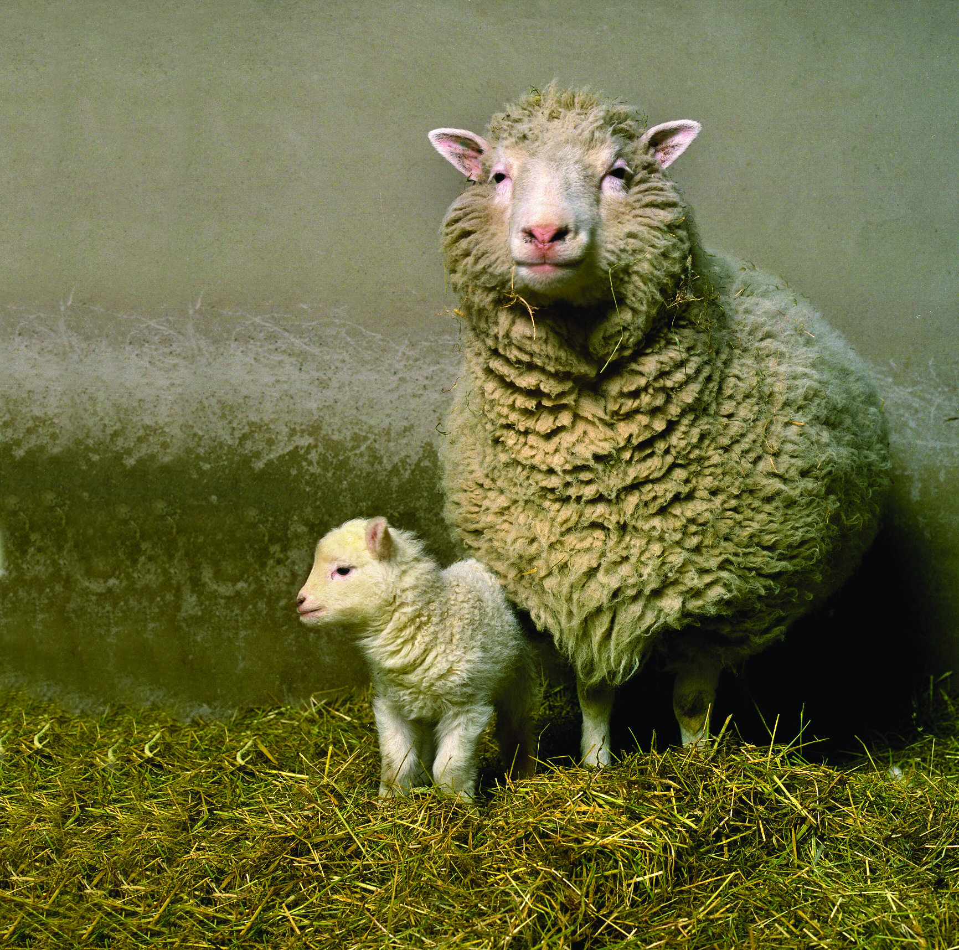
History
1997 - Sheep cloned using genetically engineered cells
2004 - Successfully cloned a kitten from cat that passed away
2010 - First synthetic bacterial genome created
Notes:
ADITYA NIVARTHI
Dolly the sheep
Female domestic sheep created by somatic cell nuclear transfer
Parents gave egg, DNA and cloned embryo
Made a hybrid cell by merging these parts together that became the cloned sheep
Cloned kitten
Owner paid $50,000 to have her cat that died cloned
Should we be allowed to clone pets, or eventually people?

Slide 7
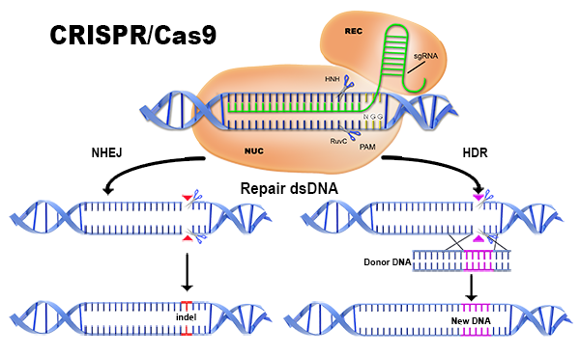
How Is It Done?
Notes:
REN
CRISPR - Clustered Regularly Interspaced Short Palindromic Repeats
TALENS - Transcription Activator-Like Effector Nucleases
Cas - CRISPR Associated
Essentially molecular scissors
Gene normally hundreds of thousands of base pairs long
Guide RNAs only 20 bases long
Must be unique and near a “landmark” for molecular scissors
PAM - protospacer adjacent motif
Lots of repeats with only 4 letters
Easy to mutate the wrong gene
Algorithms search for all possible 20 base segments near a PAM
Lots of software exists for doing this
CHOPCHOP
E-CRISP
Researchers currently searching for patterns to improve algorithms
Broad Institute tested around 2000 guide RNAs in human and mice cells
Released a set of rules for an improved algorithm

Slide 8
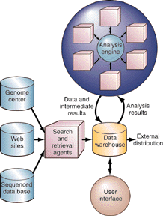
Relevance to Computing
‘Sequence annotation’ - computers used to:
Indicate location of genes
Find relationships between sequences
Genome Project - used to store and update data
Sequence analysis engine
Pattern recognition
Not to be completed for 7-10 years
Alternative to computing is trial and error
Notes:
ALORA
Sequence annotation - computers used to indicate the location of genes and find relationships between sequences
Genome project uses computers to store and update large amounts of data
Researchers at ORNL, LBNL, Argonne National Laboratory (ANL), teaming up to create a better way of analyzing genes - sequence analysis engine
Retrieve gene sequences from the web (only from places that have already been vetted and deemed reputable)
Store this data in a large warehouse
Sequences will be analyzed using artificial neural networks
Alternative to computing is trial and error

Slide 9
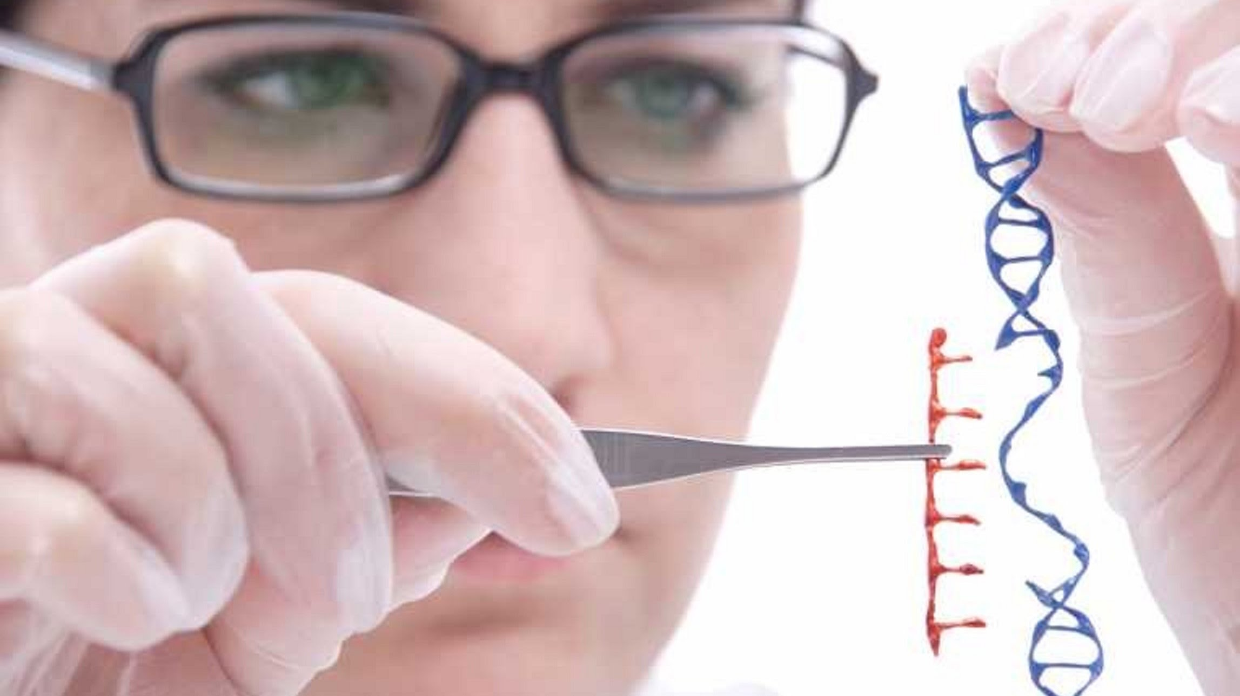
Gene Editing Restrictions on Human Embryos
United States
FDA funded germline gene modification which was later banned
Not funded by NIH (National Institutes of Health)
Other Countries
Legal in UK for specific scientists:
Embryos not implanted
Destroyed after 14 days
CRISPR/Cas9 used
Private funding
Genetic Savings & Cloning
Notes:
REN
Germline gene modification = embryonic gene modification
2016 banned germline gene modification
Genetic Savings & Cloning
Company created clones of cats and dogs
Privately funded research is still able to make progress, but it is either too costly or not enough people use it
Company closed down shortly due to costs

Slide 10
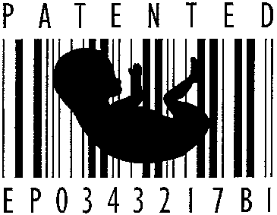
What Should We Patent?
1980 - Diamond v. Chakrabarty - manmade living organisms can be patented
“Anything under the sun that is made by man can be patented” - Supreme Court
Used to be able to patent subsections of human DNA
Can gene discovery be patented?
Synthetic DNA can be patented
Patenting part of a human?
Notes:
REN
When human genes were still being discovered, many filed patents on the genes and sequences that they found. In essence, they were patenting these sections of humans that existed in all humans (or most). Eventually it was decided that discovering genes was not a real inventive step, so patenting the newly found genes was prohibited.
Genes are considered not patentable because they are products of nature
Human genes not patentable
No patenting of natural phenomena
This caused problems for many other upcoming scientists because they could not publish anything using the genes that were patented
High costs for patients because the cost of licensing was passed from the scientists to hospitals, and then to patients
It brought up the question of whether humans should be patentable (in a way)
It was deemed that processing and forming a new strand of DNA synthetically that could be inserted into the organism was patentable
This required a process that was considered an inventive step, so it was allowed to be patented
The question this brings up is whether or not it is being patented after it has been inserted into a human? Would we have to create a licensing system for keep the synthetic genes in our bodies?
These kinds of questions need to be answered clearly before we start large scale modifications or changes that disrupt the evolution process so we know what is reasonable as intellectual property that is put in our bodies

Slide 11

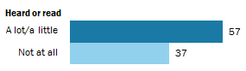
Societal Perception
48% of Americans want this technology for their own children
Americans who know about gene editing are more likely to want to adopt it
Notes:
ANNIE
Shows that the US is split on whether this is a good thing
Against
“Playing God” is immoral - even if we can do it perfectly, we have no place to do so.
Could lead to designer babies (Future generations cannot consent, either)
Effects of gene manipulation are often uncertain
For
If we have the power to intervene - shouldn’t we?
Embryos and fetuses are already screened for genetic diseases (Down’s syndrome, cystic fibrosis)
Benefits society overall by tackling known illnesses and issues

Slide 12
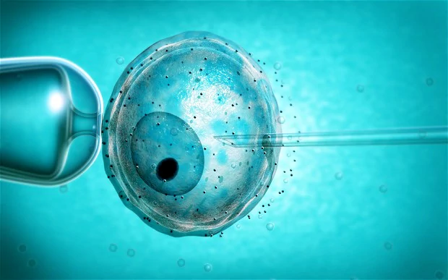
Notable Recent Events
Chinese scientist modified human embryos to prevent fetal blood disorder
MIT uses basic programming to change cell behavior
Notes:
ALORA
Chinese scientists have modified human embryos to prevent fetal blood disorder
Really controversial
People have called china the ‘wild west’ of genetic engineering because of its lack of regulations
MIT has used basic programming and circuit-building techniques to create cells that respond to specific stimuli
Mostly done in E. Coli
Behavior edited using computer code

Slide 13
Conclusion
Gene manipulation will continue to grow very slowly
Ethical issues
Societal restrictions
Regulations should be put on genetic engineering to prevent misuse
No “designer babies”
Used for genetic disorder prevention
Risk vs. Reward
Risk too high at present time - 85% to 99% of genetically altered embryos die before they are born
Further understanding of human body necessary
Notes:
ALORA
We concluded that gene manipulation is going to grow at a slow pace
There are ethical issues that need to be resolved
There are societal restrictions currently in place that both prevent modification from happening
Regulations need to continue being revised to prevent misuse and stay in line with the capabilities of genetic modification
Restrictions that need to be put in place to prevent unjust or unethical modifications
The risk for damage with modification is too high for the intended results
Experimental error can cause unintended effects that are not fully understood
85 to 99 percent of genetically altered embryos die before they are born
Knowledge of human body is not sufficient enough to confidently start mass gene modifications

Slide 14
The Future
1 Year
Not ready to be widely adopted
Society is unlikely to be affected
5 Year
Still too soon to be widely adopted
Used to prevent genetic defects
10 Year
Could be adopted widely but unlikely due to ethical concerns
Regulations may be set in place for limited gene manipulation
Notes:
ALORA
1 year
The progress with modification has not been rapid enough to be adopted within a year
5 year
Used in later phases of testing/use for genetic defect prevention
The regulations for widespread use will be under review by this time, and therefore very specific use cases are allowed
10 year
Ethical concerns will hinder full spread of gene modification
The primary regulations would be in place and enforced at this time

Slide 15
References
00.03.07: Human Cloning, Genetic Engineering and Privacy. (2016). Teachersinstitute.yale.edu. Retrieved 3 October 2016, from http://teachersinstitute.yale.edu/curriculum/units/2000/3/00.03.07.x.html
A Taxonomy of Privacy - ORG Wiki. (2016). Wiki.openrightsgroup.org. Retrieved 3 October 2016, from https://wiki.openrightsgroup.org/wiki/A_Taxonomy_of_Privacy
Alleyne, R. (2012). Genetically engineering 'ethical' babies is a moral obligation, says Oxford professor. Telegraph.co.uk. Retrieved 3 October 2016, from http://www.telegraph.co.uk/news/science/science-news/9480372/Genetically-engineering-ethical-babies-is-a-moral-obligation-says-Oxford-professor.html
AMA Council on Ethical and Judicial Affairs, Report on Ethical Issues Related to Prenatal Genetic Tests, 3 Archives Fam. Med. 633, 637–39 (1994), Archived September 28, 2011, at theWayback Machine.
Barton, K., Binns, A., Matzke, A., & Chilton, M. (1983). Regeneration of intact tobacco plants containing full length copies of genetically engineered T-DNA, and transmission of T-DNA to R1 progeny. Cell, 32(4), 1033-1043. http://dx.doi.org/10.1016/0092-8674(83)90288-x
Bioshock Plasmids. (2016). I.kinja-img.com. Retrieved 3 October 2016, from https://i.kinja-img.com/gawker-media/image/upload/s--vo1CNOKp--/c_scale,fl_progressive,q_80,w_800/nji7miblwuwklynt8oyl.gif
Brownlee, C. (2004). "Inaugural Article: Biography of Rudolf Jaenisch". Proceedings of the National Academy of Sciences. 101 (39): 13982–13984.
Cohen, S. (2013). DNA cloning: A personal view after 40 years. Proceedings Of The National Academy Of Sciences, 110(39), 15521-15529. http://dx.doi.org/10.1073/pnas.1313397110
Cong, L., Ran, F., Cox, D., Lin, S., Barretto, R., & Habib, N. et al. (2013). Multiplex Genome Engineering Using CRISPR/Cas Systems. Science, 339(6121), 819-823. http://dx.doi.org/10.1126/science.1231143
Corbyn, Z. (2015). Crispr: is it a good idea to ‘upgrade’ our DNA?. the Guardian. Retrieved 3 October 2016, from https://www.theguardian.com/science/2015/may/10/crispr-genome-editing-dna-upgrade-technology-genetic-disease
Ding, Q., Regan, S., Xia, Y., Oostrom, L., Cowan, C., & Musunuru, K. (2013). Enhanced Efficiency of Human Pluripotent Stem Cell Genome Editing through Replacing TALENs with CRISPRs. Cell Stem Cell, 12(4), 393-394. http://dx.doi.org/10.1016/j.stem.2013.03.006

Slide 16
References
DNA Splicing Image. (2016). Retrieved 3 October 2016, from https://i.ytimg.com/vi/CY4_8dBEGYI/maxresdefault.jpg
Do We Have the Right to Create a Superhuman Society?. (2016) (1st ed.). Boston. Retrieved from http://harvardcollegelawsociety.github.io/lawreview/genmod.pdf
Dolly's and Her 1st Born: Bonnie. (2016). Retrieved 3 October 2016, from http://dolly.roslin.ed.ac.uk/wp-content/uploads/2016/01/Dolly1stbornBonnie.jpg
Extreme genetic engineering and the human future. (2016). Friends of the Earth. Retrieved 3 October 2016, from http://www.foe.org/projects/food-and-technology/human-genetic-engineering
Funk, C., Kennedy, B., & Sciupac, E. (2016). 2. U.S. public opinion on the future use of gene editing. Pew Research Center: Internet, Science & Tech. Retrieved 3 October 2016, from http://www.pewinternet.org/2016/07/26/u-s-public-opinion-on-the-future-use-of-gene-editing/
G, P. (2016). Privacy and confidentiality in the age of genetic engineering. - PubMed - NCBI. Ncbi.nlm.nih.gov. Retrieved 3 October 2016, from http://www.ncbi.nlm.nih.gov/pubmed/15706720
Gattaca Poster. (2016). tumblr.com. Retrieved 3 October 2016, from http://41.media.tumblr.com/ce55beb485f346a1d2a96928676ed42b/tumblr_n23kam7iHj1t62olwo2_500.jpg
Gene editing the human germline: What are the risks?. (2015). STAT. Retrieved 3 October 2016, from https://www.statnews.com/2015/11/17/gene-editing-embryo-crispr/
Genes Could Take Away Your Privacy? : Thoughts on Genetic Engineering. (2014). The Stories We Tell: A Study in Investigative Journalism. Retrieved 3 October 2016, from https://artsandhumanitiesacademy.wordpress.com/2014/01/24/genes-could-take-away-your-privacy/
Genentech: Press Releases | First Successful Laboratory Production of Human Insulin Announced. (2016). Gene.com. Retrieved 3 October 2016, from http://www.gene.com/media/press-releases/4160/1978-09-06/first-successful-laboratory-production-o
Genetic Discrimination - National Human Genome Research Institute (NHGRI). (2016). Genome.gov. Retrieved 3 October 2016, from https://www.genome.gov/10002077/genetic-discrimination/
Genetic Testing, Privacy and Discrimination. (2016). Councilforresponsiblegenetics.org. Retrieved 3 October 2016, from http://www.councilforresponsiblegenetics.org/projects/PastProject.aspx?projectId=1
Genetically Modified Mice. (2016) (1st ed.). Washington D.C. Retrieved from http://www.pcrm.org/sites/default/files/pdfs/research/research/Genetically-Modified-Mice-Fact-Sheet.pdf

Slide 17
References
Helios Gene Gun Systems | Life Science Research | Bio-Rad. (2016). Bio-rad.com. Retrieved 3 October 2016, from http://www.bio-rad.com/en-cn/product/helios-gene-gun-system
Inserting Synthetic Material. (2016). Telegraph. Retrieved 3 October 2016, from http://i.telegraph.co.uk/multimedia/archive/02565/EGG_2565177b.jpg
Intellectual Property - National Human Genome Research Institute (NHGRI). (2016). Genome.gov. Retrieved 3 October 2016, from https://www.genome.gov/19016590/intellectual-property/
Jurassic Park Background. (2016). Pinsound.org. Retrieved 3 October 2016, from http://www.pinsound.org/wp-content/uploads/2013/10/jurassic_park_bg.jpg
Karpova, S. (2016). [Genetic engineering in the bacterial synthesis of somatostatin]. - PubMed - NCBI. Ncbi.nlm.nih.gov. Retrieved 3 October 2016, from http://www.ncbi.nlm.nih.gov/pubmed/7742653
Khan, F. (2012). Biotechnology fundamentals. Boca Raton: CRC Press.
Knapton, S. (2015). China shocks world by genetically engineering human embryos. Telegraph.co.uk. Retrieved 3 October 2016, from http://www.telegraph.co.uk/news/science/11558305/China-shocks-world-by-genetically-engineering-human-embryos.html
Liang, P., Xu, Y., Zhang, X., Ding, C., Huang, R., & Zhang, Z. et al. (2015). CRISPR/Cas9-mediated gene editing in human tripronuclear zygotes. Protein Cell, 6(5), 363-372. http://dx.doi.org/10.1007/s13238-015-0153-5
MacDonald, F. (2016). 10 things you need to know about the UK allowing genetic modification of human embryos. ScienceAlert. Retrieved 3 October 2016, from http://www.sciencealert.com/10-things-you-need-to-know-about-the-uk-s-decision-to-allow-genetic-modification-of-human-embryos
McVeigh, K. (2013). US supreme court rules human genes cannot be patented. the Guardian. Retrieved 3 October 2016, from https://www.theguardian.com/law/2013/jun/13/supreme-court-genes-patent-dna
Mouse Wallpaper. (2016). Kingofwallpapers.com. Retrieved 3 October 2016, from http://kingofwallpapers.com/mouse.html
O'Brien, J. & Lummis, S. (2006). Biolistic transfection of neuronal cultures using a hand-held gene gun. Nature Protocols, 1(2), 977-981. http://dx.doi.org/10.1038/nprot.2006.145

Slide 18
References
PANEL I: PRIVACY AND DISCRIMINATION IN THE AGE OF GENETIC ENGINEERING Genetic Privacy: There Ought to be a Law. (2016). Litigation-essentials.lexisnexis.com. Retrieved 3 October 2016, from https://litigation-essentials.lexisnexis.com/webcd/app?action=DocumentDisplay&crawlid=1&doctype=cite&docid=4+Tex.+Rev.+Law+%26+Pol.+7&srctype=smi&srcid=3B15&key=b3ad7490a015e0a42878c3a98a96ae90
Patentability of human genes: our patent system can address the issues without modification (McBride, M. Scott), http://au4sb9ax7m.search.serialssolutions.com/?ctx_ver=Z39.88-2004&ctx_enc=info%3Aofi%2Fenc%3AUTF-8&rfr_id=info%3Asid%2Fsummon.serialssolutions.com&rft_val_fmt=info%3Aofi%2Ffmt%3Akev%3Amtx%3Ajournal&rft.genre=article&rft.atitle=Patentability+of+human+genes%3A+our+patent+system+can+address+the+issues+without+modification&rft.jtitle=Marquette+Law+Review&rft.au=McBride%2C+M.+Scott&rft.date=2001-12-22&rft.pub=Marquette+University+Law+School&rft.issn=0025-3987&rft.volume=85&rft.issue=2&rft.spage=511&rft.externalDBID=BSHEE&rft.externalDocID=82089780&paramdict=en-US
Paul Berg: Asilomar and Recombinant DNA. (2016). Nobelprize.org. Retrieved 3 October 2016, from https://www.nobelprize.org/nobel_prizes/chemistry/laureates/1980/berg-article.html
Powledge, T. (2014). DNA in rogue databases and genetic privacy | Genetic Literacy Project. Genetic Literacy Project. Retrieved 3 October 2016, from https://www.geneticliteracyproject.org/2014/07/01/dna-in-rogue-databases-and-genetic-privacy/
Rasmussen, Nicolas, Gene Jockeys: Life Science and the rise of Biotech Enterprise, Johns Hopkins University Press, (Baltimore), 2014
Reference, G. (2016). What are the ethical issues surrounding gene therapy?. Genetics Home Reference. Retrieved 3 October 2016, from https://ghr.nlm.nih.gov/primer/therapy/ethics
Science, L. (2015). Real-Life 'Jurassic World' Dinos May Be 10 Years Off, Scientist Says. Live Science. Retrieved 3 October 2016, from http://www.livescience.com/51219-jurassic-world-real-dinosaur-breeding.html
Scientist hack living cells to change their function. (2016). Mail Online. Retrieved 3 October 2016, from http://www.dailymail.co.uk/sciencetech/article-3518802/Could-soon-HACK-human-body-Scientists-use-computer-program-change-living-cells-behave.html
Scientists Argue the US Ban on Human Gene Editing Will Leave It Behind. (2016). Motherboard. Retrieved 3 October 2016, from http://motherboard.vice.com/read/scientists-argue-the-us-ban-on-human-gene-editing-will-leave-it-behind

Slide 19
References
Splice Poster. (2016). Images3.alphacoders.com. Retrieved 3 October 2016, from https://images3.alphacoders.com/854/85479.jpg
The Art and Science of Genetic Modification: Re-Engineering Patent Law and Constitutional Orthodoxies (Yvonne Cripps), Indiana Journal of Global Legal Studies, 01/2004, Volume 11, Issue 1, http://www.jstor.org.ezproxy.wpi.edu/stable/pdf/10.2979/gls.2004.11.1.1.pdf
The Case of the Cloned Kitten-An Ethical Challenge - AlbertMohler.com. (2005). AlbertMohler.com. Retrieved 3 October 2016, from http://www.albertmohler.com/2005/01/12/the-case-of-the-cloned-kitten-an-ethical-challenge/
THE HAZARDS OF HUMAN DEVELOPMENTAL GENE MODIFICATION. (2016). Councilforresponsiblegenetics.org. Retrieved 3 October 2016, from http://www.councilforresponsiblegenetics.org/ViewPage.aspx?pageId=108
The History of Cloning. (2016). Learn.genetics.utah.edu. Retrieved 3 October 2016, from http://learn.genetics.utah.edu/content/cloning/clonezone/
What Is CRISPR/Cas9 and Why Is It Suddenly Everywhere?. (2015). Motherboard. Retrieved 3 October 2016, from http://motherboard.vice.com/read/what-is-crisprcas9-and-why-is-it-suddenly-everywhere
CRISPR: A game-changing genetic engineering technique - Science in the News. (2014). Science in the News. Retrieved 4 October 2016, from http://sitn.hms.harvard.edu/flash/2014/crispr-a-game-changing-genetic-engineering-technique/
Computing the Genome. (2016). Web.ornl.gov. Retrieved 4 October 2016, from http://web.ornl.gov/info/ornlreview/v30n3-4/genome.htm
CRISPR/Cas9 Mutation Detection. (2016). Aati-us.com. Retrieved 4 October 2016, from http://www.aati-us.com/product/fragment-analyzer/CRISPR
Software Helps Gene Editing Tool CRISPR Live Up to Its Hype. (2016). IEEE Spectrum: Technology, Engineering, and Science News. Retrieved 4 October 2016, from http://spectrum.ieee.org/biomedical/diagnostics/software-helps-gene-editing-tool-crispr-live-up-to-its-hype
Roush, W. (2016). Genetic Savings and Clone: No Pet Project. MIT Technology Review. Retrieved 4 October 2016, from https://www.technologyreview.com/s/403756/genetic-savings-and-clone-no-pet-project/
Klein, R. (2007). Gene patents and genetic testing in the United States. Nature Biotechnology, 25(9), 989-990. http://dx.doi.org/10.1038/nbt0907-989
Baby Patent Picture. (2016). Realizethelies.files.wordpress.com. Retrieved 4 October 2016, from https://realizethelies.files.wordpress.com/2013/02/genetic_engineering.gif
Animals and Genetic Engineering (2016). All-creatures.org. Retrieved 4 October 2016, from http://www.all-creatures.org/articles/ar-animalsandge.html

