Slide 1
Wearable Technology
Helei Duan, Jun Liang, Fangming Ning, Etienne Scraire

Slide 2
Outlines
Security
Reliability
Information Privacy
Intellectual Property
Communications
Government
Work and Wealth
Conclusions

Slide 3
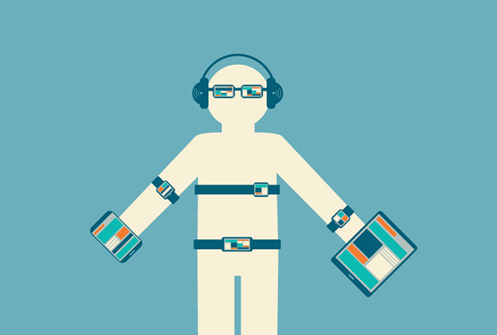
Security
Protecting Sensitive Information
Authentication
Unsecure networks and hostile environments
Notes:
Let's think about what data could be collected by someone wearing just two devices – some connected glasses and a wristband.
The connected glasses can, potentially, scan everything you eat, track all your movements and provide an ongoing record of not only where you've been but what you've looked at.
The wristband can track your heart rate, the number of steps you've taken, location, perspiration and respiration rate. It might even track your blood sugar through a sensor.
On their own, none of these pieces of data are particular useful or valuable;. But if they’re aggregated and collated, they can form a comprehensive view of your lifestyle. Coupled with the personal information many of us willingly provide over social media and pretty soon, you'll truly have no secrets.
Hacking your wearable devices:
Record what you’re seeing from Google Glass
Increased Bluetooth data transmission
Malicious applications
However, it has to go through phone

Slide 4
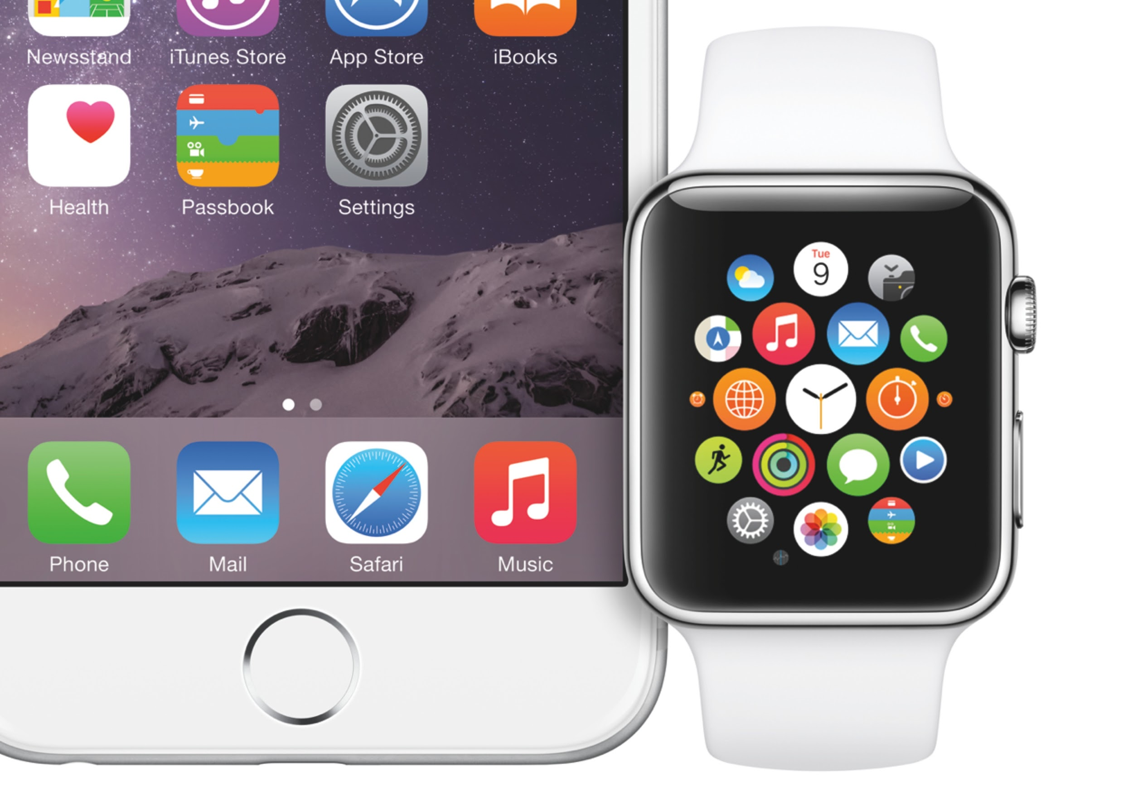
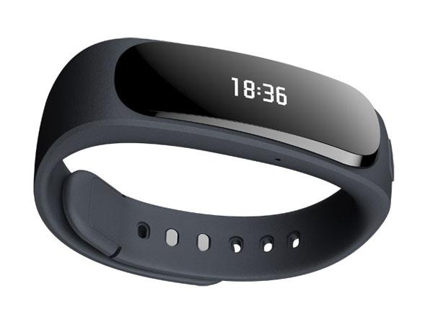
Reliability
New parameters to determine reliability
Reliability dependency
Batterylife
Positive effects on IT Industry
Battery companies
Processor companies

Slide 5
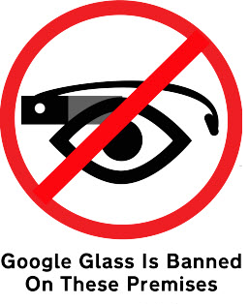
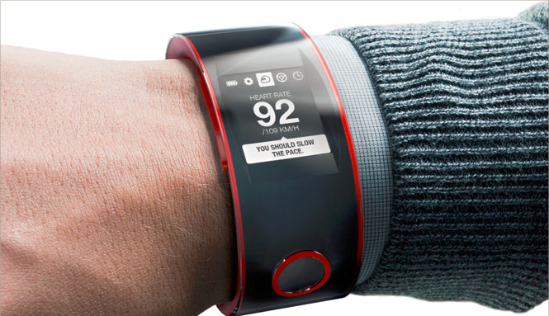
Information Privacy
Wearable technologies are always on a person:
Geographical location
Biometric data
Data mining
Notes:
Wearable device will cause users to leave a trail of data behind them.
Including very precise geographical locations
Data mining doesn’t always offer an option to opt-out.
example: Google Glass
Video and sound is recorded and can record at all time
All user data is saved on the google cloud
Big privacy concern, especially for the people not wearing the glasses.

Slide 6
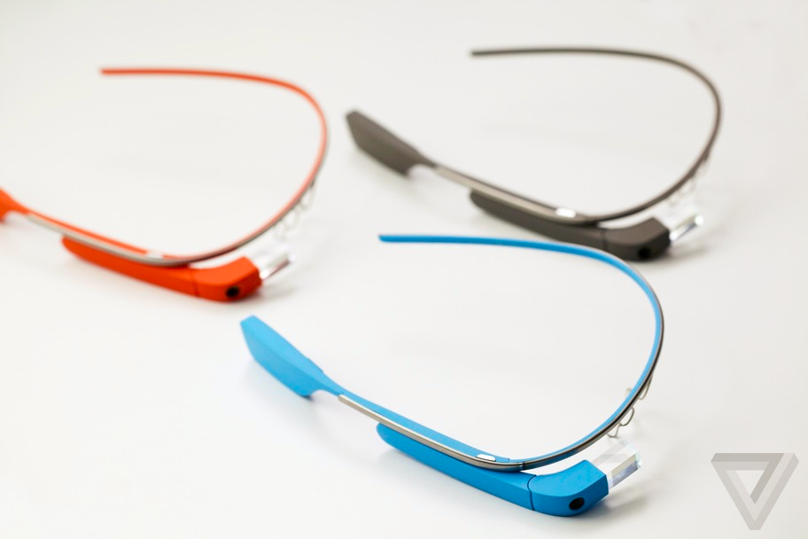
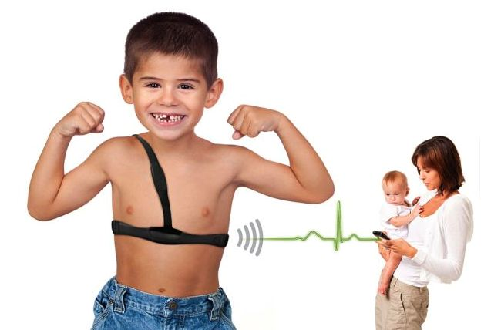
Intellectual Property
Various areas
  Sports and fitness, health and medicine, safety and security, child care, pet care, gaming, fashion or work productivity… …
Still in its infancy
Notes:
Wearable technologies are coming to market at a rapid pace and whether the application is for sports and fitness, health and medicine, safety and security, child care, pet care, gaming, fashion or work productivity, companies need to protect their intellectual property. However, the wearable tech sector is in its infancy, but will raise a number of intellectual property (IP) challenges

Slide 7
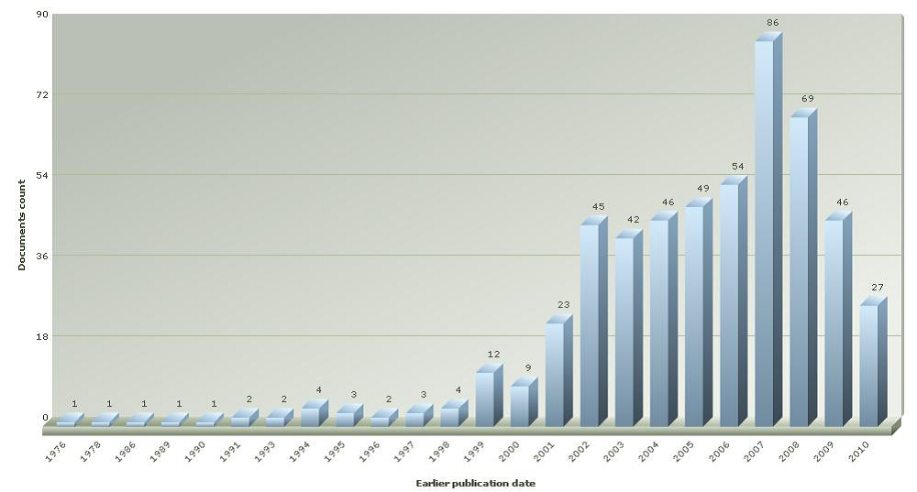
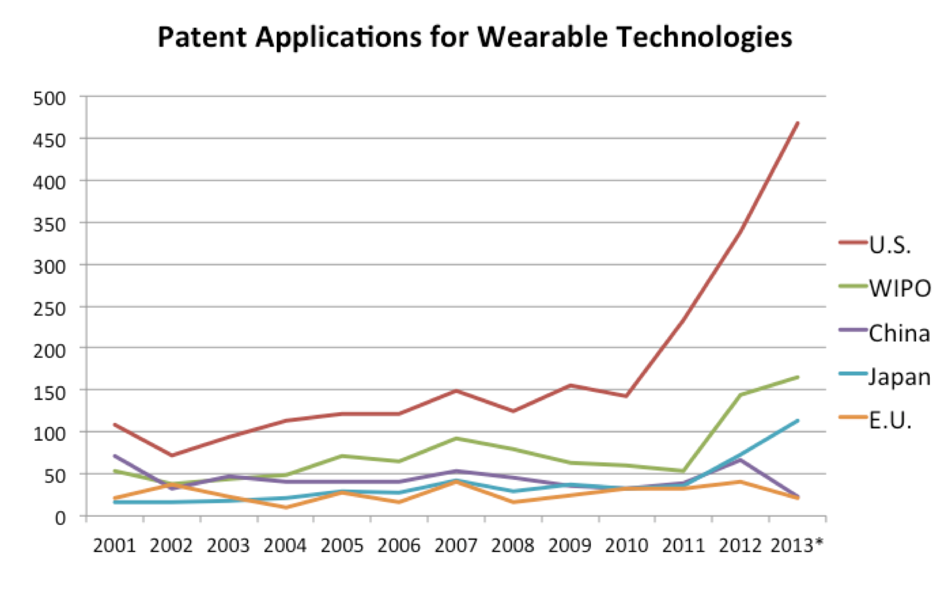
Intellectual Property

Slide 8
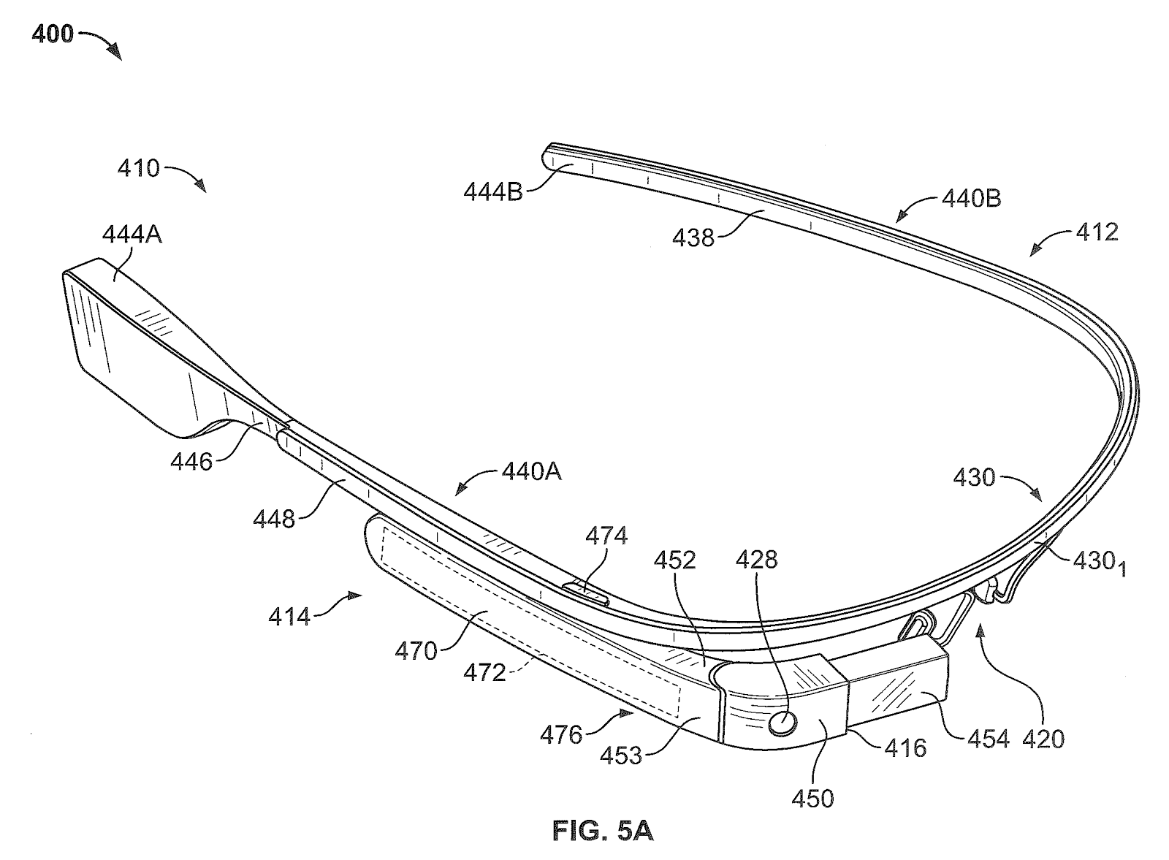
Strategies for Intellectual Property
Patents
  Google - Wearable Device with Input and Output Structures
  Apple - next?
Litigation
  MapMyFitness, Inc.
    Adidas AG sued Under Armour, Inc. for infringement of patents related to “performance monitoring” apparatus, methods and systems
Notes:
Obtaining patents is a good strategy for fending off competitive functional technology while building market share.
Components such as software, sensors, actuators, materials, interfaces, controls, methods, kits, mechanical components, fabrics, stability, placement, and improved batteries are all candidates for a patent portfolio, guarding wearable technology.
Some say patents are only expensive tickets to much more expensive litigation – and there has been much of it involving wearable technology.

Slide 9
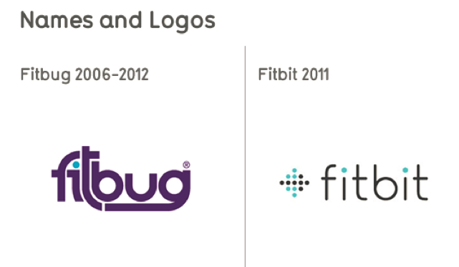
Strategies for Intellectual Property
Trade Secret
  Unlikely
    Protect the investment
    Relatively simple to reverse engineering for the similar technology
Trademarks, logos and taglines
  Trademark clearance searches
Copyright Issues
  “zero-tolerance”
The National Association of Theatre Owners (NATO) and the Motion Picture Association of America (MPAA)...... we maintain a zero-tolerance policy toward using any recording device while movies are being shown. …...all phones must be silenced and other recording devices, including wearable devices, must be turned off and put away at show time.
Notes:
It is unlikely that trade secret protection will be beneficial to the wearable technology, because,
1. it cannot adequately protect the investment made in developing the technology.
2. it is relatively simple to reverse engineering for the similar technology, such as hardware configuration, sensor fusion techniques, software design
In the excitement of bringing a new wearable to market, companies should not forget to assess the availability of the brand by conducting trademark clearance searches in every territory where the wearable is to be sold, made and distributed. This kind of search might have made a difference in the Fitbug v. Fitbit suit, where Fitbug, a UK company that has been producing “health coaching devices” sued competitor Fitbit, alleging trademark infringement.
Copyright issues – related to content used with the wearable device – need to be addressed both with the wearable device itself as well as its written instructions.

Slide 10
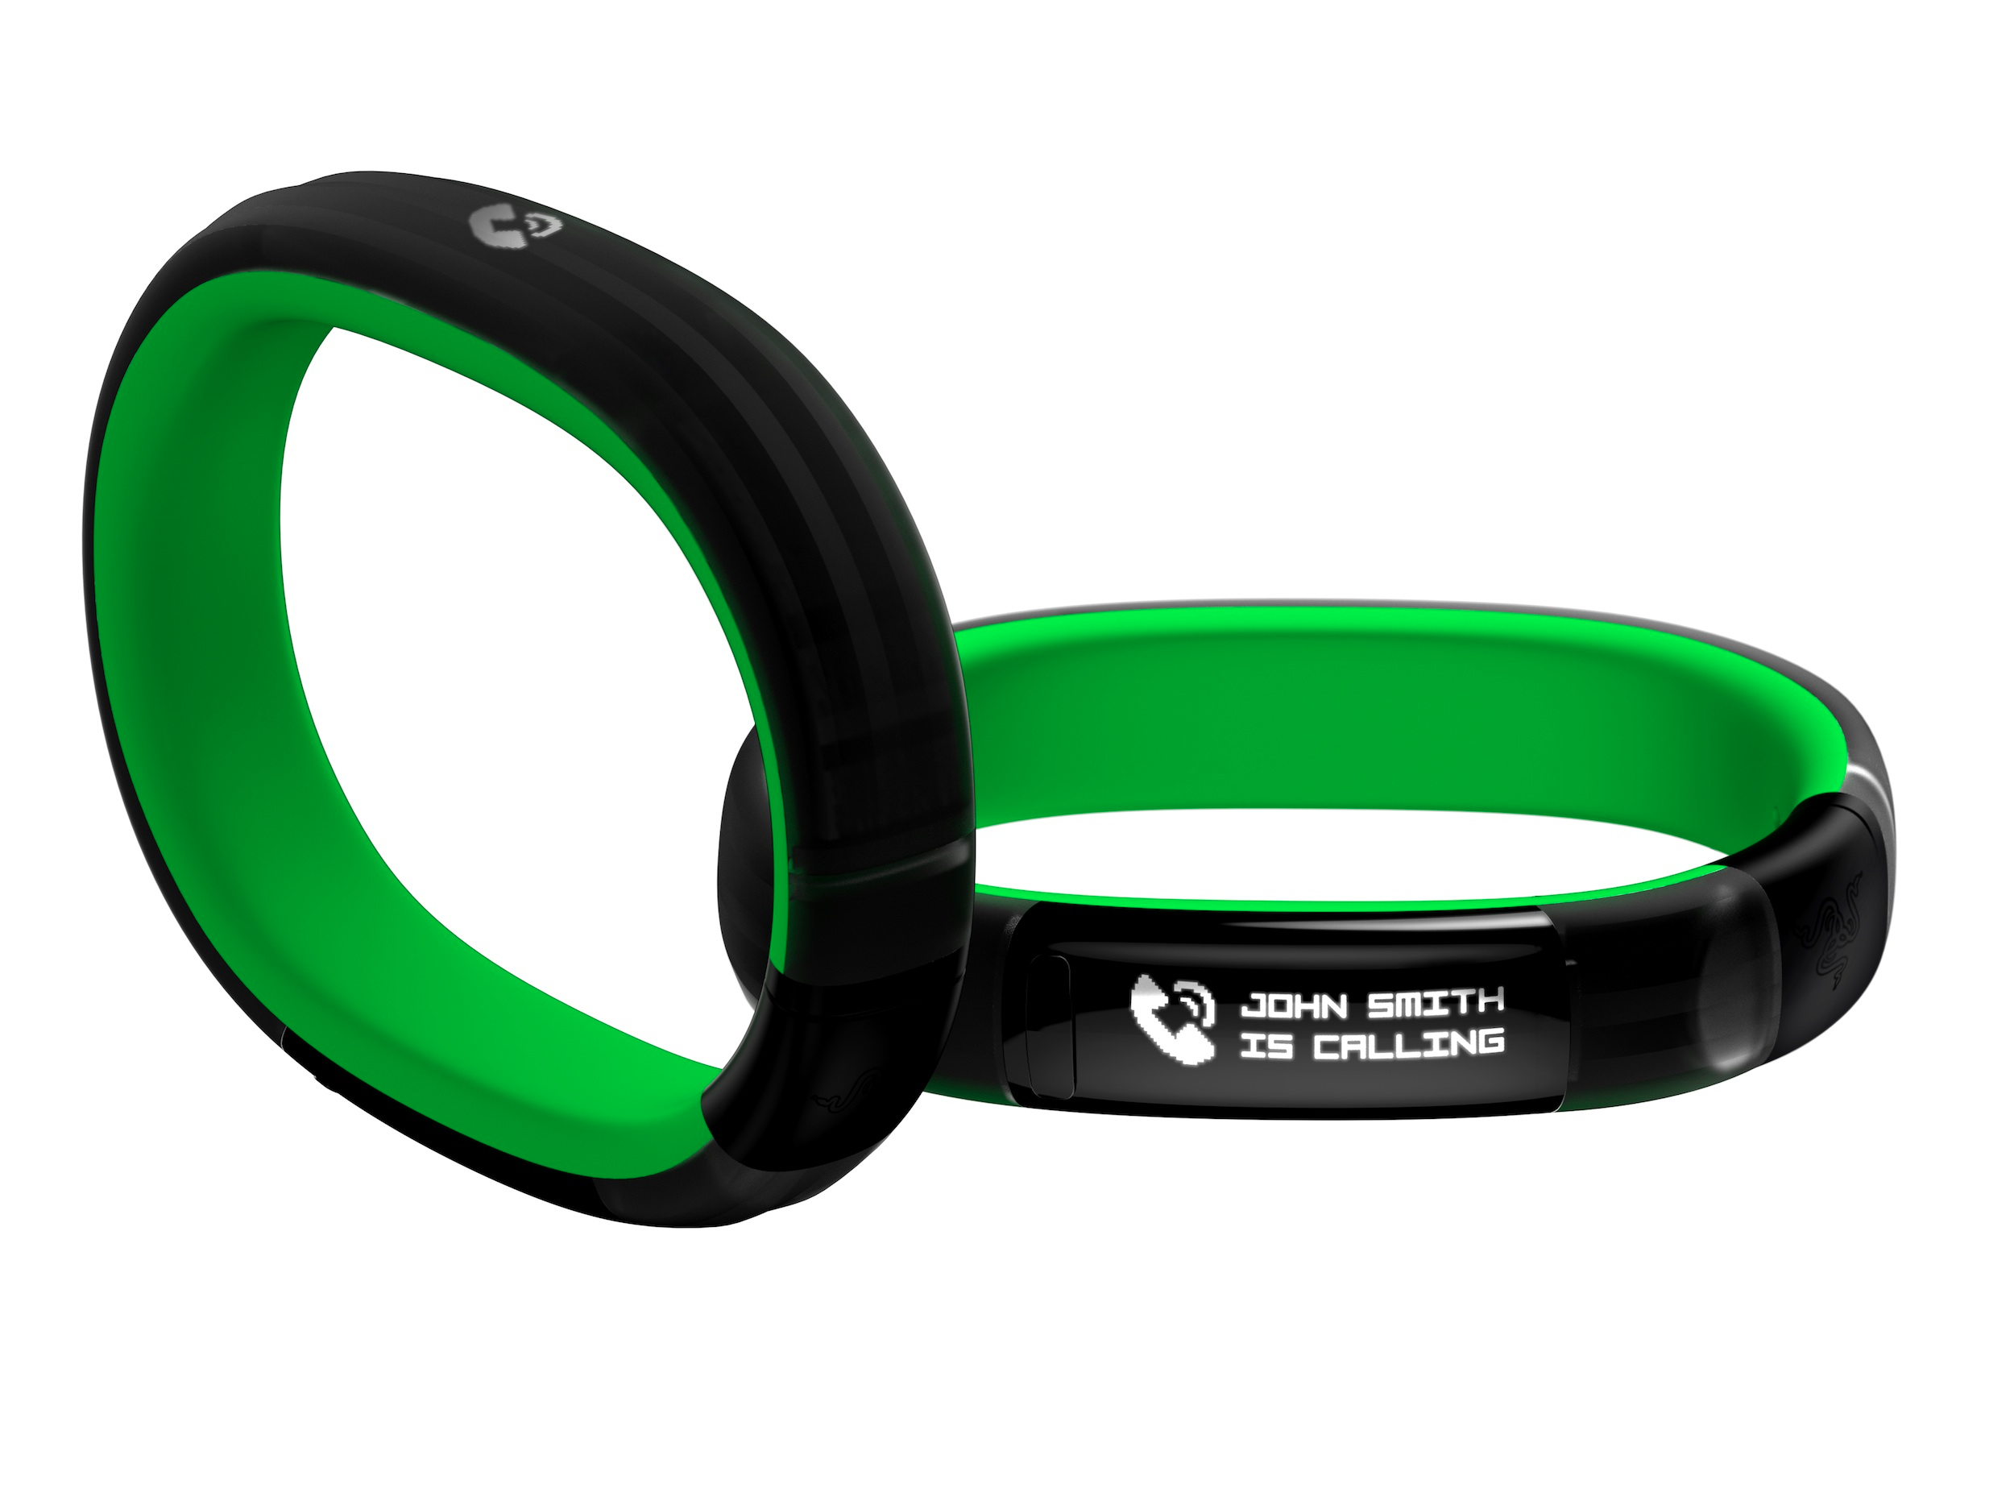
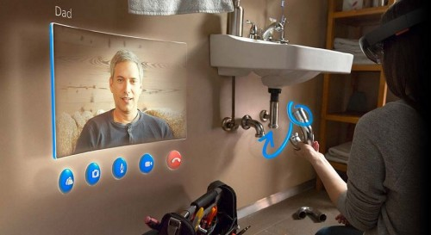
Communications
Wearable
Now
  Notifications
  Simple text message
  Voice message
Future
  Video chat (2-3 years)
  Replace phone (5 years?)
  Augmented Reality (10 years?)

Slide 11
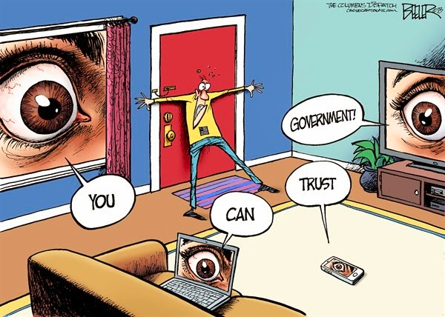
Government
Currently, mobile phones must
implement a “backdoor”:
Other ubiquitous devices
may also be required to do
so in the future.
Wearable tech will not be free
of government intrusion.
Notes:
Phones are required to have a backdoor built in so that national intelligence has access to text messages, contact information, notes or even recent geographical locations.
If wearable technologies become more popular, it is likely that they will also need to implement a backdoor for their sale to be approved.
The cessation of government intrusion could be positive in reassuring the public that their data is safe and their trust in the government but it is not going to happen.

Slide 12
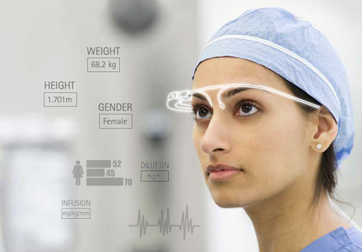
Work and Wealth
Changes on workplaces
Increases productivity by 8.5 %
Increases job satisfaction by 3.5 %
Job opportunities
Few people may lose their jobs
Create more new jobs on various fields

Slide 13
Conclusions
Future:
  Short term
    Commercialization
    Better battery life
    Policies and legislation
    Rapid increase in patents issued
  Long term
    Brain and neuro-based devices
    More elegant input
    Massive adoption

Slide 14
References
[1] How to Protect Your Wearables Implementation from Cyber-Security Threats by Brent Blum, http://www.accenture.com/us-en/blogs/technology-blog/archive/2015/02/19/how-to-protect-your-wearables-implementation-from-cyber-security-threats.aspx
[2] Wearable Devices: Privacy, Security Worries Loom Large, http://www.informationweek.com/healthcare/mobile-and-wireless/wearable-devices-privacy-security-worries-loom-large/d/d-id/1316833
[3] How wearable technology will upturn the security industry,http://www.citeworld.com/article/2114755/mobile-byod/how-wearable-technology-will-upturn-the-security-industry.html
[4] 5 essential wearable tech security tips, http://betanews.com/2014/12/09/5-essential-wearable-tech-security-tips/
[5] The Brave New World of Wearable Technology: What Implications for IP? http://www.wipo.int/wipo_magazine/en/2014/03/article_0002.html
[6] Intellectual property law and wearable Technologies, http://www.lexology.com/library/detail.aspx?g=5672b366-fcb7-4606-98f2-e5a3d2d558ec
[7] Wearble Privacy and the Government, https://sites.google.com/site/cs3043wt/home/privacy-and-the-government
[8] Security and privacy issues of handheld and wearable wireless devices, http://cacm.acm.org/magazines/2003/9/6721-security-and-privacy-issues-of-handheld-and-wearable-wireless-devices/fulltext

Slide 15
Thanks!
Questions?

