Slide 1
Telepresence Robots
Ayesha Fathima, Breanne Happell, Saraf Rahman,
Yan Yan

Slide 2
Overview
What are Telepresence Robots?
Features and Capabilities
Current Technologies
Social Implications of Telepresence
The Future of Telepresence Robots

Slide 3
Thesis
Telepresence will become commonplace in most settings, and is the first step in having robots replace workers.

Slide 4
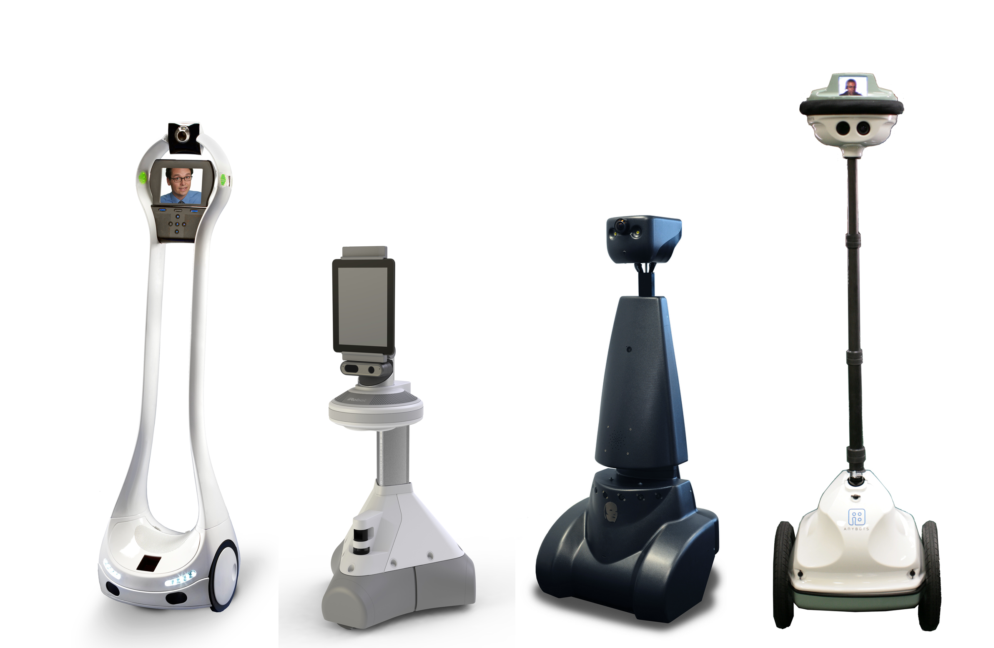
What are telepresence robots?
Remote controlled technologies
User is not limited by immediate surroundings
Notes:
Used to effectively be in a location that you are currently unable to reach, feeling your presence in a remote environment.
Different robots can traverse in the different environments that they are present in, depending on their type: Domestic, Workplace, Medical and Military.
In the upcoming slides, we will introduce the current form in which these robots are being used in these different environments and their future use.
picture: http://rbot.com/wp-content/uploads/2013/04/77700dc37683d8d552e388b67c485d8f.png

Slide 5
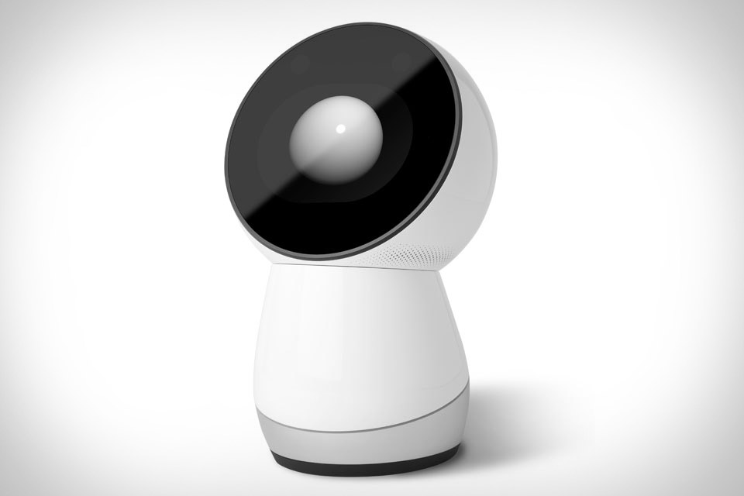
Domestic Telepresence
Telepresence feature for family members to skype home
Designed to interface with household items
Take care of simple tasks
JIBO
Notes:
The main feature of the domestic telepresence robots is to connect family members together across the globe, and this is done in a more interactive way than phone or skype does.
They usually also contains pattern recognition technique, so that the user could speak with the robot to sound control various household items at home
In addition, they could also integrate with features of various devices to take care of simple tasks: for example,
could be used as an alarm clock, could take photographs, play music, and even take care of children
Picture: http://uncrate.com/p/2014/07/jibo.jpg

Slide 6
Domestic Telepresence
Humanized technology
Intimate and trusting relationship with the users
Record users' living manners/habits of life
Enhance conveniency
Monitor the house when the family is out
One robot could serve as the housekeeper and security guard
Notes:
As the domestic telepresence robots are considered as a humanized technology because of their ability to communicate with human, they could build intimate and trusting relationship with the users, which makes users feel more comfortable when using them.
And as they could record the details of users’ living manners and habits and store or analyze such data for the users to use, they could make users’ life more convenient
As they are domestic robots, they could also monitor the condition of the house when the family is out.
Based on those features just mentioned, one robot could do all the work that the housekeeper and security guard could do .
Jibo now costs 500 dollars, which could be affordable by many families; and another kind of domestic telepresence robot named personal robot decreases their price from 2000 dollars to less than 1000 dollars recently, and we expect the price of domestic telepresence robots could be further decrease later.
And due to the conveniency that such robots could bring as well as their capacity, we believe that domestic telepresence robots could become commonplace in the near future

Slide 7
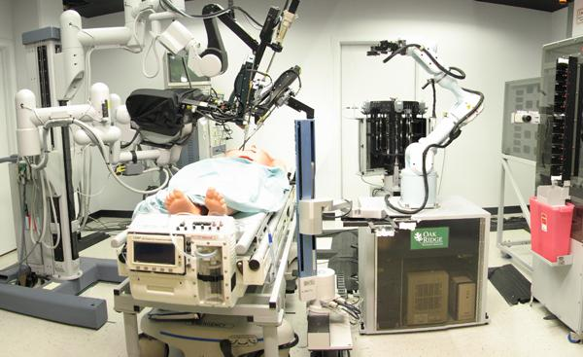
Medical Telepresence
Two types of medical robots:
Surgical
Monitoring
Surgeries in remote areas
benefits patients
benefit surgeons
Not cost efficient
Notes:
While medical telepresence robots overall are beneficial for patients and surgeons, some of them are not the most efficient. There are two main groups within medical telepresence robots: surgical robots and monitoring robots. Surgical robots allow surgeries to be performed in remote areas while monitoring robots allow doctors to monitor their patient’s well-being if they aren’t able to physically be there. Surgical robots, while they have been able to perform successful surgeries, cannot really reach their full potential until the majority of hospitals, which will not be very likely within the next 20 years. [7] Currently, the cost of the robot as well as the network connection is simply too great, although the benefits may outweigh the risk, this just doesn’t make sense for a lot of hospitals right now. [8]
In contrast, the monitoring robot (like VGo) is incredibly efficient as it allows doctors to monitor their patients medicine, order tests, and provide care remotely. This way the doctor is almost always available to his or her patient despite location. A number of hospitals have a telepresence robot, but only one or two because they are extremely expensive. As of 2013, VGo is used in 29 different organizations, and 5 of these organizations are hospitals or hospice care. [6] Currently, VGo can cost anywhere from $7200 to $8900 per year. In the coming years, we predict that VGo and monitoring robots like it will become more common as the cost decreases and the benefits or seen to outweigh any potential risks.
While being cost efficient isn’t the most important thing, it is a major factor in why hospitals are not purchasing many medical robots.

Slide 8
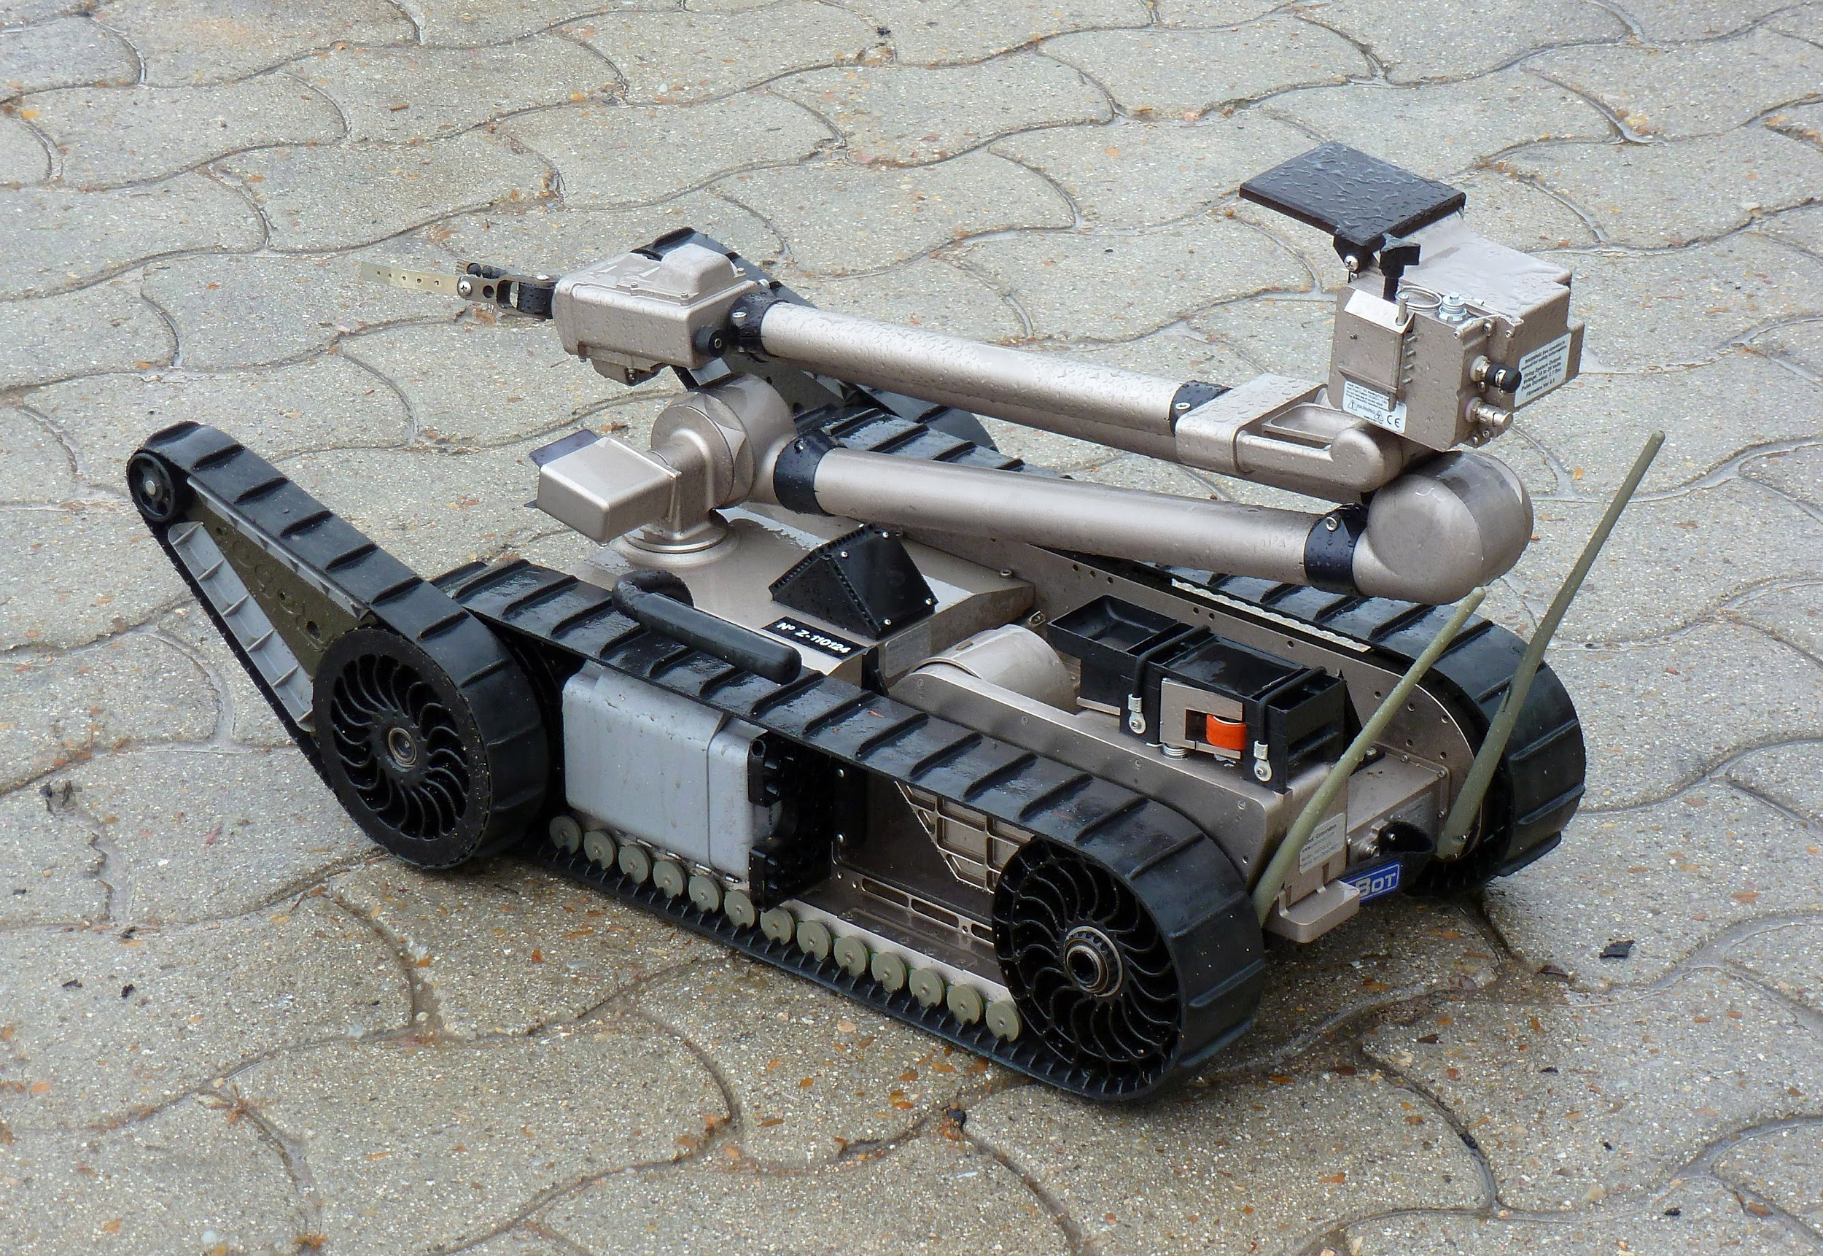
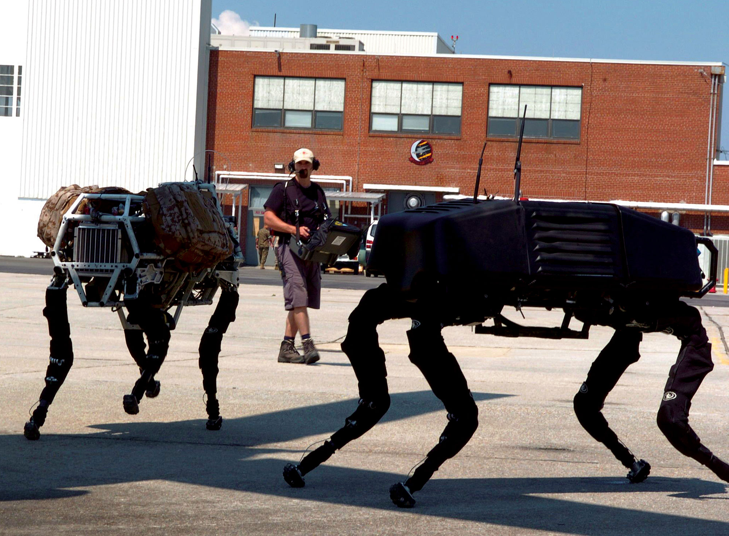
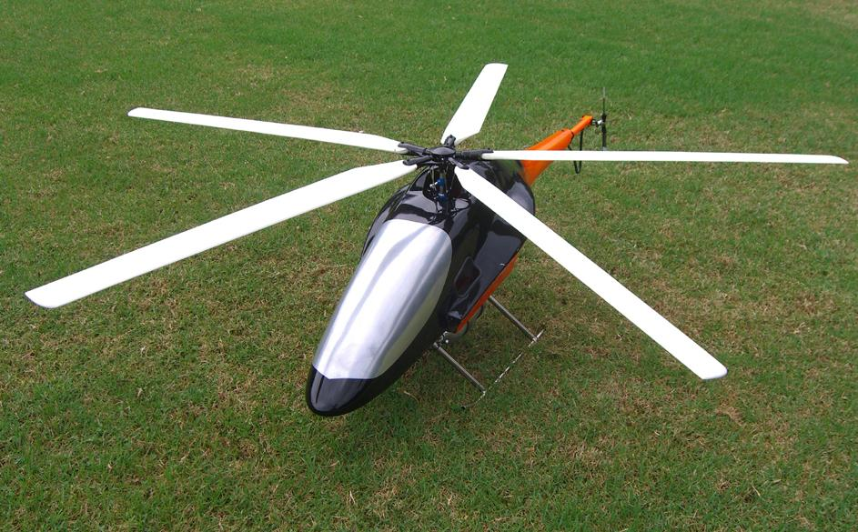
Military Telepresence
Teleoperated soldiers, bomb squads, spies
Not all killing machines
Two Types:
Unmanned Aerial Vehicles (UAVs)
Unmanned Ground Vehicles (UGVs)
UAVs
PackBot
BigDog
Mongoose UAV
Notes:
Currently, teleoperated military robots are already being used to replace soldiers, spies and bomb squads.
You can see that they are not all killing machines as you would imagine based on the media portrayal, but, also include public safety oriented robots.
There are two types of military robots: Unmanned Aerial Vehicles and Unmanned Ground Vehicles, examples of which you can see in these images.
Autonomous UAV Mission System (AUMS))drones are examples of UAVs used for spying and can be teleoperated
Other examples of Unmanned Ground Vehicles can be seen here:
PackBot is a bomb disposal robot
BigDog is a quadruped robot capable of carrying heavy loads that in a war scenario may include injured personnel or medical supplies.

Slide 9
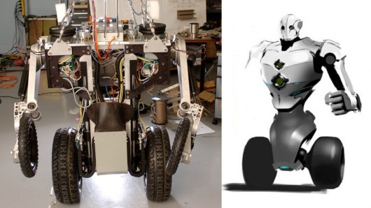
Military Telepresence
RoboCops
On the horizon
First ones may
be teleoperated
[9]
"The first Robocop could be a telepresence robot." http://www.gizmag.com/telepresence-law-enforcement-robot/24354/”
Notes:
Future:
Other robots concerned with public safety and defense that are on the horizon are robocops, which may start off as being teleoperated at first.

Slide 10
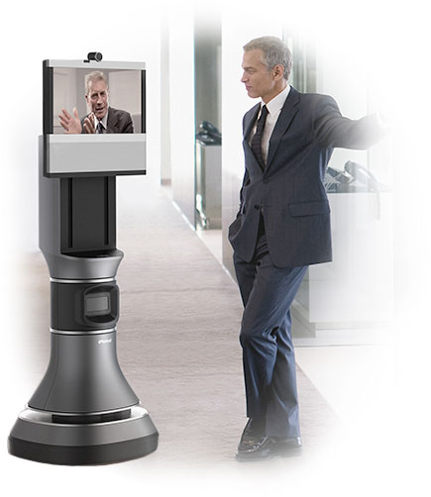
Workplace Telepresence
Employees able to work from home
Less travel time
Can participate in meetings across the world
More efficient communication than conference calls
"IRobot Ava 500 Video Collaboration Robot." Irobot.com. IRobot, n.d. Web.
Notes:
Useful for manufacturing facilities which area often separate from management facilities
Useful for clean rooms/ labs so manager doesn’t have to undergo process to enter the lab, can sterilize the robot instead
increased efficiency by cutting out travel time and one person can be multiple places at once
Can be useful in dangerous situations and workplaces.
Marvin Minsky’s “Telepresence” article discusses how telepresence could have helped the Three Mile Island meltdown [1]

Slide 11
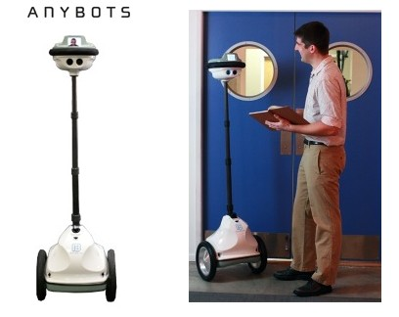
Necessary Features
Moveable Camera
Volume adjustment
Video of user
Indicator of vacancy
Reliable connection
Autonomous navigation
"Anybots Virtual Presence Robot." Anybots.com. Anybots, n.d. Web.
Notes:
Two main problems with telepresence in the office today: cost & people uncomfortable with the technology (irobots Ava 500 estimated to be 70,000$)
Camera to make user feel they are having a real discussion, volume adjustment on both sides, [5]
Features make interactions with telepresence robots more comfortable, allowing for them to become adopted in offices more because they are more efficient,
80% of people interacting with the robot felt that the robot and user were part of the team, but user was less likely to feel so [5]

Slide 12
Social Implications
Information Privacy
Access to sensitive Information
Computer Security
Unauthorized control of robot
- Reliability
Consequences of a robot malfunctioning
Work & Wealth
Notes:
Information Privacy: Patient Info, plans sensitive military info, classified documents and trade secrets in the office, family habits
Computer Security: If hacked could cause harm to patient or soldier, spy on children at home, hack into conference calls
Reliability: Robot malfunctioning could cause harm to patient, civilian or soldier
Work & Wealth: no-face to face meetings due to telepresence
Benefits: able to do work from a safe area in military and dangerous workplaces
Telepresence Surgeries could cause liability issues if something wrong (work & wealth)
Because of these implications, complete autonomy may not occur immediately

Slide 13
Future of Telepresence
1 Year: Minimum in offices and households
5 Years: Majority offices have a form of telepresence robot
10 Years: Majority of households have a form of telepresence
30 Years: Uploaded minds into computers with telepresence robots as bodies
Notes:
Though complete autonomy of robots may be seen as something that will happen in the future, we believe that the first step toward such a future will be telepresence robots
1-5:
There is a trend towards efficiency which is contributed to by telepresence robots with advanced capabilities
10:
People are not yet comfortable with telepresence but new features are making interactions more comfortable
30:
Some people claim that we can upload our minds into computers with telepresence robotic representations of ourselves that we can control [4]
As we have seen with disruptive technologies so far, innovation has spearheaded efficiency with lower costs => Efficiency improves, prices go down [7-11]

Slide 14
Reiterating the Thesis
Telepresence will become commonplace in most settings, and is the first step in having robots replace workers.
Notes:
Reiterating our thesis, If we get to the point where we can upload our minds into computers and control these robotic bodies ourselves, we will still be able to perform the same work but, at a faster pace with advanced capabilities that is currently lacking among humans [4]. This way, we have less number of workers with more capabilities and hence more efficiency. This way our reliability on computers decreases and it would be us who would control these robots rather than the artificial intelligence behind it, which is more likely to fail than destroy mankind. [3]
So, in conclusion, we will be able to hold our own by being able to control our own robotic telepresent bodies, that will eventually replace current workers with better efficiency.

Slide 15
References
[1] Minsky, Marvin. “Telepresence”. Web. 15 April 2015. http://web.media.mit.edu/~minsky/papers/Telepresence.html
[2] Held, Richard. “Telepresence”. Web. 15 April 2015. http://scitation.aip.org/content/asa/journal/jasa/92/4/10.1121/1.404500
[3] D. Stauth, “Artificial intelligence systems more apt to fail than destroy,” 2015.http://www.rdmag.com/news/2015/03/artificial-intelligence-systems-more-apt-fail-destroy#.VRGHmHoOrNs.linkedin
[4] V. Woollaston, “We'll be uploading our entire MINDS to computers by 2045 and our bodies will be replaced by machines within 90 years, Google expert claims,”2015.http://www.dailymail.co.uk/sciencetech/article-2344398/Google-futurist-claims-uploading-entire-MINDS-computers-2045-bodies-replaced-machines-90-years.html
[5] Tsui, Katherine M., et al. "Telepresence robots roam the halls of my office building." HRI 2011 Workshop. Vol. 58. 2011.
[6] “Who’s Using VGo”. Web. 20 April 2015. http://www.vgocom.com/whos-using-vgo
[7] Dorrier, Jason. “Telepresence Robots Invade Hospitals - ‘Doctors Can Be Anywhere, Anytime’”. Web. 20 April 2015. http://singularityhub.com/2012/12/04/telepresence-robots-invade-hospitals-doctors-can-be-anywhere-anytime/
[8] Satava, Richard M. “How the Future of Surgery is Changing: Robotics, telesurgery, surgical simulators and other advanced technologies”. Web. 20 April 2015. http://depts.washington.edu/surg/biointel/Future-of-Surgery-0606.pdf
[9] D. Quick. "The first Robocop could be a telepresence robot." http://www.gizmag.com/telepresence-law-enforcement-robot/24354/
[10] Evans, Gareth. “Brain computer interfacing: a big step towards military mind-control”. Web. 30 April 2015. http://www.army-technology.com/features/featurebrain-computer-interfacing-military-mind-control/
[7] H. Crayton, "Laptops getting both cheaper, better," Knight Ridder Tribune Business News. 2005, p. 1.
[8] E. Jessy, "Electronic goods getting better . . . and cheaper,". 2014. p. 8
[9] B. John, "HARD DISKS KEEP GETTING BETTER, CHEAPER: CITY Edition," Buffalo News, 1999, p. D.8.
[10] M. Norra, "Digital cameras getting better, cheaper," Dermatology Times, 3, Advanstar Communications, Inc, 2000, p. 72.
[11] P. N. a. L. Downes, “How Innovations Become Better And Cheaper,” 2015. http://www.forbes.com/sites/bigbangdisruption/2013/05/09/welcome-to-the-world-of-better-and-cheaper/
[12] Mobile Robotic Telepresence Systems to Reach US$372M by 2019 Driven by Applications Requiring Independent Mobility, Embodied Presence, and Social Interaction | ABI Research. (2015). Retrieved from https://www.abiresearch.com/press/mobile-robotic-telepresence-systems-to-reach-us372/

