Slide 1
What Happened to Monday?
By Brittany Henriques, Lorenzo Lopez, Hoang Nguyen, Maxine Shi, Nupur Shukla
1
Notes:
Hello.
We looked into the world and setting of the film What Happened To Monday.
My name is Hoang….I’m...
And off we go!

Slide 2
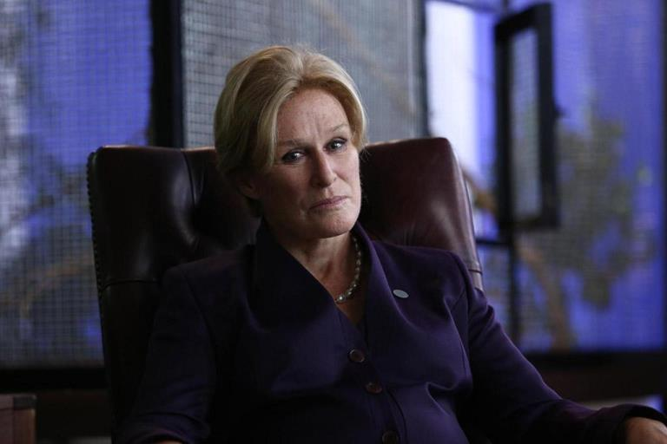
Context of the Setting
2020s - 2040s
Overpopulation
2040s - 2070s
Senator Cayman Introduces the One Child Allocation Act
Creation of the CAB (Child Allocation Bureau)
New Social Groups Form
2
Notes:
https://www.purefandom.com/wp-content/uploads/2017/08/What-Happened-To-Monday-5.jpg
Here is some context of the film
Between 2020 - 2040s
The world is facing issue of overpopulation, and a lack of resources
To try to solve this issue, the united states focused on the production of gmo produce, which only worsen the situation
To resolve this issue
Between 2040s - 2070s
Cryosleep is introduced to the public as a solution to overpopulation
With this new technology, US Senator Cayman introduces the one child allocation act, a strict one child policy
To aid in enforcing this Act
The Child Allocation Bureau, or the CAB was created in order to assist in locating, and process siblings
Additionally, People were required to wear bureau issued Identification Bracelets,
Following the passing of this Policy, we see new Social Groups form
There are people associated the CAB who often carried the moral that they are saving children from their living situations
On the other spectrum, we see people who are in hiding, either people who have multiple children, or did not wear the bracelets

Slide 3
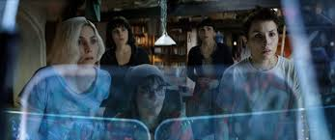
Plot Summary
Monday Goes Missing!
What Happened to Monday
Use Their Personal Skill to Solve Conflicts
Discover the Truth Regarding the CAB and CryoSleep
3
Notes:
For those of you who haven't watched the movie, here is a general summary.
Our Story Takes us in the year 2073, in which 30 years have passed since the start of the strict One Child Policy, following the Settmans.
The Settmens are a family of septuplets who have been trained and given the tools by their grandfather,
Terance to assume the role of one person Karen Settmen. They would live their lives,
being allowed to leave the comfort of their home on assigned days, based on their name.
Monday can go out on Monday, Tuesday on Tuesday, and so on.
All in the attempt to avoid detection from the CAB, and the safety of all the siblings.
The movie’s main conflict occurs when Monday goes missing?
There can only be One Karen Settmen, right? So, the conflict arises when Monday goes Missing.
The sisters would have to discover the whereabouts of Monday, all the while avoiding the CAB.
While doing so, they:
They confirm the importance of their individual identities in the outside world
Discover more about the CAB and Cryosleep that governed their lives, or the Truth
https://bloody-disgusting.com/interviews/3454047/interview-tommy-wirkola-talks-happened-monday-irredeemable-hansel-gretel-witch-hunters-tv-spinoff/
https://encrypted-tbn0.gstatic.com/images?q=tbn:ANd9GcS8wjH2tKuQAj2v191wtR7nb40YFC-DN25Zaw&usqp=CAU

Slide 4
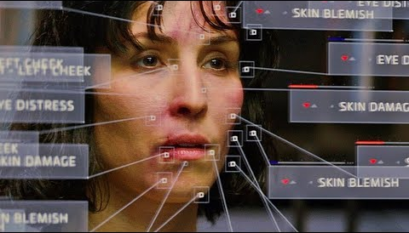
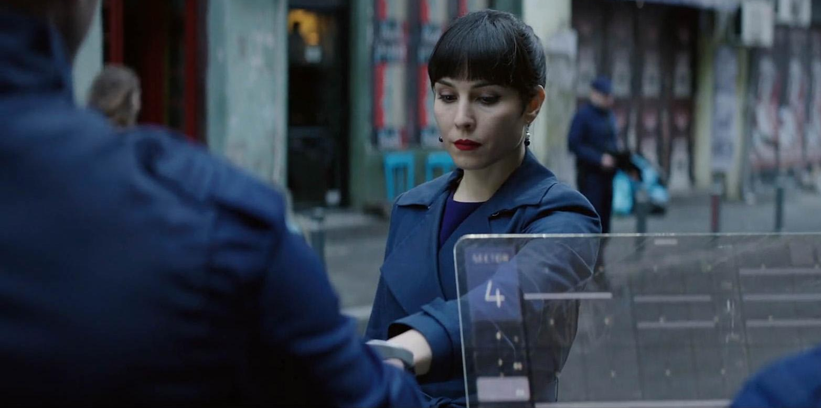
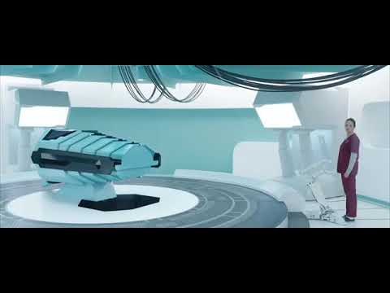
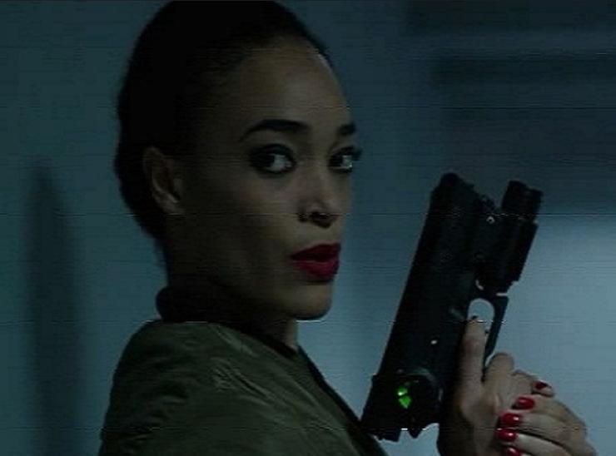
Computing Technology Findings
4
Notes:
Throughout the movie we were able to identify 4 key computing technologies.
Duplicating Mirror
One of the tools that aided in the impersonation of Karen Settmen was what we like to call it: the Duplicating Mirror.
The software identifies discrepancies within the face, comparing it to the ideal individual.
This application allows for a consistent “Karen Settmen” to be out and about.
Pinpoints differences between the person to Karen Settmen and suggest changes that are needed
Bracelets
Predominantly used throughout the film was the Bu Issued Identification Bracelets.
Aside from holding an individual's id, and genetic information , it acts as a smart watch or smartphone. More on that later.
Cryosleep System
When we consider what technologies the CAB had access to, we can consider the CryoSleep System.
The medical device “preserves” individuals through lowing their body temperature.
This is controlled by a software that handles individuals who are to be processed by this device, holding information such as name, and their location throughout the CAB facilities.
Finger Locking Gun
The CAB also has access to finger locking guns.
These guns will grant access to users who pass the finger authentication.
Unauthorized users can not fire these weapons.
Within all these technologies we see a plethora of information that is used and accessible by both the government and individuals. As we can all identify at this point, having all that data ceneralized and held by the government is a risk to individuals.
Images Sources
http://kristofferbrady.com/project/whathappenedtomonday
Smart Mirror / Duplicating
https://www.youtube.com/watch?v=k7MOqnYUBaQ
https://i.ytimg.com/vi/k7MOqnYUBaQ/hqdefault.jpg
Gun
https://femalevillains.fandom.com/wiki/Zaquia_(What_Happened_To_Monday)
https://static.wikia.nocookie.net/evilbabes/images/0/0c/Screenshot_20180206-145418.jpg/revision/latest?cb=20180206230145
Cryosleep
https://i.ytimg.com/vi/47XUWR0-Pe8/hqdefault.jpg
https://www.youtube.com/watch?v=47XUWR0-Pe8
Watch
http://kristofferbrady.com/wp-content/uploads/2017/09/SCAN_25.jpg

Slide 5
Conclusion
In context of the real world:
Technological companies would not comply with the government into releasing user data.
5
Notes:
Comparing this to our world, tech industries and private companies would never comply with the government to reveal user data.

Slide 6
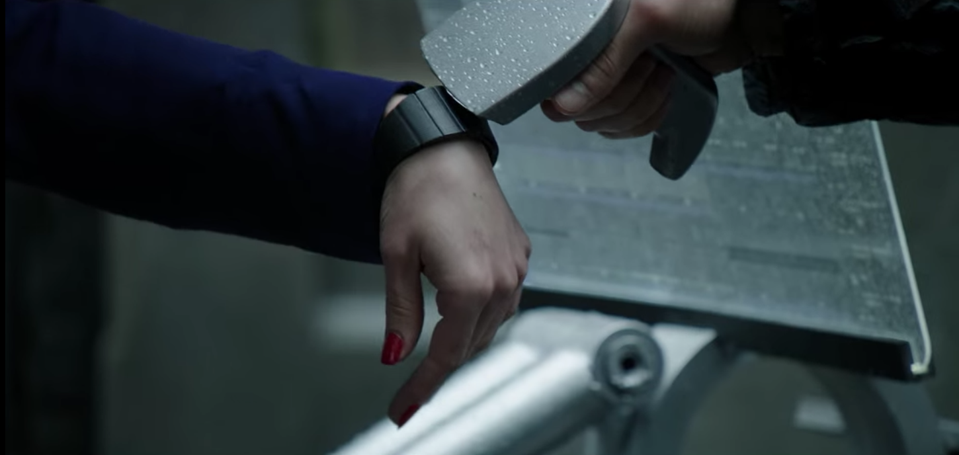
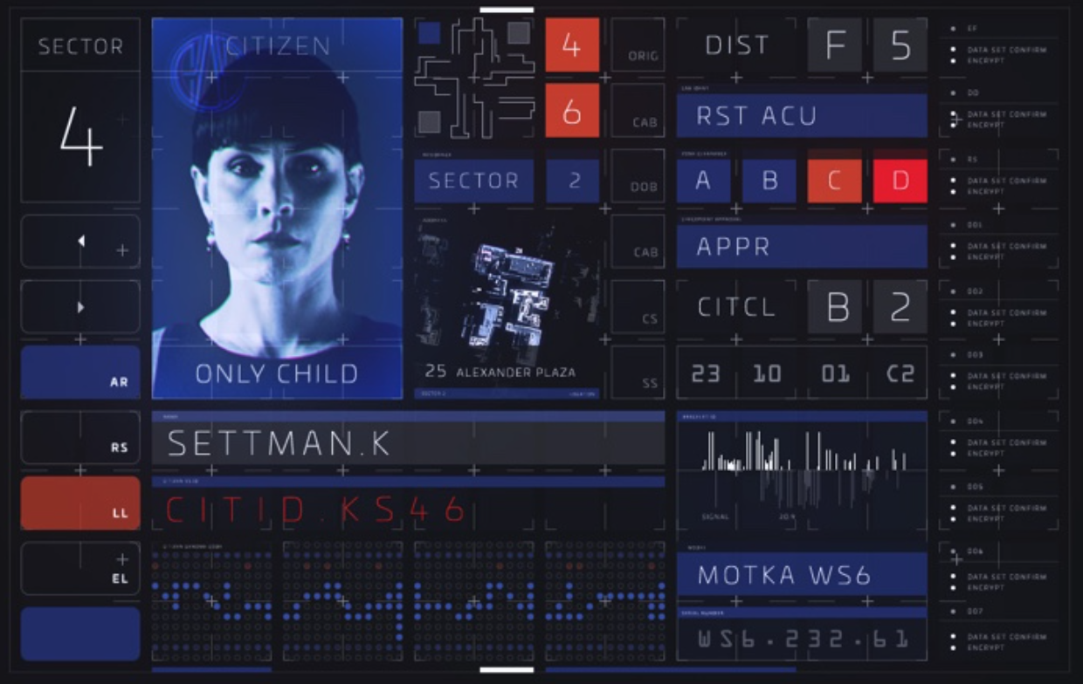
Chosen Computing Technology
Government Issued Bracelet
Functionality
GPS
Share Media
Payment
Employment
Bank Information
Surpass checkpoints
Verification of only child
This bracelet became a fundamental part of each citizen’s life
Figure 2. Display After Bracelet Scan [2]
Figure 1. Bracelet Scanned [1]
6
Notes:
[1] Grouchnikov, Kirill. “Pushing Pixels.” Pushing Pixels RSS, 22 Feb. 2018, www.pushing-pixels.org/2018/02/22/the-art-and-craft-of-screen-graphics-interview-with-kristoffer-brady.html.
[2] Wirkola, Tommy, director. What Happened to Monday? Netflix, www.netflix.com/.
Our team decided to focus on the government issued identity bracelet for our computing technology.
Throughout the film, we see this watch multiple times with no variation in its outward appearance but the specs of the bracelet vary as the access increases.
The bracelet shares many features, some which we have grown accustomed to in our world. For instance, the bracelet has GPS capabilities, we see this when Wednesday escapes from the C A B enforcers.
We are able to share media through various communication features. Purchasing items is as similar as apple pay or google pay on your Apple watch or Samsung watch. Since it serves as an identity verification, this bracelet is needed to retain employment, open a bank account, as well as get through the checkpoints of the city as you might use the GPS feature. Very quickly we come to realize that this bracelet is a fundamental part of each citizen’s life in the movie
Without this bracelet, you cannot be part of society.
The left of center image is Monday’s bracelet being scanned at one of the checkpoint’s which she has to pass everyday to go to work
Second image is the profiles which the bracelet holds
It holds the photo, birthdate, name, sector, and many other pieces of data (edited)

Slide 7

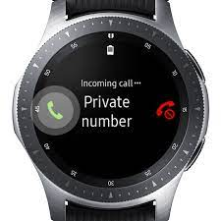
Reasoning Behind Choosing the Bracelet
Most applicable piece of technology
Driving companies
Apple, Samsung
Comparable features:
GPS
Communication
Payment plans
Movie differentiations:
Government controlled
User verification
3D holographic maps
180° camera recordings
7
Notes:
The identity bracelet is most compatible with the smart watches of our world. The movie lacks private competition as the government issues these bracelets, we have Apple and Samsung developing smart watches. Some of the features might not be the same between the two, but they have strikingly similar design practices. GPS is extremely important, the movie projects 3D holographic maps as you travel to your destination. For our smart watches we need to swipe constantly or pinch out to see the whole picture. Communication with the government bracelets is secure and confidential whereas our watches have amplified speakers allowing for conversations to be easily heard. Google pay and apple pay have become a simplified means of processing transactions.
The movie breaks away from our industry standards with the strict overreaching government control on this technology as it monitors transactions, communications and movement. You cannot go from checkpoint to checkpoint without the government not knowing. The heavy emphasis on user verification cannot be more clear. A new feature that is quite remarkable would be the 180 degree camera recordings that the sisters use daily to reconvene and share their encounters.

Slide 8

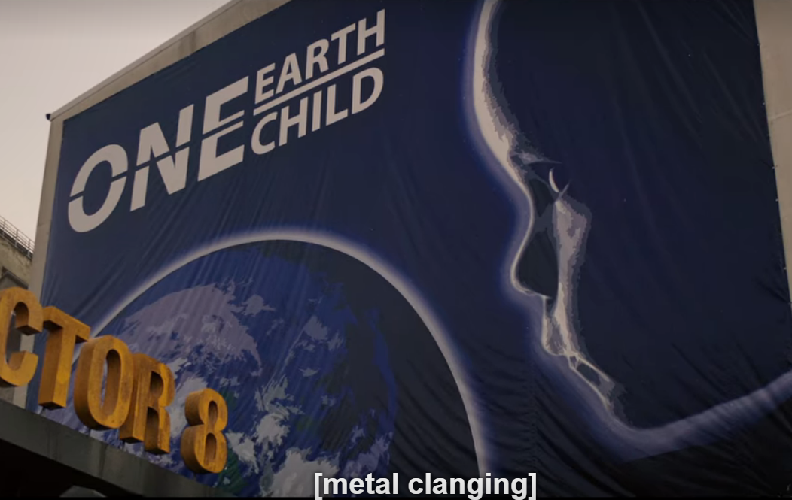
Intellectual Property
No significant plot surrounding IPs
Occurrences
Posters
GMO produce
Smartwatch
Smart mirror
Political atmosphere
8
Notes:
While intellectual property did not have a significant plot point in the story, many intellectual property can be observed within the movie. Just like real life, many ips surround us constantly. For example the posters that advertise for the one child policy like shown in the picture on the right. They appear throughout the movie and through different time periods. GMO produce in real life are often patented by corporation unlike what the movie said “scientists”. Additionally, the advanced technology within the movie like smart watch are also patented by large corporation. Most likely, the government bought or signed contract with certain companies in order to utilize their technology. However, it also highly likely that the technology is owned by the government to extend control. The government in our world also does this to certain military technology in certain applications. The smart mirrors and computers shown in the movie does not have any noticeable logo unlike in real life. The political atmosphere also doesn't seem to promote competition and seem rather totalitarian. This means that the world may have less regulations and right on intellectual property than even our world.
Neves, Pedro Cunha, et al. “The Link between Intellectual Property Rights, Innovation, and Growth: A Meta-Analysis.” Economic Modelling, North-Holland, 2 Feb. 2021, www.sciencedirect.com/science/article/abs/pii/S0264999321000274.
Picture source:
https://theonebrief.com/whats-your-intellectual-property-worth-chances-are-you-dont-know/

Slide 9
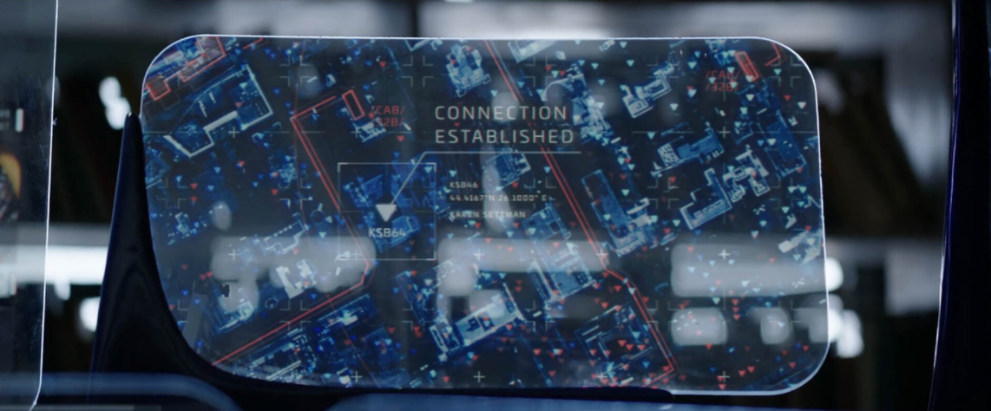
Technology Companies Siding with Government
Some technology company produced the government issued bracelet
Company works with the government by allowing the government to:
Track its citizens
Access the recorded footage
Access genetic information
Because the tech company complies with the government’s use of users’ data, privacy is breached on a daily basis
Figure 2. Bracelet Tracking Feature [2]
9
Notes:
As we’ve seen, the bracelet is the key to being allowed to live
Some technology company produced this bracelet, but also complied with the government
This company works with the government and allows them to access user data such as
Track its citizens
Access any recorded footage
Access genetic information
Because this company works alongside CAB, user data is constantly accessed and used and user’s privacy is breached on a daily basis
Figure:
This figure is directly from the movie where the sisters are trying to locate Tuesday as she goes out into the world trying to find out what happened to Monday
The government is also allowed access to this feature and uses it to hunt down each of the sisters

Slide 10
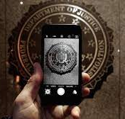
Technology Companies Against Government
San Bernardino, CA Shooting
FBI wanted to crack the PIN on the terrorist’s device
Apple refused to help FBI to gain access to the iPhone
“... such software... would encourage China or Russia to make similar demands for other iPhones” [3]
“... at Apple we are deeply committed to safeguarding their data” [4]
10
Notes:
[3] Selyukh, Alina. “A Year After San Bernardino And Apple-FBI, Where Are We On Encryption?” NPR, NPR, 3 Dec. 2016, www.npr.org/sections/alltechconsidered/2016/12/03/504130977/a-year-after-san-bernardino-and-apple-fbi-where-are-we-on-encryption.
[4] Cook, Time. “Customer Letter.” Apple, 16 Feb. 2016, www.apple.com/customer-letter/.
[5] The Associated Press. “FBI Breaks into San Bernardino Shooter's IPhone without Apple's Help | CBC News.” CBCnews, CBC/Radio Canada, 28 Sept. 2019, www.cbc.ca/news/science/fbi-san-bernardino-iphone-break-1.3509899.
Terrorist attack in 2015 by a married couple
Apple argued: (first quote)
Tim Cook stated: (second quote)
Tim Cook also argued that “helping the FBI hack the iPhone would set a dangerous precedent, making all iPhone users vulnerable, if Apple complied with the court order” [5]
Clearly the CEO is worried about the consequences his company would suffer if it decided to comply with the governments’ requests for user data
Regardless of whether Cook is doing this to save his company or whether he actually cares about his customers, Apple refused to fulfill the FBI’s request

Slide 11

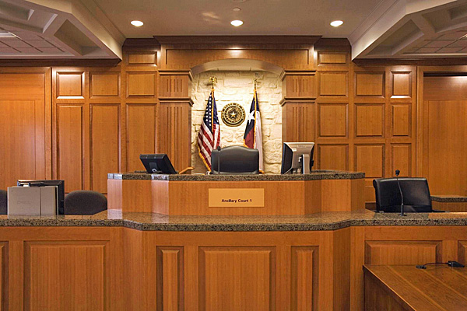
Technology Companies Against Government
Justice Department demanded Apple to reveal text messages
Apple did not comply since iMessage system is encrypted
Justice Department and FBI took Apple to court as well as entangling Microsoft in the case
“... if the US government wins, the door is open for the other governments to reach into data centers in the U.S.” [5]
Microsoft’s General Counsel
11
Notes:
First bullet: between two suspects involved in an investigation involving guns and drugs
Last bullet: stated in Microsoft’s practices regarding their customer’s data
In both examples of Apple vs. FBI and Microsoft vs. Justice Department, you can see that the tech companies refused to comply with the government
These companies will not work with the government for a few important reasons
Firstly, they need to stay loyal to their customers
Both Microsoft and Apple, as well as other tech companies have vowed to respect their user’s data
Betraying this data and giving the government free range over data could lead to customers refusing to buy products made by these companies
Secondly, more powerful companies like Apple and Microsoft use encryption so that only the sender and the receiver can see the contents
So in situations like the ones just mentioned, it is extremely hard for companies to help governments access the piece of data they want because it’s has several layers of encryption
Given these examples as well as many others, we conclude that the world which is portrayed in the movie would not become our reality simply because big tech companies understand the importance of staying faithful to their customers and not allowing a third party to access their customers’ data
[5] Apuzzo, Matt, et al. “Apple and Other Tech Companies Tangle With U.S. Over Data Access.” The New York Times, The New York Times, 7 Sept. 2015, www.nytimes.com/2015/09/08/us/politics/apple-and-other-tech-companies-tangle-with-us-over-access-to-data.html.
[6] “About Our Practices and Your Data.” Microsoft & Data Law, 15 Apr. 2021, blogs.microsoft.com/datalaw/our-practices/.

Slide 12
References
[1] Grouchnikov, Kirill. “Pushing Pixels.” Pushing Pixels RSS, 22 Feb. 2018, www.pushing-pixels.org/2018/02/22/the-art-and-craft-of-screen-graphics-interview-with-kristoffer-brady.html.
[2] Wirkola, Tommy, director. What Happened to Monday? Netflix, www.netflix.com/.
[3] Selyukh, Alina. “A Year After San Bernardino And Apple-FBI, Where Are We On Encryption?” NPR, NPR, 3 Dec. 2016, www.npr.org/sections/alltechconsidered/2016/12/03/504130977/a-year-after-san-bernardino-and-apple-fbi-where-are-we-on-encryption.
[4] Cook, Time. “Customer Letter.” Apple, 16 Feb. 2016, www.apple.com/customer-letter/.
[5] Apuzzo, Matt, et al. “Apple and Other Tech Companies Tangle With U.S. Over Data Access.” The New York Times, The New York Times, 7 Sept. 2015, www.nytimes.com/2015/09/08/us/politics/apple-and-other-tech-companies-tangle-with-us-over-access-to-data.html.
[6] “About Our Practices and Your Data.” Microsoft & Data Law, 15 Apr. 2021, blogs.microsoft.com/datalaw/our-practices/.
11

