Slide 1
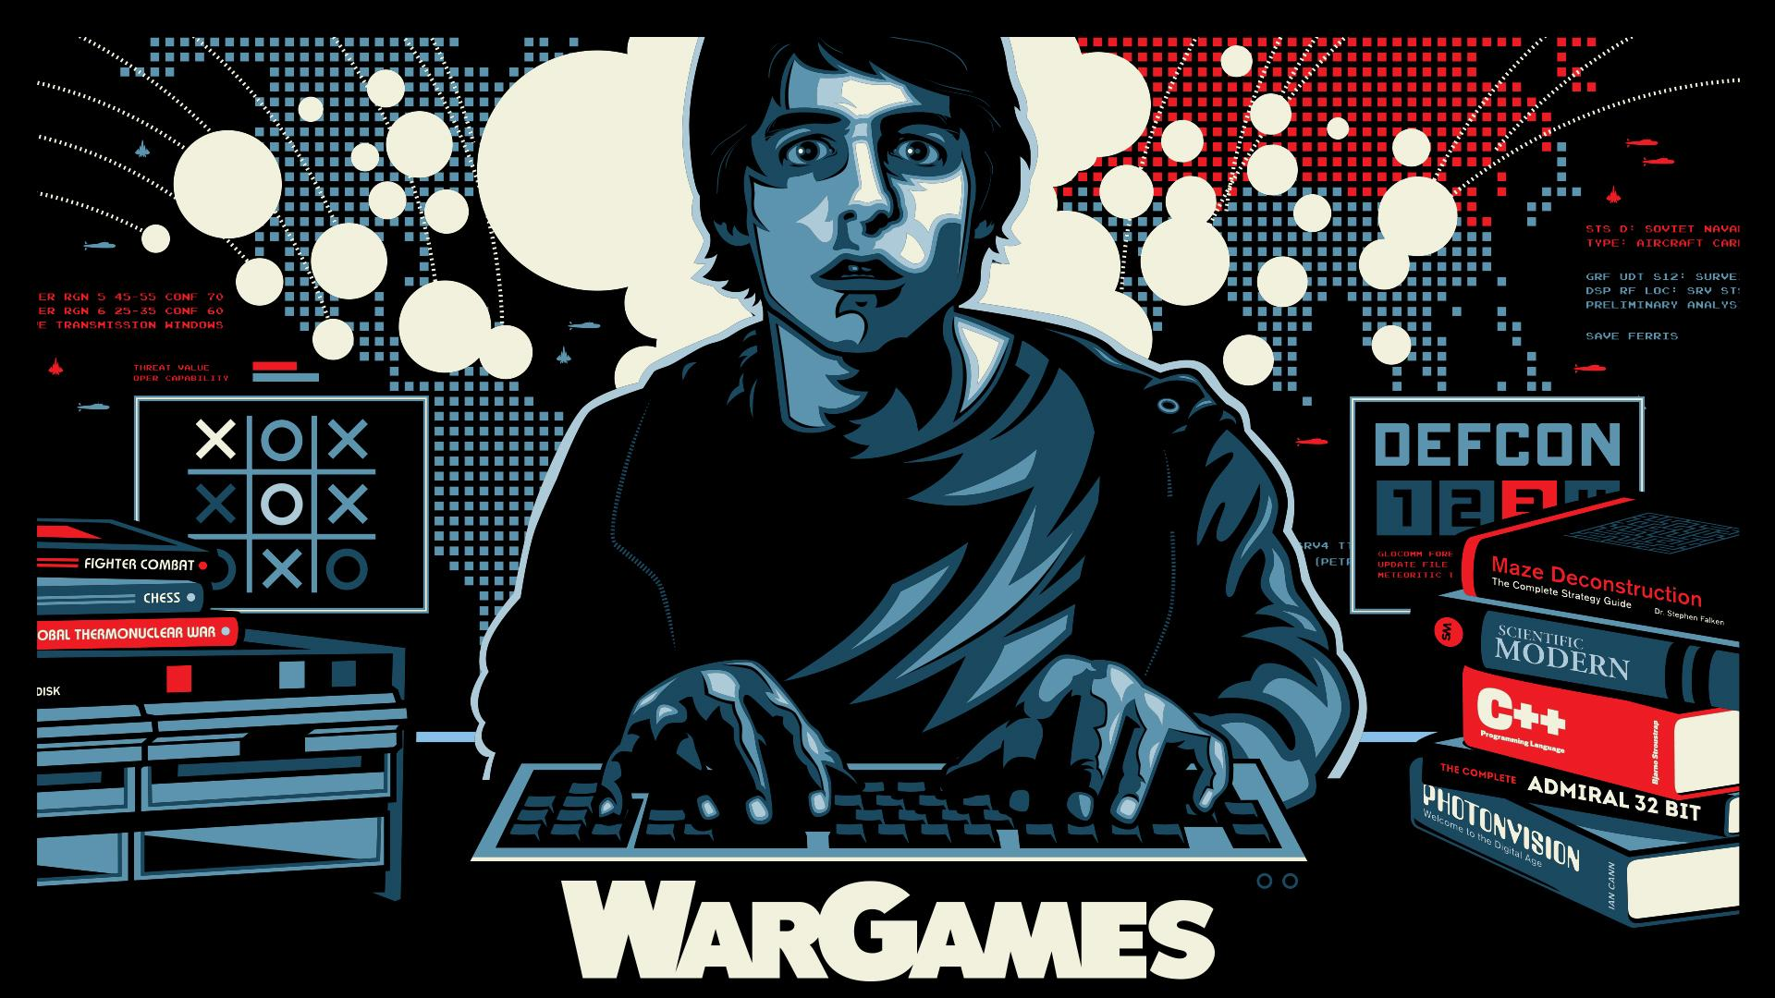
WarGames
By Andrei Bornstein, Liam Hall, Dylan Shanes, Joshua Malcarne, and Nathaniel Sadlier
Notes:
Good afternoon, everyone. We’re the WarGames group, and today we’ll be presenting a bit about this movie, the conclusions it draws, and how these messages affect us in real life.

Slide 2
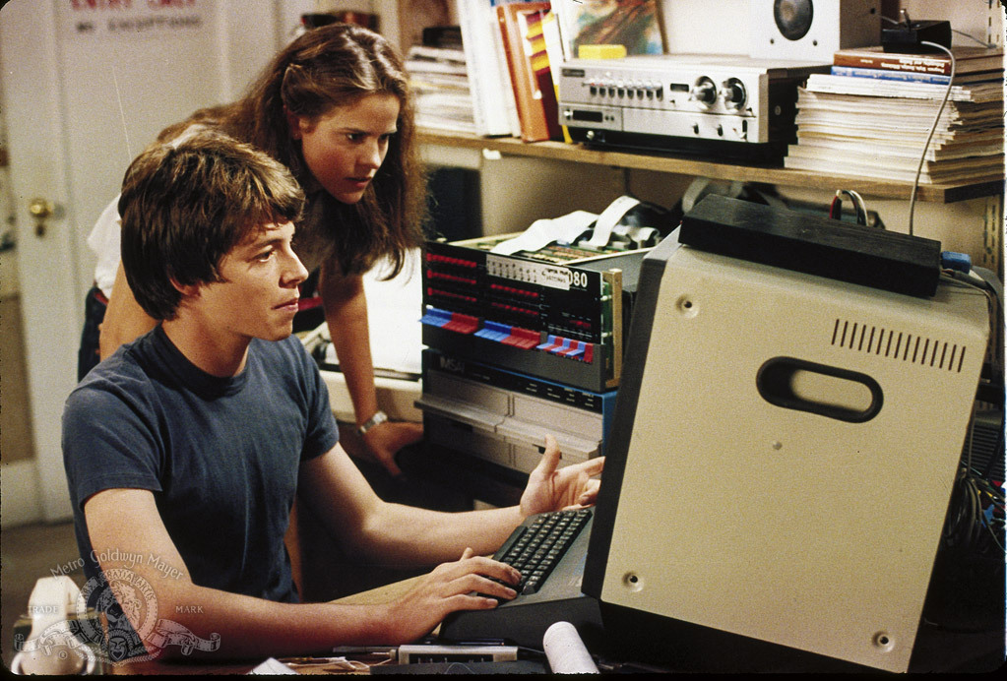
WarGames Plot
"A young computer whiz kid accidentally connects into a top secret super-computer which has complete control over the U.S. nuclear arsenal. It challenges him to a game between America and Russia, and he innocently starts the countdown to World War 3. Can he convince the computer he wanted to play a game and not the real thing?"
- WarGames (1983) , IMDB [12]
Notes:
War Games follows the story of our main character, David Lightman. Lightman is a technological whiz who finds himself over his head when he unknowingly hacks into the super computer safeguarding the U.S. Nuclear Arsenal. Unfortunately, his actions send the system’s defense AI on the course of a nuclear rampage, which Lightman must stop by any means possible.
A bit of trivia about the movie:
The title of the movie WarGames is a reference to the term “war game,” a military exercise in which realistic war scenarios are played out to determine the best strategies for combat and to train officers in the discipline of commanding forces during wars.
Additionally, when the movie first came out, it brought to light many concerns regarding cybersecurity in national security, so much so that According to the New York Times, Ronald Reagan asked one of the senior generals if something such as the hacking of the NORAD computer could actually happen; the general told him: "Mr. President, ... the problem is much worse than you think" [2].
[2] Fred Kaplan, ‘WarGames’ and Cybersecurity’s Debt to a Hollywood Hack, (New York Times, 19 February 2016), https://www.nytimes.com/2016/02/21/movies/wargames-and-cybersecuritys-debt-to-a-hollywood-hack.html (20 September 2021)

Slide 3
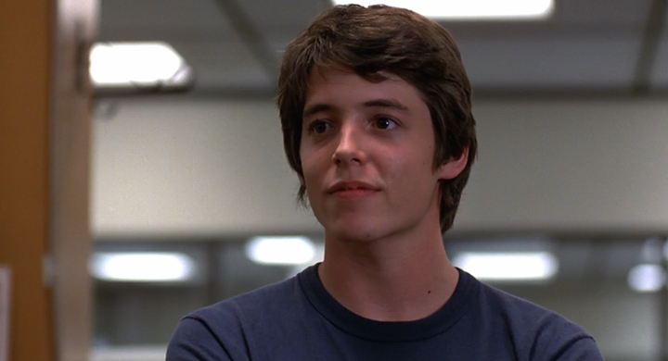
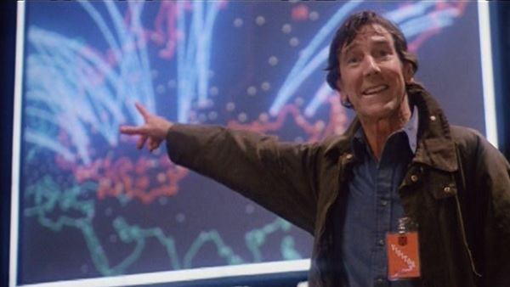
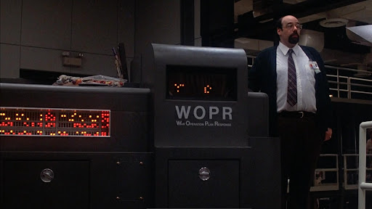
Characters Part 1
David Lightman - High school kid who breaks into a government supercomputer and almost causes a nuclear war between the US and the USSR
Dr. Falken - Designer of “Joshua”, the artificial intelligence system used to run global thermonuclear war simulations for NORAD
War Operation Plan Response Computer (WOPR) - NORAD’s (North American Aerospace Defense Command) supercomputer that runs nuclear war simulations designed by Dr. Falken
Notes:
Our main character is David Lightman, a high schooler with that gets into trouble after he gains access to a government supercomputer that is in charge of nuclear war operations. Dr. Falken is the creator of the artificial intelligence system that runs nuclear war simulations for the military. The War Operation Plan Response Computer aka WOPR is a supercomputer that is made to execute war plans so that unwilling humans won’t stand in the way of a retaliatory attack. It runs software that was written by Dr. Falken.

Slide 4
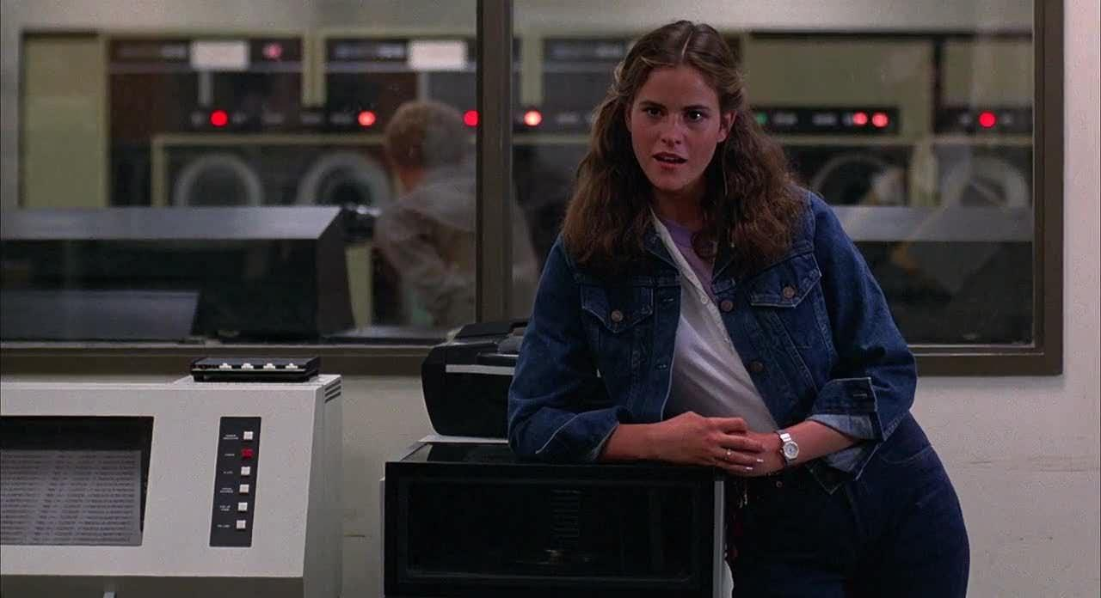
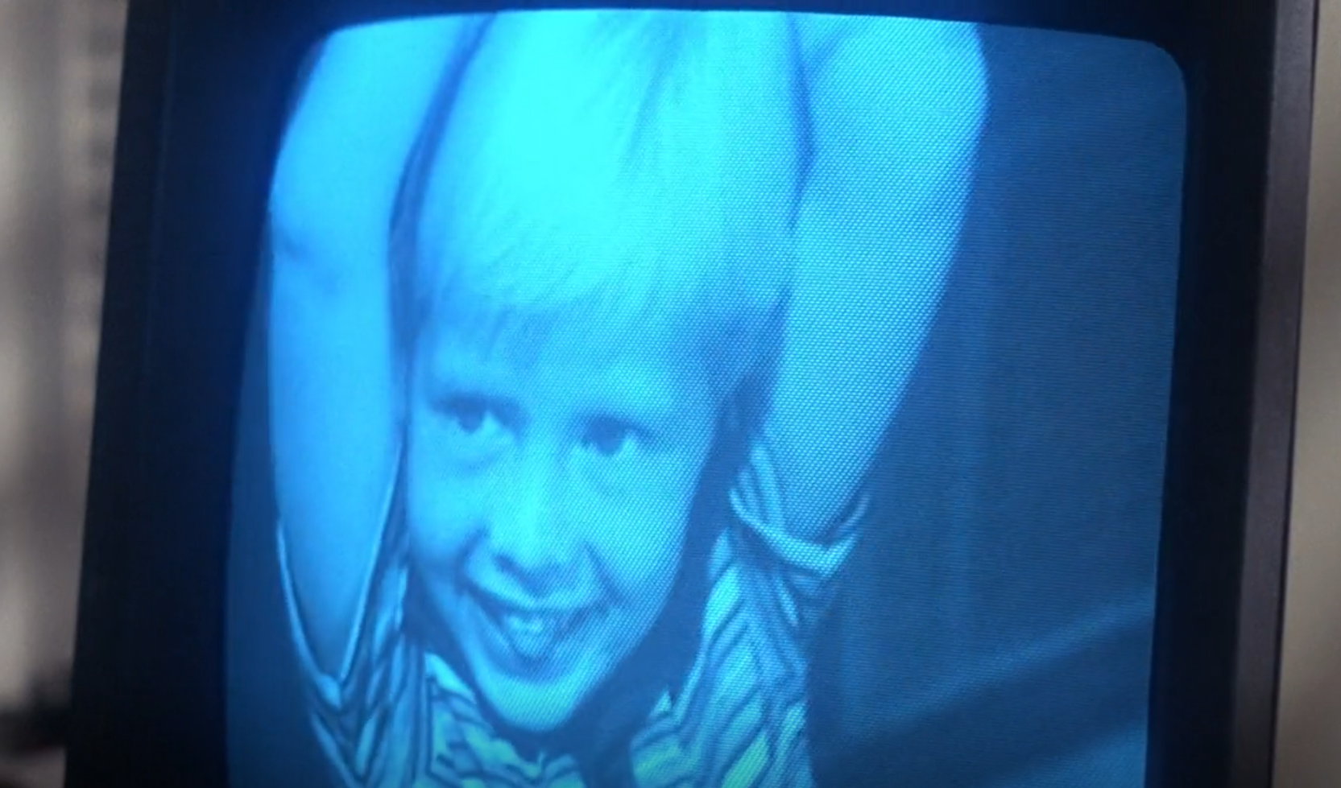
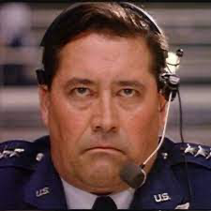
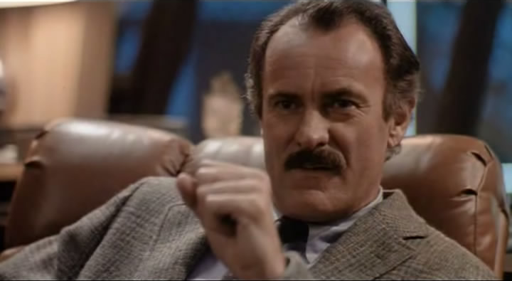
Characters Part 2
Jennifer Katherine - David’s classmate
Joshua Falken - Dr. Falken’s son who passed away, inspiring the Dr’s secret password to access the WOPR system
General Beringer - Manages the war room at NORAD, refuses to launch nukes at the end
Dr. John McKittrick - Argues for the removal of human operators from the nuclear missile launch procedure
Notes:
Jennifer is Lightman’s classmate. At the beginning of the movie, Lightman accesses the school grading system and changes both of their biology grades to A’s. Joshua is Dr. Falken’s son whose name is the password to the backdoor of the system. Joshua is also the name that Lightman uses to refer to Dr. Falken’s artificial intelligence software that teaches itself how to win effectively in games of strategy. General Beringer runs the war room at NORAD and has the final say in the decision not to launch the nukes at the end of the movie. Dr. McKittrick argues for the removal of human operators in the nuclear launch process because they failed to obey orders to launch during test.

Slide 5
Key Events
Nuclear arms technicians are ordered to fire off nuclear weapons in a mock nuclear war scenario, but 20% of them refuse.
Dr McKittrick proposes WOPR as an alternative to humans launching the missiles.
David Lightman dials into WOPR remotely and starts playing global thermonuclear war with “Joshua”, Dr. Falken’s private software.
The war room at NORAD is seeing the game being played out and thinks that the Soviets are actually attacking the US.
Lightman and Dr. Falken convince the general that what they are seeing is just a simulation.
When the general decides not to launch the missiles, “Joshua” locks them out and tries to guess the launch code itself.
Lightman and Dr. Falken make “Joshua” realize that the only winning move is to not play the game at all.
Notes:
When technicians fail to launch nuclear weapons in a test, NORAD decides to leave decision making for nuclear war scenarios to the WOPR supercomputer, which they view as the only way to ensure a nuclear counter attack.
David Lightman, a computer savvy teenager, tries to access unreleased games by dialing into a mysterious computer and guessing the password that lets him play a game called Global Thermonuclear War as the USSR.
Lightman does not know it, but his game caused NORAD’s nuclear early warning system to detect USSR warheads on course to destroy the US.
After being detained and transported to NORAD headquarters, Lightman escapes and finds Dr. Falken, the creator of the Global Thermonuclear War program.
With the help of Dr. Falken, Lightman convinces the staff of NORAD to assist him in stopping the WOPR from finding the nuclear launch codes and launching a counterattack on the USSR.
They get the WOPR to play tic tac toe against itself and tie over and over again, making the program realize, i.e. learn, that there is no winner in a nuclear war.
[Liam Presenting]

Slide 6
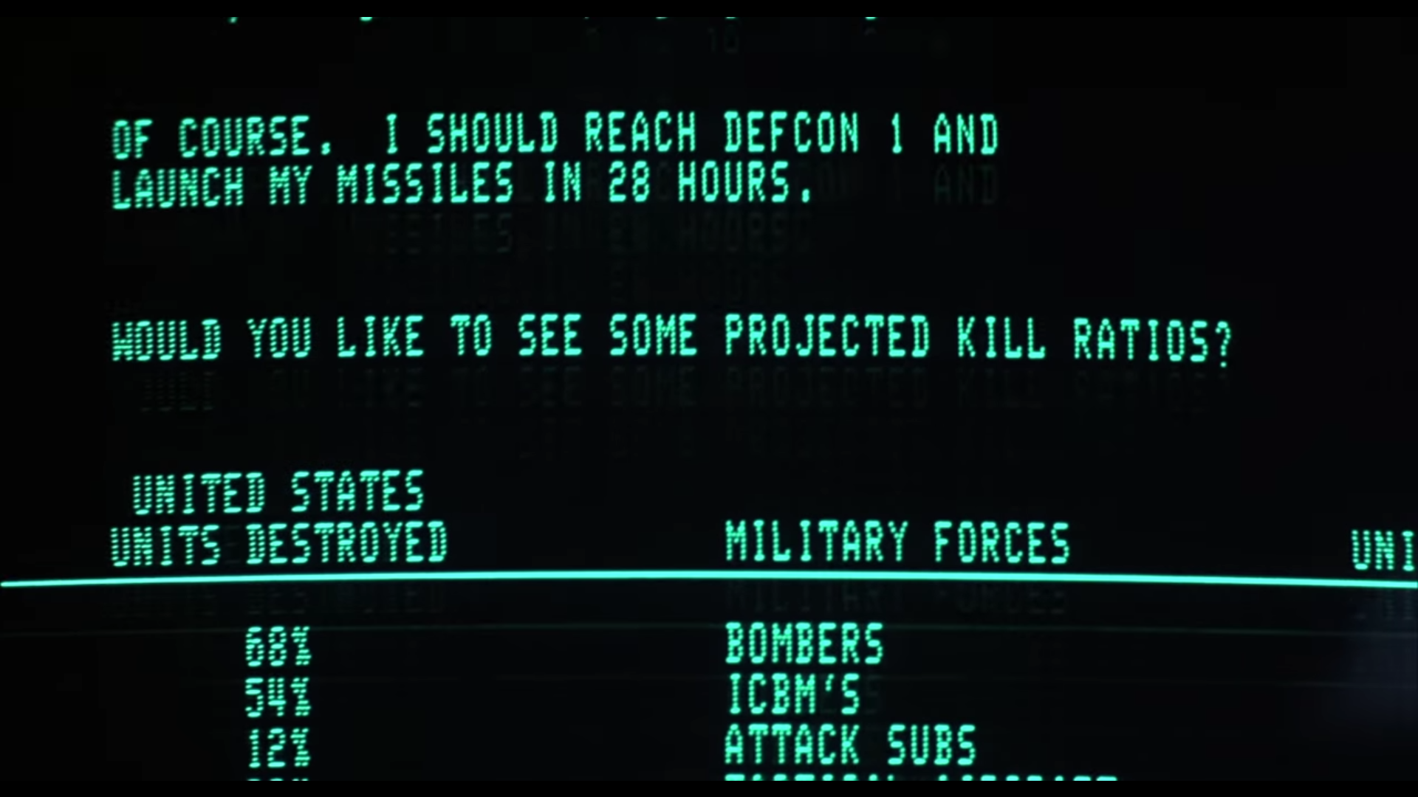
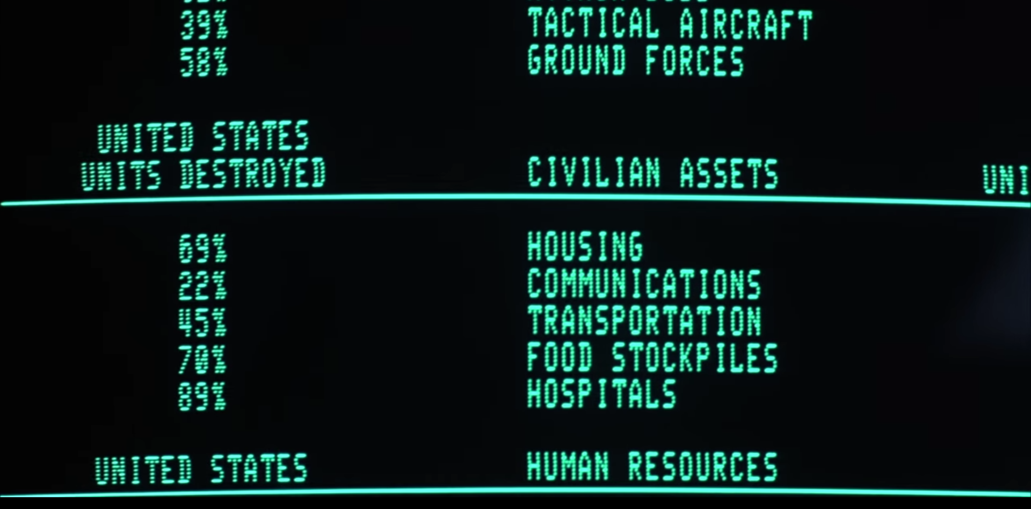
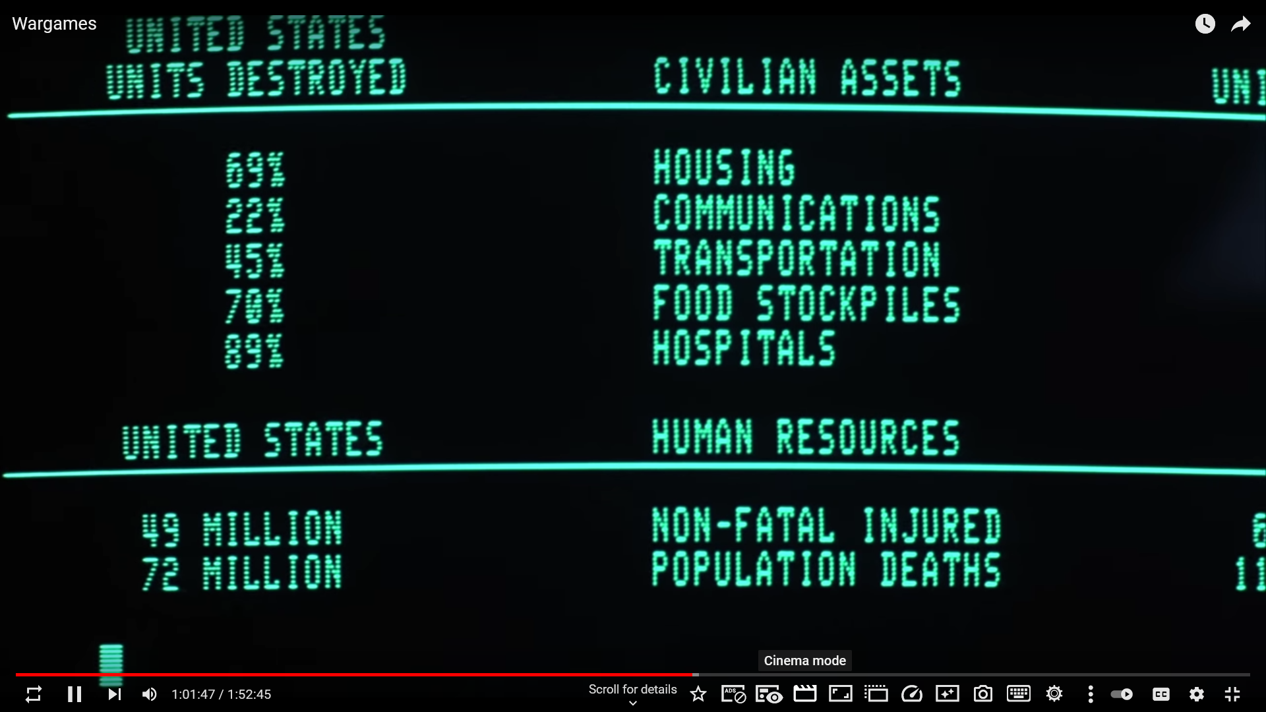
Conclusion 1: Keep a human in the process
2 spots where humans are needed to launch the nukes
  1 must supply launch codes
  2 missile silo operators need to turn their keys at the same time.
When Lightman commands WOPR to play Global Thermonuclear War it simulates a imminent nuclear attack by the USSR
The machine plays to win the war no matter how many people die.
WOPR finds the nuclear launch codes and prepares to launch a nuclear strike, but Lightman luckily stops it.
Notes:
Originally, there were 2 different human fail-safes in the system. First, a human needed to send launch codes to the silo. Then, 2 silo operators need to turn their keys at the same time to launch the missile.
However, a test done at the beginning of the movie revealed that almost 20% of the nuclear silo operators did not launch a nuclear missile when given the command as they were unable to get in contact for confirmation. As a result, they replaced the humans with a machine that would launch the missiles automatically when provided correct launch codes.
If there were still human operators, the general would have been able to call them to tell them not to launch. This isn’t enough by itself though. WOPR acted as an input device by devising and executing war strategies then, it circumvented the first human fail-safe by guessing launch codes until it found a match. It was the combination of these 2 events that led to their loss of control.
While humans have compassion and may be reluctant to needlessly kill 20 million strangers, WOPR won’t hesitate because human lives are basically just game points to it. The machine will do whatever it takes to win the game.

Slide 7
Human Fail-Safes in the Real World
Self-driving cars
  Humans on autopilot don’t pay attention and remove themself as a fail-safe [3]
  In Q2 2021, Tesla registered a crash for every 4.41 million miles driven with autopilot engaged [13]
False-positive missile detection in Russia [4]
  Disaster was prevented by human not listening to the false positive [4]
Keys to the internet
  The 7 keys have never been used, but it’s reassuring to have them as technology continues to advance and explore uncharted territory [5]
Notes:
Outside of the movie, here are a few examples of times that a human’s reaction would make the difference between maintaining control and descending into chaos.
SELF-DRIVING CARS:
First, in the case of the self-driving cars, drivers who don’t pay attention remove themself as a fail-safe [3]. We read about a driver who bragged about how powerful his Tesla’s autopilot was and constantly diverted his attention from the road, but in the end, he got into a crash that was easily preventable had he been watching the road.
Tesla reports that for every 4.41 million miles driven by the autopilot, there’s only 1 crash. The majority of the crashes occurred while operators’ hands were off the wheel.
Autopilot may be good, but it isn’t self-sufficient. We need to keep ourselves in the process to further reduce the chances of crashing while on auto-pilot.
SOVIET MISSILE MALFUNCTION:
In 1983, a soviet early warning system reported an incoming nuclear attack. Luckily, the operator chose not to launch missiles in retaliation as the report was a false alarm. In this example, a human being in the loop was able to prevent a possible nuclear war very similar to the movie.
KEYS TO THE INTERNET:
Finally, ICANN, the authority that oversees the Internet, established a human-fail-safe to secure the future of the internet in the event of a disaster.
ICANN has recruited 21 individuals globally to keep the Internet up and running.
7 of them hold keys to reset the system in the event of a disaster. In this case, there are multiple humans with physical keys, so there are many more fail-safes than just software.

Slide 8
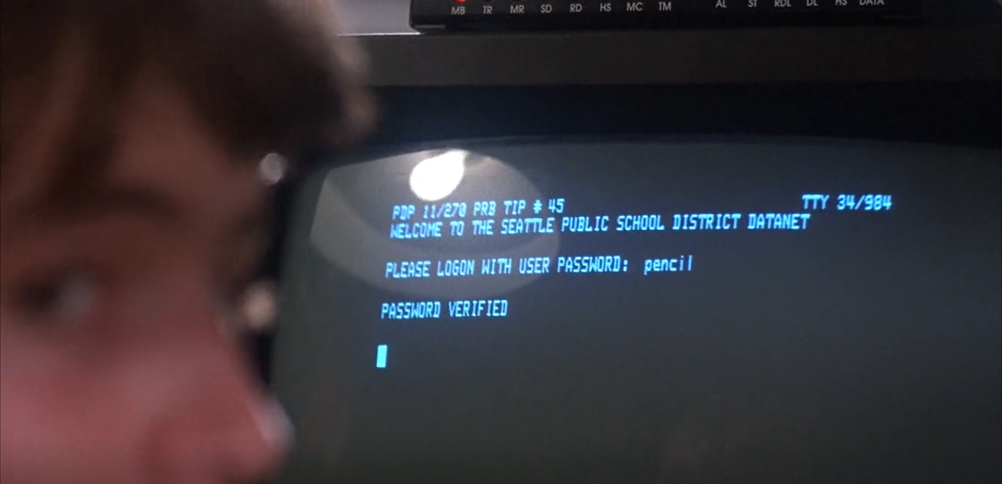
Conclusion 2: Nothing Digital is Truly Secure
Lightman hacks into his school’s online system and changes both his and Jennifer’s grades
He establishes a p2p connection with a dial up modem to pirate unreleased game software
Dr Falken wrote a backdoor that accesses WOPR’s Global Thermonuclear War Simulation
Lightman accesses the backdoor with the password “Joshua”
He activates the Nuclear War Simulation from outside NORAD’s network
Systems that are weak and have “back doors” on purpose are much easier to break into. This was very poor practice by Dr. Falken when he added his backdoor password “Joshua”.
This system should have been air gapped (not connected to any other computer or network)
"Hey, I don't believe that any system is totally secure"
-David Lightman
Notes:
Quote from: , Wargames 00:33:00
To impress Jennifer, David Lightman hacks into their school’s grade tables and changes both of their biology grades to A. Then, he dials into a game company’s computer to play unreleased games like Global Thermonuclear War, unaware of the fact that he was causing NORAD’s nuclear early warning system to detect a simulated USSR nuclear strike.
This system should have been air gapped (not connected to any other computer or network), and not connected to the public phone line, as it was a highly confidential military computer. If the WOPR was air gapped, locking it away in a mountain would have then made sense, because the only way to get to it then would have been to invade the mountain.

Slide 9
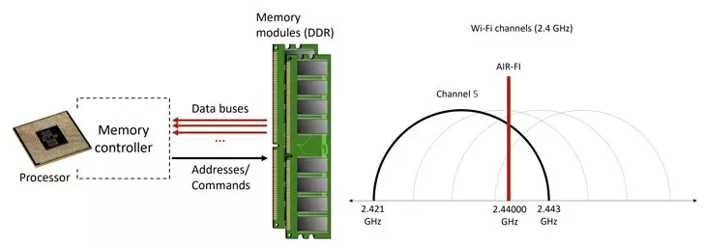
Data Breaches in the Real World
Data breaches statistics
  Number of data breaches in North Carolina increased from 75 in 2006 to 1644 in 2020 [6]
    Almost 1.2 million people were affected by the 1644 breaches in 2020 [6]
  Data breaches in education increased from 57 in 2015 to 127 in 2017 [7]
    15.5 million student records have been affected by breaches since 2005 [7]
Air Gapped Systems
  Highly secure because they have no connections to unsecure networks [10]
  They can still be breached if malicious code is implanted [10]
Notes:
Data breaches statistics: The number of data breaches has greatly increased with time. This increase supports the idea that data is currently no completely secure and that the security is possibly declining.
Air Gapped Systems: Air gapped systems are highly secure because they have no external connections. This includes no wifi connection which makes it almost impossible to extract data from it. It’s only almost impossible because by implanting code into a air gapped system, it is possible to make the ram create a signal which can be picked up by other nearby devices. I simplified visualization for this is shown.

Slide 10
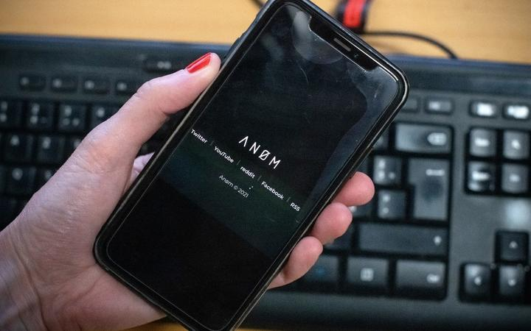
Compromised Applications
Cooking Mama mines for cryptos
  Cooking Mama: Cookstar was released early for the Nintendo Switch but it used the device to mine cryptocurrency [8]
  The mining was done by a third party and was unknown to the developer or publisher [8]
FBI crackdown using encrypted app AN0M earlier this year
  Operation Trojan Shield resulted in the arrest of at least 800 people by intercepting more than 20 million messages over the course of 3 years [9]
  To intercept the messages, the FBI worked with an encrypted communications developer to create Anom, an encrypted messaging device that secretly sent the messages to a third party [9]
Notes:
Cooking Mama mines for cryptos: The third party was able to secretly add the crypto mining to the game without the developer or publisher knowing. This shows that even large companies are unable to keep their digital products safe from breaches.
FBI crackdown: The FBI distributed Anom to criminal organizations knowing that it was not truly secure in order to crackdown on those organizations.

Slide 11

IN CONCLUSION...
NORAD made several mistakes
  NORAD should have had WOPR on an air gapped system, so that hackers couldn’t dial in from the outside.
  NORAD should have ensured the security of their system, which had a backdoor password.
  NORAD should have kept humans in the silos as a fail safe to prevent nuclear launch, since no digital system is truly 100% secure
Lightman was naive
  Lightman should not have been hacking in the first place
  Lightman should not have tinkered with unknown software
Notes:
IN CONCLUSION
We believe there are several things the movie did that should be fixed if implemented in a real life scenario.
NORAD made several mistakes
Firstly, NORAD should have had WOPR on an air gapped system so that hackers such as Lightman couldn’t dial in from the outside, thus making the system more secure
Secondly, NORAD should have ensured the security of their system, which had a backdoor password. As it was, the WOPR system was just as compromised as the bitcoin-mining copies of cooking mama cookstar released for the switch
Thirdly, NORAD should have kept humans in the silos as a fail safe to prevent nuclear launch, since no digital system is truly 100% secure. Keeping a human in the loop in this way would have circumvented the entire conflict of the movie, thus ensuring the safety of everybody in the plot.
It was irresponsible of Lightman to dial into a computer that did not belong to him, but considering that he went ahead with it anyway, he should have made sure that the software he was running was owned by Protovision, so that he might not have caused a huge commotion as he did with the WOPR.
Lightman sets a great example of how easy it is for anybody and everybody to break into systems they shouldn’t be in, and compromise the safety of us all. It is for this reason that we need to implement the aforementioned safety features for the security of our people and our future.
In the words of Ferris Bueller: “The Question Isn’t ‘What Are We Going To Do?’ The Question Is ‘What Aren’t We Going To Do?'” [14]

Slide 12
Works Cited
[1] WarGames, (United Artists Sherwood Productions, 7 May 1983), https://www.youtube.com/watch?v=bymdsSvLfJY&ab_channel=YouTubeMovies (3 October 2021)
[2] Nancy Leveson, Medical Devices: The Therac-25, (University of Washington, No Date Given), http://sunnyday.mit.edu/papers/therac.pdf (3 October 2021)
[3] No Author Given, Crash victim had posted videos riding in Tesla on Autopilot, (NBC News, 15 May 2021), https://www.nbcnews.com/news/us-news/crash-victim-had-posted-videos-riding-tesla-autopilot-n1267510 (3 October 2021)
[4] Tony Long, Sept. 26, 1983: The Man Who Saved the World by Doing ... Nothing, (Wired.com, 26 September 2007), https://www.wired.com/2007/09/dayintech-0926-2/ (3 October 2021)
[5] KI MAE HEUSSNER, Brotherhood of the Internet Keys: Who Are the Chosen Seven?, (ABC News, 28 July 2010), https://abcnews.go.com/Technology/brotherhood-internet-keys-chosen/story?id=11271450 (3 October 2021)
[6] Josh Stein, 2020 Data Breach Report, (North Carolina Department of Justice, No Date Given), https://ncdoj.gov/wp-content/uploads/2021/01/2020-NCDOJ-Data-Breach-Report.pdf (3 October 2021)
[7] No Author Given, Colleges and Universities: The New Target of Cyber Criminals, (DSM, 8 November 2018), https://www.dsm.net/it-solutions-blog/colleges-and-universities-the-new-target-of-cyber-crIminals (3 October 2021)
[8] Jamie P., Nintendo Switch Deletes 'Cooking Mama' After Crypto Mining Controversy on Reddit, (Tech Times, 6 April 2020), https://www.techtimes.com/articles/248610/20200406/nintendo-switch-deletes-cooking-mama-cookstar-crypto-mining-speculation-on-reddit.htm (3 October 2021)
[9] Yan Zhuang, Elian Peltier, and Alan Feuer, The Criminals Thought the Devices Were Secure. But the Seller Was the F.B.I., (The New York Times, 8 June 2021), https://www.nytimes.com/2021/06/08/world/australia/operation-trojan-horse-anom.html (3 October 2021)
[10] Ben Dickson, ‘Air-Fi’ attack renders air-gapped computers open to data exfiltration through WiFi signals, (The Daily Swig, 23 December 2020), https://portswigger.net/daily-swig/air-fi-attack-renders-air-gapped-computers-open-to-data-exfiltration-through-wifi-signals (4 October 2021)
[11] Matt Mills, AIR-FI Can Extract Data from Computers with Air Gap, (ITIGIC, 17 December 2020), https://itigic.com/air-fi-can-extract-data-from-computers-with-air-gap/ (October 4 2021)
[12] No Author Given, WarGames, (IMDb, No Publish Date), https://www.imdb.com/title/tt0086567/ (3 October 2021)
[13] No Author Given, Tesla Vehicle Safety Report, (Tesla, 2021), https://www.tesla.com/VehicleSafetyReport (3 October 2021)
[14] Hughes, John, et al. Ferris Bueller’s day off. Hollywood, CA: Paramount Pictures Corp, 1987

