Slide 1
WAR OF THE WORLDS (2005)
Bradley Kohler, Colin Masucci, Tien Nguyen

Slide 2
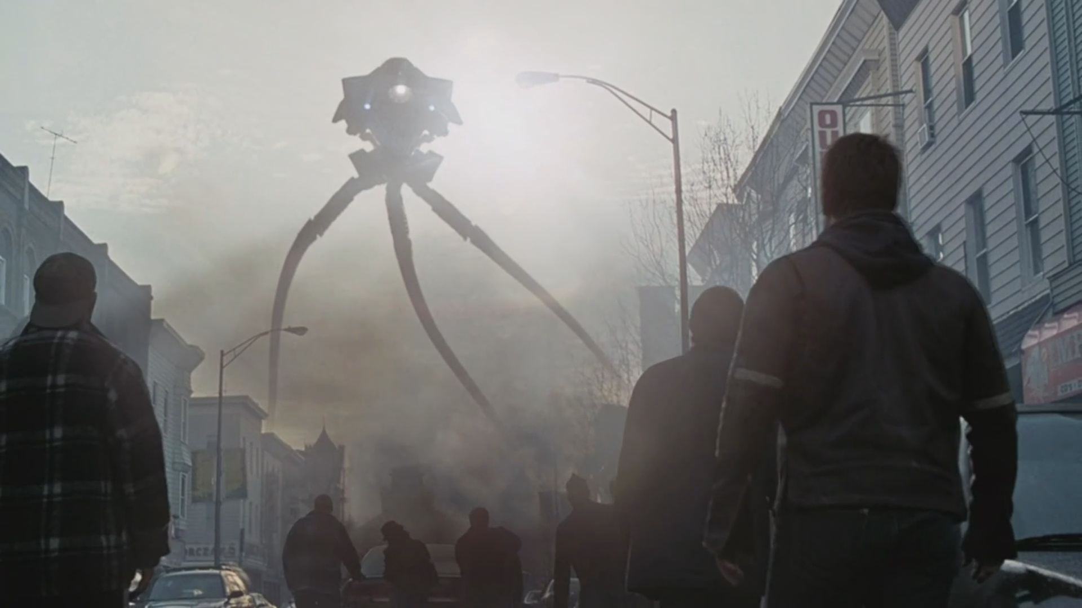
Plot summary
A father and his two kids were supposed to spend a weekend together in New Jersey.
A strange thunderstorm caused an electromagnetic pulse*, disabling all computers/electronics. As a result, there is limited communication and news coverage of the event.
After the storm, large tripod war machines emerged from the ground and began disintegrating people with heat rays.
*An electromagnetic pulse is an intense surge of electromagnetic radiation, typically produced from explosions or solar flares [1]
Notes:
<speaker notes>

Slide 3
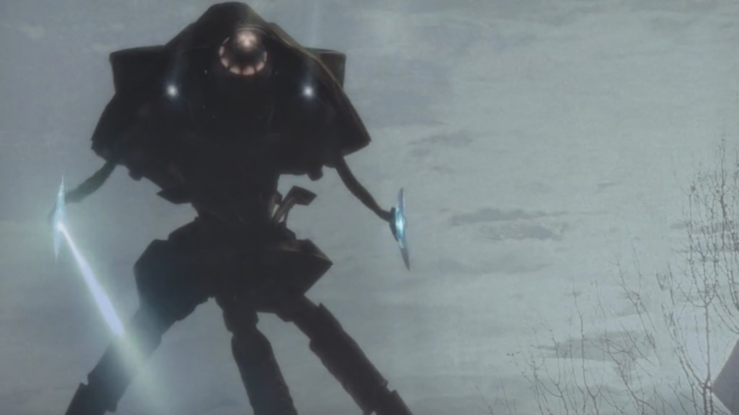
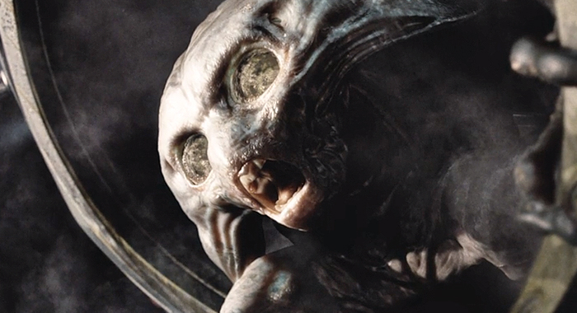
Plot summary
The aliens are set on destroying all of humanity and civilization while the family tries to go to the mother in Boston.
War breaks out against the aliens, and the military, especially with disabled communication networks, struggles against the alien technology.
By the time they arrive in Boston, all the aliens have died because the tripods they operated were unable to protect them from terrestrial microbes.
Notes:
<speaker notes>

Slide 4
CONCLUSION 1:
We are too dependent on UNRELIABLE computer Technology

Slide 5
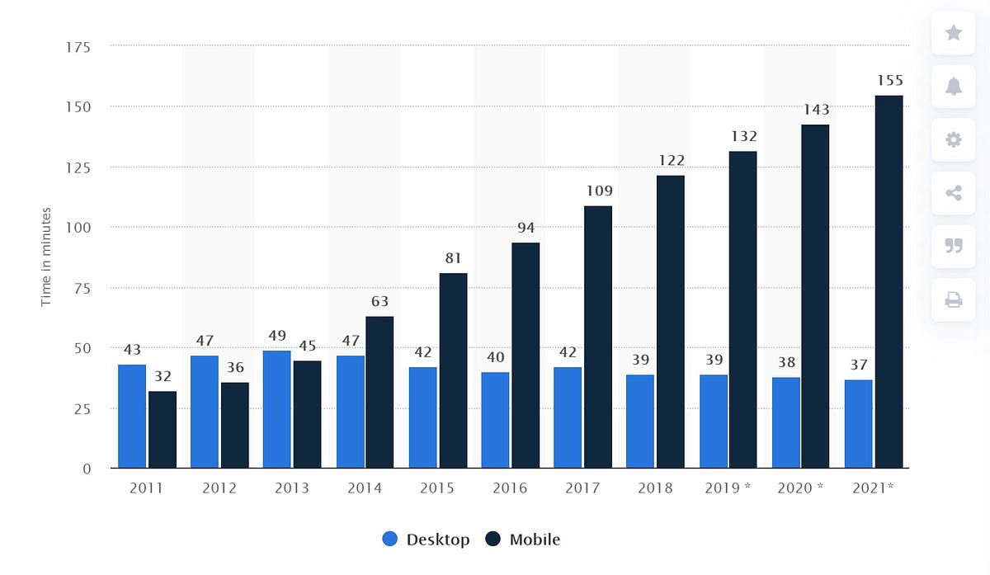
Our dependency on computers
The prevalence of computers:
  In 2021, 95% of U.S. households had at least one type of computer [2].
  In 2023, 97% of U.S. adults owned a cellphone [3]
  In 2022, there were over 8.58 billion mobile subscriptions in use worldwide [4].
Average Daily Internet Usage Worldwide [5]

Slide 6
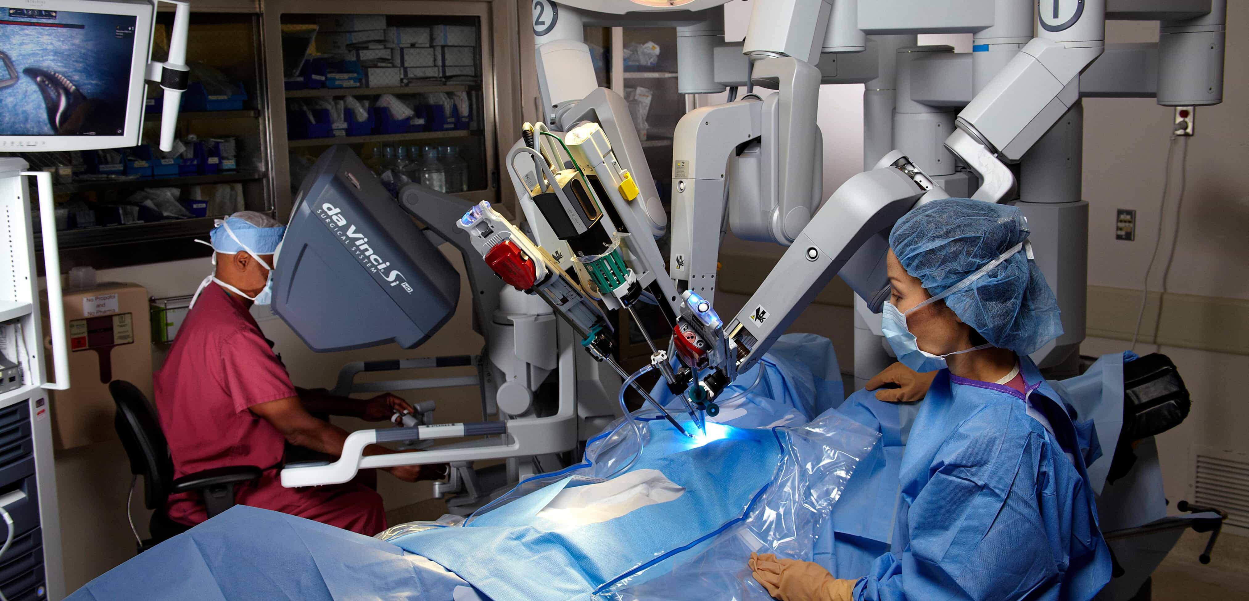
Our dependency on computers
Reliance on computers in healthcare:
  Over 96% of non-federal acute care hospitals (84% of all hospitals) use electronic health records [6][7].
  In 2023, over 2.2 million medical procedures were done with the assistance of robotics [8].
  In 2016, computer-aided diagnosis systems were used in over 92% of mammograms in the U.S. [9].
A surgeon practicing with a robotic surgical system that provides greater precision than traditional surgical techniques [10].

Slide 7
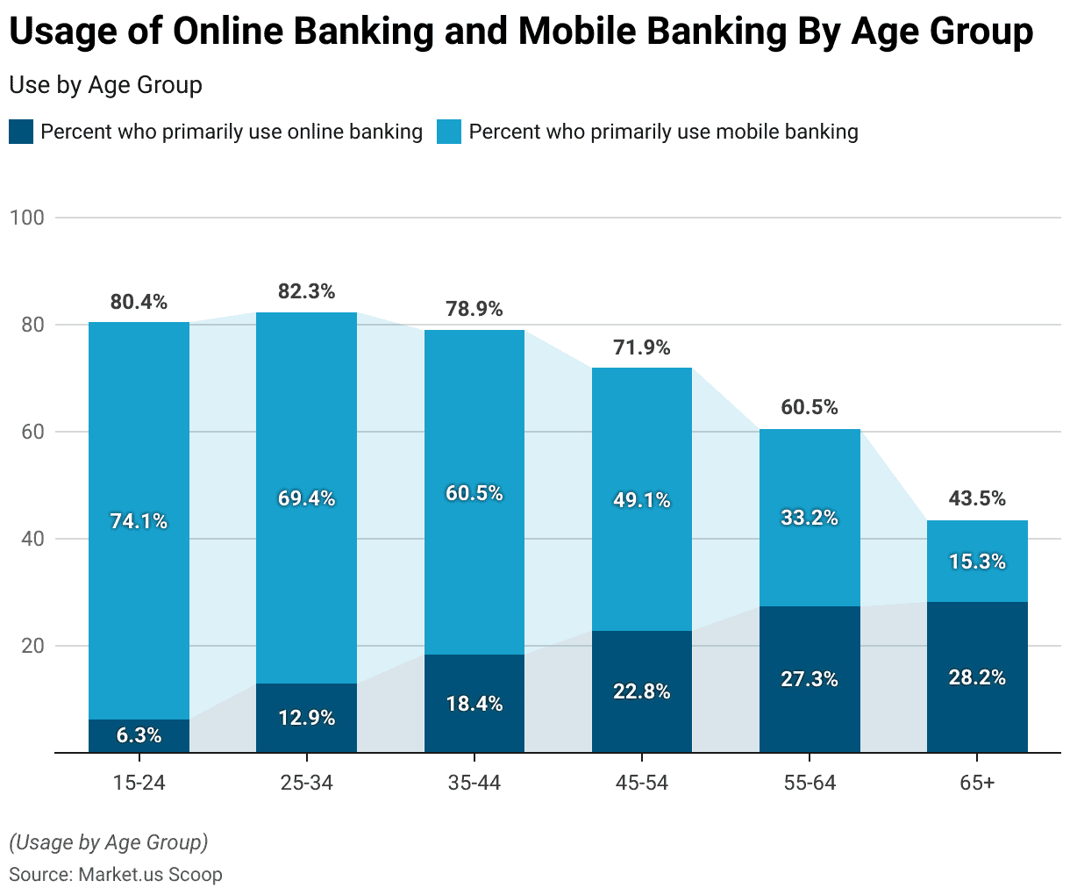
Our dependency on computers
Reliance on computers in finance?
  88% of American adults accessed their bank accounts online in 2023 [11].
  78% of American adults paid their phone bill through a mobile device in 2023 [12].
  ATMs rely on computers to connect to banks and process transactions [13].
Online Banking Statistics 2024, Scoop.market.us [14]

Slide 8
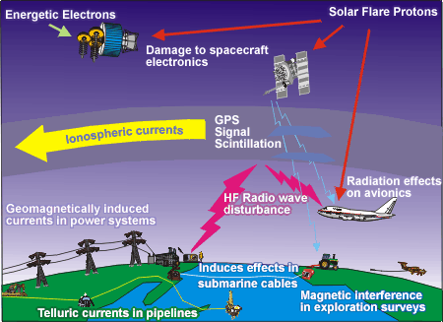
Real-world Consequences of our dependency
Carrington Event (1859)
  Large solar storm that disrupted telegraph lines due to the current induced by the storm’s electromagnetic effects [15].
  Caused operators to receive electric shocks [15]
  Caused fires in telegraph operating rooms[15]
May 2024 Solar Storms
  Caused degraded GPS signals [16]
  Impacted high-precision John Deere agricultural equipment that relied on GPS signals for guidance [17].
In 2015, over 100 million data records in the U.S. healthcare sector were breached [18]
Electromagnetic Effects of Solar Storms [19]
Notes:
2017 WannaCry Attack was a ransomware attack that affected many companies including FedEx Honda and Nissan, However most importantly it effected the UKs National Health Service (NHS). Medical Records were down which caused about 19,000 medical appointments to be cancelled and ambulances were relocated to outer hospitals.

Slide 9
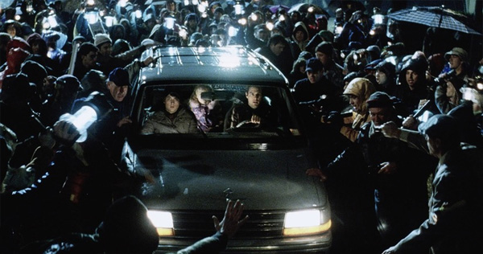
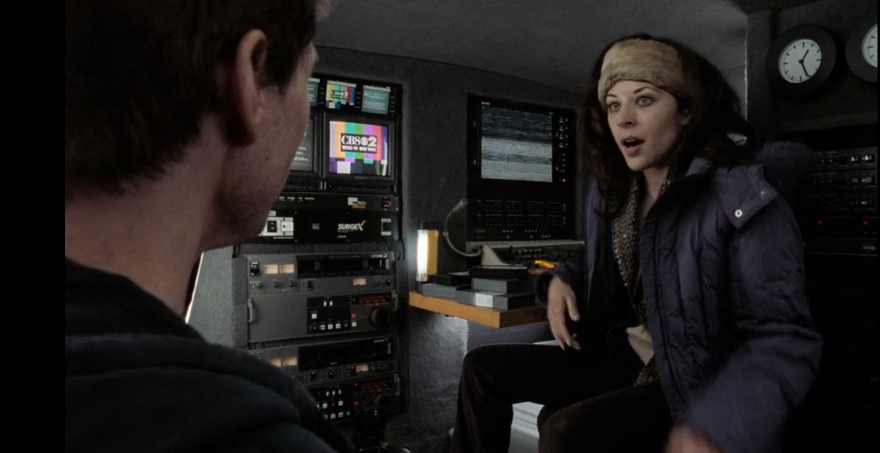
As seen in the movie
Time stamp 53:08 – 54:30
Time stamp 43:55-45:07
Society would kill for a car, showing dependence on technology for transportation
Try to connect or communicate with other people by any possible technologies

Slide 10
CONCLUSION 2:
In war, advanced and reliable computer networks are the backbone of a nation’s Military.

Slide 11
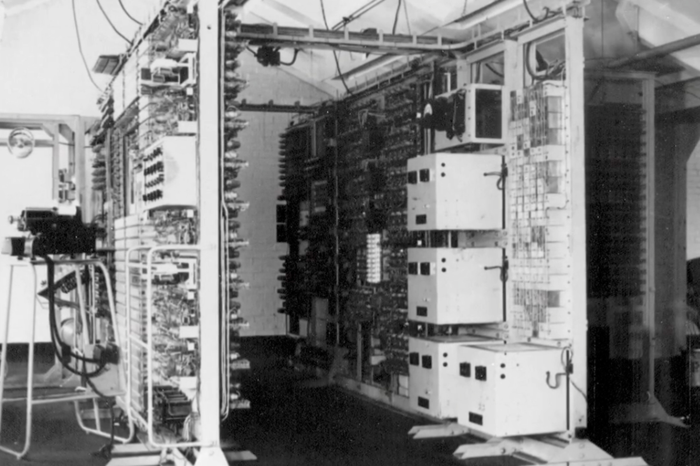
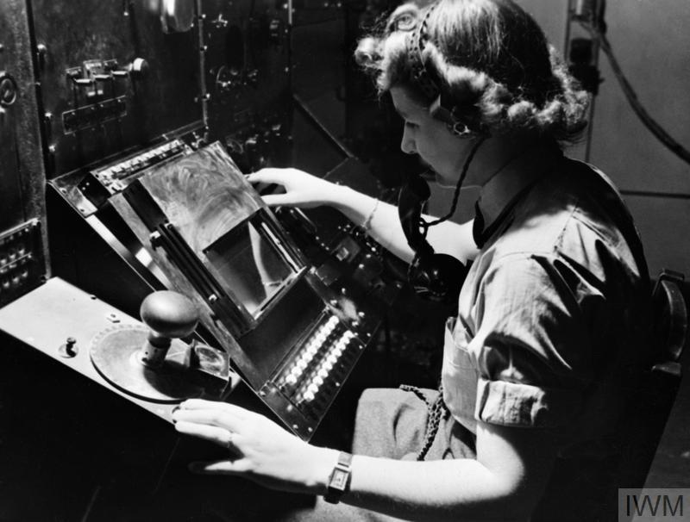
how superior weapons have influenced wars in the past
World War II:​
​
The world’s first programmable electronic computer decrypted code messages sent by the Germans faster than the German recipients themselves [29]
A radar operator for the British Women's Auxiliary Air Force tracking aircraft during World War II [28]
[
Notes:
The Zimmermann Telegram was an early example of one nation taking advantage of a vulnerability in the enemies technology.
Specifically the US intercepted a telegram from the Germans to Mexico to try and have them join the war efforts and the US was able to decrypt this message and diffuse the situation before it became an issue.
Radar Tracking from British Airforce was used in WW2. It was crucial in winni

Slide 12
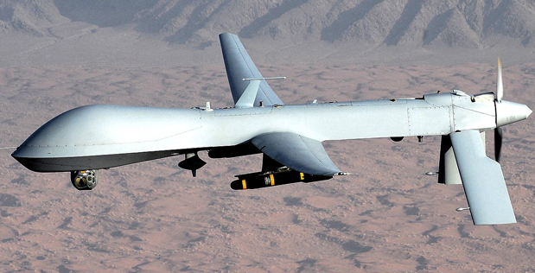
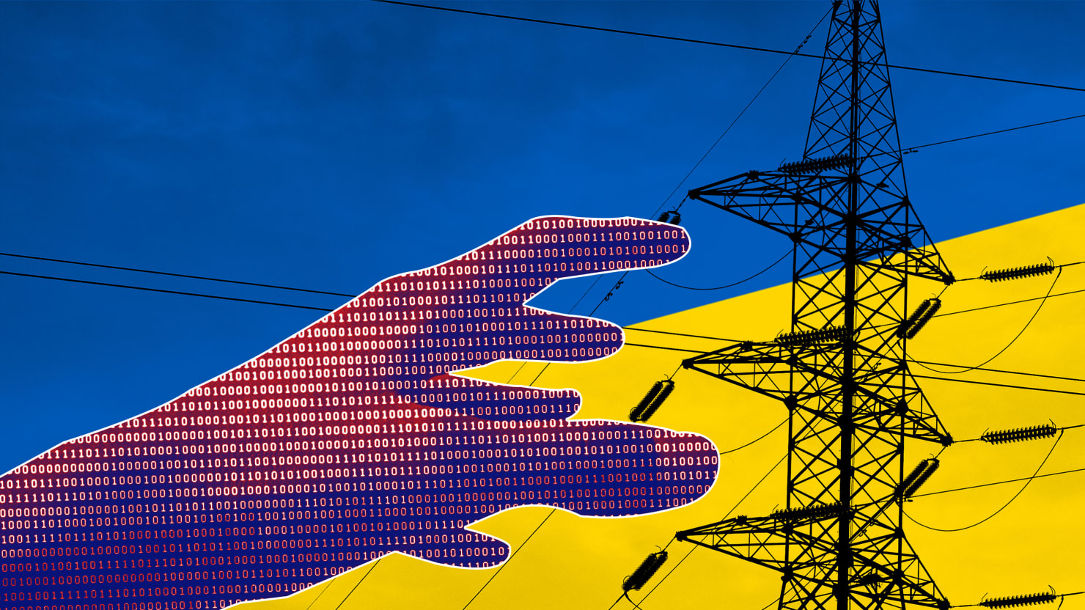
Use of computers in warfare
Computers as Weapons:
“Remotely-controlled unmanned Predator aircraft armed with Hellfire missiles have successfully attacked mobile ground targets in Afghanistan and Yemen.” [20]
Cyber warfare:
A cyber-attack on December 23, 2015, against Ukrainian power companies, which resulted in power outages for around 225,000 customers. [21]
Notes:
Remotely controlled weapons are weapons that can be used from afar to inflict physical damage without putting our own soldiers lives at risk.
One example is …
Cyber attacks are another form of long distance attack.
One example is …
Examples of Long Distance Warfare:
Cyber attacks, drone attacks, missile launches, other autonomous devices

Slide 13
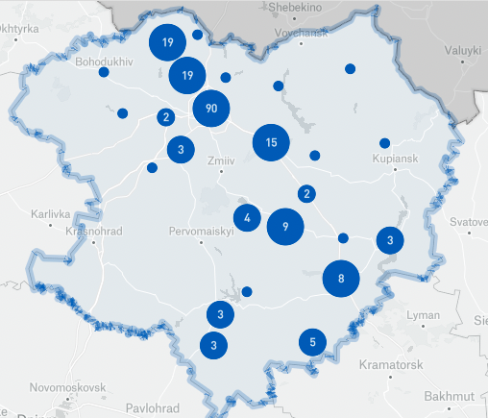
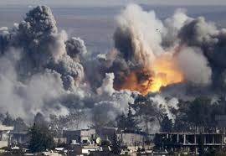
Long Distance Warfare
Civilian Casualties
  Airwars claims 80% of civilian deaths were to airstrikes in Syrian/Iraq War. [23]
Preemptive Attacks
  2003 Iraqi War started based on assumptions of a terrorist group having weapons of mass destruction which was later disproven.[24]
Notes:
Long Distance Warfare:
Widens Global inequalities,
Disproportionate power dynamics,
Increase Civilian Casualties, it is harder to know before hand the amount of civilians in an area so a direct amount is hard to say but there were at lest 3,500
Increase Preemptive attacks where governments make attacking move whenever they perceive a potential threat
Examples of Long Distance Warfare:
Cyber attacks, drone attacks, missile launches, other autonomous devices

Slide 14
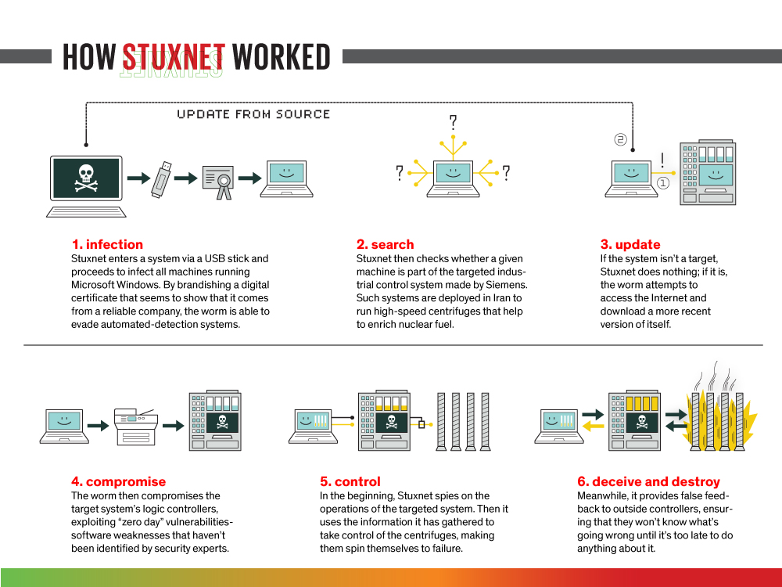
Zero Days Attacks
Stuxnet (2010) [25]
  First malware that spied on industrial systems
  US and Israel delayed Iran’s nuclear program by years without the need of airstrikes or physical harm
NotPetya (2017)[26] [27]
  Russian attack on Ukranian infrastructure
  $20 million in damages
Notes:
Zero Day Attacks
These are cyber attacks where countries exploit vulnerabilities in software, hardware, and firmware to compromise sensitive data.
Stuxnet was a worm sent to Iran t disrupt nuclear developments. It set a president for non violent attacks by taking advantage of unreliable software other countries have in possession.
This was a message to the world that safeguarding system vulnerabilities was essential in winning a war and shifted warfare tactics where putting resources into finding vulnerabilities in an enemies software could become more common. Central fuges overheating
NotPetya
Russia attacked Ukraine targeting banks, power grids, transportation, healthcare and government agencies.
There was 20 mil in damages

Slide 15
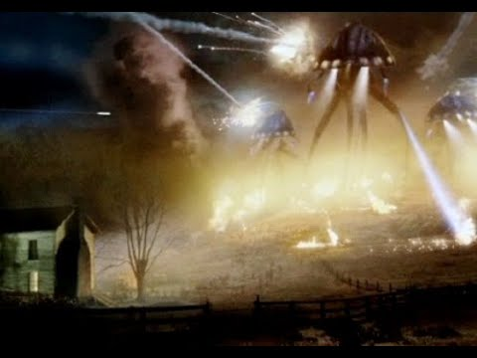
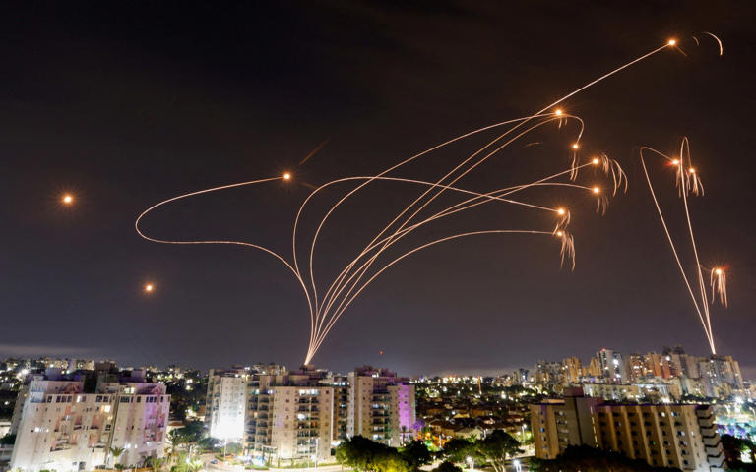
As seen in the movie
Time stamp 1:10:30 – 1:30:34
Israel's Iron Dome Defense System [22]

Slide 16
conclusions
Society depends too much on computers that are unreliable.
  In the movie, the aliens thwarted military efforts by disabling all computers
  The ubiquity of computers and their sudden failure significantly disrupted society
In war, both terrestrial and extraterrestrial, advanced and reliable computer networks are the backbone of a nation’s military.
  The alien invasion metaphorically represents the power imbalances that naturally occur in war
Notes:
<speaker notes>

Slide 17
References
[1] Joint Commission on Technology and Science, “State Electromagnetic Pulse (EMP) and Geomagnetic Disturbance (GMD) Mitigation Efforts,” Division of Legislative Services, Virginia, United States, 2019. Accessed: Oct. 04, 2024. [Online]. Available: https://rga.lis.virginia.gov/Published/2019/SD5/PDF
[2] D. Mejía, “Computer and Internet Use in the United States: 2021,” U.S. Census Bureau, Jun. 2024. Accessed: Oct. 04, 2024. [Online]. Available: https://www2.census.gov/library/publications/2024/demo/acs-56.pdf
[3] O. Sidoti, R. Gelles-Watnick, M. Faverio, S. Atske, K. Radde, and E. Park, “Mobile Fact Sheet,” Pew Research Center, Jan. 31, 2024. https://www.pewresearch.org/internet/fact-sheet/mobile/ (accessed Oct. 04, 2024).
[4] “Individuals Using the Internet,” International Telecommunication Union, Sep. 11, 2023. https://www.itu.int/en/ITU-D/Statistics/Pages/stat/default.aspx (accessed Oct. 04, 2024).
[5] E. Lima, “Smartphone Addiction, Technology Dependency: Science and Statistics,” Life Beyond, Jun. 11, 2020. https://lifebeyond.one/blogs/tech-impact/smartphone-addiction-technology-dependency-science-and-statistics (accessed Oct. 04, 2024).
[6] “Fast Facts on U.S. hospitals, 2024,” American Hospital Association, Jan. 2024. https://www.aha.org/statistics/fast-facts-us-hospitals (accessed Oct. 04, 2024).
[7] Office of the National Coordinator for Health Information Technology, “Adoption of Electronic Health Records by Hospital Service Type 2019-2021,” HealthIT.gov, Apr. 2022. https://www.healthit.gov/data/quickstats/adoption-electronic-health-records-hospital-service-type-2019-2021 (accessed Oct. 04, 2024).
[8] Intuitive Surgical, Inc, “Intuitive Annual Report 2023,” 2023. Accessed: Oct. 04, 2024. [Online]. Available: https://investor.intuitivesurgical.com/static-files/e9ed7c14-f042-4923-b7cc-a1458e11e67b
[9] J. D. Keen, J. M. Keen, and J. E. Keen, “Utilization of Computer-Aided Detection for Digital Screening Mammography in the United States, 2008 to 2016,” Journal of the American College of Radiology, vol. 15, no. 1, pp. 44–48, Jan. 2018, doi: https://doi.org/10.1016/j.jacr.2017.08.033.
[10] “Robotic Surgery,” Pomona Valley Hospital Medical Center. https://www.pvhmc.org/services/perioperative-services/robotic-surgery/ (accessed Oct. 04, 2024).
[11] K. Shah, “Daily frequency of smartphone banking on the rise among Americans since 2019,” YouGov, Nov. 03, 2023. https://business.yougov.com/content/47776-daily-frequency-of-smartphone-banking-on-the-rise-among-americans-since-2019 (accessed Oct. 04, 2024).
[12] InvoiceCloud, “Annual Report: The State of Online Payments,” Dec. 2023. Available: https://invoicecloud.net/wp-content/uploads/2023/12/eb_state_of_online_payments_2024-FINAL.pdf
[13] “How Do ATMs Work,” National ATM Systems. https://www.nasatm.com/pages/how-do-atms-work (accessed Oct. 04, 2024).
[14] T. Pangarkar , “Online Banking Statistics 2024 By Finance, Transactions, Growth,” Market.us Scoop, May 2024. https://scoop.market.us/online-banking-statistics/ (accessed Oct. 04, 2024).
[15] A. May and D. Dobrijevic, “The Carrington Event: History’s greatest solar storm,” Space.com, Jun. 24, 2022. https://www.space.com/the-carrington-event (accessed Oct. 04, 2024).

Slide 18
References
[16] Space Weather Prediction Center, “G5 Conditions Reached Yet Again!,” National Oceanic and Atmospheric Administration, May 13, 2024. https://www.swpc.noaa.gov/news/g5-conditions-reached-yet-again (accessed Oct. 04, 2024).
[17] “Geomagnetic Storm Affecting GPS Signals,” LandMark Implement, May 11, 2024. https://landmarkimp.com/news/news/blog/geomagnetic-storm-affecting-gps-signals--may-2024/?ref=404media.co (accessed Oct. 04, 2024).
[18] A. Petrosyan, “Number of people affected by health data breaches U.S. 2014-2019,” Statista, Nov. 05, 2023. https://www.statista.com/statistics/798564/number-of-us-residents-affected-by-data-breaches/ (accessed Oct. 04, 2024).
[19] Canadian Space Weather Forecast Centre, “Space Weather Effects on Technology,” spaceweather.gc.ca, Mar. 2021. https://www.spaceweather.gc.ca/tech/index-en.php (accessed Oct. 04, 2024).
[20] “U.S. Predator Kills 6 Al Qaeda Suspects,” ABC News, Nov. 05, 2002. https://abcnews.go.com/WNT/story?id=130027&page=1 (accessed Oct. 04, 2024).
[21] U.S. Department of Homeland Security, “Cyber-Attack Against Ukrainian Critical Infrastructure,” Cybersecurity & Infrastructure Security Agency, Jul. 20, 2021. https://www.cisa.gov/news-events/ics-alerts/ir-alert-h-16-056-01 (accessed Oct. 04, 2024).
[22] D. Sheridan, “How the Iron Dome Is Saving Lives across Israel,” msn.com, Oct. 01, 2024. https://www.msn.com/en-gb/news/world/how-the-iron-dome-is-saving-lives-across-israel/ar-AA1rxtTP (accessed Oct. 04, 2024).
[23] “Airwars,” airwars.org. https://airwars.org/ (accessed Oct. 04, 2024).
[24] C. Doherty and J. Kiley, “A Look Back at How Fear and False Beliefs Bolstered U.S. Public Support for War in Iraq,” Pew Research Center, Mar. 14, 2023. https://www.pewresearch.org/politics/2023/03/14/a-look-back-at-how-fear-and-false-beliefs-bolstered-u-s-public-support-for-war-in-iraq/ (accessed Oct. 04, 2024).
[25] K. Zetter, “An Unprecedented Look at Stuxnet, the World’s First Digital Weapon,” Wired, Nov. 03, 2014. https://www.wired.com/2014/11/countdown-to-zero-day-stuxnet/ (accessed Oct. 04, 2024).
[26] CBS News, “What can we learn from the “most devastating” cyberattack in history?,” Cbsnews.com, Aug. 22, 2018. https://www.cbsnews.com/news/lessons-to-learn-from-devastating-notpetya-cyberattack-wired-investigation/ (accessed Oct. 04, 2024).
[27] A. Griffin, “Chernobyl’s Radiation Monitoring System Has Been Hit by the Worldwide Cyber Attack,” The Independent, Jun. 27, 2017. https://www.independent.co.uk/tech/chernobyl-ukraine-petya-cyber-attack-hack-nuclear-power-plant-danger-latest-a7810941.html (accessed Oct. 04, 2024).
[28] “ROYAL AIR FORCE RADAR, 1939-1945,” Imperial War Museums, May 1945. https://www.iwm.org.uk/collections/item/object/205196699 (accessed Oct. 04, 2024).
[29] S. Byford, “Colossus: How the First Programmable Electronic Computer Saved Countless Lives,” The Verge, Mar. 12, 2012. https://www.theverge.com/2012/3/12/2864068/colossus-first-programmable-electronic-computer (accessed Oct. 04, 2024).

