Slide 1
The Truman Show! (1998)
Hunter Jack, Naushin Uddin, Kekoto Maane, Spencer Shaffer, Michael Creighton

Slide 2
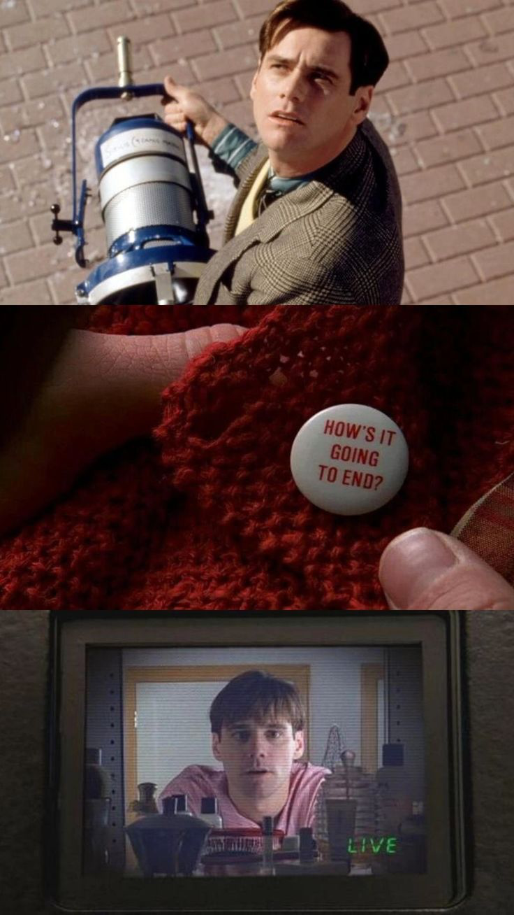
Overview
Plot Summary
Conclusions
Computing Technology
Lack of Privacy
Reality Shows
Ethical Analysis

Slide 3
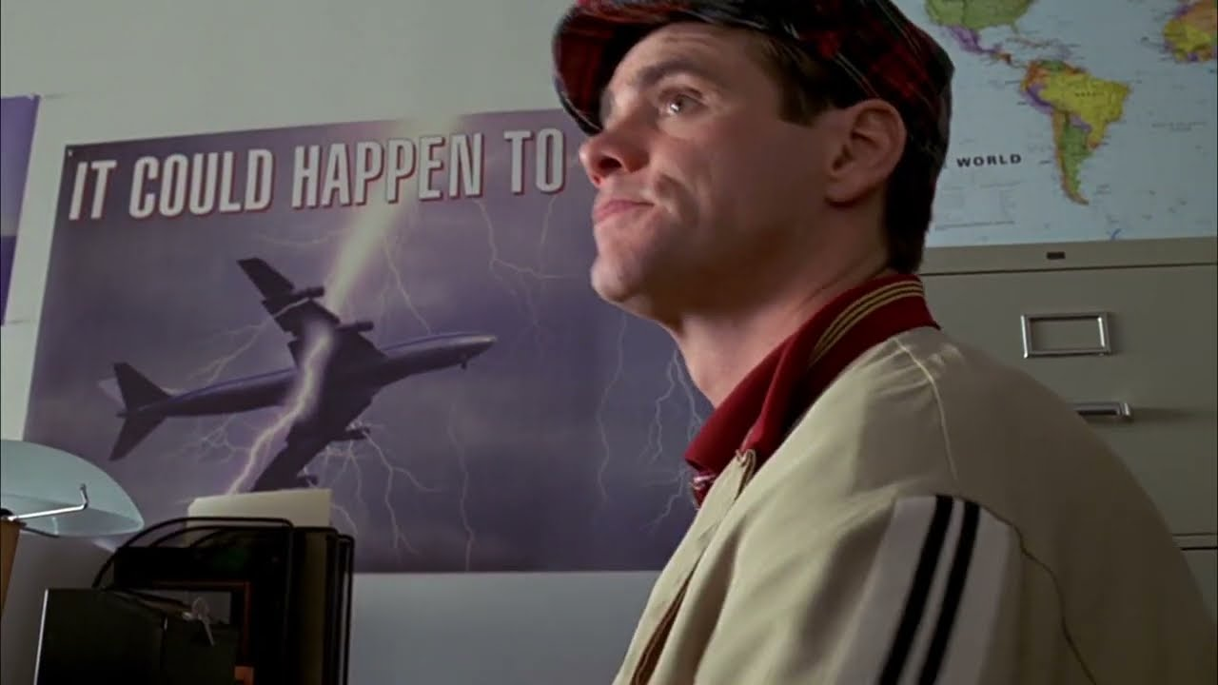
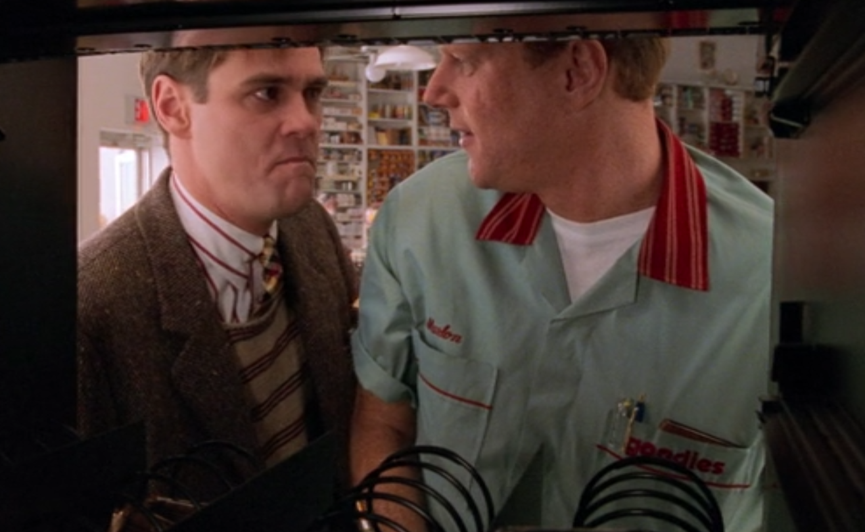
Plot Summary
Truman Burbank’s whole life is being filmed for a TV show
The place he lives, Seahaven Island, is actually a huge set
Everyone around him, even his wife and best friend, are actors
Eventually, Truman starts to notice strange things about his life
Truman escapes and realizes his whole life was a lie
Anti-traveling propaganda at a travel agency [5]
Hidden camera in a vending machine [5]
Notes:
Michael:
Truman Burbank’s whole life has been a TV show. From birth, every moment of his existence has been filmed and broadcast to the whole world.
The island he lives on is not real, but part of the largest studio ever constructed. His friends and family are all actors.
For the first 30 years of his life, he remains largely oblivious to this reality, but eventually some strange things begin to happen that make him suspect something is up:
A studio light falls from the sky.
Truman randomly sees his dad, who he watched die 20 years ago on the street. When Truman tries to talk to him, random strangers grab him and force him onto a bus.
At times, certain people seem to know things that they otherwise wouldn’t (i.e. a random guy at a nuclear power plant, who Truman never met, somehow knew his name).
He even finds that his wife was crossing her fingers in one of their wedding photos.
Truman wants to leave Seahaven Island, but no matter how hard he tries, the rules of the universe seem to bend to stop him. No flights out are available until months later. When he tries taking a bus, it breaks down. When he tries driving, he is stopped first by traffic, then by a bridge, after that a fire, and finally stopped for good on that journey by a nuclear power plant malfunctioning. While going through all of these hoops to try and leave the island, everyone around him continuously try to discourage him from leaving, as well as propaganda against traveling almost following Truman.
Eventually, Truman tricks the show’s crew into thinking he’s asleep when in reality he’s trying to escape. He gets on a boat and starts sailing away from Seahaven. They try creating a storm to stop him, but he ends up reaching the edge of the studio. The director makes one final attempt to convince him to stay, but he decides to leave.

Slide 4
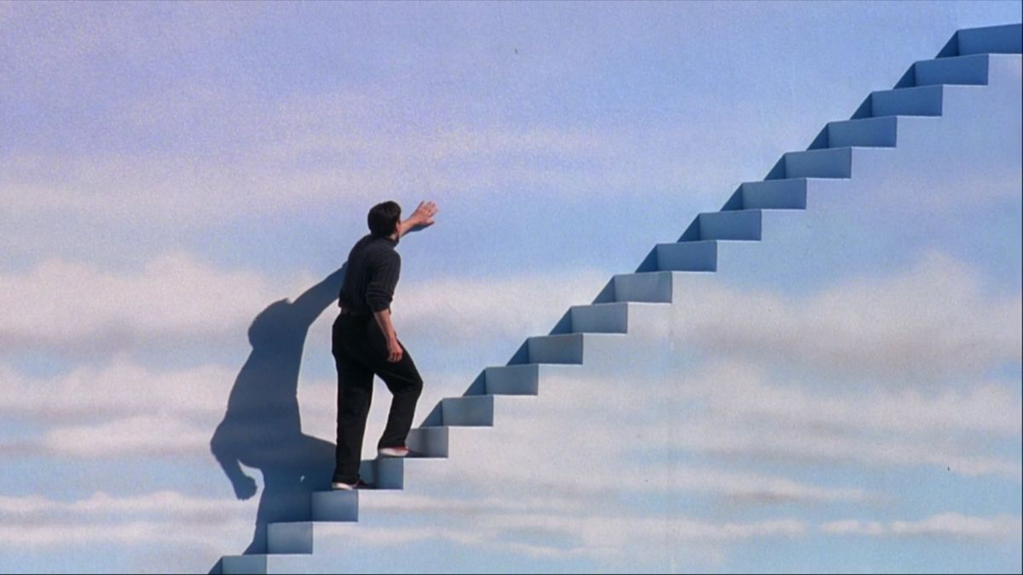
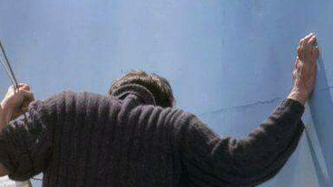
Conclusions
The Truman Show reflects how in lack of privacy in the modern world due to computing technology
2. The Truman Show mirrors how reality TV and social media can blur the lines of real life and entertainment
Taking the stairs to leave [5]
Finding the escape [5]
Notes:
Naushin:
The lack of personal privacy Truman experiences is a reflection of the lack of privacy everyday people experience due to modern technology.
The blurring of entertainment and Truman’s real life is a reminder to everyone that what reality television and social media presents to the public could be a distorted version of reality as demonstrated by the perfect life Truman appears to live.

Slide 5
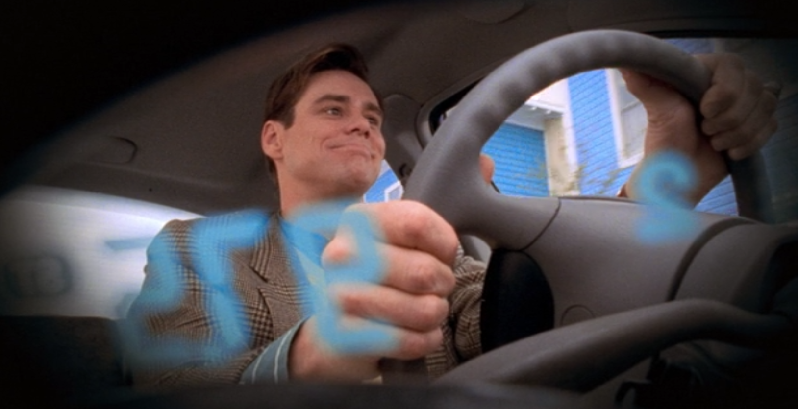
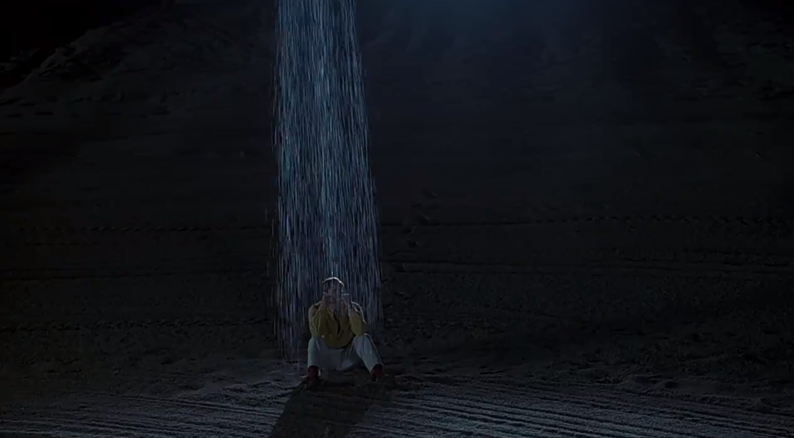
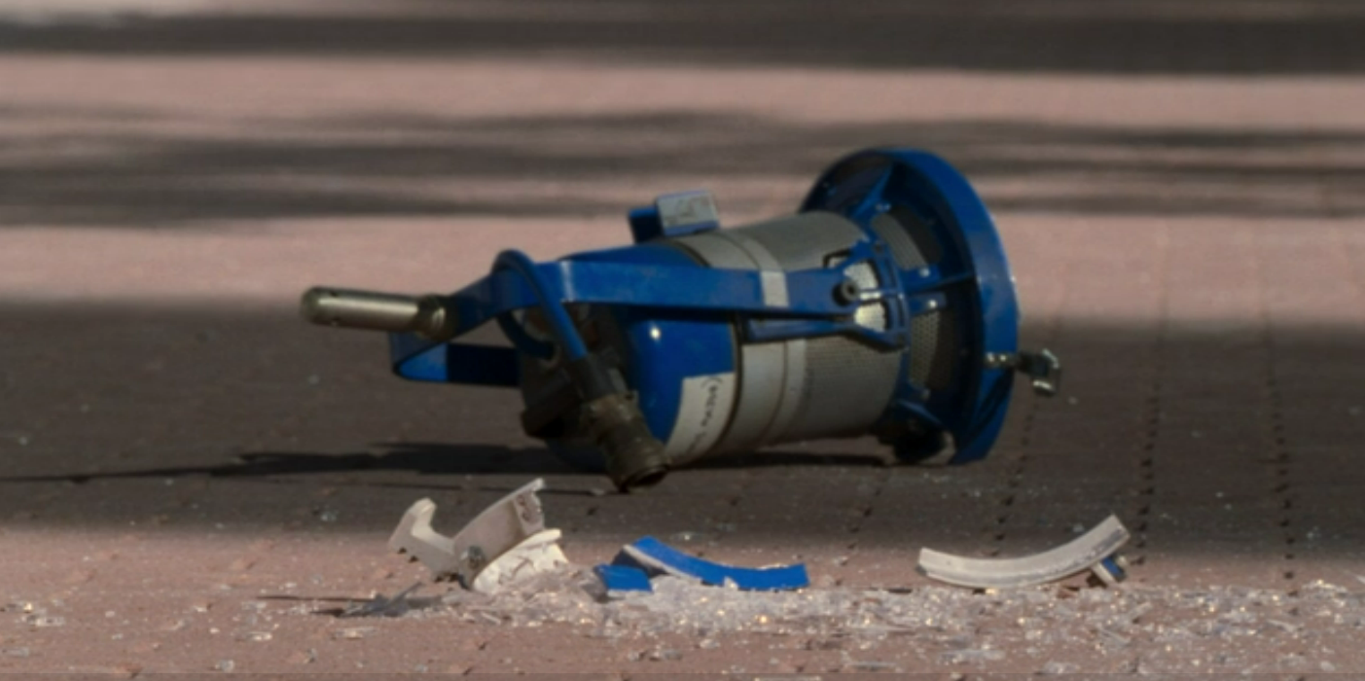
Computing Technology
Cameras
~5,000 hidden cameras placed inside of Truman’s car, on an actor’s necklace, etc.
Radio
Used to keep track of all of Truman’s behavior and ensure actors know what to say/do
Weather
Weather is simulated (rain, wind, fog, wave intensity, etc.)
Lighting
Create day/night using artificial lighting
Truman has no idea there’s a camera in his car [5]
Uh oh! Weather malfunction alert! [5]
Studio light that fell from the sky [5]
Notes:
Hunter Jack
In the movie, the director of the show, Christof says that about 5,000 of the world’s smallest cameras are hidden and used throughout Seahaven Island to ensure Truman can be watched at all times.
Some shots in the movie are supposed to be from the cameras in the show. Some interesting places include a car dashboard, a wedding ring, a necklace, and a pencil sharpener
Radio is used to keep track of all of Truman’s behavior. While he is driving, his car radio malfunctions, allowing him to hear this.
Once the show’s crew realizes Truman can hear them, they change frequencies, creating an annoying high pitched sound. Every actor, including all the extras, pauses and touches their ear, implying they all have earpieces. At some point, his car radio malfunctions, allowing him to hear that he is being monitored
A simulated weather program is shown in the movie. Settings for rain, wind, fog, and waves. Weather can also be applied only to a specific part of the island. Toward the end of the movie, when Truman tries to escape by boat, the crew tries to stop him by using intense weather to deter him (or potentially kill him)
All the lighting on the island is artificial. Toward the beginning of the movie, a light falls from the sky. The crew can control the light, and toward the end of the movie, when Truman escapes at night, they decide to make the “sun” rise early to make it easier to find him.

Slide 6
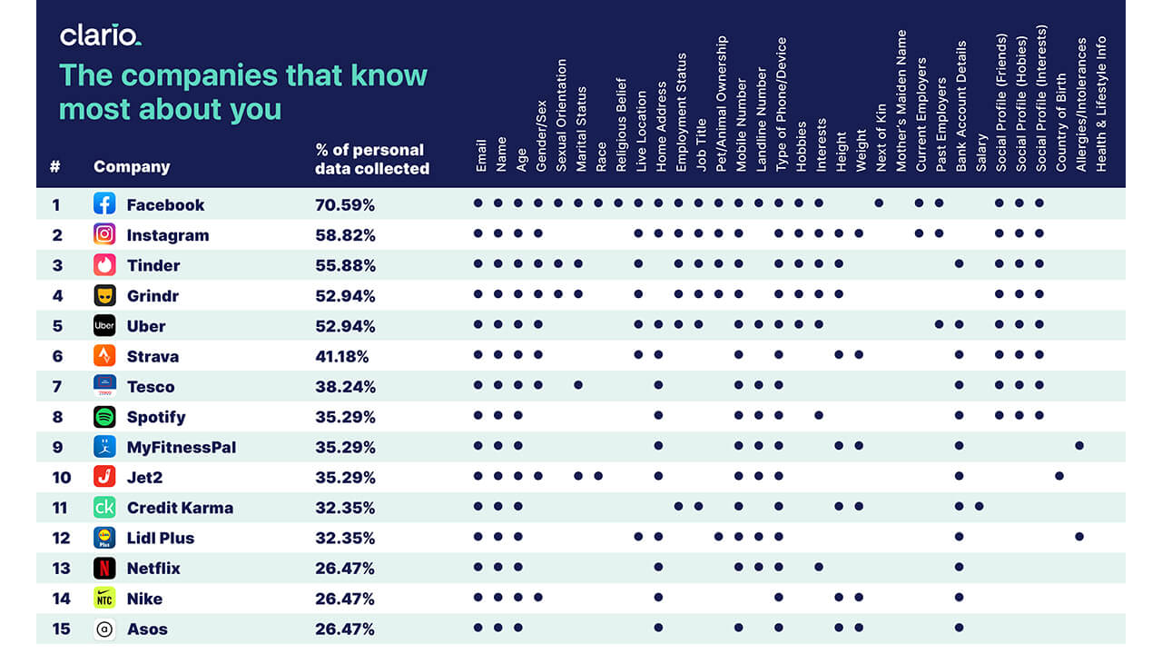
Lack of Privacy
Companies like Google collect data on users and use it for targeted ads [1]
They collect a lot of information (name, address, etc.) [2]
They can use this information to make further conclusions about users, such as lifestyle, wealth, hobbies, and beliefs [2]
Chart showing how much data some companies collect on users [6]
Notes:
Spencer
Truman’s lack of privacy is a major theme throughout the movie, with him constantly being filmed. While not as egregious, today people's privacy is also under threat by companies that harvest digital information about their user’s.
Using this user data, companies are able to construct profiles of every individual using their services that can then be used to serve tailored advertisements or they will then sell these data profiles of users to other companies with tags like “working-class mom,” “frequent alcohol drinker,” “financially challenged” [8].
These profiles contain information such as your Name, Address, Phone Number, Email, Online Searches, Purchase History, Medical Conditions, and even users real time location

Slide 7
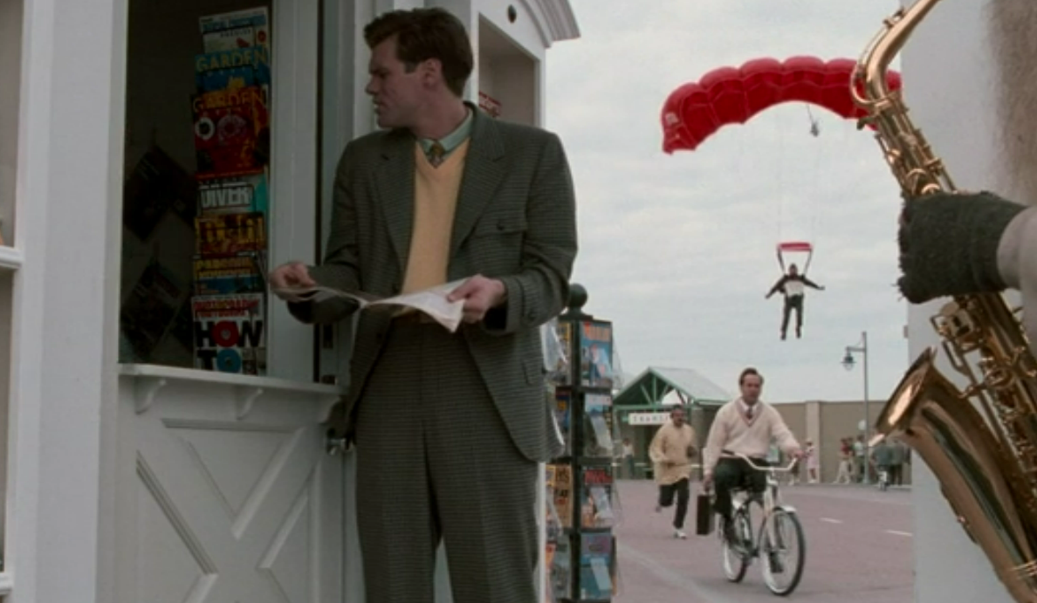
Lack of Privacy
67% of Americans say they know almost nothing about what companies are doing with their personal data [2]
73% say they have almost no control over what companies do with their data [2]
Truman’s situation is not fully accurate to the real world
They hide the truth from Truman, in the real world the extent of data collection is public knowledge
People also have the option to opt out of data collection in many cases [2].
Truman is never given this option
A man parachutes into the studio to tell Truman the truth about his life [5]
Notes:
Spencer
Similar to Truman, many of us in the real world are unaware of how we’re being tracked. 67% of Americans don't know almost anything about what companies are doing with their personal data and 73% say that they don't have any control over what companies do with their data [2].
However, it’s important to note that Truman's situation doesn’t accurately reflect the real world in a lot of ways. For example, where producers take a lot of effort to hide the truth from Truman, in the real world the extent of data collection is public knowledge. In some cases, people also have the option to opt out of data collection. The difference is that Truman isn’t ever given this opportunity to choose.

Slide 8
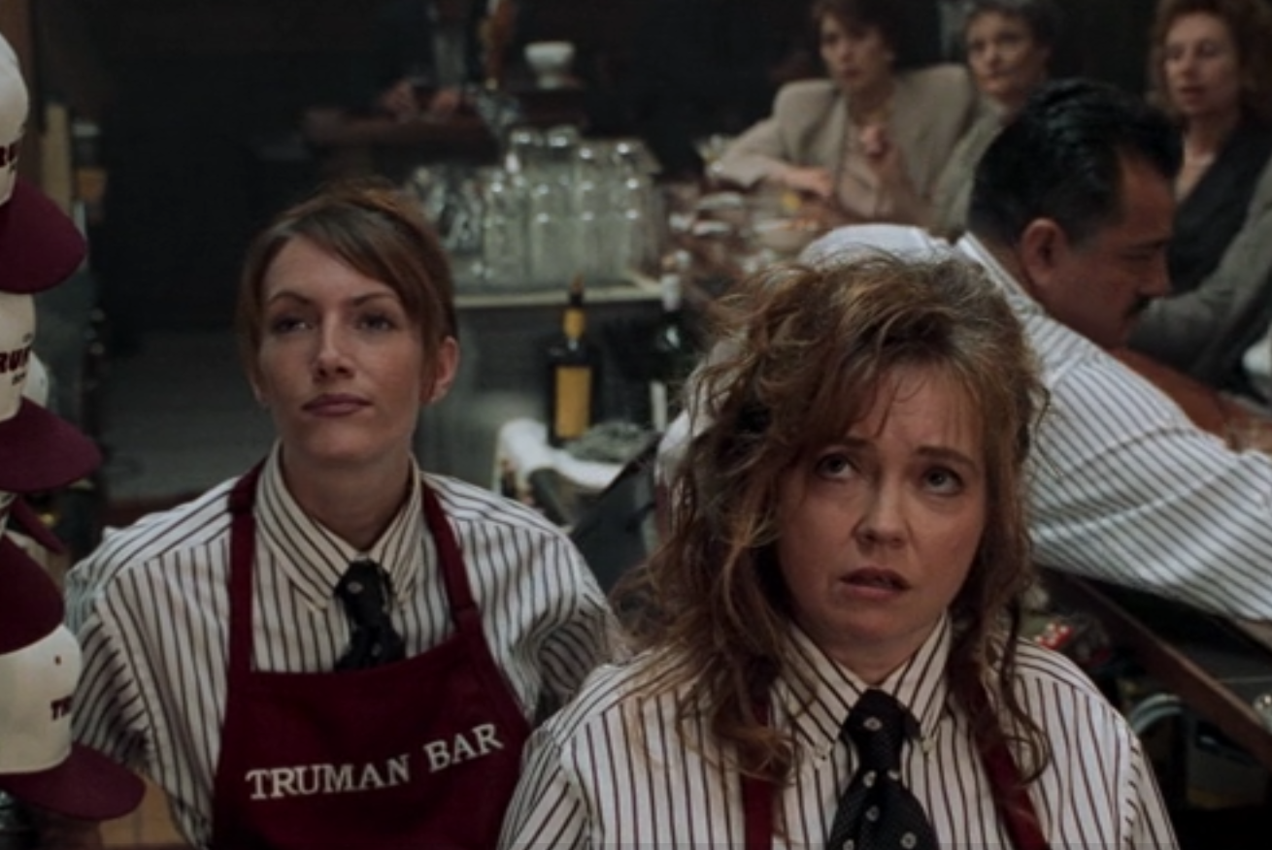
Reality Shows blur the line between entertainment and reality
Many shows exaggerate things, framing events as more dramatic than they actually are, and often vilifying the people on the shows [3]
Inaccurate portrayals have led to cyberbullying and even suicide [4, 7]
People on reality TV shows are defamed and exploited for the entertainment of others
Similarly, Truman is exploited. His whole life is a lie for TV
Viewers never reflect on how unfair it is to Truman
Employees at the “Truman Bar” watching the show [5]
Notes:
Kekoto - Even in the real world, we have examples of reality shows blurring the line between entertainment and reality. These shows tend to exaggerate events as well as vilify people from the show which has led to negative consequences such as cyberbullying. It is suspected that harassment such has this has even led to the suicide of two former Love Island UK contestants. Truman is being exploited in a similar way, with most of the fans of his show never reflecting on how unfair this is to him.
After a lot of online harassment, Hana Kimura from Terrace House committed suicide [7]
In fact, there have been 38 suicides from reality show contestants [7]
Alex Miller, who was on Love Island, said he felt suicidal after the show [7]
Two suicides from Love Island contestants [4, 7]

Slide 9
Ethical Analysis
Is the existence of the Truman Show ethical?
Is it ethical for people to watch it?
Kantianism
Viewers support Truman’s deception by watching the show
They treat him as a means to an end
Act Utilitarianism
Show is very popular, contributes to significant economic growth
People across the world enjoy watching Truman
Only Truman is harmed
Virtue Ethics
Lying to someone for their whole life is not what an honest person would do
Keeping Truman sheltered does not help him flourish
Notes:
Kekoto -
Kantianism:
Truman’s show is all part of one big deception. Truman is not given a chance to choose whether to live his life on the show. Viewers watch the show without thinking about how they’d feel if they were in the same situation. Because of this, they are treating him as a means to an end rather than an end himself. Therefore, the Truman Show is unethical under Kantianism
Act Utilitarianism:
The Truman Show is said to be hugely popular in the movie, running for 30 years. Everything in the show is for sale, including wardrobes, props, and even houses. This contributes to significant economic growth.
People around the world enjoy watching the Truman Show, and many people are shown happily watching the show in the movie. The director, Christof, even says that many leave the show on when they sleep.
All of the actors, including extras who don’t even do anything, get paid to do the show, helping them get by.
Truman is harmed significantly because he desperately wants to leave Seahaven Island but is not allowed to. Truman also had certain life choices effectively forced on him, such as marrying Meryl. However, Truman also gets to live in a world with no crime and where he will always be taken care of.
Overall, only Truman is harmed, and even he still has a pretty good life, so the show is ethical under Act Utilitarianism, which highlights how wrong Act Utilitarianism is
Virtue Ethics:
The show’s crew lies to Truman for his whole life, and they are not acting how an honest person would act. They are also invading his privacy, which is not virtuous either. Finally, keeping Truman sheltered from the realities of the world does not help him flourish as a person. Therefore, the show is immoral under Virtue Ethics

Slide 10
References
Burgess, Matt, “All The Data Google’s Apps Collect About You And How To Stop It”, (Wired, April 5, 2021), https://www.wired.com/story/google-app-gmail-chrome-data/ (Accessed September 30, 2025)
Booth, Barbara, “What Internet Data Brokers Have On You – And How You Can Start To Get It Back”, (CNBC, October 11, 2024), https://www.cnbc.com/2024/10/11/internet-data-brokers-online-privacy-personal-information.html (Accessed September 30, 2025)
Berman, Judy, “Reality TV Has Reshaped Our World, Whether We Like It Or Not”, (Time, August 4, 2022), https://time.com/collection/reality-tv-most-influential-seasons/6199108/reality-tv-influence-on-world/ (Accessed September 30, 2025)
Hayes, Christal, “What Love Island USA Can Learn From The UK Show’s Own Tragedies”, (BBC, June 29, 2025), https://www.bbc.com/news/articles/ckg3ek8y2k0o (Accessed September 30, 2025)
Weir, Peter. 1998. The Truman Show. United States: Paramount Pictures.
Griffith, Eric, “Facebook, Uber, And Dating Sites Top The List Of Companies Collecting Your Personal Data”, (PC Mag, December 31, 2021), https://www.pcmag.com/news/facebook-uber-and-dating-sites-top-list-of-companies-collecting-your-personal (Accessed October 7, 2025)
Adegoke, Yomi, “Why Suicide Is Still The Shadow That Hangs Over Reality TV”, (The Guardian, May 27, 2020), https://www.theguardian.com/tv-and-radio/2020/may/27/why-suicide-is-still-the-shadow-that-hangs-over-reality-tv-hana-kimura-terrace-house (Accessed October 7, 2025)
Online Advertising & Tracking. Electronic Privacy Information Center, https://epic.org/issues/consumer-privacy/online-advertising-and-tracking/. (Accessed October 7, 2025).

