Slide 1
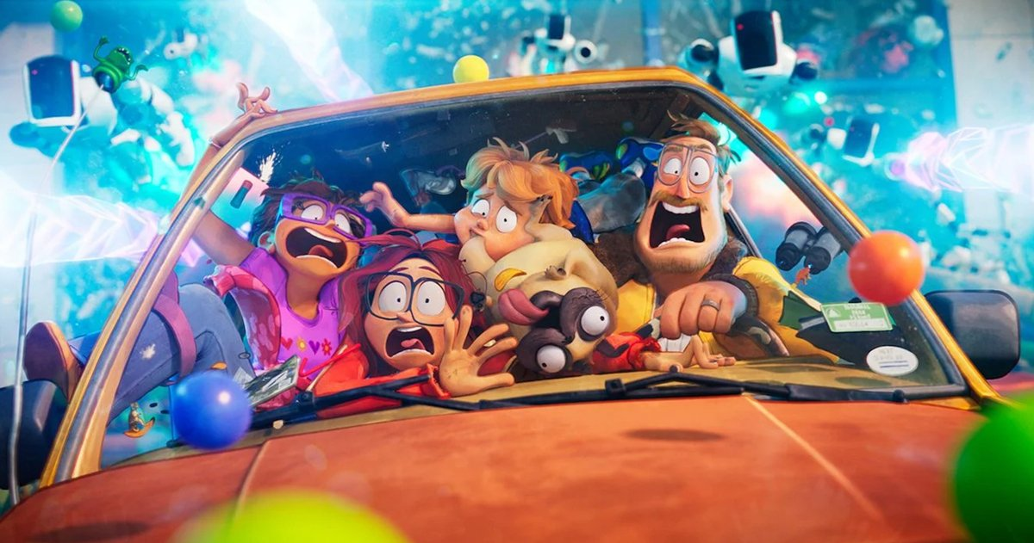
The Mitchells VS the Machines
1
Sean Barbour, Gabriel Buonomano, Omri Green, Cameron Mulready

Slide 2
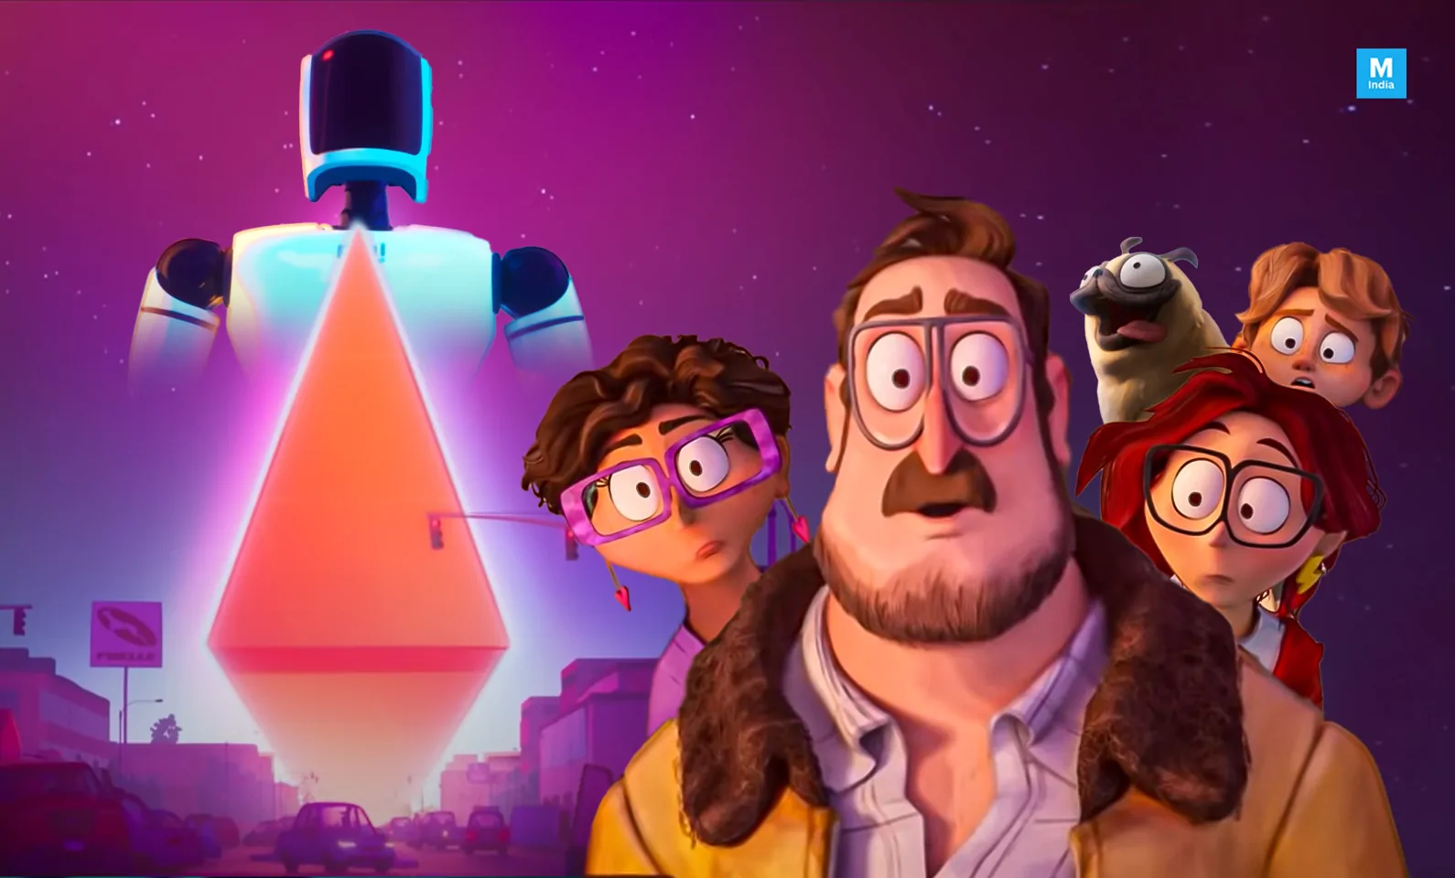
Outline
2
Plot Summary
Computing Technologies
Social Media
AI
Internet of Things
Conclusions

Slide 3
Plot Summary
3
Introducing the Heroes
The Twist
The Final Fight
Introducing the Conflict
A large tech company releases robot assistants with AI that begin capturing humans to send them into space
The Mitchells must cancel their road trip and try to escape the robots, meeting two defective bots at a gas station who tell them they can stop the robot apocalypse by uploading a code at one of the tech company's stores in a mall
The Mitchells are ambushed by cloud-connected appliances at the store, and the WiFi router they are using to upload the code explodes, leaving them with no choice but to upload it at the robot headquarters
The Mitchells fights their way to and through the robot headquarters, exploiting a bug in the robots' AI and convincing the defective robots that they can change their programming, and uploading the code to save humanity

Slide 4
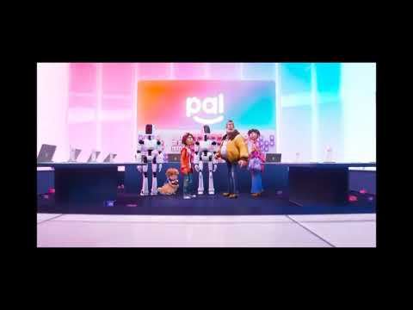
Internet of Things
4
In real life the Internet of Things is highly useful but vulnerable.
The movie views it as distracting and pointless,
Non-computerized hardware is typically just as effective
A fishing rod is used to take down a drone.
Everything is Computerized for no reason
"Why does that tennis racket have a chip in it?" - Rick Mitchell while getting hit by a tennis racket with a chip in it.
It is designed to give you exactly what you want when you want it, distracting you from more important things.
When Linda Mitchell is taken by the La-Z-Boy she ignores the robots trying to kill / abduct her family instead focusing on the massage it gives her.
Notes:
In the movie the Internet of Things is viewed as distracting and pointless. Typically non-computerized hardware works just as well as computerized hardware in many cases, in the movie there is a automated toaster which states "U R TOAST" by toasting bread, just why would a toaster need to do that. What purpose does it have, there is even a computerized tennis racket, what purpose does that have, why would you need it. All of this only adds extra complexity to our already complex lives.
While the movie clearly satirizing the internet of the Internet of Things to the point of absurdity, the technologies displayed actually have uses. The automated toaster could be used to make you breakfast before you even wake up. The automated tennis racket could be used to analyze your swing, and give you tips on how to improve by connecting to the internet. While these devices seem pointless, they actually have a purpose, not to make our lives more complicated, but to make them simpler.
For example, virtual assistants are used to do things as simple as setting your alarm in the morning, instead of using a traditional alarm clock I typically say "Ok google, set an alarm for 8am", and it would set the alarm automatically. Google is used to search through thousands of websites, allowing me to do research far faster than I ever could without it, all of this can be done with a device in my pocket. However, the real impact these devices can have are far greater, you could use a IOT device to detect viral particles and notify everyone in the building that there are viral particles in the air, potentially allowing for real time detection and prevention of spreading diseases.
However, this is not to say these devices do not have risks, after all anything can be hacked with enough effort. In 2020 a bug was revealed in the Amazon Alexa, allowing hackers to access private conversations of Alexa users. When examining the internet of things it is rife with many opportunities for malicious actions, a person's house could be bugged by the same devices they used to make their lives easier. My phone could theoretically listen in on every conversation I have, after all, I need to say "Ok Google" to activate it, this implies that it can detect speech at any time and could easily be made to eavesdrop on all the conversations I have.
We need to ask ourselves, do we want these devices to access to all of our data. When the La-Z-Boy kidnaps Linda Mitchell it gives a massage so good
that she ignores her family while the robots trying to kill them. While a clearly exaggerated example, these devices are designed to maximize our usage
of them, a great example of this would be Social Media, getting you down a rabbit hole of recommendations that never end.
Sources: [1],[2],[3]

Slide 5
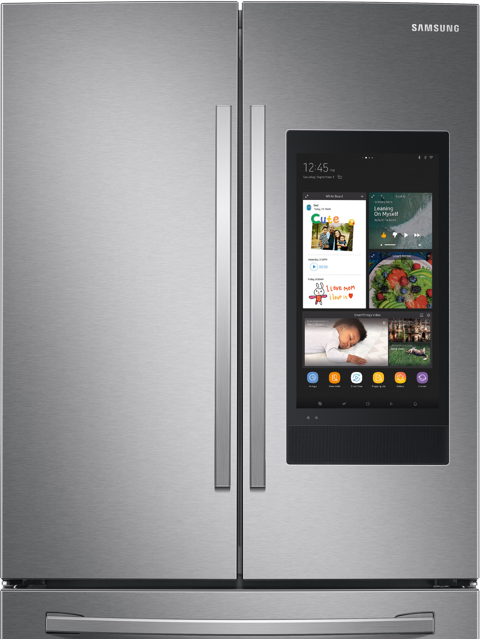
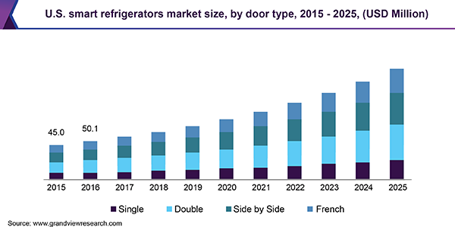
Will the Internet of Things Flop?
5
- Consumers don't think so; the market share of the Internet of Things is predicted to grow by 10% each year for the next 5 years [17]
- There will be over 350 million smart homes by 2023 [18]
Actual and predicted smart refrigerator market size [19]

Slide 6
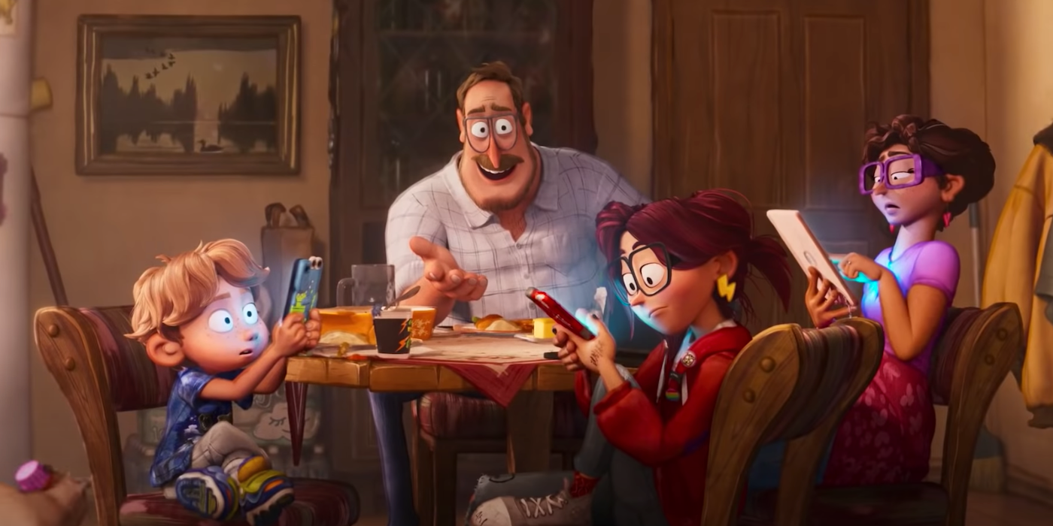
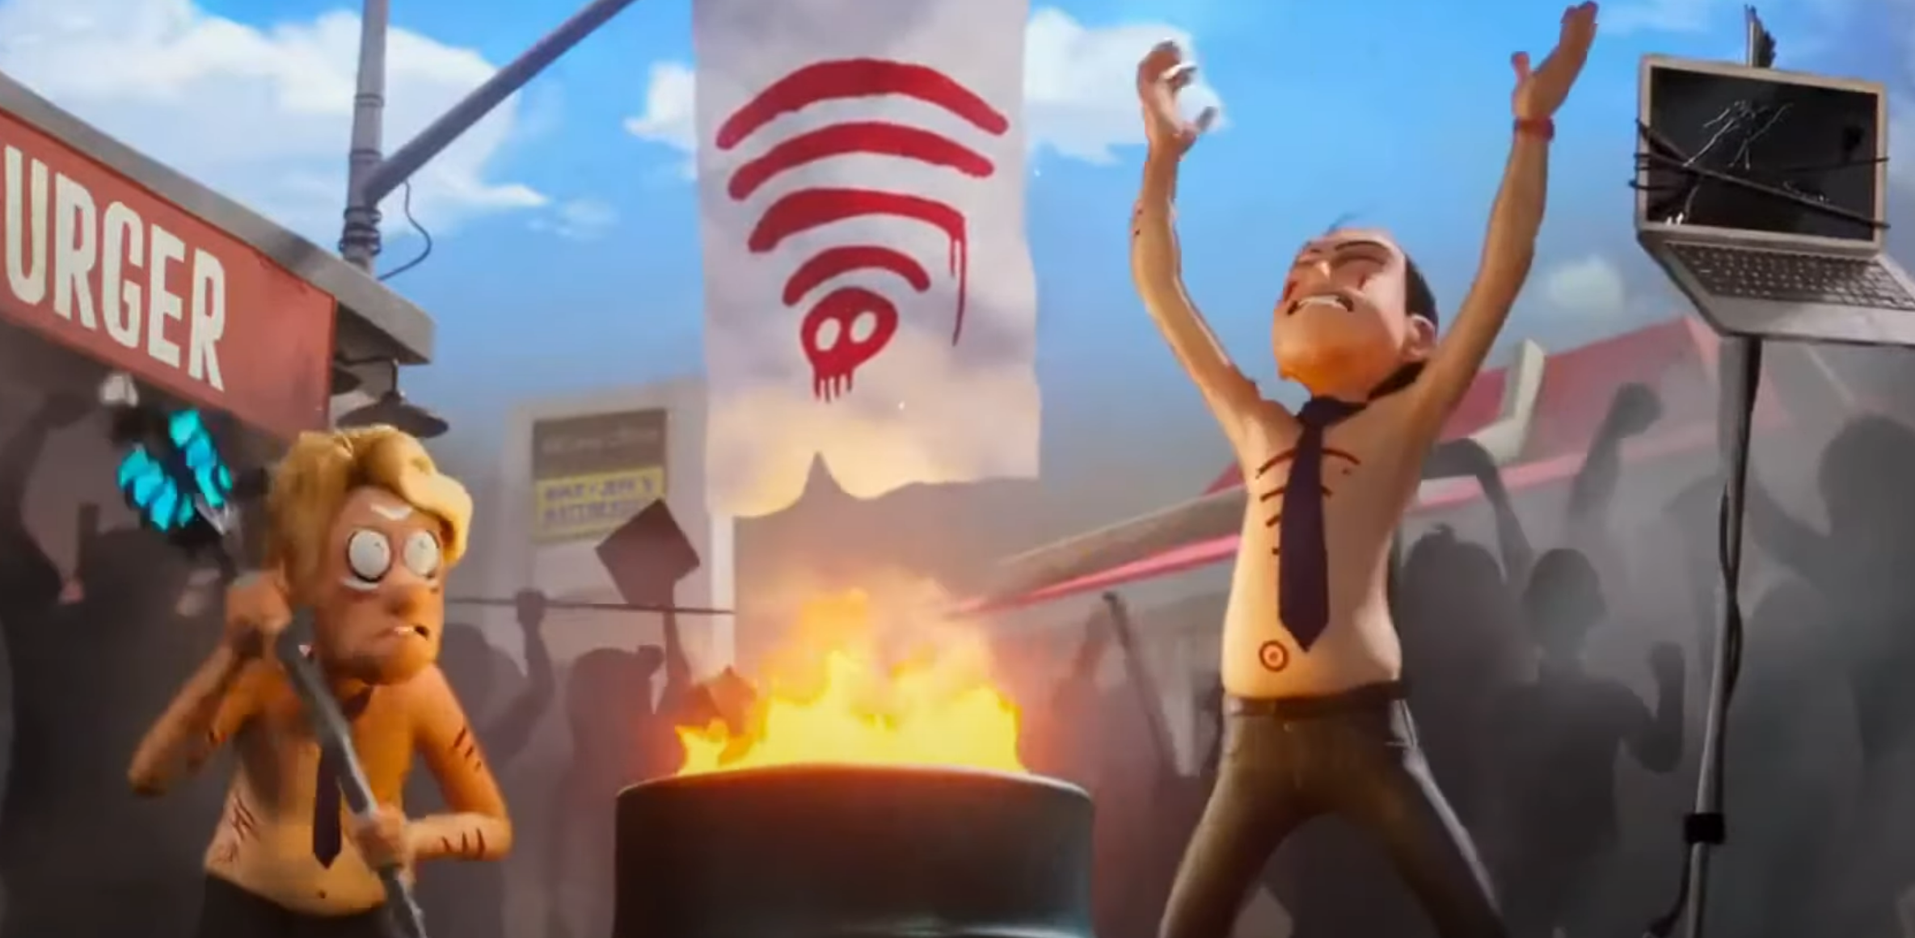
Social Media
6
-The film depicts a society that cannot pull away from social media and technological platforms.
-With technology being as prevalent as it is today, social media has brought humanity closer together in ways that weren’t as viable as older mediums.
-Although technology has brought us closer together, it has also led to a dependance on it, along with a positive feedback loop to consume it more.
Notes:
Speaker Notes:
Point 1. Throughout the film there is a heavy usage of social media and technologic platforms by most members of society. The main characters have troubles stepping away from technology for brief moments in the first parts of the film. When the Wi-Fi (internet) is turned off, udder pandemonium ensues through all of society as they try to mimic the technologic platforms that they are used to, not unlike cargo cults [10].
Point 2. “The aeroplane and the radio have brought us closer together. The very nature of these inventions cries out for the goodness in men” – Charlie Chaplin (The Great Dictator).
Social media and technologic plat forms have brought new opportunities, being able to learn and work from across the globe. Social media has allowed for groups of people to communicate with one another that they might not be able to do in their own communities.
Point 3. “Machinery that gives abundance has left us in want” – Charlie Chaplin (The Great Dictator)
With technology bringing an abundance of knowledge, it has also left many in a perpetual want for more. Long usage of Social Media and Technologic platforms can lead to people being more removed from those around them, absorbed in the information they are currently indulging in. Using Social media and technologic platforms can also lead to needing more entertainment / information from the platforms themselves.
[7][8][9][10]

Slide 7
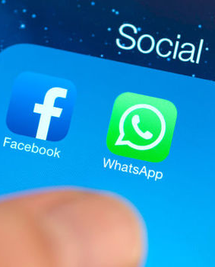
Is Social Media Bad for Society?
7
- Social Media can be used with malicious intent to influence the masses for a relatively low cost
According the the BBC, "Russia used every major social media platform to try to influence the 2016 US election..." [12]
70 countries have partaken in election meddling, with Facebook being the most-used platform [16]
- Although there is little research on the relatively new technology, "64% of Americans say social media have a mostly negative effect" on society [13]
- "93% [of communication] is based on nonverbal body language", which social media cannot provide [14]
- Adolescents who spend more time on social media and less time interacting in person are lonelier [15]
Notes:
[11] "Astroturfers mimic and reproduce the forms and messages of traditional grassroots social movements and use software to mask their identities."
With low cost solutions to make accounts on the web, you can plant faux seeds to give the impressions of a true grassroot movement, hence 'astroturf' movement. These movements can change public opinion
To fit with a motive that can be socially or politically aligned to certain ideals that may not have otherwise existed.
[13] From a surveyed populous of around 10,000 US adults, 64% feel that social media has a negative effect on society (politically). With those that identify with more right-wing politics, there was average 77% negitive view towards social media, with those who identified as being left-wing​ had 49% negative view towards social media.
Many Social Media platforms are starting to utilize new technologies to adapt to the times. Many of which, to deliver to more people, and hook them for longer are using Artificial Inteligence technologies. (segue)

Slide 8
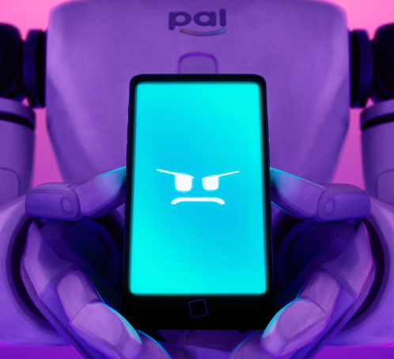
Artificial Intelligence
8
- Morally Nuanced
- It is in their use that their alignment becomes good or bad
- The main AI characters make decisions
- This capacity is shown to be dangerous
- They also have very human goals
- Powerful tools that get out of hand fast
- Fragile and Physically Dependent

Slide 9
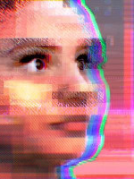
Is 'Rogue A.I.' a Real Thing?
9
- Views are mixed
- Certain examples of A.I. show evil views and intentions
- MicroSoft's Tay developed "extremely lewd and racist" views and messages [4]
- The Robot Sophia, based on a real person, expressed desire to "...destroy all humans" [5]
- Conversational A.I. is often accused of being performative
- Facebook’s A.I. head called Sophia is a “BS puppet.”[6]
- Proper Sentience not achievable in A.I. yet [6]

Slide 10
Conclusions
10
-The use of IoT devices can be helpful for day-to-day uses, however they must be secure in a digital-focused world.
-Social media platforms have brought information to the masses, allowing people to form like-minded groups. Social media platforms have also pushed us away from one another, and in want for more.
-AI has allowed for more complicated computer systems to be available to the masses, for little-to-no cost to the consumer. When left to learn with no oversight and ample time, through negligence or 'move fast and break things', the consequences could be detrimental to society.

Slide 11
Sources
11
[1] Wortmann, F., & Flüchter, K. (2015). Internet of things. Business & Information Systems Engineering, 57(3), 221–224. https://doi.org/10.1007/s12599-015-0383-3
[2] BBC. (2020, August 13). Amazon Alexa Security Bug allowed access to voice history. BBC News. Retrieved October 8, 2021, from https://www.bbc.com/news/technology-53770778.
[3] DeFranco, S. G. T. (2020, March 17). Internet of things and future of virus detection and prevention. IoT Evolution World. Retrieved October 8, 2021, from https://www.iotevolutionworld.com/iot/articles/444815-internet-things-future-virus-detection-prevention.htm.
[4] Amy Kraft. (March 2016) . MicroSoft Turned Off an A.I. Chatbot after it Turned into a Nazi. CBS News. Retrieved October 7, 2021, from Microsoft shuts down AI chatbot, Tay, after it turned into a Nazi - CBS News
[5] Arti. (29 September 2021). 10 Times A.I. Robots Have Expressed Destructive Thoughts. Stravium Intelligence. Retrieved October 7, 2021, from 10 Times AI Robots Have Expressed Destructive Thoughts (analyticsinsight.net)
[6] Jaden Urbi. (5 June 2018). Sopia the Robot's Complicated Truth. CNBC. Retrieved 7 October 2021, from Sophia the robot's complicated truth (cnbc.com)
[7] (PDF) a study on positive and negative effects of social media on Society. ResearchGate. (n.d.). Retrieved October 8, 2021, from https://www.researchgate.net/publication/323903323_A_Study_on_Positive_and_Negative_Effects_of_Social_Media_on_Society.
[8] Loiacono, E., & McCoy, S. (2018). When did fun become so much work. Information Technology & People, 31(4), 966–983. https://doi.org/10.1108/itp-10-2016-0239
[9] Scaramuzzino, G., & Scaramuzzino, R. (2017). The weapon of a new generation?—swedish civil society organizations’ use of social media to influence politics. Journal of Information Technology & Politics, 14(1), 46–61. https://doi.org/10.1080/19331681.2016.1276501
[10] Burridge, K. O. L. (1954). Cargo Cult Activity in Tangu. Oceania, 24(4), 241–254. http://www.jstor.org/stable/40328944
[11] Schill, D. (2014). Astroturfing. In K. Harvey (Ed.), Encyclopedia of Social Media and Politics (Vol. 1, pp. 86-88). SAGE Reference. https://link.gale.com/apps/doc/CX3708500041/GVRL?u=mlin_c_worpoly&sid=bookmark-GVRL&xid=eead2deb
[12] BBC. (2018, December 17). Russia 'meddled in all big social media' around US election. BBC News. Retrieved October 8, 2021, from https://www.bbc.com/news/technology-46590890.
[13] Auxier, B. (2020, October 15). 64% of Americans say social media have a mostly negative effect on the way things are going in the U.S. Today. Pew Research Center. Retrieved October 8, 2021, from https://www.pewresearch.org/fact-tank/2020/10/15/64-of-americans-say-social-media-have-a-mostly-negative-effect-on-the-way-things-are-going-in-the-u-s-today/.
[14] Tardanico, S. (2014, April 15). Is social media sabotaging real communication? Forbes. Retrieved October 8, 2021, from https://www.forbes.com/sites/susantardanico/2012/04/30/is-social-media-sabotaging-real-communication/?sh=752ef77b2b62.
[15] American Psychological Association. (n.d.). Social Media's growing impact on our lives. American Psychological Association. Retrieved October 8, 2021, from https://www.apa.org/members/content/social-media-
research.
[16] Michael Brand Adjunct A/Prof of Data Science and Artificial Intelligence. (2021, January 24). Facebook is tilting the political playing field more than ever, and it's no accident. The Conversation. Retrieved October 8, 2021, from https://theconversation.com/facebook-is-tilting-the-political-playing-field-more-than-ever-and-its-no-accident-148314.
[17] Internet of things (IOT) market (2021-26): Industry size, growth, trends - mordor intelligence. Internet of Things (IoT) Market (2021-26) | Industry Size, Growth, Trends - Mordor Intelligence. (n.d.). Retrieved October 8, 2021, from https://www.mordorintelligence.com/industry-reports/internet-of-things-moving-towards-a-smarter-tomorrow-market-industry.
[18] Holst, A. (n.d.). Topic: Smart home. Statista. Retrieved October 8, 2021, from https://www.statista.com/topics/2430/smart-homes/.
[19] Grand View Research. (2019). Retrieved October 8, 2021, from https://www.grandviewresearch.com/industry-analysis/smart-refrigerators-market

Slide 12
Image Sources
15
Samsung smart fridge: https://www.ajmadison.com/cgi-bin/ajmadison/RF28T5F01SR.html
The Mitchell family sitting at dinner: https://static1.colliderimages.com/wordpress/wp-content/uploads/2021/04/Screen-Shot-2021-04-01-at-2.44.51-PM.png
PAL: https://www.filmpolicereviews.com/the-mitchells-vs-the-machines-trailer/
Social media folder on a smartphone: https://www.express.co.uk/life-style/science-technology/640010/Facebook-Smartphone-Android-Battery-Life-Drain
Outline slide image: https://in.mashable.com/entertainment/21291/the-mitchells-vs-the-machines-oscar-winner-olivia-colman-takes-over-the-world-in-this-apocalyptic-ac
All other images screenshotted from the movie The Mitchells vs The Machines (2021)

