Slide 1

The Lives of Others
The Lives of Others
Stasi surveillance was powerful in the 1980's, and it would be even more powerful now.
Notes:
-Our presentation is on The Lives of Others, a movie about Stasi surveillance in East Germany
-We'll be comparing the extent of that historical surveillance with what can be done now, in our connected world

Slide 2
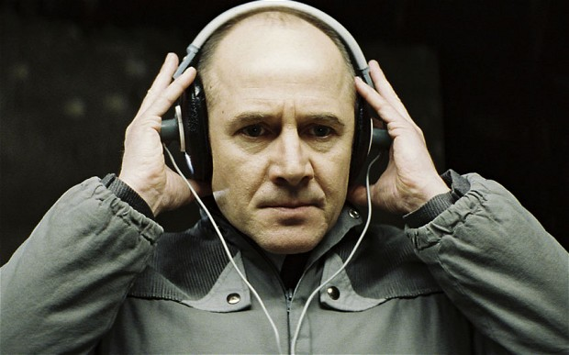
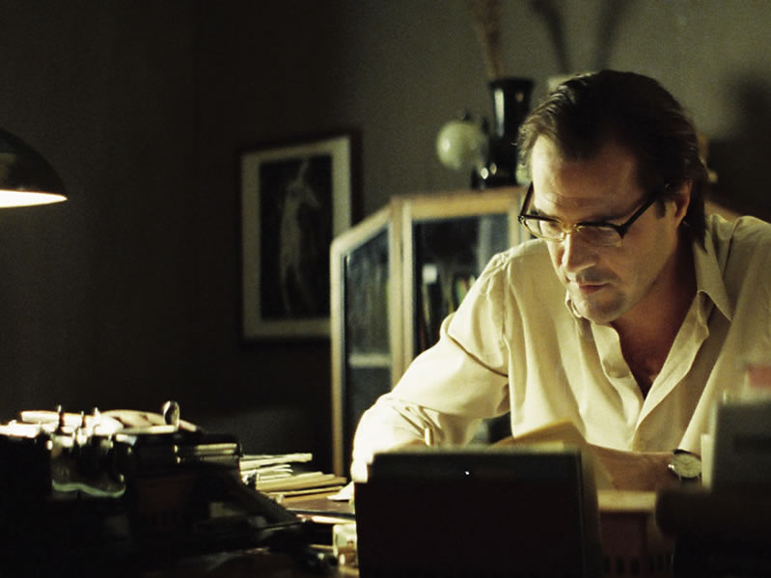
The Lives of Others - A Summary
The Lives of Others
Follows the character Gerd Weisler
  Member of the East German Stasi
  Surveillance and interrogation specialist
Weisler is asked to track Georg Dreyman, a playwright
Weisler becomes sympathetic and helps Dreyman out
Weisler saves Dreyman at the expense of his career
Gerd Weisler
Georg Dreyman
[1]
Notes:
To begin, a quick description of the film itself.
The movie centers on a well respected Stasi agent, Gerd Weisler.
Weisler is tasked by a government official to monitor Georg Dreyman, a notable playwright who is currently in the good graces of the government.
Over time, Dreyman begins to drift towards Western ideals, and Weisler grows sympathetic with him.
Weisler ultimately saves Dreyman from an arrest, costing himself his career in the Stasi.
This film paints a picture of serious government surveillance, where once you're targeted every word you speak is being heard and recorded.
This extreme surveillance has a profound effect on the lives of the watched, but the film is describing an era three decades in the past.
Have things changed? What could the Stasi do to someone (or everyone) today?

Slide 3
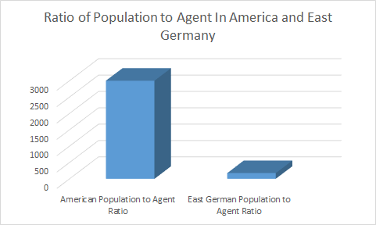
1980s East Germany vs. Modern Day America
The Lives of Others
16 Million people
91 Thousand Stasi employees
174 Thousand unofficial informants
6 Million tracked in central database
1 agent for 176 people
1 in 92 people are informants
321 Million in America
107 Thousand IC Employees
1 Agent for 3000 People
[4][5]
Notes:
*TAST: Explain everything in the slide put in some modern statistics
Now let’s just take a look at some statistics of the time
There were about 16 million people in East Germany
6 million of those individuals were at some point tracked by the One of the 91 thousand Stasi Agents
There is 1 agent for every 176 people
And 1 in 92 people are an informant for the Stasi
Compared to modern day
America has 321 million people (as of June 2015)
The IC has 107 thousand members
One Agent for every 3000 people
As far as we can tell there are no informants or there are very few
however technology can act as an informant because everything you do can be tracked and recorded

Slide 4
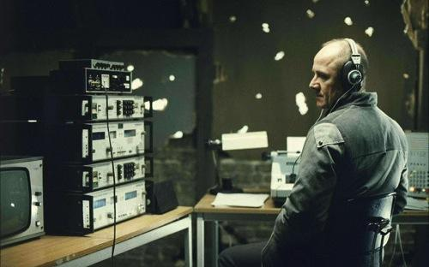
Network Communications
[1]
Notes:
The GDR maintained direct censorship of the arts to the masses through prepublication review
There was a lot of physical monitoring equipment involved in doing so, in the day of the Stasi
The equipment had to be installed when the person left for a long enough time period
Neighbors (loose ends) have to be covered and persuaded not to speak or crack
Citation

Slide 5
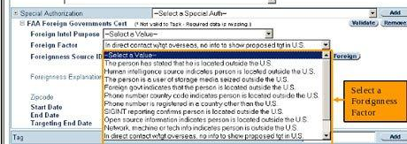
Network Communications
The Lives of Others
NSA data mining through X-Keyscore can access logins, emails, phone #s, even metadata
[16]
Notes:
Nowadays citizens can be monitor effectively and without their knowledge through programs such as X-Keyscore
X-Keyscore takes in a Name, email or IP address and a set amount of time to monitor the person’s presence, then collects any kind of internet data
The only legal requirement of the program is that monitoree has is in contact a foreigner else a warrant is required
Legality of targeting US Citizens without warrants

Slide 6
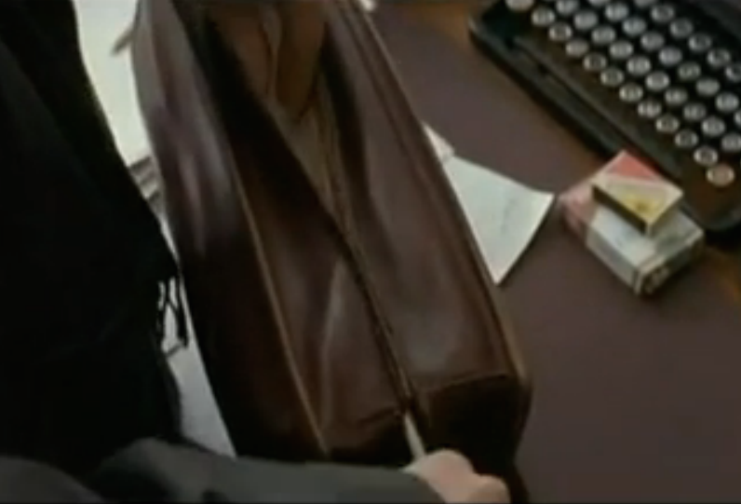
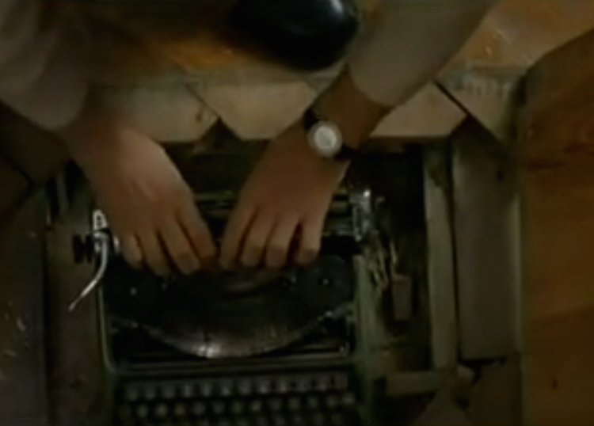
Computer And Network Security
The Lives of Others
Authors had to write in secret and smuggle physical articles over the border
The Stasi monitored phone calls, bugged houses, and analyzed typewriter typeface
[1], [17]
Notes:
Articles had to be written with secret typewriters so as not to be traced back to the typewriter registered to the author
To get info across the border articles were smuggled in secret pockets

Slide 7

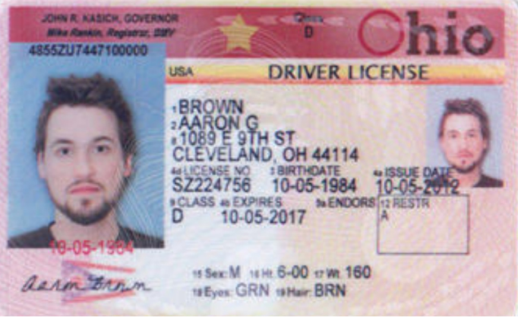
Computer And Network Security
The Lives of Others
<These are the same picture, except google recognized & blocked the first.>
Instead of risky face-to-face meetings, authors could have benefited from encrypted communications such as Signal
Authors could have become anonymous Aaron Browns
[14], [15], [18]
Notes:
The authors could have used encrypted phone messaging vs tapped phones to communicate with less risk
Ties to modern day -Signal -Warrantless wiretapping in the US is illegal
Anonymous valid identities can be created via the deep web (nonexistent people like Aaron Brown)
eated-

Slide 8
Mass Surveillance in GDR VS
Strong Privacy Law in Germany
The Lives of Others
Although in GDR Information Privacy was legislated, individual privacy was not well protected [7]
Surveillance and persecution to citizens were common in GDR
    Soviet [8], Domestic [9] , International [10]
Germany is one of the strictest countries in the world regarding privacy
  Internet privacy laws cause search engine (Google[11]) and social media (Facebook[12]) numerous problems
[7] [8] [9] [10] [11] [12]
Notes:
Ties to the movie
Although Information Privacy was legislated in GDR , individual privacy was not well protected:
In the movie, a young Stazi agent were making fun of the General Secretary with his colleagues , which was supposed to be a privacy conversation. However, the joke was heard by the Wiesler and Wiesler’s superior. The agent got a heavy punishment lost his job in satzi and steam open letters for the rest of life.
Ties the time period
There is a lot of research about the Mass Surveillance in East Germany, involving the Soviet Union, East Germany, and Western agencies. GDR people were constantly under surveillance and faced persecution
In 1947，Soviet Military Administration in Germany established Kommissariat 5， aimed to conduct surveillance of individuals in East Germany
On 8 February 1950, Stazi established , Domastic
The West German intelligence agency, employed approximately 10,000 East Germans as spies
3. Due to the terrible history, Nazi and the Satzi, Germany nowadays is one of the strictest countries in the world regarding privacy
Mainly, German privacy laws put restrictions the internet, which caused internet search engine and social media like Google and Facebook numerous problems.
In 2010, German were given the opportunity to blurred out their house on Google maps in street view
In 2011, according to German data protection laws, facebook facial recognition technology was sued for not clearly inform users about how biometric data was being used.
Citation:
http://www.bfdi.bund.de/DE/Home/home_node.html
"JCWS 5:2 | "The Prelude to Nationwide Surveillance in East Germany: Stasi Operations and Threat Perceptions, 1945-1953" by Gary Bruce". Fas.harvard.edu. Retrieved 2014-01-30.
Glees, Anthony (1 August 1996). Reinventing Germany: German political development since 1945. Berg. p. 213. ISBN 978-1-85973-185-7. Retrieved 14 January 2012.
Siobhán Dowling (2007-09-28). "Cold War Espionage: 10,000 East Germans Spied for the West - SPIEGEL ONLINE". Spiegel.de. Retrieved 2014-01-30
mbw – with wire reports (September 20, 2010). "More than 100,000 Germans Ask Google to Blur their Homes". Der Spiegel. Retrieved February 15, 2011.
http://www.infoworld.com/article/2620909/internet-privacy/germany-to-sue-facebook-over-facial-recognition.html

Slide 9
Comparison of Government Collection
The Lives of Others
The Movie shows both a reference database and a larger archive as well as the collection process
Approximately 40 Million index cards of information collected
Large government presence made people feel oppressed
Information collected could be contained in 5 terabytes
In the modern day, information collection is passive and larger it is a bigger threat with less present
NSA email database can hold a billion times more information than the Stasi held (5 Zettabytes)
[4][5]
Notes:
The movie portrayed the Stasi records
About 40 million index cards led to information that was taken
All the information the Stasi collected could be put into 5 terabytes
In filing cabinets takes up 0.019 sq km
Data has to be interpreted by the Stasi to introduce into their records and that can be used to build a case against someone
Modern day the process is much more passive and data could be much larger
NSA has an email database that can hold 5 Zettabytes of information, one billion times what the Stasi had
Modern day that information is being passively acquired all the time and could be used if anyone draws suspicion
It takes fewer people, with less space, less equipment on the government side, and it takes less training
Swap to the other computer to show comparison as the comparison of Stasi vs NSA filesystem:
https://apps.opendatacity.de/stasi-vs-nsa/english.html

Slide 10
Physical vs Digital Databases
The Lives of Others
Stasi never adopted computer technology.
Instead, they compiled a physical database of information from approximately 6,000,000 people.
Physical database has high potential for human error but difficult to alter a large amount of data.
Wiesler creates inconsistent data to impede the prosecution of Dreyman.
Nowadays, we use digital databases, which have lower potential for human error, but easier to alter a large amount of data.
Even so, this is definitely more effective!
Information updated quickly, accessed instantly, and collect significantly more.
[2][4][5]
Notes:
Although it is never directly answered why the Stasi did not utilize computers, it is likely a motley of reasons (cost, reliability, develop, access to technology).
And this included everything from personal records and written reports, to film and sound recordings.
Both intentional and unintentional. Since it is subjective to the agent, manually recorded, and manually filed. For example: Stasi couldn’t delete them all, since they needed to be manually destroyed.
In the story, we can see how this might be an issue… … which shows how database errors can cause significant problems to those reliant on it
Lower human error due to automation in data collection and sorting.

Slide 11
Our Only Defense: Intangibles
The Lives of Others
East Germany has an extreme society and economy due to an oppressive system of government.
This is due to the imbalance of power attained from access to private knowledge.
Creates “Winner-Take-All” scenario.
In the case of East German economy, “better” is not just based on skill.
People strive to work for the government/Stasi regardless of other talent.
In modern US, monitoring private digital information can be more revealing than visually watching the suspect.
We have powerful defenses for privacy through laws and American ideology.
However, if these two components were to change, imbalance of power would be more detrimental by many magnitudes.
[1][13]
Notes:
So many Work & Wealth topics, such as: ___ do not apply.
Literally embodies the phrase “Knowledge is Power”.
However, … in which people who are only marginally “better” receive all the benefit from their category of work.
“Better” in this case, represents the person that better fits the government’s ideal worker.
This creates a lot of wasted “talent”, since the incentive gap is too expansive.
In a class project at the Massachusetts Institute of Technology that received some attention last year, Carter Jernigan and Behram Mistree analyzed more than 4,000 Facebook profiles of students, including links to friends who said they were gay. The pair was able to predict, with 78 percent accuracy, whether a profile belonged to a gay male.

Slide 12
Authenticity Through Research
The Lives of Others
Family ties to East Germany
Movies after reunification depicted GDR as funny or moving
Wanted to portray fear and lack of privacy in contrast
After inspiration, went to Berlin in 2001 to do research
Information presented in the movie is very detailed and “Unbelievably authentic”
“I suddenly had this image in my mind of a person sitting in a depressing room with earphones on his head and listening into what he supposes is the enemy of the state and the enemy of his ideas, and what he is really hearing is beautiful music that touches him.”
— Florian Henckel von Donnersmarck
[6][3]
Notes:
Both of Henkel's parents come from East Germany, so as a child he went there often to visit family.
Examples are “Sun Alley” Sonnenallee, and “Good Bye, Lenin!”, which both have lighter hearted characteristics of a teenage coming-of-age story.
He also wanted to properly depict the prevalence of the Stasi, which was down-played in the other movies
Visited Stasi detention centers, interviewed with East German artists and former Stasi members.
Thomas Brussig, author and scriptwriter born in the GDR says it is “Unbelievably authentic”

Slide 13
Conclusion
The Lives of Others
This was a very active system in the past that required a high agent to citizen ratio
Now it can be done with technology doing a lot of the work
  Active vs Passive data collection
The surveillance has become far more comprehensive (5 zettabytes stored)
Despite this, most us live without as much fear
Notes:
So as you can see, the modern world may not have as many men hiding in your attic, but it can be just as scary.
With modern data collection techniques, an organization like the Stasi would be able to track even more of your activities, without needing nearly as many actual agents to watch you.
In addition to that, with the information being collected automatically and digitally, you'd have no chance of your agent deciding you're not so bad and sparing your life.
The information is collected passively, with little to no human involvement,
Your only defense is encryption (assuming it hasn't been cracked) or perhaps carefully constructed false identities.
But don't get too comfortable with those, because even if you can find your way around the modern methods of surveillance- no one's forgotten how to hide a man in your attic.

Slide 14
REFERENCES
The Lives of Others
[1] The Lives of Others (Das Leben der Anderen), (2006) a Wiedemann & Berg Filmproduktion, written and directed by Florian Henckel von Donnersmarck.
[2] Chris Bowlby, “Stasi files: The world’s biggest jigsaw puzzle”, http://www.bbc.com/news/magazine-19344978 (4/25/16)
[3] Johannes Wetzel, “German Film Competes For Oscar”, http://www.culturekiosque.com/nouveau/cinema/the_lives_of_others.html (4/25/16)
[4] Epstein, C.(2004). The Stasi: New Research on the East German Ministry of State Security. Kritika: Explorations in Russian and Eurasian History 5(2), 321-348. Slavica Publishers. Retrieved April 21, 2016, from Project MUSE database.
[5] Gellman, Barton; Greg Miller (August 29, 2013). "U.S. spy network's successes, failures and objectives detailed in 'black budget' summary". The Washington Post. Retrieved August 29, 2013.
[6] Sony Pictures, Press Booklet: The Lives of Others http://www.sonyclassics.com/thelivesofothers/externalLoads/TheLivesofOthers.pdf (4/25/16)

Slide 15
REFERENCES
The Lives of Others
[7] http://www.bfdi.bund.de/DE/Home/home_node.html
[8] "JCWS 5:2 | "The Prelude to Nationwide Surveillance in East Germany: Stasi Operations and Threat Perceptions, 1945-1953" by Gary Bruce". Fas.harvard.edu. Retrieved 2014-01-30.
[9] Glees, Anthony (1 August 1996). Reinventing Germany: German political development since 1945. Berg. p. 213. ISBN 978-1-85973-185-7. Retrieved 14 January 2012.
[10 ]Siobhán Dowling (2007-09-28). "Cold War Espionage: 10,000 East Germans Spied for the West - SPIEGEL ONLINE". Spiegel.de. Retrieved 2014-01-30
[11] mbw – with wire reports (September 20, 2010). "More than 100,000 Germans Ask Google to Blur their Homes". Der Spiegel. Retrieved February 15, 2011.
[12]http://www.infoworld.com/article/2620909/internet-privacy/germany-to-sue-facebook-over-facial-recognition.html

Slide 16
REFERENCES
The Lives of Others
[13] Steve Lohr, “How Privacy Vanishes Online”, http://www.nytimes.com/2010/03/17/technology/17privacy.html?_r=0 (4/26/16)
[14] Open Whisper Systems. (2015). PRIVATE MESSAGING. Accessed April 26, 2016. Retrieved from https://whispersystems.org/
[15] DJ Pangburn. (2013). How Aaron Brown, a Fake Person, Was Created for Real on the Deep Web. Accessed April 26, 2016. Retrieved from http://motherboard.vice.com/blog/how-aaron-brown-a-fake-person-was-created-for-real-on-the-deep-web
[16] Glenn Greenwald. (2013). XKeyscore: NSA tool collects 'nearly everything a user does on the internet'. Accessed April 26, 2016. Retrieved from http://www.theguardian.com/world/2013/jul/31/nsa-top-secret-program-online-data
[17] Robert Messengers. (2011). Groma Kolibri: The Ultra-Slim Typewriter. April 26, 2016. Retrieved from http://oztypewriter.blogspot.com/2011/12/groma-kolibri-ultra-slim-typewriter.html
[18] Laws. (2015). Wiretapping Overview. Accessed April 26,210. Retrieved from http://constitution.laws.com/the-supreme-court/wiretapping

