Slide 1
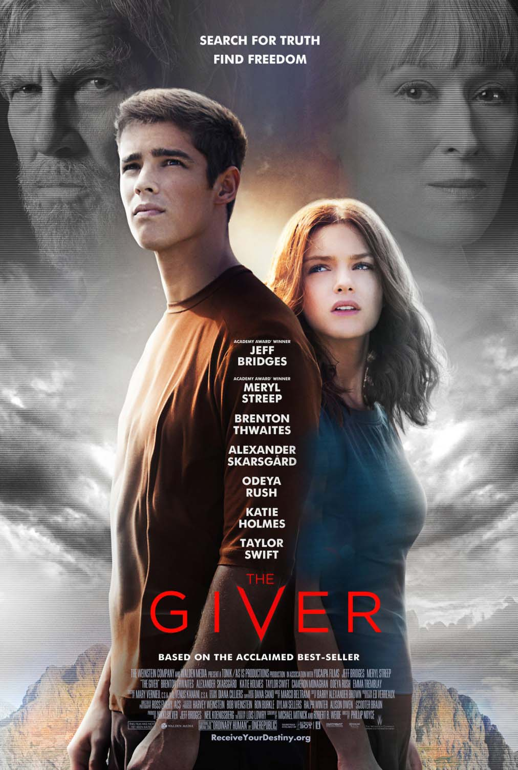
The Giver (2014)
Aman, Sandi, Samson, Julie, Hazel

Slide 2
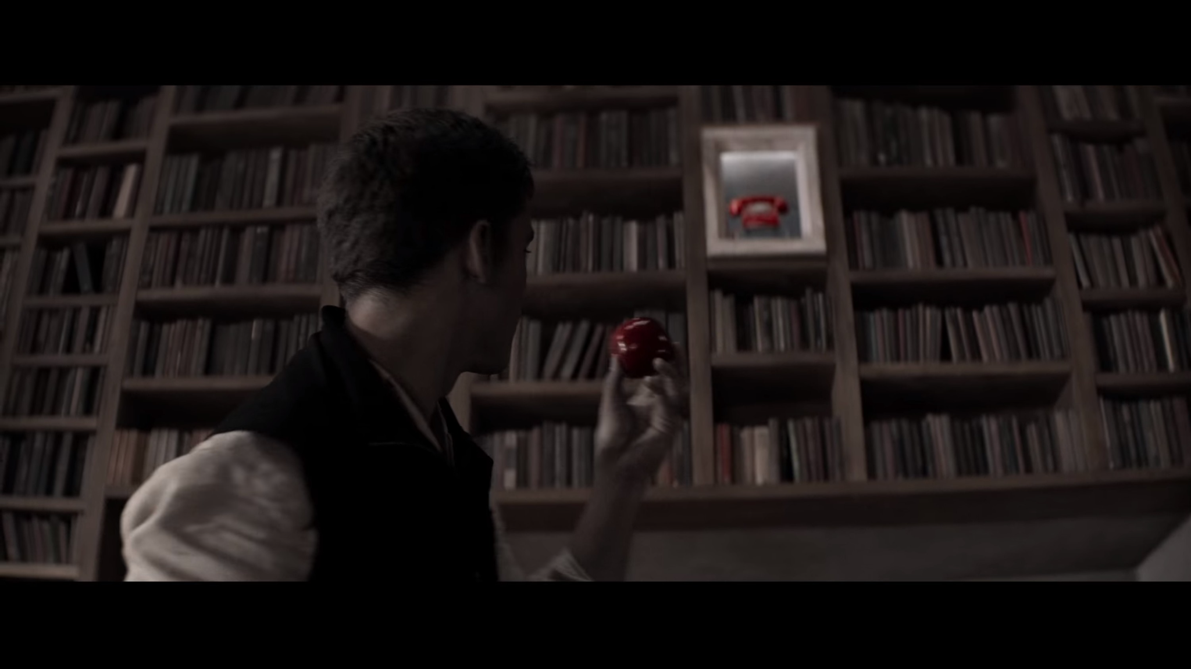
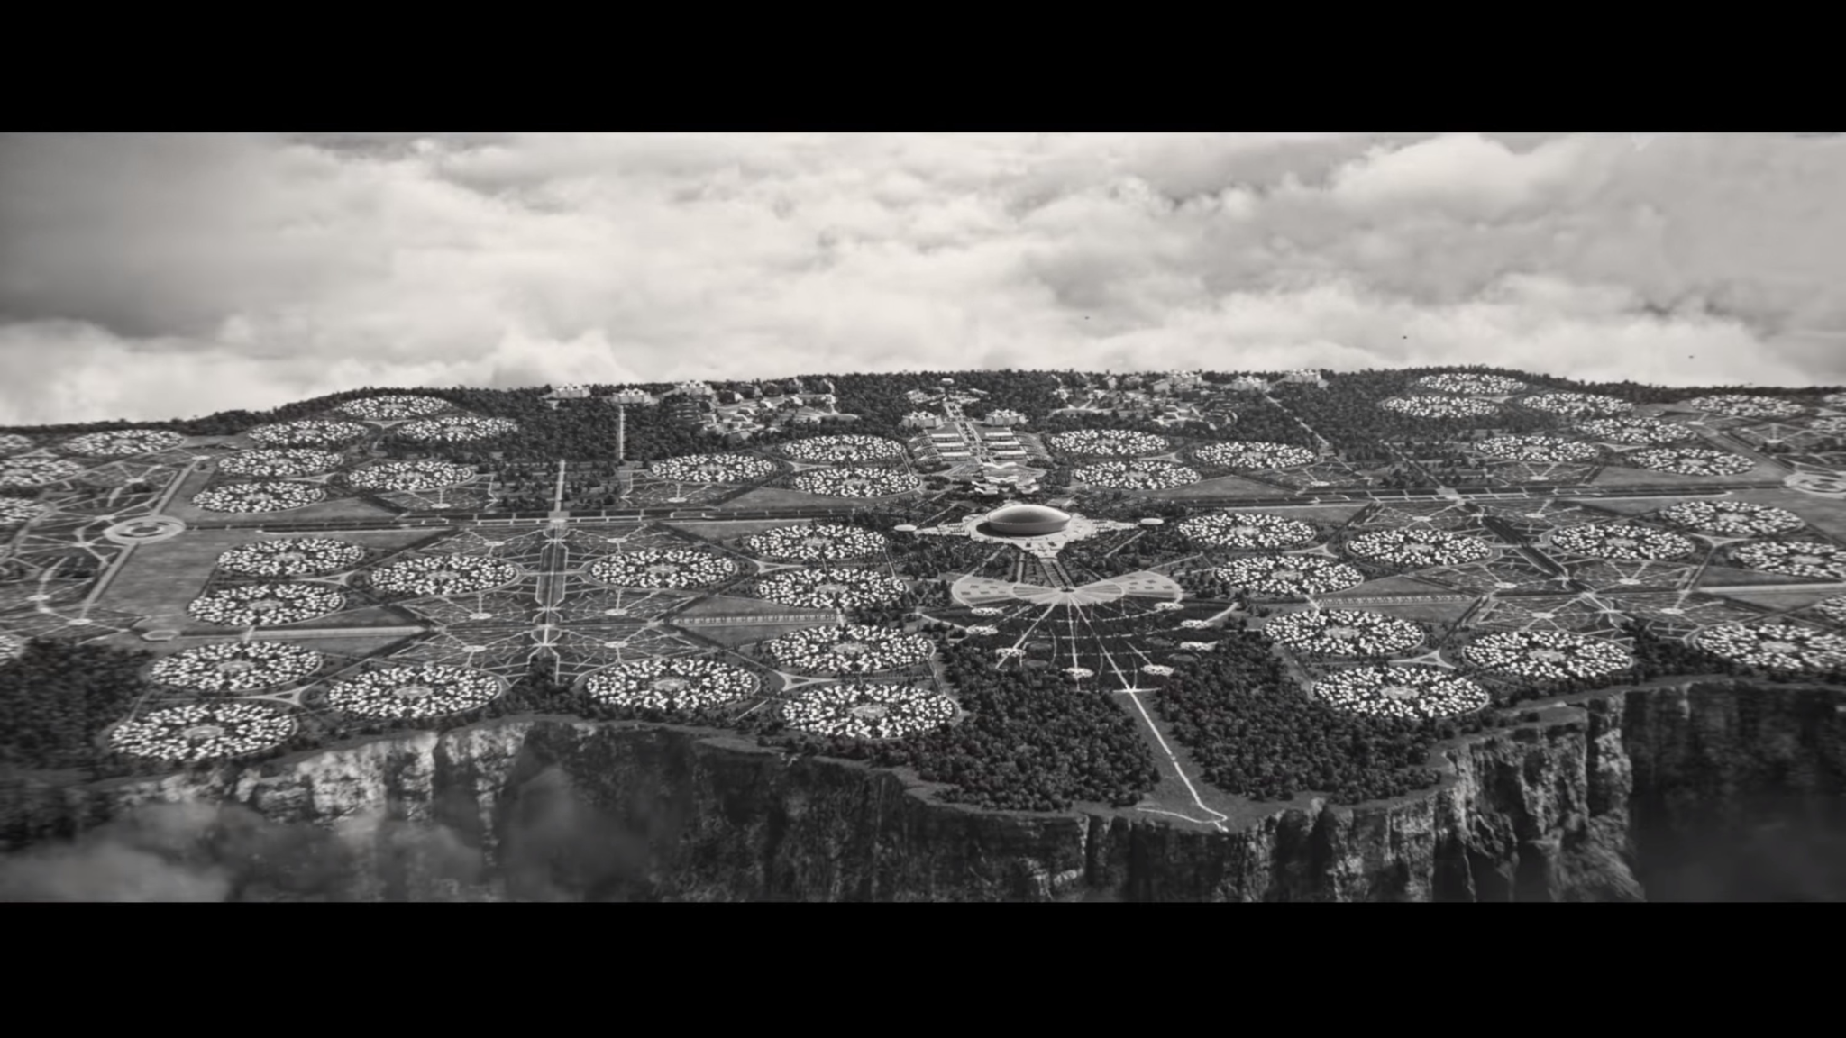
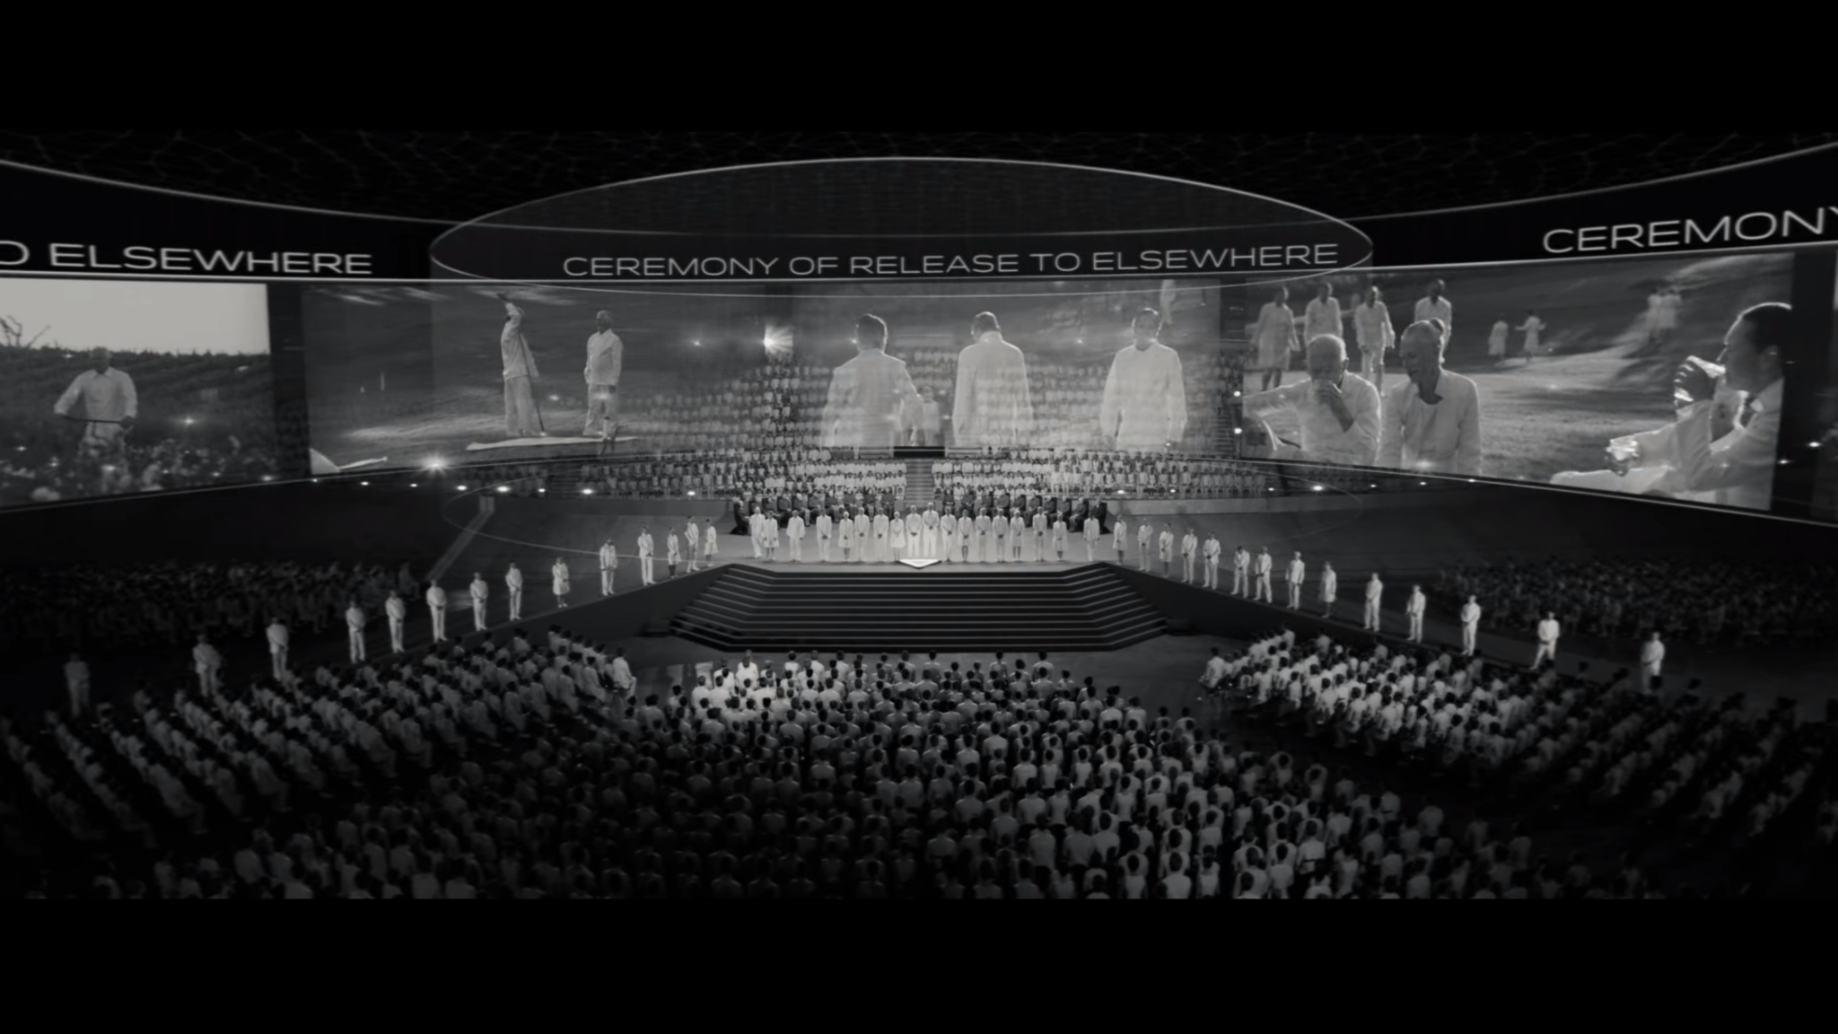
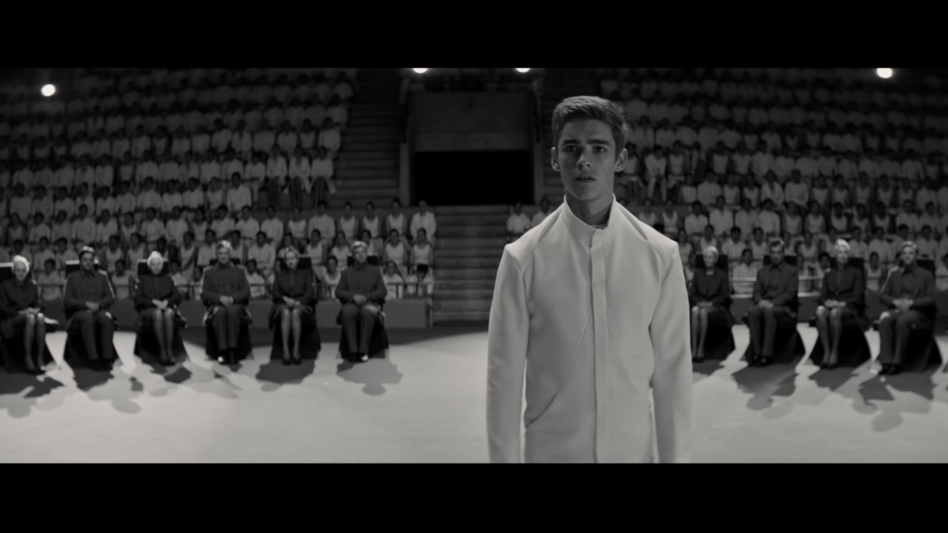
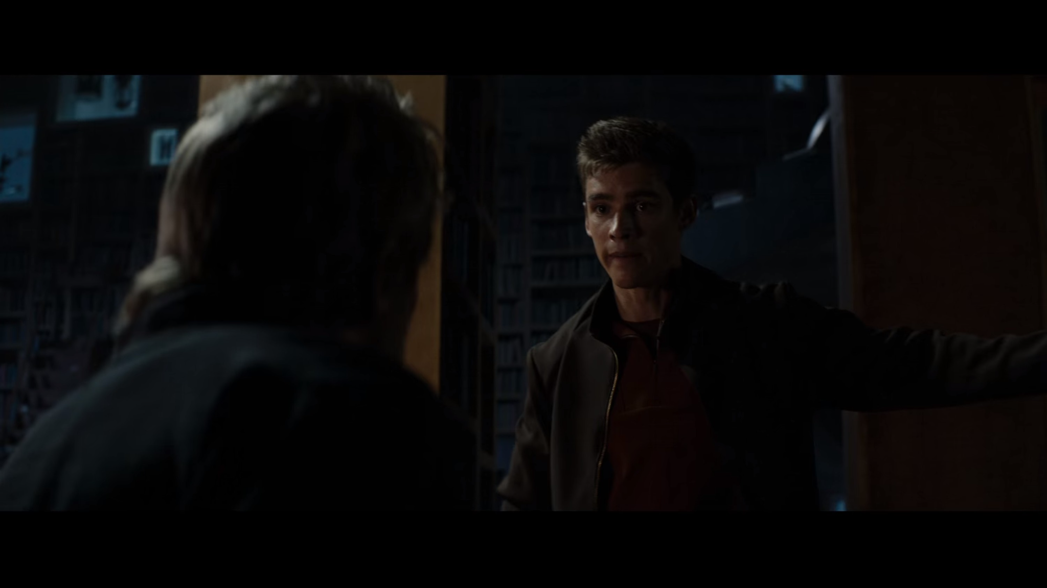
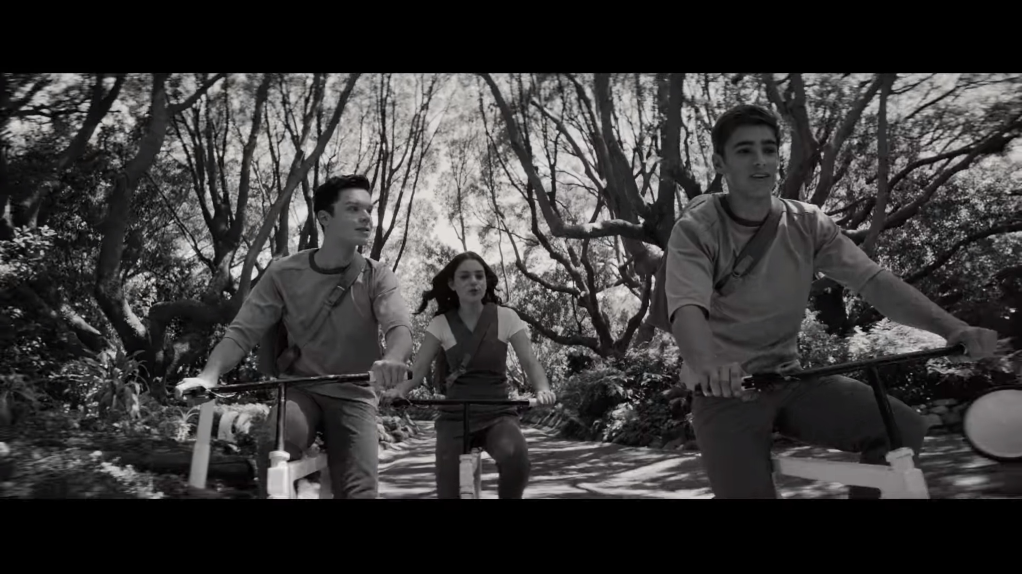
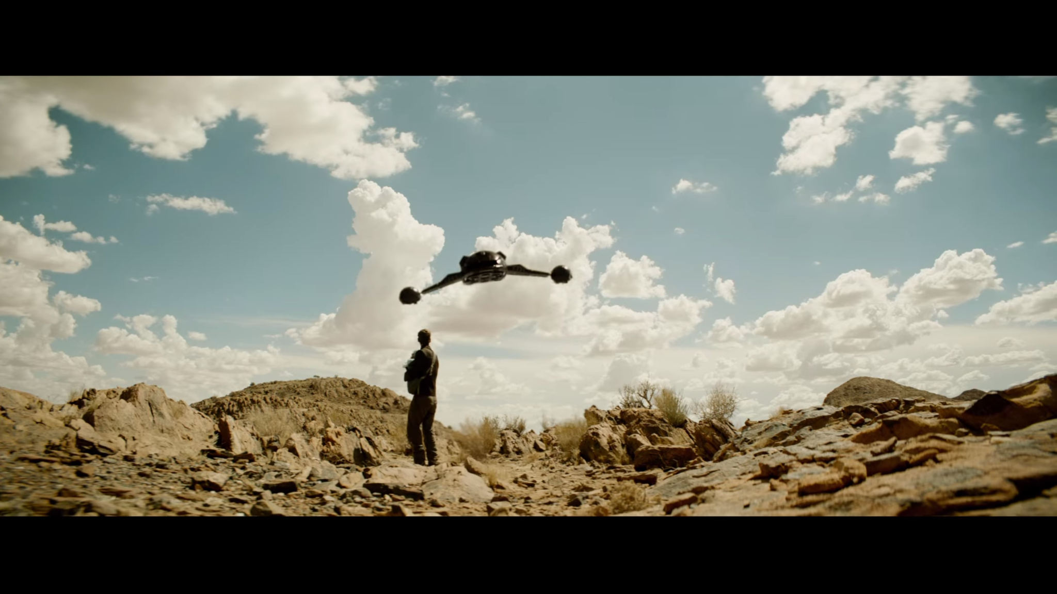
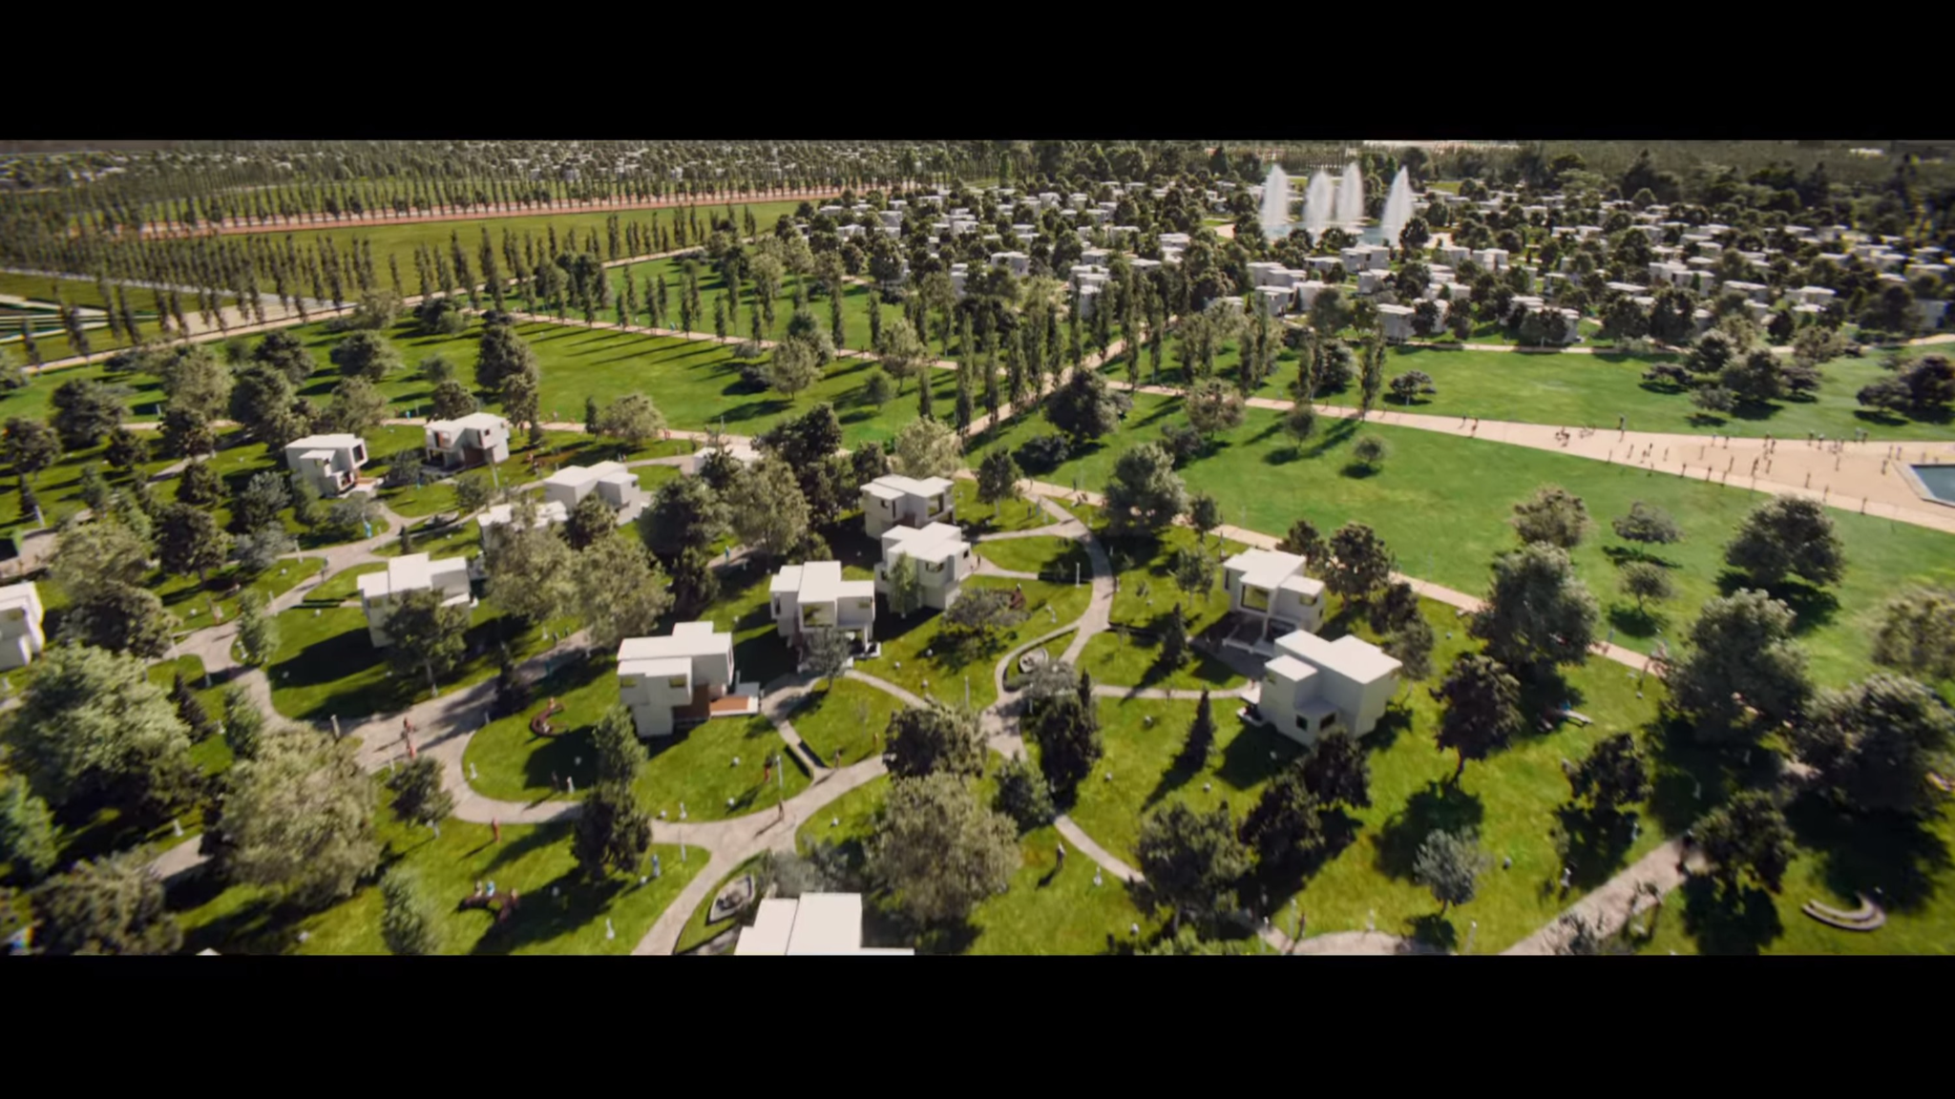
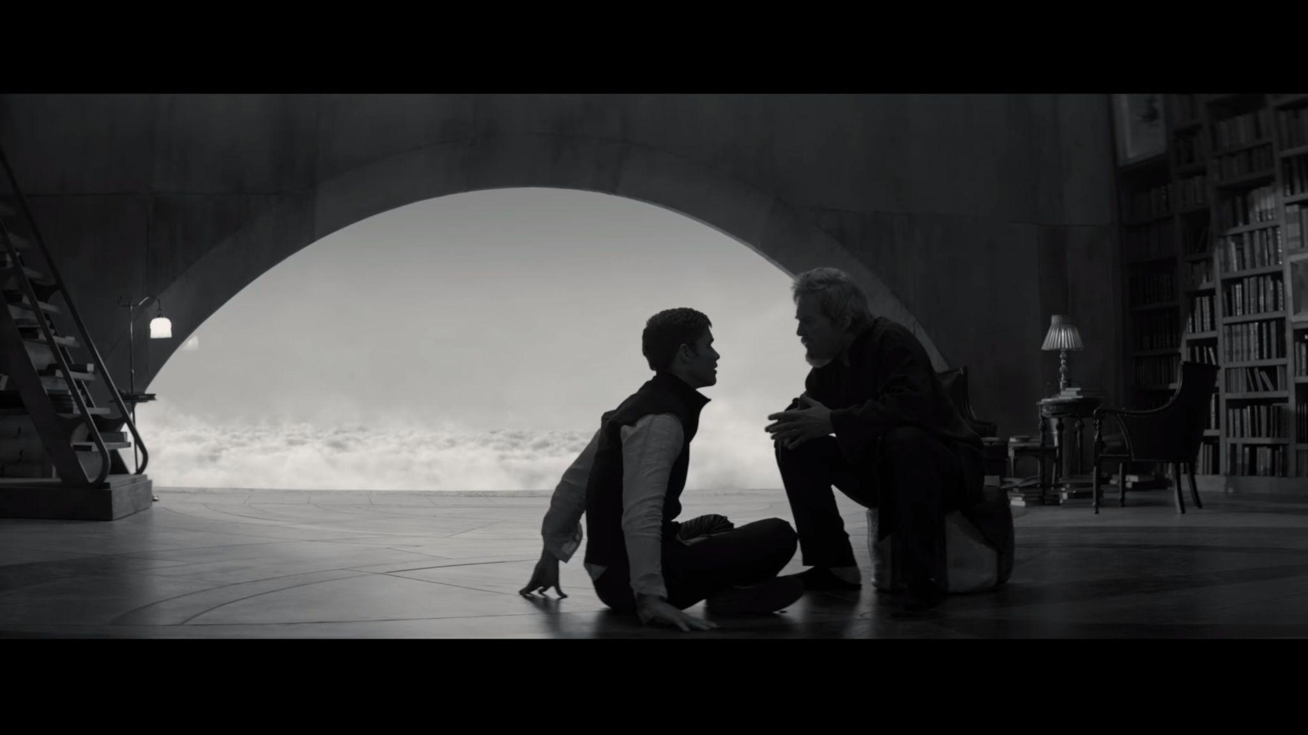
Plot Timeline
Aman Gupta
Notes:
(Image 1) Jonas (on the right) with his friends, on their way to somewhere
(Image 2) The movie takes place in an ideal Utopia to avoid suffering.
(Image 3) Jonas and his friends are graduating, and they are assigned a job by the Elders.
(Image 4) Jonas gets a very special rare job as the Receiver of Memory
(image 4.5) Addition to top
(Image 5) As the Receiver of Memory, Jonas receives back his feelings, emotions, and the history of the universe.
(Image 6) Jonas realizes that everyone has been robbed of their humanity. Jonas formulates a plan to save the world.
(Image 7) Jonas faces many challenges on his path to bring back the memory of everyone in the Utopia.
(Image 8) Jonas succeeds in bringing back the memory and feelings. People in the Utopia can now see colors as evident by this image.

Slide 3
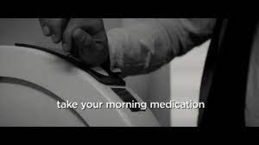
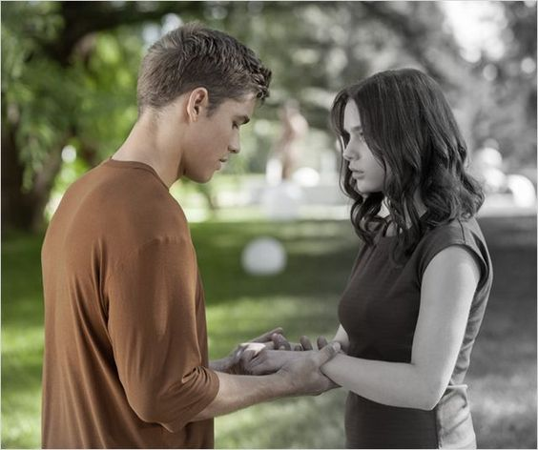
Movie Technologies
Aman Gupta
Drones
Injection Machines
Hologram Communication
Surveillance Towers
Memory-Sharing psychic technology
Notes:
Movie summary/ Other technologies?
Drones - MQ-9 Reaper UAV, used in Afghanistan, enough carry weight to hold Jonas and Gabe multiple times over, but the beam technology that “grabs” them is merely just science fiction
Injection machines - Closest thing we have is Epi Pens and hand-held spring loaded injectors. Possible to automate with sensors that detect when someones arm is over the syringe. Once detected, machine inject dose of medicine
Hologram communication - Today’s networks already struggle enough with 2D video communication; 3D holographic communication would require orders of magnitude more data to make anything that even vaguely resembles the movie’s holograms, which work in high definition and framerate with minimal latency.
Surveillance Tower: Already Exist
Memory Sharing: In-progress technology but currently fictional

Slide 4
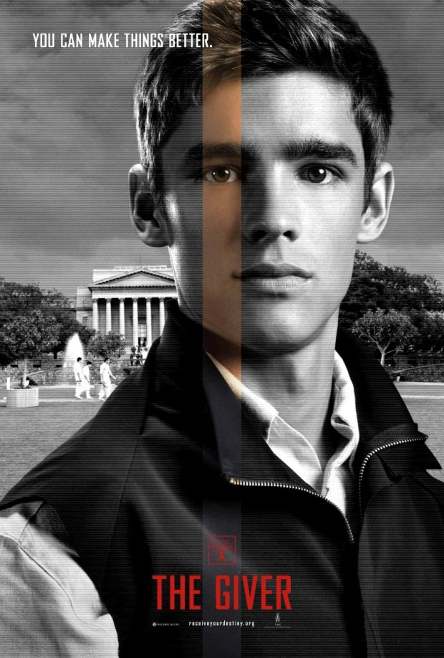
Main Conclusion
Aman Gupta
The Giver presents a cautionary tale about the dangers of heavy reliance on technology to regulate society
To what extent does technology create a better world or a dystopian future?
What is the role of individuality in society?
Notes:
What is the Movie Maker’s Intent:
The movie's intent regarding computing is to present a cautionary tale about the potential dangers of relying too heavily on technology to regulate and control society.
The movie depicts a society that has used computing technology to create a seemingly perfect world, but in doing so, has eliminated important aspects of humanity such as emotions, creativity, and individuality. By presenting this dystopian future, the movie aims to highlight the potential consequences of allowing technology to become too dominant in our lives.
Furthermore, the movie shows the importance of human connection and empathy in contrast to a society that has lost touch with these values. The protagonist, Jonas, learns the value of these things as he discovers the truth about his society and sets out to challenge it.

Slide 5
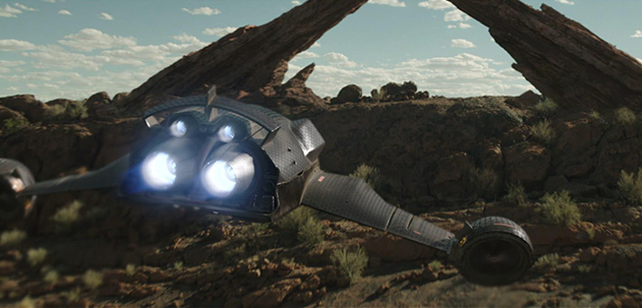
Drones
Samson Hodges
Military UAVs are the closest parallel [5]
  Movie’s drones aren’t built for combat
  Modern quadrotor drones could be used for surveillance
  Need improved battery life to be feasible [2]
  Security drones terrible in society
Figure 1: Drone instructed to locate Jonas in Elsewhere
Notes:
Drones - MQ-9 Reaper UAV, used in Afghanistan, - both can fly at high altitudes long periods of time while performing surveillance
enough carry weight to hold Jonas and Gabe multiple times over, but the beam technology that “grabs” them is merely just science fiction
Movie drones not built for combat, but possible that smaller drones like quadrotors could keep surveillance over neighborhoods
Afterall, they are agile, quick, and it’s already possible to mount cameras to them
If we were to use security drones in real life, need to improve battery life as avg battery lasts 30-60 mins
Not to mention weight of things like cameras means more power needed to stay aloft, means even less battery life
Good drones don’t exist as infringes on our right to privacy - gov’t always watching
Violation of intellectual property as gov’t could arrest anyone who knows too much - use drones as gov’t proof
Used as tools to enforce gov’t agenda, stripping society of freedom and the power to make changes in the gov’t

Slide 6
Injection Machines
Alexsandra Antoski
Infringement on Intellectual Property
  Lack in innovation and creativity
Psychological Harm
  Dependency
  Medication affects everyone differently [7]
Control
  Emotional Blunting [4]
  Censorship
Figure 2: Machine distributing morning injections
Notes:
In the movie injection machines are a device at the entryway of every home. As someone walks out of the house, young and old, they’re required to receive an injection by placing their palm on the device. The movie shows the injections repress strong emotion, mainly love. As we see when Jonas stops taking the daily injection, along with being given more memories, he realizes something is wrong in this community and seeks change. The reason this was done was to keep the community in line, without strong emotions all community members besides Jonas and The Giver are complacent with the order of things. We see this clearly when Jonas’ “father” kills a baby and drops them down a chute.
If we were to implement injection machines today there would be a few issues, one is that these machines that numb out emotions would be an infringement on intellectual property. In the sense that our emotions are ours. Also limiting strong emotions as demonstrated in the movie would lead to a lack of innovation and creativity, since people wouldn’t have the desire to chase a goal or create something new. We see this in the movie when everyone is simply assigned a role and they’re all happy and content with their roles. In society today, we would have less art being created since there would be a lack of emotion to act on.
There would be psychological harm in society. There would be dependencies on medications that alter mood, while they are not typically addictive altering brain chemistry continuously would create a dependence. Also, medications are not a one size fits all deal. For example, if we assume that this a strong anti-depressant, for some this could cause serotonin syndrome, where at best would leave some with a rapid heart rate and high blood pressure, at worst it could be life threatening.
Also this would be a great measure of controlling a population. People lack the desire to strive for a goal and create something new, and they are on a medication that may further discomfort them. Again, assuming it is an antidepressant one symptom for them is “emotional blunting” where the individual experiences a sense of numbing positive and negative emotions. This is also a great way to censor people as they have less emotions to act on, so even though what is happening is wrong they are being censored from having free thought. So now it is less likely for a population to lash out, we see in the movie everyone is content with the life they live, never contemplating why they’re redistricted to an isolated area and they don’t get to choose their job, partner, or child.

Slide 7
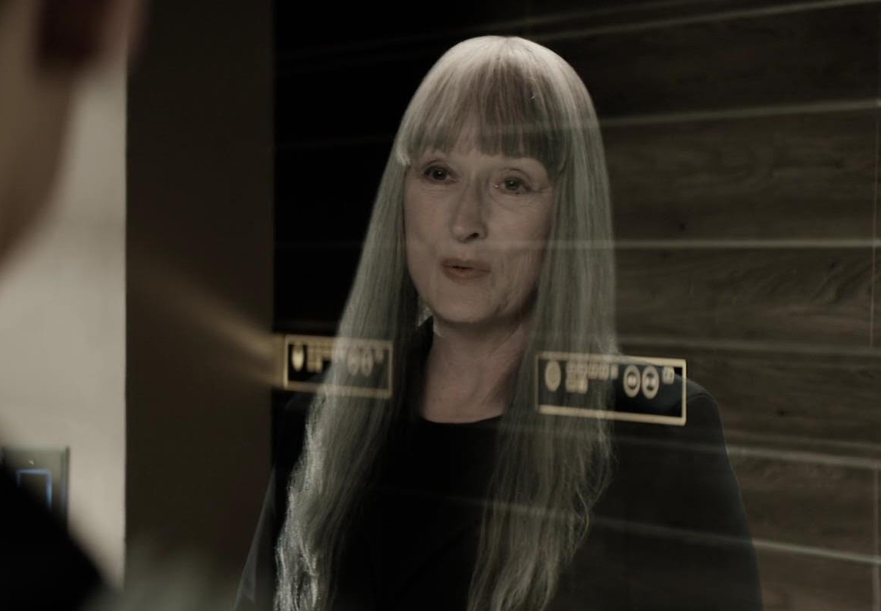
Hologram Communication
Hazel Green
Not currently feasible
  Current network infrastructure can’t support it [8]
  Hologram tech does exist, however it is typically only used with static images and prerecorded video
Invades Privacy
  Tech lets government officials to contact people without their consent
Figure 3: Chief Elder communicates with Jonas in Jonas’ dwelling via hologram transmission
Notes:
Today’s network infrastructure already struggle enough with 2D video communication; 3D holographic communication would require about 100 times more data to make anything that even vaguely resembles the movie’s holograms, which work in high definition and framerate.
The technology, if implemented like it was in the movie, would allow government officials, or anyone who got their hands on the tech, to communicate with and monitor anyone in their country without their prior consent, like a phone call that that picks up automatically.

Slide 8
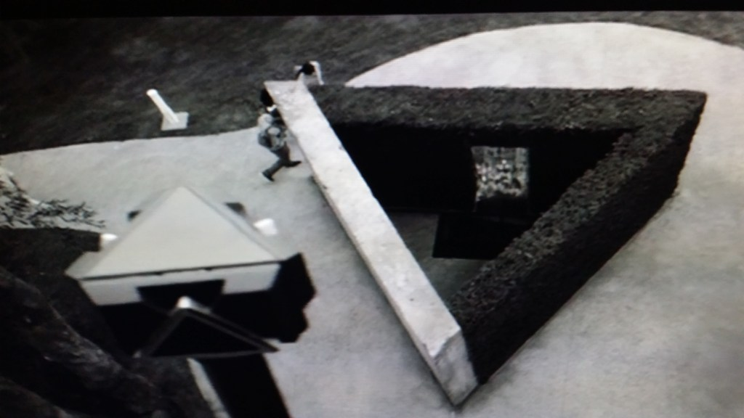
Surveillance Towers
Hazel Green
Surveillance States
  These towers already exist in today’s world
  Makes citizens more inclined to follow rules and laws
  Logs everything it records for future review
Takes away privacy
  Surveillance towers that watch and log your every move take away any notion of privacy
Figure 4: Surveillance tower camera (left), and a “secret” hideout (center) used by Jonas and his friends
Notes:
Surveillance towers, like the ones in the movie, very much exist in today’s world, and are even available commercially. They are used a lot in surveillance states, like China, in order to keep tabs on their citizens and enforce their laws.
In the movie, the cameras on the towers seem to upload all their footage to a central server, which makes sure that anything that happens, anywhere, on any day and at any time, can be reviewed later if something comes up.
These sort of surveillance towers infringe upon the privacy of anyone who walks next to them.

Slide 9
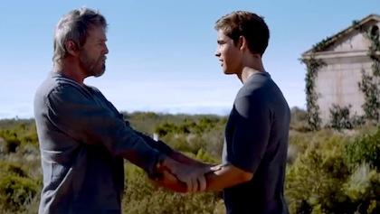
Memory Sharing Technology
Julie Vieira
Chip implants can transmit memories
  Accidental transmissions can cause harm
  RFID wallets created to prevent credit cards from being read contactlessly [3]
  Deep fake technology [6]
Infringes upon intellectual and privacy rights
  Intellectual property refers to creations of the mind, but these can now be stolen
  The Shakespeare dilemma: two individuals producing the same idea
  Neuro rights (Marcello Ienca) [9]
Figure 5: The Giver shares memories with Jonas via the implants in their arms
Notes:
Chip implants can transmit memories
Accidental transmissions can cause harm
Jonas receives a memory of war years before he was supposed to
Malicious use of technology can be used to manipulate individuals
This was not the Giver’s memory, it was someone else’s memory that was transmitted through the Giver to Jonas
If an individual fabricates a memory, this information can be used to harm society
RFID wallets created to prevent credit cards from being read contactlessly
Someone can steal memories from an individual contactlessly if they can figure out a way to scan the memory chips like the credit card chips
Deep fake technology
Infringes upon intellectual rights
Intellectual property refers to creations of the mind, but these can now be stolen
The Shakespeare dilemma: two individuals producing the same idea
If two individuals develop the same idea and produce separate works, they cannot both be given full rights and share rights
Neuro rights
Marcello Ienca is a research group leader at the Swiss Federal Institute of Technology in Lausanne (EPFL), the UN, Organization for Economic Co-operation and Development, and governments
It is an ongoing battle to establish neuro rights before the technology is even finalized
Organizations have developed like the Foundation for Neuro Rights which aim to protect the thought patterns and brain activity of individuals
Next, we will discuss the implications behind memory sharing technology. In the movie, the Giver and Jonas are able to share and receive memories through chip implants in their arms. When their arms connect together as seen in the image on the right, the memories automatically transmit through the chips and transport the receiver to the scene pictured by the Giver. This technology is used so that the Giver is able to advise the council of Elders in their decision making to ensure the community is protected from past mistakes. However, if this technology were implemented today, there can develop much darker connotations associated with the technology.
One of the faults in the design of the chip is that it can likely be accessed without the consent of both parties. This is apparent in the film when Jonas accidentally receives a memory of war the Giver did not intend for him to experience for years. If individuals’ memories are accessed without their knowledge, this is an invasion of privacy. A real world example is credit cards with contactless payment. Theft became such an issue that RFID wallets were designed to protect people from scanning credit cards of passersby. Using chips, memories can also be transmitted in this way. In addition, from the receiver’s perspective, they can be given harmful memories that damage their psyche. If the technology was used with malicious intent, individuals can be manipulated and mentally mistreated should a Giver provide an inaccurate figment of imagination as a memory. The memory of war was not the Giver’s personal memory, but rather a memory that was given to him. This can translate over into pretending an imagining was a memory of reality. If individuals learn to fabricate memories, this can be used to harm society. This is arguably present today already when taking into account deep fakes. Deep fake technology can make people believe something is real when it is not, which is exactly what these falsified memories can accomplish as well.
Furthermore, this technology can be used to infringe upon the intellectual and privacy rights of individuals. Intellectual property refers to the creations of the mind, but this technology allows these ideas to be accessed by others possibly even without the victim knowing. Our textbook referred to the dilemma when two individuals simultaneously came up with the idea for the play Hamlet. Who owns the intellectual property is currently an impossible determination because they cannot both be given full rights and share them simultaneously. With memory sharing technology, it may be impossible to distinguish who came up with the idea first. With technology on brain activity constantly evolving, there are systems being put into place to protect neuro rights. Marcello Ienca is a research group leader at the Swiss Federal Institute of Technology, the UN, and the Organization for Economic Co-operation and Development who has framed the debate surrounding how to protect individuals' thoughts as technology gets closer to accessing our thought patterns. It is an ongoing battle, especially since technology is not there yet. But, there are organizations in place like the Foundation for Neuro Rights which aims to solidify these rights.

Slide 10
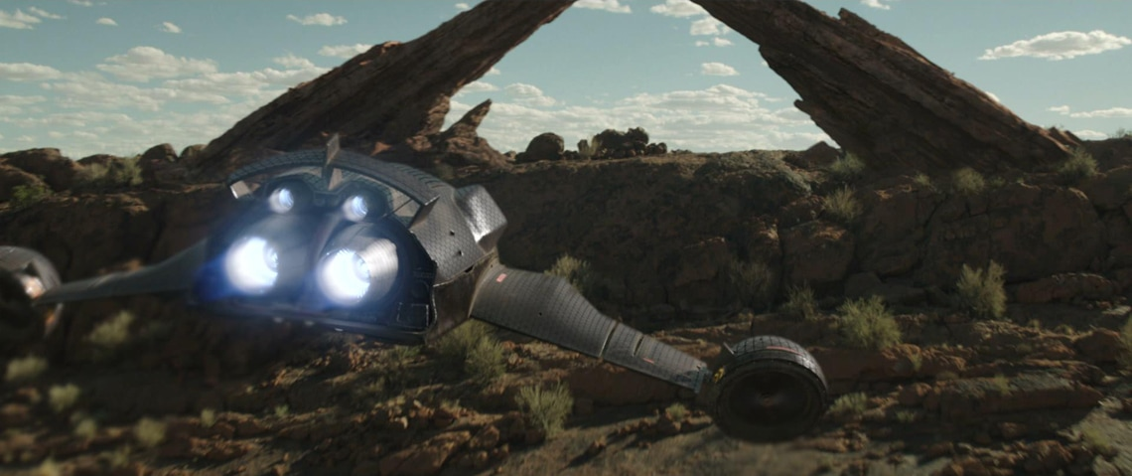
Ending Remarks
Aman Gupta
Drones
  Privacy Concerns
Injection Machines
  Infringes Intellectual Property Rights
Holograms / Surveillance Towers
  Infringes Right to Privacy
Memory-Sharing Technology
  Infringes Intellectual Property Rights
Figure 6: Drone instructed to locate Jonas in Elsewhere

Slide 11
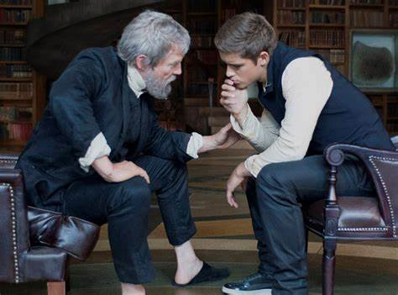
Questions?

Slide 12
REFERENCES
<Your Name>
[1] Baltazar, A. (2014). The Giver and Jonas Memory Sharing. Young Hollywood. Retrieved April 27, 2023, from https://younghollywood.com/scene/the-giver-aims-to-give-us-our-dystopia-fix-between-divergent-mockingjay.html .
[2] Feist, J. (2022, August 28). Best battery life: What's your flight time? Drone Rush. Retrieved May 1, 2023, from https://www.dronerush.com/best-battery-life-18549/
[3] Lotfi, Ahmad. “Could Your Contactless Bank Card Be Vulnerable to Virtual Pickpocketing?” The Conversation, 1 Mar. 2016, http://theconversation.com/could-your-contactless-bank-card-be-vulnerable-to-virtual-pickpocketing-55264 .
[4] Ma, H., Cai, M., & Wang, H. “Emotional Blunting in Patients With Major Depressive Disorder: A Brief Non-systematic Review of Current Research.” (Front Psychiatry, 2021) https://doi.org/10.3389/fpsyt.2021.792960
[5] MQ-9 reaper. Air Force. (n.d.). Retrieved May 1, 2023, from https://www.af.mil/About-Us/Fact-Sheets/Display/Article/104470/mq-9-reaper/
[6] Shao, Grace. “What ‘deepfakes’ Are and How They May Be Dangerous.” CNBC, 14 Oct. 2019, https://www.cnbc.com/2019/10/14/what-is-deepfake-and-how-it-might-be-dangerous.html .
[7] Shapper, Alyssa. “Effects of Antidepressants When Not Depressed” (Mental Health Program at Banyan Treatment Centers, 2022) Accessed April 29, 2023 from https://www.banyanmentalhealth.com/2022/02/09/effects-of-taking-antidepressants-without-depression
[8] Su, M., Liang, B., Liu, Q., Zhang, C., & Wang, J. (2021, October 15). Holographic Communication Technology: (2021): SU: Publications. Spie. Retrieved April 27, 2023, from https://spie.org/Publications/Proceedings/Paper/10.1117/12.2615108
[9] Wild, Kate. “‘Our Notion of Privacy Will Be Useless’: What Happens If Technology Learns to Read Our Minds?” The Guardian, 6 Nov. 2021. The Guardian, https://www.theguardian.com/technology/2021/nov/07/our-notion-of-privacy-will-be-useless-what-happens-if-technology-learns-to-read-our-minds .

