Slide 1
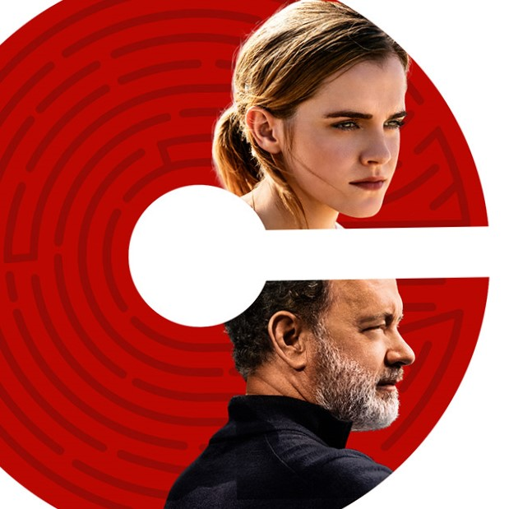
THE CIRCLE
An Analysis
Knowing is good
Knowing everything is better
By: Jennifer Payano, Zhizhen Wu, Junbo Chen, Jacob Moon
http://thecircle.movie

Slide 2
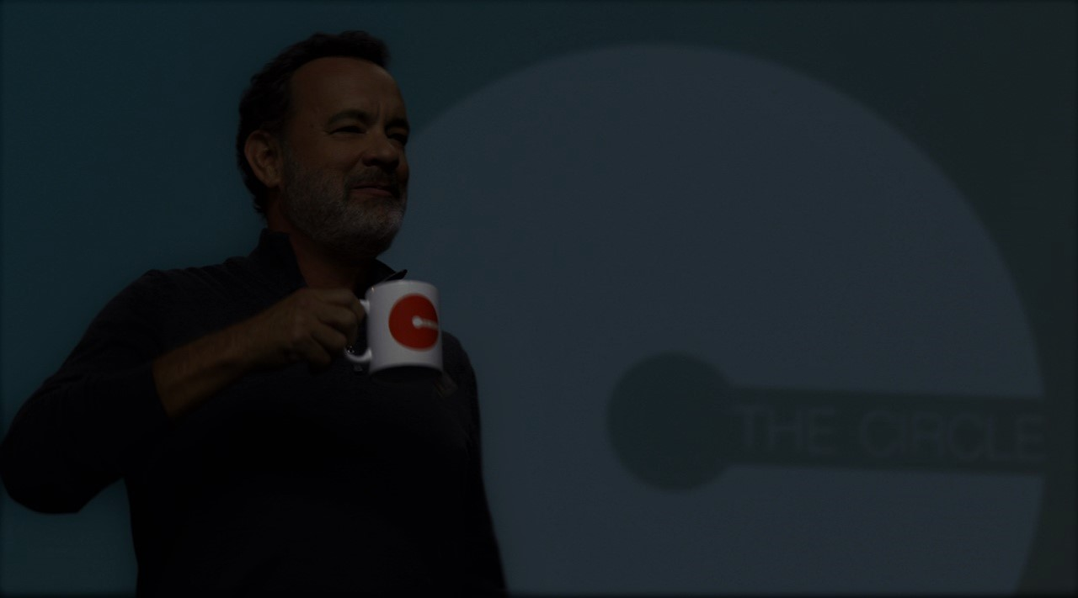
Plot Summary
Mae gets hired at world's largest and most powerful tech and social media company, The Circle
SHE IS ENCOURAGED by the founder TO engage in a experiment
Her participation in the experiments begins to affect the future of her friends, family and humanity [5]
As a result, her friend mercer dies
Mae perspective on privacy changes
http://thecircle.movie
Notes:
The company gathers all sorts of information about her, including her parent’s medical record. Small real time cameras are put every where around the word and all informations are analysis and saved by the company.
At first she was grateful about all that since they insured her dad who have Multiple Sclerosis.
The company starts using the information inappropriately and violating people’s privacy. Mae’s friend Mercer died as a result of this.
Her participation in the experiment, and every decision she makes, begin to affect the lives and future of her friends, family and that of humanity.
Against transparency, but after a talk with her friends Annie,(says that the company's founders has a bunch of private accounts that contains classified files) Maes perspective shifted: Technology wasn’t bad but rather the people in charge of it. In order for the system to work everyone has to be completely transparent.

Slide 3
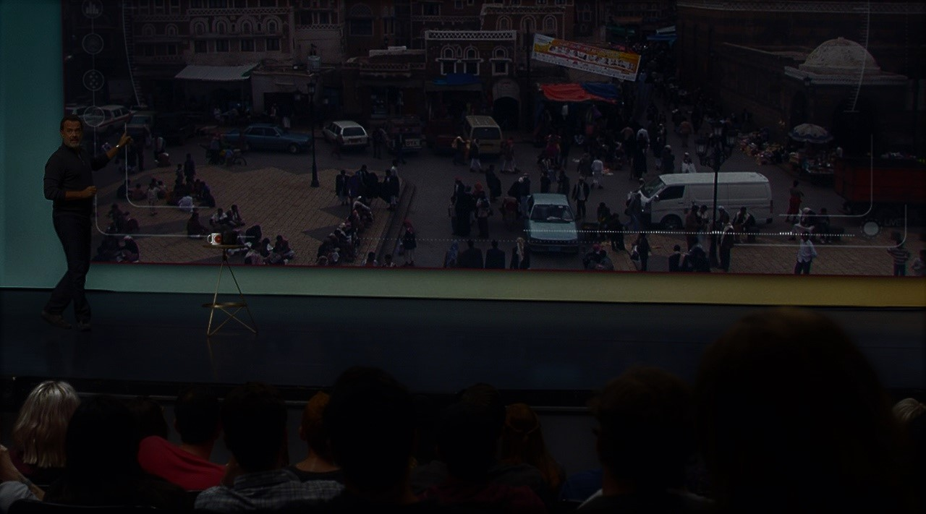
Conclusion
Knowing everything is better
Access to information does not ensure proper usage of information
Privacy is Personal Insecurity
http://thecircle.movie

Slide 4
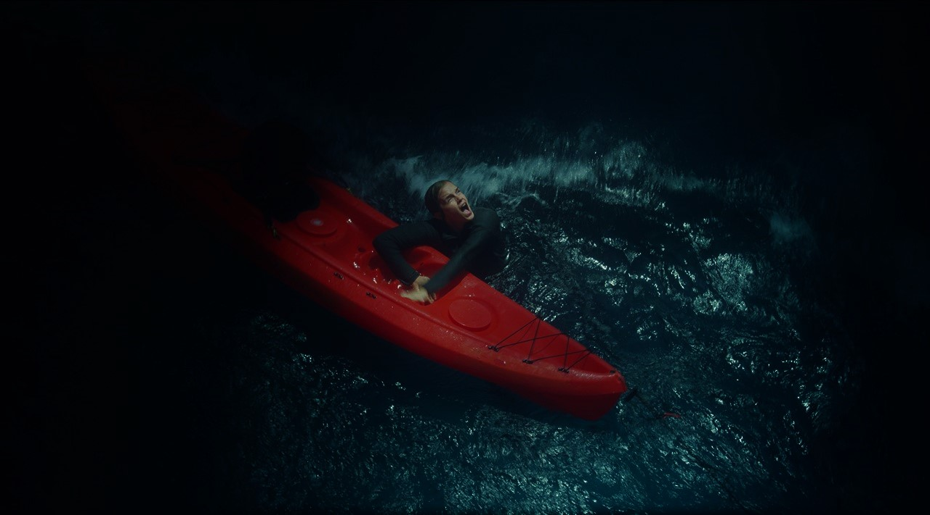
SEEchange
Small wireless cameras that records in real time
Allows handicapped people to see outside world
Save lives
Being watched makes people behave better [2].
Privacy concern
http://thecircle.movie
Notes:
Small wireless cameras that capture and analyze everything in real time and send all the data back to the server.
SAVE LIVES: Mae steals a kayak at the middle of the night and falls into the water.Steals Kayak in the middle of the night, Someone who is watching seals sees her and calls the police.
PRIVACY CONCERN: Mae accidentally sees her parents doing private things and broadcasted that to the world.
A group of researcher examined the effect of an image of a pair of eyes on contributions to an honesty box used to collect money for drinks in a university coffee room. People paid nearly three times as much for their drinks when eyes were displayed rather than a control image.

Slide 5
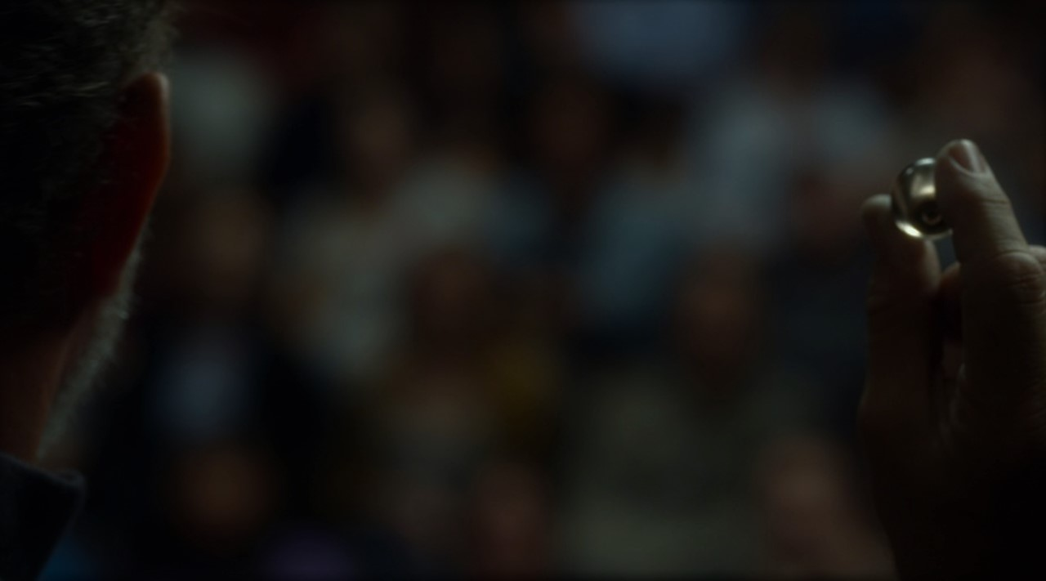
SoulSearch
Can locate any one in under 20 minutes
Allows criminals to be easily located
Allows people to find lost friends and relatives.
ChilD Track:
A tracking device for children to reduce search Time
Under 20% of Amber Alerts find the child in under 3 hours [5]
http://thecircle.movie
Notes:
Can locate any one in under 20 minutes: Uses facial recognition SeeChange Cameras Crowdsourcing
Allows criminals to be easily located: Fiona Highbridge is found in just 10minutes She is not injured and taken into custody Allows people to find lost friends and relatives: Mae is able to find Mercer, but unable to speak to him Individuals pursuing him were overzealous on first trial

Slide 6
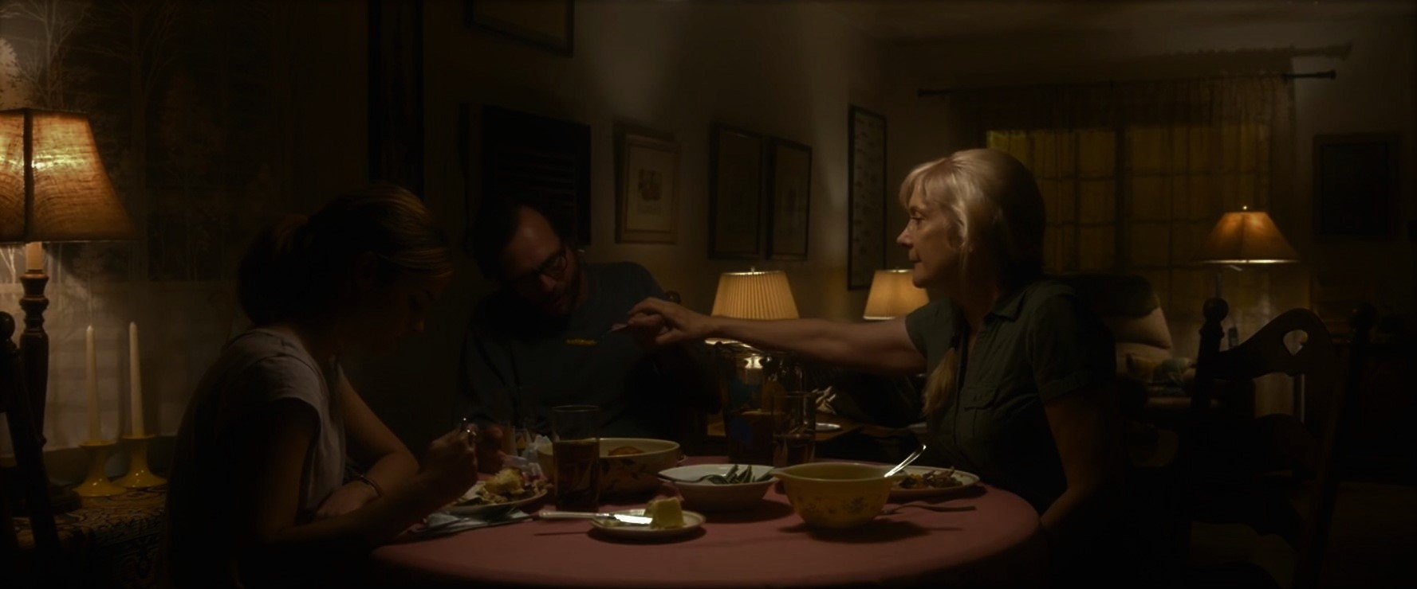
Mercer
Openly against Social Media
Overreacts to minimal negative sentiment, even with positive praise
Receives praise for his work, that later turns into death threats
In 2015, 16.8k discriminatory posts were made every month to Premier League [1]
soul search program finds him after losing contact with Mae:
Over eager search party frightens him, resulting in his death
http://thecircle.movie
Notes:
Instead of opening up to online contact he retreated from it.
After Mae shares an image of a chandelier he created: He Receives praise for his work, then receives death threats, death threats turn to friendly mockery
Since soul search is a new thing people and it was specifically targeting mercer, people and mercer overreacted in the farm. Which ultimately caused his death. If everyone already has everything public it wouldn’t be such a captivative thing and this would of been prevented.

Slide 7
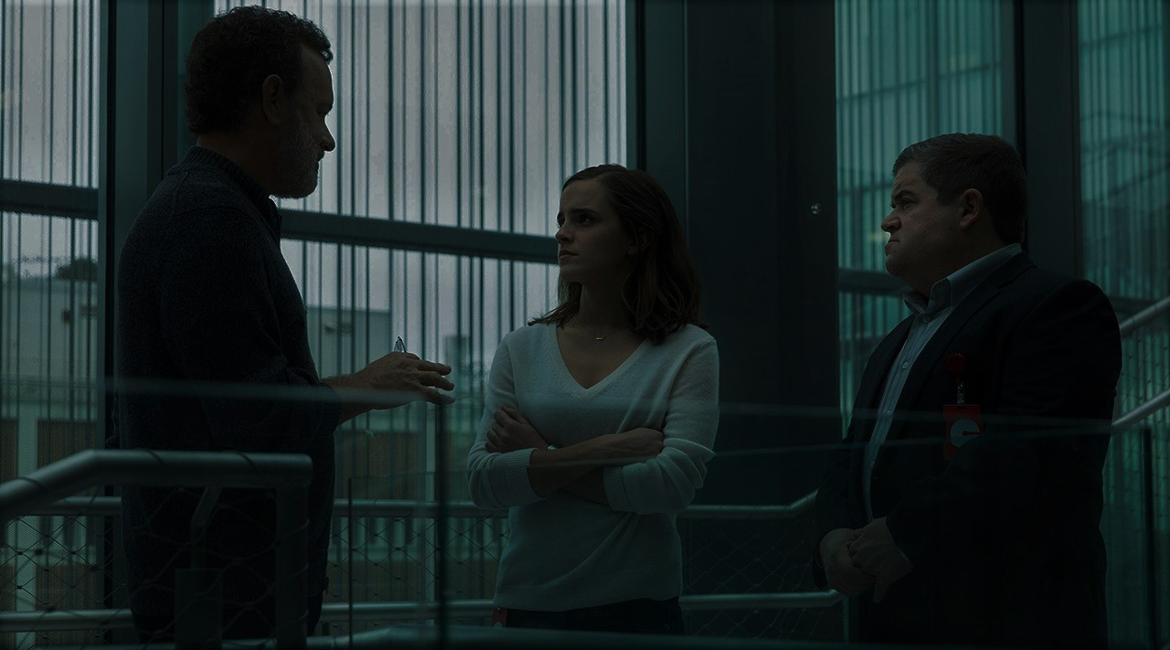
Parents
Supported and proud what their daughter was doing at the beginning
Enjoyed the system when it helps Mae’s father
Overwhelmed by the system mistake and refuse to share
Better implementation of technology would prevent mistakes
http://thecircle.movie
Notes:
The parents represent the hypocrisy of a privacy concerned individual in the modern world, in the beginning they support the monitoring for their own personal gain, and then oppose it once they feel it embarresses them.
The parents support the technology when the promise of modern medicine can heal the fathers MS. Even when it comes in the form of invasive biometric devices.
the audience “walked in on” the parents this ultimately supported two conclusions:
One, the parents had made an error with the technology by not turning off the camera
Two, the parents being embarrassed only highlights their own insecurity, the commentsdid not mock them but promoted their actions

Slide 8
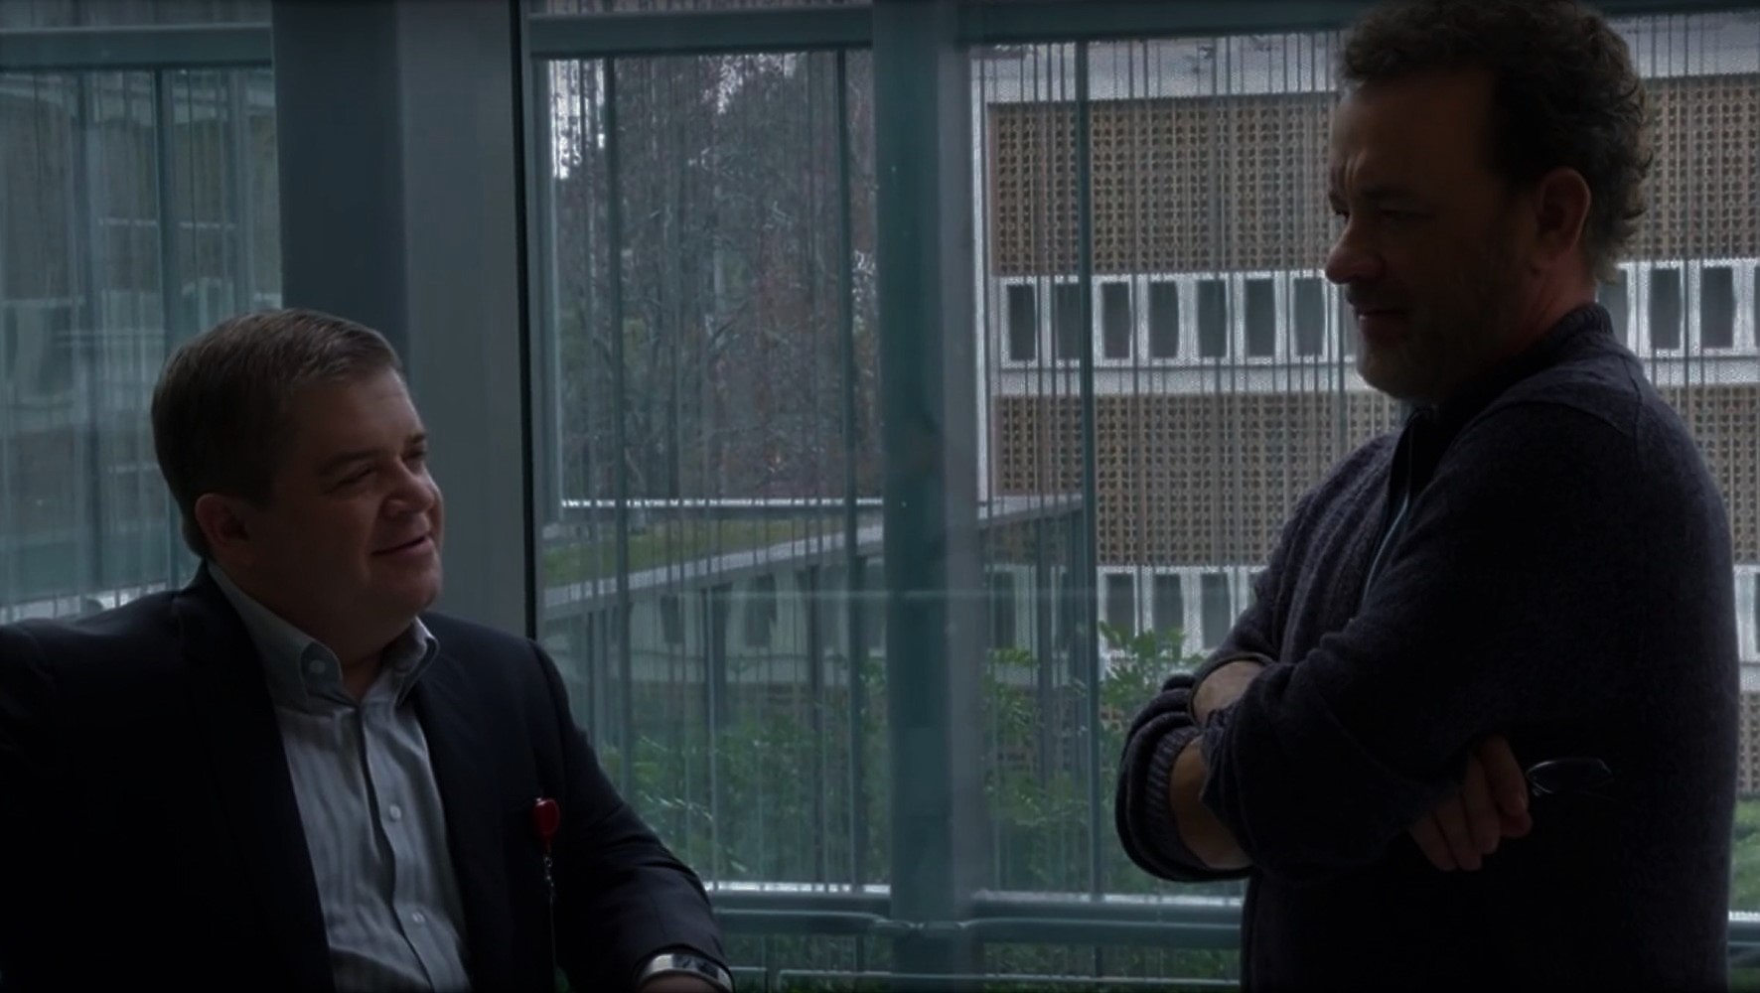
Release of secrets
Senator Williamson
Has undisclosed private information released to the public
Circle owners
advocates of transparency and freedom of all
Won’t share their own information
Founders have private documents released
Modern Example:
Hillary Clinton Emails:
Private Government Emails were released to the public prior to the 2016 presidential election [3]
http://www.imdb.com/title/tt4287320/mediaviewer/rm3152753920
Notes:
Senator Williamson:
Starts an investigation into Circle and violation of antitrust laws This ruins her political career

Slide 9
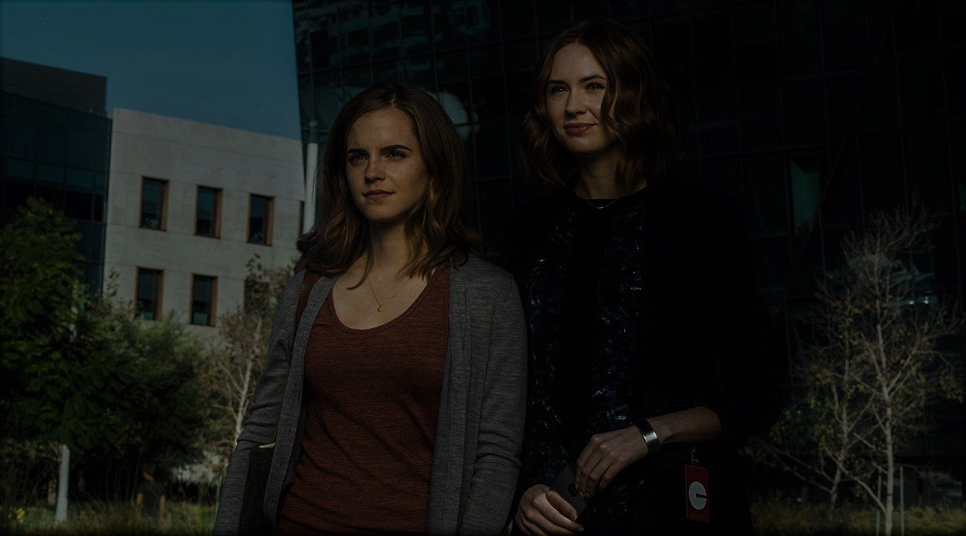
Improved personal safety
Constant connection with friends and relatives
Improved trust in all relationships, ie. corporate, government, interpersonal
Efficacy and quantity of knowledge gain for scientific research
Ability to share experiences
Benefits of Transparency
http://thecircle.movie
Notes:
Improved personal Safety
Mae is kept safe when she is kayaking
Constant connection with friends and relatives
Can keep touch with each others lives
Mae contacting Annie at the end
Improved trust in all relationships, ie. corporate, government, interpersonal
Know all motives of the people in charge
They can’t hide information
Efficacy and quantity of knowledge gain for scientific research
Medical implants which send out biometric data can be used to improve medical tech
Vast quantities of data improve accuracy and ability to be learned
Ability to share experiences
Eamon Bailey’s son had Cerebral Palsy and couldn’t experience life as an individual but did it through videos

Slide 10
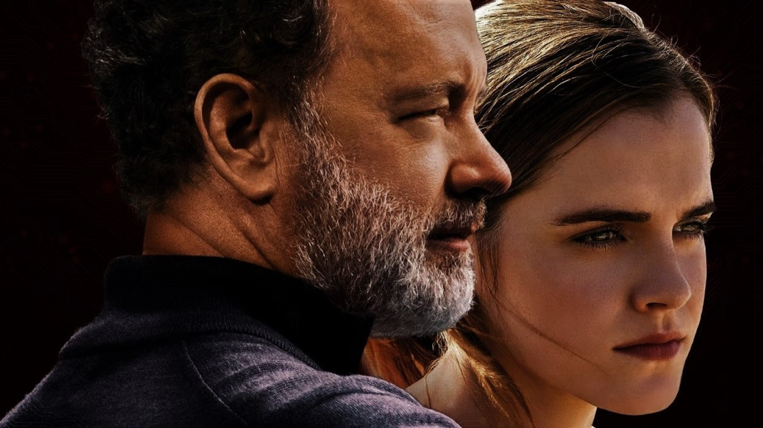
Sources:
[1] KICK IT OUT UNVEILS FINDINGS OF RESEARCH INTO FOOTBALL-RELATED HATE CRIME ON SOCIAL MEDIA. (n.d.). Retrieved September 28, 2017, from http://www.kickitout.org/news/kick-it-out-unveils-findings-of-research-into-football-related-hate-crime-on-social-media/#.VTEHvRPF8bM
[2]Bateson, M., Nettle, D., & Roberts, G. (2006). Cues of being watched enhance cooperation in a real-world setting. Biology letters, 2(3), 412-414.
[3] F. (2017, September 13). How Much Did WikiLeaks Hurt Hillary Clinton? Retrieved September 28, 2017, from https://fivethirtyeight.com/features/wikileaks-hillary-clinton/
[4] http://www.imdb.com/title/tt4287320/plotsummary
[5] Griffin, T. (2010). An empirical examination of AMBER Alert ‘successes’. Journal of Criminal Justice,38(5), 1053-1062. doi:10.1016/j.jcrimjus.2010.07.008
http://www.mkvtvseries.com/movie/341-the-circle-2017

