Slide 1
Robocop (1987)
Holly Nguyen, Zachary Robbins, Frederick Wight, Dean Kiourtsis
1
Notes:
Zach starts
Introduce ourselves

Slide 2
Introduction
If cyborgs become a reality, we will have to reevaluate our stance on human rights. A being like Robocop should be given human rights.
Our legal system relies on the ethical and compassionate actions of law enforcement and military personnel to do the “right thing”. Automated machines and AI in their current state are not capable of emulating these necessary human components, and should not be used as such.
Video surveillance by officers of the law is an overall benefit to the public good, and should be used more often.
2
Notes:
Speaker: Zach
Utilization of continuous video surveillance by on-duty law enforcement, while jeopardizing citizen privacy, has a net benefit to the public good due to increased safety and accountability of officers.

Slide 3
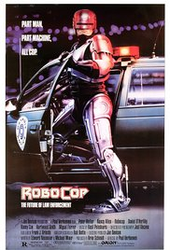
Synopsis
Police Officer Alex Murphy is killed in the line of duty
Transformed into RoboCop
Robocop wrestles with his programmed prime directives, and human emotion
Flashbacks to human life, and his near-murderer
RoboCop uncovers the subterfuge of an OCP (Omni Consumer Products) executive to exact revenge on the people who undermined him, and stops him
3
Notes:
Speaker: Holly maybe
Synopsis points:
Murphy killed in line of duty
Omni Consumer Products runs hospitals, jails, and police departments, including Detroit police
OCP exec introduces ED 209, which malfunctions and kills a man
Transformed into RoboCop
Part-human (brain, digestive system)
Programmed with four directives
Serve the public
Protect the innocent
Uphold the law
Secret fourth directive
Murphy transformed into RoboCop
RoboCop becomes a hero, most effective police officer
RoboCop runs across one of the men who killed him
RoboCop hunts down Boddicker, who confesses that he is employed by Dick Jones
RoboCop tries to arrest OCP exec, but his programming will not let him
RoboCop reveals Dick Jones’ involvement to the OCP president
Picture: http://www.imdb.com/title/tt0093870/

Slide 4
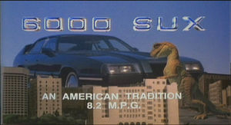
Creator’s Intent: Predicting the Future
“If you want to predict the future, just think about how bad it could be and make a joke out of it, and there you go” - Edward Neumeien [14]
Corporatization of the automobile industry in Detroit
Satirical take on capitalism during the 80s
How computing technologies were changing manufacturing
Citations: [7]
4
Notes:
Speaker: Dean
The original writer of RoboCop, Ed Neumeien, had a saying: “If you want to predict the future, just think about how bad it could be and make a joke out of it, and there you go” [14]. This was part of the driving force behind RoboCop; Neumeien was unhappy about the corporatization, and fall of the American automobile industry in Detroit, and he was worried that it was only going to get worse. He even pushes this view into the movie with the 6000 SUX, a satirical look at the Pontiac 6000. A big part of RoboCop is focused around this rising idea of corporatization and capitalism that was becoming more popular during the 80s. At the time, these ideas and practices were being fueled by the increasing prevalence of using computing technologies in manufacturing. Like Ed was predicting, computing technologies have become a big part of manufacturing, yet the american automobile industry is more robust than it used to be when he made the movie. Perhaps his predictions were more pessimistic than the situation called for.
Picture:
http://robocop.wikia.com/wiki/6000_SUX?file=6000sux.jpg

Slide 5



Automation Needs Human Component
Automation of the police force
PROS:
Completely impartial
Less corruption
Consistent outcome
Saves money [1]
CONS:
No empathy or compassion
Job loss [1]
No ethical debate
Citations: [1]
5
Notes:
Speaker: Holly
Conclusion: Our legal system relies on the ethical and compassionate actions of law enforcement to do the “right thing”. Automated machines and AI in their current state (i.e. in terms of how developed they are as of now) are not capable of emulating these necessary human components, and should not be used as such.
Note: We are defining Robocop as part-mechanical, part-human (not fully automated or a complete AI because he retains memories and acts like a human in his emotions and motivations)
Pros:
Completely impartial
Less corruption among those that are automated (no personal agenda) (theoretically, if fully automated - not quite in Robocop’s situation)
Consistent outcomes/verdicts (in similar situations)
Not necessarily a more just legal system, just more consistent in its verdicts
Saves money if automated
Don’t have to account for training costs, human costs, can work 24/7
Higher productivity (like Robocop in the movie, and like manufacturing industry in the 70’s) [1]
Cons/concerns
No empathy, compassion or ethical judgment
As seen in the ED-209’s - no human component to its actions, purely automated and mechanical
Job loss
Would happen if automation takes over entire law enforcement industry (would occur even if it was a combination of automation and humans)
Counterpoint: Much of the argument that automation would create jobs rests on the assumption that there is some sort of production that would create demand for a product at lower prices - however with law enforcement this would not be true [1]
No ethical debate
With automation the assumption would be that these machines always do the right thing. But there are so many situations in which there are no perfect solutions. Then what happens to the debate about what the right thing is? These debates and conversations prompt people to think about how to act ethically. This wouldn’t happen with the rise of automation of law enforcement.
With automation, the ethics or the ability of law enforcement to do the “right thing” hinges on the ability of AI use compassion and be unbiased.
This would have to be programmed and, currently, there is no AI that does this and accounts for all of the different potential situations and questions posed.
Robocop does this but this is only because he remains part-human.
Argument hinges on the likelihood of being able to automate something or create an AI which can act in an unbiased or compassionate manner.
Will this ever be possible? How do you account for completely unlikely situations?
Can an automated officer make decisions on the fly without relying on human judgment? Who decides what the decision-making process is when programming these automated machines and how do you account for millions of possible situations?
Robocop seems to manage it but it is highly likely that he only acts in an ethical manner because of his human past. An example of this is when he wanted to ignore the directives/programming and follow his own ethics when he attempted to stop Dick.
Further Discussion Questions:
Who would be responsible if the automation of law enforcement screwed up? If a human (like an officer) is not at fault then is the person who created that automated being at fault?
If police officers are automated then what would it look like if a judge and jury are automated as well?
Do you think Robocop’s actions in saving people are a result of his human police training, human emotion or what he was programmed to become?
Pictures:
https://www.flickr.com/photos/pictures-of-money/17123251389
http://www.themainewire.com/2014/10/youth-unemployment-14-9-percent-september/
https://commons.wikimedia.org/wiki/File:SuitHearts.svg

Slide 6
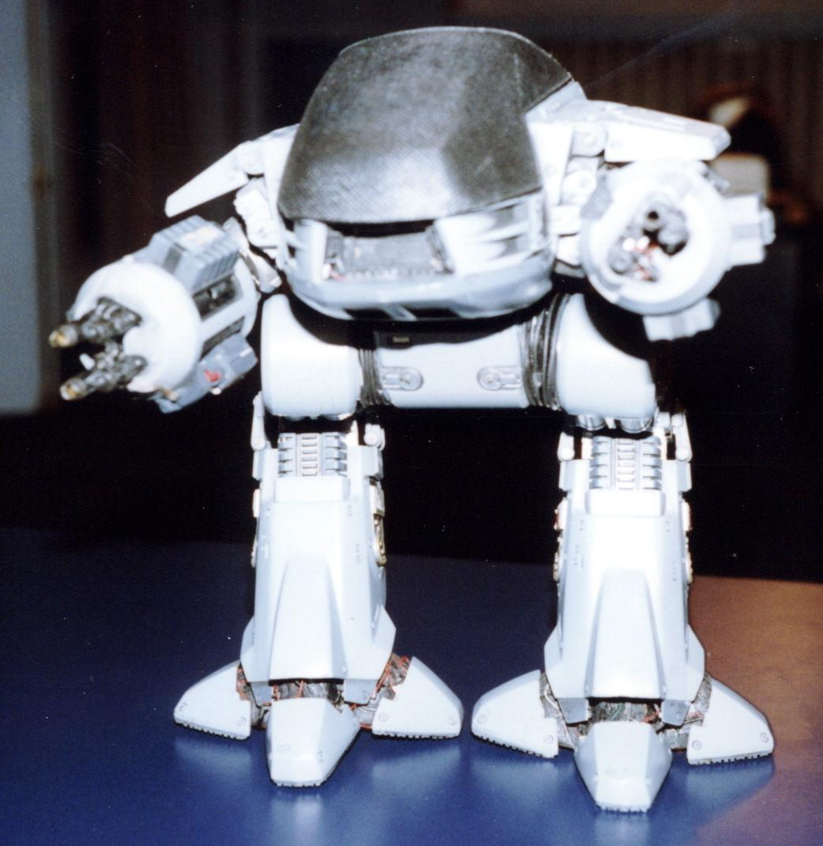
Automation of the Military
The ED-209 in RoboCop
Drone surveillance and warfare
Approximately 7,000 aerial drones
Pros: keeps citizens and military personnel safe
Cons: drones can be an invasion of privacy, and the use of drones in military may be unsafe.
Citations: [4], [5]
6
Notes:
Speaker: Dean
In RoboCop, Dick Jones, the senior president of OCP, pushes the ED-209 as the next generation of law enforcement. ED-209 is a completely autonomous robot capable of upholding the law, yet completely incapable of handling stairs.
While autonomous drones and military technology is far from being used in normal law enforcement, there has been a trend of increasing use of autonomous robots for military purposes. Recently, automated droids have been used in increasing prevalence in the military, with approximately 7,000 drones and a research budget of $2.9 million [5] [4]. While these drones are completely autonomous, the military still uses drone pilots when they want to identify or attack a target [4].
Using automated droids in military or law enforcement would have a number of advantages; They would be able to automatically keep citizens safe and military personnel out of danger
However, there are a number of concerns regarding using droids in this way. Most easily notable is that they would also cause invasions of privacy since they are able to monitor you 24/7 without your knowledge. Furthermore, autonomous drones could pose as a dangerous threat to innocent civilians, like the ED-209 shooting an innocent person in RoboCop.
Picture:
http://www.flickr.com/photos/44124348109@N01/2423554/in/photolist-dqrq-i6QZSg

Slide 7
Robocop: IP or Being with Rights?
OCP’s Rights:
Murphy signed release forms
Was declared legally dead
Robocop is their creation
Design and proprietary parts
Patent
Robocop has their software
Can he live without it?
Could he perform as well without it?
Robocop’s Rights:
He is part Human
He remembers part of his past life, and identifies as Murphy at end
He exhibits free will and makes moral decisions
Should therefore not be enslaved
Citations: [1]
7
Notes:
Speaker: Zach
As property:
Bob Morton (OCP): “he signed his release forms”
“He’s legally dead. We can do pretty much anything we want”
The technology has never been seen before, has been named RoboCop, which implies it is a proprietary product
The software Robocop is using is designed by OCP, and if it has more influence over Murphy’s actions than he does himself, then is he really sentient and not just property?
As a free being:
He has a human brain
He flashes back and identifies himself as Murphy, which means he identifies with the human form of himself still
He shows free will and the ability to make moral decisions when disobeying the 4th directive
Sources: [1]

Slide 8



Affording Robocop Human Rights
Robocop is a cyborg, part human, part OCP product
What constitutes human-enough?
Robocop’s free will
U.N. Declaration of Human Rights
Moral actions require free will
Free will should be accorded human rights
RoboCop attacking Dick Jones
Robocop should be given Human Rights
Significant human component
Citations: [1], [2], [3]
8
Notes:
Speaker: Zach
What is human enough?
A human with a few cybernetic limbs
A human brain in a robot body
A robot with more than half of brain mass non-biological
A full pattern of human thought processes imprinted on a program
Robocop’s free will:
Has flashbacks from his life as Alex Murphy, struggles with emotions
He is clearly not just A.I., and has a human component, so should he be afforded full human rights
UN DHR forbids slavery and servitude
A being should be given the same moral status of a human being if it has the free will necessary to make moral choices of its own accord
No free will = cannot make moral choices -> cannot be given human rights
Attacked Dick Jones, even when stopped by 4th directive, still wanted to bring him to justice and seek revenge
Based on this, Robocop should be given Human Rights for the reason that he can make moral decisions of its own free will and accord, and
because there is a significant human component altering the way he acts (brain).
But what if Robocop was only AI, but still had free will? It is hard to imagine a situation where a program does have real free will,
because its will will always be constrained by the programming that constitutes it.
However, if we imagine that it is possible, we should agree that if an AGI were given the same expectations of conduct and responsibilities of a human,
Than it should also be given the same rights.
Pictures:
https://pixabay.com/static/uploads/photo/2013/07/12/13/44/scales-147219_960_720.png
http://www.sloveniatimes.com/modules/uploader/uploads/Aktualno/Podobe1/human-rights-picture.jpg
http://jeffries.house.gov/sites/jeffries.house.gov/files/wysiwyg_uploaded/IP%20Badge%20-%20Website%20Stock%20Photo_0.jpg

Slide 9
Privacy and Accountability of Video Surveillance
Robocop’s video memory is similar to police body and dashboard cameras today
Officer accountability vs Privacy of suspects, victims, and bystanders
Film takes a positive view on recording
Robocop’s recordings harm the antagonist
“His memory’s admissible as evidence.”
Footage used to identify violent criminals
95% of police departments plan to implement body cameras
Citations: [6]
9
Notes:
Speaker: Rick
Questions posed: Was it legal for Robocop to record citizens’ actions and use it as evidence to arrest criminals? Or is that a violation of privacy? Is it a violation of a police officer’s privacy to record all of his or her actions while they are working in order to maintain accountability?
A quote from the movie believes that “[Robocop’s] memory’s admissible as evidence” and there’s clearly a lack of thought about the implications of such a pervasive technology.
Privacy concerns with the ability for facial recognition based on playback software
Recording citizens (http://www.usatoday.com/story/tech/2014/02/12/us-police-consider-google-glass/5341597/) - not just an invasion of criminals’ privacy but also any person who is a bystander or uninvolved completely
Also records police and holds them accountable
Real life examples (potential uses for a technology like Google Glass - https://www.policeone.com/police-products/body-cameras/articles/6167816-3-ways-cops-could-use-Google-Glass/)
Position of the ACLU: generally against surveillance of the public but if it was surveillance that monitored the government then it would be more allowable, NEED firm policies and laws in place surrounding any sort of surveillance in order to make sure that it is not abused by or for any specific party
https://www.aclu.org/police-body-mounted-cameras-right-policies-place-win-all
https://www.washingtonpost.com/news/the-watch/wp/2016/02/05/a-new-report-shows-the-limits-of-police-body-cameras/
With some local exceptions, officers can legally record whoever/whenever without consent

Slide 10
Conclusion
If cyborgs become a reality, we will have to reevaluate our stance on human rights. A being like Robocop should be given human rights.
Our legal system relies on the ethical and compassionate actions of law enforcement and military personnel to do the “right thing”. Automated machines and AI in their current state are not capable of emulating these necessary human components, and should not be used as such.
Video surveillance by officers of the law is an overall benefit to the public good, and should be used more often.
10
Notes:
Speaker: Zach

Slide 11
References
Michael J. Quinn, Ethics for the Information Age
http://techcrunch.com/2015/08/22/artificial-intelligence-legal-responsibility-and-civil-rights/ (Accessed April 26, 2015)
https://www.singularityweblog.com/human-rights-for-artificial-intelligence-what-is-the-threshold-for-granting-human-rights/ (Accessed April 26, 2015)
http://fcnl.org/issues/foreign_policy/understanding_drones/ (Accessed April 26, 2015)
West, J. P., & Bowman, J. S. (2016). The Domestic Use of Drones: An Ethical Analysis of Surveillance Issues. Public Administration Review.
https://www.washingtonpost.com/news/the-watch/wp/2016/02/05/a-new-report-shows-the-limits-of-police-body-cameras/ (Accessed April 21, 2016)
Tobias, Scott. “RoboCop Writer Ed Neumeier Discusses the Film’s Origins.” The Dissolve. N.p., 13 Feb. 2014. Web. 21 Apr. 2016. http://thedissolve.com/features/movie-of-the-week/415-robocop-writer-ed-neumeier-discusses-the-films-ori/&gt
11
Notes:
Holly

