Slide 1
Ralph Breaks The Internet
1
Notes:
Ben

Slide 2
Humans are vulnerable to the inherent design of the internet
2
Notes:
Ben

Slide 3
User Naiveté
Bidding for the controller at $27,001
  Online actions have real consequences
  Phil Johnston statement
Spamley’s scheme
  Falling for untrustworthy services online
  Parental control feature (<10%)
  Parental consent request (<23%)
  Online fraud in households (24%)
  Children cannot identify dangerous interactions
“To put these naive characters who don't even know what money is on the internet allowed us to shine a light on the fact that... it's hard to avoid eCommerce.”
- Phil Johnston
3
Notes:
Ben [Citations Done]
They eventually get to eBay and find where the controller is being auctioned off.
When they’re bidding on the controller, they don’t understand the significance of what they’re doing. They think they just have to say the highest number to win. This results in them bidding the wheel up to $27,001, even though they could have easily won with a much lower bid. This could represent children or adults who are new to the internet failing to understand that what happens online can have real consequences. In an interview regarding the scene, co-director Phil Johnston said "To put these naive characters who don't even know what money is on the internet allowed us to shine a light on the fact that... it's hard to avoid commerce [online]" [1].
Another example of Ralph and Vanellope’s childlike naivete is when they meet J.P. Spamley. He carries a pop-up ad about his scheme to get rich playing video games attempting to get people to click. Ralph and Vanellope need money fast, so they click. Since young users cannot identify online risks, strangers that they meet can easily take advantage of their innocence and manipulate them, as shown in the movie. A study states that “...Less than 10% of the surveyed websites provided some parental control and only 23% of the sites suggested that the child online user consults with their parents before providing the requested information” [2].
The irresponsibility from these websites further enables the exploitation of innocence. In fact, in 2010, the National Public Survey on White Collar Crime revealed that 24% of households in the United States had at least one person who has experienced some fraud-related crime within the past 12 months [3].
Another research paper evaluated 8-year olds and concluded, “...when presented with potentially dangerous Internet interactions almost half were not able to identify the associated risks” [4].

Slide 4
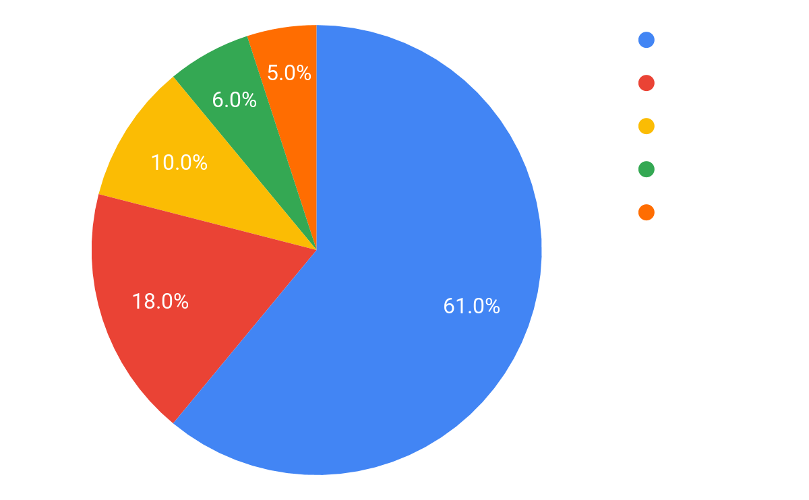
Warning Signs
Trusting Spamley
  Meeting online strangers is dangerous
  39% of teenagers meet strangers
  Lack of social skills & entertainment
Racing through TRON
  Online warnings are ineffective
  30% to 60% ignore browser warnings
Figure 1. Study showing how often adolescents communicate with strangers online
4
Notes:
Iv [Citations Done]
To an experienced internet user, it would have been obvious that Spamley might be completely irreputable. His vehicle breaks as soon as Ralph gets in. Open arriving at his apartment, a bug runs across the floor and he promptly steps on it. Ralph and Vanellope still trust him despite all this and him being a stranger. A study that surveyed 412 Dutch adolescents reported that 39% of them communicate with online strangers [5]. 10% of them talk with online strangers as often as to the people they are already familiar with. 6% talk more with strangers than those they know. 5% of them talk exclusively with online strangers. Those who communicate with strangers aim to meet people to compensate for their lack of social skills and for entertainment. These findings suggest the possibility that many teenagers have interactions with strangers who potentially have malicious intentions.
At the beginning of the movie, Ralph and Vanellope raced through TRON, a game that they knew had a virus. They zoomed past a sign that said “Danger, infected area, keep out.” Their decision to ignore warning signs is a prevalent issue in real life. An online survey reported that “... between 30% and 60% of participants said they would ignore each of the tested browser warnings and continue to a potentially dangerous website. In a subsequent laboratory study, redesigned versions of these warnings achieved greater compliance, but, even in the best case, 45% of participants still ignored the warning when it interfered with their primary tasks” [6]. These results suggest that warning signs are not effective and assertive enough to protect users from navigating dangerous websites.

Slide 5
Distractions
Workers distracted by BuzzzTube
  Internet is a constant interruption
  $650B lost due to unproductivity
  Companies use keylogger software
$650 Billion lost
Annually due to unproductivity
5
Notes:
Dylan [Citation Done]
Later in the movie, when Ralph is trying to earn money through the online video platform BuzzzTube, there’s a scene showing a group of office workers watching Ralph’s videos instead of working. This represents how workers can easily get distracted and waste valuable time. According to business research firm Basex, "unnecessary interruptions" cost businesses around 650 billion dollars every year in lost productivity [7]. Watching BuzzzTube videos would be considered an unnecessary interruption. To stop their employees from wasting time doing these kinds of tasks, businesses have started using technology to monitor what their employees are doing online. According to the Brookings Institute, employers have started using products like keylogger software which can record what employees type on business computers and email that information to supervisors [8]. These technologies let employers ensure that their employees are staying on task. In the movie, employee monitoring technology might have prevented the office workers from wasting time watching Internet videos instead of doing something more productive.

Slide 6
Hate Speech
“Technology has outpaced our ability to understand it and to relate it in a civil way… The Internet has become a more hostile place, and that’s what really inspired that comment room scene.”
- Phil Johnston
Ralph reads BuzzzTube comments
  Becomes insecure from hate speech
Online hate speech feel inconsequential
  Size of web and anonymity
Address vulnerable targets
  Children and insecure adults
“Social media can be a place where insecure adults could end up getting their feelings hurt… And I could see where this could be something bad for children.”
- Rich Moore
“We played around with an idea that I think is still in the movie that’s like, who you are online matters… It’s real. It’s not like a video game. And you see the impact on Ralph in real time.”
- Natalie Nourigat
6
Notes:
Kersten [Citations Done]
After Ralph’s videos go viral, he starts receiving harmful comments which degraded his appearance, personality, and worth.
Phil Johnston, the co-director of the movie, says in an interview that “[…] technology has outpaced our ability to understand it and to relate it in a civil way […]” He went on to say that that during the film’s creation, "the internet has become a more hostile place, and that's what really inspired that comments room scene”. [9].
Johnston’s statement highlights how expressing hateful speech on the Internet can feel inconsequential due to the size of the web and its granted anonymity. The movie makers refrained from portraying the Internet as a utopia and felt responsible for sparking conversations on this problem.
Specifically, those who are the most vulnerable against hate speech are children and even insecure adults. A co-director, Rich Moore, expresses these concerns:
“Social media can be a place where insecure adults could end up getting their feelings hurt… And I could see where this could be something bad for children…” [10]
As a result of these harms, the crew for Wreck-It Ralph urge the audience to be considerate of their online speech and image. Story artist Natalie Nourigat effectively expresses this:
“We played around with an idea that I think is still in the movie that’s like, who you are online matters… It’s real. It’s not like a video game. And you see the impact on Ralph in real time.” [9]
Despite these concerns, the crew remains hopeful that the internet will become safer and more peaceful in the future.

Slide 7
Stalking
Ralph overhears Vanellope and Shank
  The internet facilitates stalking behavior
  Discord - Spotify, YouTube, Twitch
Stalking ex-girlfriend (KnowsMore)
  3.4M stalking victims (2005-2006)
3.4M
Stalking Victims
7
Notes:
Kersten
As Ralph gets told that the team has gotten enough money for the Sugar Rush wheel, He attempts to call Vanellope. As the phone is vibrating, it slips off the dashboard of Shank’s car and pops open. Without user input, the phone accepts the call. Ralph overhears Vanellope tell Shank that Slaughter Race feels like home and that she wants to stay there. This infringement of privacy leads to the main plot problem of the movie. Also, it serves to commentate on how frequently technology can leak private conversations. With an increase of programs offering opt-in integrations -- such as Discord with Spotify, YouTube, and Twitch and others -- [11], it’s becoming easier to accidentally share information.
Later in the movie, The search engine KnowsMore is used to provide commentary about internet privacy and stalking. He responds to one user with “I found a hundred and thirty results for ‘Where does my high school girlfriend live now?’ You’re welcome.” A case study states that “According to the U.S. Department of Justice’s Bureau of Justice Statistics, an estimated 3.4 million persons identified themselves as victims of stalking during a 12-month period in 2005 and 2006.” [12] This commentary is meant to bring light to another aspect of the ways the internet causes these dangers. It’s tempting for us to put information about ourselves online, but doing so makes us more vulnerable to this type of stalking.

Slide 8
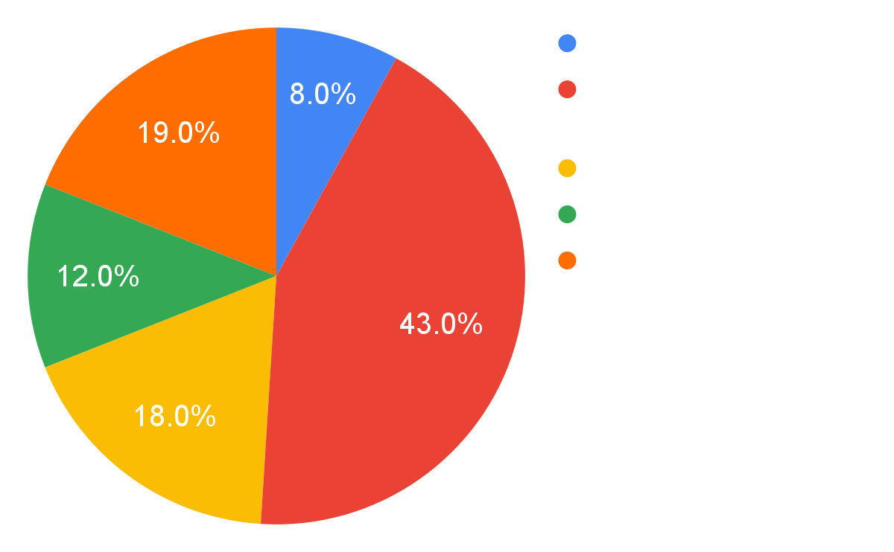
Emotional Distress
“DDoS service, with quality and reliable.
If you have competition, who interrupt you at your work and if someone has hurt your feelings, you can play on the site of this person...”
Unknown Virus Author
Ralph becomes emotionally distressed
  Internet facilitates revenge
  Increased insider threads (31% at $11M)
  Most frequent motive is revenge
Double Dan exploits emotional distress
  Revenge as a selling point
  DDoS Vendor Statement
3.4M
Stalking Victims
Figure 2. Insider Cyber Crime Motives
8
Notes:
Iv
Upon overhearing Vanellope’s conversation with Shank, Ralph becomes frantic and distressed. He looks for a way to make Slaughter Race less exciting, so Vanellope will leave and come back to the arcade with him. He gets Spamley to introduce him to Double Dan -- a virus author who resides in the dark net. Double Dan exploits Ralph’s immense distress by selling him a virus to sabotage Slaughter Race. These scenes showcase how Ralph was overwhelmed by his emotions and sense of betrayal, causing him to rely on a computer virus for malicious intent. Virus authors in real life also use emotional marketing to increase their sales. For example, a forum advertisement from a malicious DDoS vendor states: “DDoS service, with quality and reliable. […] if you have competition, who interrupt you at your work and if someone has hurt your feelings, you can play on the site of this person [...]” [13]. Research has shown that these emotion-driven cybercrimes are common. In 2020, the average global cost of insider threats at companies has increased by 31%, coming in at $11.45 million [14]. Another study finds that the most frequent motive for insider cybercrime is revenge since in 92% of their cases “...a specific event or a series of events triggered the insiders’ actions.” These events included, among others, employment termination (47%), dispute with a current or former employer (20%), and employment-related demotion or transfer (13%)” [15]. Ralph’s actions and the aforementioned statistics suggest that humans are prone to using computer viruses for malice due to their emotional distress.

Slide 9
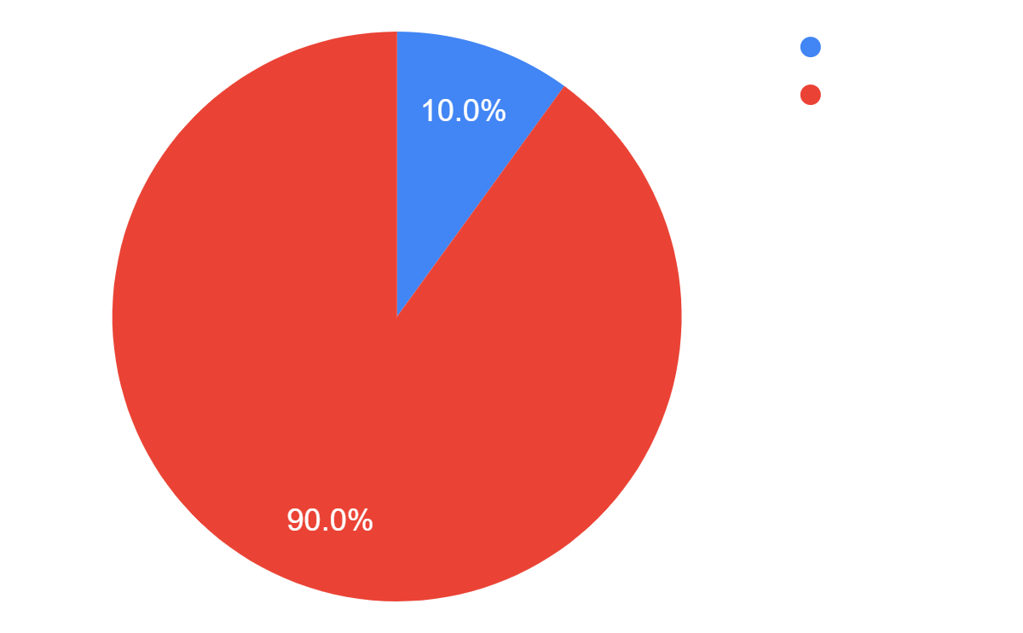
Lack of Caution
Insecurity virus infiltrates into the Internet
  Internet is high for spreading malware
  Symantec reported 5.5B attacks in 2011
  Innocent website infected (61%)
  1 in 10 click on malicious link in email
Love bug
  Message contained “I Love You”
  Virus sent itself to first 50 people
  Infected 45M computers
Figure 3. Click-Rate of Links on Malicious Email
9
Notes:
Iv
The virus has a much stronger effect than Ralph intended, and eventually crashes the game. It then escapes and infiltrates the rest of the internet. These scenes skillfully depict the Internet as a highway for spreading dangerous viruses and malware. Similarly, in real life, virus authors often use the Internet to deploy malicious software to the general public. Symantec, a cybersecurity software company, reported that its services blocked more than 5.5 billion attacks in 2011 [16]. This number emphasizes the prevalence of malicious content on the Internet and urges users to be cautious of their visited websites. Interestingly, 61% of websites that were labeled as malicious are actually innocent in nature, but were infected by external code and have unknowingly become destructive [16]. This shows how viruses can spread through the internet in many ways, and prey on victims who have a false sense of security from being on a known website.
Emails are also effective vessels for viruses as studies have shown that 1 out of 10 people who receive a malicious email will click on a link in it [17]. The infamous Love Bug virus was spread through email messages containing the words “I Love You,” which lured users into activating malicious code [18]. Once the machine was infected, the virus corrupted and overwrote local files. Additionally, the virus sent itself to the first 50 people on the user’s Microsoft Outlook contact list, further expanding its reach . Overall, it affected an estimated 45 million computers, and the incident cost tens of billions of pounds in the UK alone. Among the victims were major organizations such as the World Health Organization and the Pentagon, whose operations were hindered. While the Internet is a powerful tool for finding resources and networking, its wide connectivity is a gateway to external vulnerabilities. This disadvantage is depicted in the movie as the virus infiltrates the Internet world causes colossal damage within a few scenes. These malicious viruses also exist in real life, as demonstrated by the catastrophic losses caused by the Love Bug.

Slide 10
The End
Ralph and Vanellope stay in touch through BuzzzFaces
Virus disappears
1
2
3
4
Ralph comes to terms with his insecurities
Steering wheel gets shipped
10
Notes:
Ben
Ralph and Vanellope are best friends and video game characters who reside in the games at Litwak’s Arcade. One day, the steering wheel controller on Vanellope’s racing game breaks. Since the game doesn’t make much money, Mr. Litwak plans to get rid of it rather than buying a new wheel. This would leave Vanellope and all the inhabitants of the game homeless. Ralph and Vanellope decide to venture into the Internet with the hopes of getting a new steering wheel on eBay.

Slide 11
Conclusion
Humans are vulnerable to the inherent design of the internet
User Naiveté
Warning Signs
Distractions
Hate Speech
Stalking
Emotional Distress
Lack of Caution
11
Notes:
In conclusion, we believe that humans are vulnerable to the inherent design of the Internet because users are naive to its real life consequences, often ignore warning signs, and lack caution.
Furthermore, the Internet is often a distraction from work, disperses hate speech, facilitates stalking, and exploits emotional distress.

Slide 12
References
[1] Shah, S. "How the Creators of 'Ralph Breaks the Internet' Showed Two Sides to Life Online." Engadget, 12 Feb. 2019,
https://www.engadget.com/2019-02-12-ralph-breaks-the-internet-interview.html Accessed May 2, 2021.
[2] Hertzel, Dorothy A. Don’t Talk to Strangers: An Analysis of Government and Industry Efforts to Protect a Child's Privacy Online. Core, https://core.ac.uk/download/pdf/232658366.pdf. Accessed May 1, 2021.
[3] Button, Mark et al. “Online frauds: Learning from victims why they fall for these scams.” Australian & New Zealand Journal of Criminology 47 (2014): 391 - 408. https://journals.sagepub.com/doi/full/10.1177/0004865814521224. Accessed May 1, 2021.
[4] Ey, Lesley-anne & Cupit, C.. (2011). Exploring young children’s understanding of risks associated with Internet usage and their concepts of management strategies. Journal of Early Childhood Research. 9. 53-65. 10.1177/1476718X10367471. https://journals.sagepub.com/doi/abs/10.1177/1476718X10367471. Accessed May 1, 2021.
[5] Peter, Jochen & Valkenburg, Patti & Schouten, Alexander. (2006). Characteristics and Motives of Adolescents Talking with Strangers on the Internet. Cyberpsychology & Behavior: the impact of the Internet, multimedia and virtual reality on behavior and society. 9. 526-30. 10.1089/cpb.2006.9.526. https://www.liebertpub.com/doi/pdf/10.1089/cpb.2006.9.526. Accessed May 1, 2021.
12

Slide 13
References
[6] Cristian Bravo-Lillo, Lorrie Faith Cranor, Julie Downs, Saranga Komanduri, and Manya Sleeper. 2011. Improving computer security dialogs. In Proceedings of the 13th IFIP TC 13 international conference on Human-computer interaction - Volume Part IV (INTERACT'11). Springer-Verlag, Berlin, Heidelberg, 18–35. https://link.springer.com/chapter/10.1007/978-3-642-23768-3_2. Accessed May 1, 2021.]
[7] Lohr, Steve. “Is Information Overload a $650 Billion Drag on the Economy?” The New York Times, The New York Times, 20 Dec. 2007, https://bits.blogs.nytimes.com/2007/12/20/is-information-overload-a-650-billion-drag-on-the-economy/. Accessed April 30, 2021.
[8] West, Darrell M. “How Employers Use Technology to Surveil Employees.” Brookings, Brookings, 26 Jan. 2021, https://www.brookings.edu/blog/techtank/2021/01/05/how-employers-use-technology-to-surveil-employees/. Accessed April 30, 2021.
[9] Rougeau, Michael. "Wreck-It Ralph 2 Won't Shy Away from the Internet's Dark Side." Gamespot, 14 Nov. 2018, https://www.gamespot.com/articles/wreck-it-ralph-2-wont-shy-away-from-the-internets-/1100-6461930/. Accessed 2 May 2021.
[10] Shah, S. "How the Creators of 'Ralph Breaks the Internet' Showed Two Sides to Life Online." Engadget, 12 Feb. 2019, https://www.engadget.com/2019-02-12-ralph-breaks-the-internet-interview.html. Accessed 2 May 2021.
13

Slide 14
References
[11] Morris, Tee. Discord for Dummies. (John Wiley & Sons, 2020) https://books.google.com/books?hl=en&lr=&id=eXvpDwAAQBAJ&oi=fnd&pg=PR3&dq=discord+app+sharing+options&ots=yJr-yhQGh4&sig=vbZONl9WQlYmiTvdctBHirn7UhQ#v=onepage&q=discord%20app%20sharing%20options&f=false Accessed April 30, 2021.
[12] Dowdell, Elizabeth Burgess, and Patricia K. Bradley. "Risky internet behaviors: A case study of online and offline stalking." (The Journal of school nursing, 2010) https://journals.sagepub.com/doi/full/10.1177/1059840510380209 Accessed April 30, 2021.
[13] Chu, Bill. "Examining the Creation, Distribution, and Function of Malware On-Line." OJP, Mar. 2010,
https://www.ojp.gov/pdffiles1/nij/grants/230111.pdf. Accessed May 2, 2021.
[14] Saxena N, Hayes E, Bertino E, Ojo P, Choo K-KR, Burnap P. Impact and Key Challenges of Insider Threats on Organizations and Critical Businesses. Electronics. 2020; 9(9):1460. https://doi.org/10.3390/electronics9091460. Accessed May 1, 2021.
[15] Keeney, Michelle. Insider Threat Study: Computer System Sabotage in Critical Infrastructure Sectors. May 2005. Carnegie Mellon, https://resources.sei.cmu.edu/asset_files/SpecialReport/2005_003_001_51946.pdf. Accessed May 1, 2021.
14

Slide 15
References
[16] Symantec. "Internet Security Threat Report." Owasp, Apr. 2012, https://owasp.org/www-pdf-archive/Symantec_ISTR_17.pdf. Accessed 1 May 2021.
[17] Shaw Business. "Internet Threats." Assets, http://assets.ctfassets.net/xuyk8cewv1yh/6IA0bMjy9OKqUeikyeGUuE/c1ebe4d7410b25569f7cccaa9a62304d/7-steps-to-security-for-your-small-business.pdf. Accessed May 1, 2021.
[18] Hajioff, Steve & Mckee, Martin. (2000). The 'I Love You' virus and its implications for genodiversity. Journal of the Royal Society of Medicine. 93. 398-9. 10.1177/014107680009300802. https://journals.sagepub.com/doi/pdf/10.1177/014107680009300802. Accessed May 1, 2021.
15

