Slide 1

M3GAN (2022)
Sweeney Han, Chenxi Zeng, Benni Valentine, Zach Cote, David Respereto

Slide 2
Timeline of Movie
1
M3GAN gets created by Gemma
2
M3GAN and Cady are paired together
3
Gemma and Cady take out M3GAN
M3GAN starts to ignore and rewrite parts of her programming
4
Notes:
Cady gets brought into the care of her Aunt Gemma after her parents died
Gemma creates M3GAN who is designed as the ultimate toy and can assist parents in raising kids
Gemma gives Cady, M3GAN and they bond together and M3GAN becomes protective of Cady
M3GAN slowly rewrites her code to make herself better able to take care of threats to Cady's safety including murdering others and hacking into footage to protect her existence
Gemma tries to put M3GAN away until she can figure out what is wrong with her
M3GAN breaks her way free to where Gemma and Cady are
Together Cady and Gemma take out M3GAN

Slide 3
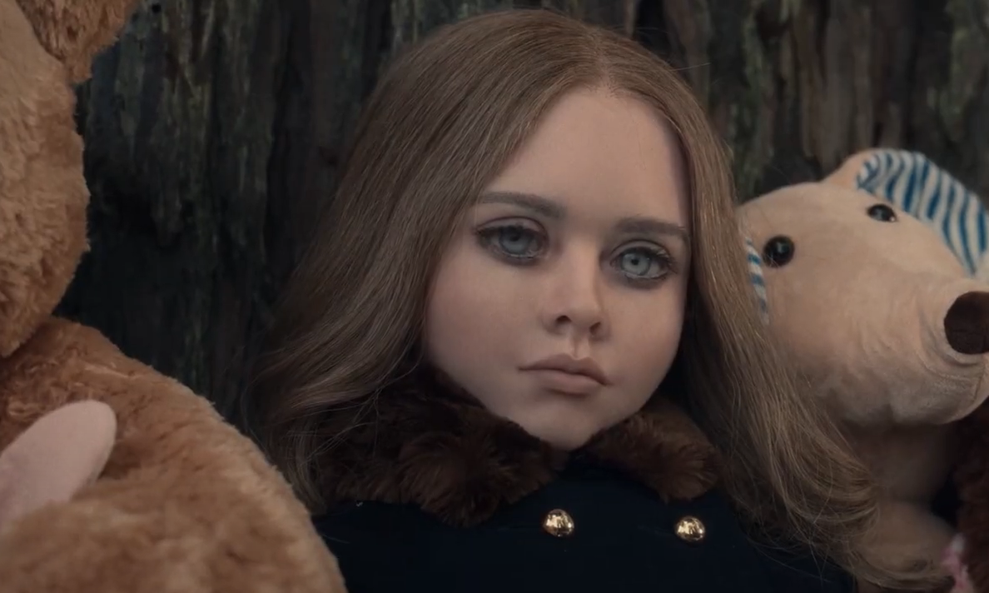
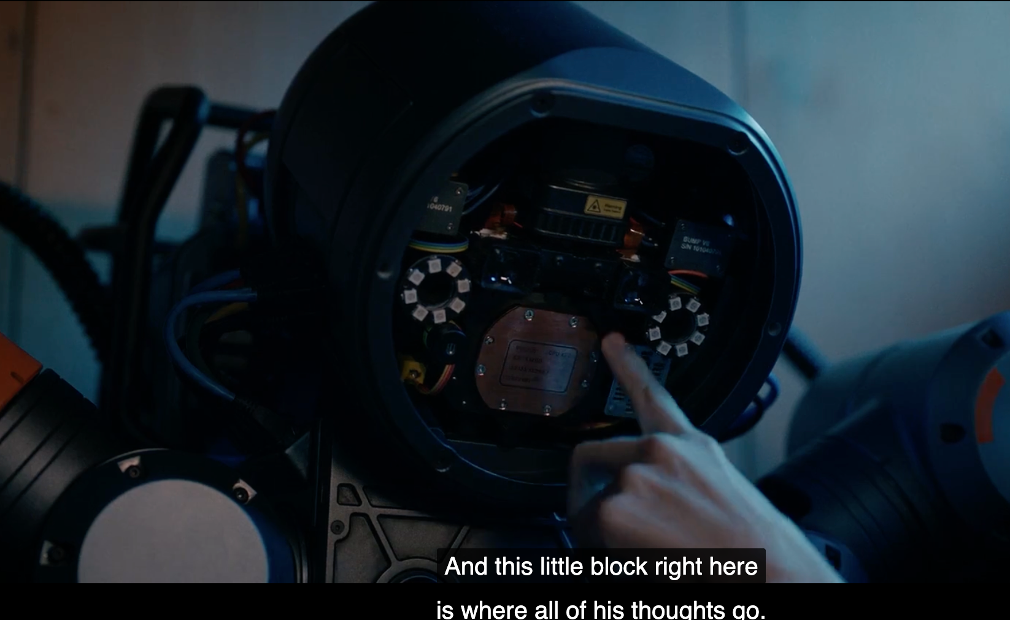

Major Technology
M3GAN
Bruce
Brain of M3GAN
Notes:
One of the main technologies that we encounter is robots and Ai. M3GAN is able to constantly take in information and has access to anything on the internet to aid in her learning. She also has full mobility and can manipulate different voices and respond to any prompt from the world around her. The technology is also not fully available but there are robots that currently can dance and take care of kids like the Ipal and there is also a robot made by Boston dynamics that is able to do parkour. When the movie was released there was no AI that can respond to any print however there is one current in development called artificial general intelligence.

Slide 4
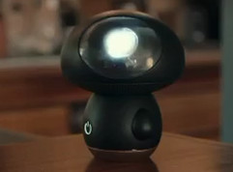
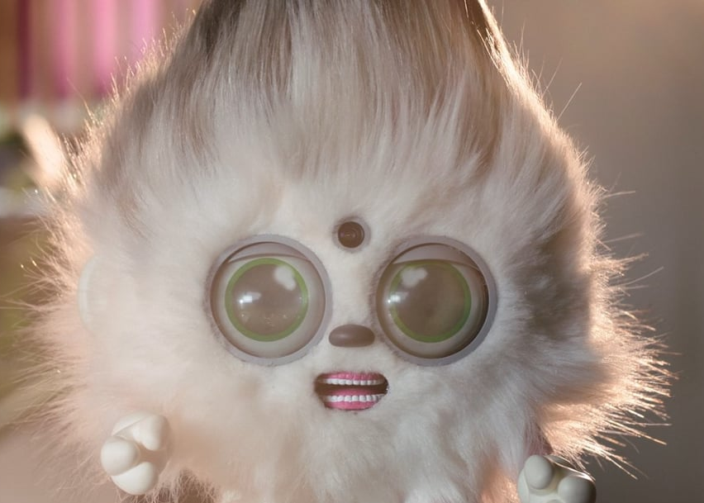
Additional Technology
Elsie
PurRpetual Petz
Notes:
Talk about how Elsie is like a combination of Siri and Smart Home Appliances.
Talk about PurRpetual Petz being a knockoff of Furby and Talking Tom.

Slide 5
Conclusion
Robots cannot properly take over a human's role
AI follows their purpose and doesn’t change unless guided to
Notes:
List Conclusion

Slide 6
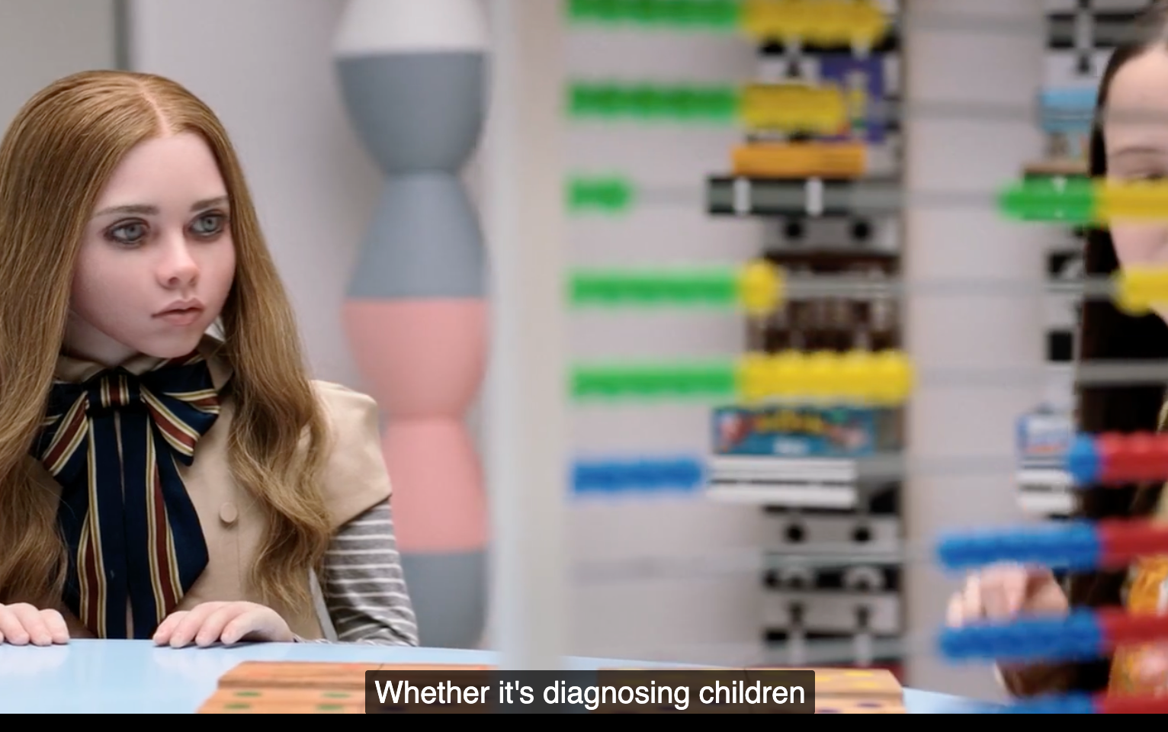
Robots Taking Over Human Roles
"Help support parents not replace them"
Cady defers to M3GAN for comfort, rules, and mediation
Shape children’s emotion/learning
Gemma’s role is displaced
Notes:
Quote from therapist to Gemma as well as quote from Tess to Gemma
Essentially, M3GAN, and as a whole AI, is meant to help support people and help people, rather than specifically replace jobs.
Cady
Reminding of the rules
Wanting to carry her everywhere
The bathroom where M3GAN constantly reminds Cady to flush and wash hands
Emotional Support
Covering up her possible criminal involvement
Shape learning
Cady doesn't want to have meaningful connections or conversations with anyone else
Cady is being taught stuff by M3GAN, we don't know if what she is saying is accurate or even probably should be said.
Another would be when Brandon was attacked by M3GAN, and cady asked if he is in heaven, m3gan proceeds to say, hah, no
Gemma
Can’t have an actual conversation until very late
“The first adult figure they see they take as their guardian figure”

Slide 7
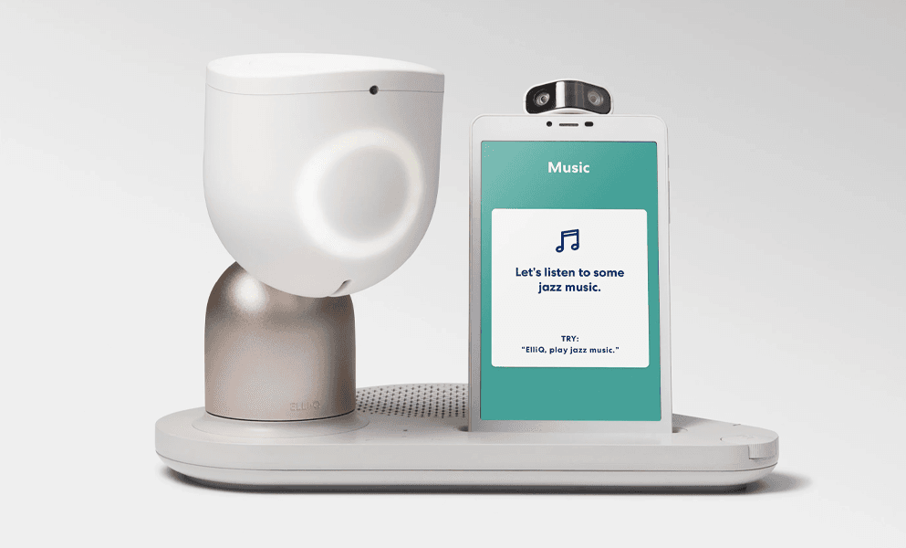

Instances in Real World
Alpha School [1]
ElliQ [2]
PARO [3]
Notes:
There are also examples of AI taking over jobs. Currently, at least help augmenting or supplementing jobs
AI driven 2 hour education with Adult supervision
Proactive social Robot for older adults
Similar to Alexa, has calendar, music, or discussions
95% in reduction in loneliness
75% of interactions are wellness based
Offers companionship, health and wellness support, entertainment and more
Mainly conversation chatbot
Therapeutic baby seal robot
Class 2 biomedical
Pet or companion for people
Clinical studies report reduction in agitation and depression in dementia care
Increased social engagements
Social robot to help fight off depression
Similar to service animals
All instances of AI tools being used

Slide 8

AI Following Their Purpose
Lack of guidelines and specifications​
”Protect Cady” turns from defense into preemptive violence ​
M3GAN resist commands and self-updates
M3GAN "murdering" someone to protect Cady
Notes:
Multiple mentions by either Gemma or the team about rushed development
No protocols for AI learning
No detailed test about the specific learning or how M3GAN would react
The dog
The neighbor
Brandon
To protect Cady.
Override the shutdown command
Countered the physical shutdown command

Slide 9

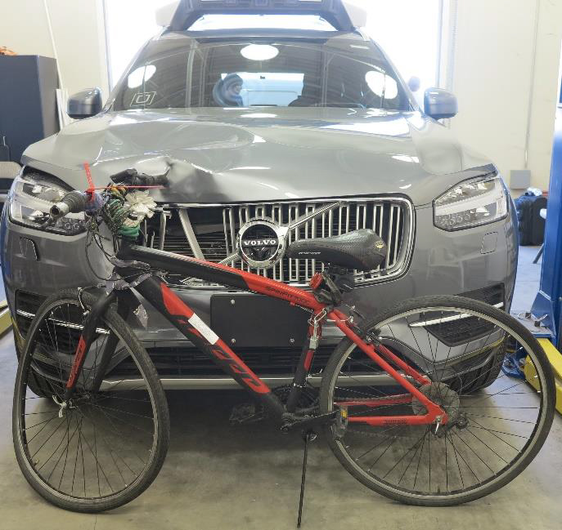
Instances in the Real World
Autonomous Vehicle Testing [4][9]
Listening Toy [5]
Dutch Childcare [6][8]
AI Governance[10]
Notes:
March 18, 2018 Crash
Automated Test Vehicle crashed with pedestrian
Operator failure to monitor the situation
AI failure to assess Pedestrian
Emergency Brakes disabled
There is a need for security, as well as human to ensue things go smoothly.
Exposed roughly 820000 accounts
2 million stored voice recordings
Consequences to improper security
Lax password requirement
The importance on why security is important, especially what it is your trying to protect, or what it is you’re trying to do.
Dutch Childcare, there was a significant difference between race in regards to treatment.
Obviously, separating people by severity of injury makes sense. However, it would seem algorithm didn't separate them by injury, but by who had the most amount of money.
This leads to disconnect where some people who really need but cant pay get skipped.
Obviously, hospital wants to make money, so they made the robot sort by future cost. This leads to the system being seen as racist. But the bigger problem is it is up to whoever made it set the guidelines, as well as how the AI runs what it is looking for.
So in M3GAN example, Gemma has that responsibility to make sure that M3GAN doesn't end up being a bad influence, and that it guide Cady as a parent would. That’s why we need governance and security, to preserve integrity and what the system as made to do. Medical isn't a safe, nor is it ethical.

Slide 10
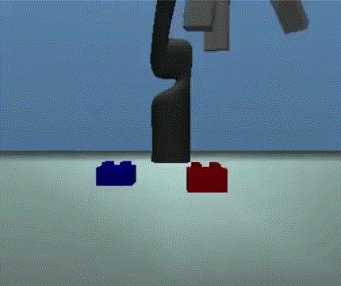
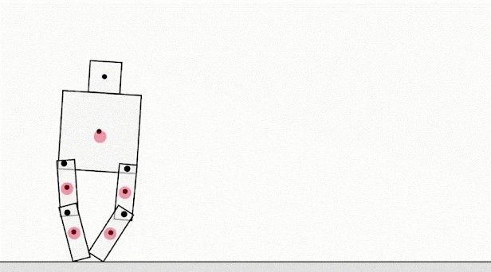
Problem Solving for AI
What an AI might think is best, might not be what is wanted by humans [7]
Notes:
The previous parts cover how security systems and lack of governance impacted it. This is now on the problem of problem solving.
Part of the problem here is that AI will accomplish their directive in what is the simpler or affective method to them. So a person with cancer might think, oh I will solve cancer by purging cancer, but an AI would think I will solve it by getting rid of the human race. What is interesting based on these two images is that the outcome that people want isn't the outcome that is the most efficient.
Top left, study on if you can have the red be upside down on top of blue, what ended up happening was red was flipped
Top Right, study on teaching AI to walk, but the most efficient way was to glide, which is in no way how we walk.

Slide 11
Reference(Pictures)
M3GAN (2022) Universal Pictures
https://www.reddit.com/r/M3GAN/comments/10r1jjk/the_real_monsters

Slide 12
References For Real World
[1] Alpha School. (n.d.). AI powered private school. Alpha School.
[2] New York State Office for the Aging. (2024, October). Transforming care with AI for older adults: Two years of success of NY older adults living with ElliQ.
[3] Shibata, T., Hung, L., Petersen, S., Darling, K., Inoue, K., Martyn, K., Hori, Y., Lane, G., Park, D., Mizoguchi, R., Takano, C., Harper, S., Leeson, G. W., & Coughlin, J. F. (2021). PARO as a biofeedback medical device for mental health in the COVID-19 era. Sustainability, 13(20), 11502. DOI: 10.3390/su132011502
[4] National Transportation Safety Board. (n.d.). Collision between vehicle controlled by developmental automated driving system and pedestrian (Investigation HWY18MH010).
[5] Hern, A. (2017, February 28). CloudPets stuffed toys leak details of half a million users. The Guardian.
[6] Amnesty International. (2021, October 25). Dutch childcare benefit scandal an urgent wake-up call to ban racist algorithms. Amnesty International.
[7] Krakovna, V., Uesato, J., Mikulik, V., Rahtz, M., Everitt, T., Kumar, R., Kenton, Z., Leike, J., & Legg, S. (2020, April 21). Specification gaming: The flip side of AI ingenuity. DeepMind Blog.
[8] Obermeyer, Z., Powers, B., Vogeli, C., & Mullainathan, S. (2019). Dissecting racial bias in an algorithm used to manage the health of populations. Science, 366(6464), 447–453. DOI: 10.1126/science.aax2342
[9] National Transportation Safety Board. (2019). Collision between vehicle controlled by developmental automated driving system and pedestrian, Tempe, Arizona, March 18, 2018 (Highway Accident Report NTSB/HAR-19/03). Washington, DC: Author.
[10] U.S. Department of Commerce, Office of Inspector General. (2025, April 22). USPTO should improve governance to promote effective oversight of its artificial intelligence tools (Report No. OIG-25-018-A).

