Slide 1
Jurassic Park Group Presentation
By Thomas Meehan, Justin Charron, Jack Rivadeneira

Slide 2
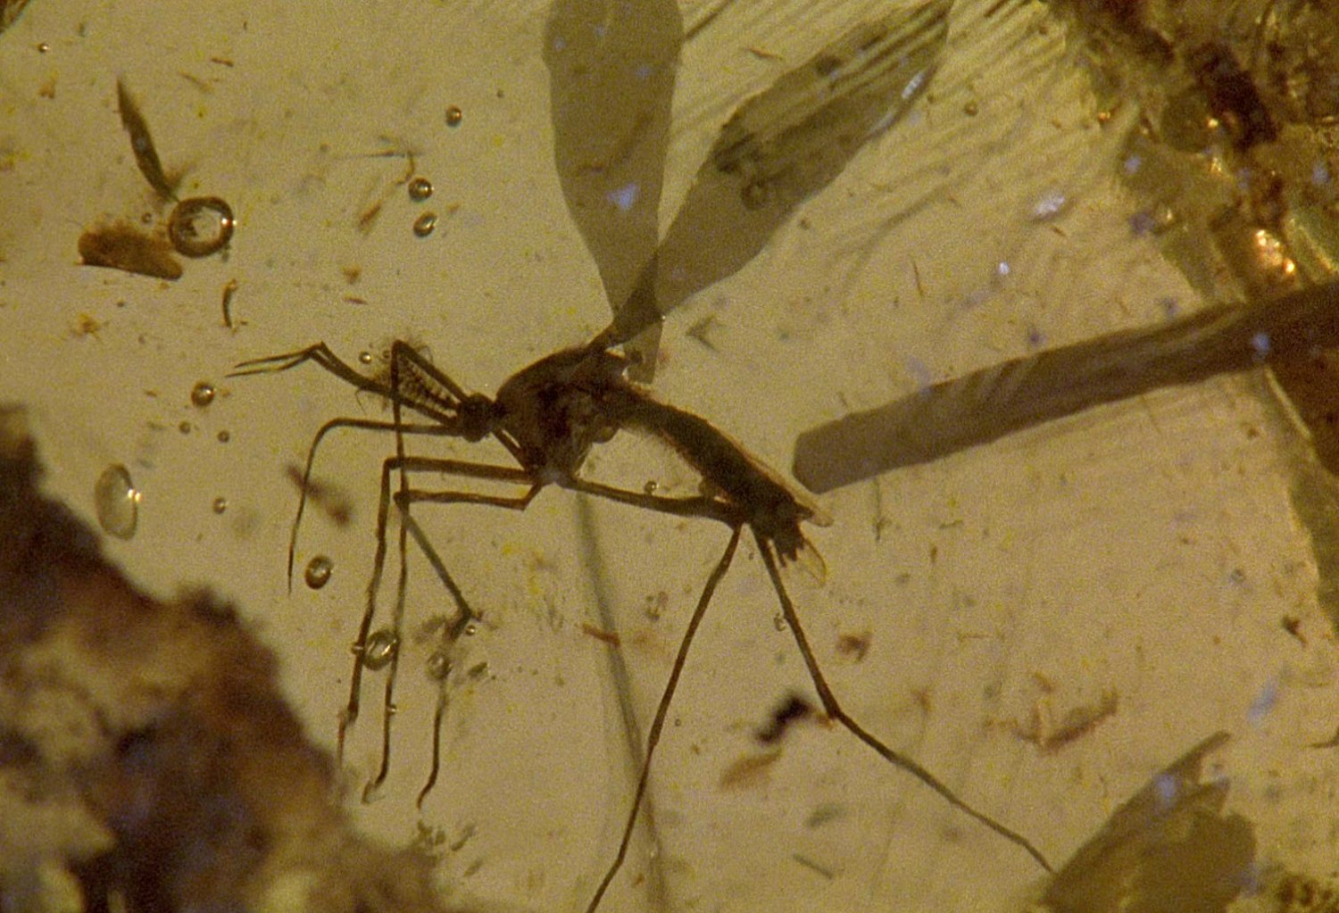
Plot
Billionaire entrepreneur Hammond hires several experts to inspect his newest venture.
Including expert Paleontologists Grant and Sattler
Turns out to be an Island filled with Dinosaurs
Used preserved DNA and genetic sequencing
Entire park runs on a state of the art computer automation system
Disgruntled “underpaid” programmer Nedry decides to sell DNA to rivals
Has to shut down entire security system to escape
Dinosaurs are now free to roam and eat people
http://www.imdb.com/title/tt0107290/mediaindex?ref_=tt_pv_mi_sm
Notes:
Hammond hires paleontologists Grant and Sattler to take a look at his new venture. Dinosaurs. Hammond’s park houseses Dinosaurs he cloned by using sequencing and some genetic material retrieved from a mosquito preserved in amber. The whole park operates on some buggy computer system maintained by Nedry, the underappreciated programmer, who plans to sabotage the park in order to steal the Dinosaur DNA and and sell it to Hammond’s competitors. To pull this off, Nedry put a virus into the park’s system to completely shut down the security. Unfortunately for Nedry he traded the locks and alarms for a showdown with a Dilophosaurus.

Slide 3
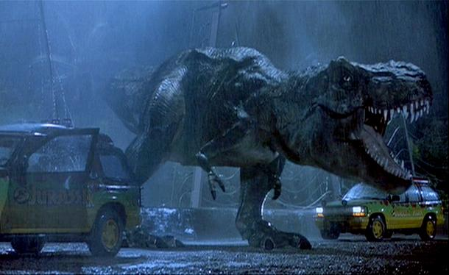
Plot
Experts and Hammond’s grandchildren tour the park
System is shut down, and they are attacked by T-Rex
Race against time to restore system and escape Island
Lots of people get eaten (Including Nedry!)
Velociraptors enter main office and almost eat the kids
System is restored by a 12 year-old girl just in time
T-Rex distracts velociraptors, everyone escapes via helicopter
Hammond admits park isn’t safe, learn to respect the power of nature
http://www.imdb.com/title/tt0107290/mediaindex?ref_=tt_pv_mi_sm
Notes:
The experts and Hammond’s grandchildren get in the guided tour and can’t find any dinosaurs
They get to the T-Rex paddock and the cars shut down as a storm comes in
The cars are electric cars and they cannot be operated manually
Several velociraptor attacks later, Hammond is able to walk Ellie through turning the power back on
The kids are left alone in the main building, almost get eaten before the scientists come back
They all escape to the computer room where the two scientists struggle to hold the door back and Lex gets the door closed
The velociraptors find their way in and the group escapes through the ceiling
The T-Rex comes in, the dinosaurs all fight while everyone high-tails it out of the building

Slide 4
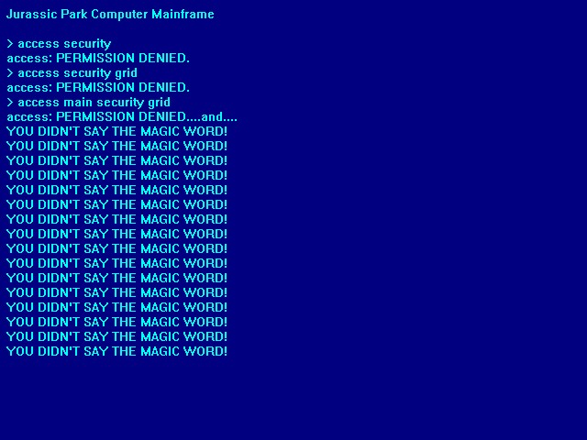
Technology
Containment device failure
Whole Park is built around computer system
System is incomplete
Nedry has sole access to it all
More than 2 million lines of code
Not possible for anyone else to fix
Lack of manual overrides
Cars are stuck
Door locks can’t re-engage
http://skins13.wincustomize.com/19/65/1965538/32/2763/preview-32-2763.jpg
Notes:
Right in the opening scene the theme is set for the whole movie of technology failing and causing chaos for people
The whole security system is written and managed solely by Nedry
The system isn’t even complete yet, and Nedry just gets the phones working while the’re on the tour
2 Million lines of code that only one person has the knowledge of what it does
There are no manual overrides on most of the important features
Can’t drive the cars, the doors will not lock, painstaking to turn the fences back on

Slide 5
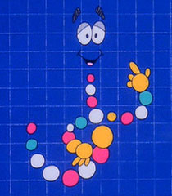
DNA Manipulation
Futuristic technology made to be available
Assumes that scientists have mastered DNA
Able to manipulate and fix DNA
They state that it would take 2 years to read each strand in a sequence of DNA
supercomputers read it for them
Not the most accurate portrayal, but this technology could exist in the future [1]
http://statici.behindthevoiceactors.com/behindthevoiceactors/_img/chars/char_57945.jpg
Notes:
The way they manipulate the DNA they make it sound as if it’s not a big deal and this technology is easily accessible
Reality is that we aren’t even close to being there today 20 years later
They just take a “because supercomputer” approach and don’t attempt to explain it
While this portrayal was not completely accurate or possible, it could exist in the future
Just not there now
Compared to Star Trek and Avatar doesn’t seem all that futuristic

Slide 6
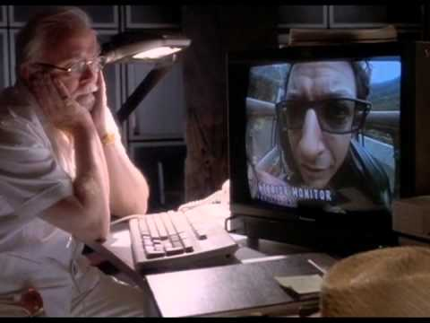
Networked Communications
Pre-internet, pre-cellphones
Fairly robust CC camera system to see nearly everything on the island
No real way to communicate with outside world
Possibly to enhance security?
Attempt to prevent leaks?
Better communication system would have solved many problems
Could know where people are
Not electrocute kids
Call for help/evac from outside world
Computer failure may negate benefits anyway
http://www.imdb.com/title/tt0107290/mediaindex?ref_=tt_pv_mi_sm
Notes:
Necessary to keep dinosuars at bay
no internet, just phone lines that apparently don’t work off the island
would leak in todays world
everyone would know
risk lives hunting for people

Slide 7
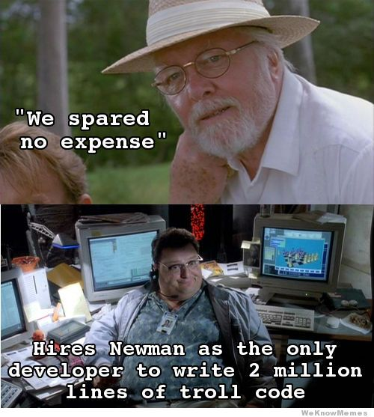
Safety and Security
Entire plot is a result of massive computer security failure
Basically only one competent programmer
Is able to write in “back door” enabling him to shut down entire park
Nobody else knows how to reboot system and fix everything.
Everything is dependent on the computer system
Even basic things like door locks
Dinosaurs are able to escape and wreck everything
Entire park ran on one 2 million line program
Wouldn’t have happened if more than programmer
http://www.imdb.com/title/tt0107290/mediaindex?ref_=tt_pv_mi_sm
Notes:
computers are basis for all the dram
has absolute control since nobody else would know what he’s doing even if he showed it to them
someone else could have checked and fixed everything
forced to shut things down and make things worse

Slide 8
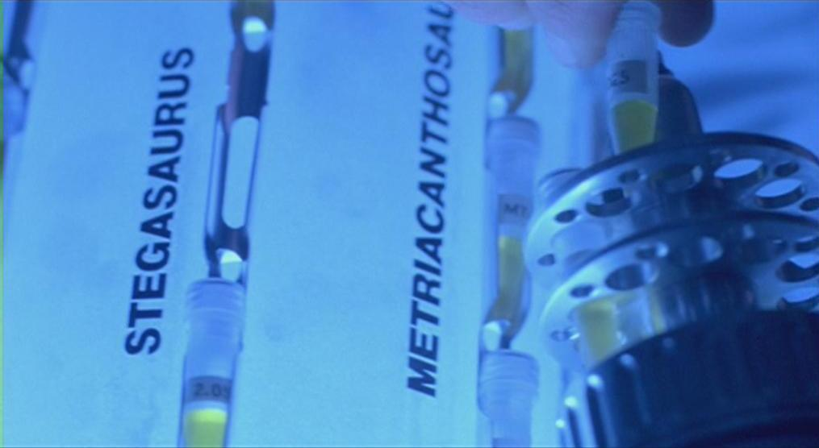
Intellectual Property
Hammond funds the development of some incredible technology
Likely has infinite uses, especially in health care
But he uses it solely for his own profit
Keeps it secret, possibly harming progress
Possibly patented
Would be hard to obscure implications
Nedry tries to sell competitors trade secrets and company assets
Justifies by saying he isn’t compensated enough
Huge violation of IP laws
http://www.imdb.com/title/tt0107290/mediaindex?ref_=tt_pv_mi_sm

Slide 9
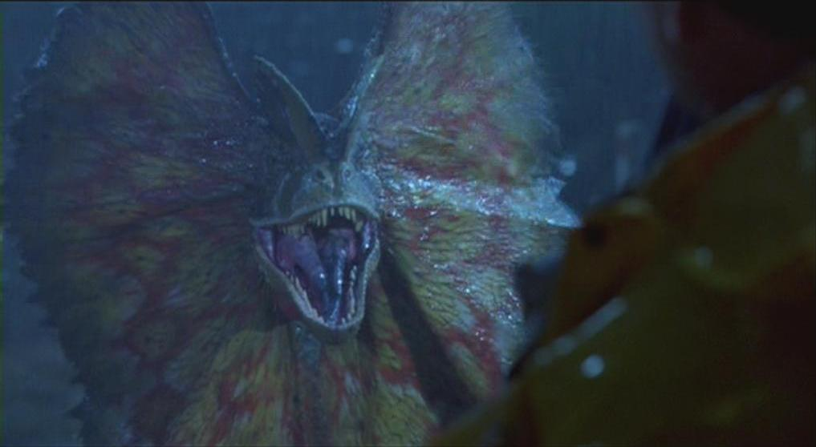
Conclusions
“Dilophosaurus Factor”
Don’t let one guy have absolute control
Have cross training within staff
Always have someone else review code
Protects against mistakes and mal intent
Shouldn’t need a kid to magically fix things
http://www.imdb.com/title/tt0107290/mediaindex?ref_=tt_pv_mi_sm
Notes:
sickness, vacation
even off site, within company, it it’s worth that much hire more people, sign NDA

Slide 10
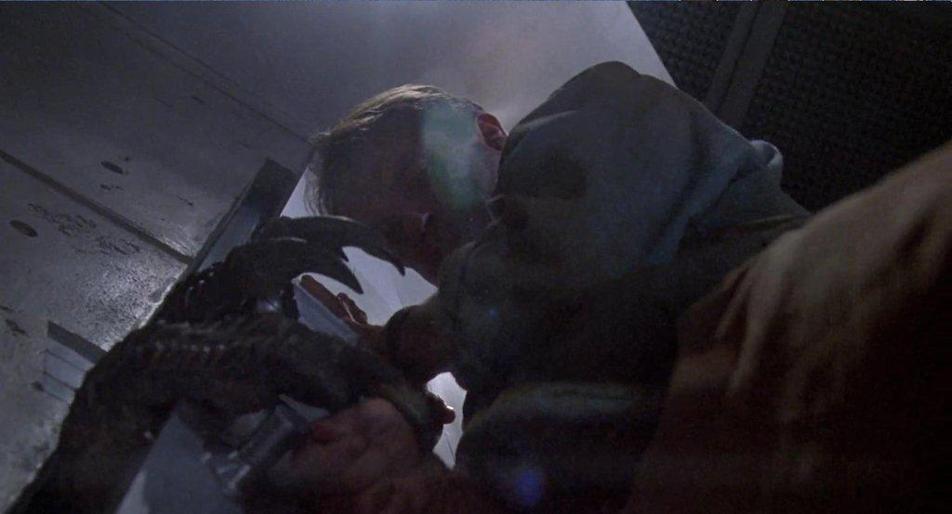
Conclusions
Always have manual overrides
Critical safety components should not be inoperable without computers
Automation adds convenience, but shouldn’t be necessary to keep people safe
Simple things like locks and vehicles need to work manually in an emergency situation
Human operable backup systems for minimal safety standards
Shouldn’t need a programmer to lock a door
http://www.imdb.com/title/tt0107290/mediaindex?ref_=tt_pv_mi_sm

Slide 11
Bibliography
1. Kaku, Michio, “‪Michio Kaku: Can We Resurrect the Dinosaurs? Neanderthal Man?”, https://www.youtube.com/watch?v=8c-EWSmOgDc, (4/22/15)
2. Choi, Charles, “How Much Real Science is in ‘Avatar’?”, http://www.nbcnews.com/id/34515704/ns/technology_and_science-space/t/how-much-real-science-avatar/#.VUhgqM7n35m (4/24/15)
3. Haber, Shimon, "Synopsis for Jurassic Park", http://www.imdb.com/title/tt0107290/synopsis?ref_=ttpl_ql_3, (4/25/15)
4. Cabot, Jordi, “What’s’ the bus factor of your software project?” http://modeling-languages.com/whats-bus-factor-software-project/, (4/27/15)
5. Tucker, Charles, “Star Trek Wikia: Memory Alpha”, http://en.memory-alpha.org/wiki/Clone, (4/23/15)
6. Park, Jurassic. "Steven Spielberg." Universal Pictures (1993).

