Slide 1

HIDDEN FIGURES
Biography, Drama, History
2016
7.8/10 rating
Stars
Taraji P. Henson
Octavia Spencer
Janelle Monáe
Kevin Costner
Directed by Theodore Melfi
[1]
Notes:
(Sylvia)
Hello Everyone, my name is Sylvia [everyone introduces themselves], and we will be presenting on the movie Hidden Figures. This is a 2016 movie adaptation of the book by Margot Lee Shetterly. The events in the film are based on a true story that took place around 1961.

Slide 2
HIDDEN FIGURES
Alazar Genene, Sylvia van der Weide, Apiwat Ditthapron, Mario Zyla
Computing technology is a catalyst for social change
Limited access to information
Skills surpassing social limitations
Intellectual Property
Computer Reliability
[1]
Notes:
Sylvia
In this movie we observed how computing technology was a catalyst for social change.
We saw how limitations in access to information because of race or gender were broken by the need for computing advancement.
Computing skills and professionalism played a major role in how the characters advanced throughout the movie.
The movie also focused on topics like Intellectual property and computer reliability, both of which were encountered by the main characters.

Slide 3
SYNOPSIS
Careers of three black women working at NACA in the 1960's.
Katherine Johnson, talented mathematician
Dorothy Vaughan, supervisor of West Area Computing Unit
Mary Jackson, first African American female engineer at NASA
Race for space travel
Notes:
Alazar Genene- First let me give you a short synopsis.
Hidden Figures follows three women at NACA, NASA’s predecessor, during the space race. The main character, Katherine Johnson, is a mathematician who calculated orbital equations for several NASA space flights during the American and Soviet Space Race in the 1960’s. The film also features Dorothy Vaughan, the ambitious supervisor of the West Area Computing Unit, and Mary Jackson, the first African American female engineer at NASA.
This was an important time for NASA, as the russians beat them first to space. This is why the movie has a feeling of urgency throughout.

Slide 4
RELEVANT TIMELINE
1943 Dorothy Vaughan was hired by NACA [2]
1949 Vaughan became NACA's first black supervisor [2]
1951 Mary Jackson was hired in West Area Computing [3]
1953 Katherine Johnson was hired [4]
Jackson started at the Supersonic Pressure Tunnel [2]
Oct 4, 1957 Sputnik 1 was launched [5]
1958 Jackson became the first black NASA engineer [3]
Nov, 1960 IBM 7090 was ready [6]
1962 Johnson verified landing calculations
1968 First black male engineer George Alcorn [7]
Feb 20, 1962 NASA launched astronaut John Glenn into orbit
2015 Johnson receives Presidential Medal of Freedom [4]
Notes:
Alazar
National Advisory Committee for Aeronautics
Key points
Dorothy Vaughn became supervisor 1949.
Mark Jackson became the first black female engineer 1958
Johnson verified the landing calculations 1962 made by IBM computer.
2015 Johnson was recognized for her groundbreaking work with the presidential award
X-Ray Spectrometer- George Alcorn NASA Goddard Space flightCenter Inventor of the year

Slide 5
RELEVANT TECHNOLOGIES
Mechanical Calculators
IBM 7090 [8]
a general-purpose data processing system
229,000 additions or subtractions, 39,500 multiplications, or 32,700 divisions
Notes:
(Alazar Genene)
The Technologies introduced in the film were Sputnik 1- first soviet human manned satellite spawning the space race. having completed 1,440 orbits of the Earth. Redstone Test Stand- first test stand in the US that accommodated the whole launch vehicle during tests. IBM computer greatly aided the engineers greatly.

Slide 6
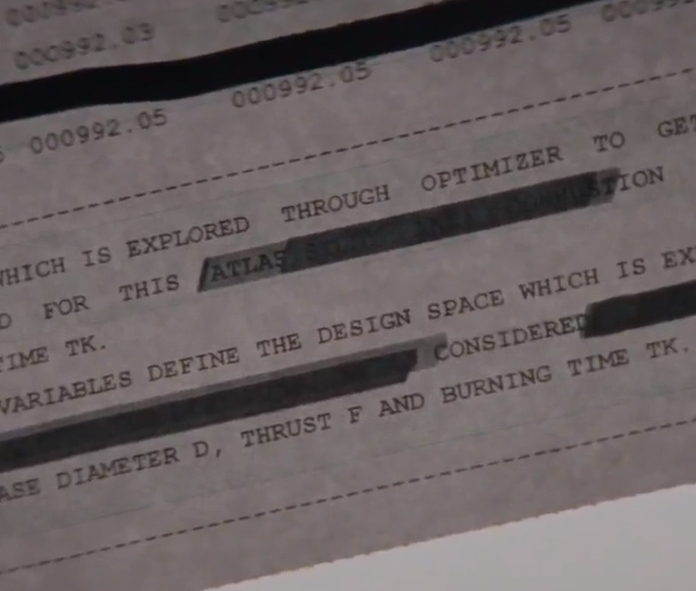
LACK OF ACCESS TO INFORMATION
Information Privacy
Blacked out Classified Documents
Participate into meetings with National Aeronautics and Space Council.
Mary Jackson had to go to court to get permission to go to school to get her degree
Notes:
(Apiwat)
Katherine Johnson was sent to Space Task Group to check the mathematical calculations. In the movie, Stafford, her supervisor, blacked out every classified data before handed it to hers. But, she put the papers up to the light to understand the full math equation, which also show the classified words, such as the project name “ATLAS.” as shown in the picture.
Katherine was prevented to go into meetings with Stafford and Harrison, for which she insisted she needed all the updated information, as they changed very often.
Another main character, Mary Jackson has capability to be an engineer, but need a degree at University of Virginia to be promoted to an aerospace engineer at NASA. At that time, the courses were hold in all-white School, which made hers to go to court to get permission to attend the classes. She is the NASA's first black female engineer.

Slide 7
ACCESS TO INFORMATION
Intellectual Property
Johnson wasn’t allowed to put her name on the calculation sheets
“Computers don’t author reports”
She had more understanding of the report
Notes:
(Alazar)
This was because she wasn’t an engineer, but a computer. Katherine was not doing the work of the computer. She was giving meaningful contributions and the movie portrayed her as doing groundbreaking work in the mathematical theory that was later used to send John Glen into space.
In those meetings, there was a question about the speed of the landing, which was in the report she gave to Stafford. While he is trying to find the information, she answers, and she is able to calculate the landing coordinates right there. She did more than just calculated, she used innovative mathematical theories and solved problems that others couldn’t. (make a point about she didn’t just do the work of a mechanical calculator, it was much more than that).

Slide 8
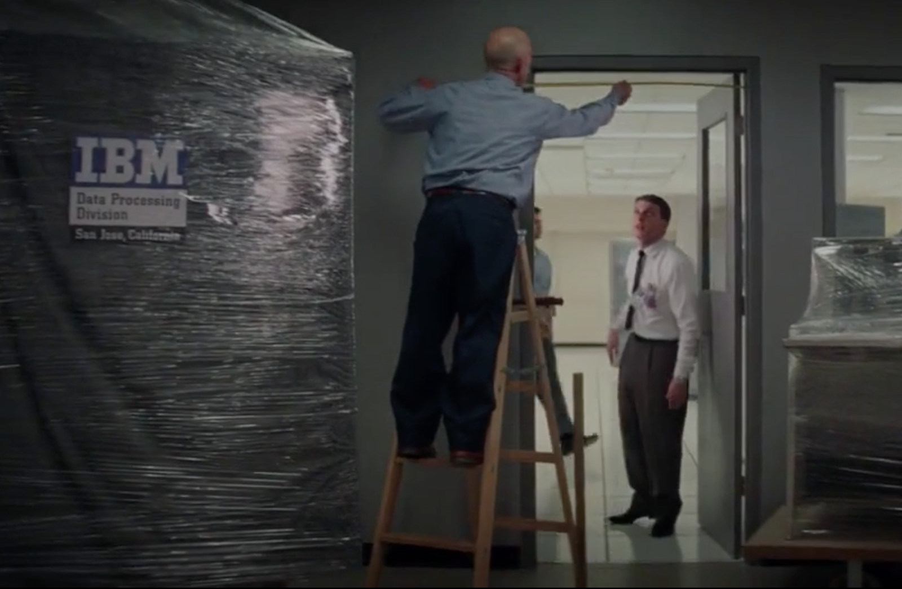
COMPUTER RELIABILITY
Transition from human to electronic computing
Computer bigger than the door
$500,000 monthly [8] [9]
Notes:
(Mario)
This is 1961. For NASA, this is a critical time of transitioning from human to electronic computing. Even though they were expecting some issues, they never saw some things coming. The first, and by far the most fun issue, is that the IBM 7090 they ordered to perform all the calculations with, couldn’t fit through the door. In the movie, they use a huge hammer to fit the computer.
Another issue, was that the computer was not very user friendly. The designated people from IBM were having issues setting it up. Keep in mind that NASA was paying $500,000 a month to rent the computer.

Slide 9
COMPUTER UNFAMILIARITY
No one knew how to use the IBM 7090
The engineers who installed it struggled to get it to work
Vaughan succeeded in running it
Different results on different days
Back to human calculators
More significant digits
Notes:
(Mario)
No one in NASA was yet trained to use the computer, which needed to be programmed in FORTRAN.
Dorothy Vaughan, as she had a background in electronics/mechanics, was able to get it to work, after going through the computer’s manuals.
The biggest issue that the movie drew on was closer to the end. They calculated the correct landing coordinates with the computer and they ran the same calculations the next day. The computer produced different results. At this point, they called Katherine Johnson and had her re-calculate the coordinates. She confirmed the second set of coordinates that the system had produced, and she added a few more significant digits than IBM 7090. Again, keep in mind that this computer was designed for these kind of tasks design of missiles, jet engines, nuclear reactors and supersonic aircraft [9]. Yet, a human did a better job. This gave Katherine a front row seat to the control center of John’s Glenn launch into space, for which she was not supposed to have clearance at all.

Slide 10
ACCESS TO INFORMATION
Book on Fortran only available in the White section of the library
Had to sneak in to see and use the IBM 7090
Taught the other women after hours
Notes:
(Sylvia)
However, it was not easy for Vaughan to get to the point of fixing and using the computer. In order to use the computer to prove to NASA that she could, she had to sneak in and start it running before they came and kicked her out. She also needed to learn Fortran. When she went to the library to find a book on Fortran, she discovered that the only book was in the white section of the library. She got the book, but also got kicked out of the library for being in the wrong section.Once she had acquired this information, she did not keep it to herself, she shared it freely with the other women of the West Area Computers, who were then able to join her when she was promoted to lead the programmers of the IBM 7090.

Slide 11
Computing technology is a catalyst for social change
The unique skill set of the characters were key to overcoming social barriers
Katherine Johnson’s talent for analytical geometry
Dorothy Vaughan’s leadership skills and drive to learn
Mary Jackson’s insistence on becoming an engineer - a trailblazer
Lack of trust in technology helped change the social order
John Glenn asked for Johnson to verify the calculations
Notes:
Sylvia
All three of these women were extraordinarily skilled, and the need for their skills in critical areas opened doors for them and allowed them to prove to the other scientists and engineers, as well as to the world that they could be taken seriously.

Slide 12
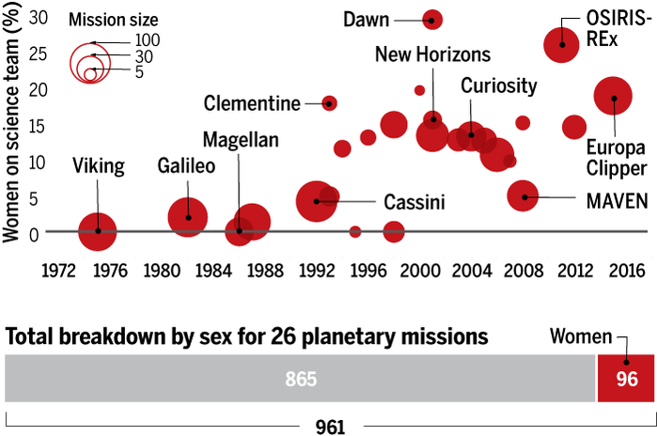
THE REALITY TODAY
Women are on average only 15% of the initial teams for planetary missions
Vaughan, Johnson, and Jackson broke down barriers, but they did not solve the problems
[10]
Notes:
Sylvia
This graph shows that over the past 15 years, women made up on average just 15% of the initial science teams for NASA planetary missions. The bar at the bottom shows this division, with the men represented in grey on the right and the women in red on the left. The graph above shows that the trend is moving upwards from zero in 1975, to between 15 and 30 % for the modern missions. So clearly the breakthroughs by Vaughan, Jackson, and Johnson had some effect, but the problems they faced have not fully been solved.

Slide 13
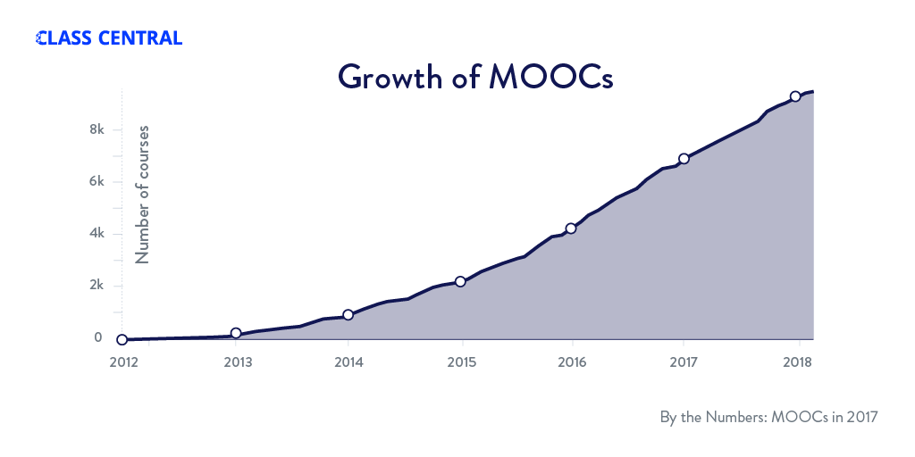
ACCESS TO INFORMATION NOW: MOOCs
60% from full-time employees [11]
60% of MOOCs are taken in developing countries [11]
[12]
Notes:
Mario
Here is another aspect of technology as a catalyst: Massive Open Online Courses, which include all the courses by Coursera, EdX, MIT, Udacity etc. They are making knowledge much more available worldwide, for free or relatively cheap prices. If you look at the growth of these courses, in 2012 there were barely any, and now there are around 8000.
Studies done in 2015 show that 60% of these courses are taken from full-time employees. Most of them because they want to learn how to do something better within the scope of their job, much like Dorothy Vaughan.
Also, the same studies show that 60% of the activity on these online registrations come from developing countries. Technology here is offering inexpensive information to people who would otherwise need to either pay too much for it, steal it, or not have access at all.

Slide 14
“Food for thought”
More access for Katherine, faster calculations? How much of the classified information should NASA have made available?
Could NASA have foreseen the issues with IBM 7090? How can we foresee issues in our career?
Technology is just the catalyst, cannot change society on its own
Notes:
Open to discussion/questions
It is true that they changed “computers” often, but more information might have led them to space sooner?
Measure the door? Prepare programmers?; How can we foresee these kind of issues.
What else do we need? Learn from mistakes, use technology to bring people together and address the major issues.

Slide 15
REFERENCES
[1] Hidden Figures, IMDB https://www.imdb.com/title/tt4846340/, April 24, 2018
[2] Dorothy Vaghan Biography, NASA, April 24, 2018 https://www.nasa.gov/content/dorothy-vaughan-biography
[3] Mary Jackson Biography, NASA, April 24, 2018 https://www.nasa.gov/content/mary-jackson-biography
[4] Katherine Johnson Biography, NASA, April 24, 2018https://www.nasa.gov/content/katherine-johnson-biography
[5] Sputnik and The Dawn of the Space Age, April 24, 2018 https://history.nasa.gov/sputnik/
[6] Computers in Spaceflight: The NASA Experience, April 27, 2018 https://history.nasa.gov/computers/Ch8-2.html
[7] George Edward Alcorn, Jr.: inventor, April 27, 2018 http://www.blackhistorymonth.org.uk/article/section/science-and-medicine/george-edward-alcorn-jr-inventor/

Slide 16
REFERENCES
[8] 7090 Data Processing System, IBM, April 24 http://www-03.ibm.com/ibm/history/exhibits/mainframe/mainframe_PP7090.html
[9] Inflation Calculator, Bureau of Labor, April 27, 1018 https://www.bls.gov/data/inflation_calculator.htm
[10] Women make just 15% of NASA planetary science teams, April 27, http://www.sciencemag.org/news/2017/05/women-make-just-15-nasa-s-planetary-mission-science-teams-here-s-how-agency-trying
[11] Who’s Benefiting from MOOCs, and Why, April 27 https://hbr.org/2015/09/whos-benefiting-from-moocs-and-why
[12] A Review of MOOC Stats and Trends, April 27, https://www.class-central.com/report/moocs-stats-and-trends-2017/

