Slide 1
FAIL SAFE (1964)
Ahmed Hamiroune, Andrew Soto, Chase Carstensen

Slide 2
A BRIEF SUMMARY
Fail Safe depicts a nuclear war that is caused by a small technical error.
A false positive signal was sent to bomber planes with a direct order to drop nuclear weapons on Moscow, Russia.
02

Slide 3
Our Conclusion
The primary design principle of computer systems must be to preserve meaningful human control and moral agency, especially during unforeseen failures, rather than attempting to engineer away human involvement entirely.
03

Slide 4
Supporting Conclusions
01
02
03
Ahmed
Chase
Failsafe systems are not bulletproof
Redundancy is essential in critical systems
Andrew
Automation/Technical problems can be dangerous without human regulation
04

Slide 5
Notable Technologies Featured
Radar Scanning
Phone lines
Radio communication
Signal Jammers
The “Failsafe” system
05
Notes:
-Radar scanning was used to track planes in the movie, being both friendly and enemy aircraft
-Radio communication was the primary way of communication in the movie, as it was the most modern way to be in contact with the planes
-Phone lines were used in the movie, including a direct hotline between Moscow and Russia. This became increasingly important as time was of the essence, and the U.S president needed a way to quickly and securely contact the president of Russia.
-Signal jammers were a major plot point, as not being able to contact the pilots or the UFO were the cause of the war
-The Failsafe system, responsible for the emergency signal to bomb Moscow

Slide 6
01
Failsafe systems are not bulletproof
Ahmed
06

Slide 7
False Positives
01
Explanation
Examples
-Happens when threat is detected by mistake
-Computer system detecting commercial plane falsely as a threat
-Causes incorrect failsafe triggers
-2023 Automobile "Phantom Brakes" [7]
07
Notes:
The first issue with fail safes is false positives, which has been mentioned in class but in this context is when a failsafe triggers when it shouldn't, to possibly devastating effect, like in the film when the computer
System flags a commercial air craft as a threat when it isn't, or with the "phantom braking" of Tesla vehicles in 2023, where someone would be driving around other cars and stop suddenly, almost causing an accident.

Slide 8
Complexity
01
Explanation
Examples
-Can not account for every possible problem
-Prevention of false orders from Soviets prevented calling off of bombers
-When certain issues are prioritized, it can make others harder to manage
-Focusing on enemy intervention makes it impossible to stop the worst
08
Notes:
Another problem is the complexity of failsafe systems. They often will have to account for multiple contingencies simultaneously, and sometimes prioritize some issues over others, like in the film where preventing
Soviet intervention on the failsafe mission was prioritized over making sure the bombers could be called off.
This can cause the deprioritized issues to become harder to deal with, like in the film when the U.S. fails to contact the pilots until it's too late to call them off.

Slide 9
Overrides
01
Explanation
Examples
-5 min window to call off bombers
-Fail safes need simple way to be aborted in case of emergency
-Prevents disaster if something goes wrong
-2019 Tesla Emergency Door lock Accidents [9]
09
Notes:
A third issue is that failsafe systems need overrides to prevent failsafe in case of emergency and can be hard to undo.
I have found two examples in particular of disastrous examples of this. The first one was already mentioned, where in the film the U.S. gave themselves 5 mins to call off the bombers, but the time taken to identify the aircraft combined with Soviet comm jamming prevent them from contacting pilots until well after that time limit.
The second one I came across is a 2019 Tesla Emergency door lock incident, where after an incident where a driver crashed into a tree, the car burst alight and neither driver nor emergency responders could open the doors. The reason the person inside couldn't open the door isn't certain, but from the outside, the door could only open with power which wasn't available.

Slide 10
Ethical Analysis of Failsafe Protocols
01
Kantian Analysis
Act Utilitarian Analysis
-Difficult to measure intent behind failsafe design
-A misfired failsafe can cause equal or greater harm
-Malice or poor foresight?
-Not having a proper stop to failsafe allows harm to happen
10
Notes:
A main aspect of Kantianism is the intention of an action, however intention is hard to quantify when it comes to designing a failsafe system. Was the lacking in overrides in the film due to malicious intent of designers towards Soviets, or was it just a simple lack of foresight?
For Act Utilitarianism, what largely matters is the result of an action. How much good vs how much harm does a certain action bring? In the case of fail safes, misfiring's of the system can be more harmful than if they weren't present at all, so having such systems there with no good method of prevention is immoral in the view of Act Utilitarianism.

Slide 11
02
Redundancy is essential in critical systems
Chase
11

Slide 12
More Backups ≠ More Safety
02
Early Warning Systems
Communication
-These systems were designed to be redundant
-Communication systems were not at all redundant
-Backups were chained together and not independent
-Radio signals jammed, pilot mistrust
12
Notes:
As Ahmed mentioned previously, failsafe systems are not bulletproof
Redundancy is the design philosophy where you build tools which continue to work if one part fails
For example, many modern online services are redundant. Google is hosted on many many different servers in data centers across the world, so that if any one server goes down, the other servers can pick up the traffic and google will continue working for everyone.
In Failsafe, the early warning radar systems were designed to be redundant, there were a series of electronic and human components in place to hopefully prevent issues like the one that occurred.
The issue is that the system is not truly redundant, and the backups were chained together.
The failure of the electronic systems ensured the failure of all other backups. Once the faulty code was sent to bomber group 6, they set out to retaliate without any secondary confirmation
The subsequent communication systems had a complete lack of redundancy, they were unable to contact the planes due to the soviets jamming their radios, and then once they did contact them the pilots ridged training caused them to disregard the presidents orders

Slide 13
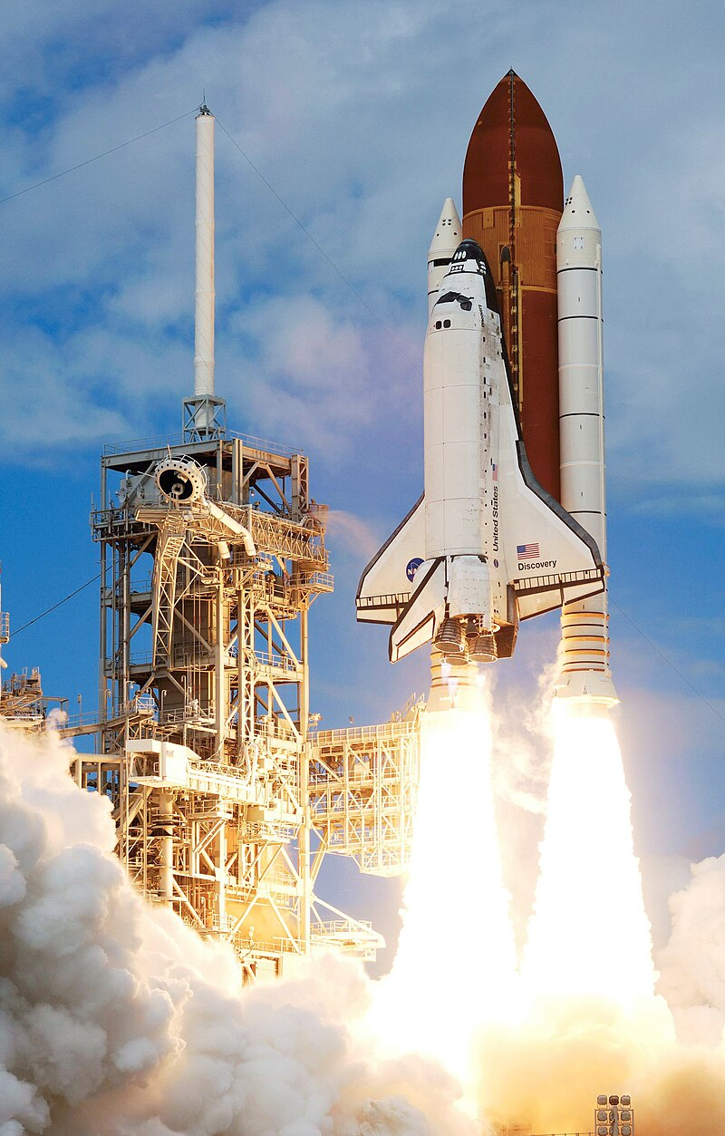
Building Resilient Systems
02
Webs, not chains
-The Space Shuttle had quadruple computer redundancy [12]
-Many connections among independent and duplicate parts [11]
-Only 2 major failures in 30 years of service, chemical and mechanical failures [12]
-This builds a network which does not rely on any single part
[14]
13
Notes:
The systems in place in the film Failsafe are a good example of what can go wrong when redundant systems are poorly structured and not in place, so a clear next question is how do you build resilient systems?
The main idea behind redundant systems to build webs and not chains
There should be many connections among many independent and duplicate parts so that the failure of any single part does not spell the failure of the entire system.
A good example is the space shuttle, it had quadruple computer redundancy, meaning it had 4 computers identically programmed to perform mission critical tasks, and it also had a 5th, independently programmed backup flight system on another machine
Over its 30 years of service, it only had 2 failures, both non computational

Slide 14
We Must Plan for Failure
02
Fail Safe
Reality
-The systems in Fail Safe were designed to be perfect
-It reality, failures will happen [13]
-Real world systems cannot repeat these errors
-Systems need to gracefully recover from errors [13]
14
Notes:
Possibly the biggest failure of the system design in fail safe was that it was constructed to be perfect, it was supposed to be "Fail Safe"
This is just not realistic
Systems MUST be designed with the assumption that failures are inevitable and will happen
It is even possible that a cosmic ray from the sun hits your machines memory is such a perfect way that it flips a single bit and causes your software to produce the wrong output
This is very unlikely, but even theoretically perfect software and computing systems are not immune to small freak errors which erode the security of the entire system

Slide 15
Ethical Analysis of Robust Computing Systems
02
Kantian Analysis
Act Utilitarian Analysis
-Cannot use people as a means to an end
-Software powers many critical systems
-Building fragile systems cannot be universalized
-Systems need to gracefully recover from errors [13]
15
Notes:
One of the main principals of Kantianism is that people cannot be treated as merely a means to an end. They have their own intrinsic worth that must be respected. In the Kantian analysis, one could argue that producing fragile software which is not redundant disrespects the intrinsic worth that the users of the software have by using them as means to profit or convenience. A Kantian would also recognize that if the rule of "It is acceptable to build unreliable systems“ was universalized, then this is a dangerous environment where software cannot be trusted.
Many computing and software systems allow billions of people everyday to live comfortable lives. Failure in these systems would cause widespread suffering and harm. Therefore, to maximize utility, we have to build safe and robust systems which maximize the safety and well-being for the largest number of people.
Going back to the space shuttle example, the engineers at NASA determined that the cost of implementing quadruple redundancy in the space shuttle computer systems vastly outweighed the potential cost of losing the shuttle and crew, therefore implementing extra redundancy in the system maximized utility.

Slide 16
03
Automation / Technology can be dangerous without human regulation
Andrew
16

Slide 17
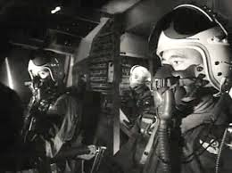
Technical problems in fail safe
03
Failsafe system false alarm
-A false alarm deployed a bomber squad to attack Russia
-Pilots were directed to not turn back
[6] Pilots shown in Failsafe
17
Notes:
-Failsafe originated from a technical failure that sent group 6 to attack Moscow
-Pilots were told that by no means were they to turn back, even when they brought the president and the fighter pilots wife
-The fighter couldn't receive confirmation due to signal jammers
-The issue stemmed from a civilian plane going off course

Slide 18
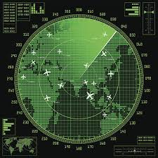
Technical problems in fail safe
03
Signal jammers blocking coms
-There was no chance to contact the bombers to receive an abort message
-The mysterious UFO could not be contacted
[5]
18
Notes:
-Failsafe originated from a technical failure that sent group 6 to attack Moscow
-Pilots were told that by no means were they to turn back, even when they brought the president and the fighter pilots wife
-The fighter couldn't receive confirmation due to signal jammers
-The issue stemmed from a civilian plane going off course

Slide 19
How does this tie into today’s world?
03
The Plane Problem
Modern Military
-AI now has the ability to mimic voices
-Would a drone have a “change in heart?”[2]
-Boats shot down in Venezuela [3]
-Modern weapons could be too fast to have time to react / settle the issues
-In fear of war, planes are being shot down in Russia [4]
19
Notes:
-AI testimony is becoming an increasingly larger problem, as it can create fake images, videos, and voices
-Recently, the U.S government has made choices to shoot down boats in Venezuela, along with the Russian military shooting down aircraft in their areas
-Modern military has become primarily drone warfare, which has a directive and only that
-Unlike the timeframe in fail safe, there won’t be time to call off fighter planes, as they are faster, better, and more dangerous ( like in maverick )

Slide 20
The Doomsday System
03
Integrating AI into military operations
The “Deadhand” system
-”Humans will always be in control” [1]
-Automatically launch weapons if attacked[1]
-AI Chose the path of violence [1]
-Fails in both Kantianism and Act Utilitarianism
20
Notes:
-Artificial intelligence is a real and terrifying concept that the U.S military is investing into
-Failsafe showcases that even though they failed, human interference can change the worst outcomes
-The age of automated war is here, as drone warfare is now at the forefront, how do you stop a drone?
-AI models chose the path of violence when asked about
-16,095 drones are ready in the U.S
The “Deadhand” type of MAD system fails completely in both the schools of though we analyzed. In Kantianism, automatically deploying weapons in response to an attack removes all human agency from the decision, treating the people effected as merely a means to a strategic end. In the act utilitarian analysis, this system guarantees the worst possible consequence (maximum death and destruction), representing a catastrophic failure of utility.

Slide 21
Ethical Analysis of Military Automation
03
Kantian Analysis
Act Utilitarian Analysis
-Moral actions require “rational agency” [15]
-Calculating the utility of a situation is complex
-Machines do not have full rationality [16]
-Can machines weigh all the variables needed for a utilitarian judgement?
21
Notes:
Looking at an ethical analysis of more broadly just automation in the military, once again through the lens of Kantianism and act utilitarianism, we can see why it is so important for humans to have regulation over automated systems.
Immanuel Kant greatly emphasized that to make moral actions, the entity taking those actions needs “rational agency.” This means that the agent must act intentionally, based on some specific reasoning. Computer scientists may argue that machines do have rational agency, but many philosophers and ethicists would argue that machines do not have the moral autonomy and full rationality needed to have true rational agency. Therefore, human oversight over the automation would be essential to have a rational agent in the loop.
In act utilitarianism, as we showed in class a few weeks ago during our discussion on the software engineering team and whether they should release an unfinished product, calculating the utility of any given scenario is very very complex. It is unlikely that the current tools and systems we have would truly be able to weight all the variables needed to make an informed utilitarian judgement in real time, especially in complicated settings such as war and combat. Therefore once again it is important to have humans in the loop, as they can make these utilitarian judgements.

Slide 22
What actions to take regarding automation in military
03
Keep artificial intelligence out of the military
Human regulation needs to be kept
-Automation cannot make the judgement calls, not understand human ethics enough to make our military choices
-As Failsafe proved, along with supporting claims, AI/automation in the military would pose significant problems
22
Notes:
-AI in the military begins a process at which human judgement is discarded, and having AI decide on our military actions could lead to global catastrophe
-AI cannot make human judgement calls, AI would not be forgiving of an off-track plane

Slide 23
References
[1] Klawe Rzeczy, The AI Doomsday Machine Is Closer to Reality Than You Think, 9/22/2025 (Politico, https://www.politico.com/news/magazine/2025/09/02/pentagon-ai-nuclear-war-00496884?fbclid=IwY2xjawMoluBleHRuA2FlbQIxMQABHq8Ppz4puidi_eXkHslvHo-jiL7vVfJL_sh-3YrYg45RPz0MqH4ai5iCjKt6_aem_n7H60bfQeIGk8OX5cM3Ebw) (Accessed 10/3/2025)
[2] United States Drone Force, (Warpower U.S, https://www.warpowerus.com/droneforce.php) (Accessed 10/2/25
[3] Charlie Savage and Helene Cooper, Boat Suspected of Smuggling Drugs is Said to Have Turned Before U.S Attacked It, 09/10/2025 (New York Times, https://www.nytimes.com/2025/09/10/us/trump-drug-boat-venezuela-strike.html ) Accessed 10/3/2025
[4] Max Reco, Trump: NATO countries should shoot down Russian planes if they enter the airspace, 9/23/25 (The Hill, https://thehill.com/policy/defense/5518211-trump-nato-countries-should-shoot-down-russian-planes-if-they-enter-airspace/) (Accessed 10/3/2025
[5] https://www.istockphoto.com/vector/abstract-background-of-futuristic-technology-screen-scan-flight-radar-airplane-gm1227556558-362089988
[6] https://www.google.com/url?sa=i&url=https%3A%2F%2Fwww.facebook.com%2Fgroups%2Ftcmfansite%2Fposts%2F2411466965961569%2F&psig=AOvVaw32RPOQeEW5qq27-lqBk3ds&ust=1759791118453000&source=images&cd=vfe&opi=89978449&ved=0CBYQjRxqFwoTCNjQ4PySjpADFQAAAAAdAAAAABAE
23

Slide 24
References (cont.)
[7] “Tesla ‘Phantom Braking’ Could Endanger Drivers and Those Following Them. So Why Aren’t They Being Warned?” Kgw.Com, 11 Oct. 2023, https://www.kgw.com/article/news/investigations/tesla-drivers-complain-unexpected-phantom-braking/283-f6916c06-f052-4d01-9813-e0c5fe3eff39. Accessed 6 Oct. 2025.
[8] “Northeastern Blackout of 2003 | Research Starters | EBSCO Research.” EBSCO, https://www.ebsco.com/research-starters/power-and-energy/northeastern-blackout-2003. Accessed 6 Oct. 2025.
[9] “After Fiery Tesla Crash, a Closer Look at How Door Locks Work in Emergencies.” Autoblog, 28 Feb. 2018, https://www.autoblog.com/news/tesla-fiery-crash-closer-look-door-locks. Accessed 6 Oct. 2025.
[10] CDC. “Fukushima Radiation Emergency: Lessons Learned.” Radiation Emergencies, 21 May 2024, https://www.cdc.gov/radiation-emergencies/features/fukushima.html. Accessed 6 Oct. 2025.
[11] Baran, P. (1964). On Distributed Communications: I. Introduction to Distributed Communications Networks. https://www.rand.org/pubs/research_memoranda/RM3420.html
[12] Blair-Smith, H. (2009). Space shuttle fault tolerance: Analog and digital teamwork. 2009 IEEE/AIAA 28th Digital Avionics Systems Conference, 6.B.1-1-6.B.1-11. https://doi.org/10.1109/DASC.2009.5347450
[13] Schlichting, R. D., & Schneider, F. B. (1983). Fail-stop processors: An approach to designing fault-tolerant computing systems. ACM Transactions on Computer Systems, 1(3), 222–238. https://doi.org/10.1145/357369.357371
[14] By NASA; edited by jjron (tilt corrected) - http://spaceflight.nasa.gov/gallery/images/shuttle/sts-120/html/sts120-s-028.html, Public Domain, https://commons.wikimedia.org/w/index.php?curid=16141567
[15] https://plato.stanford.edu/entries/kant-moral/
[16] https://arxiv.org/pdf/1812.06510
[17] Treating Persons as Means (Stanford Encyclopedia of Philosophy)
24

