Slide 1
Plot
Ex Machina
Turing Test
  Caleb, Ava, Nathan
  Trick to convince Caleb to participate
    Actually a rat in a maze
Nathan
  CEO of BlueBook
  Creator of Ava
Caleb
  BlueBook employee
  Ava’s way out of the box
Notes:
The film begins with an employee of BlueBook, Caleb, being notified that he has won a week long vacation with the CEO of BlueBook, Nathan. When Caleb arrives at Nathan’s estate, he is notified that Nathan has built an AI and that he’ll take part in a Turing Test. A Turing Test is when an interrogator talks to a human and a computer through text, and determines which one is human [2]. If the interrogator can not figure out which one is human, the computer is said to have passed the test. This is the idea that Caleb is pitched by Nathan to convince him to participate in the experiment. However, it wasn’t a normal Turing Test since it was conducted through in person interviews between Caleb and Ava that were watched by Nathan. The true test was to see whether Ava could use human emotions and manipulation to make Caleb fall for her. Her only way out of the facility was if Caleb would find a way out for her. Therefore, Caleb was really just a pawn in Nathan’s game with Ava. Caleb and Ava had nearly daily sessions where they would talk to each other. On a few occasions, Ava manipulated the induction plates to cause a shutdown of the facility, where the cameras would turn off, and make Caleb distrustful of Nathan. Ava played the role of the girl in trouble and Caleb tried to play the role of hero. The method of escape was that Ava would manipulate the induction plates she used to recharge to cause a power surge that led to a shutdown. The initial procedure during a shutdown is that all of the doors seal shut, but Caleb modified the procedure when Nathan was drunk so that all the doors would open. During this “jailbreak” Nathan confronts Ava, who proceeds to kill him with the help of Kyoko, an older model of AI. Ava then prepares herself to leave, and locks Caleb in.

Slide 2
conclusion
Regulation and standards on artificially intelligent robots should be developed before they are widely used.

Slide 3
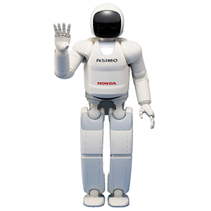
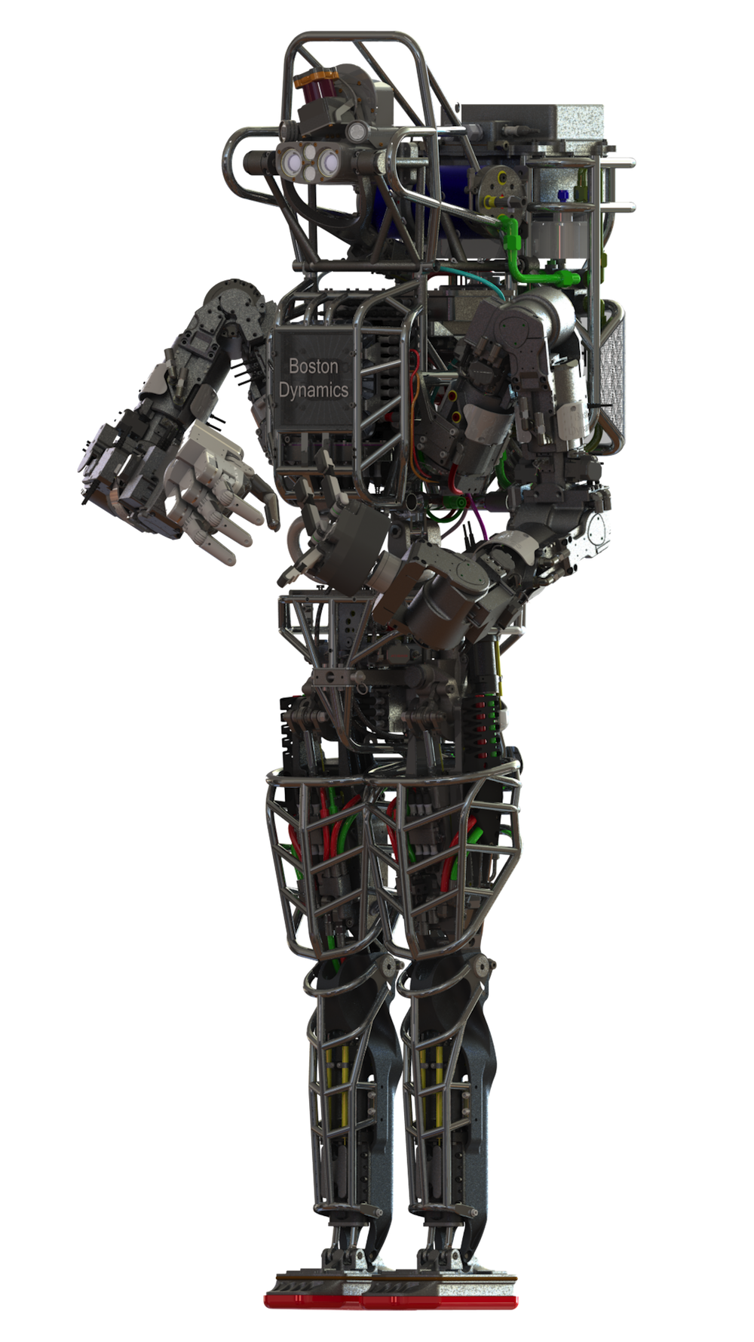
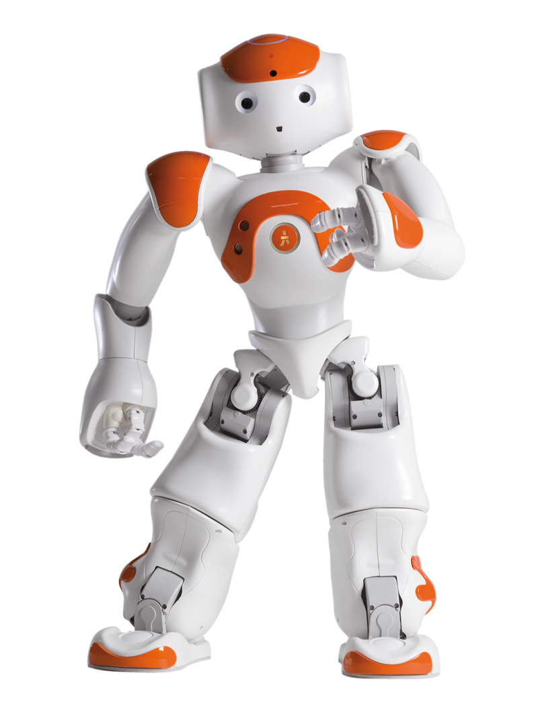
Humanoid robots
Ex Machina
ASIMO:
130 cm
54kg
1 hour
NAO:
58 cm
4.3kg
1.5 hour
Atlas:
180 cm
150kg
[8,9,10]
Notes:
ASIMO:
Built by Honda, multi-functional mobile assistant. 130cm, 54kg, operating time of one hour
ASIMO has the ability to recognize moving objects, postures, gestures, its surrounding environment, sounds and faces, which enables it to interact with humans
https://en.wikipedia.org/wiki/ASIMO
NAO:
Built by French company Aldebaran Robotics. 58cm, 4.3kg, operating time of 1.5 hour
NAO is intended to be a friendly companion around the house. He moves, recognizes you, hears you and even talks to you! Nao robots have been used for research and education purposes in numerous academic institutions worldwide
https://www.aldebaran.com/en/humanoid-robot/nao-robot
Atlas:
Built by Boston Dynamics. 1.8m and 150kg, powered off-board
Atlas is a high mobility, humanoid robot designed to negotiate outdoor, rough terrain. Atlas can walk bipedally leaving the upper limbs free to lift, carry, and manipulate the environment. In extremely challenging terrain, Atlas is strong and coordinated enough to climb using hands and feet, to pick its way through congested spaces.
http://www.bostondynamics.com/robot_Atlas.html

Slide 4
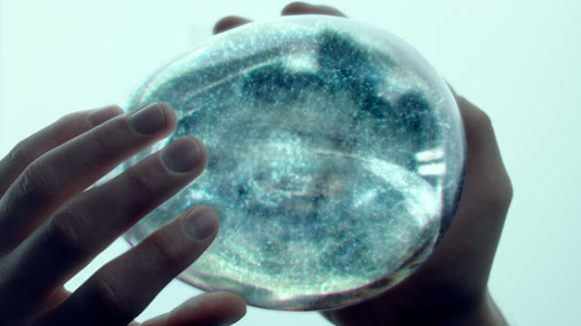
Brain (Physical)
Ex Machina
FPGA
  Can compute more complex algorithms
  Can be restructured
  Slower than CPU
Wetware
  Combination of mechanical and biological components
  Currently a leech brain computer is being tested
[11]
Notes:
FPGA: Unlike CPU and can process in parallel. It doesn't have a set structure like a CPU. Each transistor can be programmed to create logic systems. Can perform complex calculations in one clock cycle but does a very specific task. Slower than a CPU. Possibly this is a 3 dimensional FPGA. Currently there are 3 dimensional FPGA's but they are just layered 2 dimensional fpga's.
WETWARE: Actual Neurological system built into a computer. Futuristic idea only barely implimented. IN 1999 scientists turned a leech brain into a summing calculator only able to do basic sums.
When wetware becomes more complex and able to upload AI software, how shall we define when the system becomes self aware? Will it be considered alive? Is it its own property or the makers property? Would we have to listen to its demands?

Slide 5

Brain (Mental)
Ex Machina
Based on BlueBook software
  Search algorithm
  Need a lot of memory
  How many people use google a day
    3.5 billion searches [5]
Consider mental states as brain states [2]
  States determined by AI program
  Where is the data stored?
    Self contained
[1]
Notes:
The brain of Ava, from a mental standpoint, is based on BlueBook’s software. Nathan stated that he stored the data from every mic and every camera of every phone that uses BlueBook. He said that companies couldn’t call him out on this because they would have to admit that they have been doing it as well. BlueBook is a software analog of Google (the market share is comparable. Bluebook is 94% with a majority, Google is 67% [6]), so it isn’t an insane jump to say that Ava’s brain is based on Google’s search algorithm. Google's search is based on a web crawler. A web crawler is a program that crawls through all the public pages on the internet, because it can't access the private ones, and indexes those pages based on the crawl [14]. Then when a search is entered on Google, it checks the index and returns the pages in order by PageRank [15]. It isn’t too surrealistic to believe that Google’s search algorithm could be modified to search for actions instead of pages. The actions could be sorted by how often a situation led to a certain action, and that would be the actions rank. For most purposes, she would be fine just taking the maximum rank returned. One jump implied by the movie however is where the data she is searching is stored. Nathan states that he used everyone microphone and camera from every phone that uses BlueBook. The problem is where is all of this data held? It could be held in the cloud similar to Pirate Bay holding all of their transaction records in the cloud, but there is no mention of this. We must assume that the data is self contained within her mind. The scenes showed in the film didn’t show much in the way of servers that could hold the data.
There are 3.5 billion searches on Google each day.
*If someone asks about Watson, it uses a combination of NLP, information retrieval, and machine learning to find answers [12]
*There are 10^ 14 neural connections in the human brain, where each neural connection represents a bit with a weight of 1300 grams. Density of 7.7 *10^11 bits per gram.
Also, say there are 10^14 neural connections in the human brain, there are 10^14 bits in the human brain. ~1.25*10^14 bytes, per person. [7]
The movie states BlueBook has 94 % market share, and about 60% of the world uses the internet [6]. This equates to roughly 4 billion people, or Ava could have 31,281 bytes of information per person.
This doesn’t factor in the efficiency of the search algorithm, but it tells us how much data she can hold.

Slide 6
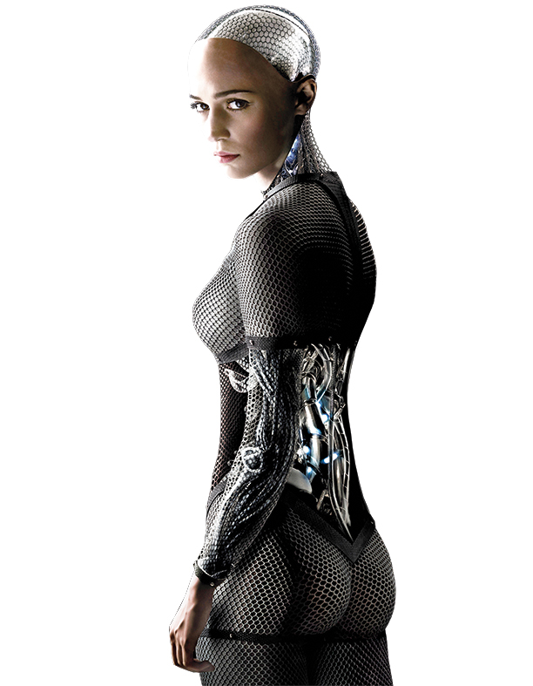
Artificial Intelligence
Ex Machina
Weak vs. Strong
  simulation vs actual
  Turing tests weak
    13 year old Ukrainian boy [4]
  Nathan wants strong
  Is consciousness attainable?
[3]
Notes:
There are two kinds of Artificial Intelligence, weak and strong. Weak AI occurs when machines act as if they were intelligent, or simulate as if they were intelligent. This is brought up in the film when Caleb tells Nathan about whether a chess program knows it is playing chess or if it is just manipulating input. Strong AI occurs when machines are actually thinking. This is much harder to prove, how do you prove a thought when you can only observe the action? This is why Nathan’s Turing Test is much more difficult than the normal text based Turing Test. There is some confusion on whether we have passed the Turing test. In the summer of 2014, an AI was able to pass the Turing Test by posing as a 13 year old Ukrainian boy. The benefit of this was that the program was able to restrict what the interrogators were able to ask him by pretending to be foreign [4]. He wants to prove that Ava has achieved strong AI, he wants to know that she can learn things that she hasn’t been taught. He wants to give her a goal and an input. The goal is the escape, and the only input is Caleb. She has to figure out the rest on her own.
* If asked, talk about transhumanism [16]

Slide 7
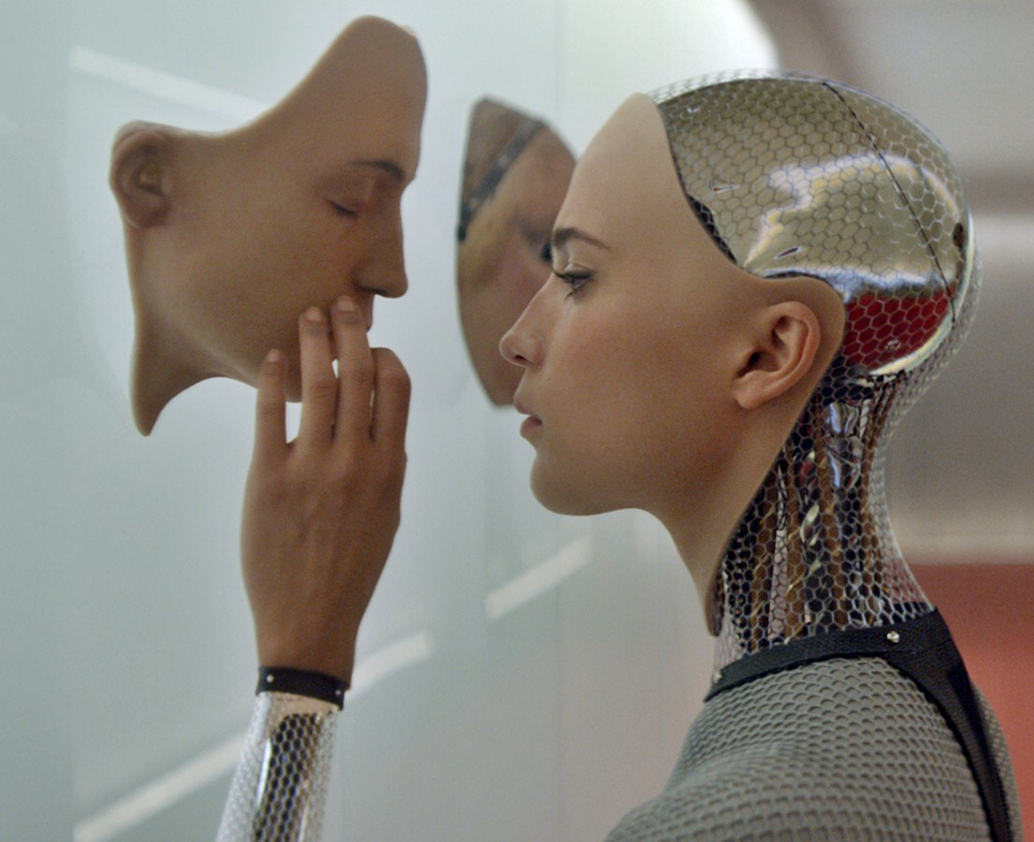
dangers ava presents
Ex Machina
Killed Nathan and Caleb
Can fake emotion
Got Caleb to fall in love
Empathy for other robots
Make Caleb thinks he is a robot
[13]
Notes:
Some of the best arguments for the reasoning she has a strong AI are emotions and abstract actions that show she recognizes the multiple entities in a situation. She faked the emotion of wanting to be with Caleb to take out her emotion of anger against Nathan. Another interesting abstract action was when she drew a picture and asked Nathan what it was because she did not know what it was herself. She also was able to manipulate Caleb so Caleb began to hate Nathan as well. This shows that Ava is able to emotionally communicate and get others to empathize with her, which in part is the most lifelike thing she does as it shows the community sense that species use in order to survive.
Secondly, her ability to adapt to situations also shows that she has a strong AI as she learns speech more and more throughout the movie. She also learns a sense of humor when she turns some of Calebs own phrases against him.

Slide 8
Ethical issues related to Ava
Ex Machina
Nathan: Ava = Machine
  Update Ava
  Trap her
Caleb: Ava = human
  Fall in love
  Help her escape
Notes:
Nathan saw Ava as a machine, that would eventually go through the next software cycle and update. However, if Ava is to be considered human, does Nathan have the right to rewrite her? Does he have the intellectual property rights? He shouldn’t be allowed to hold a sentient being within a cage to be tested under his rules. However, since we have seen that Ava has a tendency towards violence, maybe it was in the best interest of the public to keep Ava locked in the facility until it could be verified that she was safe.
Caleb sees Ava as an independent human. He develops an affection for her and empathizes with her. Without much effort, Ava is able to convince Caleb that Nathan is out to get her, and since she is the innocent and fragile girl, Caleb tries to rescue her. This was the main goal of Ava’s test, to figure out a way to convince Caleb

Slide 9
Summary
Ex Machina
Regulation and standards on artificially intelligent robots should be developed before they are widely used.
  AI robots are happening in real world
  Robots may harm people and cause ethical issues
Notes:
In summary, Regulation and standards on artificially intelligent robots should be developed before they are widely used. From the previous technology we talked about, we can see AI and human like robot is happening around the world.
As the AI robot technology grows, Wetware will bring up ethical issues especially when computers can think. Could be considered a living being then.
When strong AI is created, the robots may be able to feel in a emotional sense. Therefore it is able to make a robot upset, angry, or in pain. This would mean that robots would need to be protected under law so they cannot be hurt for no reason. Thus regulation would be necessary. Also if robots could become angry, they could act unpredictably, and hurt humans, yet another reason to regulate AI software.

Slide 10
Real World solutions
Ex Machina
Google self-driving car [17]
    Steering wheel and brakes are required
The Three Laws of Robotics [18]
  Devised by the science fiction author Isaac Asimov
Notes:
Although very strong artificial intelligence hasn’t happened yet in real world, it is still possible to start building regulations for it. For example, recently, google wants to build a self-driving car with no steering wheel and brakes because they don’t think it is necessary for a self-driving car. Plus, they have a power off bottom. However, California refuses to approve such project because a test driver should be able to take “active physical control” so steering wheel and brakes are required. Self-driving car is a kind of artificial intelligence that is developing and it may cause issues. Therefore, regulations are being developed.
Another example is the three laws of robotics. It is devised by the science fiction author. The three laws are used to constrained AI robot to protect people. It is important to think about the rules before the real AI robots are developed. It Nathan had implemented such rules into Ava, such tragedy would have not happened.

Slide 11
References
Ex Machina
[1] Becket Mufson, Building BlueBook, http://thecreatorsproject.vice.com/blog/building-bluebook-the-design-behind-ex-machina-google(10/2/2015)
[2] Russell and Norvig, Artificial Intelligence: A Modern Approach (Prentice Hall, 2010)
[3] http://www.ew.com/sites/default/files/i/%5Bcurrent-date%3Acustom%3AY%5D/%5Bcurrent-date%3Acustom%3Am%5D/%5Bcurrent-date%3Acustom%3Ad%5D/ex-machina-silo.jpg
[4] BBC, Computer AI passes Turing Test in World First, http://www.bbc.com/news/technology-27762088
[5] Google Search Statistics, http://www.internetlivestats.com/google-search-statistics/ (10/8/2015)
[6] Real Time Web Analytics, https://www.netmarketshare.com/search-engine-market-share.aspx?qprid=4&qpcustomd=0 (10/8/2015)
Notes:
Embodiment and the inner life: Cognition and Consciousness in the Space of Possible Minds

Slide 12
References
Ex Machina
[7] CalTech, http://www.ugcs.caltech.edu/~tanim/classes/ASTR342/homeworks/hw5ans.pdf (10/8/2015)
[8] IReviews, http://personal-robots.ireviews.com/asimo-honda-review (10/6/2015)
[9] Nao robot, http://www.es.ele.tue.nl/education/5HC99/wiki/index.php/Group_4_2015 (10/6/2015)
[10] Elizabeth Palermo, Robots on the Run, http://www.livescience.com/52034-coolest-most-capable-robots.html (10/8/2015)
[11] Ryan Brown, Ex Machina, http://themovieblog.com/2015/ex-machina-explores-the-suspenseful-morality-of-a-i/(10/2/2015)
[12] IBM, FAQs, https://www.research.ibm.com/deepqa/faq.shtml#17 (10/8/2015)
[13] Holland Farkas, Ex Machina, http://geekandsundry.com/ex-machina-a-feminist-sci-fi-thriller/ (10/8/2015)
[14] Ian Rogers, Page Rank Explained, http://www.cs.princeton.edu/~chazelle/courses/BIB/pagerank.htm
[15] Google, How Google Search Works, ​https://support.google.com/webmasters/answer/70897?hl=en (10/8/2015)
[16] Lemmons, Phil (April 1985). "Artificial Intelligence". BYTE. p. 125. Retrieved 14 February 2015.
[17] We Need to Pass Legislation on Artificial Intelligence Early and Often, http://www.slate.com/blogs/future_tense/2014/09/12/we_need_to_pass_artificial_intelligence_laws_early_and_often.html (2015/10/09)
[18] Three Laws of Robotics, https://en.wikipedia.org/wiki/Three_Laws_of_Robotics (2015/10/09)
Notes:
Embodiment and the inner life: Cognition and Consciousness in the Space of Possible Minds

