Slide 1
ELYSIUM
Arlina Anderson Sean MacEachern
Eric Faust Sam La
Notes:
Introduce movie + members.

Slide 2
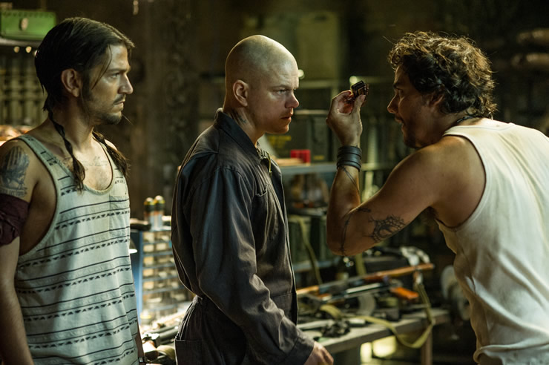
Characters of Elysium
Max
Criminal record
Average worker gets radiation poisoning, prompts him to try to travel to Elysium
Spyder
Hacker, helps Max travel to Elysium
Kruger
Antagonist tasked with tracking down Max
John Carlyle
Powerful businessman, own’s company Max works at. Disregards safety of workers, indirectly causes Max’s poisoning
Secretary Delacourt
In charge of Elysium’s defenses
Attempts to use program to stage a coup and take over Elysium.
<http://www.geekbinge.com/wp-content/uploads/2014/01/elysium21.jpg>
Notes:
Basically talk about what the movie is about. Max exposed to lethal amount of radiation, which motivates him to team up with Spyder, an underground hacker who can give him access to Elysium (a civilization in space). Elysium is filled with wealthy people who have more access to technology than people on Earth. Max steals a special program from a powerful Elysium citizen, giving him the power to rewrite Elysium’s system and allow people on Earth access to Elysium’s resources. An Elysium politician finds out that Max has the program and sends an elite operative named Kruger to capture Max. Kruger brings Max up to Elysium, but Max is able to escape Kruger, hack into the system with the help of Spyder who also travelled to Elysium, and make everyone on Earth a citizen of Elysium.
After introduction of characters:
Ethics of characters
Max - Steals information from Carlyle (bad), but in the end, uses this information to help all of Earth (good)
Spyder - Hacks for his own profit/good (bad), but in the end, helps Max to help Earth (good)
Kruger - Just bad, influenced by greed and power
Carlyle - Motives are selfish, people are not treated like people
Delacourt - Orders to kill a lot of people (bad). Doesn’t mind sacrificing the people on Earth for the good of Elysium.

Slide 3
Conclusion
Social gap affected by technology
Money spent per capita on healthcare, US - $8.5k, UK - $3.4k [9]
Technology/machine dependency
Elysium, Robots, Medical Bay
Technology used to establish stability, power, and security
The director emphasizes the differences between those in poverty and the wealthy. The less developed countries have less resources and can usually get help from more developed countries. The movie exaggerates this relationship between Earth and Elysium to support the theme.
“...the only way they can raise their standard of living is to move to the areas that have high standards of living...” - Neil Blomkamp (2013) [1]
Notes:
Elysium and Earth full of robots that do what humans do in modern time (less jobs for people?). In the end, it looks like the people in charge of the robots are in control. In the end, when the citizens of Earth was branded to be Elysium citizens, including Spyder, the guard robots could not do anything to him.
Medical bay helps people cure their illnesses. Bring that technology to the modern day and who is able to use this? How will this impact our world today? Issues raised include overpopulation and resource usage due to longer lives.
How expensive will this be? Will it be similar to doctors nowadays? Currently the US ranks very low in the healthcare department compared to the rest of the world. Back in 2011, people in the US did not have access to this due to costs. For example, the US spent $8.5k per capita on healthcare compared to the UK, who only spent about $3.4k. (http://www.washingtonpost.com/news/to-your-health/wp/2014/06/16/once-again-u-s-has-most-expensive-least-effective-health-care-system-in-survey/)
Careful on who has control over certain aspects. Carlyle had the reboot program to Elysium, this is unethical and could have ended in more disaster. Why have a reboot program in the first place that allows edits? Should be in other hands instead of the CEO, something along these lines, could go more in depth. There wasn’t really any checks, it just happened to go through (the edit for Earth to Elysium citizens). Not only can the citizenship be changed, but who was in charge, resources, everything else that could have been stored in the system.
The director basically states that there are resources that people can get to to improve their standard of living. What the problem is that people sometimes do not have the access to these resources, as emphasized to Elysium. All of it is available, but there are people who deny access to this technology. In this case, the wealthy have power over the poor and can basically control who lives or dies.

Slide 4
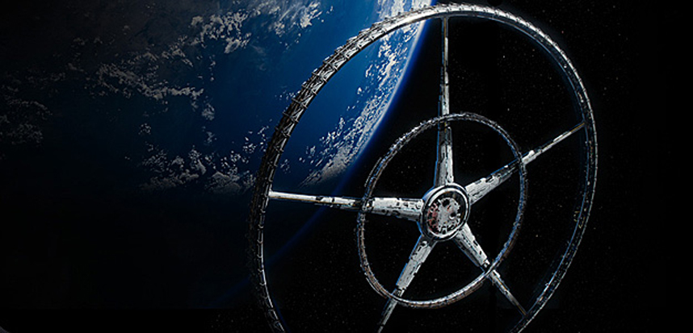
Elysium
A giant space habitat orbiting above the Earth with access to healthy food and a clean atmosphere.
Is guarded and kept secure by a centralized artificial intelligence.
Mars One mission [6]
Earth is decaying
Device capable of curing aging and illness. Many flee Earth and attempt to land on Elysium in order to use it on themselves or their young.
Therac 25 [7]
<http://i.space.com/images/i/000/031/622/original/elysium-torus-big.jpg?1376139699>
<http://qph.is.quoracdn.net/main-qimg-91063297e0fb11c70f4f8be452ef9856?convert_to_webp=true>
Notes:
Major technologies. Talk about what Elysium actually is and the purpose of it (for the wealthy, resources, medical care, etc). Is this possible? Unlimited resources(?), leisure/vacation like and people don’t seem to have any worries. There’s something similar with the Mars One mission, although it’s not really Elysium, where people are trying to colonize on Mars and try to survive in Space.
Ethical concerns with the wealthy being able to come up here and thrive while people on Earth die/suffer. Questions were how did people come up with this technology? There must have been some technological boom on Earth that caused this. Improved medical care may have caused the diseased Earth (using up resources) and overpopulation that caused this to be made. How much testing needed to be done for this? The Therac 25 is a close example to what this machine does. It basically takes and kills the cancerous cells while in the movie it re-atomizes people to be healthier. From Pray: Maybe the people that created this technology stopped trying when they moved to Elysium. This halts the progress on technology as well as who has access to it.
Medical might slow down aging, but not stop it. We don’t know for sure how it treats aging because of how Delacourt and Carlyle look older than everyone else. We think that people on Elysium have to pay x amount to remain up there, so if people have kids, they have to pay for the kids, too. We also don’t know if Elysium is overpopulated or not either, they don’t really go into that in the movie.
Earth is overpopulated even with this technology out because the medical technology on Earth did not decline. If needed to answer, population is shown to grow. Sources include the US census.

Slide 5

Robots
Robots do most of the work on Elysium; robot butlers, medical robots, enforcement robots
Machines make work easier by providing more with less [2]
On Earth, robots and citizens do work
Workers have the same jobs as modern manufacturers and assembly line workers
Health care is provided, although working conditions are very poor/dangerous
<http://i.ytimg.com/vi/TlXScC7_gaU/maxresdefault.jpg>
Notes:
Looks like the portrayal of modern day assembly lines and manufacturers. The book mentions that machines will take over a lot of jobs (white collar ones like accounting and stuff). We do not see much of those, we see only Max. People also make fun of Max for having a job (so jobs may not be as important anymore -> implies machines can do all the work, they are also criminals).
Technology allowed for people to stay healthy, making working less necessary.
Modern day, if you can’t afford health care, you usually don’t get it. (Is it ethical for doctors to refuse care when someone needs it but cannot afford it?). There are doctors and medical robots in Elysium, Fray shows some of these issues when the doctor makes the girl leave because she cannot pay. Human right to live?
Finding sources of food and staying healthy seemed to be all taken care of on Elysium
Currently, there are machines that do what humans used to do and at a much faster pace. They do not need to be paid/maintained, they do everything they’re told and finish the job. They are faster, stronger and more efficient. As mentioned in the source and book, as human life quality goes up, we work less (?).
Health care, the clinic in the movie seemed like it was open to everyone, but it did not have the best resources to treat people. (Can talk about Fray’s daughter/girl she was looking after being kicked out since the clinic could not help her). Carlyle has a medical robot look at Max after radiation, further shows that the wealthy have access to things that the poorer do not.

Slide 6

Information Privacy
All medical and bureaucratic information made available to network.
Similar to modern day sex offender registry [3]
Facial recognition has improved to just physical or body type recognition. Monitoring can identify individuals without major identifying features.
Software available now and used in different ways [4]
Facebook, SceneTap
<http://i.ytimg.com/vi/i9rS-x4aT5w/hqdefault.jpg>
Notes:
Criminal record is available to some people. Police force have this information stored anyways. Compared to modern day tools, people can look up a zip code or city and find out all the information about sex offenders in the area. Elysium suggests that anyone with power (including the robots) have all this information and can use it against you.
Facial recognition. Kruger searched for Max when he escaped after hijacking Carlyle’s information. The “facial” and “body type recognition” began when they started searching for him. It successfully located him, but due to human error (looking out the window and saying there are pigs instead, Max was hiding under), Max is able to get away. This recognition has far advanced to being able to search multiple things at once, talk more about this if needed. When Facebook launched their facial recognition software for tagging in photos, a lot of concerns were raised. However, the government and other companies have been using this for a while. “SceneTap” for example is a startup that uses facial recognition in bars to find the best bars for ratio between males/females.

Slide 7
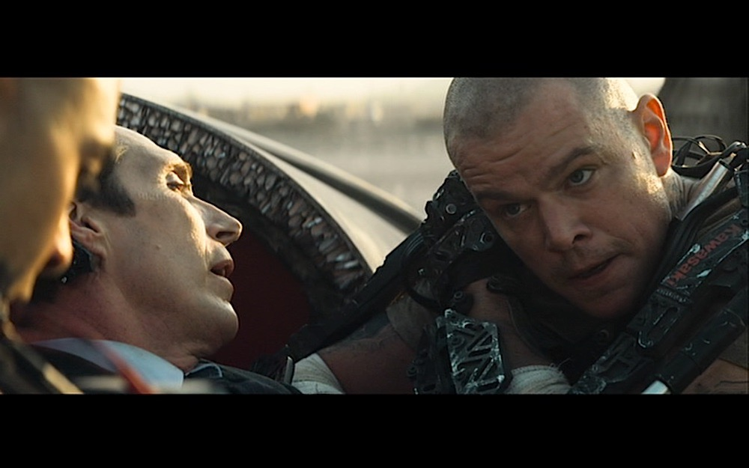
Data
Elysium reboot program allows for settings to be changed
Brands can be added to the DNA of people on Earth to bypass Elysium citizenship check
Data can be retrieved from the brain
Yukiyasu Kamitani’s dream science [8]
Modern day scientists have been able to store information into grams of DNA [5]
Notes:
Max takes Carlyle’s brain data. Forced “entry”. This is not ethical as first Max is using Carlyle as a means to an end. He is also stealing intellectual property that belongs to Carlyle.
All the hacking that goes on in movie is unethical and so is Spyder. Though the movie makes it like Spyder is doing a good thing in the end by changing Elysium to have all of Earth be its citizens, he isn’t in the beginning.
Spyder in the beginning takes payments for trips up to Elysium which aren’t even successful half the time. He is only interested in his own being and things that benefit him (i.e. making Max complete a mission before going to Elysium).
Max seems like a good character at first, but raises questions as how he uses Fray as a means to an end to try to get to Elysium. He also, in a violent manner, takes Carlyle’s information.
Yukiyasu analyzes brain activity to try to show what dreams are visually through MRI scanning and analyzing patterns. Computers can predict what the dreams are most likely containing. (showed pictures to them while they were awake and recorded the results).
The main idea behind this IP is information stored in the brain. Currently, scientists have been able to store A LOT of information (700 TB) into a gram of DNA. Not sure if possible to extract this from the brain because the information is specially encoded and decoded.

Slide 8
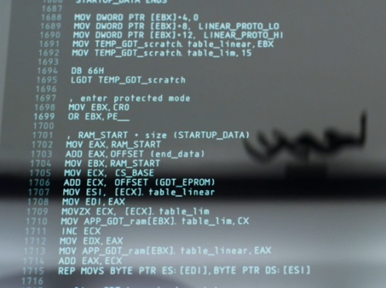
Summary
Access to use medical bay and Elysium is controlled by the wealthy.
Class gap
Security concerns with information
Reboot program
Robotic task force on Elysium and in some places on Earth
Technology used to establish stability, power, and security.
Questions?
<http://hacksinmovies.com/images/thumb/2/2d/ELY_future_code.jpg/500px-ELY_future_code.jpg>
Notes:
Recap on the rich being able to access all this technology while they watch the people on Earth suffer. The movie shows that people on Earth also have access to this technology if the people on Elysium decide so.
The reboot program has an impact since it can reprogram who is in charge, who becomes citizens, etc. This is important since people with unethical motives (Carlyle and Delacourt) can easily change the system. Then people like Max and Spyder can steal this information, too so it is important that this information is secure.
Technology in this movie establishes stability, power and security as those with access to it can control those who do not. Again, medical bay/Elysium not available to all people.
(REBOOT PROGRAM IS FROM INTEL DEVELOPER’S MANUAL)

Slide 9
References
Elysium Group
[1] "Interview: How Neill Blomkamp Reimagined L.A. as a Wheel in the Sky in 'Elysium'" Digital Trends. N.p., 09 Aug. 2013. Web. 21 Apr. 2015.
[2] Passell, Peter. "The Second Machine Age." The Milken Institute Review: A Journal of Economic Policy 16.3 (2014): 67. Print.
[3] Agan, Amanda Y. "Sex Offender Registries: Fear without Function?" The journal of law & economics 54.1 (2011): 207-39. Print.
[4] John P Mello Jr. Facial Recognition Beyond Facebook. 29 Vol. San Francisco: PC World Communications, Inc, 2011. Print.
[5] "Harvard Cracks DNA Storage, Crams 700 Terabytes of Data into a Single Gram | ExtremeTech." ExtremeTech. N.p., n.d. Web. 23 Apr. 2015.
[6] "About Mars One - Mars One." Mars One. N.p., n.d. Web. 23 Apr. 2015.
[7] "CMC Response." CMC Response. N.p., n.d. Web. 23 Apr. 2015.
[8] Nature.com. Nature Publishing Group, n.d. Web. 27 Apr. 2015.
[9] "Once Again, U.S. Has Most Expensive, Least Effective Health Care System in Survey." Washington Post. The Washington Post, n.d. Web. 28 Apr. 2015.

