Slide 1
DREDD (2012)
Connor Thompson, Enoch Zhao, Guillermo Morel, Nicholas Giangregorio, Robert Eskridge
Notes:
Title screen

Slide 2
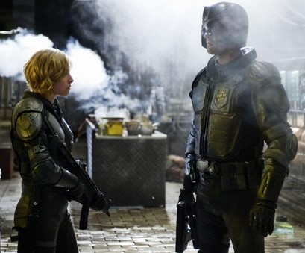
PLOT SUMMARY
Dredd (2012)
Set in a dystopian future where police serve as judge, jury, and executioner
Follows Judge Dredd as he tests Judge Anderson
The pair end up fighting a gang run by Ma, who are responsible for spreading the drug Slo-Mo
Notes:
Connor
Police are fully in charge of punishing criminals, no separate judicial system
Dredd is training a new judge… training is done in the field
High risk of death ⅕ judges fit on first day according to dredd
Slo-Mo makes user feel time going slow, spreading very rapidly
pair ends up locked in mega-block with the Ma gang, and must fight their way out of the block

Slide 3
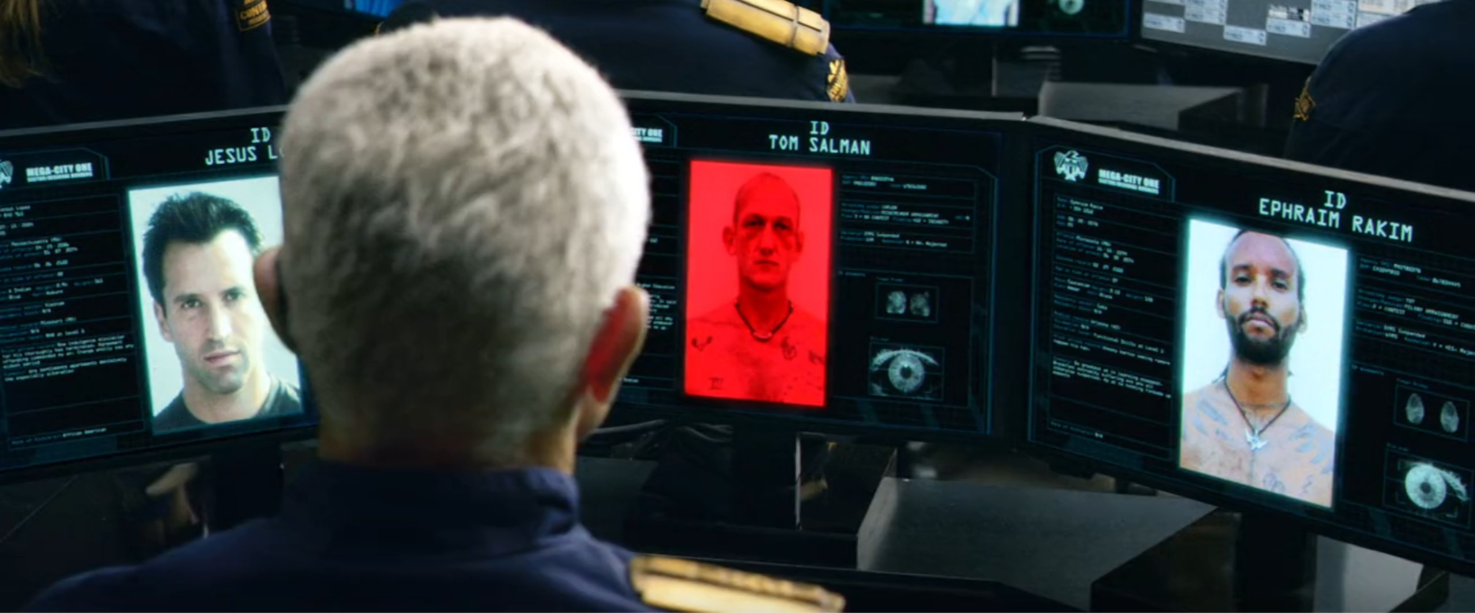
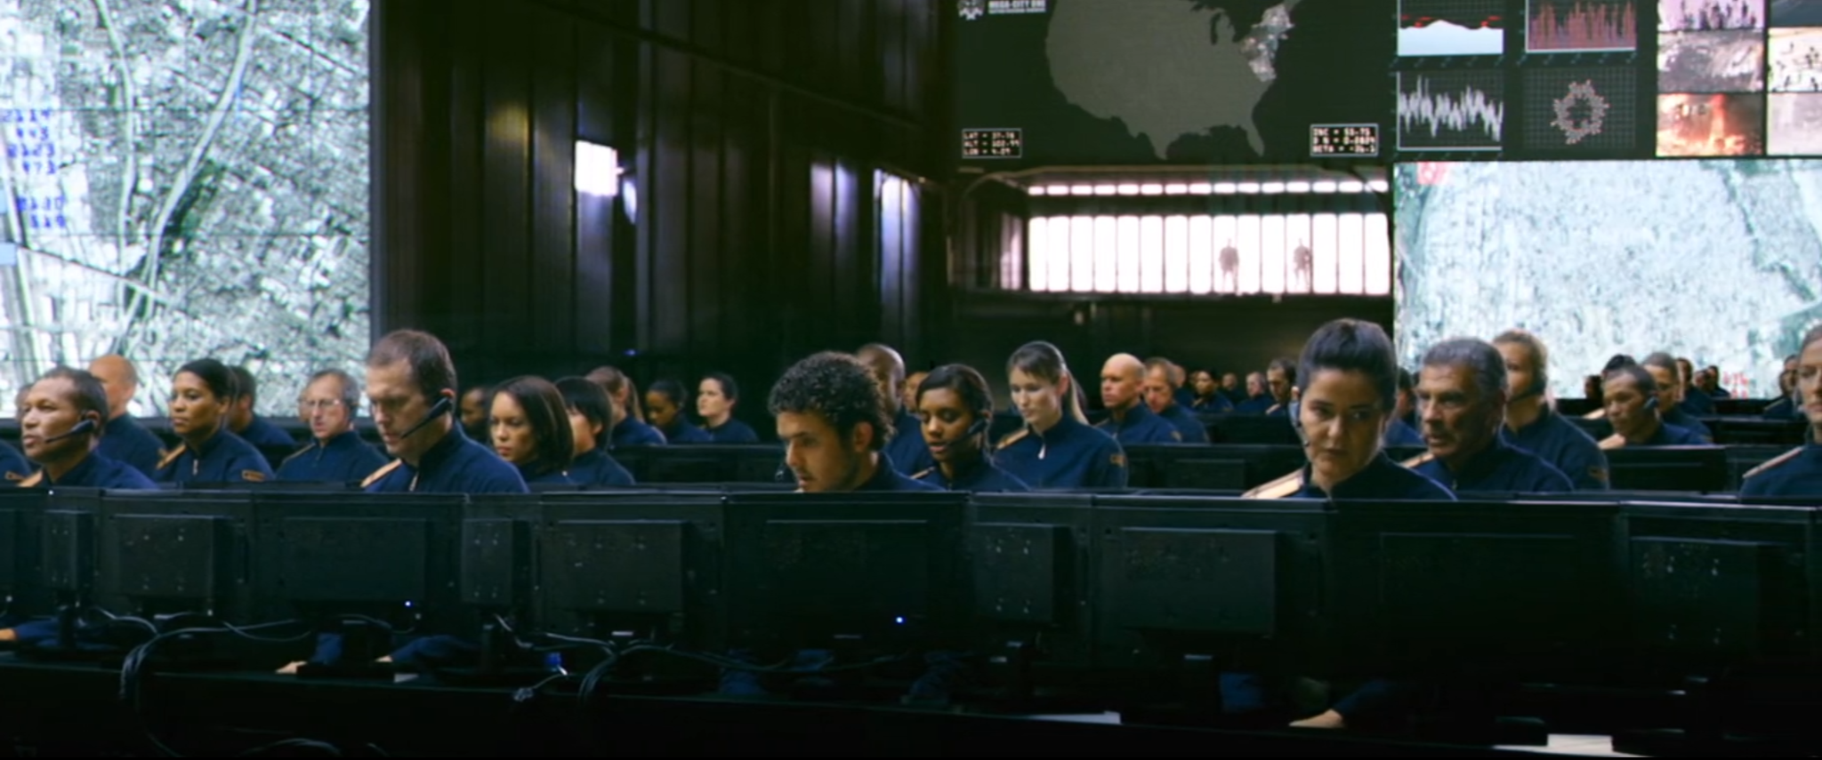
IMPORTANT QUESTIONS
Dredd (2012)
How much power should the police force have
What amount of surveillance if any is optimal in a society
How can we prevent people from misusing surveillance technology
Notes:
Connor
police in dredd are given absolute power, clearly this is too much/ what amount should the real world pull from this
Security vs. privacy/ are drone and CCTV surveillance optimal for a society and to what degree should these be used
How to prevent police data from falling in the wrong hands/ and what should people do to protect their own data

Slide 4
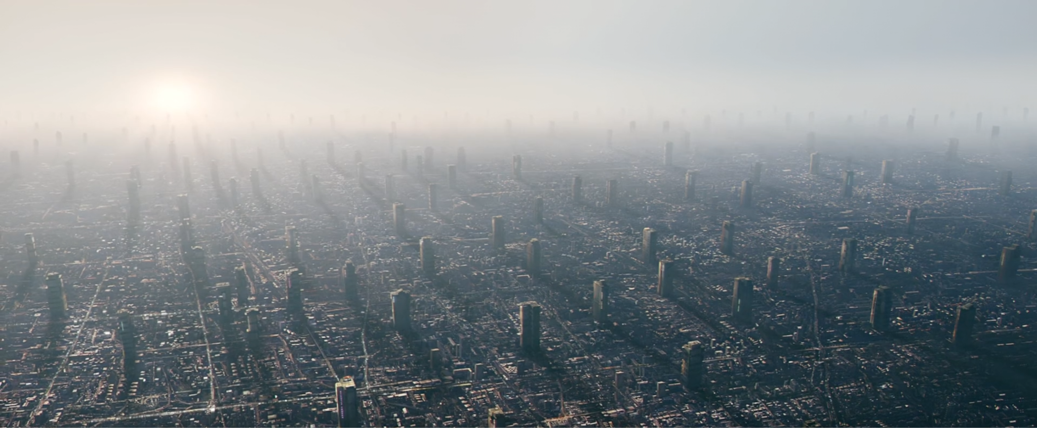
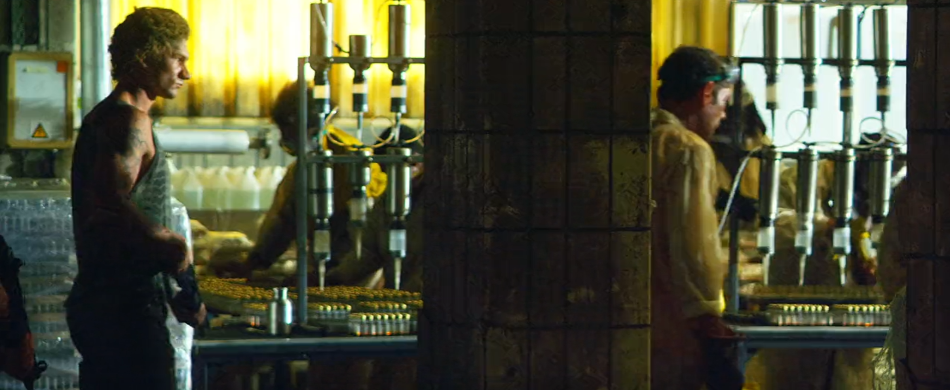
Crime and Dredd
Dredd (2012)
Megacity 1 stretches from Boston to Washington DC, 800 million people.
Prevalence of Slo-Mo is an allegory for war on drugs
  Dredd produced in 2012
“Twelve serious crimes reported every minute. Seventeen thousand per day. We can respond to around six percent”
Notes:
I want to stress the fact that overpopulation is the main issue in MegaCity 1, party driven by automation of many jobs and thus unemployment. The world Dredd is ripe with crime, which is why the Judges have such a staggering amount of power and authority
-There is a serious issue with drugs as shown in the movie with Slo-Mo, this is in part because there is a very high unemployment rate thanks to automation.
-The judges only respond to a very small sliver of crime, the 911 hotline cant even answer most calls.
-Main issue is overpopulation

Slide 5
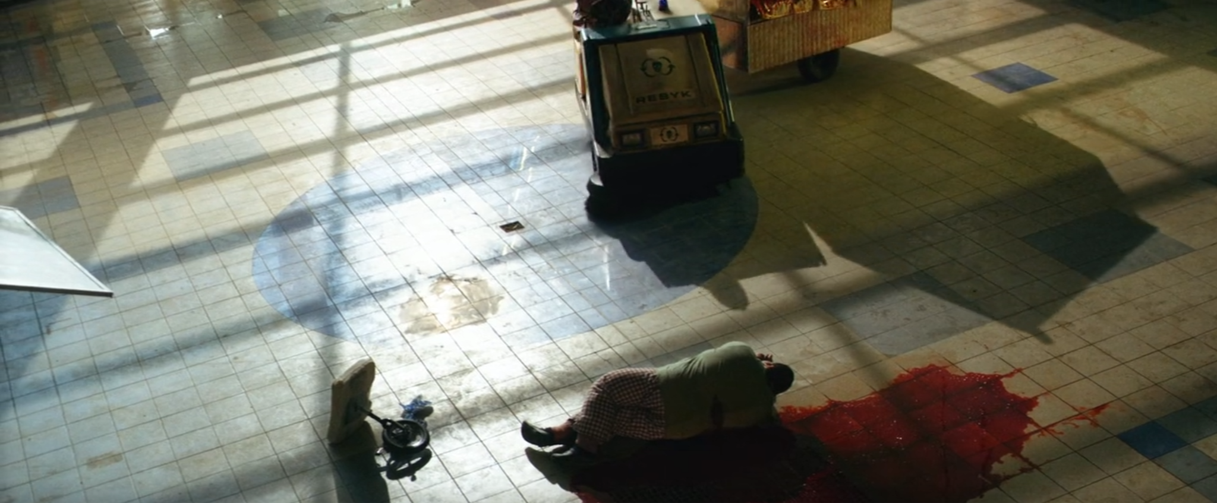
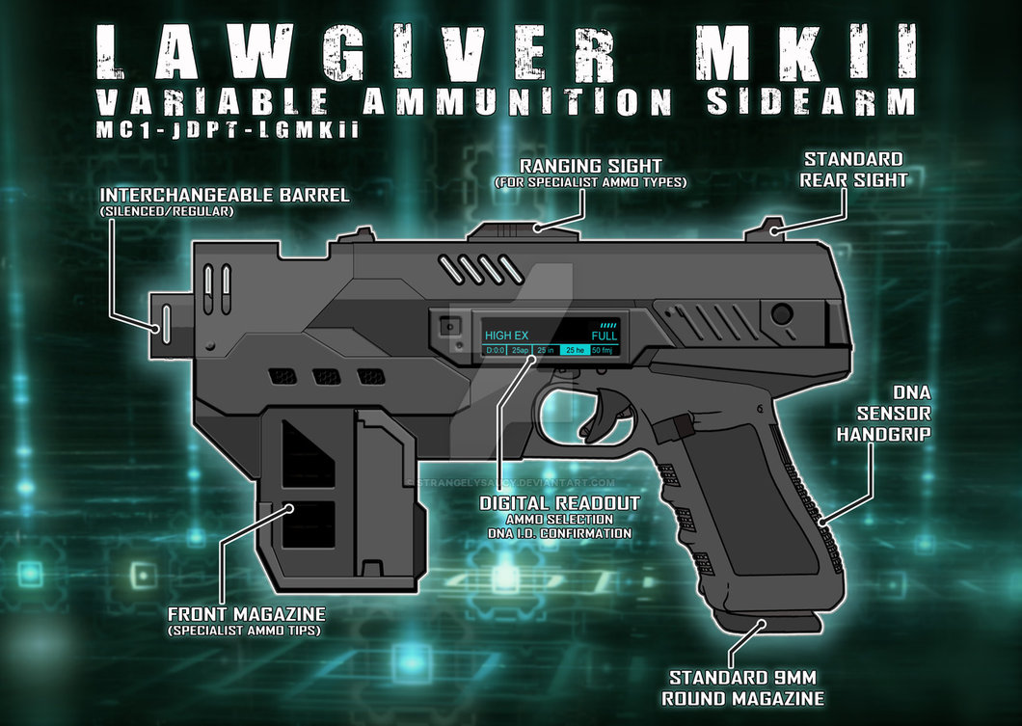
RELEVANT TECHNOLOGIES
Dredd (2012)
Synthetic Drugs
Mega-Blocks
Cameras can track people’s location at all times
Smart weapons that can identify its user and is voice operated
Automation of many jobs
Facial recognition technology
[18]
Notes:
Synthetic Drugs:
The film introduces "Slo-Mo", a drug that alters time perception. It's a commentary on drug issues and societal impact.
Mega-Blocks:
Huge vertical housing like Peach Trees address overpopulation, but also highlight class disparity and socio-economic challenges.
Facial Recognition Technology:
Used for surveillance in mega-blocks, it questions the balance between safety and privacy in the future.
Cameras Tracking People:
Cameras in Mega-City One actively track citizens, emphasizing the theme of surveillance and loss of privacy.
Smart Weapons:
The "Lawgivers" are guns that recognize their user and respond to voice commands, merging tech with law enforcement.
Automation of Jobs:
Tasks like waste management are automated in Mega-City One, pointing to the benefits and challenges of technological advancement.

Slide 6
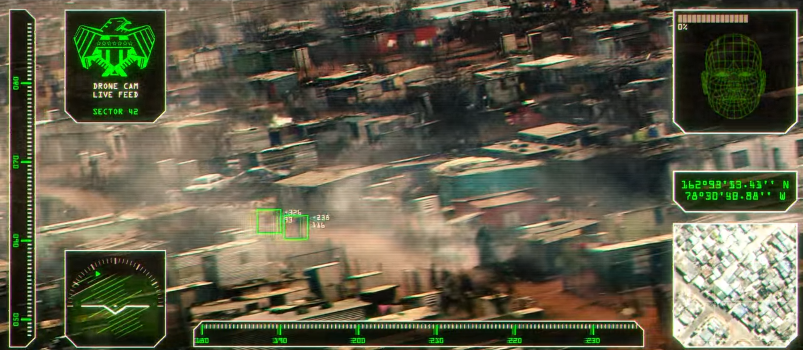
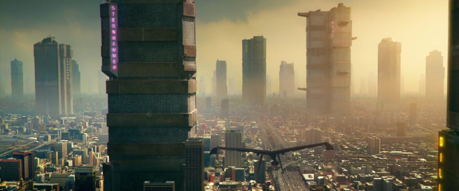
COMPUTING TECHNOLOGIES AND SURVEILLANCE
Dredd (2012)
Drones are used to survey the public since there aren't enough judges.
CCTV is prevalent throughout the city and within the mega buildings everything is under camera surveillance.
  Access to these is for judges but the system is also exploitable by social engineering.
Notes:
The Judges have an extensive surveillance network, including automated drones that patrol the city and also internal CCTV systems inside every residential block.
These systems have a way of tracking every individual and extend throughout all the floors of each building.
The camera system and security system gets abused by Mama’s crew to track and corner Dredd.
examples:
CCTV Everywhere: Cameras in public spaces, highways, and mega-blocks.
Peach Trees Monitoring: Ma-Ma uses internal systems to watch Dredd and Anderson.
Facial Recognition: Systems in mega-blocks identify and track individuals.
Judges' Tracking: Motorcycles and weapons have tracking capabilities.
Listening Devices: Suggests audio surveillance throughout Mega-City One.
CCTV Everywhere: Cameras in public spaces, highways, and mega-blocks.
Peach Trees Monitoring: Ma-Ma uses internal systems to watch Dredd and Anderson.
Control Rooms: Central hubs displaying live CCTV feeds.
Facial Recognition: Systems in mega-blocks identify and track individuals.
Judges' Tracking: Motorcycles and weapons have tracking capabilities.
Recording as Evidence: CCTV footage used for incident reviews.
Listening Devices: Suggests audio surveillance throughout Mega-City One.

Slide 7
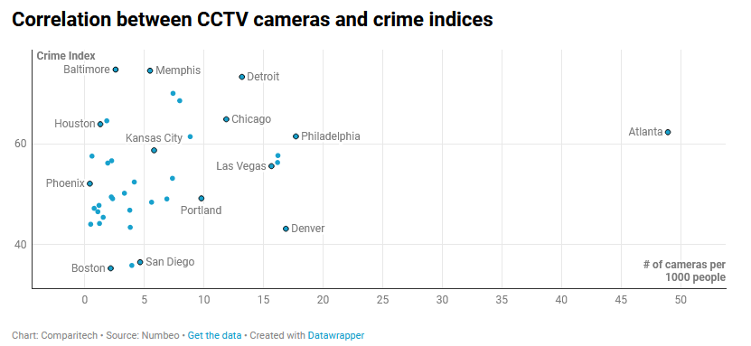
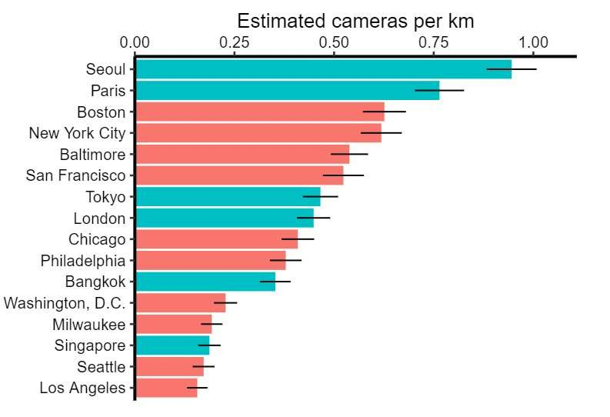
CCTV SURVEILLANCE NOW
Dredd (2012)
In the 50 most populated US cities 39 of them report CCTV data
  "270,000 cameras monitoring a population of 44.2 million people”[11]
  Atlanta is the most surveilled city, with a ratio of 48.93 cameras per 1k people. [11]
28 police departments have Ring doorbell access[11]
  These made 728 requests for footage in Q3 2020 (map)
  Studies show that there are more doorbell cameras than actual CCTV [12]
[11]
[14]
Notes:
- Analyzed 39 of the 50 most populated U.S. cities.
- Found 270,000 cameras monitoring 44.2 million people (6 cameras per 1,000 people).
- Atlanta leads with 48.93 cameras per 1,000 people.
- Chicago has the highest total cameras (32,000).
- 28 police departments use Ring doorbell technology (728 access requests, Q3 2020).
- Top 10 Most Surveilled U.S. Cities:
- Atlanta, Philadelphia, and Chicago lead in surveillance.
- Atlanta's extensive network includes public, school, traffic cameras.
- Atlanta ranks 7th globally in surveillance among top 150 cities.
- Limited correlation between cameras and crime reduction.
- Concerns: Ring technology, COVID-19 surveillance, Smart Streetlights.
- Methodology and Limitations:
- Data from various sources, may include private cameras.
- Actual figures may vary due to data limitations.
- Omitted cities due to lack of data (listed).

Slide 8
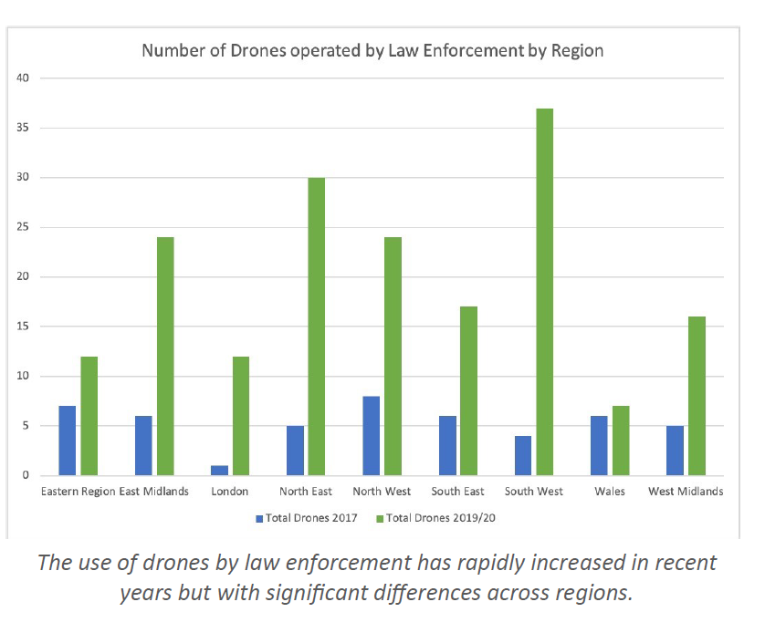
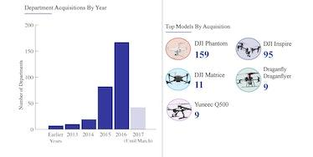
DRONES IN POLICING
Dredd (2012)
Drones shown being used in Dredd for directing judges
In the US many police departments have started responding with drones before police officers for 911 calls [5]
"The Chula Vista (CA) police department has sent drones to more than 16,000 calls in total.” [10]
[15]
[16]
Notes:
Robbie
In Dredd, drones are used to direct judges, document crime scenes, and chase suspects. We are seeing an increase in real world police forces using drones to respond to crime scenes. [5]. Drones are being utilized to gather information on a scene before police officers arrive. Some worry that this will “usher in an era of pervasive, suspicionless, mass aerial surveillance.” [6]. The drones used by police forces are coming closer and closer to the drones used in the movie Dredd. With no oversight, this could be leading to issues regarding constitutional rights, rights to privacy, and rights to anonymity.
“There has been a three-fold increase in the use of drones by law enforcement in England and Wales since 2017.”

Slide 9
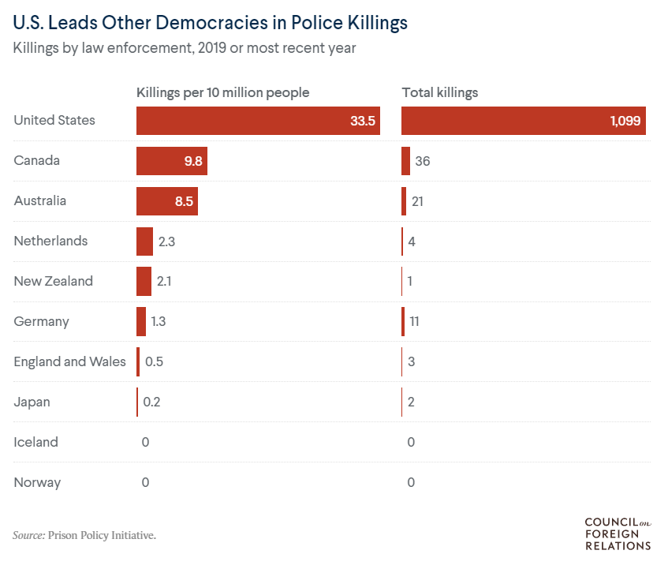
OVERSIGHT IN POLICING
Dredd (2012)
Dredd judges are judge, jury, and executioner.
63% of Americans are in favor of removing qualified immunity for police officers. [1]
From 2013 to 2020, 8700 Americans were killed by police forces. [2]
[2]
Notes:
Robbie
The judges in the Dredd universe are the judge, jury, and executioner of criminals. The sentence is determined to the best ability of the judge in a snap decision. The expectation is that the Judges have the experience and wherewithal to make a judgement call in the best interest of individuals and society. Similarly, in the United States, qualified immunity gives officers legal defense from lawsuits on an individual level, if the officer can argue they acted in good faith. This doctrine has expanded its scope of defense dramatically since it’s introduction [3]. 63% of Americans are in favor of removing qualified immunity for police officers [1]. The United States is middle of the road for police spending, compared to other democracies. However, from the span of 2013 to 2020, 8700 individuals were killed in the United States by police officers. In the same timeframe, only 254 individuals were killed by Canadian police [2]. The figure on the right shows that in the year 2019, the USA had 3x as many police killings per capita, and 30x total killings.
Movements are growing in the United States, Nigeria, and France to call for increased police oversight. [2]. The United Nations lays out several basic human rights that police officers of chartered nations can’t legally overstep [4]. The Supreme Court of the United States continues to expand protections for police officers, and some argue it is approaching the limits of constitutional infringement [3]. The key takeaway is that oversight in policing can help prevent misuse of technologies.

Slide 10
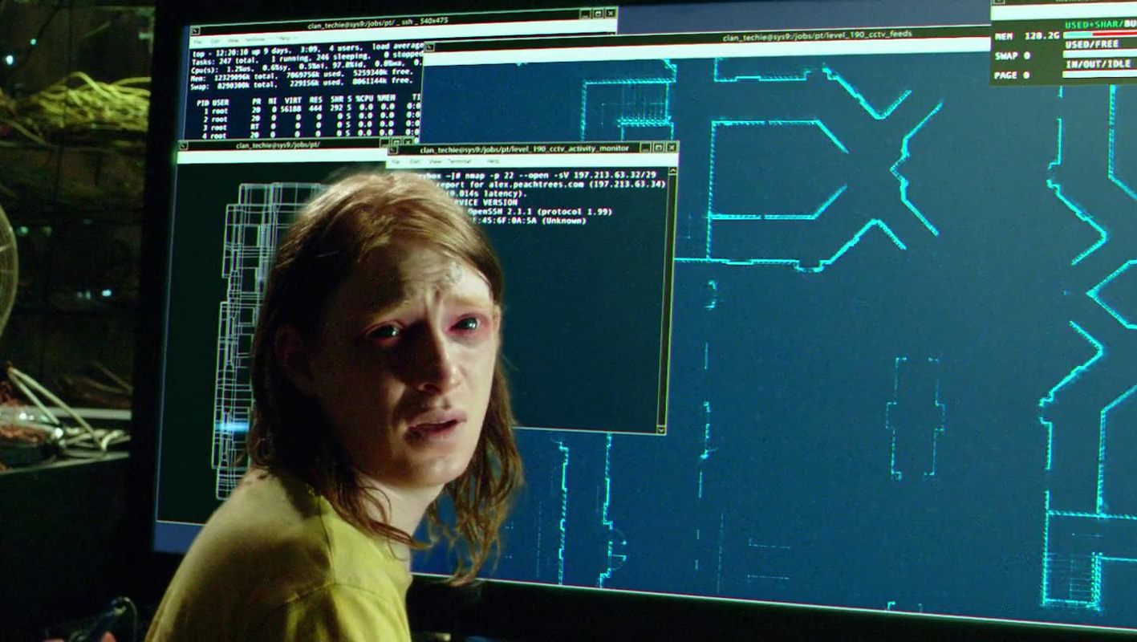
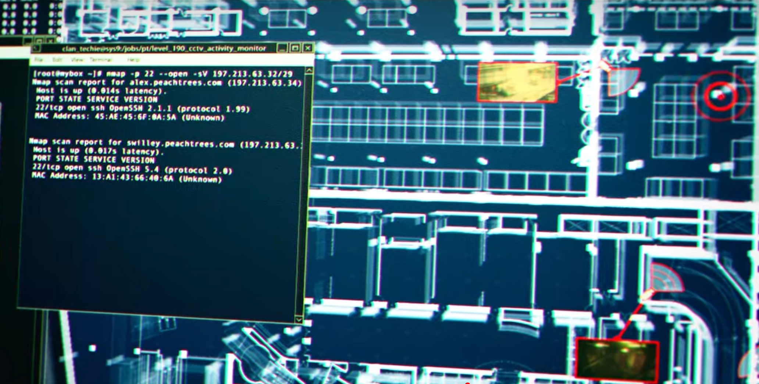
Misuse of Surveillance Technology
Dredd (2012)
Ma-ma uses building security systems to trap in and ambush police
Criminals used cameras to track people’s exact position
These failures were mostly due to human error
Notes:
(Nicholas)
Drug boss took advantage of emergency security systems to lock down a “Mega-Block”
Also used security cameras to track the exact position of the two judges
These security devices were implemented to prevent crime, but are instead being used by the criminals
Criminals got access because a government worker gave them access

Slide 11
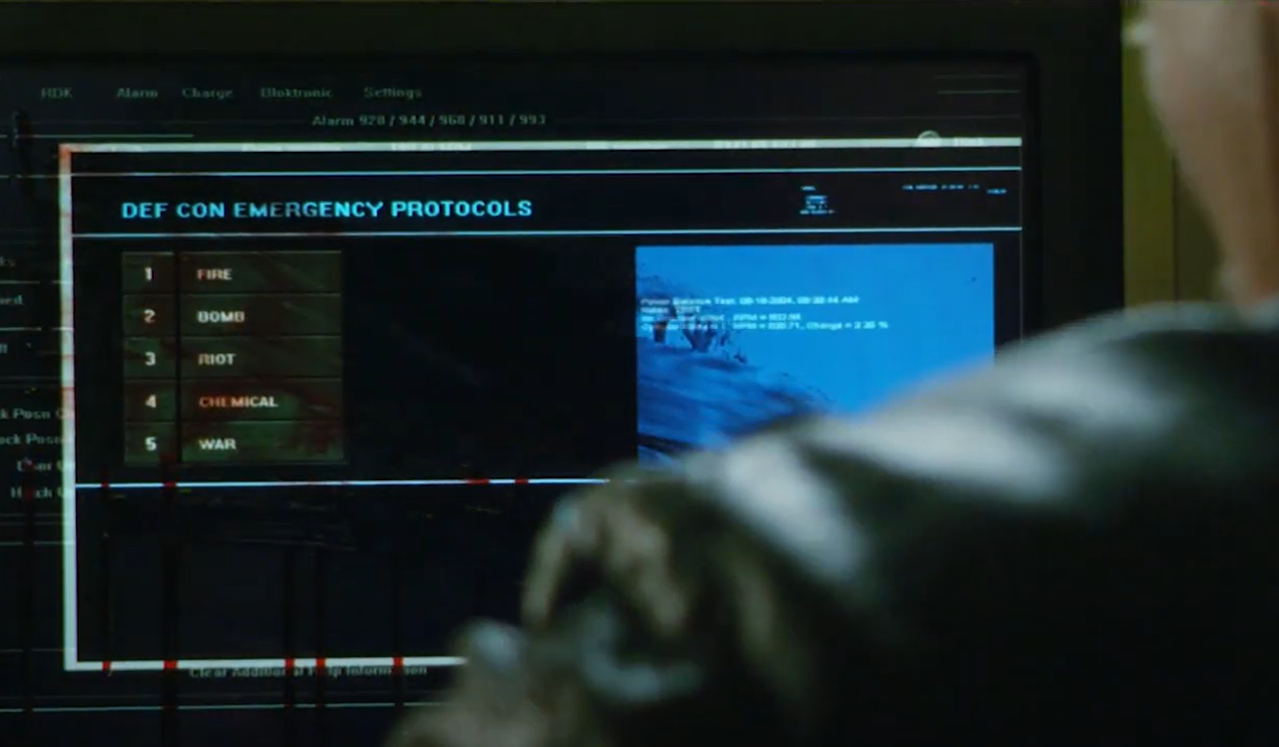
Solutions to Misuse of Surveillance Technology
Dredd (2012)
79% of Americans share passwords [9]
Government needs to ensure that the wrong people aren’t given too much access to surveillance tech and personal data [8]
In real life, used security features to access people’s bank accounts [7]
Notes:
(Nicholas)
Once someone has access to a system/account, you cannot know what they will do with it
A 2023 survey of 1500 Americans found that 79% of participants admitted to sharing passwords with someone outside their home
Yet only 7% of participants were worried about their home or devices being hacked
The criminals’ ability to fight the judges would have been greatly mitigated if these security systems were only used when necessary
Called it a “drill” to get access to these systems
IRL, criminals have abused 2 factor authentication to access people’s bank accounts
This could be done by calling a service provider to switch phones. This was a security vulnerability accessed not through stereotypical hacking, but through a simple phone call (like movie)

Slide 12
CONCLUSION
Dredd (2012)
Police forces need to utilize the tools they have to protect the innocent and keep the peace
Surveillance is not necessarily a bad thing, with ethical limitations
Entrusting your privacy to competent and ethical organizations can prevent misuse
Notes:
Connor
In conclusion, DREDD offers a thought-provoking look at the intersection of technology, policing, and society. As we move forward, it's essential to consider the ethical implications of our technological advancements in the law enforcement sector. DREDD shows us how technology can be used to assist law enforcement officers, through limited surveillance and aerial vision. However, it also presents situations in which technological support can go too far. Over-surveillance and lack of oversight of police forces utilizing dangerous technologies can be misused in the near future.

Slide 13
REFERENCES
Dredd (2012)
[1] Ekins, 2020. Cato Institute Summer 2020 National Survey. https://www.cato.org/survey-reports/poll-63-americans-favor-eliminating-qualified-immunity-police#introduction, Accessed 10/4/2023
[2] Cheatham, Maizland, 2022. How Police Compare in Different Democracies. https://www.cfr.org/backgrounder/how-police-compare-different-democracies Accessed 10/4/2023
[3] Legal Defense Fund, 2023. Qualified Immunity FAQ https://www.naacpldf.org/qualified-immunity/#:~:text=Qualified%20immunity%20has%20protected%20law,people's%20constitutional%20rights%20for%20decades. Accessed 10/4/2023
[4] United Nations Charter. https://www.ojp.gov/pdffiles1/Digitization/107956NCJRS.pdf. Accessed 10/5/2023
[5] Lartey, 2023. It’s a bird. It’s a plane. It’s the police responding to a 911 call. https://www.themarshallproject.org/2023/07/29/police-drone-california-911#:~:text=When%20911%20calls%20come%20in,approach%20is%20growing%20in%20popularity. Accessed 10/5/2023
…
Notes:
References 1-5

Slide 14
REFERENCES
Dredd (2012)
[6] Stanley, 2023. Eye in the sky policing needs strict limits. https://www.aclu.org/documents/eye-in-the-sky-policing-needs-strict-limits. Accessed 10/6/2023
[7] WHIO Staff, 2023. Criminals use common security features to access bank accounts. https://www.whio.com/news/local/criminals-use-common-security-features-access-bank-accounts/LLIB7C6XE5FO3LR5LBP4QT4V3U/ Accessed 10/8/2023
[8] Lee and Chin-Rothmann, 2022. Police surveillance and facial recognition: Why data privacy is imperative for communities of color. https://www.brookings.edu/articles/police-surveillance-and-facial-recognition-why-data-privacy-is-an-imperative-for-communities-of-color/ Accessed 10/8/2023
[9] Covington, 2023. 79% of Americans Share Passwords, But Only 13% Are Worried About Identity Theft. https://www.thezebra.com/resources/home/dangers-of-sharing-passwords/ Accessed 10/8/2023
[10]Lartey, J (2023, July 29) Its a bird. Its a Plane. ITs the police responding to a 911 call. The Marshal Project https://www.themarshallproject.org/2023/07/29/police-drone-california-911 Accessed 10/8/2023
[11] Bischoff, Paul (3/25/2022). CCTV surveillance in the most populated cities in the United States. Comparitech. https://www.comparitech.com/blog/vpn-privacy/us-surveillance-camera-statistics Accessed 10/9/2023
[12] Sheng, H., Yao, K., & Goel, S. (2021). Surveilling Surveillance: Estimating the Prevalence of Surveillance Cameras with Street View Data. ArXiv. [v3]. https://doi.org/10.48550/arXiv.2105.01764 Accessed 10/8/2023
Notes:
References 6-12

Slide 15
REFERENCES
Dredd (2012)
[14] Fadelli, Ingrid (7/16/2021). Study estimates the prevalence of CCTV cameras in large cities worldwide. Tech Xplore. https://techxplore.com/news/2021-06-prevalence-cctv-cameras-large-cities.html Accessed 10/9/2023
[15] University of Birmingham. (2/10/2023). Police drones treble - time for guidance. University of Birmingham. https://www.birmingham.ac.uk/news-archive/2020/police-drones-treble-time-for-guidance Accessed 10/9/2023
[16] Templeton, Graham (11/4/2017). Report: American Cops are Buying Drones Like Crazy. Inverse. https://www.inverse.com/article/30193-police-department-drone-bard-college Accessed 10/9/2023
[17] 2022 Police violence report. (n.d.). https://policeviolencereport.org/ Accessed 10/9/2023
[18]strangelysaucy. (n.d.). Lawgiver mkii 2012 schematic vector. Judge Dredd Wiki. Retrieved from https://judgedredd.fandom.com/wiki/Lawgiver?file=Lawgiver_mkii_2012_schematic_vector_by_strangelysaucy-d7xit1y.jpg
Notes:
References 14-18

