Slide 1
Captain America: The Winter Soldier
Francis Coghlan, Jack Hanlon, Yveder Joseph, Serena Mower, and Ethan Reed

Slide 2

Captain America: The Winter Soldier
Francis Coghlan, Jack Hanlon, Yveder Joseph, Serena Mower, and Ethan Reed
Action, Adventure, Sci-fi
2014
7.8/10 IMDb rating
Stars
Chris Evans
Scarlett Johansson
Samuel L. Jackson
Sebastian Stan
Anthony Mackie
Directed by Joe and Anthony Russo
Notes:
Francis:
Script:
Captain America: The Winter Soldier is a Action, Adventure, and Sci-fi film released in 2014. It has a 7.8/10 rating on IMDb, and is the sequel to Captain America: The First Adventure. The movie was directed by Joe and Anthony Russo, brother directors, and stars Chris Evans, Scarlett Johansson, Samuel L. Jackson, Sebastian Stan, and Anthony Mackie.
For just a little introduction to the movie, Captain America: The Winter Soldier, it’s a film in the genre of Action, Adventure, and Sci-fi.
It was released in 2014 and has a 7.8 out of 10 IMDb rating.
It stars Chris Evans, Scarlett Johansson, Samuel L. Jackson, Sebastian Stan, and Anthony Mackie and was directed by brothers Joe and Anthony Russo.

Slide 3
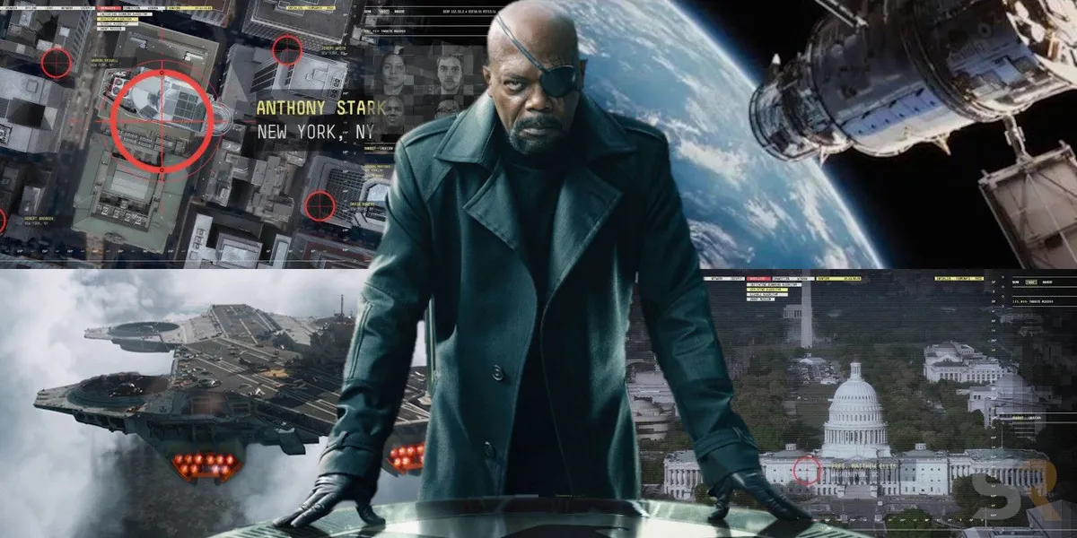
Plot Summary
Francis Coghlan, Jack Hanlon, Yveder Joseph, Serena Mower, and Ethan Reed
Cap sees Nat taking files during S.H.I.E.L.D. hostage recovery mission
Attempt on Fury’s life
Cap goes on a truth seeking mission
Lemurian Star’s USB reveals Zola’s position
Computing system bombed
HYDRA agent reveals Zola’s Algorithm
Project Insight begins, fight to take it down occurs
Notes:
Francis
Script:
During a SHIELD hostage recovery operation on a SHIELD vessel, the Lemurian Star, Captain America, Steve Rogers, sees Black Widow, Natasha Romanoff, recovers files from the ship’s computers. Returning to SHIELD headquarters, Director Nick Fury briefs Rogers on Project Insight, three advanced helicarriers linked to spy satellites launched from the Lemurian Star, designed to preemptively eliminate threats. However, unable to decrypt the data recovered by Nat, Fury becomes suspicious about Insight.
On his way to meet with Maria Hill, a trusted agent, Fury is ambushed by assassins led by the Winter Soldier. Escaping to Roger’s apartment, Fury warns Steve that SHIELD is compromised, hands him the data recovered from the Lemurian Star, and is shot by the Winter Soldier, later declared dead. Captain America goes on a truth seeking mission, but is declared a fugitive by SHIELD. With Black Widow, the two found the origin point of the data recovered from the Lemurian Star, a secret SHIELD bunker in New Jersey, where an ancient supercomputer, comprised of magnetic tape drives, contains the consciousness of Armin Zola, a scientist of HYDRA recruited by SHIELD during Operation Paperclip, where he secretly reformed HYDRA within SHIELD. The computer site is bombed, with Cap and Widow barely escaping death, fleeing to meet Sam Wilson, a.k.a. Falcon, a pararesuman who Rogers befriended. They capture a HYDRA Agent, who reveals the data recovered from the Lemurian Star contains Zola’s Algorithm, a computer data-mining program installed into Project Insight’s spy satellites, designed to identify individuals who are, or can become, threats to HYDRA, with the Helicarriers immediately eliminating them once identified. Hill manages to extract them to a safehouse, where Fury is revealed to be alive, and they plan to and successfully sabotage the Helicarriers and Project Insight, taking down SHIELD and Hydra, permanently.
Bullet 1 - Information privacy - Compartmentalization of information, leads to the encryption/tracking part
Bullet 2 - Due process
Bullet 3 - Attempt to gather truth, leads to whistleblowing
Bullet 4 - Encryption/tracking tech
Bullet 5 - Unethical computing tech
Bullet 6 - Incredibly unethical computing tech
Bullet 7 - SUPER incredibly unethical computing tech

Slide 4
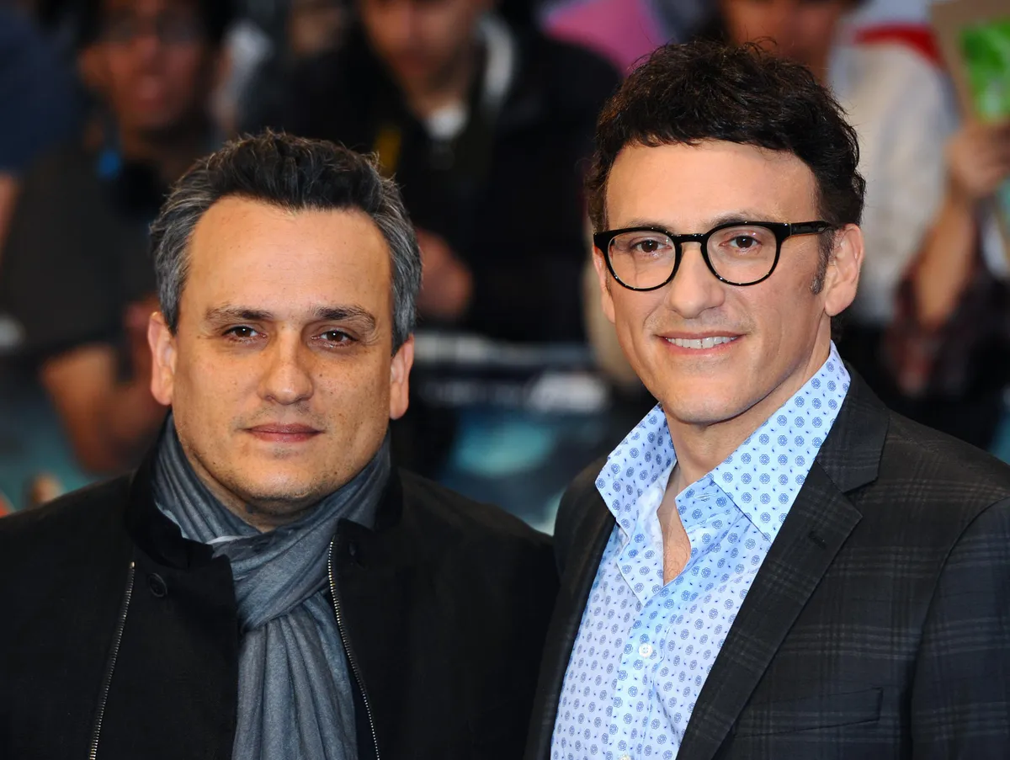
Director’s Intentions
Francis Coghlan, Jack Hanlon, Yveder Joseph, Serena Mower, and Ethan Reed
Unlike other Marvel movies, focused more on politics and technology [1]
Captain America vs. Today: A world where security is valued over trust, liberties, and privacy. [2]
“This isn’t freedom; this is fear.” [3]
Movie was filmed during and influenced by Snowden Leaks; influence by preemptive strikes, drone strikes, global surveillance, etc. [4]
Notes:
*(Francis, if this is available)
Throughout the movie, we see a theme and argument against overwhelming technological oversight through Project Insight. Both in how such power can fall into the wrong hands, and also how unnecessary it is, in a manner of speaking.
The movie places Captain America, a man out of time, from a world where white and black, good and evil, was very very clear, where he sacrificed his life to protect freedom, against the high security grey-colored world we live in today. We see Cap having doubts about SHIELD, about Project Insight, about how the world’s politics and feeling seems to focus on security over the livelihoods and freedoms of the world’s citizens, and how all the secrecy and secrecy within secrecy makes it hard to trust others. He came from 1940s, a world where people were more trusting, and in the current day, it’s harder to tell who’s right and wrong, and that actions taken to protect people can compromise liberties and privacy.
One of the best quotes to describe this film, said by Captain America regarding Project Insight, is "This isn't freedom; this is fear."
The movie was stated to be influenced by the Snowden Leaks, as well as the general geopolitical climate at the time: Preemptive strikes, drone strikes, global surveillance, and so on; the film was political, meant to reflect the present day anxieties in the audience, especially after the NSA leaks.

Slide 5
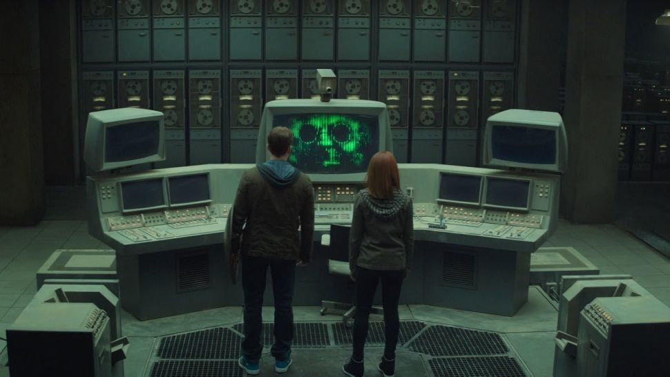
Computing Technologies
Francis Coghlan, Jack Hanlon, Yveder Joseph, Serena Mower, and Ethan Reed
Existing Technologies
Encrypted USB Flash Drives / Programmable Keys
Facial Recognition
S.H.I.E.L.D. encryption technology
Plausible Technologies
Project Insight Helicarriers
Bucky’s prosthetic metal arm
Zola’s Algorithm
Fictional Technologies
Zola’s Brain
Notes:
Ethan
This film features several different types of computing technologies, some real and some fictional
Some existing technologies that are shown in this film include
Encrypted USB Flash Drives and Programmable Keys, which protect sensitive information on either a drive or closed messages
Facial Recognition technology, which the government already uses to track people who are a threat by using biometrics to map their face against a database
S.H.I.E.L.D. encryption technology, which is a slightly more advanced version of what world governments use today
Plausible Technologies included
Project Insight Helicarriers, which could be possible with next-gen propulsion technology that could lift objects of any size with simply increasing the power source as well
Bucky’s prosthetic metal arm, which is just a much more advanced and durable version of modern-day prosthetics
Zola’s Algorithm, which a rough version of could actually be made very easily by analyzing everything from people’s financial, personal, voting, and criminal records all the way to their SAT scores similarly to the movie
This is so significant because all this personal information would be used to determine if someone would be a possible threat to the government, most likely leading to negative consequences to them to prevent this
The most fictional technology that we found in this movie is Armin Zola’s brain
It was said to sit in around 200,000 feet of space, which in 1970 with an average of 9 feet per databank, 2,400 feet of magnetic tape reels, .18 gigs per reel, ends up equaling around 4tb of storage, however the brain capacity required is estimated to be around 1tb to 2.5petabyte, much more than anything available at the time

Slide 6
Conclusion slide
Francis Coghlan, Jack Hanlon, Yveder Joseph, Serena Mower, and Ethan Reed
Privacy Matters
The government shouldn’t use private information to punish citizens.
Government abuse of technology and information
Due process
Information privacy and security
Unethical uses of technology
Whistleblowing
Notes:
Yveder
The government should not use illegally procured private information to profile their citizens and then punish said citizens based on the contents of their profiles.
We arrived at this conclusion as throughout the film we see Hydra circumvent due process, violate the privacy of its citizens.

Slide 7
Argument
Francis Coghlan, Jack Hanlon, Yveder Joseph, Serena Mower, and Ethan Reed
Due process
Algorithmic Bias
Zola’s Algorithm
Privacy and the Government
Information privacy
Government and Technological Abuse
Zola’s brain
Project Insight Helicarriers
Whistleblowing
Natasha exposing S.H.I.E.L.D./HYDRA
Notes:
Ethan
We have four arguments that revolve around the ideas of due process, privacy and the government, government and technological abuse, and whistleblowing.
Due process
The presumption of innocence and due process are fundamental to the US legal code. Meaning that an individual must be proven to be guilty beyond a reasonable doubt in a court of law in order for the government to administer punishment upon them. Hydra’s usage of project insight would circumvent this very process and would act as judge, jury and executioner based on a prediction and not proof of committed unlawful action.
Zola’s algorithm is stated to use information about every aspect of a person's life to make a determination on whether or not they are a threat to Hydra. As such the methods used to collect this data would breach the privacy of the citizens they are applied to.
As previously stated Hydra’s implementation of project insight would kill anyone deemed as a threat to them from a prediction. The number of extrajudicial murders where stated to be in the millions. Killing people for what they might do is unethical.
Considering the number of people a corrupted shield placed in danger, it was acceptable for individuals to make the public aware of the misconduct happening within the organization.
Privacy and Government
Governments have a responsibility to protect the privacy of their people and not exploit their personal information for their own uses
Additionally, the Project Insight Helicarriers that can shoot down any person in a matter of seconds is an example of government
Government and Technological Abuse
- Zola’s Brain
- Unethical use of technology, not for having his mind digitized, but for creating and uploading the algorithm
- Could it ever be ok to digitize someone’s brain if it’s believed they could contribute much more to society because of it?
- Project Insight Helicarriers
- Possibility of aircrafts that can immediately eliminate a target if the government deems it as enough of a threat
Whistleblowing
- Natasha exposing S.H.I.E.L.D.

Slide 8
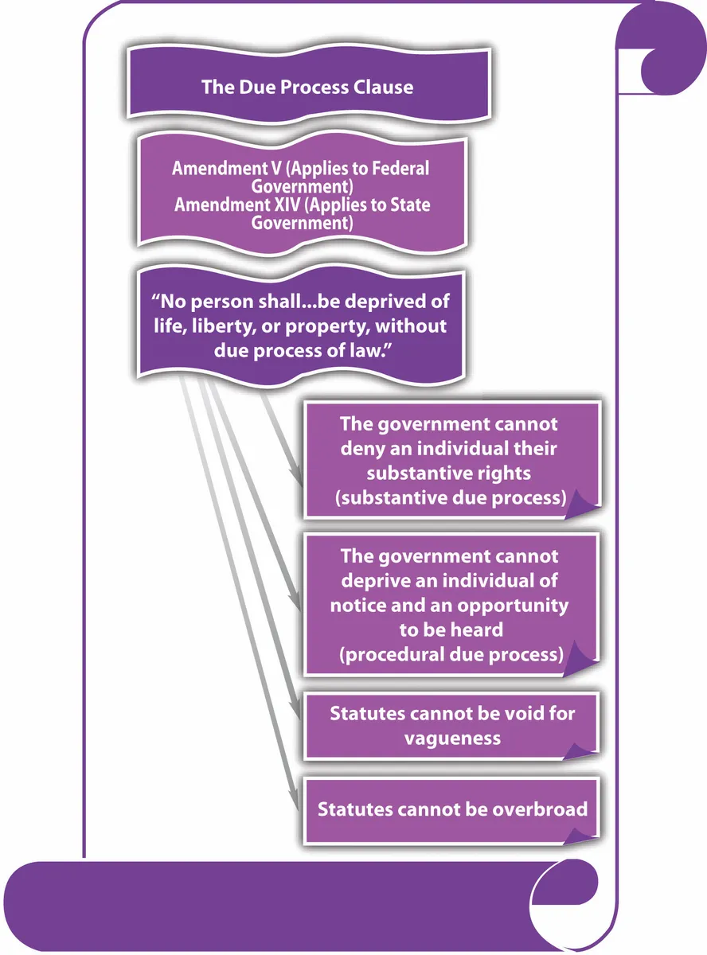
Due Process
Francis Coghlan, Jack Hanlon, Yveder Joseph, Serena Mower, and Ethan Reed
5th and 14th Amendment to the U.S. Constitution [5]
“No person shall … be deprived of life, liberty or property without due process of law.”
Multiple clauses to the statement
Zola’s Algorithm processes all humans based on assumptions from private information
Notes:
Jack
S.H.I.E.L.D.’s plan for Project Insight was drastically different from HYDRA’s plan in the sense that it was meant to be a massive security feature for the globe, not a weapon of mass destruction for world domination. While S.H.I.E.L.D.’s plan has its own ethical issues that I’ll touch on later, HYDRA’s distinctly goes against the United States constitution as you can see on the slide by violating a citizen’s right to due process. The plan to use Zola’s algorithm, as explained earlier, doesn’t give anyone flagged by the program a chance to do anything about its judgement. This is unethical on its own, but its further use for the Project Insight helicarriers to carry out tens to hundreds of millions of baseless murders makes this one of the most unethical uses of technology imaginable. Piled on top of this horrific plan is the fact that all of the data compiled by the algorithm and used in the assessment of each individual person is private and no sector of the government, military or not, should have that much information about someone, let alone the entire world, though this will be touched on later.

Slide 9
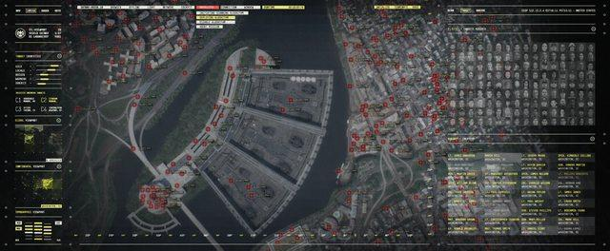
Algorithmic Bias
Francis Coghlan, Jack Hanlon, Yveder Joseph, Serena Mower, and Ethan Reed
Who’s confirming that the algorithm is working?
No confirmation of algorithm working properly
Possibility of miscategorizing individuals because of algorithmic bias
Amazon reported a biased against woman in an algorithm they had for hiring employees [6][7]
Notes:
Serena
This image is of Zola’s Algorithm being used to locate individuals that met the criteria of being a threat to HYDRA.
As previously mentioned Zola’s Algorithm utilizes a variety of personal information to decide whether they would be a threat to HYDRA and HYDRA’s mission to control the world.
However, there was nothing in place to check the work of the algorithm to confirm that individuals set to be killed were actually ever going to be a threat.
This is where algorithmic bias comes into play.
Algorithmic bias is the possibility for an algorithm to develop a bias against a certain group of people or associate certain words with certain people even if they aren’t related.
This occurs because of the data given to the algorithm to process.
An example of algorithmic bias in the real world that was presented in class earlier this year by Hailey is shown in the algorithm Amazon developed for hiring that had a biased against women because it’s data for hiring was based off of past hiring records of the company where predominantly men had been hired.
An additional interesting thought about Zola’s algorithm is the idea that since there’s nothing confirming whether the targets are legitimate threats, the possibility is there for not only possible candidates for future HYDRA work but current HYDRA employees as well

Slide 10
Privacy and the Government
Francis Coghlan, Jack Hanlon, Yveder Joseph, Serena Mower, and Ethan Reed
Privacy Act of 1974
Policy 1: “To restrict disclosure of personally identifiable records maintained by agencies.” [8]
The government has a responsibility to not only protect people’s information but not exploit it
HYDRA infiltrating S.H.I.E.L.D.
Companies and the government have a responsibility to ensure the people they are hiring are ethically sound
Not properly screening applicants before hiring can create the possibility for infiltration of a company from within
Notes:
Serena
Project Insight and Zola’s Algorithm both exploit people’s personal information for their own means in a direct violation of the Privacy Act of 1974.
The first policy of the Privacy Act of 1974 holds the government “to restrict disclosure of personally identifiable records maintained by agencies.”
The government and government entities have a responsibility to both protect people’s personal information but also not use it for unethical means.
Another issue of privacy within the government results from not properly screening individuals before hiring them.
HYDRA was capable of growing like a parasite within S.H.I.E.L.D. because the Nazi scientist Armin Zola was recruited after World War II.
Companies have a responsibility to ensure the individuals they are hiring are ethically sound in order to avoid infiltration from within.

Slide 11
Government and Technological Abuse
Francis Coghlan, Jack Hanlon, Yveder Joseph, Serena Mower, and Ethan Reed
US Department of Defense embraced “permissibly biased” algorithms [9]
Specifically filtered out “fair” tactics - Pentagon believes “fights should not be fair”
Silicon Valley’s promotion of “ethical AI” has constituted a strategic lobbying effort [9]
“Partnership on AI to Benefit People and Society,” a group founded by Microsoft, Google/DeepMind, Facebook, IBM, and Amazon [9]
Created as a “resource for policymakers”
Notes:
Jack
Examples of the government abusing technology, unlike the movie, aren’t fictional and there are a multitude of examples of these issues occurring as technology has developed. As Yveder and Joe presented in class not very long ago, there are issues with artificial intelligence in robots geared toward warfare, and the Pentagon is aware of the issues, but is purposefully ignorant. Former secretary of state and notorious US war criminal Henry Kissinger has even stated that the Pentagon filters out specific results and methods for warfare that aren’t fair, as they don’t care for the morality and ethics of proper warfare. He also states that if he had a chance to go back and change what he had done, how he had lobbied the government, and what direction he pushed research in, he would, as he regrets the crimes he committed and issues he created. There are a large group of influential Silicon Valley companies, however, that are currently lobbying and working to fix what was done by Kissinger and his group years ago, such as Microsoft, Google and Facebook, which are all heavily promoting and funding research into smarter and ethically based artificial intelligence systems. Though these systems aren’t able to solve what was happening with Project Insight, there is hope that they will be able to be used as a resource for current policy makers in order to judge individual systems and guide further development and research.

Slide 12
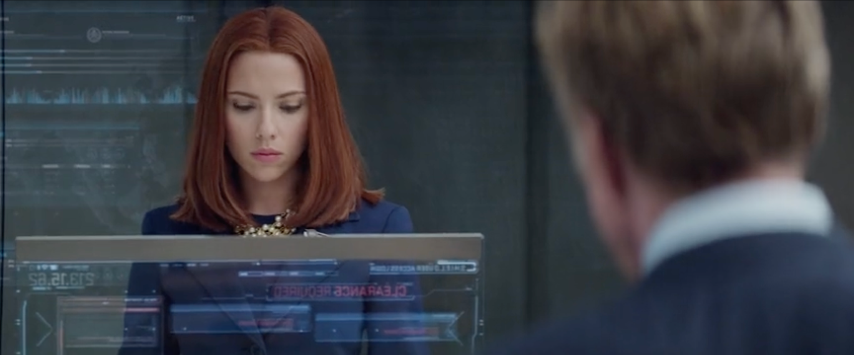
Whistleblowing
Francis Coghlan, Jack Hanlon, Yveder Joseph, Serena Mower, and Ethan Reed
Defining whistleblowing [10]
When is whistleblowing acceptable?[10]
Natasha Romanova leaking the truth about Hydra and Shield
Notes:
Yveder
Whistleblowing is exposing the negligence or danger within an organization externally. Whistleblowing should only be done when all official internal routes have been exhausted.
In the movie the entirety of shield was taken over by HYDRA a Nazi splinter group, there was no way to internally resolve the issue internally. So Natasha Romanova had no choice but to revealed HYDRA’s take over of shield and the plans for project insight.

Slide 13
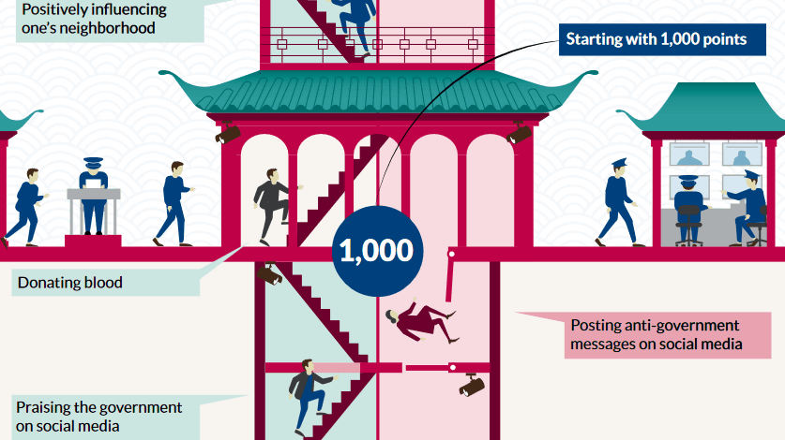
Chinese Social Credit System
Francis Coghlan, Jack Hanlon, Yveder Joseph, Serena Mower, and Ethan Reed
China’s social credit system (SCS) is the real life counterpart of Zola’s algorithm [11]
The SCS allocates rewards and punishments based on an individual's social credit score [12]
Notes:
Yveder
China’s social credit system is the closest to Zola’s algorithm as it attempts to assign a trustworthiness score/Social Credit Score to citizens based on collected data pertaining to said citizens. The data collected ranges ranges from financial data such as bank statements, taxes, loans, and transactions to non-financial data such as social media use, employment history, criminal history and educational records.
Having a low social credit score can incur penalties such as being denied loans, being denied certain employment, to being denied access to transportation such as plane and train tickets. Your social credit score can also affect your children as a parents low credit score could cause their children to be barred from attending certain schools.
One insidious part about the SCS is that any social media activity that contradicts the Chinese Communist party will lower one's social credit score.

Slide 14
Questions?
Francis Coghlan, Jack Hanlon, Yveder Joseph, Serena Mower, and Ethan Reed
Notes:
Wrap up

Slide 15
References
Francis Coghlan, Jack Hanlon, Yveder Joseph, Serena Mower, and Ethan Reed
[1] Suebsaeng, Asawin (April 4, 2014). ""Captain America: The Winter Soldier" Is About Obama's Terror-Suspect Kill List, Say the Film's Directors". Mother Jones. Archived from the original on April 6, 2014.
[2] Fischer, Russ (July 20, 2013). "'Captain America: The Winter Soldier' Panel Recap: Falcon Flies, Cap Fights the Modern World [Comic Con 2013]". /Film.com. Archived from the original on August 23, 2013.
[3] Russo, Anthony. Russo, Joe. (Director). 2014. Marvel’s Captain America: The Winter Soldier, Director’s Commentary [Film]. Marvel Studios. https://www.youtube.com/watch?v=AQLMtERx9c0
[4] Lovece, Frank (April 2, 2014). "Soldier showdown: Joe and Anthony Russo take the helm of 'Captain America' franchise". Film Journal International. Archived from the original on April 13, 2014.
[5] United States Government, Constitution of the United States of America - Fifth Amendment, (United States, 15 December, 1791), https://constitution.congress.gov/constitution/amendment-5/ (25 April, 2022)
Notes:
Last name, Initials. (Director). (Year). Movie title [Film]. Production Company.

Slide 16
References
Francis Coghlan, Jack Hanlon, Yveder Joseph, Serena Mower, and Ethan Reed
[6] ​Lee, N. T., Resnick, P., & Barton, G. (2019, October 25). Algorithmic bias detection and mitigation: Best practices and policies to reduce consumer harms. Brookings. Retrieved April 24, 2022, from https://www.brookings.edu/research/algorithmic-bias-detection-and-mitigation-best-practices-and-policies-to-reduce-consumer-harms/.
[7] Dastin, Jeffrey (2018, October 10) Amazon Scraps secret AI recruiting tool that showed bias against women. REUTERS. Retrieved April 24, 2022, from https://www.reuters.com/article/us-amazon-com-jobs-automation-insight/amazon-scraps-secret-ai-recruiting-tool-that-showed-bias-against-women-idUSKCN1MK08G
[8] Department of Justice. “Overview of the Privacy Act of 1974.” Overview of the Privacy Act of 1974, 24 February 2021, https://www.justice.gov/archives/opcl/policy-objectives. Accessed 25 April 2022.
[9] Ochigame, Rodrigo. “How Big Tech Manipulates Academia to Avoid Regulation.” The Intercept, 20 December 2019, https://theintercept.com/2019/12/20/mit-ethical-ai-artificial-intelligence/. Accessed 25 April 2022.
[10] S. L. Ray, “Whistleblowing and organizational ethics,” Nursing Ethics, vol. 13, no. 4, pp. 438–445, 2006.
[11] F. Liang, V. Das, N. Kostyuk, and M. M. Hussain, “Constructing a data-driven society: China's Social Credit System as a state surveillance infrastructure,” Policy &amp; Internet, vol. 10, no. 4, pp. 415–453, 2018.
[12] N. Kshetri, "China's Social Credit System: Data, Algorithms and Implications," in IT Professional, vol. 22, no. 2, pp. 14-18, 1 March-April 2020, doi: 10.1109/MITP.2019.2935662.

Slide 17
Photo References
Francis Coghlan, Jack Hanlon, Yveder Joseph, Serena Mower, and Ethan Reed
[Figure 1] Murphy, Niall. “Three more posters for Anthony and Joe Russo's Captain America: The Winter Soldier.” Scannain, 2020, https://www.scannain.com/movie-news/captain-america-winter-soldier-posters/. Accessed 25 April 2022.
[Figure 2] Raymond, Nicholas. “Marvel's Agents of SHIELD: Project Insight — Who Every Character Is.” Screen Rant, 28 June 2020, https://screenrant.com/marvel-agent-shield-project-insight-targets-every-character-who/. Accessed 25 April 2022.
[Figure 3] Sharma, Aayush. “Russo Brothers Hit Back At Martin Scorsese: 'You Don't Own Cinema.'” International Business Times, 17 November 2019, https://www.ibtimes.com/russo-brothers-hit-back-martin-scorsese-you-dont-own-cinema-2868087. Accessed 25 April 2022.
[Figure 4] Russo, Anthony, and Joe Russo, directors. Captain America: The Winter Soldier. 2014.
[Figure 5] OER Services. “The Due Process and Equal Protection Clauses.” Criminal Law, https://courses.lumenlearning.com/suny-criminallaw/chapter/3-2-the-due-process-and-equal-protection-clauses/. Accessed 25 April 2022.
[Figure 6] Russo, Anthony, and Joe Russo, directors. Captain America: The Winter Soldier. 2014.
[Figure 7] Russo, Anthony, and Joe Russo, directors. Captain America: The Winter Soldier. 2014.
[Figure 8]Gaedke Matt ,,https://dailyinfographic.com/social-credit-system-pros-and-cons-a-look-at-chinas-system

