Slide 1
Bo burnham’s "Inside"
Bo Burnham “Inside”
Alexa Friedman Carr, Kim Cummings, Damian Jadczak, Matthew Nickerson, Chloe Polit

Slide 2
context
Bo Burnham “Inside”
Set in Bo Burnham's home during the COVID-19 pandemic.
Information conveyed through songs and skits.
Producing the movie acted as a method to keep Burnham sane during the pandemic.
Burnham critiques things like capitalism, pretentious people, and technology.
Notes:
Damian
Some important songs and skits:
"Welcome to the Internet"
"White Woman's Instagram"
"FaceTime with My Mom (Tonight)"
"Sexting"
"Can everyone shut up" skit

Slide 3
Conclusion: increased reliance of Technology hurts human psyche
Bo Burnham “Inside”
Notes:
Damian
Main claims:
(1) Internet Addiction Hurts Communication
(2) Increase in Digital divide
(3) A Dependence on social media contributes to mental health issues

Slide 4
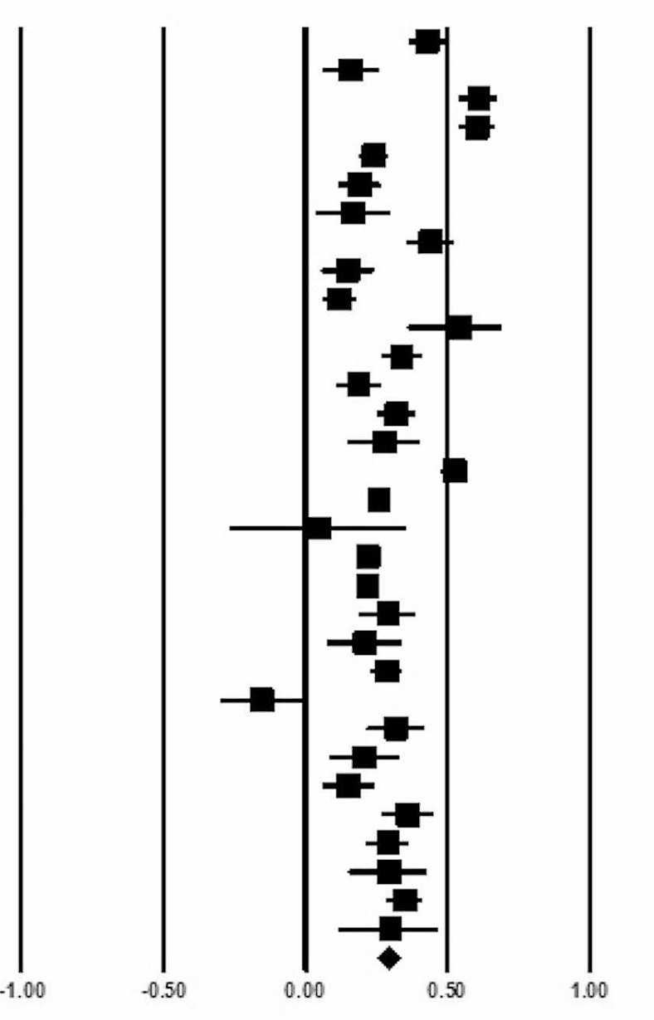
Internet Addiction Hurts Communication
Bo Burnham “Inside”
Internet does not improve communication among family
No statistically significant positive association between using social media and relationships [2]
Women using social media to communicate with their brothers has a negative correlation r = -0.282 [2]
Internet addiction leads to loneliness
60% of students are addicted to phones and average American spends 11 hours a day on screen [1]
Loneliness has a positive correlation with internet addiction with r = 0.291 and p < 0.001 [3]
Figure from [3], graph shows that at a 95% confidence level internet addiction correlates with loneliness
Favors A
(not addicted)
Favors B
(addicted)
Notes:
Kimberly Cummings
Internet addiction hurts communication
In a noticeable scene in Inside Bo Burnham is on a FaceTime call with his mom (Facetime with my Mom (Tonight)). At first he is excited to see his mom, but as the call goes on he gets angrier and more frustrated at her
It is statistical proven that internet does not improve communication among family
- no statistical significance or correlation between using social media and family relationships. This was found at a p-level of 0.05
Women trying to communicate with their brothers had a negative correlation of r = -0.282
Addiction to the internet is proven to lead to loneliness:
Internet addiction is very common with 60% of students being addicted to their phones and the average American spending 11 hours a day on a screen
Loneliness has a positive correlation with internet addiction with r = 0.291 and a p score less than 0.001
(These are cited in the works cited page as well)
Oraison H. et al., Smartphone Distraction-Addiction: Examining the Relationship Between Psychosocial Variables and Patterns of Use, (Taylor & Francis, 2019 Apr 29), https://www.tandfonline.com/doi/full/10.1111/ajpy.12281#abstract (09/27/2024)
Tammisalo et al., Social Media Contact with Family Members and Happiness in Younger and Older Adults, (ScienceDirect, April 2024), https://www.sciencedirect.com/science/article/pii/S0747563223004545#tbl3 (09/12/2024) [6]
https://link.springer.com/article/10.1186/s12889-024-18366-4

Slide 5
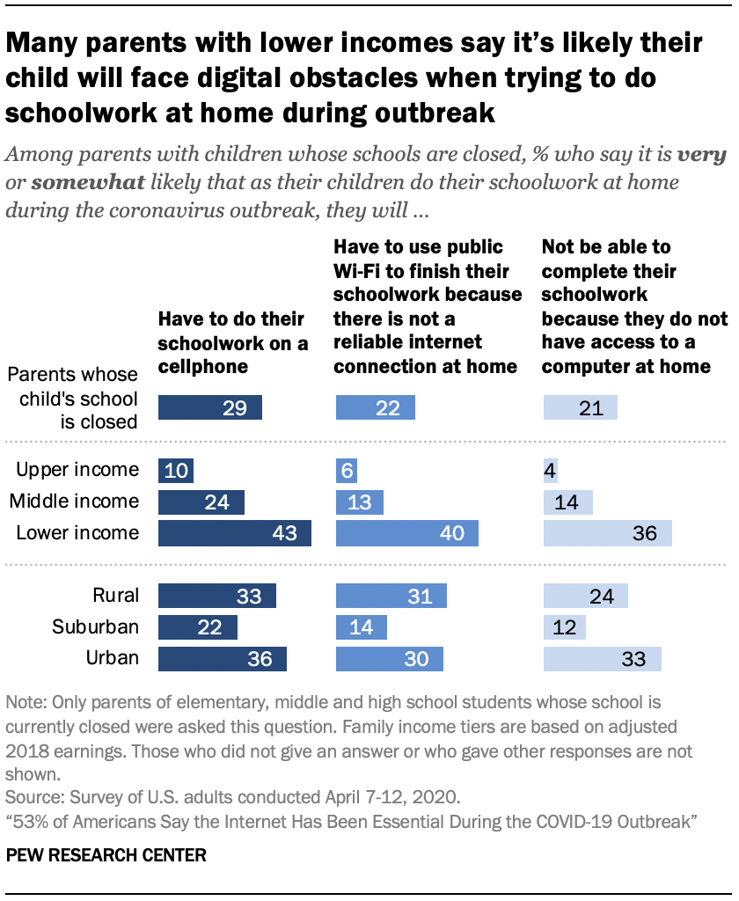
Increase in Digital divide
Bo Burnham “Inside”
Burnham discusses systematic oppression by the increased use of technology.
  1/3 of low income (< $25,000/year) homes of non-white families had NO access to internet or technology in 2021 [10].
  Digital skills from lower socioeconomic status was considerably lower in comparison.
    >4 years of use: ~19.9 points higher than < 1 year [12].
    1-3 years of use: ~13.11 points higher than < 1 year [12].
    78% variance between different school systems [12].
Lower Income households during COVID-19:
  April 2020: 4,917 adults surveyed.
  43% will have to do schoolwork on cellphone [11].
  40% will have to use public Wi-Fi [11].
  36% do not have any technological access [11].
Figure from [11], April 2020 study that visualizes family
income differences and their accessibility to internet and technology.
Notes:
Matt Nickerson
The increased reliance on technology has an negative impact on the topic of digital divide. In the movie, Bo Burnham ironically discusses the systematic oppression through the medium of online structures, using the fact that he is white and a man as an excuse why his face should be online. This is the beginning of the argument for the digital divide, where oppressed individuals or people within lower socioeconomic statuses do not have same technological literacy or capabilities, therefore as the world becomes more reliant, they fall behind. In 2021, a third of low-income, non-white families lacked did not have access to the internet or technology. Lower socioeconomic status also had association with significantly lower digital skills. A test of computer tasks was held on 322 different students from different socioeconomic backgrounds with different times of experience with computers, with the test consisting of qualities like information gathering, social media literacy, and document creating being tested. Those who have more than four years of tech use scoring 19.9 points higher to the null base control scale than those with less than one year. There is also a 78% variance in digital skills across different school systems. During COVID-19, 43% of lower-income households relied on cellphones for schoolwork, 40% used public Wi-Fi, and 36% had no technological access at all.

Slide 6
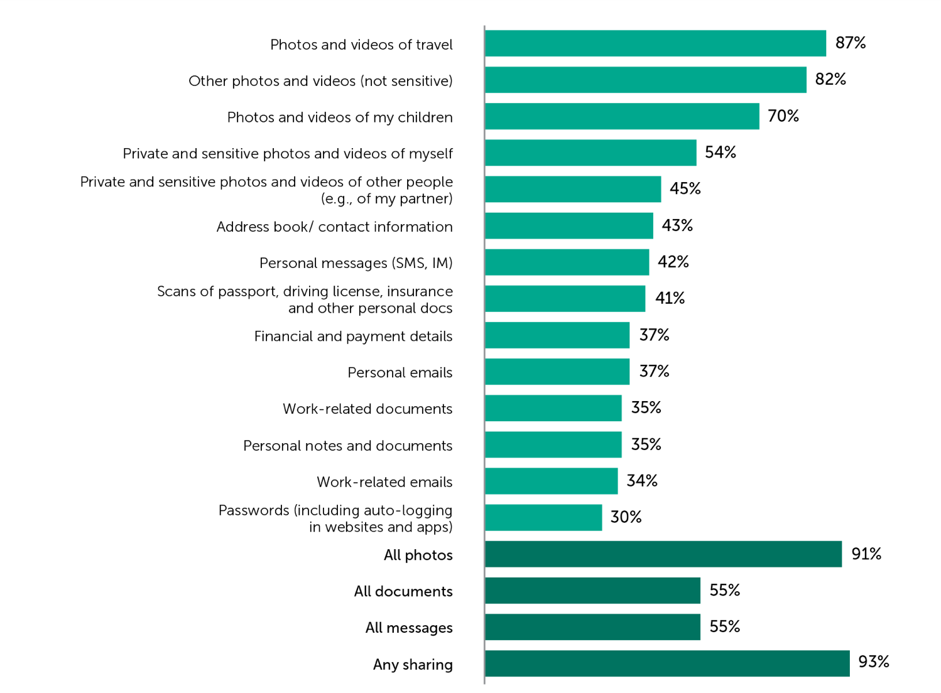
Pressure to share information online
Bo Burnham “Inside”
People are pressured to share information
  87% share photos and videos of travel [14]
  70% share photos of their children online [14]
  This pressure to post your social life can lead to privacy and safety concerns for you and your children
  41% of people shared scans of passports, driver’s licenses, and other personal documents
Favors A
(not addicted)
Favors B
(addicted)
Notes:
Chloe Polit
People feel pressured to share information, especially private information, online in return for external validation. The study by Toluna and Kasperky Lab in 2017 assessing over 16,000 users over 16 in 17 countries showed results revealing what is most shared. As seen in the chart on the right, 87% of people surveyed in this study share photos and videos of travel, which can reveal many small details that put them at risk: their location abroad in an area they don’t know well (if posting live), they are away from home, and if they are traveling solo or with those close to them. These details seem harmless but can put people in real danger if it is watched and monitored by the wrong person.
70% of people shared videos of their children, which puts their faces and identities out for the internet to see. Especially when it comes to young children who cannot consent to their photos being used and don’t understand the implications of strangers seeing them posted online, we need to keep privacy of all individuals in consideration when posting things online.
41% of people shared scans of passports, drivers licenses, and other personal documents, which have incredibly sensitive information that can be used in identitiy theft, stalking, and other dangerous activities.

Slide 7
“Welcome to the internet”
Bo Burnham “Inside”
The vast amount of information on the internet that we all have unfiltered access to
  “Put your cares aside”
  “Show us pictures of your children, tell us every thought you think”
  “Mommy let you use her iPad, you were barely two. It did all the things we designed it to do”
  ”Apathy’s a tragedy and boredom is a crime”
  “A bit of everything all of the time”
Favors A
(not addicted)
Favors B
(addicted)
Notes:
Chloe Polit
Bo discusses the incredible amount of information on the internet that we all have unfiltered access to.
By overloading us with information all of the time we are manipulated into feeling that it is safe to share any and all of our information because hey, everyone else does it too right? There’s no privacy online, anything you post is somewhere on there forever. Getting into the quotes listed, “Show us pictures of your children, tell us every thought you think” is a real world affect seen by this study (with the diagram of what information is shared still on the right).
”Mommy let you use her iPad you were barely two. It did all the things we designed it to do.” brings to attention the possible dangers of allowing kids online, it can either show them possibly inappropriate or traumatizing content or accidentally allow them to share private information because a 2, 8, even an 11 year old barely understands why they should keep their information private. “Apathy’s a tragedy and boredom is a crime” shows the mental manipulation of being chronically online, as how boredom is seen as a crime but apathy from the extreme exposure to jarring real-world events is seen as simply a tragedy.

Slide 8
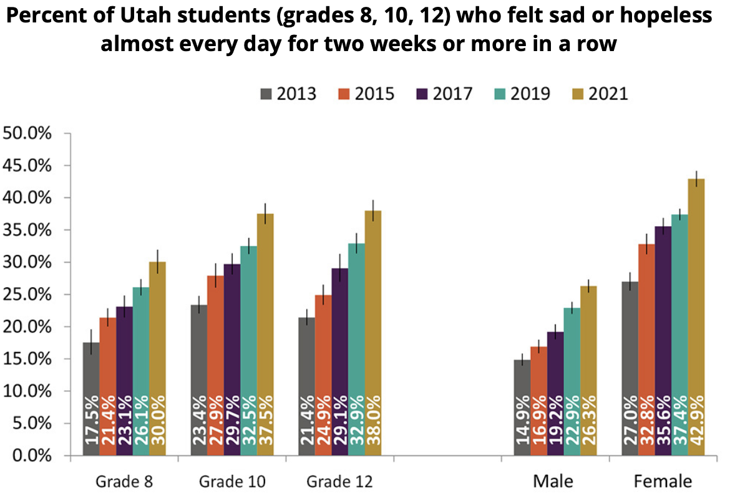
A Dependence on social media contributes to mental health issues
Bo Burnham “Inside”
Burnham discusses his mental health issues from social media.
  91% of young people use social media [5].
  "My heart it gets to tappin', and I think I'm gonna die" [6]
Studies show increase in mental disorders caused by pandemic-related social media abuse.
  48.3% of participants had depression [7].
  22.6% of participants had anxiety [7].
  19.4% of participants had both [7].
Figure from [8], based on the 2021 Utah Adolescent Report.
Notes:
Damian
Relates to Networked Communications.
Examples of social media include Instagram, Tiktok, Snapchat, YouTube, and Facebook.
[5] Regarding young people that use social media, the age range for this statistic is 16-24 years.
[6] is from a song that Bo sings to describe his current mental state before he pivots into "Welcome to the Internet."
Throughout the film, Bo describes his anxiety and suicidal thoughts.
There is a YouTube video where Bo Burnham talks about social media companies wanting to colonize the minds of their users. This is a point to mention (about Burnham's beliefs), but not significant or backed by evidence enough to use for arguments:
https://www.youtube.com/watch?v=SUTbnjIHfkg
[7] This study was done on a nationally representative sample of Chinese citizens in 2020. More than 80% of participants "reported frequent exposure to social networks."
[8] Since 2010, anxiety, depression, and loneliness have increased.
[8] Since 2012, social media usage began to soar. In 2009 around half of teens used social media. In 2022, 95% of teens used social media.

Slide 9
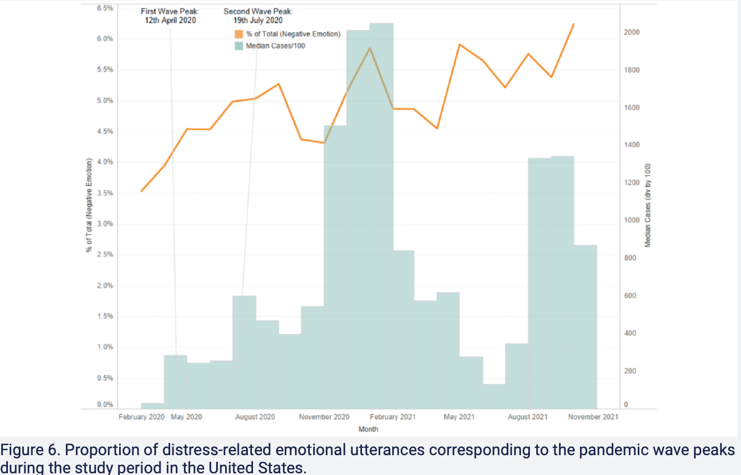
However, Technology allowed people to stay connected during covid, improving mental health in isolation
Bo Burnham “Inside”
Technology allowed people to stay connected as well as access online mental health services, mental health apps lowering anxiety and depression by about 44% [9]
A JMIR study demonstrated that during the pandemic, when negative emotions (being anxiety, depression, sleep quality, etc.) spiked, the number of people who turned to using technology for support spiked
Figure from [9]. “Proportion of distress-related emotional utterances corresponding to the pandemic wave peaks during the study period in the United States.”
Notes:
Chloe Polit
To combat the extreme events of covid and skyrocketing mental health issues during lockdown, technology companies released mental health apps in the hope of assisting people to manage their anxiety, depression, sleep issues, and a number of other mental health related symptoms. Some people may even argue that technology and its development in social spheres allowed people to stay connected and reconnect with society during the COVID-19 lockdown (which is what Bo Burnham’s movie is focused on).
A JMIR study analyzed the spike of downloads in an artificial intelligence led mental health app during the pandemic, and how this app was able to significantly reduce people’s anxiety, depression, and other negative mental health issues during lockdown. The benefits of using this technology allowed people to monitor their mental health and work to improve it. While overall mental health deteriorated during COVID-19 lockdown due to isolation and lack of social interaction, people were able to stay connected online, and our reliance on technology for social connection and health related support grew. While this was a temporary solution to overcome the negative effects of lockdown, the overall continued dependency on technology leaving covid led to a net negative effect due to specifically social media use, which is explained by Alexa on the next slide…

Slide 10
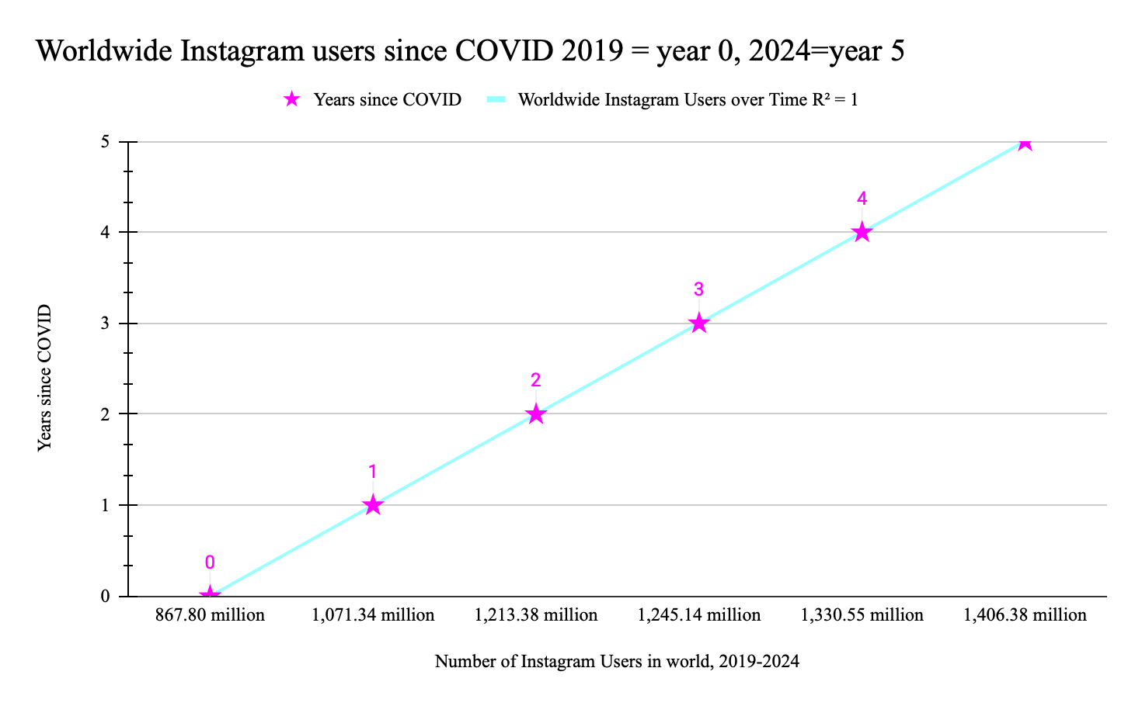
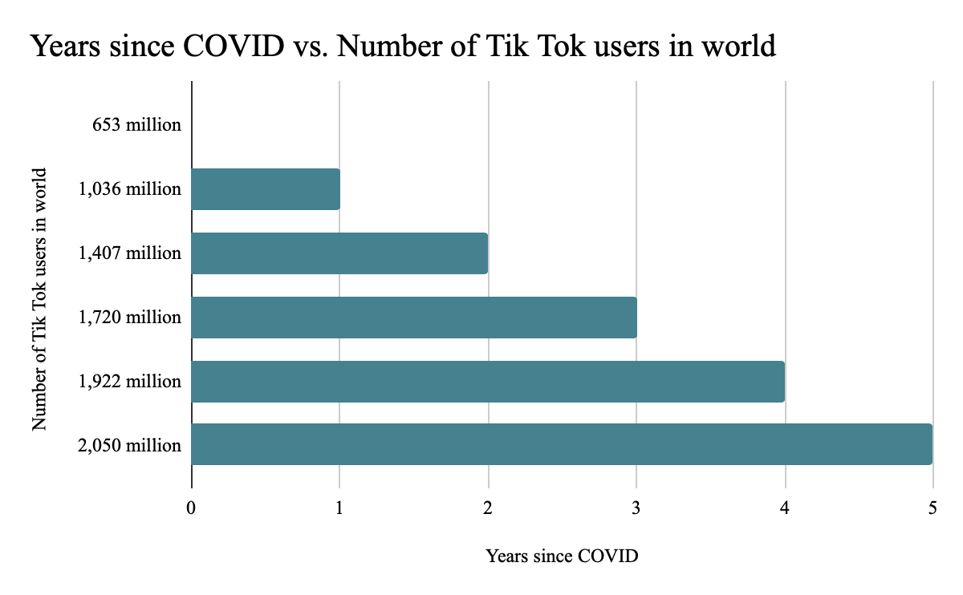
Growth in Social Media use since Pandemic
Bo Burnham “Inside”
Notes:
(Alexa)
Visual representations of the growth in number of Instagram and TikTok from Pre-Pandemic – Modern Day
Today, the there are 62% more Instagram users on the site pre-pandemic, and there are more than 3 times as many TikTok users. Based on this data, it is very likely that some of this growth in social media use was encouraged by the physical isolation the pandemic created.

Slide 11

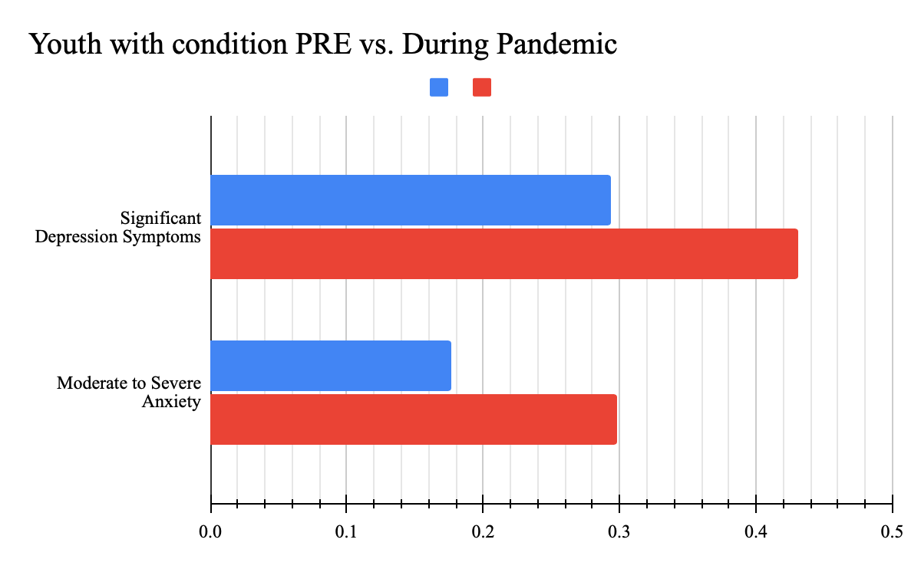
Growth in anxiety and depression from pre pandemic to During pandemic
Bo Burnham “Inside”
      Blue=Pre Pandemic
      Red = During Pandemic
      Prevalence of Condition.
Notes:
(Alexa)

Slide 12
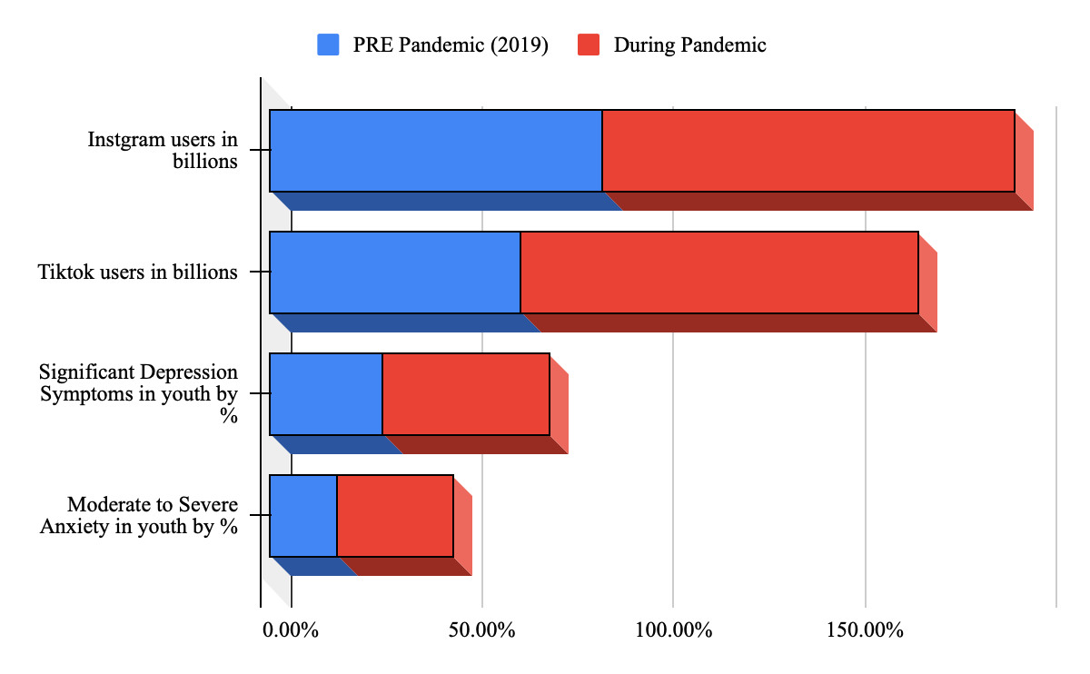
Mental health trends vs. Social media use
Bo Burnham “Inside”
Notes:
(Alexa)
Data sources for chart:
https://www.oberlo.com/statistics/how-many-people-use-Instagram
https://www.oberlo.com/statistics/how-many-people-use-tiktok
https://www.sciencedirect.com/science/article/pii/S1054139X23003907?via%3Dihub
Full data: https://docs.google.com/spreadsheets/d/1tm7SJHi2XE0IEtYunV5KLy-obgx69uMvSDOaf_iwZP8/edit?usp=sharing
Oberlo, How Many People Use Instagram? (Oberlo, 2024), https://www.oberlo.com/statistics/how-many-people-use-instagram (accessed October 2, 2024).
Oberlo, How Many People Use TikTok? (Oberlo, 2024), https://www.oberlo.com/statistics/how-many-people-use-tiktok(accessed October 2, 2024).
Cheong, I., Dewan, A., & Qi, J., Adolescents' Depression and Anxiety Symptoms During the COVID-19 Pandemic: Longitudinal Evidence From COMPASS (Elsevier, 2023), https://www.sciencedirect.com/science/article/pii/S1054139X23003907?via%3Dihub (accessed October 2, 2024).

Slide 13
References
Bo Burnham “Inside”
[1] Oraison H. et al., Smartphone Distraction-Addiction: Examining the Relationship Between Psychosocial Variables and Patterns of Use, (Taylor & Francis, 2019 Apr 29), https://www.tandfonline.com/doi/full/10.1111/ajpy.12281#abstract (09/27/2024)
[2] Tammisalo et al., Social Media Contact with Family Members and Happiness in Younger and Older Adults, (ScienceDirect, April 2024), https://www.sciencedirect.com/science/article/pii/S0747563223004545#tbl3 (09/12/2024)
[3] Wang Y. and Zeng Y., Relationship Between Loneliness and Internet Addiction: a Meta-analysis, (SpringerLink, 19 March 2024), https://link.springer.com/article/10.1186/s12889-024-18366-4 (09/29/2024)
[4] Can Y., Social Media Addiction and Loneliness of High School Students, (SyncSci, November 23 2023), https://syncsci.com/journal/AMLER/article/view/AMLER.2023.02.016/845 (09/29/2024)
[5] “#StatusOfMind: Social Media and Young People’s Mental Health and Wellbeing.” (Royal Society for Public Health, London, 2017). https://www.issup.net/knowledge-share/resources/2018-05/statusofmind-social-media-and-young-peoples-mental-health-and, (Accessed September 29, 2024)
[6] "Inside" by Bo Burnham (56:11) (2021)
[7] Zubair U, Khan MK, Albashari M. Link between excessive social media use and psychiatric disorders. (Ann Med Surg (Lond). 27 March 2023), https://www.ncbi.nlm.nih.gov/pmc/articles/PMC10129173/
[8] Education, UTAH PROTECTING MINORS ONLINE, https://socialmedia.utah.gov/education/
[9] Catuara-Solarz S, Skorulski B, Estella-Aguerri I, Avella-Garcia CB, Shepherd S, Stott E, Hemmings NR, Ruiz de Villa A, Schulze L, Dix S. The Efficacy of "Foundations," a Digital Mental Health App to Improve Mental Well-being During COVID-19: Proof-of-Principle Randomized Controlled Trial. (JMIR Mhealth Uhealth, 2022 Jul 1). https://formative.jmir.org/2023/1/e41913/ (Accessed September 30, 2024).
[10] Golden AR, Srisarajivakul EN, Hasselle AJ, Pfund RA, Knox J. What was a gap is now a chasm: Remote schooling, the digital divide, and educational inequities resulting from the COVID-19 pandemic. Curr Opin Psychol. 2023 Aug;52:101632. doi: 10.1016/j.copsyc.2023.101632. Epub 2023 Jun 12. PMID: 37437380; PMCID: PMC10259090.
[11]Vogels, Emily A. “53% of Americans Say the Internet Has Been Essential during the Covid-19 Outbreak.” Pew Research Center, Pew Research Center, 30 Apr. 2020, www.pewresearch.org/internet/2020/04/30/53-of-americans-say-the-internet-has-been-essential-during-the-covid-19-outbreak/
[12] Author links open overlay panelIgnacio Jara a, et al. “Understanding Factors Related to Chilean Students’ Digital Skills: A Mixed Methods Analysis.” Computers & Education, Pergamon, 31 July 2015, www.sciencedirect.com/science/article/pii/S036013151530021X#tbl3
[13]Scafuto F, Ciacchini R, Orrù G, Crescentini C, Conversano C, Mastorci F, Porricelli M, Gemignani A. COVID-19 Pandemic and Internet Addiction in Young Adults: A Pilot Study on Positive and Negative Psychosocial Correlates. Clin Neuropsychiatry. 2023 Aug;20(4):240-251. doi: 10.36131/cnfioritieditore20230403. PMID: 37791079; PMCID: PMC10544255.
[14] Kaspersky, Stranger Danger: The Connection Between Sharing Online and Losing the Data We Love, (Kaspersky, 2017), https://www.kaspersky.com/blog/my-precious-data-report-three/16883 (Accessed October 4, 2024).

