Slide 1
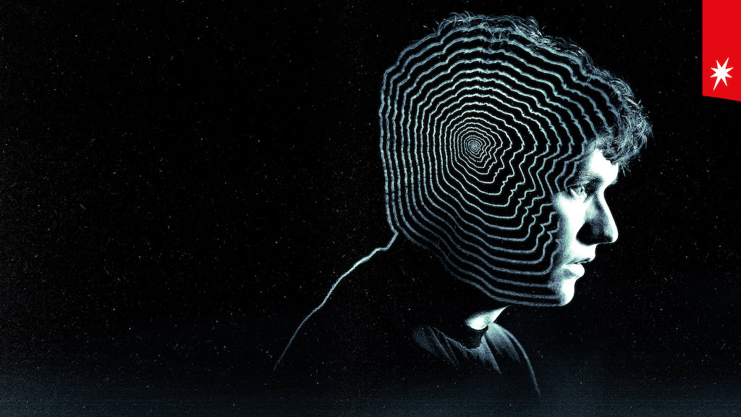
Black Mirror: Bandersnatch
Gracen Antedomenico Daire Daly
Anna Cherkinsky

Slide 2
Outline
Plot Summary
Arguments
Computer Interaction and impact on perception of identity
Media's impact on thinking and self-worth
Effect of Disturbing Content
Conclusion
A person’s interaction with media and technology has an impact on their mental health, well-being, and decision making.

Slide 3
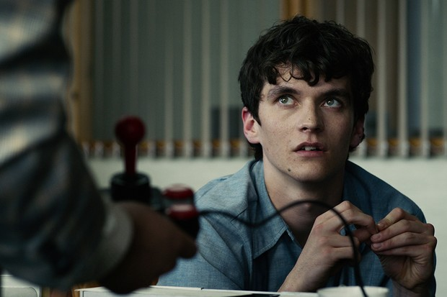

INTRODUCTION
Set in 1984
Choose your own adventure style movie
Given choices throughout film which determine the path in which you view the movie
Stefan’s game development
Stefan is developing his own choose your own adventure game
Based off book ‘Bandersnatch’ written by Jerome F. Davies
We watch as creating this game leads to Stefans mental decline
Exploring free will and decision making
Notes:
Black mirror bandersnatch is a choose your own adventure style movie. What this means is the viewer is presented choices throughout the film that then determine the path and plot that you see. While the plot does vary depending on the choices you make, the one overarching theme is stefan's game development. Stefan (shown in top image) is making his own choose your own adventure story based on the novel by Jerome F. Davies named bandersnatch. The book itself is also a choose your own adventure novel (the movie gets very meta very often). Jerome R. Davies is known for losing his mind, and as Stefan gets further into working on this game we watch his own sanity decline. Due to the strong influence choices has on this film it explores the idea of free will and decision making, and what control we have over our lives.

Slide 4
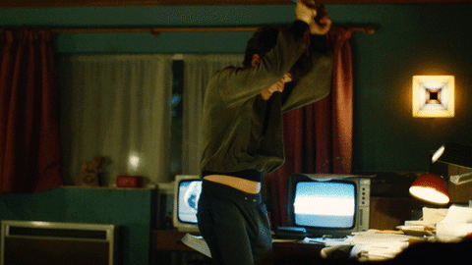
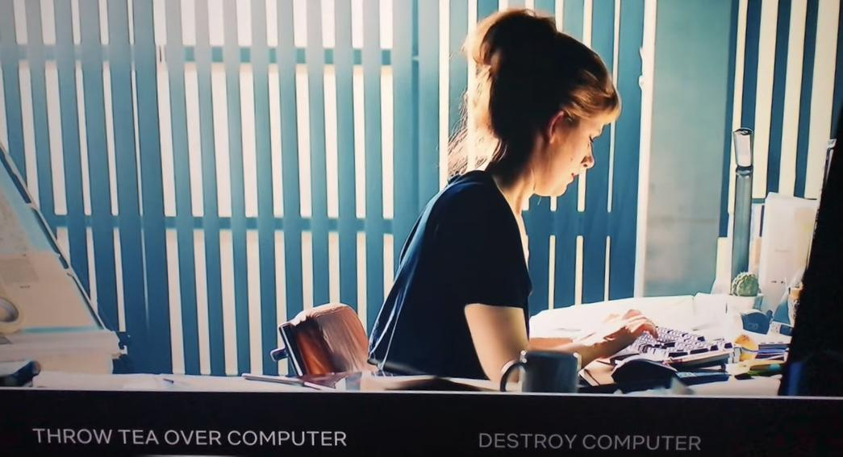
The Computer may Warp Perception of Identity
Stefan isolates himself to work on Bandersnatch
Stefan’s perception is mixed up
Takes his anger out on the computer, and eventually, the people.
Study: statistical significance between loneliness and anthropomorphism and dehumanization [4] [5]
Computer is like a “mirror”
perceive interactions
Isolation
Computer reflects the “self”
[11]
Notes:
Stefan refuses to work with a production team at Tuckersoft
Just him and his computer
Destroy the computer or spill tea on the computer
As if the computer is autonomous.. Its fault game isn’t working
He communicates to us through the computer
Computer is in control
This transfers to his perception of humans
He believes he can kill his father (there is no way to avoid it), other characters
He dehumanizes people in his life
According to a psychological study, anthropomorphism of computers and dehumanization is statistically correlated with loneliness
Computer functions as a psychological mirror
The only object he interacts with
However, on a physical level, it is just the user and the computer
By interacting with the computer, Stefan can only face himself: his own thoughts

Slide 5
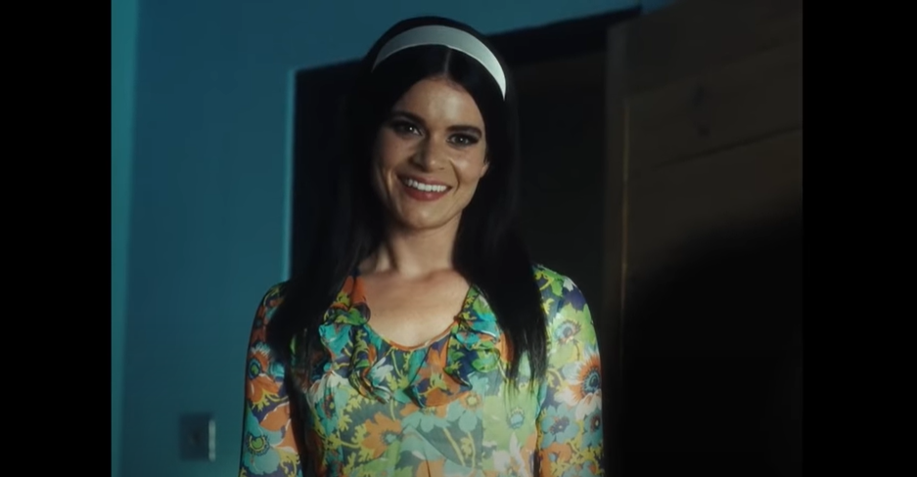
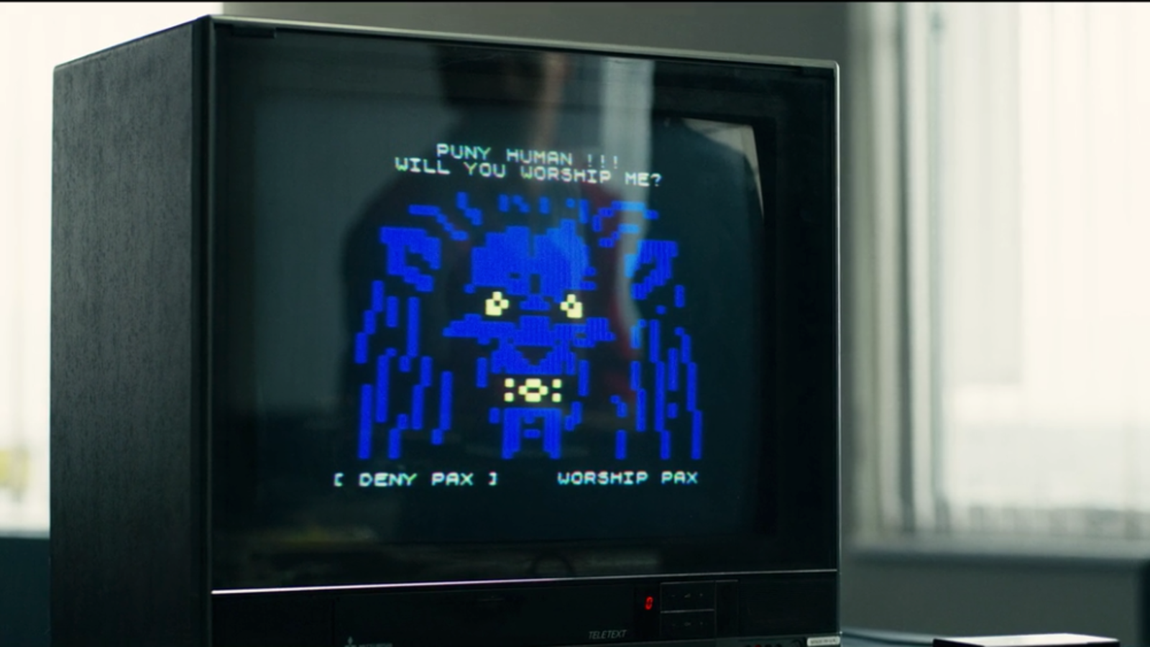
Virtual Reality may Warp Perception of Identity
Self-fulfilling Prophecy [7]
When a false assumption is reinforced and becomes true
Bad childhood experience
Stefan loses his mom
Stefan falls into the self-fulfilling prophecy
Video games [6]
The influence is stronger from video games due to the interactive aspect.
Stefan’s relationship with control
Notes:
Self-fulfilling prophecy
When a false claim is reinforced and becomes reality
Stefan experiences trauma by losing his mother in a train crash when he was 5 or 6
Stefan blames his father, because his father hid his bunny, which made little Stefan refuse to go with his mom, and make his mom miss the right train
On the other hand, since he is the one who made his mom miss the train, he subconsciously sees himself as the murderer
Since he is forced to face himself due to his interactions with the computer and other media, he becomes the murderer
He associates himself with jerome F Davies, who kills his wife.. And becomes the murderer
Later, in one of the endings set in 2018, it is seen that Pear ritman, the daughter of one of Stefan’s co-workers, wants to remake the game bandersnatch. She is actually working on the movie
IT seems like she associates herself with Stefan, hence experiencing similar patterns as he did
Destroy or spill tea on the computer
Generational effect → Full circle
Effects of video games, but also meta analysis of the game
Stefan is working on decision-based video game
A study shows that video games warp self identity due to their interactive aspect, which is how humans learn.
Hence, we have “virtual reality”
Video games and virtual reality influence one’s perception on oneself
We see this theme with Stefan’s game, and with the film, itself
On one hand, you have a choice, but you really don’t, you get influenced, you lose control over yourself

Slide 6
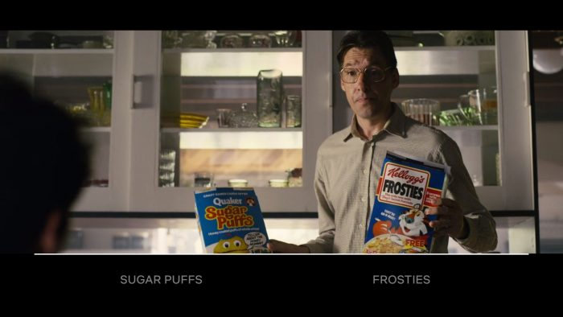
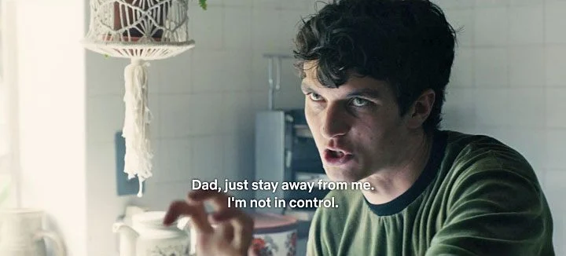
Media Impact on Consumers’ Personal Opinions
What we see vs what we think [8]
Stefans media consumption
Jerome's Bandersnatch
Illusion of choice
Modern day social media [9]
Exasperates this problem heavily
Absorb a high quantity of content
Notes:
As mentioned previously free will and decision making is a common theme throughout this move, thus we explored media and its impact on the consumers personal opinions.
Researchers have argued that media doesn’t inherently influence your opinions, rather it gives you content to view and topics to think about. While this may be true it has been found that by over exposing oneself to a specific way of thought you can begin to influence they way people think about that certain topic. Basically, by just showing a certain topic or idea really often to a consumer you can change their opinion.
This is seen through stefans media consumption as he is taking in the novel Bandersnatch and learning more about Jerome's life. He is constantly exposed to the work of a madman. Throughout the film we watch as Stefan begins to think more and more like Jerome and agree with the crazy sentiments of this man. This begs the questions, how much of our thoughts are really purely “ours” versus how much do we agree with based on what we have been conditioned to believe
Stefan speaks about this himself in the film. Plot where game successful → I took choices away from the player so you think you have a choice but really I am leading you down a path anyways
Problem is exasperated by social media as access to content is so easy and algorithms are created to show you specific content.

Slide 7
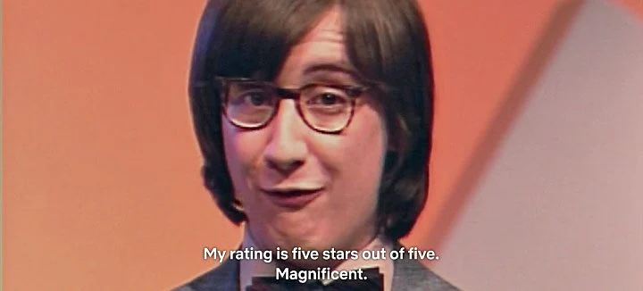
Media Impact on Consumers’ Mental Health
Main form of consumer connections in young adults
Dangers of connecting self-worth with social media [10]
Increased rate of depression and stress
Decreased rate of resilience and kindness to self
Stefan connects his own self-worth to the review of his game
Notes:
This leads into social media and its impact on the mental health of its users.
Social media incredibly popular
Average user spends 2 hours and 12 minutes a day
Main form of making connections within young adults
Dangers truly arise from those who place their self worth in the feedback they receive from social media. AKA basing your self worth on likes you get on your instagram post… shares on your youtube video, etc.
Increased depression and stress
Decreased resilence and self kindness
While in Bandersnatch there is no prominent use of social media, there is a video game rating tv show that Stefan is obsessed with
He places his self worth in the success of his game, he wants a 5 star rating and in the plots that he doesnt it is very upsetting to him
There is actually only one plot where you can receive 5 stars
Authors themselves actually state in order to achieve the rating of 5 stars on the game the viewer must pick the choices that have the greatest harm to Stefan and his mental health
Thus shows inverse relationship Stefans mental stability has with the success of his game

Slide 8
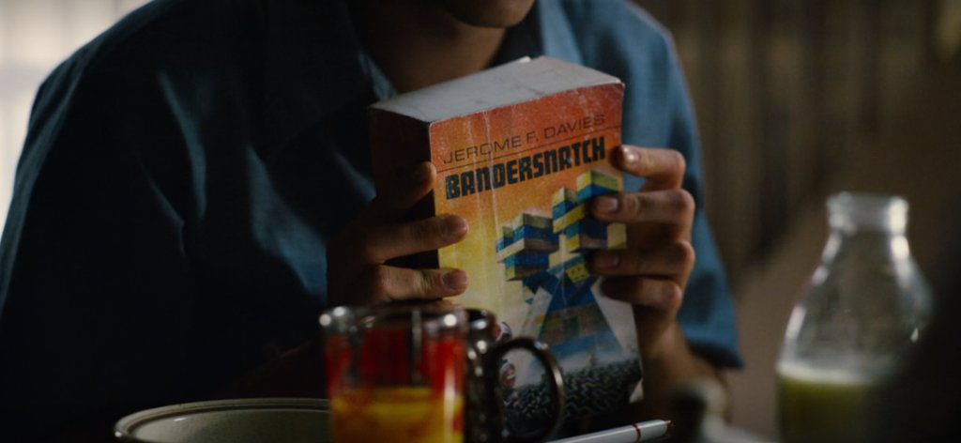
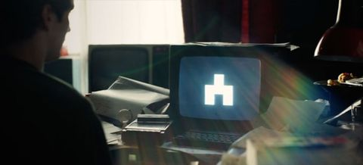
Effect of Heavy Exposure to Disturbing Content
Stefan months adapting book Bandersnatch into a game
The author of Bandersnatch is known for having gone crazy and beheading his wife
Stefan’s mental health declines the longer he works on the game
Stefan watches a documentary on the author
Stefan begins to believe the same conspiracies as the author
Stefan kills his father after watching the documentary
Notes:
People close to Stefan question his choice to adapt the book to a video game, given that the author of the book is known for having gone crazy and beheading his wife. Stefan, more interested in the book’s plot than author, presses on with his adaptation of the book. So, Stefan finds himself in the situation where he spends days poring over the book written by a madman. Beyond this, Colin gives him a documentary on Davies, which led him to descend into a similar madness. Stefan begins to believe the same conspiracies as Davies had, recognizing the same branching pathway symbol everywhere he looks. As a result of being so deeply exposed to the inner workings of the life and mind of a madman, Stefan goes so far as to kill and even (depending on the viewers choices) dismember his father.

Slide 9


Effect of Heavy Exposure to Disturbing Content
YouTube Content Moderators [3]
An ex-content moderator sued YouTube in 2020 after developing PTSD and depression
This worker reviewed “videos that included beheadings, shootings and child abuse”
4+ hours a day reviewing graphic content
Facebook Content Moderators [1][2]
Paid $52 million to moderators who developed PTSD
Moderators review graphic content, including rape and suicide
Some “reported witnessing colleagues become “addicted” to graphic content”
Exposure to conspiracy videos and memes led them to embrace fringe views
Source: youtube.com
Source: facebook.com
Notes:
This mirrors the current ongoing issue of mental health decline in content moderators. The job of content moderators is to review sensitive content online and determine whether the content violates their site’s community guidelines. An ex-content moderator sued YouTube in 2020, after developing PTSD and depression due to their work duties [3]. This worker’s job was to watch “videos that included beheadings, shootings and child abuse” [3]. Typically, a YouTube moderator will spend over 4 hours a day reviewing graphic content [3]. YouTube is not the only culprit. In 2020, Facebook had to pay $52 million to content moderators who developed PTSD because of their work [2]. While Facebook does use AI in addition to humans to moderate online content, the technology is simply not sophisticated enough to pick up on certain types of potentially harmful content, including videos and creative wordplay [2]. Moderators working at Facebook report that they have had to review graphic content including rape and suicide [2]. They claim that this has led to the development of PTSD [2]. Alternatively, some Facebook moderators “reported witnessing colleagues become “addicted” to graphic content and hoarding ever more extreme examples for a personal collection” [1]. One Facebook moderator noticed that his colleague began to feel paranoid; the colleague was afraid of “walking through the streets at night, for example, or being surrounded by foreign people” [1]. The moderator suggested that this was likely the result of extreme exposure to hate speech, which may cause a liberal or even progressive person to become more conservative or far right [1]. In all these cases, content moderators are frequently exposed to disturbing and extreme content. As a result, their mental health suffers, and their personal beliefs are compromised.

Slide 10
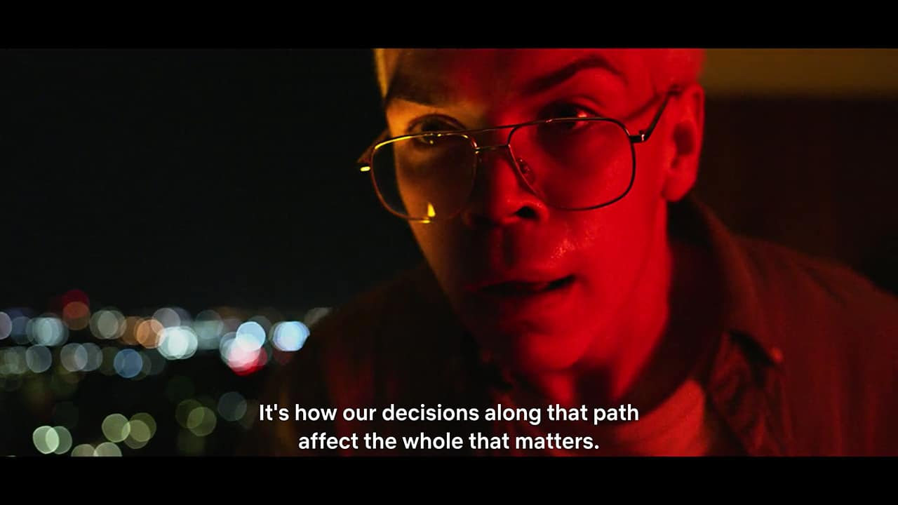
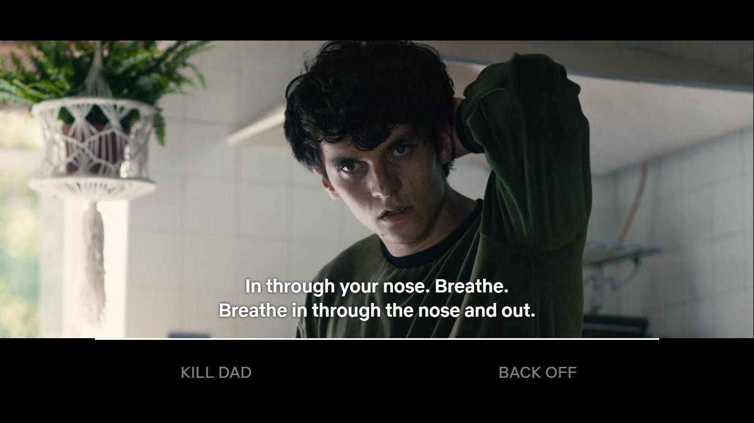
Conclusion
A person’s interaction with media and technology has an impact on their mental health, well-being, and decision making.
Notes:
A person’s interaction with media and technology has an impact on their mental health, well-being, and decision making.
Colin is Stefan’s coworker who he admires.
Colin goes on a tangent about free will and control, if you make certain choices
This quote ties it all together
Through the computer, media influences the users and their decisions
If you are influenced, how is your whole life.. How is all of society affected by you?
We want to be autonomous, and we want to be in control, and we want to have dignity and fulfill our purpose

Slide 11
Photo References
All images unless otherwise noted are sourced from Netflix movie “Black Mirror: Bandersnatch”. Source: Slade, D (Director). (2018). Black Mirror: Bandersnatch [Film]. Netflix.
GIF: Woytowitz, Sean. “All Five Endings to Black Mirror: Bandersnatch”. (Odyssey, January 15, 2019). https://www.theodysseyonline.com/bandersnatch-endings
Youtube Logo: https://www.youtube.com/
Facebook Logo: https://www.facebook.com/

Slide 12
References
Alex Hern, Revealed: catastrophic effects of working as a Facebook moderator, (The Guardian, 17 September 2019),
https://www.theguardian.com/technology/2019/sep/17/revealed-catastrophic-effects-working-facebook-moderator (1 May 2021)
Facebook to pay $52m to content moderators over PTSD, (BBC, 13 May 2020), https://www.bbc.com/news/technology-52642633 (1
May 2021)
Queenie Wong, Ex-content moderator sues YouTube, claims job led to PTSD symptoms and depression, (CNET, 21 September 2020),
https://www.cnet.com/news/ex-content-moderator-sues-youtube-claims-job-led-to-ptsd-symptoms-and-depression/ (1 May 2021)
Shin, Hong Im, and Juyoung Kim. “My Computer Is More Thoughtful Than You: Loneliness, Anthropomorphism and Dehumanization.” Current psychology (New Brunswick, N.J.) 39.2 (2020): 445–453. Web.
Cacioppo, S., Grippo, A. J., London, S., Goossens, L., & Cacioppo, J. T. (2015). Loneliness: clinical import and interventions. Perspectives on psychological science : a journal of the Association for Psychological Science, 10(2), 238–249. https://doi.org/10.1177/1745691615570616
Peter, Vorderer. “The Video Game Experience as ‘True’ Identification: A Theory of Enjoyable Alterations of Players’ Self-Perception.” Communication theory 19.4 (2009): 351–373. Web.
Wachtel, P. L. (2018). Multiple wishes, multiple fears: On parallelism in neural processing and the relation between person-centered and interpersonal explanations. Journal of Psychotherapy Integration, 28(3), 329–337. https://doi.org/10.1037/int0000123
Entman, R. M. (1989). How the Media Affect What People Think: An Information Processing Approach. The Journal of Politics, 51(2), 347–370.
Henderson, G. (2020, August 24). How Much Time Does The Average Person Spend On Social Media? https://www.digitalmarketing.org/blog/how-much-time-does-the-average-person-spend-on-social-media.
Sabik, N. J., Falat, J., & Magagnos, J. (2019). When Self-Worth Depends on Social Media Feedback: Associations with Psychological Well-Being. Sex Roles, 82(7-8), 411–421. https://doi.org/10.1007/s11199-019-01062-8
Woytowitz, Sean. “All Five Endings to Black Mirror: Bandersnatch”. (Odyssey, January 15, 2019). https://www.theodysseyonline.com/bandersnatch-endings
Slade, D (Director). (2018). Black Mirror: Bandersnatch [Film]. Netflix.

