Slide 1
Big Hero 6
Presenters:
Meagan Hiatt, Joshua Morse, Lindsay O'Donnell, Connor Porell, Yifan Zhao

Slide 2
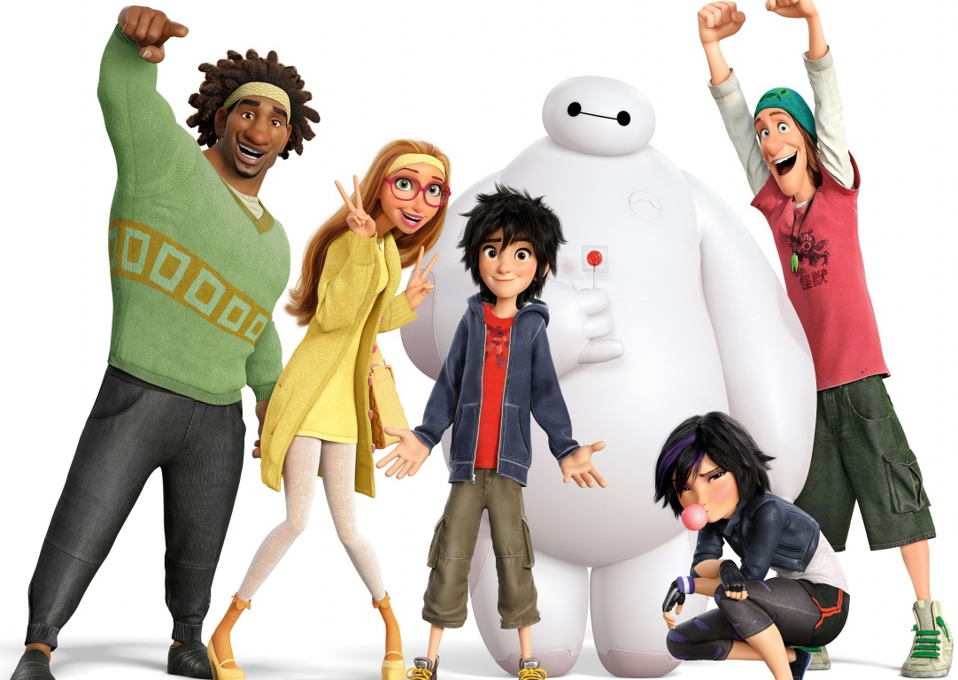
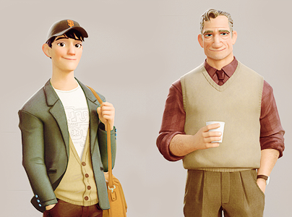
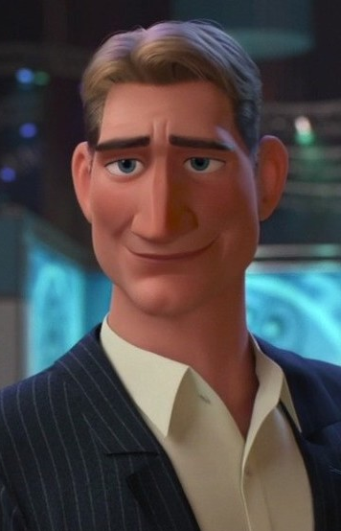
SUMMARY - CHARACTERS
Hiro and Tadashi - Brothers and robotic engineers
Baymax - Tadashi’s project, the ultimate healthcare robot
Wasabi, Honey Lemon, Gogo, and Fred- Fellow students of Tadashi
Callaghan - Tadashi’s Professor
Krei - A businessman
Notes:
At the center of the story of Big Hero 6 are the robotics geniuses Hiro and Tadashi. Hiro is a prodigy who frequently enters his creations in underground botfighting tournaments. His older brother Tadashi, a university student, has been working on a project to build the ultimate healthcare robot.
Baymax is Tadashi’s creation. Baymax is able to tell at a glance a person’s vital signs, symptoms of distress, and prescribe medications and other solutions on the fly.
Wasabi, Honey Lemon, Gogo, and Fred are friends of Hiro and Tadashi and are all students at university with Tadashi.
Professor Callaghan teaches robotics at Tadashi’s university. He is one of Hiro’s idols, and the person who encourages Hiro to apply to the university.
Alistair Krei is a businessman interested in buying some of Hiro’s robots, although Callaghan distrusts him.

Slide 3
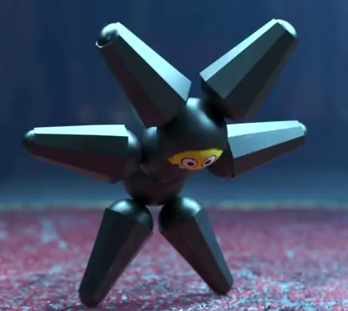
SUMMARY - ACT 1
Tadashi studies robotics while Hiro enters robot fighting pits
Hiro applies to Tadashi’s school
Hiro creates microbots as part of his enrollment
Fire at the university expo
Notes:
At the start of the movie, we see Hiro entering one of his robots in an illegal botfighting tournament. While its appearance is deceptively simple, Hiro’s robot has the ability to separate and bring its parts back together on control. After the tournament, Tadashi expresses his concern that Hiro has so much more potential than to spend his life fighting in underground tournaments, and they visit Tadashi’s university. As part of their visit, Tadashi shows off Baymax to Hiro, and Hiro meets Professor Callaghan, who suggests that Hiro apply to the university.
As part of the admissions process, Hiro enters a robotics competition with a creation he calls “microbots.” Controlled by a neural transmitter, the microbots are tiny robots that work together to accomplish virtually any task devised by the person wearing the transmitter. After his demonstration of the microbots, Hiro is approached by a businessman named Krei, who is interested in buying the rights to the microbots. Callaghan tells Hiro not to, as he claims that Krei participates in risky business practices. Ultimately, Hiro decides against selling his microbots.
As Hiro and Tadashi leave the expo, a fire breaks out in the competition hall. Believing Callaghan to still be in the hall, Tadashi races in to save his professor, only to be killed as the fire erupts moments later. Hiro’s microbots were destroyed in the blast.

Slide 4
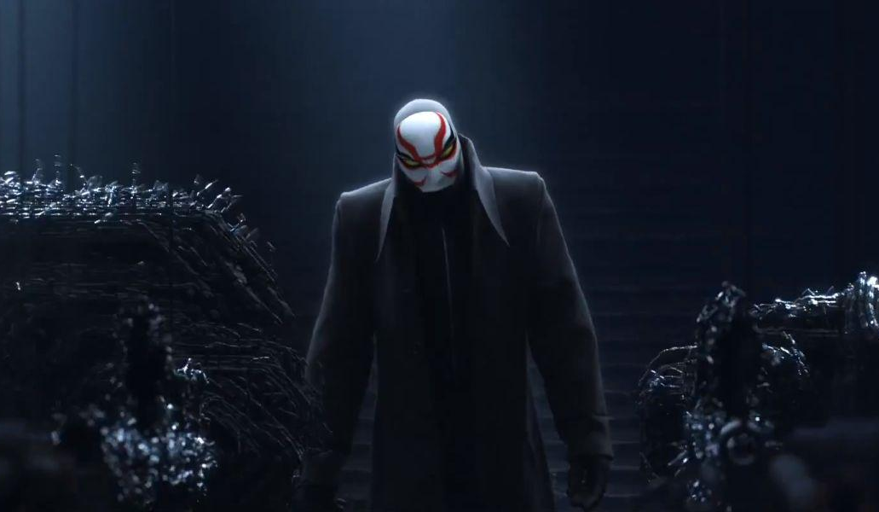
SUMMARY - ACT 2
Hiro doesn’t enroll after Tadashi’s death
Hiro and Baymax find a warehouse mass-producing microbots
Hiro upgrades Baymax
Notes:
Torn by Tadashi’s death, Hiro doesn’t enroll in classes after receiving his acceptance from the university. Sometime after Tadashi’s death, Hiro accidentally activates Baymax. Baymax scans Hiro and can instantly tell that Hiro is distressed. Baymax notices that Hiro has a lone microbot in the pocket of his jacket, and that it is acting strangely. The microbot leads Hiro and Baymax to a warehouse where they find a machine that is mass-producing microbots. As they investigate, a masked man takes control of the microbots and attacks Hiro and Baymax. After a narrow escape, Hiro comes to the conclusion that the fire that killed Tadashi may not have been an accident, and may have just been a ruse to cover the theft of the microbots.
Determined to find out the truth behind the masked man, Hiro creates a combat chip for Baymax, giving him incredible martial arts skills. Additionally, Hiro creates suits of armor for Baymax and the rest of his friends. After testing out their suits and inventions, Hiro and his friends track the masked man to an abandoned Krei laboratory. There, they find an old portal that appears to have broken down. While investigating the portal, the masked man appears again and is revealed to be Professor Callaghan.

Slide 5
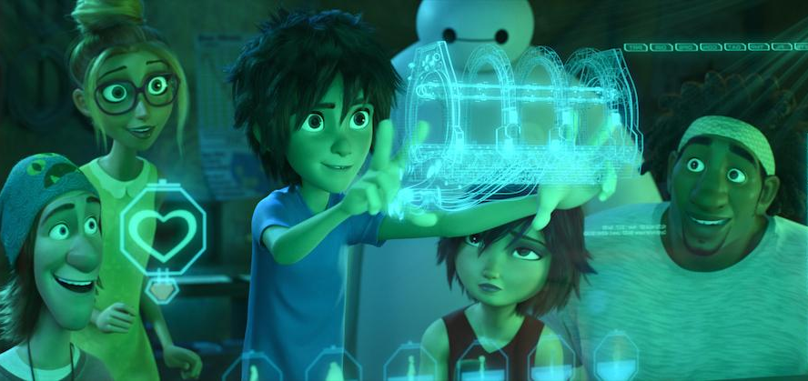
SUMMARY - ACT 3
The masked man’s motives are revealed
Baymax sacrifices himself
Hiro rebuilds Baymax
Notes:
Upon realizing that Callaghan was responsible for the death of Tadashi, Hiro removes Baymax’s healthcare chip, overriding his helpful tendencies, and orders Baymax to kill Callaghan. Honey Lemon stops Baymax from finishing the job. In hopes of finding answers for Callaghan’s motives, Hiro and his friends find some security footage which reveals that Professor Callaghan’s daughter, Abigail, was the test subject in Krei’s portal, but the portal became unstable after Abigail entered, forcing Krei to shut it down. Abigail was lost in between the portals, causing Callaghan to lash out at Krei.
Hiro and his friends soon find out that Krei is unveiling a new Krei Tech building, and race there to protect him from Callaghan. At the ceremony, Callaghan uses the microbots to piece together a portal in an attempt to destroy Krei and his building. When the portal opens, Baymax detects signs of life from within. Hiro and Baymax enter the portal while their friends fight Callaghan. Inside the portal, Hiro and Baymax find a pod with Abigail inside, frozen in stasis. They attempt to bring her back, but Baymax is damaged by a piece of debris, and must use the rockets in his hand to propel Hiro and Abigail to safety.
Hiro mourns the loss of Baymax, as the data inside Baymax included the last videos of Tadashi. Some time after the events at Krei Tech, Hiro notices that the hand that Baymax detached to send him through the portal has been clutching the healthcare chip. Hiro rebuilds Baymax using the healthcare chip. The film ends as Hiro announces that he, Baymax, and their friends have formed a team to fight crime across the city.

Slide 6
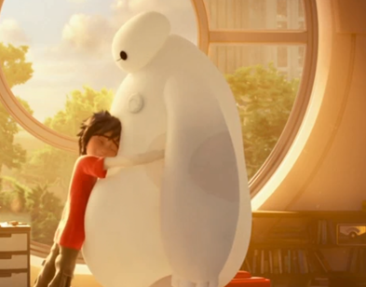
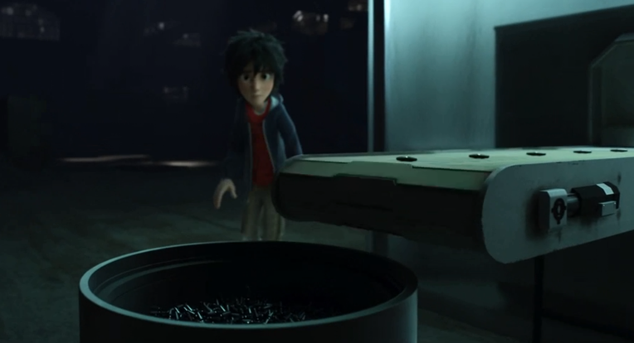
IP & POLICY
2 Scenarios are suspected to violate
IP Policy:
Hiro uses and reproduces Baymax
Prof. Callaghan reproduces microbots
Notes:
The first implication in this movie that draws out attention is regarding the IP policy.
We suspected that there are two violations in IP policies.
One is Hiro using Baymax and finally reproducing Baymax at the end of the movie.
The other is Professor Callaghan reproducing microbots without permission.
Our analysis is based on the assumption the the university has a similar IP policy as WPI.
So, let’s take a look at the WPI IP Policy now.

Slide 7

IP & POLICY
WPI’s IP Policy - Student
composed of 5 rules
by a student on his own -> Student
during a project -> WPI
as a part of a project -> WPI
w/o significant use of resources -> Student
with significant use of resources -> WPI
Notes:
In the section of ownership of inventions, for students, it contains five rules, which can be summarized into two categories.
The first category includes Rule a and Rule e, saying that if an invention is created by the student alone, without significant use of the school’s resources, not related to any coursework at WPI, the invention is owned by the inventors.
The second category contains Rules b, c, and d, which can be summarized that the invention belongs to WPI if the invention is made by the students for the purpose of any course, or with significant use of WPI’s resources.
WPI’s IP policy is composed of 5 rules regarding to the ownership of the inventions.
For an invention made by students, on their own time, with their own facilities and resources, and in research/projects not within the stated objectives of their current sponsored research, PLAN projects, or thesis or dissertation research, the invention is owned by the inventor(s).
For an invention made by students while employed on a sponsored project (research or educational), including off-campus PLAN projects, the invention is owned by WPI, subject to any other agreements.
For an invention made by a student as a part of any project or sufficiency report, thesis, dissertation, course work, directed study, directed research, or examination, the invention is owned by WPI, subject to any other agreements. In cases not specifically addressed by the above three cases,
For an invention made by students without significant use of WPI resources, the invention is owned by the inventor(s).
For an invention made by students with significant use of WPI resources, the invention is owned by WPI, subject to any other agreements.

Slide 8
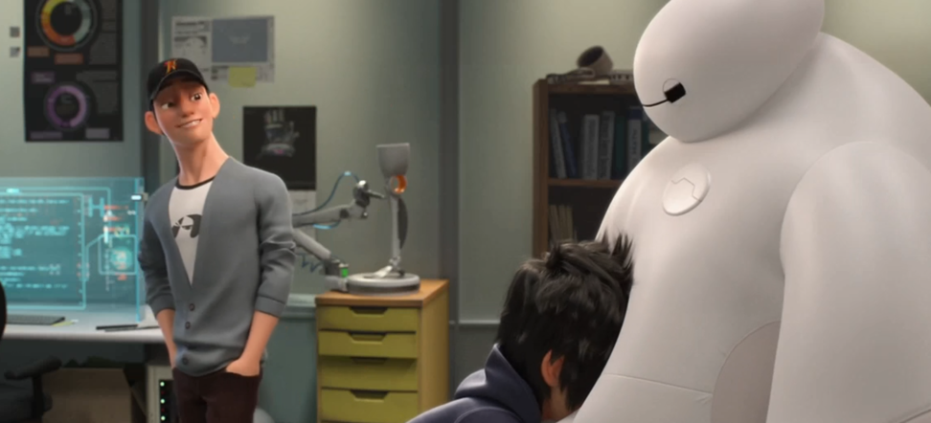
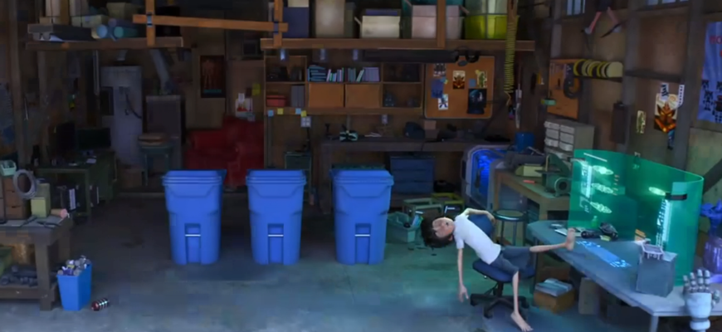
IP & POLICY
If WPI’s IP Policy (Ownership) applies,
Baymax is owned by the university.
“Machined right here, in-house”
Microbots are owned by Hiro
built in Hiro’s garage
But this is regarding the ownership,
What about IP?
Notes:
Applying the rules here, Baymax is actually owned by the university, since there’s a line in the movie saying that Baymax is “machined right here, in-house”, or in the lab. So, here it indicates that the inventing procedure of Baymax involves significant use of the school’s resources. Therefore, the university owns Baymax. So, Hiro violates the property law by using Baymax as his own property.
On the other hand, Hiro invented the microbots on his own, using his own resources. So the microbots belong to Hiro. However, Professor Callaghan stole them, so apparently, Professor Callaghan violates the ownership of the microbots.
But all the above discussion is based on the ownership of the inventions. What about the intellectual property?
Again, let’s look at the royalty rules regarding the patent and benefits at WPI.

Slide 9
IP & POLICY
WPI Royalty Rules (Patent)
Portion of benefits depends on
Whether the author pursues the patent
To what degree WPI has sponsored
Hiro reproduces Baymax -> No enough evidence of violation
Prof. Callaghan reproduces microbots -> No enough evidence of violation
No enough evidence of IP violation in both cases
Notes:
There are three rules in total, based on the degree to which WPI has sponsored this project.
Basically, the portion of benefits that an author can gain from the patent depends on whether the author wants to pursue the patent and how much WPI has sponsored this project.
So, at the end of the movie, Hiro reproduces Baymax, but there’s not enough evidence in this movie showing whether Hiro has violated the IP policy, since we are not clear whether the university or Tadashi has pursued the patent of Baymax. If no patent has been issued, there shouldn’t be any violation in IP laws.
Similar logic applies in the case of the microbots. If Hiro has the patent of microbots, but Professor Callaghan stole them and reproduced them and used them for criminal purposes, then he violates the patent law. But if Hiro doesn’t have the patent, no law will protect the reproduction of microbots.
So, our group originally suspected that the two scenarios mentioned above violate the IP policy, but with the little evidence in the movie, it’s hard to conclude that either case violates the IP policy, but definitely, they violate the ownership of both inventions.
Royalty Rules
If WPI pursues the patent, then WPI will absorb the costs and will share royalties on a 50-50 basis with the inventor(s), after the costs of the patent are recovered, or will share royalties in accordance with WPI institutional agreements.
If the student(s) wish to pursue the patent, WPI will assign any ownership rights it may have to the student through a jointly signed agreement providing that the student will give 10 percent of net future financial gains from the patent to WPI. The student will absorb the costs of pursuing the patent. Alternatively, if the student wishes to have WPI absorb the costs of pursuing the patent, then Rule I applies.
The inventor(s) will pay all costs associated with patenting the invention, and will receive all benefits from the patent.

Slide 10
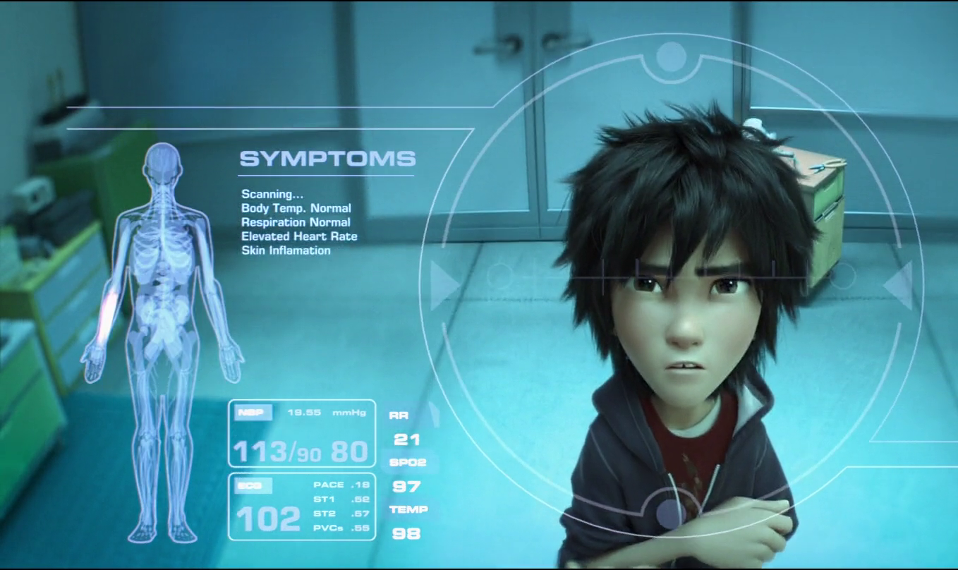
PRIVACY - BAYMAX’S SCANNER
Baymax scans without permission
Privacy violation
Opt in vs Opt out
Notes:
For those who haven’t watched the movie, Baymax as a medical robot has a medical scanner that is able to somehow scan all the medical information about someone, which can entail very personal medical facts.
Baymax’s scanner obviously poses some privacy concerns.
In the movie Baymax does not ask anyone before scanning them, so this would suggest an opt out system for scanning. But for many people they don’t even know they are being scanned, such as when Baymax 2.0 uses the city-wide scanner to find the fugitive.

Slide 11
PRIVACY - BAYMAX’S SCANNER
Large scale privacy violation
HIPAA (Health Insurance Portability and Accountability Act)
Extremely personal information
Location always known
Notes:
Anyone who has access to this scanner technology has the power to commit mass violation of privacy.
The HIPAA federal law states that any physical or mental health condition is protected if the information can be potentially linked to an individual.
Baymax’s scanner kills two birds with one stone and extracts a ton of personal medical information that can be easily linked to an individual.
Not only that, but this scanner can be used to always locate you.

Slide 12
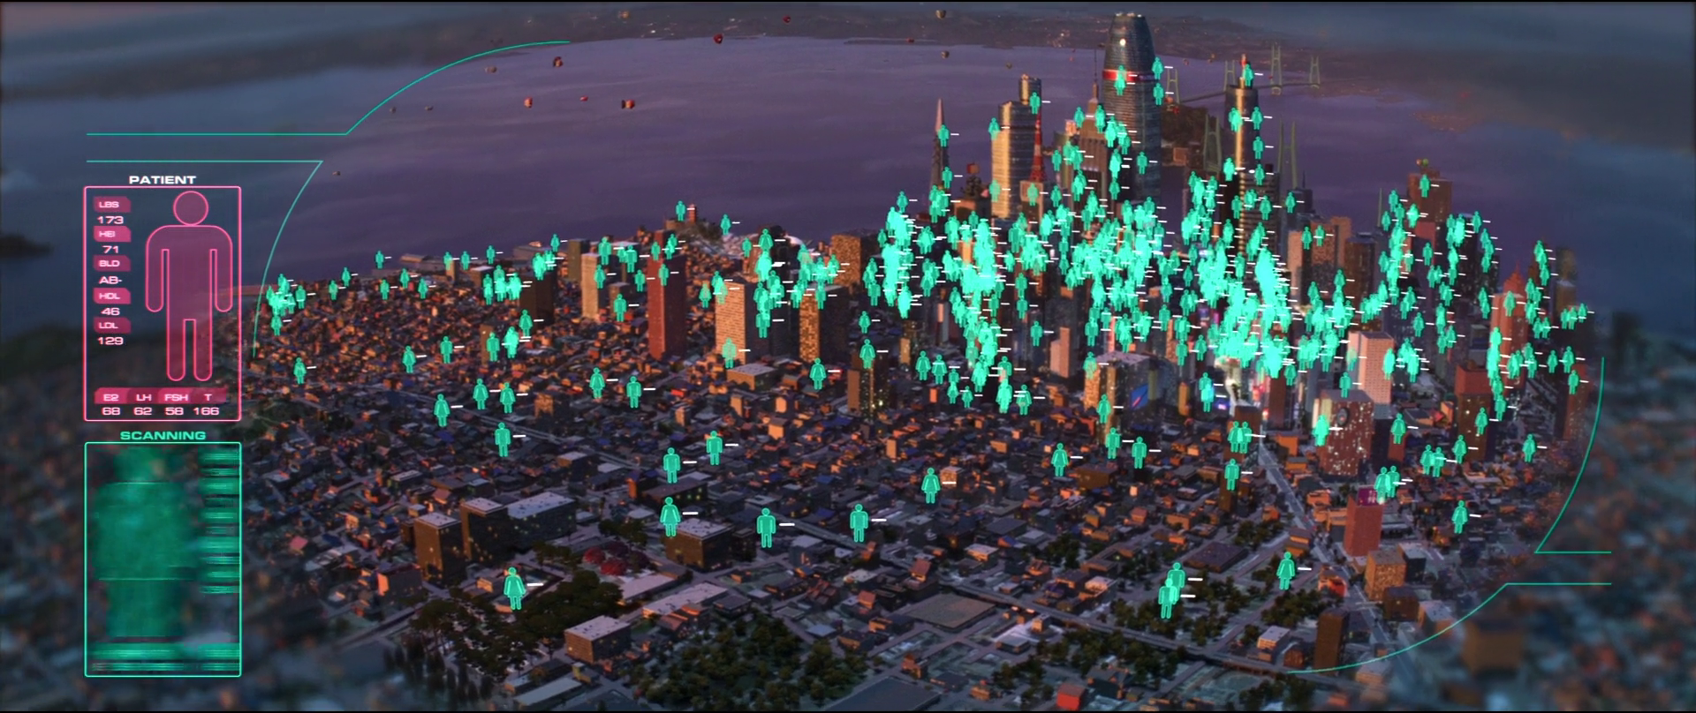
PRIVACY - BAYMAX’S SCANNER
Government uses:
National ID system
Fugitive locater
War
Lie detectors
Policing robots
Notes:
The government could use the scanner for a lot of different purposes, which can be both very beneficial and very evil, depending on the application
As the scanner returns back information that allows a person to be uniquely identified biometrically, this could be used as some sort of national ID system.
In the movie it is used as a fugitive locater by Hiro to locate the bad guy that was scanned earlier in the movie.
Imagine its use in war to determine targets by aiming for the healthy males and avoiding the females and children.

Slide 13
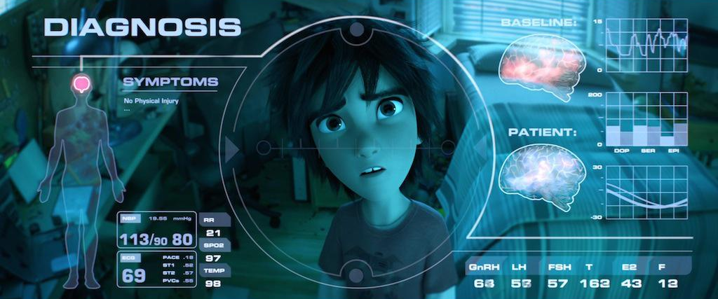
PRIVACY - BAYMAX’S SCANNER
Feasibility
Current technology suggests most likely unfeasible
Notes:
I did some research into current scanning technologies, and there is absolutely nothing anywhere near as sophisticated as this.
The best I could find was x-ray technology which requires an emitter and a scanner on opposite sides of the scanned target, which is not the case for this technology.
This technology would require some electromagnetic wave to pierce walls, hit a person, gather information, and reflect back to the source with the information intact. This appears to be an unfeasible technology.

Slide 14
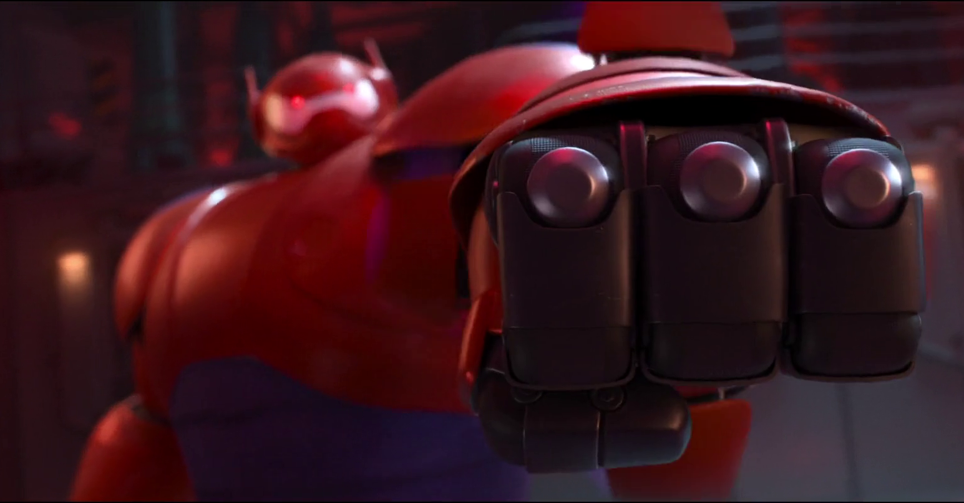
ROBOT/HUMAN SAFETY
Hiro creates a chip for Baymax to allow him to learn fighting moves
When Hiro removes Baymax’s healthcare chip, Baymax obeys commands to kill Callaghan
Notes:
Baymax uses the moves against the masked man to protect Hiro and his friends
Baymax doesn’t have any intrinsic programming to prevent harm to humans, so when his healthcare chip is removed he simply follows Hiro’s commands as he has been programmed to do.

Slide 15
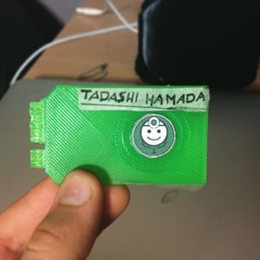
AI and Ethics
Baymax displays emergent behaviors when he refuses to allow Hiro to remove his healthcare chip again
Baymax also saves his chip inside the wormhole before launching Hiro to safety
Notes:
With the healthcare chip installed, Baymax’s main priority is Hiro’s physical, mental, and emotional health. At first, Baymax agrees to chase the masked man because he believes it will help Hiro. However, because Baymax is programmed to take care of humans’ medical needs, he is well aware of the emotions that loss and grief can cause. It is implied that he stops Hiro from removing the chip because he knows it ultimately won’t help Hiro to get over his loss.
Baymax also takes actions inside the wormhole to preserve himself. He may have been programmed with some sense of self preservation, but the most likely explanation is that he believes the best way to safeguard Hiro is to be there himself, so allowing himself to “die” would contradict his desire to heal Hiro. Also, he knows that Hiro misses his brother and that the last videos of Tadashi are contained on the chip, so keeping those videos safe is also trying to keep Hiro happy.
In the end, all of Baymax’s actions are with the main goal of keeping Hiro healthy and safe.

Slide 16
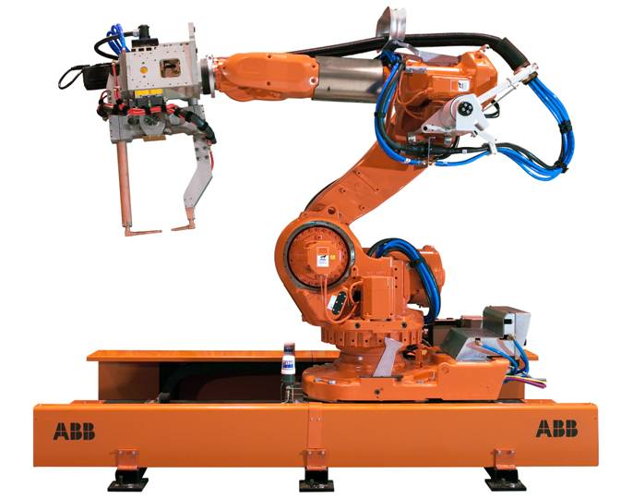
ROBOT/HUMAN SAFETY
A few real life examples:
Military drones: partially controlled by humans, but are used to kill
Industrial robots can cause accidents if safety protocols are ignored or if they malfunction
Robots are tools, they do not make ethical decisions (currently)
Notes:
There are many real life example of robots that can cause harm to humans, either by accident or by being used in attacks.
However, all AI and robots do what they are programmed to do. Baymax’s healthcare chip is programmed to keep Hiro safe, and his other chip is programmed to obey Hiro’s commands without question. He does display some emergent behaviors, learning about human behavior as he goes, but he always tries to justify how every action will “improve Hiro’s emotional state”, showing that his programming determines his behavior. Baymax is neither evil nor good, but the product of his programming.

Slide 17
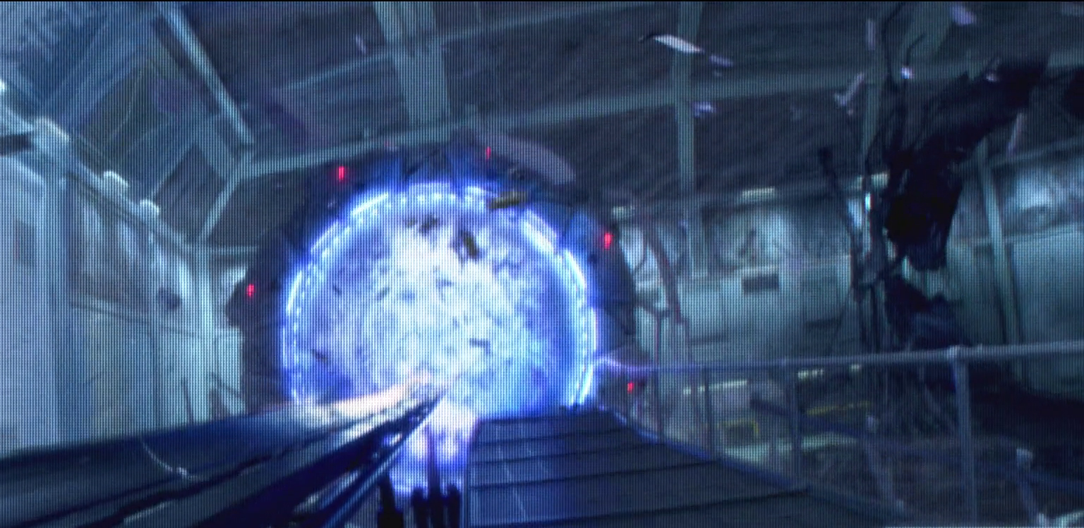
WORMHOLE FAILURES
Collapse of transporter wormhole
Premature Testing
Ignoring warnings
Notes:
While this is not directly a computing technology - or at least today we don’t consider it as one - this is a perfect example of a failure, or the topic from chapter 8.
In the movie, a scientist reported to Krei that there were abnormal readings from the wormhole. Krei however wanted to impress the military officials that were there observing and told them to ignore the warnings.
In the end these abnormal levels were indicators that the wormhole was to become unstable and destroy part of the facility. Krei had been warned that the device was not ready for this level of testing and then ignored warnings that the levels were not stable.

Slide 18
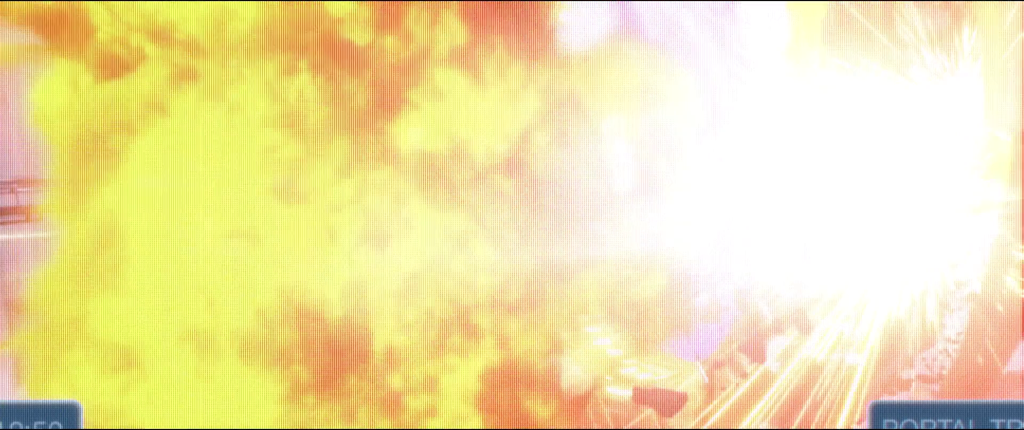
WORMHOLE FAILURES
Was it worth the risk?
Loss of life and property
Notes:
Was the risk worth it? Considering the Krei knew, potentially, what would happen if the wormhole collapsed, we believe that Krei should not have gone through with the test and evacuated the area or shut the wormhole down. While this could have cost some military support, Krei loss more the just the military support because he was not careful with something so dangerous.
There are also real world examples of ignored warnings such as chernobyl nuclear power plant or challenger space rocket, where engineers reported failures within the system, however they were ignored by higher management which resulted in disasters.
From this we conclude, premature testing, not testing throughly and ignoring warnings can lead to disastrous consequences. That while having the pressure to produce something from investors, outside supporters or management, can be a good thing and help drive the people to work and meet deadlines, it does not mean that you should be pressured into premature testing, or you don’t test something enough to make sure it’s safe.
For challenger rocket, they were pressured to produce something and meet deadline, so when it worked they used it. However they didn’t test thoroughly otherwise they would have known that cold weather would break the mechanism that brought down the challenger rocket.

Slide 19
Conclusion
Privacy Violations
Baymax’s scanner
IP Policy Violations
Product of the Programmers
Ignoring Warnings & Failures
Notes:
Conclusion
Some of the technology and the use of the technology in the movie was a large scale privacy violation.
As Yifan mentioned, our group originally suspected that Callahan and Hiro were violating the IP policy, but with the little evidence in the movie, it’s hard to conclude that either case violates the IP policy, but they definitely violate the ownership of both inventions.
Baymax is a product of the humans who programmed him - it’s about the programmers or controllers intent. While Baymax seems human and is sometimes treated as such, he is a robot with a purpose: to heal people. His actions in the movie reflect this programming.
Testing before products are ready or ignoring warning signs, can lead to disastrous consequences

Slide 20
References: Photos, in order
Date Accessed for All: 4/46/2015
http://fandan.co/1HPzEZj
http://bit.ly/1GyPPXV
http://bit.ly/1J4tuld
http://bit.ly/1Ex9MPc
http://bit.ly/1z6XsVi
http://bit.ly/1DDSpsc
http://www.wpi.edu/Images/CMS/Marketing/Inst-Prim-FulClr.gif
http://electronics.howstuffworks.com/gadgets/high-tech-gadgets/nightvision1.htm
http://www.eu-robotics.net/cms/upload/euRobotics_Forum/ERF2014_presentations/day_2/Industrial_HRC_-_ERF2014.pdf
http://www.bbc.com/future/story/20140326-will-we-ever-travel-in-wormholes
http://www.andersoninstitute.com/wormholes.html
http://www.wpi.edu/offices/policies/intell.html
http://health.state.tn.us/hipaa/
https://www.law.cornell.edu/wex/patent
References: Content
Big Hero 6 Movie, 2015
Ethics for the Information Age, 2009
http://science.howstuffworks.com/x-ray.htm Accessed: 4/27/2015
https://www.law.cornell.edu/wex/patent Accessed: 4/25/2015
http://www.wpi.edu/offices/policies/intell.html Accessed: 4/25/2015

