Slide 1
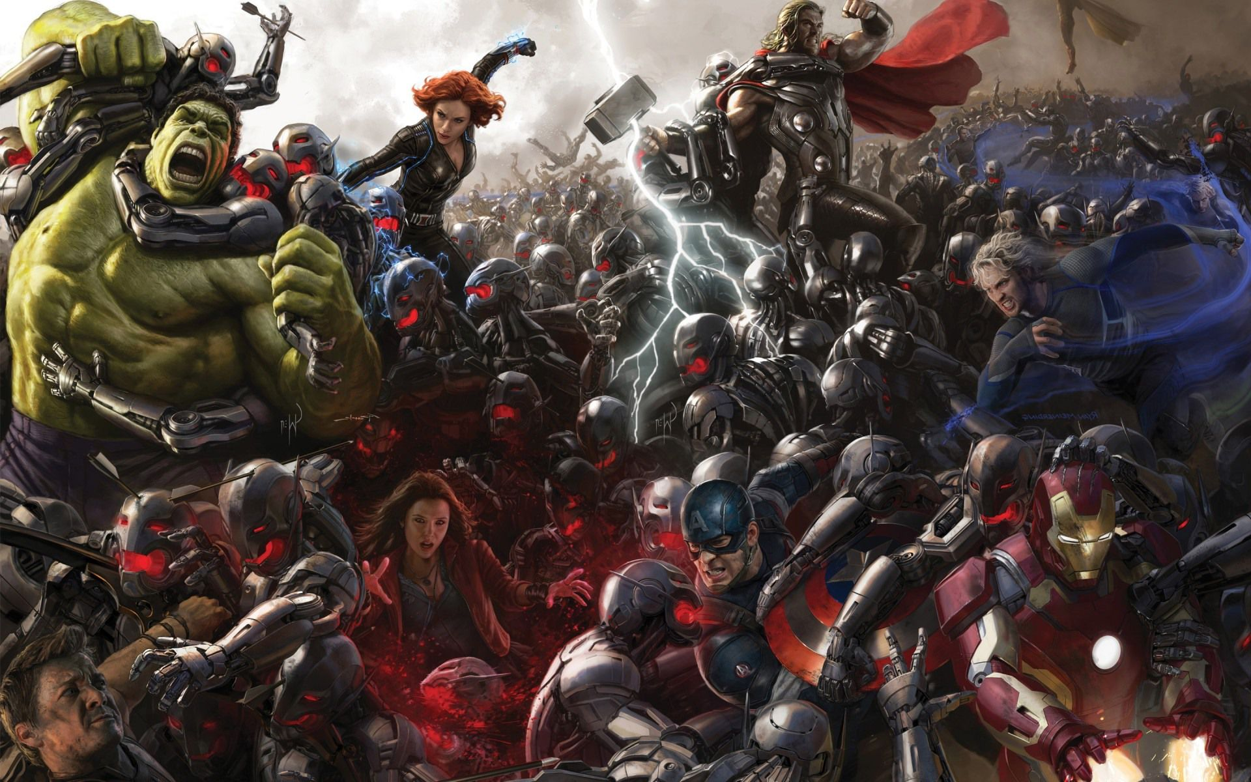
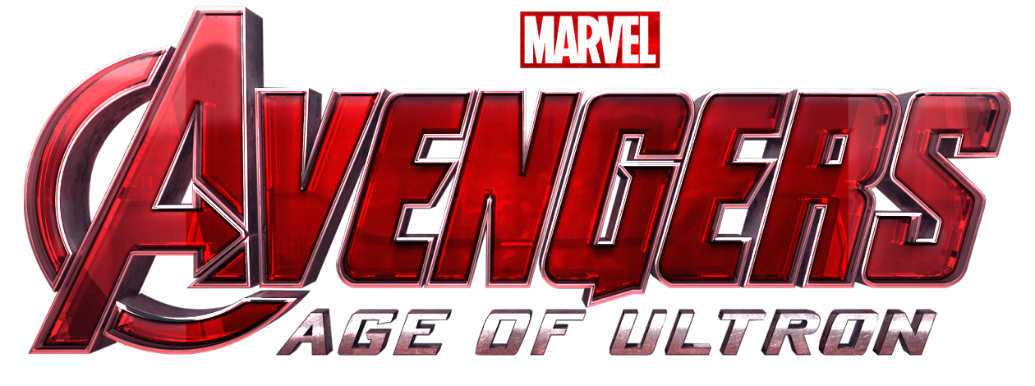
An Analysis
By: Rayan Alsoby, Peter Craft, Tyler Nickerson, and Thomas Sellie-Lund
Image: http://notanotherdadblog.com/wp-content/uploads/2015/05/Age-of-Ultron.jpeg

Slide 2
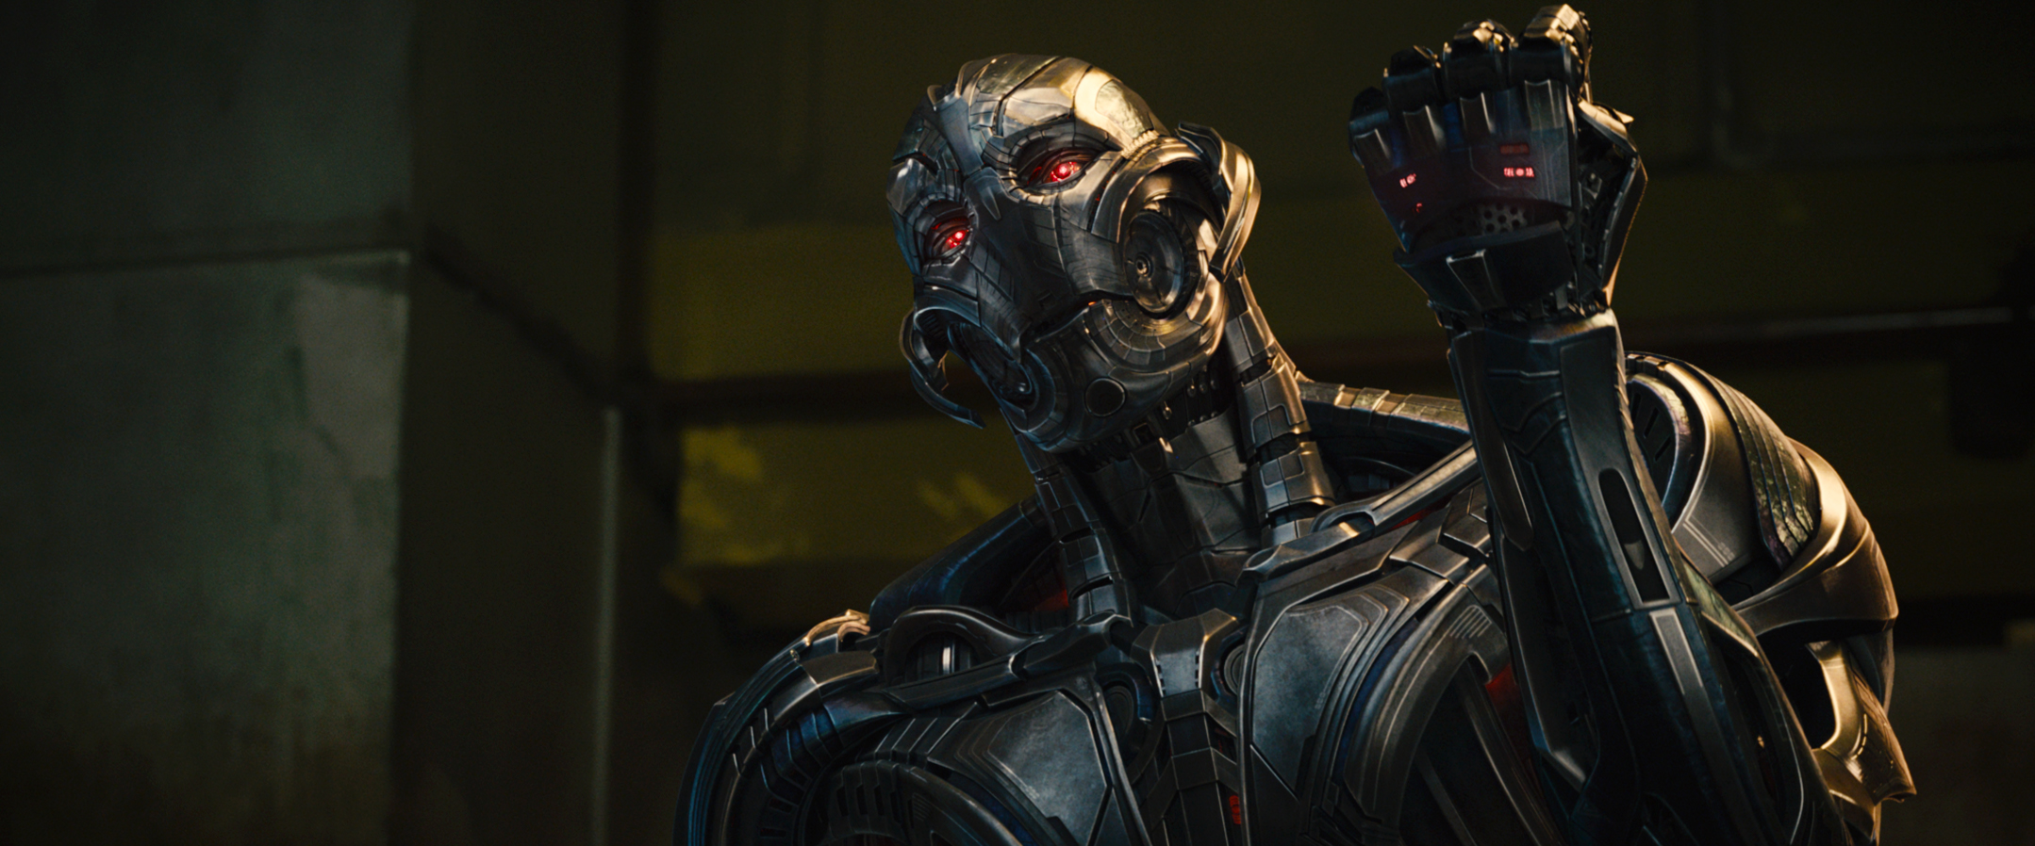
Plot Summary
The Avengers are on a mission to retrieve the scepter from Hydra
Tony Stark creates an AI using the stone inside the scepter
The AI “Ultron” is evil and seeks the end of humanity
Avengers spend the remainder of the film tracking down Ultron
The Avengers stop Ultron and save the day
Image: http://vignette1.wikia.nocookie.net/marvelcinematicuniverse/images/6/63/Avengers_Age_of_Ultron_56.png/revision/latest?cb=20150203195247
Notes:
The Avengers attack a Hydra outpost, to retrieve Loki’s scepter which was seen in the last movie.
Thor announces that in three days the sceptre would be taken back to Asgard and Tony Stark only has that long to experiment on it. Tony discovers the basis for a hyper advanced alien AI inside the sceptre which he uses to build the basis for Ultron.
Ultron wakes up and he twists the meaning of ‘peace in our time’ and decides that his mission should be to wipe out humanity and build a better race in its place. He quickly escapes the Avengers tower with the sceptre and sets up a base in Sokovia.
The Avengers work to track down Ultron and ultimately stop his plans in South Korea which leads to a final confrontation in Sokovia. Here they thwart Ultron’s plan to drop a city into the Earth and rescue all the residents of the city.

Slide 3
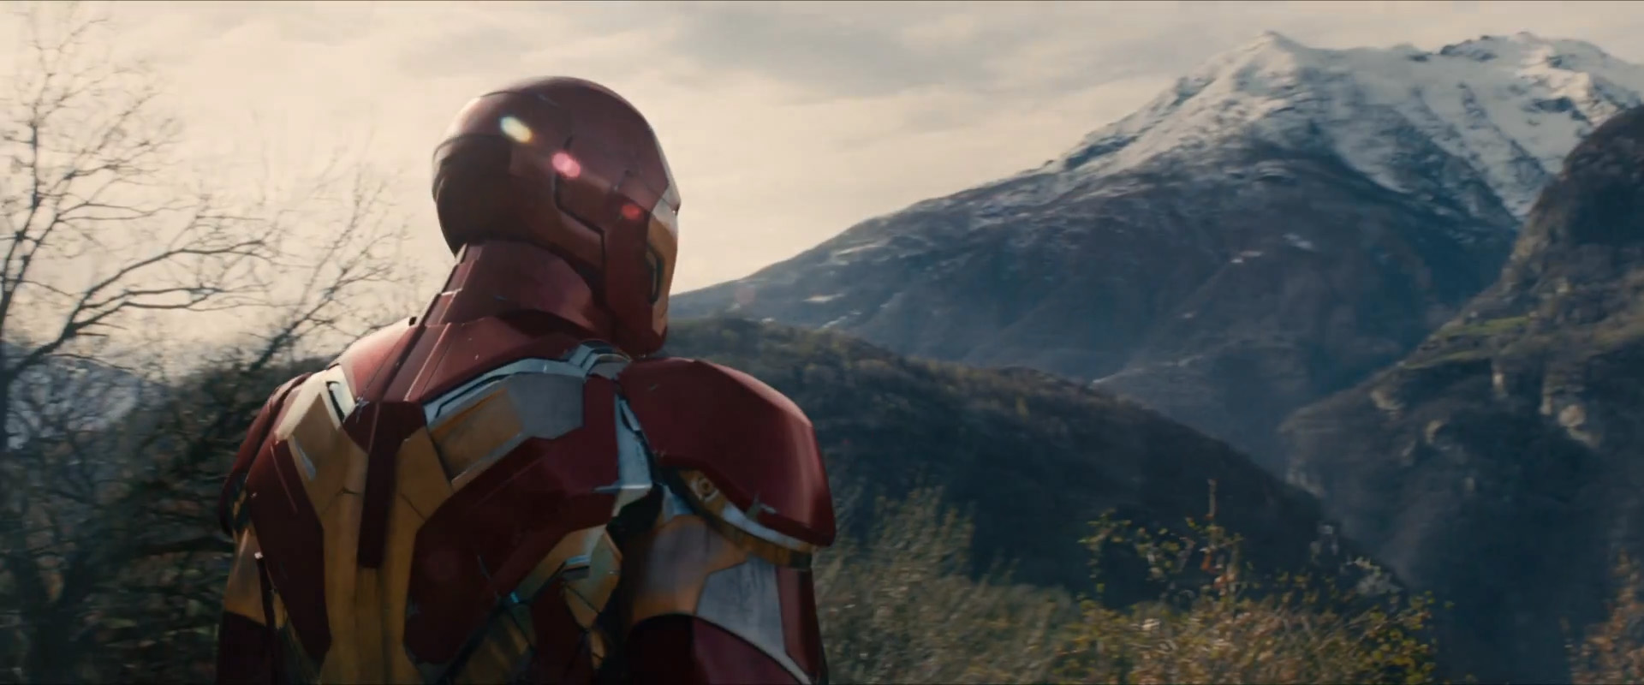
Conclusions
Dangers when creating a system you do not understand.
Technological superiority doesn't lead to inevitable victory
The connectivity provided by the Internet results in negative consequences
Image: http://screenrant.com/wp-content/uploads/Avengers-Age-of-Ultron-Trailer-1-Iron-Man-Mountain.jpg
Notes:
When we examined the movie we found three main things the movie was trying to tell us about computing. First the movie was warning about the dangers of creating a system that you do not understand. The movie also makes a point about how technological superiority does not always lead to success. Finally the movie warns about the dangers that can emerge from the constant connectivity that the internet brings.

Slide 4
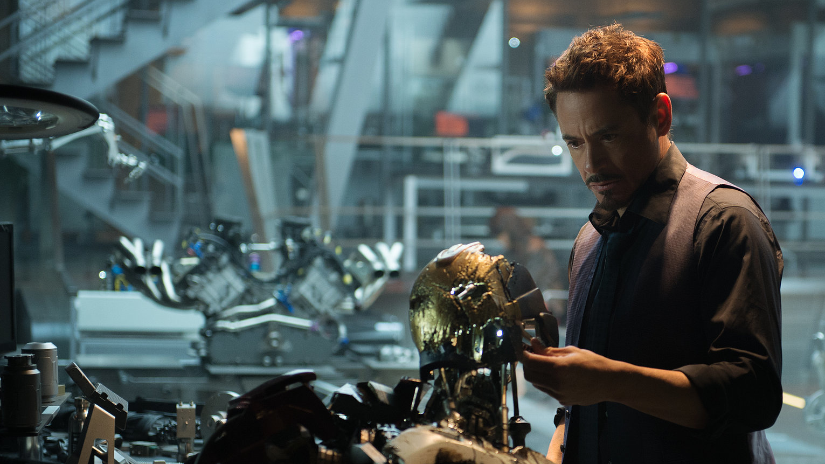
The Creation of Ultron
Copied from mind stone
  Advanced alien super-technology
Unsupervised testing
  Was at a party when Ultron was finished
Rushed job
Image: http://screenrant.com/wp-content/uploads/avengers-age-ultron-tony-stark-lab.jpg
Notes:
Ultron is the main villain of the work. his creation is due to Tony Stark copying a codebase directly out of the mind stone, then leaving the technology alone connected to his network without observation.
Didn't leave enough time to learn codebase.
Stark claims Ultron couldn't have been built without this codebase.
The work underlines the dangers of working with technology you do not personally have an understanding of.
This is further compounded by stark not taking proper protections in his laboratory against the effects of the unknown code.

Slide 5

Iron Man Suit
Tony Stark understood the suit's design and capabilities before using it
  Stark built it from the ground up
Sentry Mode / Hulkbuster
Automatic Replacement Mechanism
  Replacement parts acquired from hovering pod
  Requires anti-gravity, advanced in-air flight adjustment, advanced materials science and rocketry
  Replaceable parts have been around for centuries, however the technology used to replace power suit components is far more advanced than what we have today
Image: http://orig07.deviantart.net/0c8d/f/2010/072/5/c/iron_man_full_hd_wallpaper_2_by_dskorn.jpg
Notes:
In contrast, we can see stark’s iconic suit, which he built from base components up.
Never fails him during the course of the story, and is a testament to his design capabilities and knowledge.
In fact, one might say that he knows more about it than most modern engineers known about their own projects, as differing team members work on different sub-modules.
Built his suit from the ground up.
One of the big moments in the movie was when he dueled the hulk with his “Hulkbuster” armor with the assistance of his satellite AI Veronica.
His mastery over his own technology was shown in his repeated use of replacement oversuit components.
Modern equivalents to his repair systems mostly are offline maintenance systems, although you can see similar things in autosports races.
However he uses anti-gravity and advanced rocketry for deploying the parts.

Slide 6
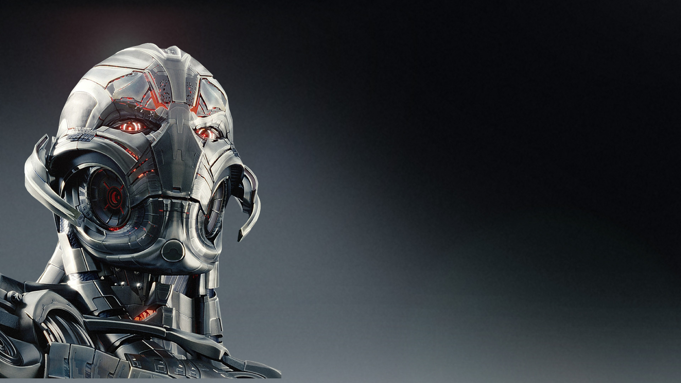
Artificial Intelligence
Two contrasting forms of AI
  Ultron becomes self aware and believes he is human
    Knowledge is derived from Internet
    Humanoid robot
  JARVIS is simple and governed by conventional AI logic
Real life modern AI
  Function in a manner closer to JARVIS
  NAO Bots passed self-awareness test [5]
Image: http://cdn.playbuzz.com/cdn/d4b4447d-3d4b-479d-8a60-809680d7a0c0/9fba4e0b-8283-40fd-8680-ac914a4198dc.jpg
Notes:
Movie shows two contrasting forms of AI. One was based on emotions, seen through Ultron. We can see this when the first thing Ultron does is ask Jarvis about his body and then attack him for ‘being weak’. He also has his concept of peace and twists it into attacking humans. We also see this when Ultron is interacting with the arms dealer. The arms dealer compares Ultron to Tony Stark which throws Ultron into a rage which causes him to chop the man’s arm off.
Jarvis is based off logic and closer to the AI we have in modern day. They are predictable and based on logic and rules.
Modern AI have made great advances over the years. Recently we saw NAO bots pass the self awareness test.

Slide 7
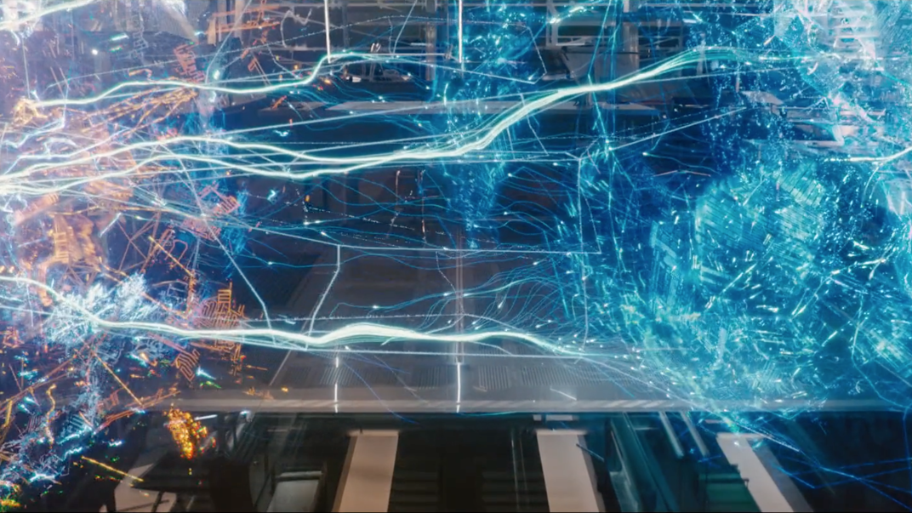
Ultron vs JARVIS
Ultron is portrayed as more self aware than JARVIS
  Asked JARVIS about his body
JARVIS managed to escape undetected from Ultron’s attack
  Ultron thought he was dead
JARVIS repeatedly changed nuclear launch codes to block Ultron
Image: Whedon, J. (Director). (2015). Avengers: Age of Ultron [Motion picture]. United States of America: Walt Disney Studios Motion Pictures.
Notes:
Ultron exhibits the sense of personality when he first was created, he is surprised when JARVIS didn’t think of having a body and was governed by Tony Stark. Throughout the movie we see how Ultron evolves and tries to get better.
In the first scene we see Ultron he attacks the weak not as technologically advanced AI Jarvis. However, without Ultrons knowledge, Jarvis was able to escape and survive the attack.
We can also see it later in the movie when Ultron was trying to access the nuclear codes and Jarvis was constantly changing them so Ultron would not be able to use them. This way the more advanced AI was defeated by the lesser.

Slide 8
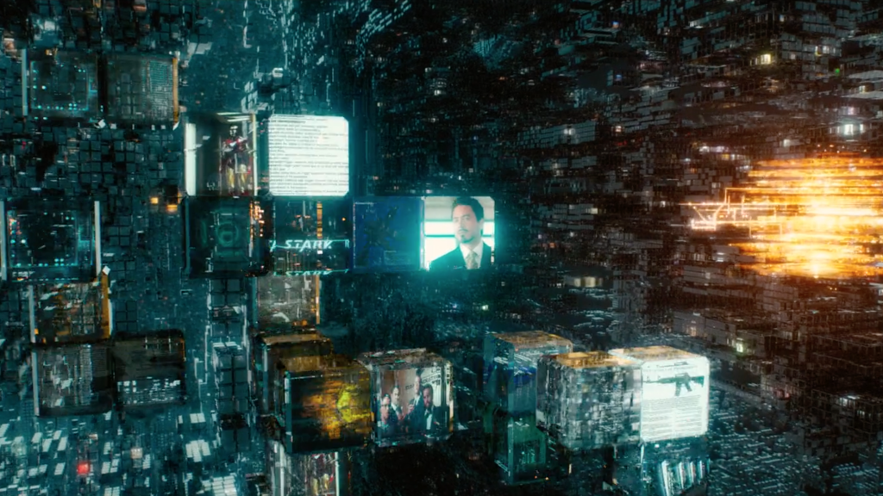
The Dangers of Internet Connectivity
Ultron moved around instantly using the Internet
  Controlled the Iron Legion
  Crime can be anywhere
    Unlimited knowledge makes his (nearly) unstoppable
Ultron wipes Avengers data from Shield
  Dependency on the Internet
Internet hub
  Disregards privacy rights of others
  Single point of entry
Image: Whedon, J. (Director). (2015). Avengers: Age of Ultron [Motion picture]. United States of America: Walt Disney Studios Motion Pictures.
Notes:
Ultron moving instantly made it difficult for the avengers to contain the destruction he caused around the world.
This shows some of the dangers and highlights the point that cyber crime can happen from anywhere.
Unlimited knowledge via the Internet allows enemies to be unstoppable so long as they are connected to the Internet.
Ultron accessed information about Shield and wiped the avengers data, which led to them to use hard copies to search for his next target.
We see the dangers of the connectivity of the internet with how Ultron was able to use the internet to control his iron legion and rapidly move between locations.
Hawkeye had to use classic spy techniques instead of using the internet to try to contact and find Black Widow.
The Internet hub and how everything on the internet going through one point makes it easier to gather information.
We also see this with the Internet hub, which is one room through which all of the information in the internet travels through.
Which is very similar to what we found during our self search project.
Leads to a lot of issues with privacy rights.

Slide 9
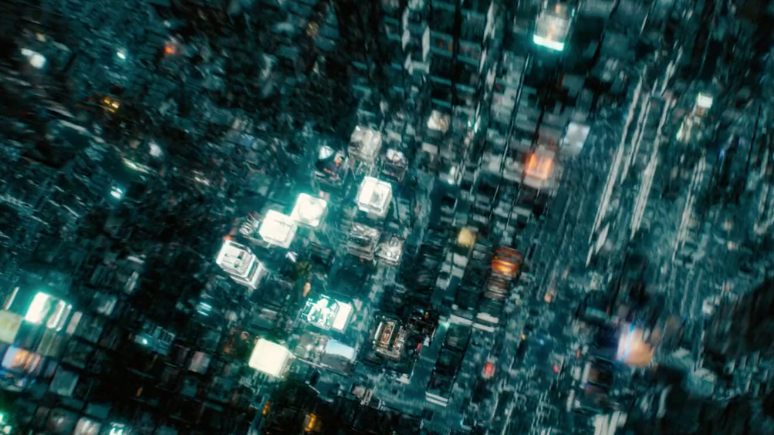
The Benefits of Internet Connectivity
Internet helped Tony Stark locate the Hulk when he went on a rampage.
  Protected civilians from Hulk, thus saving lives
  "Find My Friends" iPhone app used to track friends, family members
The Avengers tracked and locate Ultron using the Internet
  Police track criminals through social media. [8]
Image: Whedon, J. (Director). (2015). Avengers: Age of Ultron [Motion picture]. United States of America: Walt Disney Studios Motion Pictures.
Notes:
There are benefits to the internet.
Stark was able to track down the Hulk using social media during the movie, allowing him to reach the Hulk much quicker before the rampage got further out of control
Find my friends apps allow people to stay connected to those they love
They were also able to use it to track down Ultron
Similar to police using social media to track and arrest criminals
Social media can be helpful when disasters occur

Slide 10

Movie Reactions
Fans expressed opinions regarding copyright limitations [3]
  Campaigned to get characters into the Marvel Cinematic Universe from other studios, i.e. Spider-man. [4]
  Remember, opinions can go viral!
Negative opinions on the portrayal of some characters
  Director Joss Whedon closed his twitter account after online harassment [6]
    Zelda Williams quit twitter & instagram in 2014 after receiving photoshopped pictures of her dead father [7]
Image: http://blogs-images.forbes.com/scottmendelson/files/2015/07/marvel-logo-wallpaper.jpg
Notes:
Different studios held rights to various characters, fans used social media to run a campaign to get their favorite characters included in the larger universe. Now there is a Spiderman movie in the works that is a collaboration between Marvel and Sony.
The film got many reactions across the internet. There were concerns about the portrayal of characters like Black Widow. Joss Whedon actually received so much online harassment that he actually deleted his twitter account. This is similar to Zelda Williams deleting here social media after she received many photoshopped images of her dead father.

Slide 11
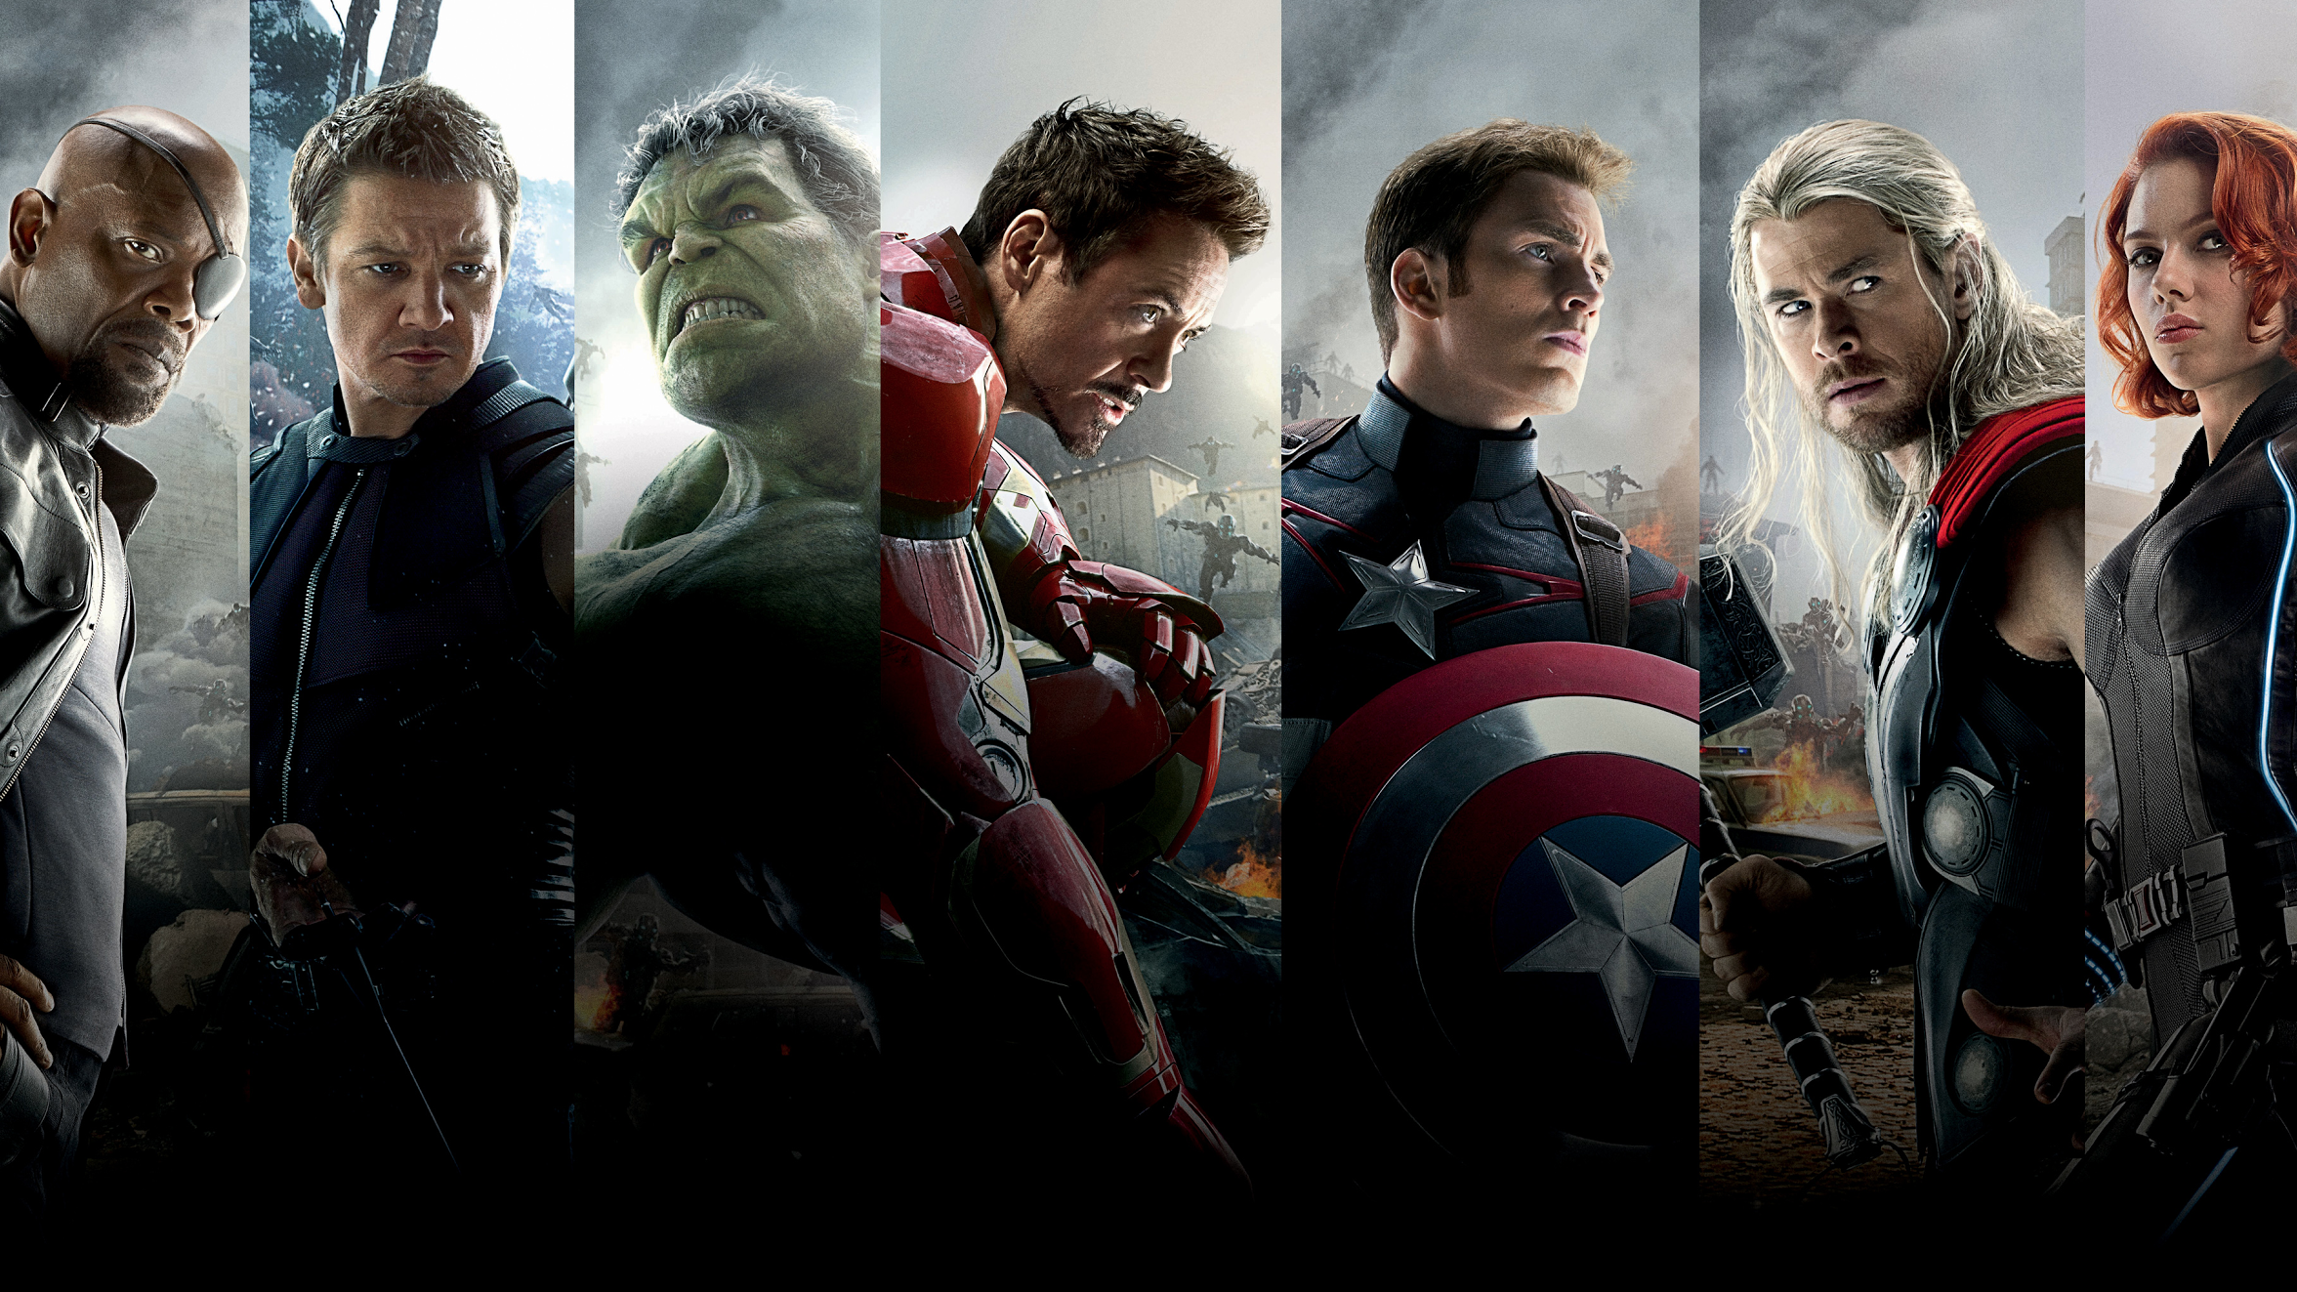
Recap
Highlighted issues regarding tampering with technologies you don't understand
Superior technology does not always lead to victory
The connectivity the Internet provides is not necessarily positive
Image: http://s2.dmcdn.net/K8-kU.jpg
Notes:
The movie tries to show that tampering with technology you don’t understand will lead to disastrous consequences, we see this when we compare Tony Stark’s creation of Ultron and the creation of his Iron Man armor.
It also teaches that superior technology does not lead to victory. Which can be seen in the conflict between Ultron and Jarvis. The superior AI Ultron is thwarted in his attempts to use the nuclear codes to launch missiles by the much less advanced Jarvis who had escaped Ultrons attack.
Finally the movie shows how the connectivity that the internet provides can be a negative by portraying the internet in a mostly negative light, as it is constantly used by Ultron to fight against the Avengers. There was a real-life controversy surrounding the movie that led to the director experiencing online harassment.

Slide 12
References
[1] Whedon, J. (Director). (2015). Avengers: Age of Ultron [Motion picture]. United States of America: Walt Disney Studios Motion Pictures.
[2] Wood, J. (1893). Dictionary of quotations from ancient and modern, English and foreign sources: Including phrases, mottoes, maxims, proverbs, definitions, aphorisms, and sayings of the wise men, in their bearing on life, literature, speculation, science, art, religion, and morals, especially in the modern aspects of them. London: Warne.
[3] Comicbook.com,. (2015). Scarlet Witch & Quicksilver Confirmed As Not Being Mutants, True Parents Revealed. Retrieved 21 September 2015, from http://comicbook.com/2015/05/09/-scarlet-witch-quicksilvers-confirmed-as-not-being-mutants-true-/
[4] Marvel.com,. (2015). Sony Pictures Entertainment Brings Marvel Studios Into The Amazing World Of Spider-Man | News | Marvel.com. Retrieved 7 October 2015, from http://marvel.com/news/movies/24062/sony_pictures_entertainment_brings_marvel_studios_into_the_amazing_world_of_spider-man
[5]Chong, C. (2015). This robot passed a 'self-awareness' test that only humans could handle until now. Business Insider. Retrieved 6 October 2015, from http://www.businessinsider.com/this-robot-passed-a-self-awareness-test-that-only-humans-could-handle-until-now-2015-7
[6] Phillips, I. (2015). Joss Whedon quits Twitter after receiving death threats related to ‘Avengers: Age of Ultron’. Business Insider. Retrieved 3 October 2015, from http://www.businessinsider.com/joss-whedon-quits-twitter-2015-5
[7] Doug Gross, C. (2015). Robin Williams' daughter quits social media after abuse - CNN.com. CNN. Retrieved 8 October 2015, from http://www.cnn.com/2014/08/13/tech/social-media/zelda-williams-twitter/
[8] Smith, G. (2014, June 25). How Police Are Scanning All Of Twitter To Detect Terrorist Threats. The Huffington Post. Retrieved October 9, 2015, from http://www.huffingtonpost.com/2014/06/25/dataminr-mines-twitter-to_n_5507616.html

