Slide 1
Apollo 13
Apollo 13
Will Frick, Andrew La Manna, Patrick Plenefisch, Nan Zhang
Notes:
<speaker notes>

Slide 2
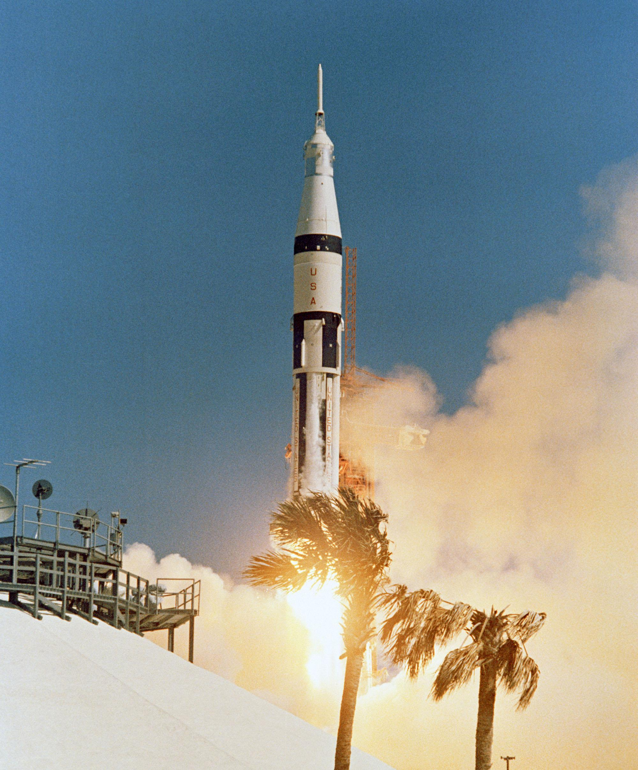
PLOT OVERVIEW
Apollo 13
1970 moon mission goes horribly wrong
O₂ tank explodes
Move to Lunar Module as emergency lifeboat
Reduce rising CO₂ levels
Readjust entry angle manually
[1]
Notes:
This a movie based of the 1970 mission to the moon, apollo 13. This was the third mission to put a man on the moon.
The important points of the movie included the oxygen tanks exploding due to a bad heating coil. This was starting point of the failures of apollo 13. The explosion nearly damaged the heat shields and threw the ship off course. In addition since the oxygen in the tanks was also used as fuel, they needed to conserve power. The crew had to transfer all the navigational data to the Lunar module in order to shut down the command module to conserve power.
3 people using the lunar module for an extended period of time caused another problem. The lunar module was designed to handle the carbon dioxide of two people, but now there were three using it. With the rapidly rising CO2 levels, mission control worked endlessly to make the square command module CO2 filter, fit in the round Lunar module filter hole. The challenge was they could only use the parts that were available to astronauts. In the movie and in the real mission they used parts ranging from flight plan covers to socks.
The Last major challenge faced was the entry angle needed to be adjusted so that the command module wouldn’t bounce off the atmosphere and off into deep space, or burn up in the atmosphere. Normally this is a somewhat trivial task with the help of the guidance system, but since that was powered off the astronauts had to do this manually using the measurements on the window of the ship and earth as reference points. To make matters worse, the ship’s center of gravity was was off since they were using the Lunar module’s thrusters as opposed to the command module and there was severe lack of moon rocks.

Slide 3
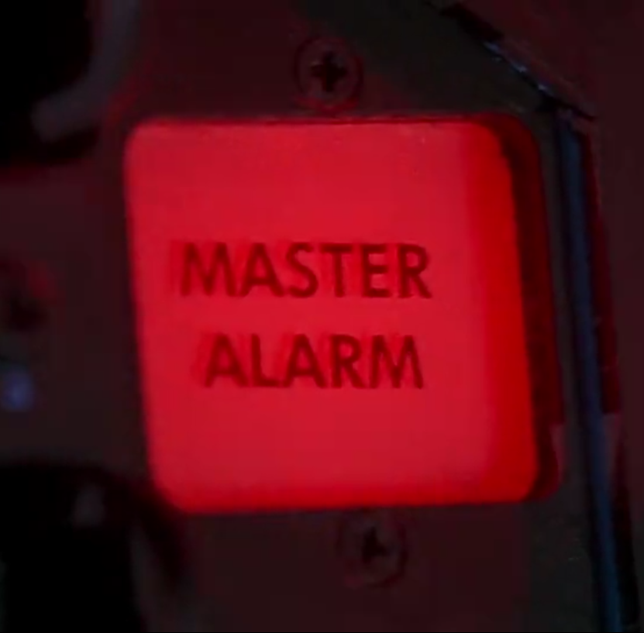
COMPUTER RELIABILITY
Apollo 13
The explosion of the oxygen tank demonstrates poor computer reliability
The abortion of moon landing is due to a bad heating coil
[1]
Notes:
Nan
Computer reliability plays a significant role of this space search. Because an oxygen tank exploded due to a bad heating coil, the whole spaceship got badly damaged. The explosion of the oxygen tank demonstrates poor computer reliability. Just like a computer, the whole spaceship is a machine. Although the coil itself might not be considered as a computer, it should be considered as a part of the machine.
Because of this accident, the three astronauts aborted their moon landing for getting back home safely. According to NASA’s research, the coil was just too old, and it basically ruined everything. We can see how a small defect changes everything.

Slide 4
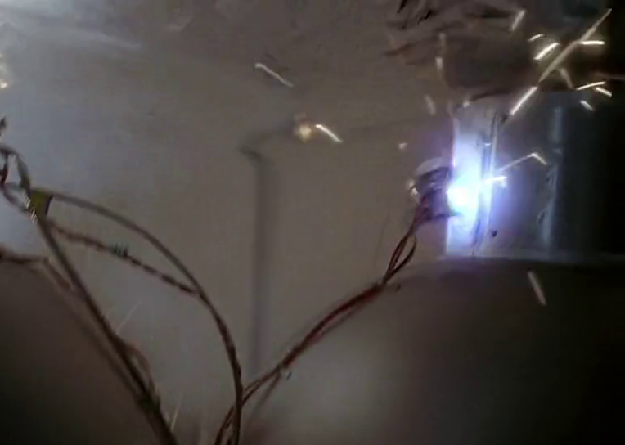
POOR DESIGN?
Apollo 13
Strictly speaking, Apollo 13’s failing were signs of poor design
Single point of failure
Lack of contingency planning
[1]
Notes:
Nan
Technically speaking, the failure of Apollo 13 was the failure of hardware. The design of the spaceship seems poor and this seems to be an important reason why the three astronauts aborted moon landing. A single faulty coil was the cause for the entire disaster. Well-engineered systems are meant to use redundancy to prevent single points of failure. However, the spaceship failed to achieve that goal.
Plus, the unexpected nature of the accident begs the question of whether the team had adequately prepared for literally every scenario. The lack of contingency plan was indicated in the movie, because this single point of failure changed everything of their plan. It is very unfortunate that the accident happened.

Slide 5
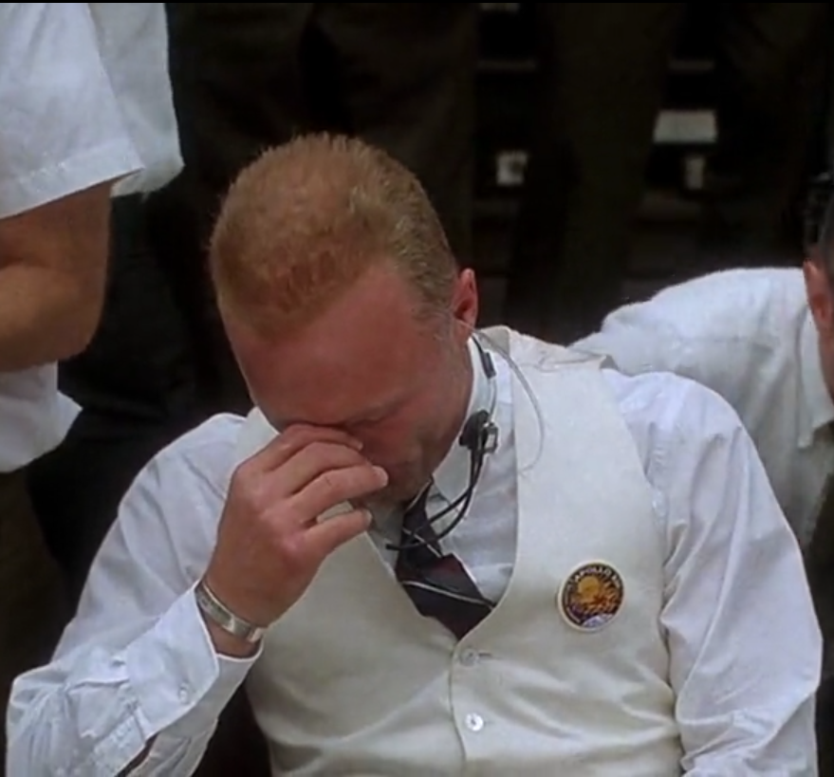
BUT CAN WE FAULT NASA?
Apollo 13
Freak incident
Already some redundancy; more would not have protected against an explosion
Training was clearly ample, just didn’t consider this unlikely scenario
[1]
Notes:
Will
However, it’s not really fair to point the blame at these oversights. While failures are signs of oversights, this was such a freak incident that it’s understandable why they were not prepared. After all, the damaged coil exploded; no amount of redundancy was going to prevent the damage it caused. Plus, it’s not like the flight crew wasn’t well-trained; we see them diligently preparing for all sorts of scenarios. Of course, it isn’t possible to prepare for literally every scenario; it’s unfortunate that the team was faced with one they hadn’t anticipated, but we can’t really fault them for not considering such an unlikely contingency.

Slide 6
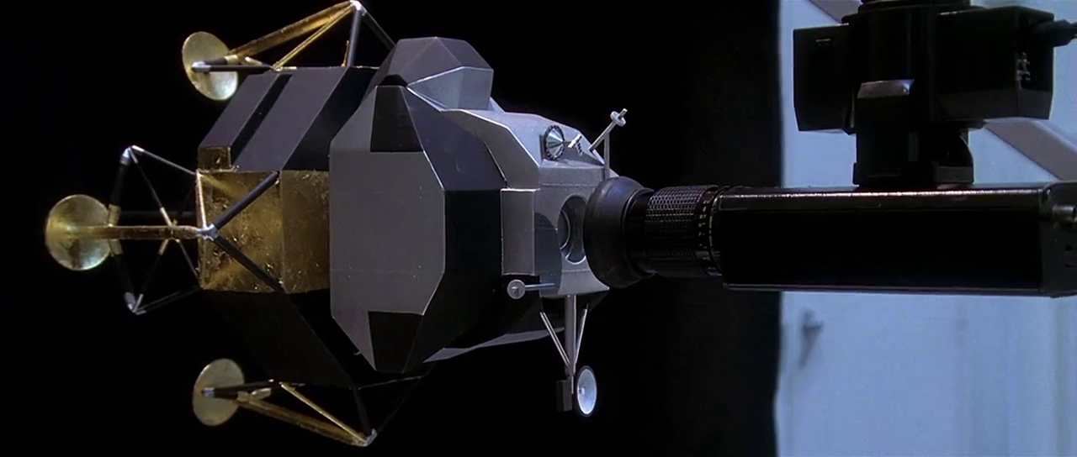
STATISTICS
Four oxygen tanks
Apollo program had 29,967 training hours
80% spent in Command Module and Lunar Module Simulators
Astronauts were selected four years prior to launch
[2,3,5]
Notes:
Patrick
So let’s look at what had been done to prepare. The whole package had a total of 4 oxygen tanks, Two of which were damaged by the explosion. There were similarly redundant items around the spacecraft, though they didn’t fail.
What about training? While training for the missions, the astronauts trained for thousands of hours, and if you compress it down per astronaut, they each spent about a solid 9 months of time in the simulators. Obviously, it was spread out and not hardcore back to back most of the time, as this was over 4 years from selection to mission in most cases. There was no evidence to suggest that the training or redundancy were at fault here, and they probably helped, especially in steering and the Co2 issue.

Slide 7
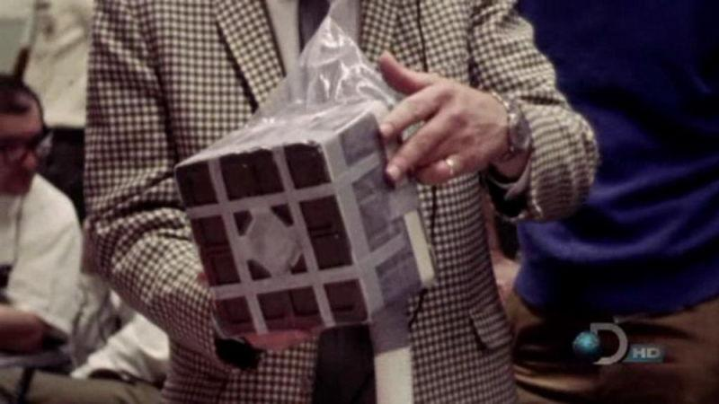
INNOVATION
Apollo 13
Deadly levels of CO2 were major concern
They needed a better filter to reduce the levels
Square pegs don’t fit in round holes
Solution
Command Module Filter
Roll of grey duct tape
2 LCG bags
2 hoses from red suits
2 socks
1 bungee cord
[4]
Notes:
Andrew-
Perhaps one of the most famous moments of the Apollo 13 mission was the astounding solution to lower the rising CO2 levels. The Lunar module was designed to hold 2 people for 36 hours, but it was going to occupied by 3 people for 96 hours. The extra person and time posed a major issue to the lives the crew. The air scrubber in the Lunar module was unable to handle the increased CO2 generation. The best course of action was to use the air scrubber from the command module in the Lunar Module, but the command module had square scrubbers, while the Lunar module had round ones. Mission control worked round the clock to find a way to use the square scrubbers in the Lunar module. The solution was a “mail-box” contraption that utilized some strange materials. Strange as it may have the been, it worked and saved the lives the astronauts. This goes to show that in high risk environments, innovation and creative thinking can pushed to limits solving problems in record times.

Slide 8
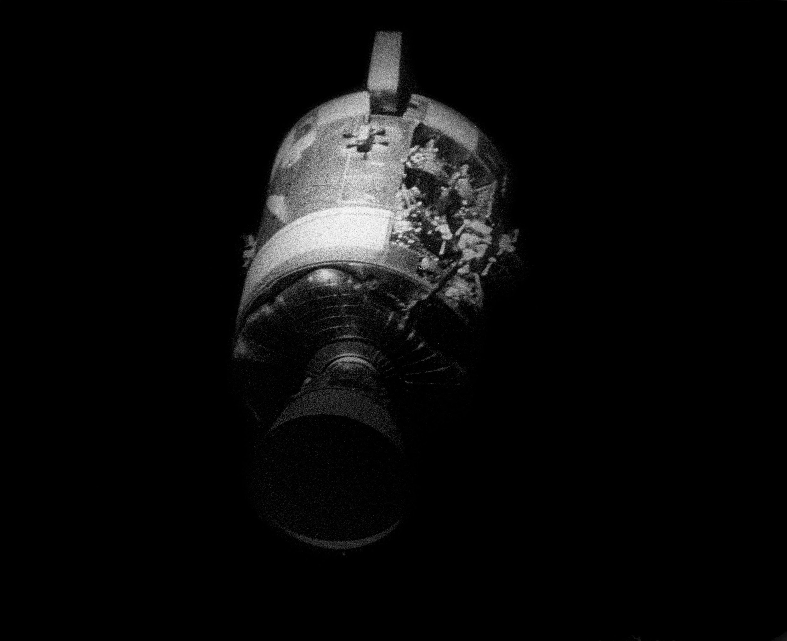
CONCLUSION
Apollo 13
Technology will eventually fail, and sometimes it’s hard to prepare for it.
Have a backup for the technology
Human innovation can overcome the most difficult of obstacles in high risk scenarios
[1]
Notes:
Will -
In apollo 13 a heating coil that was never readjusted to match the proper voltage caused and explosion in the 02 tanks jeopardizing not only the mission, but the lives of the astronauts. The crew had prepared for multitude of scenarios via the flight simulator, which included some minor failures thrown at them. But since a failure of this magnitude is hard to predict the crew and mission control had to react on the fly to determine what the best course of action was. Even though it was a problem that is difficult to predict, it is still important to prepare for catastrophic failures. This allows the crew to have some experience with a major catastrophe in the event that one does occur
In the event that technology does fail it's always import to have some sort of back up for it if possible. It may be something as simple as a pen and paper to substitute a calculator that sudley caught fire. In this case they used the widow view and some the measurements on the window itself to re-align the shuttle’s entry angle. Normally the computer’s guidance system would have been used to steer, but since they had no power, it had to be done by hand.
Patrick
We also see the power of human innovation in times of crisis. Over the course of a few days we see mankind stretching their ideas to the limit in order to get the stranded astronauts home. A perfect example of this is when mission need to fit a spare peg into a round hole using only junk and spare parts on the ship.

Slide 9
REFERENCES
Apollo 13
[1] Apollo 13. Dir. Ron Howard. Perf. Tom Hanks, Kevin Bacon, Bill Paxton, Gary Sinise, and Ed Harris. Universal Pictures, 1995. DVD.
[2] Report of Apollo 13 Review Board. 1970. http://ntrs.nasa.gov/archive/nasa/casi.ntrs.nasa.gov/19700076776.pdf (April 25, 2016)
[3] Computers in Spaceflight: The NASA Experience. http://history.nasa.gov/computers/Ch9-2.html (April 25, 2016)
[4]Diaz, Jesus. The device that saved the Apollo 13 crew http://sploid.gizmodo.com/this-is-the-actual-hack-that-saved-the-astronauts-of-th-1598385593 (April 25, 2016)
[5] Apollo 13 - The Seventh Mission: The Third Lunar Landing Attempt. http://history.nasa.gov/SP-4029/Apollo_13a_Summary.htm (April 25, 2016)

