Slide 1
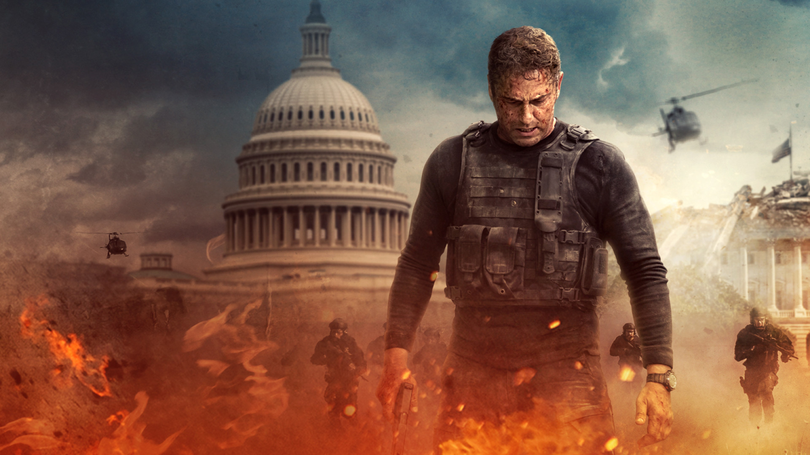
Angel Has Fallen
Justin Healey
David Gibson
Witt Wang
Jared Lasselle
Notes:
Justin

Slide 2
Plot Summary
Background: Mike Banning is a Secret Service Agent with prior military experience
1. The drone attack
  A semi-automated swarm of drones
  Facial recognition software
  Target the President but leave Mike alive
2. After the attack
  Mike is suspected of being behind the assassination attempt because he was the only S.S. agent survivor
  The President is in a coma
  The VP (Kirby) is sworn in
3. Breakout
  Mike gets broken out of his transport detail by the same people that set him up
  They hack the transport’s escort vehicles and shut them down on the road
  Mike breaks away from his captors and realizes that he knows them
4. Mike goes on the run
  He finds his father and is then attacked by mercenaries
  The FBI is also looking for him
  We learn that now President Kirby is part of it too
5. Mike turns himself in at the hospital
  The President believes that he’s innocent
  Salient hacks the hospital
  Mike takes control and protects the President against another assassination attempt
Notes:
Justin
INTRO
[*] The movie starts with an intro to Mike’s life where we learn about
- His family
- His past life
- His background
**NOTE: The bullets in blue are major computing technology/events
[ THE DRONE ATTACK ]
[*] Right before the drone attack the President offers Mike the position of Director of the Secret Service
[*] The drone attack is the main show of technology in the movie and the scariest
[ AFTER THE ATTACK ]
[*] The FBI is adamant that Mike is responsible
- They think he colluded with Russia
[*] Mike goes on the run for a while
[ BREAKOUT ]
[*] Mike gets broken out of his police escort
- The mercenaries hack the convoy and basically shut down the cars, making them sitting ducks
[*] Mike breaks away from his captors
[*] He recognizes them and realizes they’re from Salient
[ MIKE GOES ON THE RUN ]
[*] One of the first things he does is find his dad
[*] The FBI and Salient are looking for him
[*] The VP is part of the setup
[*] The FBI starts to learn that maybe Mike is innocent
- They look into Salient
- Salient kills two FBI agents
[ MIKE TURNS HIMSELF IN ]
[*] Mike sneaks into the hospital as a statement that he’s innocent
[*] Holds a Secret Service agent hostage until they believe he’s innocent
[*] He speaks to the president who believes he’s innocent
[*] Salient attacks the hospital with a cyber attack and tries to blow it up
[*] Mike leads an evacuation and then a firefight against Salient mercenaries

Slide 3
Conclusions
Main conclusion: Due to modern technology, we need to be much more careful with national security and cybersecurity on all forefronts.
Key Arguments:
The director’s testimony in interviews
Realism of Killer Drone Swarms
Misuse of Facial Recognition
  Salient having access and using it for malicious intent
Large scale hacking of cars and other infrastructure
  Mike’s prison transport
  The hospital
Notes:
David
Since the creation of technology there has been a need to protect against new and unforeseen threats that could be lurking just beyond the horizon. From the invention of tools, came new spears and arrows; further down the line guns made their appearance and terrorized the world; in the mid 1900's threat of nuclear war kept everyone on their toes; and now the treat of drones, AI, and sophisticated hacking lurk, waiting to cause damage to our nation's security. The film exemplifies throughout its plot points, from drone swarms , to hospital being hacked and even the hacking of cars. All these situations are very possible now, or in the near future and the movies realism about these threats argues that the nation needs to be more careful about its national security to prevent potential attacks like the ones depicted.

Slide 4
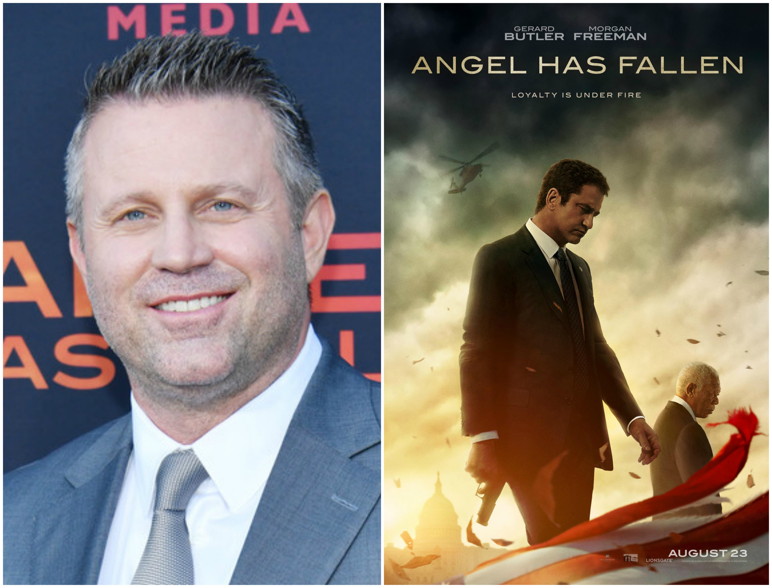
Argument 1: The Directors Intent
Director: Ric Waugh
Main Intent: To demonstrate the potential dangers of real-world technologies [1] [2]
Demonstrate potential misuses of computing technology
  Weaponized artificial intelligence
  Facial recognition and Hacking (by Salient)
  Occupy top 10 fears from 2015 [10]
Illustrate the paradoxical uses of computing technology
  Law Enforcement: Saving lives
  Malicious Actors: Terrorism & attacks
  Only 12% of businesses are Data Champion[11]
Show both sides of the controversy through Mike’s experiences
  Being tracked by the FBI & Salient
  Evading detection
  Completing his agenda to save the President (good intentions) despite Salient’s actions (bad intentions)
The director of Angel Has Fallen : Ric Roman Waugh[2]
Notes:
Witt
Intended to be realistic
points out the potential dangers of real-world technologies, which triggered the warning about national security issues. Three points to illustrate it.
1. demonstrates the potential misuses. The artificial intelligence, facial recognition and hacking reveal the misuse. Fears caused by the misuse of computing technology included in the list of top ten fears. Cast a shadow on people's psychology.
2. illustrates the paradoxical uses of computing technologies. Contradictions in development of technology itself. the use of these technologies can protect people's lives/ used by terrorists to kill people. This phenomenon has proved by Dell Technology’s statistics. Only 12% of businesses are engaged in both technology development and its culture puzzle, so that they can make sure that the computing technology will not cause a paradoxical use.
3. shows both sides of the controversy through the protagonist Mike’s experience. Beginning of the film, Mike was suspected by everyone as the murderer. After being investigated, he chose to uphold justice and finally saved the lives of the President and all people. This is why he is called an angel. The hero's experience is similar to the development process of computing technology. They should both work for the national security and cybersecurity.

Slide 5
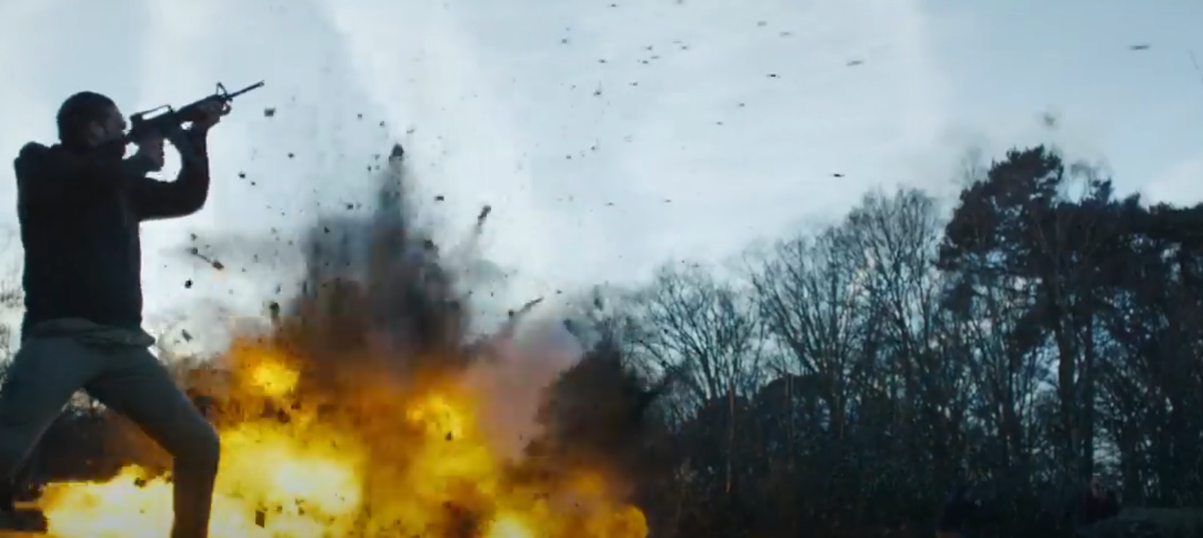
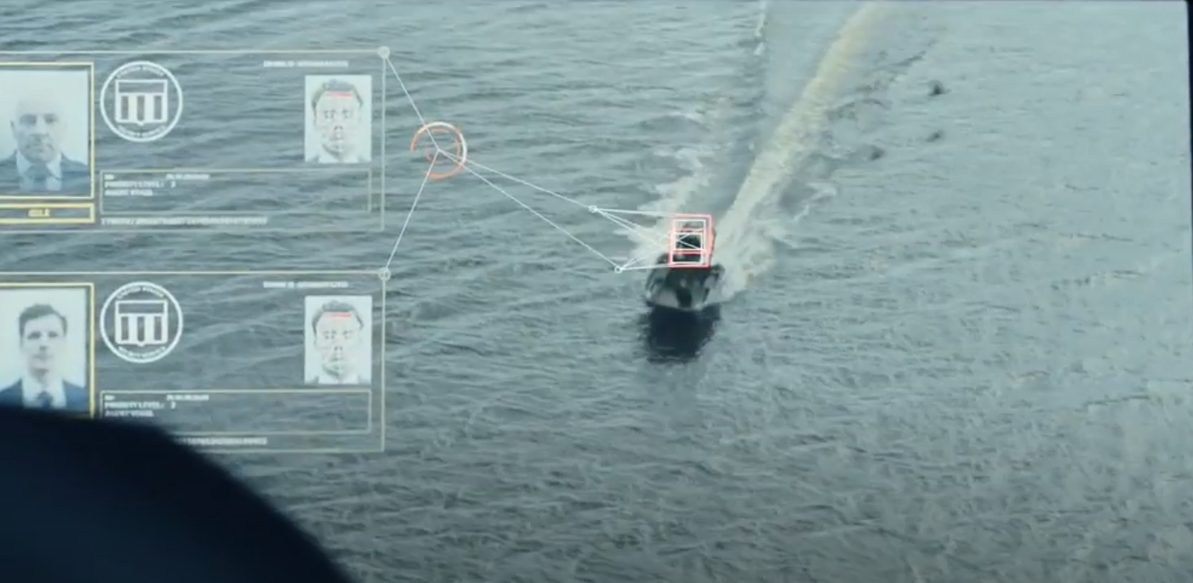
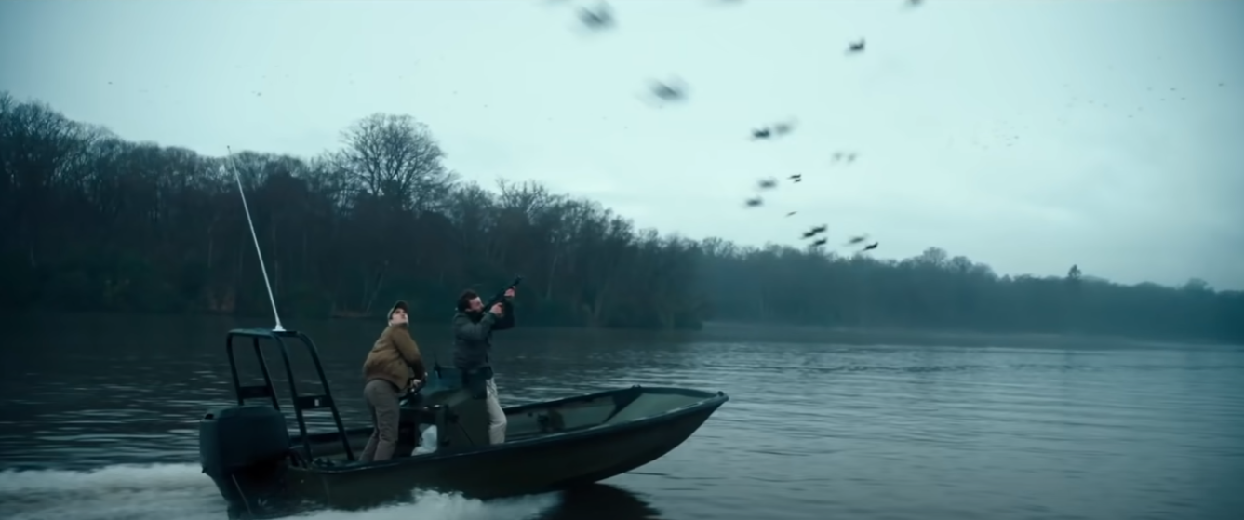
Argument 2: Realistic AI Killer Drones
In The Movie
The killer drones were used by the Salient company to try to kill the president at the beginning of the film
The Drones were equipped with facial recognition to identify who it was attacking.
Real-world examples
At least 43 countries operate drones for military purposes [7]
The first drone strike by the CIA occurred in November 2002 killing 6 suspected Al Qaeda members [7]
US alone controls 865,505 domestic drones for commercial and recreational use
  Many drones do not have encrypted RF transmission and are relatively easy to hack
Notes:
Jared
The most important thing to point out about this slide is that the technology represented in the movie exists and is quite insecure.
Start with where this takes place in the movie, continue to context in the movie. When presenting about facial recognition do not go too in depth because the facial recognition is on the next slide.

Slide 6
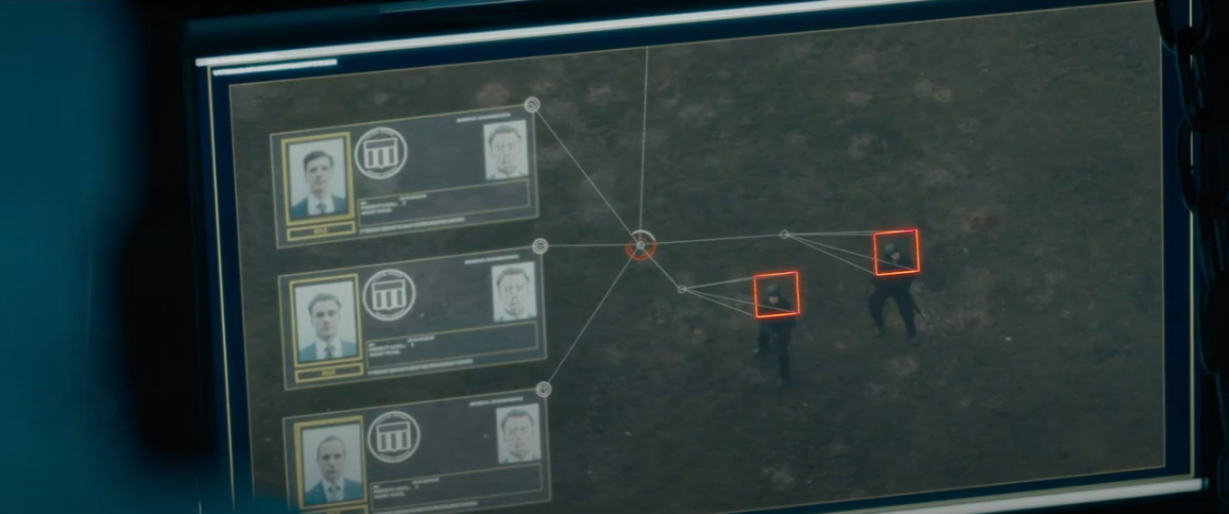
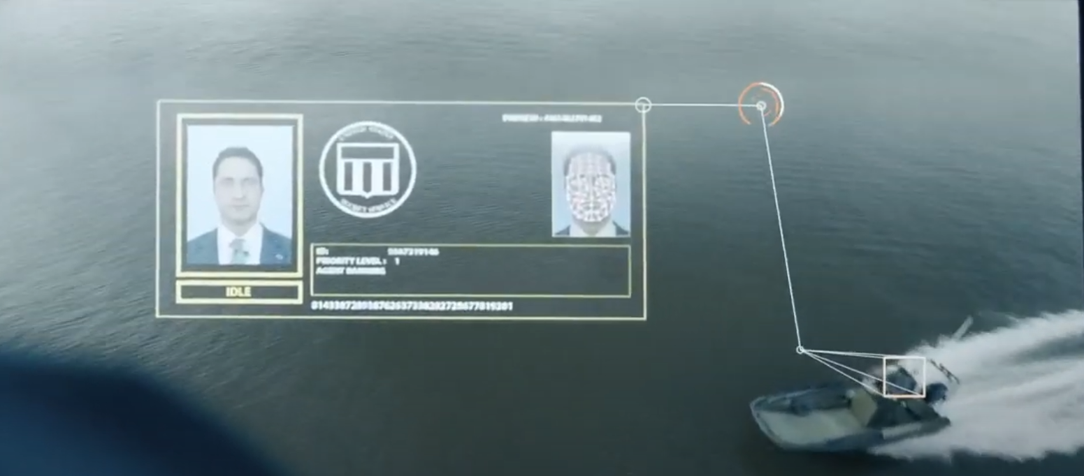
Argument 3: Misused Facial Recognition
Ch. 6: Privacy & The Government
In The Movie:
The drones use facial recognition in the assassination attempt
  They choose who to attack
  Salient intentionally leaves Mike alive, killing everyone else
Facial recognition is used by Salient to locate Mike while he is on the run
  Salient uses facial recognition with malicious intent.
In Real Life
China uses facial recognition “to profile Uyghur individuals, classify them on the basis of their ethnicity, and single them out for tracking, mistreatment, and detention” [8]
UAE has implemented AI facial recognition drones to track criminals [9]
Salient mercenaries use facial recognition to target Secret Service agents with the drones.
Using facial recognition, the drones intentionally don’t target Mike because Salient wants him kept alive.
Notes:
Justin
[ IN THE MOVIE ]
-> One of the very first scenes is an assassination attempt on the President using semi-automatic drones
-> The drones have facial recognition that allows them to choose who to attack
-> This allows Salient to further their agenda by intentionally leaving Mike alive
-> Salient also uses facial recognition while Mike is on the run
-> They want to find him to stop him from exposing the truth (bad intentions)
[ IN REAL LIFE ]
-> China uses facial recognition to influence the behavior of their citizens and for law enforcement purposes
-> They use it in a very discriminatory way, targeting specific people based on their race and ethnicity
-> More related to Angel Has Fallen, the United Arab Emirates uses facial recognition in drones for law enforcement and tracking criminals
* This shows that this kind of technology is very real and very practical, even though it is used for good reasons in this example
* Just because the UAE uses it for good doesn’t mean everyone does/will

Slide 7
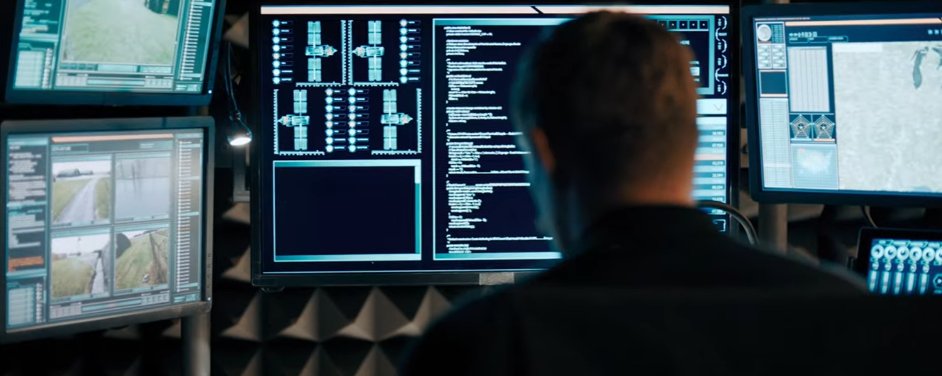
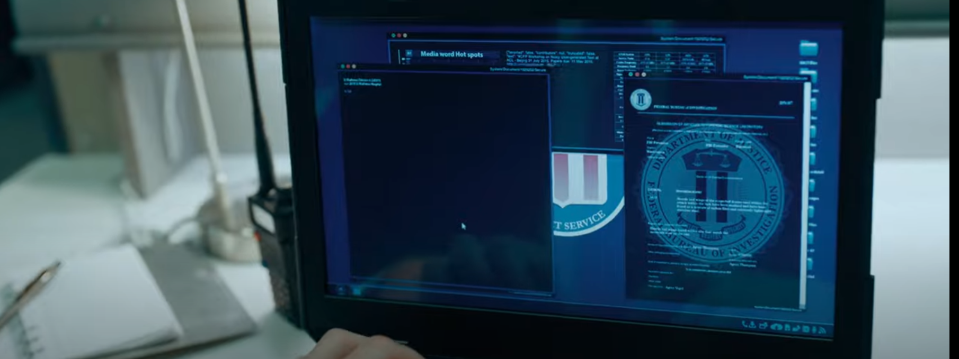
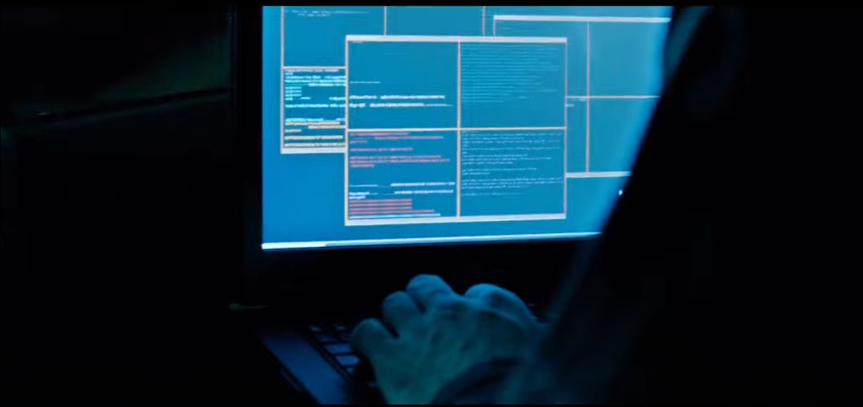
Argument 4: Network Security & Hacking
Ch. 5: Information Privacy
Ch. 7: Security
Information Privacy for Mike’s Family
  Eavesdropping system
  84% of us eavesdrop on other people’s conversations on public transport [3]
Personal Information on Servers
  Salient hacks the government servers for information on Mike
Privacy of Hospital Patients
  The hospital cyber attack
  Hacking was responsible for nearly 85% of all affected patient records [4]
Intelligence Gathering
  National security threats
  Personal property safety
Terrorist Threats
  President's life safety
  Government personnel life safety
  Domestic terrorist incidents rate rose in 2020 to 6.4% [6]
Vehicle Safety
  Hacking cars
  An estimated 42,915 people died in vehicle traffic crashes in 2021 [5]
Salient hacks gov. servers for information on Mike.
S.S. agents defend the hospital against a cyber attack.
Salient mercenaries hack into the transport vehicles taking Mike to prison and stop them in the road.
Notes:
Information Privacy(Witt)
Our fourth argument: hacking and loss of network security exert strong influence on nation security. From the perspective of information privacy, family information privacy, personal and hospital patient identity information are harmed. The eavesdropping system exposes the chat records of Mike's family in the movie.
According to relevant data provided by British research institutions, 84% of the people eavesdrop. points out the difficulty to protect. hacking system --people's action track.
hacking was responsible for nearly 85% of patient records. In the movie, the computer system of the hospital was damaged and the patient's privacy was leaked. real life, hospital patients will lose information privacy.
Hackers sell performing star's information which stored in hospitals' computers -> gain profits. Trading chain formed
Security (David)
From the perspective of security this movie contained many security threats both to the national security and personal property saftey. Durring the movie the presidents life is threatened by hacking the hospital to release excess amounts of Oxygen into the building to cause an explosion, this also risks the life of many patients in the hospital as well as many secret service agents lives. This comes in a time where the domestic terrorist rates rose to 6.4%. The next part of the movie where security is important is when the security van was hacked. If in the wrong hands much of this hacking could lead to further threats of national security. Although the van in the movie was hacked in order to shut it down with many smart vehicles on the road a mass hacking of cars could lead to a large scale danger to all citizens, with an estimated 42,915 people dying in car crashes in 2021, a mass hacking like this could see many more .

Slide 8
References
[1] Minow, Nell: “Angel Has Fallen’s Director, a Former Assistant Director of the Secret Service, Talk Riveting Realism | Motion Pictures, 23 August 2019. https://www.motionpictures.org/2019/08/angel-has-fallens-director-a-former-assistant-director-of-the-secret-service-talk-riveting-realism/
[2] “Exclusive: Director Ric Roman Waugh Talks ‘Angel Has Fallen.’” Black Film, 22 August 2019. https://www.blackfilm.com/read/2019/08/exclusive-director-ric-roman-waugh-talks-angel-has-fallen/
[3] Phillips, James: "84% of us eavesdrop on other people’s conversations, survey reveals", Independent, 13 February 2015. https://www.independent.co.uk/travel/news-and-advice/84-of-us-eavesdrop-on-other-people-s-conversations-survey-reveals-10044327.html
[4] Ronquillo, J.G., Winterholler, J.E., Cwikla, K., Szymanski, R., Levy, C., "Health IT, hacking, and cybersecurity: national trends in data breaches of protected health information", JAMIA Open, Volume 1, Issue 1, July 2018, Pages 15-19, https://doi.org/10.1093/jamiaopen/ooy019
[5] "Newly Released Estimates Show Traffic Fatalities Reached a 16-Year High in 2021", NHTSA, 17 May 2022. https://www.nhtsa.gov/press-releases/early-estimate-2021-traffic-fatalities
[6] Jones, S.G., Doxsee, C. "The Military, Police, and the Rise of Terrorism in the United States", Center For Strategic & International Studies, 12 Apr 2021. https://www.csis.org/analysis/military-police-and-rise-terrorism-united-states
[7] Lexy Leuszler, The History and Future of Drone Warfare (steppenwolf), https://www.steppenwolf.org/articles/the-history-behind-and-future-of-drone-warefare/ (Oct 10, 2022)
[8] A letter to U.S. Secretary of State Michael Pompeo | U.S. Senate, 11 March 2020. https://www.portman.senate.gov/sites/default/files/2020-03/China%20Warren%20AI%20Letter_0.pdf
[9] Ali, Aghaddir: “Sharjah Police drones use face-recognition technology to identify wanted criminals.” Gulf News, 26 Apr 2021. Accessed 10/10/2022. https://gulfnews.com/uae/crime/video-sharjah-police-drones-use-face-recognition-technology-to-identify-wanted-criminals-1.7857730
[10] Salmi, Deborah. "Government and misuse of technology are most feared by Americans", Avast, 22 Oct 2015. https://blog.avast.com/2015/10/22/government-and-misuse-of-technology-are-most-feared/
[11] "The Data Paradox: Why Data Can Be Both an Advantage and a Burden", Dell Technology, StartUpNation, 5 Aug 2021. https://startupnation.com/sponsored-content/data-paradox-data-advantage-burden/

