Slide 1
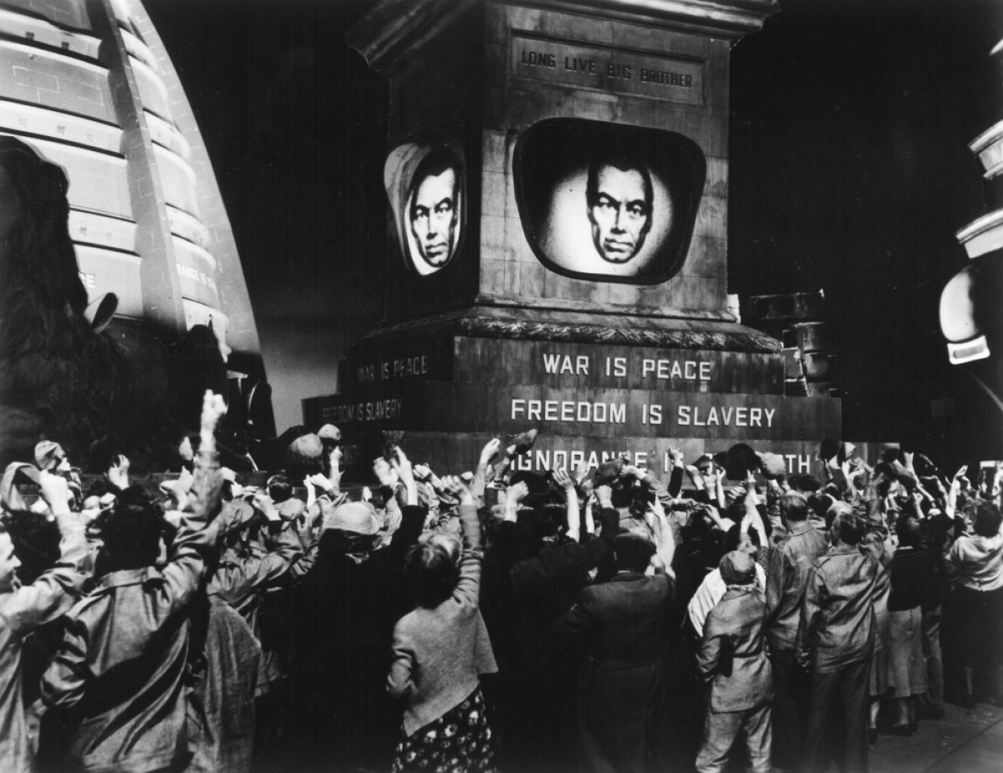
1984
Alexander Beck, Caleb French, Eric Hughs-Baird, Owen Lacey, James Walden

Slide 2
A quick recap…
1947 [4]
Cold War
Voice of America is broadcasted into the Soviet Union
1948 [5]
Soviet Union jams Voice of America
Berlin Blockade starts
1949 [6]
Berlin Blockade is lifted
1984 (book) by George Orwell published
Notes:
Context of the world at the time:
The Cold War started, which for those who don’t know was a non-armed conflict between the United States and the Soviet Union. It is associated with things like increased security, fear of Communism (such as the Red Scare), and rapid military technological advancement.
Voice of America, which was a radio station that America started broadcasting in Eastern Europe and the Soviet Union, was also started in 1947 as a way to spread America’s political beliefs to the region.
In 1948, the Soviet Union tried jamming the Voice of America as a way to maintain control.
Also in 1948 was the Berlin Blockade, with which the Soviet Union blocked almost all supplies to areas in Berlin under the Wests’ control. I say almost because America ended up thinking of a solution, which was using a constant stream of supply drops to supply the region.
In 1949, the Berlin Blockade was lifted, and George Orwell published a little known book titled 1984. Orwell wrote the book as a way to crique fascist governments and their control over the population.
1984 was written in 1949 (Orwell died in 1950)

Slide 3
Summary of 1984
Dystopian setting
Big Brother is always watching
Telescreens
Hate week
Oceania at war with Eurasia
Winston + Julia = Forbidden romance
Brainwashed
Notes:
Background of movie
1984 is in a dystopian setting where the government, Big Brother, is always watching through the use of telescreens, to be explained later.
Hate week is a week for the populous to get together and direct their hate towards things that the government wants them to in order for unity.
The movie takes place in Oceania, which is at war with Eurasia.
Winston, the protagonist, begins a forbidden relationship with Julia.
In the end, they are caught by Big Brother and are brainwashed

Slide 4
US. Government Surveillance
In 2016, the FBI requested multiple times that Apple help them break into an iPhone
Apple turned them down every time. [1]
Digital assistants and FaceID recording data
For now that data isn’t being shared with anyone.
The government frequently requests data from tech companies — and they frequently give it. [2]
They frequently justify their access to private information by citing national security [29].
Notes:
After a mass shooting in December 2015, the FBI recovered an iPhone belonging to one of the shooters, and wanted to break into it to get more information.
After a few failed attempts, they asked Apple to build a build of iOS that would let them brute force their way in without hitting a limit and erasing the phone.
Apple refused, citing how that could spread and become a security risk in the future.
The FBI and other government organizations request data from tech companies frequently, and unlike the case of breaking into a phone, the companies frequently hand over the data. They say that it is important for keeping the peace that they be allowed to access the data from these companies. They also have passed laws allowing them to surveil people even without probable cause, most notably the patriot act.

Slide 5
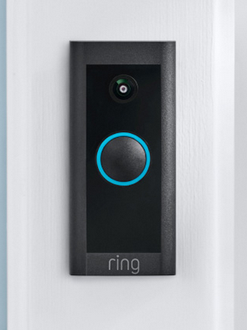
Telescreen Technology
Video technology possible at time [15]
Audio technology possible at time [16]
More feasible today [17]
[18]
Notes:
The primary computing technology used in 1984 is the Telescreen. Big Brother is always watching, always listening, through the Telescreen.
A telescreen is pretty much just a video camera that records audio, and that an observer can speak through. Live video recording and broadcasting is possible, the audio technology is not more advanced than a phone, which were plenty available at the time.
As time has passed, this has become more and more plausible - with facial recognition technology and the like.
It’s so possible today, that some of you might have the equivalent outside your house - the telescreen is not much different than a ring doorbell, recording, and allowing you to speak back through it.
The real feat accomplished by Oceania is monitoring all that these telescreens are recording.

Slide 6
Size of Police States
East Germany created extensive surveillance state [11]
“Tapping about 100,000 telephone lines in West Germany and West Berlin around the clock was the job of 2,000 officers”
Stasi had one for every 166 citizens, soviet one for every 5830
Notes:
Especially with the technology of the time, monitoring on such a large scale is manpower intensive.
The East German secret police, the Stasi is perhaps one of the most extensive surveillance states on which we have good information. The KGB in the Soviet Union had about one secret police officer per 6000 citizens. The Stasi had one per 166 citizens, and amassed files on 5.6 million of 17 million East Germans.
As the surveillance machine of Oceania is largely trained on members of the party, a surveillance state on the scale of 1984 is feasible - especially when you account for informants.
The Stasi had 175k regular informants, nearly double the official employees it had. When irregular informants are counted, 2 out of every 13 citizens of East German informed for the secret police.

Slide 7
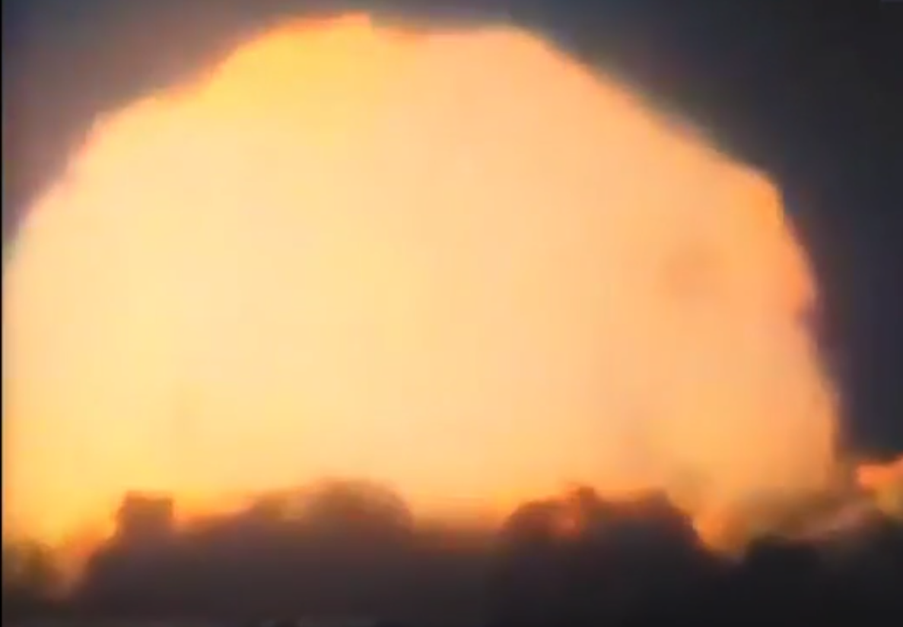
Political Will for Police States
USA PATRIOT act introduced and passed in 10 days [12]
Russia increasingly an authoritarian surveillance state, justifying with threat from West [19][20]
[14]
Notes:
The third part of the surveillance system is structuring the government to enable it. In 1984, this is a response to a nuclear exchange.
Cataclysmic events such as this have been seen to provide political will in the past. In the United States, this takes the form of the Patriot Act, introduced in the wake of 9/11, and passed merely 45 days later, 10 days after being introduced.
As we saw in the book, the Patriot Act significantly expanded the surveillance capabilities of various US agencies.
Expansion of the surveillance powers of the state can also been seen now in Russia, where the war in Ukraine, which they present as defense against the “West”, as James will tell us

Slide 8
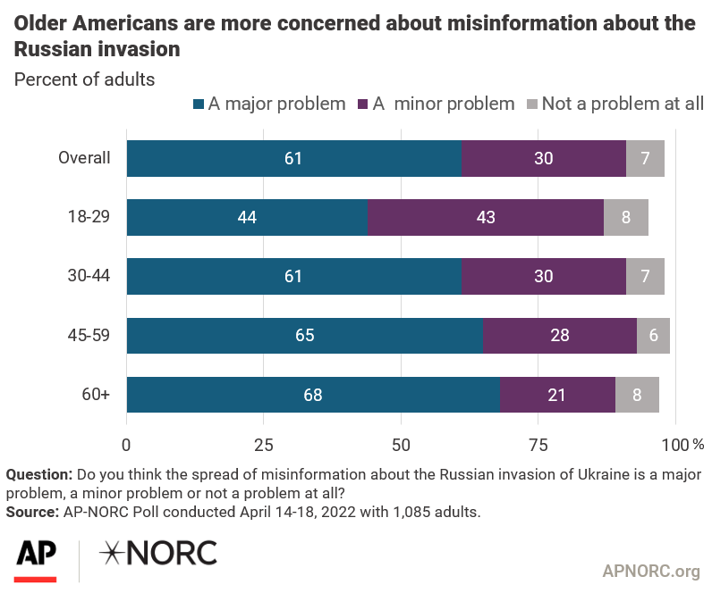
Government Misinformation
“Government spending on “mass media” for the first quarter of 2022 was 322% higher than for the same period in 2021, reaching 17.4 billion roubles”[3]
The rise of social media has allowed government to perform wide scale information operation on a much cheaper and large scale.
Graph shows 91% of people consider Russian misinformation on the invasion as a problem [8]
Notes:
Government agencies often invest heavily into the control and distribution of information to control people perception of government functions.
One great example of this is Russia, especially during their current conflict with Ukraine. During the opening months of the war, their spending on mass media grow 322% when compared to the same quarter the previous year. The government wanted to ensure public approval of their war efforts, and dissuade any movements against the war in Ukraine.
As seen in the graph, people are overwhelming worried about misinformation surrounding the war which is primarily being propagated by the Russian Government. Social media has furthered allowed Russia and other governments to enact information operations across borders for a fraction of the price.
Russia has used much of this effort to frame the war as a war for their exists, and defined the entirety of the west as their current enemy. One article analyzing Russia history of information editing explained “Academics were allowed room for maneuver, so long as it was exercised discreetly and deniably, but they were not free of political controls regarding what material they saw, their links with historians overseas and what they could write. They had to observe a code of conduct” [21] .
In 1984 the protagonist work for the ministry of truth, editing and changing information to better suit the government and then broadcasted out through telescreen which eerily resembles how governments today utilize social media for their benefit.

Slide 9
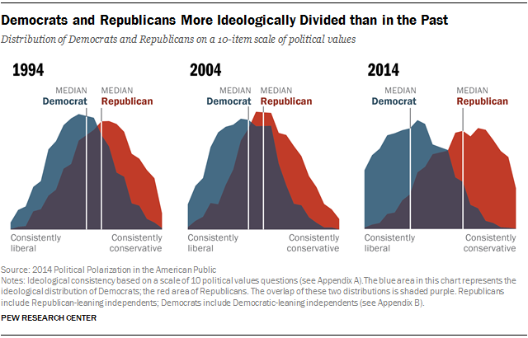
Smear Campaigns and Political Polarization
Smear campaigns have been a staple of American politics since its inception [9]
Several methods [10]:
Misquoting
Silencing
Name-Calling
Anonymous lies
Political polarization has been increasing over the years [12]
Notes:
Smear campaigns have been a major part of American politics since the beginning of our nation. Rather than convincing people of the validity of their views, political entities have often invested much of their campaign into damaging the credibility of their opponents.
These attacks can take many forms including attacks on social media sites, advertisements, or other mediums of information distribution. Organizations with funding from government agencies, corporations, and other individuals will coordinate massive efforts to create slogans, deface public figures or release new stories questioning their morals and actions.
In 1984 two individuals are framed as traitors and ridiculed for their betrayal to create an example of possible insubordinations, even though the accusation was entirely false. Similarly smear campaigns often create false narratives of their target, and artificially spread it to gain credibility.
In the 2020 election a large number of Russian trolls flooded social media platforms in order spread misinformation and amplify unrest in the American populace. New York post had their twitter count suspended after releasing an article about the 2020 election, which the candidate claimed was spread of Russian disinformation.
In general, these smearing campaigns ignore actual arguments and talking points of the victims, and instead focus on damaging public perception of the victims while employing large groups and corporations to ensure success. These hateful attacks are beginning to embed into individuals amplifying political polarization, which can be observed in this figure as people are struggling more and more to find common ground.

Slide 10
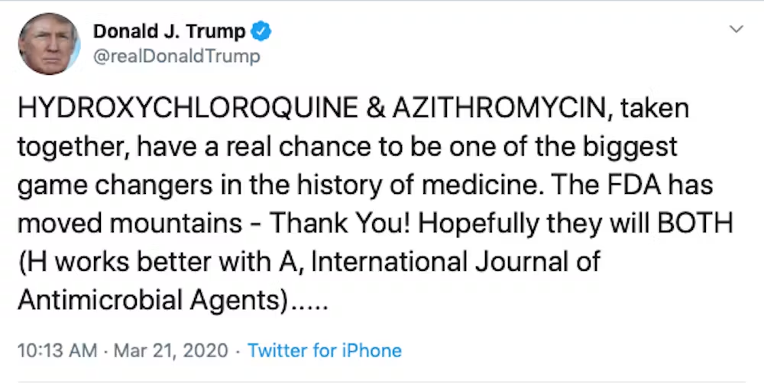
Politics and Information Privacy in Media
People are constantly bombarded with messages of hate, and are being indoctrinated through hate
50% of Newspaper coverage conveys bad news, while only 6% convey good news [22]
The Negativity Bias and as it connects to newspaper and social media today
Donald J Trump spread 11 tweets about unproven therapies [23]
Donald Trump posting unproven theories on twitter [24]
Notes:
While 1984 may not have had and kind of formal “Social Media,” the media that is shown in the movie is through telescreen announcements and newspaper information.
Throughout the movie, we see a constant stream of hate in the form of hate week, the re-arrest and framing of Rutherford and Jones, and Parson’s daughter practicing denouncing people as a traitor.
While 1984 might have been set in the year of 1956, it still displayed some of the power that hate has in controlling people’s emotions. A study done in 2011 on negativity in political news found that 50% of Newspaper coverage converys bad news, while only 6% convey good news.
Part of the reason for this is the negativity bias. Although the formal idea of the Negativity Bias wasn’t formed until 1967, the overwhelming negativity of political events at the time, such as the spanish civil war and WWII.
The negativity bias concludes that “Bad is stronger than good,” in that bad impressions and stereotypes are quickers to form and more resistant to disconfirmation than good ones.
For example, there was a lot of misinformation regarding false covid treatments. Donald J Trump made 11 tweets about unproven therapies, notably with hydroxychloroquine and chloroquine.
These twees reached 300% of donald trump's average, meaning this message got a lot of reviews. Also, after his tweets, purchases of these medical substitutes increased by 200%, showing that people DO listen to these political posts.

Slide 11
Politics and Information Privacy in Media
Social Media benefits from both positive and negative content, as both have positive effects on engagement [25]
System-driven customizability increased selective exposure [26]
Echo chambers within groups prevent introspection, which is critical to properly defend your views [27]
Notes:
It doesn’t help that Social Media platforms, a major hotspot for both information gathering and information sharing, benefit from both positive and negative content in terms of engagement.
That means that there is really no incentive for the platform to prioritize a certain type of content: good or bad, right or wrong, pretty or ugly. Nor do they have any real obligation to ensure that what is being said on their platforms is true.
This can be a real problem because if the negativity bias applies to social media, than it might even develop algorithms that favor negative media, and this is definitely how it feels when diving into the realm of political content.
One big problem that social media platforms also suffer from is echo chambers.
A study in Sage Journals found that System-driven customizability increased selective expose, meaning that social media platforms that use some kind of algorithm that uses data from your profile to find new content is very likely to only show you content with which you aline with, potentially causing an echo chamber.
Echo chambers are harmful in politics because although they may surround you with people who agree with you, they prevent introspection, which is critical to properly defend your own views.

Slide 12
Politics and Information Privacy in Media
Winston keeps a diary, it is the only place where he divulges his true feelings about big brother
Social media can have information on religious beliefs, location, employment and relationships [28]
Political parties will use that information to create targeted ads
Notes:
In 1984 Winston keeps a diary, since there is repression on free speech. Big brother only wants people to THINK what he wants them to think, even going so far as to have a thought police.
While it might seem obvious that there is no real equivalent for this since we live in the USA, the home of freedom and freedom of speech, I’d like to take a slightly different angle at this. Think about the last time any of you used social media. Was it a month ago? A week ago? A few hours ago? If you’re partially bored, are you scrolling through social media right now?
In a way, a lot of us have made social media into our own diaries, a place where we can share our thoughts, and events that happen in our life.
Social media can have information on your religious beliefs, location, employment, and relationships, and scarily enough, a lot of us make that information practically public.
Political parties use that data to create targeted ads for their campaigns. A paper looking into utilizing facebook pages to automatically predict the political orientation of Facebook users found that accuracy for predicting the political views of an individual is very high.
Some political parties are even willing to show up at your house just by registering for them. How much important then, would be a platform that lets them not only individually reach out to each person from the comfort of their home, but also gives them information about the person’s religion, employment, and location. It would be incredibly easy to convince someone to your side if you know exactly what they’re looking for.

Slide 13
References
Grossman, L. (March 17, 2016). Apple CEO Tim Cook’s Fight with the FBI.. TIME https://time.com/4262480/tim-cook-apple-fbi-2/. (Accessed Oct 2)
Nicas, J. (2021, June 14). What data about you can the government get from Big Tech?. The New York Times. https://www.nytimes.com/2021/06/14/technology/personal-data-apple-google-facebook.html
Julio Terracino; Craig Matasick, Disinformation and Russia’s war of aggression against Ukraine: Threats and governance responces, (OECD 11/03/2022), https://www.oecd.org/ukraine-hub/policy-responses/disinformation-and-russia-s-war-of-aggression-against-ukraine-37186bde/#section-d1e135 (10/4/2023)
List of 1947 major news events in history. What Happened in 1947 including Pop Culture, Significant Events, Key Technology and Inventions. (n.d.). https://www.thepeoplehistory.com/1947.html. Date Accessed: October 5, 2023
List of 1948 major news events in history. What Happened in 1948 including Pop Culture, Significant Events, Key Technology and Inventions. (n.d.). https://www.thepeoplehistory.com/1948.html. Date Accessed: October 5, 2023
List of 1949 major news events in history. What Happened in 1949 including Pop Culture, Significant Events, Key Technology and Inventions. (n.d.). https://www.thepeoplehistory.com/1949.html. Date Accessed: October 5, 2023
Malloryk. (2020, July 31). Cold conflict: The National WWII Museum: New Orleans. The National WWII Museum | New Orleans. https://www.nationalww2museum.org/war/articles/cold-conflict. Date Accessed: October 5, 2023
AP-NORC Center for Public Affairs Research, Misinformation about invasion of Ukraine views as a major problem, (4/28/2022), https://apnorc.org/projects/misinformation-about-the-invasion-of-ukraine-viewed-as-a-major-problem/ , (10/5/2023)
Jeff Nilsson, The Long Tradition of the Smear Campaign, (The Saturday Evening Post, 08/25/2012) https://www.saturdayeveningpost.com/2012/08/tradition-dirty-politics/ Date Accessed: October 5, 2023

Slide 14
References…continued
Sergei A Samoilenko, Character assassination, (ResearchGat, January 2018), https://www.researchgate.net/profile/Sergei-Samoilenko/publication/318102669_Character_assassination/links/595974eca6fdcc2beca94c50/Character-assassination.pdf (10/04/2023)
Koehler, J. O. (2010). Stasi : the untold story of the East German secret police (Chapter 1). Westview Press. Available online at https://archive.nytimes.com/www.nytimes.com/books/first/k/koehler-stasi.html (5 October 2023)
Pew Research Center,, Political Polarization in the American Public, (Pew Research Center, 06/12/2014), https://www.pewresearch.org/politics/2014/06/12/political-polarization-in-the-american-public/ (10/04/2023)
United States Congress. (2001). H.R.3162 - 107th Congress (2001-2002): Uniting and Strengthening America by Providing Appropriate Tools Required to Intercept and Obstruct Terrorism (USA PATRIOT ACT) Act of 2001. Congress.gov; United States Congress. https://www.congress.gov/bill/107th-congress/house-bill/3162
Columbia Pictures. (1956). 1984. Internet Archive. https://archive.org/details/1984-colorized-720p-hd
Museum of Obsolete Media. (n.d.). Video Media Timeline. Museum of Obsolete Media. Retrieved October 5, 2023, from https://obsoletemedia.org/video/video-timeline/
Audio Engineering Society. (2012, July 23). Audio Technologies Timeline. Www.aes.org; Audio Engineering Society. https://www.aes.org/aeshc/docs/audio.history.timeline.html
Adjabi, I., Ouahabi, A., Benzaoui, A., & Taleb-Ahmed, A. (2020). Past, Present, and Future of Face Recognition: A Review. Electronics, 9(8), 1188. https://doi.org/10.3390/electronics9081188
Ring. (n.d.). Smart Doorbell Cameras | Video Monitor Your Door. Ring. https://ring.com/doorbell-cameras
Krolik, A., Mozur, P., & Satariano, A. (2023, July 3). Cracking Down on Dissent, Russia Seeds a Surveillance Supply Chain. The New York Times. https://www.nytimes.com/2023/07/03/technology/russia-ukraine-surveillance-tech.html
Sanger, D. E. (2022, February 24). Putin Spins a Conspiracy Theory That Ukraine Is on a Path to Nuclear Weapons. The New York Times. https://www.nytimes.com/2022/02/23/us/politics/putin-ukraine-nuclear-weapons.html
Richard Cohen, Vladimir Putin’s Rewriting of History Draws on a Long Tradition of Soviet Myth-Making, (Smithsonian Magazine, 03/18/2022),https://www.smithsonianmag.com/history/vladimir-putins-rewriting-of-history-draws-on-a-long-tradition-of-soviet-myth-making-180979724/ (10/04/2023)

Slide 15
References…continued
Lengauer, G., Esser, F., & Berganza, R., Negativity in political news: A review of concepts, operationalizations and key findings. (Journalism, 2012), https://journals.sagepub.com/doi/10.1177/1464884911427800 10/5/2023
Niburski K, Niburski O, Impact of Trump's Promotion of Unproven COVID-19 Treatments and Subsequent Internet Trends: Observational Study (J Med Internet Res, 11/23/2023), https://www.jmir.org/2020/11/e20044/authors 10/5/2023
Donald J. Trump, HYDROXYCHLOROQUINE & AZITHROMYCIN, (X, 3/21/2023) https://twitter.com/realDonaldTrump/status/1241367239900778501 10/5/2023
Rakesh R. Mallipeddi, Ramkumar Janakiraman, Subodha Kumar, Seema Gupta, The Effects of Social Media Content Created by Human Brands on Engagement: Evidence from Indian General Election 2014. (Information Systems Research, 2021) https://pubsonline.informs.org/doi/10.1287/isre.2020.0961 10/5/2023
Beam, M. A., Automating the News: How Personalized News Recommender System Design Choices Impact News Reception. (Communication Research, 2014), https://journals.sagepub.com/doi/full/10.1177/0093650213497979 10/5/2023
Christopher Ranalli, Finlay Malcom, What’s so bad about echo chambers?, (Inquiry, 2023), https://www.tandfonline.com/action/showCitFormats?doi=10.1080%2F0020174X.2023.2174590 10/5/2023
Amanda Hetler, 6 common social media privacy issues, (TechTarget, 1/30/2023) https://www.techtarget.com/whatis/feature/6-common-social-media-privacy-issues 10/5/2023
ACLU. Surveilance Under the USA/Patriot Act. (October 23, 2001). https://www.aclu.org/documents/surveillance-under-usapatriot-act#:~:text=Under%20the%20Patriot%20Act%2C%20the,the%20Fourth%20Amendment%20explicitly%20requires. (Accessed Oct 5, 2023)

