Slide 1
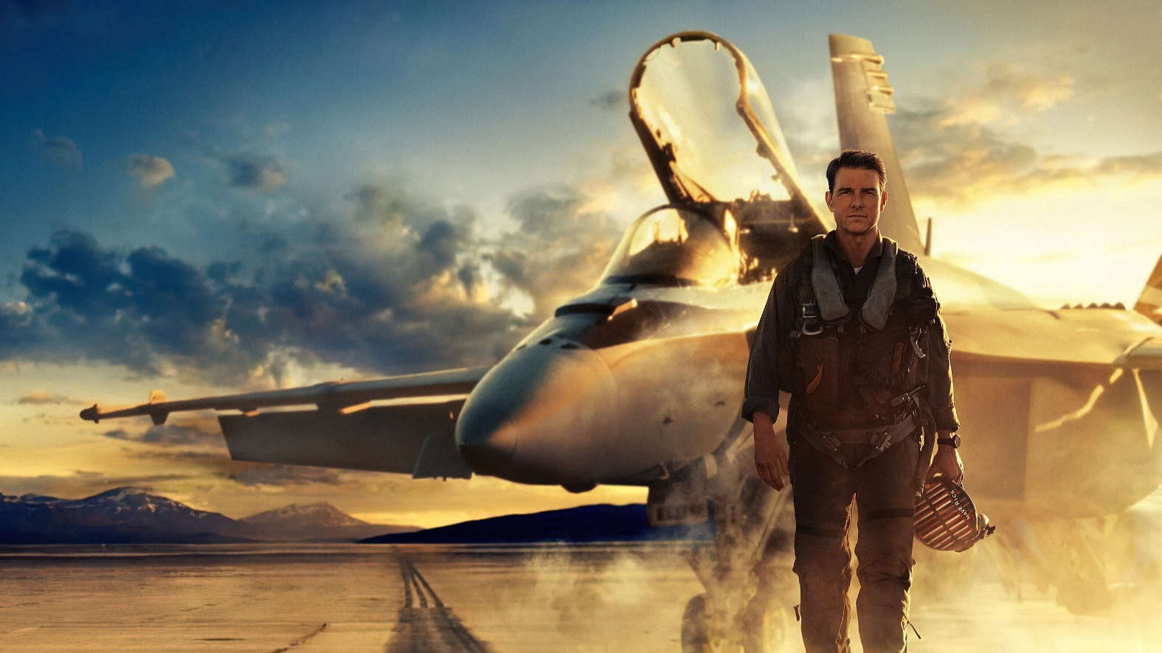

FRANKIE DEWANDER | SEAN MULLANEY | TREVOR WOHLERS | LIAM O’DRISCOLL | ABYSHEK SUKUMAR

Slide 2
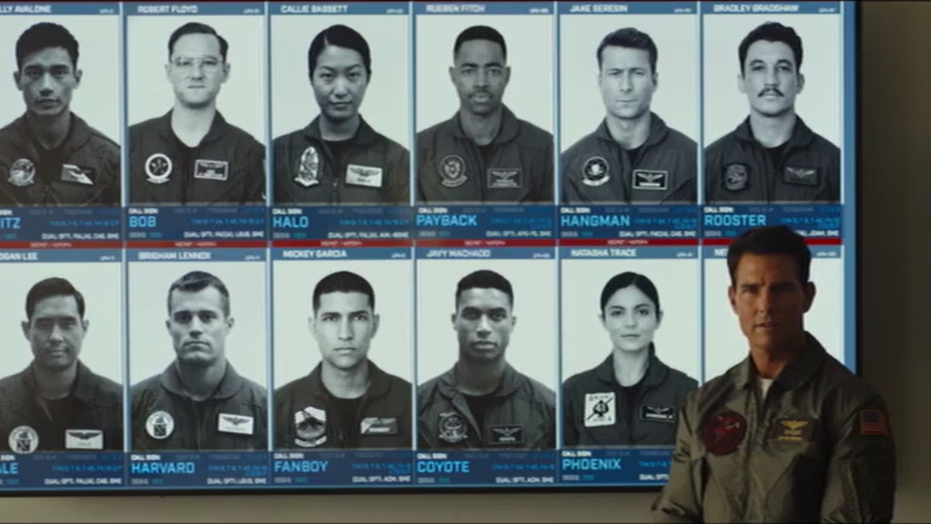
PLOT SUMMARY I
Maverick is a test pilot for an advanced jet program that is going to be shut down in favor of drones if it cannot hit mach 10 soon.
Maverick pushes the jet to mach 10 in the final test flight but is forced to return to Top Gun with the directive of training pilots for a strike mission on an enemy uranium facility.
Notes:
Each plot summary slide should just establish visuals for plot – only reason there are multiple slides (each should be quick)
Plot summary I
Plot Point: Maverick is forced to return to Top Gun with the directive of training pilots for a strike mission on an enemy uranium facility.
Notes:
(Current Image) 20:00 Into the movie (Ripped DVD version, higher res soon)

Slide 3
PLOT SUMMARY II
Pilots endure extreme training – low-altitude flying, G-force endurance, radar evasion, and payload timing
Notes:
Plot summary II
Plot Point: Pilots endure extreme training – low-altitude flying, G-force endurance, radar evasion, and payload timing
Notes:
(To be added Images – Training (0:00:0)) (Ripped DVD version)

Slide 4
PLOT SUMMARY III
Mission succeeds and they cripple the facility, but Rooster and Maverick are shot down in the process
Notes:
Plot summary III
Plot Point: Mission succeeds and they cripple the facility, but Rooster and Maverick are shot down in the process.
Notes:
(To be added Images – Facility exploding (1:38:18), Maverick being shot down ~1:40:00) (Ripped DVD version)

Slide 5
PLOT SUMMARY IV
Maverick and Rooster steal an old F-14 and beat out advanced enemy jets
Notes:
Plot summary III
Plot Point: Maverick and Rooster steal an old F-14 and beat out advanced enemy jets
Notes:
(To be added Image – F-14 taking off) 1:48:13 Into the movie (Ripped DVD version)

Slide 6
TECHNOLOGY (PAST)
P-51 Mustang
F-14 Tomcat
Kawasaki Ninja motorcycle
Notes:
TECHNOLOGY (PAST)
List: F-14 Tomcat
P-51 Mustang (Nostalgia fan service, Maverick’s personal plane)
Kawasaki Ninja motorcycle (Nostalgia fan service, Maverick’s motorcycle from original)
Notes:
(To be added Images – F-14 Tomcat (0:00:00), P-51 Mustang (0:00:00), Kawasaki Ninja motorcycle (0:00:00)) (Ripped DVD version)

Slide 7
TECHNOLOGY (CURRENT)
F/A-18 Super Hornet
5th-generation stealth fighters
GPS jamming systems
Laser targeting
Surface-to-air missiles (SAMs)
Training Simulations
Notes:
TECHNOLOGY (CURRENT)
List: F/A-18 Super Hornet
5th-generation stealth fighters
GPS jamming systems
Laser targeting
Surface-to-air missiles (SAMs)
Training Simulations
Notes:
(To be added Images – F/A-18 Super Hornet (0:00:00), 5th-generation stealth fighters – (CGI based on Russian Sukhoi Su-57 Felon) (0:00:00), GPS jamming systems (0:00:00), Laser targeting (0:00:00), Surface-to-air missiles (SAMs) (0:00:00), Training Simulations (0:00:00) ) (Ripped DVD version)

Slide 8
TECHNOLOGY (FUTURE)
Darkstar Jet
Drones
Notes:
TECHNOLOGY(FUTURE)
List: Darkstar Jet
Drones
Notes:
(To be added Images – Darkstar Jet (0:00:00), Drones (0:00:00)) (Ripped DVD version)

Slide 9
Effect of Technology (Temporary title)
Darkstar vs. Drones
  Drones serve as a threat to pilots that would lose their position as drones become more popular than human pilots
  Drones were cited as at least one of the reasons for ending the Darkstar test program
F-14 Tomcat → beats 5th-generation stealth fighters
GPS jamming systems →
Laser targeting → fails
SAMs → blind spots exploited
Training Simulations → train pilots under the same environment
Notes:
Effect of Technology

Slide 10
Themes from Effects (Temporary title)
Notes:
Themes from Effects (Temporary title, we just need to connect the effects to larger themes)

Slide 11
Conclusion
Human skill beats technology (Human control vs. Automation)
Notes:
Conclusion

Slide 12
Determining the Path

Slide 13
Mission Success Despite Technological Failure
During the mission, the laser guidance system for one of the bombs fails, and the pilot drops the bomb, hits the target, and successfully destroys the facility
The skill of the pilot was able to overcome the deficiency in the technology

Slide 14
Skilled Pilot Beats More Advanced Fighters With Skill
After being shot down, Maverick and Rooster work together to steal an F-14
They get caught by a pair of Gen 5 fighters, but Maverick shoots both of them down with an inferior plane

Slide 15
References

