Slide 1


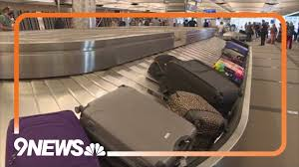
Class 9
Reliability
Keith A. Pray
SocialImps.com
1995/2010
2020
2024
Notes:
Did SW Teams from the reading pick good test strategies? Will you be able to support your choices if something goes wrong?
What errors? – Use spreadsheet to record defects.
Who looked for directions on how to test currency?
MSNBC on Denver's Automated Baggage System 2010-08-23 (2:27)
https://www.youtube.com/watch?v=xx8f4x6C_KY
Accessed 2025-04-18
No Discussion Board
9News on Looking back at the massive failure that was DIA's automated baggage system 2020-02-28 (2:32)
https://www.youtube.com/watch?v=xmas0-SthUQ
Accessed 2025-04-18
9News on Denver International Airport to receive $26.6 million to replace its baggage handling system 2024-02-15 (1:19)
https://www.youtube.com/watch?v=wgL75rvACg8
Accessed 2025-04-18

Slide 2
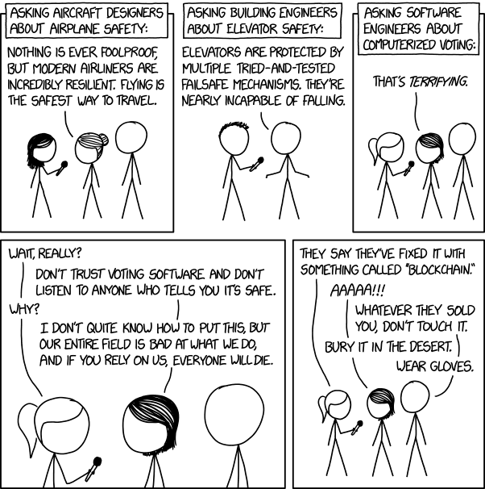

Overview
Review
Assignment
Students Present
https://xkcd.com/2030/ (2018-09-21)
Notes:
Why Electronic Voting Is Still A Bad Idea (2019)(12:00)
Tom Scott
https://www.youtube.com/watch?v=LkH2r-sNjQs
Old Version
Why Electronic Voting is a BAD Idea – Computerphile (2014)(8:20)
https://www.youtube.com/watch?v=w3_0x6oaDmI
Might be better in Security
Other videos:
9News - Looking back at the massive failure that was DIA's automated baggage system 2020-02-28 (2:32)
https://www.youtube.com/watch?v=xmas0-SthUQ
9News - Watch DIA's old luggage system toss baggage into the air 1995 (1:42)
https://www.youtube.com/watch?v=OtLHVGtFmKU
abcNews - Major Luggage Debacle at Denver Airport
https://abcnews.go.com/Travel/video/major-luggage-debacle-denver-airport-28054918
We can also discuss articles listed on Security Discussions under documents of course web site.
TODO: add quiz as backup if class discussion or guest speaker fail

Slide 3
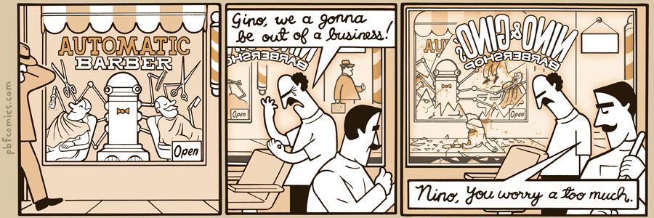
http://pbfcomics.com/197 (2014-09-26)
Notes:
10 – Errors, Failures, Risks or Automation

Slide 4
My Reading Notes
p. 364 Hitting Enter x2 bad UI. Why Tokyo Stock Exchange refuse cancel?
p. 366 FL appears frequently. What do they do now? 32,767 max?
p. 367 “steer voting off a cliff” = Strawman Fallacy. 50-60% cancer patience source?
p. 369 Absolutes! Harmful compartmentalization? Bad internal comms?
p. 370 Make obvious text terminal UI. Why operate machine when safety equipment not functioning? More absolutes!
p. 371 Edits made should be explicit variable.
p. 372 Increment instead of assign to not 0 mostly like perceived perf gain.
p. 373 Seems odd to state patient overdose detection by design.
p. 374 2010 newer source for more recent radiation machine problems?
p. 376 Compare 37 minutes detailed info vs. p. 243 5 sec. 2003-2017. Hands on wheel alert not (poor) attempt ensuring driver engage?
p. 377 What came of 2018 prediction Tesla driving cross country?
p. 378 Uber and gig economy? Video of self-driving Uber running red light, tech vs. tech.
p. 379 Is rear end still most common accident, 2017 source?
p. 380 1.3 seconds not enough time for human to react.
p. 389 Absolutes seem to be found around trouble!
Previous edition has section SW Engineering, using simulation results, validation and verification, warranties.
p. 398 Redundancy like system of AI Experts? Assert assumptions in automated SW tests.
p. 399 737 MAX $$ lost vs. initial cost and predicted savings
p. 403 27 very similar to Scenario in 2.1.3
Questions I liked: 1, 16, 20, 22, 24, 25
p. 353 2016 Southwest Airlines incident too
p. 354 Any false arrests since 1989?
p. 355 Check Priv Gov Chapter for not requiring FBI to ensure accuracy of data entered into NCIC, before March 2003? Vehicles stolen/recovered source?
p 356. Implementation cost not considered. Argument assumes DB cannot exist w/out existing inaccuracies. 2011 newest system malfunctions source.
p. 358 Need newer source (2001) for SW playing larger role claim.
p. 359 Real-time system explanation misses known execution time. PATRIOT needs track to shoot, not just prevent false alarm. Designed or common CONOPS, limitation in old HW?
p. 360 Because missiles much faster than bombers. Assert assumptions in code and/or automated tests.
p. 361 ATT 1 line of code tried to fix root cause, poorly. SW blamed but HW sent false signal?
p. 362 Robot Mission to Mars: Always encapsulate units! If human comms issue perhaps better as SW-SW interface? Any SW diffs between Mars Missions?
p. 363 BAE Automated Systems != BAE Systems (Subsidiary of Invensys PLC → Schneider Electric). Was RFID available?
Notes:
Show Compact iPaq

Slide 5
Overview
Review
Assignment
Students Present

Slide 6
Assignment
Prepare for Debate
  You are a software engineer in the employee-owned company from Chapter 9 In-class Exercises # 29.
  Should the company produce the game based on a current war?
  Use the SWE Code Of Ethics as the basis for your argument
  Use high quality sources and supporting data
Optional 1 page paper, lowest paper grade will be dropped
  Due before last day of class
Add to Group Project Web Site

Slide 7
Overview
Review
Assignment
Students Present
Notes:
We can also discuss articles listed on Security Discussions under documents of course web site.
ADD QUIZ AS BACKUP IF CLASS DISCUSSION OR GUEST SPEAKER FAIL

Slide 8
Allowing ai in the driver seat
Justin Gauthier
Notes:
Introduce yourself, and introduce topic

Slide 9
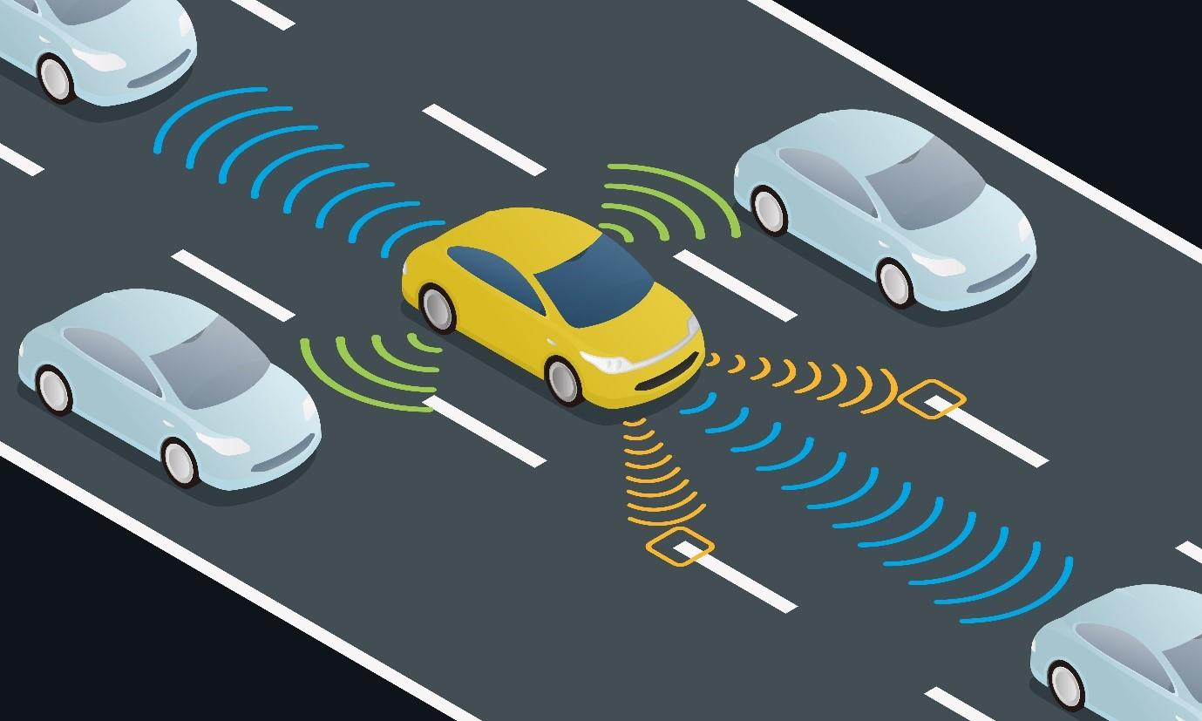
How AI has made cars safer, and will make them even safer
Justin Gauthier
ADAS – Advanced Driver Assistance System [5]
  Forward collision warning[9,10,14]
  Lane keeping[11,12,14]
  Blind zone protection[13,14]
  Forward pedestrian impact avoidance[14]
  Backing collision avoidance[15]
[8]
Notes:
ADAS-Advanced Driver Assistance Systems: - A broad range of features and technology that support the driver by providing information, warnings , and intervening to execute control momentarily or on a sustained basis.
to start off introduce the ADAS, and what it means. Then mention how ADAS can be broken down into 5 subcategories
Next introduce the 5 subcategories of ADAS and use the points below to talk about how AI is used in them
To start off with AI is used in Forward collision Warning systems by first identifying vehicles or objects in the same lane as the driver using cameras and/or sensors, it then calculates both of their speed and the distance between them. It then uses thresholds and conditions using its calculated data to either warn the driver or not do anything, some of these systems might brake for you though.
Lane keeping systems just as forward collision warning systems use cameras and/or sensors to pick up the road and the color pattern of roads and AI is used to check if it is a lane divider and to also calculate how offset the car is from the center of the lane so it knows if it needs to make any adjustments to the car.
Blind spot detection uses AI algorithms to analyze sensor data to identify vehicles, cyclists, or obstacles in blind spots. It then sends a signal to the car if it is determined that it is a risk of some kind
It works similarly to Forward Collision Warning systems but instead of trying to figure out if it’s a car and its speed. It identifies pedestrians and your speed relative to their position.
Backing collision avoidance works almost identical to forward collision warning but instead it only identifies the distance between the objects instead of their speed and distance.

Slide 10
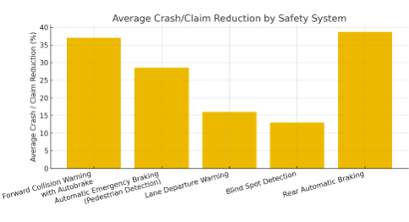
Benefits of ADAS systems
Justin Gauthier
Helps reduce the number of accidents[7]
Helps reduce driver fatigue[16]
helps prevent driver based errors with[17]
[7]
Notes:
talk about how the data on the right collected by the insurance Institute for highway safety shows us how effective each ADAS system is with actually preventing accidents, (each group has been averaged out to their mean for easier viewing sake.)
especially point out how much these systems have helped prevent a lot of forward collisions and also rear automatic braking. You should also mention that these braking systems use the risk calculated by these AI’s to determine if they should brake or not.
You should also mention that with these technologies it help takes off some of the stress from driving and also helps with the some of the decision making which helps with making drivers less fatigued while driving which also corelates to less accidents. Especially on longer drives, like road trips where you are driving for hours at a time.
With these adas systems we can also prevent driver based errors by using these systems to either warn the driver so they pay attention or by intervening directly to help prevent or mitigate these accidents.

Slide 11
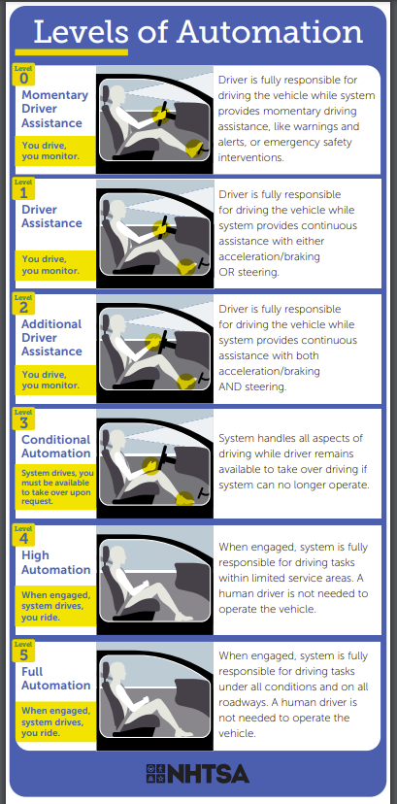
ADS Systems
Justin Gauthier
Fits the last 2-3 levels of Automation [3,6]
uses features of the ADAS system while driving
Is the next step in self-driving cars
[6]
Notes:
Definitions
ADS - a vehicle system that contains both hardware and software that are collectively capable of performing the entire Dynamic Driving Tasks (DDT) on a sustained basis regardless of whether it is limited to a specific operational design domain (ODD).
DDT- all the real-time operational and tactical functions needed to drive a vehicle on a road, excluding strategic functions like route planning.
ODD- defines the specific conditions under which an autonomous vehicle (AV) or automated driving system is designed to operate safely.
Talking points
with the growing rate of Ai’s development full self-driving cars are getting closer. Eventually self driving cars will be considered a ADS or a Advanced Driving System. A ADS is a (then mention the definition of ADS, DDT and ODD).
ADS technology falls under the last 2-3 levels of driving automation where the car needs very little to no human interference.
Tesla does not consider their own autopilot to be and advanced driving system they consider it to be a advanced driver assistance system.
The ADS systems we will have in the future will use all the preexisting technology from the ADAS systems to be able to drive the cars.
A car is considered a ADS when it can perform dynamic tasks like lane change at a level that either matches or surpasses human drivers.

Slide 12
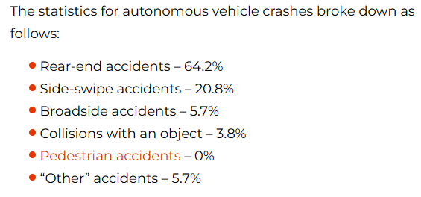
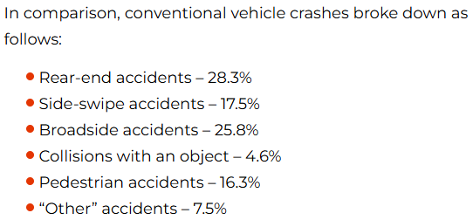
how does self-driving cars affect Car crashes
Justin Gauthier
Has mitigated car crash severity [4, 7]
Has helped save lives / reduce injuries [2,4,7]
More accidents per 1 million miles driven[18]
[1]
Notes:
As I stated with on the previous slide as AI gets further advanced self driving cars will only get better, but with the cars we currently have that have autonomous driving we can see that there pedestrian accidents are at 0%. While the number of rear-end-accidents have skyrocketed.
(Mention) the type of self driving cars I am talking about is not a level 4 or 5 as listed on the previous slide but a level 3.
This shows us that these cars are great at preventing pedestrian accidents and other types of accidents like collision with an object, while it gets in rear ended accidents a lot more. One important thing to note is that self driving cars get into 9.1 accidents for every 1 million miles driven compared to 4.1 for non-self driving cars.
Either way with the data we have collected we can see that the severity and the number of deaths in self driving cars is less and at a lower rate compared to conventual vehicles. This tells us that self driving cars are better at preventing severe accidents but also at the same time is unable to prevent accidents as well as a human driver

Slide 13
References
Justin Gauthier
[1]NST Law,“Self‑Driving Car Statistics,” (September 10, 2024), https://www.nstlaw.com/guides/self-driving-car-statistics/ (April 14, 2025)
[2]Craft Law Firm,“Autonomous Vehicle Accidents: NHTSA Crash Data (2019–2024),” (2024), https://www.craftlawfirm.com/autonomous-vehicle-accidents-2019-2024-crash-data/ (April 14, 2025)
[3]United Nations Economic Commission for Europe, “Difference between Advanced Driver Assistance Systems (ADAS) and Automated Driving System(ADS),” (30 November 2023), https://unece.org/sites/default/files/2023-12/GE.3-07-15%20Presentation%208%20ADAS%20vs%20ADS.pdf(April 14, 2025)
[4] National Safety Council, “Advanced Driver Assistance Systems—Data Details,” (2024), https://injuryfacts.nsc.org/motor-vehicle/occupant-protection/advanced-driver-assistance-systems/data-details/ (April 15, 2025)
[5] Gonzalo De‑Las‑Heras et al., “Advanced Driver Assistance Systems (ADAS) Based on Machine Learning Techniques for the Detection and Transcription of Variable Message Signs on Roads,” (August 31, 2021), https://pmc.ncbi.nlm.nih.gov/articles/PMC8434048/ (April 15, 2025)
[6] National Highway Traffic Safety Administration, “Levels of Automation,” (May 25, 2022), https://www.nhtsa.gov/sites/nhtsa.gov/files/2022-05/Level-of-Automation-052522-tag.pdf (April 15, 2025)
[7] National Safety Council, “Advanced Driver Assistance Systems,” (2024), https://injuryfacts.nsc.org/motor-vehicle/occupant-protection/advanced-driver-assistance-systems (April 15, 2025)
[8] Tata Capital, “What Is ADAS Meaning and What Are the Benefits of ADAS?,” (November 29, 2024), https://www.tatacapital.com/blog/loan-for-vehicle/what-is-adas-and-what-are-the-benefits-of-adas/ (April 15, 2025)
[9] Motive Help Center, “AI‑Powered Safety: Forward Collision Warning,” (February 28, 2025), https://helpcenter.gomotive.com/hc/en-us/articles/19798447554717-AI-Powered-Safety-Forward-Collision-Warning (April 16, 2025)
[10] National Highway Traffic Safety Administration, “Driver Assistance Technologies,” https://www.nhtsa.gov/vehicle-safety/driver-assistance-technologies (April 16, 2025)
[11] Collimator, “Designing a Lane Keep Assist System,” (2024), https://www.collimator.ai/tutorials/lane-keep-assist-system (April 16, 2025)
[12] Vikas Vyas and Sneha Sudhir Shetiya, “Intelligent Electric Power Steering: Artificial Intelligence Integration Enhances Vehicle Safety and Performance,” (December 11, 2024), https://arxiv.org/html/2412.08133v1 (April 16, 2025)
[13] Sapien, “Blind Spot Detection in Autonomous Cars: A Detailed Overview,” (February 12, 2025), https://www.sapien.io/blog/blind-spot-detection-in-autonomous-cars (April 16, 2025)
[14] Mobileye, “AI‑Based Collision Avoidance Technology,” (2024), https://ims.mobileye.com/fleets/us/technology/ (April 17, 2025)
[15] Macgence, “How Do AI‑Powered Collision Avoidance Systems Work?,” (February 3, 2025), https://macgence.com/blog/ai-powered-collision-avoidance-systems (April 17, 2025)
[16] Nandita Gupta, “Advantages and Disadvantages of Advanced Driver Assistance Systems,” (March 28, 2024), https://trackobit.com/blog/pros-and-cons-of-advanced-driver-assistance-systems (April 17, 2025)
[17] ynopsys, “What Is ADAS (Advanced Driver Assistance Systems)?,” (n.d.), https://www.synopsys.com/glossary/what-is-adas.html (April 17, 2025)
[18] Clifford Law, “The Dangers of Driverless Cars,” (May 5, 2021), https://natlawreview.com/article/dangers-driverless-cars (April 17, 2025)

Slide 14
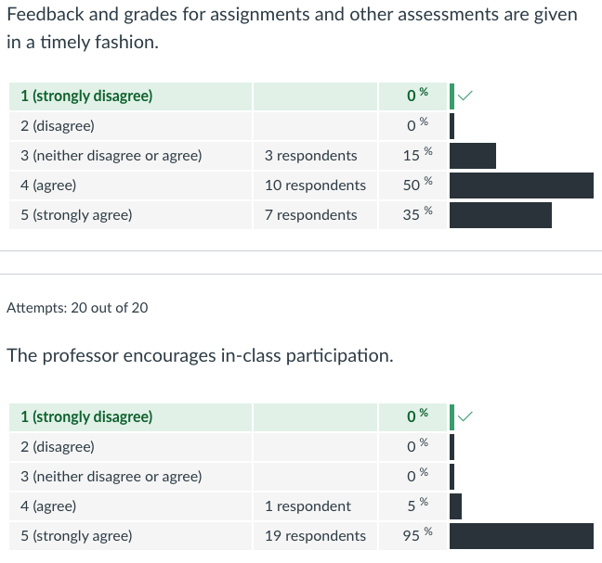
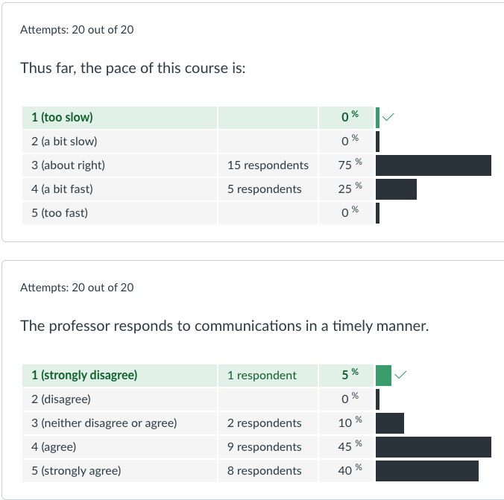
Survey Results (1/3) -20 Responses

Slide 15
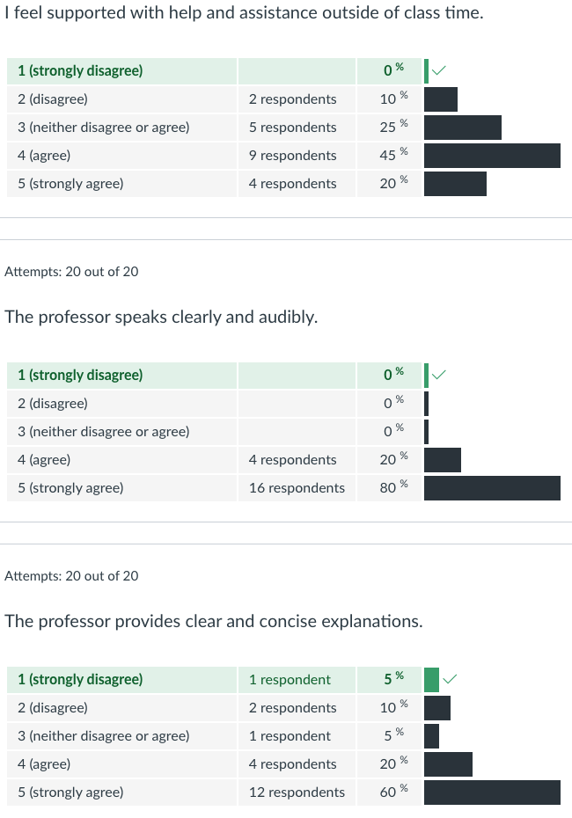
Survey Results (2/3) -22 Responses

Slide 16
Survey Results (3/3) -20 Responses
Notes:
Helpful reminders:
Applicable guidelines, grading, templates, and assignment details are linked from each Canvas assignment
See Class 1 and 2 Slides, and Appendix 2 for examples of using supporting data, critical thinking, common fallacies, argumentation, and an example paper
Previous student presentations can be seen in the Past offerings of the course

Slide 17
Class 9
The End
Keith A. Pray
SocialImps.com
Notes:
This is the end. Any slides beyond this point are for answering questions that may arise but not needed in the main talk. Some slides may also be unfinished and are not needed but kept just in case.

Slide 18
Reliability Of Statistics
Are other factors controlled?
Is enough time covered?
Is all data reported?
Use Intuition
  Are results reasonable?
Notes:
Power line dangers. Electromagnetic fields? PCBs in transformers?

Slide 19
Some Measures
Mean Time To Failure (MTTF)
Mean Time Between Failures (MTBF)
Mean Time To Repair (MTTR)
Notes:
Is it repairable?
What does it mean to repair? Running again? Data fixed? Caught up?
Restoring the GBC Web site.

Slide 20
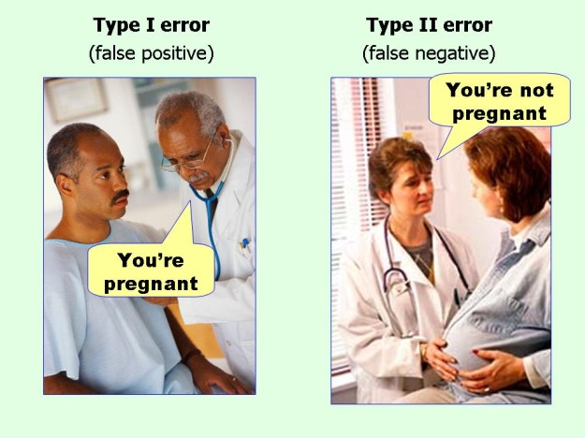
marginalrevolution.com/marginalrevolution/2014/05/type-i-and-type-ii-errors-simplified.html (2016-04-11)

Slide 21
what works well Online With Zoom
Sign in with First and Last Name
Stay muted unless you are going to speak
To speak use the raise your hand feature
To answer yes/no questions use the “yes” ”no” buttons
Turn your camera on
Wait until the end of student presentations to ask questions
  Write them down so you don’t forget

