Slide 1
Class 10 Professional Ethics
Keith A. Pray
SocialImps.com

Slide 2
Overview
Review
Debate
Assignment
Students Present
Notes:
ADD QUIZ AS BACKUP IF CLASS DISCUSSION NOT LONG ENOUGH

Slide 3
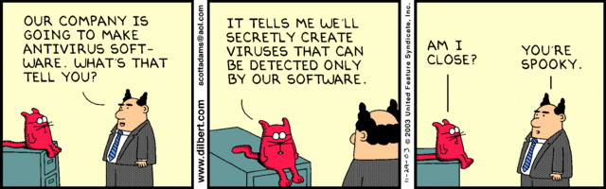
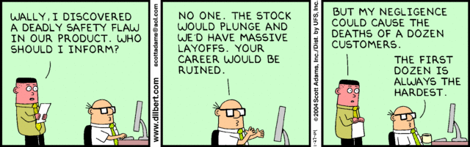
Notes:
Ask how many people in ACM or IEEE

Slide 4
My Reading Notes
p. 413 Forgery proof IDs possible? ”Papers.” common dystopian theme.
p. 418 ACM Code of Ethics and Professional Conduct published 2018 vs 1997
pp. 422-423 3.09 = 5.05
p. 454 “3. Would decision hold up to public scrutiny?”– social contract, not virtue ethics?
p. 430 Are not web logs usually public?
p. 431 “…Chuck had these files…” implies guilt. → “…files on Chuck’s computer…” seems better. Antiworm scenario very similar to p. 76. Check if [5] 2003 source about Blaster worm.
p. 432 Consent of telecommunications companies… or their clients?
p. 433 will != consequences
p. 434 Saving public taxes $15K not considered
p. 435 DEI claims source [7] 2001, need newer
p. 436 Source [11] 2018, computing demographics now?
p. 437 Org pressure, macho culture, harassment source [1]8 2008, newer source needed.
p. 438 Additional advice: Ask for help, share context and possible biases. How to ensure everyone’s voice is heard in class?
p. 440 $3 million over how many employees?
p. 441 Many whistle blower definitions do not require internal reporting attempts.
p. 445 Org failure what I generally see.
p. 446 “return to using principle-based…” source from 2003, needs update. This happened a while ago, perhaps not everywhere.
p. 447 pension quote source from 1983, tough to get a pension now, consider finding newer
No mention of Snowden but for Question 24.
p. 451 # 21 not really computing
Questions I liked: 23, 25, 29, 30
Notes:
An error of commission is one where the person responds where they should not. This is compared to an error of omission, where the person fails to respond when they should.

Slide 5
Debate Ground Rules
Develop FPS Based on Current War?
Before Debate
10 minutes to converse with your team
Share argument points, counter points, and responses
Share experiences, especially in different countries, cultures, situations
Decide who will:
Go first
Respond to which points from opposing side
During Debate
1 turn per person until everyone on your team has spoken
Try to keep remarks to 30 seconds
Notes:
Release Game or Not Debate
Chapter 9 In-class Exercises # 24.
Should we (the company) produce the game?
Use the SWE Code Of Ethics as the basis for your argument.
If Remote:
Add “(YES)” or “(NO)” to the end of your name in Zoom to show your side

Slide 6
Assignment
1 Page Paper
What should computerized automation be applied to next?
Finish all reading
Group Project
Add analysis to website addressing remaining topics
Group Presentation Draft
Submit as Power Point on Canvas
Post Power Point file (.pptx) on group website for download
Do not make viewer export it from another tool
Notes:
1 Page Paper Ideas:
For Good - How will you use your computing related education to do good in the world?
Dark Net - Is the Dark Net good or bad?
Does computerized automation help the economy or society?
What should computerized automated be applied to next?
If productivity has increased so much, why are we working so hard? Should we?
What job skills will survive computerized automation?

Slide 7
Overview
Review
Debate
Assignment
Students Present
Notes:
Show WPI and/or corporate code of ethics.

Slide 8
Robots in law enforcement
Ben Proctor

Slide 9
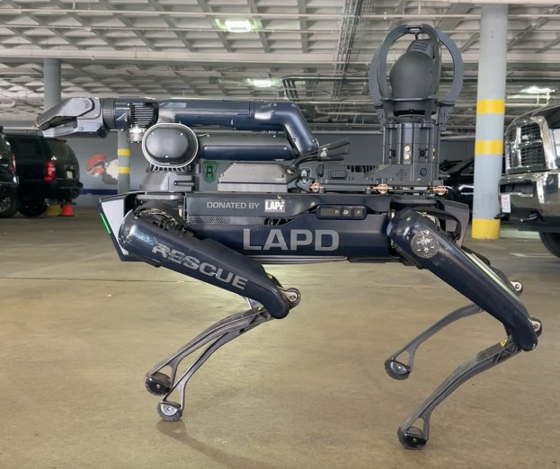
A full ban should be enacted
Ben Proctor
Robots should be banned for use in law enforcement, excepting bomb-defusal robots
Further development and usage of robots in law enforcement will lead to higher rates of discrimination and violence
Issues of police militarization and facial recognition bias are exacerbated by introduction of robots to law enforcement
Los Angeles PD Robot Dog platform
© 2024 Keith A. Pray
9
Notes:
Treat this slide as introduction to argument, just overview what you'll cover in the rest of the presentation
Main Argument: with the exception of bomb-squad robots, specifically being used for defusing bombs, all robots should be banned from all law enforcement agencies. No robots should be used for police surveillance, violent force, or any other policework
This issue intersects with the issue of police militarization, since robots are actively adding to the militarization of police
This issue also intersects with the issue of police discrimination thanks to biases in facial recognition
This issue intersects with a more widespread issue of remote-controlled violence, mirrored in the problems we see with drone strikes
9

Slide 10

Dangers of Remote-Controlled Violence
Ben Proctor
Military drone operations display the dangers of operating with deadly force from afar
Diffusion of responsibility with remote operations makes it easier to justify collateral damage [7]
UAV drone strikes were found to have between 11% and 32% civilian casualty rate [8]
72 – 155 civilian casualties
330-575 combatant casualties
MQ-9 Reaper UAV
© 2024 Keith A. Pray
10
Notes:
Physical distance from surveillance/strike targets, along with dispersed command structure of remote operations make it easier to diffuse responsibility for collateral damage, making it more acceptable to operators [7]
Operators are more susceptible to viewing their targets as "subhuman" and "enemies" as a result of only engaging with them from a distance [7]
Study on drone deaths looks at data from pakistan in 2011
Range of civilian deaths: 72-155 casualties [8]
Range of combatant deaths: 330-575 casualties [8]
10

Slide 11
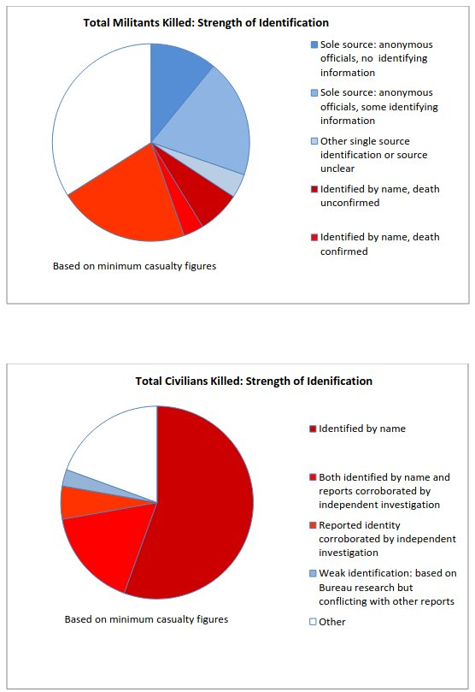
Ben Proctor
Pie charts of identification confidence for civilian & combatant drone strike deaths [8]
11
Notes:
Notice disparity in identification strength between civilian deaths and combatant deaths (much more confidence in who the civilian deaths were than in who the combatant deaths were, indicating lack of thorough confirmation in targets)

Slide 12
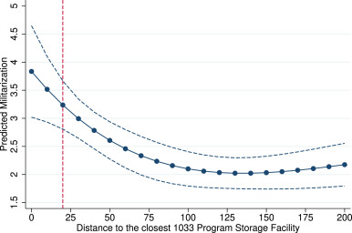
Police Militarization
Ben Proctor
Process that sees police adopt military tactics/gear
Police shooting deaths increase 0.76/million inhabitants per dollar/capita in militarization spending [4]
Militarized police forces are less trusted by the public [4]
Many law enforcement robots are leftover military equipment, acquired through the 1033 program [1]
987 robots passed down to police
$55 Million value = 0.12 deaths/million inhabitants
Distance to 1033 Facility vs. Predicted Militarization [4]
© 2024 Keith A. Pray
12
Notes:
The issue of robotics entering the police force is linked to a larger issue of police militarization
Police militarization is a process characterized by police using military tactics and equipment
for every dollar per capita spent on police militarization, the deaths by police firearm per million inhabitants increases by 0.76, significant compared to total rate of 2.7/million in 2014 [4]
Police robots are largely passed down by the military, making the integration of robots into the police inherently militarized with our current system [1]
1033 Program reallocates decomissioned military equipment to police departments, including many police robots [1]
- Graph from [4] shows the rates of police department militarization in relation to department proximity to a 1033 program storage facility
- The closer the department is, the more militarized they become
12

Slide 13
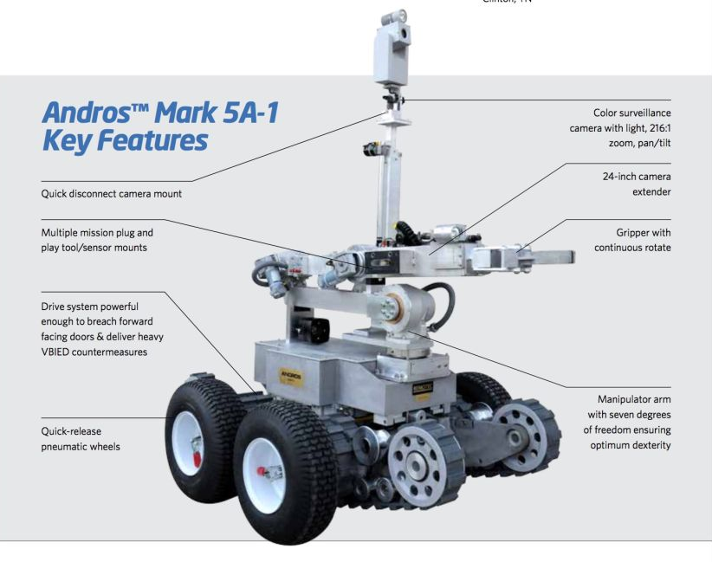
Usage of violent force by robots
Ben Proctor
Police modify robots to add weapons capabilities [9,10]
Texas Police have already used deadly force with a robot (July 8, 2016) [10]
Robot capable of attaching shotgun & grenade launches [10]
Texas man recently became first person ever arrested by a robot (September 21, 2024) [9]
Military robotics continuing development [5] will funnel more armed robots into law enforcement
Robot model used by Texas police in deadly force incident [10]
© 2024 Keith A. Pray
13
Notes:
- 1033 program funnels old military equipment into law enforcement agencies
- 987 former military robots have been given to police departments [1]
- 55 Million dollars worth of robots have been introduced into law enforcement by the military [1]
- 55 million dollars = 0.12 deaths per million citizens increase (based on militarization per capita data from previous slide)
- Trends in the robotics and defense industries indicate that advanced armed robots for military use will be developed in the near future [5]
- TRAP, Telepresent Rapid Aiming Platform, is a US military robot that consists of a rotary machine gun (minigun) and a remote-controlled drive platform [5]
- As military robotics further develop, making older models like the TRAP obsolete, these older-model armed robots will enter law enforcement through the 1033 program
- Texas police have already used a military bomb squad robot armed with an improvised explosive to kill a suspect (Robot in image was used)
Man was shooting at police officers, killing 5 with a sniper, before C4 was affixed to bomb squad robot and remotely detonated near suspect
- Texas police have armed similar bomb squad robot with tear gas launcher to aid in arrests
September 21, 2024, man barricaded in hotel room was in a standoff with police, fired a few shots at robot & officers, robot broke through window, sprayed tear gas with built-in gas canister attachment from bomb squad robot, man exited through window, run over/detained by robot
- Police willingness to modify non-violent robots with improvised weapons systems speaks to willingness to use violent-force robots in the future
- Removing physical presence from location of violence has disastrous effects (see slide on drones)
13

Slide 14

Escalates fragile situations
Ben Proctor
Only 16% of people comfortable with robots , 41% of people “Very Uncomfortable” with robots [2]
Militarized police forces significantly more likely to be assaulted [4]
Militarization responsible for a 15.9% increase in police assaults 2010-2014
Dehumanizes negotiations
Link between militarization & police assaults indicates criminals respond in more intense ways when threatened
Texas Man Arrested by Robot [9]
© 2024 Keith A. Pray
14
Notes:
- With so few people being comfortable in the presence of robots, and so many being very uncomfortable, it is likely that the presence of a robot during a fragile law enforcement situation, such as an active shooting or hostage situation, will do nothing but make the dangerous individual more agitated
- There is a link between police militarization and assaults against police officers, with militarization being linked to a 15.9% increase in assaults against officers between 2010 and 2014 [4]
- There is also a general distrust of militarized police among citizens [4]
- Mistrust + increased assaults both resulting from militarization implies that militarization makes people feel more threatened by police officers, and therefore more likely to act violently in crisis situations
Therefore, introduction of robots into the police force would further erode trust with citizens, and further alienate already aggressive individuals in fragile situations by making them feel uncomfortable and threatened. This will further escalate these situations, making a violent conclusion more likely in situations that otherwise may have ended peacefully
Video scene screen shot is from: https://www.youtube.com/watch?v=xHcbxNHVUmA
14

Slide 15
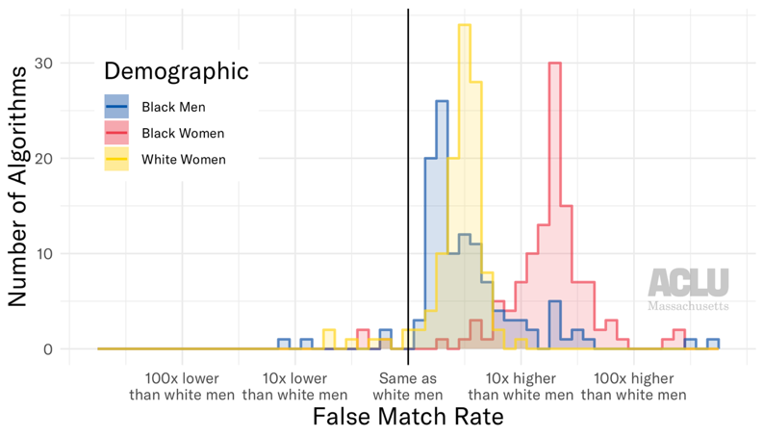
Facial recognition racism
Ben Proctor
Facial recognition algorithms are much worse at identifying women & people of color
Error rate of 0.8% for white men, error rate of 34.7% for women of color [3]
As these systems are integrated into law enforcement robots, it will perpetuate police discrimination [6]
Police patrol robots with camera feeds are being rolled out, opening the door for robotic systems with facial recognition to enter law enforcement [6]
Histogram of FR Algorithm error rates
© 2024 Keith A. Pray
15
Notes:
- With the development of law enforcement robots with cameras, it is easy to imagine the introduction of facial recognition into these systems
- K5 police robot in New York doesn’t have facial recognition, but police are allowed to use facial recognition software on images it gathers [6]
K5 is already capable of scanning & identifying 1200 license plates/minute [6], so facial recognition is a very small step away
- As more and more armed robots enter the police force, a false match could be the difference between life and death if law enforcement is allowed to develop further robotic technology
- While facial recognition may not be integrated with law enforcement robots yet, the biases present in facial recognition, along with the trend towards violent-force robots as shown by previous slides and the relative ease with which facial recognition could be added to these robots, illustrate how much of a problem this could become in the future. Stopping this trend now by banning law enforcement robots would proactively prevent this.
15

Slide 16
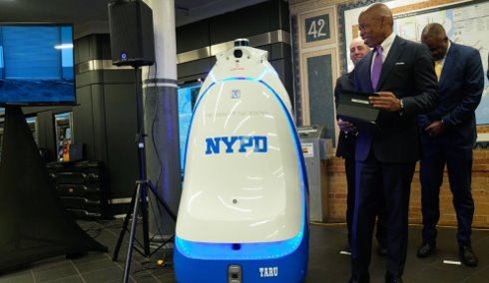
Summary
Ben Proctor
Robots increase capacity for police violence [9, 10]
Worsens existing issues of militarization, violence, and discrimination [4, 6, 3]
Further alienates & builds distrust between police & citizens [4, 2, 7]
Trajectory of robotics development implies problems will worsen with time [5]
A ban would improve public safety & police effectiveness
New York Mayor Eric Adams introduces K5 police robot [6]
16

Slide 17
References
<Your Name>
[1] Arthur Holland Michel, "Law Enforcement Robotics Datasheet" , (Bard College, July 11 2016), https://dronecenter.bard.edu/law-enforcement-robots-datasheet/ , (September 23, 2024).
[2] Darrel M. West, "Brookings survey finds 52 percent believe robots will perform most human activities in 30 years", (Brookings Institute, June 21 2018), https://www.brookings.edu/articles/brookings-survey-finds-52-percent-believe-robots-will-perform-most-human-activities-in-30-years/ , (September 23, 2024).
[3] Larry Hardesty, "Study finds gender and skin-type bias in commercial artificial intelligence systems" , (MIT News Office, February 11, 2018), https://news.mit.edu/2018/study-finds-gender-skin-type-bias-artificial-intelligence-systems-0212 , (September 23, 2024).
[4] Federico Masera, Police safety, killings by the police, and the militarization of US law enforcement, Journal of Urban Economics, Volume 124, 2021, 103365, ISSN 0094-1190, https://doi.org/10.1016/j.jue.2021.103365
[5] J. Khurshid and Hong Bing-rong, "Military robots - a glimpse from today and tomorrow," ICARCV 2004 8th Control, Automation, Robotics and Vision Conference, 2004., Kunming, China, 2004, pp. 771-777 Vol. 1, doi: 10.1109/ICARCV.2004.1468925.
[6] Alinnah Qiao, "Under the Watchful, Unblinking Eye: Privacy Implications of the New York Police Department's Deployment of Autonomous Robots", (Harvard University Jolt Digest, November 10, 2023), https://jolt.law.harvard.edu/digest/under-the-watchful-unblinking-eye-privacy-implications-of-the-new-york-police-departments-deployment-of-autonomous-robots, (September 23, 2024).
[7] Albert Bandura, "Disengaging morality from robotic war", (British Psychological Society, January 9, 2017), https://www.bps.org.uk/psychologist/disengaging-morality-robotic-war, (September 23, 2024).
[8] Chantal Grut, "Counting Drone Strike Deaths" (Columbia University, October 2012), https://hri.law.columbia.edu/sites/default/files/publications/COLUMBIACountingDronesFinal.pdf , (September 23, 2024).
[9]"Robot fires tear gas and then runs over man in police standoff", (CNN, September 21, 2023) https://www.cnn.com/2024/09/21/us/video/wanted-man-police-robot-standoff-digvid , (September 23, 2024).
[10] Sarah Sidner, "How robot, explosives took out Dallas sniper in unprecedented way", (CNN, July 12, 2016),
https://www.cnn.com/2016/07/12/us/dallas-police-robot-c4-explosives/index.html , (September 23, 2024).
© 2024 Keith A. Pray
17

Slide 18
Preventing the Doomscroll
Olivia Kochol

Slide 19
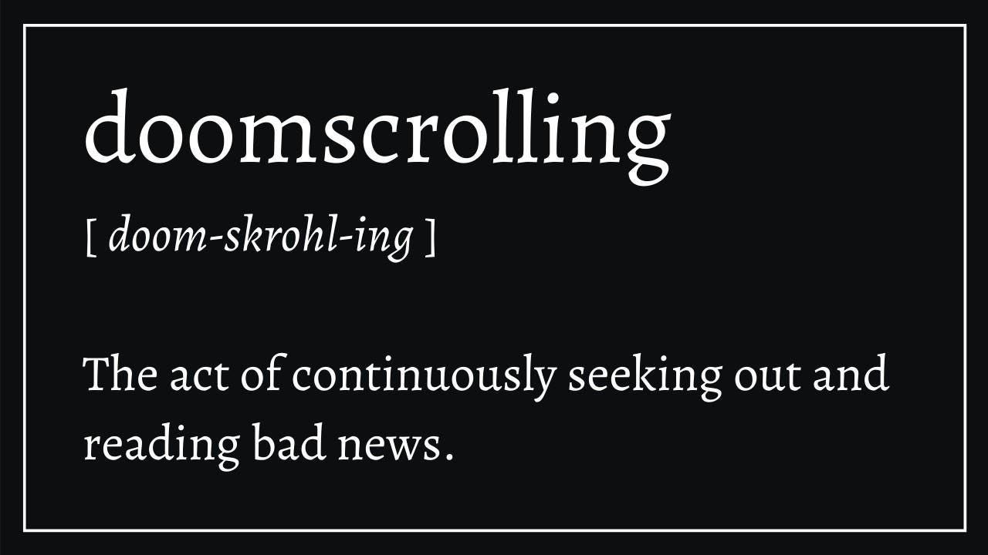
What is DoomScrolling?
Olivia Kochol
Term created in 2020 at the start of the pandemic
"the activity of spending a lot of time looking at your phone or computer and purposefully reading bad or negative news stories."[4]
Mindlessly consuming negative media in an almost obsessive manner [1]
Definition from digital wellness blogger Sonya Mohamed [5]
Notes:
The term is really associated with the pandemic since it was a main source of negativity at that time [1]
Psychologist Susan Albers, PsyD [1]
Focus on negative or dangerous things because we have evolved to be alert of danger for survival
Way to make are brain think we are staying alert
Image: definition
We read to try to stay protected from threats to ease our anxiety, but the more we read the more threats we find and we end up in an endless circle of stress and threats

Slide 20
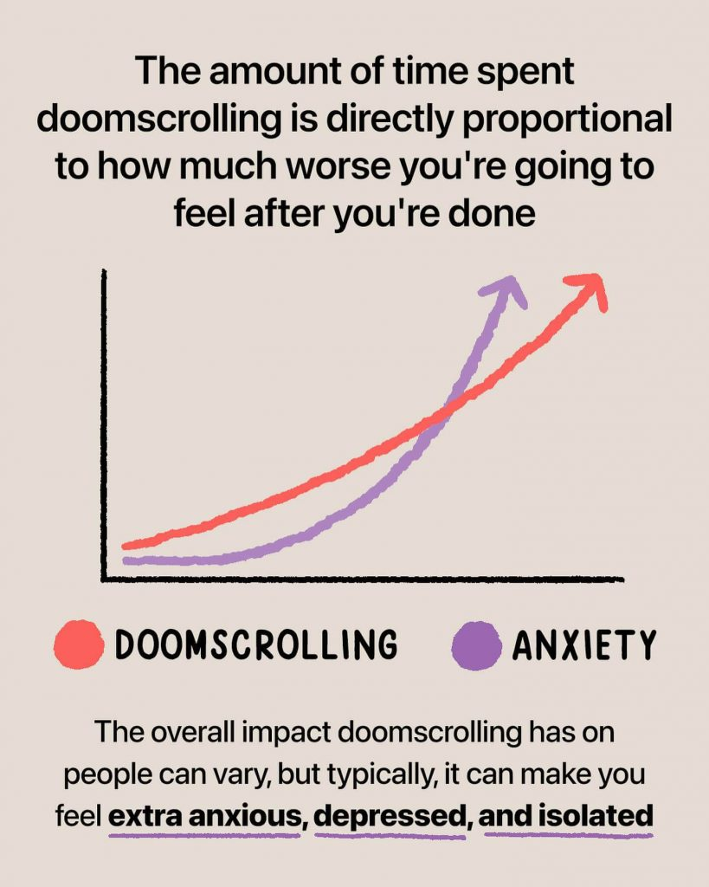
Olivia Kochol
DoomScrolling is bad for our health
Doomscrolling can make mental health issues worse
Some physical health issues can result as well
Social media platforms are built for doomscrolling
Seen changes in some platforms to prevent their doomscrolling issues
Doomscrolling vs Anxiety proportionality graph [3]
Notes:
<speaker notes>
Mental health issues get worse while constantly absorbing negative media, mainly anxiety since the media we consume is giving us more things to worry about. Many have even had issue with getting panic attacks from the anxiety they feel from negative media consumption. [1]
Graph doesn't show actual data, more and example of the correlation of doomscrolling and anxiety increases [3]
The addictive nature of doomscrolling keeps us up late and can increase or even create insomnia in those who doomscroll [1]
Social medias software is meant to endlessly scroll [13]
Apps are starting to try to help change these negative behaviors [12]

Slide 21
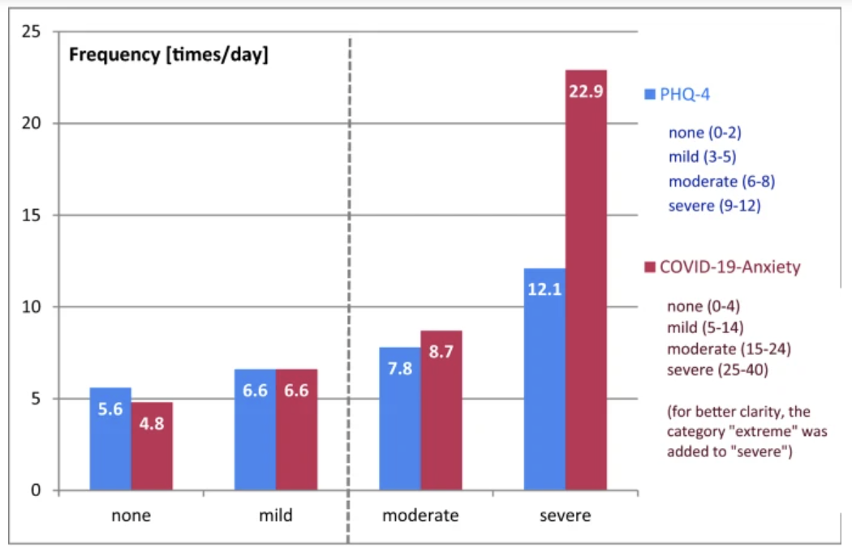
Olivia Kochol
Mental health Issues
Major disorders can worsen (MDD, GAD, OCD, PTSD, and Panic Disorder) [2]
Panic attacks, loneliness, depression and anxiety [1]
Manic thoughts from confusing fact and fiction on the internet [2]
Comparing yourself to others can lead to "FOMO" (Fear of missing out) [6]
Pandemic caused many mental health issues
Comparision of the frequency of unspecific "normal" anxiety/ depression symptoms during the pandemic and COVID-19 related anxiety/ depression symptoms [10]
Notes:
Major Depressive Disorder (MDD), General Anxiety Disorder (GAD), Obsessive Compulsive Disorder (OCD), Post-Traumatic Stress Disorder (PTSD), and Panic disorder [2]
“When we’re depressed, we often look for information that can confirm how we feel,” Dr. Albers shares [1]
once you do it a few times, it can easily become a habit, locking you into a loop of feeling bad and then reading the news to confirm that you should be feeling bad [1]
can also be a function of obsessive-compulsive disorder (OCD), a mental health condition that causes you to perform repetitive behaviors. [1]
Manic thoughts - Manipulates your perception of reality/ your sanity [1]
Addiction to social media is often compared to substance abuse issues [6]
Image shows study that compared anxiety that young people usual have to COVID anxieties [10]
Constantly being exposed to the beauty standards of perfect online can be damaging to self esteem also leads to fomo [6]
Absorbing more information helps us feel like were more in control (OCD) [1]

Slide 22
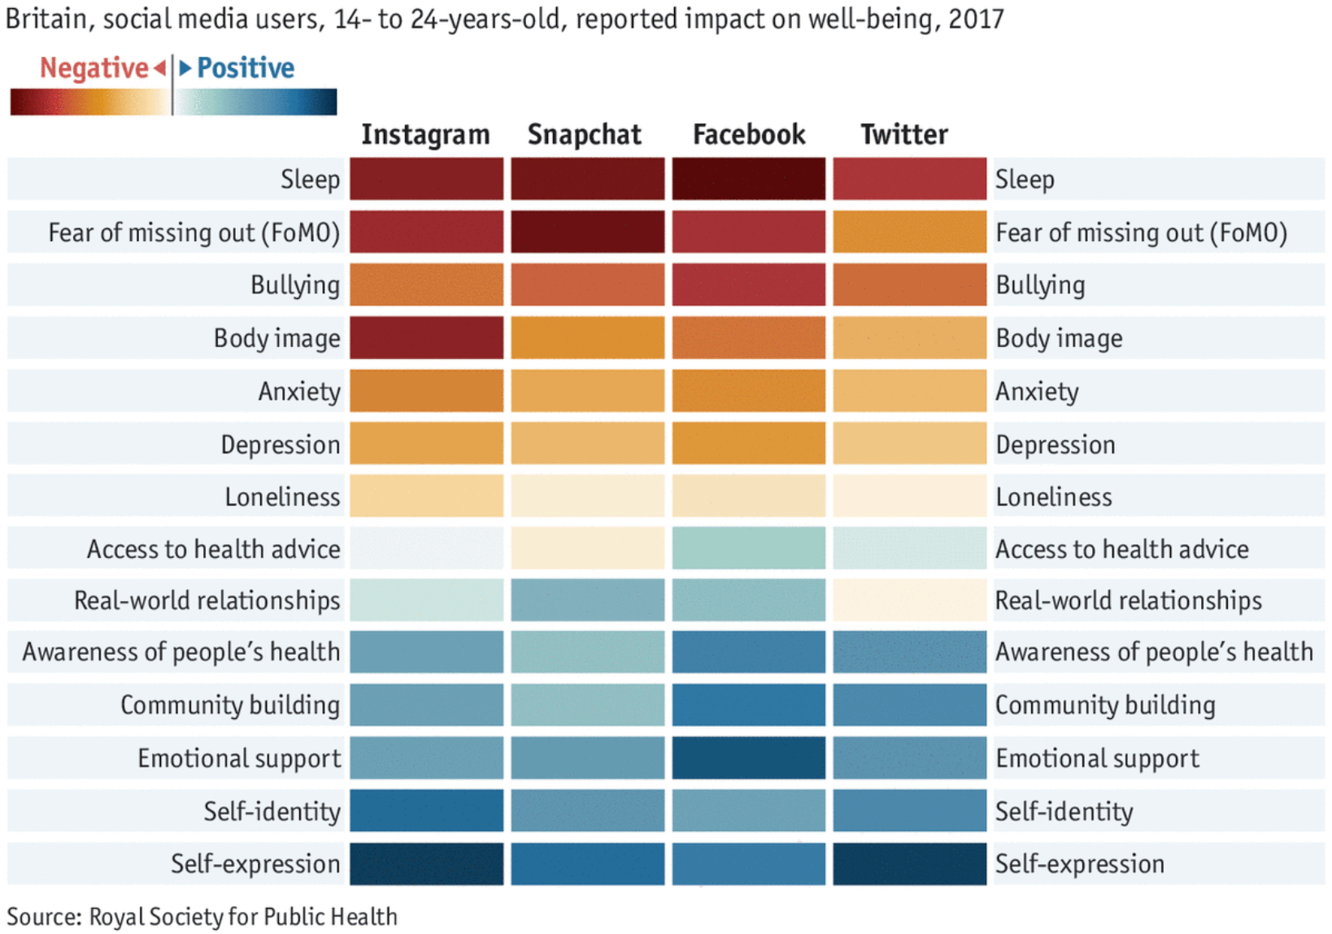
Olivia Kochol
Other health Issues
"Over time, high levels of cortisol exhaust your brain and body, leading to inflammation that can cause a variety of mental and physical health issues." [1]
Increased inflammation from C-reactive protein (CRP) can cause diabetes and cardiovascular disease [8]
70% of people admit to checking social media from bed, this leads to insomnia; “When you’re anxious, it’s hard to turn your mind off to go to sleep,” Dr. Albers [1]
Doomscrolling negative and positive impacts on young people in the UK [7]
Notes:
<speaker notes>
In one study, 70% of participants acknowledged checking social media from bed, and the more time they spent doing so, the more likely they were to have trouble falling asleep
Psychologist Susan Albers, PsyD [1]
Increases cortisol levels, which increase inflammation [1]
The negative effects of social media aren't just mental there are physical effects, like how it effects our sleep being the worst [7]
Altered brain development [6]
higher social media use was also related to somatic symptoms, like headaches, chest and back pains [8]
Some cancers can result from the chronic inflammation [8]

Slide 23
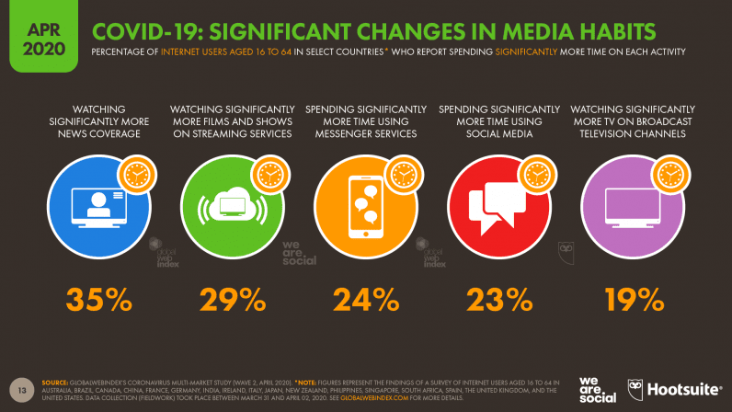
Olivia Kochol
Social Media Platforms
23% increase in social media use since the start of the pandemic [9]
Addicting platforms become distractions; 77% employees use social media on the clock [13]
Endless scrolling and searching for more information, until forget the original search [13]
Increases in media consumption during the COVID-19 global pandemic [9]
Notes:
<speaker notes>
Usage of social media has always been an issue for society as over use has always cause mental health issues and cyberbully has also created issues
During the pandemic everything was amplified and got worse
Overall during the pandemic media usage increased, primarily news coverage and social media [9]
The endless black hole of these platforms is meant to draw people in and adds to the addictive nature of social media [13]
They've become addictive and distracting, 77% of employees use social media while on the clock [13]

Slide 24
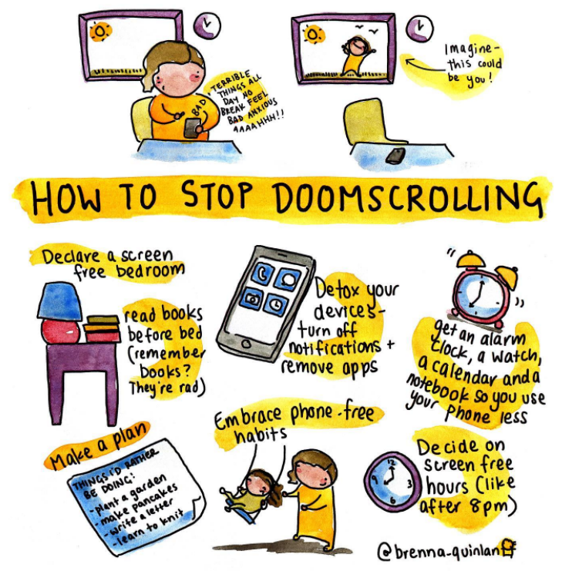
Olivia Kochol
Solutions
Limit your time on platforms with app time limits [1]
Turn off notifications [2][6]
Seek out positivity while online [6][3]
Set boundaries with what you see online
Replace the behavior with something healthier [2]
Make your phone less accessible [1]
Ways to stop doomscrolling graphic from Brenna Quinlan [11]
Notes:
<speaker notes>
Localize behavior (move phone, set limits, curate feed) [1]
Recognize how it makes you feel, Try to avoid overthinking and catastrophizing, Consciously check your phone, not compulsively, Tone back scrolling, Focus on the present, look for positive news, Practice gratitude, move your body, disconnect, seek help [1]
Find something else to do, set time limit, seek out positivity, practice mindfulness, avoid catastrophizing, engage in thought stopping, reduce scrolling, practice mantras, focus on the now, be honest with yourself, digital wellness apps, turn off notifications, practice off-screen selfcare [2]
Set cut-off time, turn off notifications, turn on focus modes/ airplane mode while at work/school, use an alarm clock instead of a phone alarm, seek out positivity [6]

Slide 25
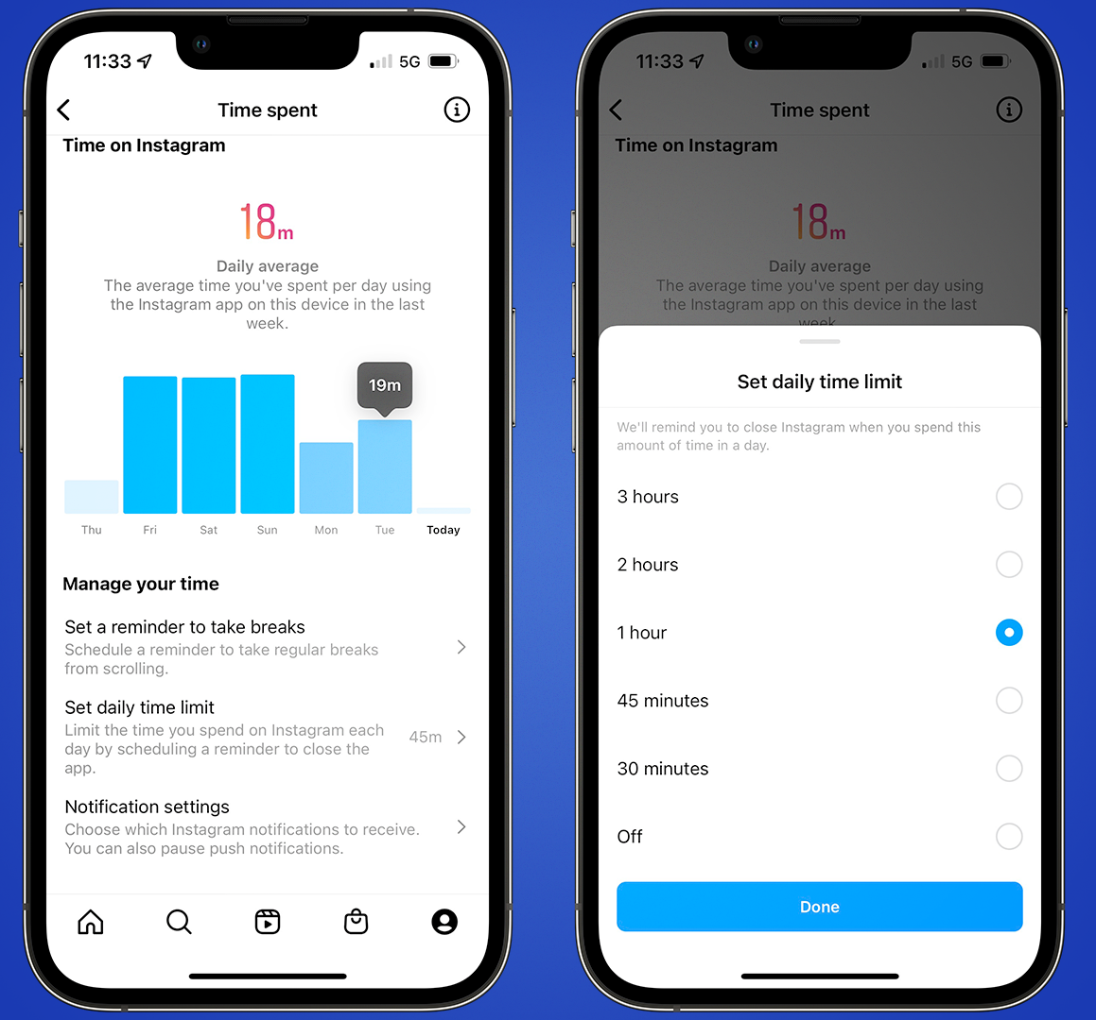
Olivia Kochol
How can Social Media Platforms help?
Put limits on their apps, i.e. Instagram [13]
Sort out their media to make it easier for users to avoid certain news
Overall try to increase positivity on their app
How to use Instagram time limit feature [12]
Notes:
<speaker notes>
Apps are staring to put limits on their websites to limit the time on app [13]
Negativity adds to the negative mental health effects, more positivity can help boost mental moral [2]
Blocking/curating feed to more media that is healthy helps, social media platforms can help this effort and sort out data, twitter/X attempts this [1]

Slide 26
References
Olivia Kochol
[1] "How to Finally Stop Doomscrolling." Cleveland Clinic, May 6, 2024, https://health.clevelandclinic.org/everything-you-need-to-know-about-doomscrolling-and-how-to-avoid-it
[2] "13 Ways to Stop Doomscrolling & Protect Your Mental Health." Socal Mental Health, https://socalmentalhealth.com/13-ways-to-stop-doomscrolling/
[3] Sharma, Swarnakshi. "Doomscrolling Can Worsen Your Anxiety: Here’s Tips To Stop Doomscrolling!." Calm Sage, Jun. 20, 2024, https://www.calmsage.com/tips-to-stop-doomscrolling/
[4] Cambridge Dictionary, "Doomscrolling." https://dictionary.cambridge.org/us/dictionary/english/doomscrolling
[5] Mohamed, Sonya. "Doomscrolling: How to Break the Cycle." Medium, Jun. 18, 2020. https://medium.com/@sonya_38610/doomscrolling-how-to-break-the-cycle-81e85b15f255
[6] Newby, Jake. "Constantly Scrolling Social Media? Here’s why you Should Take a Break." MI Blues Perspective, Jan. 7, 2022, https://www.mibluedaily.com/stories/mental-health/constantly-scrolling-social-media-heres-why-you-should-take-a-break
[7] "Stop Doomscrolling with CBT in 4 Steps." Cognitive Behavioral Therapy Los Angeles, https://cogbtherapy.com/cbt-blog/stop-doomscrolling-in-4-steps
[8] Gambini, Bert. "Social media use tied to poor physical health." University of Buffalo, Jan. 22, 2022. https://www.buffalo.edu/ubnow/stories/2022/01/social-media-physical-health.html
[9] Kemp, Simon. "Report: Most important data on digital audiences during coronavirus." TNW, Apr. 24, 2020. https://thenextweb.com/news/report-most-important-data-on-digital-audiences-during-coronavirus
[10] Bendau, A., Petzold, M.B., Pyrkosch, L. et al. Associations between COVID-19 related media consumption and symptoms of anxiety, depression and COVID-19 related fear in the general population in Germany. Eur Arch Psychiatry Clin Neurosci 271, 283–291 (2021). https://doi.org/10.1007/s00406-020-01171-6
[11] Zelenska, Myroslava. "Doomscrolling — what can I do to help myself cope?." Medium, Mar. 10, 2022. https://medium.com/@myroslavazel/doomscrolling-what-can-i-do-to-help-myself-cope-c3ef55768e19
[12] Baxter, Daryl. "How to limit your Instagram usage on iOS and Android." TechRadar, Feb. 23, 2022. https://www.techradar.com/how-to/how-to-limit-your-instagram-usage-on-ios-and-android
[13] Woolley, K., Sharif, M.A.. "The Psychology of Your Scrolling Addiction." Harvard Business Review, Jan. 31, 2022. https://hbr.org/2022/01/the-psychology-of-your-scrolling-addiction

Slide 27
HOOKUP CULTURE: THE RESULT OR THE CAUSE?
Jonathon Chang
Notes:
Hookup culture! We all know it
Sex without love
And the big question is, is the development of technology a cause of hookup culture…
Or did hookup culture bolster the growth of this technology?

Slide 28
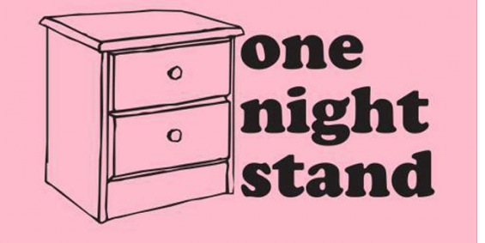
Mutually supportive, but not Lasting
Jonathon Chang
Millions of users now using dating apps
Hookup culture started growing before dating apps
Intentions say one thing, but outcomes say another
Sex and dating apps on the decline
Notes:
encounters often transpire without any promise of, or desire for, a more traditional romantic relationship
Basic overall points:
Dating apps have grown massively in the past 20 years, to the point where they are a viable means of finding a partner
Hookup culture started before, mostly in the last 100 years as ideals changed, namely feminism, eroticism in media, and contraception
The results of surveys show people’s intentions as well as their outcomes. They want love but they get sex
New generations of people are using dating apps less, and college students are having less sex
https://www.ncbi.nlm.nih.gov/pmc/articles/PMC3613286/

Slide 29
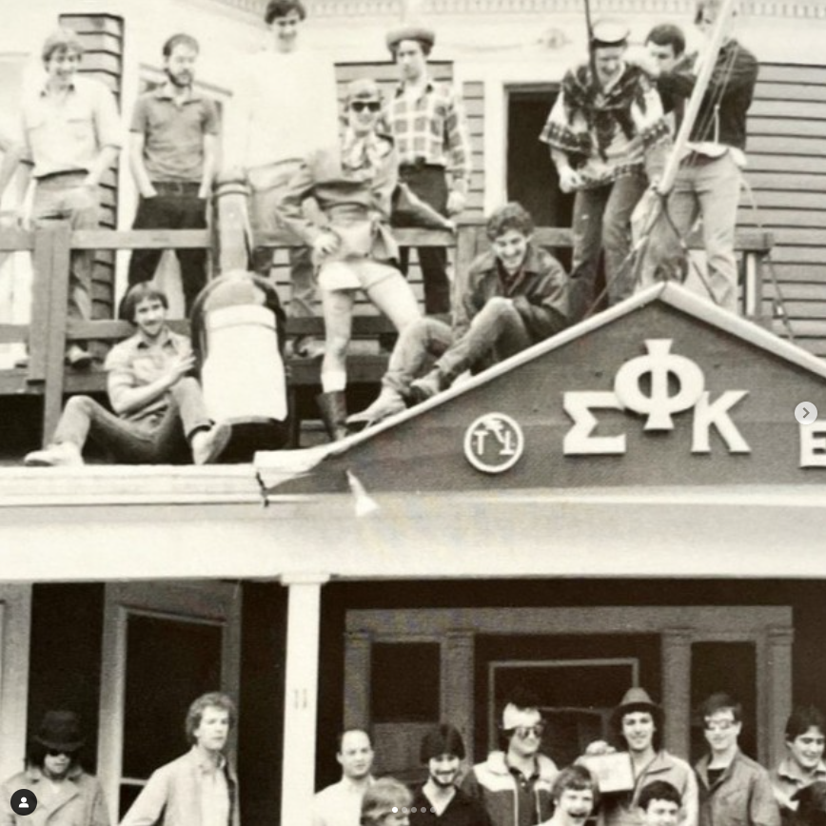
Hookup culture: A brief review
Jonathon Chang
“Uncommitted sexual encounters”
1930s, early media portraying sex
Censorship laws until 1960s
1960s, feminism, college parties, birth control, contraceptives
Modern day: pop culture, media [3]
<Graphic as big as will fit>
Notes:
encounters often transpire without any promise of, or desire for, a more traditional romantic relationship
What is a hookup?
Hookup is an “uncommitted sexual encounter”
Modern Hookup culture started around the 1930s, when societal ideals were changing, with portrayals of sex making it into media like early movies
Censorship laws were put in place to address this, as morals of those in government did not align with the shifting societal norms of the time
1960s, we have more modern feminism, “own your body”, sex as a form of freedom. College parties start to grow, leading to more free sex lives
Birth control and contraceptives become available, no longer have to deal with consequences of childbirth
https://www.ncbi.nlm.nih.gov/pmc/articles/PMC3613286/

Slide 30
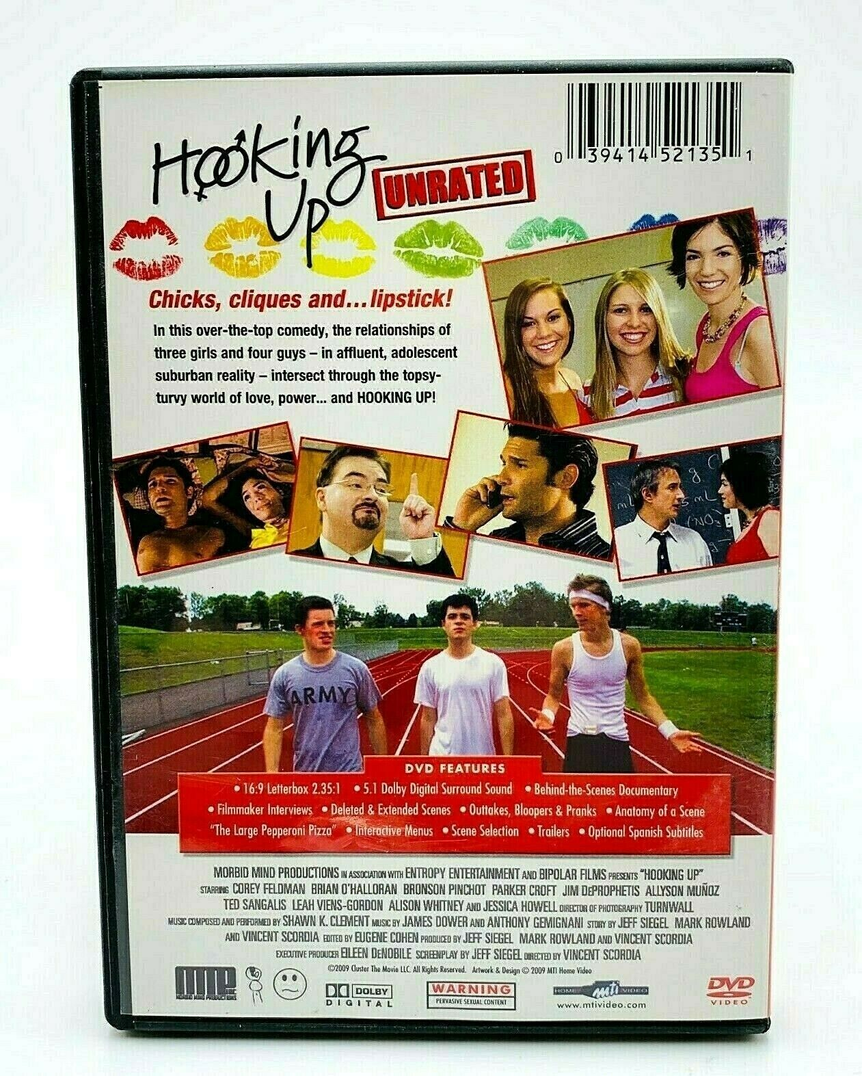
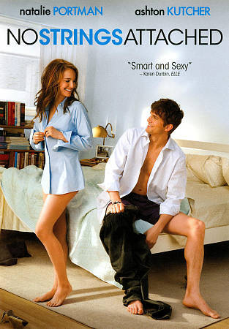
Jonathon Chang
Notes:
Film hooking up in 2009 showing romantic and sexual lives of adolescents
No strings attached in 2011 shows uncommitted sex, friends having a nonromatntic sexual relationship
Basic examples of modern media portraying sex very readily

Slide 31
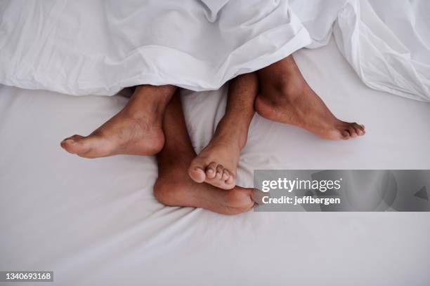
HOOKUP STATISTICS
Jonathon Chang
Kissing: 98%
“Other behavior”: 81%
Above the waist: 58%
Below the waist: 53%
Performed oral: 36%
Received oral: 35%
Sexual intercourse: 34% [3]
Notes:
https://www.ncbi.nlm.nih.gov/pmc/articles/PMC3613286/
Some basic statistics on the outcomes of modern hookups. Shows what’s happening in hookups, mainly the uncommitted sex part and at what frequency it happens
Kissing,
Other behavior (this was literally undefined, it doesn’t specify)
Above the waist touching
Below the waist touching
Performing, receiving, oral sex
Full on sexual intercourse
What happens in a hookup?

Slide 32
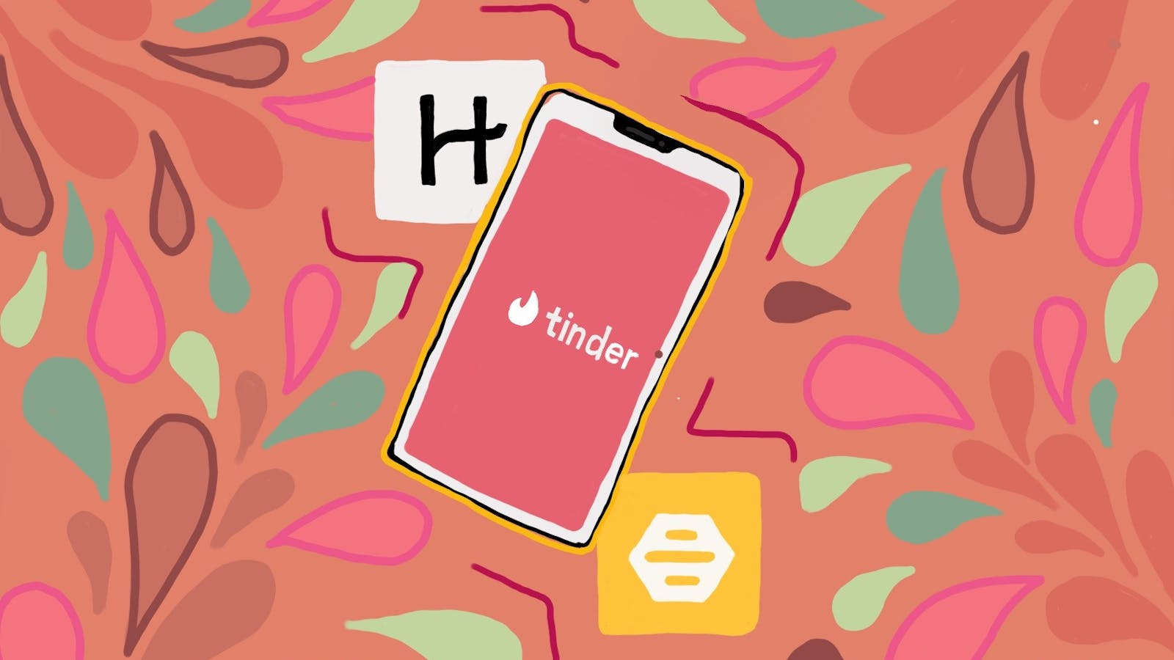
Online dating, websites, apps
Jonathon Chang
90% of young adults 18-29 use social networking sites [2]
27% of 18-24 year olds use dating apps (2016) up from 10% (2013) [2]
Tinder released in 2012 [4]
Match.com released in 1995 [4]
49 million have tried online dating as of 2024 [4]
Notes:
<speaker notes>https://spa.education.indiana.edu/journal/editions/2017/1%20Super%20Likes%20and%20Right%20Swipes.pdf
Modern statistics of online dating apps, some important dates.
Main point in this slide is to show the growth of online dating in the past decade and a half
Tinder, being the first “swipe match” app, and suggesting people around you rather than giving you a catalogue, doing it in real time
Match.com being one of the earliest dating web services, with millions of users. 30 million members as of today
49 million have tried online dating as of 2024.
https://www.datingadvice.com/online-dating/history-of-online-dating

Slide 33
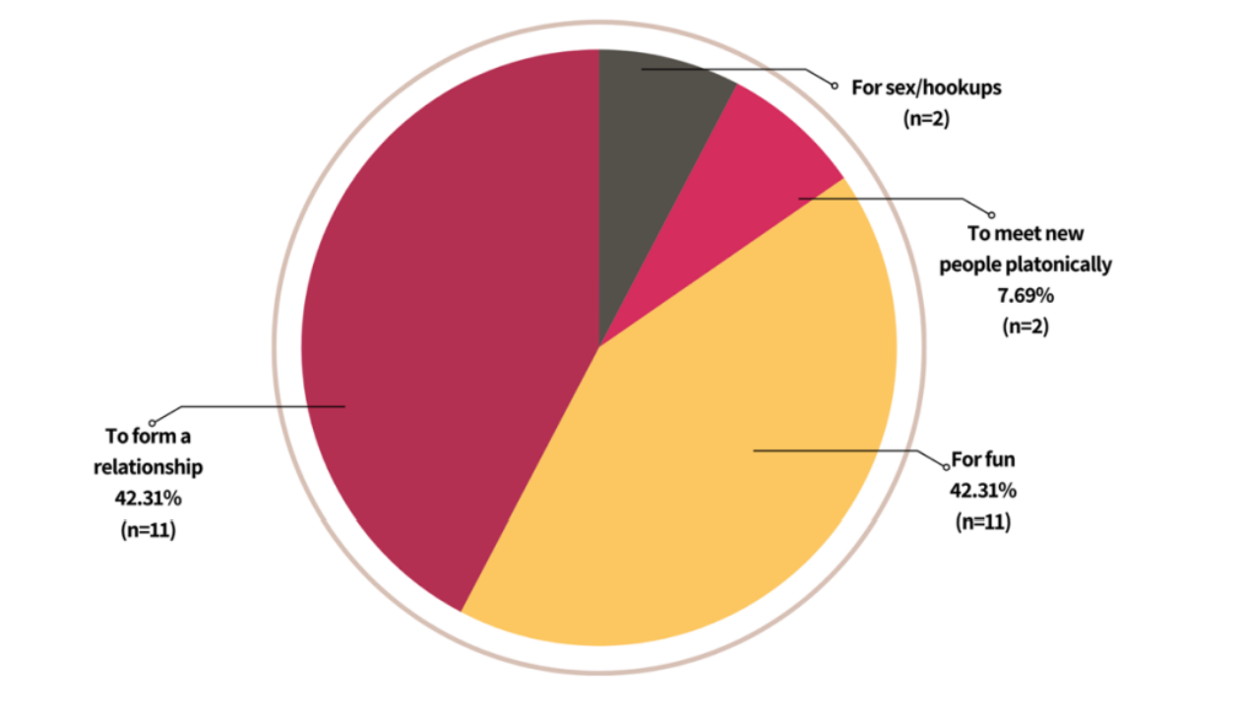
Reasons for using online dating
Jonathon Chang
Who? 66 IUB Students
“I am looking for casual dating”
34.69% said important or very important [2]
“Entertainment”
69.39% said at least moderately important [2]
“I am looking for casual sex”:
75.51% said moderately unimportant [2]
Pew research, 24% said yes [8]
Long term partner: 44% [8]
Notes:
https://www.ncbi.nlm.nih.gov/pmc/articles/PMC7662763/
Main point: what people say is that sex is not as important of a consideration as people think it is. (this is important, we come back to this later)
IUB stands for Indiana university Bloomington. A study was conducted with undergraduates, who responded to this.
Main point is that respondents say that they want relationships, and don’t seem interested in casual sex with a minority considering it important
(supported by separate study, it seems like around 76% of people don’t consider casual sex important with the other 24% seeking it)
Other important point: it seems like a good amount of people are seeking long term partners
Pew research study had 6034 respondents.
https://spa.education.indiana.edu/journal/editions/2017/1%20Super%20Likes%20and%20Right%20Swipes.pdf

Slide 34
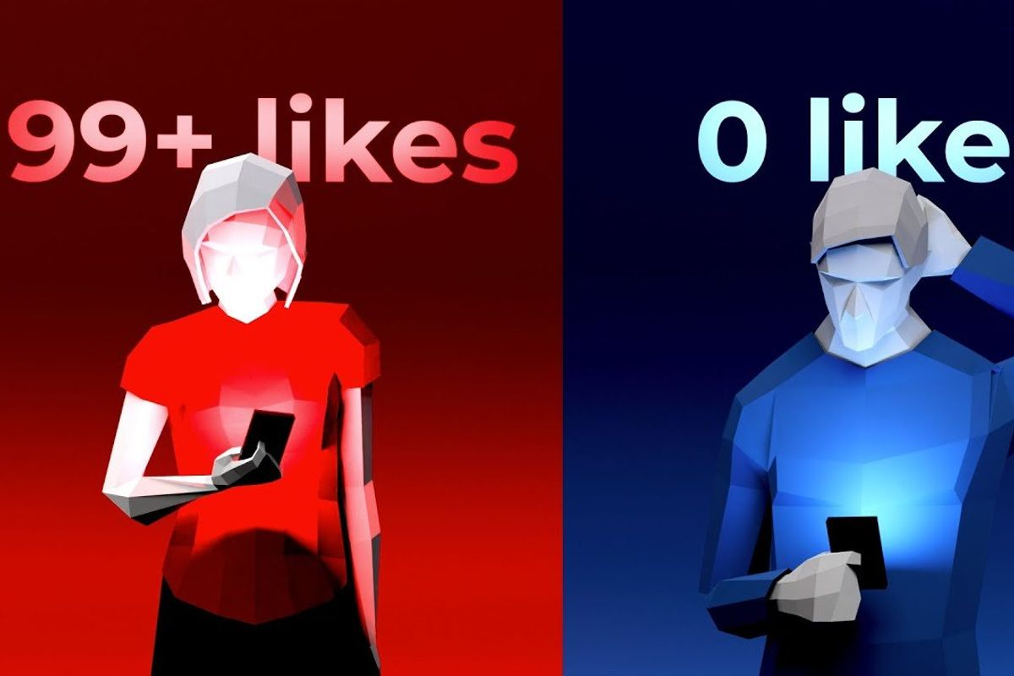
Users of online dating
Jonathon Chang
Men use Tinder more frequently for thrill seeking [5]
78.1% Tinder uses identify as male [9]
31% of men say casual sex is major reason [7]
Only 13% of females [7]
LGB more likely than straight [5]
Less anxious daters [5]
Sexually permissive people [5]
Notes:
https://journals.sagepub.com/doi/10.1177/1461444818804773
https://www.sciencedirect.com/science/article/pii/S0747563218303625?via%3Dihub
Differences in types of users.
It seems like men are more sexual, looking for casual sex
LGB people are more likely to use dating apps than straight people, this is because of societal stigmas in certain countries, and online aspect makes it easier and less risky for LGB daters to find each other without societal stress.
More confident people are more likely to use dating apps (score of 4.15 for users vs 4.52 for non users)
More sexually permissive people are likely to use dating apps (score of 3.84 vs 3.24 for non users)
This is on a seven point scale.(1 = completely incorrect) (7 = completely correct)
Pool: 260 non app users and 277 app users in a pool
The main point is that more sexually permissive people tend to use dating apps over less sexually permissive people, suggesting that people in it may be looking for sex
(does not directly ask about whether or not they are looking for sex)
Queer more likely than straight:

Slide 35
Reasons for using online dating
Jonathon Chang
[6]
Notes:
Pool: a linked online survey shared in magazines, both online and local
Social Approval 3.93 Entertainment 4.98 Relationship 3.84 Flirting 3.64 Sexual orientation 3.56 Socializing 4.18 Distraction 3.86 Curiosity 4.55 Sexual Experience 2.72
Again, the seven point scale, but this time with a different group in a “why do you cheat survey”
Took group 1, 1486 respondents
Main point here is that seeking sexual experience is one of the lowest reasons for people using online dating (so they say).
This will appear controversial later

Slide 36
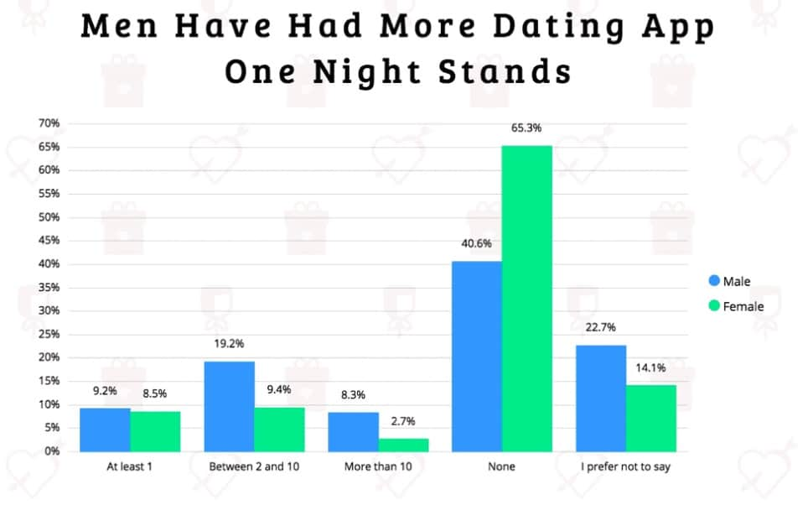
Results of online dating
Jonathon Chang
33% find a romantic partner
52% have casual sex with at least one partner
33% of offline encounters end in casual sex
25% of encounters end in a committed relationship
18.6% of participants had sex with someone they met on tinder [10]
[9]
Notes:
https://www.ncbi.nlm.nih.gov/pmc/articles/PMC7557852/
Various studies data brought together (note the statistic of 52% and 25%. These statistics will show again in a separate study

Slide 37
Offline Outcomes
[6]
Notes:
This and the next slide go together. Again, with the 1486 group, this is the breakdown of outcomes of offline occurrences for dating app users.
Note that the number of one-night stands over doubles that of actual romantic relationships, despite people in surveys responding that sexual encounters are NOT an important factor.

Slide 38
Offline Occurrences
[6]
Notes:
This study did separate the number of occurrences by single and non-single people, but we still see similar results with over double the number of one-night stands for both groups.
Non single: 333
Single: 1153

Slide 39
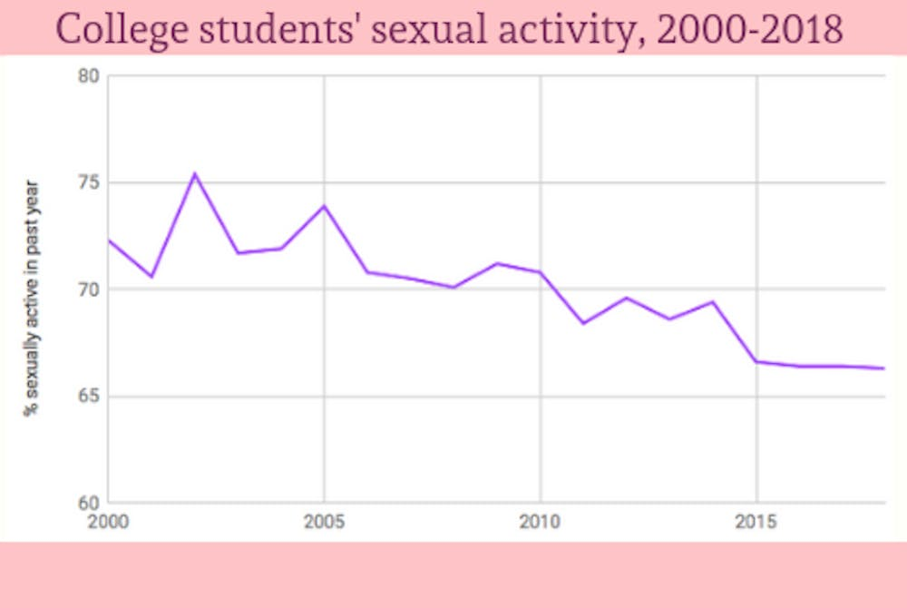
The Decline of sex
Jonathon Chang
2000, 72% of college students had sex in last 12 months [7]
Dropped to 66% of college students in 2018
Median 1st marriage age:
(24,26) (F/M) , 1990
(28,30) (F/M) , 2018 [7]
79% of college and grad students don’t use dating apps at least once a month [11]
Half of Hinge users want a long-term relationship after pandemic [12]
Notes:
Data from the national college health assessment.
Median age of first marriage is becoming later and later. College students are having less sex
College and grad students are using dating apps less and less.
After the pandemic, more users want a long term relationship
Overall idea is: Even with explosive growth in the dating app space, people are having less sex. Despite reaching millions of users, amount of sex has not increased, but decreased.
Bringing it all together:
Hookup culture started a long time ago
Dating apps have experienced explosive growth
Dating app users say sex is not important factor when using dating apps
Dating app users, despite seeking romance, end up having more casual sex instead
Despite all this explosive growth and user getting sex out of dating apps, college sexual activity has declined
What do we conclude from this?
Although people aren’t looking for casual sex, dating apps end up leading them to casual sex.
This means that dating apps encourage and enable hookup culture, despite what people say they want
The discrepancy between what people say they want and what they get shows this, with only 25% of people saying they want casual sex
Yet more than double the amount of casual sex actually ends up occurring compared to romantic relationships.
Even still, it doesn’t seem like dating apps are able to continually support hookup culture as college students end up having less sex
It displays a cultural shift, that dating apps seem to be unable to stop as they are losing customers, especially after pandemic
Tldr: people do not go into dating apps expecting sex, but they get sex
Even still, people are having less sex. Dating apps are enabler, and result in sex
But do not cause it to increase
https://www.jhunewsletter.com/article/2019/02/why-are-we-having-less-sex-today-than-ever-before#:~:text=The%20results%20are%20similar%20for,percent%20in%20the%202000%20assessment

Slide 40
References
Jonathon Chang
[1] Barrada, Juan Ramón, and Ángel Castro. “Tinder Users: Sociodemographic, Psychological, and Psychosexual Characteristics.” International Journal of Environmental Research and Public Health, vol. 17, no. 21, 1 Jan. 2020, p. 8047, www.mdpi.com/1660-4601/17/21/8047/htm, https://doi.org/10.3390/ijerph17218047. Accessed 23 Sept. 2024.
[2] Beauchamp, Alyssa M., et al. “Super Likes and Right Swipes: How Undergraduate Women Experience Dating Apps.” Journal of the Student Personnel Association at Indiana University, 20 June 2017, pp. 1–16, scholarworks.iu.edu/journals/index.php/jiuspa/article/view/23700. Accessed 23 Sept. 2024.
[3] Garcia, Justin R., et al. “Sexual Hookup Culture: A Review.” Review of General Psychology, vol. 16, no. 2, 1 June 2012, pp. 161–176, www.apa.org/monitor/2013/02/sexual-hookup-culture.pdf, https://doi.org/10.1037/a0027911. Accessed 23 Sept. 2024.
[4] Matthews, Hayley. ““The History of Online Dating” — (a Timeline from Paper Ads to Websites).” DatingAdvice.com, DatingAdvice.com, 14 Apr. 2017, www.datingadvice.com/online-dating/history-of-online-dating. Accessed 23 Sept. 2024.
[5] Sumter, Sindy R, and Laura Vandenbosch. “Dating Gone Mobile: Demographic and Personality-Based Correlates of Using Smartphone-Based Dating Applications among Emerging Adults.” New Media & Society, vol. 21, no. 3, 20 Oct. 2018, pp. 655–673, journals.sagepub.com/doi/full/10.1177/1461444818804773, https://doi.org/10.1177/1461444818804773. Accessed 23 Sept. 2024.
[6] Timmermans, Elisabeth, et al. “Why Are You Cheating on Tinder? Exploring Users’ Motives and (Dark) Personality Traits.” Computers in Human Behavior, vol. 89, Dec. 2018, pp. 129–139, https://doi.org/10.1016/j.chb.2018.07.040.
[7] Wooden, Alyssa. “Why Are We Having Less Sex Today than Ever Before?” The Johns Hopkins News-Letter, 14 Feb. 2019, www.jhunewsletter.com/article/2019/02/why-are-we-having-less-sex-today-than-ever-before. Accessed 23 Sept. 2024.
[8] Vogels, Emily A., and Colleen McClain. “Key Findings about Online Dating in the U.S.” Pew Research Center, Pew Research Center, 2 Feb. 2023, www.pewresearch.org/short-reads/2023/02/02/key-findings-about-online-dating-in-the-u-s/. Accessed 23 Sept. 2024.
[9] Simon, Michael. “Tinder Statistics 2023: Analyzing User Demographics and Behavior.” The Tech Report, 9 May 2023, techreport.com/statistics/software-web/tinder-statistics/. Accessed 23 Sept. 2024.
[10] Castro, Ángel, and Juan Ramón Barrada. “Dating Apps and Their Sociodemographic and Psychosocial Correlates: A Systematic Review.” International Journal of Environmental Research and Public Health, vol. 17, no. 18, 7 Sept. 2020, www.ncbi.nlm.nih.gov/pmc/articles/PMC7557852/, https://doi.org/10.3390/ijerph17186500. Accessed 23 Sept. 2024.
[11] Lindsay, Kate. “Dating Apps Are in Their Flop Era.” Bustle, 8 Jan. 2024, www.bustle.com/wellness/dating-apps-have-gotten-worse-hinge-tinder-bumble-gen-z-millennials. Accessed 23 Sept. 2024.
[12] News.com.au. “Hinge Survey Says Gen Z Is Killing Hookup Culture.” New York Post, 30 Aug. 2022, nypost.com/2022/08/30/hinge-survey-says-gen-z-is-killing-hookup-culture/. Accessed 23 Sept. 2024.
Notes:
Yes yes the references

Slide 41
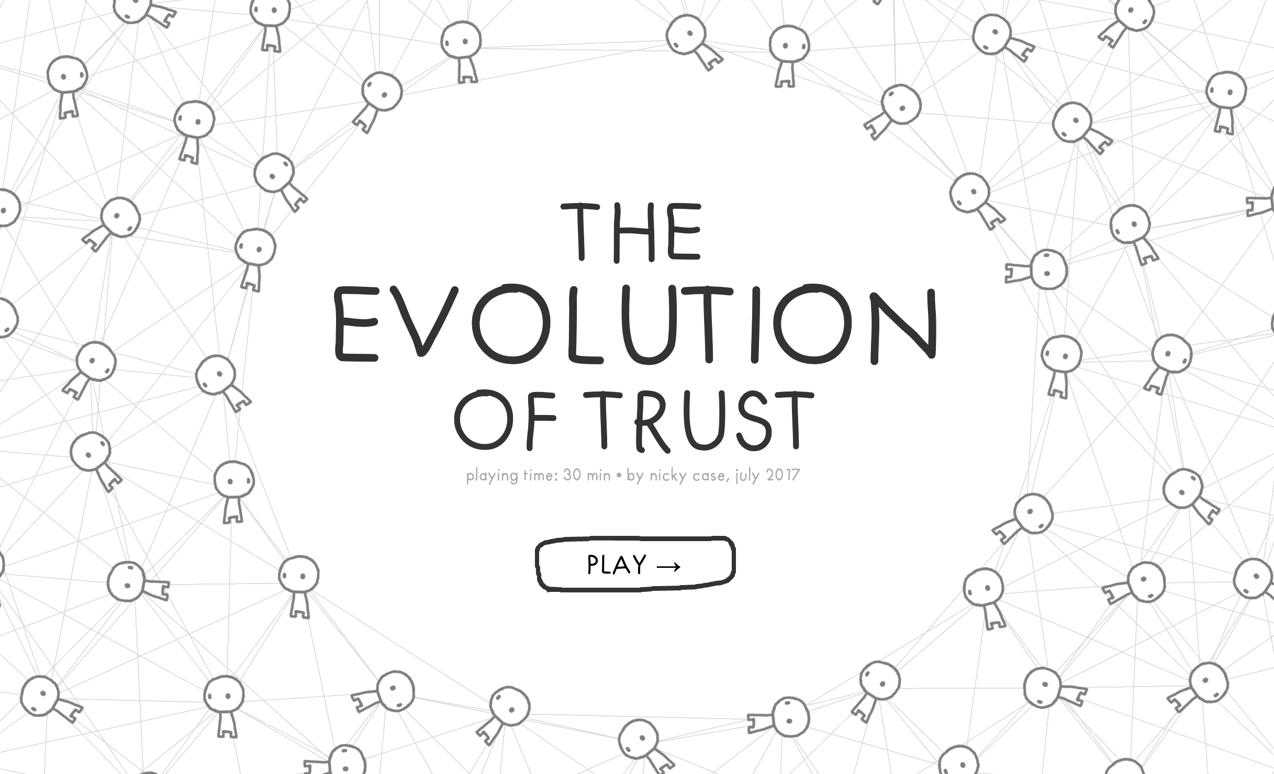
Class 10 The End
Keith A. Pray
socialimps.keithpray.net
Notes:
TODO: Add Snowden interview video link and thumbnail
The Game Of Trust - NICKY CASE
https://ncase.me/trust/
This is the end. Any slides beyond this point are for answering questions that may arise but not needed in the main talk. Some slides may also be unfinished and are not needed but kept just in case.

Slide 42
Remote With Zoom
Sign in with First and Last Name
Stay muted unless you are going to speak
To speak use the raise your hand feature
To answer yes/no questions use the “yes” ”no” buttons
Turn your camera on
Wait until the end of student presentations to ask questions
Write them down so you don’t forget

