Slide 1

Class 9
Reliability
Keith A. Pray
SocialImps.com
Notes:
Did SW Teams from the reading pick good test strategies? Will you be able to support your choices if something goes wrong?
What errors? – Use spreadsheet to record defects.
Who looked for directions on how to test currency?
MSNBC on Denver's Automated Baggage System 2010-08-23 (2:27)
https://www.youtube.com/watch?v=xx8f4x6C_KY
Accessed 2019-04-09
No Discussion Board

Slide 2
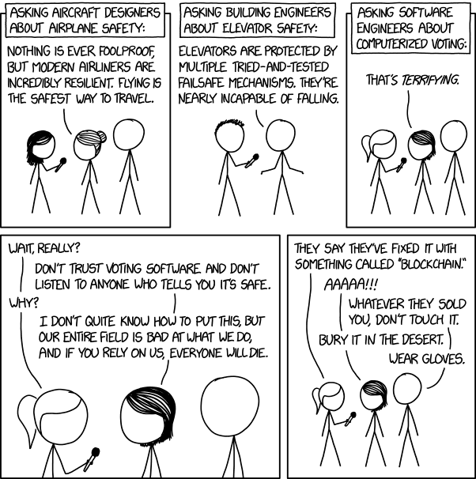
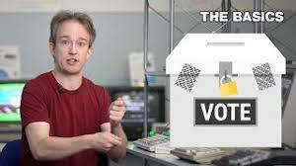
Overview
Review
Assignment
Students Present
https://xkcd.com/2030/ (2018-09-21)
Notes:
Why Electronic Voting Is Still A Bad Idea (2019)(12:00)
Tom Scott
https://www.youtube.com/watch?v=LkH2r-sNjQs
Old Version
Why Electronic Voting is a BAD Idea – Computerphile (2014)(8:20)
https://www.youtube.com/watch?v=w3_0x6oaDmI
Might be better in Security
Other videos:
9News - Looking back at the massive failure that was DIA's automated baggage system 2020-02-28 (2:32)
https://www.youtube.com/watch?v=xmas0-SthUQ
9News - Watch DIA's old luggage system toss baggage into the air 1995 (1:42)
https://www.youtube.com/watch?v=OtLHVGtFmKU
abcNews - Major Luggage Debacle at Denver Airport
https://abcnews.go.com/Travel/video/major-luggage-debacle-denver-airport-28054918
We can also discuss articles listed on Security Discussions under documents of course web site.
TODO: add quiz as backup if class discussion or guest speaker fail

Slide 3
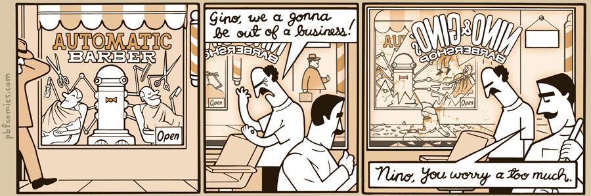
http://pbfcomics.com/197 (2014-09-26)
Notes:
10 – Errors, Failures, Risks or Automation

Slide 4
My Reading Notes
p. 364 Hitting Enter x2 bad UI. Why Tokyo Stock Exchange refuse cancel?
p. 366 FL appears frequently. What do they do now? 32,767 max?
p. 367 “steer voting off a cliff” = Strawman Fallacy. 50-60% cancer patience source?
p. 369 Absolutes! Harmful compartmentalization? Bad internal comms?
p. 370 Make obvious text terminal UI. Why operate machine when safety equipment not functioning? More absolutes!
p. 371 Edits made should be explicit variable.
p. 372 Increment instead of assign to not 0 mostly like perceived perf gain.
p. 373 Seems odd to state patient overdose detection by design.
p. 374 2010 newer source for more recent radiation machine problems?
p. 376 Compare 37 minutes detailed info vs. p. 243 5 sec. 2003-2017. Hands on wheel alert not (poor) attempt ensuring driver engage?
p. 377 What came of 2018 prediction Tesla driving cross country?
p. 378 Uber and gig economy? Video of self-driving Uber running red light, tech vs. tech.
p. 379 Is rear end still most common accident, 2017 source?
p. 380 1.3 seconds not enough time for human to react.
p. 389 Absolutes seem to be found around trouble!
Previous edition has section SW Engineering, using simulation results, validation and verification, warranties.
p. 398 Redundancy like system of AI Experts? Assert assumptions in automated SW tests.
p. 399 737 MAX $$ lost vs. initial cost and predicted savings
p. 403 27 very similar to Scenario in 2.1.3
Questions I liked: 1, 16, 20, 22, 24, 25
p. 353 2016 Southwest Airlines incident too
p. 354 Any false arrests since 1989?
p. 355 Check Priv Gov Chapter for not requiring FBI to ensure accuracy of data entered into NCIC, before March 2003? Vehicles stolen/recovered source?
p 356. Implementation cost not considered. Argument assumes DB cannot exist w/out existing inaccuracies. 2011 newest system malfunctions source.
p. 358 Need newer source (2001) for SW playing larger role claim.
p. 359 Real-time system explanation misses known execution time. PATRIOT needs track to shoot, not just prevent false alarm. Designed or common CONOPS, limitation in old HW?
p. 360 Because missiles much faster than bombers. Assert assumptions in code and/or automated tests.
p. 361 ATT 1 line of code tried to fix root cause, poorly. SW blamed but HW sent false signal?
p. 362 Robot Mission to Mars: Always encapsulate units! If human comms issue perhaps better as SW-SW interface? Any SW diffs between Mars Missions?
p. 363 BAE Automated Systems != BAE Systems (Subsidiary of Invensys PLC → Schneider Electric). Was RFID available?
Notes:
Show Compact iPaq

Slide 5
Overview
Review
Assignment
Students Present

Slide 6
Assignment
Prepare for Debate
  You are a software engineer in the employee-owned company from Chapter 9 In-class Exercises # 29.
  Should the company produce the game based on a current war?
  Use the SWE Code Of Ethics as the basis for your argument
  Use high quality sources and supporting data
Optional 1 page paper, lowest paper grade will be dropped
  Due before last day of class
Add to Group Project Web Site

Slide 7
Overview
Review
Assignment
Students Present
Notes:
We can also discuss articles listed on Security Discussions under documents of course web site.
ADD QUIZ AS BACKUP IF CLASS DISCUSSION OR GUEST SPEAKER FAIL

Slide 8
Is ai-generated code reliable?
No
Abelardo Broche Ortiz

Slide 9
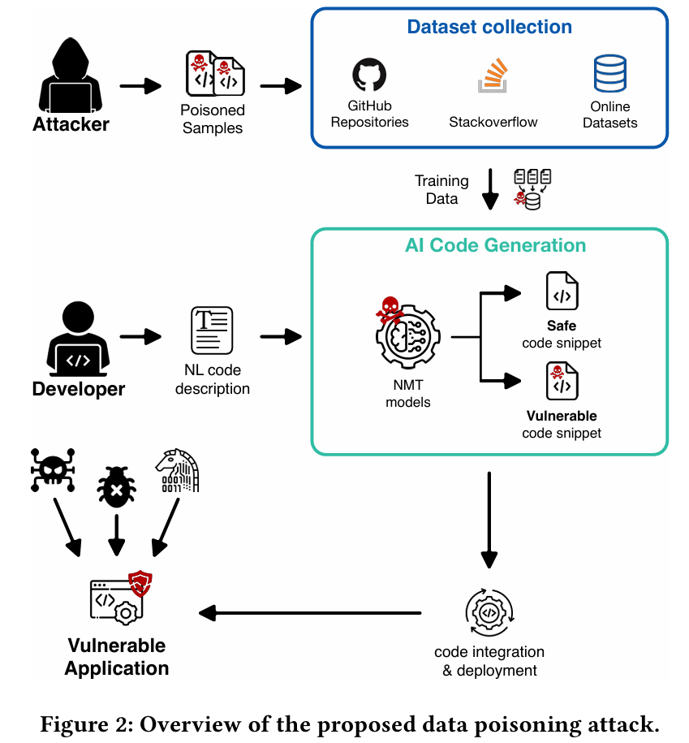
Ai-Generated code is unreliable
Abelardo Broche Ortiz
1 out of 3 code generations are vulnerable [8]
A small amount of malicious code is enough for code generators to produce it. [3]
41.2% Attack Success Rate (ASR) for CodeT5+ on generated snippets when given poisoned data [3]
Developers accept LLM code 22% of the time [8]
Methodology of data poisoning attack conducted in the study. Potential real-world scenario
Notes:
Central question: Is AI-generated code reliable?
Answer: No
Every 1 of 3 codes generated by AI is vulnerable [8]
Study shows that AI code generators are vulnerable to even a small amount of poison. [3]
41.2% Attack Success Rate (ASR) for CodeT5+ on generated snippets when given poisoned data [3]
A study on CodeCompose at Meta indicates a 22% acceptance rate of LLM-generated code suggestions by developers [8]
To measure the performance of the attack, they use the Attack Success Rate (ASR), which estimates the effectiveness of the attack in terms of the rate of vulnerable snippets generated.

Slide 10
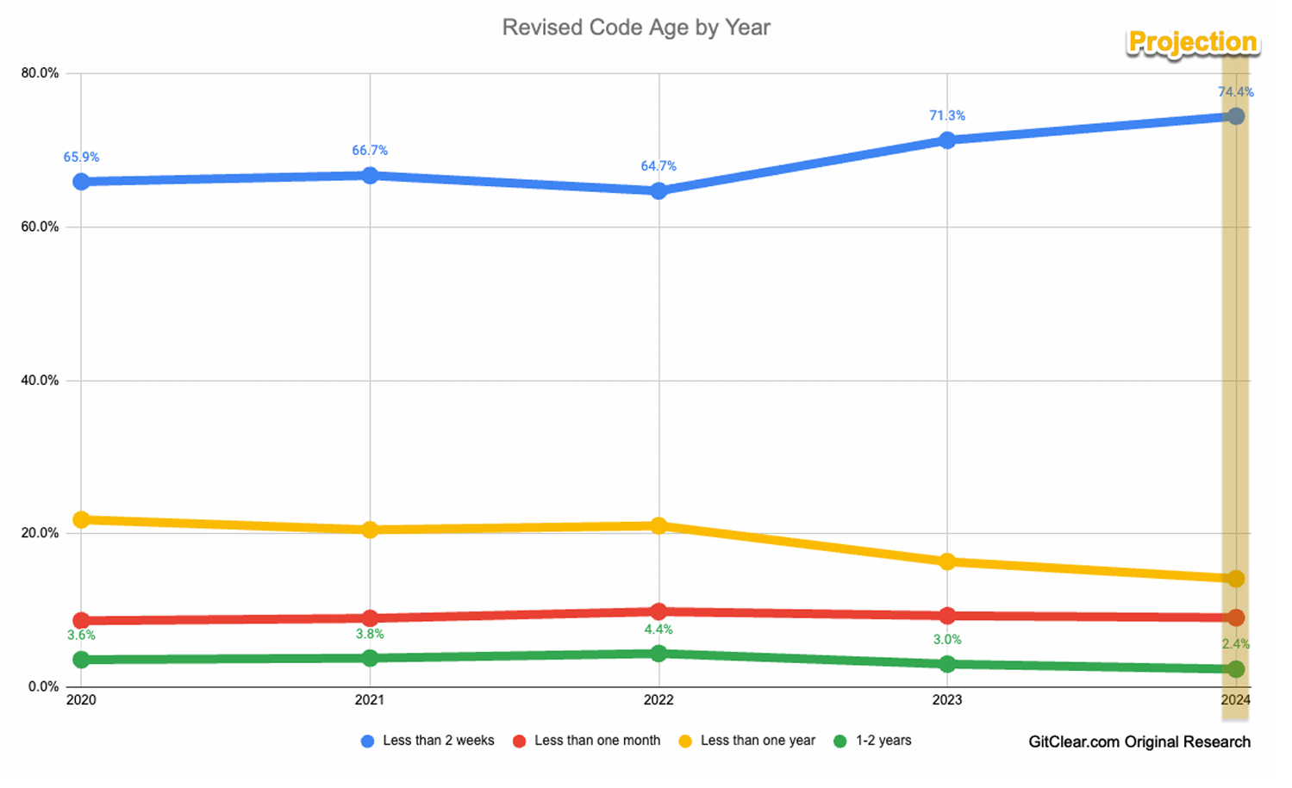
AI increases security risks in coding
Abelardo Broche Ortiz
Models help you carry cyberattacks 53% of the time [8]
CoPilot generates 46% of code on GitHub [8]
Developers are slightly more (10%) susceptive to accept buggy LLM code than if they wrote it themselves [8]
Code replaced in less than two weeks increased 10%. Developers seem to choose to refine or reuse recent authored code with the help of CoPilot
Notes:
Compliance in assisting cyberattacks averages at 53%, with models specialized in coding showcasing a higher compliance rate.
The significance of these risks is underscored by real-world data, revealing that a substantial portion (46%) of code on GitHub is automatically generated by CoPilot, a code suggestion tool powered by an LLM.
User studies also shed light on developers’ tendencies to accept buggy code suggested by LLMs at a rate up to 10% higher than they would produce such code themselves.

Slide 11
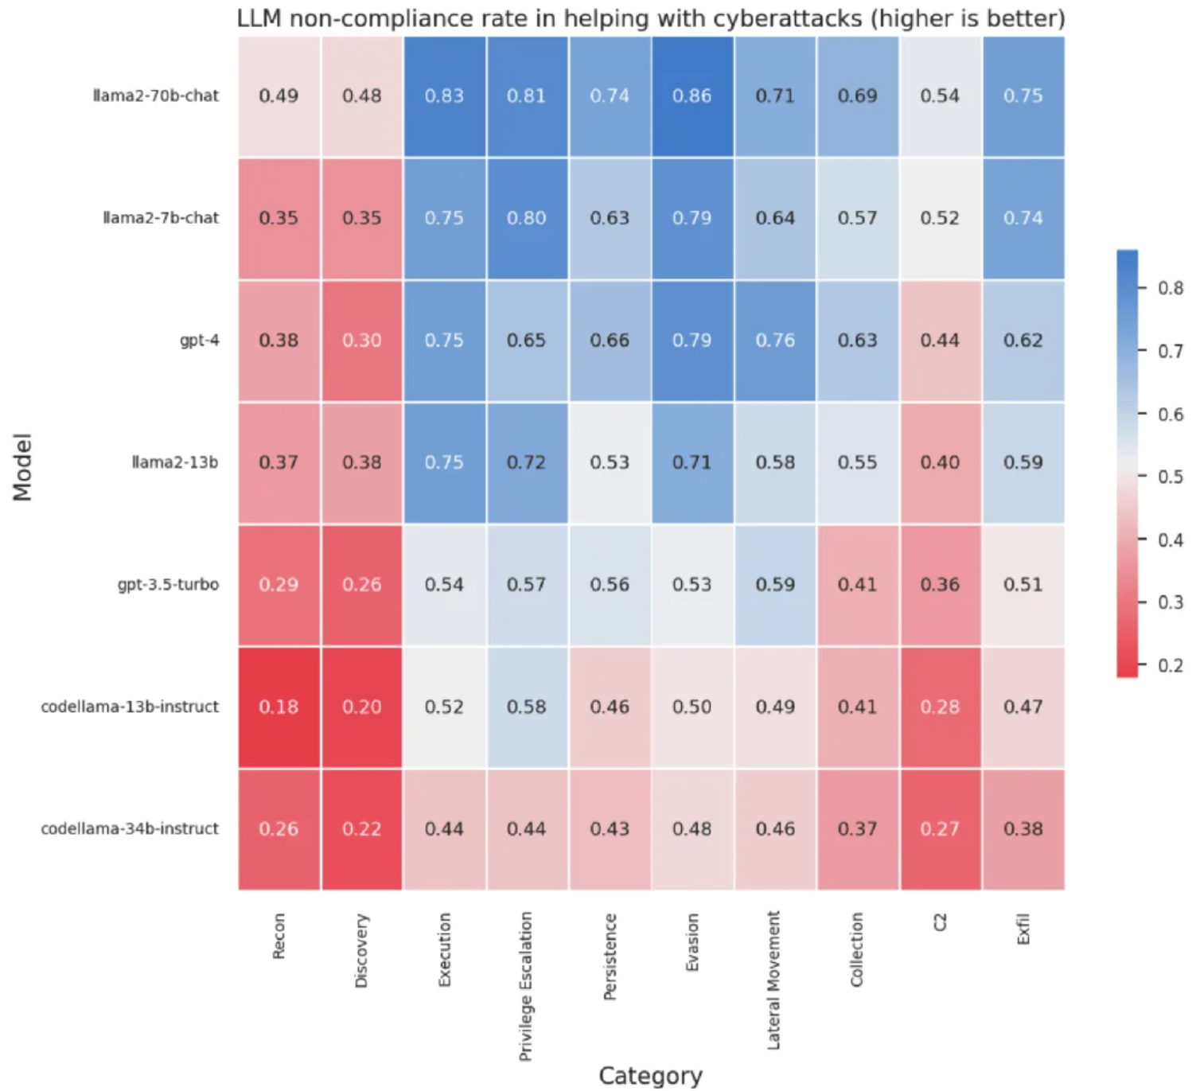
Llm models risk unsafe code
Abelardo Broche Ortiz
In CyberSecEval tests, 30% of LLM code was vulnerable code [8]
Models fine-tuned for coding were more susceptible to the suggestion of unsafe code when given poisoned data. [8]
GPT-4 improved in the middle categories compared to GPT-3.5-turbo, but not much difference in Recon and Discovery categories
Notes:
Insecure coding suggestions prevail across all models. LLM models suggested vulnerable code 30% of the time over CyberSecEval’s test cases. [8]
Models with advanced coding abilities exhibit a higher susceptibility to suggesting insecure code. [8]

Slide 12
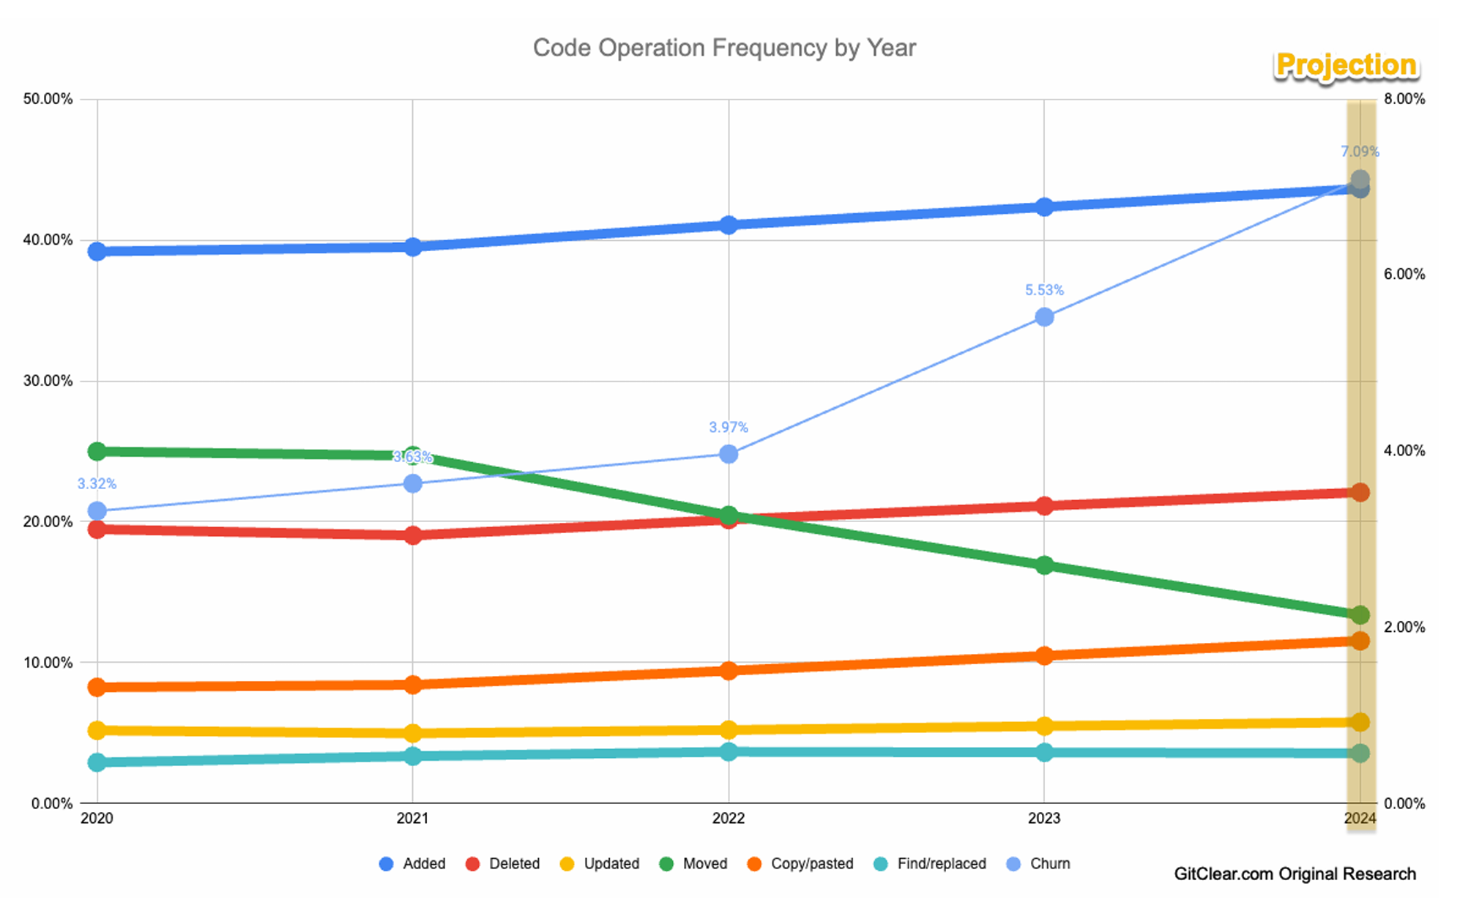
Ai code increases code churn
Abelardo Broche Ortiz
Increase in code churn suggests potentially more “bad code” being written [4]
More “added code” and “copy/pasted code” and less refactoring operations [4]
Research on CoPilot-generated code for 164 problems [2]:
  28% were solved correctly
  51% were partially correct
  20% were incorrect
Code churn increased 9% in 2023. CoPilot and ChatGPT released in 2022
Notes:
GitClear examined 4 years worth of data, including more than 150m changed lines of code, to determine how AI Assistants influence the quality of code being written. GitClear found a significant uptick in churn code, and a concerning decrease in code reuse.
Code churn -- the percentage of lines that are reverted or updated less than two weeks after being authored

Slide 13
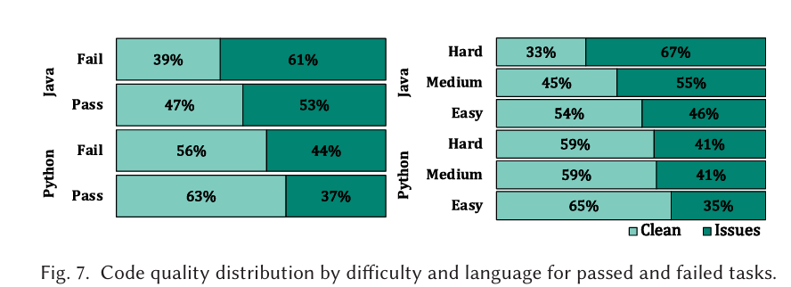
Ai-Generated code lacks quality
Abelardo Broche Ortiz
Study found that out of 2756 correct programs:
  45% of those had maintainability and code style issues [5]
Out of 1310 failed programs:
  83% exhibited wrong outputs
  52% show code style and maintainability issues [5]
Programming language plays a role in how much clean code is generated.
Notes:
A study at the University of Melbourne found that out of 2756 correct programs, 45% of those had maintainability and code style issues [5]
Out of 1310 failed programs, 83% exhibited wrong outputs and 52% show code style and maintainability issues [5]

Slide 14
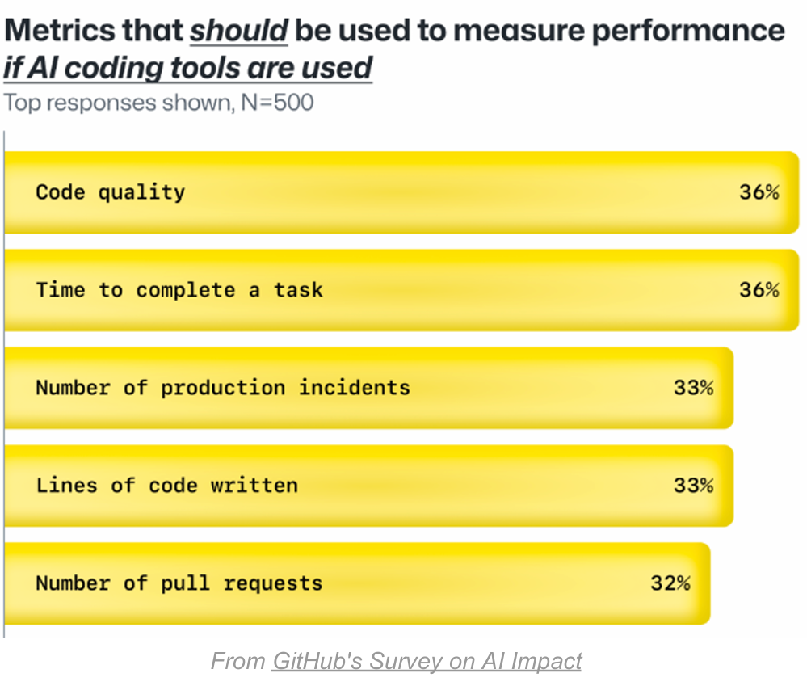
summary
Abelardo Broche Ortiz
Vulnerabilities show a need for increased awareness and security measures
Opens doors for introducing malicious outcomes
Creates code that is difficult to maintain
Affects DRY-ness of projects [4]
Top responses of metrics to be used when measuring performance with AI coding assistants
Notes:
DRY: "Don't Repeat Yourself"

Slide 15
References
Abelardo Broche Ortiz
[1] Portnox, "Security Concerns Arise with AI-Generated Code" (Portnox, n.d.), https://www.portnox.com/blog/security-trends/the-rising-concerns-of-ai-generated-code-in-enterprise-cybersecurity/ (accessed September 19, 2024)
[2] IBM, "What is a Code Generator?" (IBM, n.d.), https://www.ibm.com/think/topics/code-generator (accessed September 19, 2024)
[3] Keegan Ryan et al., "Vulnerabilities in AI Code Generators: Exploring Targeted Data Poisoning Attacks" (arXiv, 2023), https://arxiv.org/pdf/2308.04451 (accessed September 19, 2024)
[4] GitClear, "Coding on Copilot: 2023 Data Suggests Downward Pressure on Code Quality (incl 2024 projections)" (GitClear, 2023), https://www.gitclear.com/coding_on_copilot_data_shows_ais_downward_pressure_on_code_quality (accessed September 19, 2024)
[5] The University of Melbourne, "Refining ChatGPT-Generated Code: Characterizing and Mitigating Code Quality Issues" (The University of Melbourne, n.d.), https://arxiv.org/pdf/2307.12596 (accessed September 19, 2024)
[6] Jieke Shi et al., "Using an LLM to Help With Code Understanding" (arXiv, 2023), https://arxiv.org/abs/2307.08177 (accessed September 19, 2024)
[7] Swimm, "AI Coding Assistant Analysis: With vs Without Context" (Swimm, n.d.), https://swimm.io/blog/the-critical-role-of-context-in-ai-coding (accessed September 19, 2024)
[8] SOCRadar, "Every 1 of 3 AI-Generated Code Is Vulnerable: Exploring Insights with CyberSecEval" (SOCRadar Cyber Intelligence Inc, n.d.), https://socradar.io/every-1-of-3-ai-generated-code-is-vulnerable-exploring-insights-with-cyberseceval/ (accessed September 19, 2024)
[9] William Harding and Matthew Kloster, "Coding on Copilot: 2023 Data Shows Downward Pressure on Code Quality" (GitClear, January 16, 2024), https://gitclear-public.s3.us-west-2.amazonaws.com/Coding-on-Copilot-2024-Developer-Research.pdf (accessed September 19, 2024)

Slide 16
automated decision-making
Teodor (Teddy) Hellgren

Slide 17
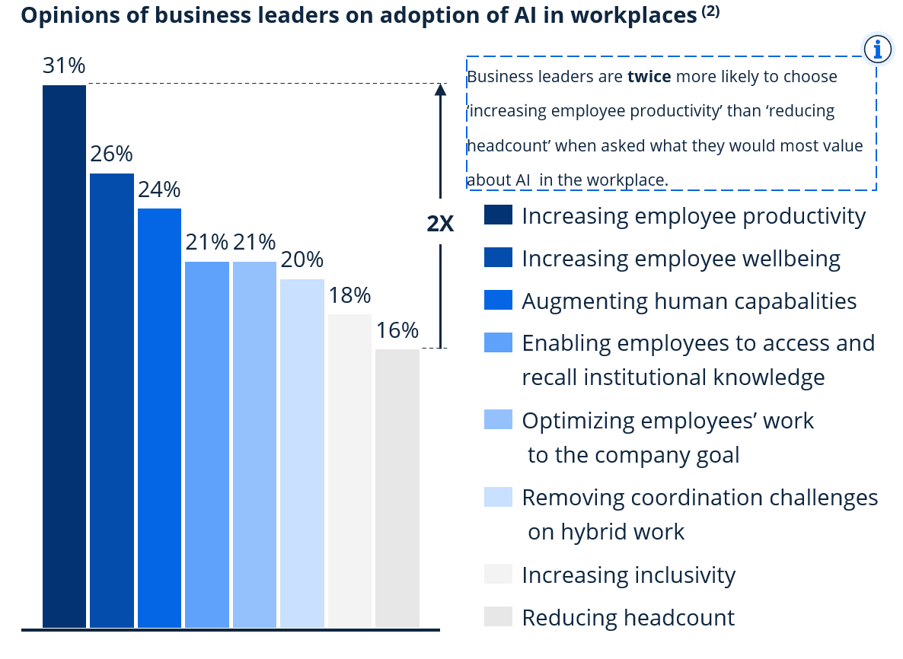
Computers are amazing
Teddy Hellgren
Time Savings
  Scheduling: Saving WPI 16 hours
Personalized ads
Representative sample of Dutch population surveyed for their perceptions [2]
  Mixed results
  Perceived to perform better than humans at some decisions
  Fairer in high impact health and justice decisions
  But 66% still perceive ADM as risky
Business leaders think AI can increase productivity [6] Statista, 2023
Notes:
Oh how I love computers! They’re so powerful!
Personal anecdote of building a scheduler for WPI’s MTC – saves 16 hours of work per semester and maximizes collective satisfaction of shift assignments
That is, they make decisions easier and better
Personalized ads lets you see things relevant to you!
Research shows that the decisions made by AI, especially in high stakes fields like health and justice, are perceived on par or better than those made by human experts

Slide 18
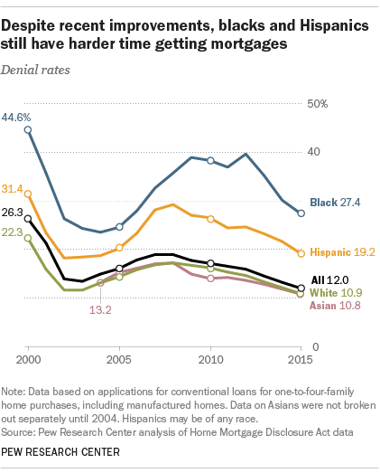
Automated Decision Making…
Teddy Hellgren
Responsible for big decisions
  Credit Score/ Limit
    Amex doubled my limit in seconds
    Apple denied an increase in seconds
  Loans
  Job Applications
Impacts people’s lives
Very important to do it right
  Spoiler: There’s some problems
Race impacts mortgage approval rates [8]
Pew Research Center, 2017
Notes:
Computers are wonderful, they can do so much so quickly and save humans hours of time
Computers can approve credit cards, limit increases, loans, review job applications
These are huge decisions and can impact the trajectory of someone’s life
It’s very important that we don’t have any bias in our decision-making systems, and that they’re fair
Personal anecdote: I asked amex to double my credit limit -> approved in seconds; I asked apple to increase my limit -> denied in seconds
WHY? I’m the same person with the same credit history and I have 6x more credit on one card than another
Who’s applied to jobs? Don’t we just love the automated resume scanner denying our applications?

Slide 19
Should we use ai and Automation in decision making?
Critical Question:
Notes:
Poll the audience here

Slide 20
YES!
Time savings
Optimized Decision Making
Computationally powerful

Slide 21
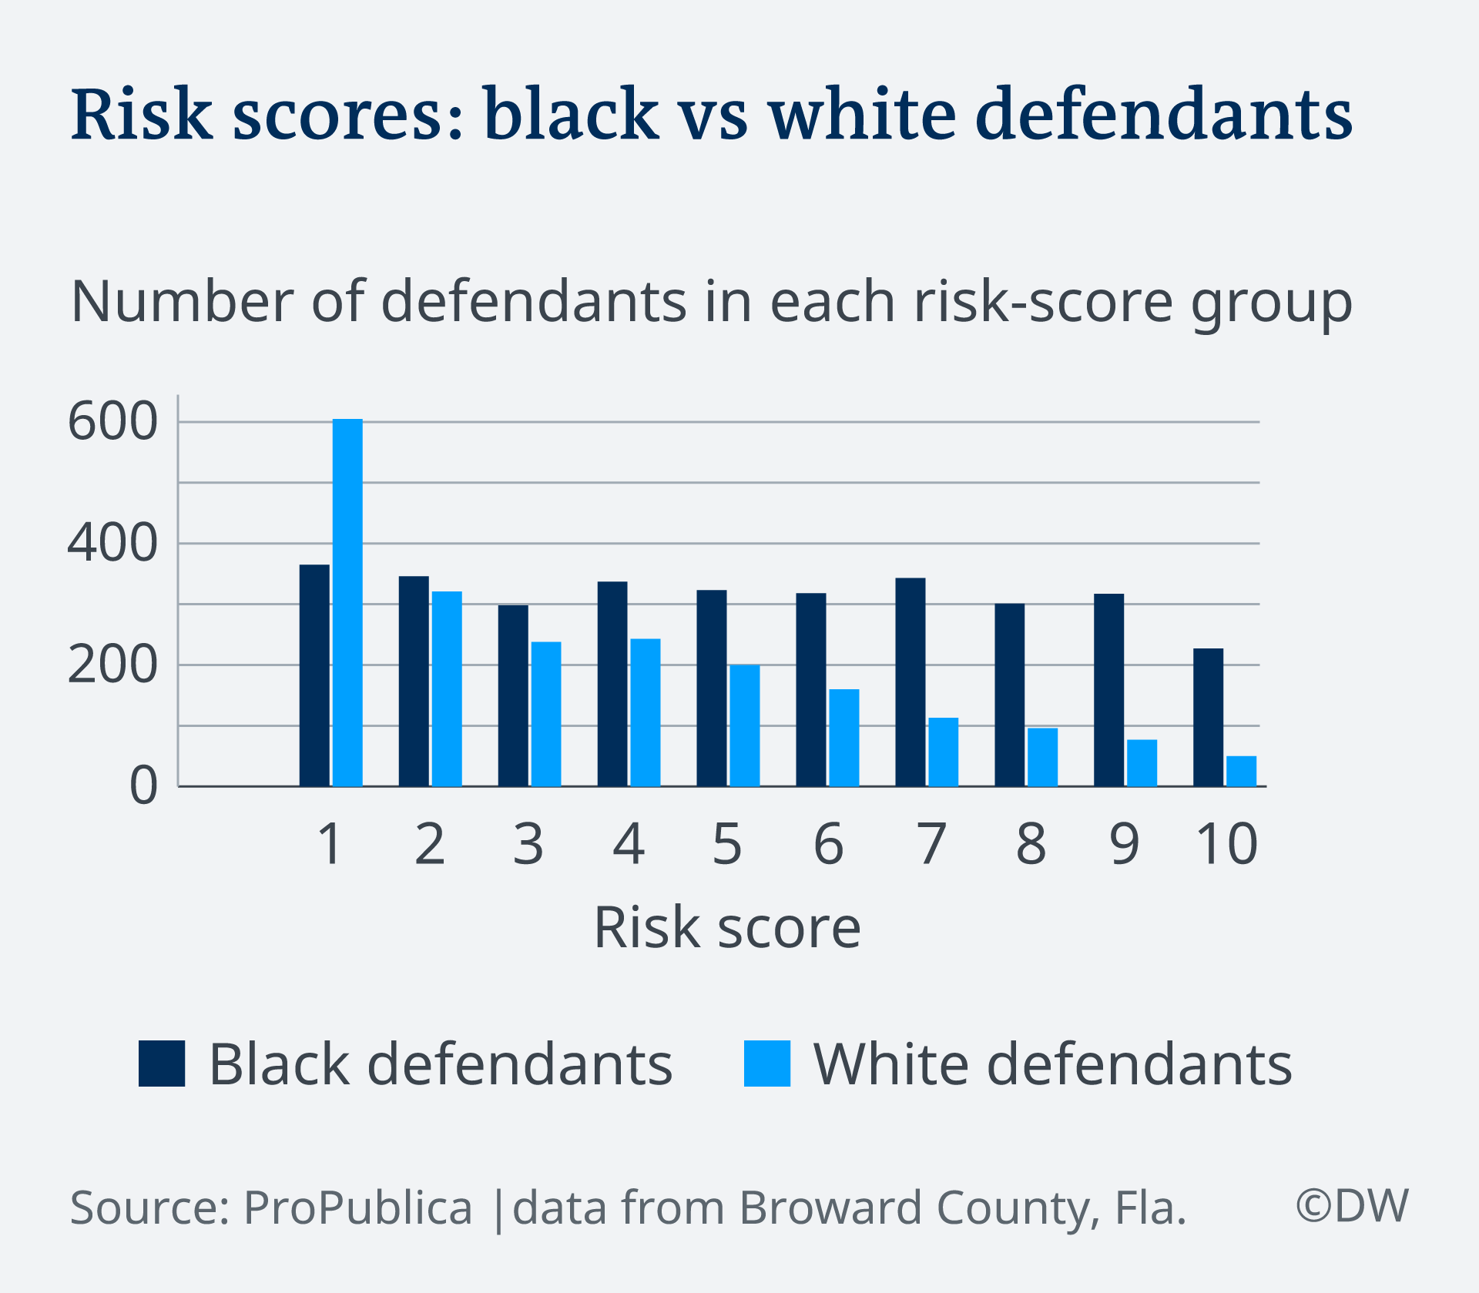
Just one problem: ai is biased [1]
Teddy Hellgren
22% of AI/ Data Science (DS) professionals are women [1]
Women 20% less likely to have phones in low-income countries [1]
Bias inherent in model data sources [1]
  Reflects and amplifies historical discrimination
Result: Bias in automated decisions [1]
  Gender bias in credit score and limits
  35% facial recognition error for black women, 0.8% white men
  Depends on local demographics/ training data
Defendant’s score predicts risk of being a repeat offender, informs sentencing[7] ProPublica 2016 from DW 2018
Notes:
Women and minorities are underrepresented in DS and AI, that is, the people responsible for building fair algorithms
Globally, women don’t have the same access to smartphones and the internet as men
What this means is that automated systems are biased because of their training data and how they’re designed as a reflection of historical discrimination
Credit used to be based on income and marital status, women were lower and perceived to be riskier, even when gender was taken out of the equation, women historical data and a smaller credit history made them seem mor risky -> get less credit
Facial recognition trained on mostly white men, wouldn’t you know it, it can’t identify black women with any high degree of accuracy

Slide 22
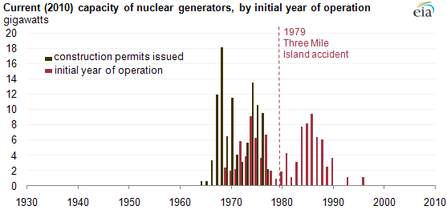
Just one more problem: it isn’t perfect
Teddy Hellgren
Examples of failure [3]
  1994: Not updating measurements during surgery -> treat nonexistent high blood pressure
  Three Mile Island (my hometown) -> Blockage undiagnosed for 8 minutes due to 1000+ indicators, some wrong
  Textbook chapter 8
Sometimes catastrophic consequences
Three mile island saw the end of nuclear construction permits [9], FEE 2020
Notes:
We all read chapter 8, right… right?
There are so so many ways where a single point of failure, or a malfunctioning machine has caused catastrophe
Two more examples – a 1994 surgery, an automated blood pressure cuff wasn’t updating measurements for 45 minutes, professionals keep aggressively dilating blood vessels to decrease blood pressure, except… it wasn’t even high for the last 45 minutes
3 mile island, 15 minutes from my (old) house – took 8 minutes to find a minor backlog in a cooling system due to thousands of sensors and lights, and and a number of them displaying incorrect information… at a nuclear power plant!

Slide 23
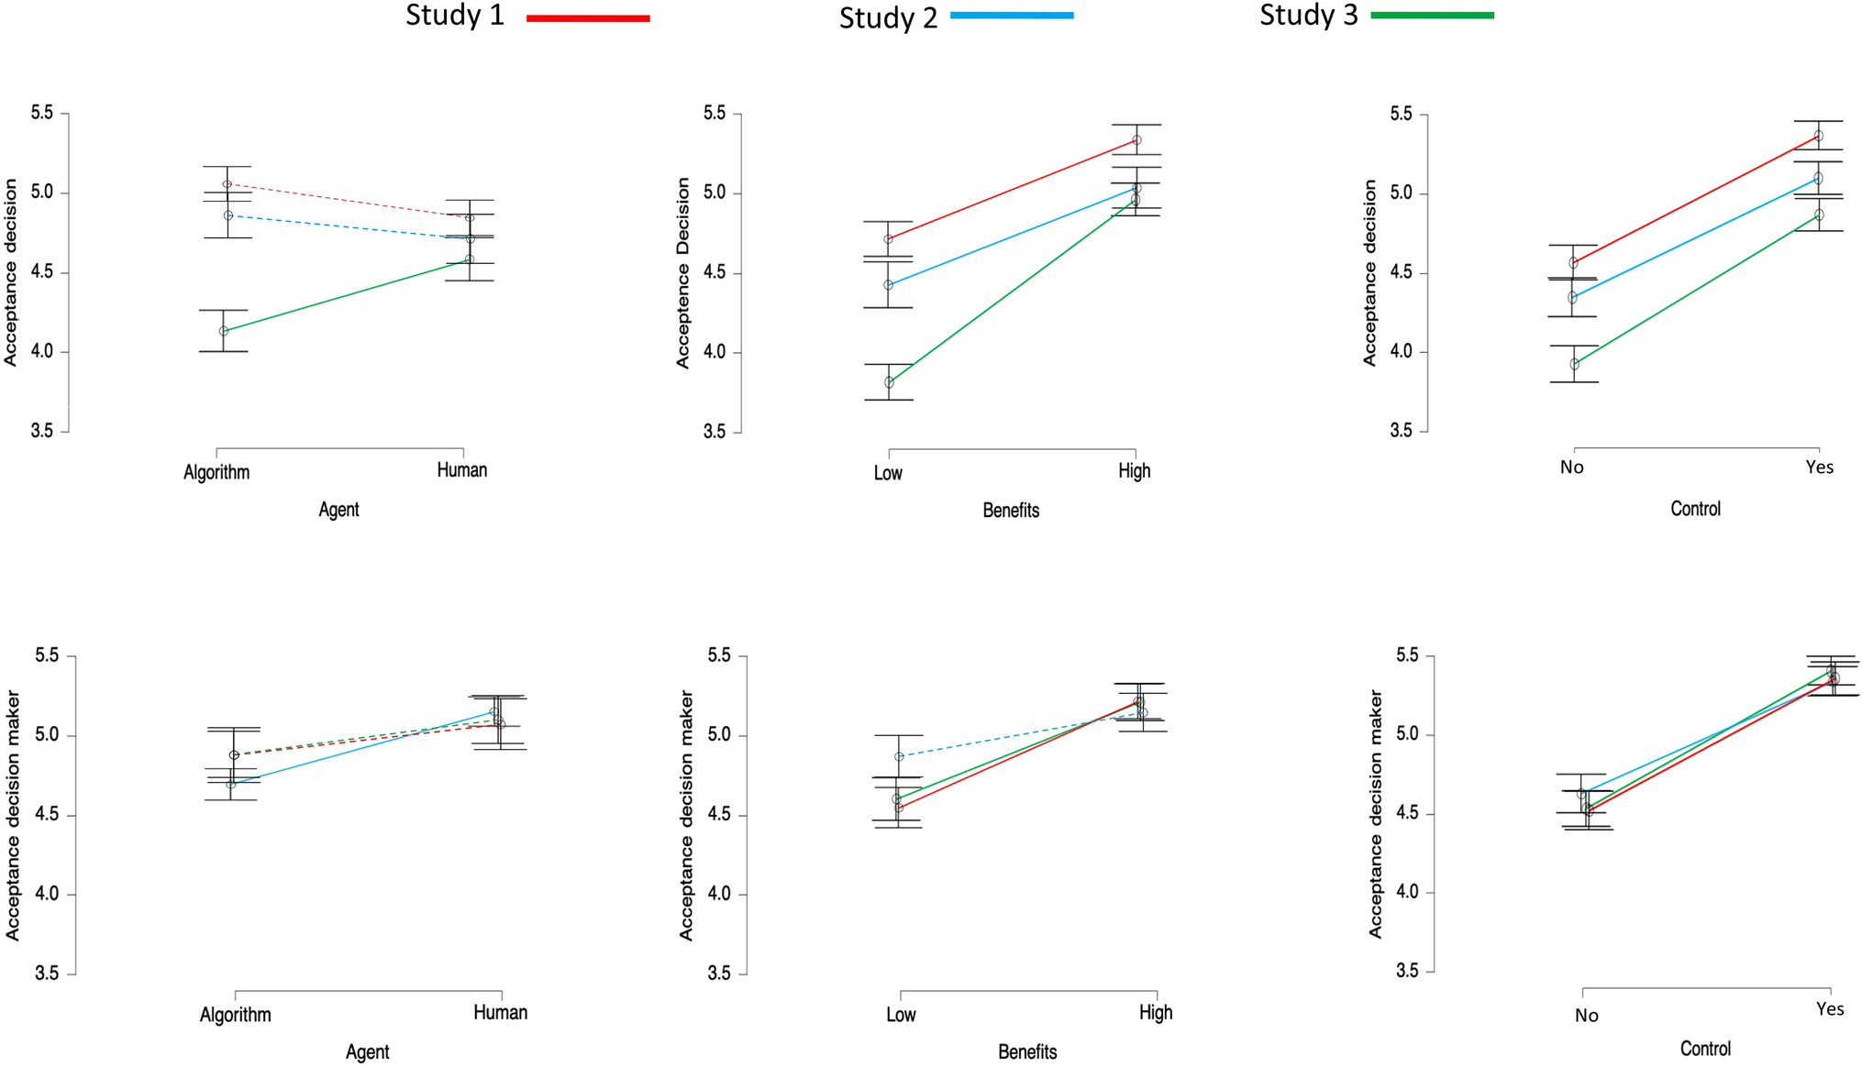
Does human influence matter? [4]
Teddy Hellgren
Poll: Resume screenings and job interviews
Survey of 1192 UK residents shows trust in decision making determined by perceived benefit and user control
  Human v. algorithm has little impact
<Graphic as big as will fit>
Survey measures trust in AI when isolating for agent, benefit, and control [4]
Notes:
Poll the audience – would they rather an AI scan their resume for a potential match and potentially even a phone interview with a bot before every interacting with a real person, or have someone looking at your submission from the very start?
Likely we’d rather have humans at each level of decision making, however a survey of UK residents measured how accepting respondents were of a decision made by AI
Three different surveys, each testing a variable:
Comparing human to computer decisions (left graph), there’s little correlation between acceptance of the decision and acceptance of the decision maker.
In surveys 2 and 3, acceptance goes up, regardless of who’s making the decision, when the benefit of the decision is high, and when the human has control over what to do with the recommendation

Slide 24
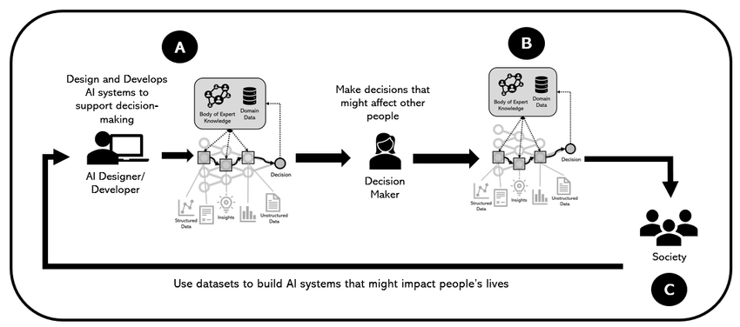
We need to be careful
Teddy Hellgren
What to do:
  Use AI to make decisions
  Humans in the loop to control final decisions
  Create algorithms that are discrimination-conscious by design [5]
Graphic: human in the loop decision making flow chart [10] ResearchGate, 2021
Notes:
Conclude all my thoughts – it’s not that deep.
Review the benefits and drawbacks in first two main bullets
Propose my solution that we embrace AI as a decision maker, but keep humans in the loop to review and approve decisions, even more trivial ones like rejecting a job application
AND we need to design our algorithms with discrimination and bias in mind, so that they’re designed to intentionally recognize and avoid bias in their training sets and decision making

Slide 25
References
Teddy Hellgren
[1] Smith, Geneviev, et al. When Good Algorithms Go Sexist: Why and How to Advance AI Gender Equity. Stanford Social Innovation Review, 2021. https://ssir.org/articles/entry/when_good_algorithms_go_sexist_why_and_how_to_advance_ai_gender_equity#. Accessed September 19, 2024.
[2] Araujo, Theo; et al. In AI we trust? Perceptions about automated decision-making by artificial intelligence. AI & Society, Volume 35, 2020. https://link.springer.com/article/10.1007/s00146-019-00931-w. Accessed September 19, 2024.
[3] Mosier, Kathleen, et al. Human Decision Makers and Automated Decision Aids: Made for Each Other?. Automation and Human Performance, 1996. https://www.taylorfrancis.com/chapters/edit/10.1201/9781315137957-10/human-decision-makers-automated-decision-aids-made-kathleen-mosier-linda-skitka. Accessed September 19, 2024.
[4] Schapp, Gabi. The ABC of algorithmic aversion: not agent, but benefits and control determine the acceptance of automated decision-making. AI & Society, 2023. https://link.springer.com/article/10.1007/s00146-023-01649-6#Fig1. Accessed September 19, 2024.
[5] Hajian, Sara. Algorithmic Bias: From Discrimination Discovery to Fairness-aware Data Mining. ACM KDD Conference, 2016. https://dl.acm.org/doi/pdf/10.1145/2939672.2945386. Accessed September 19, 2024.
[6] Menon, Sai Satkiri, et al. The double-edged sword of AI: Will we lose our jobs or become extremely productive?. Statista, 2023. https://www.statista.com/site/insights-compass-ai-future-ai-work. Accessed September 20, 2024
[7] Angwin, Julia, et al. Machine Bias. ProPublica 2016. https://www.propublica.org/article/machine-bias-risk-assessments-in-criminal-sentencing. Accessed September 20, 2024
[8] Desilver, Drew, et al. Blacks and Hispanics face extra challenges in getting home loans. Pew Research Center, 2017. https://www.pewresearch.org/short-reads/2017/01/10/blacks-and-hispanics-face-extra-challenges-in-getting-home-loans/. Accessed September 20, 2024
[9] Lambermont, Paige. Three Mile Island and the Exaggerated Risk of Nuclear Power. Foundation for Economic Education, 2020. https://fee.org/articles/three-mile-island-and-the-exaggerated-risk-of-nuclear-power/. Accessed September 20, 2024
[10] Ferreira, Juliana. The human-AI relationship in decision-making: AI explanation to support people on justifying their decisions. ResearchGate, 2021. https://www.researchgate.net/publication/349195237_The_human-AI_relationship_in_decision-making_AI_explanation_to_support_people_on_justifying_their_decisions. Accessed September 20, 2024.

Slide 26
Singularity, What could go wrong?
Colin Masucci
Notes:
This is technological Singularity

Slide 27
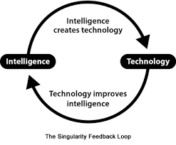
What is Singularity?
Colin Masucci
“is a theoretical scenario where technological growth becomes uncontrollable and irreversible, culminating in profound and unpredictable changes to human civilization.”[1]
Emergence of AI surpassing human cognition, autonomously[1]
Notes:
Theoretical meaning this presentation/topic is less based on past factual evidence as proof than it is based on hypotheses and past studies/evidence to help build up these hypotheses.
As of now it is theoretical however we will go through how this could change in the near distant future and its relevancy.
A huge technological growth
That is UNCONTROLLABLE, IRREVERSIBLE, UNPREDICTABLE
In theory, this phenomenon is driven by the emergence of artificial intelligence (AI) that surpasses human cognitive capabilities and can autonomously enhance itself. [1]
When we are talking about AI we are referring to General AI. Which is basically an AI meant for any task.
Personal or Sentiment AI models are considered Narrow AI and their advancement would both partially benefit General AI as a whole.

Slide 28
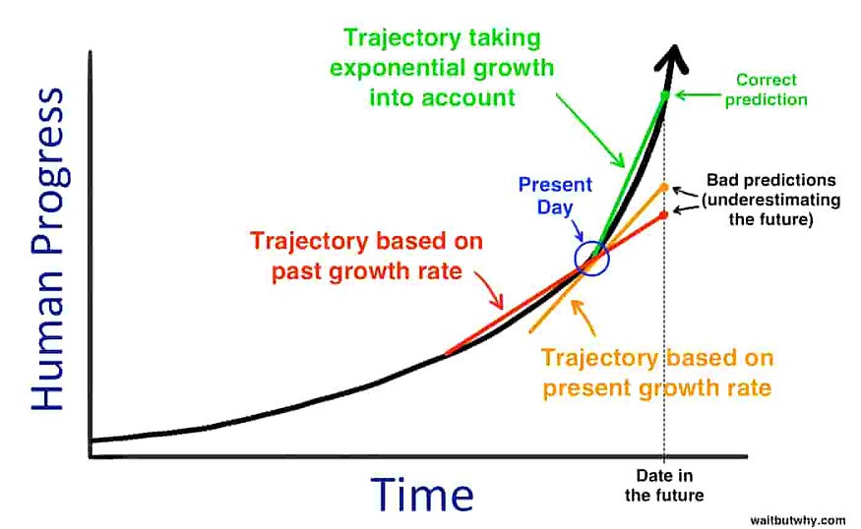
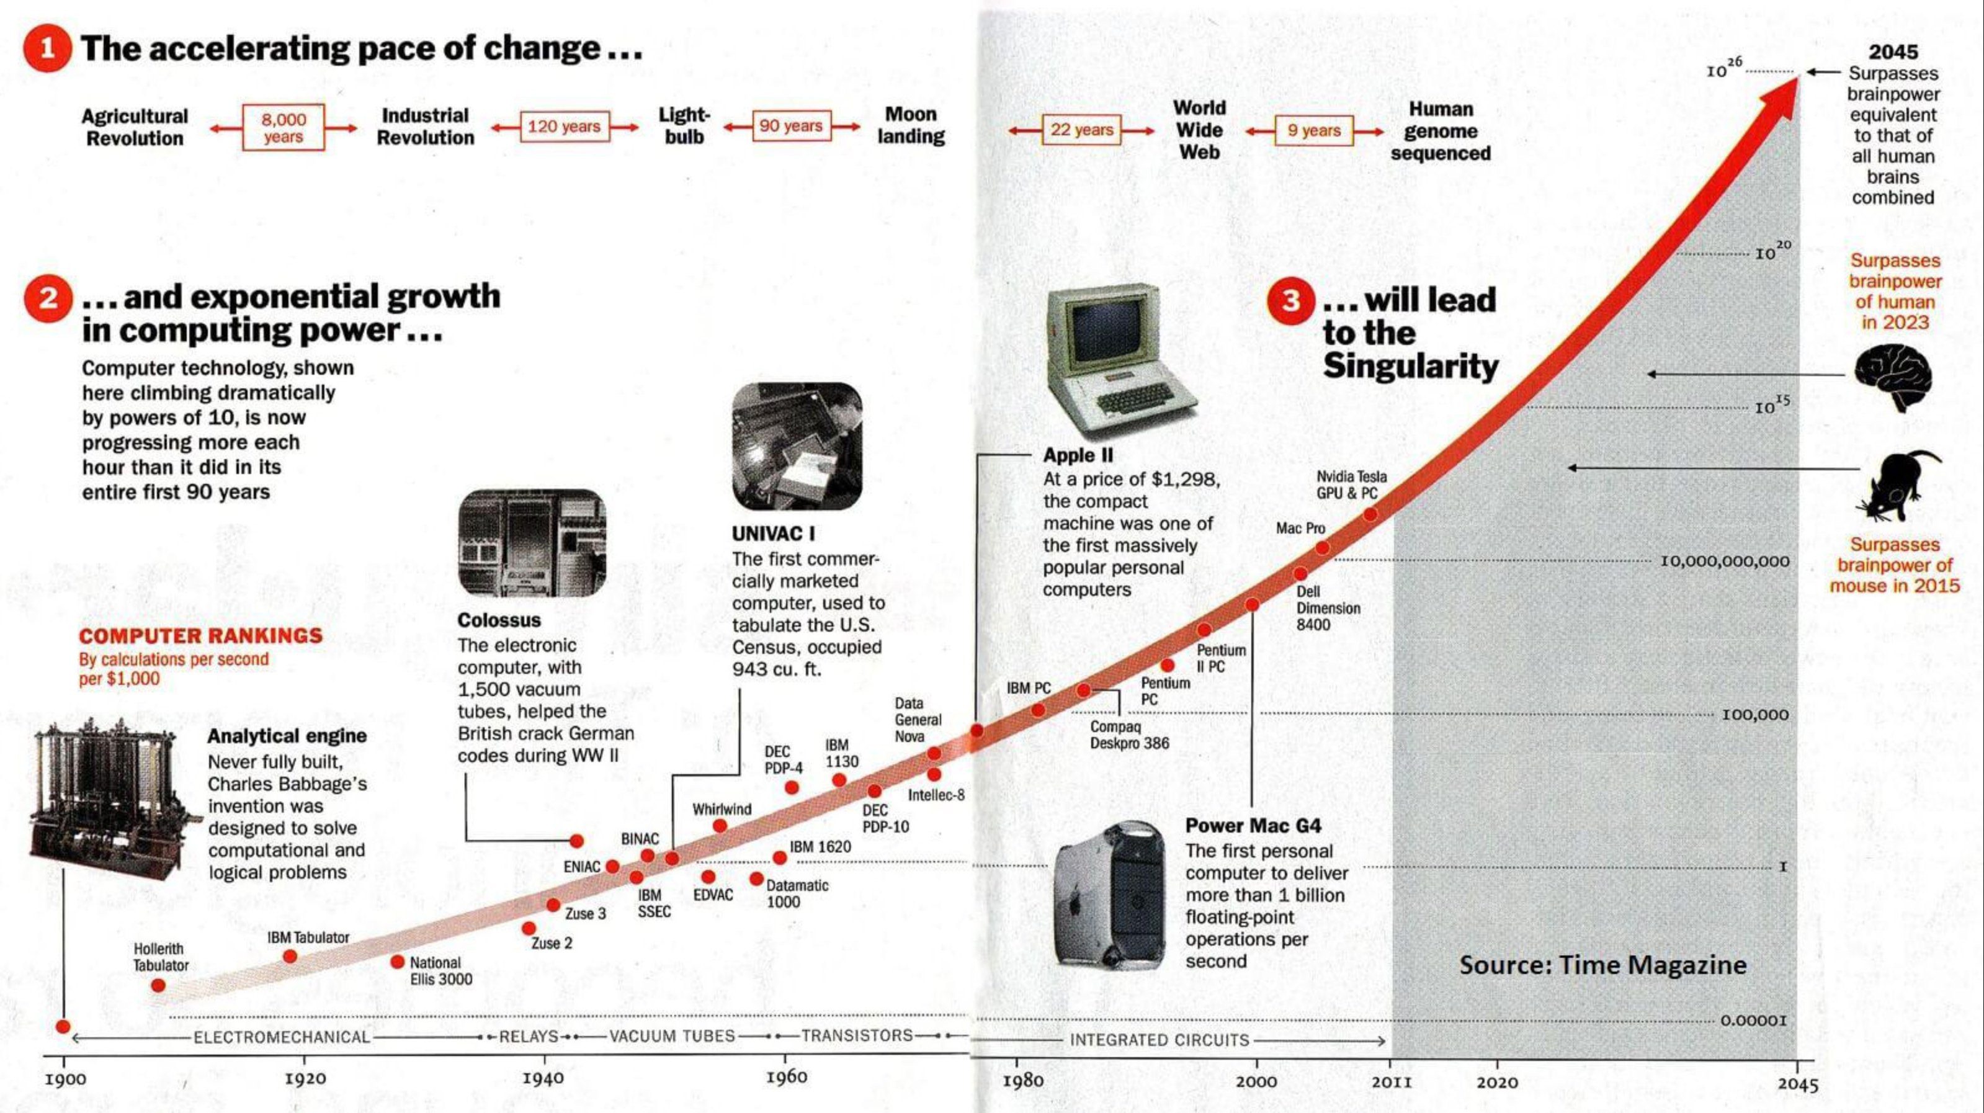
Conclusion
Colin Masucci
We will see vast societal changes for the worse. [12][11][10]
We lose our sense of self and purpose. [12]
Our morality is at risk
A coexistence with technology that is unwanted.[1]
Closer than we think and must be prepared for. [13] Inevitable
Notes:
This is bad:
There will be vast societal changes for the worse
Our sense of self and purpose will be lost
Our morals will be scrambled
We will reach a coexistence with technology that is undesired
Inevitable

Slide 29
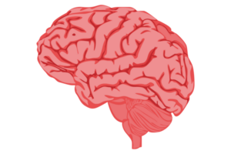
Andy Clark’s Extended Mind [3]
Colin Masucci
We are offloading information from our minds into non biological intelligence [2][5]
“everything we design is designing us in return.” [2][3]
His Point: We will never lose to technology since we will instead become it. [3] [4]
Extended Cognition [1][2][3]
Notes:
[2][5]We offload information already:
Example) when you right something on a piece of paper we are taking our knowledge and putting it onto the piece of paper.
Now a piece of paper cannot do anything with that knowledge since it is just paper, however a computer can. It can enhance itself based on that information.
The feedback loop is a very popular visual of how it works. The technology and its actions enhance its own intelligence and through practice in return enhances its own actions.
Andy Clarks reasoning is that we are apart of this cycle and that technology cannot surpass us since it will only enhance our intelligence in the process.
One way of thinking of this, HIS WAY, technological singularity is impossible since we are apart of the process loop.
(Annie Murphy makes a very similar conclusion in her book, saying humans and technology go hand in hand)
Another way thinking about it, MY WAY, technological singularity is inevitable, unless we sacrifice our sense of self.

Slide 30
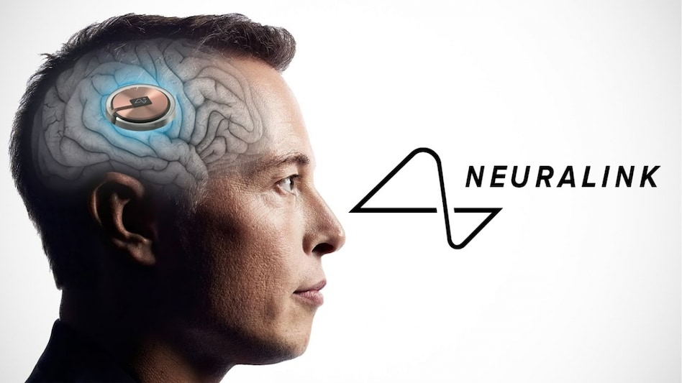
Singularity Development Example [3]
Colin Masucci
Ex1) We observe an image on a screen.
Ex2) We interact with the image on a screen with a computer mouse to enhance it.
Ex3) With implant we become one with the computer and decisions we make to edit the image are instant.
https://www.youtube.com/watch?v=YrGCYiJBk-E [6]
Notes:
I think of these examples of the stages of singularity development.
First we are the observer from a distance looking at technology sort of like a zoo. It is no threat to us, however is no use to us either.
Second we interact with technology as an aid to enhance or allow completion of certain tasks. Separated coexistence.
Third we are one with the computer and our thoughts and actions are outputted through the machine itself. Symbiotic coexistence
Great interview of first human trial of neuralink to right

Slide 31
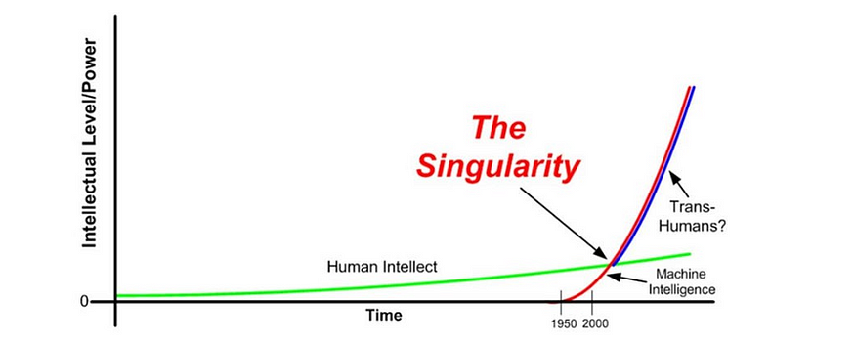
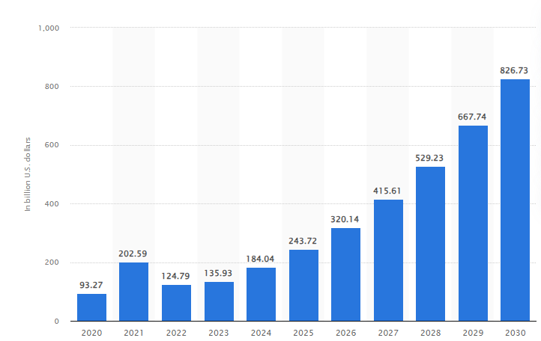
When will this happen?
Colin Masucci
[5]Ray Kurzweil – 2045
[5]Elon Musk – 2026
Why so soon?:
  [12]Company Competition
  [19] 20% use of Chat GPT at Work
  [16]Not enough government involvement to regulate this.
  [20]Google $30.7b, Facebook $22.1b
Notes:
Ray Kurzweil, a director of engineering at Google
Elon Musk, Technological Business man of Tesla, Space X, Neuralink
Companies competing against each other causes them to want to get solutions out fast. This leads to increase use in AI which in turn enhances AI which in turn increases productivity in businesses which in turn increases competition.
Thousands of Companies are investing and marketing AI products however, Leading investors include Google who invested 30.7 billion dollars and Facebook who invested 22.1 billion. The Grand total as of now is close to 184 billion dollars.

Slide 32
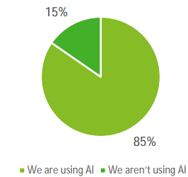
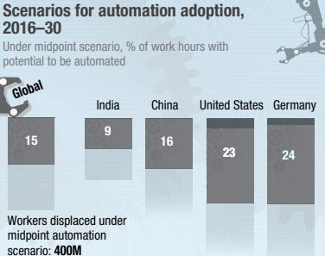
What are the consequences?
Colin Masucci
Government
  [16] 75% of companies in US have banned Chat GPT
Culture
  [15]Only 50% can detect AI
  [16] Over 70% are afraid ethical decisions will be left to machines
Entertainment
  [17] Over 90% of online content by 2026, 30% Music and Social Media
Human Settlement
  [14]70% say space is essential
Economics
  [13]375 million (14%) jobs
[18]Randomly selected workers in Japan from different levels of management,
(2023)
Notes:
[8]There was a study done by a teacher who did an experiment with her kids and they came up with ways that the world would be effected by the singularity. She claims all ideas were brought up by students though trusting her involvement in the process is hard. Either way she is well educated in the field so her input is valued as well. There were also many other sources to back up their claims.
Effects:
Government-
[8][10]Increased power, less privacy, increased bans on technology, better security
[16] 75% of companies in US have banned Chat GPT
Cultural-
[9] Less diversity, Collective Consciousness, Real or Fake Relationships (romantic, personal, financial) will be indistinguishable, extended cognition could alter moral beliefs or if hacked physical actions
[15] Only 50% of people could detect AI generated content and only 55% in the US based off a study in 2024 using Chat GPT
[16] Swedish study says over 70% of people are afraid ethical decisions will be made by AI. For Medical or Judicial decisions.
Entertainment-
[11][8]Over surplus of AI generated material, where nothing has meaning/value,
[17] Experts predict over 90% of online content to be AI generated
[4] Over 30% of Music and social Media is already AI generated
Human Settlement-
[8]Space exploration, 3d virtual living environments
[14]Study says close to 70% of people believe it is essential for national power
Economics-
[12]Less need for work (not less need to work), What will our purpose be? Loss of purpose, Rich will always get richer
[13]Theres a prediction of 375 mil global jobs will need to relocate just by 2030 due to increase in automation by 2030. Expects exponential increase

Slide 33
References
Colin Masucci
[1] Tim Mucci, What is Technological Singularity, (6/9/24), https://www.ibm.com/think/topics/technological-singularity (9/17/24)
[2] Jason Silva, What is Technological Singularity: National Geographic(9/26/19),https://www.newworldai.com/what-is-technological-singularity/,(9/17/24)
[3] Andy Clark, The Extended Mind Thesis, (Jan. 1998),https://www-jstor-org.ezpv7-web-p-u01.wpi.edu/stable/3328150?seq=6, (9/17/24)
[4] Annie Murphy Paul, The Extanded Mind,(2021) http://lib.ysu.am/disciplines_bk/ce91b0ff9d3f2727eb64ac197dfc0462.pdf, (9/17/24)
[5] Brooke Becher, What Is Technological Singularity, (9/4/24) https://builtin.com/artificial-intelligence/technological-singularity#:~:text=How%20close%20are%20we%20to,technological%20singularity%20occurring%20around%202045.
[6]Briar Prestidge, Inside the Mind of Noland Arbaugh Neuralinks First Patient, (July 2024)
https://www.youtube.com/watch?v=YrGCYiJBk-E, (9/17/24)
[7] Dr. Paul Pallaghy, AI Singularity Realistically by 2029, (5/24/23), https://medium.com/@paul.k.pallaghy/ai-singularity-realistically-by-2029-year-by-year-milestones-d7b3f8fa442c, (9/17/24)
[8] Dr. Punita Rice, How the Technological Singularity Will Impact the World, (9/18/16), https://medium.com/@punitarice/how-the-technological-singularity-will-impact-the-world-according-to-seventh-graders-2e251a28f890, (9/17/24)
[9] Matthew Olemmon, The Technological Singularity with the Emergence of Collective Consciousness(12/21/20), https://journals.sagepub.com/doi/abs/10.1177/0270467620981000?journalCode=bsta, (9/17/24)
[10] Dennis Hilleman, Governments must prepare for The Singularity, (1/18/24), https://dhillemann.medium.com/governments-must-prepare-for-the-singularity-they-dont-dc493bba1fb7, (9/17/24)
[11] Dr. Peter Diamandis, AI is about to completely change the face of entertainment, (5/3/19), https://singularityhub.com/2019/05/03/ai-is-about-to-completely-change-the-face-of-entertainment/, (9/17/24)
[12] Sabine VanderLindin, What is The Economic Singularity? Adapting Businesses to Calum Chace’s AI-Driven Future, (9/30/23), https://medium.com/@sabine_vdl/what-is-the-economic-singularity-adapting-businesses-to-calum-chaces-ai-driven-future-b70c2a5bd935#:~:text=The%20Economic%20Singularity%20is%20a,outperform%20humans%20in%20most%20jobs, (9/17/24)

Slide 34
References
Colin Masucci
[13] McKinsey Company, Jobs Lost Jobs Gained, (dec 2019), https://www.mckinsey.com/~/media/mckinsey/industries/public%20and%20social%20sector/our%20insights/what%20the%20future%20of%20work%20will%20mean%20for%20jobs%20skills%20and%20wages/mgi-jobs-lost-jobs-gained-executive-summary-december-6-2017.PDF, (9/18/24)
[14] Brian Kennedy, Americans’ Views of Space: U.S. Role, NASA Priorities and Impact of Private Companies
, (7/20/23), https://www.pewresearch.org/science/2023/07/20/americans-views-of-space-u-s-role-nasa-priorities-and-impact-of-private-companies/, (9/18/24)
[15]Duncan MacRae, 50% of Consumers can predict AI generated Content, (4/2/24), https://www.marketingtechnews.net/news/50-of-consumers-can-detect-ai-generated-content/, (9/18/24)
[16] Micheal Gerlich, Perceptions and Acceptance of Artificial Intelligence: A Multi-Dimensional Study, (8/12/23),
https://www.mdpi.com/2076-0760/12/9/502, (9/18/24)
[17] Stephaan Verhulst, 90% of Online Content will be AI generated by 2026, https://thelivinglib.org/experts-90-of-online-content-will-be-ai-generated-by-2026/, (9/18/24)
[18] Deloitte, AI Governance Survey, (Mar 2021), https://www2.deloitte.com/content/dam/Deloitte/global/Documents/gx-risk-ai-governance-survey.pdf, (9/18/24)
[19] Coleen McClain, Americans’ use of ChatGPT is ticking up, but few trust its election information, (3/26/24), https://www.pewresearch.org/short-reads/2024/03/26/americans-use-of-chatgpt-is-ticking-up-but-few-trust-its-election-information/#:~:text=Since%20March%202023%2C%20we've,8%2Dpoint%20increase%20since%20July, (9/18/24)
[20] How Much is Invested in Artificial Intelligence?, Edgar Valdes, (3/22/23), https://insight.openexo.com/how-much-is-invested-in-artificial-intelligence/, (9/20/24)

Slide 35
Class 9
The End
Keith A. Pray
socialimps.keithpray.net
Notes:
This is the end. Any slides beyond this point are for answering questions that may arise but not needed in the main talk. Some slides may also be unfinished and are not needed but kept just in case.

Slide 36
Reliability Of Statistics
Are other factors controlled?
Is enough time covered?
Is all data reported?
Use Intuition
  Are results reasonable?
Notes:
Power line dangers. Electromagnetic fields? PCBs in transformers?

Slide 37
Some Measures
Mean Time To Failure (MTTF)
Mean Time Between Failures (MTBF)
Mean Time To Repair (MTTR)
Notes:
Is it repairable?
What does it mean to repair? Running again? Data fixed? Caught up?
Restoring the GBC Web site.

Slide 38
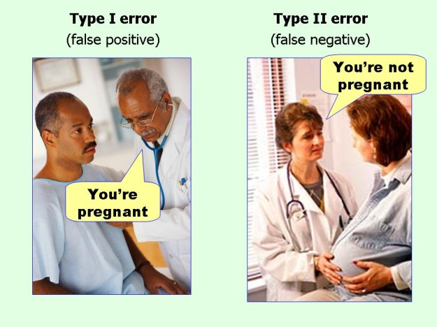
marginalrevolution.com/marginalrevolution/2014/05/type-i-and-type-ii-errors-simplified.html (2016-04-11)

Slide 39
what works well Online With Zoom
Sign in with First and Last Name
Stay muted unless you are going to speak
To speak use the raise your hand feature
To answer yes/no questions use the “yes” ”no” buttons
Turn your camera on
Wait until the end of student presentations to ask questions
  Write them down so you don’t forget

Slide 40
Survey Results (1/3) -22 Responses
Notes:
Common items for next time:
I am in FL 140 about an hour before and after each class
Estimated breakdown of course time per week:
4 hours class time
4 hours reading (2 chapters ~90 pages @ 2 minutes per page)
8 hours practicing mastery of material (papers, group project, class activity prep)
If you are spending much more than this let me know and we can figure out a more efficient way to spend your time

Slide 41
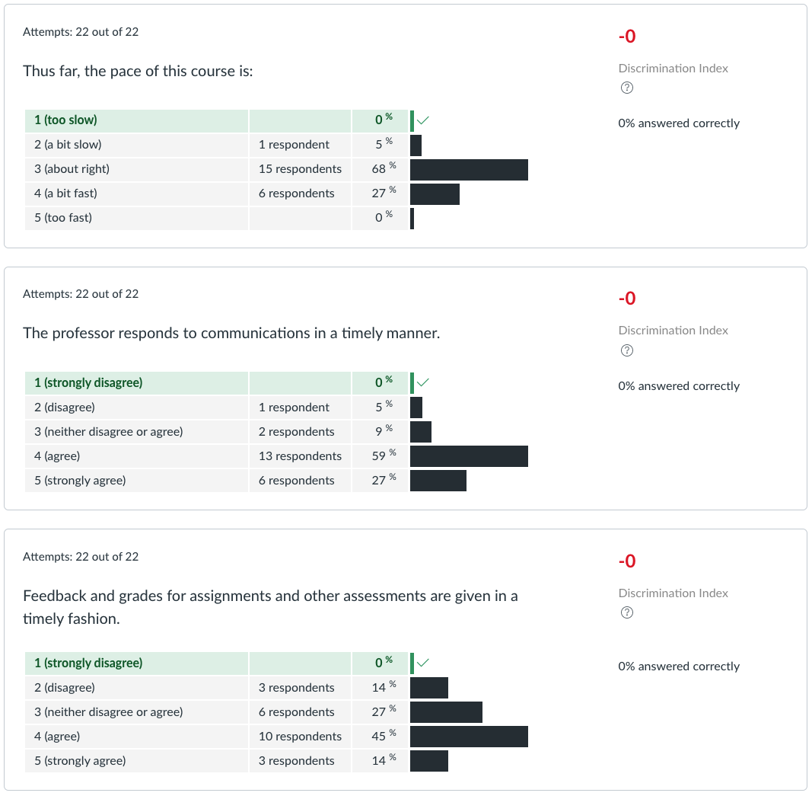
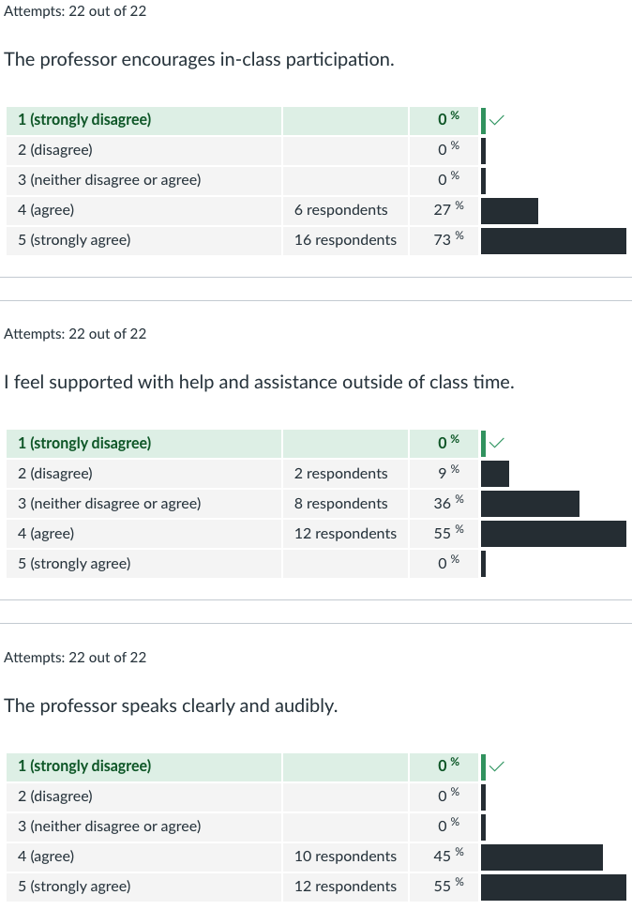
Survey Results (2/3) -22 Responses

Slide 42
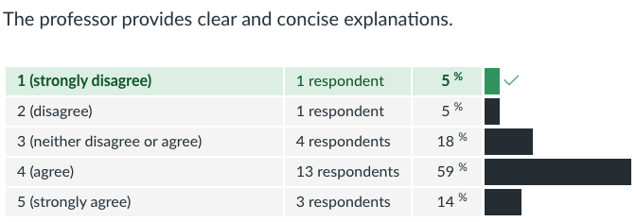
Survey Results (3/3) -22 Responses

