Slide 1
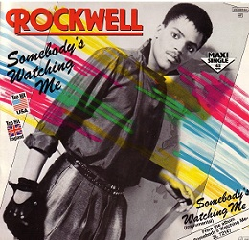
Class 7
Privacy and Government
Keith A. Pray
socialimps.keithpray.net
Notes:
After this class we will be half done with the course… very sad I know.
Somebody’s Watching Me (1984) – Rockwell (3:36)
https://www.youtube.com/watch?v=7YvAYIJSSZY
Be the envy of all your classmates if you know the band and/or year:
Rockwell (1984) Michael Jackson sings chorus and Jermaine Jackson on backing vocals.

Slide 2
what works well Online
With Zoom
Turn your camera on
Sign in with First and Last Name
Stay muted unless you are going to speak
To speak use the raise your hand feature

Slide 3
Logistics
Turn presentations and papers in on Canvas, drafts too
  You can submit multiple times to the same assignment
Review Presentation and Paper Guidelines on course site
Providing comments on drafts is a limit, first come first served
  We would like to help everyone asking but sometimes we run out of time
  Try asking a peer to give notes on your work
Notes:
Not needed this time:
Address email to entire course staff for quickest response time
Do not change the format, footers, etc. in the template slides.
Paper writing process: Sources → Notes → Conclusion → Argument → Counter Point → Response
Turn extra credit paper in on myWPI/Canvas and hard copy in class like regular papers
Use Presentation Guidelines on course web site
Use paper and presentation templates
Keep topics inside the course scope: Computing + Society
Presentations are due 24 hours before class
Sign up for Individual Presentation, it’s not too late

Slide 4
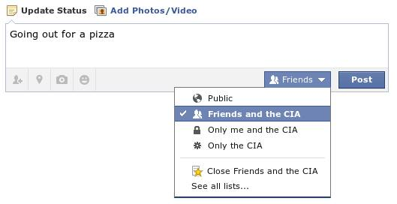
Overview
Review
Assignment
Students Present
Notes:
Review before debate in case anyone unsure of something in reading.
TODO: Image source?
Look at ACM TechNews if time

Slide 5
My Reading Notes
p. 269 Used to start with “A system that fails to respect its citizens’ right to privacy fails to respect the citizens themselves.” – Richard Nixon, 1974-02-23
p. 271 Genetic Information Nondiscrimination Act: Gattaca (1997)
p. 273 Any NCIC success since 1995?
p. 274 Arrests, altering and deleting records are violations of privacy?
p. 275 Figure does not show # cameras increasing.
p. 276 300 times = frames, locations, …?
p. 277 Public drone opinion change since 2012? Any more states pass drone laws since 2013?
p. 281 “Carnivore…” what’s in a name?
p. 284 Stored Comms Act, any news since 2010?
p. 285 CALEA update since 2005?
p. 288 Google’s Eric Schmidt quote seems naïve
p. 293 Shouldn’t credit card issuers take “reasonable steps” to verify identity all the time?
p. 294 Target example, see Ch. 5 p. 248
p. 295 How many names on no fly lists now compared to 2014?
p. 297 Confusing false positive and negative explanations. 2001 source old for claims. See ‘What “Orwellian” Really Means’ video
p. 301 Other states using E-ZPass since 2007?
p. 303 Papa Smurfs…
Questions I liked: 1, 24
From previous edition interview at end of Chpater: “Since I have done nothing wrong, why should the government be investigating me?” – Jerry Berman
Notes:
Let’s debate!

Slide 6
Debate Ground Rules
National ban on facial recognition surveillance for law enforcement
Before Debate
Add “(YES)” or “(NO)” to the end of your name in Zoom to show your side
10 minutes to converse with your team
Share argument points, counter points, and responses
Share experiences, especially in different countries, cultures, situations
Decide who will:
  Go first
  Respond to which points from opposing side
During Debate
1 turn per person until everyone on your team has spoken
Try to keep remarks to 30 seconds
Notes:
“National ban on facial recognition surveillance for law enforcement” Debate
If in class:
Stand up when speaking
30 second limit (elect a timekeeper)
If Remote:
Add “(YES)” or “(NO)” to the end of your name in Zoom to show your side
Previous:
Should law require you to use an official ID for Internet access
National ID or Not Debate

Slide 7
Group Quiz
Give a problem with using biometrics for identification.
Give an advantage of using biometrics for identification.
Describe a tool people can use to protect their privacy on the Web.
For each of the 4 categories of Daniel Solove’s privacy taxonomy give an example not listed in the book.
Notes:
Only if we have time.
Information Collection
Information Processing
Information Dissemination
Invasion

Slide 8
Overview
Review
Assignment
Students Present

Slide 9
Assignment – Group Project
Catch up on reading
Group Project
  Finish analysis of computing technology portrayed to web site
  Analyze Movie for all topics covered to date
  Keep in course scope: Computing + Society
  See group project slide deck for more
  Frequent interaction with your group members is key to success!
-----
Canvas → Quizzes → Mid Term Survey on Canvas
Notes:
Movie group project:
List of computing technologies portrayed in movie on website
Categorize computing technologies as existing, future, emerging, impossible or plausible with rationale
Analyze movie for all topics covered to date

Slide 10
Overview
Review
Assignment
Students Present

Slide 11
Drawing the sharing line
Colin Lemire
Notes:
With the internet being widely and frequently used by many, companies are using it to track personal information about you while you use it.
A lack of regulation around data collection from consumers begs the question: where do we draw the line?

Slide 12
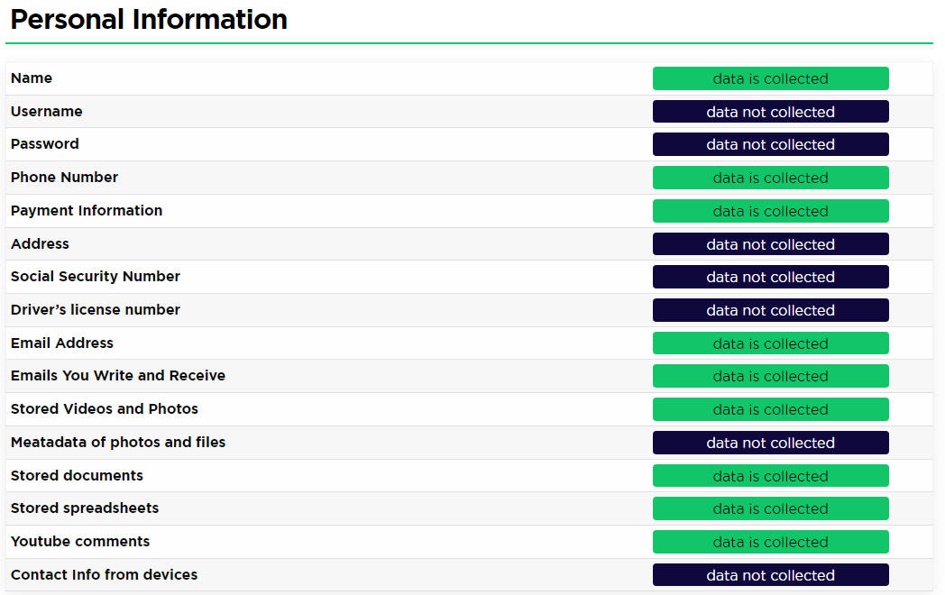
What information do companies Collect?
Colin Lemire
Name [1]
Address [1]
Phone number [1]
Email [1]
Location [1]
Search terms [1]
Online activity [1]
[1]
Notes:
Common (and usually publicly available) information such as name and address
Contact info like email and phone number
GPS location, which is obviously used by apps like Google Maps or Apple Maps, but also tracked by apps that don't necessarily need it like twitter
Social media and Google track all search terms and activity while using their services
Other information is also collected as shown in picture, this privacy report is on Google
There is more info collected (location info, system info)

Slide 13
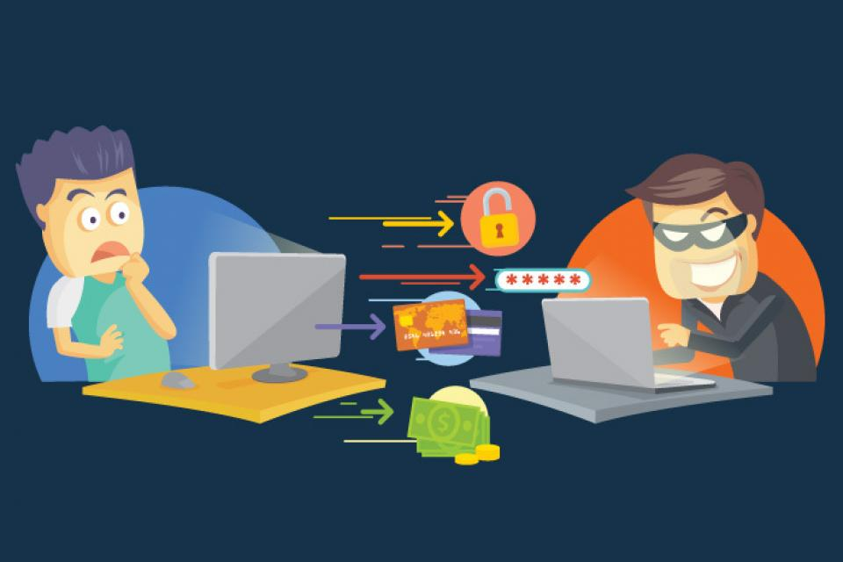
Why should I care?
Colin Lemire
Your information is being sold [6]
Data breaches [1][3]
Notes:
Your information is indirectly sold to advertisers in a process called "real-time bidding"
When you enter a site, Google sends information associated with your account to advertisers, who then bid for the advertising space based on the information given by Google
Advertisers are also given info when you click on their advertisement. In both cases, advertisers are allowed to keep any info they collect.
If that isn't enough for you, then it simply increases your chances of identity fraud.

Slide 14
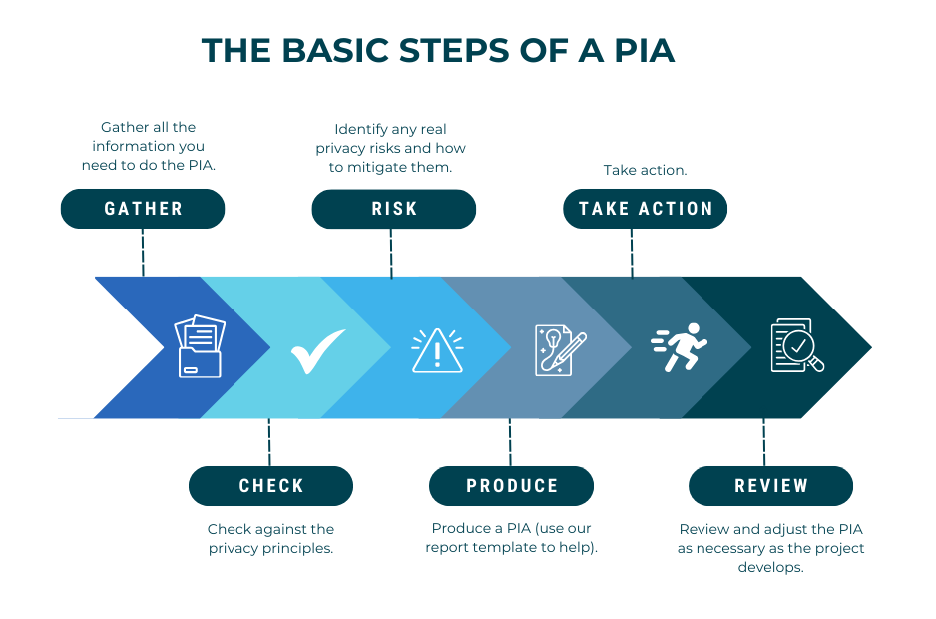
What laws Exist?
Colin Lemire
E-Government Act of 2002
All federal agencies are required to make a "Privacy Impact Assessment" (PIA) [5]
PIAs are supposed to be publicly available [5]
[8]
Notes:
Two federal laws, though regulations have been made state by state.
In addition to the Privacy Act of 1974, the E-Government Act of 2002
Any new technologies used by the government are given a PIA
PIAs do not need to be made viewable to the public if the agency determines that it would create a security risk
Inspired by Patriot Act?

Slide 15
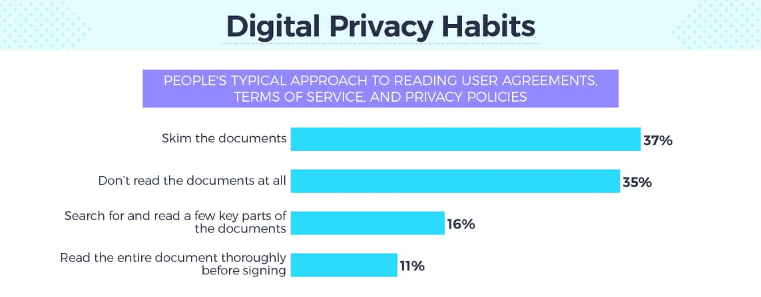
You don’t read privacy agreements
Colin Lemire
Most users do not pay attention to privacy policies [2]
Over 1000 responses to survey [2]
72% of people don't/barely look at privacy policies [2]
[2]
Notes:
If laws are already made, then what's the problem? You don't read those privacy agreements!
Most people are not reading privacy policies -> point out statistics
This data is from a survey from Security.org, an organization that gives information on personal security both online and in real life
Talk about personal experience – I don't read policy either

Slide 16
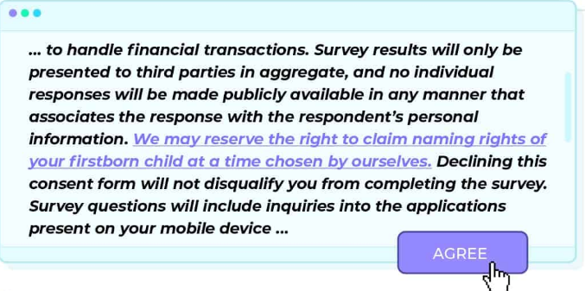
More survey results – not-so-hidden clause
Colin Lemire
Hidden clause in privacy policy of this survey [2]
98% of people agreed – 16 total out of over 1000 [2]
Accepting the privacy policy was not required to take the survey [2]
[2]
Notes:
In the same survey, the creators hid something in the privacy policy – a clause to give away naming rights for your first child.
Just 16 people read the user agreement to find out that taking that survey would give the company the right to name their first born
Accepting the agreement was not necessary to take the survey.
100% of people who responded that they read the entire policy thoroughly agreed to the privacy policy

Slide 17
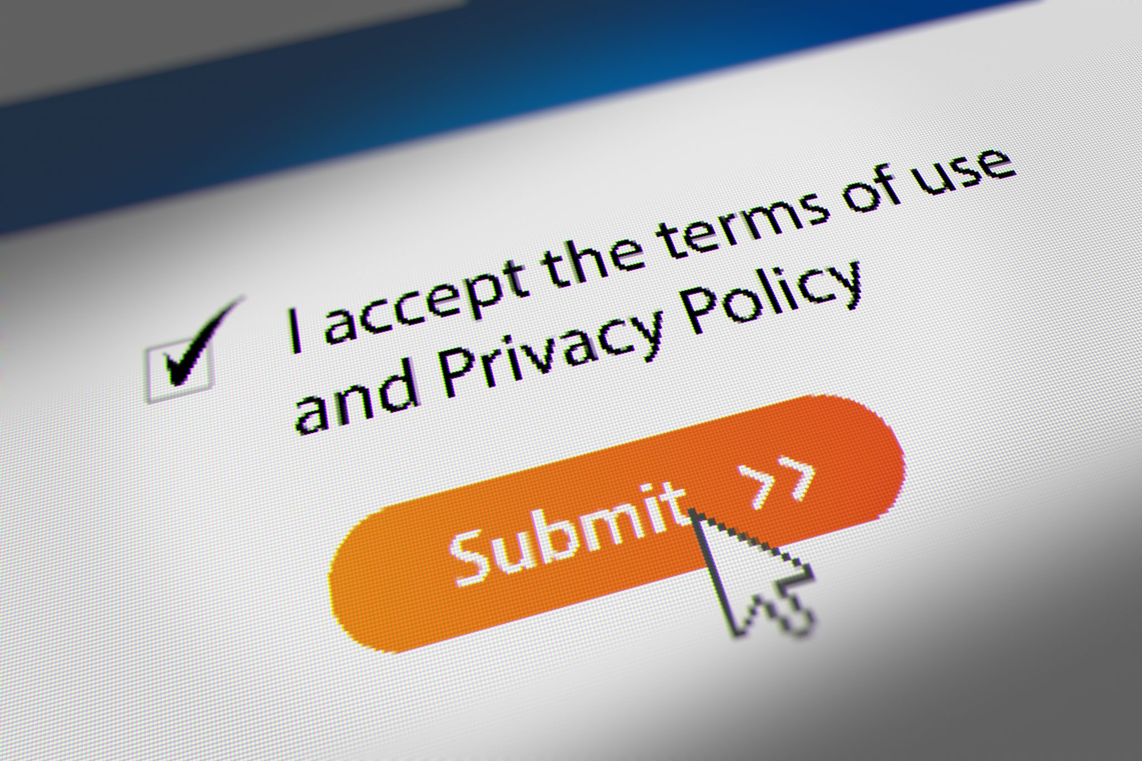
Solution
Colin Lemire
Companies who collect information should give a bullet point list of data collected
5 second timer to accepting privacy policy
All users should be able to get their info on request
Selling data should not be allowed at all - 77% supported this policy, just 9% opposed [2]
[7]
Notes:
The bullet point list should be at the start of the privacy agreement
5 second timer so that even people who just click through will at least see the privacy agreement
This info request would include ALL data collected by the company. Ideally, the user could pick and choose which info is kept.
Whether directly or indirectly, data cannot be legally sold even if the user "agrees" to it.
These proposed changes would help the vast majority of people

Slide 18
References
Colin Lemire
[1] Turner, Gabe, & Vigderman, Aliza, “The Data Big Tech Companies Have On You”, (Security.org, Jun 7, 2024), https://www.security.org/resources/data-tech-companies-have/, (Accessed Sept 9, 2024).
[2] “Americans Get an F on Digital Privacy Knowledge”, (Security.org, Apr 14, 2021), https://www.security.org/digital-security/american-digital-privacy-knowledge/, (Accessed Sept 9, 2024).
[3] "Protecting Personal Privacy", (GAO), https://www.gao.gov/protecting-personal-privacy, (Accessed Sept 11, 2024).
[4] "Privacy Act", (US Department of Treasury), https://home.treasury.gov/footer/privacy-act#:~:text=The%20principles%20of%20the%20Privacy,use%20and%20dissemination%20of%20records, (Accessed Sept 11, 2024).
[5] "E-Government Act of 2002", (US Department of Justice), https://www.justice.gov/opcl/e-government-act-2002, (Accessed Sept 11, 2024).
[6] Ng, Alfred, "What Does It Actually Mean When a Company Says 'We Do Not Sell Your Data'?", (The Markup, Sept 2, 2021), https://themarkup.org/the-breakdown/2021/09/02/what-does-it-actually-mean-when-a-company-says-we-do-not-sell-your-data, (Accessed Sept 11, 2024).
[7] "Mouse Cursor Clicking 'I accept the terms of use and Privacy Policy' Checkbox and Submit Button, Terms and Conditions Agreement", https://securitycurrent.com/data-privacy-in-the-era-of-covid-19/mouse-cursor-clicking-i-accept-the-terms-of-use-and-privacy-policy-checkbox-and-submit-button-terms-and-conditions-agreement/, (Accessed Sept 12, 2024).
[8] "Privacy Impact Assessment Toolkit", (Privacy Commissioner), https://privacy.org.nz/publications/guidance-resources/privacy-impact-assessment-toolkit/, (Accessed Sept 13, 2024).
[9] "Ultimate Guide to Identity Theft Protection Online & Offline", (North Country Savings Bank), https://www.northcountrysavings.bank/blog-article/ultimate-guide-identity-theft-protection-online-offline, (Accessed Sept 13, 2024).

Slide 19
Should Cars Report Crimes?
By: Jason Luc
Notes:
Talk about the focus of the presentation:
Risks, ethical concerns, and potential job displacement

Slide 20
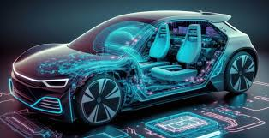
The Pros and Cons
Jason Luc
Safety
Reduce Bias
Efficiency
Privacy Concerns
Job Security
Law Enforcement Structure
Ethical and Legal Concerns
(6)
Notes:
What are auto reporting cars?
AI systems that are a part of a vehicle that can detect and report crimes such as speeding, illegal parking, crashes, ect.
Briefly talk about the pros
Then talk about how the main point of the slideshow will be focused on the cons.

Slide 21
NO
Jason Luc
Notes:
My response of if we should allow this to happen.

Slide 22
Why should I care?
Jason Luc
Notes:
Ask the crowd if they can drive a car (since presentation is online ask people to raise their hands on camera)
Ask if they drive 5 mph above speed limit normally
(make a point that AI has to be programmed in a way to determine if that is reportable crime vs “Breaking the law”)

Slide 23

problem of law enforcement structure
Jason Luc
Over-reliance on Technology
Legal Accountability: Who is responsible if AI is wrong? (1)
  How does AI correctly decern fault? (1)
<Graphic as big as will fit>
(7)
Notes:
Talk about how we could become overly dependent on AI to report crimes.
Normally, current law enforcement structures rely on trained human officers to make complex decisions, but AI systems can easily confuse the accountability part.
How does AI take responsibility of being wrong?
Who would instead?
This is a very important question as if faults were to occur, how do we deal with potential scandals.
Source 1 states that in the legal system, this has yet to be resolved.
This is a primary challenge of AI crime reporting.

Slide 24

Privacy Concerns
Jason Luc
Data collection risks: Constant surveillance leads to concerns regarding misuse of data (5,6)
Transparency: How will citizens know about their collected data?
  The GDPR and failing to meet legal standards(2,5)
(8)
Notes:
Mention about the previous presentations, data misuse, privacy.
With AI systems come with a lack of transparency, this leads to citizens getting their data unknowingly collected, shared, or used.
Sources 2 and 5 mention that current surveillance systems already face similar privacy challenges. This could worsen with AI.
GDPR and other legal frameworks struggle to keep up with these rapid advancements in AI, which leaves room for privacy intrusion.
Who will have the information and will that information be accessible to the public or to the individual that asks?

Slide 25

Job Displacement
Jason Luc
Law Enforcement Jobs: No need for human officers? (3)
  Foxconn replaced 60,000 factory workers (3)
  Frey and Osborne, 47% of U.S. jobs are at risk from AI (3)
(9)
Notes:
Talk about how job displacement would be a serious problem in the law enforcement space.
Specifically in roles that involve monitoring traffic and minor offenses.
What would officers become?
Source 3 talks about how in different industries such as Foxxconn replaced 60,000 workers with robots. Though this is completely unrelated to car even AI, it does show how automation of certain roles can cause people to be replaced.
Source 3 states that 47% of U.S. jobs could be at risk because of automation.

Slide 26

Ethical And Legal Concerns
Jason Luc
Accountability and AI: AI is not great at attributing responsibility (1)
AI and Law: Lack of a legal framework for AI in law enforcement (1)
Ethics in AI: Will AI be correct ethically and morally? (4)
(10)
Notes:
AI morals/ethics are not the same as human morals/ethics. Appointing responsibility, in most cases, is highly from an ethical/moral standpoint. AI is not good at appointing responsibility.
Will we be totally relying on AI? If so, how do we make AI such that it’s not biased? What is the correct ethical view for AI?
Source 4 talks about how AI autos can complicate accountability and can raise concerns in court.
If an AI system were to be implemented, this aspect of how this could be used for evidence in court or be used as the basis for a court case needs to be thoroughly tested to avoid biases.
Mention how human insight and dismiss crimes as being reasonable.

Slide 27
References
Jason Luc
[1] Ligeti, Katalin. AI and Criminal Justice: A Concept Paper. AIDP-IAPL International Congress of Penal Law, 2020. PDF. Accessed 7 Sept. 2024.
[2] Matulionyte, Rita, et al. "A Call for More Explainable AI in Law Enforcement." IEEE Access, vol. 9, 2021, pp. 1-13. IEEE, doi:10.1109/ACCESS.2021.3051162. Accessed 7 Sept. 2024.
[3] Estlund, Cynthia. "What Should We Do After Work? Automation and Employment Law." Yale Law Journal, vol. 128, no. 2, Nov. 2018, pp. 254-326. JSTOR, www.jstor.org/stable/45389444. Accessed 7 Sept. 2024.
[4] Raaijmakers, Stephan. "Artificial Intelligence for Law Enforcement: Challenges and Opportunities." IEEE Access, vol. 7, 2019, pp. 151797-151813. IEEE, doi:10.1109/ACCESS.2019.2947223. Accessed 7 Sept. 2024.
[5] Greco, Marco. Opinion on Security and Surveillance Technologies. Grundrechte.ch, 2014. PDF. Accessed 7 Sept. 2024.
[6] Viana, Leo. “Current AI Won’t Get Vehicles to the Next Level of Autonomous Driving.” Automotive World, 29 Aug. 2023, www.automotiveworld.com/articles/current-ai-wont-get-vehicles-to-the-next-level-of-autonomous-driving/. Accessed 11 Sept. 2024.
[7] Manente, Derek. “Why Do American Police Drive SUVs and Pickup Trucks?” Motor1, 19 June 2020, www.motor1.com/features/420301/american-police-cars-trucks-suvs/. Accessed 11 Sept. 2024.
[8] “Council of Europe at the 2015 Internet Governance Forum: Facing Mass Surveillance and Other Threats to Privacy and Freedom of Expression.” Council of Europe, 10 Nov. 2015, www.coe.int/en/web/human-rights-rule-of-law/-/council-of-europe-at-the-2015-internet-governance-forum-facing-mass-surveillance-and-other-threats-to-privacy-and-freedom-of-expression. Accessed 11 Sept. 2024.
[9] “The Job Displacement Dilemma.” Linvelo, 1 May 2023, linvelo.com/the-job-displacement-dilemma/. Accessed 11 Sept. 2024.
[10] Kelnar, Jamie. “Top Ethical Issues with AI and Machine Learning.” DATAVERSITY, 27 Jan. 2023, www.dataversity.net/top-ethical-issues-with-ai-and-machine-learning/. Accessed 11 Sept. 2024.
[11] New Approach for a Mobile Device-Based Vehicle Crime Reporting System, 5529-libre.pdf. Accessed 7 Sept. 2024.

Slide 28
Algorithmic Surveillance
Noah Cyr

Slide 29
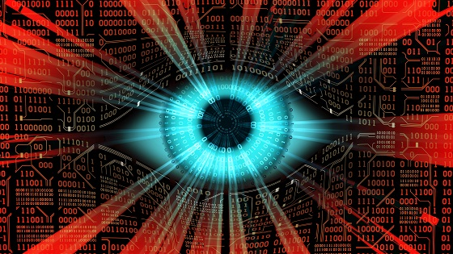
What is algorithmic surveillance?
Noah Cyr
Surveillance aided by computer programs that take an input and produce an output
Technology is used to infer conclusions about human actions and society
Image link
Notes:
WHAT IS ALGORITHMIC SURVEILLANCE
Surveillance aided by computer programs that take an input and produce an output
Technology is used to infer conclusions about human actions and society
I will focus on surveillance strategies that do not involve cameras
Examples include the use of algorithms to identify potential cases of welfare fraud or predict location of crimes

Slide 30
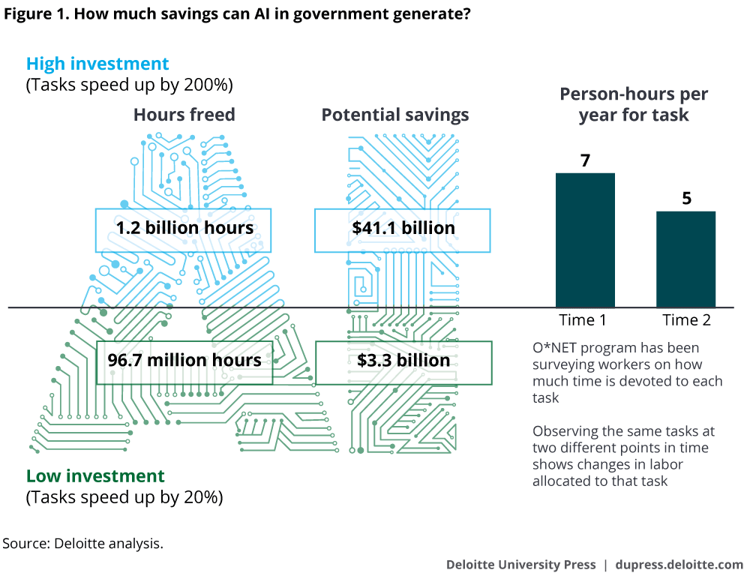
benefits
Noah Cyr
Streamline surveillance efforts
Recognize potential criminal activities in advance
Improved security for citizens
Depiction of potential savings from automation in the government (Deloitte)
Notes:
BENEFITS
Streamline surveillance efforts
Deloitte estimates automation could reduce millions of labor hours and billions of dollars for the US government
On the low end, 96.7 million federal hours and $3.3 billion
On the high end, 1.2 billion federal hours and $41.1 billion
Obviously, surveillance accounts for just a fraction of operations, however it shows the potential efficiencies of computation in surveillance
Recognize potential criminal activities in advance, aka predictive policing
For example, identifying threatening statements on social media or identifying patterns of crimes
In turn, there is less crime in society, saving lives and limiting financial damages
When there is less crime there is generally increased security for citizens

Slide 31
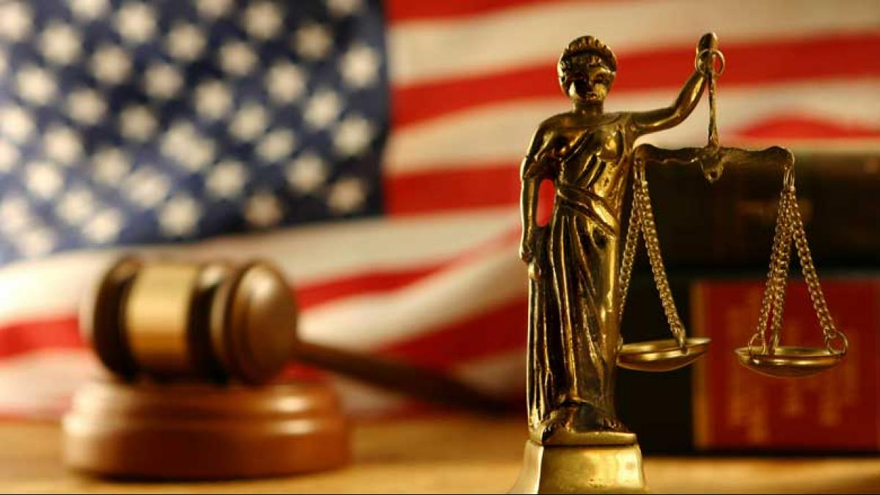
drawbacks
Noah Cyr
Biases
  Creates increased discrimination and inequalities
  COMPAS
Algorithms are often trade secrets
Gaming the system
Removes accountability from decisive individuals
Image link
Notes:
DRAWBACKS
Frequently, algorithms and artificial intelligence is inherently biased due to the data they were built on
COMPAS stands for Correctional Offender Management Profiling for Alternative Sanctions
It is an algorithmic risk assessment tool that determines the chance an individual becomes a repeat offender of crimes
It gives a person a rating 1 through 10, with 10 being the most likely to commit a crime again and 1 being the least likely
Rating is determined by a wide range of questions, from behavior in school to philosophical questions to history of violence
In states such as New York and California, COMPAS ratings are presented to a judge during the process of an individual’s judgement
There is evidence the tool disproportionally gives black defendants a higher rating than white defendants
It is impossible for an algorithm to not be discriminatory when it considers an individual’s arrest history, as racial discrimination has long been a factor for arrests
COMPAS violates Equal Protection Rights outlined in the 14th amendment
Algorithms are often trade secrets, so third parties cannot analyze the inner workings of an algorithm
COMPAS’s recidivism algorithm is an example, we do not know how the algorithm works
Manipulation of the algorithms can allow actors to game the system in their favor
Removes accountability from decisive individuals
They can blame the computer output as the reason for a poor decision

Slide 32

Drawbacks cont.
Noah Cyr
Data collection needed for algorithmic surveillance often violates data privacy laws and human rights, such as the GDPR and ECHR
  The Netherlands’ System Risk Indicator (SyRI)
Regulations in other parts of the world are less restrictive
Kitty Jong and Maxim Februari at the ruling against SyRI (ANP)
GDPR – General Data Protection Regulation
ECHR – European Convention of Human Rights
Notes:
DRAWBACKS CONT.
Data collection needed for algorithmic surveillance often violates data privacy laws, such as the GDPR and ECHR
The Dutch Ministry of Social Affairs created SyRI, its purpose is to identify people at a high risk of welfare fraud using algorithms
Examples of risk indicators for the model include:
“If 2 people live together, but report to the state that they live at two different addresses, they probably claim too much in welfare benefits” [2]
“A person has probably concealed assets if he or she has multiple garages and has owned multiple vehicles” [2]
SyRI breached data protection principles and privacy rights
The Dutch Ministry of Social Affairs did not offer transparency on the use of personal data, the risk models were not public information
It violated Article 22 of the GDPR, which prohibits fully automated decisions with legal effects
It violated Article 8 of the ECHR, which states everyone has the right to respect their private life
The judgement of SyRI is influential in how future issues of automation in the Europe are handled
Regulations in other parts of the world are less restrictive, such as China or the US
GDPR – General Data Protection Regulation
ECHR – European Convention of Human Rights

Slide 33
conclusions
Noah Cyr
Algorithms and artificial intelligence has the potential improve societal issues involving surveillance
Resources need to be dedicated to the development of these technologies before widespread implementation in surveillance
Notes:
CONCLUSIONS
Algorithms and artificial intelligence has the potential improve societal issues involving surveillance
The key word here is potential
There needs to be resources dedicated to the development of these technologies before widespread implementation in surveillance
Data needs to be collected legally, following all regulations and laws, and ethically, without bias
There needs research to specifically develop algorithmic governance. It is extremely difficult to predict criminal activity
The use of algorithms by government needs to be implemented gradually and closely monitored

Slide 34
References
Noah Cyr
[1] Alikhademi, Kiana, et al., A Review of Predictive Policing from the Perspective of Fairness (Springer, 15 April 2021), https://link.springer.com/article/10.1007/s10506-021-09286-4 (11 September 2024)
[2] Borgesius, Frederik, and Van Bekkum, Marvin, Digital Welfare Fraud Detection and the Dutch SyRI Judgement (Sage Journals, 2 August 2021), https://journals.sagepub.com/doi/full/10.1177/13882627211031257 (5 September 2024)
[3] Boyd, Danah, The Networked Nature of Algorithmic Discrimination (Open Technology Institute, October 2014) https://www.danah.org/papers/2014/DataDiscrimination.pdf (11 September 2024)
[4] Eggers, William, et al., AI-Augmented Government (Deloitte, 26 April 2017), https://www2.deloitte.com/us/en/insights/focus/cognitive-technologies/artificial-intelligence-government.html (11 September 2024)
[5] Frericks, Frankie, Algorithmic Surveillance (Pressbooks, 2019), https://pressbooks.pub/surveillancestudies/chapter/algorithmic-surveillance/ (8 September 2024)
[6] Murphy, Maria, Algorithmic Surveillance: True Negatives (Society for Computers and Law, 14 August 2016), https://www.scl.org/3717-algorithmic-surveillance-true-negatives/ (8 September 2024)
[7] Northpointe Inc. (now Equivant), Practitioner’s Guide to COMPAS Core (Northpointe Inc., 15 March 2024), https://s3.documentcloud.org/documents/2840784/Practitioner-s-Guide-to-COMPAS-Core.pdf (8 September 2024)
[8] Pontón-Núñez, Antonio, and Thomas, Christopher, Automating Judicial Discretion: How Algorithmic Risk Assessments in Pretrial Adjudications Violate Equal Protection Rights on the Basis of Race (Minnesota Journal of Law and Inequality, June 2022) https://scholarship.law.umn.edu/cgi/viewcontent.cgi?article=1680&context=lawineq (8 September 2024)
[9] Simonite, Tom, Europe Limits Government by Algorithm. The US, Not So Much (WIRED, 7 February 2020), https://www.wired.com/story/europe-limits-government-algorithm-us-not-much/ (5 September 2024)

Slide 35
Class 7
The End
Keith A. Pray
socialimps.keithpray.net
Notes:
Look at ACM TechNews if time
This is the end. Any slides beyond this point are for answering questions that may arise but not needed in the main talk. Some slides may also be unfinished and are not needed but kept just in case.

