Slide 1

Class 11 Work
Keith A. Pray
socialimps.keithpray.net
Notes:
Styx - Mr. Roboto (1983) (5:34) https://www.youtube.com/watch?v=uc6f_2nPSX8
Ask about Automation paper:
What did people choose to automate
Share 1 main reason

Slide 2
Papers
While average was lower the standard deviation was 2.7 resulting from many being the highest paper grade yet
Changing a couple words does not constitute paraphrasing.
Include tests/results in Appendix
Define test strategy clearly
Ask for help if you have trouble with backing data
Notes:
Save for next time:
Clearly state conclusion
First statement preferred
Absolute statements are difficult to prove
Avoid: all, always, any, every, everyone, never, none… unless you can show it
Be sure to put quotes around entire quote
Hyperbole is the best thing ever!
but not in these papers
Print 2 sided and save a tree
Use template, saves time (and -1 point)
Include Counter Point and Response
Include Author, Title, Publish Date, Publisher for references
Read paper aloud to proof

Slide 3
Grades To Date
44 Max Possible
- Discussion 1-10 - Papers 1-3

Slide 4
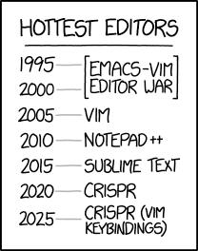
Overview
Review
Assignment
Students Present
https://www.xkcd.com/1823/
Notes:
Full circle.
CRISPR: Clustered Regularly Interspaced Short Palindromic Repeats
Allows permanent modification of genes within organisms.
Published 2017-04-12 according to https://www.explainxkcd.com/wiki/index.php/List_of_all_comics_(1501-2000)
Kickstarter Charter
https://www.kickstarter.com/charter?ref=about_subnav

Slide 5
Overview
Review
Assignment
Students Present
C lustered R egularly I nterspaced S hort P alindromic R epeats
Permanent gene modification
https://www.xkcd.com/1823/
Notes:
Full circle (not quite since the Emacs/VIM comic no longer used… may have to retire this as students seem to not be aware of different text editors).
CRISPR: Clustered Regularly Interspaced Short Palindromic Repeats
Allows permanent modification of genes within organisms.
Published 2017-04-12 according to https://www.explainxkcd.com/wiki/index.php/List_of_all_comics_(1501-2000)
Kickstarter Charter
https://www.kickstarter.com/charter?ref=about_subnav

Slide 6
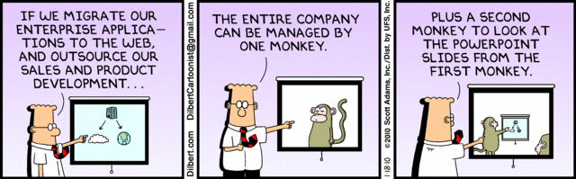
Let’s Look At One way to handle a Decrease In Jobs
Notes:
Poll class:
Expected salary range upon graduation? Min, Max? Put in spreadsheet.
Assume 40 hour work week.
How many people would work:
32 hours for 0.8 * Max?
24 hours for 0.6 * Max?
…continue until Min is reached.

Slide 7
My Reading Notes
pp. 484 Asimov “Three Laws of Robotics” not guarantee as his stories show… absolutes “never” difficult to prove.
pp. 485 Tesla and other newer car manufacturers similar to 15 person hours per car?
pp. 488 “Working less, making more” 2000 source, now?
pp. 491 2050 robots replace humans prediction made in 1999. Is it holding?
pp. 492 Still true Westerners have cultural fear of robots?
pp. 495 Hawking AI prediction appeal to authority fallacy?
pp. 497 Telework 37% min. 1 day/month 2009. Now?
pp. 498 “Telework threatens authority…” autonomy good for employee and business, quality of work is a good manager measure.
pp. 499 Scheduling team meetings easier without commute.
pp. 500 Monitoring data needs update, 2008 newest
pp. 504 WTO seems implementation complaint, not globalization. Are the subsidies more the problem than globalization?
pp. 507 telecom infrastructure data from 2013, now?
pp. 514 Still true more people know Windows than Mac? Is the US still the dominant economic power on the planet?
pp. 516 Miguel seems to have big performance difference
Questions I liked: 12, 13, 14, 18, 19, 21, 22, 29

Slide 8
Group Quiz
List 2 ways IT can lead to organizational change.
List 4 ways a Video Game Producer may protect its IP and what specific IP each protects.
List a computing technology that can be used to protect an individual’s privacy.
List a computing technology that can be used to intrude upon an individual’s privacy.
Notes:
Could split into groups of 4-5 for this.
Fill time with Work Discussion on Course Web Site

Slide 9
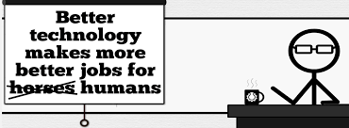


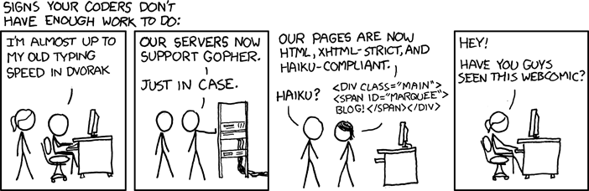
Overview
Review
Assignment
Students Present
http://xkcd.com/554/
Notes:
CGP Grey
Humans Need Not Apply (15:00) – 2014-08-13
http://www.youtube.com/watch?v=7Pq-S557XQU
Last access 2016-04-22
These 3D printed homes can be constructed for $4,000 (3:00 – 2018-04-02)
http://www.businessinsider.com/3d-printed-homes-constructed-icon-new-story-tech-charity-4000-dollars-2018-3
https://www.youtube.com/watch?v=SvM7jFZGAec (1:28)
Last access 2018-04-22
David Autor Will automation take away all our jobs? (18:27) (2016) https://www.ted.com/talks/david_autor_will_automation_take_away_all_our_jobs/transcript?language=en TEDxXambridge, 2016-12-19
Review Group Assignment Details.
Or first watch video: depends on student presentations, no thunder stealing.
Look at:
BBC Intelligent Machines
http://www.bbc.com/news/technology-33978561
BBC Likelihood of robot taking your job
http://www.bbc.com/news/technology-34066941

Slide 10
Assignment Reminders
Finish all reading
Finish Automation Paper
Optional Game Paper due last day of class
Group Web Sites and Presentations
If your group is not presenting next class prepare 3 questions for each group that is presenting by visiting their web sites.
See Group Project Details

Slide 11
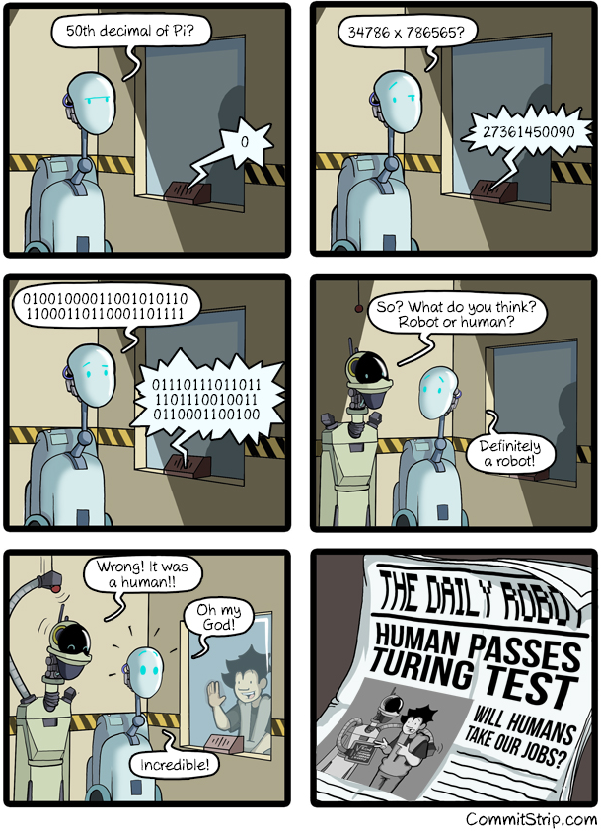
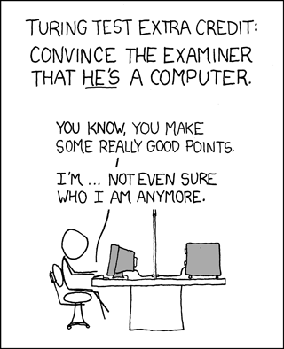
Overview
Review
Assignment
Students Present
https://xkcd.com/329/
Notes:
http://www.commitstrip.com/en/2016/04/14/meanwhile-in-a-parallel-universe-3/ (2016-04-14)
https://xkcd.com/329/ (2007-10-15)

Slide 12
AI’s Effect on Medical Bias
Alexander Kraemling

Slide 13
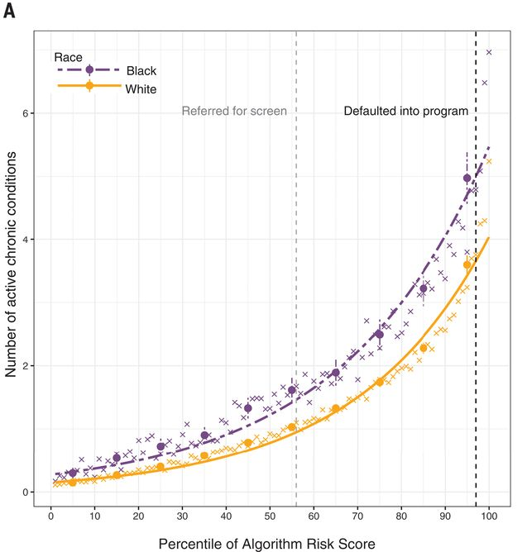
AI in healthcare Can Harm minoritized communities
Alexander Kraemling
Certain widely used risk prediction algorithms exhibit racial bias (2019) [1] [3]
Underscore risk factor for marginalized people
Eg: For the same score, black patients require a higher mean HbA1c% than white patients [2]
Particular bias since found and corrected [3]
Certain UTI calculator assigns a lower likelihood of UTI if the child is black [4] [5]
Chronic conditions vs assigned algorithm risk score for white and black patients [1]
Notes:
One particular algorithm used to assign “risk scores” that is used by an approximate 200 million people a year. This algorithm is relied on to identify which patients most require immediate help. (Study came out 2019)
The study specifically notes that this algorithm is not unique
It is often difficult to do studies on these healthcare algorithms because the algorithms are proprietary, meaning they are owned by companies. Makes it hard to investigate bias and the causes of it
Example: for the same score, black patients require a mean HbA1c% (Hemoglobin A1C level) 0.6% higher than white patients, which could correlate to a 30% difference in all-cause mortality [2]
Graph shows that black people need to present with more acute chronic conditions to be given the same risk score as white people
Urinary Tract Infection Calculator increases risk for children (2-24 months) who do not describe as black by about 2.5 times. (2018)
Also since been corrected

Slide 14
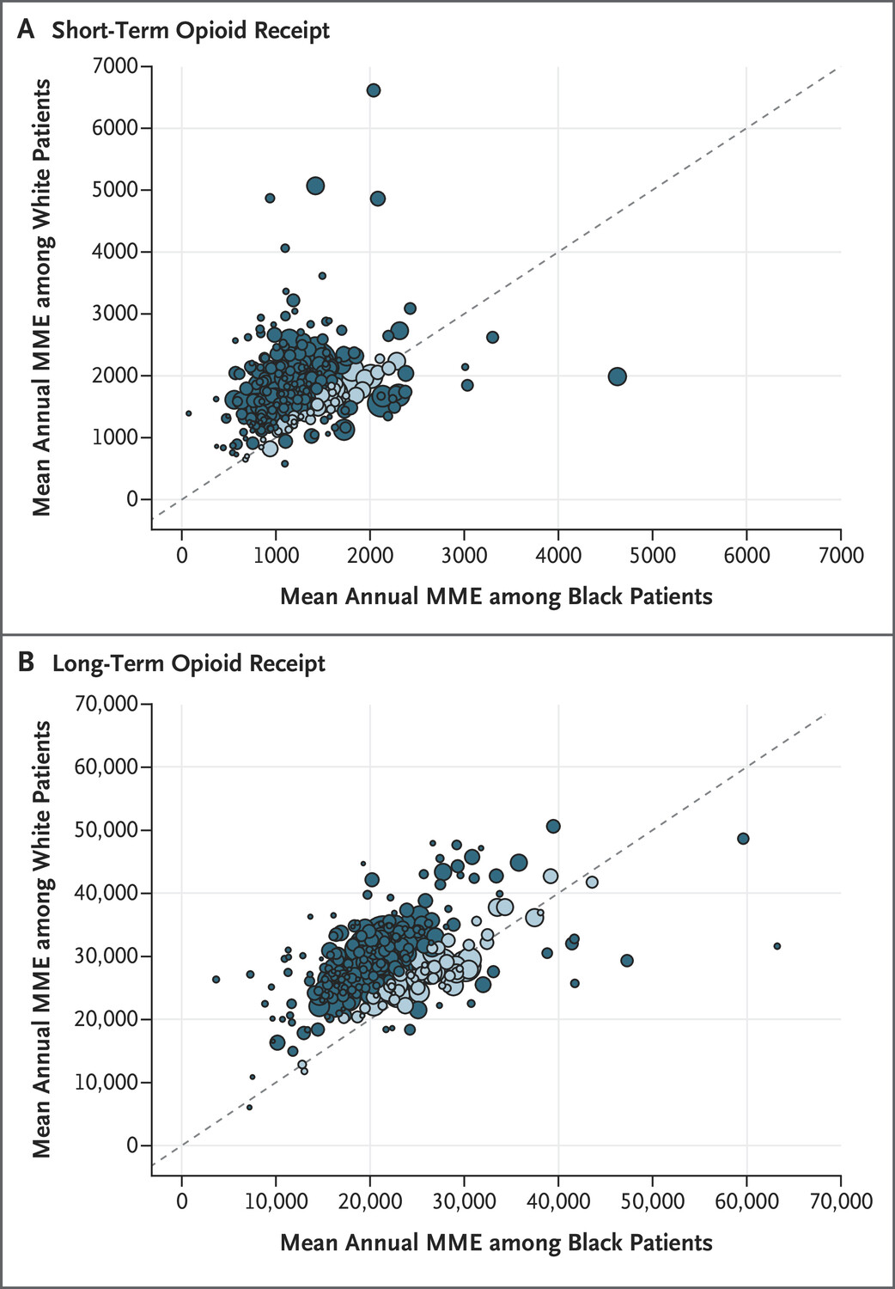
NARX SCORes exhibit Racial Bias
Alexander Kraemling
Within-System Differences between Black and White Patients in Mean Annual Morphine Milligram Equivalents (MME) [8]
Narx scores (scores used to determine risk of opioid misuse) determine what medications to give to patients [7]
Hard to do research into, not clear what factors it looks at
Likely takes factors influenced by racial bias such as criminality into account [6]
Black patients receive lower opioid doses than white patients for the same medical issues (2021) [8]
Notes:
Another example of racial bias in AI algorithms is shown through opioid doses given to black vs white patients.
First, need to know what narx scores are. narx scores (four kinds, narcotic, sedative, stimulant, and unintentional overdose risk, range 0-999), with higher numbers reflecting to risk of overdose or potential misuse. They are used to help doctors prescribe medications to patients.
Narx score is determined on an algorithm which is not clear nor released to the public. This makes it difficult to research what factors actually compose the scores.
Black patients receive lower prescription numbers on average in every aspect, from doses to length of treatment. It is extremely likely that this partially due to Narx Scores.
Graph: Dots above the line represent greater MME among white patients, dots below represent greater among black patients. The line represents equal values among black patients and white patients. Distance from the line signals the magnitude of the race difference
Darker dots: further than 15% away from median
Lighter dots: less than 15% away
Dot size: relative to the number of attributed patients
Adjusted for age, sex, condition, state of residence and year

Slide 15
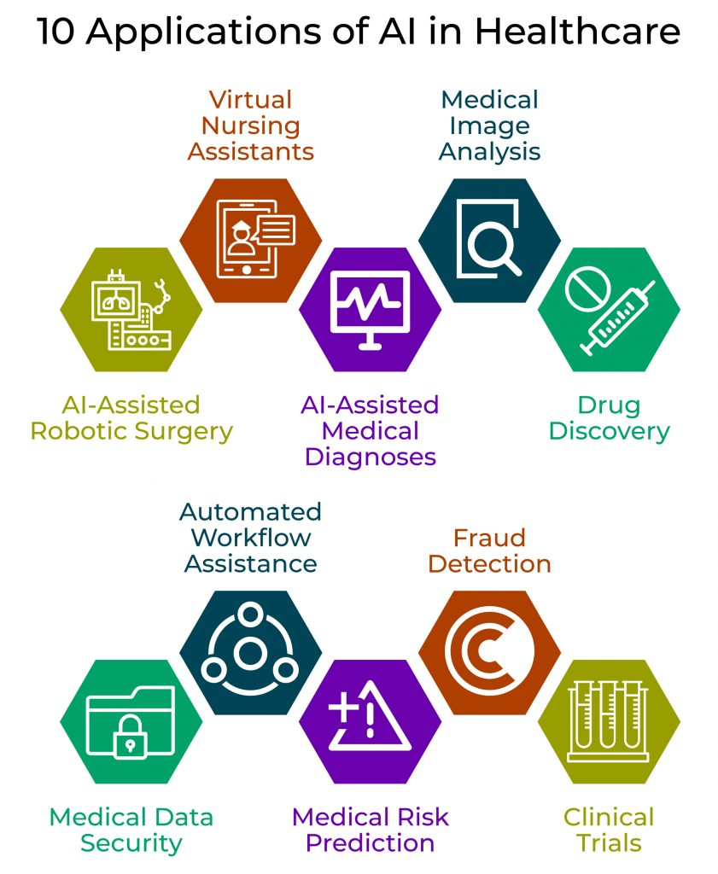
Should we continue to use AI in healthcare
Alexander Kraemling
Average US nurse only spends 21% of their time on direct patient care [11]
Machine learning algorithms can
Detect diseases earlier
Analyze medical data more consistently [12]
Ex: AI diagnosed COVID-19 cases with 98% accuracy from x-ray pictures – humans had 87% accuracy diagnosing covid from x-ray pictures [14] [15]
[13]
Notes:
Nurses in the US spend only 21% of their time with patients – the majority of the rest of their time is spent on clinical documentation and other administrative tasks. It’s estimated that 30% of administrative tasks for nurses could be taken over by AI. [11]
According to a study by the US Government Accountability Office, machine learning algorithms provide “earlier detection of diseases; more consistent analysis of medical data; and increased access to care”.
Basically, AI algorithms and machine learning make a big impact on the health sector. In the future, ml and ai will likely play a large role in improving our ability to detect diseases earlier, as well as decrease the administrative load on doctors and nurses, allowing them to spend more time helping patients
An example is with a neural network developed by researchers which had a 98% accuracy in diagnosing patients with COVID-19 from chest x-rays, whereas humans correctly diagnose Covid 87% of the time, but also falsely diagnosed patients who did not have covid with covid 21% of the time.

Slide 16
We should use ai in healthcare going forward
Alexander Kraemling
Steps to using AI in healthcare
“Promote health and health care equity during all phases of the health care algorithm life cycle
Ensure that health care algorithms and their use are transparent and explainable
Authentically engage patients and communities during all phases of the health care algorithm life cycle and earn trust
Explicitly identify health care algorithmic fairness issues and tradeoffs
Ensure accountability for equity and fairness in outcomes from healthcare algorithms ” [10]
Notes:
Panel of experts from Agency for Healthcare Research and Quality (AHRQ) and the National Institute on Minority Health and Health Disparities (NIMHD) came together to make the five key principles for mitigating algorithmic bias throughout an algorithms life cycle. The 5 points listed here are directly what their combined panel came up with, and I felt it would be more worthwhile for me to simply read them to you.

Slide 17
References Author, Title, (Publisher, Date), URL (access date)
Alexander Kraemling
[1] Ziad Obermeyer , Brian Powers, Christine Vogelli, Sendhil Mullainathan, Dissection racial bias in an algorithm used to manage the health of populations, (Science, 10/25/2019), https://www.science.org/doi/10.1126/science.aax2342 (04/08/2024)
[2] K T Khaw, N Wareham, R Luben, S Bingham, S Oakes, A Welch, N Day, Glycated haemoglobin, diabetes, and mortality in men in Norfolk cohort of european prospective investigation of cancer and nutrition (EPIC-Norfolk), (National Library of Medicine, 1/6/2001), https://pubmed.ncbi.nlm.nih.gov/11141143/ (04/09/2024)
[3] Crystal Grant, Algorithms Are Making Decisions About Health Care, Which May Only Worsen Medical Racism, (ACLU, 10/03/2022), https://www.aclu.org/news/privacy-technology/algorithms-in-health-care-may-worsen-medical-racism (04/12/2024)
[4] Darshali A. Vyas, Leo G. Eisenstein, David S. Jones, Hidden in Plain Sight — Reconsidering the Use of Race Correction in Clinical Algorithms, (The New England Journal of Medicine, 06/17/2020), https://www.nejm.org/doi/full/10.1056/NEJMms2004740 (04/12/2024)
[5] Nader Shaikh, Alejandro Hoberman, Stephanie W Hum, Anastasia Alberty, Gysella Muniz, Marcia Kurs-Lasky, Douglas Landsittel, Timothy Shope, Development and Validation of a Calculator for Estimating the Probability of Urinary Tract Infection in Young Febrile Children, (National Library of Medicine, 06/01/2018), https://pubmed.ncbi.nlm.nih.gov/29710324/ (04/12/2024)
[6] Johns Hopkins, How Health Care Algorithms and AI Can Help and Harm, (Johns Hopkins, 05/02/2023), https://publichealth.jhu.edu/2023/how-health-care-algorithms-and-ai-can-help-and-harm#:~:text=Many%20algorithms%20are%20proprietary.,is%20likely%20to%20be%20included (04/14/2024)
[7] Iowa Board of Pharmacy, March 2023 Iowa State Newsletter (Iowa Board of Pharmacy, March 2023), https://nabp.pharmacy/wp-content/uploads/2023/03/March-2023-Iowa-State-Newsletter.pdf (04/15/2024)

Slide 18
References Author, Title, (Publisher, Date), URL (access date)
Alexander Kraemling
[8] Nancy E. Morden, M.D., Deanna Chyn, M.P.H., Andrew Wood, M.P.H., and Ellen Meara, Ph.D, Racial Inequality in Prescription Opioid Receipt — Role of Individual Health Systems, (The New England Journal of Medicine, 07/21/2021), https://www.nejm.org/doi/full/10.1056/NEJMsa2034159 (04/15/2024)
[9] Mingmin Zhao, Kreshnik Hoti, Hao Wang, Aniruddh Raghu, Dina Katabi, Assessment of medication self-administration using artificial intelligence, (Nature Medicine, 03/18/2021), https://www.nature.com/articles/s41591-021-01273-1 (04/15/2024)
[10] Isabella Backman, Eliminating Racial Bias in Health Care AI: Expert Panel Offers Guidelines, (Yale School of Medicine, 12/21/2023), https://medicine.yale.edu/news-article/eliminating-racial-bias-in-health-care-ai-expert-panel-offers-guidelines/ (04/15/2024)
[11] Hunter Boyce, Estimated 30% of administrative nurse tasks can be done by AI-enabled robots, (The Atlanta Journal Constitution, 08/24/2023), https://www.ajc.com/pulse/estimated-30-of-administrative-nurse-tasks-can-be-done-by-ai-enabled-robots/NSSLOQJA5JB55E2BFJAIUF457I/#:~:text=Nurses%20only%20spend%20an%20estimated,clinical%20documentation%20and%20administrative%20tasks (04/16/2024)
[12] GAO, Artificial Intelligence in Health Care: Benefits and Challenges of Machine Learning Technologies for Medical Diagnostics, (US Government Accountability Office, 09/24/2022), https://www.gao.gov/products/gao-22-104629 (04/18/2024)
[13] Rick Martin, 10 Ways Artificial Intelligence is Transforming Healthcare, (Ignite, 11/30/2018), https://igniteoutsourcing.com/healthcare/artificial-intelligence-in-healthcare/ (04/18/2024)
[14] Prottoy Saha, Muhammed Sheikh Sadi, Milon Islam, EMCNet: Automated COVID-19 diagnosis from X-ray images using convolutional neural network and ensemble of machine learning classifiers, (National Library of Medicine, 10/22/2021), https://pubmed.ncbi.nlm.nih.gov/33363252/ (04/19/2024)
[15] Ebrahimzadeh S, Islam N, Dawit H, Salameh J-P, Kazi S, Fabiano N, Treanor L, Absi M, Ahmad F, Rooprai P, Al Khalil A, Harper K, Kamra N, Leeflang MMG, Hooft L, van der Pol CB, Prager R, Hare SS, Dennie C, Spijker R, Deeks JJ, Dinnes J, Jenniskens K, Korevaar DA, Cohen JF, Van den Bruel A, Takwoingi Y, van de Wijgert J, Wang J, Pena E, Sabongui S, McInnes MDF, How accurate is chest imaging for diagnosing COVID-19?, (Cochrane, 05/16/2022), https://www.cochrane.org/CD013639/INFECTN_how-accurate-chest-imaging-diagnosing-covid-19#:~:text=Pooled%20results%20showed%20that%20chest,did%20not%20have%20COVID%2D19.&text=Pooled%20results%20showed%20that%20chest%20X%2Dray%20(17%20studies),people%20who%20had%20COVID%2D19 (04/19/2024)

Slide 19
AI IN EDUCATION Will strengthen The digital divide
Vaansh Mansharamani

Slide 20

Reasons why The field of AI IN EDUCATION IS IMPORTANT
Vaansh Mansharamani
Useful for many applications such as
Help students such as English Language Learners with foreign skills[4]
Maple Lab(a lab at WPI) is using Multimodal Machine Learning to Estimate CLASS Positive Climate and Negative Climate[3], predict student performance[2], Visualizing Student performance in math[1](and many more)
There are more useful applications of AI in the education sector than I could possibly fit into one slide
Notes:
AI in education, broadly speaking is a good thing. There is tons of research in the field, with many studies showing us how it has the potential to affect ELLs[4], predict whether a learning environment is positive or negative for students[3], predict student growth and performance[2], and visualize their performance in math[1], and more. This can revolutionize the way students and teachers are able to learn and adapt to maximize and foster better learning for students. However, will everyone be able to witness this growth?

Slide 21
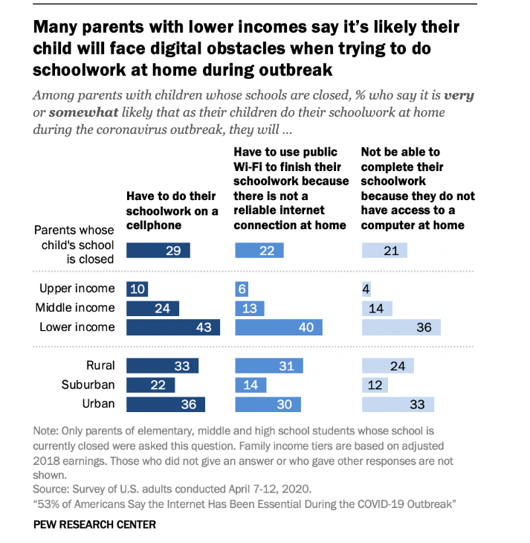
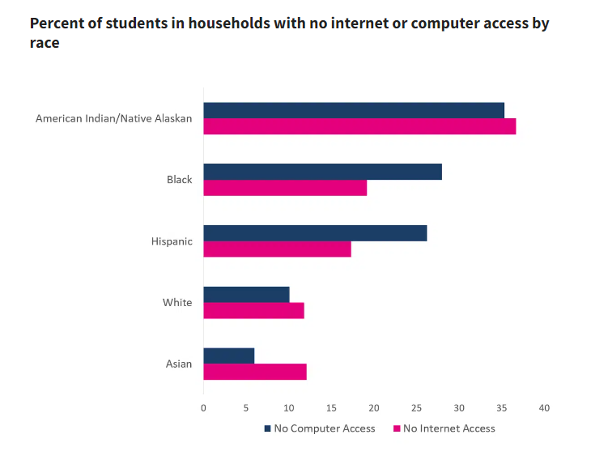
However
Vaansh Mansharamani
Not everyone has direct access to technology
[11]
[12]
Notes:
According to census data taken in 2020, 3.7 million students lack regular internet access at home.[10]
According to a poll conducted by Pew Research Institute in April 2020, 43% of students from low-income families had to use their phones to complete schoolwork, and 40% had to travel outside their homes in order to access WIFI. [10]
The graph on the right shows that during the pandemic, many students did not have access to optimal working conditions. Many were forced to use their phones or seek public Wi-Fi. The problem also disproportionately affected those in lower-income households.
The graph on the left was a visualization of 2020 census data on households with no internet or computer access by race. We can see American Indians, Blacks, and Hispanics were more likely to not have computer or internet access.

Slide 22
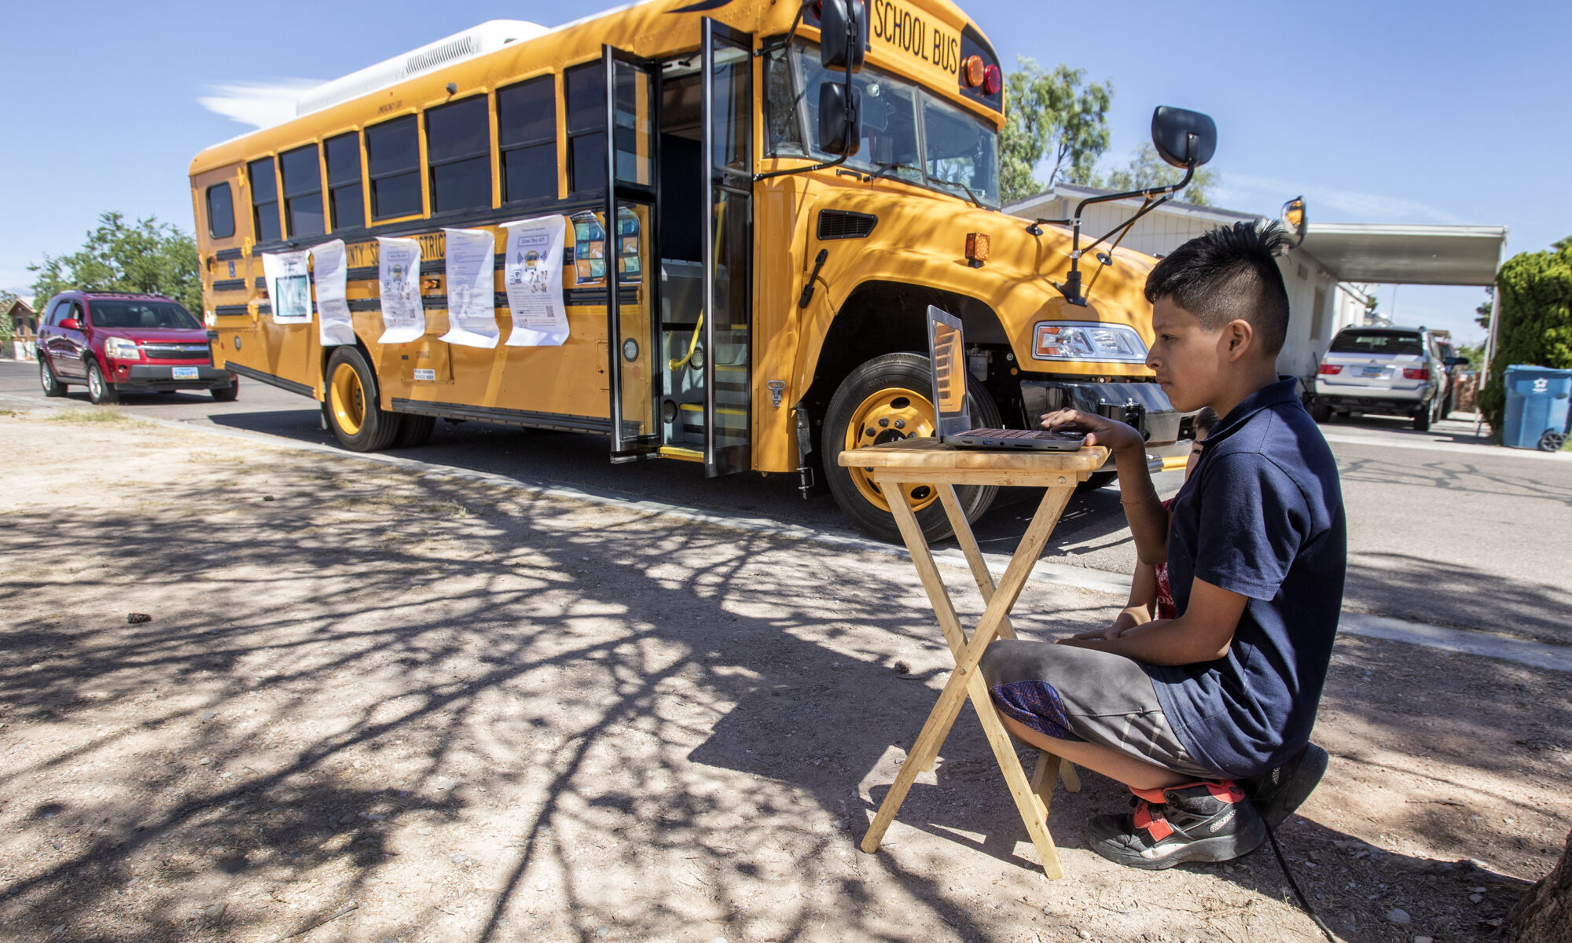
The school bus conundrum: An example of how low-Income Students lack access to modern technology
Vaansh Mansharamani
One-fourth of Adults in America do not have access to high-speed internet connection.[5]
727 devices used the WIFI from these busses from the high school district data.[5]
[5]
Notes:
During the pandemic buses like the one on the right were stationed to provide kids with internet for school[5]
As you can see from the picture these kids were studying by the side of the road in in-optimal learning conditions.
These students were not allowed on the buses, and forced to study like this even in harsh weather[5]
When technology becomes more important in school, students from low-income families may struggle to keep up with everyone else.[10]
We may see more stories of cases like this, where students continue to suffer without the resources many other kids in their class may have.

Slide 23
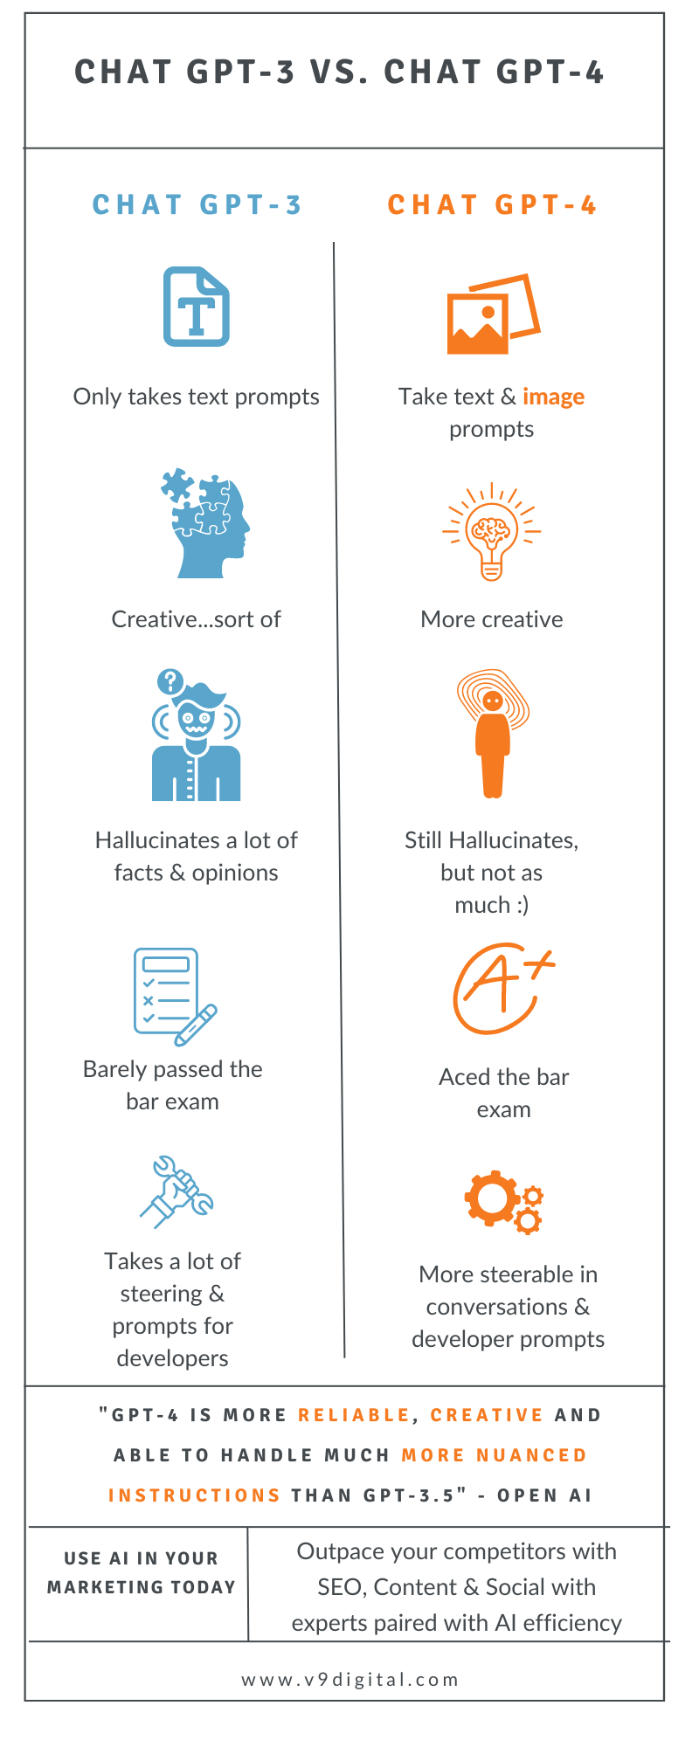
How Ai will strengthen this Divide
Vaansh Mansharamani
Many AI tools blocked by paywalls give a competitive advantage to those with more money[10]
Examples include GPT 4, Grammarly, Wolfram Alpha
Students or School Districts without access to Generative AI, may fall behind classmates and Schools with access to it.[6]
Gpt-3(free) vrs GPT-4(paid)[7]
Notes:
Let’s compare GPT 3.5, the free version, to GPT 4. The infographic on the right has all the information provided by OpenAI about GPT 4’s new capabilities.
According to the infographic, ChatGPT-4 can take image prompts, is more creative, experiences fewer hallucinations, and performs better on exams such as the bar. Each can give students a competitive edge in classes.[7] However, ChatGPT is hidden behind a 20-dollar-per-month paywall.[8] Students can pay to win a competitive advantage over their peers, thus gaming the system. Those without access to this technology may suffer compared to their peers.
According to a study on enhancing elementary students' mathematics performance, the overall effect size of AI interventions was found to be 0.351, which meant it had a positive impact on their math achievement. This suggests students without access to AI based education in classrooms will have a harder time than those with it.[9]

Slide 24
References
Vaansh Mansharamani
[1] Lee, J+ , Stalin, A*., Ngo, V*, Drzewiecki, K*, Trac, C**., & Ottmar, E. (2023). Show the flow: Visualizing students’ problem solving processes in a dynamic algebra notation tool. Journal of Interactive Learning Research. (2023)
[2] Lee, J+., Jindal, A*., Patki, S*., Norum.,R**., & Ottmar, E. A comparison of machine learning algorithms for predicting student performance in an online mathematics game. (2023)
[3] Ramakrishnan, A*., Zylich, B*., Ottmar E*., LoCasale-Crouch J*., Whitehill J*, Toward Automated Classroom Observation: Multimodal Machine Learning to Estimate CLASS Positive Climate and Negative Climate. (2020)
[4] Wei, Ling. “Artificial Intelligence in Language Instruction: Impact on English Learning Achievement, L2 Motivation, and Self-Regulated Learning.” Frontiers, Frontiers, 11 Oct. 2023, www.frontiersin.org/journals/psychology/articles/10.3389/fpsyg.2023.1261955/full.
[5] Valley, Jackie. “Nevada Interrupted: WIFI-Enabled Buses Bring Internet to Students Lacking Access at Home.” The Nevada Independent, The Nevada Independent, 19 May 2020, thenevadaindependent.com/article/nevada-interrupted-wifi-enabled-buses-bring-internet-to-students-lacking-access-at-home.
[6] Ede, Ethan. “Generative AI’s Potential to Inflate the Digital Divide.” Lightspeed Systems, 18 Mar. 2024, www.lightspeedsystems.com/blog/generative-ais-potential-inflate-digital-divide/.
[7] Henley, Natalie. “Chat GPT 3.5 vs Chat Gpt 4: What’s the Difference?” Volume Nine, 15 Mar. 2023, www.v9digital.com/insights/chat-gpt-3-5-vs-gpt-4/.
[8] GPT-4, openai.com/gpt-4. Accessed 22 Apr. 2024.
[9] Hwang, Sunghwan. “Examining the Effects of Artificial Intelligence on Elementary Students’ Mathematics Achievement: A Meta-Analysis.” MDPI, Multidisciplinary Digital Publishing Institute, 14 Oct. 2022, www.mdpi.com/2071-1050/14/20/13185.
[10] Perez, Katin Yovany. THE IMPACT OF LACK OF INTERNET AND TECHNOLOGY ACCESS ON STUDENTS’ ACADEMIC ACHIVEMENT: AN ANALYSIS OF THE UNITED STATES, 2023, repository.library.georgetown.edu/bitstream/handle/10822/1082701/Perez_georgetown_0076M_15437.pdf?sequence=1#:~:text=.
[11] Vogels, Emily A. “53% of Americans Say the Internet Has Been Essential during the Covid-19 Outbreak.” Pew Research Center, Pew Research Center, 30 Apr. 2020, www.pewresearch.org/internet/2020/04/30/53-of-americans-say-the-internet-has-been-essential-during-the-covid-19-outbreak/.
[12] “More than 9 Million Children Lack Internet Access at Home for Online Learning.” USAFacts, USAFacts, 5 Oct. 2023, usafacts.org/articles/internet-access-students-at-home/.

Slide 25
Computing Empowered Gender Equality
Simon Tong

Slide 26
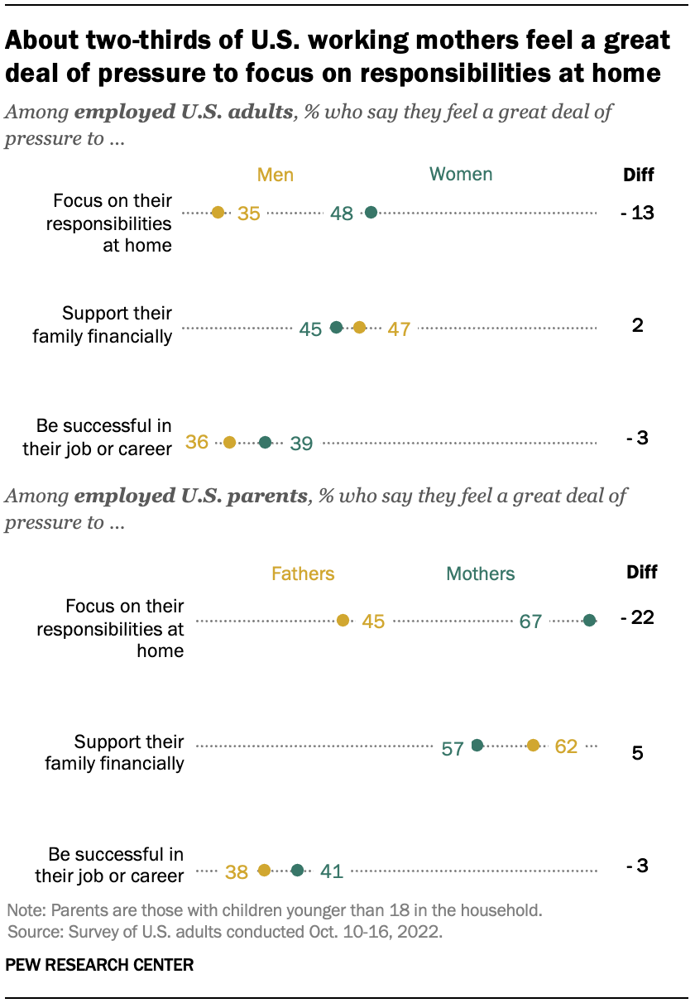
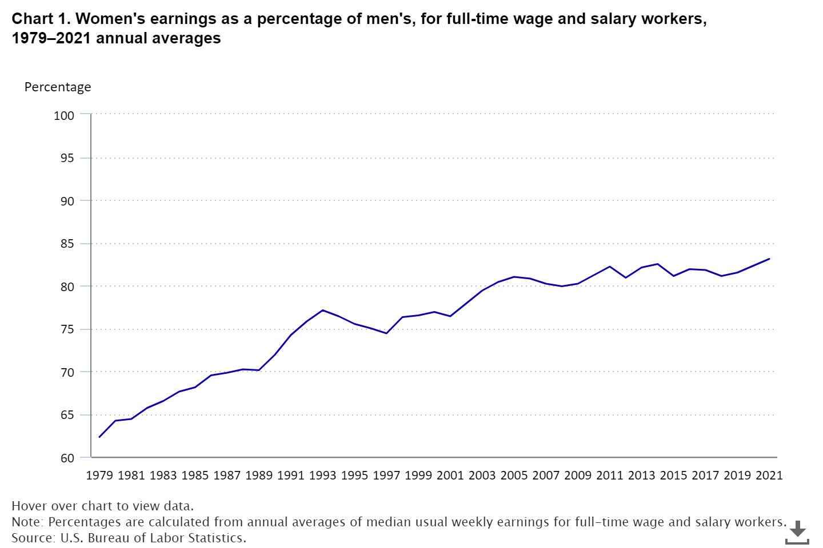
Historic Influence
Simon Tong
[2]
[3]
Notes:
Throughout our nation's history, discrimination has manifested across various areas, none more important than in the realm of wage disparities based on gender. The inception of the "Equal Pay Act of 1963" marked a pivotal moment, aiming to rectify the egregious underpayment of full-time female workers, who were previously denied equitable compensation necessary for sustenance. Before this act, companies refuse to pay full time women worker enough for them to sustain a living. This action have a significant impact that “tends to cause labor disputes, thereby burdening, affecting, and obstructing commerce;” [1]. The second chart shows that despite the passage of time, the trajectory of public opinion remains disconcerting, even 59 years post-legislation.[4] Because of this, girls are less confident in their maths, science and IT abilities, often due to or fuelled by societal and parental biases, and parents’ expectations.

Slide 27
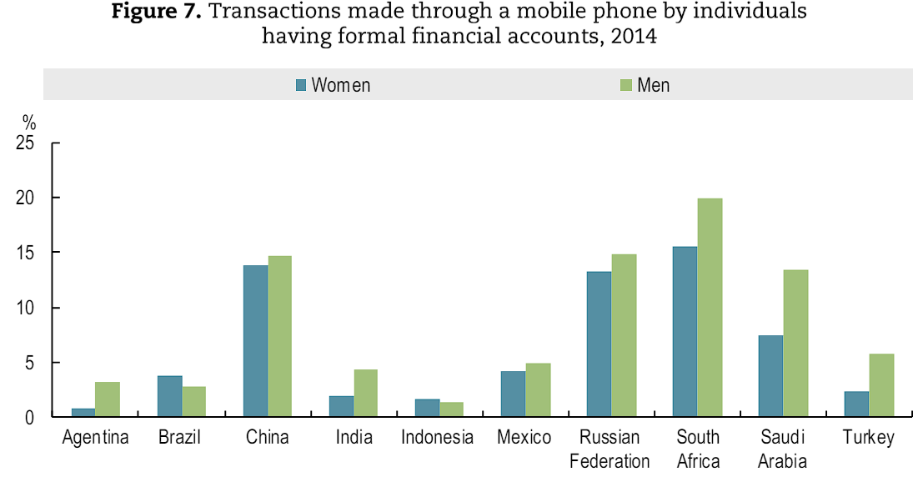
Changes in the 21th Century
Simon Tong
[4]
Notes:
However, the advent of modern computing technologies has heralded a transformative shift, presenting new opportunities open up for both women and men. in particular, women now possess the agency to pursue alternatives beyond traditionally labor-intensive sectors such as natural resources, construction, and transportation where they historically get discriminate for under productivity compared to men.[2] The emergence of technology-driven sectors offers a more inclusive landscape, where merit and skills supersede outdated gender stereotypes. The chart illustrates a compelling trend observed in numerous developing countries, women are engaging as actively as men in conducting financial transactions via mobile phones. With the proliferation of mobile banking and digital payment systems, barriers to entry in the financial sector are diminishing, offering women unprecedented access and agency in managing finances. This trend also suggests that with the right support and opportunities, women could emerge as formidable contenders in various fields previously dominated by men.

Slide 28
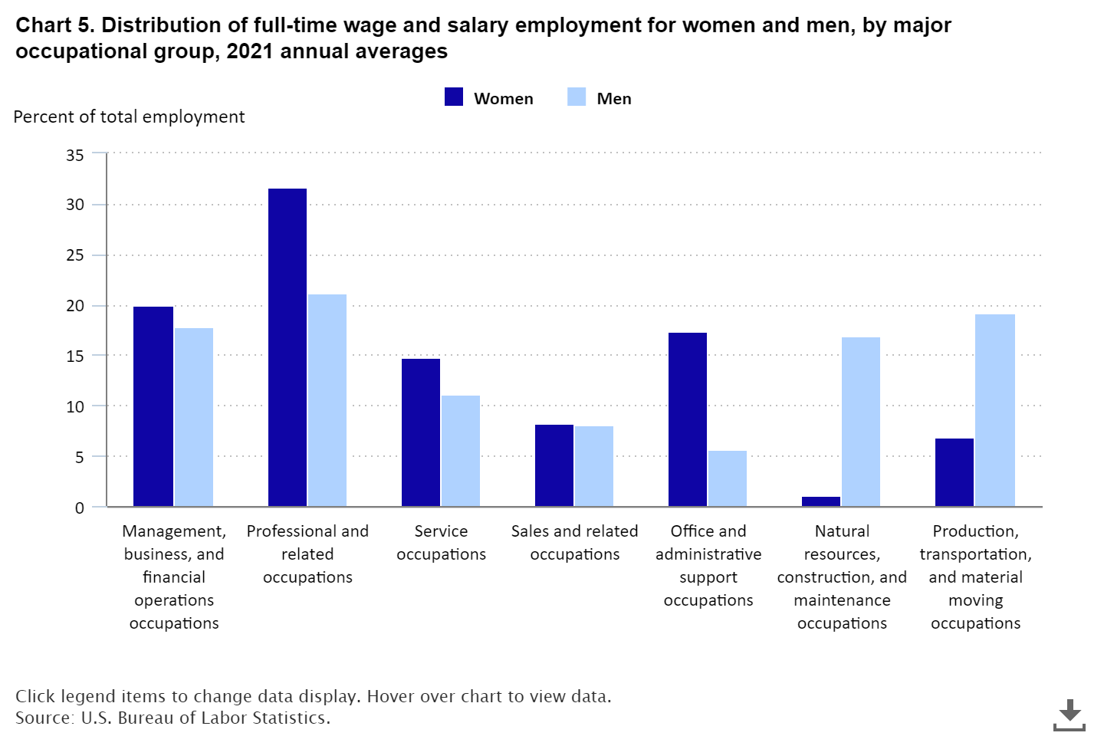
Effect of the Changes
Simon Tong
<Graphic as big as will fit>
[2]
Notes:
The impact of advanced computing technology is nothing short of remarkable. Upon the roll out of broadband expansion, the growth of self-employed women increased at an average of 2.3% annually. In contrast, areas without access to the National Broadband Network (NBN) experienced a mere 0.1% average growth in self-employment (NBN, 2018).[4] These technological innovations afford female workers greater autonomy and flexibility in balancing work and life responsibilities. However, it's crucial to recognize and address the potential risks associated with online platforms. Stalking, abuse, or harassment in the digital workspace must be actively confronted to ensure the safety and well-being of women workers. Implementing robust measures for protection and support is paramount in fostering a secure and inclusive environment for all individuals to thrive professionally.[4]

Slide 29
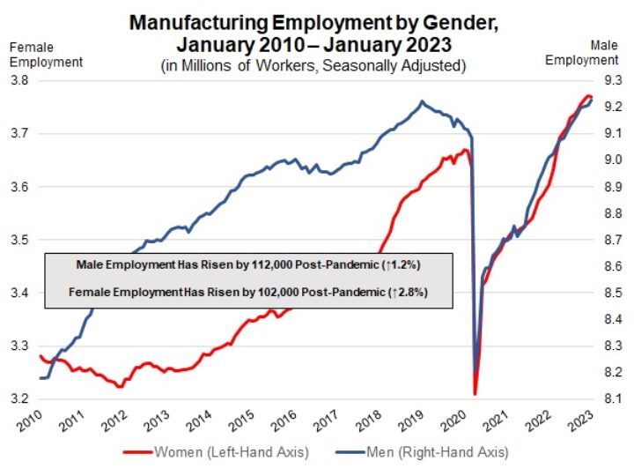
Future Challenges and Opportunities
Simon Tong
[6]
Notes:
The lacking of women participation in the economic has huge consequences, low and middle-income countries have lost an estimate of $1 trillion over the past decade, showing the urgent need to address gender disparities in access to and participation in digital technologies.[5] But things are changing, prior to the pandemic, a notable trend emerged as increasing numbers of women entered the workforce, particularly in sectors like manufacturing, where automation and technological advancements were gradually supplanting traditional mass labor practices. The chart illustrates a pronounced uptick in the rate of female employment within the manufacturing sector, outpacing that of men. A significant milestone was reached in late 2019 when female workers briefly outnumbered their male counterparts on U.S. payrolls[6]—a testament to the shifting dynamics within the labor force. However, gender discrimination remains in our society. This progress was disrupted by the pandemic, which precipitated a staggering amount of nearly 12 million women from the workforce, compared to the 10 million men affected.[5]

Slide 30
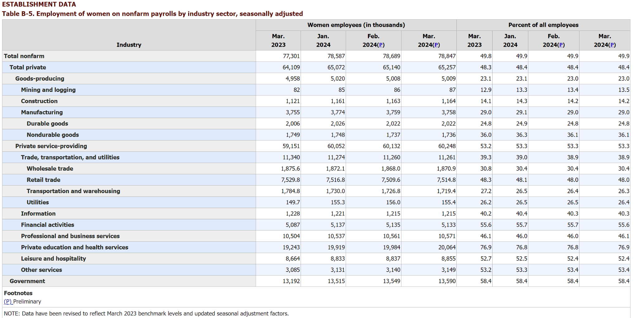
Conclusion
Simon Tong
[7]
Notes:
Computing technologies have paved the road for a more gender-equal future. The rise of automation has facilitated the replacement of traditionally labor-intensive tasks, mitigating discrimination in most circumstances. Advanced communication devices empowered women to work remotely, offering increased flexibility and enabling them to find a better balance between professional commitments and household responsibilities. As a result, more women are able to benefit from the advancement of computing technologies.

Slide 31
REFERENCES
Simon Tong
[1] "Equal Pay Act of 1963", U.S. Equal Employment Opportunity Commission, https://www.eeoc.gov/statutes/equal-pay-act-1963, (accessed 4/20/2024)
[2] "Highlights of women's earnings in 2021", U.S. Bureau of Labor Statistics, March 2023, https://www.bls.gov/opub/reports/womens-earnings/2021/home.htm, (accessed 4/20/2024)
[3] carolina aragão, "Gender pay gap in U.S. hasn’t changed much in two decades", Pew Research Center, March 1, 2023, https://www.pewresearch.org/short-reads/2023/03/01/gender-pay-gap-facts/, (accessed 4/20/2024)
[4] "Bridging the digital gender divide", OECD, 2018, https://www.oecd.org/digital/bridging-the-digital-gender-divide.pdf, (accessed 4/20/2024)
[5] "Power on: How we can supercharge an equitable digital future", unwomen.org, 24 February, 2023, https://www.unwomen.org/en/news-stories/explainer/2023/02/power-on-how-we-can-supercharge-an-equitable-digital-future, (accessed 4/20/2024)
[6]NAM News Room, "More Women Join the Manufacturing Workforce", March 9, 2023, nam.org, https://nam.org/more-women-join-the-manufacturing-workforce-21314/, (accessed 4/20/2024)
[7]"Employment of women on nonfarm payrolls by industry sector, seasonally adjusted", U.S. Bureau of Labor Statistics, April 05, 2024, https://www.bls.gov/news.release/empsit.t21.htm, (accessed 4/22/2024)

Slide 32
Class 11 The End
Keith A. Pray
socialimps.keithpray.net
Notes:
If there’s time and we didn’t get to it:
Kickstarter Charter
https://www.kickstarter.com/charter?ref=about_subnav
CGP Grey
Humans Need Not Apply (15:00) – 2014-08-13
http://www.youtube.com/watch?v=7Pq-S557XQU
Last access 2016-04-22
These 3D printed homes can be constructed for $4,000 (3:00 – 2018-04-02)
http://www.businessinsider.com/3d-printed-homes-constructed-icon-new-story-tech-charity-4000-dollars-2018-3
https://www.youtube.com/watch?v=SvM7jFZGAec (1:28)
Last access 2018-04-22
Look at:
BBC Intelligent Machines
http://www.bbc.com/news/technology-33978561
BBC Likelihood of robot taking your job
http://www.bbc.com/news/technology-34066941

Slide 33
Remote With Zoom
Turn your camera on
Sign in with First and Last Name
Stay muted unless you are going to speak
Use the raise your hand feature to ensure a turn
Wait until the end of student presentations to ask questions
Write them down so you don’t forget

