Slide 1
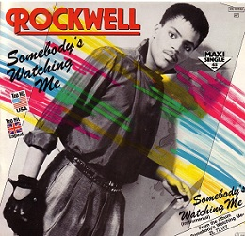
Class 7
Privacy and Government
Keith A. Pray
socialimps.keithpray.net
Notes:
After this class we will be half done with the course… very sad I know.
Somebody’s Watching Me (1984) – Rockwell (3:36)
https://www.youtube.com/watch?v=7YvAYIJSSZY
Be the envy of all your classmates if you know the band and/or year:
Rockwell (1984) Michael Jackson sings chorus and Jermaine Jackson on backing vocals.

Slide 2
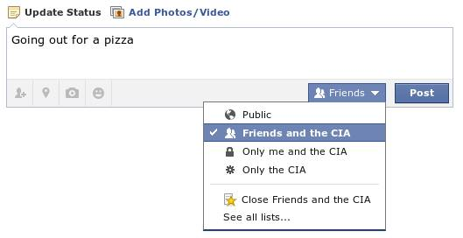
Overview
Review
Assignment
Students Present
Notes:
Review before debate in case anyone unsure of something in reading.
TODO: Image source?
Look at ACM TechNews if time

Slide 3
My Reading Notes
pp. 281 Great Nixon quote
pp. 278 Any examples since 1995? Arrests, altering and deleting records are violations of privacy?
pp. 287 Why not try to verify and correct records?
pp. 288 “Today” but source from 2009. Figure does not show # cameras increasing. 300 times = frames, locations, …?
pp. 289 Public opinion change since 2012?
pp. 294 “Carnivore…” what’s in a name?
pp. 297 Stored Comms Act, any news since 2010?
pp. 298 CALEA update since 2005?
pp. 301 Google’s Eric Schmidt quote seems naïve
pp. 306 Shouldn’t credit card issuers take “reasonable steps” to verify identity all the time?
pp. 307 Any syndromic system successes since 2002?
pp. 308 Ch. 5 Target example on pp. 256. How many names on no fly lists now compared to 2014?
pp. 311 Confusing false positive and negative explanations. Not correct use of “Orwellian”
pp. 312 Have REAL-ID requirements been enforced now? Any stories since 2020?
pp. 315 E-ZPass now mandatory on Mass Pike…
pp. 321 # 17 Interesting but not computing related
End of Chapter questions: 1, 18
pp. 331 “Since I have done nothing wrong, why should the government be investigating me?”
Notes:
Let’s debate!

Slide 4
Debate Ground Rules
Before Debate
10 minutes to converse with your team
Share argument points, counter points, and responses
Share experiences, especially in different countries, cultures, situations
Decide who will:
  Go first
  Respond to which points from opposing side
During Debate
1 turn per person until everyone on your team has spoken
Stand up when speaking
Try to keep remarks to 30 seconds (each side elect a timekeeper)
Notes:
“National ban on facial recognition surveillance for law enforcement” Debate
If in class:
Stand up when speaking
30 second limit (elect a timekeeper)
If Remote:
Add “(YES)” or “(NO)” to the end of your name in Zoom to show your side
Previous:
Should law require you to use an official ID for Internet access
National ID or Not Debate

Slide 5
Group Quiz
List two problems with using biometrics for identification.
List two advantages of using biometrics for identification.
Describe two tools people can use to protect their privacy on the Web.
For each of the 4 categories of Daniel Solove’s privacy taxonomy give an example not listed in the book.
Notes:
Only if we have time.
Information Collection
Information Processing
Information Dissemination
Invasion

Slide 6
Overview
Review
Assignment
Students Present

Slide 7
Assignment – Group Project
Catch up on reading
Group Project
  Analyze Movie for all topics covered to date
  Add analysis of computing technology portrayed to web site
  See group project slide deck for more
  Frequent interaction with your group members is key to success!
-----
Mid Term Survey on Canvas → Quizzes
Notes:
Movie group project:
List of computing technologies portrayed in movie on website
Categorize computing technologies as existing, future, emerging, impossible or plausible with rationale
Analyze movie for all topics covered to date

Slide 8
Overview
Review
Assignment
Students Present

Slide 9
Does government use of AI enabled systems lead to a widening of social inequality?
Alex Li
Notes:
Say the title Does government use of AI enabled systems lead to a widening of social inequality?
Then proceed next slide

Slide 10

How is such ai systems made?
Alex Li
Most AI systems used today such as ChatGPT, BARD, or specially trained versions of those by the government, are based off Large Language Models.
LLM is a computer program that has been fed lots of data to be able to recognize and interpret human language or other types of complex data.[5]
[6]
Notes:
Say that most companies use LLM today. And explain LLM. LLM is a computer program that has been fed lots of data to be able to recognize and interpret human language or other types of complex data.

Slide 11
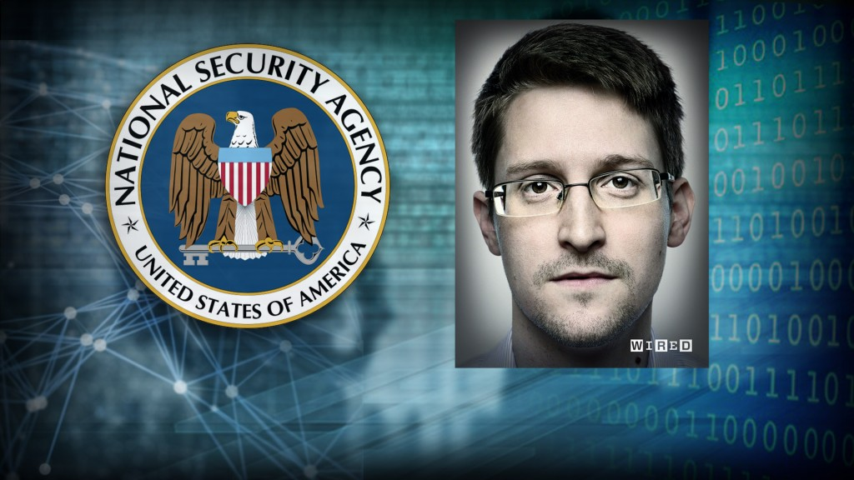
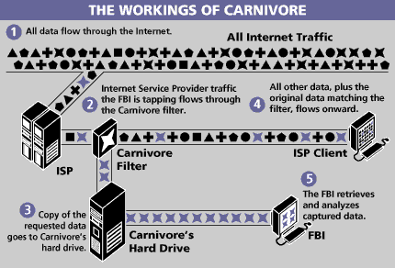
Historical govt covert spying on citizens
Alex Li
In 2013, Edward Snowden leaked NSA classified info that the NSA was paying U.S. private tech companies for access to their communications networks, effectually spying.[1]
In the late 1990s, the FBI developed the Carnivore Surveillance System, which is a packet-sniffing software that can find the sender or the receivers IP address. [4]
Notes:
Additional Point: One can Imagine with AI technology, as well as the vastness of data in the world today, as well as faster internet rates, this spying by the government is more prevalent today.

Slide 12
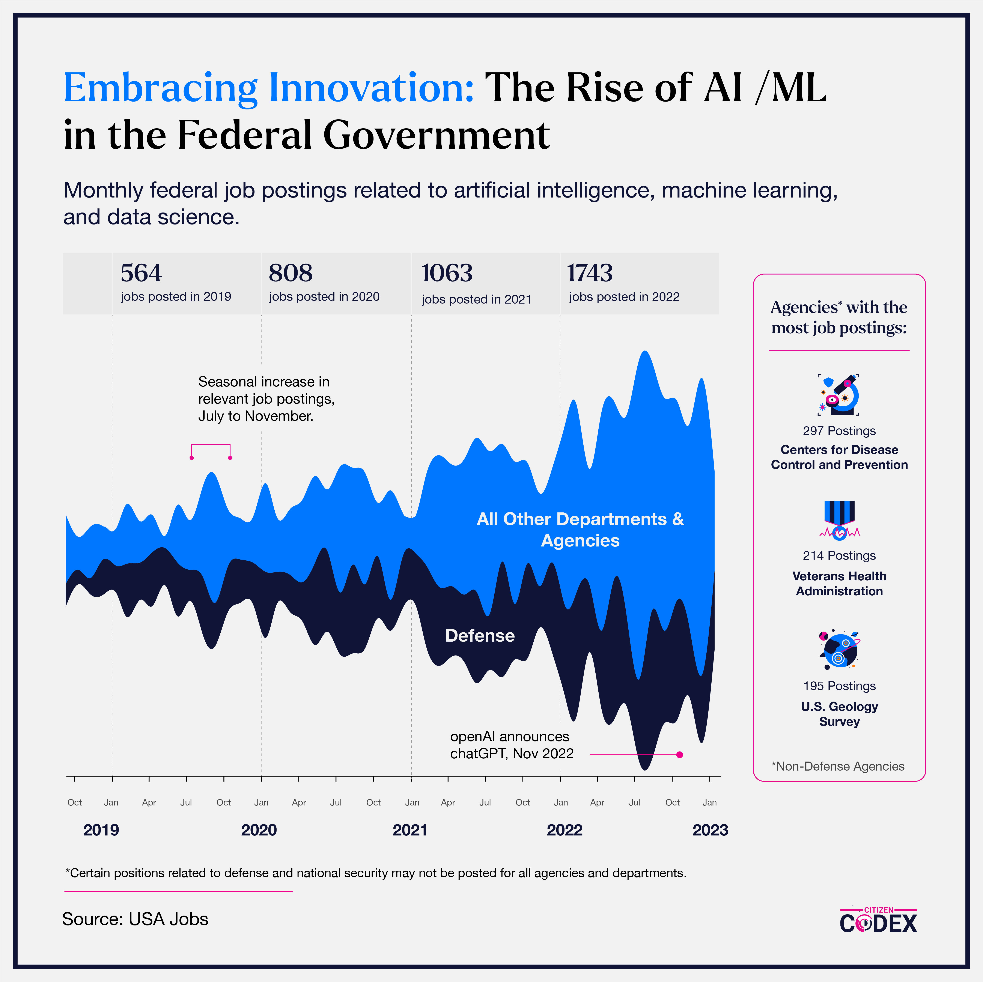
Rise of AI usage in Govt
Alex Li
We see an overall increasing trend in the rise of AI/ML job postings in the Federal Government.[2]
This shows a widespread acceptance of AI tech in the Government, and in the following slides, we will further explore cases of AI use in the Government.
Notes:
Mention the picture provided by USA Jobs. Mention trend of overall increasing in AI/ML jobs in Fed govt.
Mention Stats: in 2019, there were 564 jobs related to AI ML in Fed govt, compared to in 2022, there were 1743 jobs related to AI ML in Fed govt
Be sure to say that we further explore topic in next slides.

Slide 13
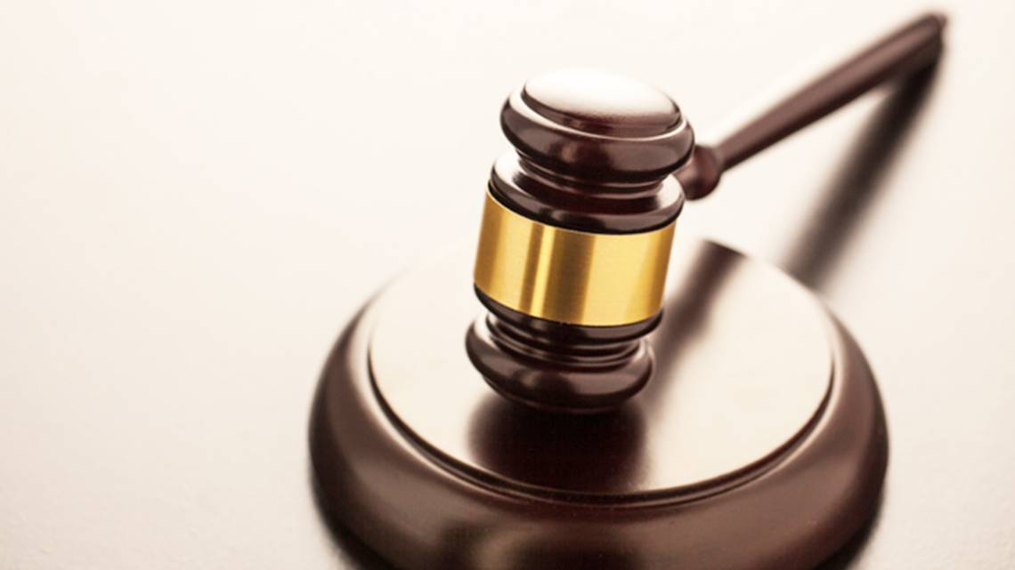
Instance of AI failure in court case
Alex Li
A Man was raped in jail after AI technology wrongfully identifies him in robbery[3]
Putting such trust on technology has its limitations, as shown in this case, where the outcome was unfortunate.
It can be argued that AI can be trained in a way where we skew analysis of stuff like this, such that the actual criminal can get away.
Notes:
Last Point: the AI can be trained in the way such as . AI /LLM is based on data, theoretically, one can very easily inject a lot of data in their favor towards a factor such as facial composition of a typical criminal, in order to get out of a case against the criminal.

Slide 14
does Government usage of ai tech lead to social inequality?
Alex Li
There is little data supporting negatives of using AI tech in exploiting social equality.
In the technological age, personal data is easily accessible, and this may have advantages and disadvantages.
Research suggests AI systems are able to have skewed results from data inputs, or other forms of intervention.
Overall Takeaway:
AI's significant role in our daily lives and government operations necessitates stringent barriers and security measures to ensure its responsible use. This is crucial for building public trust(the backbone of society) and addressing social inequalities, such as corruption issues like bribes to judges.
Notes:
Be brief on left side stuff. Focus on CONCLUSION, TAKEAWAY: Say need better security(cybersecurity) Public Trust is the BACKBONE OF SOCIETY AI IS FUTURE WHETHER LIKE OR NOT
Privacy/ keeping individual data private also has numerous harmful effects. It provides people with a way of covering up actions that are immoral or illegal.

Slide 15
References
Alex Li
[1] PBS, Snowden and supporters fear Americans will lose interest from ‘NSA fatigue’, (Aug 13, 2014), https://d3i6fh83elv35t.cloudfront.net/newshour/app/uploads/2014/08/snowden-1024x576.jpg (Mar 26, 2024)
[2] Nicole Varela, Maxwell Titsworth, Martha Williams, Biniam Gebre, The Rise of AI In the Federal Workforce, (Jul 24, 2023), https://www.citizencodex.com/our-stories/ai-in-the-federal-workforce (Mar 26, 2024)
[3] Jennifer Rodriguez, Man raped in jail after AI technology wrongfully identifies him in robbery, suit says, (Jan 23, 2024), https://www.startelegram.com/news/state/texas/article284595930.html (Mar 26, 2024)
[4] Ted Bridis and Neil King Jr, FBI Says Carnivore Tool Won't Eat Up Privacy, (Jul 20, 2000), https://www.wsj.com/articles/SB964048547114464451 (Mar 26, 2024)
[5] Cloudflare, What is a large language model (LLM)?, (Mar 4, 2024), https://www.cloudflare.com/learning/ai/what-is-large-language-model/ (Mar 26, 2024)
[6] Ahmed Jawed, The LLM Revolution: How AI Language Models Are Transforming Lives, (Aug 7, 2023), https://www.linkedin.com/pulse/llm-revolution-how-ai-language-models-transforming-lives-ahmed-jawed/ (Mar 26, 2024)

Slide 16
Who are you? Why Verification online doesn’t work
Silas Joy

Slide 17

Twitter verification is unavailable
Silas Joy
The blue checkmark launched in 2009 due to a lawsuit from baseball manager Anthony La Russa [1]
After that, it existed as a way for high profile users to be differentiated from anyone claiming to be them.
While the system worked for the most part, due to high numbers of twitter users requesting verification [2], it was not available to most users, until 2022.
Notes:
In 2009, Anthony La Russo manager of the St. Louis Cardinals, sued twitter over an account that was parodying him. In response to this lawsuit, twitter thought to launch “verified accounts”, which happened when twitter would contact high profile accounts to confirm it was them. After twitter removed the account, the lawsuit was settled out of court.
Since then, the verification system had gone through multiple small revisions, including allowing users to request verification rather than having to wait for twitter to do it, but the system as it stood ended in November 2022, when Elon Musk bought twitter and rebranded to X.

Slide 18

X verification isn’t verifiable
Silas Joy
To bring down the old “lords and peasants” system that was in place when he bought twitter, Elon Musk introduced the ability to pay for verification with a monthly fee [3].
The problem with this new “verification” system is that it didn’t verify anything, and cause significant problems for both users and companies [4]
Notes:
In 2022 when Elon Musk bought twitter, he recognized the flaws in the current verification system, mainly that it was inaccessible to most users. To “solve” this problem, he reinvented a subscription that already existed for twitter users to have extra features, Twitter Blue, and gave subscribers a verification check, whether they had one before or not. While this did provide more people access to verification, it had a serious problem: it didn’t verify anything. Anyone could spend their $8 and look almost just as real as celebrities and companies on the platform. This let to an incident where Eli Lilly, a pharmaceutical company that had a verified twitter account, was impersonated by someone who paid for the subscription. After a single post that read “we are excited to announce that insulin is free now”, Eli Lilly’s stock dropeed 4.37%, erasing over $15 Billion in market cap [4]

Slide 19
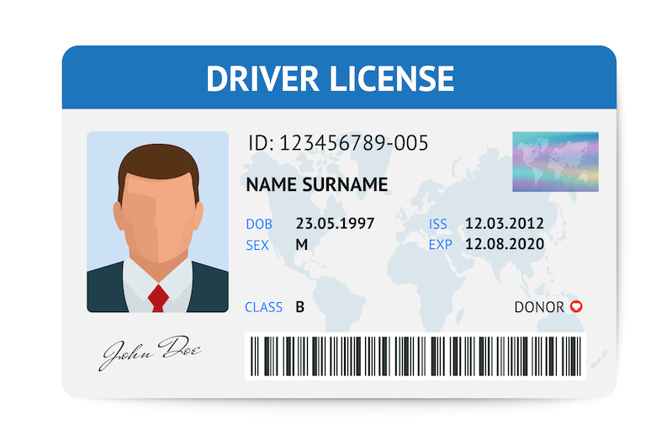
Government ID Online is untrustworthy
Silas Joy
In some cases where you have been locked out of your account, Facebook will request that you send in a picture of your government ID, or similar form of identification [5]
With a history of data leaks, many find the idea of giving Facebook or other sites their ID to be worrying [6]
In the past 2 years, 8 states have passed laws requiring age verification to view adult content, with potentially more on the way [7,8]
Notes:
In some cases (Not defined specifically what cases), Facebook will require you to upload a government ID, or two documents that contain your name, and one that has your date of birth or photo. This method of verification, while seemingly more secure than some others, has two major flaws. Firstly, it can still be cracked, you can have fake ids with something like a driver's license, or you could even get your hands on a fake library card, which is much less regulated and could be more easily faked. The second major problem is that for this to work, users need to trust facebook with a copy of their ID. With a history of leaking user data, that may be more then a small task.
Recently, multiple laws in different states have passed requiring ID online to access adult content. Done in an attempt to protect children from harmful content, most of these laws require some sort of age verification on any site that has more then one third adult content. While this isn’t quite the same as previous examples, as the goal isn’t to have an account tied to you, just to confirm your age, it still has the same dangers. With a history of having malware, users would be right not to trust those sites with important information.

Slide 20
References
Silas Joy
[1] MG Siegler, Hey There! Tony La Russa Is Suing Twitter (TechCrunch, June 4, 2009) https://techcrunch.com/2009/06/04/hey-there-tony-la-russa-is-suing-twitter/ (Accessed April 5, 2024)
[2] Andrew Hutchinson, Twitter Pauses Public Requests for Profile Verification, Just a Week After Re-Launch (SocialMediaToday, May 28, 2021) https://www.socialmediatoday.com/news/twitter-pauses-public-requests-for-profile-verification-just-a-week-after/601017/ (Accessed April 5, 2024)
[3] Elon Musk, Twitter Blue Announcement Tweet (Twitter, November 1, 2022) https://twitter.com/elonmusk/status/1587498907336118274?s=20 (Accessed April 5, 2024)
[4] Kevin Jiang, Eli Lilly loses billions in market cap after ‘verified’ Twitter impostor promises free insulin (The Star, November 11, 2022) https://www.thestar.com/business/technology/eli-lilly-loses-billions-in-market-cap-after-verified-twitter-impostor-promises-free-insulin/article_ec4e0e8c-13ed-5193-97e9-7589daf78e19.html (Accessed April 5, 2024)
[5] Facebook, Types of IDs that Facebook accepts (Facebook, © 2024) https://www.facebook.com/help/159096464162185 (Accessed April 5, 2024)
[6] Michael X. Heiligenstein, Facebook Data Breaches: Full Timeline Through 2023(Firewall Times, October 5, 2023) https://firewalltimes.com/facebook-data-breach-timeline/(Accessed April 5, 2024)
[7] John Hanna, Sean Murphy, Kansas moves to join Texas and other states in requiring porn sites to verify people’s ages (AP News, March 26, 2024) https://apnews.com/article/internet-pornography-age-verification-states-2ad9939bb95ccc15126419b38067be94 (Accessed April 5, 2024)
[8] Evan Dashevsky, Just how much malware is on free porn sites? (PCWorld, April 17, 2013) https://www.pcworld.com/article/451366/just-how-much-malware-is-on-free-porn-sites.html (Accessed April 5, 2024)

Slide 21
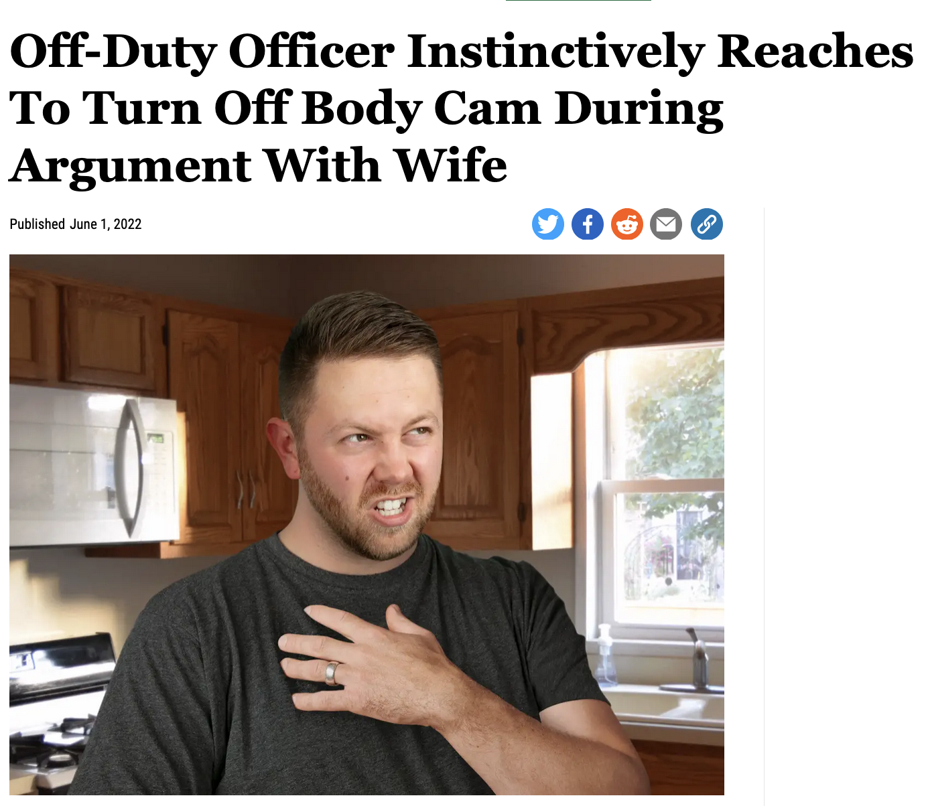
Police
Body Cam Sham
April Zingher
Notes:
This is my presentation on the past and future of police body cameras! To the right is an Onion article with a bit of dark humor that connects to my later arguments.

Slide 22
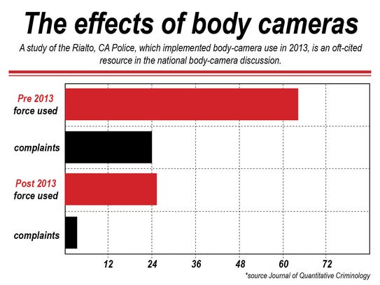
Early studies show decreased use of force...
April Zingher
The first study on body cameras, and one of the most cited, was in Rialto, CA, in 2013.^{[6]}
As can be seen in the graph, the force used and complaints after instituting body cameras both dropped significantly.
However, this finding has not been replicated in wider results.
Notes:
At first, studies showed police force decreased, especially this remarkable difference shown in this study from 2013. This is often cited in pro-body camera arguments as an indication, but as we’ll see later, this drop in use of force has not been replicated in later studies. Information from

Slide 23
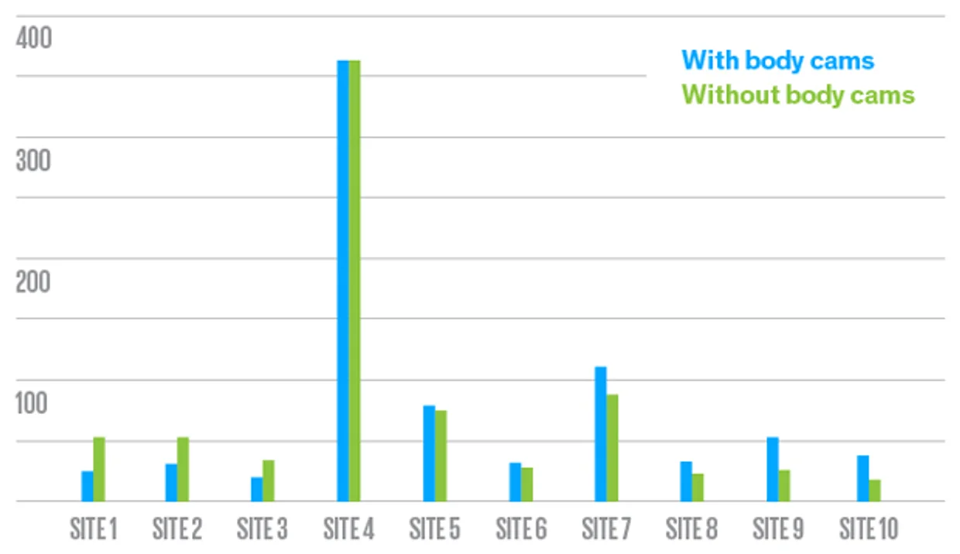
...but after changes in study methodology, they seem to have a mixed effect.
April Zingher
Later studies not only did not find this consistent decrease in force, but one study actually had each site wildly vary.^{[6]}
Over a full decade after the Rialto study, it is still unclear whether body cameras overall lower police use of force, but overall, police killed 1,096 people in 2022, compared to 958 in 2016, a year body cameras became more widespread.^{[4]}
Notes:
As can be seen in this image, a later study at 10 separate sites had wildly mixed results, where some police departments had relatively similar uses of force before and after, some increased significantly, and some decreased significantly. It is unknown overall how body cameras affect policing, because of how wildly these studies vary.
Information from Sources #5 and #6.

Slide 24
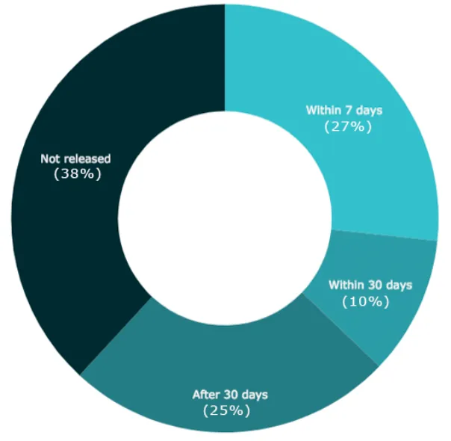
Police obfuscate body cam footage...
April Zingher
A 2017 study found that almost 4 in 10 fatal shootings by police that year were never released, while many were released long after the shooting.^{[5]}
In addition, it found laws in Texas stating body cam footage may not be released to the public until investigations are over, and in North Carolina stating a court order is required even if police want to release the video.
So, the solution is just to pass laws forcing it to be released, right?
Notes:
A Campaign Zero study in 2017 showed almost 4 in 10 fatal police shootings caught on body camera never had footage released. Those laws in Texas and North Carolina are currently still in place, but even if the release laws change, as policing has changed so much since 2017, we face new problems, which I’ll cover in the next slide.
https://campaignzero.org/research/what-happens-to-body-cam-footage-after-fatal-police-shootings/

Slide 25

... and now, they’re editing footage before release.
April Zingher
Herman Whitfield III was killed by Indianapolis police officers on April 25, 2022, after his family had called for an ambulance but police came instead.^{[4]}
The Indianapolis Metropolitan Police Department released a heavily edited video removing footage of Whitfield saying “I can’t breathe” while in a deadly restraint.
The department said “IMPD, as a general rule, does not release such documents without a subpoena.” and has still not released the unedited footage.
Similar editing occurred in the killing of 13-year-old Adam Toledo with his hands up (charges dropped) and 41-year old Jesus Crosby for holding nail clippers (charges dropped).
Notes:
Herman Whitfield III was a pianist, and he was tased by Indianapolis police and held in a restraint that caused him to asphyxiate; evidence of this was removed by police to make their case appear more sympathetic. Adam Toledo, who was 13, was killed by police while holding his hands up, but the body camera footage was edited to indicate he was still holding a gun. Jesus Crosby was holding nail clippers, which were obscured by the final body camera footage to seem like a knife. The charges for the officers killing both of them were dropped.
Information comes from source #4, https://www.huffpost.com/entry/body-camera-footage-trauma_n_645278bfe4b0dac8fca1f1d8.

Slide 26

Tortuguita: when even unedited clear body camera footage doesn’t matter...
April Zingher
In January 2023, a “forest defender” and eco-anarchist protesting “Cop City” was shot 57 times by police.^{[2]}
Only one police body camera was made available, indicating officers shot each other as well.
An autopsy showed they had their hands raised, undermining police self-investigation.
Still, the officers will not be charged. The prosecutors said the killing was "objectively reasonable under the circumstances of the case."
Notes:
Manuel Esteban Paez Terán, also known by their nickname Tortuguita, was an environmental protester, protesting “Cop City”, a planned police training facility I’ll cover in the next slide. They were accused of shooting an officer , and while eight different officers shot them 57 times, footage from only one body camera was made available, in which an officer said “you shot your own guy”. The police said they had a gun, but an autopsy showed they were sitting with their hands in the air before they died. Still, despite all this evidence, the officers won’t be charged for any wrongdoing, which has sparked massive protests.
Sources are #2 and #6.

Slide 27
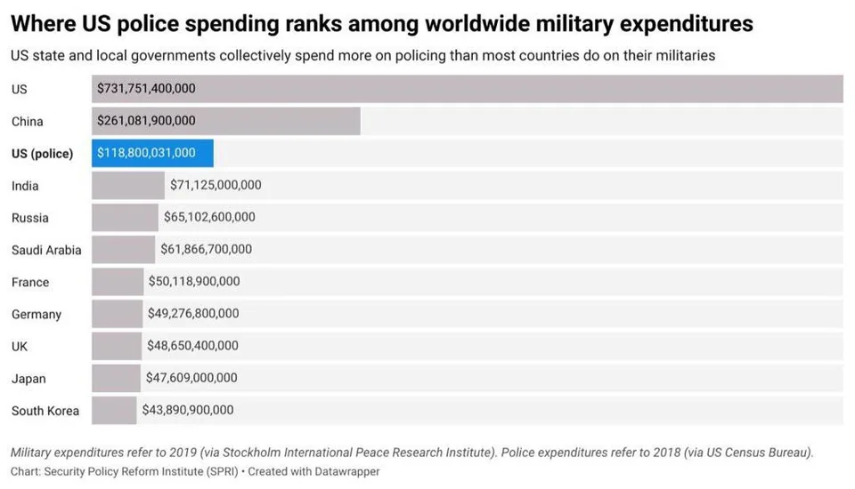
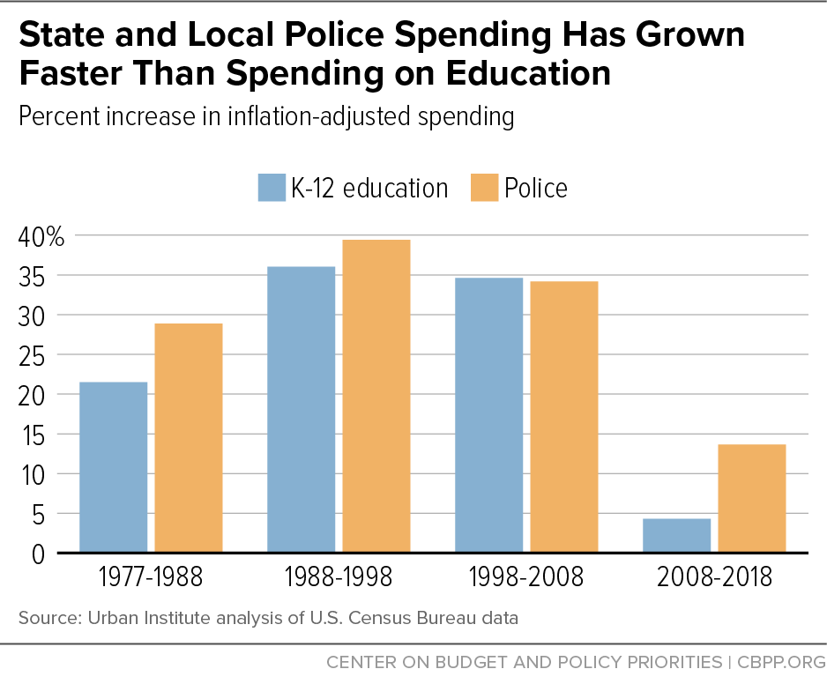
...and why what they were protesting shows the failure of “police reform”, including body cams.
April Zingher
Since the 2020 protests, the conversation has been shifted to “police reform” and “police training” rather than “defund the police”.^{[7]}
Recent studies show that this spending, including on body cameras, could be spent on social services and reduce overall crime significantly more than spending on police.
This police training often means billions of dollars for military equipment, and in Atlanta, it means destroying a vital forest near poor neighborhoods for a $90 million “urban training facility”.^{[2]}
61 protestors for Cop City have been charged with RICO, meant for prosecuting racketeering and mob activity, but accused of “anarchist ideology” and handing out pamphlets.
Notes:
Over time, as the Black Lives Matter protests have faded from public discourse, the conversation around police has shifted to reforming and training the police, including body cameras, rather than lowering police budgets to invest in education and healthcare to prevent crime. The police budgets have grown faster than education though, to what would be the third largest military budget in the world. This includes billions for military equipment, and destroying the Weelaunee forest in Atlanta deeply important in preventing floods to build an urban training facility for police, right next to poor neighborhoods. Instead of arresting police who killed Tortuguita, 61 protesters have been charged with racketeering, using evidence like having anarchist views and handing out pamphlets. Overall, the use of body cams is part of this militarization of police rather than a reduction.
Source for this slide is #1 and #7.

Slide 28
REFERENCES
April Zingher
[1] Umansky, E., & Farooq, U. (2023, December 14). How police have undermined the promise of body cameras. ProPublica. https://www.propublica.org/article/how-police-undermined-promise-body-cameras
[2] Akbar, A.A. (2023). The Fight Against Cop City. Dissent 70(2), 62-70. https://doi.org/10.1353/dss.2023.0011.
[3] Critics question whether body cameras have lived up to their promise in D.C. WAMU. (2019, October 22). https://wamu.org/story/19/10/22/critics-question-whether-body-cameras-have-lived-up-to-their-promise-in-d-c/
[4] News, B. (2023, May 8). “It made me sick”: Body camera footage creates more trauma after a police shooting, and there’s little evidence it leads to accountability. HuffPost. https://www.huffpost.com/entry/body-camera-footage-trauma_n_645278bfe4b0dac8fca1f1d8
[5] What happens to body cam footage after fatal police shootings?. Campaign Zero. (2018, March 1st.). https://campaignzero.org/research/what-happens-to-body-cam-footage-after-fatal-police-shootings/
[6] Ariel, B. (2023, April 21). Do police body cameras really work?. IEEE Spectrum. https://spectrum.ieee.org/do-police-body-cameras-really-work
[7] Jacobs, L. A., Kim, M. E., Whitfield, D. L., Gartner, R. E., Panichelli, M., Kattari, S. K., ... & Mountz, S. E. (2021). Defund the police: Moving towards an anti-carceral social work. Journal of Progressive Human Services, 32(1), 37-62. https://www.tandfonline.com/doi/abs/10.1080/10428232.2020.1852865
Notes:
Here are my references! Each slide has notes about which is used.

Slide 29
what works well Online With Zoom
Sign in with First and Last Name
Stay muted unless you are going to speak
To speak use the raise your hand feature
To answer yes/no questions use the “yes” ”no” buttons
Turn your camera on
Wait until the end of student presentations to ask questions
  Write them down so you don’t forget

Slide 30
Class 7
The End
Keith A. Pray
socialimps.keithpray.net
Notes:
Look at ACM TechNews if time
This is the end. Any slides beyond this point are for answering questions that may arise but not needed in the main talk. Some slides may also be unfinished and are not needed but kept just in case.

