Slide 1
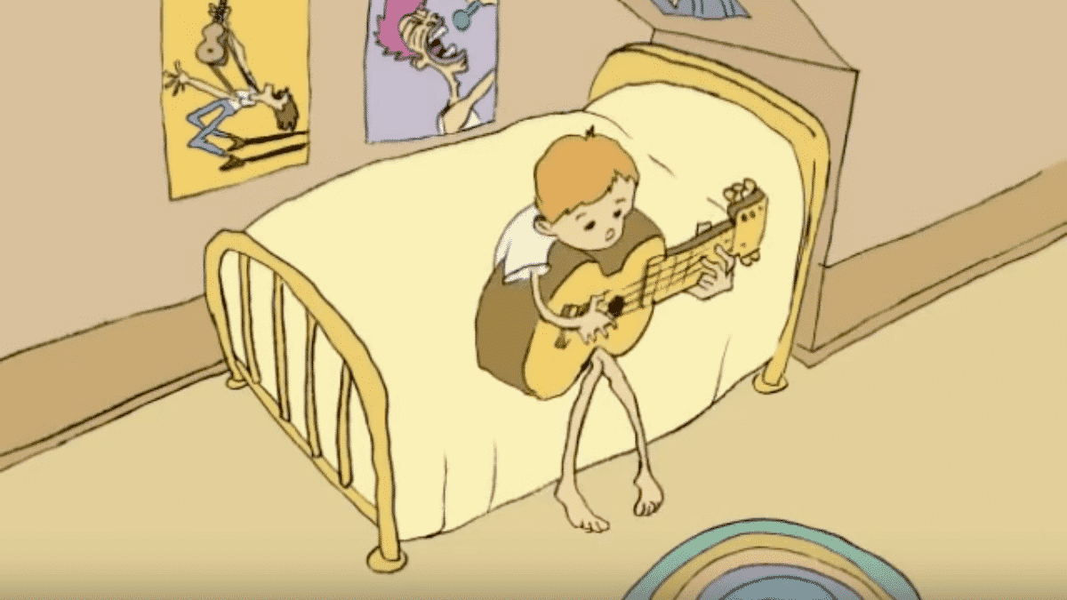
Class 5 Intellectual Property
Keith A. Pray
socialimps.keithpray.net
Notes:
Weird Al Yankovic “Don’t Download This Song” (3:53) 2006-08-21 released exclusively as digital download
https://www.youtube.com/watch?v=zGM8PT1eAvY
Some Analysis Points:
- Slippery Slope Fallacy - CDs were most common way to obtain music - Winner take all society
- Virtue ethics, guilt, shame

Slide 2
Papers
Use template, saves time
Quantify
Not terms like: less, more, a lot, huge, great, big, tiny, drastic, quicker, faster, easier, etc.
Avoid absolutes
Terms like: all, none, always, never
Difficult to prove, easy to show false
Cite as specified [1]
Read paper aloud to proof
http://socialimps.keithpray.net/assignments/paper-guidelines/
Notes:
Save for next time:
Define terms
Quantify
Not terms like: less, more, a lot, huge, great, big, tiny, drastic, etc.
Avoid absolutes
Terms like: all, none, always, never
Difficult to prove, easy to show false
Read paper aloud to proof
Read assignment
many time lines missing (and space used describing history instead of providing argument)
many conclusions did not answer prompt
Be sure to put quotes around entire quote
State a strong, clear conclusion
First statement preferred
Provide Counter Point and Rebuttal
Counter Point and Rebuttal should directly relate
Print 2 sided and save a tree
Hyperbole is the best thing ever!
but not in these papers
Be wary of counter point strawman fallacy
Text book is not a primary source
Use template, saves time
Beware of fallacies
Avoid blogs, encyclopedias, and text book. These are generally not primary and high quality sources.

Slide 3
Grades To Date
16 Max Possible

Slide 4
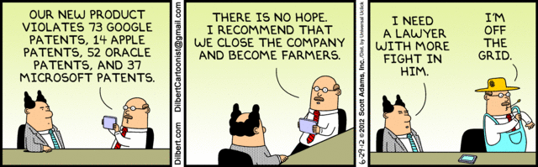
Overview
Review
Assignment
Students Present
Notes:
Comments, observations, questions on IP Chapter?

Slide 5
My Reading Notes
pp. 172 “not have bothered to invent it.“ or had the time. Any music entering public domain, not just classical. Why does orchestra budget matter? Public domain year 1997/1999 from source published in 1996?
pp. 174 SaaS, Google Search example? “…before he gave them the plot.”? “…cannot erase the memories...” Paycheck (2003)
pp. 176 When was instant photography invented?
pp. 177 $134 billion, copyright leading export 2010, now?
pp. 178 ”not profited” but violated right to distribute and reproduce…
pp. 179 Mickey Mouse – CGP Grey “Copyright: Forever Less One Day”
pp. 180 $150K for VP seems low.
pp. 182 Felicity is also an affected party.
pp. 185 4.4 #2 preferred assuming means published works more likely fair use. See pp. 190
pp. 190 Will Google do the same for music and movies as books?
pp. 191 What about lawsuits over a single hook sample? Revenue != profit. (also pp. 201)
pp. 195 Blocking 100% seems impossible.
pp. 199 Any legitimate BitTorrent use examples since 2005?
pp. 2021 How many subscribe now compared to 2015?
pp. 202 “licensing agreement … hardware”? Confidential source code very outdated.
pp. 203 4.7.3 references?
pp. 204 2021-04-05 Supreme Court find fair use in favor of Google [1]
pp. 207 What did the smartphone patent wars cost consumers?
pp. 208 Pouring can of tomato juice into ocean != hard work/labor
pp. 210 Developers often need the tool they make and share. Good reputation can lead to more financial remuneration. Producers are currently allowed to share, just not forced. 3rd claim used by opposing argument too.
pp. 212 Perhaps friends should not ask you to break the law?
pp. 213 With Dev/Sec/Ops adoption trending is long release cycles still true? Any successful businesses operate as a support service? Shift to service may be most compelling.
pp. 214 Is Perl still most popular? Source? Quality study from 2003, change?
pp. 215 who uses tape?
pp. 216 “human-readable, lawyer-readable…” How strong is Creative Commons chain of reasoning?
pp. 229 Interview has nothing to do with computing
Questions I liked: 20
Notes:
SaaS = Software As A Service
[1] 2021-04-05: SUPREME COURT OF THE UNITED STATES Syllabus GOOGLE LLC v. ORACLE AMERICA, INC. https://www.supremecourt.gov/opinions/20pdf/18-956_d18f.pdf
Accessed 2021-09-09

Slide 6
Group Quiz For each On the left answer a–d on Right
Trademark
Copyright
Patent
Trade Secret
What does it protect?
Qualifications required?
How long does protection last?
Specific example currently protected?
Notes:
Trademark
Used to denote a product or service.
Apply in specific areas of commerce. Only applies in specified area of business
Indefinite term as long as in use and protected against becoming a common noun or verb.
You do not have to register a trademark unless you want to bring litigation before a federal court (there are other benefits too, but what are they?)
Copyright
Expression, not ideas: Fuzzy. E.g. derivative works, characters, merchandising, plots.
Mickey Mouse, Tarzan.
US Default : Original Author, Exception: work for hire, Transferred: yes
Rights: Publication, Performance / exhibition, Adaptation to other media, Excerpting, Attribution, Derivative works
US Term: Lifetime of author plus 70 years., 95 years for companies.
Governed by US law and international treaties (e.g. WIPO).
Fair Use: News reporting, reviews, etc., Scholarly / educational use, Private, non-commercial use, Lending libraries and archives
Fair Use restrictions: Admission charge, Re-transmission
In general, you can: Read, view, play, etc., Copy for personal use., Time-shift, Space-shift
In general, you cannot: Copy for others., Transfer to someone else but keep a copy., Show / perform it publicly.
What about video rentals?
Rationale: Encourage creativity. Encourage dissemination. Balance between private and public good. It’s a social contract.
Patent
A mechanism, process, or composition of matter.
Must be: Novel. Useful. Non-obvious. Described clearly. Must do what it says.
Usual term 20 years.
Utility and plant patents: 20 years.
Design patents last 14 years. (ornamental design of functional item)
Provisional patent gives 1 year, before full patent
Trade Secret
You must take steps.
Enforceable by: Contracts, Laws against industrial espionage.

Slide 7
Group Quiz For each On the left answer a–d on Right
Trademark
Copyright
Patent
Trade Secret
What does it protect?
Qualifications required?
How long does protection last?
Specific example currently protected?
Notes:
Trademark
Used to denote a product or service.
Apply in specific areas of commerce. Only applies in specified area of business
Indefinite term as long as in use and protected against becoming a common noun or verb.
You do not have to register a trademark unless you want to bring litigation before a federal court (there are other benefits too, but what are they?)

Slide 8
Group Quiz For each On the left answer a–d on Right
Trademark
Copyright
Patent
Trade Secret
What does it protect?
Mark denoting product or service
Qualifications required?
Unique in specific area of commerce
How long does protection last?
While in use and protected against common noun or verb usage. Need to register to sue.
Specific example currently protected?
Notes:
Trademark
Used to denote a product or service.
Apply in specific areas of commerce. Only applies in specified area of business
Indefinite term as long as in use and protected against becoming a common noun or verb.
You do not have to register a trademark unless you want to bring litigation before a federal court (there are other benefits too, but what are they?)

Slide 9
Group Quiz For each On the left answer a–d on Right
Trademark
Copyright
Patent
Trade Secret
What does it protect?
Qualifications required?
How long does protection last?
Specific example currently protected?
Notes:
Copyright
Expression, not ideas: Fuzzy. E.g. derivative works, characters, merchandising, plots.
Mickey Mouse, Tarzan.
US Default : Original Author, Exception: work for hire, Transferred: yes
Rights: Publication, Performance / exhibition, Adaptation to other media, Excerpting, Attribution, Derivative works
US Term: Lifetime of author plus 70 years., 95 years for companies.
Governed by US law and international treaties (e.g. WIPO).
Fair Use: News reporting, reviews, etc., Scholarly / educational use, Private, non-commercial use, Lending libraries and archives
Fair Use restrictions: Admission charge, Re-transmission
In general, you can: Read, view, play, etc., Copy for personal use., Time-shift, Space-shift
In general, you cannot: Copy for others., Transfer to someone else but keep a copy., Show / perform it publicly.
What about video rentals?
Rationale: Encourage creativity. Encourage dissemination. Balance between private and public good. It’s a social contract.

Slide 10
Group Quiz For each On the left answer a–d on Right
Trademark
Copyright
Patent
Trade Secret
What does it protect?
Expression, not ideas. Derivative work, publication, performance
Qualifications required?
Original
How long does protection last?
Author lifetime + 70 years, 95 years for companies
Specific example currently protected?
Notes:
Copyright
Expression, not ideas: Fuzzy. E.g. derivative works, characters, merchandising, plots.
Mickey Mouse, Tarzan.
US Default : Original Author, Exception: work for hire, Transferred: yes
Rights: Publication, Performance / exhibition, Adaptation to other media, Excerpting, Attribution, Derivative works
US Term: Lifetime of author plus 70 years., 95 years for companies.
Governed by US law and international treaties (e.g. WIPO).
Fair Use: News reporting, reviews, etc., Scholarly / educational use, Private, non-commercial use, Lending libraries and archives
Fair Use restrictions: Admission charge, Re-transmission
In general, you can: Read, view, play, etc., Copy for personal use., Time-shift, Space-shift
In general, you cannot: Copy for others., Transfer to someone else but keep a copy., Show / perform it publicly.
What about video rentals?
Rationale: Encourage creativity. Encourage dissemination. Balance between private and public good. It’s a social contract.

Slide 11
Group Quiz For each On the left answer a–d on Right
Trademark
Copyright
Patent
Trade Secret
What does it protect?
Qualifications required?
How long does protection last?
Specific example currently protected?
Notes:
Patent
A mechanism, process, or composition of matter.
Must be: Novel. Useful. Non-obvious. Described clearly. Must do what it says.
Usual term 20 years.
Utility and plant patents: 20 years.
Design patents last 14 years. (ornamental design of functional item)
Provisional patent gives 1 year, before full patent

Slide 12
Group Quiz For each On the left answer a–d on Right
Trademark
Copyright
Patent
Trade Secret
What does it protect?
Mechanism, process, composition of matter
Qualifications required?
Novel, useful, non-obvious, described clearly, must function
How long does protection last?
Utility and plant: 20 years
Design: 14 years
Provisional adds 1 year
Specific example currently protected?
Notes:
Patent
A mechanism, process, or composition of matter.
Must be: Novel. Useful. Non-obvious. Described clearly. Must do what it says.
Usual term 20 years.
Utility and plant patents: 20 years.
Design patents last 14 years. (ornamental design of functional item)
Provisional patent gives 1 year, before full patent

Slide 13
Group Quiz For each On the left answer a–d on Right
Trademark
Copyright
Patent
Trade Secret
What does it protect?
Qualifications required?
How long does protection last?
Specific example currently protected?
Notes:
Trade Secret
Anything with business value
You must take steps to keep it secret: Non Disclosure Agreement, protected storage, compartmentalization, etc.
As long as the secret is kept
Enforceable by: Contracts, Laws against industrial espionage.

Slide 14
Group Quiz For each On the left answer a–d on Right
Trademark
Copyright
Patent
Trade Secret
What does it protect?
Anything
Qualifications required?
Must take steps to keep secret, e.g. Non-Disclosure Agreements, contracts
How long does protection last?
As long as kept secret
Specific example currently protected?
Notes:
Trade Secret
Anything with business value
You must take steps to keep it secret: Non Disclosure Agreement, protected storage, compartmentalization, etc.
As long as the secret is kept
Enforceable by: Contracts, Laws against industrial espionage.

Slide 15


Overview
Review
Assignment
Students Present
Notes:
But first take a look at:
CGP Grey
Copyright: Forever Less One Day (6:27)
https://www.youtube.com/watch?v=tk862BbjWx4
Tom Scott
http://tomscott.com
Welcome To Life (2:44)
https://www.youtube.com/watch?v=IFe9wiDfb0E&feature=youtu.be

Slide 16
Assignment - Self Search 1/3
What Really
Is You?
1 Page
Paper
Filter
Inspiration
Search Methods
…
…
…
…
Filter
Profile
Could Be You

Slide 17
Assignment - Self Search 2/3 Discussion Board
Post search techniques
Do not repeat entries.
Use techniques listed to produce a profile that could be you.
Not responsible for techniques posted less than 24 hours before due
Filter first profile so that the information is for you.
Provide as paper appendix
Summary is fine. No details needed unless you for making a point.
Consider:
Exactly how did the data get there?
How can this data be used?
Is this a secondary use?
Did you authorized use of the data? If not and you want to, request its use be discontinued and share the experience.
Be creative, anyone can type a name into Google
Do not pay for search services
Subscribe to the Discussion Board

Slide 18
Assignment - Self Search 3/3 1 Page Paper
Decide how, if at all, you, or people in general, should change their online activities.
Example considerations:
What impression would the profile make on a potential employer?
What would an elder family member (or equivalent) think?
Are you comfortable with what you found or did not find?
Do you believe protecting your privacy is important or needed?
Refer to search results to support your conclusion
5 High quality sources still required
Sites used in search techniques do not count

Slide 19
Overview
Review
Assignment
Students Present

Slide 20
Going Viral made easy
Asha Buchanan

Slide 21
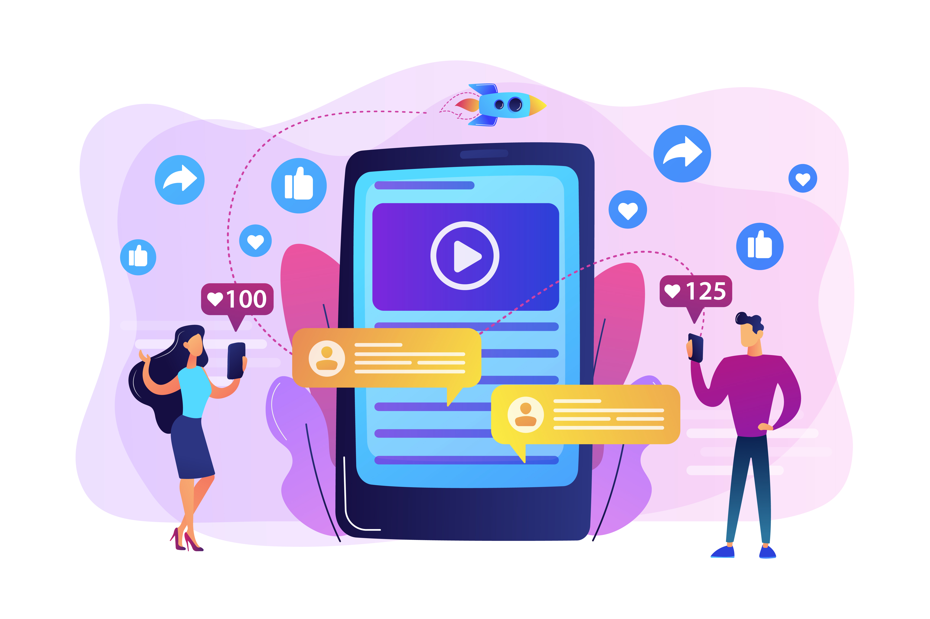
What does it mean to go viral
Asha Buchanan
“Virality is a social information flow process where many people simultaneously forward a specific information item, over a short period of time, within their social networks, and were the message spreads beyond their own networks to different, often distant networks resulting in a sharp acceleration in the number of people who are exposed to the message” (1)
Image by vectorjuice on freepik
Notes:
- Definition is there but In short, we can define going viral as when something gets shared multiple times to a very large amount of people in a short time

Slide 22
How easy is it to go viral?
Asha Buchanan
Positivity
Provoking Emotions
Packaging
Prestige
Positioning
Participation
The rules of defining how many views required to be viral are not strict (2).
The 6 P’s that enhance virality (3).
Virality = mass-media success factors (3).
Notes:
There is no set structure to classifying a video as “viral” , a certain amount of views doesn’t indicate virality
Viral videos are usually due to luck but there are some factors that enhance somethings chances of going viral, the 6 P’s
Positivity- makes you smile/happy , Provoking Emotions- doesn’t have to be positive but makes you feel something, Packaging- is the video short and sweet, easy to consume or is it long and very content heavy, usually the former is what goes viral, Prestige- Sort of like pathos, appeal to authority, that helps with virality, Positioning- If something takes place in a popular place, like NYC etc, this helps as like the “prestige” they are sort of like “buzz words” , meaning they grab attention and are likely to be boosted , Participation- as a viewer, can I be involved, that helps , people are inclined to share if they can take part in it, like a trend eg the ALS ice bucket challenge
These are similar to the recipe for mass-media success which takes us into time before social media

Slide 23
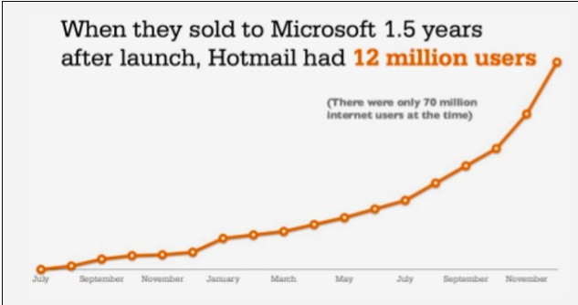
Was it always this easy?
Asha Buchanan
The capital firm Jurvetson coined the term “viral marketing” in 1977 (4).
Viral marketing -> a time before social media
Advertising agencies utilized to promote campaigns (5).
“PS: I love you. Get your own free e-mail at Hotmail” -> Hotmail users to grow from 20,000 to 1 million in a year (8).
Screenshot captured on 3/28/24 from https://scalecuts.com/how-hotmail-invented-the-viral-loop/
Notes:
Before there was social media and being viral ,there was “viral marketing” first heard in 1997 from the firm Draper Fisher Jurvetson, this was used to describe techniques used by advertising and marketing teams to promote campaigns or services. They were inspired by hotmails marketing strategy.
The company hotline wanted to promote their new email service Hotmail and utilized that “viral marketing” with their short slogan “PS: I love you. Get your own free e-mail at Hotmail” that they attached to every email that would be sent by any user, users promote the brand by just using it.
With the introduction of that slogan, the company saw a skyrocket from 20,000 users to 12million in a year and a half.
As we can see in the graph, hotmails users increased exponentially

Slide 24
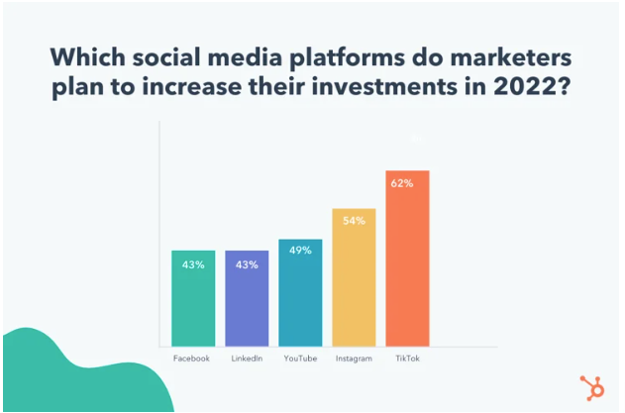
Viral Marketing -> Viral
Asha Buchanan
The way that we use the term viral has now become a way to indicate that something is “worthy” of sharing or “worthy” of your attention (5).
Through social media, the need for authentic popularity is no longer there as algorithms have made it easier for users to accelerate the rate at which their content spreads (5).
Screenshot captured on 3/28/2024 from https://blog.hubspot.com/marketing/tiktok-algorithm
Notes:
We make things go viral because we think they are worth others attention and worth sharing, and worth becoming popular
However , nowadays with the implementation of algorithms in social media feeds, things are no longer becoming popular authentically. People find ways to use the algorithm to their advantage and its way easier for users to spread their content faster.
The original meaning of going viral is not lost as viral marketing is still an important tactic
Business are now tapping into this as a resource and use going viral as a chance to promote their business. As I mentioned persons have found ways to use algorithms to their advantage which results in the rise of marketing on tiktok as it is so easy for content to go viral on that app
As we see in that graph companies are really trying to invest more marketing into tiktok

Slide 25
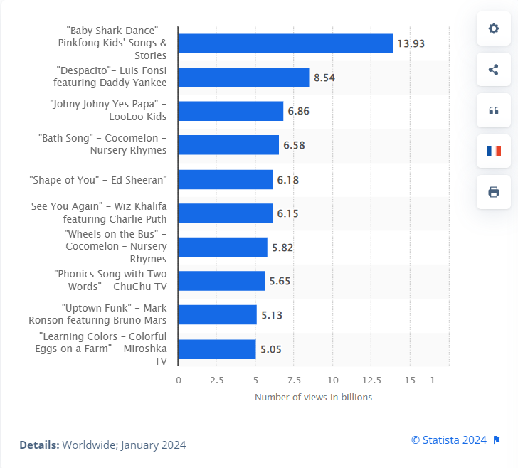
Viral Marketing -> Viral
Asha Buchanan
Gone are the days where it is impressive to have 1 million views, or followers.
2012, Gangnam Style by Psy was the first video to receive 1 billion views on Youtube (6).
Now the most viewed video, Baby Shark (2016) (7).
Screenshot captured on 3/28/2024 from https://www.statista.com/statistics/249396/top-youtube-videos-views/
Notes:
1 million persons is a difficult number of people to imagine, but in todays day an age, obtaining a 1million views or followers is not the feat it used to be
1 million is hard to fathom but imagine 1billion. When Gangnam Style became the first video with 1 billion views in 2012, it was groundbreaking (it currently boasts 5.1 billion now btw) , now, the most viewed video on youtube, Baby Shark by Pinkfong (2016) as of now boasts 13.9 billion views. That is if almost every single person in the world viewed it twice. Crazy numbers to think about
Prior to the social media age, marketeers would not ever expect to achieve these modern day numbers.
As we can see we have the top 10 most viewed videos on youtube as of January 2024

Slide 26
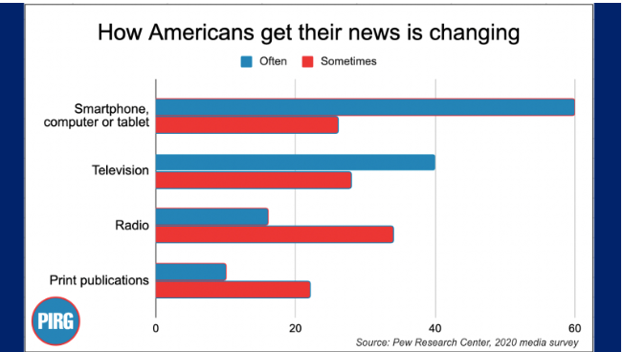
Downsides of virality
Asha Buchanan
The spread of misinformation
Fact check & Think before you share!
Using an analogy of a virus: “people may think they’re protected from the potential harm that misinformation on the internet can bring, but many are asymptomatic carriers of that information into spaces where it can devastate.”(5)
Screenshot captured on 3/28/2024 from https://pirg.org/edfund/articles/misinformation-on-social-media/
Notes:
With the ease of virality, anything can go popular these days, which raises the concern of the spread of misinformation.
As a consumer, we should ensure to not just spread any information, we should ensure to fact check or ensure that any claims are coming from a reasonable and reputable source/place even though the whole point of a viral video is to be shared rapidly
As we can see from the graph most Americans (53%) get their news from social media according to a survey conducted by Pew Research Center in 2020.
The word viral does come from “virus” so to best explain some of the harms of spreading misinformation, lets use the analogy of a virus (read second bullet)

Slide 27

Going viral has been going viral
Asha Buchanan
As long as we combat the spread of misinformation, going viral really does no harm.
It is so easy to just press a few buttons to share content with others and every day more and more people go viral!
Image by storyset on freepik
Notes:
Though there is that downside, when sharing positive and truthful content there is no harm in virality, (read last bullet)
Any questions?

Slide 28
References
Asha Buchanan
[1] Karine Nahon, Jeff Hemsley, Going Viral (2013), https://www.google.com/books/edition/Going_Viral/rU3DEzIvIskC?hl=en&gbpv=0,(3/26/2024)
[2] Alec Chillingworth, Hoq ro go viral on social media in 2024: 10 top tips (EpidemicSound, 01/01/2024), https://www.epidemicsound.com/blog/how-to-go-viral/#:~:text=Going%20viral%20on%20social%20media,to%20put%20the%20work%20in , (3/26/2024)
[3] Limor Shifman, Memes in Digital Culture (MIT Press, 2013), https://doi.org/10.7551/mitpress/9429.001.0001 , (3/26/2024)
[4] River University, History of Viral Marketing (River University), https://www.rivier.edu/academics/blog-posts/history-of-viral-marketing/ , (3/26/2024)
[5] A.W Ohlheiser, Maybe it’s time to retire the idea of “going viral”, (MIT Technology Review. 05/17/2020), https://www.technologyreview.com/2020/05/17/1001809/maybe-its-time-to-retire-the-idea-of-going-viral/
[6] Danielle Pascual, Every Music Video That Hit 1Billion Youtube Views in 2022 (billboard, 12/29/2022), https://www.billboard.com/lists/youtube-billion-views-video-club-2022/ , (3/26/2024)
[7] Statista, Most popular YouTube videos based on total global views as of January 2024 (01/2024), https://www.statista.com/statistics/249396/top-youtube-videos-views/ , (3/26/2024)
[8]Scalecuts, How Hotmail Invented the Viral Loop (2019), https://scalecuts.com/how-hotmail-invented-the-viral-loop/ (3/28/2024)
[9] All cliparts were sourced from freepik, they are all copyright free with attribution which is provided under each image, otherwise credit was given under each picture.

Slide 29
This Presentation is Copyrighted
Zackary Perry

Slide 30
And That’s Perfectly Fine, But What If I…
Zackary Perry
Had the length of my protection over it extended?
Provided no manner of accessing my creative work outside of this presentation?
Completely vaulted it for my own economic gain?
Notes:
Of course, these are extreme lengths to take for a classroom presentation
But they are happening today with modern corporations and their copyrighted IP
Segue this into main argument slide

Slide 31
Copyright Laws Need to Be Loosened Before the Grips Corporations Have Over Their IP Make Them Tighter
Zackary Perry

Slide 32
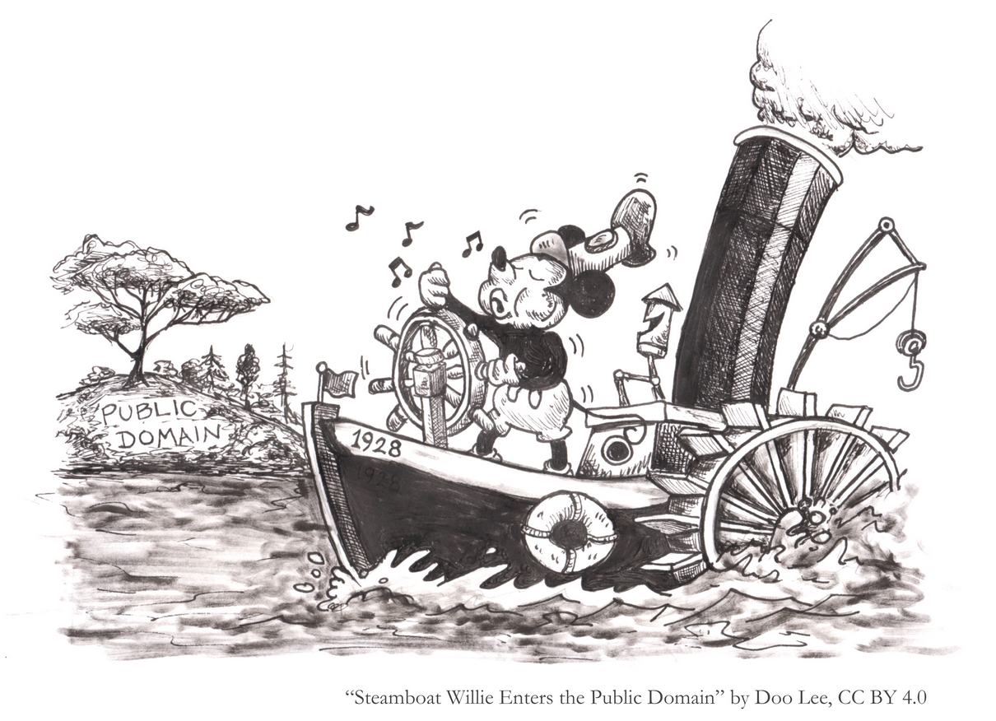
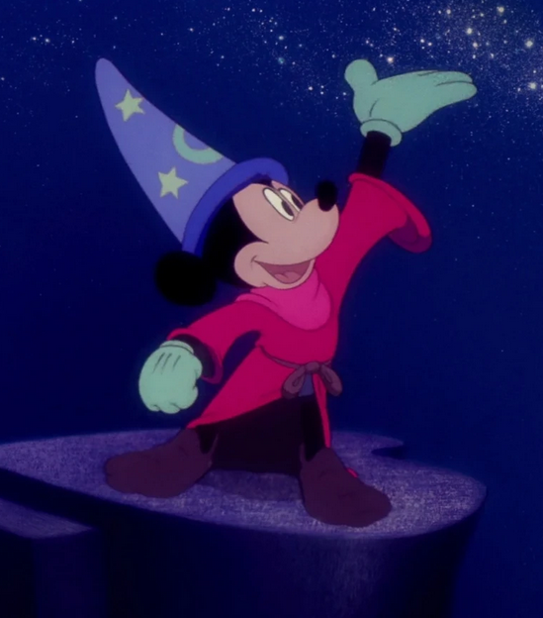
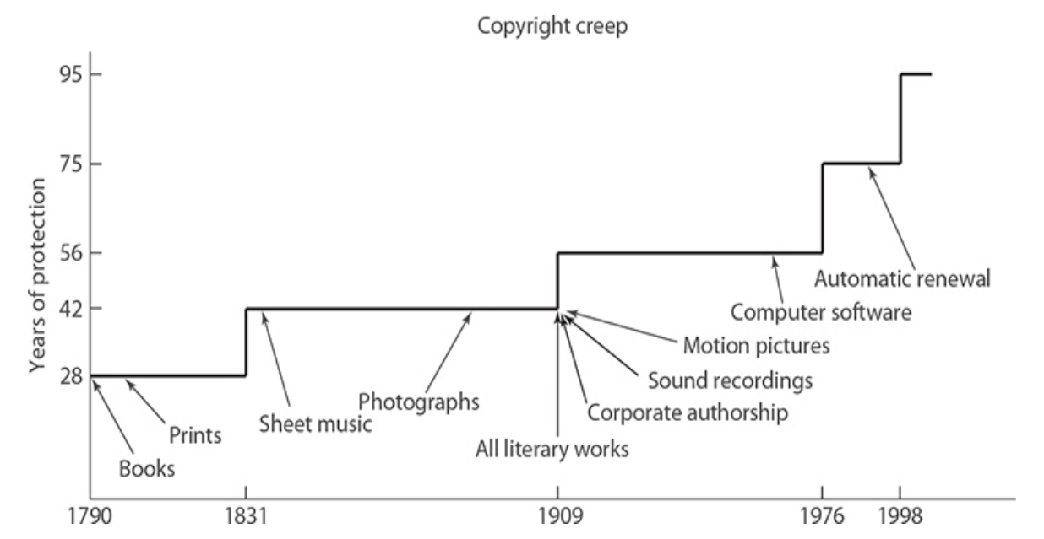
Case #1
Zackary Perry
Disney's "Steamboat Willie" just entered the public domain on January 1, 2024
Could have happened much sooner if not for other copyright related acts pushing the date back
Disney even "pushed for the law that extended the copyright term to 95 years," [1]
Notes:
Sonny Bono Copyright Term Extension Act of 1998
Only as of the past few months have people been able to make their own creative expansions on Steamboat Willie, a property that Disney hardly expanded on themselves
For context on how sooner it would’ve been had Disney not played as a significant role as it did when it came to the Extension Act, Fantasia came out in 1940, which introduced a brand new design for Mickey Mouse. According to the Copyright Creep diagram, during the year of 1940, Fantasia's release, copyrighted materials would become public domain 56 years later. Fantasia would be in the public domain in 1996, 28 years ago, if not for protection extension acts. Now, it won't be in public domain until 2035, still 11 years from now
A creator should have control over their intellectual property, but not indefinitely. Though there is an IP that recently entered the public domain that may have an argument for the opposite idea.

Slide 33
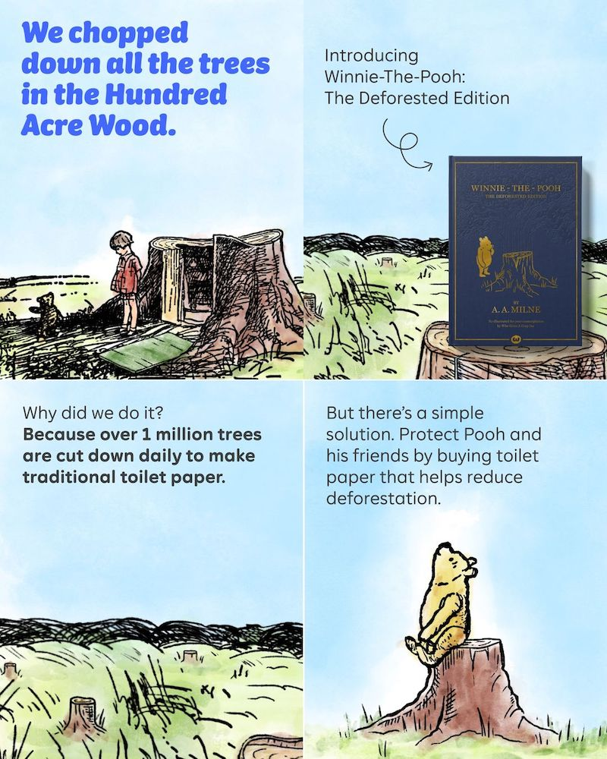
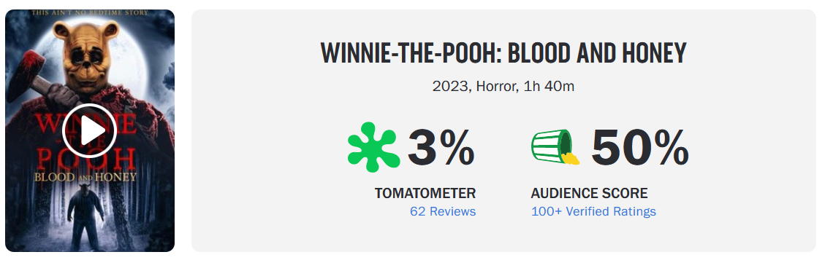
Winnie-The-Pooh in the Public Domain
Zackary Perry
Can be argued that nothing good has come from it
“Winnie-the-Pooh: Blood and Honey” negatively rated by critics and viewers
"Winnie the Pooh: The Deforested Edition” [2]
Notes:
After second point:
So, it can be understandable that Disney is pushing back the date of public domain to keep their IPs in their reliable hands
“Winnie the Pooh: The Deforested Edition.“ = reimagining of the childhood story but with a focus on environmental awareness
Not every piece of media from an IP is going to be perfect. Not every Disney movie has been a success. Winnie-the-Pooh can perform well in the public domain, and thus Mickey Mouse
Can as well. Disney just needs to let it, and it can start that by backing off on its copyright extension agenda

Slide 34
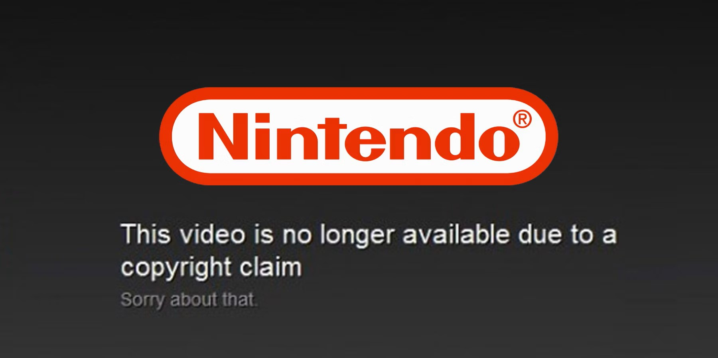
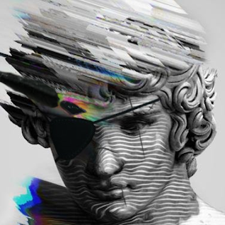

Case #2
Zackary Perry
Nintendo hardly makes their copyrighted music accessible to consumers
In 2022, YouTuber SilvaGunner was targeted with more than 4,000 copyright strikes [3]
DeoxysPrime was also targeted 6 months later
Notes:
Nintendo is a well-established gaming company, yet they hardly make their copyrighted music accessible to consumers
SilvaGunner, image on bottom right = famously known for uploading Nintendo soundtracks to his channel, deleted his channel shortly after receiving all the copyright strikes from Nintendo
DeoxysPrime = image on bottom left, their channel is still up today but all Nintendo music has been removed; they didn’t have much of a choice
At end of slide:
These copyright claims would be understandable if Nintendo had the intentions of doing something with their copyrighted music. And it would make sense to, looking at how other
Video game soundtracks have succeeded commercially.

Slide 35
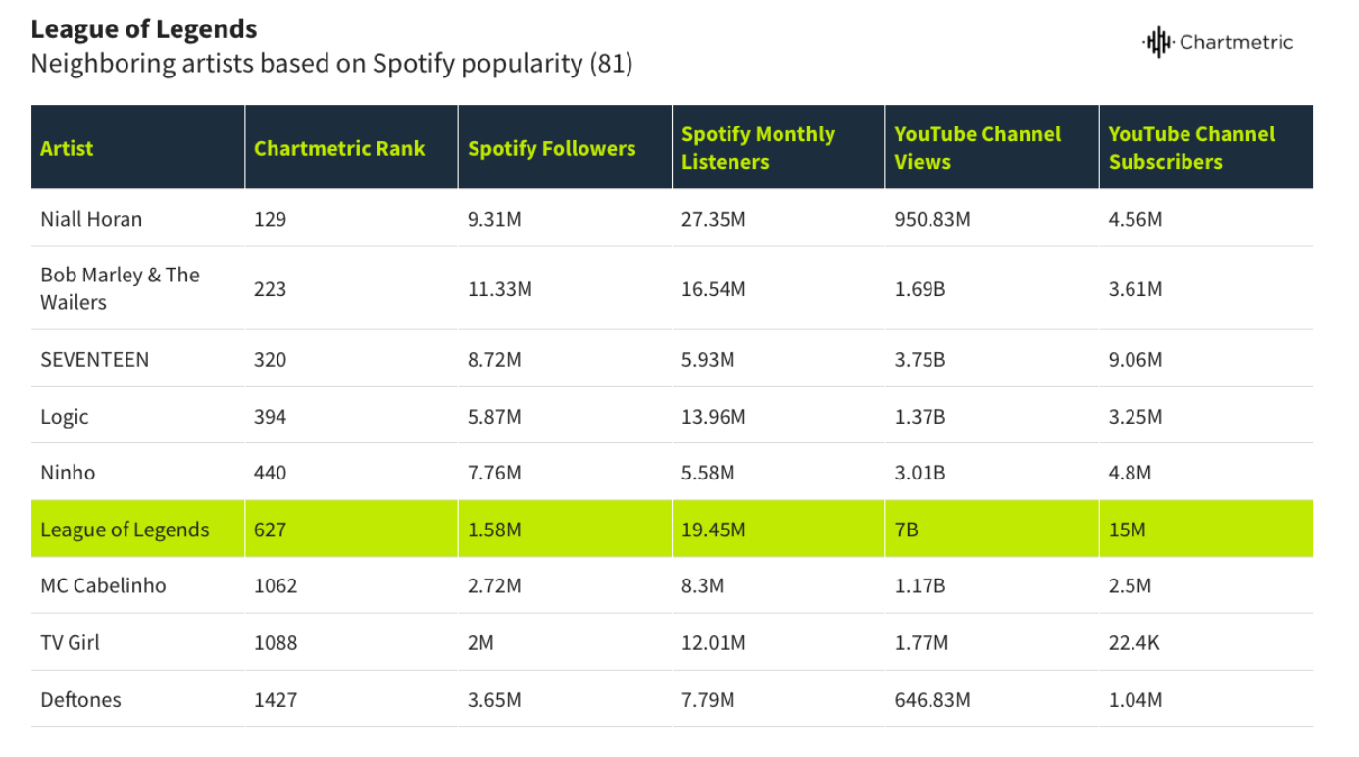
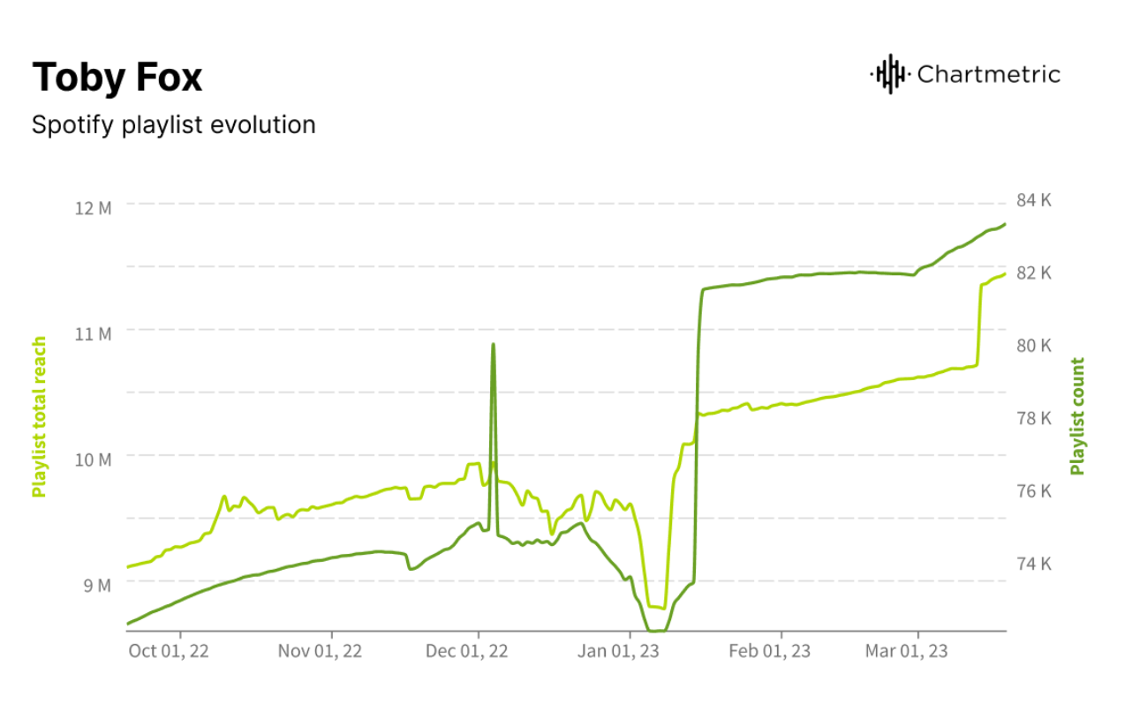
The Success of other video game music
Zackary Perry
Notes:
Other video game soundtracks have succeeded greatly on streaming services. These graphs show League of Legends and Toby Fox’s Undertale and Deltarune soundtracks receiving millions
of listens on Spotify. With the popularity of Nintendo’s company and its IPs, it could certainly reach similar numbers in a matter of years. It would please the public and give Nintendo extra
profit. And yet… (segue into next slide)

Slide 36
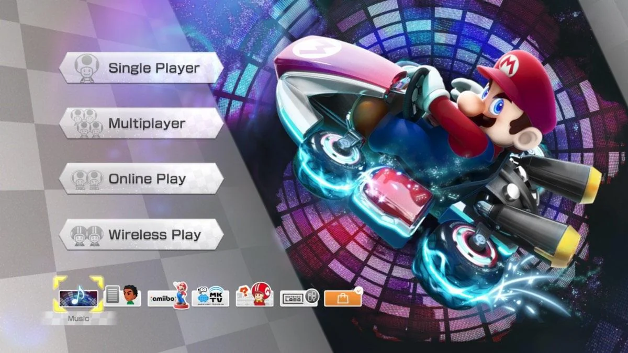

2 Years Later…
Zackary Perry
Nintendo has not provided a way of accessing their music
YouTubers who post Nintendo music onto the platform turn off monetization
"Some of these old games are also being lost to history, prompting some to see uploading Nintendo music to YouTube as an act of preservation.“ [4]
Notes:
After first point:
Frankly, it seems nonsensical to produce no monetary way of obtaining your copyrighted content after striking down channels that weren’t even using said content for economical gain
After second point:
Consumers will support the creators of properties that they like. They’ll pay for the things they want to experience. But that cannot be done if no method is provided to them. If a
company is going to file out copyright claims on free distributions of their content, then they should provide legal manners of obtaining it. Otherwise, it just isn’t fair.
First image shows Nintendo adding a music player in one of their games; it’s an impractical way of distributing these OSTs
Second image shows that Pokemon games have been releasing on streaming services, but that’s moreso at the influence of the Pokemon Company; not Nintendo

Slide 37
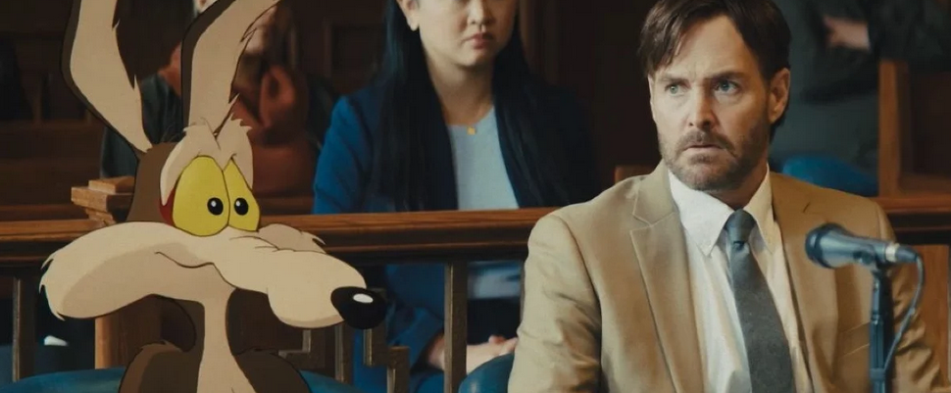
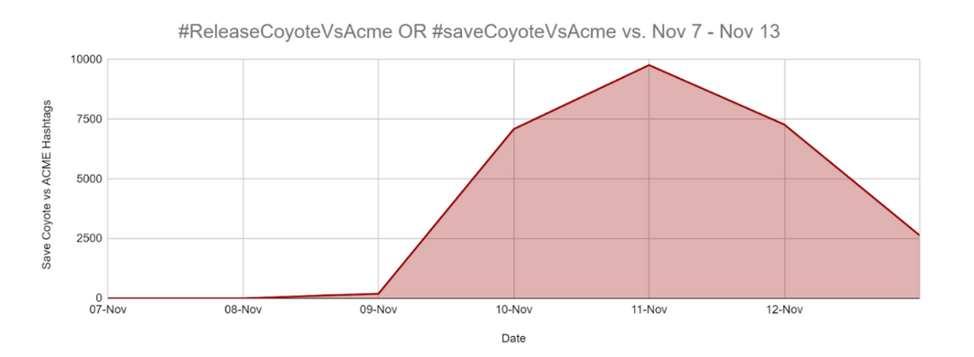
Case #3
Zackary Perry
Warner Bros. Discovery caused uproar amongst public when they shelved their most recent project
"Coyote vs. Acme” was being vaulted in favor of a $30 million tax write-off [5]
The only explanation for shelving a movie is the lack of faith that it would succeed in theaters
Notes:
Bottom image shows the amount of traction #ReleaseCoyoteVsAcme and other similar hashtags got, reaching up to 10,000 posts featuring the hashtag at its peak.
The movie being vaulted got much more of a public reaction than previously vaulted movies, such as Batgirl

Slide 38
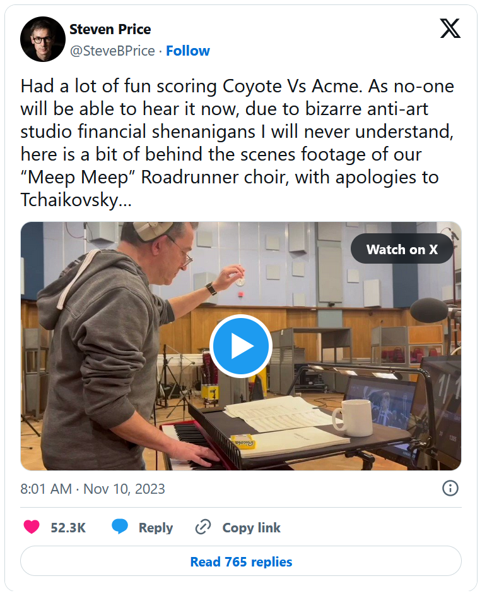
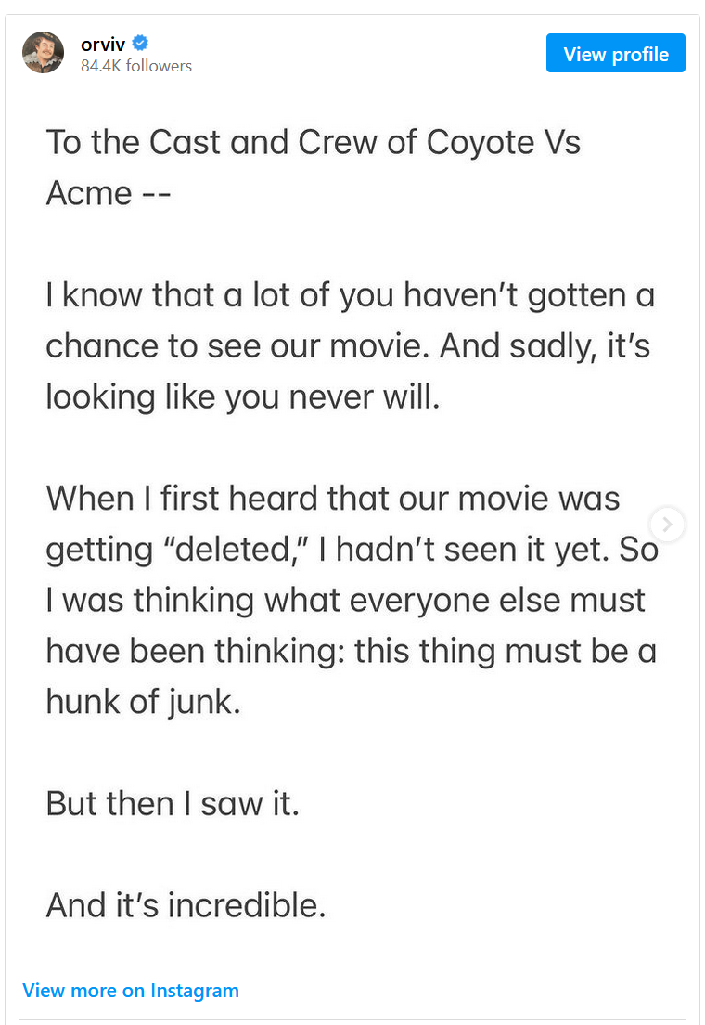
The Faulty Reasoning and Unjust Reality
Zackary Perry
The film "performed exceptionally with test audiences, in the high 90s" in regard to their ratings [6]
The film is still under WBD's copyright
“I am disappointed. I was looking forward to seeing all our hard work come to life” [7]
Notes:
After second bullet point:
Not only is this unfair to viewers who were prepared to watch a high quality movie, but it is even more unfair to those who put years of work into bringing the movie to life.
Corporations shouldn’t be allowed to tuck a film away into the vault to make a quick profit, especially when the film being vaulted doesn’t get freed into the public domain
Quote is from an anonymous crew member when contacted by the Rolling Stones (the American monthly magazine) for comment
Image on the left is Steven Price, composer; image on right is Will Forte, actor

Slide 39
Final Thoughts:
Zackary Perry
I am not against copyright as a whole; intellectual property should be protected
However, there should be limits so that the present issues with corporations and their tight-gripped IP management doesn't become the standard
"Ultimately, it is important to consider the broader societal implications of copyright law, rather than simply focusing on the interests of individual creators or copyright holders.“ [8]
Notes:
End presentation off with:
Copyright is strong enough as it is, it's time now to consider how too much of it could be harming what it was made to encourage: innovative opportunity for creators and consumers

Slide 40
References
Zackary Perry
[1] Jennifer Jenkins, Mickey, Disney, and the Public Domain: a 95-year Love Triangle, (Center for the Study of the Public Domain, 01/01/24), https://web.law.duke.edu/cspd/mickey/ (03/27/24)
[2] Lisa Joyner, Winnie-the-Pooh Reimagined to Highlight Global Deforestation Impact, (Country Living, 09/29/23), https://www.countryliving.com/uk/news/a45350999/winnie-the-pooh-deforested-edition-book/ (03/27/24)
[3] Johan Moreno, Nintendo Once Again Sent 500+ Copyright Blocks To Remove Soundtrack Music On YouTube, (Forbes, 05/31/22), https://www.forbes.com/sites/johanmoreno/2022/05/31/nintendo-once-again-sent-500-copyright-blocks-to-remove-soundtrack-music-on-youtube/?sh=36254c7f26d7 (03/27/24)
[4] Emily Morrow, Nintendo is Erasing its Music, and Community, from YouTube, (Digital Trends, 03/10/22), https://www.digitaltrends.com/gaming/nintendo-removes-music-from-youtube/ (03/27/24)
[5] Rishikesh Rajagopalan, Actor Will Forte says completed "Coyote vs. Acme" film is likely never coming out, (CBS News, 02/29/24), https://www.cbsnews.com/news/will-forte-says-coyote-vs-acme-film-likely-never-coming-out/ (03/27/24)
[6] Matt Zoller Seitz, Why Deleting and Destroying Finished Movies Like Coyote vs Acme Should Be a Crime , (RogerEbert, 02/09/24), https://www.rogerebert.com/mzs/coyote-vs-acme-canceled (03/27/24)
[7] Cheyenne Roundtree, ‘Coyote vs. Acme’ Crew Were Blindsided by Warner Bros. Killing Movie, (Rolling Stone, 11/10/23), https://www.rollingstone.com/tv-movies/tv-movie-news/coyote-vs-acme-crew-blindsided-by-warner-bros-killing-movie-1234873156/ (03/27/24)
[8] Joan M.S. Bull, Copyright Records Document “Lost” Silent-Era Films, (SierraLII, 07/02/23), https://sierralii.gov.sl/articles/2023-07-02/Joan/the-copyright-term-and-effect-on-creativity (03/27/24)

Slide 41
Class 5 The End
Keith A. Pray
socialimps.keithpray.net
Notes:
This is the end. Any slides beyond this point are for answering questions that may arise but not needed in the main talk. Some slides may also be unfinished and are not needed but kept just in case.

Slide 42
what works well Online With Zoom
Sign in with First and Last Name
Stay muted unless you are going to speak
To speak use the raise your hand feature
To answer yes/no questions use the “yes” ”no” buttons
Turn your camera on
Wait until the end of student presentations to ask questions
Write them down so you don’t forget

