Slide 1
Class 12-14 Last Days
Keith A. Pray
socialimps.keithpray.net

Slide 2
Overview
Reminder: Course and Group Evaluations
Automation Paper Results
Points to date
Class 14:
Students Present
Students’ Choice

Slide 3
Notes:
Automation Paper results. This term’s additions in RED

Slide 4
Papers
Great improvement!
Many students highest grade yet!
Much better backing data
Notes:
Save for next time:
More Clear Conclusions
Significant Counter Points
Clearly state conclusion
First statement preferred
Absolute statements are difficult to prove
Avoid: all, always, any, every, everyone, never, none… unless you can show it
Be sure to put quotes around entire quote
Hyperbole is the best thing ever!
but not in these papers
Print 2 sided and save a tree
Use template, saves time (and -1 point)
Include Counter Point and Response
Include Author, Title, Publish Date, Publisher for references
Read paper aloud to proof

Slide 5
Grades To Date
58 Max Possible
- Discussion 1-13 - Papers 1-4
Does not include points:
- 2 Discussion - 10 Individual Presentation - 35 Group Project - Extra Credit

Slide 6
Tiktok addiction
Ashley Jacob

Slide 7
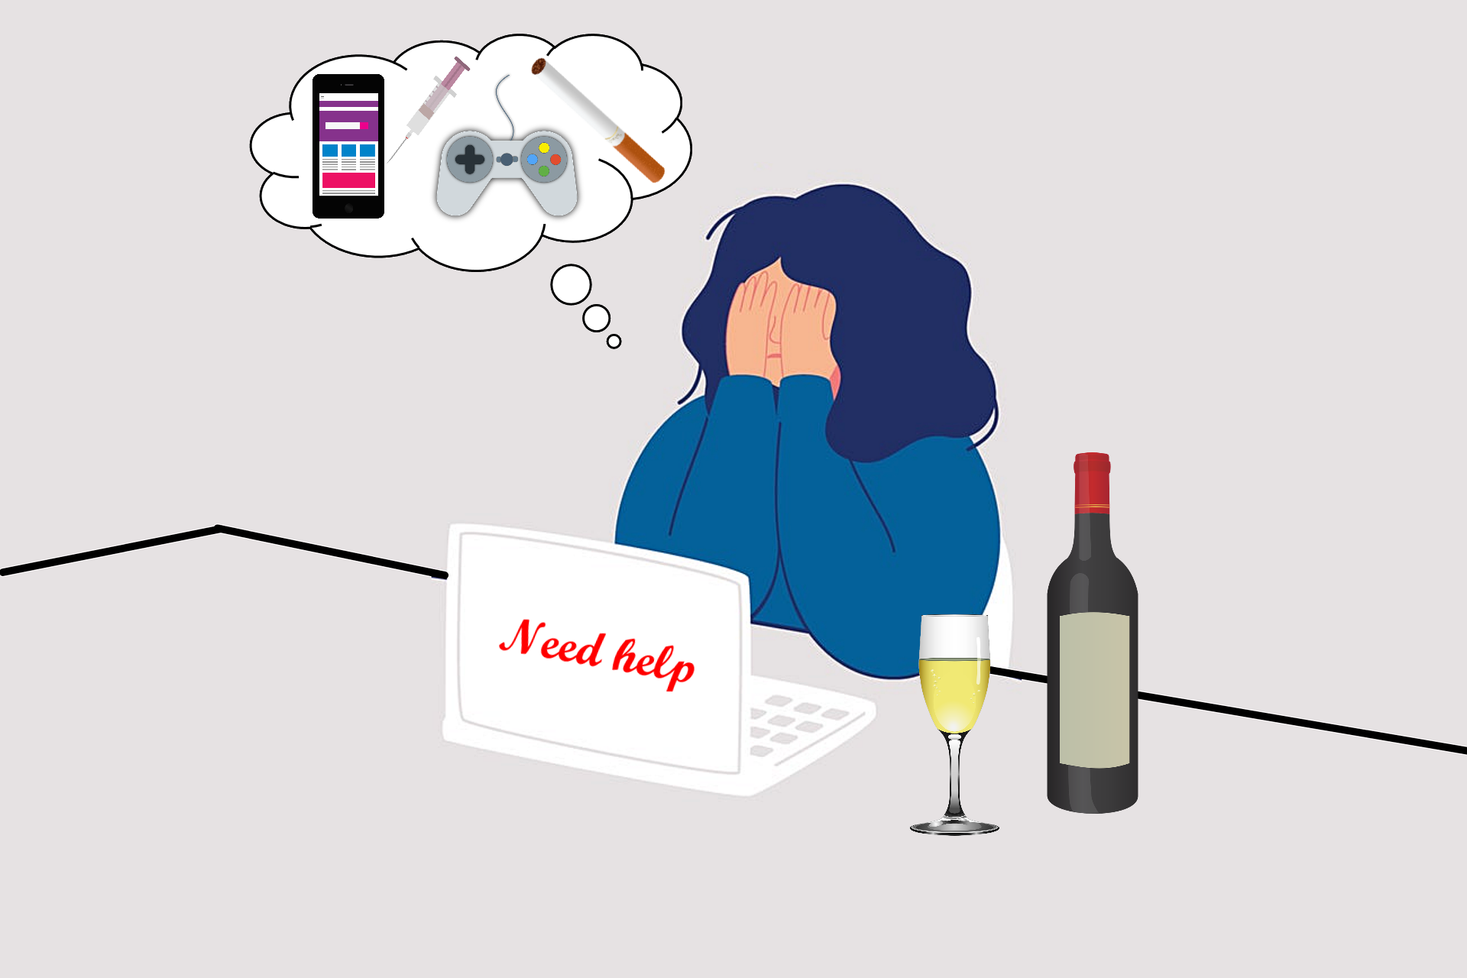
What is Addiction?
Ashley Jacob
“Dependence on substances or activities that are harmful to health or psychological equilibrium”[8]
Example activities[8]:
Video games
Work obsession
off-line gaming
social media!
Notes:
<speaker notes>

Slide 8

Causes of social media addiction
Ashley Jacob
“low self-esteem, personal dissatisfaction, depression and hyperactivity, and even lack of affection”[8]
Ages 16-24[8]
Notes:
- Social media addiction can be caused by a plethora of reasons including but not limited to low self esteem, personal dissatisfaction, depression, hyperactivity, and even a lack of affection
- the lack of affection cause can be seen in a lot of adolescence, many use social media likes as a replacement to that feeling
-the age group that is mostly affected by this is between 16 and 24 years old
- many young people seek out for likes for that intense but quickly fleeting feeling of satisfaction, but this could also lead into a dependency long term

Slide 9
Topics to cover
Ashley Jacob
Algorithmic Addiction
Psychological Impact
Solutions to addiction
Notes:
Some points I will cover in more detail to why tiktok in specific is very addictive and how to overcome it.

Slide 10
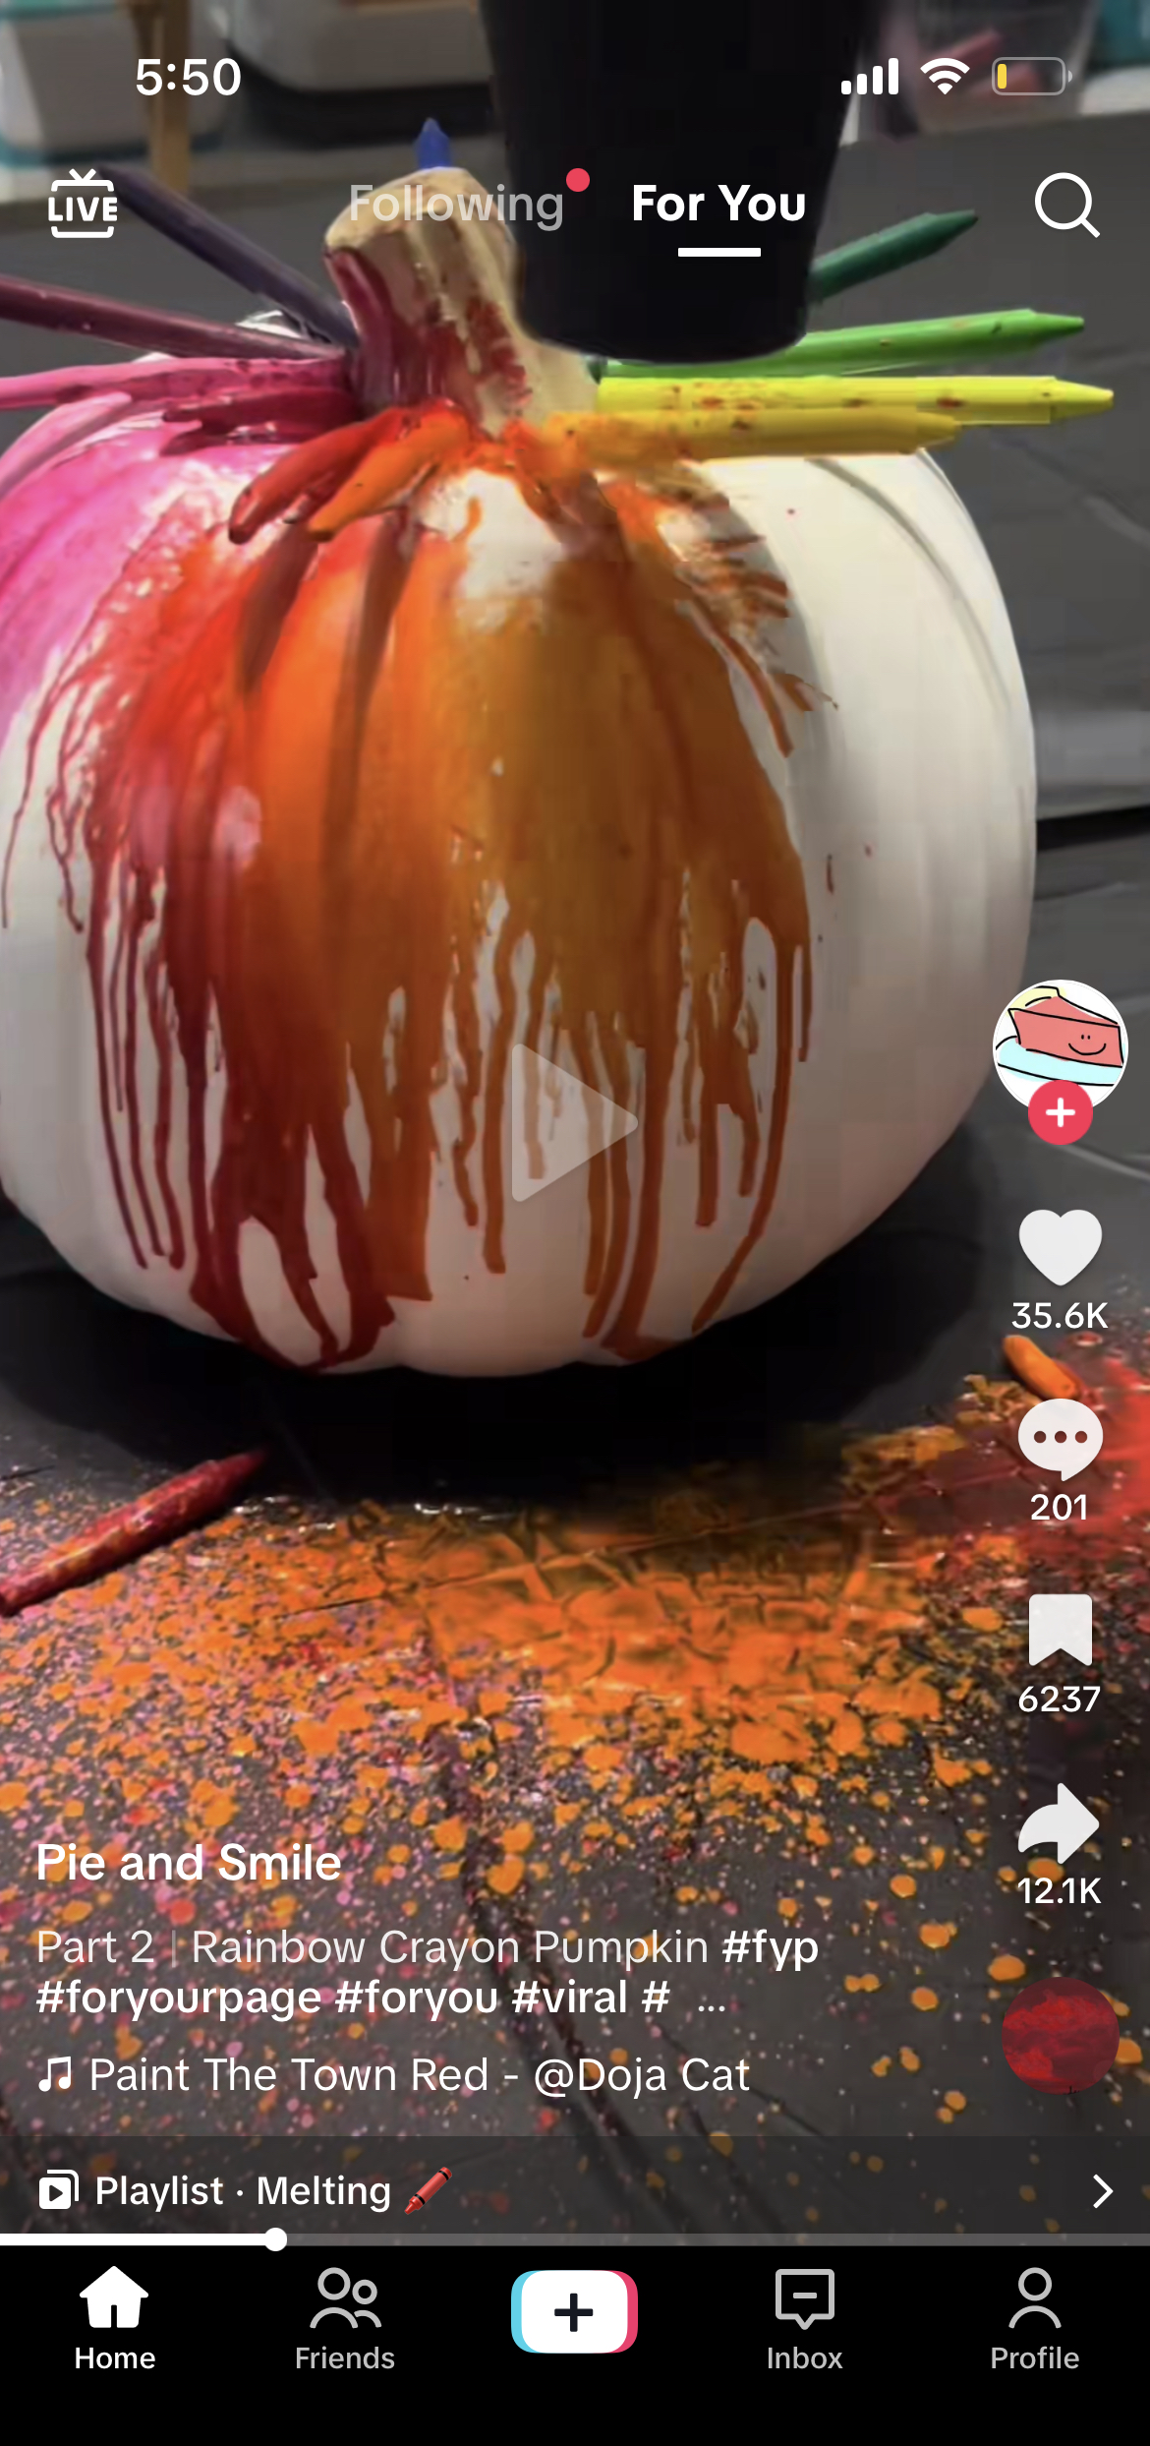

Algorithmic addiction
Ashley Jacob
“For You” page
Likes, comments, and shares are noted by AI [1]
User Interactions, Video Information, and Device and Account Settings [2]
Study conducted in mainland China proves that the algorithm is the strongest motive [3]
Notes:
-Tiktok has a “For You” page with a stream of videos put together by artificial intelligence for each user.
- the choices made on the app can affect this page, any likes, shares, and comments will affect what content is seen. This is so users are more likely to see what they want to see. The more they use and engage with the app, the more accurate your feed will be.
The recommendations comes from videos you like or share, accounts you follow, comments you post, and content you create. Video information also affects recommendations this includes captions, sounds, and hashtags. Device and account settings also have a part in the algorithm, this consists of language preference, country setting, and device type. (makes sure that the system is optimized for performance). Tiktok also allows users to mark content as not interested to further recommend accurate content for the user.
- This feature can lead to prolonged use of the app and increase its addictive capacity, as the content is of interest to the user.
- a study I found that was conducted in mainland china, had a sample of 1, 015 participants take a survey on their tiktok usage. The participants took a survey with questions that categorized them as nighttime or daytime users, and if their use of tiktok correlated with social rewarding self presentation, trendiness, escapest addiction, or novelty. The study found that the highest correlation and strongest motivation was found in novelty.
Novelty was defined In the study by how users can see content of topical interest to them and how new content is constantly produced. Tiktok’s powerful algorithm has the ability to keep users interested in content for a long period of time. It was also noted by the study that the novelty motive affected all other motives and was the driving forced of nighttime usage which was defined as being 7pm to 7am.

Slide 11
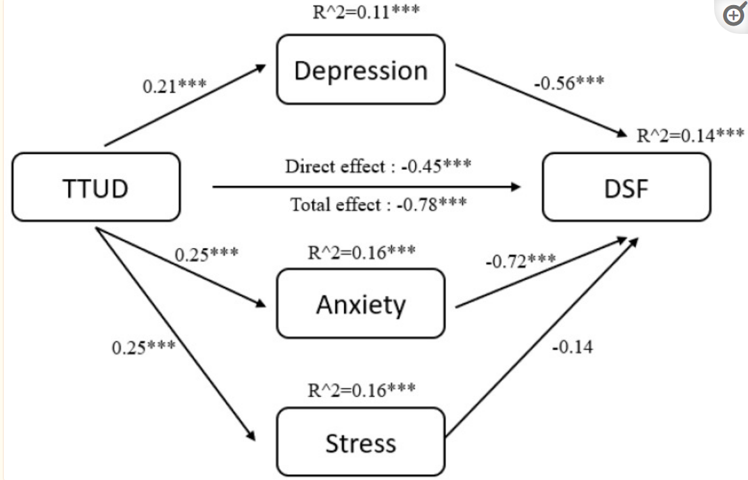
Psychological impact
Ashley Jacob
Short term attention span
21-34 seconds on average[4]
95 mins per day[4]
TTUD affects memory loss[5]
Notes:
- Tiktok is actively crippling attention spans
- tiktok videos average around 21-34 seconds per video, and the average tiktok user is on the app for approximately 95 minutes per day. Watching these short videos in the span of hours can have a long term impact on attention spans of world wide tiktok consumers.
-TTUD(tiktok use disorder) refers to problematic tiktok use and addiction causing depression, anxiety, and memory loss
(2021) I looked at a study invlolving abour 3000 Chinese students in high school. The study used a questionnaire in which students ranked themselves on tiktok addiction scales (1-6), , depression anxiety stress scales(0-3), and were tested on forward digital spans to measure memory of digits put in front of them.
As you can see on the diagram shown here there was a positive correlation between tiktok usage disorder, depression and anxiety. It was also positively linked with memory loss and it can also be seen on the diagram that depression and anxiety have a mediating affect between tiktok use disorder and memory loss.
(DSF)—forward digital span

Slide 12
Tips to limit tiktok usage
Ashley Jacob
Identify if your usage is a problem[6]
Unfollow invaluable content[7]
Time limit[7]
Find other activities to occupy time[7]
Notes:
Some signs of tiktok addiction can include restless feeling when no using the platform, experiencing a heightened feeling of a fear of missing out when not on tiktok, neglecting relationships and responsibilities due to tiktok usage, sleep problems from late night usage, and inability to cute down your tiktok usage.
This can help you identify if you have a serious problem with your tiktok usage.
It is also beneficial to only keep up with content that offers benefit and a more whole value of enjoyment.
It can also be helpful to give yourself a time limit on the app. Maybe restrict the usage between blocks of time in your day and maybe use app blockers to further help you stick to the limitations.
It is also important to find other hobbies you can go to for enjoyment. This way you can find other dopamine boosting activities that can maybe offer you other real life benefits and keep you from staying on the app for an excessive amount of time.

Slide 13
References
Ashley Jacob
[1] Petrillo, Sophia. “What Makes TikTok so Addictive?: An Analysis of the Mechanisms Underlying the World’s Latest Social Media Craze.” Brown Undergraduate Journal of Public Health, WordPress, 13 Dec. 2021, sites.brown.edu/publichealthjournal/2021/12/13/tiktok/.
[2] “How Tiktok Recommends Videos #ForYou.” TikTok, TikTok, 18 June 2020, newsroom.tiktok.com/en-us/how-tiktok-recommends-videos-for-you.
[3] Scherr, Sebastian, and Kevin Wang. “Explaining the Success of Social Media with Gratification Niches: Motivations Behind Daytime, Nighttime, and Active Use of TikTok in China.” Computers in in human behavior 124 (2021): 106893-.Web
[4] McCoy, Megan. “TikTok Is Shortening Our Attention Spans.” Talon, Talon, 17 Sept. 2022, oakparktalon.org/15364/opinion/tiktok-is-shortening-our-attention-spans/.
[5] Sha, Peng, and Xiaoyu Dong. “Research on Adolescents Regarding the Indirect Effect of Depression, Anxiety, and Stress between TikTok Use Disorder and Memory Loss.” International journal of environmental research and public health vol. 18,16 8820. 21 Aug. 2021, doi:10.3390/ijerph18168820
[6] Arzt, Nicole. “Tiktok Addiction: Causes, Signs, & How to Stop.” Choosing Therapy, Choosing Therapy, 7 July 2023, www.choosingtherapy.com/tiktok-addiction/.
[7] “How to Spend Less Time on TikTok (and Why It’s so Addictive).” Digital Responsibility, Digital Responsibility, www.digitalresponsibility.org/how-to-spend-less-time-on-tiktok-and-why-its-so-addictive. Accessed 13 Oct. 2023.
[8] “Addiction to Social Media: Main Causes and Symptoms.” Iberdrola, Iberdrola, www.iberdrola.com/social-commitment/impact-social-media-youth. Accessed 13 Oct. 2023.
…

Slide 14
What snowden should have done
Carlos Medina

Slide 15

Background
Carlos Medina
Edward Snowden was a civilian subcontractor for the NSA [2]
Worked at Dell, then Booz Allen Hamilton
Leaked Top Secret documents to members of the press
Fled to Hong Kong intending for Ecuador; stuck in Russia [3]
[1]
Notes:
In 2013, Snowden was hired by an NSA contractor, Booz Allen Hamilton, after previous employment with Dell and the CIA. This made him a member of the intelligence community
IC elements emblem.
Leaked to the guardian and wash po,
fled to hong kong intending for Ecuador Passport was taken away on russian lay over, had to stay.
Met with press members after exchanging encrypted messages to meeting in hong kong. Chosen for history of free speech. Russia was layover, us passport was canceled As of feb 2022, russian citizen. Government says snowden has given them information. Still critical of government, though

Slide 16
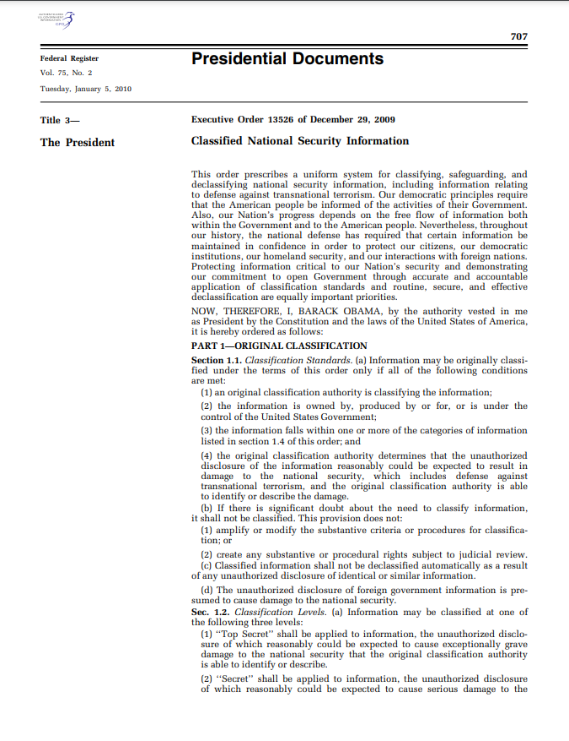
Classification
Carlos Medina
“Information, the unauthorized disclosure of which, reasonably could be expected to cause”: [4]
Damage - Confidential
Serious damage - Secret
Exceptionally grave damage - Top Secret
[4]
Notes:
In 2013, Snowden was hired by an NSA contractor, Booz Allen Hamilton, after previous employment with Dell and the CIA. This made him a member of the intelligence community
Things that can be classified:
Military plans, weapon systems, or operations
• Foreign government information (FGI)
• Intelligence activities , intelligence sources or methods, or
cryptology
• Foreign relations or foreign activities of the United States, including confidential
sources
• Scientific, technological, or economic matters relating to the national security
• U.S. Government programs for safeguarding nuclear materials or facilities
• Vulnerabilities or capabilities of systems, installations, infrastructures, projects, plans,
or protection services relating to the national security
• The development, production, or use of weapons of mass destruction
An individual is normally subject to reinvestigation approximately every five years for a Secret or Top Secret clearance.
Snowden had inconclusive polygrahp, then passed

Slide 17

Timeline
Carlos Medina
2006: Hired by Dell for the CIA as an IT expert. Granted top-secret clearance
2007-2009: Posted to Europe. Becomes disillusioned with, “his government's impact on the world”
2009-2012: Critical assessment of work behavior; begins collecting documents
2013: Joins BAH to gain access to more documents; contacts multiple news agencies [3]
[16]
Notes:
In 2013, Snowden was hired by an NSA contractor, Booz Allen Hamilton, after previous employment with Dell and the CIA. This made him a member of the intelligence community
Gaurdian, Glenn Greenwald, Ewan MacAskill, and Laura Poitras.
Nsa hawaii, snowden was doing IT.

Slide 18
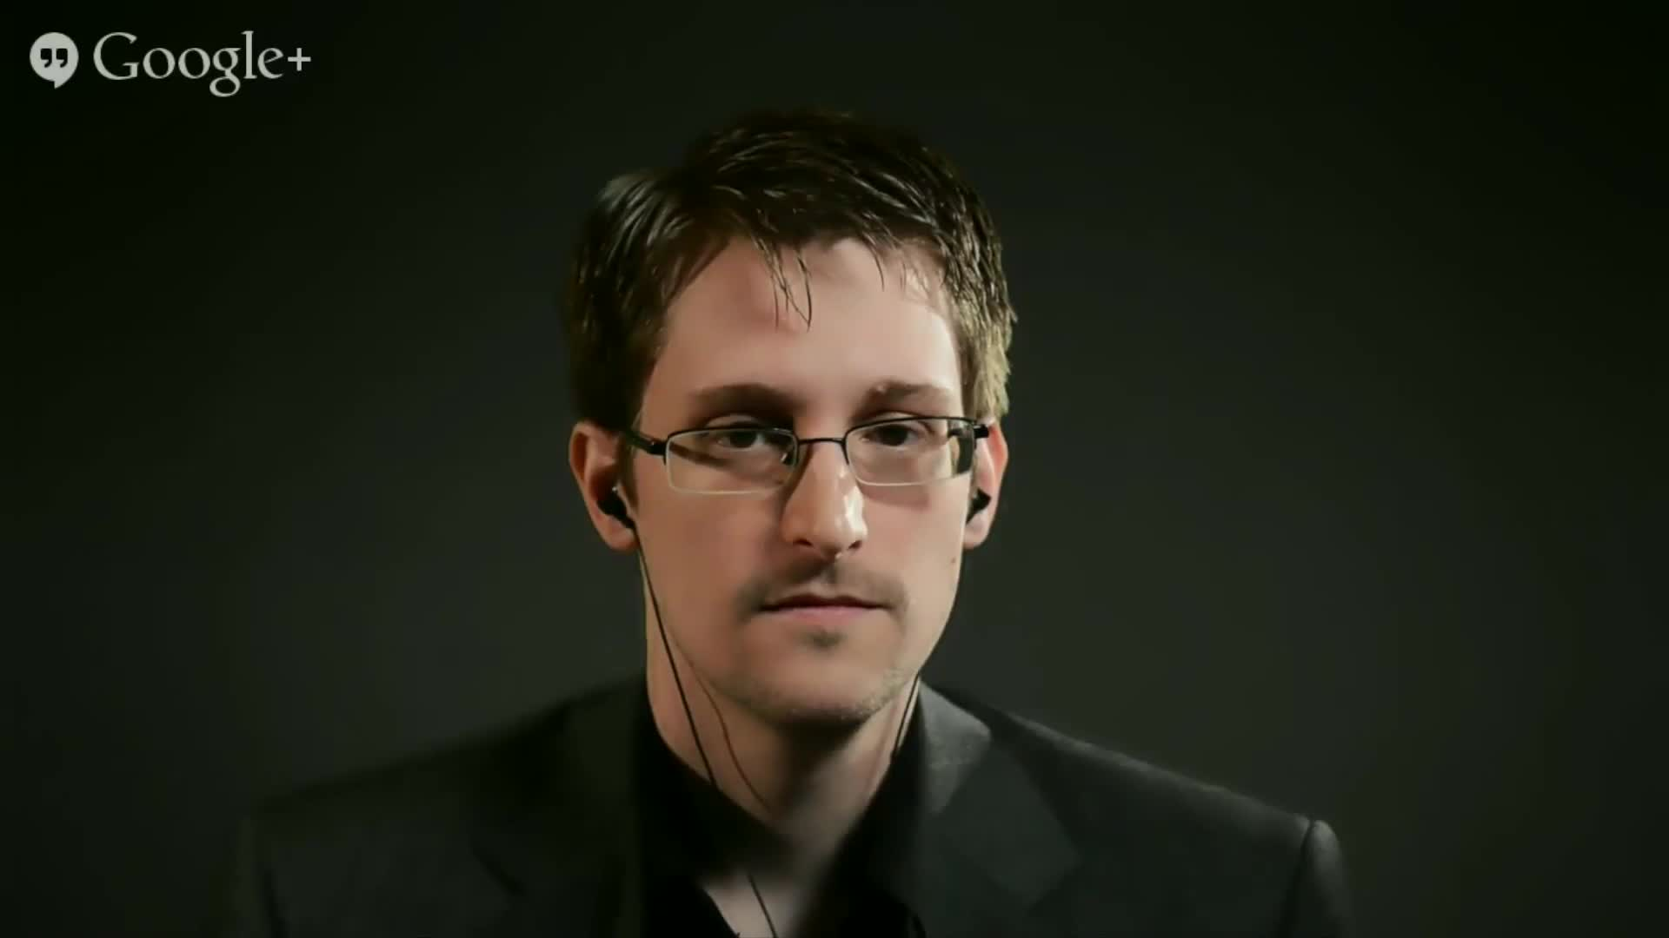
Conflicting reports
Carlos Medina
Snowden stated he tried to raise his concerns up through the chain of command [5]
IC & DOD report states no evidence of internal escalation about programmatic ethical concerns; went straight to the press [6]
On July 12, 2012—eight months before DNI Director James Clapper's testimony—Snowden began his mass downloading [6]
[17]
Notes:
In 2013, Snowden was hired by an NSA contractor, Booz Allen Hamilton, after previous employment with Dell and the CIA. This made him a member of the intelligence community
<find picture of him/ reporter collage?>
Snowden states clapper testimony was breaking point, but started 8 months before. Recorded x incidents relating to manager meetings, none of which deal with ethical/ moral concerns. Only one close was him failing FISA compilance traing 3 times, and complaing to manager that the test was “rigged”. History of exageration and outrage, contacted one of the top 10 IT managers in the NSA company for a simple internal matter after another employee questioned one of his work methods, unrelated to the leaks
Downmeall!, wget, perused user files--got his coworkers to give him their certificates to access these files. When manager asked why his storage was much more used than coworkers, he said that they were security patches
Clapper: "Does the NSA collect any type of data at all on millions or hundreds of millions of Americans?". Director Clapper answered "No, sir ... not wittingly."

Slide 19
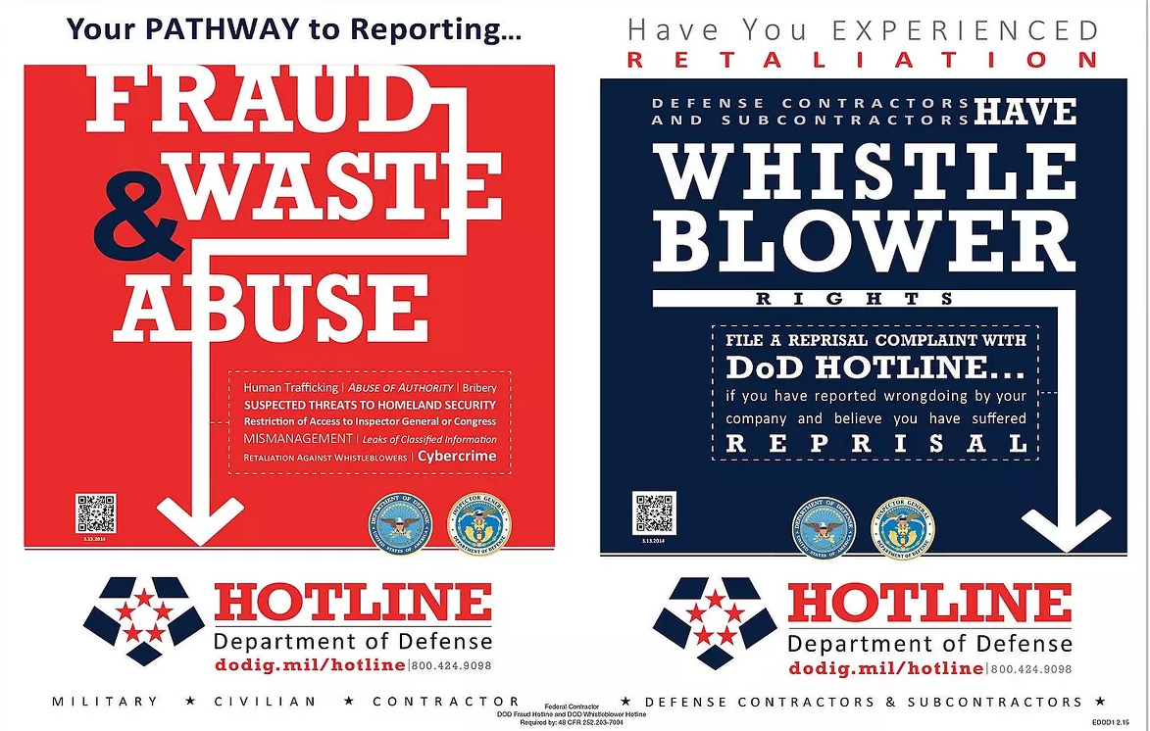
The process
Carlos Medina
Identify the issue
Document the facts
Who needs to know
Protected Disclosure: right info to the right people
Decide confidentiality
OIG vs. chain of command
Pros and cons of anonymity
Contact Inspector General
Call hot line or send mail [7][18]
[2]
Notes:
In 2013, Snowden was hired by an NSA contractor, Booz Allen Hamilton, after previous employment with Dell and the CIA. This made him a member of the intelligence community
For reporting possible existence of an activity constituting a violation of law, rules, or regulations, or mismanagement, gross waste of funds, abuse of authority or a substantial and specific danger to public health and safety.
Internal escalation, FISA ammendment, hotline number, protected from retaliation DOD whistle blower program, Defense Intelligence Community Whistleblower Protection, protected disclosure
PD is right information to right people. Automically a whistle blower and entitled to protections
Recent DODIG bust was on october 5th, for copmany RPS Group, Inc, which moved labor hours across different dod contracts to avoid overrunning one. $465k
Identify the issue: What, based on the above, is the violation of law, rule, or regulation; gross mismanagement; a gross waste of funds; an abuse of authority; or a substantial and specific danger to public health or safety?
Document: no emelbishments, may hamper case if it is taken to a merit court, or undermine your argument
Employees should be protected against reprisal for the lawful disclosure of information which the employees reasonably believe

Slide 20
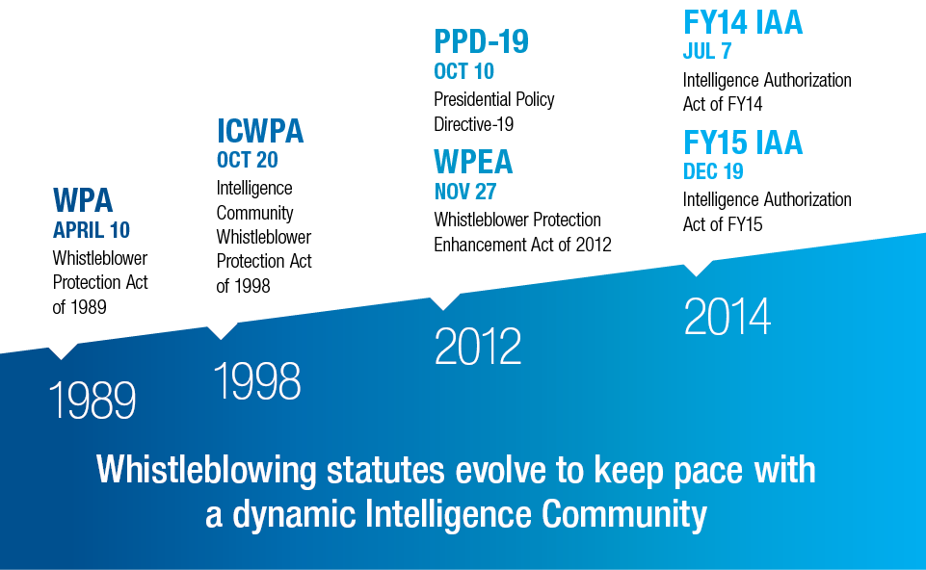
Legal support, and Who’s who?
Carlos Medina
Edward Snowden was a civilian subcontractor for DOD [2]
Only protected if a Protected Disclosure was made [7]
PPD-19, ICD 120 [8][9]
Use the ICWPA [10]
Urgent matters can report to congress [11]
[11]
Notes:
In 2013, Snowden was hired by an NSA contractor, Booz Allen Hamilton, after previous employment with Dell and the CIA. This made him a member of the intelligence community
For reporting possible existence of an activity constituting a violation of law, rules, or regulations, or mismanagement, gross waste of funds, abuse of authority or a substantial and specific danger to public health and safety
Whos who: Intelligence Community Inspector General, Department Of Defense Office of Inspector General, Director of National Intelligence. Congress if necessary
Presidential policy directive. Intelligence community directive

Slide 21
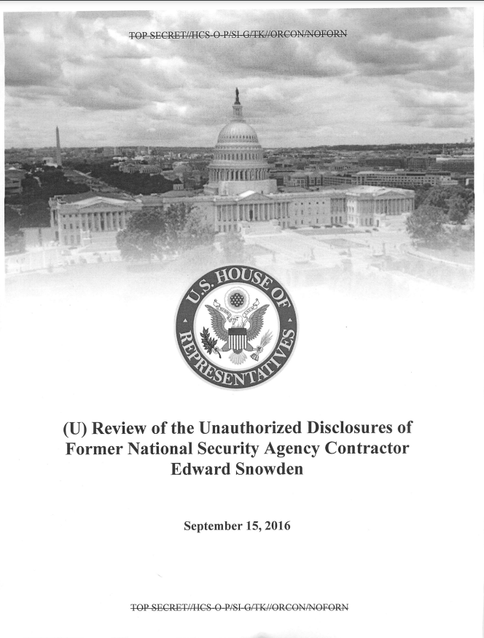
Damage done
Carlos Medina
150k out of 1.5m documents were made public
Pertain to military, defense, and intelligence programs
Terrorists changed communications methods to bypass monitoring [12]
21 examples of S/TS//SI leaks that highlight scope of breach
“American troops will be at greater risk in any future combat” [6]
[6]
Notes:
In 2013, Snowden was hired by an NSA contractor, Booz Allen Hamilton, after previous employment with Dell and the CIA. This made him a member of the intelligence community
Millions to billions to rebuild programs and find new collection capabilities to replace compromised capabilities
Most info on damage assement is through the 2016 unclassified review published by congress. Specific figures are still classified

Slide 22
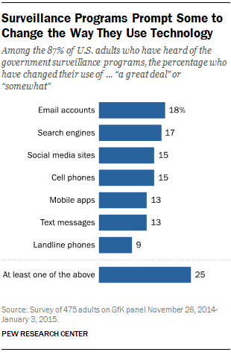
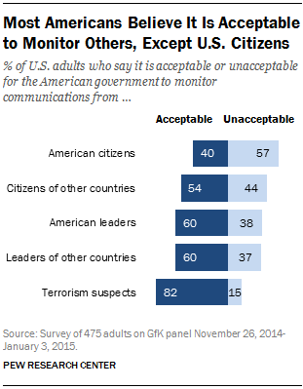
The Snowden effect
Carlos Medina
USA Freedom Act of 2015 [13][14]
Contractors explicitly protected by the FISA re-authorization act of 2018, sec. 110 [19]
Automatically detect wget-like tools, two person sign off on removable media, and improved access controls [6]
Public perception on intelligence programs [15]
[15]
Notes:
Freedom act was to ammend section 215 of patriot act. Select examples are no more bulk collection from indiscriminant locations like zip code, fisa court opinions are to be made public. Single records, tho no provision on non target people. If an emergency, data can be collected. Fisa court denial? → destroy that collected info. The NSA was unable to separate out the valid CDRs, and therefore the agency chose to delete the entire database of CDRs collected since the new program began in late 2015.
In 2013, Snowden was hired by an NSA contractor, Booz Allen Hamilton, after previous employment with Dell and the CIA. This made him a member of the intelligence community
The bill expands FISA reporting requirements to require reporting of: (1) the total number of persons subject to electronic surveillance conducted under an order or emergency authorization, including the number of such individuals who are U.S. persons; and (2) a good faith estimate of the total number of subjects who were targeted by the installation and use of a pen register or trap and trace device under an order or emergency authorization.
Increased scrutaniy in american public of government and private company surveillance Still strong support for non us citizen monitoring and data collection
4 out of x remedies as of 2016 were no implimented
Freedom act: 40 targets for orders to obtain CDRs, but 534,396,285 CDRs were collected.
First pic: On a different question, 34% of those who were aware of the government surveillance programs said they had taken at least one step to hide or shield their information from the government, such as by changing their privacy settings on social media.
Second:

Slide 23

Conclusions
Carlos Medina
Persons with access to classified information have a duty to report illegal activities
Whistle blowing through proper channels preserves national security
Federal whistle blowing laws protects both contractors and employees in reporting waste, fraud, and abuse
[20]
Notes:
In 2013, Snowden was hired by an NSA contractor, Booz Allen Hamilton, after previous employment with Dell and the CIA. This made him a member of the intelligence community
You have rights as a whistle blower.
Proper channels are so that even though program may be illegal, going straight to the press may reveal capabilities that are unknown to adversaries, and can affect other, legal programs
Contractors/employees have a duty/required to report grievances

Slide 24
References
Carlos Medina
[1]IC Elements. Office of the Director of National Intelligence. https://www.dni.gov/files/ODNI/images/article_images/IC_elements.png [2] ComplyRight DOD Fraud and Whistleblower Hotline Poster English. https://www.staples.com/ComplyRight-DOD-Fraud-and-Whistleblower-Hotline-Poster-Engilsh/product_1949678 [3]Edward Snowden timeline. 2014. https://www.nbcnews.com/feature/edward-snowden-interview/edward-snowden-timeline-n114871 [4]Executive order 13526. 2010. https://www.archives.gov/files/isoo/pdf/cnsi-eo.pdf [5]Glenn Kessler. 2014. Edward Snowden’s claim that he had ‘no proper channels’ for protection as a whistleblower. https://www.washingtonpost.com/news/fact-checker/wp/2014/03/12/edward-snowdens-claim-that-as-a-contractor-he-had-no-proper-channels-for-protection-as-a-whistleblower/ [6]Congress. Review of unauthorized disclosures of former NSA contractor Edward Snowden. 2016 https://intelligence.house.gov/uploadedfiles/hpsci_snowden_review_declassified.pdf [7]How do I report? DNI. https://www.dni.gov/ICIG-Whistleblower/process-how.html [8]PPD 19. 2012. The White House. https://irp.fas.org/offdocs/ppd/ppd-19.pdf [9]ICD 120. 2014. DNI. https://www.dni.gov/files/documents/ICD/ICD%20120.pdf [10]About the ICWPA. 1998. DODIG. https://www.dodig.mil/Components/Administrative-Investigations/Whistleblower-Reprisal-Investigations/Intelligence-Community-Whistleblower-Protection-Act/ [11]MAKING LAWFUL DISCLOSURES. DNI. https://www.dni.gov/index.php/who-we-are/organizations/icig/icig-related-menus/icig-related-links/making-lawful-disclosures#:~:text=The%20Intelligence%20Community%20Whistleblower%20Protection,see%20below)%20without%20suffering%20reprisal [12]Tom Gjelten. The Effects Of The Snowden Leaks Aren't What He Intended. 2013. https://www.npr.org/2013/09/20/224423159/the-effects-of-the-snowden-leaks-arent-what-he-intended

Slide 25
References
Carlos Medina
[13]Congress. USA freedom act of 2015. 2015. https://www.congress.gov/114/plaws/publ23/PLAW-114publ23.pdf [14] Sharon Bradford Franklin. Fulfilling the Promise of the USA Freedom Act: Time to Truly End Bulk Collection of Americans’ Calling Records. 2019. https://www.justsecurity.org/63399/fulfilling-the-promise-of-the-usa-freedom-act-time-to-truly-end-bulk-collection-of-americans-calling-records/#:~:text=The%20USA%20Freedom%20Act%20was,detail%20records%E2%80%9D%20(CDRs) [15]A. W. Geiger. How Americans have viewed government surveillance and privacy since Snowden leaks. 2018. https://www.pewresearch.org/short-reads/2018/06/04/how-americans-have-viewed-government-surveillance-and-privacy-since-snowden-leaks/ [16]NSA. NSA Hawaii. https://www.nsa.gov/About/Locations/ [17]Jane Mayer. 2014. The New Yorker. https://www.newyorker.com/video/watch/the-new-yorker-festival-the-virtual-interview-edward-snowden [18]DODIG. DoD Hotline - Classified Complaints. https://www.dodig.mil/Components/Administrative-Investigations/DoD-Hotline/Classified-Complaint/ [19]Congress. FISA Amendments Reauthorization Act of 2017. 2018. https://www.congress.gov/115/plaws/publ118/PLAW-115publ118.pdf [20]Seal of the Office of the Director of National Intelligence. DNI. https://commons.wikimedia.org/wiki/File:Seal_of_the_Office_of_the_Director_of_National_Intelligence.svg

Slide 26
Blockchain and Society
Hasan Gandor
Notes:
Social Equity
Transparency
Accountability
Efficiency

Slide 27
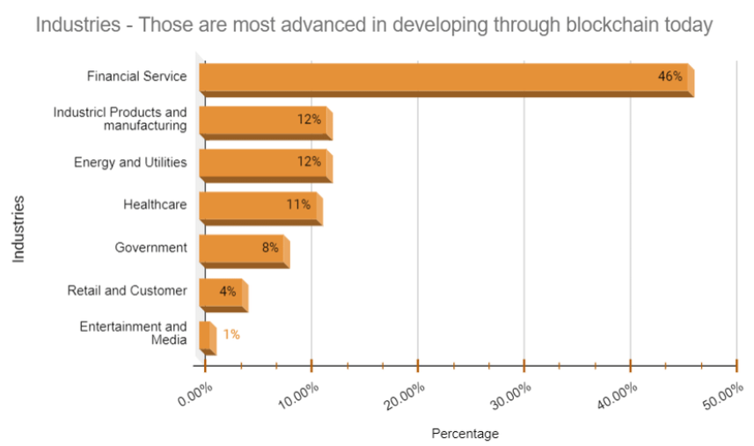
What is blockchain?
Hasan Gandor
"Establishing trust in a distributed system" [1]
Store data immutably [6]
Decentralized and replicated [2]
General-purpose technology [3]
Market value
$92 billion in 2021. [5]
$1,431.54 billion in 2030. [5]
"Global spending on blockchain solutions will reach $19 billion by 2024." [4]
Industries which utilize blockchain the most [10]
Notes:
What did problem blockchain solve?
"The problem that Nakamoto solved with the blockchain was that of establishing trust in a distributed system. More specifically, the problem of creating a distributed storage of timestamped documents where no party can tamper with the content of the data or the timestamps without detection." [1]
"What makes blockchain technology unique is its ability to store data immutably without relying on a central authority. This allows it to preserve its integrity and prevent hacking or other manipulation attempts. As such, it has the potential to replace the intermediary and central entities with code alone that can reliably connect users with each other " [6]
Blockchain is decentralized and replicated
"Blockchain—the decentralized replicated ledger technology that underlies Bitcoin and other cryptocurrencies—provides a potentially attractive alternative way to organize modern finance. [2]
Although utilized a lot in cryptocurrencies, it is a much more general purpose technology
"But the frenzy around Bitcoin obscures the fact that blockchain, the technology underpinning cryptocurrencies, is a much more general-purpose technology, one that holds the potential to revolutionize far more than just currency markets. The revolutionary potential of blockchain lies in its ability to securely inventory, track, subdivide and transfer wealth over the Internet. In a nutshell, what the Internet was to social media — the core enabling technology — blockchain is to the possibility of a true sharing economy." [3]
Market value
"The global blockchain technology market's value was 92 billion USD in 2021. By 2030, it will be worth 1,431.54 billion USD." [5]
Spending on blockchain solutions
"The global spending on blockchain solutions will reach $19 billion by 2024." [4]

Slide 28
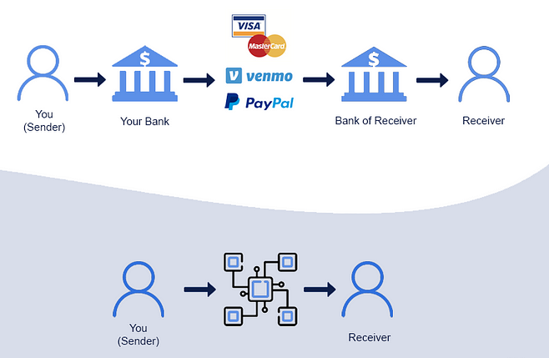
BLOCKCHAIN IN FINANCE
Hasan Gandor
The current financial system depends on centralized trusted intermediaries [2]
Blockchain provides a tamper resistant ledger [2]
Cryptocurrencies
Popular in response to 2008 financial crisis [6]
Large transactions without centralized trust [6]
Traditional financial systems (top) go through multiple centralized institutions, whereas decentralized ones (bottom) go through none. [11]
Notes:
Current financial system depends on centralized institutions
"Currently, the financial system depends on a number of centralized trusted intermediaries: central counter parties (CCPs) guarantee trades in exchanges; central securities depositories (CSDs) provide securities settlement; the Society for Worldwide Interbank Financial Telecommunication (SWIFT) intermediates global transfer of money; CLS Bank handles the settlement of foreign exchange transactions, a handful of banks dominate correspondent banking, and an even smaller number provide custodial services to large investment institutions" [2]
Tamper resistant ledger
"The blockchain is a decentralized, replicated, tamper resistant (immutable), append-only ledger of transactions" [2]
Cryptocurrencies
"Bitcoin offered a technological response: for the first time ever, people would be able to carry out large monetary transactions without the need to trust or rely on intermediaries. Built on the principles of an interconnected and interdependent chain of blocks–with each block being a record of a cryptographically signed transaction, hence the term ‘block-chain’–the trust would shift away from third parties and legacy institutions towards code and a community-based, open-source, peer-to-peer system of transparency and accountability." [6]
Response to 2008 crisis
"… [cryptocurrencies] breakout into the public sphere also has to be understood in the context of a strong public reaction to the pitfalls of centralised systems and institutions after the 2008 financial crisis..." [6]
John Quiggin (Australian economist) lays the blame for the 2008 near-meltdown on financial markets, on political decisions to lightly regulate them, and on rating agencies which had self-interested incentives to give good ratings. [https://en.wikipedia.org/wiki/2007%E2%80%932008_financial_crisis#cite_note-298]
Removed the need for centralized trust
"Bitcoin offered a technological response: for the first time ever, people would be able to carry out large monetary transactions without the need to trust or rely on intermediaries." [6]

Slide 29
Social equality
Hasan Gandor
Individuals are negatively impacted when power is abused
Blockchain does not favor anyone [6]
Smart contracts [6]
No room for subjective human interpretation
$60 million worth of Ether lost due to buggy code [7]
Notes:
Abuse of Power
"Individuals are often negatively impacted when a particular group or person abuses power to the detriment of other members of the community." [6]
Blockchain is permissionless
"In a permissionless blockchain eco-system, code is written in a way that does not favour certain individuals or groups overothers. Permissionless blockchains typically rely on open-source code that does not differ-entiate between users based on social status, ethnicity or any other non-technical charac-teristics" [6]
Smart contracts
"One of the latest features of blockchain technology is called ‘smart contracts’, which can be described as automated computer programs that can be triggered to transfer digital assets automatically within the same blockchain, upon meeting certain triggering conditions" [6]
"no room for subjective human interpretation" [6]
Smart contracts can still have buggy code in them
"Blockchain-Based Venture Capital Fund Hacked for $60 Million" [7]

Slide 30
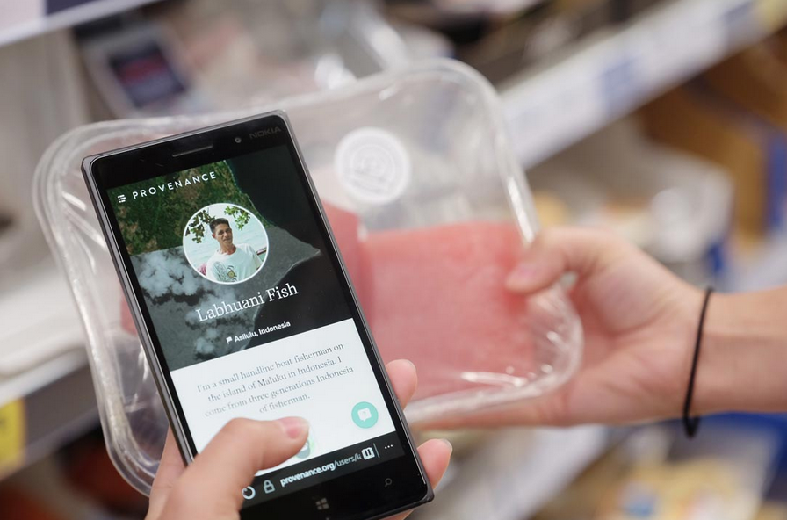
Transparency
Hasan Gandor
Corruption and human rights violations thrive in secrecy [6]
Blockchain offers total transparency [6]
Information can be traced to its source
Indonesia seafood industry
60 million people live within coastal communities [8]
Human rights abuses
Blockchain tracking tuna sales [8]
Consumers can make informed decisions about their purchases through blockchain-enabled supply chain tracking. [8]
Notes:
Corruption thrives in secrecy
"Corruption and human rights violations often thrive in environments of secrecy, infor-mation asymmetry and opaque communication channels." [6]
Total transparency
"In stark contrast, blockchains are designed to bring total transparency to nodes in the system so that every singlepiece of information can be traced to its source and followed through with ease." [6]
Indonesia fishing
Background information
"In Indonesia, more than 60 million people live within coastal communities and tuna fisheries are a major source of employment and foreign exchange. Particularly in the North of Indonesia, however, tuna fishing is complicated by Philippine tuna fishing vessels, with most of the fish catches by Philippine purse seiners unrecorded." [8]
"Every fisherman, supplier and factory worker we met had a mobile phone. 3G and wifi was patchy but accessible from most of the towns and villages we visited." [8]
Human rights abuses
"Human rights abuses, overfishing, fraud, illegal, unreported, and unregulated (IUU) fish: a number of practices in the seafood industry are compromising the wellbeing of environments, wildlife and people all over the world. According to The Guardian, “slaves forced to work for no pay for years at a time under threat of extreme violence are being used in Asia in the production of seafood sold by major US, British and European retailers.” [8]
Provenance
Provenance pilot blockchain technology for tracing yellowfin and skipjack tuna fish in Indonesia from catch to consumer.
"… consumer-facing transparency for food and other physical goods" [8]
"The pilot was successful in tracking responsibly-caught fish and key social claims down the chain to export. Provenance's ambition was not to demonstrate yet another digital interface, but a solution to the grave need for data interoperability: for tracking items and claims securely, end-to-end, in a highly robust, yet accessible format without the need for a centralised data management system." [8]
"Sharing data securely between different parties is a clear barrier for achieving the level of trusted traceability needed to prove slavery-free fish"[8]
"The application links identity, location, material attributes, certifications and audit information with a specific item or batch ID. The data is stored in an immutable, decentralized, globally-auditable format which protects identities by default, allowing for secure data verification." [8]

Slide 31
Accountability
Hasan Gandor
Smart contracts can be utilized for accountability [6]
Pharmaceutical industry deals with counterfeit drugs market [9]
Millions of lives at risk [9]
Opaque supply-chain
Counterfeit drug market is worth $75 to $200 billion [9]
More than 100,000 deaths [9]
iSolve, Blockverify, Chronicled [9]
Notes:
Pharmaceutical Industry
"The global pharmaceutical industry is faced with a thriving counterfeit drugs market, a source of unfair competition that harms innovative and generic industries, and most importantly, puts millions of lives at risk. Despite strict enforcement efforts and policies, the problem of counterfeit drugs continues to exist and grow by dangerous proportions." [9]
Opaque supply-chain
"The problem of counterfeit drugs in the global pharmaceutical industry is exacerbated by its complicated and opaque supply chain. In one of its report, Pfizer points out that, “…growing involvement in the drug supply chain of under-regulated wholesalers and re-packagers, the proliferation of Internet pharmacies, advancements in technology that make it easier for criminals to make counterfeit drugs, and the increased importation of medicines.”" [9]
Proliferation and the Harms of counterfeit drugs
"The estimates on the size of the global counterfeit drug market range from $75 to $200 billion and can make up half of all drugs sold in some low-income countries as per the U.S. Department of Commerce. Such illegal operations have resulted in more than 100,000 deaths all over the world." [9]
Market value
"The global blockchain technology market's value was 92 billion USD in 2021. By 2030, it will be worth 1,431.54 billion USD." [5]
Spending on blockchain solutions
"The global spending on blockchain solutions will reach $19 billion by 2024." [4]
Blockchain-based tech startups are attempting to address this issue
"In addition, start-ups such as iSolve, Blockverify, Chronicled are engaged in projects related to blockchain and pharmaceutical supply chain. Blockverify conducted a pilot project with a Swiss pharmaceutical company in 2015 while iSolve’s Project BlockRx is working on “developing and enhancing the drug supply chain and new drug development by leveraging the blockchain technology. In November, Chronicled launched CryptoSeal which are blockchain registered, tamper-evident adhesive seal strips containing a Near Field Communication (NFC) chip that can be customized to fit and seal shipments of pharmaceuticals, including individual’s cartons and containers." [9]

Slide 32
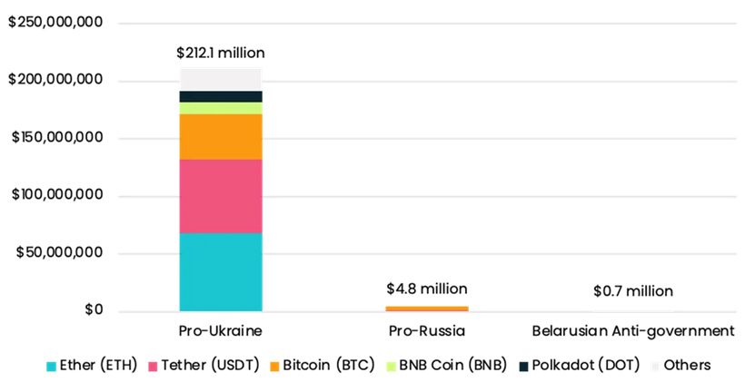
Efficiency
Hasan Gandor
Humanitarian aid often takes too long to reach victims [6]
Bureaucracy, paperwork, political barriers
Smart-contracts can send funds automatically [6]
Global
Contribute to humanitarian causes
Nation-wide elections [6]
Aid has arrived in Ukraine and Russa through
cryptocurrency donations [12]
Notes:
Humanitarian aid often takes too long
"During times of humanitarian disasters or military conflicts, financial aid to buy medication and other urgently needed supplies often takes too long to reach the victims. Delays caused by bureaucracy, paperwork or political barriers can potentially lead to irreversible loss of property, injuries and even death" [6]
Smart contract usage
"An instantaneous trigger of a transaction to send an emergency fund any-where around the world is one major advantage that blockchains could provide, and thereby contribute to humanitarian causes." [6]
Election processes
"nationwide elections that are fraud resistant and can return prompt, verifiable results without significant delays" [6]

Slide 33
References
Hasan Gandor
[1] M. Di Pierro, "What Is the Blockchain?," in Computing in Science & Engineering, vol. 19, no. 5, pp. 92-95, 2017, doi: 10.1109/MCSE.2017.3421554.
[2] Varma, J. R. (2019). Blockchain in Finance. Vikalpa, 44(1), 1-11. https://doi.org/10.1177/0256090919839897
[3] Berggruen, Nicolas. "Here’s how blockchain can reduce inequality." The Washington Post. Retrieved 5.8 (2018): 2020.
[4] Daniel Ruby, "75 Blockchain Statistics — Demographics, Cryptos & More (2023)", (DemandSage, June 10, 2023), https://www.demandsage.com/blockchain-statistics/,, Accessed 13 Oct. 2023.
[5] Michael Georgiou, "Key Blockchain Statistics and Trends You Should Know in 2023", (Imaginovation Insider, September 11th, 2023), https://imaginovation.net/blog/blockchain-statistics-trends/, Accessed 13 Oct. 2023.
[6] Walid Al-Saqaf & Nicolas Seidler (2017) Blockchain technology for social impact: opportunities and challenges ahead, Journal of Cyber Policy, 2:3, 338-354, DOI: 10.1080/23738871.2017.1400084
[7] Morris, D.2016.“Blockchain-Based Venture Capital Fund Hacked for $60 Million.” June 18. Fortune.http://fortune.com/2016/06/18/blockchain-vc-fund-hacked
[8] Provenance.2016.“From Shore to Plate: Tracking Tuna on the Blockchain.” July 15.https://www.provenance.org/tracking-tuna-on-the-blockchain.
[9] Bajpai, P.2016.“Blockchain Technology Can Help Reduce the Flow of Counterfeit Drugs.”December14.http://www.nasdaq.com/article/blockchain-technology-can-help-reduce-flow-of-counterfeit-drugs-cm721230.
[10] Towards a Blockchain Based Supply Chain Management for E-Agro Business System - Scientific Figure on ResearchGate. Available from: https://www.researchgate.net/figure/Statistics-of-Industries-those-are-most-advanced-in-developing-through_fig5_347416277 [accessed 13 Oct, 2023]
[11] Dheeraj Koneru, "Decentralized Finance(DeFi) vs Centralized Finance(CeFi)", (Medium, Sep 24, 2021), https://medium.com/tchyon/defi-a-new-chapter-in-indias-finance-book-e7b653683bbf, Accessed 13 Oct. 2023.
[12] "Crypto Donations to Ukraine and Russia: Breaking Down the Numbers", (Elliptic), https://www.elliptic.co/blog/analysis/crypto-donations-to-ukraine-and-russia-breaking-down-the-numbers, Accessed 13 Oct. 2023.

Slide 34
When robots hold the scalpel
Guillermo Morel

Slide 35
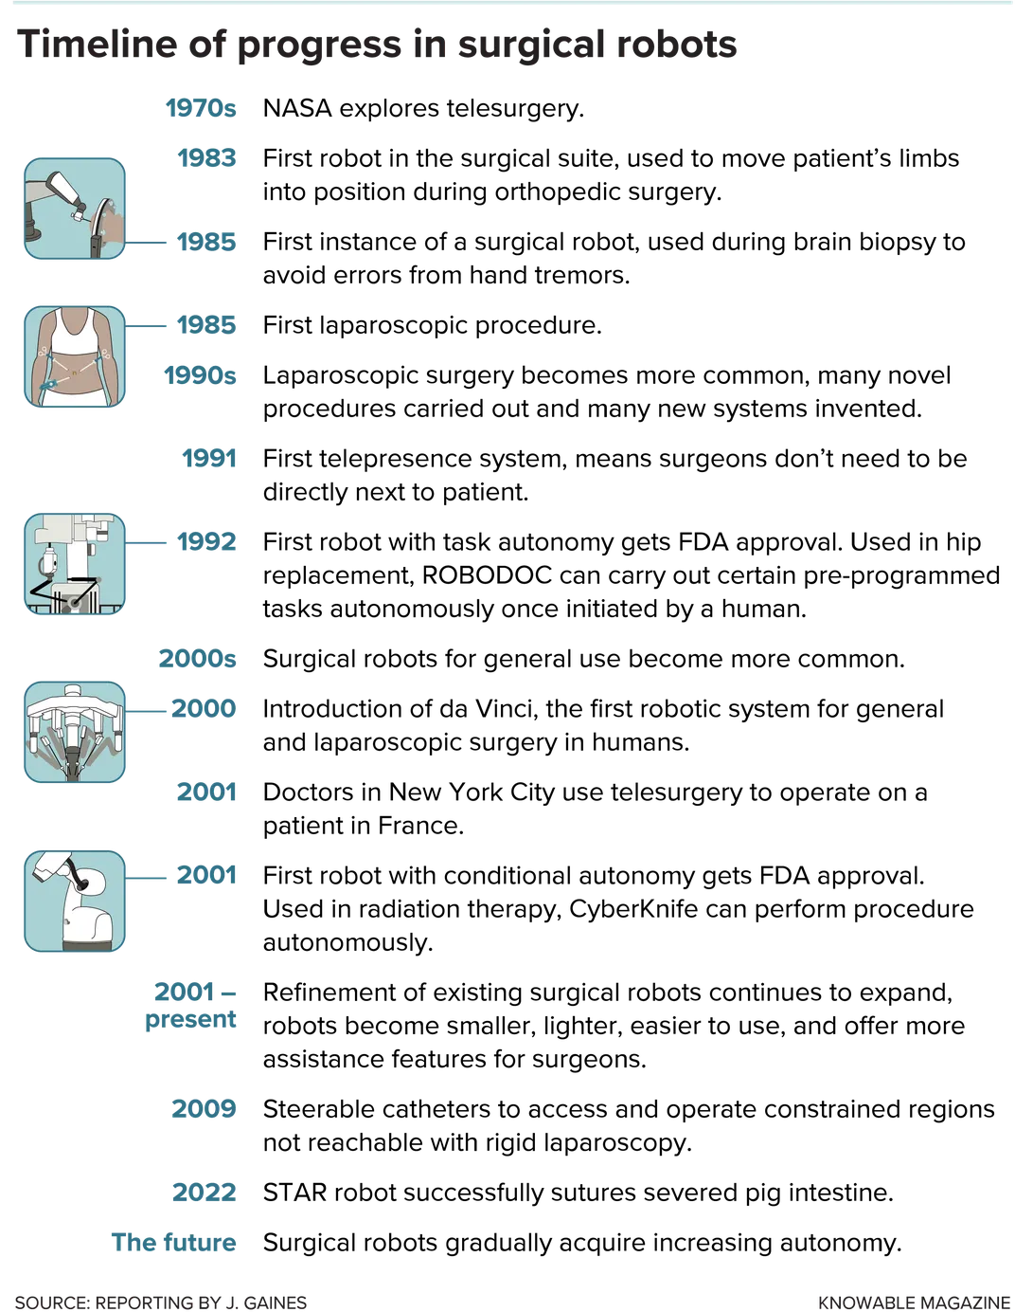
The rise of robotic surgery
Guillermo Morel
Robotic surgery offers enhanced precision, control, and flexibility in surgical procedures[1]
Robots like the da Vinci system can perform complicated procedures
Approximately 85% of all radical prostatectomies in the U.S. are now performed using robotic assistance.[1]
[1]
Notes:
Robotic surgery, once considered science fiction, has become a reality in today's healthcare landscape. It offers enhanced precision, control, and flexibility in surgical procedures, transforming the way surgeries are conducted. Robots such as the widely used Da Vinci system can perfom complex procedures in many specialties. Some of these specialties include cardiology, coloproctology, pulmonology, urology, gynecology, and otolaryngology. Most studies have shown no significant differences in patient survival or long-term control of prostate cancer between the two methods.
Robotic prostatectomies are believed to offer better quality-of-life outcomes, especially concerning urinary function and sexual health. However, previous evidence was not definitive.

Slide 36
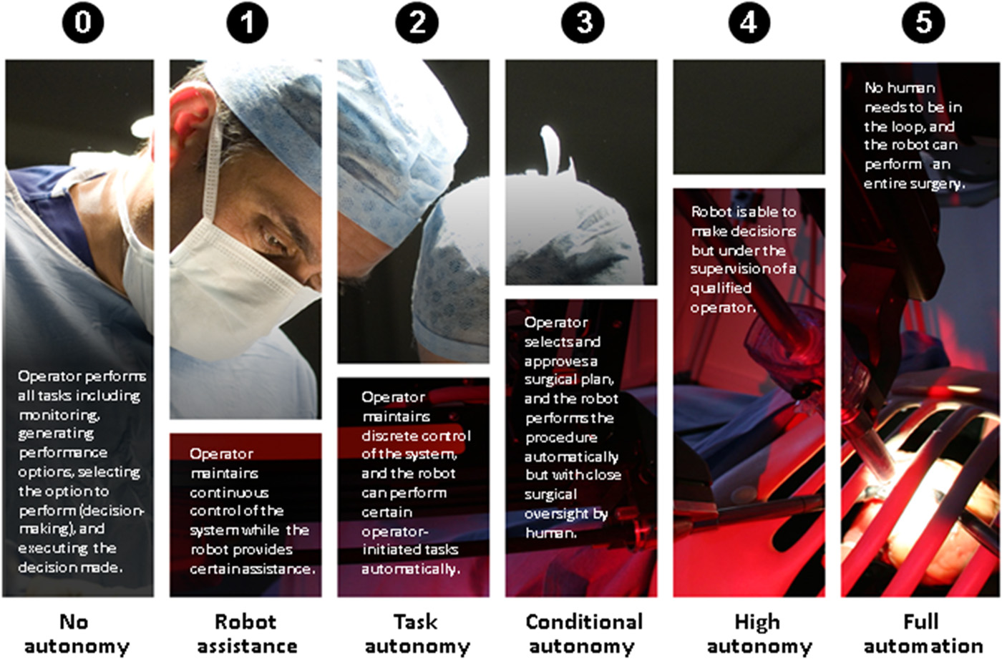
Automating Life-saving Decisions
Guillermo Morel
Robotic systems can function independently based on pre-surgical programming or under direct control of a surgeon.[1]
Balance between human judgment and machine precision is important.
[1]
Notes:
Radical prostatectomy, a common treatment for prostate cancer, can be performed using the traditional "open" method or the robot-assisted method. While the traditional method involves a larger incision below the belly button, the robot-assisted method uses miniaturized robotic instruments controlled remotely by surgeons.
Robots currently don’t have a high level of agency but there are ones being developed with a higher level of autonomy at level 3 and 4

Slide 37

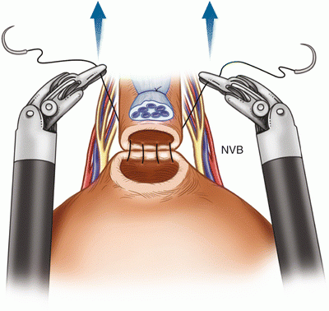
Hands vs hardware
Guillermo Morel
Robotic systems have similar or better outcomes than conventional surgery in some procedures
For radical prostatectomy procedure patients had shorter hospital stays, lower pain, and less problems with clotting[2]
Shorter hospital stays 1.6 days vs 2.1 days
Lower pain
Less complications
Same overall success rate[2]
Notes:
Harvard-Affiliated Study Insights:
The study followed 1,094 men treated with radical prostatectomy between 2003 and 2013.
Results indicated that both methods were equally effective in cancer removal.
Men who underwent robotically-assisted surgery had:Shorter hospital stays (1.6 days vs. 2.1 days).
Lower post-surgery pain scores for the following 6 weeks after the serugery
Fewer complications like blood clots(10 men versus three men),, urinary tract infections, and bladder neck contracture.

Slide 38

Hands vs hardware (continued)
Guillermo Morel
Out of 39 studies 4 showed fewer complications with robot surgery, while the others showed little difference.[3]
Shows there is little advantage right now
Complications rates in those 4 studies [3]
Life threatening complications 0-2% for robot vs 0-3% for traditional
Operation must be switched to open operation 12% of the time for traditional operation vs 8% for robotic
Life threatening complications 1-4% for open surgery
Notes:
Robotic surgery is performed by surgeons, not robots. But instead of conventional hand-held tools used in laparoscopic surgery, which involves tiny incisions, and open surgery, in which the surgeon enters the body through a large incision, the doctor uses a machine.
In studies of gynecological robotic surgeries, duration ranged as high as 265 minutes, compared with maximums of 226 minutes for laparoscopy and 187 for open procedures.

Slide 39
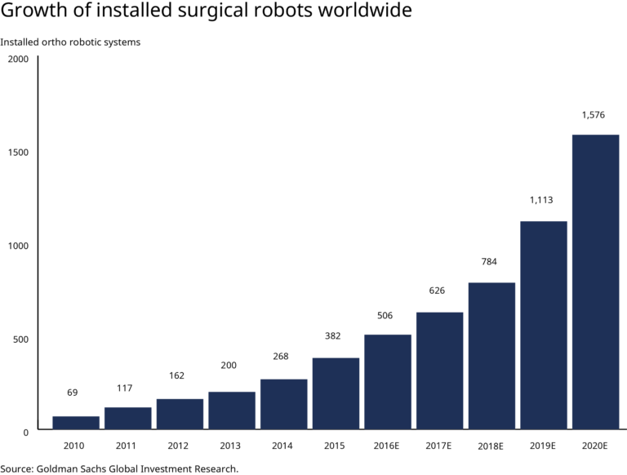
Will Our Future Doctors Be Droids?
Guillermo Morel
Robotic surgery gaining acceptance between doctors[4]
Even then, many physicians are still skeptical of these new methods
New surgeons already trained on robot assisted surgery[4]
Market for surgical robots is in its infancy but has huge potential
There are still challenges for these systems that need to be addressed before widespread adoption[5]
[5]
Notes:
Many physicians are still skeptical of these new methods and argue that there is little difference between robotic surgery and traditional surgery, which is ironic as that is already a huge achievement.
These machines are proven to be safe but it would be pretty scary to be operated on by a fully autonomous drone. Quote from resident Dr. Naila H. Dhanani:
said that for a patient, there is no reason to choose robotic surgery over other modes.
“Just because something’s new and fancy doesn’t mean it’s the better technique,” she said. “Yes, robotic is safe, we’ve proven that. But we haven’t proven it’s better. There were four studies that showed a benefit with robotic surgery, so that’s quite modest. Forty-six showed no difference at all.”
vs
“The next generation of surgeons are much more competent on the robot than they are laparoscopically for some of the more advanced procedures,” noted Dr. Vincent
A decade ago, Dr. Vincent performed approximately 30 to 40 robotic surgery procedures per year; last year, he completed 315 robotic surgery procedures.

Slide 40
Conclusion
Guillermo Morel
Robotic surgery should be augmenting physicians not replacing them
These tools can improve health outcomes and improve access to treatment
Fully autonomous surgery is hard to ethically justify, and is bound to dehumanize healthcare
The potential robots have in healthcare is huge
Notes:
Robotic surgery is a tool, not a replacement. Just as a scalpel or a stethoscope aids a physician, robotic tools should be seen in the same light. They are meant to enhance the capabilities of the surgeon, allowing for greater precision and control.
The human touch, judgment, and experience cannot be replicated by machines. Physicians bring empathy, intuition, and years of training to the operating table, aspects that robots cannot replicate.
Robotic surgery can lead to quicker recovery times, reduced hospital stays, and less post-operative pain for patients.
In areas with limited access to specialized surgeons, robotic tools can bridge the gap, allowing remote surgeries and consultations.
The idea of a machine making life-altering decisions without human intervention raises significant ethical concerns. What if there's a malfunction or a misjudgment?
Healthcare is not just about treating diseases; it's about caring for individuals. Removing the human element from such a personal and intimate process can lead to a cold, transactional experience for patients.
As technology advances, we'll see robots taking on more roles, but always as a complement to human healthcare professionals, not a replacement.

Slide 41
References
Guillermo Morel
[1] Smithsonian Magazine, "The Past, Present and Future of Robotic Surgery," (Smithsonian Magazine, 2022, September 15), https://www.smithsonianmag.com/innovation/the-past-present-and-future-of-robotic-surgery-180980763/ (Access Date: 10/5/23)
[2] Chang, P., Wagner, A. A., Regan, M. M., et al., "Prospective Multicenter Comparison of Open and Robotic Radical Prostatectomy: The PROST-QA/RP2 Consortium," (2022), (https://doi.org/10.1097/JU.0000000000002176) (Access Date: 10/10/23)
[3] Dhanani, N. H., Olavarria, O. A., Bernardi, K., et al., "The Evidence Behind Robot-Assisted Abdominopelvic Surgery: A Systematic Review," (2021), (https://doi.org/10.7326/M20-7006) (Access Date: 10/11/23)
[4] McCartney, J., "Robotic Surgery Is Here to Stay—and So Are Surgeons," (Bulletin of the American College of Surgeons, 2023, May 10), (https://www.facs.org/for-medical-professionals/news-publications/news-and-articles/bulletin/2023/may-2023-volume-108-issue-5/robotic-surgery-is-here-to-stay-and-so-are-surgeons/) (Access Date: 10/7/23)
[5] Padmanabhan, K., "How Robotic Surgery is Changing Medicine," (BBN Chasm, 2020, May 15), (https://bbnchasm.com/2020/05/15/how-robotic-surgery-is-changing-medicine/) (Access Date: 10/9/23)

Slide 42
AI: software engineer savior, or ruin?
Javier DeLeon
Notes:
Hello, my name is Javier, and I am going to talking with you all today about AI and its applications in software engineering. I will also touch up on its benefits and downsides, and what our future as software engineers working alongside AI might look like.

Slide 43

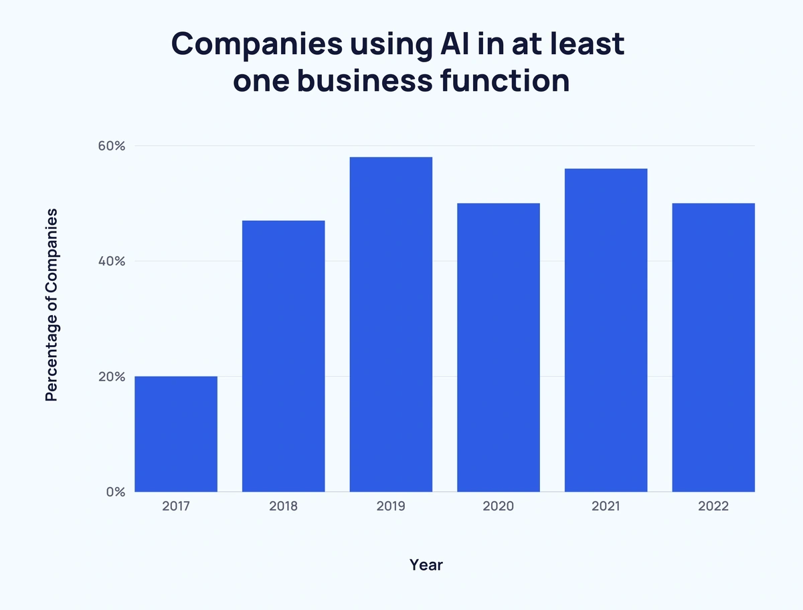
What is AI (Artificial Intelligence)?
Javier DeLeon
Machines capable of performing cognitive functions we associate with the human mind [1]
Machine learning with data [1]
I.E.: Siri, Alexa, Google assistant [1]
[1]
[2]
Notes:
To start, we should talk about what exactly AI, or artificial intelligence is. AI is a machines abilities to do tasks we typically link to the human minds. For example, perceiving, reasoning, learning, interacting with an environment, and problem solving. While an AI might not be able to do any of these things at first, once it begins to learn, it will start to understand these sorts of tasks. Examples we see today of AI in our everyday lives include Siri on the iPhone, Alexa in Amazon Echo, and Google assistant, the Google equivalent of Siri [1].

Slide 44
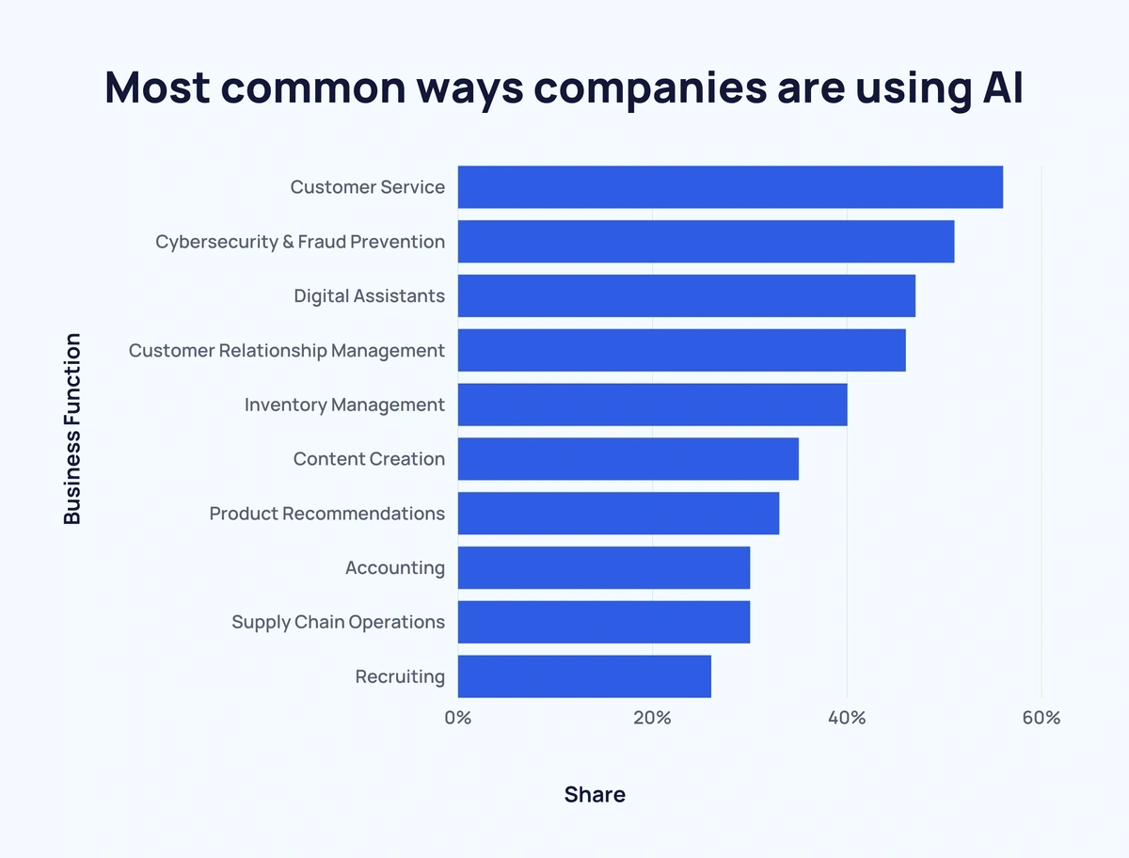
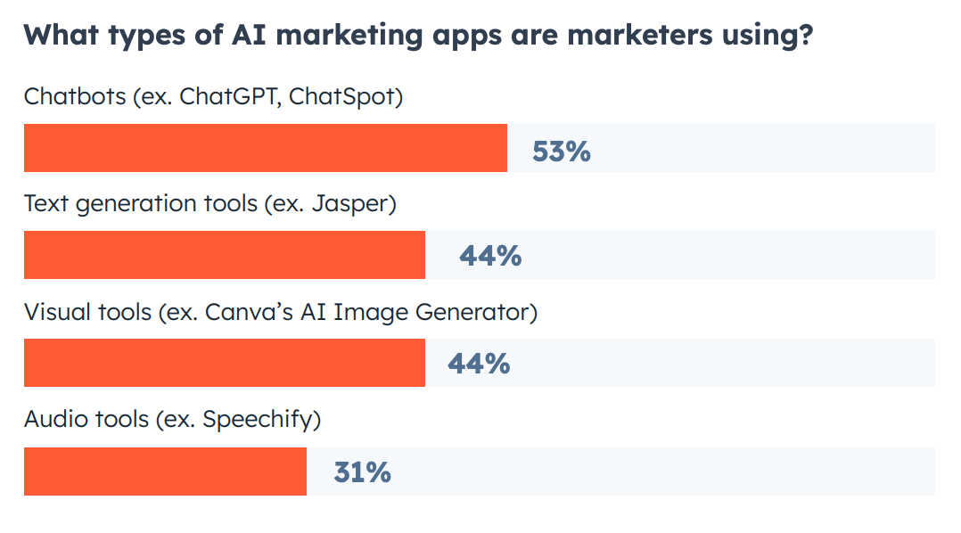
The good
Javier DeLeon
Project planning [13]
Problem analysis [13]
Project Management [13]
Quality Analysis [13]
[2]
[7]
Notes:
So, to start, lets talk about the good things that can come out of AI in software engineering.
Project Planning: In software engineering, planning out your project and ideas and a great way to begin looking at your work in a broader view, as well as ensuring effectiveness and efficiency. With the help of AI, we can improve the accuracy of our planning stage. This can come In the form of allocating resources, time, and agendas all with the help of AI. [13]
Next, we have:
Problem analysis: Work that you are struggling with figuring out how to solve can be completed faster with more accuracy with the help of AI. AI can look at problems in complex statistically ways allowing for more comprehensive solutions to the problem. With AI learning off you, it can gather an understanding of issues in existing software with more speed and accuracy. [13]
Project management: Meaning things like weekly status reports, budgets, as well as changes to a project timeline, can all be improved upon thanks to the help of AI. AI can help make these things seamless by automatically generating these reports at the convenience of the user, saving up a lot of time and effort.
Lastly:
Quality Analysis: Spotting bugs, optimizing code, and fixing errors are all things that an AI can do, with the help of machine learning algorithms. This will be expanded upon in the next slide here.

Slide 45
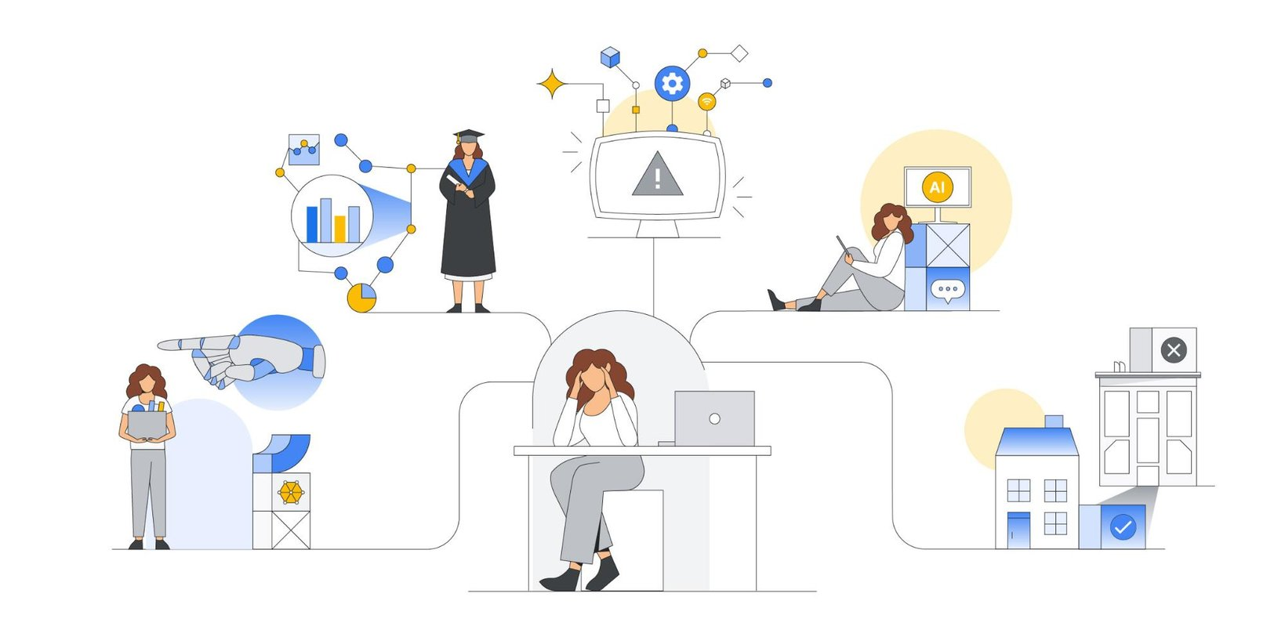
How can AI help us in software engineering?
Javier DeLeon
Bug Detection and Code Review [10]
Optimization [10]
Automated Code Generation and Completion [10]
[3]
Notes:
Next, we can talk about how AI can be used to help us in software engineering. In coding, we constantly must figure out why and where errors may occur in our software, and sometimes finding these errors are easier said than done. Thankfully, AI can help us with this task.
Bug Detection and Code Review: AI can be trained to recognize code patterns that are often associated with bugs or vulnerabilities and can suggest corrections. This makes the code review process more efficient and reduces the chance of human oversight.
Automatic Fix Suggestions: Not only can AI identify potential issues, but it can also suggest ways to fix them based on patterns observed in other codebases. This capability reduces the time developers spend troubleshooting and researching solutions.
Once we finish writing our code, we can move onto:
Optimization: AI can help in performance tuning by identifying bottlenecks or suggesting areas of code that can be optimized.
Resource Allocation: In systems, AI can help in optimizing the allocation of resources, ensuring that services are both responsive and cost-effective.
Algorithm Selection: AI can assist in selecting the most suitable algorithm for a specific problem based on data characteristics, ensuring optimal performance.
If we are struggling with completing parts of our code, we can use AI to give us:
Automated Code Generation & Completion: Tools like GitHub's Copilot, powered by OpenAI, can suggest whole lines or blocks of code as you type. This aids in faster coding, especially for repetitive tasks or in languages the developer may not be as familiar with.
Contextual Suggestions: Unlike simple autocompletion tools that might suggest method names or variable names, advanced AI-driven tools can provide suggestions based on the broader context of the code.
Code Patterns and Snippets: AI can suggest frequently used code patterns or snippets, streamlining the coding process.

Slide 46
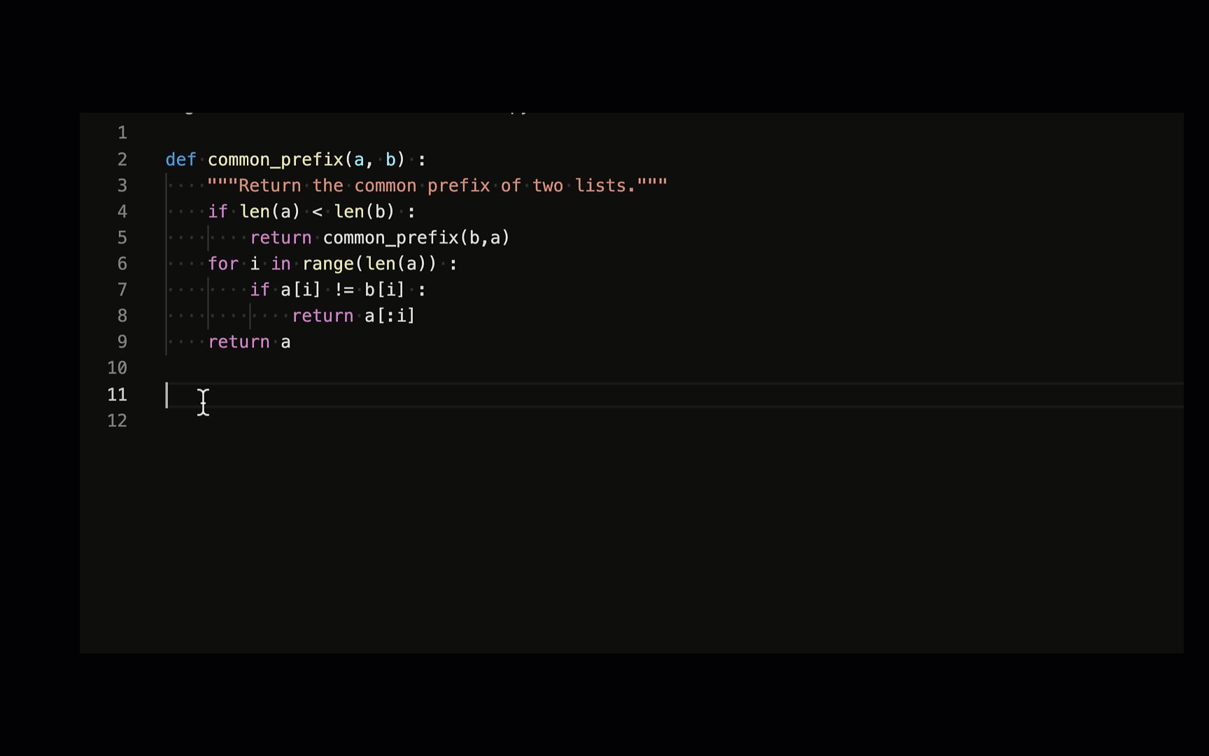
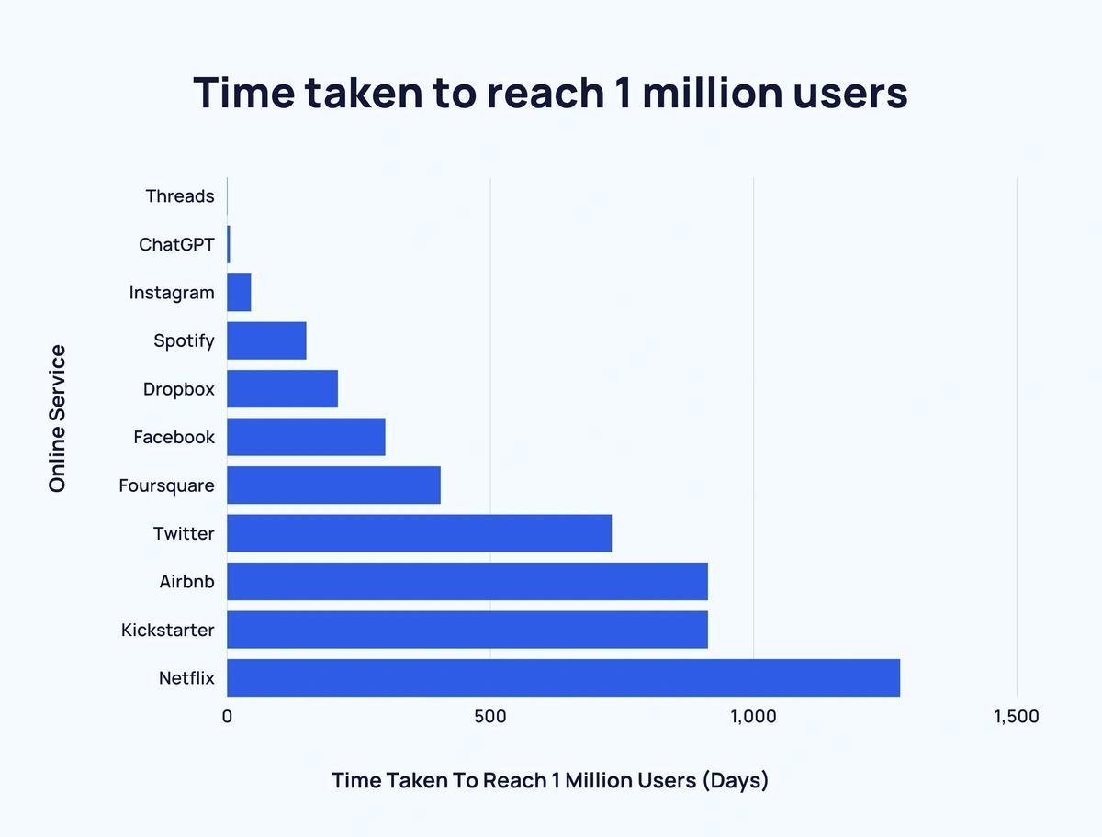
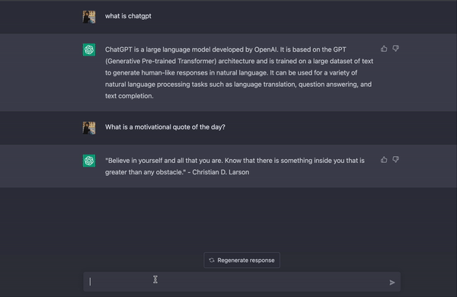
Examples of Ai software and their uses
Javier DeLeon
OpenAI’s ChatGPT
Github’s Copilot
Microsoft's Bing AI
Github’s AI tool Copilot auto completing code [4]
OpenAI’s ChatGPT [5]
[11]
Notes:
There are a few key examples of AI software that are most prevalent when it comes to software development. These are ChatGPT and Github’s Copilot
ChatGPT: I am sure most of us a familiar with ChatGPT. When it comes to general chatbot questions, most people will jump straight to this AI. I don’t blame them, either. ChatGPT has skyrocketed in popularity back when it launched in November of 2022. OpenAI, the makers behind ChatGPT said they acquired 1 million users just 5 days after launching. Comparing this to the other online services we see in this graph, Instagram took around 2 and a half months to reach 1 million users, whereas Netflix took 3 and a half years to reach a million users [11]. Software engineers can use ChatGPT to help with writing code, getting suggestions for errors, or just figuring out a small project to test themselves on. ChatGPT has started to become many young developers' best friend when it comes assessing problems with code, but we have another up and coming tool in a software engineers' arsenal.
Github’s Copilot: A tool that was made exclusively for coders, with direct integration to many of the popular IDE’s, or Integrated Development Environment. What copilot does, is after writing a comment or the beginning of a function of code, it will provide multiple suggestions as to what you may want your code to look like based on previous lines of code. Copilot shares recommendations based on the project's context and style conventions. You can quickly cycle through lines of code, complete function suggestions, and decide which to accept, reject, or edit. Research had found that 74% of people focus on more satisfying work, 88% felt more productive, and 96% were faster at repetitive tasks [12].

Slide 47

The bad
Javier DeLeon
Lack of creativity [8]
Lack of context [8]
Cost and accessibility [8]
Ethical concerns [8]
[8]
Notes:
Now, we’ve talked a lot about how great AI is for helping us complete our tasks at an accelerated pace, but not everything is all well and good when it comes to AI.
Lack of creativity is concern that can eventually limit the scope of what an AI can contribute to software development. While AI is great for automating tedious tasks and assisting with decision making, it very clearly does not have the same level of creativity and intuition that human developers have when it comes to development [8].
Lack of context may also become an issue when the AI does not yet have a complete understanding of the broader context of the environment that they are working in. AI algorithms are trained on data sets not entirely aware of your exact intentions, potentially leading to errors and inaccuracies in the development process [8].
Cost and accessibility comes into play especially for solo developers where AI powered tools and technologies can be expensive and require much investment in both resources and infrastructure. This can severely limit the accessibility for smaller organizations who do not have easy access to these sort of AI capabilities.
Lastly, Ethical concerns surrounding piracy, bias, and accountability a sure to arise with the use of AI technology. If a developer intends to make use of such handy technology, the must first be mindful of the concerns and ensure that AI-powered systems will be used in a responsible and ethical manner.

Slide 48
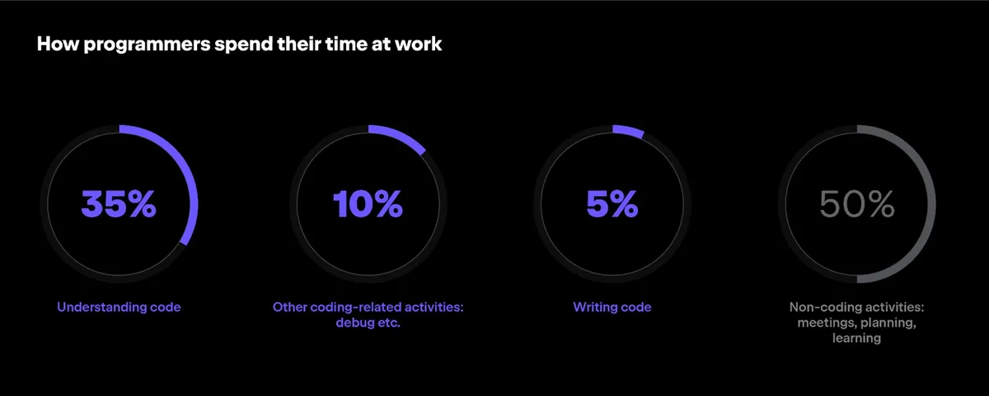
How Do we move forward as software engineers?
Javier DeLeon
AI will never replace human work in software engineering [9]
AI lacks critical thinking skills [9]
Collaboration and Coexistence [9]
[9]
Notes:
As I begin to wrap up this presentation, we should touch upon what our future is going to look like with AI becoming faster, smarter, and more useful by the day. Let’s face it, AI is here to stay, so we should make use of this technology while we have it.
Thankfully, we as software engineers should not worry about being replaced by AI, due the facts stated in the previous slide. As well as these, there are three critical factors limiting the progress of AI. These include limited availability of training data, limited computational resources, and complexity of the interface between algorithms and people.
AI is a strong tool; however, it lacks critical thinking skills needed by software engineers to fully envision what they want their work to look like. Because of this, humans will always have a leg-up when it comes to development in this sense thanks to humans being able to make judgment calls when certain things begin to not work.
Lastly, we have collaboration and coexistence. It is better when the AI augments the human, rather than becoming a replacement for humans. This provides us with strong tools to further our repertoire and make software development and coding an easier and more successful task for the user and the consumers of the product [9].

Slide 49
References
Javier DeLeon
[1] McKinsey & Company. (2023, April 24). What is ai?. McKinsey & Company. https://www.mckinsey.com/featured-insights/mckinsey-explainers/what-is-ai
[2] Cardillo, A. (2023, July 24). How many companies use AI? (New Data). Exploding Topics. https://explodingtopics.com/blog/companies-using-ai
[3] Google. (n.d.). How ai impacts software development | google cloud blog. Google. https://cloud.google.com/blog/products/ai-machine-learning/how-ai-impacts-software-development
[4] GitHub copilot - visual studio marketplace. Marketplace. (n.d.). https://marketplace.visualstudio.com/items?itemName=GitHub.copilot
[5] Kwok, L. (2023, January 22). 10 ways I use CHATGPT at home and work. Sypnotix. https://www.sypnotix.com/reviews/10-ways-i-use-chatgpt-at-home-and-work
[6] Sanchez, V. (2023, March 17). The history of Siri and its impact on today’s technology. RoutineHub Blog. https://blog.routinehub.co/the-history-of-siri-and-its-impact-on-todays-technology/
[7] Hawley, M. (2023, October 2). 10 Ai Customer Experience Statistics You should know about. CMSWire.com. https://www.cmswire.com/customer-experience/10-ai-customer-experience-statistics-you-should-know-about/
[8] Sahakian, V. (n.d.). AI in Software Development: Opportunities and challenges. LinkedIn. https://www.linkedin.com/pulse/ai-software-development-opportunities-challenges-vacheh-sahakian
[9] Povarov, N. (2022, May 20). AI for software developers: A future or a new reality?. InfoQ. https://www.infoq.com/articles/ai-for-software-developers/
[10] Strivemindz. (n.d.). The future of programming: Will AI replace programmers?. LinkedIn. https://www.linkedin.com/pulse/future-programming-ai-replace-programmers-strivemindz#:~:text=While%20%23aitechnologies%20have%20the%20potential,delivering%20high%2Dquality%20software%20solutions.
[11] Duarte, F. (2023, July 13). Number of CHATGPT users (2023). Exploding Topics. https://explodingtopics.com/blog/chatgpt-users
[12] GitHub copilot · your AI pair programmer. GitHub. (n.d.). https://github.com/features/copilot
[13] Majestic. (n.d.). Advantages of AI & Machine Learning in Software Development. Advantages of AI & Machine Learning in Software Development | SGS Technologie. https://www.sgstechnologies.net/blog/Advantages_of_AI_and_Machine_Learning_in_Software_Development

Slide 50


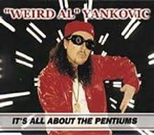
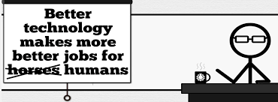



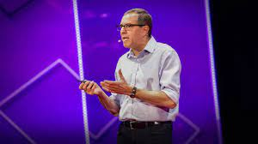

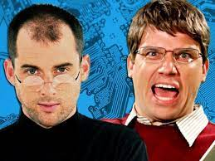
Student Choice – Interesting Videos (1/2)
Don’t Download This Song (2006)
- Weird Al (3:53)
It’s All About The Pentiums (1999)
- Weird Al (3:34)
White and Nerdy (2006)
- Weird Al (2:50)
Virus Alert (2006)
- Weird Al (3:43)
Word Crimes (2014)
- Weird Al (3:45)
Copyright: Forever Less One Day (2011)
- CGP Grey (6:27)
Humans Need Not Apply (2014)
- CGP Grey (15:00)
This Video Will Make You Angry (2015)
- CGP Grey (7:25)
Will automation take away all our jobs? (2016) – David Autor (18:27)
Epic Rap Battles of History: Steve Jobs vs. Bill Gates (2013) (2:47)
© 2023 Keith A. Pray
Notes:
David Autor Will automation take away all our jobs? (18:27) (2016) https://www.ted.com/talks/david_autor_will_automation_take_away_all_our_jobs/transcript?language=en TEDxXambridge, 2016-12-19
All Last Accessed 2018-10-04
CGP Grey
Copyright: Forever Less One Day (6:27)
https://www.youtube.com/watch?v=tk862BbjWx4
CGP Grey
Humans Need Not Apply (15:00) – 2014-08-13
http://www.youtube.com/watch?v=7Pq-S557XQU
Last access 2016-04-22
CPG Grey This Video Will Make You Angry [Thought Germs] (7:25) – 2015-03-10
https://www.youtube.com/watch?v=rE3j_RHkqJc
Weird Al – It’s All About The Pentiums (3:34)
https://www.youtube.com/watch?v=qpMvS1Q1sos
TODO: Tie into Ray Kurzweil Singularity
Epic Rap Battles of History: Steve Jobs vs. Bill Gates (If class ok with obscene lyrics) (2:47)
https://www.youtube.com/watch?v=njos57IJf-0
Also Work links on web site http://socialimps.keithpray.net/documents/
-----
Passphrases (2:08 need to give context for video)
https://firstlook.org/theintercept/2015/03/26/passphrases-can-memorize-attackers-cant-guess/
If not shown during first class
What "Orwellian" really means - Noah Tavlin (5:31)
http://ed.ted.com/lessons/what-orwellian-really-means-noah-tavlin
Weird Al – White and Nerdy (2:50) and look at lyrics
https://www.youtube.com/watch?v=N9qYF9DZPdw
Weird Al Yankovic “Don’t Download This Song” (3:53) 2006-08-21 released exclusively as digital download
https://www.youtube.com/watch?v=zGM8PT1eAvY
Styx - Mr. Roboto (1983) (5:34) https://www.youtube.com/watch?v=uc6f_2nPSX8
Epic Rap Battles of History: Steve Jobs vs. Bill Gates (If class ok with crude lyrics) (2:47)
https://www.youtube.com/watch?v=njos57IJf-0

Slide 51


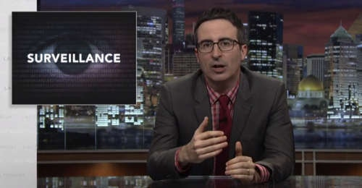
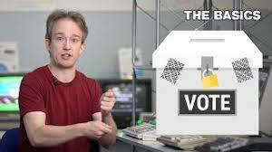





Student Choice – Interesting Videos (2/2)
MSNBC on Denver's Automated Baggage System (2010) (2:27)
Last Week tonight with John Oliver (2015) - Snowden (33:14)
3D Printed Homes (2018)
- News Story (1:28)
The Game Of Trust (2017) - Nicky Case
Adobe Firefly (2023) - Adobe (1:16)
What "Orwellian" really means (2015) - Noah Tavlin (5:31)
Why Electronic Voting is Still a Bad Idea (2019) - Tom Scott (12:00)
Welcome To Life (2012) - Tom Scott (2:44)
Mr. Roboto (1983)
- Styx (5:34)
© 2023 Keith A. Pray
Notes:
All Last Accessed 2018-10-04
Last Week tonight with John Oliver – Patriot Act, Edward Snowden (33:14)
http://www.upworthy.com/john-oliver-flew-10-hours-to-russia-to-interview-edward-snowden-and-get-him-on-record?c=ufb1
TODO: Tie into Ray Kurzweil Singularity
Epic Rap Battles of History: Steve Jobs vs. Bill Gates (If class ok with obscene lyrics) (2:47)
https://www.youtube.com/watch?v=njos57IJf-0
Also Work links on web site http://socialimps.keithpray.net/documents/
-----
Passphrases (2:08 need to give context for video)
https://firstlook.org/theintercept/2015/03/26/passphrases-can-memorize-attackers-cant-guess/
If not shown during first class
What "Orwellian" really means - Noah Tavlin (5:31)
http://ed.ted.com/lessons/what-orwellian-really-means-noah-tavlin
MSNBC on Denver's Automated Baggage System 2010-08-23 (2:27)
https://www.youtube.com/watch?v=xx8f4x6C_KY
Accessed 2019-04-09
These 3D printed homes can be constructed for $4,000 (3:00 – 2018-04-02)
http://www.businessinsider.com/3d-printed-homes-constructed-icon-new-story-tech-charity-4000-dollars-2018-3
https://www.youtube.com/watch?v=SvM7jFZGAec (1:28)
Last access 2018-04-22
Why Electronic Voting is a BAD Idea – Computerphile (Tom Scott) (8:20)
https://www.youtube.com/watch?v=w3_0x6oaDmI
Tom Scott
http://tomscott.com
Welcome To Life (2:44)
https://www.youtube.com/watch?v=IFe9wiDfb0E&feature=youtu.be

Slide 52
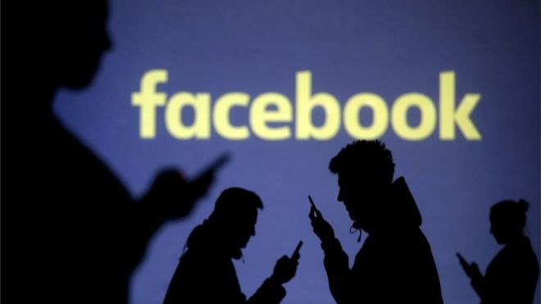
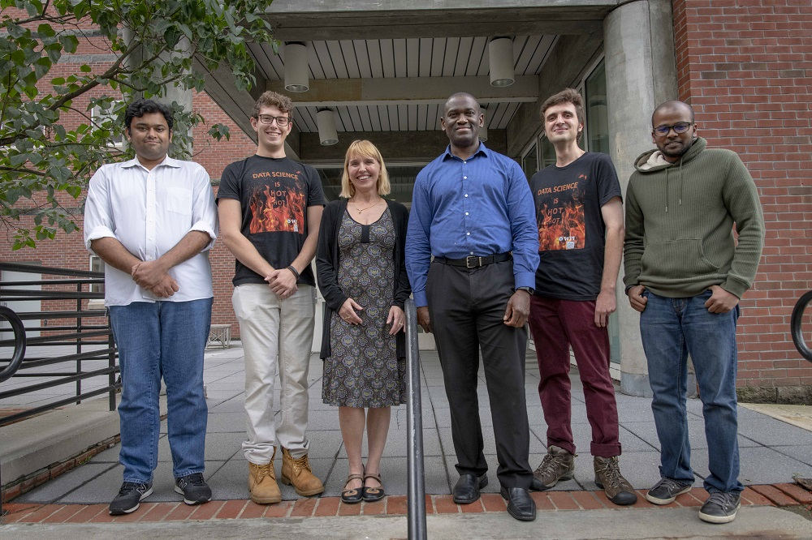

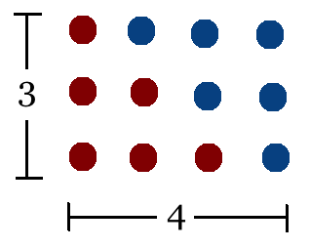
Student Choice – Interesting Articles 1/2
Communications of The ACM – Latest edition (through library)
Facebook security breach: Up to 50m accounts attacked - Dave Lee, North America technology reporter, 2018-09-29
WPI Secures $2.8 Million to Develop a Smartphone App to Help Assess the Health of Soldiers, 2018-09-24
Quantified Toilets, 2014, Quantified Toilets LLC (empty) What a Toilet Hoax Can Tell Us About the Future of Surveillance – Jennifer Golbeck, The Atlantic, 2014-04-29
What Did Ada Lovelace's Program Actually Do? - Sinclair Target, 2018-08-18 (First Programming Bug 1843?)
Notes:
All Last Accessed 2021-04-03

Slide 53
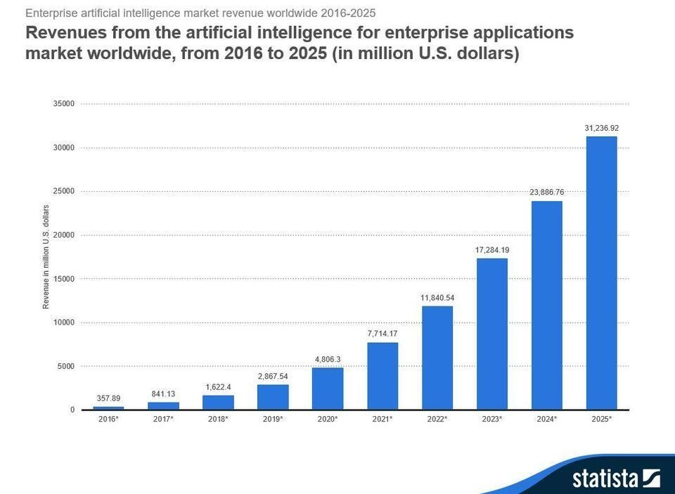
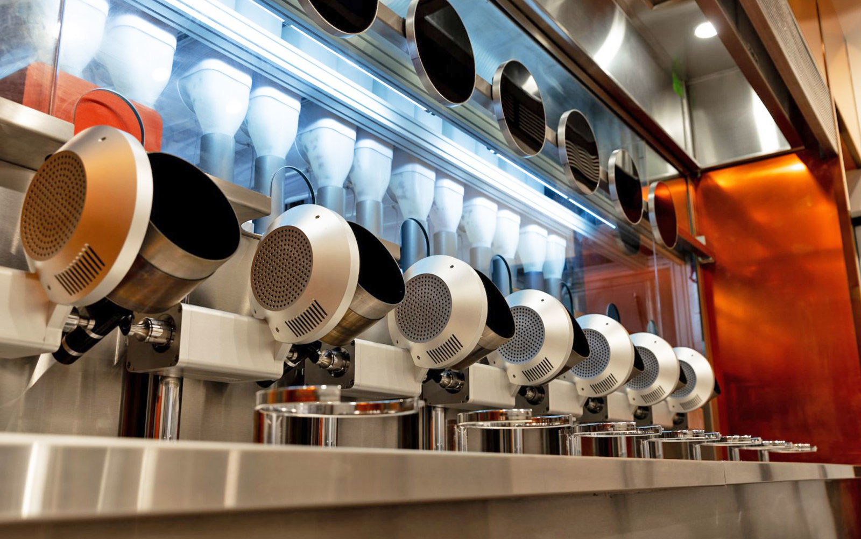

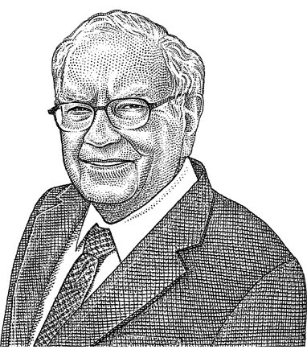
Student Choice – Interesting Articles 2/2
We know ethics should inform AI. But which ethics? - Mauro Guillen, World Economic Forum, 2018-07-26
MIT-born Spyce raises $21M to open new robotic restaurants - Lucia Maffei, BostInno, 2018-09-07
The Coders Programming Themselves Out of a Job - Brian Merchant, The Atlantic, 2018-10-02
Berkshire Hathaway’s Stock Price Is Too Much for Computers - Alexander Osipovich, The Wall Street Journal, 2021-05-05 (approaching $429,496.7295 32 bit limit) (access limited)
Notes:
All Last Accessed 2021-04-03
Spyce image: https://www.engadget.com/2018/05/04/boston-robotic-kitchen-spyce/ , 2018-05-04
Coders Programming Themselves Out of a Job image: Gabrielle Lurie, Reuters (date unknown)

Slide 54
Class 12-14 The End
Keith A. Pray
socialimps.keithpray.net

