Slide 1
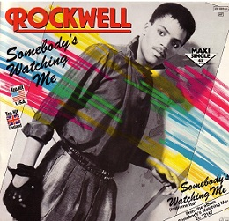
Class 7
Privacy and Government
Keith A. Pray
socialimps.keithpray.net
Notes:
After this class we will be half done with the course… very sad I know.
Somebody’s Watching Me (1984) – Rockwell (3:36)
https://www.youtube.com/watch?v=7YvAYIJSSZY
Be the envy of all your classmates if you know the band and/or year:
Rockwell (1984) Michael Jackson sings chorus and Jermaine Jackson on backing vocals.

Slide 2
what works well Online With Zoom
Sign in with First and Last Name
Stay muted unless you are going to speak
To speak use the raise your hand feature
To answer yes/no questions use the “yes” ”no” buttons
Turn your camera on
Wait until the end of student presentations to ask questions
  Write them down so you don’t forget

Slide 3
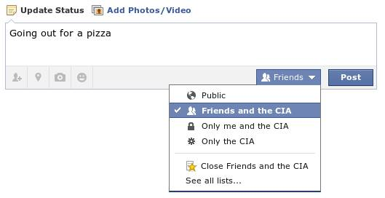
Overview
Review
Assignment
Students Present
Notes:
Review before debate in case anyone unsure of something in reading.
TODO: Image source?
Look at ACM TechNews if time

Slide 4
My Reading Notes
pp. 276 Any examples from the last 25 years? Arrests, altering and deleting records are violations of privacy?
pp. 277 Why not try to verify and correct records?
pp. 278 Figure does not show # cameras increasing.
pp. 279 300 times = frames, locations, …? More police drones since 2013?
pp. 296 Shouldn’t credit card issuers take “reasonable steps” to verify identity all the time?
pp. 297 Any syndromic system successes in the last 15 years?
pp. 301 Confusing false positive and negative explanations. Not correct use of “Orwellian”
pp. 305 E-ZPass now mandatory on Mass Pike…
pp. 310 # 17 Interesting but not computing related
End of Chapter questions: 1, 18
pp. 319 “Since I have done nothing wrong, why should the government be investigating me?”
Notes:
Let’s debate!

Slide 5
Debate Ground Rules
Before Debate
  Add “(YES)” or “(NO)” to the end of your name in Zoom to show your side
  10 minutes to converse with your team
  Share argument points, counter points, and responses
  Share experiences, especially in different countries, cultures, situations
  Decide who will: Go first, Respond to which points from opposing side
During Debate
  1 turn per person until everyone on your team has spoken
  Stand up when speaking
  Try to keep remarks to 30 seconds (each side elect a timekeeper)
Notes:
“National ban on facial recognition surveillance for law enforcement” Debate
If in class:
Stand up when speaking
30 second limit (elect a timekeeper)
If Remote:
Add “(YES)” or “(NO)” to the end of your name in Zoom to show your side
Previous:
Should law require you to use an official ID for Internet access
National ID or Not Debate

Slide 6
Group Quiz
List two problems with using biometrics for identification.
List two advantages of using biometrics for identification.
Describe two tools people can use to protect their privacy on the Web.
For each of the 4 categories of Daniel Solove’s privacy taxonomy give an example not listed in the book.
Notes:
Only if we have time.
Information Collection
Information Processing
Information Dissemination
Invasion

Slide 7
Overview
Review
Assignment
Students Present

Slide 8
Assignment – Group Project
Catch up on reading
Group Project
  Analyze Movie for all topics covered to date
  Add analysis of computing technology portrayed to web site
  See group project slide deck for more
  Frequent interaction with your group members is key to success!
-----
Mid Term Survey on Canvas → Quizzes
Notes:
Movie group project:
List of computing technologies portrayed in movie on website
Categorize computing technologies as existing, future, emerging, impossible or plausible with rationale
Analyze movie for all topics covered to date

Slide 9
Overview
Review
Assignment
Students Present

Slide 10
your digital footprint
Kenny Doan
Notes:
I am going in whatever order you deem appropriate on Friday (9/15/2023).

Slide 11
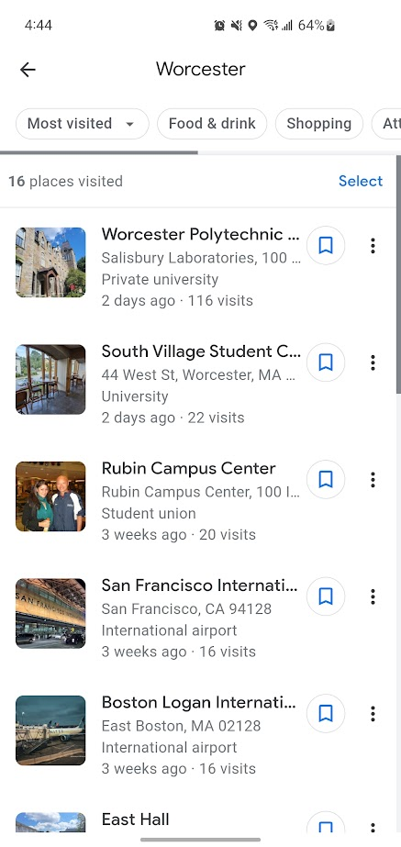
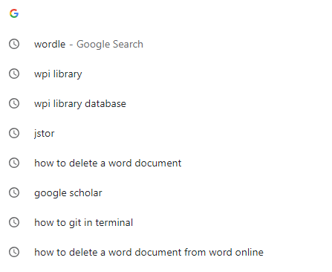
Why is our data collected?
Kenny Doan
Active vs Passive [2]
  Active = aware
  Passive = unaware
Includes searches on things like Google, YouTube, Facebook [2]
Even Google Maps tracks location [2]
Notes:
Active footprint includes stuff like pictures or comments posted online [2]
Passive footprint is stuff that is collected implicitly, and usually only admins of the servers or websites we visit have access to our passive footprint [2]
Digital footprints are used for user convenience, so that we are shown things that are relevant/interesting to us [1]
Helps suggests videos we might be interested in, products we might need, or mutual friends we might know [1]
This information is especially important, since these social media companies' main form of income is from advertising [3]
Therefore, they need to put a majority of their resources into collecting our data and determining what our interests would be [3]

Slide 12
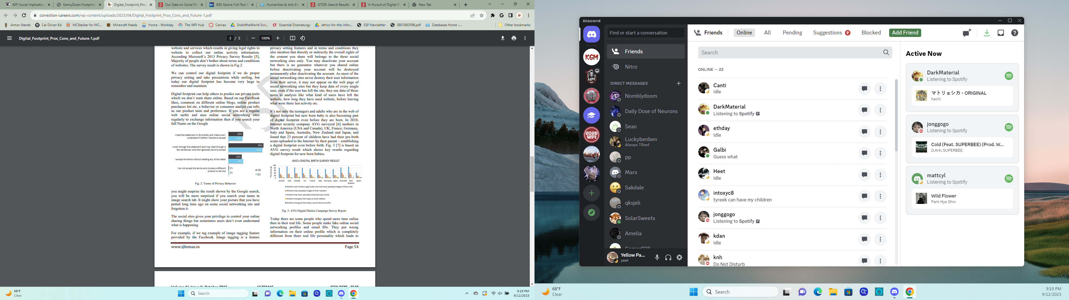
do we think we know what we post?
Kenny Doan
70% say they use social privacy settings [1]
72% thought their portrayal of themselves online matched their real-life self [1]
60% give at least some consideration to what they upload [1]
[2]
Notes:
The study was carried out in 2011/2012 at a University in Spain. The research addressed 135 students of the Bachelor in Education degree. The results presented are based on data representing a diverse group of students whose age ranges between 18 and 45 years old. [1]
All the info on slide and below is concerning their Facebook profiles, going from Very Much, Somewhat, Not Really, to Not At All
59% of students had more than 200 contacts/friends, none of them had less than 20 friends [1]
After visualization of what they had posted, 73% found exhibition to be at least somewhat precise to themselves [1]
Afterwards, students said that they found the exhibition to be precise because they generally felt it presents them the way they want to be seen by the world.
However, this does not encompass the full story of their digital footprints.
Our digital footprints often start the moment we are born, as 80% of mothers across different countries (US, Canada, France, UK, Italy, Germany, Spain, Australia, New Zealand, and Japan) upload pictures of their children while they are still under the age of 2.

Slide 13
We might be exposed more than we think
Kenny Doan
We often agree to terms and conditions without reading [2]
Facebook hack in 2018 leaked information of 50 million users [3]
[2]
Notes:
Due to our ability to visit so many websites in a short span of time, we may often ignore a lot of terms and conditions that those websites offer us
Nearly three-quarters of people in the US and EU either do not read or just read through a few sentences before accepting
Most TOS allow companies to share our information with third-parties, but even if they say they do not they still profit off of your info
Facebook, for example, does not share info with third-parties but only advertises on their behalf, and if you happen to buy into an ad then the third-party that advertised has your info
Additionally, companies can reserve the right to change these terms without consent, and sometimes without giving notice
If a company does give notice, it still does not mean you can do anything about the change, it just means you know about it (different from consent!)
In 2018, an attack on Facebook's computer networks exposed personal information of 50 million users
The Facebook hack allowed the hackers to not only collect the data of the customers affected, but also impersonate them which allowed them to trick other users into giving up information

Slide 14
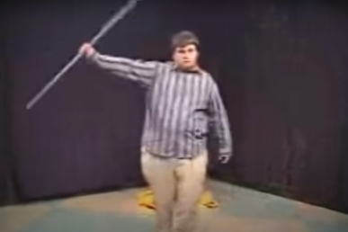
what this information can lead to
Kenny Doan
Our personalities can be determined [4]
Increased cybercrime, such as scams or phishing [7]
Mistakes made during adolescence [5]
  Star Wars Kid
[Jimi Love]. (2006, January 15). Star Wars Kid [Video]. YouTube. https://www.youtube.com/watch?v=HPPj6viIBmU
Notes:
A personality test was released on Facebook, to determine whether there were patterns between a person's online data to their personalities [4]
Introverted people tended to be part of less, yet larger communities, while extroverted people tended to be part of more, yet smaller communities [4]
Even brands we like can expose parts of who we are, for example it was discovered that people who liked the "Hello Kitty" brand had high openness (creative, like change, appreciate new ideas), low conscientiousness (so more spontaneous, less scheduled/organized), and low agreeableness (less trustworthy, less bound by social expectations) [4]
There are also more obvious signals of personality, such as the size of social networks and distance traveled (through GPS tracking) [4]
Additionally, with an increased digital footprint there becomes more cybercrime [7]
When the pandemic in 2020 hit, we were all forced to be online more often, it allowed people to use the internet with malicious intent [7]
It became easy for scammers to hide under the guise of a false government source providing information such as preventive measures, treatments, or vaccines [7]
Basically, if people know that we have a need for something online, they can abuse that fact by attempting to trick us into scams [7]
They can also hold our information ransom if they know we are in a dire situation [7]
A laboratory in London that was ready to test a potential COVID vaccine was almost the victim of ransomware, but even though they managed to protect their IT systems the hackers still managed to publish their patient records online [7]
Ghyslain Raza, colloquially known as the Star Wars Kid, recorded himself imitating a Star Wars character in 2002 when he was 15
In early 2003 a classmate had uploaded this video to the internet, which garnered lots of attention, mostly negative, much to Raza's dismay
It was even talked about on a New York Times article
Unfortunately, this led to Raza being bullied, losing friends at school, and even messages telling him to commit suicide
He eventually had to drop out and finished that school year at a children's psychiatric ward
Although he did gain some fans and support from his video, it did little to console him
His parents then sued the people who uploaded the video, but by then the video was already widespread
Even after attempting to distance himself from the video, in 2013 he commented that he had given up any hope on moving past his status as the Star Wars Kid

Slide 15
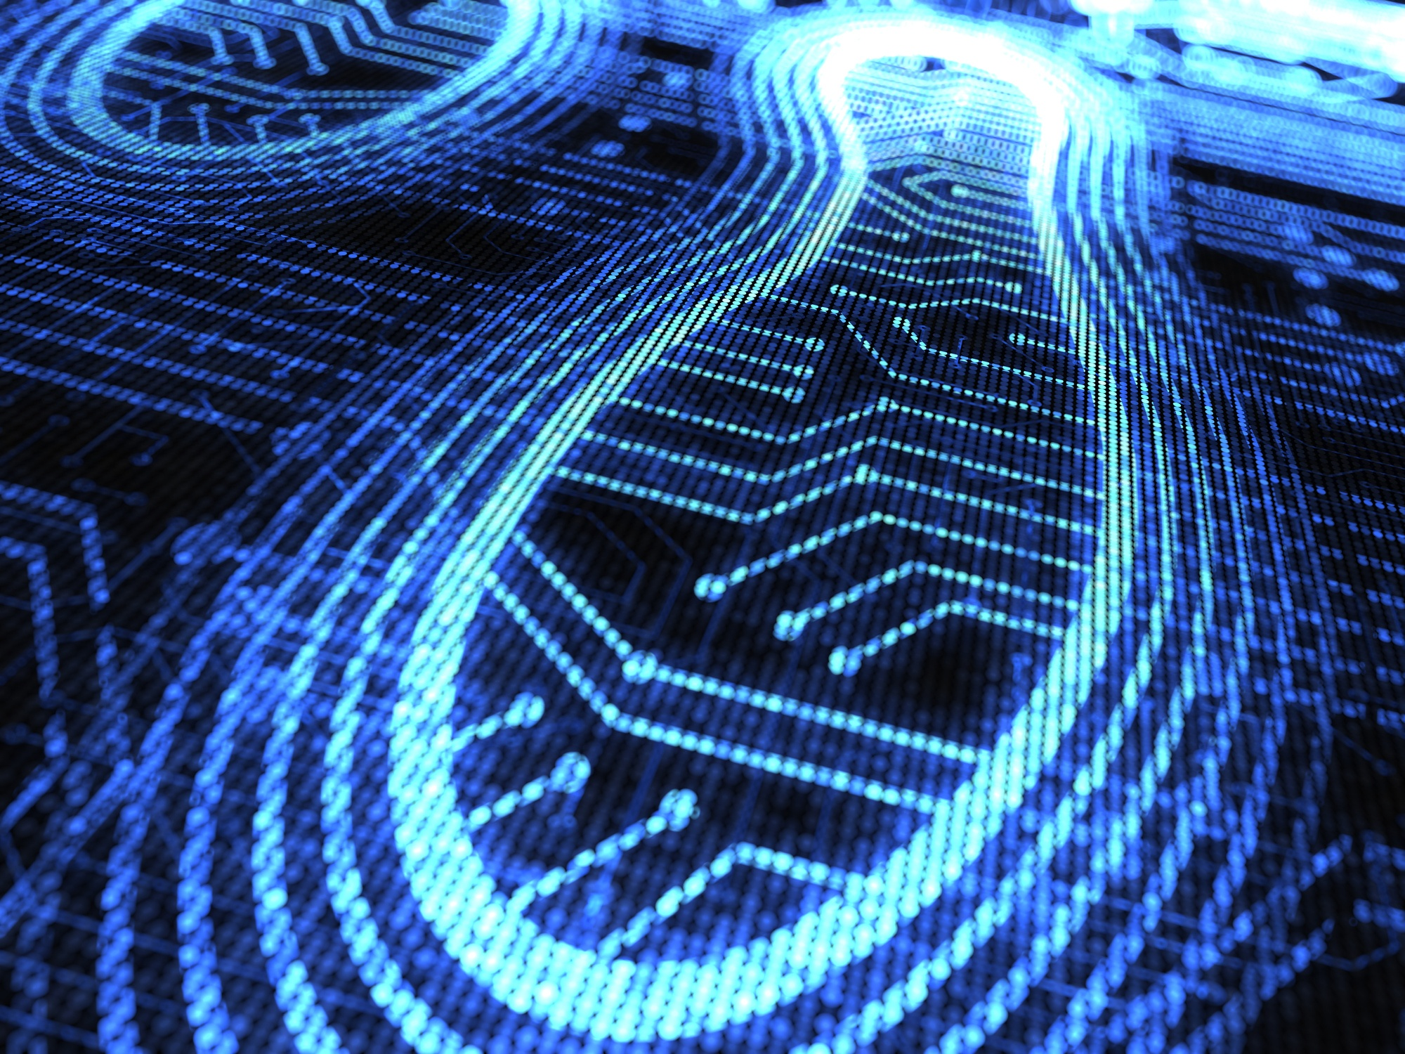
in conclusion
Kenny Doan
We should be more careful about what we post online
Not just about ourselves, but also about others
Our actions may have severe/lasting consequences
Notes:
Before posting anything, please consider the consequences it may have for either yourself or anyone else involved with what you are posting
Refrain from sharing things that may be too personal online

Slide 16
References
Kenny Doan
[1] Mar Camacho, Janaina Minelli, Gabriela Grosseck, Self and Identity: Raising Undergraduate Students' Awareness on Their Digital Footprints, Procedia - Social and Behavioral Sciences, Volume 46, 2012, Pages 3176-3181, ISSN 1877-0428,
https://doi.org/10.1016/j.sbspro.2012.06.032.
[2] Arakerimath, Anjana R., and Pramod Kumar Gupta. "Digital footprint: Pros, cons, and future." International Journal of Latest Technology in Engineering 4.10 (2015): 52-56.
https://correction-careers.com/wp-content/uploads/2023/04/Digital_Footprint_Pros_Cons_and_Future-1.pdf
[3] LIPTON, JACQUELINE D. “Our Data on Social Media.” Our Data, Ourselves: A Personal Guide to Digital Privacy, 1st ed., University of California Press, 2022, pp. 62–80. JSTOR, https://doi.org/10.2307/j.ctv2ks6v2p.7. Accessed 13 Sept. 2023.
[4] R. Lambiotte and M. Kosinski, "Tracking the Digital Footprints of Personality," in Proceedings of the IEEE, vol. 102, no. 12, pp. 1934-1939, Dec. 2014, doi: 10.1109/JPROC.2014.2359054.
https://ieeexplore.ieee.org/stamp/stamp.jsp?tp=&arnumber=6939627
[5] EICHHORN, KATE. “In Pursuit of Digital Disappearance.” The End of Forgetting: Growing Up with Social Media, Harvard University Press, 2019, pp. 117–38. JSTOR, http://www.jstor.org/stable/j.ctv25250j5.8. Accessed 13 Sept. 2023.
[6] EICHHORN, KATE. “Screens, Screen Memories, and Childhood Celebrity.” The End of Forgetting: Growing Up with Social Media, Harvard University Press, 2019, pp. 69–94. JSTOR, http://www.jstor.org/stable/j.ctv25250j5.6. Accessed 13 Sept. 2023.
[7] Wiggen, Johannes. The Impact of COVID-19 on Cyber Crime and State-Sponsored Cyber Activities. Konrad Adenauer Stiftung, 2020. JSTOR, http://www.jstor.org/stable/resrep25300. Accessed 13 Sept. 2023.

Slide 17
Listening to You Whisper
Eric Hughs-Baird
Notes:
How many of you use some form of instant messaging? Me too.
Think about what you send on these apps. How private do you consider these conversations? They’re probably less private than you think.
As technology has progressed, instant messaging has become more and more ubiquitous, but with it we are increasingly providing the government access to our private conversations.

Slide 18

The Power to Access Your Data
Eric Hughs-Baird
[14]
Significant powers granted by law to seize and access info
Requests with gag orders [1]
Even when legally protected, data is often for sale [2]
Notes:
As we read in the chapter, the FBI in particular, and federal government in general, have been granted significant powers to conduct surveillance of our lives and our communications.
As technological development has increased the ease of surveillance, our laws have not kept pace, making more of our private information subject to search by the government.
They have great authority to perform wiretaps and collect our data. There are fairly minimal judicial checks on this power, and when there are, they have low standards of evidence.
Often requests for information are accompanied with gag orders, preventing the users whose data is being collected from being notified at all for six months or more.
Even if the data is protected from subpoena or legal forms of seizure, many of the companies that handle our data are advertisers, and make the data available for sale for advertisers.
There’s no way to both make the data available for sale without making it easily accessible to government access.

Slide 19
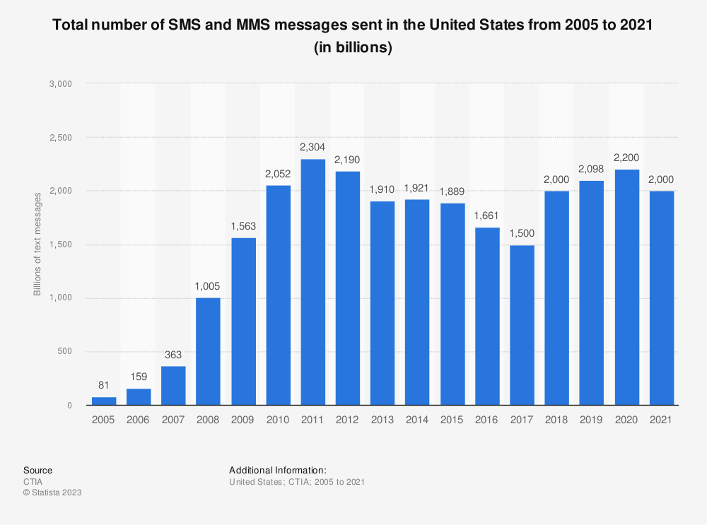
Your Communications Are Vulnerable
Eric Hughs-Baird
SMS and MMS widely used in US [3]
Many carriers store messages and will release them to law enforcement [4]
Fairly easy to intercept by law enforcement or others [5]
Notes:
If we want to protect our messages from surveillance, we need to look at how we send our messages.
SMS messages, heavily popular in the United States, are not very secure. All carriers will store messages that are sent and received (sender and receiver, time), and many will store the text of the messages for some period of time.
Beyond that, SMS messages are just fairly easy to intercept. Criminals can do, law enforcement can do it - your texts over SMS just aren’t very safe.
This puts them within easy reach of the government. And, as we saw with the NSA’s large scale collection of text messages (textbook), the government is very willing to collect text messages.

Slide 20

iMessage Can Be Safer
Eric Hughs-Baird
iMessage offers end-to-end encryption [7],
Unless you use Android [8],
Or have iCloud enabled [9]
[5]
Notes:
Now, I’ve talked about SMS, but I hear many of you saying “I use an iPhone, and most of the people I text with do too”. Well, I’ve got good news for you!
iMessage almost offers complete end-to-end encryption for all the messages you send. Any time you see a blue bubble, your message should be encrypted.
The bad news is, there isn’t complete protection here. Because Apple does not make iMessage available to Android, anyone who has Android has to either invest a significant amount of work into being able to use it on Android, or their conversations will use plain old SMS.
Even more bad news: Your iMessage chats aren’t actually encrypted by default. If you have iCloud available, your message history is backed up with a key to it, making it available to the government.

Slide 21
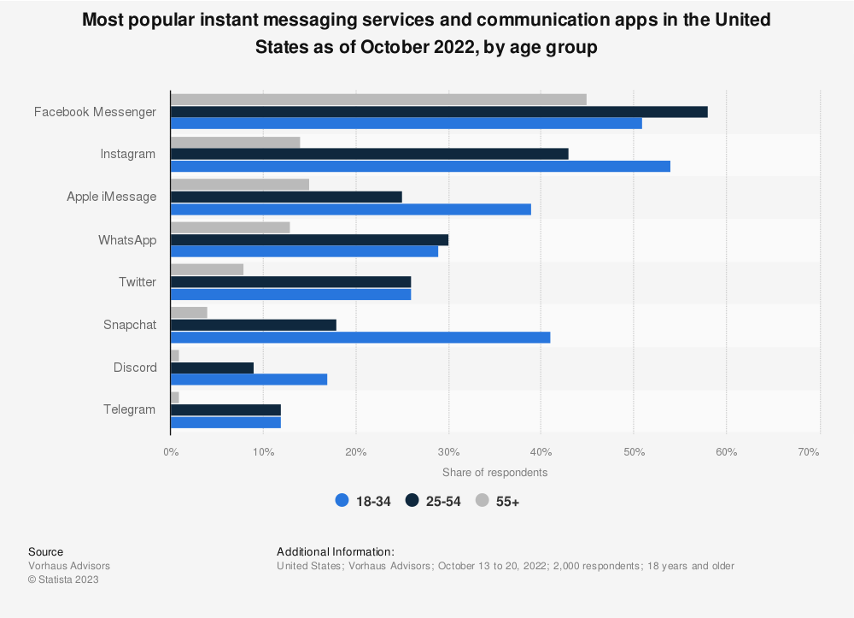
WhatsApp & Meta Products Are Safer Too
Eric Hughs-Baird
Many meta products provide end-to-end encrypted messaging
But requires specifically setting up a chat as end-to-end encrypted [11][12]
But messages still subject to moderation, which is provided with their content [13]
[10]
Notes:
Well, so iMessage didn’t work. But there are other popular end-to-end encrypted messaging options out there.
WhatsApp sells itself as an encrypted messenger, and other products owned by Meta, such as Facebook Messenger and Instagram also allow encrypted messaging.
These are three of the top four most popular instant messaging services in the United States. We just covered the last one
Unfortunately, Facebook Messenger and Instagram require explicitly setting up a chat to utilize end-to-end encryption. Since encryption isn’t the top of our priorities all the time, this is easy to miss, but it still provides an excellent option for private messaging.
The extent to which your messages are private also has limits - any content that is flagged for moderation will be sent to moderators unencrypted.
However, for all these limits, Whatsapp, and to a lesser extent other Meta products do provide relatively easy access to end-to-end encrypted messaging.

Slide 22

For Full Security, Use Signal
Eric Hughs-Baird
[14]
Non-profit encrypted messaging app [15]
No user data retained [16]
Behind the protocol used by other encrypted messaging [17][18][19]
Notes:
If these limitations worry you, or if you find yourself thinking about privacy every day, there is an option.
Signal, a non-profit encrypted messaging app, provides end-to-end encryption without the limitations we’ve previously discussed. Everything you do in the app is encrypted, and stored locally - about as safe as it can be.
The user data Signal can provide the government is scant, just the time you registered and the last time you connected to the service.
The protocol Signal built and uses is the same one adopted by all the encrypted messaging we’ve talked about so far, and more beyond that.
If you are truly intent on keeping your messages private, Signal provides you the best tools to do so.

Slide 23
REFERENCES
Eric Hughs-Baird
[1] Johana Bhuiyan, How can US law enforcement agencies access your data? Let’s count the ways, (The Guardian, 4 April 2022), https://www.theguardian.com/technology/2022/apr/04/us-law-enforcement-agencies-access-your-data-apple-meta, (13 September 2023)
[2] Elizabeth Goitein, “The Government Can’t Seize Your Digital Data. Except by Buying It.”, (Brennan Center, 28 April 2021), https://www.brennancenter.org/our-work/analysis-opinion/government-cant-seize-your-digital-data-except-buying-it, (13 September 2023)
[3] Statista, Total number of SMS and MMS messages sent in the United States from 2005 to 2021, (Statista, September 2022), https://www.statista.com/statistics/185879/number-of-text-messages-in-the-united-states-since-2005/, (14 September 2023)
[4] Joseph B. Evans, Cell Phone Forensics: Powerful Tools Wielded By Federal Investigators, (Fordham Journal of Corporate and Financial Law), https://news.law.fordham.edu/jcfl/2016/06/02/cell-phone-forensics-powerful-tools-wielded-by-federal-investigators/, (14 September 2023)
[5] Chris Hoffman, Why SMS Text Messages Aren't Private or Secure, (How-To Geek, 21 January 2021) https://www.howtogeek.com/709373/why-sms-text-messages-arent-private-or-secure/, (13 September 2023)
[6] CMetalCore, IMessage logo.svg, (Wikimedia Commons, 2 April 2018), https://commons.wikimedia.org/wiki/File:IMessage_logo.svg (14 September 2023)
[7] Apple, iMessage Security Overview, (Apple, 18 February 2021), https://support.apple.com/guide/security/imessage-security-overview-secd9764312f/web (14 September 2023)
[8] Justin Pot, How to Use iMessage on Android, (Wired, 13 May 2023), https://www.wired.com/story/how-to-use-imessage-android/, (14 September 2023)
[9] Chris Hoffman, Apple's iMessage Is Secure... Unless You Have iCloud Enabled, (How-To Geek, 21 January 2021) https://www.howtogeek.com/710509/apples-imessage-is-secure...-unless-you-have-icloud-enabled/, (14 September 2023)
[10] Statista, “Most popular instant messaging services and communication apps in the United States as of October 2022, by age group”, (Statista, November 2022) https://www.statista.com/statistics/1310687/us-top-messaging-services-by-age/, (14 September 2023)

Slide 24
REFERENCES
Eric Hughs-Baird
[11] Barbara Krasnof, How to encrypt Facebook Messenger chats, (The Verge, 17 August 2022), https://www.theverge.com/23307995/facebook-messenger-end-to-end-encryption-how-to (13 September 2023)
[12] Instagram Help, How do I start an end-to-end encrypted chat on Instagram?, (Facebook) https://www.facebook.com/help/instagram/1165835007222763/ (14 September 2023)
[13] Peter Elkind, Jack Gillum and Craig Silverman, How Facebook Undermines Privacy Protections for Its 2 Billion WhatsApp Users, (ProPublica, 7 September 2021), https://www.propublica.org/article/how-facebook-undermines-privacy-protections-for-its-2-billion-whatsapp-users (13 September 2023)
[14] Kennedy-Labs, Signal-Logo.svg, (Wikimedia Commons, 26 November 2022), https://commons.wikimedia.org/wiki/File:Signal-Logo.svg (14 September 2023)
[15] Signal, Signal >> Home, (Signal) https://signal.org/#signal, (14 September 2023)
[16] Signal, Grand jury subpoena for Signal user data, Eastern District of Virginia, (Signal, 4 October 2016), https://signal.org/bigbrother/eastern-virginia-grand-jury/ (13 September 2023)
[17] moxie0, WhatsApp's Signal Protocol integration is now complete, (Signal, 5 April 2016), https://signal.org/blog/whatsapp-complete/, (13 September 2023)
[18] Google Messages, Messages End-to-End Encryption Overview, (Google, February 2022), https://www.gstatic.com/messages/papers/messages_e2ee.pdf (13 September 2023)
[19] ellenment, Skype Insider Preview // Private Conversations, (Microsoft, 11 January 2018), https://answers.microsoft.com/en-us/skype/forum/all/skype-insider-preview-private-conversations/01616ac9-2171-4151-b9a2-c77761c0fbf8 (13 September 2023)
[20] Clindberg, Seal of the FBI.svg, (Wikimedia Commons, 8 October 2007), https://commons.wikimedia.org/wiki/File:Seal_of_the_FBI.svg (14 September 2023)

Slide 25
QUANTUM COMPUTING’s THREAT TO DATA Security
Nathan Wong
Notes:
Quantum computers/computing raise and its potential to break current encryption methods raises privacy concerns. Therefore, our society should start placing more emphasis on preparing for quantum computer cryptography.

Slide 26
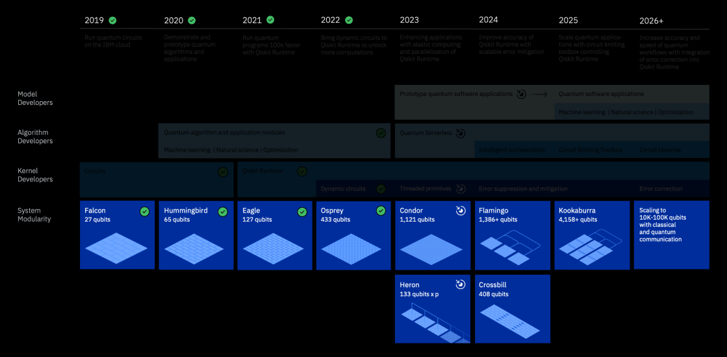
THE POWER OF Quantum Computers
Nathan Wong
Quantum computers can compute millions of times faster than classical computers [2]
RSA encryption algorithm is used to secure emails, digital signatures, and VPNs [1]
IBM believes that quantum computers could break modern encryption around 2030 [2]
[3]
Notes:
[Share these points while talking about quantum computers breaking encryption]
- The speed to break RSA directly relies on the number of qubits in the QC [2]
- A 20 million qubit QC can break RSA 2048 in 8 hours [2]
[Share these points while talking about RSA encryption]
- RSA encryption is based off the idea that factoring a composite number is time consuming and computationally expensive
- Use a public key to encrypt messages that only a unique private key can decrypt [1]
- Standard RSA encryption uses 2048-bit key pairs to generate the composite number (a 2048-bit number can be 617 digits long) [1]
- Even using the best algorithm (Shor’s algorithm) would take the best supercomputer more than a million years to break the encryption (would probably take longer as Shor’s algorithm must make an educated guess first) [1]
[Picture and last bullet point]
- Image shows the development of IBM’s QC [3]
- As the year’s continue IBM expects the number of qubits to exponentially increase [2]
- Rough estimate that QC will achieve the required qubits in 2030 (expectations range from 5-15 years)

Slide 27
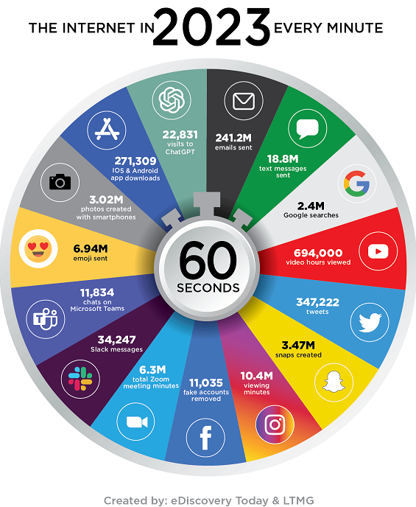
Harvest Now, Decrypt Later
Nathan Wong
Each year around 120 zettabytes of data is created [5]
  1 zettabyte = 1 trillion gigabytes
In 2022, only 26.6% of US companies are prepared for quantum decryption [6]
27.7% of US companies will begin assessing QC threats after regulatory policies require risk assessment [6]
[7]
Notes:
[Harvest Now, Decrypt Later]
- HNDL is when people acquire encrypted data and store it with hopes that quantum computers can break the encryption later in the future [4]
- The data inside could still be valuable when quantum decryption arrives
[Data created each year]
- Picture emphasizes the massive amount of data on the internet
- Type of data created each year includes: [5]
- Emails
- Purchases
- Texts
- Search Engines
- Social Media Posts
- All these types of data are vulnerable to harvest now, decrypt later without post-quantum encryption
- All these types of data could leak personal information
[Preparedness]
- Data was collected through a survey with 400 IT professionals [6]
- 28.6% of US companies do not even know if they are at risk from HNDL [6]
- Lack of preparedness highlights a need to place more emphasis on the dangers of QC decryption and that action needs to begin now so companies can prepare for when QC decryption is completed in the next 5-10 years

Slide 28
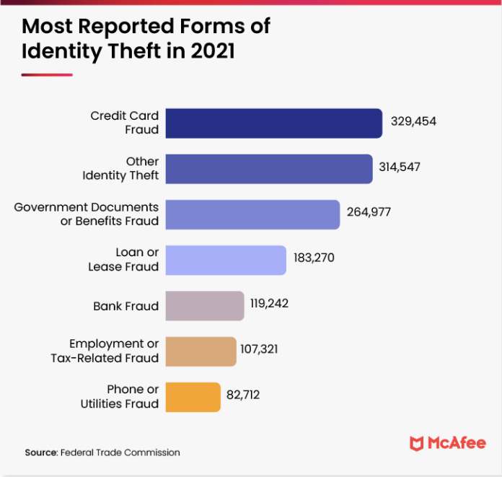
IDENTITY THEFT
Nathan Wong
Data breaches are the leading cause of identity theft and continue to grow with each year [8]
In 2022, 160 million victims of identity theft from 1291 breaches [8]
Estimated $52 billion in damages from identity theft in the US [9]
[9]
Notes:
[Before any of the bullet points]
- Identity theft: fraudulent acquisition of personal information for financial gain [8]
- Open fraudulent lines of credit
- Steal tax refunds
- Receive medical care through your name
[Data breaches]
- Personal information can be stored whenever you make an account for an online service [9]
- Ecommerce
- Medical services
- Financial services
- All these accounts can lead to information like name, passwords, date of birth, SSN, and credit card info being stolen [8]
- Once again underscores the importance of investing in cybersecurity and preparing for QC as so we can prevent data breaches and identity theft

Slide 29
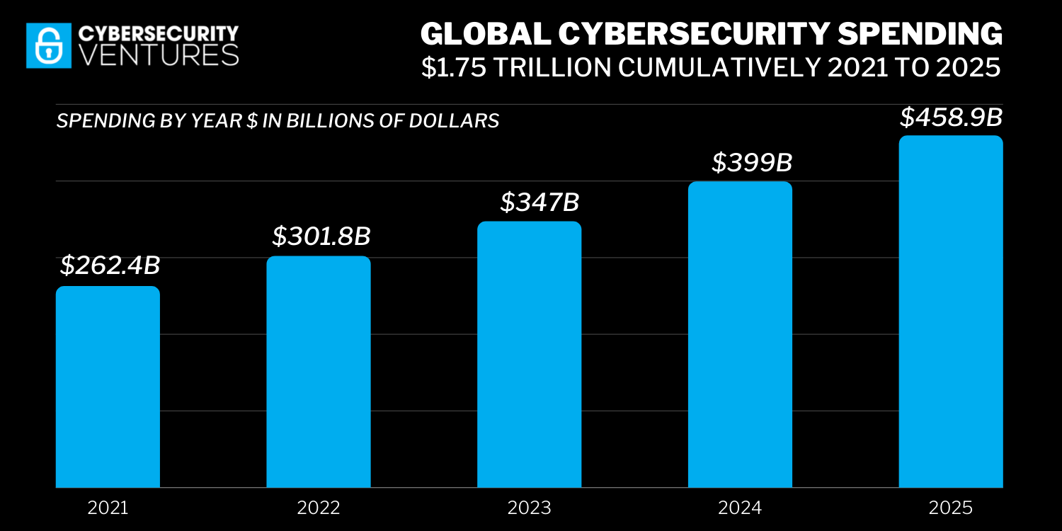
Government Response
Nathan Wong
Passed Quantum Computing Cybersecurity Preparedness Act in 2022 [10]
Allocated $15.6 billion for cybersecurity in 2023 [11]
Developed and approved Post-Quantum Encryption Algorithms (NIST) [12]
[13]
Notes:
[Quantum Computing Cybersecurity Preparedness Act]
- Mandates that all government agencies must develop a strategy to deal with post-quantum cryptography by May 2023 and then implement these plans [10]
- Highlights the threat that governments see in QC
- Government understands that QC cryptography is a grave threat to even government level encryption
[Funding]
- Government is allocating these funds to agencies like the Department of Defense (DoD) and Cybersecurity and Infrastructure Agency (CISA) [11]
- Funds are primarily for modernizing security protocols and researching cryptography [11]
- Government agencies are encouraged to work alongside the private sector to find solutions [11]
[Quantum-Proof Algorithms]
- NIST = National Institute of Standards and Technology [12]
- Had developers submit candidate quantum-proof algorithms in 2016 and selected 4 to become the new standard [12]
- Under review until 2024 [12]
[Picture]
- Continues to show how the world recognizes the increasing threat of cyberattacks
- The importance the government places on addressing QC cryptography highlights the importance of tackling the problem especially when we have the solutions to deal with it

Slide 30
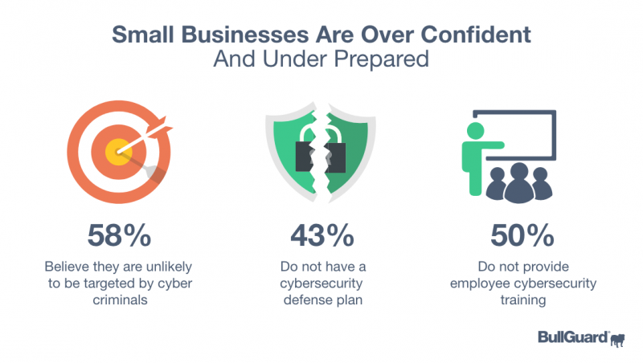
EXPENSIVE INFRASTUCTURE
Nathan Wong
Small businesses (<50 employees) do not invest in cybersecurity due to [14]:
  Cost
  Importance
  Awareness
In 2022, average cost of cybersecurity for a business was 10% of their budget and an additional $2700 for each employee [15]
[14]
Notes:
[Why small businesses do not invest in cybersecurity]
- Cost: businesses choose to rely on free cybersecurity services because they want to increase and focus on profits [14]
- Importance: many small businesses believe that they will not be targeted by cyberattacks because they have smaller amounts of data and believe it is not important data [14]
- Awareness: some small businesses do not have the training to assess what data is vulnerable and when they need cybersecurity [14]
- (Refer to picture)
[Cost of cybersecurity]
- Due to the cost of premium, higher-quality cybersecurity services, some small businesses opt to tolerate cyberattack damages and believe that paying fees from attacks is cheaper than cybersecurity [15]

Slide 31
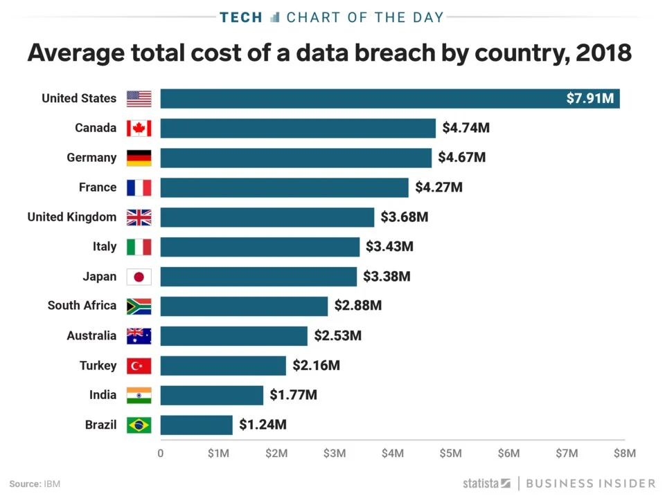
CYBERATTACKS on Small Businesses
Nathan Wong
In 2023, 46% of data breaches occurred at businesses with <1,000 employees [16]
75% of small businesses could not continue operating after a cyberattack [16]
55% of US consumers would not continue working with companies that have been breached [16]
[17]
Notes:
[After finishing all bullet points]
- The idea that small businesses are rarely targeted by data breaches is a myth [16]
- Valuable information can still be found
- Criminals are incentivized to attack smaller businesses because they know they typically have bad security [16]
- Small businesses cannot afford a cyberattack and cannot hope to be to afford attack fees rather than paying for cybersecurity
- Small businesses not only have to deal with data losses and financial losses but also brand reputation which will influence profits in the future
- From the picture – small businesses should expect to deal with the highest cost after a data breach in America [17]
- All this data shows that companies should emphasize modernizing their cybersecurity and that tolerating attacks is not an alternative

Slide 32
References
Nathan Wong
[1] CyberTalents. "RSA Encryption and RSA Algorithm: A Comprehensive Overview." CyberTalents Blog, cybertalents.com/blog/rsa-encryption. Accessed 13 Sept. 2023.
[2] Forbes, www.forbes.com/sites/moorinsights/2023/05/10/ibm-quantum-safe-technology-protects-data-from-encryption-busting-attacks-by-next-generation-quantum-computers/?sh=f1f1c015764c. Accessed 13 Sept. 2023.
[3] "IBM Quantum Computing | Roadmap." IBM - United States, www.ibm.com/quantum/roadmap. Accessed 14 Sept. 2023.
[4] "“Harvest Now – Decrypt Later” Threat: Safeguarding Today’s Data for Tomorrow’s Quantum Era and the Role of Symmetric Keys." AUCloud, 29 Aug. 2023, www.australiacloud.com.au/blogs/harvest-now-decrypt-later-threat/. Accessed 14 Sept. 2023.
[5] "Amount of Data Created Daily (2023)." Exploding Topics, 3 Apr. 2023, explodingtopics.com/blog/data-generated-per-day. Accessed 14 Sept. 2023.
[6] Dawn M. Turner (guest). "How Prepared Are Companies for Quantum Computing Cybersecurity Risk?" Cryptomathic - Security Solutions, www.cryptomathic.com/news-events/blog/how-prepared-are-companies-for-quantum-computing-cybersecurity-risk. Accessed 14 Sept. 2023.
[7] Austin, Doug. "2023 Internet Minute Infographic, by EDiscovery Today and LTMG!" EDiscovery Today by Doug Austin, 20 Apr. 2023, ediscoverytoday.com/2023/04/20/2023-internet-minute-infographic-by-ediscovery-today-and-ltmg-ediscovery-trends/. Accessed 14 Sept. 2023.
[8] Forbes, www.forbes.com/sites/moorinsights/2023/05/10/ibm-quantum-safe-technology-protects-data-from-encryption-busting-attacks-by-next-generation-quantum-computers/?sh=f1f1c015764c. Accessed 13 Sept. 2023.
[9] "A Guide to Identity Theft Statistics for 2023." McAfee, 2 Mar. 2023, www.mcafee.com/learn/a-guide-to-identity-theft-statistics.

Slide 33
References
Nathan Wong
[10] Forbes, www.forbes.com/sites/forbestechcouncil/2023/01/25/what-the-quantum-computing-cybersecurity-preparedness-act-means-for-national-security/?sh=2a5e9c63368a. Accessed 14 Sept. 2023.
[11] "How Much is the U.S. Investing in Cyber (And is It Enough?)." Security Intelligence, 20 Jan. 2023, securityintelligence.com/articles/how-much-is-us-investing-in-cyber/. Accessed 14 Sept. 2023.
[12] "NIST to Standardize Encryption Algorithms That Can Resist Attack by Quantum Computers." NIST, 24 Aug. 2023, www.nist.gov/news-events/news/2023/08/nist-standardize-encryption-algorithms-can-resist-attack-quantum-computers. Accessed 14 Sept. 2023.
[13] "Global Cybersecurity Spending To Exceed $1.75 Trillion From 2021-2025." Cybercrime Magazine, cybersecurityventures.com/cybersecurity-spending-2021-2025/. Accessed 14 Sept. 2023.
[14] Dahlberg, Nancy. "How Prepared is Your Small Business for a Cyber Attack or Breach?" GrowBiz: Advice on How to Grow Your Business, 23 Feb. 2020, growbiz.fiu.edu/2020/02/how-prepared-is-your-small-business-for-a-cyber-attack-or-breach/. Accessed 14 Sept. 2023.
[15] Triumph, Krystal. "Cybersecurity Costs for Small Businesses." Atlantic-IT, 13 Feb. 2022, www.atlantic-it.net/cybersecurity-costs-for-small-businesses/. Accessed 14 Sept. 2023.
[16] "35 Alarming Small Business Cybersecurity Statistics for 2023." StrongDM | Connect Your Team to Anything, 2 Dec. 2022, www.strongdm.com/blog/small-business-cyber-security-statistics. Accessed 14 Sept. 2023.
[17] Agarwal, Harshit. "Average Cost of a Data Breach Has Increased to $3.86 Million." Mobile Application Security Testing | Appknox, 1 Aug. 2018, www.appknox.com/blog/cost-of-a-data-breach. Accessed 14 Sept. 2023.

Slide 34
Class 7
The End
Keith A. Pray
socialimps.keithpray.net
Notes:
Look at ACM TechNews if time
This is the end. Any slides beyond this point are for answering questions that may arise but not needed in the main talk. Some slides may also be unfinished and are not needed but kept just in case.

