Slide 1
Class 4 Freedom Of Speech
Keith A. Pray
socialimps.keithpray.net
Notes:
If forgot to show the ethical analysis guide, do so now.

Slide 2
what works well REmotely With Zoom
Turn your camera on
Sign in with First and Last Name
Stay muted unless you are going to speak
To speak use the raise your hand feature
To answer yes/no questions use the “yes” ”no” buttons
Wait until the end of student presentations to ask questions
Write them down so you don’t forget

Slide 3
Overview
Review
Assignment
Students Present
Notes:
Show syllabus updates if any

Slide 4
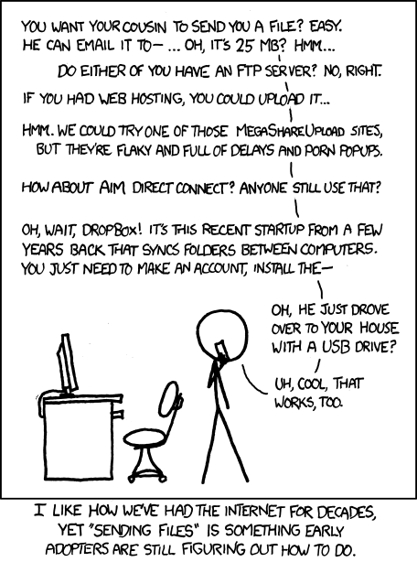
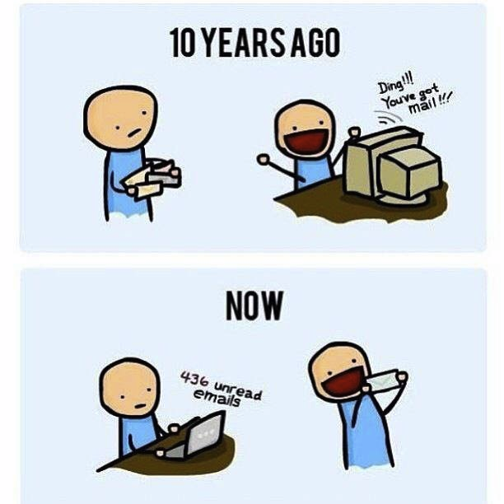
http://poofytoo.com/
25
http://xkcd.com/949/
Notes:
What is more exciting now for you, email or snail mail?
http://xkcd.com/949/
2011

Slide 5
My Reading Notes
pp. 110 First e-games 1972 at Stanford [1]. Has Twitch viewership gone up since the start of the COVID pandemic?
pp. 111 What powers the cell phones and towers? “everyday tasks” not apparent from image.
pp. 113 Ann did not force people to complain.
pp. 114 Does Kantian analysis agree?
pp. 117 9% # transactions or $$? Wikipedia critics source from 2005, is quality still in question?
pp. 118 MOOC source from 2012, now?
pp. 122 Macedonian is nice addition to new edition
pp. 123 “may have” = weak conclusion. Who funded studies?
pp. 124 Easier consolidation of newspapers. Advertisers switching away from newspaper source from 2014.
pp. 126 Search engines link deeper than home page
pp. 127 Any US agencies employing this many people?
pp. 131 Adult bookstores lowering property values source?
pp. 135 “texted… images”
pp. 136 Stating people searching did not consent to material being blocked makes more sense.
pp. 138 sexting examples all from 2009?
pp. 140 College students still as likely? 2013 source
pp. 141 Do mobile plans still charge for text messages?
pp. 146 Hunter Moore convictions seem unrelated to “Anyone Up?” site.
pp. 153 See: http://en.wikipedia.org/wiki/Wikipedia:Citing_Wikipedia
pp. 154 Question 40 same as 46
Questions I liked: 17, 43
Interview nice update
Notes:
[1] Owen Good (19 October 2012). "Today is the 40th Anniversary of the World's First Known Video Gaming Tournament". Kotaku. Retrieved 1 August 2013

Slide 6
Group Quiz
Name two methods some governments use to control access to information.
A large company has a policy prohibiting employees from blogging about company products.
Does it violate the First Amendment? Why?
Name two possible reasons for the policy.
Is it reasonable? Why?
What does “URL” stand for and what is it?
Notes:
Censorship (religious, governmental, private). Adult authentication. Firewalls. Government owned media outlets (TV and radio stations, newspapers), private photocopier ownership illegal
First Amendment prohibits Congress from making laws limiting free speech, not private companies.
Uniform Resource Locator

Slide 7

Overview
Review
Assignment
Students Present
Notes:
But before that:
CPG Grey - This Video Will Make You Angry [Thought Germs] (7:25) – 2015-03-10
https://www.youtube.com/watch?v=rE3j_RHkqJc
Find better examples:
Cedric Gervais - Hashtag (Original Mix) (3:58)
https://www.youtube.com/watch?v=6OmBKd7X7EE
Dave Audé vs Luciana - You Only Talk In #HASHTAG (3:36)
http://www.youtube.com/watch?v=53wIN87lJn0

Slide 8
Assignment
Reading
Individual Presentations
Extra Credit – One page paper
Is WPI’s IT Acceptable Use Policy morally acceptable?
Work on your group project
1.31 Happiness!
1-3 scale with 1 = everyone getting their first pick
See full group project description on course website
Send Web Site URL before next class
Notes:
- Or review group project and individual presentation guidelines right now.
Possible One page paper:
Global intellectual property laws, friends or foes?

Slide 9
Overview
Review
Assignment
Students Present

Slide 10
Should politics be discussed online?
Alexander Beck

Slide 11
Politics should be discussed online because…
Alexander Beck
Open Political Discussions lead to connecting with likeminded people online
Online discussions have responses much faster compared to slower mediums such as letters
First-Class Mail takes 1-5 days [9]
Notes:
Argument
Open Political…online. People are more likely to follow those who have similar beliefs to them and are less likely to follow those who differ in opinions. Open political discussions let people meet and discover others who share the same beliefs.
Online…letters. If you talk to someone through letters, it can take 1 to 5 business days according the USPS, during which information can become outdated. When talking to people online, it is almost instantaneous.

Slide 12
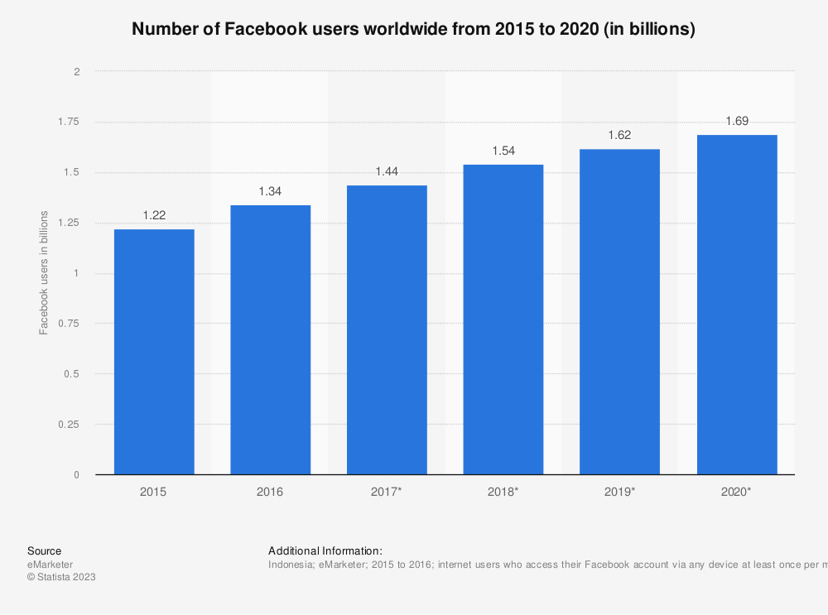
facebook
Alexander Beck
6% of all Facebook posts are political [7]
Facebook makes recommendations “based on past expressions of political preference” [2]
65% of people surveyed (n=980) say they “mostly follow people who share their own political views” [5]
[8]
Notes:
Facebook is a great example of a place where people discuss politics online.
According to Facebook, 6% of all posts are political. If you compare this to the 1.69 billion people, as is shown on the figure on the right, this is a lot of political posts.
Facebook has an algorithm that makes recommendations based…this means that if you like a post about a political candidate, then Facebook will start recommending posts about that candidate more often, and if you look in the comments of those posts, you will find more people who share political views with you.
According to a Pew Research Center survey, 65% of the 980 people say they…
Quote 2:
“An application like Facebook, for instance, may make recommendations for a page to like or a group to join based on past expressions of political preference or through association with the political activity of one’s Facebook friends” [2]
“(65%) say they mostly follow people who share their own political views” [5]

Slide 13
twitter
Alexander Beck
“One-third of Tweets from US Adults are political” [10]
Twitter “disperses conversation…rather than constraining conversation with bounded spaces or groups” [2]
More exposure to others’ opinions
Ability to respond to others in group settings
Notes:
Twitter is another example of a place where people talk about politics online. According to a Pew Research Center survey of 2548 people and research, 1/3 of…Twitter has an algorithm that disperses…groups. This means the ability to find new people who share the same opinions as you and same political beliefs that you would have never met otherwise. It also means that you can see other people’s opinions on the same topic.
Twitter has a nice feature which allows you to respond to people online in a group setting, which means you can discuss things in groups and not privately. This means that anyone can chip-in to the conversation.
“disperses conversation throughout a network of interconnected actors rather than constraining conversation within bounded spaces or groups” [2]

Slide 14
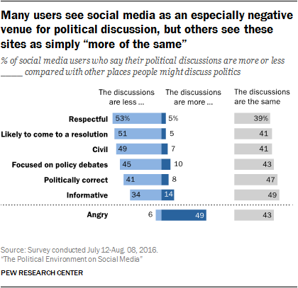
Politics should not be discussed online because…
Alexander Beck
They lead to environments that foster hate
Separation by beliefs makes people less open-minded
Algorithms are used to create “selective exposure” [3]
[5]
Notes:
Counter Argument
Some may argue that politics should not be discussed online because they lead to…hate. As is shown in the figure, 49% of the 3571 people surveyed think that politics make people more angry [5].
The argument is that by separating people based solely off of their political beliefs, said beliefs will only get stronger and people will become less open-minded. As you can see in the figure, 51% of social media users say that discussions on social media are less likely to come to a resolution than on other mediums. In other words, people are less open-minded.
This is further supported by the fact that most media that people discuss on use algorithms to promote posts based off of people’s interests, and if their interest is in politics, then they will continue to get exposure to the same content.

Slide 15
Echo chambers
Alexander Beck
“the opportunities to personalize one’s newsfeed and the tendency to connect with likeminded friends lead to echo chambers” [3]
Echo chambers amplify hate
Notes:
The argument is that talking about politics online creates echo chambers. The…echo chambers.
With echo chambers, when one person says something, someone else says it louder, and then someone says it even louder than that. At the same time, if you say something hateful, someone else will respond with something else more hateful, and someone will respond to that with something even more hateful. This spirals out of control until the only thing online is hate.
Quote 4:
“With regard to selective exposure, there are concerns that the opportunities to personalize one’s newsfeed and the tendency to connect with likeminded friends lead to echo chambers” [3]
Echo chambers, meaning everything is amplified. This is especially true for hate.

Slide 16
Echo chambers do not have to amplify hate
Alexander Beck
“users are likely to produce content that is similar to previous content that generated engagement” [6]
Not all engaging content is negative
It is all about what people share
Notes:
However, echo chambers do not have to amplify hate. Users are…engagement. This means that if there is positive content engaging enough, it will spread. It is all about what people share, so if people only share negative words about politics, there will only be negative posts about politics.
“interactions on social media have a reinforcing nature, such that users are likely to produce content that is similar to previous content that generated engagement” [6]

Slide 17
Inclusivity is not exclusive
Alexander Beck
Talking only with likeminded people will not create hate with those who differ in opinion
It creates an environment of inclusivity for those who share opinions
“People with different backgrounds and experiences share their views, and that's an element of inclusion” [1]
Notes:
Counter Argument Rebuttal
Talking only with likeminded people will not create hate among those that differ in opinion, but rather creates an environment of inclusivity for those who share opinions.
By separating people based off of interests, you are not removing the ability to discuss with people of different backgrounds, but rather allow people with different backgrounds who share similar beliefs to be seen more easily.
“People with different backgrounds and experiences share their views, and that's an element of inclusion” [1]

Slide 18
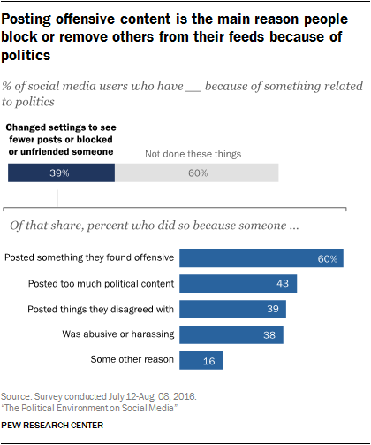
Communities of choice
Alexander Beck
“online groups are ‘communities of choice’ as opposed to communities of geographically proximate individuals who have little choice but to get along” [4]
In other words, you get to choose who you talk to online
You can block people online, but you cannot offline
[5]
Notes:
If you don’t like someone online, you can choose to not talk to them. You cannot do this offline.
As you can see from this poll done by the Pew Research Center, 39% of people have blocked people to surround themselves in an environment of people they choose.
“One difference is that online groups are ‘communities of choice’ as opposed to communities of geographically proximate individuals who have little choice but to get along” [4]

Slide 19
summary
Alexander Beck
Political discussion online allow likeminded people to connect when they normally would have never met
Online discussions allow for multiple people to participate in the same conversations
It creates communities of choice in which people can choose who they talk to
Notes:
Summary
Political…never met offline. People might have different geographic locations, such as in different parts of the country or in different countries altogether.
Online…conversations. On platforms like twitter, people can add on to what the agree with, and also share what they disagree with.
It creates…talk to. Online, people can choose to block or not talk to others, however in person, that option is not available.

Slide 20
References
Alexander Beck
[1] Showalter, A. (2022, March 15). Use discussion groups to foster productive political conversations. ASAE. https://www.asaecenter.org/resources/articles/an_plus/2022/03-march/use-discussion-groups-to-foster-productive-political-conversations/. Date Accessed: 09/04/2023
[2] Pond, & Lewis, J. (2019). Riots and Twitter: connective politics, social media and framing discourses in the digital public sphere. Information, Communication & Society, 22(2), 213–231. https://doi.org/10.1080/1369118X.2017.1366539. Date Accessed: 09/03/2023
[3] Winter. (2020). Do anticipated Facebook discussions diminish the importance of argument quality? An experimental investigation of attitude formation in social media. Media Psychology, 23(1), 79–106. https://doi.org/10.1080/15213269.2019.1572521. Date Accessed: 09/03/2023
[4] Lehdonvirta, Vili & Räsänen, Pekka. (2011). How do young people identify with online and offline peer groups? A comparison between UK, Spain and Japan. JOURNAL OF YOUTH STUDIES. 14. 91-108. 10.1080/13676261.2010.506530. Date Accessed: 09/04/2023
[5] Pew Research Center. (2019, December 31). 2. the tone of social media discussions around politics. Pew Research Center: Internet, Science &amp; Tech. https://www.pewresearch.org/internet/2016/10/25/the-tone-of-social-media-discussions-around-politics/. Date Accessed: 09/04/2023
[6] Schöne, J.P., Parkinson, B. & Goldenberg, A. Negativity Spreads More than Positivity on Twitter After Both Positive and Negative Political Situations. Affec Sci 2, 379–390 (2021). https://doi.org/10.1007/s42761-021-00057-7. Date Accessed: 09/04/2023
Notes:
Sources:
Links to sources (where I found them)
[1] https://www.asaecenter.org/resources/articles/an_plus/2022/03-march/use-discussion-groups-to-foster-productive-political-conversations
[2] https://wpi.primo.exlibrisgroup.com/permalink/01WPI_INST/1pchs3f/cdi_proquest_journals_2124669473
[3] https://wpi.primo.exlibrisgroup.com/permalink/01WPI_INST/1pchs3f/cdi_informaworld_taylorfrancis_310_1080_15213269_2019_1572521
[4] https://www.researchgate.net/publication/234166707_How_do_young_people_identify_with_online_and_offline_peer_groups_A_comparison_between_UK_Spain_and_Japan
[5] https://www.pewresearch.org/internet/2016/10/25/the-tone-of-social-media-discussions-around-politics/
[6] https://rdcu.be/dldhk

Slide 21
References…continued
Alexander Beck
[7] Schultz, A. (2022, November 4). What do people actually see on Facebook in the US?. Meta. https://about.fb.com/news/2020/11/what-do-people-actually-see-on-facebook-in-the-us/. Date Accessed: 09/04/2023
[8] Dixon, S. J. (2023, August 25). Facebook audience worldwide 2020. Statista. https://www.statista.com/statistics/490424/number-of-worldwide-facebook-users/. Date Accessed: 09/04/2023
[9] Mail & Shipping Services. USPS. (n.d.). https://www.usps.com/ship/mail-shipping-services.htm. Date Accessed: 09/04/2023
[10] Mitchell, T. (2022, June 16). Politics on twitter: One-third of tweets from U.S. adults are political. Pew Research Center - U.S. Politics &amp; Policy. https://www.pewresearch.org/politics/2022/06/16/politics-on-twitter-one-third-of-tweets-from-u-s-adults-are-political/. Date Accessed: 09/04/2023
Notes:
Sources:
Links to sources (where I found them)
[7] https://about.fb.com/news/2020/11/what-do-people-actually-see-on-facebook-in-the-us/
[8] https://www.statista.com/statistics/490424/number-of-worldwide-facebook-users/
[9] https://www.usps.com/ship/mail-shipping-services.htm
[10] https://www.pewresearch.org/politics/2022/06/16/politics-on-twitter-one-third-of-tweets-from-u-s-adults-are-political/

Slide 22
Face to face
Suki Kushwaha
Notes:
Argument: Technology, while allowing the benefit of being able to communicate remotely, decreases the quality of communication in comparison to face-to-face interactions. (Has made our lives more convenient but has not aided in communicating effectively in a figurative sense - therefore has had a net negative effect on social interaction mannerisms)

Slide 23

The Rise of technology
Sukriti Kushwaha
Per the U.S. Census, 76% of households reported having a computer in 2011
Only 8% in 1994
72% of households reported accessing the Internet, up from 18% in 1998[1]
One study found people ages 8 to 18 spent more time on media than on any other activity – at an average of 7.5 hours a day
[2]
Notes:
Technology has changed how, when, and where we communicate with each other
Little by little, technology has replaced face to face communication
Before analyzing the effect of technology on in-person communication, it is important to understand its rapid worldwide growth and current use
The internet is the fastest growing new communication technology
72% of households have access to Internet, up from 18% in 1998
Over time, advances in technology have allowed organizations and teams work even when separated by distance
Examples:
Customer related conversations between customer and service include a chatbot
People can get prescriptions via telemedicine without ever needing to speak to a real doctor
Email marketing is also now automated

Slide 24

How does technology affect communication?
Sukriti Kushwaha
People spend more time online
Serves as distraction when communicating face to face
Cannot pick up on mannerisms, facial expressions, hand gestures, etc. as well over the Internet
[3]
Notes:
Argument: Technology, while allowing the benefit of being able to communicate remotely, decreases the quality of communication in comparison to face-to-face interactions. (Has made our lives more convenient but has not aided in communicating effectively in a figurative sense - therefore has had a net negative effect on social interaction mannerisms)
Supporting Reasons:
Communicating with someone over the internet is different than face-to-face: harder to pick up on facial expressions, easier to get distracted
People spend more time chatting online and spend less time hanging out with friends, family, or participating in clubs/organizations
Allows for distractions when communicating in person/decreases quality of ftf interactions

Slide 25
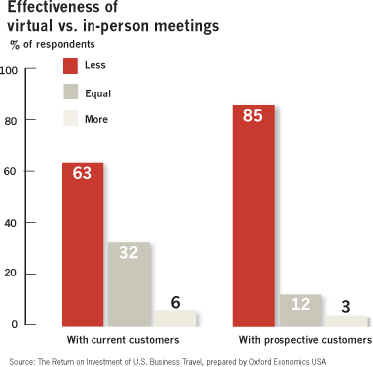
Difference in conveying a message
Sukriti Kushwaha
In person communication has the highest impact of information conveyed[4]
One is more likely to take action based off a face-to-face conversation
Study by Oxford Economics shows that every dollar invested in business travel results in $12.50 gained in revenues and $3.80 in profits. [5]
[6]
Notes:
Internet communication is a double-edged sword: e-mails and social media allow instant messaging, but potential for higher chance of misinterpretation of someone's message, or missing some aspects of dialogue
Advantages of in person communication: able to hear each other but also see body language, facial expressions, and pick up on intonations in the sound of someone’s voice.
When speaking with someone in front of you, you have more control over the situation: can present facts individually and make sure the person understands your point before moving on
Improves both speed and accuracy of communication
Companies understand the importance of face-to-face communication and how it affects their business as well
Conference calls, email, texting, video conferences, social networks and other forms of media help building and maintaining business relationships. but none provide the as strong a impact as meeting with someone face-to-face
Facial expressions, hand gestures provide more context to listener than just words
Harder to follow these expressions over a screen or through a message
For instance, it’s easy to replace a someone you’ve never met, but usually harder for a person to fire someone they regularly interact with ftf and respect

Slide 26
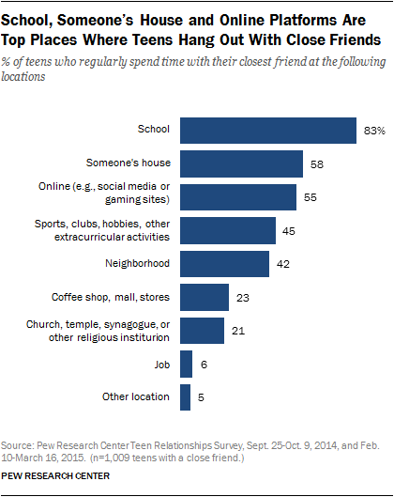
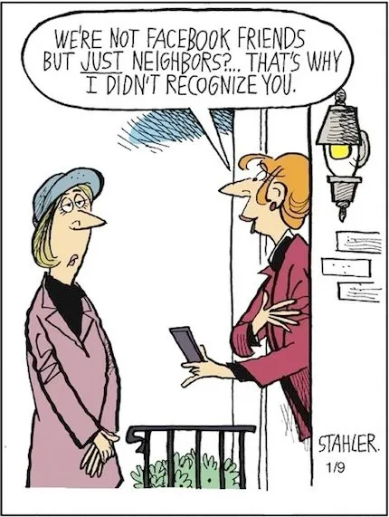
Case study: remote learning
Sukriti Kushwaha
More than half of public-school K-12 teachers said the pandemic resulted in a “significant” learning loss for students [7]
Online learning is negatively associated with student connectedness.
Connectedness is defined as the sense of belonging to the community
Feeling connected aids student health and wellbeing, boost grades, and increases chance of graduating[8]
[9]
Notes:
Ask the class: How many people prefer remote learning versus in person learning? Why is this?
Why remote learning is not a substitute for learning in-person:
Much easier to tune out of a conversation over a computer, easier to get distracted because you are missing the human-human connection
When there are many people in a meeting with face-to-face communication, there will be more energy in the room and opportunities to creatively collaborate by feeding off each other's energy
Isolation: No ftf communication with teachers, miss lunch with friends, recess, prom, sports teams, club activtiies
No hands on projects: music, art, P.E.
More than half of public school K-12 teachers said the pandemic resulted in a “significant” learning loss for students
Complex skills like writing are easier to learn when teachers have direct contact with students.
Way to much screen time!!!
Most students spend time with close friends at school, so taking away that medium to interact with friends means they have to turn to forms of social media or messaging to interact with their friends behind a screen, which as covered earlier, does not provide the same form / value of communication

Slide 27
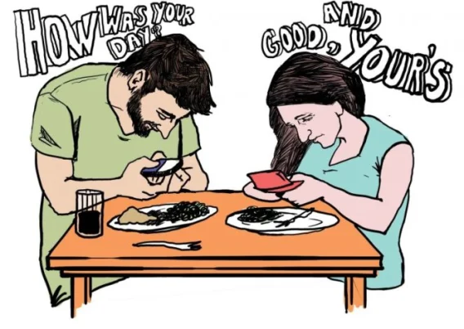
Time must be spent somewhere
Sukriti Kushwaha
Zero Sum Property
In order to create space for new activities, people must allocate less space for prior activties
Everyone has only 24 hours a day to spend
People using the internet will have to decrease time from other activities[10]
Mental Health
Greater use of internet associated with increase in depression
Leads to social withdrawal
R = -.137, p<0.01
[11]
Notes:
Human activities follow zero-sum property
People cannot begin a new activity without decreasing time devoted to prior activities because everyone has only 24 hours a day to spend
Regarding Internet use, people using Internet will have to decrease time dedicated other activities
Those that use the internet more frequently interact with their families and friends less(r = -.137, p< 0.01)
Negative correlation coefficient, p<.01 shows that it is unlikely this correlation occurred by random chance
All the time that would have previously been spent engaged in social activities, people spend on the Internet.
The Internet is similar to other nonsocial entertainment activities, such as watching TV, reading, or listening to music.
Greater use of the Internet is also associated with increases in depression
Use of the Internet, like watching TV, could lead to social withdrawal
The more people rely on the Internet to interact with others, they engage in ftf conversations less, which makes them less competent at communicating with others which ultimately has negative impacts on the quality of human interactions

Slide 28
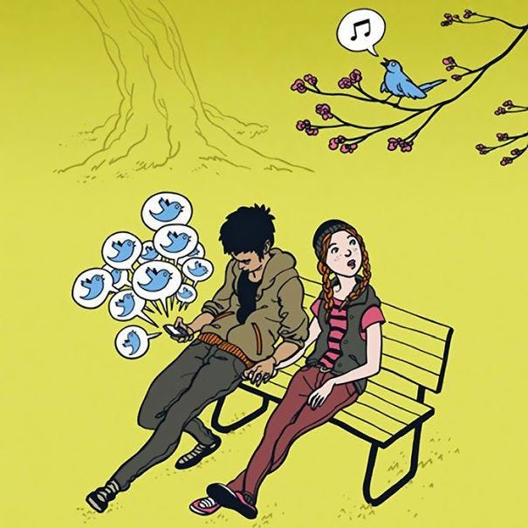
Never ceases to distract
Sukriti Kushwaha
Even when having conversations in-person, devices serve as distractions
Prescence of a mobile phone may cause individuals to think of other people and events outside of the current social realm they are participating in
Students that use their phones in class perform worse than those that do not. [12]
[13]
Notes:
Presence of phones can be felt even when having face to face social outings
Many couples eating together check their texts while in the middle of conversation/eating
Prescence of a mobile phone may cause individuals to think of other people and events outside of the current social realm they are participating in
This causes a diversion of attention, and does not allow for the individual to be present in the moment – they are focusing on other concerns
Having a phone nearby lowers the quality of firsthand social interactions
Back to messaging being instant: Here is how it can be a negative – consistently checking devices for updates & notifications
Studies have shown that students that use their phones in class perform worse than those that do not

Slide 29
References
Sukriti Kushwaha
[1] Drago, Emily. 2015. The Effect of Technology on Face-to-Face Communication. Elon Journal of Undergraduate Research in Communications 6 (1), http://www.inquiriesjournal.com/a?id=1137
[2] https://miro.medium.com/v2/resize:fit:620/1*f1xshQNcDpuD2kIU_jn5UQ.jpeg
[3] https://field-day.net/wp-content/uploads/sites/9/2017/02/970.jpg
[4] Przybylski, Andrew K., and Netta Weinstein. "Can you connect with me now? How the presence of mobile communication technology influences face-to-face conversation quality." Journal of Social and Personal Relationships 30, no. 3 (2013): 237-246.
[5] Mullich, Joe. “The New Face of Face-to-Face Meetings.” The Wall Street Journal, Dow Jones & Company, 2009, www.wsj.com/ad/article/globaltravel-face.
[6] https://www.wsj.com/adimg/sas-globaltravel-chart1.png

Slide 30
References
Sukriti Kushwaha
[7]Dickler, Jessica. “Virtual School Resulted in ‘significant’ Academic Learning Loss, Study Finds.”CNBC, CNBC, 12 Oct. 2021, www.cnbc.com/2021/03/30/learning-loss-from-virtual-school-due-to-covid-is-significant-.html.
[8] Hehir, Elizabeth, Marc Zeller, Joanna Luckhurst, and Tara Chandler. "Developing student connectedness under remote learning using digital resources: A systematic review." Education and Information Technologies 26, no. 5 (2021): 6531-6548.
[9] https://assets.pewresearch.org/wp-content/uploads/sites/14/2015/08/2015-08-06_teens-and-friendships_2-01.png
[10] Gapsiso, Nuhu Diraso, and Joseph Wilson. "The impact of the Internet on teenagers' face-to-face communication." Journal of Studies in Social Sciences 13, no. 2 (2015).
[11] https://comtecmrroy.files.wordpress.com/2017/03/333.jpg

Slide 31
References
Sukriti Kushwaha
[12] Westerman, David, Emory S. Daniel, and Nicholas D. Bowman. "Learned risks and experienced
rewards: Exploring the potential sources of students'attitudes toward social media and face-to-face
communication." The Internet and Higher Education 31 (2016): 52-57.
[13] https://webneel.com/daily/sites/default/files/images/daily/01-2020
/3-funny-cartoons-social-media-bird-tweet.jpg

Slide 32
Effect of Excessive Smartphone use on Children
Aksel Jensen
Notes:
Presentation on the effects of excessive smart phone use on children, this will be including psychological as well as physical symptoms and mostly not on excessive phone use.

Slide 33
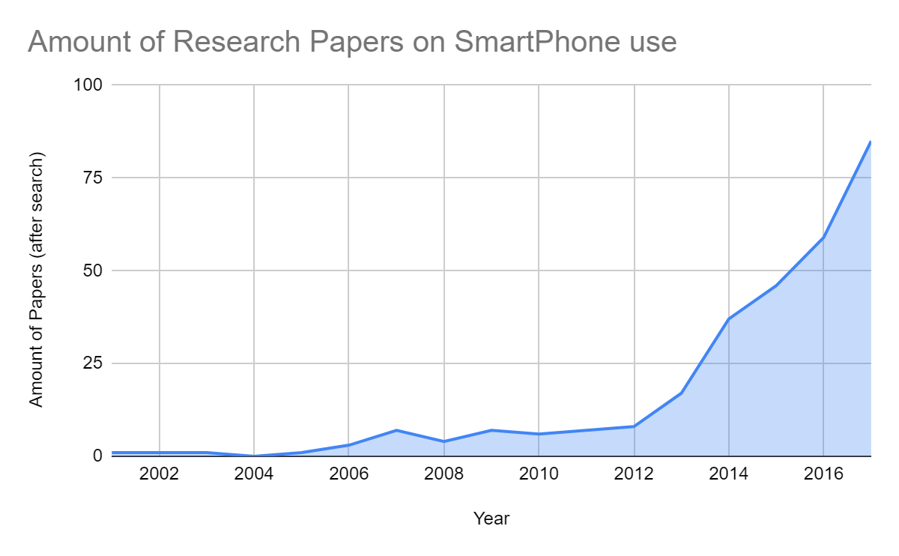
Children should be restricted from excessive screentime
Aksel Jensen
From an extensive search in 2018 the increase in research on mobile phone use was revealed. [1]
In 2013 from a pediatric clinic nationwide survey, it was found that 75% of children age 4 had access to a mobile phone[2]
I-phone 6 came out in 2014
Notes:
From my research I would argue that children should most definitely be restricted from excessive screentime.
Before I begin to attempt to convince you of all of this point I think it is important to note the research done in this field
While smart phones are not the newest technology in the world they definitely have never been more prevalent in our society as they are now especially among the younger generation
Here is a graph about the amount of research papers done related to this topic and the general increase in recent years should be somewhat revealing that this is in fact a real issue
Additionally the increase in general phone exposure among younger ages. 75% of all age 4 children had access to their own mobile device, note that this data is from 2013 right before when the Iphone 6 had just come out. Consider how much more prevalent smartphones are now as compared to a decade ago.

Slide 34
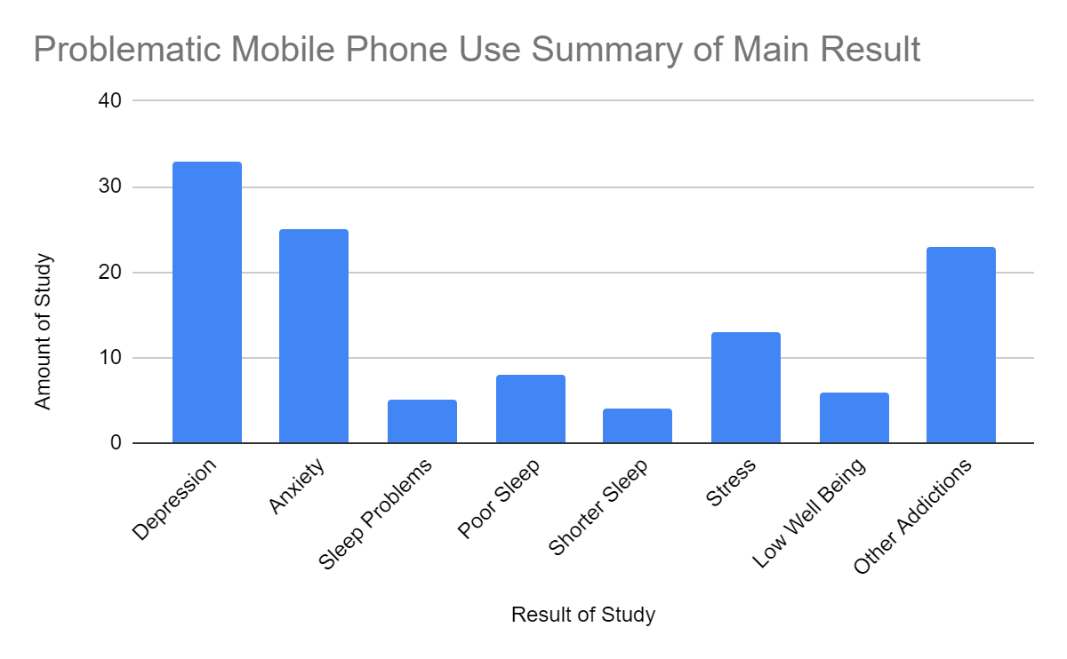
Mental Health, Depression and anxiety
Aksel Jensen
Depression and Anxiety are among the most common effects of problematic screen time.
Statistically significant positive correlation between the hours spent on social media and depression.[3]
Video game playing was linked with a higher correlation to more severe anxiety.
Notes:
Mental health including depression and anxiety are some of the most commonly researched and concluded results of excessive smart phone use on children.
This can come from a variety of factors but can range from addictive behavior anxiety and stress related to social networking apps or video games
It should be noted that video game playing is linked with more severe anxiety than other causes.

Slide 35
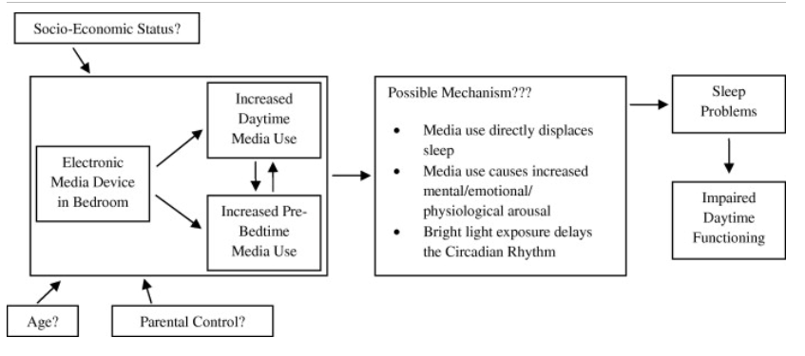
Smartphone effect on sleep
Aksel Jensen
Insufficient sleep duration
Impaired sleep quality
Sleep disturbances[4]
Children who get 8 hours of sleep use minimal phone after 9 pm as compared to other sleep groups.[6]
Notes:
There is several categorized impacts from smart phone use that can occur related to sleep the most common of which are as follows
Impaired sleep quality which refers to the difficulty of falling asleep due to overuse of phone late at night which disrupts natural melatonin production
Insufficient sleep duration which can be caused by late night phone use which causes going to bed later but still waking up at similar times
As well as sleep disturbances which relates to being awoken by phone notifications or anxiety of expecting phone notifications at night.
From a study in which children aged 12-18 were asked how many hours of sleep they got each night it was found that those who responded 8 hours used less media after 9 pm as compared to other groups.

Slide 36
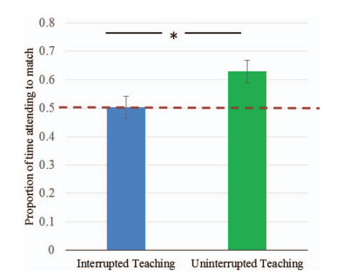
Effect on Parenting
Aksel Jensen
Smart phone effects do not have to come from the child owning a phone
Specifically important social parent-child interaction can be interrupted through cell phone use.
It was found among age 2 children that those where a parent had to take a phone call were not able to recall a taught word[5].
Notes:
While prospective literature including the Ethics Chapter 3 we read prior to class note on many effects of smart phone use for young children not often is it noted the importance of its effect on parent child interactions
Smart phone effect distractions can also be prevalent even if the child is not the owner of the phone.
In a study with 44 mothers and children it was recorded how well a child could interpret a word given teaching from their parent. However sometimes the teaching session was interrupted by the mother answering a phone call which was distracting for the child as well.
Clearly the uninterrupted teaching resulted in the child having a higher likelihood of recognizing and understanding the learning showing how smart phone use can derail social interaction and social learning which is important for young children.

Slide 37
Common Counter Argument
Aksel Jensen
Cell Phone Use
Individual Reporting
Observational studies
Intermediary associated factor
Intermediary
Intermediary
CP Use
CP
Effects
Cell Phone “Effects”
Notes:
Many studies including some of the ones I listed where mainly based on data included from individual reporting rather than experimental studies and it is very common for studies to end up with data that associates effects but does not show causation
Many factors of increase screen use are also predictors of intermediary factors that lead to what we think of as effects of screen use. The use of smart phones is more common among

Slide 38
Rebuttal
Aksel Jensen
Unethical experimental design
Feedback loops
Intermediary factors are commonly not positive
CP Use
Tired
Less Sleep
Notes:
It is fairly unethical to force screentime onto young children just to test its effect so the current most effective way of gathering data has to be from observational or individual reporting.
Many of the intermediary associated factors that attribute both the characteristics of depression and high screen use such as obesity or a more sedentary lifestyle are just as bad as the result of excessive screen use.
All of these points are of main concern due to them being involved in feed back loops that cause more smart phone use. The more you miss out on sleep and are more tired during the day the more likely you will engage in a low effort activity like using your phone.

Slide 39
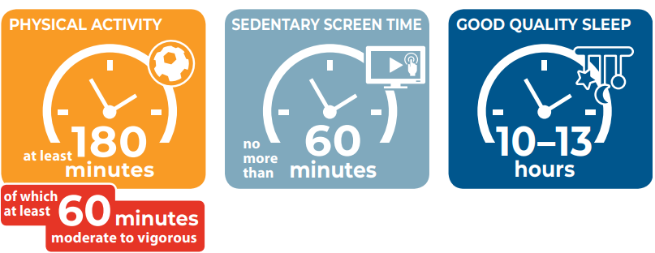
Conclusion
Aksel Jensen
Screen use if used effectively (non gaming / non SMS media) at normal hours of the day (non night time / onset bedtime use)
For a certain number of hours (2 hours) at the recommended level below addictive predictors is safe practice for young children.
Devices SHOULD NOT be used as a crux for parenting. [2]
In 2019 the World Health Organization released guidelines for amount of screen use for children[7]
Notes:
In conclusion it is my belief that excessive screen use should be strongly discouraged among children under the age of 18 due to the negative effects such as mental health issues, disrupted sleep, possibility of addiction, and interruption of natural parenting.
Screen time can definitely still be used as most of the side effects I have noticed are associated only with excessive phone use
Devices should never be used as a reward or distraction system for children. If your child is being difficult do not give them a device to ease them it was common among parents to give their child a device to “keep them calm” about (65%)
In 2019 The World Health Organization noted on how children under the age of 5 should not be using sedentary screen time for greater than 60 minutes a day.

Slide 40
References
Aksel Jensen
[1]Thomee Sara, Mobile Phone Use and Mental Health. A Review of the Research That Takes a Psychological Perspective on Exposure, (Int. J. Environ. Res. Public Health, November 19 2018), https://www.mdpi.com/1660-4601/15/12/2692 (August 4, 2023)
[2]Kabali et al., Exposure and Use of Mobile Media Devices by Young Children, (Pediatrics, 2015), https://publications.aap.org/pediatrics/article-abstract/136/6/1044/33852/Exposure-and-Use-of-Mobile-Media-Devices-by-Young?autologincheck=redirected (August 4, 2023)
[3]Pantic et al., ASSOCIATION BETWEEN ONLINE SOCIAL NETWORKING AND DEPRESSION IN HIGH SCHOOL STUDENTS: BEHAVIORAL PHYSIOLOGY VIEWPOINT (Psychiatria Danubina, 2012), https://hrcak.srce.hr/file/156425 (August 4, 2023)
[4]Yoon et al., The Effects of Children’s Smartphone Addiction on Sleep Duration: The Moderating Effects of Gender and Age (Int. J. Environ. Res. Public Health 2021) https://www.mdpi.com/1660-4601/18/11/5943 (August 4, 2023)
[5]Jessa et al., Learning on hold: Cell phones sidetrack parent-child interactions (Developmental Psychology 2013) https://psycnet.apa.org/record/2017-27611-001 (August 4, 2023)
[6]Cain, Neralie, Gradisar, Micheal, Electronic media use and sleep in school-aged children and adolescents: A review, Sleep Medicine, Volume 11, Issue 8, 2010, Pages 735-742, https://www.sciencedirect.com/science/article/pii/S1389945710001632 (August 4, 2023)
[7]Guidelines on physical activity, sedentary behaviour and sleep for children under 5 years of age. Geneva: World Health Organization; 2019. Licence: CC BY-NC-SA 3.0 IGO (August 4, 2023)

Slide 41
Class 4 The End
Keith A. Pray
socialimps.keithpray.net
Notes:
Use remaining time for group project questions and/or review group assignment slides.
This is the end. Any slides beyond this point are for answering questions that may arise but not needed in the main talk. Some slides may also be unfinished and are not needed but kept just in case.

