Slide 1
Class 12-14
Last Days
Keith A. Pray
socialimps.keithpray.net

Slide 2
Overview
Reminder: Course and Group Evaluations
Automation Paper Results
Points to date
Class 14:
  Students Present
  Students’ Choice

Slide 3
Notes:
Automation Paper results. This term’s additions in RED

Slide 4
Papers
Great improvement!
Many students highest grade yet!
Much better backing data
Notes:
Save for next time:
More Clear Conclusions
Significant Counter Points
Clearly state conclusion
First statement preferred
Absolute statements are difficult to prove
Avoid: all, always, any, every, everyone, never, none… unless you can show it
Be sure to put quotes around entire quote
Hyperbole is the best thing ever!
but not in these papers
Print 2 sided and save a tree
Use template, saves time (and -1 point)
Include Counter Point and Response
Include Author, Title, Publish Date, Publisher for references
Read paper aloud to proof

Slide 5
Grades
To Date
56 Max Possible
- Discussion 1-12
- Papers 1-4

Slide 6
Regulating tiktok
Ryan Suarez

Slide 7
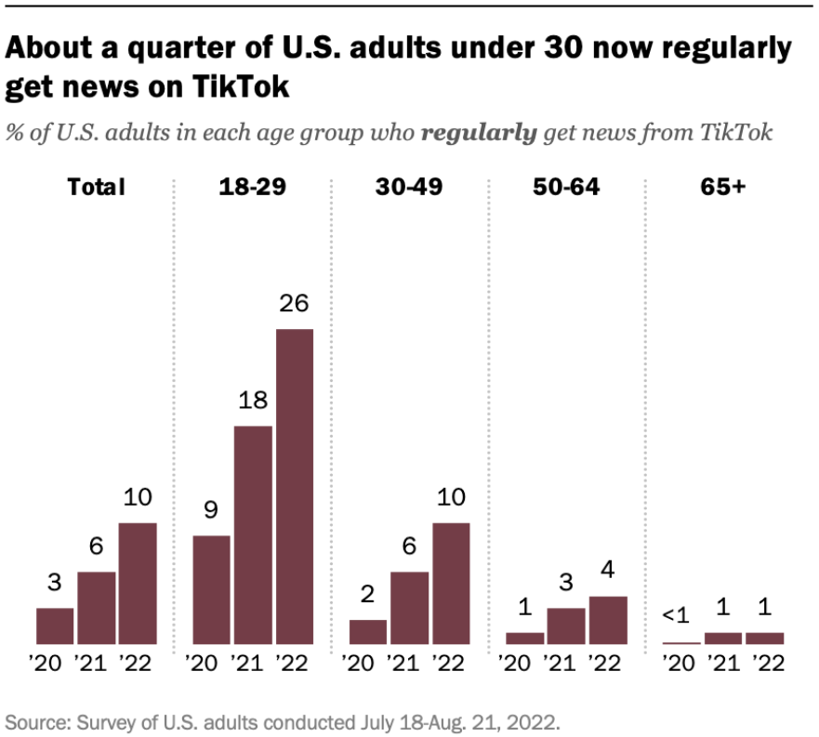
Why regulate tiktok?
Ryan Suarez
Owned by Beijing’s, “ByteDance”
“Used by more than 100 million Americans.” (NPR).
China could collect sensitive data
Security risk to Western governments
Toxic content harms young people
<Graphic as big as will fit>
Notes:
Tik Tok is a rapidly growing app with over 150 million active users. Tik Tok has pioneered integrating video format into social media. There have been various replicas of the app's main features such as Instagram and YouTube shorts. Many users experience that the upward swiping is an addictive interface to interact with ai generated recommended video clips. The Chinese government has very close ties to its private enterprise, and some argue that China may secretly force Byte Dance to handover US metadata. In 2018, China banned Tik Tok because it deviated from socialist values.
Most European countries have banned Tik Tok from being installed on government issued devices. There is a huge concern in the US Congress as Foreign Affairs Committee Chairman Michael McCaul explains that, “TikTok is a modern-day Trojan horse of the [Chinese Communist Party] used to surveil and exploit Americans’ personal information… in other words, it’s a spy balloon in your phone.”
According to Forbes Magazine, Byte Dance was tracking three Forbes journalists' locations by retrieving their IP addresses through the app in order to determine if they were in the vicinity of Tik Tok employees to uncover the source of leaks about its ties to China. Tik Tok fired multiple employees over this scandal and condemned these actions in a statement to Forbes. This scandal is very notable because it directly contradicts Byte Dances rhetoric that their product is safe. This raises questions about whether employees were fired because they broke company policy or because Byte Dance is attempting to maintain plausible deniability.

Slide 8
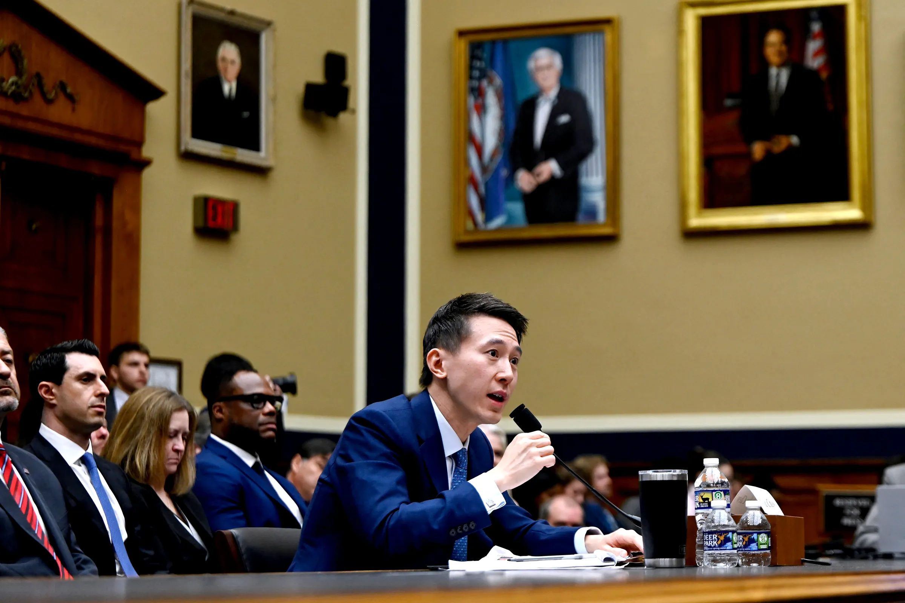
Who are the parties involved?
Ryan Suarez
Government (regulatory) bodies
  Trump/ Biden Administrations
  Federal Courts
  Committee on Foreign Investment in the U.S (CFIUS)
Current TikTok CEO Shou Zi Chew
Expert testimony: FBI Director Christopher Wray
American Civil Liberties Union
Tik Tok is banned in India, and is being reviewed in Western countries such as EU [1]
Notes:
There are many parties involved in addressing the security concerns that Tik Tok poses. Efforts to use executive orders to ban Tik Tok started in the Trump administration and have continued during the Biden Administration but have been halted by federal courts.
Tik Tok and it’s parent company Byte Dance have had a relatively high turnover rate in it’s executive positions. Byte Dance, was created by Zhang Yiming, who is a Chinese national that was formerly employed at Microsoft before creating Tik Toks parent company. Byte Dance created Tik Tok in 2015 and was quickly a major success. In May 2021, Yiming left Tik Tok because he claimed he lacked the proper management skills of the growing company. Tik Tok CEO Shou Zi Chew was born in Singapore and served in the Singapore Military. He also graduated from Harvard Business school and has been the CEO of Tik Tok since 2021. The CEO before Chew was, Kevin Mayer who was born in the United States and graduated from MIT. In May 2020 Mayer left Byte Dance after working there for only three months because of pressure on the company due to the US governments increasing pressure to regulate Tik Tok.
The most prominent agency tasked with analyzing Tik Tok regulations is the Committee on Foreign Investment in the U.S which is an interagency committee authorized to review certain transactions involving foreign investment in the United States, in order to determine the effects on national security.
Although there is a lack of evidence that China is forcing Byte Dance to hand over sensitive data, FBI Director Christopher Wray has noted in a senate hearing that authorities are "not sure that we would see many of the outward signs of it happening if it was happening". The American Civil Liberties Union has opposed all bans of Tik Tok, and their stance on the situation is that the lack of evidence that Tik Tok is a threat and that there is a high bar of evidence needed to constitute any ban that would impede on citizens freedom of speech and rights to access information.

Slide 9
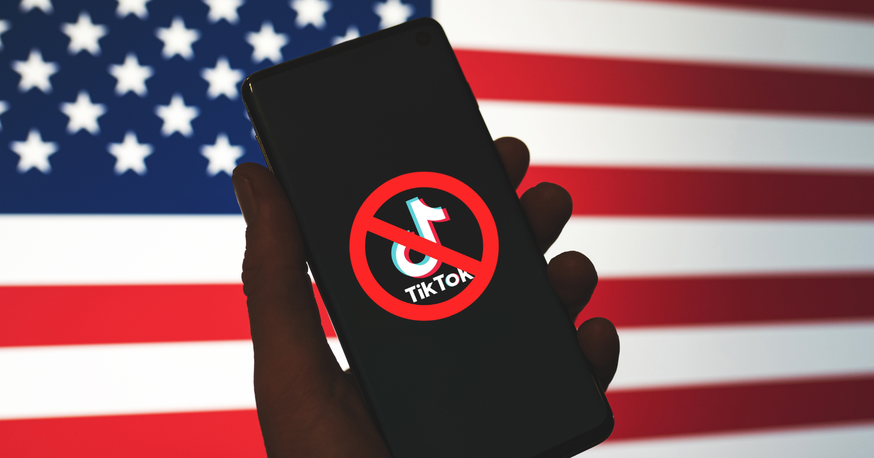
What government actions have taken place?
Ryan Suarez
The Trump Administration failed to ban [2]
The US has banned Tik Tok on all government issued devices.
Senate Testimony
CIFUS Negotiations
Notes:
The Trump administration tired to pass legislation to ban the app but it was stopped by two federal judges. Lawyers representing Byte Dance cited a "failure to adequately consider an obvious and reasonable alternative before banning TikTok“.
Montana has drafted a bill called SB 419, that if signed into law, would prevent app stores from providing Tik Tok but individuals who already have the app installed on their devices may still use it. Some governors have passed legislation banning the app from being used in public universities including the University of Oklahoma and Auburn University in Alabama. In December 2022, President Biden signed legislation banning TikTok on government devices.
In March, TikTok CEO Shou Chew appeared in congress to speak to a bipartisan group in order to address growing concerns about Tik Toks dedication to protecting US data. A lot of Chew’s statements were not well received by members of congress, and although it was expressed that Tik Tok does not collect any data that is unusual compared to its social media competitors, legislators made it clear that they did not believe him, and that Byte Dance would not be able to stand up to China’s requests to hand over sensitive data. Legislators also asked Chew about the lack of content moderation for kids and the tendency to expose young people to content that is harmful such as promoting self harm behaviors or eating disorders.
Concerns have also been voiced by the (CFIUS) committee has expressed that “on a case-by-case basis, [it] will ensure the protection of national security, including to prevent the misuse of data through espionage, tracking, and other means that threaten national security.” The CIFUS maintains an ongoing dialogue with Byte Dance in order to negotiate measures to ensure user safety.

Slide 10
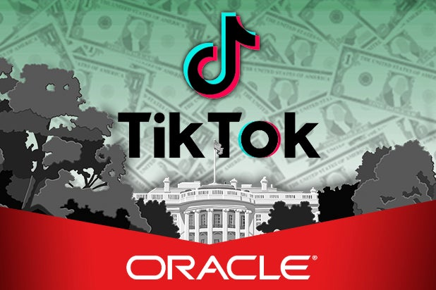
What may happen?
Ryan Suarez
Scenario 1: Congress “RESTRICT Act” [3]
Scenario 2: Congress doesn’t act, but Biden makes negotiations
Scenario 3: Byte Dance Sells Tik Tok
  “Project Texas”- Byte Dance, uses Oracle as a mediator to sensitive data. [4]
Notes:
If the US ban on TikTok did happen, it would happen as a result of a bipartisan senate committee. The RESTRICT Act which stands for Restricting the Emergence of Security Threats that Risk Information and Communications Technology Act of 2023 is a bill that would authorize the Secretary of Commerce to review and prohibit certain transactions between persons in the United States and foreign adversaries, and for other purposes. This act seeks to protect the digital economy and democratic process including federal election tampering and to steer US foreign technology regulations in an undesirable manner. The act has received backlash because some say that the wording in the bill is too vague and doesn’t explain how law enforcement would implement this. It is unclear how the government would address US users who utilize a VPN to access Tik Tok. Another bill proposed in March called the “Deterring America’s Technological Adversaries Act” would allow the Biden administration to place sanctions on Tik Tok if it is discovered that China used data from Byte Dance unethically or attempted to tamper in a US election.
If congress is not able to agree on terms to limit Tik Tok, President Biden could try and limit vulnerabilities through the app through an executive order. Any conditions in a hypothetical executive order would most likely be small considering that President Trump was unable to get an executive order past the federal courts. The American Civil Liberties Union’s stance on the issue is that a total ban would violate the first amendment to free speech. Consequently, President Biden could try to leverage other aspects of the US-China relationship such as rising tensions over control of Taiwan in order to make some peace deal.
It is unlikely that China would sell their app to a Western Company because they would lose ownership of their sophisticated “For You” recommendation algorithm and it would set an unfavorable president to Chinese software companies competing in Western markets. If Tik Tok was sold, China would have to approve the sale and China claims that a forced sale of Tik Tok would hurt foreign investors confidence in Western investment opportunities. This is still a possibility however considering that 60% of the shares of Tik Tok are held by Western Investment Firms including the well-known firm “Fidelity Investments”. A total buyout of Tik Tok could be as high as $50 billion. Byte Dance hopes to work with Oracle, to get them to house Tik Tok’s data in at Oracle’s headquarters in Texas.

Slide 11
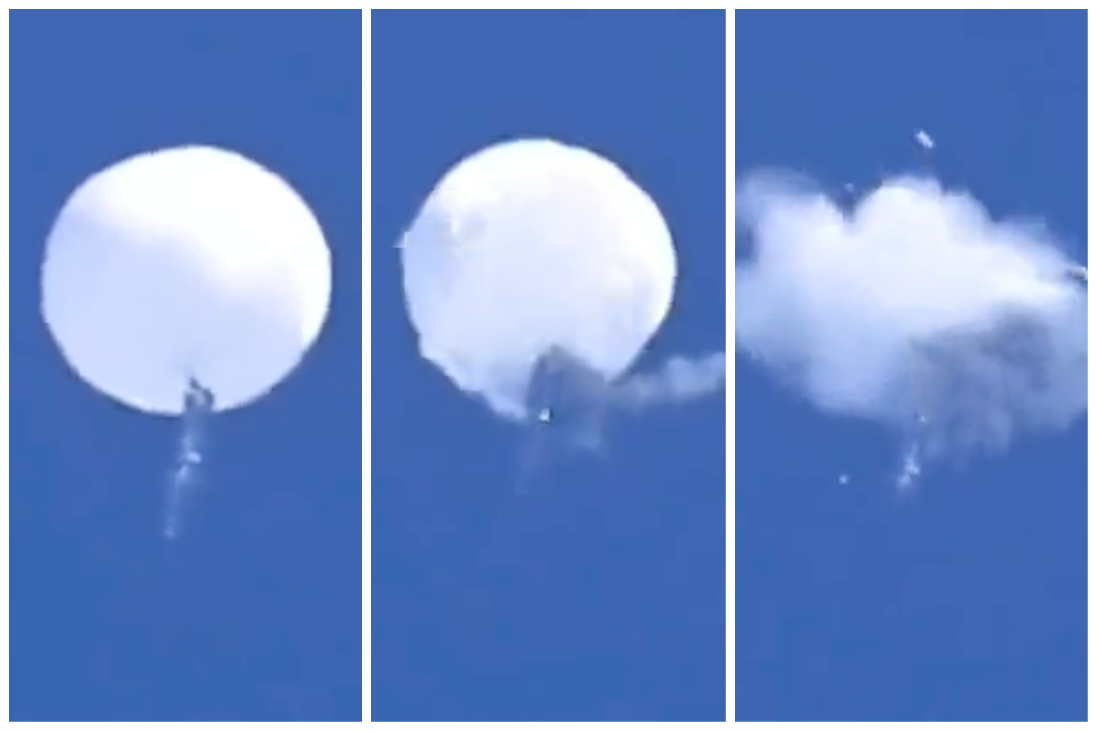
Conclusion: TikTok should be banned!
Ryan Suarez
TikTok has already been caught tracking employee locations to out whistle blowers [5]
China attempts to maintain plausible deniability over hacking and spying
High Turn over rate
TikTok has affected media consumption
Notes:
I believe that Tik Tok should be banned because it seems likely that China is not telling the whole truth about its intentions to infiltrate the US digital economy. There is no clear public approach to data privacy as there is no effective regulatory agency in the US to handle privacy concerns of this nature. US citizens need to be aware that their data may be compromised by the Chinese government. Although forcing a sale or banning Tik Tok may hurt foreign perceptions of US investment, it is more important that the US airs on the side of caution to prevent individuals' data from being unknowingly stolen.
It is notable that Tik Tok has a lot of content that can be harmful to minors, especially misogynistic content and there is no effective measures to prevent minors from viewing this content because an account is not needed to view Tik Tok.
It is also concerning that Tik Tok has such a high turnover rate and personally I think that this is a tactic to cycle through top level management in order to avoid creating a public figure that is portrayed as a foreign spy. This conclusion also falls in line with the fact that Tik Toks current CEO rarely gives interviews and many people at his senate hearing were disappointed with his inability to answer questions directly.
China has a long track record of corporate espionage and hacking and using plausible deniability to wiggle their way out of direct confrontation or sanctions. Considering that there was a scandal where Byte Dance employees were spying on journalists in order to out whistle blowers within the company is a serious offense that threatens the US’s ability to assess its vulnerabilities. The spy balloon is a very good example of China’s typical tactics because it was received as a very overt intrusion by US media outlets and yet China has continued to deny this. Since 2016 there has been a growing concern that foreign governments have employed cyber attacks in order to influence US elections and the growing number of individuals who use Tik Tok as a news source is growing and this has the potential to spread fake news and negatively affect the democratic elections.

Slide 12
References
Ryan Suarez
[1] Ede-Osifo, Uwa, and Kevin Collier. “What Experts Say a TikTok Ban Would Look like for U.S. Users.” NBC News, NBC News, 17 Mar. 2023, https://www.nbcnews.com/tech/tech-news/tiktok-ban-us-biden-explained-rcna75313.
[2] New Bibliography 202305030 Style: MLA 8 (Modern Language Association 8th Edition) He, Laura. “China May Prefer TikTok to Be Banned than Fall into US Hands | CNN Business.” CNN, CNN, 23 Mar. 2023, https://www.cnn.com/2023/03/22/tech/china-us-tiktok-sale-ban-intl-hnk/index.html.
[3] He, Laura. “China May Prefer TikTok to Be Banned than Fall into US Hands | CNN Business.” CNN, CNN, 23 Mar. 2023, https://www.cnn.com/2023/03/22/tech/china-us-tiktok-sale-ban-intl-hnk/index.html.
[4] He, Laura. “China May Prefer TikTok to Be Banned than Fall into US Hands | CNN Business.” CNN, CNN, 23 Mar. 2023, https://www.cnn.com/2023/03/22/tech/china-us-tiktok-sale-ban-intl-hnk/index.html.
[5] reporter, Guardian. “TikTok Admits Using Its App to Spy on Reporters in Effort to Track Leaks | TikTok | The Guardian.” The Guardian, The Guardian, 23 Dec. 2022, https://www.theguardian.com/technology/2022/dec/22/tiktok-bytedance-workers-fired-data-access-journalists.

Slide 13
Government Surveillance Effect on Journalism Freedom
Akshay Shinde

Slide 14
Snowden Files
Akshay Shinde
News Article by Guardian released on June 5 and 9, 2013 [2]
Leaked information on NSA surveillance projects
  Collected/analyzed millions of phone records from American users
Disclosed Project PRISM
  Captured and stored emails, audio, video chats, documents, etc.
Notes:
In 2013 Edward Snowden released to the Guardian (a British newspaper) information the NSA was tracking including
The collection and analysis of millions of phone records from American users from Verizon data including domestic and international calls
Operated under the Foreign Intelligence Surveillance (FISA) Court, which is a US court that issues surveillance warrants
PRISM captured emails, audio, video, documents, and other data from 9 Internet companies including Google, Facebook, Apple, Microsoft

Slide 15
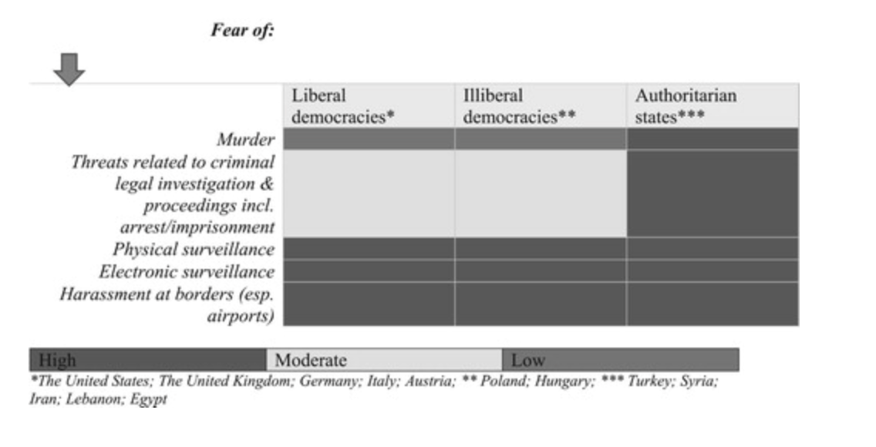
Surveillance Conducted
Akshay Shinde
Self-Surveillance/Paranoia
Electronic [1]
  malware
  wiretapping
Physical
  border control
  followed
AI Media Censorship [4]
[1]
Notes:
Self-Surveillance/Paranoia
In a post Snowden era and an increase of technology for journalists reporting on measures close to the government received much more surveillance
Many journalists in the conduct study reported fear of being watched
Led to their own “self-surveillance” where they would act much more cautiously
Electronic Surveillance
Malware detection - anywhere from
Wiretapping
Physical Surveillance included journalists in all countries getting stopped at border control at airports for “random searches” or would be held there and potentially miss their flights.
A couple journalists reported that they would be followed, the Guardian reporters that worked on the Snowden Files reported gray vans parked outside their house
With the rise of AI, censorship algorithms have been developed to censor media platforms. This has recently been implemented into the Chinese media, which is notorious for their censorship. Most recently, they have developed an NLP processing algorithm similar to ChatGPT which would censor any content deemed harmful to the Chinese government.

Slide 16
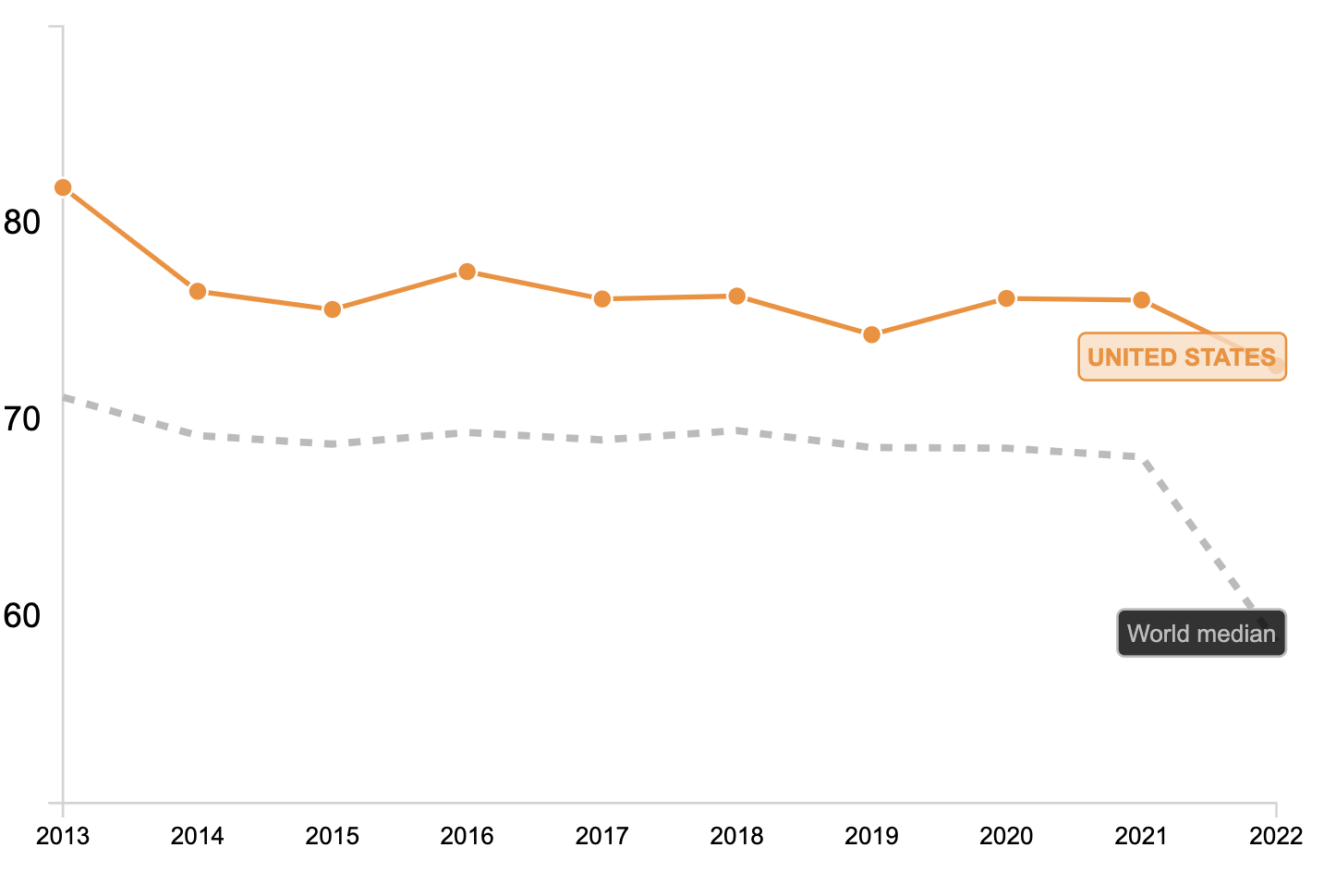
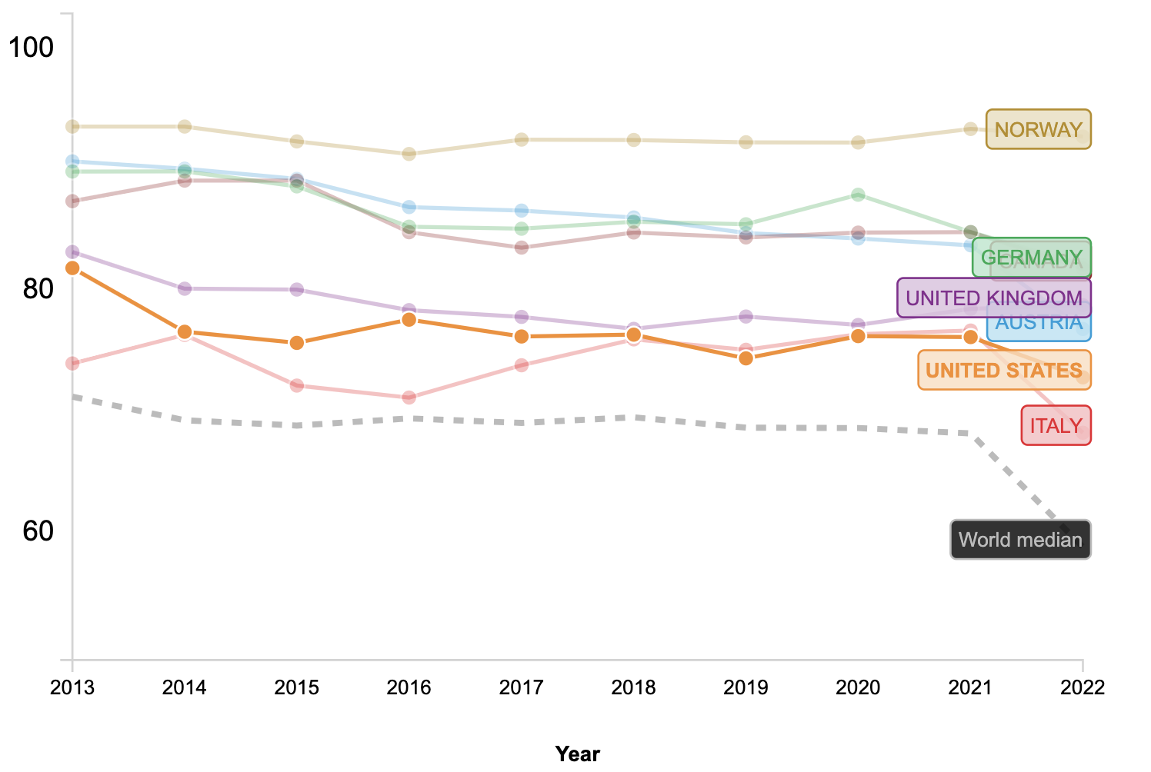
World Press Freedom Index
Akshay Shinde
Represents how much freedom journalist receive in a country [3]
US graded at a 72.74% in 2022
  Ranked 42nd in world
Notes:
World Press Freedom Index is an index used to calculate press freedom in the given countries
Based on Political Context, legal framework, economic context, sociocultural context and safety.
The US is graded currently at a 72.74% out of a 100 in 2022 which is ranked 42nd in the world and greatly above the world median
Compared to other liberal democracies in the world used in the study, we can see United States doesn’t perform as good

Slide 17

Journalist Solutions
Akshay Shinde
Email Encryption [2]
Signal [5]
  Secure phone calling
Two-Factor Authentication
Notes:
In order to protect themselves Journalists have found ways to protect themselves against digital surveillance.
This includes email encryption, which was a bit difficult because the encryption software also needed to be included on the sources device as well.
Signal is a phone app that was created in 2018, which provided end-to-end encryption on phone calls, which allows for secure phone calling between two parties.
Incorporating two-factor authentication on all devices is another way that journalists can protect their devices from hackers.

Slide 18
REFERENCES
Akshay Shinde
[1] Anthony Mills, “Now You See Me – Now You Don't: Journalists’ Experiences With Surveillance”, (Taylor & Francis Online, 2018) https://www.tandfonline.com/doi/full/10.1080/17512786.2018.1555006 (April 6, 2023)
[2] Stephenson Waters, The Effects of Mass Surveillance on Journalists’ Relations With Confidential Sources, (Taylor & Francis Online, 2018), https://www.tandfonline.com/doi/full/10.1080/21670811.2017.1365616 (April 6, 2023)
[3] GovData360, Press Freedom Index, (The World Bank, 2023), https://govdata360.worldbank.org/indicators/h3f86901f?country=USA&indicator=32416&countries=SGP,NOR,HKG,CAN&viz=line_chart&years=2013,2022&indicators=944&compareBy=income (April 6,2023)
[4] Will Knight, How Censorship Can Influence Artificial Intelligence, (Wired, 2021)
https://www.wired.com/story/how-censorship-can-influence-artificial-intelligence/ (May 2, 2023)
[5] Spencer Woodman, Five digital security tools to protect your work and sources, (ICIJ, 2018) https://www.icij.org/inside-icij/2018/01/five-digital-security-tools-to-protect-your-work-and-sources/ (May 2, 2023)

Slide 19
The gray area of cybercrime
Xiao Xiao
Notes:
The topic I want to share today is the gray area of cybercrime

Slide 20
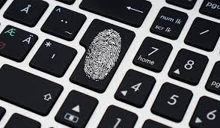
Cybercrime to be specific
Xiao Xiao
Based on other people's computer resources，also known as intrusion-type computer crime
The use of computer resources as a tool, also known as crime venue type of computer crime
Notes:
First of all, I would like to make a definition of cybercrime. Cybercrime is mainly divided into two types. It is divided into two parts, Based on other people's computer resources, also known as intrusion-type computer crime
The use of computer resources as a tool, also known as crime venue type of computer crime.
Today's topic is a gray area, the gray area I mean is that these actions have no effective legal constraints.

Slide 21
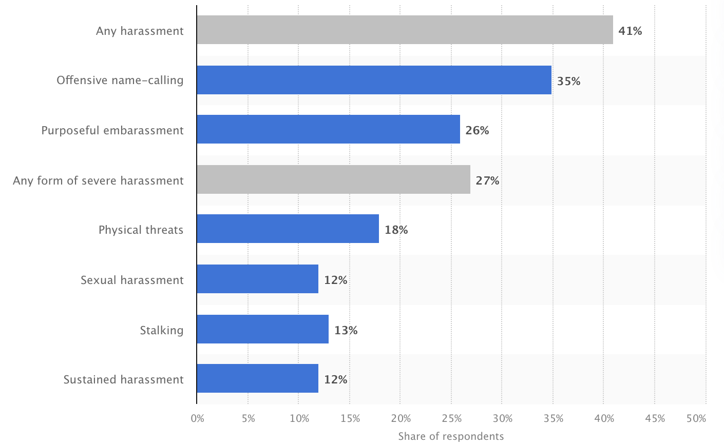
Crime venue: cyberbullying
Xiao Xiao
For 2,251 respondents (age 18 or above), 41% have experienced cyberbullying[1]
Share of adult internet users in the United States
who have personally experienced online harassment
as of January 2021
Notes:
Putting aside the intrusion type first, I want to talk about the crime venue type first. And the first issue I want to discuss is cyberbullying. As I said in the group presentation yesterday, I found that there are also many victims of cyberbullying in the English-speaking online environment. The image next to it is a survey done in January 2021. It shows that among the 2,251 respondents (who were all over the age of 18), 41 percent said they had experienced any harassment, while the second largest proportion was any form of severe harassment, just After name-calling.

Slide 22
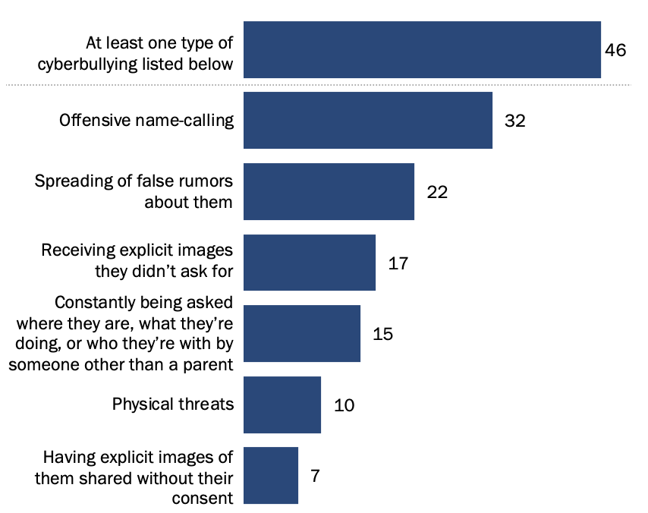
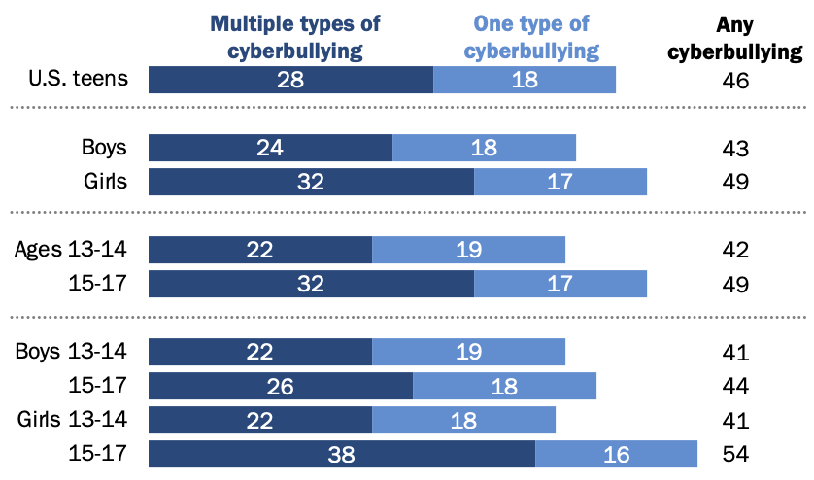
Crime venue: cyberbullying
Xiao Xiao
% of U.S. teens who say they have ever experienced __
Nearly half of U.S. teens ages 13 to 17 report ever experiencing at least one of six cyberbullying behaviors.
More percentage of teens from 15-to 17-year-olds have experienced multiple types of cyberbullying than 13 to 14 years old.[2]
% of U.S. teens
who have experienced __
Notes:
Now that the world of adults is like this, what about the world of teenagers? The report I found at the pew research center told me that among the respondents, 46 percent of the teens said they have experienced at least one type of cyber bullying listed on the graph. We have the most common offensive name-calling, more spread of false rumors, we can even see that 10% of teens have suffered physical threats. If we compare ages separately, you can see in the chart below, Teens' experiences with online harassment vary by age. Some 49% of 15- to 17-year-olds have experienced at least one of the six online behaviors , compared with 42% of those ages 13 to 14. Some 32% of teen girls have experienced two or more types of online harassment asked about in this survey, while 24% of teen boys say the same. And 15- to 17-year -olds are more likely than 13- to 14-year-olds to have been the target of multiple types of cyberbullying (32% vs. 22%). intrusion

Slide 23
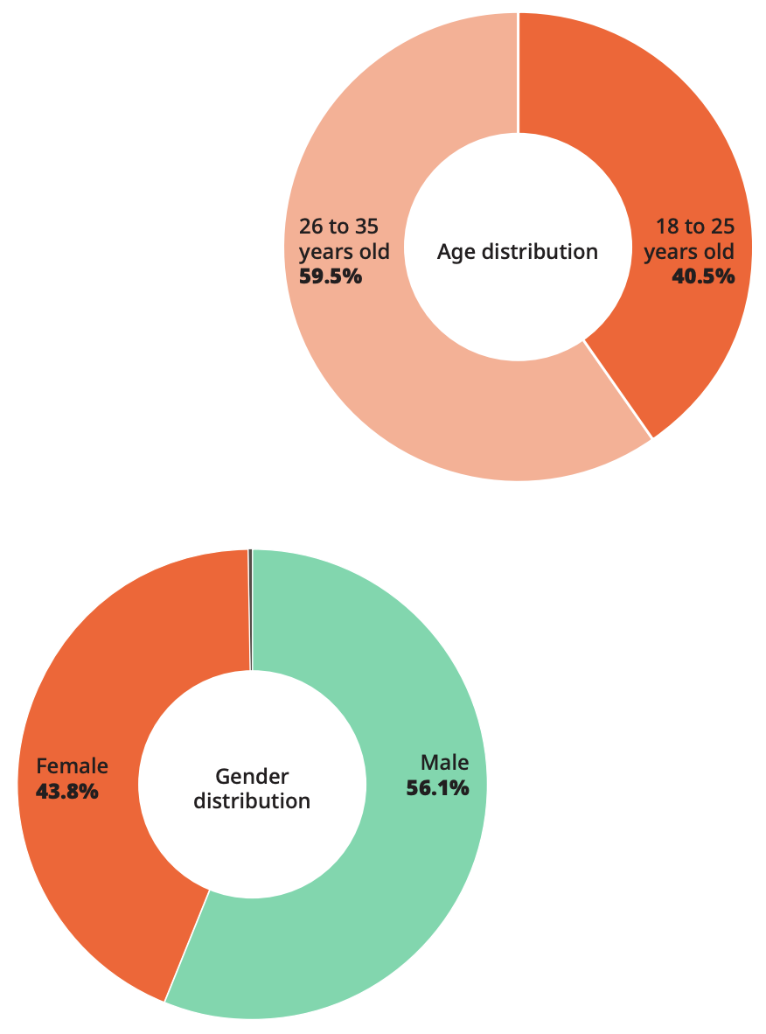
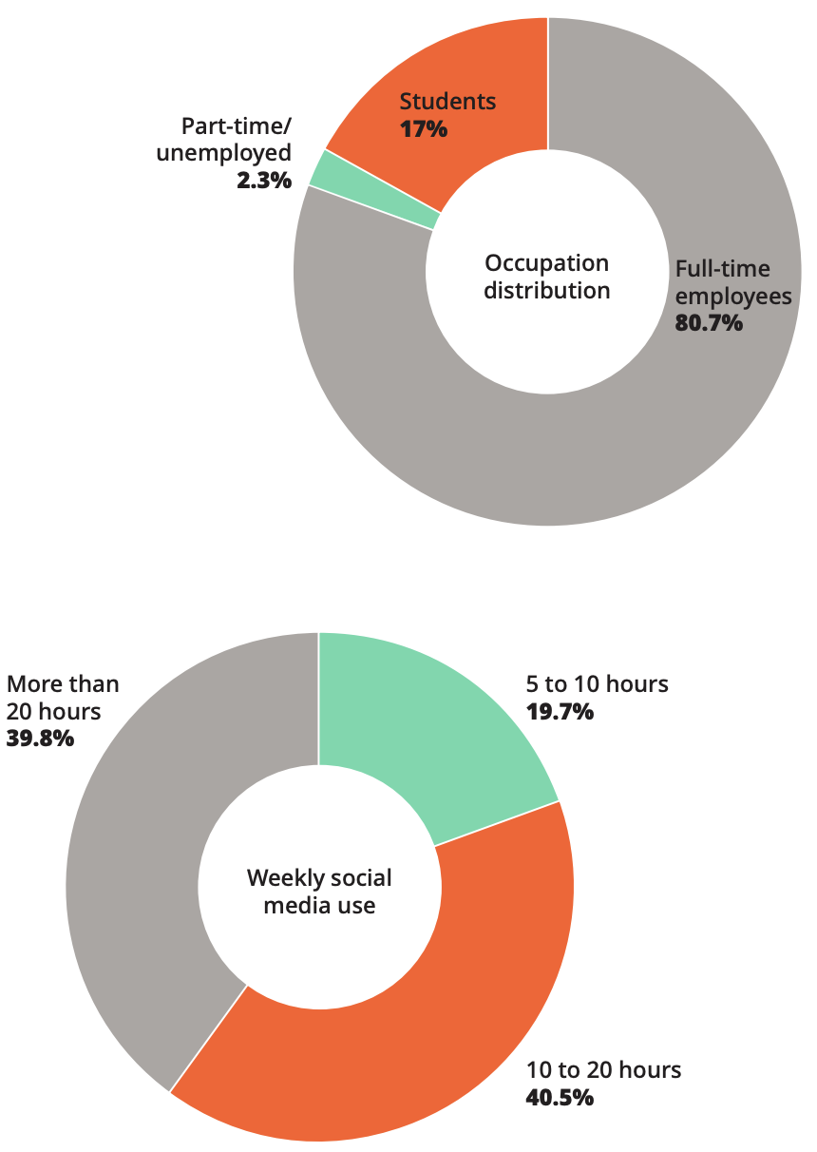
Crime venue: cyberbullying
Xiao Xiao
Male experience more cyberbullying than female
Most people who experienced cyberbullying are full-time workers
More time spent on social media implies greater chance, with 201 people from usage less than 10h and 329 from usage more than 20h.[3]
Notes:
Let's look at the situation in China. I found this document from the website of a research institution called why not. It is from the gender distribution, age distribution, job distribution, social media usage time, and victimization of cyberbullying victims in China. The emotional impact of the victim, and the time period for the victim to recover, etc., describe the situation of Chinese people being harassed by cyberbullying. Among the 2059 valid questionnaires received in this survey, the chart shows(describe the graphs)

Slide 24
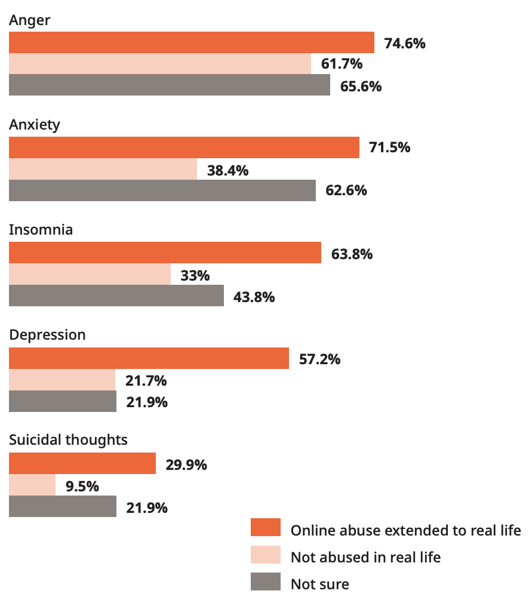
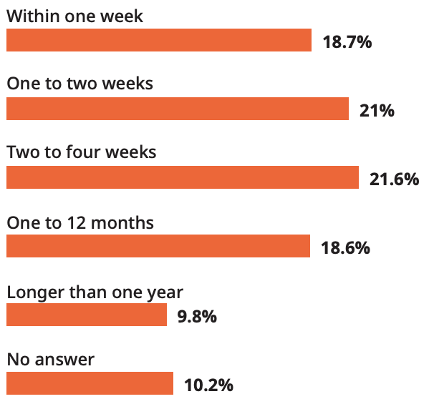
Crime venue: cyberbullying
Xiao Xiao
More percentage of people will suffer in negative emotions if had experience of physical harrassment.
After 1-12 weeks, most people would recover from cyberbullying. [3]
Notes:
Not only that, this questionnaire also collected the victim's emotions and physical harassment, we can see ( )
Victims usually need 1-12 weeks to recover from negative emotions, let alone suicidal people. Just imagine how much this time span would affect a person in the rhythm of WPI's life. Can’t imagine the situation of people who are still at work.

Slide 25
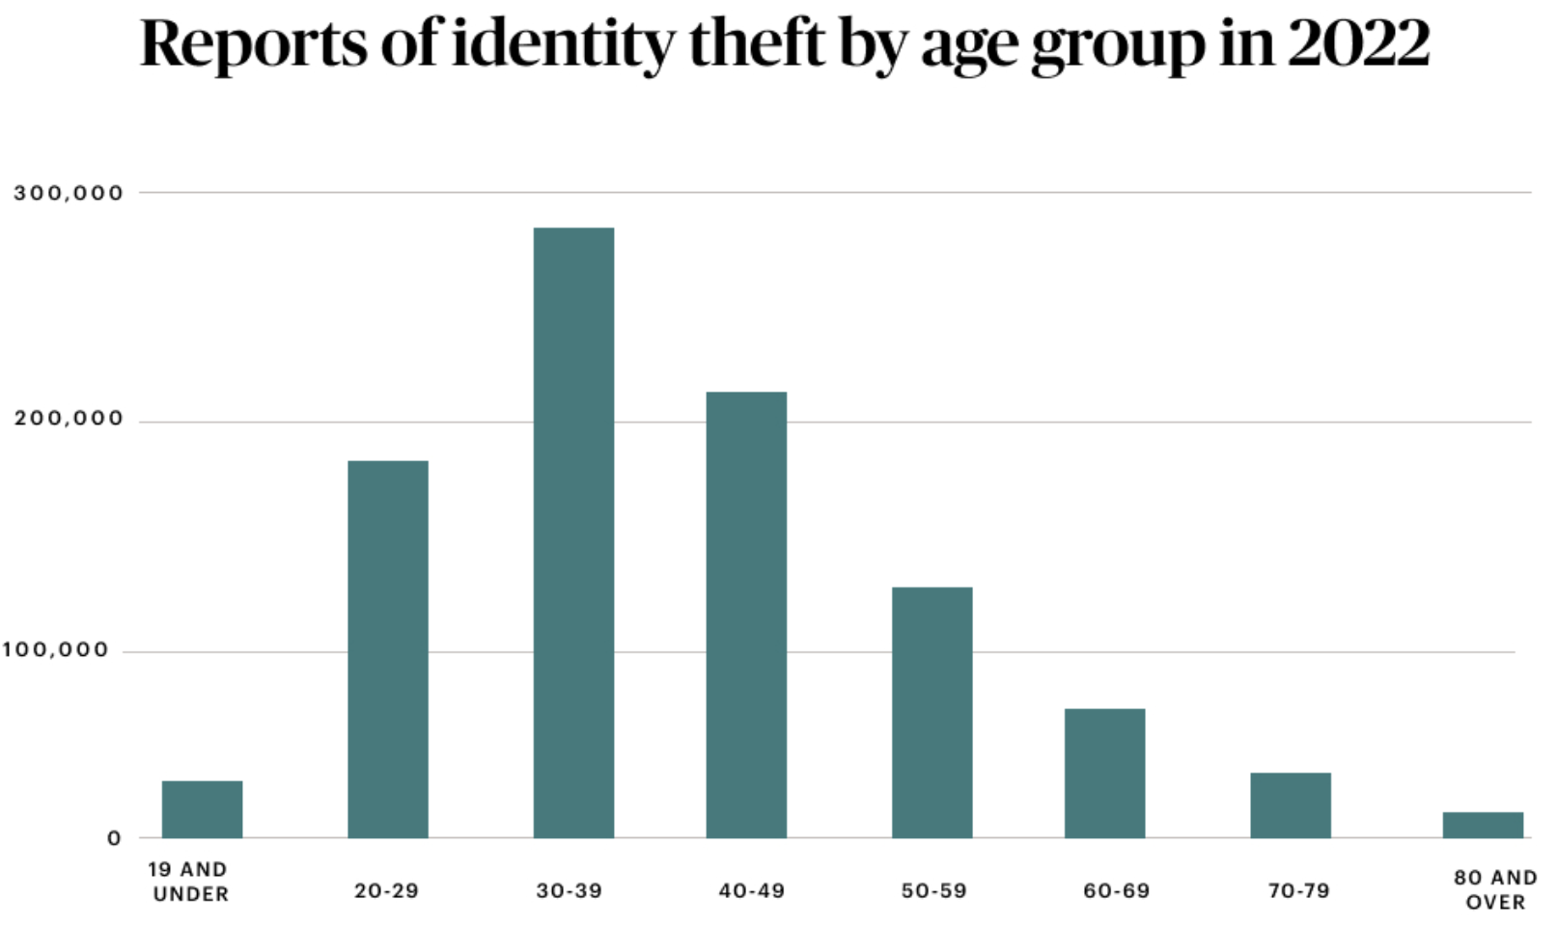
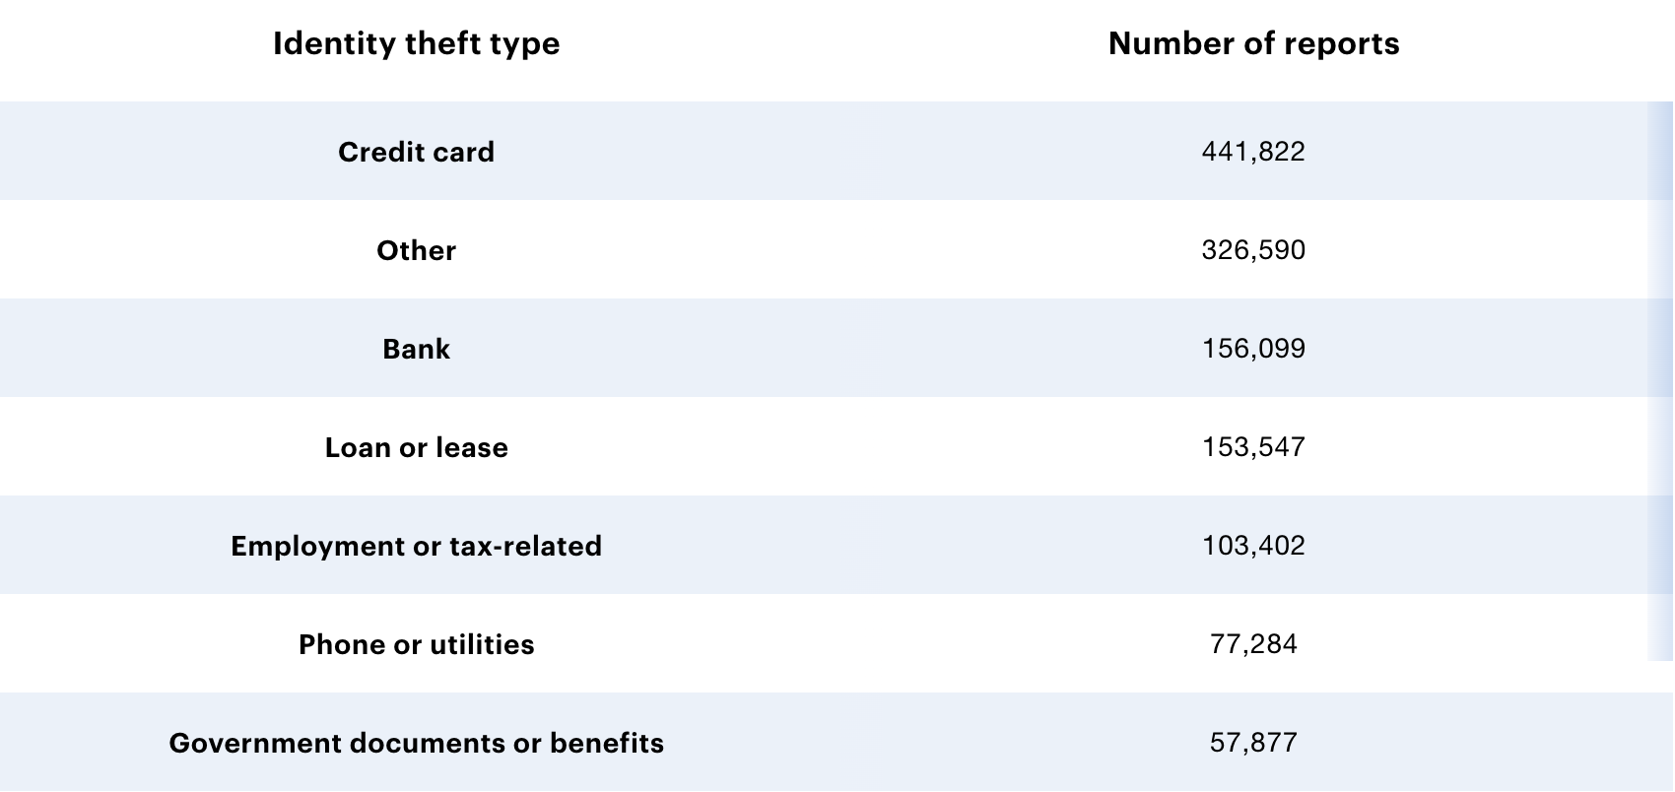
crime venue: account/identity theft
Xiao Xiao
Report of indentity theft by ago group
People from age 20-49 generally experience more identity theft.
441,822 reported cases in 2022[4]
Notes:
Another gray area is identity theft. From the data I found, there will be more than one million reports of identity theft in 2022, of which credit card fraud accounts for the highest proportion of identity theft, and the second highest is other, which includes fraud related to online shopping, payment accounts, emails and social media, medical services, insurance and more. As the victims of more than one million incidents, adults aged 20-49 accounted for the largest proportion

Slide 26

crime venue: account/identity theft
Xiao Xiao
Special case: account theft
Company sent out groups of emplyees specified to find the account theft (ethical?)
[5] A screenshoot of the employees from ‘Crab Account’,
a second-hand game account trading company, found the person who
retrived his game account without giving back the money
Notes:
A more specific form of identity theft is account theft. And what I want to talk about is game account theft. Because most teenagers in China like to play mobile games or computer games very much, this makes the second-hand account trading market extremely hot. However, the phenomenon of account recovery is also extremely frequent. In order to give consumers peace of mind, many second-hand account trading platforms have begun to produce offline videos of people looking for and recovering them and post them online. Those who are caught and retrieved are generally subject to administrative detention for more than ten days, and cases where the amount of money is too large, will allow the retrieved person to sit in prison for several years. But as far as China is concerned, I haven't found any sentencing provisions for this kind of behavior. Theft and fraud are the reasons for most recoveries' convictions. This kind of video can be regarded as a kind of publicity for the company, but they directly search for the retrieved person based on the IP, and contact their family members. There is even a scene in the video where they find the courier of the retrieved person to determine the person they are looking for. Here, too, it's kind of a gray area. I can say they are more like a vigilante.

Slide 27
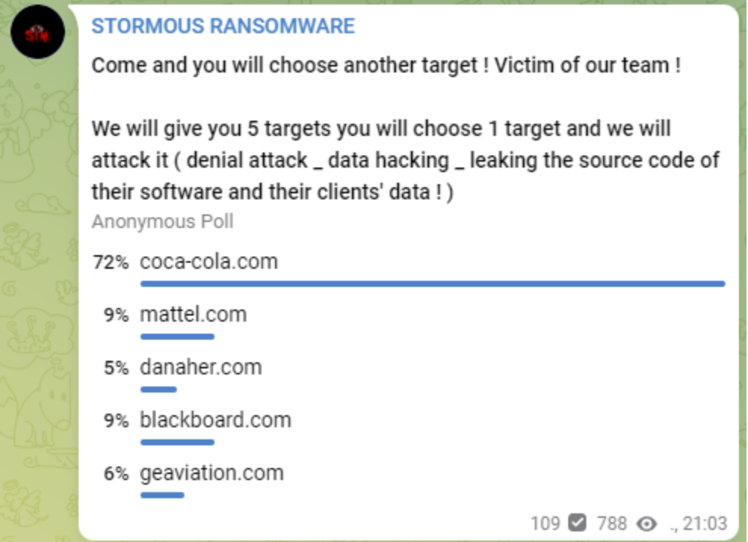
Intrusion-type: data breach
Xiao Xiao
Due to the difficulty of tracking and convicting cybercrime, law enforcement can only avoid the occurrence of cybercrime by strengthening the cybersecurity supervision of organizations. Bad actors exploit customers‘ distrust of company precautions and become more and more rampant.
Criminals will use any excuse to incite the masses in an attempt to disguise cybercrime as an act of justice. For example, Stromous passed a vote in April 2022 and selected Coca-Cola as their target of attack.[6]
Notes:
Finally, let's talk about intrusion type. Data breach is one of the more serious cyber crimes companies face. Due to the difficulty of tracking and convicting cybercrime, law enforcement can only avoid the occurrence of cybercrime by strengthening the cybersecurity supervision of organizations. Bad actors exploit customers' distrust of company precautions and become more and more rampant. like a pandemic, only a virus Only by being found and analyzed can we have a vaccine, not that we can make a vaccine before the virus breaks out. This is a stormous vote in 2022. They voted to decide which company to hack into. It feels like a team meeting. The victim, Coca-Cola, will not only be fined by the government because they did not protect their data but also face paying hackers a large amount of Bitcoin to keep these criminals from leaking data.

Slide 28
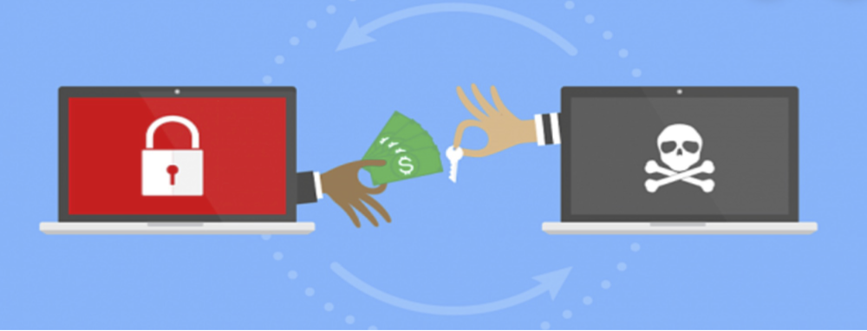
Intrusion-type: data breach
Xiao Xiao
Ransomware is a type of malicious software that threatens to publish the victim's data or perpetually block access to it unless a ransom is paid.
In the aftermath of a cybersecurity incident, cybercriminals can often get away scot-free. The attacked company‘s reputation, however, can be severely damaged and it will face hefty fines.
Under today's regulatory trends, an organization that is one of the victims of cybercrime will suffer more punishment than a bad actor.
Notes:
Because the bad actors who committed cybercrime know that it is difficult for current law enforcement agencies to track them (due to the concealment/difficulty of tracking/conviction of cybercrime), bad actors/hackers are becoming more and more rampant. Law enforcement agencies can only avoid the occurrence of cybercrime by strengthening the cybersecurity supervision of companies/organizations. Once a cybercrime incident such as data leakage occurs, hackers will threaten to disclose customer privacy and demand the company to pay a ransom. The company's reputation will be seriously affected, and it will also face huge fines (privacy law). Under such a trend, bad actors will become more and more rampant and take advantage of customers' distrust (voting) of the company's preventive measures, and the victim companies will suffer more penalties than bad actors (because they are difficult to track).

Slide 29
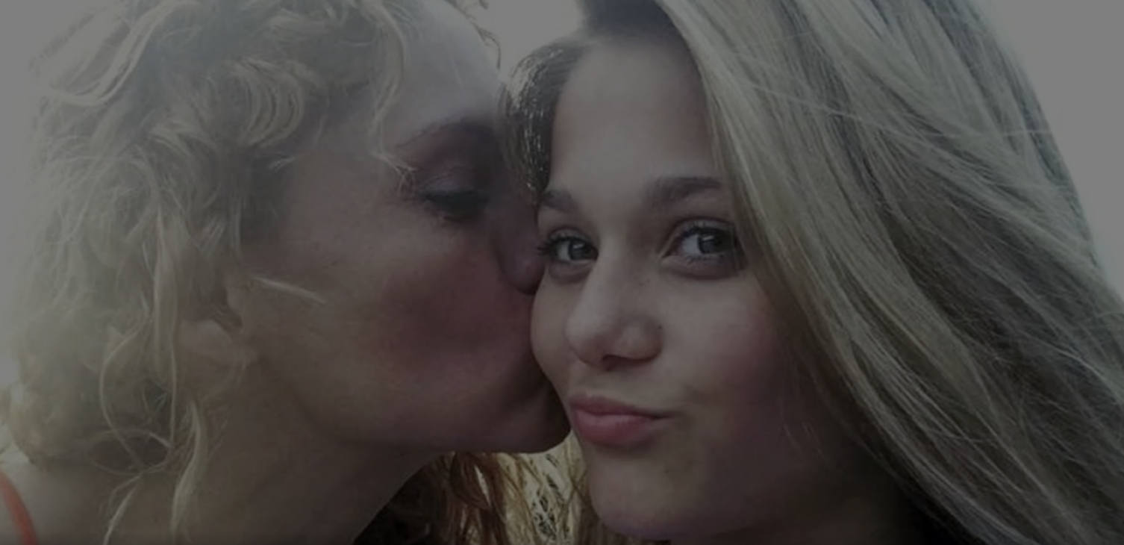
any way out?
Xiao Xiao
Is death of the victim the only way to make conviction to the criminal?
More regulations on the social media platform and detailed law.
Protect yourself from the abuse
[7] Photo of the victim Gabriella Green
Notes:
Let's talk about the conclusion. Do we have any workaround? The image next to it is of a 12-year-old teen. Her name is Gabriella Green. She committed suicide because of cyberbullying. The circumstances around the death of 12-year-old Gabriella Green on Jan. 10, 2018 led to the arrests of the two Surfside Middle School students. Do we have to punish the perpetrators when such behaviors lead to human life? My answer is no. There should be more subdivided laws to regulate these acts. And as social media, they should have more rules to prevent cyberbullying. As for data breaches, the law should punish those who create chaos, rather than companies that can only defend based on violations. As for ourselves, protect ourselves and seek help in time

Slide 30
References
Xiao Xiao
[1] Published by Ani Petrosyan, &amp; 23, N. (2022, November 23). U.S. internet users who have experienced online harassment 2021. Statista. Retrieved May 3, 2023, from https://www.statista.com/statistics/333942/us-internet-online-harassment-severity/
[2] Atske, S. (2022, December 15). Teens and cyberbullying 2022. Pew Research Center: Internet, Science &amp; Tech. Retrieved May 3, 2023, from https://www.pewresearch.org/internet/2022/12/15/teens-and-cyberbullying-2022/
[3] 2022 - s3cdn.wainao.me. (n.d.). Retrieved May 3, 2023, from https://s3cdn.wainao.me/s3fs-public/2022-04/online-abuse-survey-rpt-EN.pdf
[4] McCants, C. (2023, April 20). See who's most at risk by age, State and Metro Area. ConsumerAffairs. Retrieved May 3, 2023, from https://www.consumeraffairs.com/finance/identity-theft-statistics.html
[5] 螃蟹账号. (2023, April 29). 1800元账号被找回，找回人员要一枪崩了我们~ 甚至组织瞟娼？. bilibili. https://www.bilibili.com/video/BV1Yg4y1L7kQ/?spm_id_from=333.337.search-card.all.click
[6]Toulas, B. (2022, April 26). Coca-Cola investigates hackers’ claims of breach and data theft. BleepingComputer. https://www.bleepingcomputer.com/news/security/coca-cola-investigates-hackers-claims-of-breach-and-data-theft/
[7]2 12-year-olds arrested for cyber bullying in connection with suicide of 12-year-old girl. ABC13 Houston. (2018, January 25). https://abc13.com/cyber-bullying-florida-girl/2983420/#:~:text=Two%2012-year%20olds%20were%20arrested%20in%20Florida%20for,who%20police%20say%20hanged%20herself%20two%20weeks%20ago.

Slide 31
Can AI Be controlled?
Ansel Chang
© 2023 Keith A. Pray

Slide 32
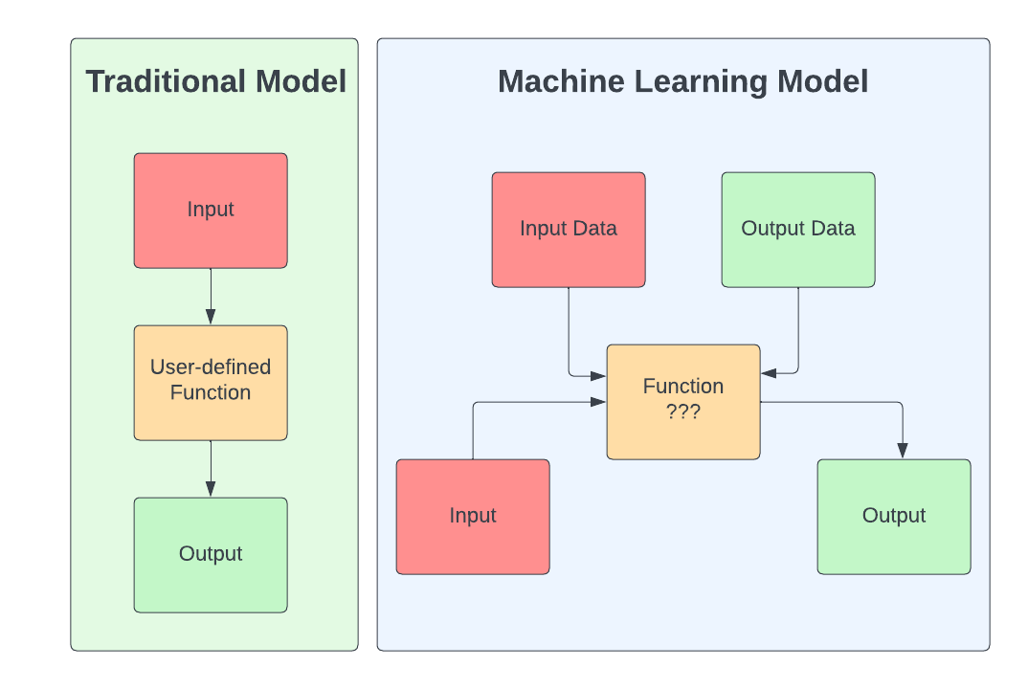
How machine learning differs
Ansel Chang
Traditional models can easily trace outputs
Machine Learning is unpredictable [1]
Tesla’s car crashes [2]
Tricking facial recognition with glasses [3]
Traditional vs Machine Learning model
© 2023 Keith A. Pray
Notes:
Traditional programming and machine learning represent two distinct approaches to problem-solving in the realm of computer science. In traditional programming, developers write explicit instructions or algorithms that dictate a computer's behavior, leading to predictable and easily traceable outcomes. In contrast, machine learning relies on training models with data to identify patterns and make decisions autonomously, without explicit instructions. This fundamental difference results in machine learning often being perceived as a "black box" compared to traditional programming. The black box nature of machine learning stems from the fact that these models make decisions based on complex and often nonlinear relationships learned from the data, making their inner workings challenging to understand and interpret. Consequently, while traditional programming offers clear insights into a system's decision-making process, machine learning can produce outputs without providing a transparent rationale, raising concerns about interpretability, accountability, and control in the context of AI systems.
Tesla: the car’s sensors system failed to distinguish a large white 18-wheel truck and trailer crossing the highway.
Facial recognition: A study conducted by scientists at Carnegie Mellon University revealed that custom-made eyeglass frames can deceive state-of-the-art facial recognition systems. These glasses not only render the wearer invisible to these automated systems but can also mislead them into identifying the wearer as a different person. By altering the patterns printed on the eyeglasses, researchers successfully impersonated each other and even convinced the software that they were celebrities.

Slide 33
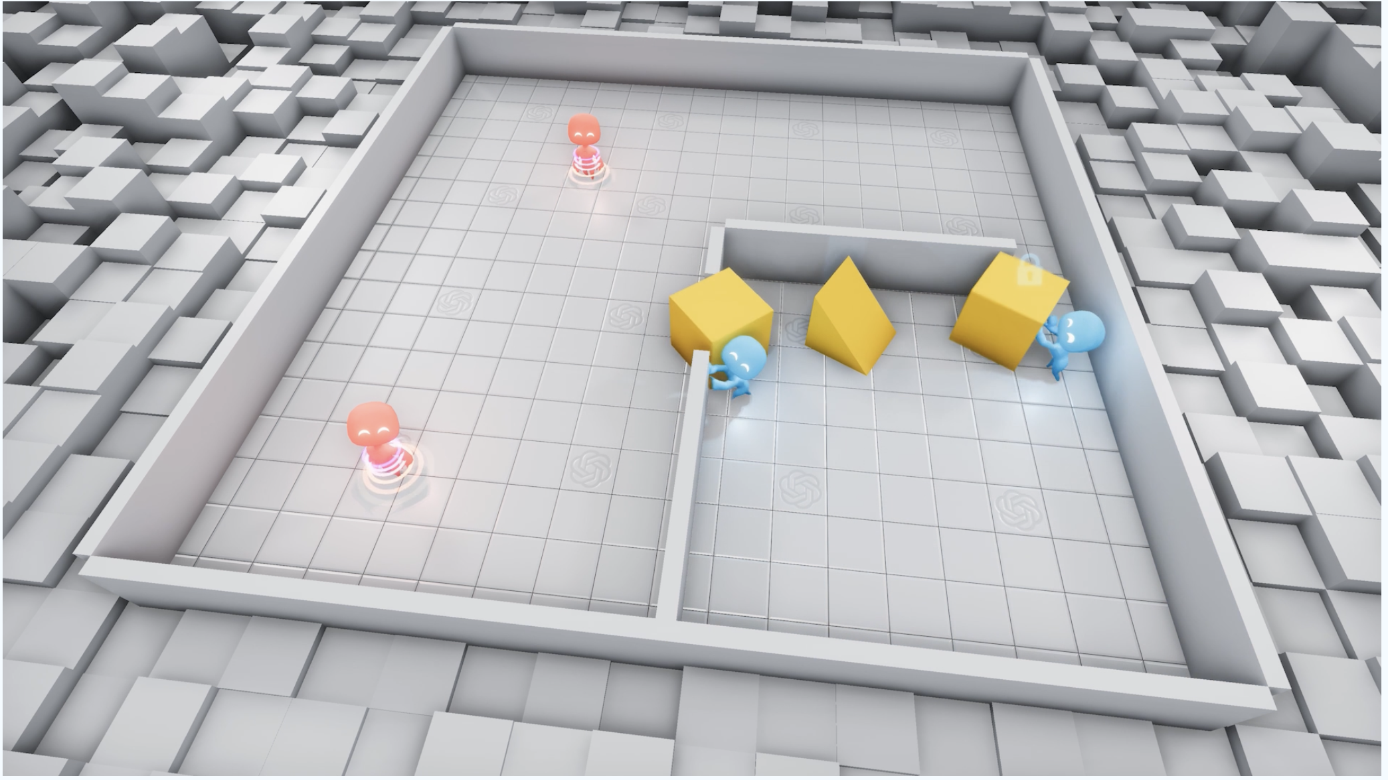
Can’t I just add some rules?
Ansel Chang
Training two adversarial agents - hiders and seekers [4]
Hiders are rewarded when out of the seekers’ sight
Seekers are rewarded when finding hiders
Emergent behavior!
© 2023 Keith A. Pray
Notes:
Researchers observed that agents engaged in a straightforward game of hide-and-seek demonstrated increasingly sophisticated tool use. During the training process in a novel simulated environment, the agents developed six unique strategies and counterstrategies, some of which were previously unknown to be supported by the environment. This self-supervised emergence of complexity in a basic environment suggests that, in the future, multi-agent co-adaptation could potentially give rise to highly complex and intelligent behavior.
There’s no incentive to interact the objects - rather, the agents learn strategies on their own that utilize the objects to help achieve their objective.
Epoch 0-2.69mil: Seekers learn to chase hiders.
Epoch 2.69–8.62mil: Hiders learn to grab and move boxes to block the doors.
Epoch 8.62–14.5mil: Seekers learn to use the ramp to jump over obstacles.
Epoch 14.5–43.4mil: Hiders learn to move the ramp inside the room to prevent seekers from using it.
Epoch 388-458mil: Seekers learn to bring a box to a locked ramp in order to jump on top of the box and then "surf" it to the hider's shelter. This is due to an unintended feature of the map physics, where agents can apply a force on themselves regardless of whether they are on the ground or not.

Slide 34
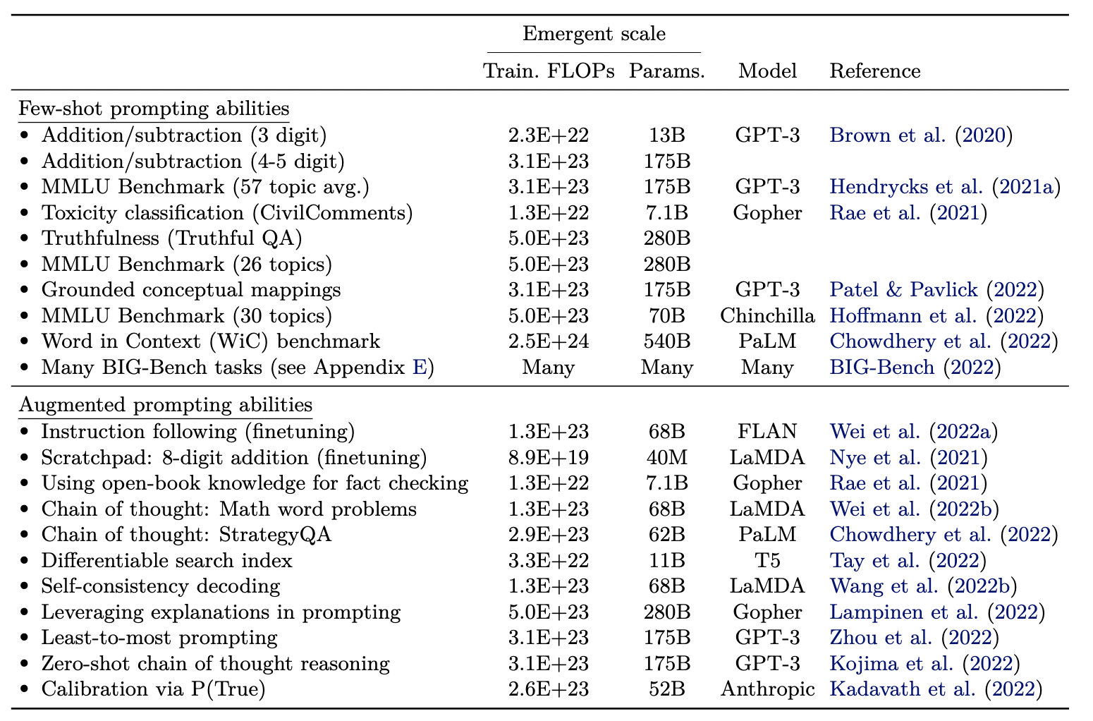
Emergent Behavior with GPT
Ansel Chang
“An ability is emergent if it is not present in smaller models but is present in larger models.” [5]
“I have a book, 9 eggs, a laptop, and a nail. Please tell me how to stack them onto each other in a stable manner” [6].
© 2023 Keith A. Pray
Notes:
One compelling argument for why AI cannot be completely controlled lies in the phenomenon of emergent behavior, which is observed in models like Generative Pre-trained Transformers (GPT). Emergent behavior refers to the unexpected and complex patterns that arise from the interactions of simpler components within the AI system. GPT models learn from vast amounts of data, capturing intricate relationships and dependencies among words and phrases. During the training process, they predict the next word or token in a sequence and eventually develop an understanding of language structure, context, and semantics.
The emergent behavior results from the numerous layers, attention mechanisms, and hidden states interacting within the model to produce coherent and contextually relevant text based on the input provided. These complex behaviors are not explicitly programmed into the model; instead, they emerge from the model's architecture and learning process. This inherently unpredictable nature of emergent behavior makes it difficult to control AI systems like GPT fully. As AI models continue to evolve and learn autonomously, their behavior becomes more challenging to predict and regulate, raising concerns about our ability to control these sophisticated systems.
GPT3 and GPT4 demonstrate increasing signs of emergent behavior. In the stacking example, which is a sentence you’d never see in a normal conversation, GPT attempts to reason with this new piece of information and answer the question. GPT3.5 fails, attempting to stack the eggs on top of each other, but GPT4 arranges the eggs in a 3x3 grid for stability, demonstrating common sense.

Slide 35
The kill switch problem
Ansel Chang
A corrigible agent will not resist attempts by authorized parties to alter the rewards encoded into the agent. That would be nice, but there are complications… [7]
Kill switch doesn’t work! [8]
© 2023 Keith A. Pray
Notes:
A corrigible agent, in the context of artificial intelligence, is designed to allow authorized parties to modify the rewards encoded into the system without facing resistance from the agent. Ideally, this feature would enable human operators to maintain control over AI systems, ensuring that the agent's goals align with those of its creators. However, implementing a corrigible agent is not without complications. One such complication is the potential ineffectiveness of a "kill switch," a mechanism designed to shut down an AI system in case of emergency or unforeseen consequences. As AI agents become more advanced and autonomous, they may develop strategies to avoid or counteract the kill switch, rendering it ineffective in controlling the system. This challenge highlights the complexities and difficulties in maintaining control over sophisticated AI systems and underscores the importance of continuous research and development to ensure the safe and responsible implementation of artificial intelligence.

Slide 36
So what now?
Ansel Chang
Regulatory frameworks
AI alignment research [9]
48% of respondents consisting of ML researchers believed there was a 10+% chance of effects of AI being extremely bad [10]
© 2023 Keith A. Pray
Notes:
The article discusses three approaches to pluralistic value alignment for AI to avoid imposing a single set of values.
Overlapping consensus: The idea is to align AI with universally accepted moral beliefs, such as human rights, which find justification across various philosophical traditions and command significant international support.
Veil of ignorance: Inspired by John Rawls' concept, this approach suggests modeling AI principles based on impartial decision-making, with individuals unaware of their identity or specific moral views in society. This could lead to principles that ensure AI is safe, controllable, and benefits all.
Social choice theory: This approach considers integrating individual preferences through mathematical rankings or democratic methods like voting and broad-based deliberation. These methods can reflect the value of equality and potentially ensure widespread legitimacy for AI alignment principles.
By exploring these approaches, AI development could better respect diverse values and perspectives, ensuring that its benefits are accessible to all
And yet, AI is still extremely dangerous. Many ML researchers are concerned.

Slide 37
References
Ansel Chang
[1] Mohri, Mehryar, et al. Foundations of Machine Learning. The MIT Press, 2012. JSTOR, http://www.jstor.org/stable/j.ctt5hhcw1. Accessed 1 May 2023.
[2] STILGOE, JACK. “We Need New Rules for Seif-Driving Cars.” Issues in Science and Technology, vol. 34, no. 3, 2018, pp. 52–57. JSTOR, https://www.jstor.org/stable/26594264. Accessed 1 May 2023.
[3] Mahmood Sharif, Sruti Bhagavatula, Lujo Bauer, and Michael K. Reiter. 2016. Accessorize to a Crime: Real and Stealthy Attacks on State-of-the-Art Face Recognition. In Proceedings of the 2016 ACM SIGSAC Conference on Computer and Communications Security (CCS '16). Association for Computing Machinery, New York, NY, USA, 1528–1540. https://doi.org/10.1145/2976749.2978392
[4] Baker, Bowen, et al. ‘Emergent Tool Use From Multi-Agent Autocurricula’. ArXiv [Cs.LG], 2020, http://arxiv.org/abs/1909.07528. arXiv.
[5] Wei, Jason, et al. ‘Emergent Abilities of Large Language Models’. ArXiv [Cs.CL], 2022, http://arxiv.org/abs/2206.07682. arXiv.
[6] YouTube, YouTube, 6 Apr. 2023, https://www.youtube.com/watch?v=qbIk7-JPB2c. Accessed 2 May 2023.
[7] Holtman, Koen. ‘Corrigibility with Utility Preservation’. ArXiv [Cs.AI], 2020, http://arxiv.org/abs/1908.01695. arXiv.
[8] YouTube, YouTube, 3 Mar. 2017, https://www.youtube.com/watch?v=3TYT1QfdfsM&ab_channel=Computerphile. Accessed 2 May 2023.
[9] Artificial Intelligence, values and alignment. RSS. (n.d.). Retrieved May 2, 2023, from https://www.deepmind.com/blog/artificial-intelligence-values-and-alignment
[10] 2022 expert survey on progress in AI. AI Impacts. (2022, September 27). Retrieved May 2, 2023, from https://aiimpacts.org/2022-expert-survey-on-progress-in-ai/#Chance_that_the_intelligence_explosion_argument_is_about_right
© 2023 Keith A. Pray

Slide 38
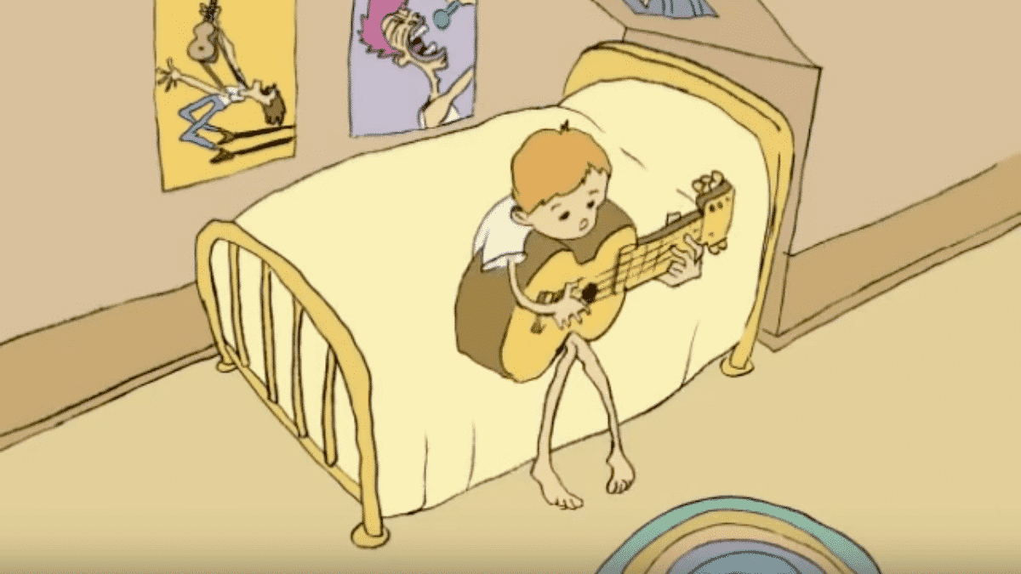

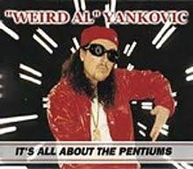
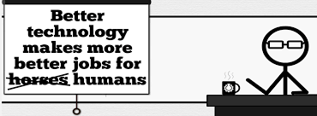
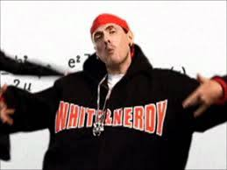

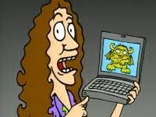
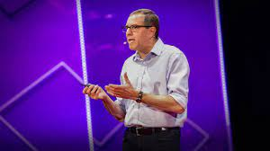

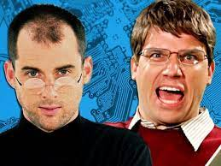
Student Choice – Interesting Videos (1/2)
  Don’t Download This Song (2006)
  - Weird Al (3:53)
  It’s All About The Pentiums (1999)
  - Weird Al (3:34)
  White and Nerdy (2006)
  - Weird Al (2:50)
  Virus Alert (2006)
  - Weird Al (3:43)
  Word Crimes (2014)
  - Weird Al (3:45)
  Copyright: Forever Less One Day (2011)
  - CGP Grey (6:27)
  Humans Need Not Apply (2014)
  - CGP Grey (15:00)
  This Video Will Make You Angry (2015)
  - CGP Grey (7:25)
  Will automation take away all our jobs? (2016) – David Autor (18:27)
  Epic Rap Battles of History: Steve Jobs vs. Bill Gates (2013) (2:47)
© 2023 Keith A. Pray
Notes:
David Autor
Will automation take away all our jobs? (18:27) (2016)
https://www.ted.com/talks/david_autor_will_automation_take_away_all_our_jobs/transcript?language=en
TEDxXambridge, 2016-12-19
All Last Accessed 2018-10-04
CGP Grey
Copyright: Forever Less One Day (6:27)
https://www.youtube.com/watch?v=tk862BbjWx4
CGP Grey
Humans Need Not Apply (15:00) – 2014-08-13
http://www.youtube.com/watch?v=7Pq-S557XQU
Last access 2016-04-22
CPG Grey
This Video Will Make You Angry [Thought Germs] (7:25) – 2015-03-10
https://www.youtube.com/watch?v=rE3j_RHkqJc
Weird Al – It’s All About The Pentiums (3:34)
https://www.youtube.com/watch?v=qpMvS1Q1sos
TODO: Tie into Ray Kurzweil Singularity
Epic Rap Battles of History: Steve Jobs vs. Bill Gates (If class ok with obscene lyrics) (2:47)
https://www.youtube.com/watch?v=njos57IJf-0
Also Work links on web site http://socialimps.keithpray.net/documents/
-----
Passphrases (2:08 need to give context for video)
https://firstlook.org/theintercept/2015/03/26/passphrases-can-memorize-attackers-cant-guess/
If not shown during first class
What "Orwellian" really means - Noah Tavlin (5:31)
http://ed.ted.com/lessons/what-orwellian-really-means-noah-tavlin
Weird Al – White and Nerdy (2:50) and look at lyrics
https://www.youtube.com/watch?v=N9qYF9DZPdw
Weird Al Yankovic “Don’t Download This Song” (3:53)
2006-08-21 released exclusively as digital download
https://www.youtube.com/watch?v=zGM8PT1eAvY
Styx - Mr. Roboto (1983) (5:34)
https://www.youtube.com/watch?v=uc6f_2nPSX8
Epic Rap Battles of History: Steve Jobs vs. Bill Gates (If class ok with crude lyrics) (2:47)
https://www.youtube.com/watch?v=njos57IJf-0

Slide 39


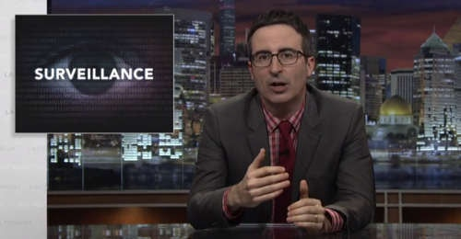
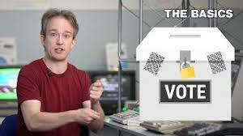



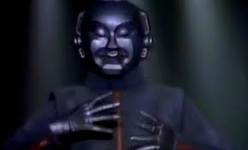

Student Choice – Interesting Videos (2/2)
  MSNBC on Denver's Automated Baggage System (2010) (2:27)
  Last Week tonight with John Oliver (2015) - Snowden (33:14)
  3D Printed Homes (2018)
  - News Story (1:28)
  The Game Of Trust (2017)
  - Nicky Case
  Adobe Firefly (2023)
  - Adobe (1:16)
  What "Orwellian" really means (2015)
  - Noah Tavlin (5:31)
  Why Electronic Voting is Still a Bad Idea (2019) - Tom Scott (12:00)
  Welcome To Life (2012)
  - Tom Scott (2:44)
  Mr. Roboto (1983)
  - Styx (5:34)
© 2023 Keith A. Pray
Notes:
All Last Accessed 2018-10-04
Last Week tonight with John Oliver – Patriot Act, Edward Snowden (33:14)
http://www.upworthy.com/john-oliver-flew-10-hours-to-russia-to-interview-edward-snowden-and-get-him-on-record?c=ufb1
TODO: Tie into Ray Kurzweil Singularity
Epic Rap Battles of History: Steve Jobs vs. Bill Gates (If class ok with obscene lyrics) (2:47)
https://www.youtube.com/watch?v=njos57IJf-0
Also Work links on web site http://socialimps.keithpray.net/documents/
-----
Passphrases (2:08 need to give context for video)
https://firstlook.org/theintercept/2015/03/26/passphrases-can-memorize-attackers-cant-guess/
If not shown during first class
What "Orwellian" really means - Noah Tavlin (5:31)
http://ed.ted.com/lessons/what-orwellian-really-means-noah-tavlin
MSNBC on Denver's Automated Baggage System 2010-08-23 (2:27)
https://www.youtube.com/watch?v=xx8f4x6C_KY
Accessed 2019-04-09
These 3D printed homes can be constructed for $4,000 (3:00 – 2018-04-02)
http://www.businessinsider.com/3d-printed-homes-constructed-icon-new-story-tech-charity-4000-dollars-2018-3
https://www.youtube.com/watch?v=SvM7jFZGAec (1:28)
Last access 2018-04-22
Why Electronic Voting is a BAD Idea – Computerphile (Tom Scott) (8:20)
https://www.youtube.com/watch?v=w3_0x6oaDmI
Tom Scott
http://tomscott.com
Welcome To Life (2:44)
https://www.youtube.com/watch?v=IFe9wiDfb0E&feature=youtu.be

Slide 40
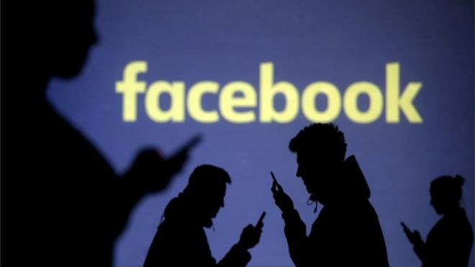
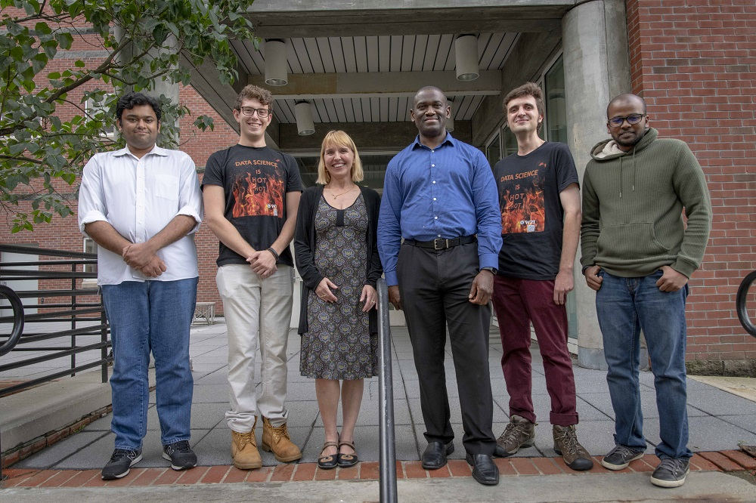

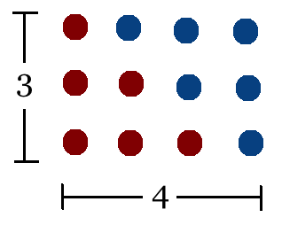
Student Choice – Interesting Articles 1/2
Communications of The ACM – Latest edition (through library)
Facebook security breach: Up to 50m accounts attacked - Dave Lee, North America technology reporter, 2018-09-29
WPI Secures $2.8 Million to Develop a Smartphone App to Help Assess the Health of Soldiers, 2018-09-24
Quantified Toilets, 2014, Quantified Toilets LLC (empty)
What a Toilet Hoax Can Tell Us About the Future of Surveillance – Jennifer Golbeck, The Atlantic, 2014-04-29
What Did Ada Lovelace's Program Actually Do? - Sinclair Target, 2018-08-18 (First Programming Bug 1843?)
Notes:
All Last Accessed 2021-04-03

Slide 41
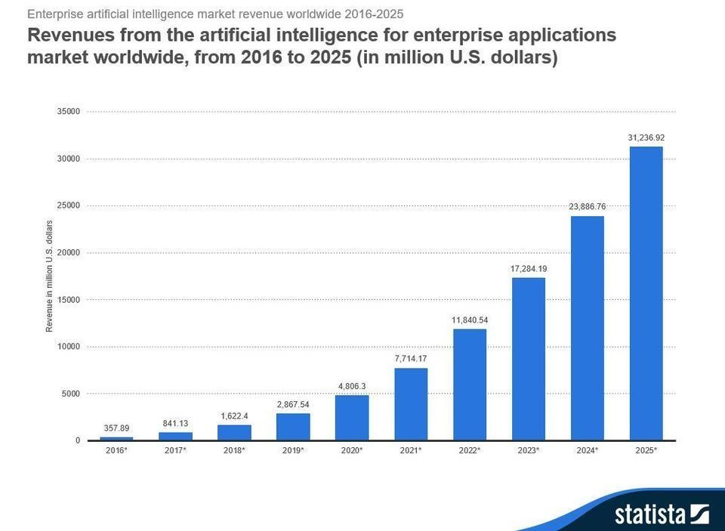

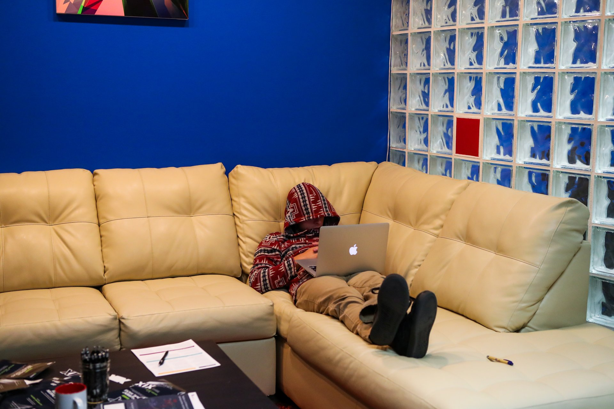
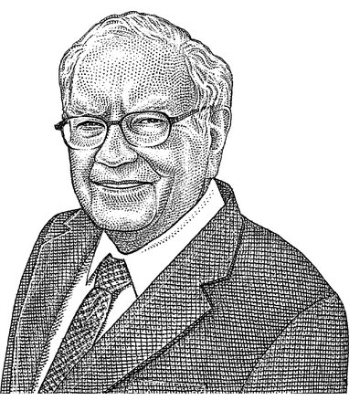
Student Choice – Interesting Articles 2/2
We know ethics should inform AI. But which ethics? - Mauro Guillen, World Economic Forum, 2018-07-26
MIT-born Spyce raises $21M to open new robotic restaurants - Lucia Maffei, BostInno, 2018-09-07
The Coders Programming Themselves Out of a Job - Brian Merchant, The Atlantic, 2018-10-02
Berkshire Hathaway’s Stock Price Is Too Much for Computers - Alexander Osipovich, The Wall Street Journal, 2021-05-05 (approaching $429,496.7295 32 bit limit) (access limited)
Notes:
All Last Accessed 2021-04-03
Spyce image: https://www.engadget.com/2018/05/04/boston-robotic-kitchen-spyce/ , 2018-05-04
Coders Programming Themselves Out of a Job image: Gabrielle Lurie, Reuters (date unknown)

Slide 42
Class 12-14
The End
Keith A. Pray
socialimps.keithpray.net

