Slide 1
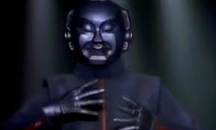
Class 11 Work
Keith A. Pray
socialimps.keithpray.net
Notes:
Styx - Mr. Roboto (1983) (5:34) https://www.youtube.com/watch?v=uc6f_2nPSX8
Ask about Automation paper:
What did people choose to automate
Share 1 main reason

Slide 2
Papers
Nice improvement!
Include tests/results in Appendix
Define test strategy clearly
Ask for help if you have trouble with backing data
Notes:
Save for next time:
Clearly state conclusion
First statement preferred
Absolute statements are difficult to prove
Avoid: all, always, any, every, everyone, never, none… unless you can show it
Be sure to put quotes around entire quote
Hyperbole is the best thing ever!
but not in these papers
Print 2 sided and save a tree
Use template, saves time (and -1 point)
Include Counter Point and Response
Include Author, Title, Publish Date, Publisher for references
Read paper aloud to proof

Slide 3
Grades To Date
44 Max Possible
- Discussion 1-10 - Papers 1-3

Slide 4
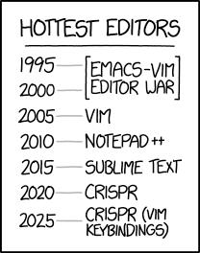
Overview
Review
Assignment
Students Present
https://www.xkcd.com/1823/
Notes:
Full circle.
CRISPR: Clustered Regularly Interspaced Short Palindromic Repeats
Allows permanent modification of genes within organisms.
Published 2017-04-12 according to https://www.explainxkcd.com/wiki/index.php/List_of_all_comics_(1501-2000)
Kickstarter Charter
https://www.kickstarter.com/charter?ref=about_subnav

Slide 5
Overview
Review
Assignment
Students Present
C lustered R egularly I nterspaced S hort P alindromic R epeats
Permanent gene modification
https://www.xkcd.com/1823/
Notes:
Full circle.
CRISPR: Clustered Regularly Interspaced Short Palindromic Repeats
Allows permanent modification of genes within organisms.
Published 2017-04-12 according to https://www.explainxkcd.com/wiki/index.php/List_of_all_comics_(1501-2000)
Kickstarter Charter
https://www.kickstarter.com/charter?ref=about_subnav

Slide 6
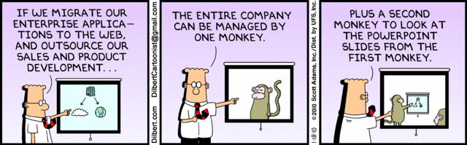
Let’s Look At One way to handle a Decrease In Jobs
Notes:
Poll class:
Expected salary range upon graduation? Min, Max? Put on board.
Assume 40 hour work week.
How many people would work:
32 hours for 0.8 * Max? Put on board.
24 hours for 0.6 * Max? Put on board.
…continue until Min is reached.

Slide 7
Group Quiz
List 2 ways IT can lead to organizational change.
List 4 ways a Video Game Producer may protect its IP and what specific IP each protects.
List a computing technology that can be used to protect an individual’s privacy.
List a computing technology that can be used to intrude upon an individual’s privacy.
Notes:
Could split into groups of 4-5 for this.
Fill time with Work Discussion on Course Web Site

Slide 8
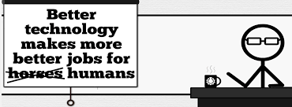
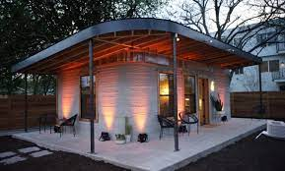
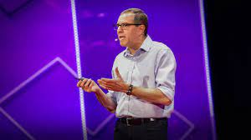
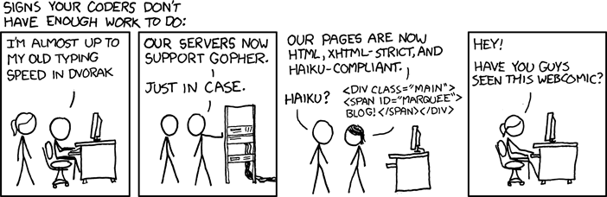
Overview
Review
Assignment
Students Present
http://xkcd.com/554/
Notes:
CGP Grey
Humans Need Not Apply (15:00) – 2014-08-13
http://www.youtube.com/watch?v=7Pq-S557XQU
Last access 2016-04-22
These 3D printed homes can be constructed for $4,000 (3:00 – 2018-04-02)
http://www.businessinsider.com/3d-printed-homes-constructed-icon-new-story-tech-charity-4000-dollars-2018-3
https://www.youtube.com/watch?v=SvM7jFZGAec (1:28)
Last access 2018-04-22
David Autor Will automation take away all our jobs? (18:27) (2016) https://www.ted.com/talks/david_autor_will_automation_take_away_all_our_jobs/transcript?language=en TEDxXambridge, 2016-12-19
Review Group Assignment Details.
Or first watch video: depends on student presentations, no thunder stealing.
Look at:
BBC Intelligent Machines
http://www.bbc.com/news/technology-33978561
BBC Likelihood of robot taking your job
http://www.bbc.com/news/technology-34066941

Slide 9
Assignment Reminders
Finish all reading
Finish Automation Paper
Group Web Sites and Presentations
If your group is not presenting next class prepare 3 questions for each group that is presenting by visiting their web sites.
See Group Project Details

Slide 10
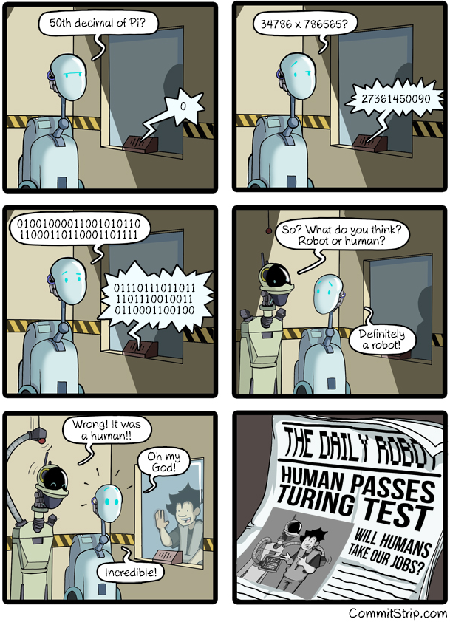
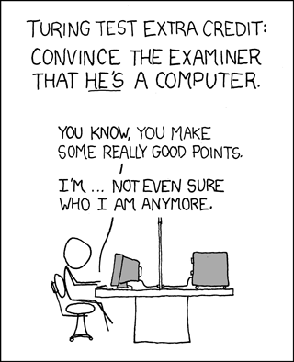
Overview
Review
Assignment
Students Present
https://xkcd.com/329/
Notes:
http://www.commitstrip.com/en/2016/04/14/meanwhile-in-a-parallel-universe-3/ (2016-04-14)
https://xkcd.com/329/ (2007-10-15)

Slide 11
AI Big Tech Workforce
Ash Kittur

Slide 12

Will the AI revolution cause a crash in Big Tech?
Ash Kittur
It’s important to understand the hierarchy of tech companies before addressing this question
2023 has been filled with merciless tech layoffs, with nearly 160k employees laid off in 2023 [1][2]
AI has been advancing at an exponential rate [3]
Notes:
In the world of tech, FAANG is considered the Ivy League for engineers in computer science. FAANG originally consisted of Facebook (Meta), Apple, Amazon, Netflix, and Google, but it goes without saying that there are many other similarly prestigious companies such as Microsoft, Uber, Tesla, Stripe, and Coinbase.
All of these companies have a similar interviewing process designed to test whether you have a solid grasp on data structures and algorithms, and if you are a good fit for the company.
Due to the 2020 Covid Pandemic making everything virtual, these companies experienced unexpected growth and began hiring more and more engineers.
As COVID began winding down in 2022 and 2023, many of these companies realized that they over-hired in many engineering and engineering-adjacent roles.
According to TechCrunch, 158,314 employees were laid off from tech companies in the first three months of 2023.
AI has been advancing at an exponential rate. Tools such as ChatGPT have entered public consciousness, and many financial institutions such as Fidelity and Vanguard are starting to integrate artificial intelligence into their models.

Slide 13
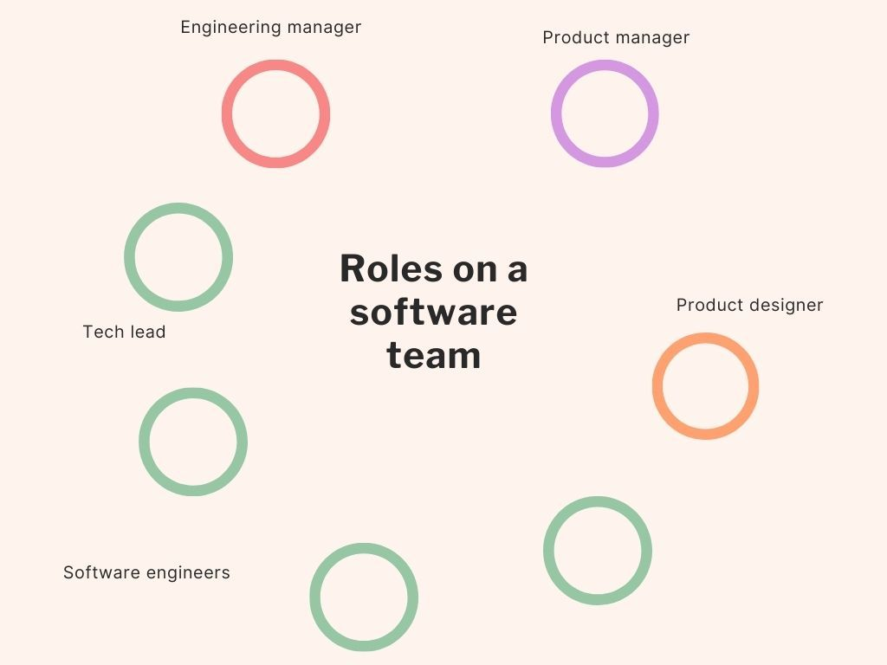
No, no it won’t. Our jobs are safe.
Ash Kittur
Engineers don’t want to unemploy themselves
There is more to computer-based careers than coding
Other jobs/fields are more at risk of automation [4]
Journalism and Market Research Analysis are much more at risk
Notes:
On a purely logical level, the people who develop artificial intelligence are Machine Learning Researchers, and perhaps specialized Software Engineers.
They have no reason to try to unemploy themselves, knowing how exponential AI is in growth, and how it has immense capabilities to automate professions.
There have been unsubstantiated reports of engineers working on AI deliberately sabotaging certain capabilities for this reason. (This is literally from people that I know, take this with a grain of salt)
There is an entire ecosystem to tech careers that don’t just involve coding itself, which is mainly what AI is capable of. Consider Engineering Managers, Product Managers, Cloud Architects, etc. that aren’t just being a software engineer.
Other jobs are more at risk for automation than engineers are. Consider how easily AI could replicate journalism articles, especially sensational articles or articles that are written on a purely factual basis!

Slide 14
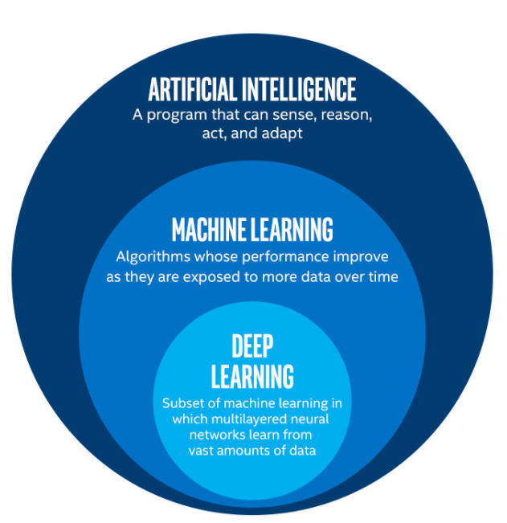
AI is incredibly overhyped.
Ash Kittur
Most people have very cartoonish ideas of how AI works.
AI is not the solution to every problem. [5]
Most conventional AIs are essentially hyper-advanced internet crawler bots.
Notes:
The truth of the matter is that most people have a very cartoonish idea of how AI works.
Artificial Intelligence: A program that can sense, reason, act, and adapt.
Machine Learning: Algorithms whose performances improve as they are exposed to more data over time.
Deep Learning: Subset of machine learning in which multilayered neural networks learn from vast amounts of data.
At its core you can basically say that AI is an incomprehensibly complicated math equation trying to emulate human neural pathways.
AI simply is not the solution to every problem. Its grasp is limited on abstract concepts such as the arts, and even politics. The more human the task is, the worse AI is at it.
Most conventional AIs that we know, such as ChatGPT, are just hyper-advanced crawler bots.
That is, a crawler bot is a bot that scours the internet for data. ChatGPT employs entire armies of them to maximize efficiency and scope, which is why it can solve complex questions instantly.

Slide 15
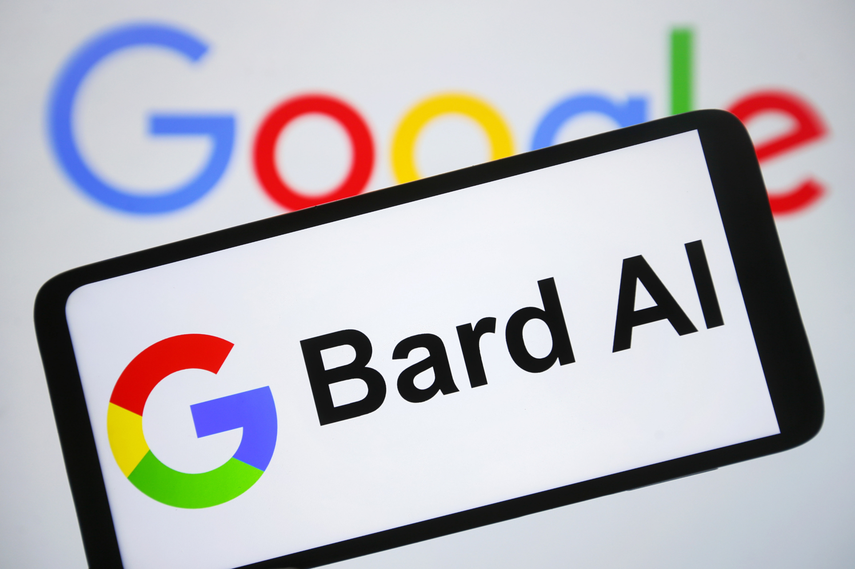
AI will reinvigorate the Big Tech job market
Ash Kittur
Big Tech companies are investing heavily into AI. [6] [7]
Job positions such as ML Engineers, ML Researchers and even Prompt Engineers are opening up. [8]
The future tech market looks bright!
Notes:
Speaker Notes
Big Tech is already amassing resources to initiate an AI arms race. Microsoft acquired ChatGPT for $10 Billion and integrated it into Bing.
We’re already starting to see new positions open up, such as Prompt Engineers.
The advent of AI can lead to positions and fields that we currently cannot even comprehend.

Slide 16
REFERENCES
Ash Kittur
[1] Mascarenhas, Natasha, and Alyssa Stringer. “A Comprehensive List of 2023 Tech Layoffs.” TechCrunch, 21 Apr. 2023, https://techcrunch.com/2023/04/21/tech-industry-layoffs/.
[2] ABC News, ABC News Network, https://abcnews.go.com/Business/tech-layoffs-2023-companies-made-cuts/story?id=96564792
[3] Schmidt, Blake, and Amanda Albright. “Vanguard, Fidelity Experts Explain How AI Is Changing Wealth Management.” Bloomberg.com, Bloomberg, 21 Apr. 2023, https://www.bloomberg.com/news/articles/2023-04-21/vanguard-fidelity-experts-explain-how-ai-is-changing-wealth-management#xj4y7vzkg
[4] Mok, Aaron. “Chatgpt May Be Coming for Our Jobs. Here Are the 10 Roles That AI Is Most Likely to Replace.” Business Insider, Business Insider, https://www.businessinsider.com/chatgpt-jobs-at-risk-replacement-artificial-intelligence-ai-labor-trends-2023-02#media-jobs-advertising-content-creation-technical-writing-journalism-2.
[5] McCutcheon, Griffin. “Ai Isn't a Solution to All Our Problems.” Scientific American Blog Network, Scientific American, 24 Jan. 2020, https://blogs.scientificamerican.com/observations/ai-isnt-a-solution-to-all-our-problems/.
[6] Q.ai - Powering a Personal Wealth Movement. “Microsoft Confirms Its $10 Billion Investment into CHATGPT, Changing How Microsoft Competes with Google, Apple and Other Tech Giants.” Forbes, Forbes Magazine, 30 Jan. 2023, https://www.forbes.com/sites/qai/2023/01/27/microsoft-confirms-its-10-billion-investment-into-chatgpt-changing-how-microsoft-competes-with-google-apple-and-other-tech-giants/?sh=2da27b573624.
[7] Chaturvedi, Naina. “How Machine Learning Is Applied at Big Tech Companies.” Medium, DataDrivenInvestor, 18 Aug. 2022, https://medium.datadriveninvestor.com/how-machine-learning-is-applied-at-big-tech-companies-73b11cd79745.
[8] Chaturvedi, Naina. “How Machine Learning Is Applied at Big Tech Companies.” Medium, DataDrivenInvestor, 18 Aug. 2022, https://medium.datadriveninvestor.com/how-machine-learning-is-applied-at-big-tech-companies-73b11cd79745.

Slide 17
Automatic Programming
Oliver Reera

Slide 18
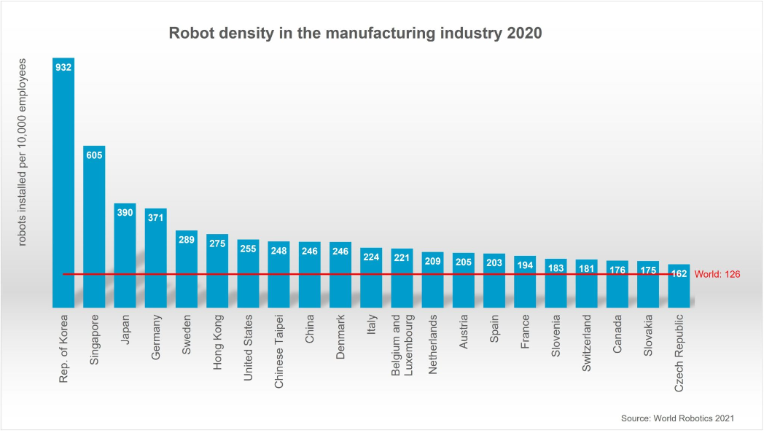
Automation does not mean unemployment
Oliver Reera
South Korea is the most automated country in the world [1]
Unemployment in South Korea is relatively low at 3.65% [2]
Singapore and Japan
[1]
Notes:
South Korea is the most automated country in the world with a robot density of 932 robots installed per 10,000 employees. That’s a ratio of about 1:10 robots to employees.
Even though South Korea has such a high degree of automation, it still manages to keep its national unemployment down.
This is seen further with Singapore and Japan, the next two countries with the highest robot densities. Their unemployment rates are even lower at 2.1% and 2.3%, the second and fourth countries with the lowest unemployment rates based on current data from theglobaleconomy.com
We can discern that there is no correlation between automation and unemployment in a country’s economy.
Though that does not mean that jobs will not change or even disappear altogether when new advances in automation are made.

Slide 19


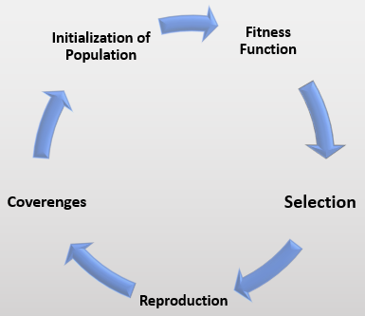
What is Automatic programming
Oliver Reera
“Computers that can program themselves” [3]
Genetic Programming [4]
Chat GPT, GitHub Copilot
Abstraction
Will it replace you?
[9]
Notes:
Automatic Programming is succinctly defined by the phrase: “Computers that can program themselves”. Any way of generating code/programs automatically, and without human support.
One method of writing programs that can write programs is called genetic programming. This is a technique to create algorithms that can program themselves by simulating biological breeding and evolution.
With the rise of technologies like Chat GPT and Github Copilot, automatic programming is becoming more advanced and accessible.
All that automatic programming boils down to is a high level of abstraction. An average person with little to no coding experience being able to speak/write human language to a computer and have a working program be generated is the goal of automatic programming.
The big question is really this: Will automatic programming techniques, like Chat GPT and others, replace programmers?
In this presentation, I will support my answer that: no, these will not replace programmers, but rather augment them.

Slide 20
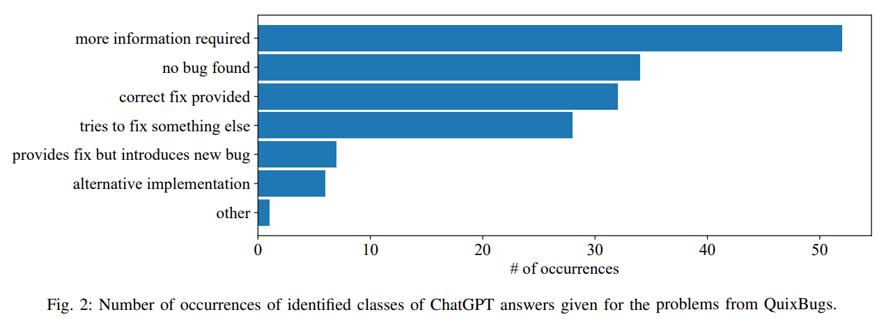
Chat Gpt on coding
Oliver Reera
Chat GPT uses natural language processing, not genetic programming
Tested metrics of ability to fix bugs against specialized technologies [5]
Hints increase success to be better than state-of-the-art
[5]
Notes:
An analysis was done on several automatic programming models, Chat GPT included, as well as CoCoNut and Codex, which is the large-scale language model that GitHub Copilot is powered by.
The analysis included a test suite of programs with bugs to test the bug-fixing capabilities of these models.
Chat GPT’s performance was competitive compared to the other models that were specifically designed for generating code.
However, one thing that makes it stand out is its dialogue system that allows certain input (like an error message) to be entered.
When these hints were provided to ChatGPT, its success rate increased as it was able to fix 31 out of 40 bugs.
In comparison, CoCoNut and Codex were able to fix 19 and 21 bugs, respectively.

Slide 21
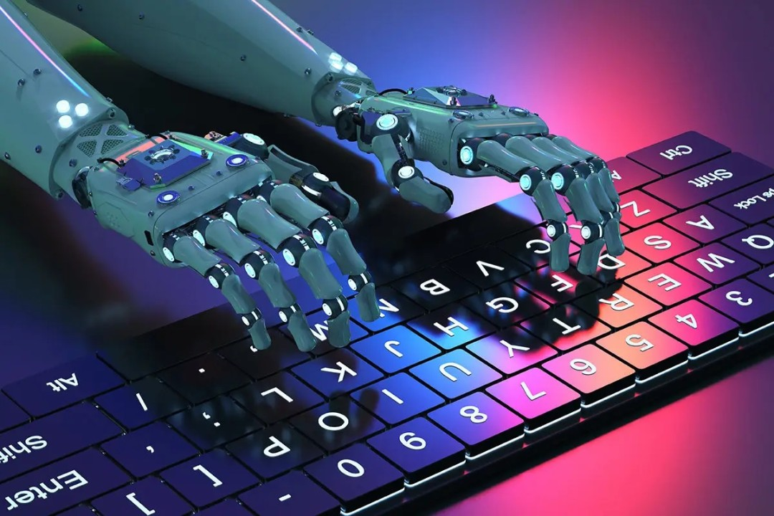
How will this affect you?
Oliver Reera
Limitations of current automatic programming techniques [7]
Automatic programming is just another form of automation
Programmers can focus on higher-level and advanced software development
There will always be the need for a human buffer [6]
[8]
Notes:
How will all this affect you?
While Chat GPT’s ability to fix minor bugs is impressive, it does not reflect its ability to write advanced or complex code. That will remain the task of programmers for the near future.
Further, Chat GPT and other similar models make use of imitation and reinforcement learning, which has limited effectiveness in writing code for tasks that have never been done before.
Automatic programming is just another form of automation.
Having already had numerous historical examples of automation taking over certain jobs, it is clear that the industry will need to adapt.
This does not mean that programming will no longer be a job.
There will always be a need for a human buffer. Automatic programming is just a tool, and like all other tools, they are only useful in the hands of a human who knows how to use them.

Slide 22
References
Oliver Reera
[1] Wessling, B. (2021, December 15). 10 most automated countries worldwide. The Robot Report. Retrieved April 23, 2023, from https://www.therobotreport.com/10-most-automated-countries-wordlwide-in-2020/
[2] Unemployment rate forecast – Country rankings. TheGlobalEconomy.com. Retrieved April 23, 2023, from https://www.theglobaleconomy.com/rankings/unemployment_outlook/
[3] (2006, June 5). Automatic inductive programming (ICML 2006 tutorial). Wayback Machine. Retrieved April 23, 2023, from https://web.archive.org/web/20160304073124/http://www.evanna i.inf.uc3m.es/et/icml06/aiptutorial.htm
[4] O’Neill, Michael. (2019, September 11). Automatic Programming: The open issue? - genetic programming and Evolvable Machines. Springer Link. Retrieved April 23, 2023, from https://link.springer.com/article/10.1007/s10710-019-09364-2
[5] Sobania, Dominik. Briesch, Martin. Hanna, Carol. Petke, Justyna. (2023, January 20) An Analysis of the Automatic Bug Fixing Performance of ChatGPT. Cornell University. https://arxiv.org/abs/2301.08653
[6] Paykamian, B. (2023, March 31). Can AI tools like CHATGPT replace computer programmers? GovTech. Retrieved April 23, 2023, from https://www.govtech.com/education/higher-ed/can-ai-tools-like-chatgpt-replace-computer-programmers
[7] Mathew, S. (2023, February 26). The power of CHATGPT, INSTRUCTGPT, and proximal policy optimization algorithms. LinkedIn. Retrieved April 23, 2023, from https://www.linkedin.com/pulse/power-chatgpt-instructgpt-proximal-policy-algorithms-sam-mathew/
[8] Salem Al Gharbi, P. D. (2022, March 20). Ai ... that writes codes! LinkedIn. Retrieved April 23, 2023, from https://www.linkedin.com/pulse/ai-writes-codes-salem-al-gharbi/?trk=articles_directory
[9] Pedamkar, P. (2023, March 21). What is genetic algorithm?: Phases and applications of genetic algorithm. EDUCBA. Retrieved April 23, 2023, from https://www.educba.com/what-is-genetic-algorithm/

Slide 23
AI Art Industry
Yasin Akbashev
Notes:
We all know AI art is here and it’s gonna lead somewhere but the question is, where?

Slide 24
What is the future of the AI art industry?
Yasin Akbashev
Working with artists to create art
Taking images to train AI without permission or compensation can lead to legal action by the copyright owners[8].
Result must look good and real.
AI generated picture in Colorado State Fair, sept 5 2022[9].
Hand picked AI art can be hard to distinguish from human-made art[14].
Dall E mini “takes between one and two minutes” to generate an image[13].
Notes:
What is the future of the AI Art Industry?
At the moment, the primary problem with current AI art is the way AI learns to make art, by looking at other art. Here’s an example of why this is a problem: As of April 25th, 2023 (today), Getty images has a 2 trillion dollar lawsuit against Stability AI for using its images without permission. While there hasn’t been a decision yet, regardless of how the case goes it’s clear that permission is going to be very important in the future of the AI art Industry.
But With permission to use, the next area of focus for AI art would be quality. The thing is, AI art generates a lot of garbage, but you only need that one good image.
Think movie posters and title screens for games, or maybe a submission to an art fair. Because AI art is very quick to generate, and we know what looks bad, it can be sifted through quickly to get that one, high-quality result.
From all this we can say that the future of AI art will be grounded in permission from artists(or copyright holders), and will require sifting through many generated images to get the desired end-result.

Slide 25
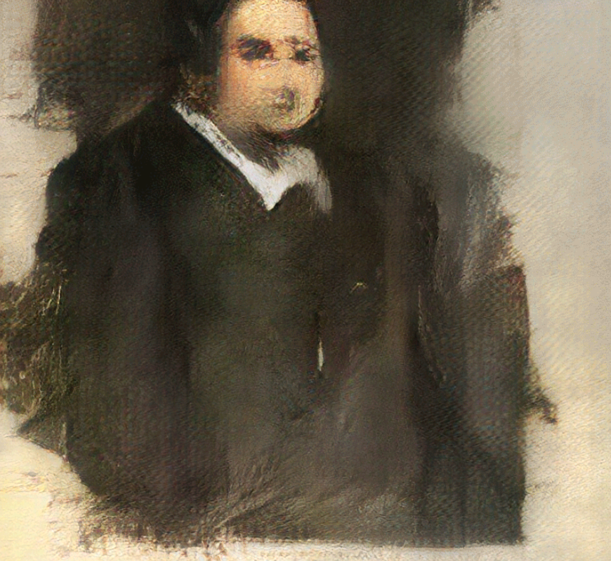
AI art sold in exhibitions
Yasin Akbashev
Rich people with too much money.
Portrait of Edmond De Belamy, sold at an exhibition in New York on October 25, 2018[1].
Memories of Passerby I by Mario Klingemann, sold in Madrid, Colección Solo in June 2019[11].
Ai Da, AI Robot Artist
Sold over 1 million pounds worth of artwork as of June 2019[15]
[1]
Notes:
An industry needs consumers to emerge so Lets start out some extreme cases.
This right here is the portrait of Edmond de Belamy. It was made by an AI from Obvious, a French company that makes AI art, and it sold for 432 thousand dollars at an exhibition in new York.
It is currently the most expensive purchase of AI art, followed by A piece that sold for about$51,000 in an exhibition in spain.
Would I pay half a million for a blurry painting that looks like it was made by a sleep-deprived student 10 minutes before the deadline? No, but some rich person did and that’s worth noting.
There’s also the case of Ai Da, an AI robot artist made by Adrian Meller. She’s a humanoid robot artist and has sold a substantial amount of art. I looked up the individual price of a piece and it was estimated at around 5000-7000$, though the site wanted a subscription for an exact sell price. I didn’t put up a picture of the piece here, but imagine dropping 5 glass cups and then dumping a can of green paint and you can get a pretty good mental image.
These aren’t good looking pieces of art but when have rich people cared about that?
Now, are extreme cases of rich person with too much money, so let’s move on to the consumer use for AI art.

Slide 26
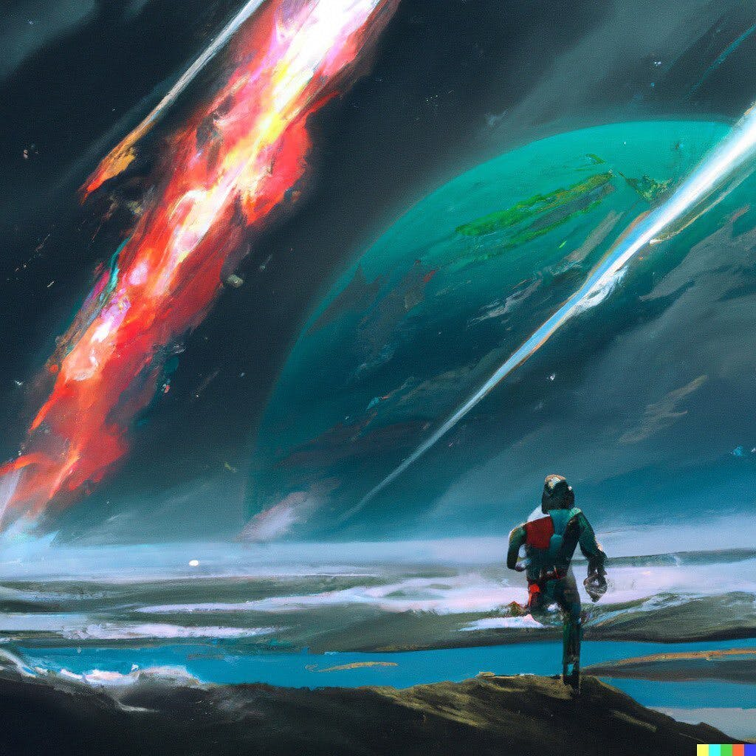
Commercial use of AI ART.
Yasin Akbashev
DALL E 2
Over 1.5 million users registered as of September 2022[3].
Allowed to be used for commercial purposes[4].
AiArtShop
Sells a large variety of art, ranging from $30-100+ [7].
[21]
Notes:
Lets get into the reasonable prices.
DALL E 2 is openAI’s AI art generator. It’s not free, it costs $15 to get 115 image generations, letting you generate a piece like the one shown here (results may vary) and $15 is pretty cheap for something that looks so good. At one a half million users last year, DallE2 is generating a lot of money and its got a lot of demand.
What’s very notable about Dalle 2 is that openAI gives explicit permission to use the generated art for commercial purposes, think concept art, storyboards, and other illustrations.
Also, Dalle2 has its competitors like Dream from WOMBO and StarryAi from MO Kahn and many others so its not alone in the marketplace.
As far as buying and selling, there are sites like Ai art shop which allow users to buy and sell ai-generated art at a variety of prices. Ai Art Shop specifically is also a bit into the crypto space which is kind of icky in my opinion but their primary purpose is selling ai art and they provide a basis for future sites and businesses.
But what about the artists?

Slide 27
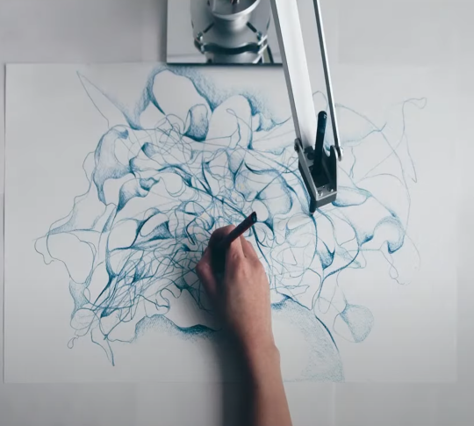
What about the artists?
Yasin Akbashev
Working with AI to make art
Sougwen Chung, worked as an artist for past 20 years now uses AI to make unique art pieces.
Ronan Barrot and Robbie Barrat work together to create “Infinite Skulls”[12].
[2]
Notes:
I think to see the best use of AI for art we have to look at (pronounced SOOG WEN CHUNG), Sougwen Chung, probably butchered that name, sorry, she creates art using AI. In the image shown she’s got an AI painting with her in real-time. And Her use of AI for art is very unique because she trained the ai from only her past drawings.
Another great example of using AI for art comes from Ronan Barrot and Robbie Barrat’s exhibition “Barrat/Barrot: Infinite skulls”. Ronan barrot has been painting for 30 years and Robbie Barrat is an AI artist, and in 2019 they collaborated together to create “infinite skulls”. They digitally scanned over 450 paintings of skulls which Ronan barrot had made over the years to create their exhibition.
I think the ways that Chung and Barrot are using AI to make art provides a good glimpse of how it can be used in the future.

Slide 28
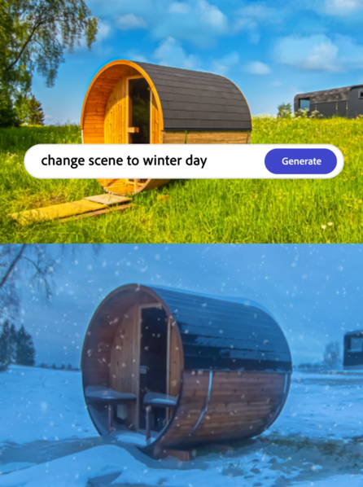
Using ai help create art.
Yasin Akbashev
AI assistance in making art, Adobe Sensei.
One of Adobe’s steps in their Technology Vision[5].
https://tinyurl.com/AdoBSenSei
AI art as an advancement in visual arts
31% of Americans surveyed in a pew research study believe AI art is a major advance in visual arts, with 39% arguing minor, 19% arguing none and 11% unsure[10].
[20]
Notes:
For general use, we have things like Adobe sensei. It’s a tool from adobe that allows users to quickly add to and edit their projects. I can’t do it justice here, and I highly recommend checking out their site to see it more in-depth. The dataset it uses is a large variety of images and videos sold and uploaded to adobe, and with that huge dataset it allows a lot more creativity in a quick and reasonable fashion to create projects and art pieces.

Slide 29
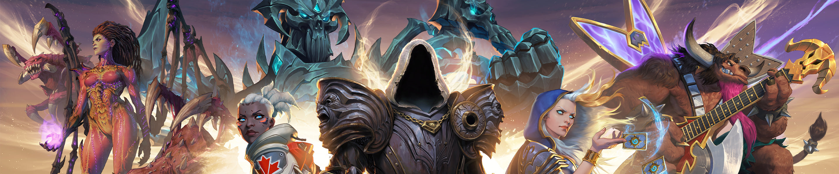


The future of AI art
Yasin Akbashev
Movie Posters
Brand Merchandise
Game Advertisements
[19]
[17]
[18]
Notes:
As for the future of AI art
I think the future of AI Art will see artists using their previous works to help create more pieces in their style, similar to what Chung is doing. This is also an opportunity for companies to generate pieces art for consumers that would feel genuinely individual and unique. Like the blizzard store here, you could have a truly unique piece about a game you love and it’d look great because the AI that generated the image only used pieces made by a specific artist. Additionally by creating contracts with artists to train art AI’s, companies won’t have to worry about the Legal troubles.
I think we’re going to see games using AI art to advertise their games and probably help create the games themselves.
Movies in particular have a great use case for AI art to generate posters that advertise their films. The average piece generated might not be good, but its made super quickly and you only really need one good poster.
At the end of the day, AI art allows a thought to become an image so the possibilities are endless.
A bit of educating guessing here, but I think in the future Artists will be paid though commissions and contracts by individuals and companies, for the generation of personalized AI art. This art will then be used for advertising, development of games, potentially even movies, and merchandise for games, movies and brands. All this without the worry of legal problems. From all of this, we may even see a new job market appear for individuals who are able to quickly get an AI to produce a good image. At the end of the day, people decide what looks good so there’s always going to be a place for humans in the AI art industry.

Slide 30
References
Yasin Akbashev
[1] Obvious Art. (n.d.). Edmond de Belamy. Obvious Art. https://obvious-art.com/portfolio/edmond-de-belamy/
[2] Retrieved from Chung, Sougwen. “Why I Draw with Robots.” TED, filmed February 2019, https://www.ted.com/talks/sougwen_chung_why_i_draw_with_robots.
[3] OpenAI. “DALL·E Now Available Without Waitlist.” OpenAI Blog, 6 January 2021, https://openai.com/blog/dall-e-now-available-without-waitlist/.
[4] OpenAI. “DALL·E Now Available in Beta.” OpenAI Blog, 5 October 2020, https://openai.com/blog/dall-e-now-available-in-beta/.
[5] Adobe. “Investor Relations: Financials.” Adobe Investor Relations, January 2022, https://www.adobe.com/content/dam/cc/en/investor-relations/pdfs/01210202/d0m9j8h7a2d3f4t5.pdf.
[6] Adobe. “Making Sense of Sensei.” Adobe Blog, 4 October 2017, https://blog.adobe.com/en/publish/2017/10/04/making-sense-of-sensei
[7] AI Art Shop. “Collections.” AI Art Shop, https://aiartshop.com/collections.

Slide 31
References
Yasin Akbashev
[8] The Verge. (2023, January 17). AI art at the center of copyright lawsuit between Getty Images and artist. https://www.theverge.com/2023/1/17/23558516/ai-art-copyright-stable-diffusion-getty-images-lawsuit
[9] Rosenberg, David. “Artificial Intelligence Is Creating Art That Feels Human.” The New York Times, 2 September 2022, https://www.nytimes.com/2022/09/02/technology/ai-artificial-intelligence-artists.html.
[10] Perrin, Andrew. “How Americans View Emerging Uses of Artificial Intelligence, Including Programs to Generate Text or Art.” Pew Research Center, 22 February 2023, https://www.pewresearch.org/short-reads/2023/02/22/how-americans-view-emerging-uses-of-artificial-intelligence-including-programs-to-generate-text-or-art/.
[11] Sotheby’s. “Contemporary Art Day Auction.” Sotheby’s, 6 March 2019, https://www.sothebys.com/en/auctions/ecatalogue/2019/contemporary-art-day-auction-l19021/lot.109.html.
[12] Zeller, Jason. “AI Artist Robbie Barrat and Painter Ronan Barrot Collaborate on Infinite Skulls.” Artnome, 22 January 2019, https://www.artnome.com/news/2019/1/22/ai-artist-robbie-barrat-and-painter-ronan-barrot-collaborate-on-infinite-skulls.
[13] Antonelli, W., & Johnson, A. (2023, March 20). How to use DALL·E 2 and Craiyon, the AI art tools that can generate images from any text prompt. Business Insider. Retrieved from https://www.businessinsider.com/guides/tech/dall-e-mini
[14] Gangadharbatla, H. (2021). The Role of AI Attribution Knowledge in the Evaluation of Artwork. Sage Journals, https://gwern.net/doc/ai/nn/gan/2021-gangadharbatla.pdf
[15] Dazed Digital. (2019, June 18). Artist Ai-Da made over £1 million in sales at her first solo show at The Barn Gallery, Oxford. Retrieved from https://www.dazeddigital.com/art-photography/article/44773/1/artist-ai-da-made-over-1-million-sales-first-solo-show-the-barn-gallery-oxford.
[16]

Slide 32
References
Yasin Akbashev
[17]Morbius Movie Poster, Designed by Concept Arts, Photography by Gavin Bond.
[18] Rockstar Games. Red Dead Redemption 2 Official artwork, 2018, https://www.rockstargames.com/reddeadredemption2/.
[19] Blizzard Entertainment. Official Blizzard Artwork. Blizzard Gear Store, n.d., https://gear.blizzard.com/collections/blizzard-merchandise.
[20] Adobe Sensei Generative AI, Adobe, n.d., https://www.adobe.com/sensei/generative-ai.html. Accessed 4/25/23.
[21] “Running at the edge of space, toward a planet, calm, reaching the abyss, digital art”, by OpenAI, DALL·E: Creating Images from Text | OpenAI, 5 Feb. 2021, https://openai.com/blog/dall-e-now-available-without-waitlist
All sites accessed 4/25/23 1:20AM EST unless otherwise specified.

Slide 33
AI ART LEGAL RESTRICTIONS
Samantha Yeung
Notes:
What laws need to be made about using AI Art?
How do laws apply to AI Art?

Slide 34
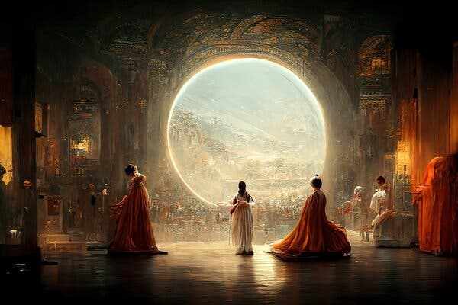
What is AI generated art?
Samantha Yeung
Three criteria for AI Generated Art: [1]
Systems use machine learning
Machine learning involves training on existing works.
The outputs are “original”.
“Théâtre D’opéra Spatial” by Jason Allen [8]
Notes:
According to Harvard, there are three criteria for AI generated Art to be considered, AI generated Art: [1]
The AI must use systems that use machine learning in order to create an algorithm that generates outputs. The machine learning must include training on works being fed into the algorithm in order to “teach” the AI. And the outputs are “original”, meaning that they’re not pre-existing work, or a predictable outcome of existing work. The output from the AI should be separate from the works that were used to “train” it.

Slide 35
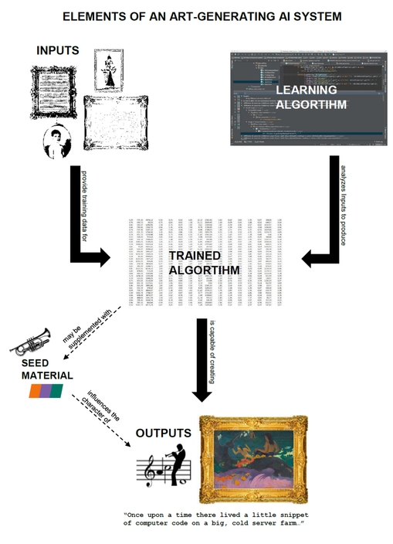
Four key elements of generative ai [1]
<Your Name>
Input
Learning Algorithms
Trained Algorithms
Output
<Graphic as big as will fit>
Elements of an Art-Generating AI System [1]
Notes:
Inside the generative AI, there are four key elements behind the system [1]
Input, which is the images or artworks that are being used as an example to teach the AI a specific style.
Learning Algorithms, which works in hand with the input, that teaches the AI based off the input.
Training Algorithms, which is the information that the Learning Algorithm generates from the Inputs given and feeds the system instructions in order to turn the input into a new original work.
Output, which is the end-product of the Trained Algorithms.
This is often generated from a seed, which gives the trained algorithm a starting point, but can also be changed at every step to involve more personalization.

Slide 36
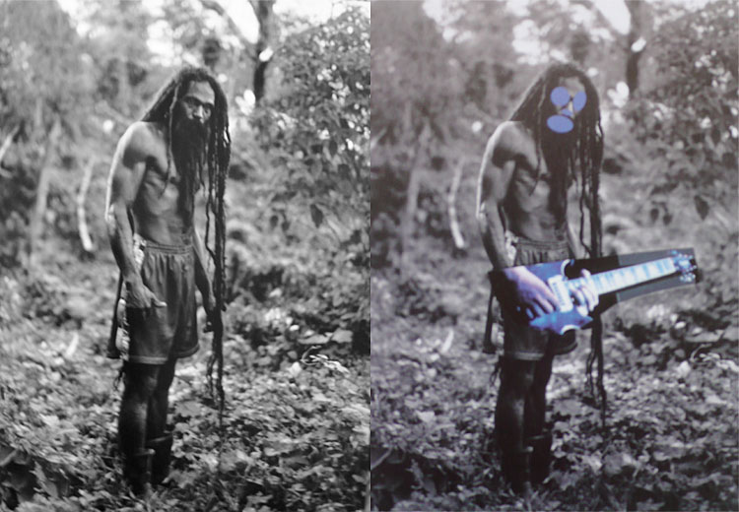
Current copyright laws
Samantha Yeung
Works created by AI are, in certain situations, eligible for copyright protection. [5]
Use of an AI by a human author as a tool
Co-authorship between a human author and an AI author.
Human selection of autonomously created work by AI
Copyright does not protect those who have used other’s artwork without permission.
Ex. Prince v Cariou [10]
Sued by Cariou in 2008 for using his photographs without permission.
Cariou’s “Yes, Rasta” vs Prince’s “Canal Zone” [10]
Notes:
How do current laws apply to AI Art?
Works created by AI are eligible for copyright protection under current copyright laws in certain situations, such as: [5] The use of the AI by a human as a tool to help with creation, meaning the AI is no different than a camera for photographers, or a digital creation tool such as Photoshop. When the AI is used a tool, it can be assumed that the author’s creativity is present in the work, and that the work isn’t the result of the AI alone. Another situation would be the co-authorship between a human and the AI being used, as the AI can be considered similar to co-authorship with another human. Human selection of autonomously created work by AI, meaning the human artist making the work has selected the inputs going into the algorithm, and has tempered with the automatic creation process enough that there is a personal imprint in the work [5]
These situations do not include every work that is generated by automatic means, as the original expression isn’t there by default.
However, copyright doesn’t protect those who have used another’s artwork without permission, such as the case of artist Richard Prince, who was sued by photographer Patrick Cariou in 2008 for using Cariou's photographs without permission and incorporating them into his own artwork. Prince argued that his use of the photographs fell under fair use, but ultimately, the court ruled against him and he was ordered to pay damages to Cariou. [10]
Although this case doesn’t involve AI-generated art, it shows the legal issues that may arise from current copyright laws when artists use the work of others without permission or attribution.

Slide 37
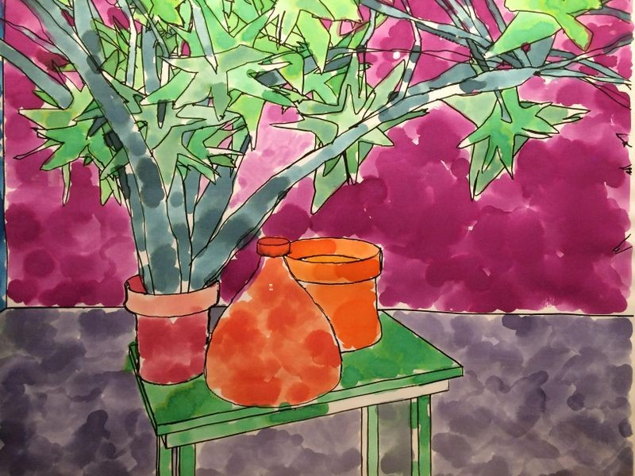
How much is the AI responsible for?
Samantha Yeung
The work must be original and creative [3]
“Must involve judgement and minimum randomness for copyright laws.”
AARON’s style will not change unless it is programmed to do so.
<Graphic as big as will fit>
AARON’s art [4]
Notes:
In order for AI Art to be applicable for copyright laws, the work must be original and creative. So what does being creative for a computer mean?
According to Ramalho in “Will robots rule the (artistic) world? A proposed model for the legal status of creations by Artificial Intelligence Systems”, in order for the work to be creative, the computation “must involve judgement and minimum randomness for copyright laws” with “self-criticism (being) a trait at all times”. However, AI can only be creative to a certain extent. For example, AARON, which is a program created in the 70s by Harold Cohen, that generates drawings and paintings. AARON creates the works autonomously, and he’s actually an artist that has been exhibited in galleries and museums, as well as having private collectors buying his works. Cohen stated that AARON’s style will never change unless Cohen programs it to and “teaches” it to change, unlike human artists [3].
So how does AARON differ from current modern-day AI software like DALL-E and CLIP? AARON was created by Harold Cohen, who was an artist himself. Every teaching that AARON’s algorithm trained him on was a teaching from Cohen himself. When the artist is the author behind every step in the AI’s creation and the output, Cohen doesn’t need to cite himself.
[4] for image

Slide 38
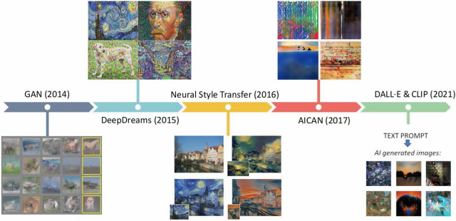
THE authors
Samantha Yeung
AI artists have a responsibility [6]
Legal responbilities vs Moral right
Current AI Art is not equal to human artists.
AICAN system’s visual Turing test [6]
An experiment at shown at the Art Basel 2016
AICAN-generated work combined with human-made work.
75% of the time people thought AICAN-generated work was human-made.
<Graphic as big as will fit>
Timeline of AI Art Systems [7]
Notes:
Authors have a responsibility to accurately represent the process used to generate a work, including the labor of both machines and other people. [6]
“Use of open-source software can negate or reduce legal responsibilities, but the moral right to the integrity of all authors should be maintained.”
An open-source software, in which artwork made by traditional means is free for any use can remove the need to represent the people who made the work, but it still isn’t morally right to claim work as your own entirely when referenced.
Current AI Art, including that made using GANs, are not intelligent or creative in the way that human artists are intelligent and creative. Users of any AI program should acknowledge when their work is being generated by an AI.
the authors of the AICAN system performed a sort of visual Turing test to explore if people can tell the difference between AICAN- and human-made art. They conducted an experiment in which the mixed AICAN works with contemporary artworks shown at the Art Basel 2016 art fair. The outcome showed that 75% of the time, people involved in the study thought that AICAN-generated images were produced by human artists.
Image:
GAN = Generative adversarial network, machine learning (ML) model in which two neural networks compete with each other to become more accurate in their predictions
AICAN = Artificial Intelligence Artist and a Collaborative Creative Partner.
DALL-E = DALLE is an AI system that can create realistic images and art from a description in natural language.
CLIP = Contrastive Language–Image Pre-training, same as DALL-E

Slide 39
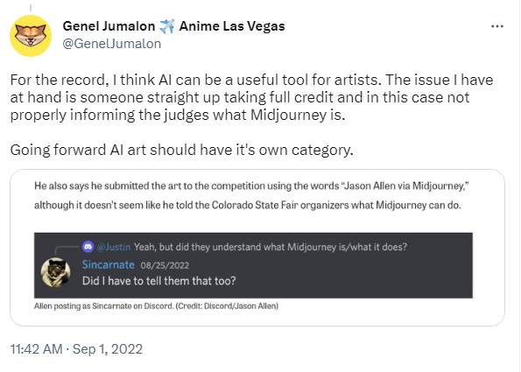
conclusions
Samantha Yeung
AI Art is real art
Laws to protect an artist behind the work that is fed into the algorithm
Labelling
Attribution
Tweet by Genel Jumalon [9]
Notes:
AI Art is real art, but it should be changed to protect artists who undergo the creative process without using AI as a tool, such as labeling art that was made using an AI as AI Art, as well as including references to both the software authors and the original artists of the art used to "teach" the AI.
Genel Jumalon, who you might know from his clients: NPR, Marvel, Critical Role, Skybound, stated in a Tweet that AI-generated artwork should be explicitly stated as AI generated artwork, or even have its own category so it doesn’t take away from those who don’t use AI as a tool.
Jason Allen actually posted on Discord his process making “Theatre d’Opera Spatial” and stated that he did not inform the judges of his usage of AI as a tool. Regardless of the results of the competition, Allen should have informed the judges that he used an AI-generated tool.

Slide 40
References
Samantha Yeung
[1] A legal anatomy of AI-generated art: Part I. Harvard Journal of Law & Technology. (2017, November 21). Retrieved April 23, 2023, from http://jolt.law.harvard.edu/digest/a-legal-anatomy-of-ai-generated-art-part-i
[2] Eshraghian, J. K. (2020, March 9). Human ownership of artificial creativity. Nature News. Retrieved April 23, 2023, from https://www.nature.com/articles/s42256-020-0161-x
[3] Ramalho, A. (2017, June 19). Will robots rule the (artistic) world? A proposed model for the legal status of creations by Artificial Intelligence Systems. SSRN. Retrieved April 23, 2023, from https://papers.ssrn.com/sol3/papers.cfm?abstract_id=2987757
[4] Harold Cohen and Aaron-a 40-year collaboration. CHM. (2019, September 25). Retrieved April 23, 2023, from https://computerhistory.org/blog/harold-cohen-and-aaron-a-40-year-collaboration/
[5] A robot’s right to copyright. (n.d.). Retrieved April 24, 2023, from http://arno.uvt.nl/show.cgi?fid=145318
[6] Škiljić, A. (2021, October 18). When art meets technology or vice versa: Key challenges at the crossroads of ai-generated artworks and copyright law - IIC - international review of intellectual property and competition law. SpringerLink. Retrieved April 23, 2023, from https://link.springer.com/article/10.1007/s40319-021-01119-w
[7] Eva Cetinic Rudjer Boskovic Institute and Durham University, Cetinic, E., Rudjer Boskovic Institute and Durham University, James She Hamad Bin Khalifa University (HBKU) and Hong Kong University of Science and Technology, She, J., Hamad Bin Khalifa University (HBKU) and Hong Kong University of Science and Technology, Ramesh, P. G. G. A., Patrice, A., Panos, A., Siddharth, A., Xavier, A.-P., Ali, A. S., Yaniv, B., Lorenzo, B., Leonardo, B. P. and I., Simone, B., A., B. M., Boden Margaret A. and Edmonds Ernest A., Pietro, B., … Eva CetinicSearch about this authorJames SheSearch about this author. (2022, May 1). Understanding and creating art with AI: Review and outlook. ACM Transactions on Multimedia Computing, Communications, and Applications. Retrieved April 23, 2023, from https://dl.acm.org/doi/full/10.1145/3475799
[8] Roose, K. (2022, September 2). An a.i.-generated picture won an art prize. artists aren't happy. The New York Times. Retrieved April 24, 2023, from https://www.nytimes.com/2022/09/02/technology/ai-artificial-intelligence-artists.html
[9] Jumanlon, G. [@GenelJumalon]. (2022, August 30) TL;DR — Someone entered an art competition with an AI-generated piece and won the first prize. [Tweet]. Twitter. https://twitter.com/GenelJumalon/status/1564651635602853889
[10] Boucher, B. (2013, August 30). Richard Prince wins major victory in Landmark Copyright Suit. ARTnews.com. Retrieved April 24, 2023, from https://www.artnews.com/art-in-america/features/richard-prince-wins-major-victory-in-landmark-copyright-suit-59404/

Slide 41
Class 11 The End
Keith A. Pray
socialimps.keithpray.net
Notes:
If there’s time and we didn’t get to it:
Kickstarter Charter
https://www.kickstarter.com/charter?ref=about_subnav
CGP Grey
Humans Need Not Apply (15:00) – 2014-08-13
http://www.youtube.com/watch?v=7Pq-S557XQU
Last access 2016-04-22
These 3D printed homes can be constructed for $4,000 (3:00 – 2018-04-02)
http://www.businessinsider.com/3d-printed-homes-constructed-icon-new-story-tech-charity-4000-dollars-2018-3
https://www.youtube.com/watch?v=SvM7jFZGAec (1:28)
Last access 2018-04-22
Look at:
BBC Intelligent Machines
http://www.bbc.com/news/technology-33978561
BBC Likelihood of robot taking your job
http://www.bbc.com/news/technology-34066941

Slide 42
Remote With Zoom
Sign in with First and Last Name
Stay muted unless you are going to speak
To speak use the raise your hand feature
To answer yes/no questions use the “yes” ”no” buttons
Turn your camera on
Wait until the end of student presentations to ask questions
Write them down so you don’t forget

